Slide 1
CuW baseplate R&D and production
Han Wang (IHEP)
On behalf of Chinese HGCal Group
November 15,2024
CLHCP 2024, Qingdao

Slide 2
Outline:
CuW baseplate introduction & production status
Irradiation test, peel test, mechanics study and heat flow study for IHEP baseplates
Future production plan

Slide 3
CuW baseplate introduction & production status

Slide 4
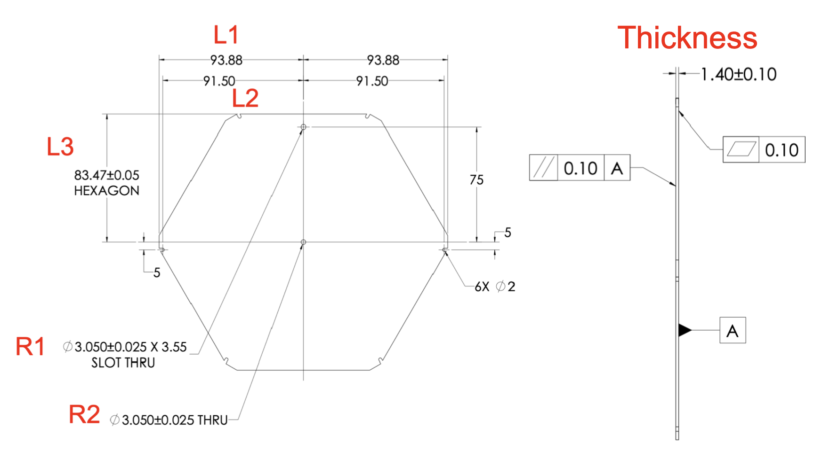
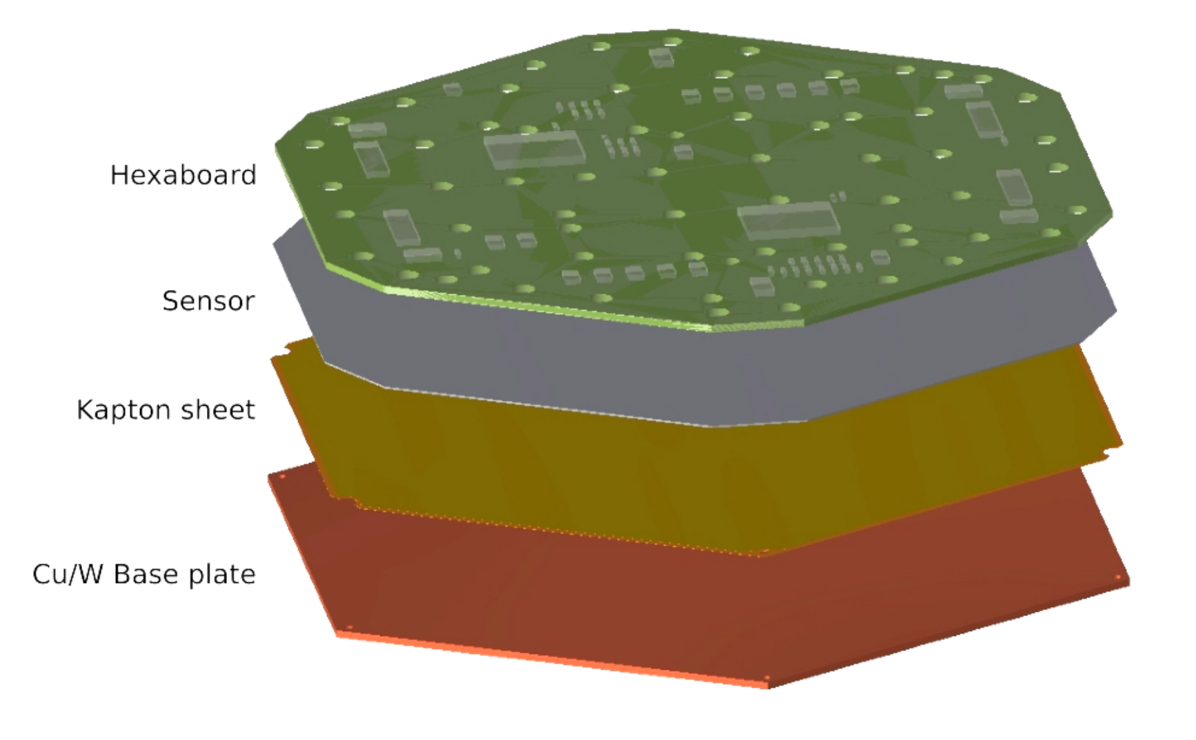
CuW baseplate introduction
CuW baseplate in HGCal: will be used in ECal; insulation layer, absorber, thermal conductive layer, sensor protection, noise shelding, supporting.
2 Kapton assembly process(bonding Kapton and CuW): KIT plan, IHEP plan.
First time Chinese entities participate and will produce the largest area(~90%) of CuW baseplates.
Participating entities: IHEP, THU, ZJU, FDU, NNU.
Complete CuW baseplate
Complete HGCal module
CuW baseplate design

Slide 5
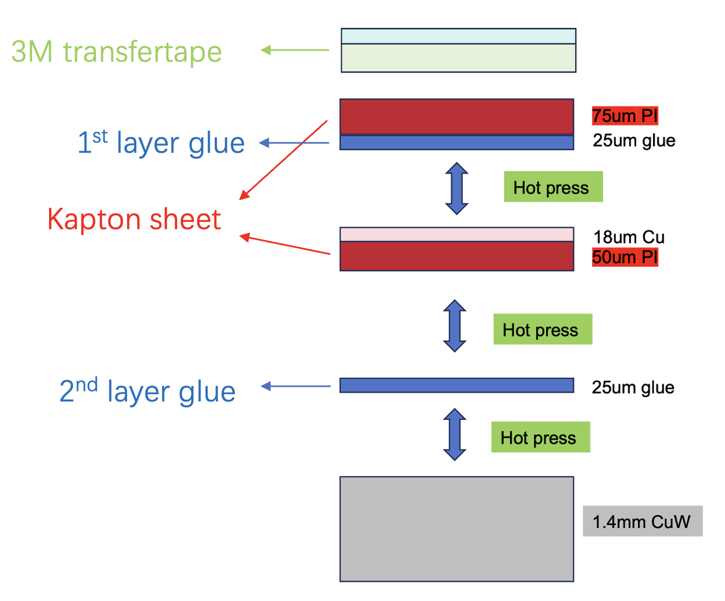
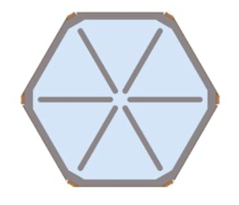
Introduction of KIT plan and IHEP plan
KIT Kapton assembly process
Hybrid attachment with 3M glue and epoxy.
Using gantry in KIT’s lab to dispense glue on CuW baseplate.
Use partially-overlapping glue dispensing pattern.
Laminate using pressure.
IHEP Kapton assembly process
Using hot melt adhesive to bond different layers.
Glue fully covers entire CuW baseplate.
Layers bonded together by hot pressing process.
KIT plan’s glue pattern

Slide 6
Comparison & advantage
 | KIT plan | IHEP plan | IHEP plan’s advantage
Glue dispensing pattern | Partially-overlapping glue dispensing pattern. | Fully-overlapping glue dispensing pattern. | Have larger glue coverage area.
Bonding method | Laminate using pressure. | Hot pressing process.
Production method | Laboratory production. | Industrial production. | Capable of mass production.
All kinds of test | Irradiation test, lack of mechanical test. | Irradiation test, peel test, mechanical test, etc. | Passed all tests so far.

Slide 7
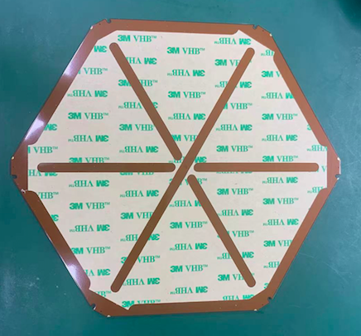
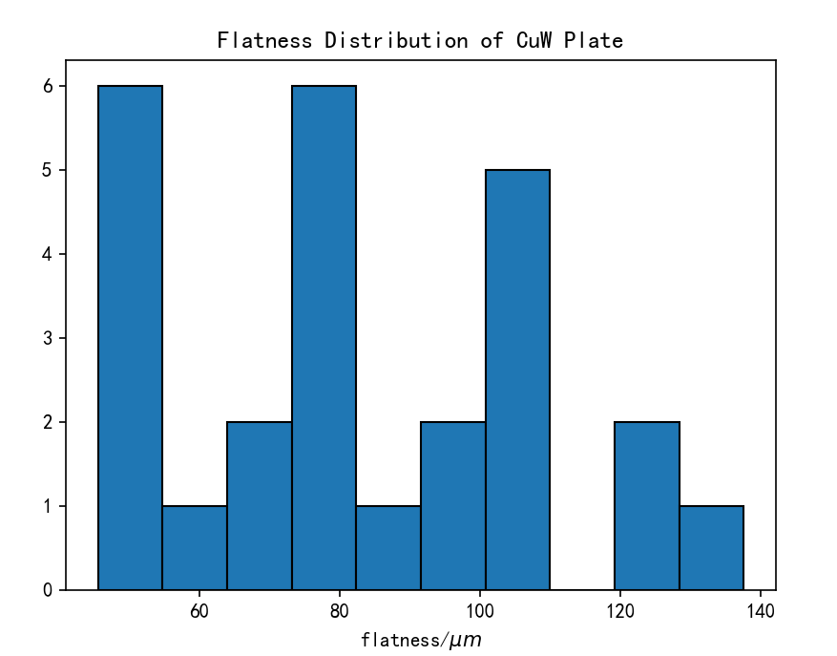
CuW baseplate production status
3 batches of CuW baseplate produced:
1st batch,10 CuW baseplates, 2022.09
Mainly for all kinds of tests.
2nd batch,41 CuW baseplates, 2023.09
13 send to NTU for module assembly.
13 send to UCSB for module assembly.
15 @IHEP for module assembly and test.
3rd batch,30 CuW baseplates, 2024.07
7 send to NTU for module assembly.
2 send to CERN for irradiation test and peel test.
8 for IHEP’s pre-production modules.
10 for IHEP’s pre-series modules.
So far, IHEP has produced the most CuW baseplates used for module assembly and testing.
3rd batch’s flatness
(target: <100 um)

Slide 8
Irradiation test, peel test, mechanics study and heat flow study for IHEP baseplates

Slide 9
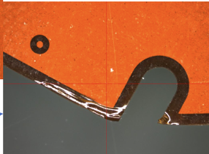
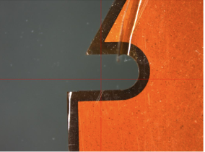
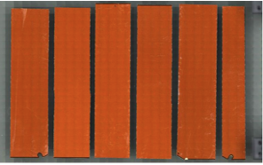
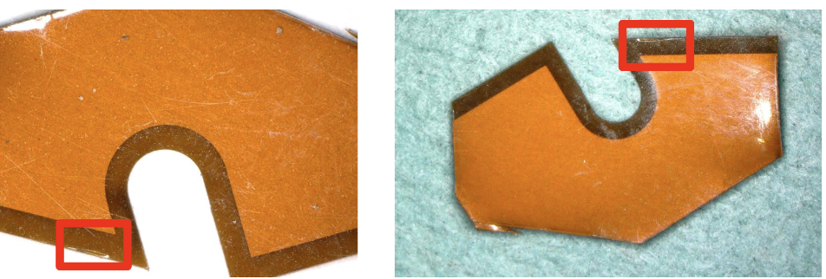
Irradiation test
IHEP produced CuW baseplates have undergone 3 rounds of irradiation test and part of peel test.
1st round irradiation test
2024.05 @CIEMAT.
Integrated dose: 2 MGy.
Sample: old version IHEP baseplates(2 layers of different version glue).
High humidity(~80/90%)
Delamination discovered.
2nd round irradiation test
2024.05 @KIT.
Integrated dose: 2 MGy.
Sample: new version IHEP baseplates(2 layers of same version glue).
Humidity control: done.
Heat-treated for 5 min at 170-180 $°C$.
No delamination observed, only small defect appeared after heat treatment.
3rd round irradiation test
2024.09 @CIEMAT.
Integrated dose: 0.5 MGy, 1 MGy, 1~2 MGy.
Sample: new version IHEP baseplates(2 layers of same version glue).
Humidity control: done.
No delamination observed.

Slide 10
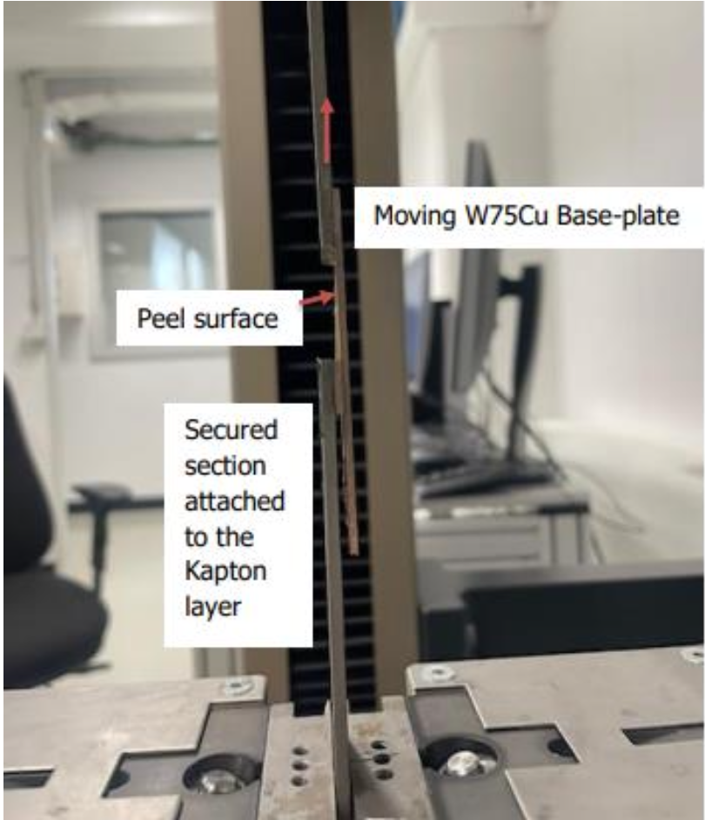
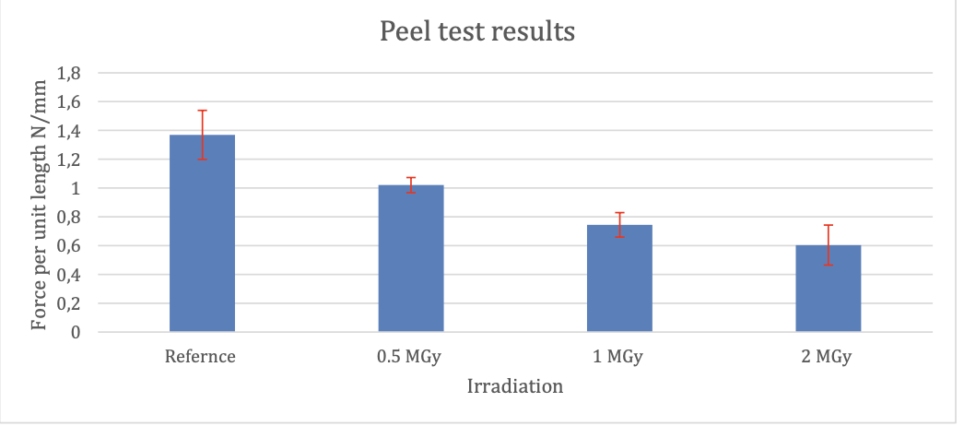
Peel test
Motivation: evaluate whether irradiation caused significant degradation to adhesive.
Using mechanical testing machine, test adhesive performance of 2nd layer glue.
Sample: unirradiated reference sample, irradiated by 0.5 MGy, 1 MGy, 2 MGy samples.
Results: samples showed a steady decline in peel strength with the increase in accumulated doses. 2 MGy sample showed significant peeling after test.
Although irradiation can affect peel strength, the test results meet the requirements(glue specifications: < 0.5 N/mm when irradiation dose = 2 MGy).
Glue specs

Slide 11
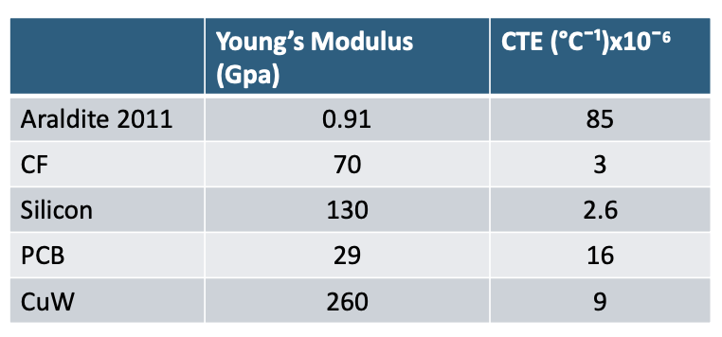
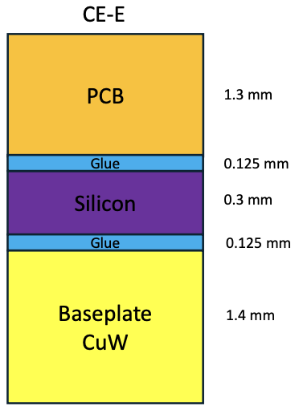
Mechanics study
Motivation: when module cool down from room temperature to -35 °𝐶, stress is generated in Silicon sensor.
Silicon Yield stress ~ 350 MPa, CuW baseplate’s Si max stress is 84 MPa, so it’s safety in simulation.
In the temperature cycling tests conducted by NTU and KIT so far, no module damage has been found.
Material properties:
Complete module:
Simulation results:

Slide 12
Heat flow study
Steady state thermal simulation of heat flow through the module.
Determine sensor temperature and temperature gradient, using different airgaps and materials.
Better flatness, smaller airgap, temperature distribution more uniform.
All cases’ max/min temperature and temperature gradient performed well. It will not cause damage to the Silicon sensor.

Slide 13
Future production plan

Slide 14
Production plan & contract status
Production plan(tentative):
IHEP:
Industrial production, including lamination.
~13k full-pattern pieces.
Production time: ~230 days.
KIT:
Machining of remaining CuW partials.
~1.5k CuW partials.
Lamination of all partial CuW baseplates.
Contract status:
CERN’s K-contract:
CERN’s K-contract has been signed.
Industrial production contract:
The production contract with the factory is in the process of being signed.
IHEP industrial production capacity：
~4 months producing 4000 CuW baseplates.
6~8 months producing 17000 CuW baseplates.
Most of the CuW baseplates(~90%) will be produced using the IHEP method.

Slide 15
Summary

Slide 16
Summary
CuW baseplate introduction & production status:
2 Kapton assembly process : IHEP,KIT.
So far, IHEP has produced the most CuW baseplates used for module assembly and testing.
Irradiation test, Mechanics study, Heat flow study & peel test:
Irradiation test: No delamination observed.
Peel test: test results satisfy our requirements.
Mechanics study: Silicon Yield stress ~ 350 MPa CuW baseplate’s Si max stress is 84 MPa , it’s safety for Silicon sensor.
Heat flow study: Heat flow and temperature gradient perform well, it will not cause damage to the Silicon sensor.
IHEP CuW baseplates have passed all tests so far.
Future production plan:
IHEP will produce most of CuW baseplates(~90%).
CERN’s K-contract and industrial production contract is in the process of being signed.

Slide 17
Thanks

Slide 18
Backup

Slide 19
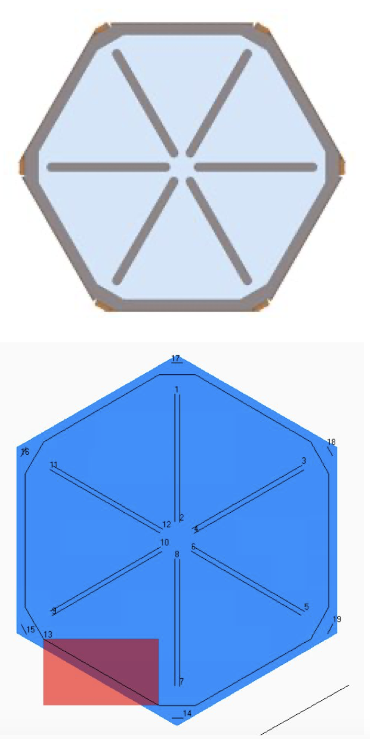
CuW Baseplate production status
KIT Kapton assembly process:
Hybrid attachment with 3M F9460PC tape (top image, blue area) and Araldite 2011 epoxy (grey).
Using PreciFluid volumetric glue dispenser and our Tracker lab’s 3-axis gantry.
Glue application pattern consists of 2 lines of glue in each cutout, dodecagon following the shape of the tape, and a line in each corner.
After lamination, put in book press overnight to cure.

Slide 20
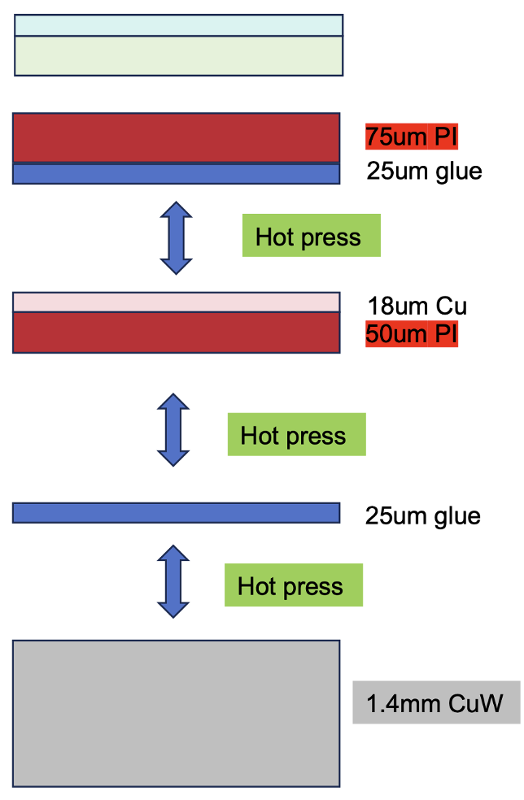
CuW Baseplate production status
IHEP Kapton assembly process :
Optional: 50 um 3M transfertape + protection paper for hybrid sensor gluing.
Coverlay: Taihong MHK3025 (100um= 75um PI + 25um glue), made of a polyimide film, one side or both sides of which is coated with a prescribed adhesive and then overlaid with polyimide film.
Bottom layer: Panasonic R-F777 (18 um Cu+50 um PI).
Pure adhesive: HaynerTaiXing Electronics HC25 (25um), epoxy adhesive, melts when heated.
Kapton and CuW are bonded together through a hot pressing process at a temperature of approximately 180℃.

Slide 21
2nd batch’s baseplates detail

Slide 22
3rd batch’s baseplates detail
New batch of 30 CuW baseplates
Lamination with Kapton foil and transfer tape: done
The flatness of them less than 150 mm (unconstrained)
2 baseplates use the epoxy adhesive for each layer of kapton and CuW baseplate lamination in hot press.（sent to CERN in last month for irradiation test）
28 baseplates use the epoxy adhesive only for between kapton and CuW baseplate lamination (for module production)
Shipment
7 CuW baseplates sent to NTU last week
21

Slide 23
Irradiation test
Irradiation test @CIEMAT: May 2024 and Sept 2024
1st test in May. 2024:
2 MGy over 10 days and 15 h, ~ 8 kGy/h
Integrated dose is homogeneous in the bottom 10 cm of the plate, gradually decreases
Due to High humidity (80/90 %), delamination of coverlay observed
2nd test in Sept. 2024:
Humidity control: done
Irradiated to 0.5MGy,1MGy, 1~2MGy
No delamination observed
Peel test will be done @CERN

Slide 24
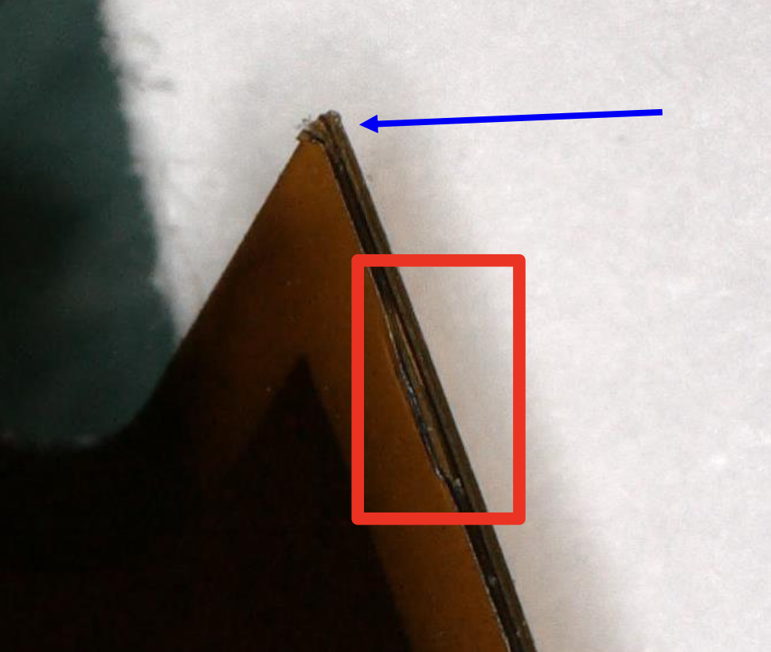
Irradiation test
Irradiation test @KIT: May. 2024
Irradiation of heat-treated “IHEP” type Kapton to 2 MGy after 5 minutes at 170 - 180 $°C$
No delamination observed
Only small defect appeared after heat treatment

Slide 25
Production plan
Factory’s production capacity：
~4 months producing 4000 CuW baseplates
6~8 months producing 17000 CuW baseplates
Most of the CuW baseplates(~90%) will be produced using the IHEP method.

