Slide 1
Introduction to ALICE Computing
Qiye Shou, Fudan University
Ran Du, Computing Center, IHEP
2024-Nov-16

Slide 2
Outline
The China ALICE group
The ALICE Tier2 Site at IHEP
Summary

Slide 3
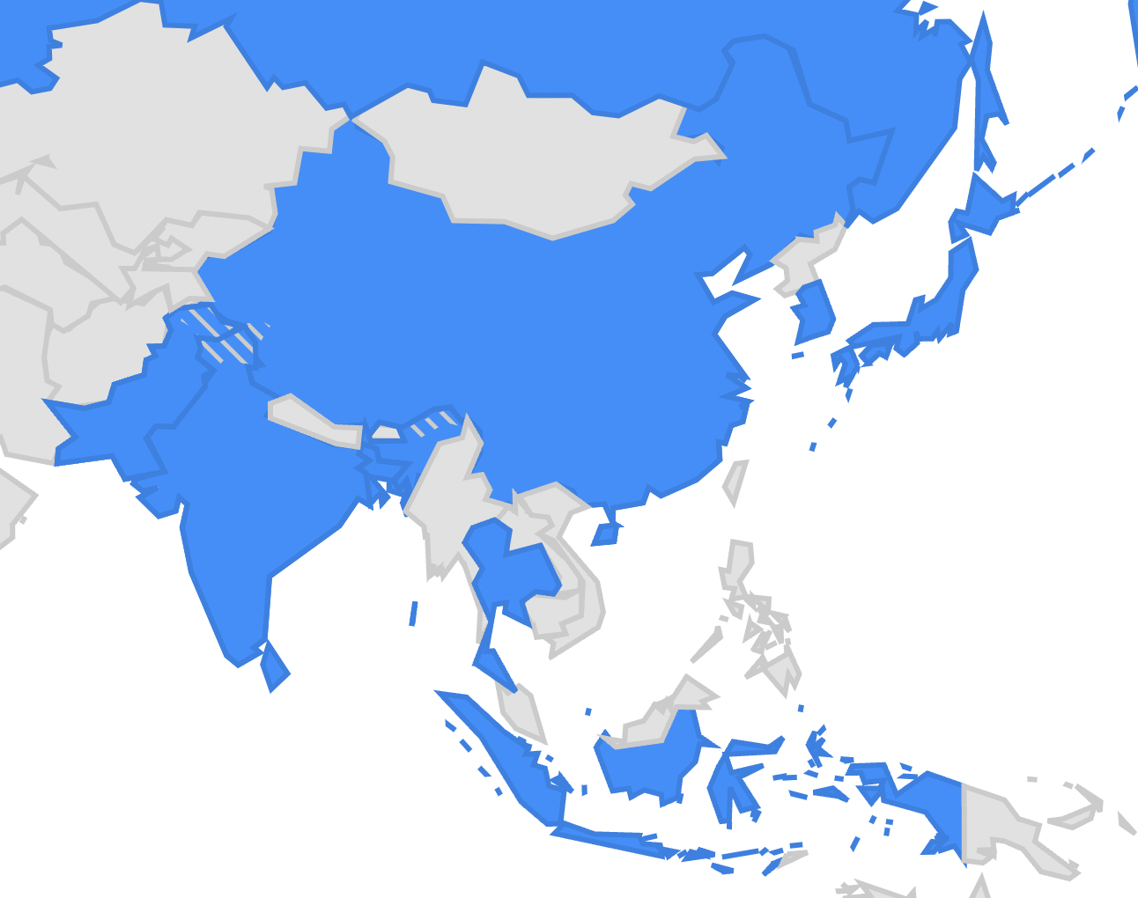
The China ALICE Group
Central China Normal University (Wuhan)
also a member of LHCb
China University of Geosciences(Wuhan)
China Institute of Atomic Energy (Beijing)
Fudan University (Shanghai)
also a member of CMS
University of Science and Technology of China (Hefei)
also a member of ATLAS, CMS
China
5 institutes
98 members
Beijing
Hefei
Wuhan
Shanghai
ALICE general introduction & physics: Xiaoming Zhang’s talk on Thu

Slide 4
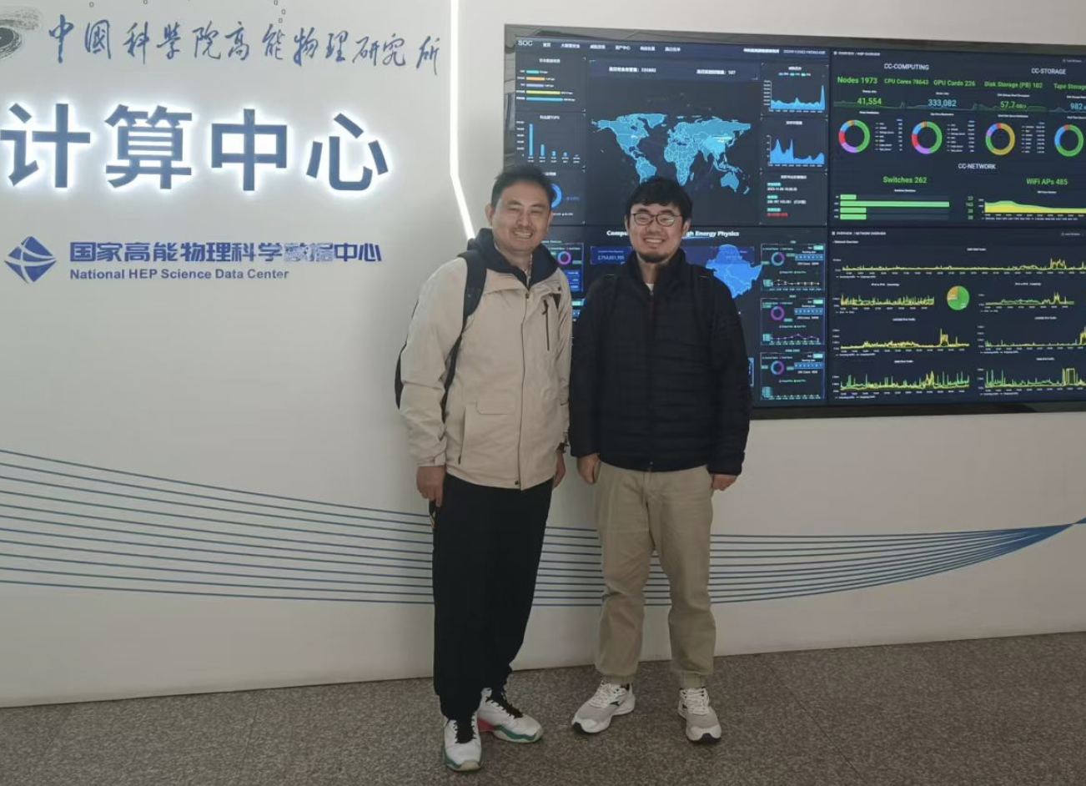
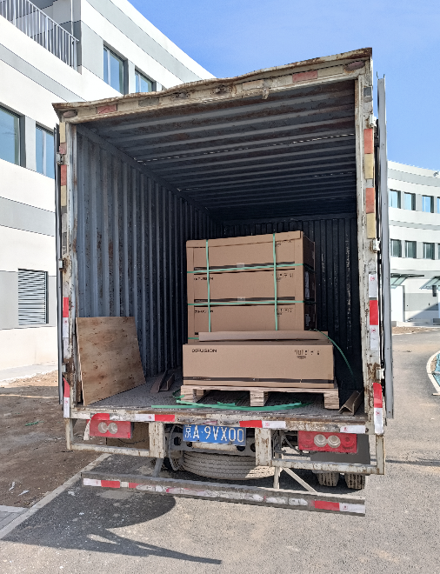
The China ALICE Group
One decade ago, there was a small Tier2 in Wuhan (240 cores + 80 TB), however, it has been shelved due to network/budget limitations
Long-standing request from ALICE to reactivate China T2 up to 2024, 2.6% (15 M&O) obligation, corresponding to: CPU: 33000 HS23 + Disk: 3600 TB
Since late 2023, we have started building a new T2 in Beijing! where the clusters of the other 3 LHC experiments are also located
2023年11月， 寿齐烨、钟晨访问高能所 首批设备运抵怀柔

Slide 5
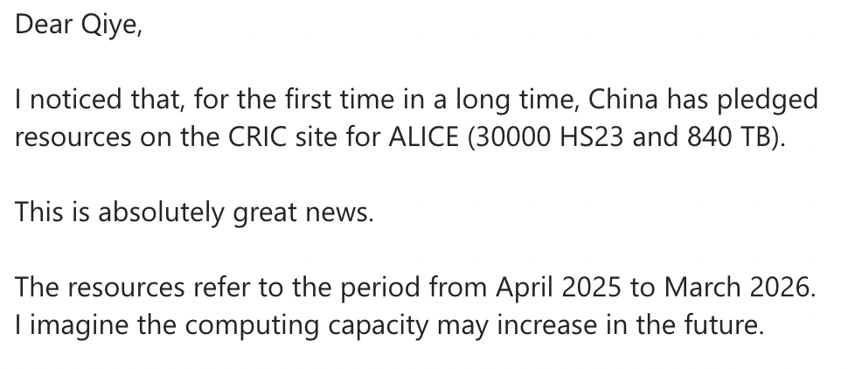
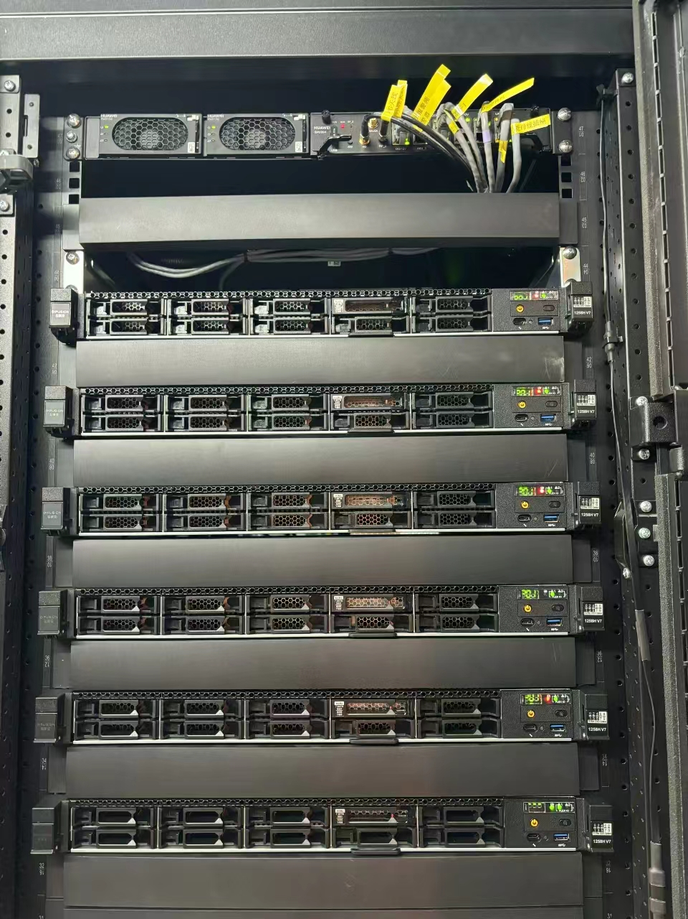
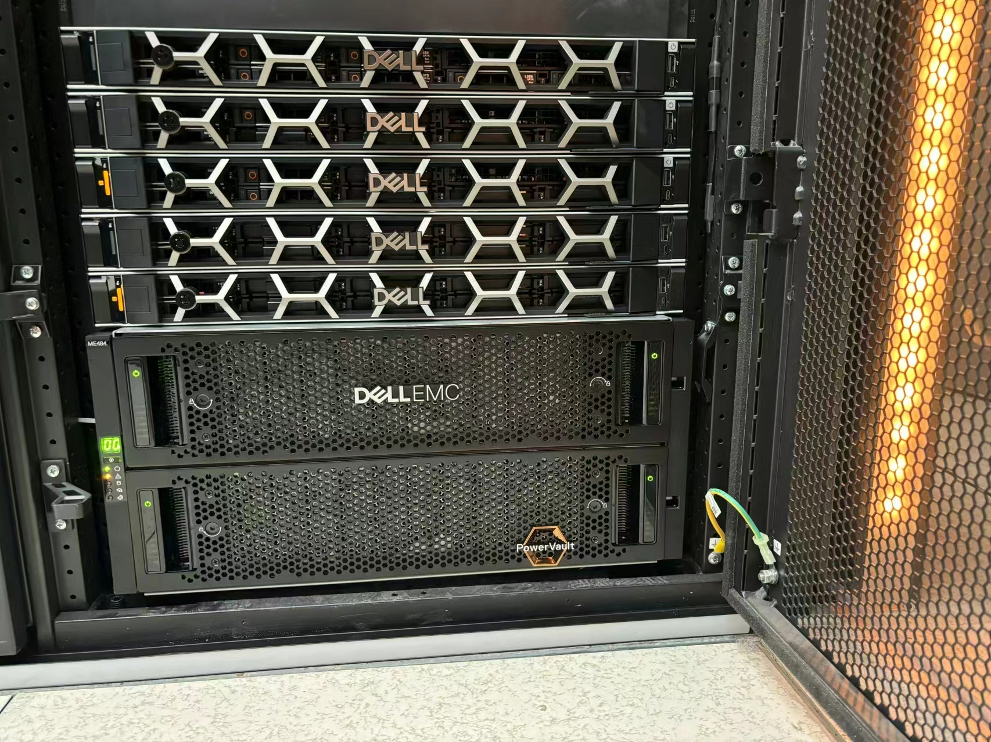
The China ALICE Group
An email from Stefano Piano,
ALICE computing board chairperson

Slide 6
Alice Tier2 Site at IHEP – Site Information
The first large-scale ALICE Tier2 site in China, in production since Oct. 2024
Resources are provided by Fudan University
Site management by IHEP, site rank( 3/49 )
Computing Element | Storage Element | OS
HTCondor CE | EOS SE | AlmaLinux 9
CPU Cores | Disk Storage
1152, AMD | 800 TB

Slide 7
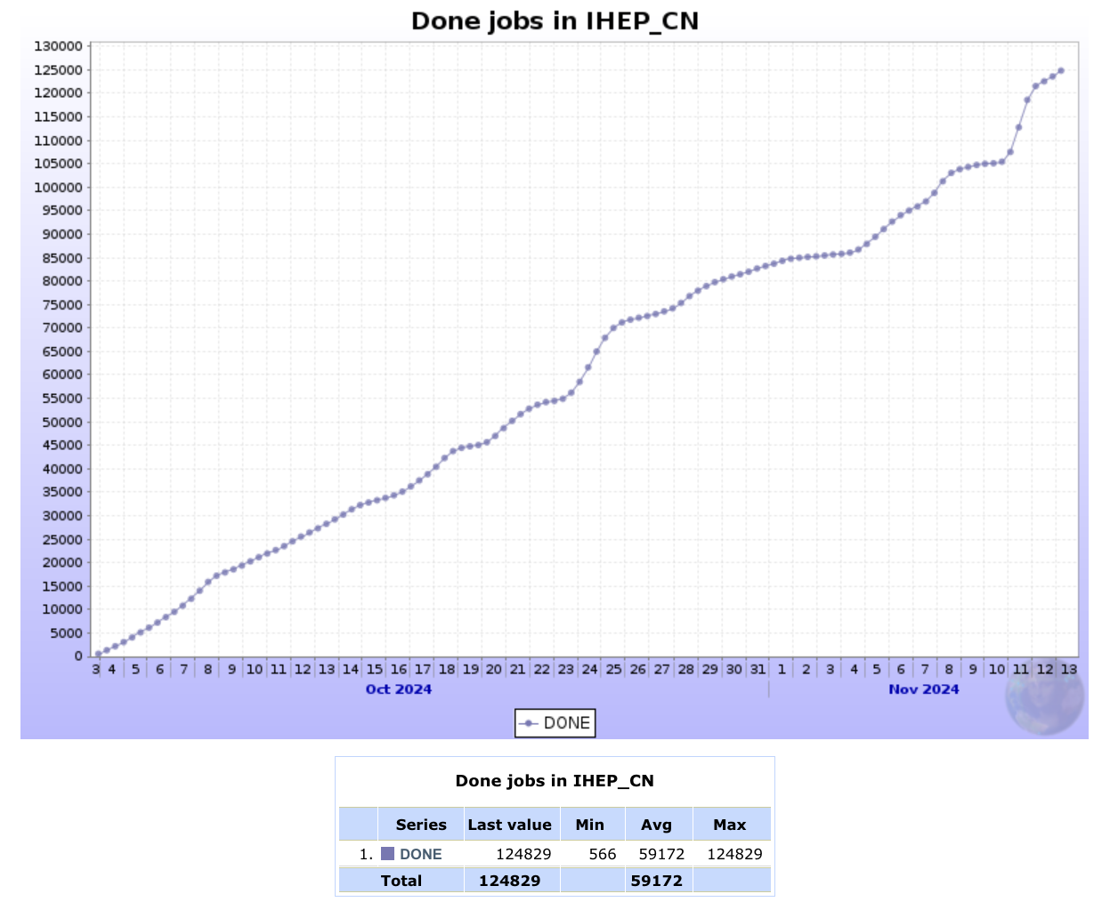
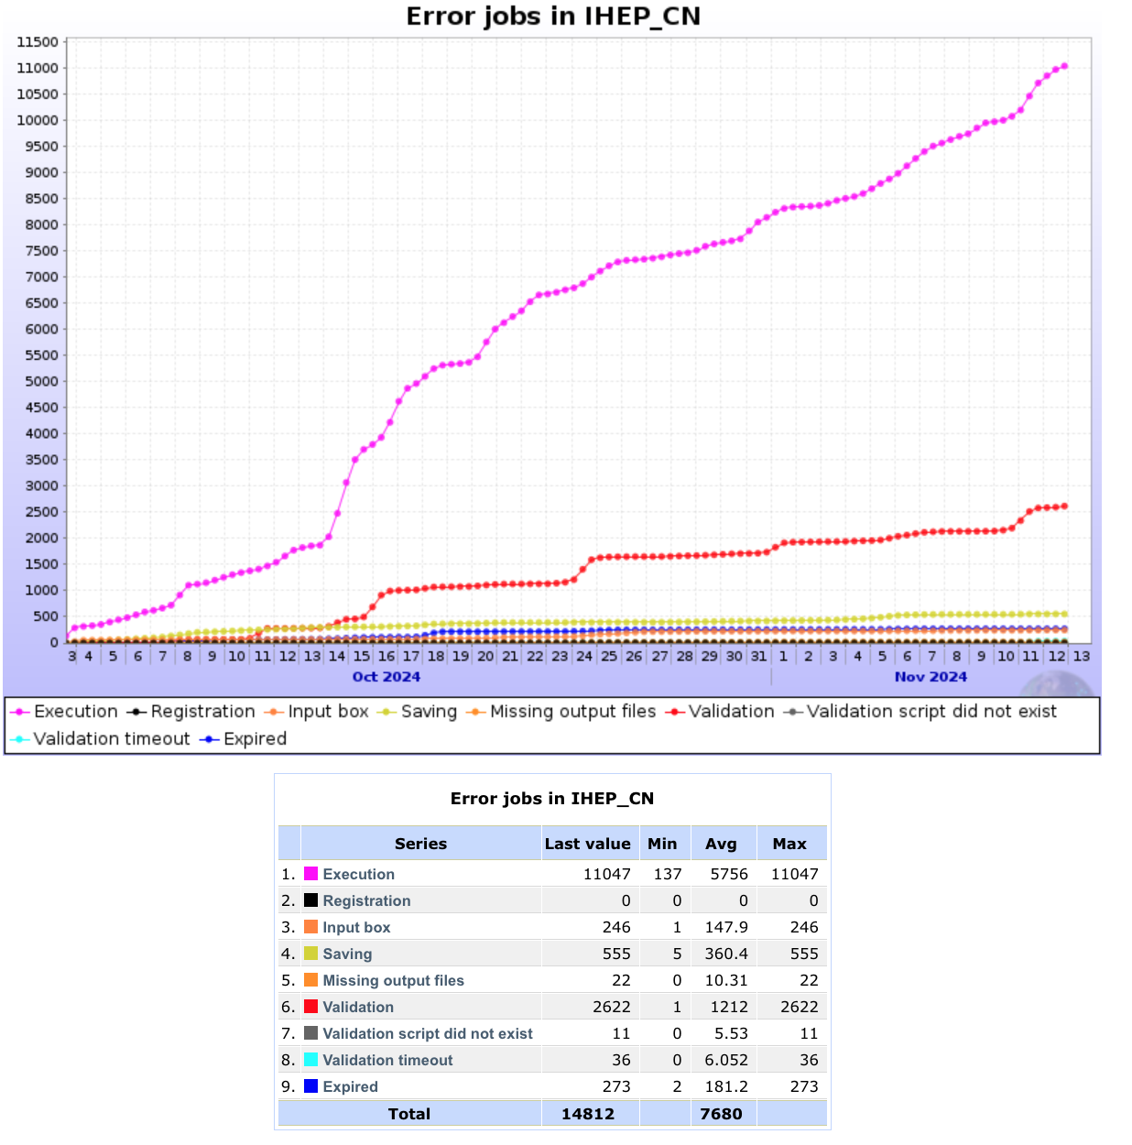
Alice Tier2 Site at IHEP - Jobs
124,829 jobs are done, ratio of success reaches 89.39%

Slide 8
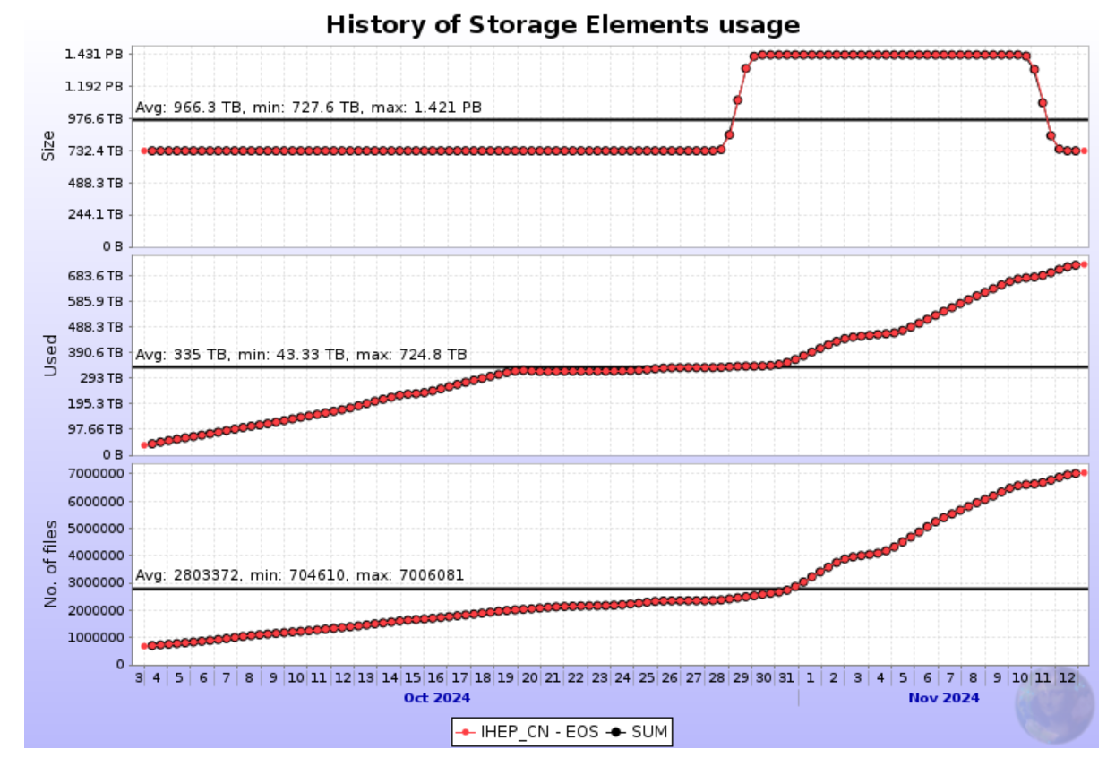
Alice Tier2 Site at IHEP - Storage
734 TB storage space used with 7,083,885 files

Slide 9
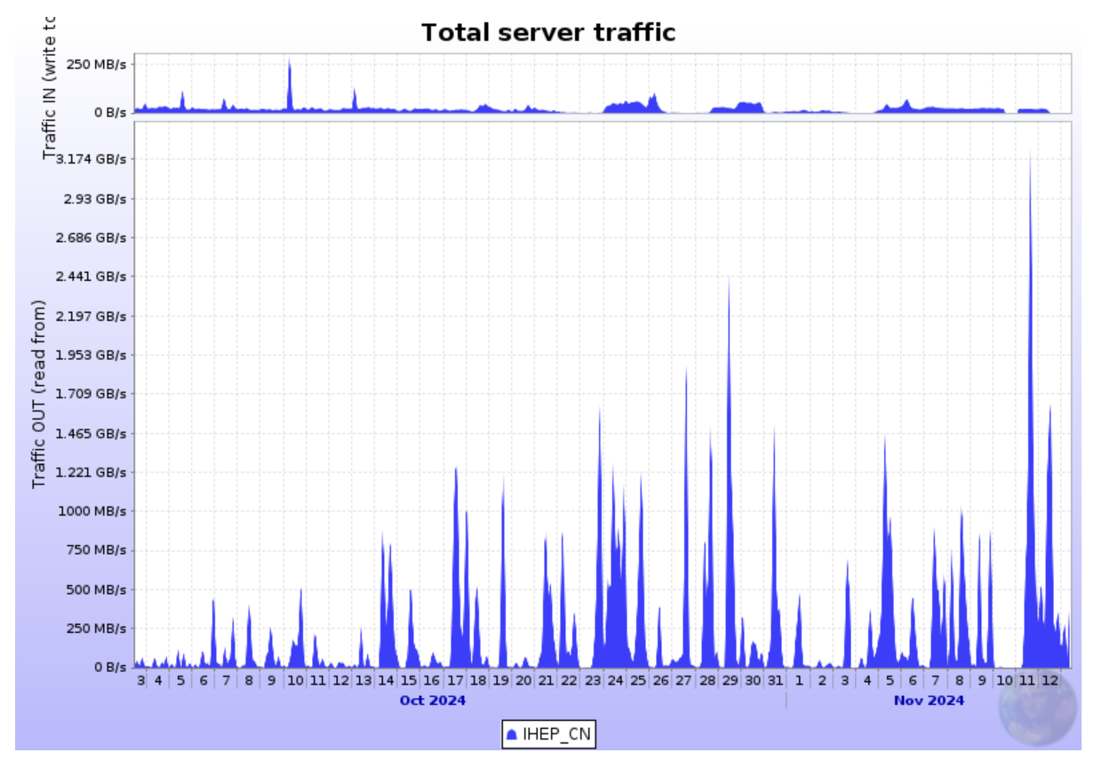
Alice Tier2 Site at IHEP – Data Transfer
72.51 TB downloaded with max throughput 2.733 GB/s
819.5 TB uploaded with max throughput 6.808 GB/s

Slide 10
For the first time in a long while, the China T2 has been established and is running well. Further upgrades are planned. Thanks & Questions

Slide 11
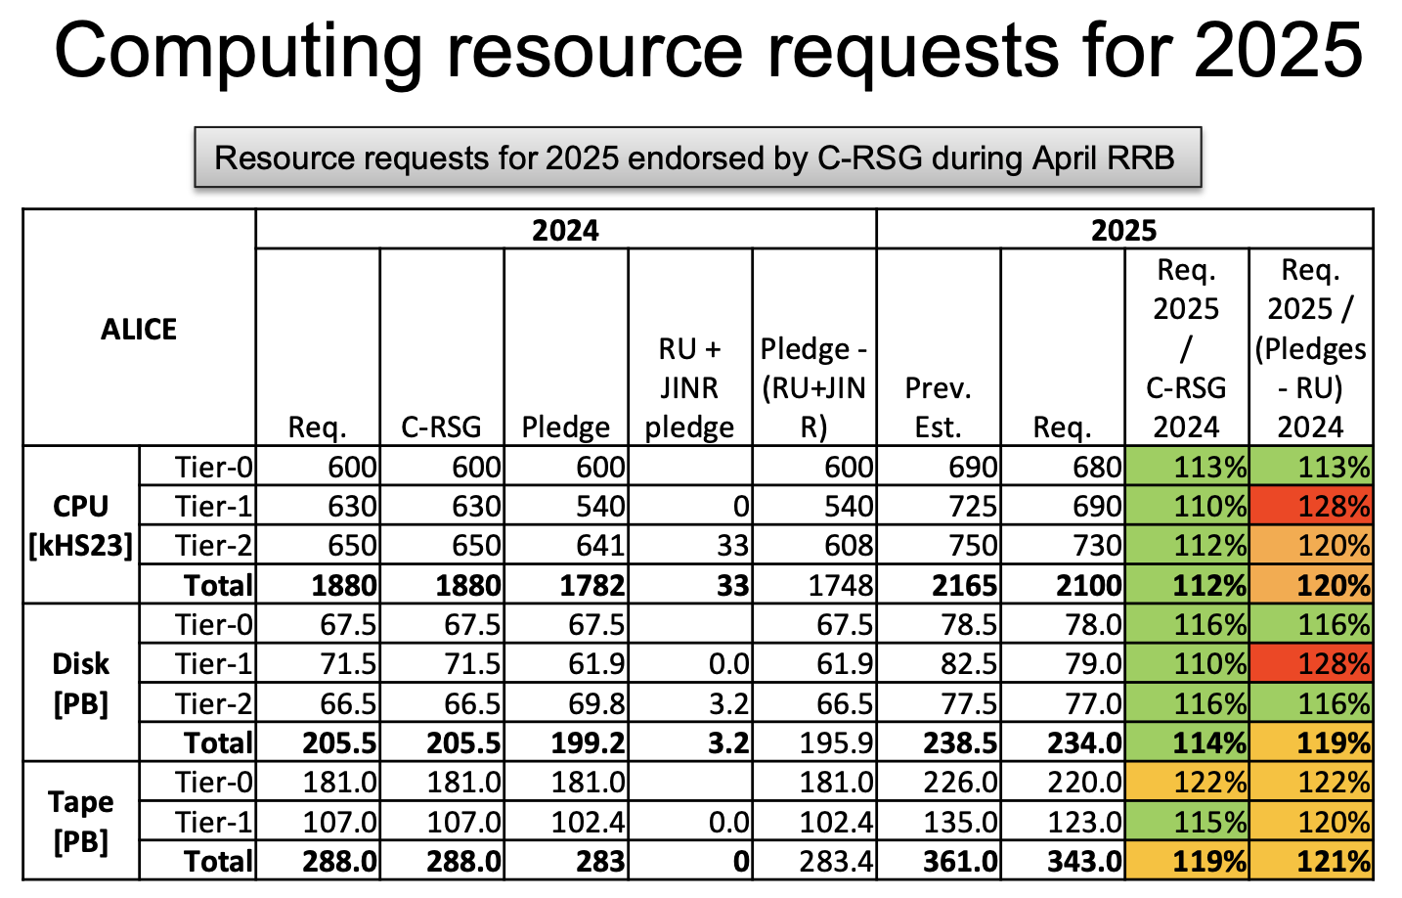
Backup: ALICE computing resource plan

