Slide 1




CLHCP2024, Qingdao
Measurements of Higgs boson production cross sections in the four-lepton final state at 13.6 TeV in CMS
Yuji Li^{1,2} for CMS Collaboration
1. Fudan University, Shanghai
2. IHEP, Beijing

Slide 2
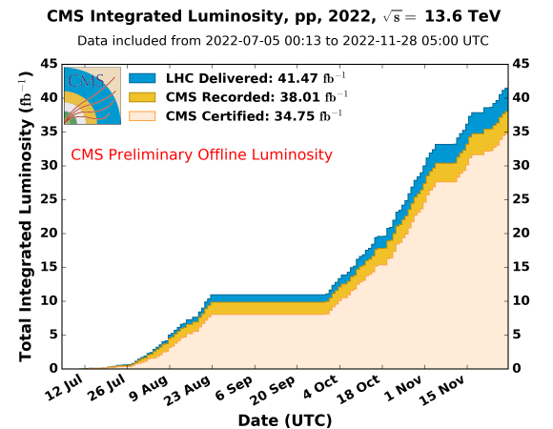
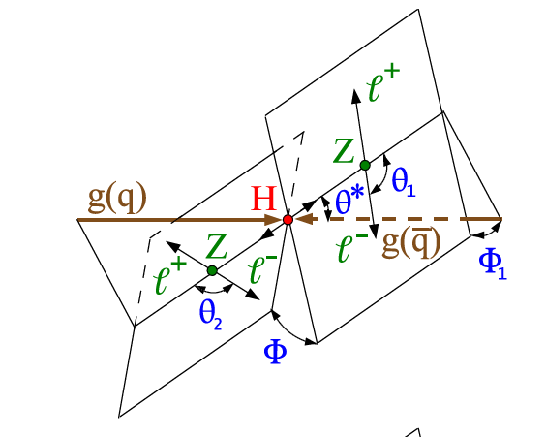
Introduction
Measure fiducial cross section of H->ZZ->4l at 13.6 TeV using the 2022 Data collected by CMS.
The result has been open to public(ICHEP 2024), and the paper will be submitted to JHEP.
Analysis performed on 2022preEE (ECAL leak) ReReco and 2022postEE Prompt datasets
A total of 34.7 fb-1 has been analysed, for 7.98fb-1 in preEE era and 26.67fb-1 in postEE era.
Cross section is measured by unfolding experimental data to the fiducial phase space at generator level.
Differencial XS for Higgs production are also measured with several observables.

Slide 3
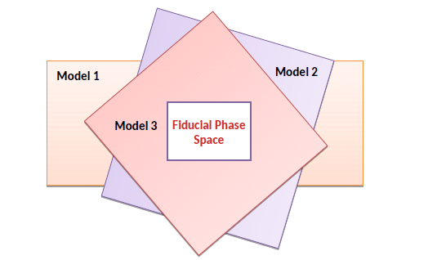
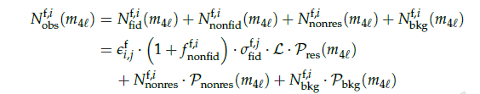





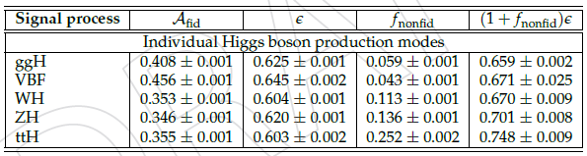
Analysis strategy
is skimmed from Data.
is measured from signal samples.
are described by signal shape.
is evaluated from backgrounds
Finally, the fiducial XS can be measured with a simutanous fitting method. Similarly, the differential XS can also be fitted with suitable observables binning.

Slide 4
Object Selection
Electrons:
pT > 7GeV, |eta|<2.5, dxy<0.5cm, dz<1cm
SIP3d<4, BDT ID
FSR Photons:
pT > 2GeV, |eta|<2.5, ISO<1.8
△R(l,γ)<0.5 △R(l,γ)/(pT^2)<0.012
Muons:
pT > 5GeV, |eta|<2.4, dxy<0.5cm, dz<1cm
SIP3d<4, PF ID if pT<200,
PF ID or HighPTID if pT>200, ISO<0.35
Jets:
To be updated (not used in this analysis)

Slide 5
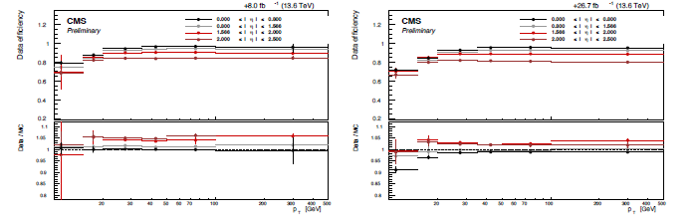
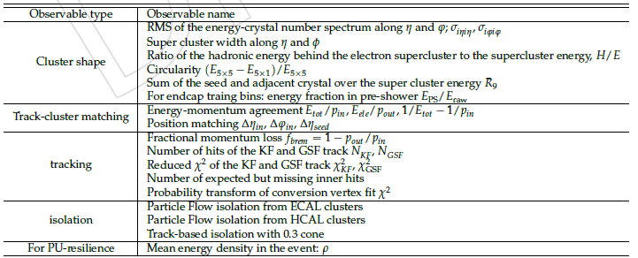
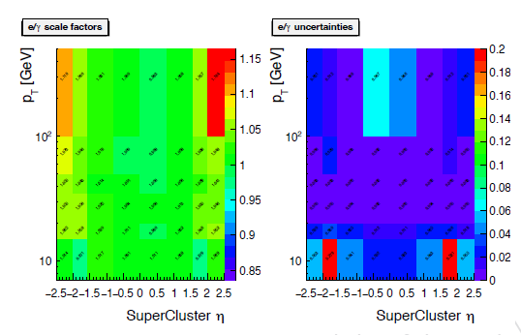
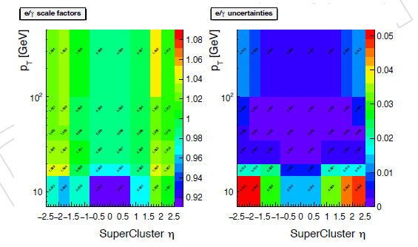
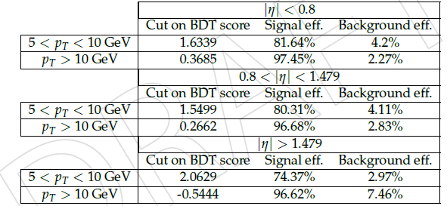
Electron SFs
Electron pT/Eta/IP selection was inherited from Run2, but the BDT ID is investigated again in 2022.
Corresponding Effs with tag-and-probe methods
BDT input Features
preEE SFs
postEE SFs
BDT WPs for tight electron selection

Slide 6
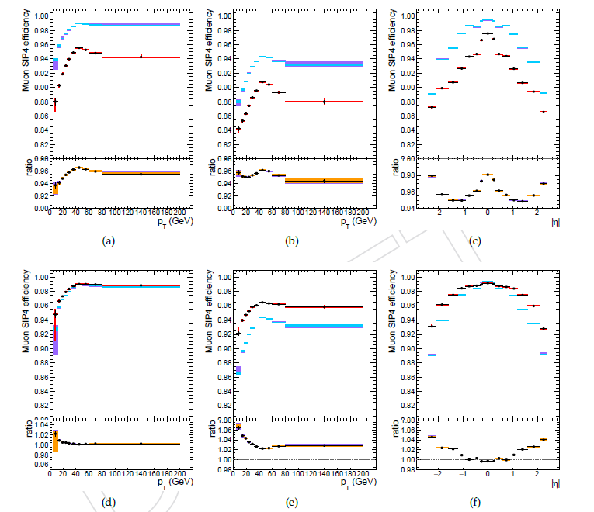
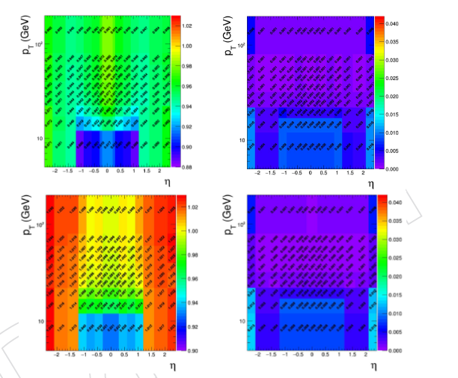
Muon SFs
Muon Efficiencies are measured under LooseID, SIP, ISO cuts with tag-and-probe method, and finally combined as the SFs.
PreEE
PostEE

Slide 7
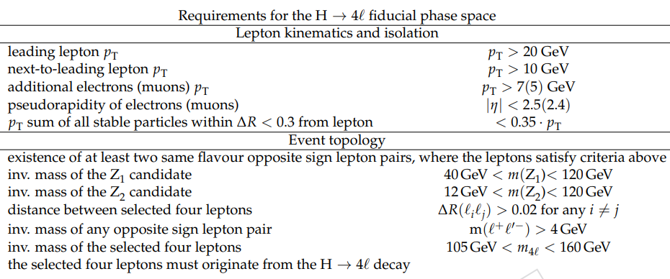
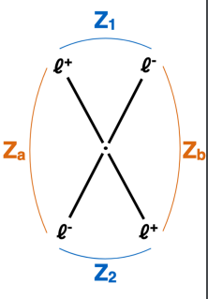
Event Selection
Fiducial Space
Z Candidates:
any OS-SF lepton pairs with 12 GeV<m_ll<120GeV
ZZ Candidates:
a) Build all possible ZZ pair
b)m_Z1>40GeV, leading Lep_pT>20GeV, sub leading Lep_pT>10GeV, △R(l,l)>0.02
c)For each OS pair, m_ll>4GeV(QCD rejection)
d)For 4e/4mu events, reject |mZa – mZ| <|mZ1 mZ|AND mZb < 12GeV).
Fiducial phase space defined at gen-level to match closely the experimental selections at reco-level to ensure model-independency of the measurement and easy re-interpretability.
Unfolding

Slide 8
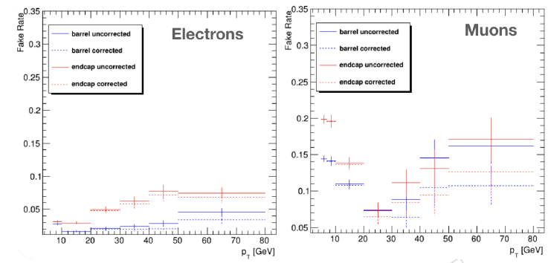
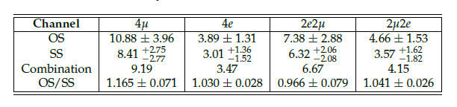
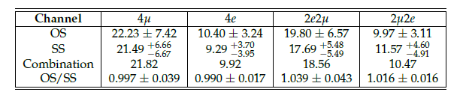
BKG estimation
In our selection, two main kinds of bkg process should be taken into account.
Irreducible bkg with 4 prompt lepton: qqZZ4l, ggZZ4l, MC well simulated
Reducible bkg by the misidentification of non-prompt leptons: Z+X, using Data Driven method.
Fake rate measurement:
Z+1L CR requires 2 tight OSSF lepton, and an additional loose lepton. We can count how many prompt in this CR to get Fake Rates.
Estimation:
For 2P2F and 3P1F CR in Z+X, once we know the probability for a “fake” lepton identified as a prompt lepton, we can evaluate how many Z+X evts in SR according to CR yields and fake rates.
NSR = (fr2/(1-fr2))N3P1F - (fr1/(1-fr1))*(fr2/(1-fr2))N2P2F
2022 preEE Z+X yield in SR
Fake rate in 2022 preEE
2022 postEE Z+X yield in SR

Slide 9
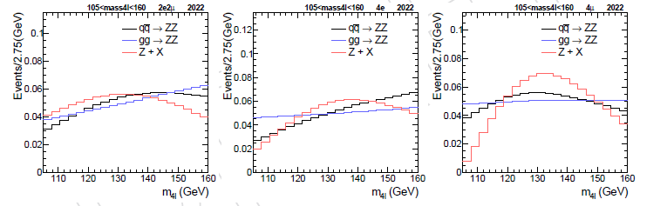
BKG Modeling
Both kind of Bkg can be fitted with the histogram template of reconstructed mass4l.
Irreducible bkg qqZZ4l, ggZZ4l extracted this shape from MC simulation
Reducible bkg Z+X is filled from the reweighted distribution from CR
qqZZ was generated in NLO, but the diff. XS was computed as NNLO. (Consider for both EW & QCD)
The NNLO/NLO k-factors are applied for qqZZ as a part of the event weight.
Similarly, ggZZ can only be generated in LO, so the NNLO/LO or NNLO/LO k-factors should applied for ggZZ as a part of the event weight.

Slide 10


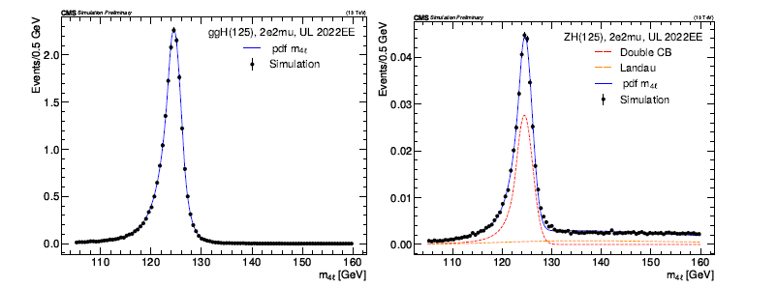
Signal Modeling
Signal of resonance 4l can be fitted with Double CB functions, where a set of parameters can be determined. Meanwhile, the non-resonance (VH, ttH) 4l will be described by Landau shape.

Slide 11
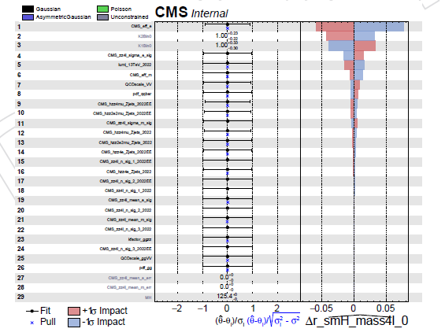
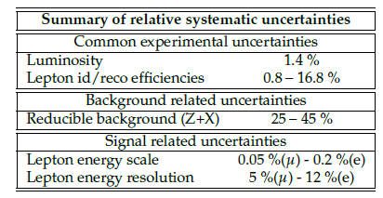
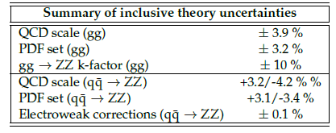
Systematic Uncertainties
Systematic Uncertainties can be traced from experimental source and theoretical source.
Electron Efficiency is the most relevant!

Slide 12
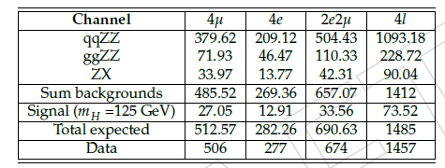
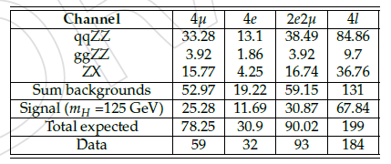
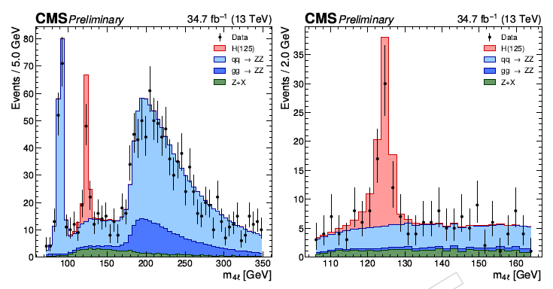
Yields in SR(Pre-fit)
m_4l>70GeV
105GeV<m_4l<160GeV

Slide 13
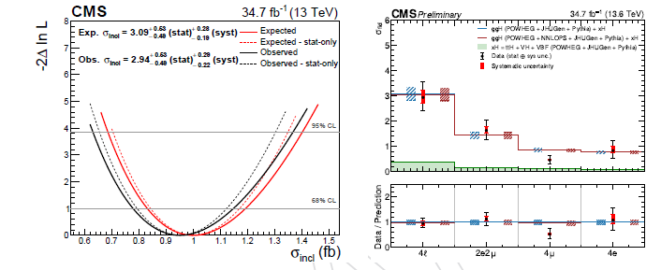
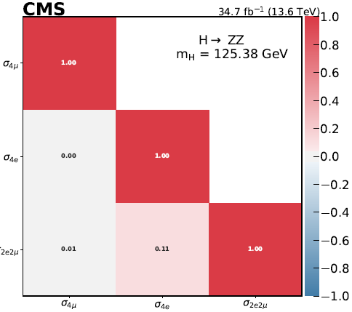
Final Results
Inclusive fiducial XS fitting result, and the x-axis of the left plots is represented by signal strength. The uncertainy of XS can be extracted by 1-d likehood scanning.
Correlation of different final states.

Slide 14
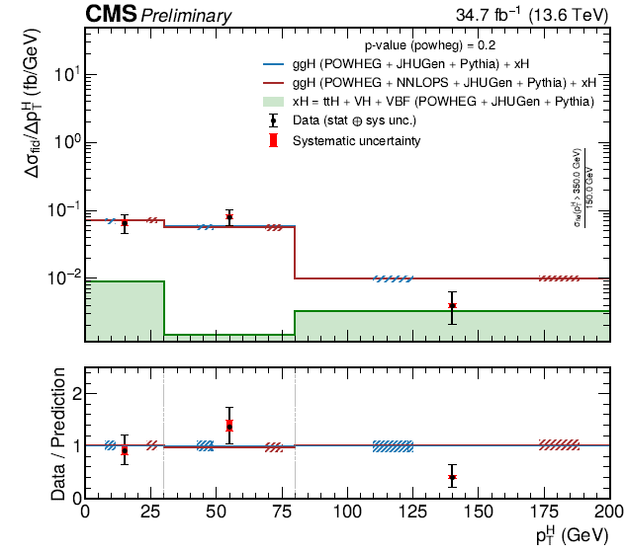
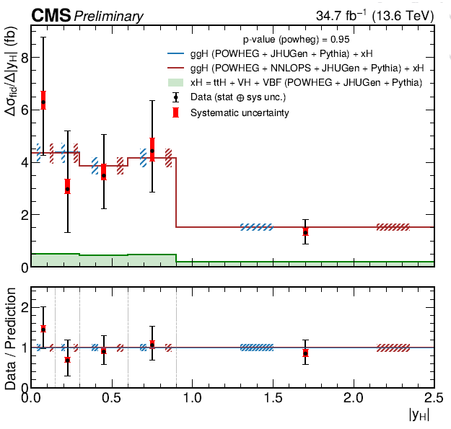
Final Results
Different XS for Higgs Production could be measured as a function of transverse momentum and rapidity.

Slide 15
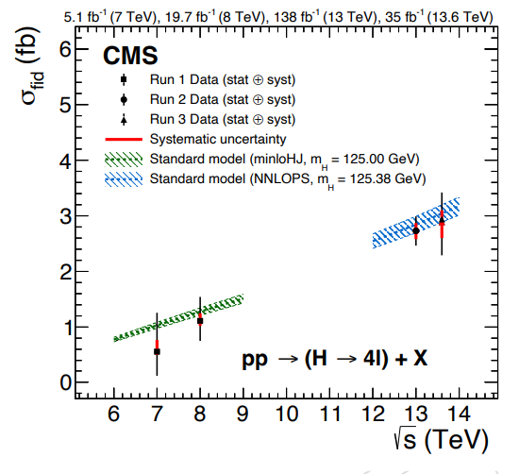
Summary
Same analysis strategy as Run2 is performed.
The performace of electron and muon are well
measured in Run3 2022 data.
Fiducial XS are measured with unbinned
max-likelihood method, and the result is:
Comparing with Run1 and Run2 results,
they are corresponding with SM predictions.
Differential XS can also be measured with this
framework, whichwill bring more information when
we have more statistics in Run3.(2022-2025)

Slide 16
Thanks!

Slide 17
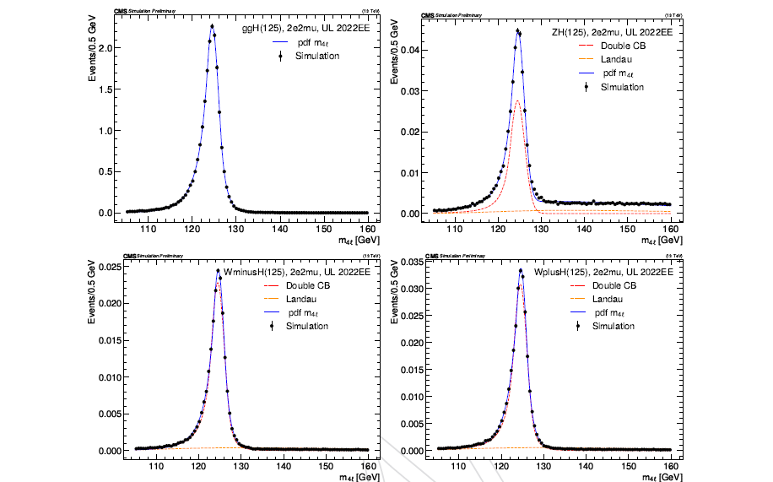
Backup

Slide 18
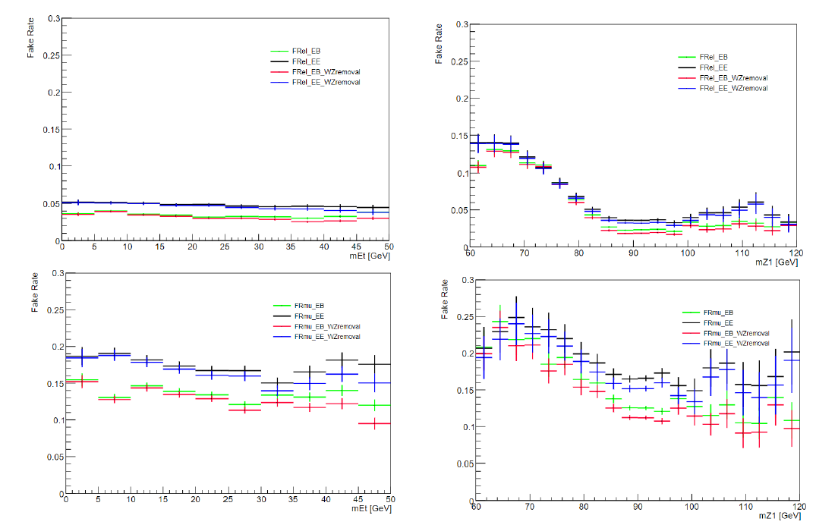
Fake rates

Slide 19
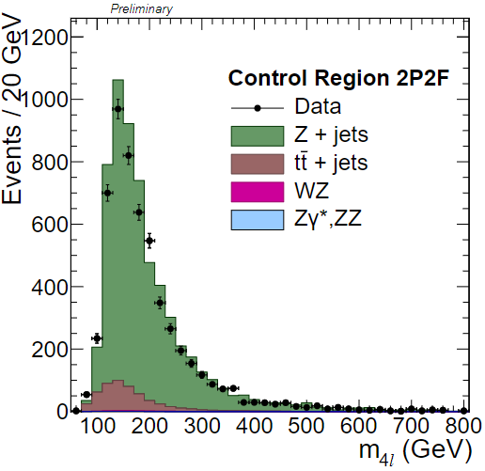
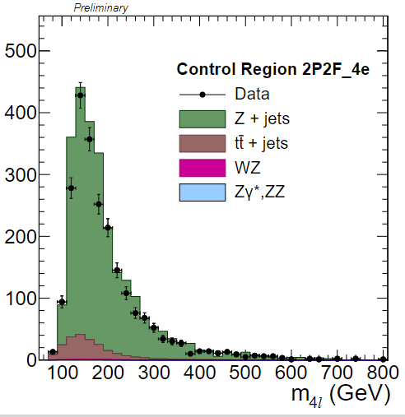
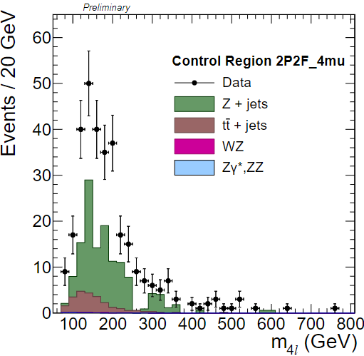
ZXCR plots

Slide 20
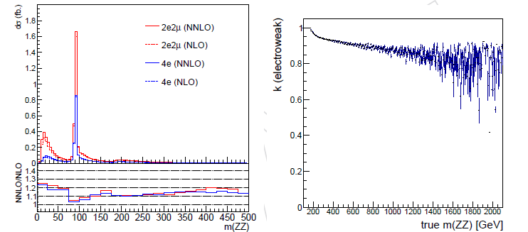
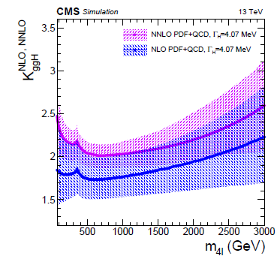
BKG estimation
qqZZ was generated in NLO, but the diff. XS was computed as NNLO. (Consider for both EW & QCD)
The NNLO/NLO k-factors are applied for qqZZ as a part of the event weight.
Similarly, ggZZ can only be generated in LO, so the NNLO/LO or NNLO/LO k-factors should applied for ggZZ as a part of the event weight.

Slide 21
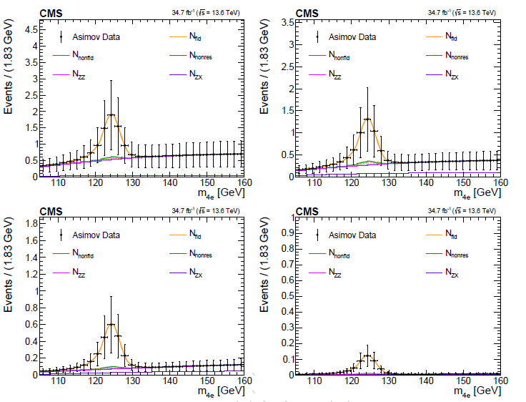
Simutanous fits

Slide 22
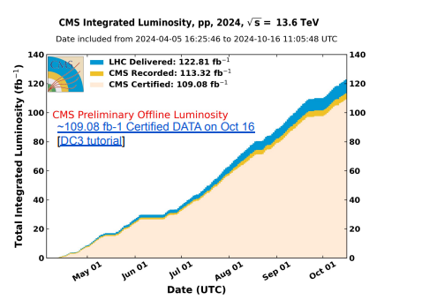
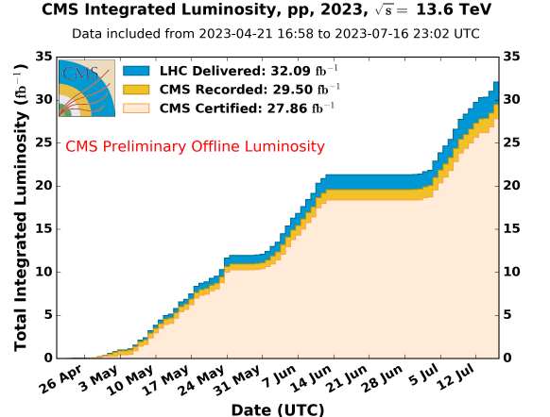
CMS Lumi

Slide 23
