Slide 1
The bubble wall velocity: from the local Boltzmann equations to the non-local Kadanoff-Baym equations
Jiang Zhu
In collaboration with Michael J. Ramsey-Musolf
11/15/2024
QingDao CLHCP 2024

Slide 2
Content
1. Introduction
The Boltzmann equation and Non-local effect
Deriving Boltzmann equation from the K-B equation
Summary

Slide 3
Content
1. Introduction
The Boltzmann equation and Non-local effect
Deriving Boltzmann equation from the K-B equation
Summary

Slide 4
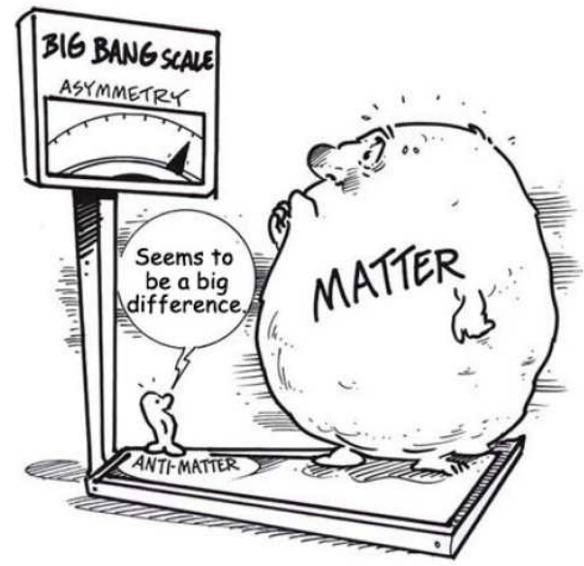
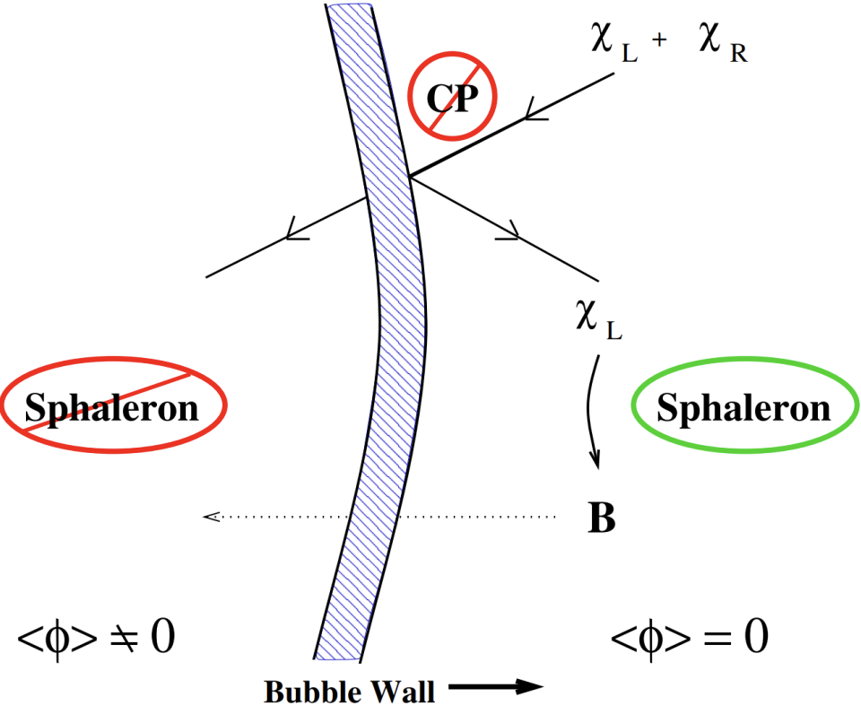
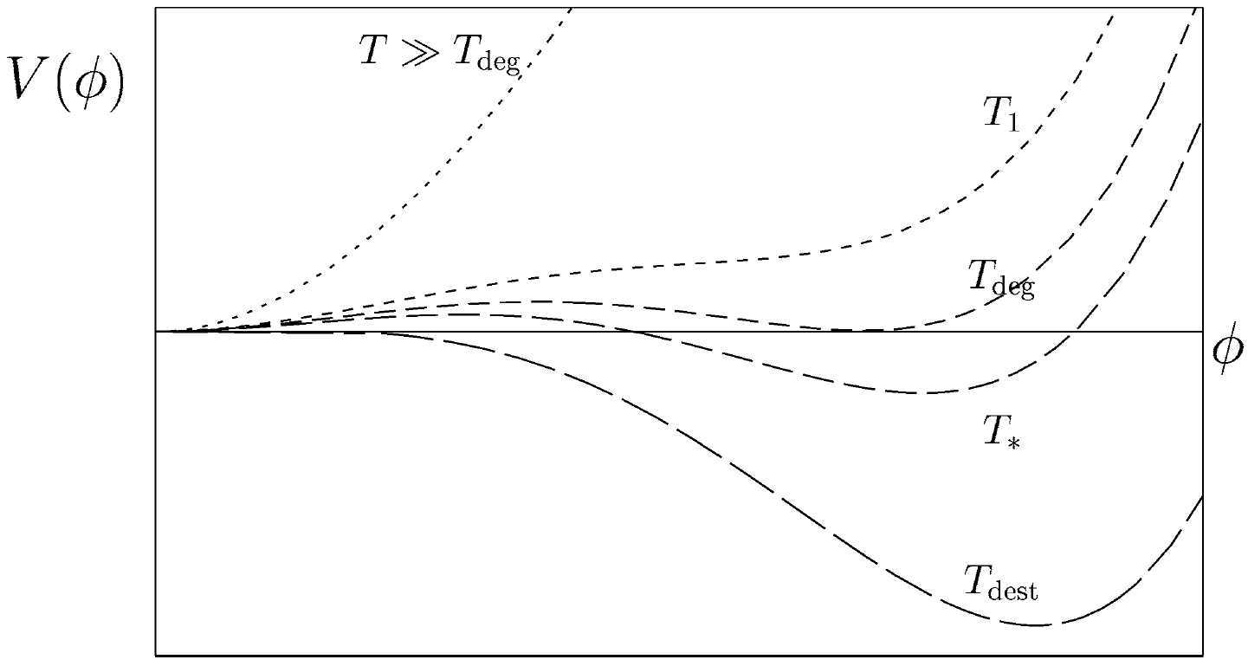
Introduction
New Physics and Electroweak Phase Transition
The particle physics SM is good but not good enough, there is still many problems/phenomenon which can’t be explain by it
Matter and Antimatter asymmetry
Dark matter and energy
Mass of Neutrino
……
One popular way to generate the anti-matter asymmetry is EWBG
This can be achieved by a BSM first-order EWPT

Slide 5
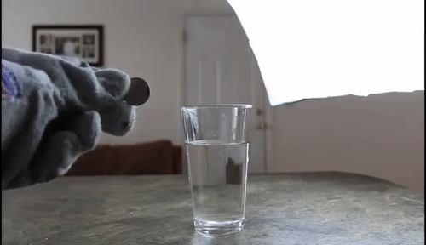
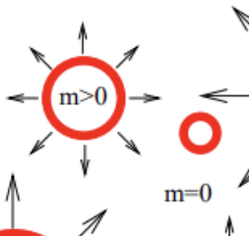
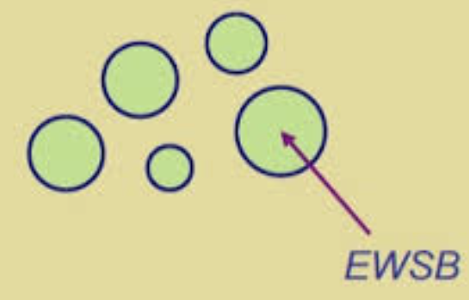
Introduction
New Physics and Electroweak Phase Transition
The barrier between two vacuum will separate two phase and create some bubble in the universe, Just like water vapour bubble in the boiling water
the true vacuum bubble

Slide 6
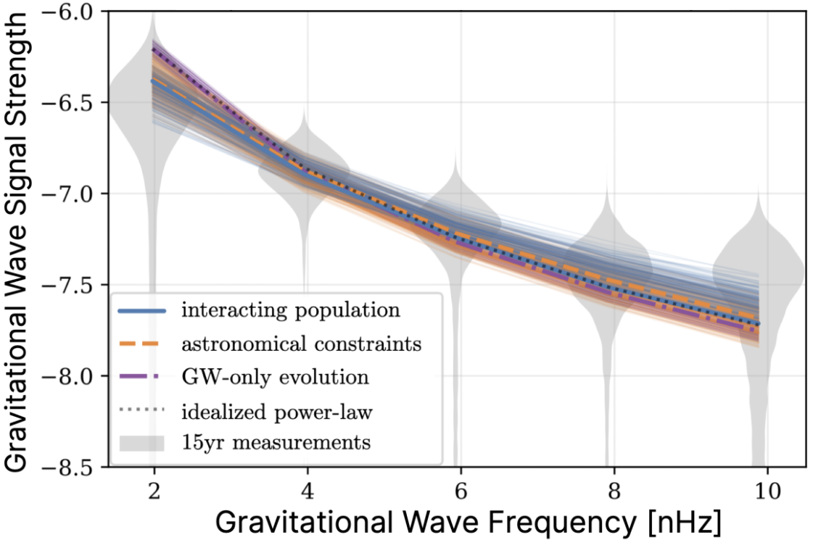
Introduction
Why should we study the EWPT?
Collision
Except from the observational signal from early universe, EWPT can be also be a idea Collider Physics target for new physics.
It is found that to trigger the EWPT there must be some new scalar field with^{[1]}
Sizable interaction between Higgs field
Mass should be less then $M_{φ}<600GeV$
So, EWPT is a great target to probe the BSM new physics both in collider and early universe signal
[1] M. J. Ramsey-Musolf, JHEP 09, 179 (2020)

Slide 7
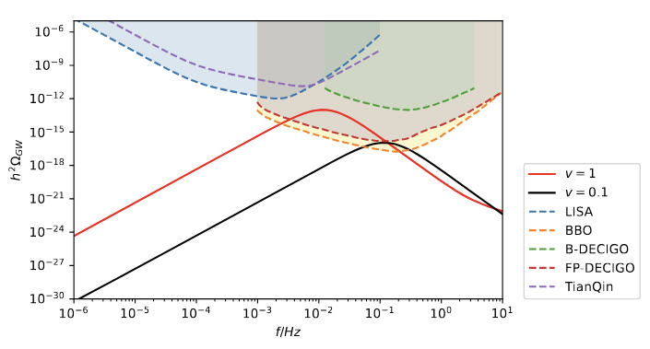
Introduction
Why should we study the Bubble wall velocity
Those stochastic GWs as an observational signal can be well predict by impute a parameters which is the bubble wall velocity when collision.
Different bubble wall velocity $v$ will significantly affect the GWs
Peak frequency
Amplitude
So, it is important to find out
Will there a terminal velocity(bubble expand stably)?
If is, how fast the terminal velocity is?

Slide 8
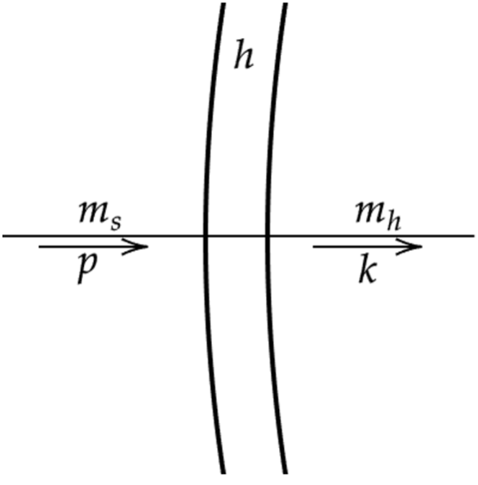
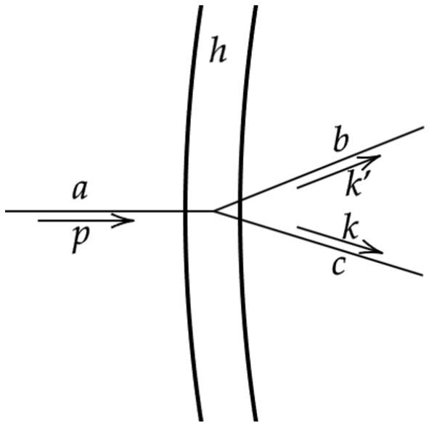
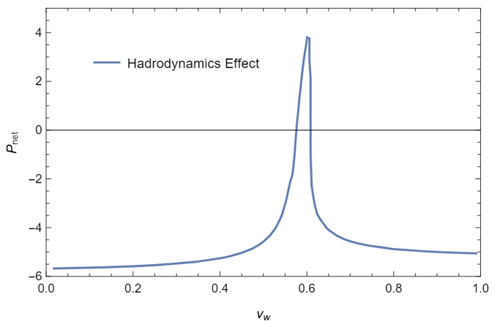
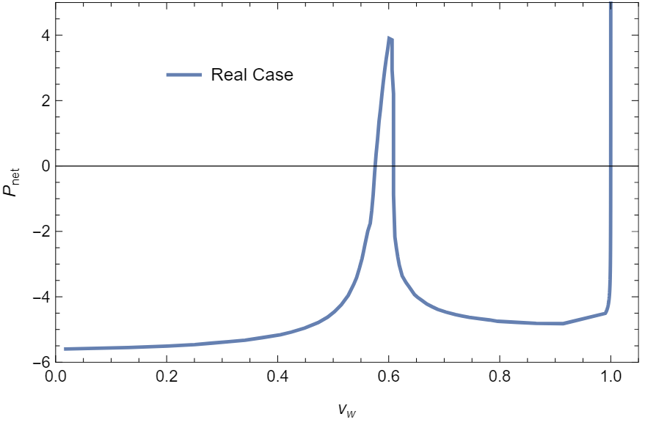
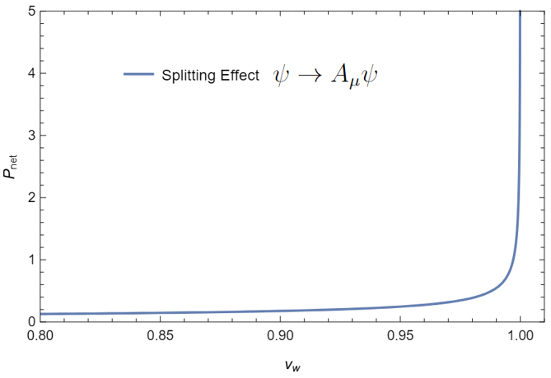
Introduction
The problem is how to compute it?
The Macroscopic Method
The Microscopic Method
$$P_{fric}\left(v_{w}\right)=ΔV_{0}$$
The Macroscopic Method: the Boltzmann+$T^{μν}$ conservation($v_{w}<1$)
The Microscopic Method: pressure in multi-particle-bubble interaction($v_{w}→1$)
B. Laurent and J. M. Cline, Phys. Rev. D 2022
D. Bodeker and G. D. Moore, JCAP 2017
$γ_{w}$enhanced behavior
$$p−k≠0$$
$$p−k−k^{′}≠0$$
Affect the prediction of GWs

Slide 9
Content
1. Introduction
The Boltzmann equation and Non-local effect
Deriving Boltzmann equation from the K-B equation
Summary

Slide 10
The Boltzmann equation and Non-local effect
Where did this inconsistency come from?
Just like we discussed in previous discussion, the key ingredient of computing $v_{w}$ is the force balance
$$P_{fric}\left(v_{w}\right)=ΔV_{0}$$
The force is govern by the momentum transport between the bubble and particle: The kinetic Boltzmann equation
$$=0$$
$T_{f}^{zz}$ component of fluid EMT
Classical force
Particle interaction

Slide 11
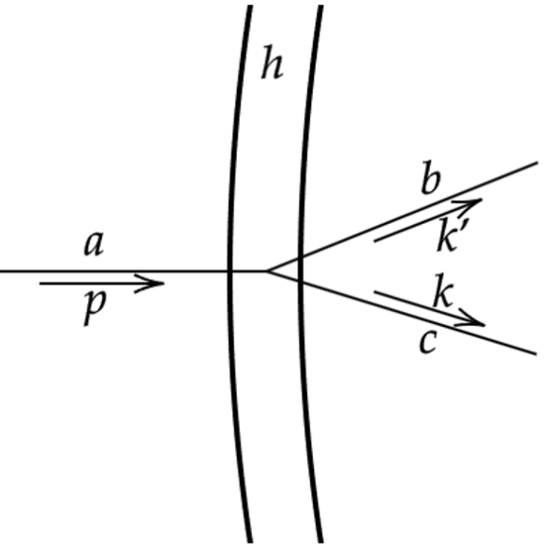
The Boltzmann equation and Non-local effect
The QFT in Background field and Boltzmann Equations
$$p−k−k^{′}≠0$$
Indicate we need momentum non-conservation effect which induced by the background field(VEV)
$$≠0$$
We find the natural way is to introducing the effect of the background Field(the bubble) as source for $p−k−k^{′}≠0$.

Slide 12
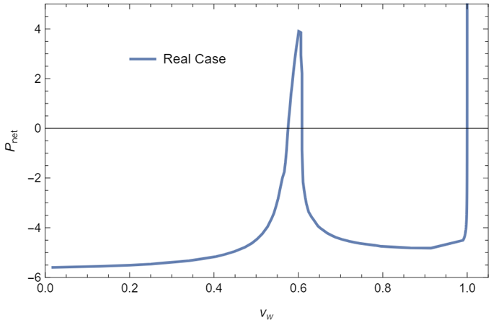
The Boltzmann equation and Non-local effect
The QFT in Background field and Boltzmann Equations
One can derive the corresponding Boltzmann equation in BQFT as
$γ_{w}$ enhanced behavior
So, the Key to solve this inconsistency and find the solution of $v_{w}$ is to include the momentum non-conservations effect and $γ_{w}$ enhanced behavior in the Boltzmann equations

Slide 13
Content
1. Introduction
The Boltzmann equation and Non-local effect
Deriving Boltzmann equation from the K-B equation
Summary

Slide 14
Deriving Boltzmann equation from the K-B equation
Can we get those Result from the first principle?
Idea is obtain the quantum kinetic equation from the Dyson-Schwinger Equation + The Closed Time Path formalism^{[1,2]}
The Closed Time Path Formalism
The Kadanoff-Baym equation
Include the Non-local effect bring by the Non-trivial VEV field
[1] G. Z. Zhou, Z. B. Su, B. l. Hao and L. Yu, Phys. Rev. B 22, 3385-3407 (1980)
[2] V. Cirigliano, C. Lee, M. J. Ramsey-Musolf and S. Tulin, Phys. Rev. D 2010

Slide 15
Deriving Boltzmann equation from the K-B equation
Deriving the effect in Modified BE from KBE
Using the ansatz of the two point Greens functions in the Closed Time Path formalism one can established the relation between $G$ and $f$
Deriving the modified non-local modified Boltzmann equation from KBE
The collision term do not have full momentum conservations anymore, and it will back to ordinary Boltzmann equation if interaction and momentum a coordinate independent
$$P_{fric}\left(v_{w}\right)=$$

Slide 16
Deriving Boltzmann equation from the K-B equation
Toy Model
In SM, the electroweak SSB is described by a crossover in early universe, to obtain a FOPT to get EWBG, we always need Scalar extension of SM
We choice a toy model to demonstrate the solution of the inconsistency
is the Higgs and is New Scalar extension of SM
$$P_{fric}\left(v_{w}\right)=$$

Slide 17
Content
1. Introduction
The Boltzmann equation and Non-local effect
Deriving Boltzmann equation from the K-B equation
Summary

Slide 18
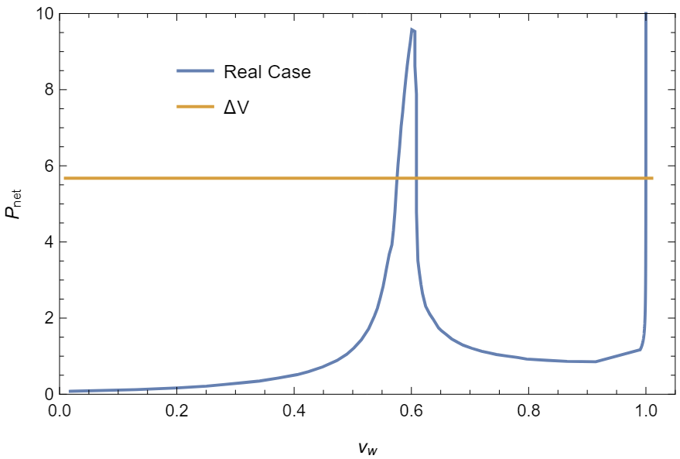
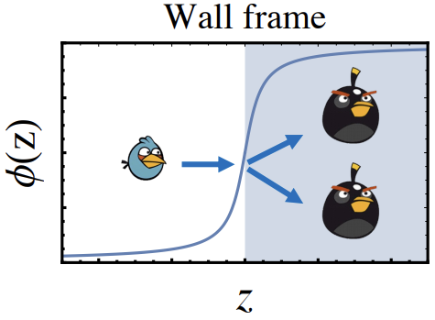
Summary
Summary
We build a systematic frameworks to solve the inconsistency between two method to compute $v_{w}$ by the modified BE.
We find, in principle, those effect can be found by solving the K-B equation, and discuss $v_{w}$ for any $i→f$ interaction, even in QCD PT.
Those $2→2$ in $φ^{2}Φ^{2}$ theory will induce a friction force $∝γ_{w}$ and eliminate run-aways bubble configuration.
Take Home message:
To solve the problem of $v_{w}$, one need to consider the KBE rather than directly used BE which lose some critical non-local effect
But, since the complicated of KBE normally we need to do the approximations to get the non-local effect(BQFT, $ε_{wall}$)

Slide 19
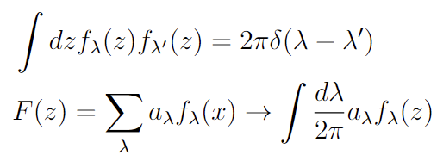
Backup
Quantization of the Field

Slide 20
Backup
Quantization of the Field

Slide 21
Backup
Quantization of the Field
Or

Slide 22
Backup
General Boltzmann Equation

Slide 23
Backup
General Boltzmann Equation

Slide 24
Backup
Collision terms

Slide 25
Backup
Collision terms

Slide 26
Backup
The constrain equation

Slide 27
Backup
The constrain equation

Slide 28
Backup
The kinetic equation

Slide 29
Backup
The kinetic equation

Slide 30
Backup
The kinetic equation

Slide 31
Backup
The kinetic equation

Slide 32
Backup
The kinetic equation

