Slide 1


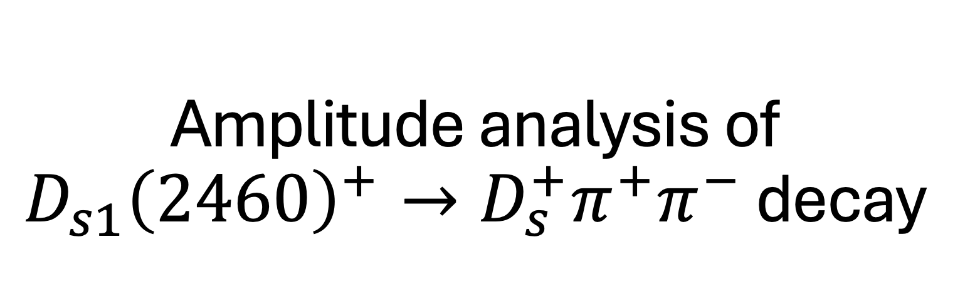
Amplitude analysis of $D_{s1}{\left(2460\right)}^{+}→D_{s}^{+}π^{+}π^{−}$ decay
Linxuan Zhu
on behalf of LHCb collaboration

Slide 2
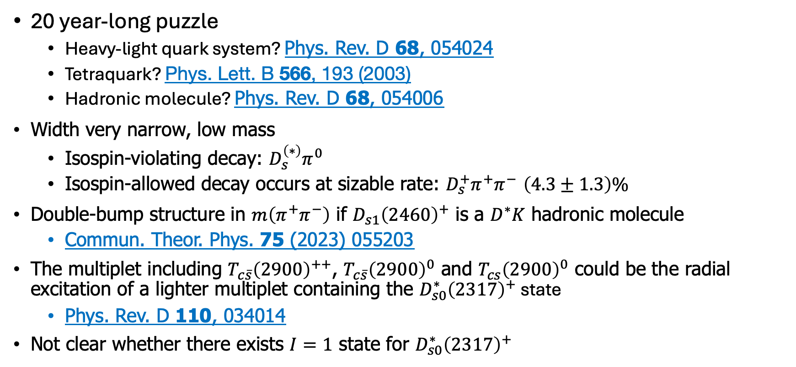


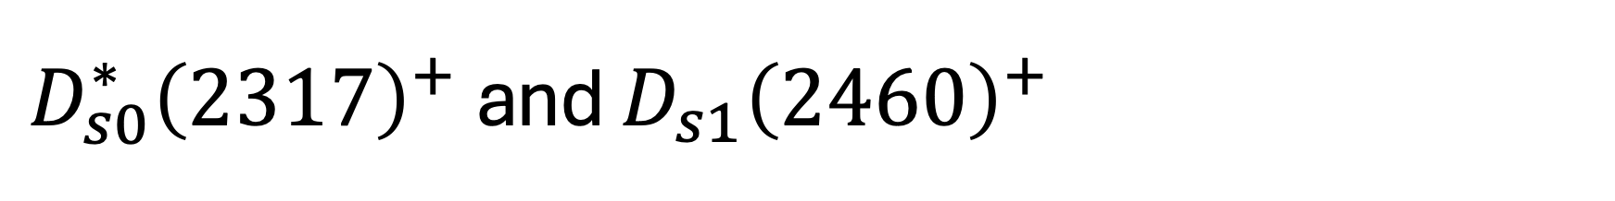





$D_{s0}^{∗}{\left(2317\right)}^{+}$ and $D_{s1}{\left(2460\right)}^{+}$
$${\vec{s}}_{Q}$$
$\vec{L}$
${\vec{s}}_{q}$
20 year-long puzzle
  Heavy-light quark system? Phys. Rev. D 68, 054024
  Tetraquark? Phys. Lett. B 566, 193 (2003)
  Hadronic molecule? Phys. Rev. D 68, 054006
Width very narrow, low mass
  Isospin-violating decay: $D_{s}^{\left(∗\right)}π^{0}$
  Isospin-allowed decay occurs at sizable rate: $D_{s}^{+}π^{+}π^{−}$ $\left(4.3±1.3\right)\%$
Double-bump structure in $m\left(π^{+}π^{−}\right)$ if $D_{s1}{\left(2460\right)}^{+}$ is a $D^{∗}K$ hadronic molecule
  Commun. Theor. Phys. 75 (2023) 055203
The multiplet including $T_{c\overline{s}}{\left(2900\right)}^{++}$, $T_{c\overline{s}}{\left(2900\right)}^{0}$ and $T_{cs}{\left(2900\right)}^{0}$ could be the radial excitation of a lighter multiplet containing the $D_{s0}^{∗}{\left(2317\right)}^{+}$ state
  Phys. Rev. D 110, 034014
Not clear whether there exists $I=1$ state for $D_{s0}^{∗}{\left(2317\right)}^{+}$
$$c$$
$$\overline{s}$$
$$q$$
$$\overline{q}$$

Slide 3
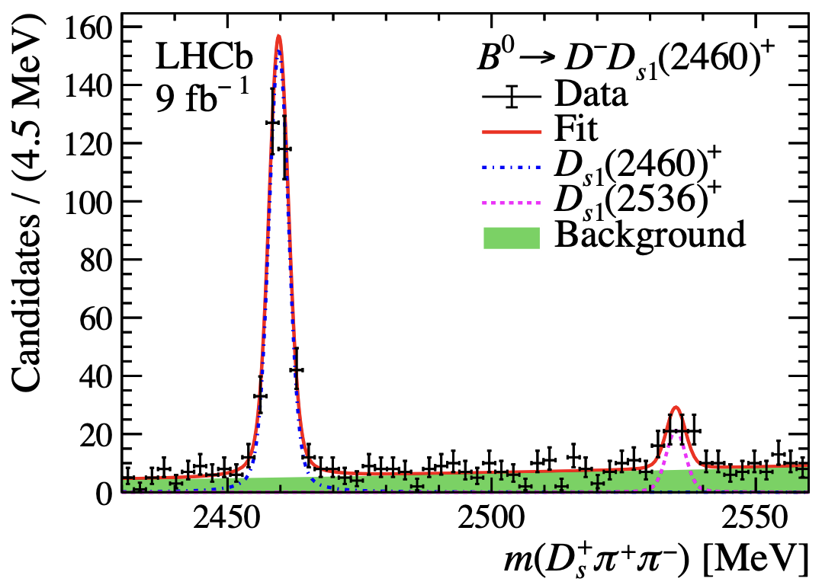
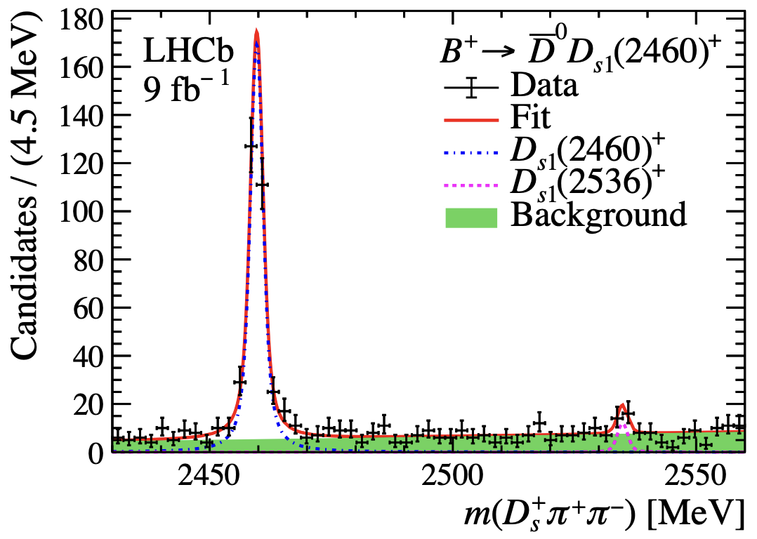
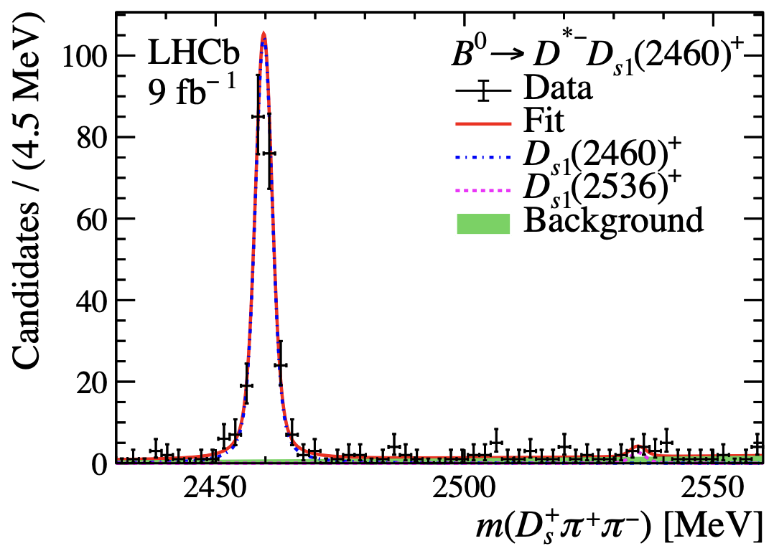
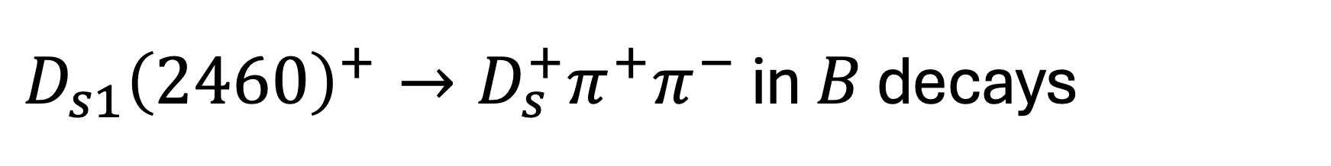

$D_{s1}{\left(2460\right)}^{+}→D_{s}^{+}π^{+}π^{−}$ in $B$ decays
LHCb data 9.0 ${fb}^{−1}$
  https://arxiv.org/abs/2411.03399
$B^{0}→D^{−}D_{s1}{\left(2460\right)}^{+}$, $B^{+}→{\overline{D}}^{0}D_{s1}{\left(2460\right)}^{+}$, and $B^{0}→D^{∗−}D_{s1}{\left(2460\right)}^{+}$
Clear $D_{s1}{\left(2460\right)}^{+}$ signal, small contribution from $D_{s1}{\left(2536\right)}^{+}$
High purity

Slide 4
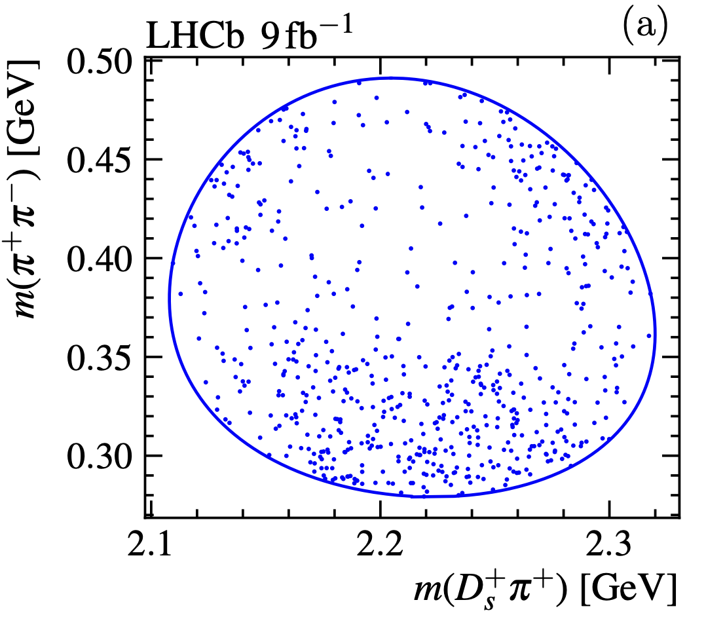
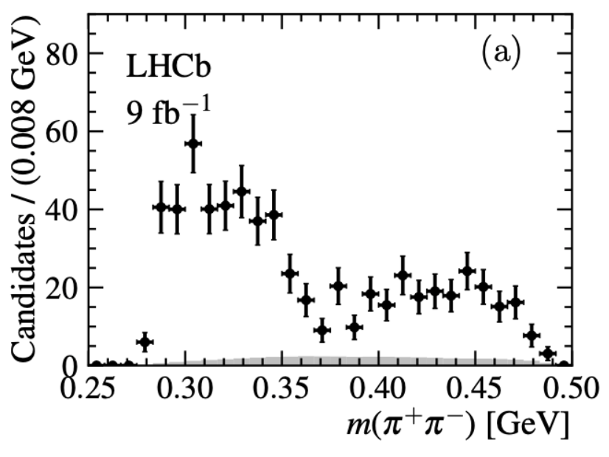
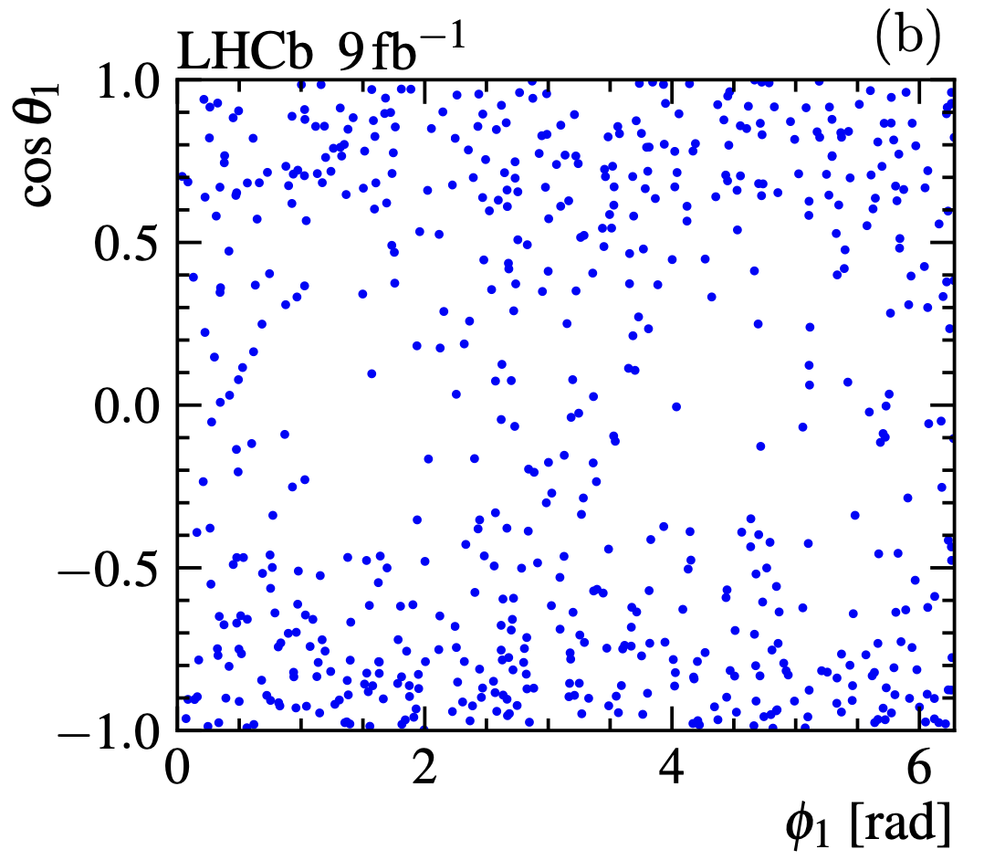
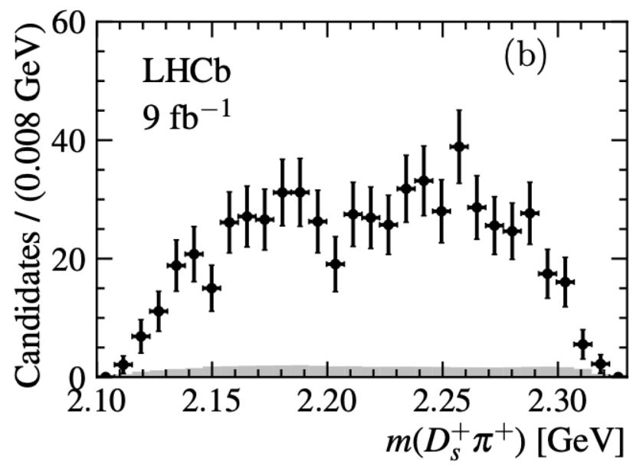
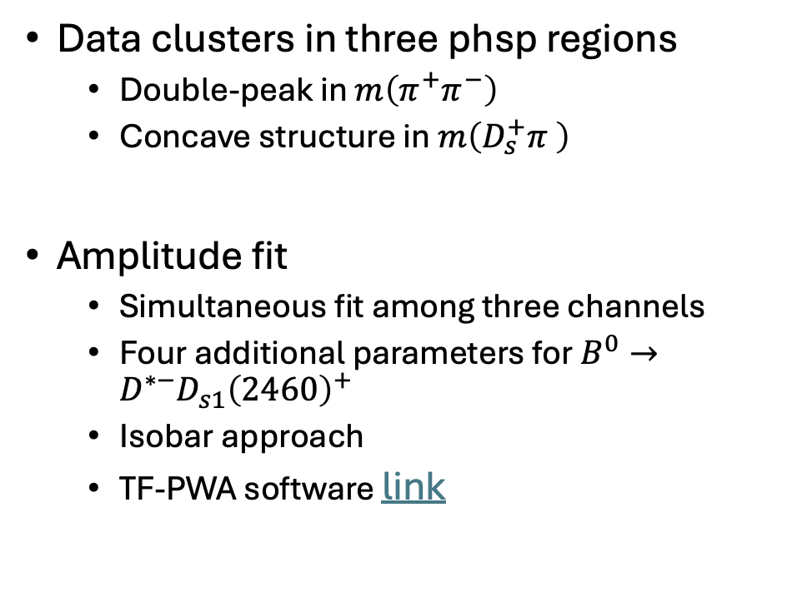
Data distribution
Data clusters in three phsp regions
  Double-peak in $m\left(π^{+}π^{−}\right)$
  Concave structure in $m\left(D_{s}^{+}π \right)$
Amplitude fit
  Simultaneous fit among three channels
  Four additional parameters for $B^{0}→D^{∗−}D_{s1}{\left(2460\right)}^{+}$
  Isobar approach
  TF-PWA software link

Slide 5
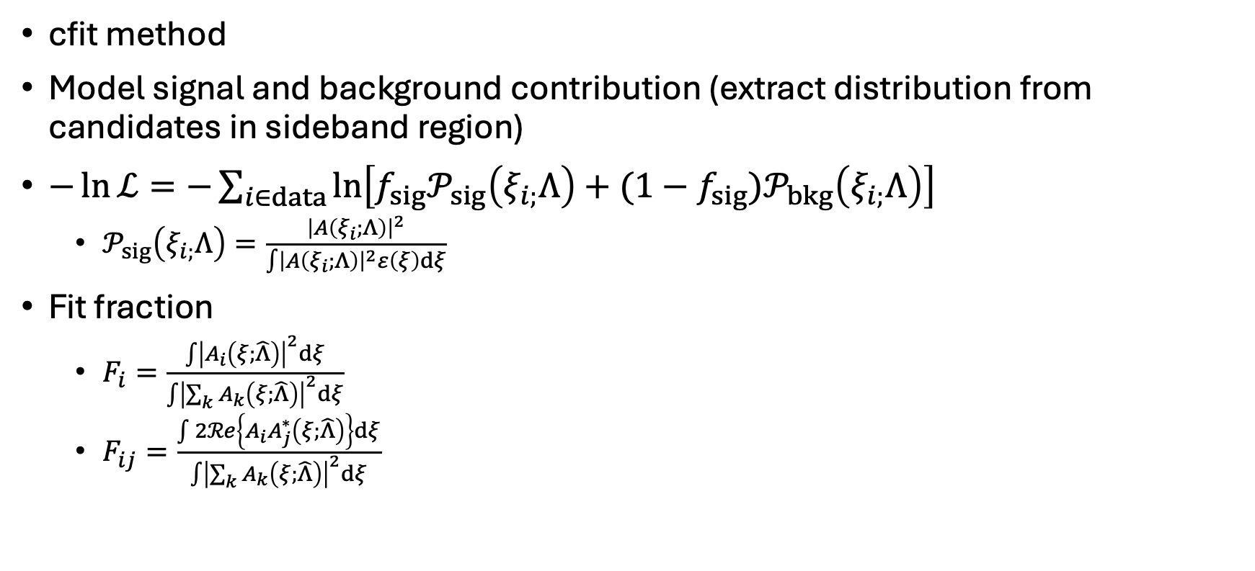
Amplitude fit method
cfit method
Model signal and background contribution (extract distribution from candidates in sideband region)
$−\ln{ℒ}=−\sum_{i∈data}{\ln\left[f_{sig}𝒫_{sig}\left(ξ_{i;}Λ\right)+(1−f_{sig})𝒫_{bkg}\left(ξ_{i;}Λ\right)\right]}$
  $𝒫_{sig}\left(ξ_{i;}Λ\right)=\frac{{\left|A\left(ξ_{i};Λ\right)\right|}^{2}}{\int{{\left|A\left(ξ_{i};Λ\right)\right|}^{2}ε\left(ξ\right)dξ}}$
Fit fraction
  $F_{i}=\frac{\int{{\left|A_{i}\left(ξ;\hat{Λ}\right)\right|}^{2}d}ξ}{\int{{\left|\sum_{k}{A_{k}\left(ξ;\hat{Λ}\right)}\right|}^{2}dξ}}$
  $F_{ij}=\frac{\int{2ℛe\left\{A_{i}A_{j}^{∗}\left(ξ;\hat{Λ}\right)\right\}d}ξ}{\int{{\left|\sum_{k}{A_{k}\left(ξ;\hat{Λ}\right)}\right|}^{2}dξ}}$

Slide 6
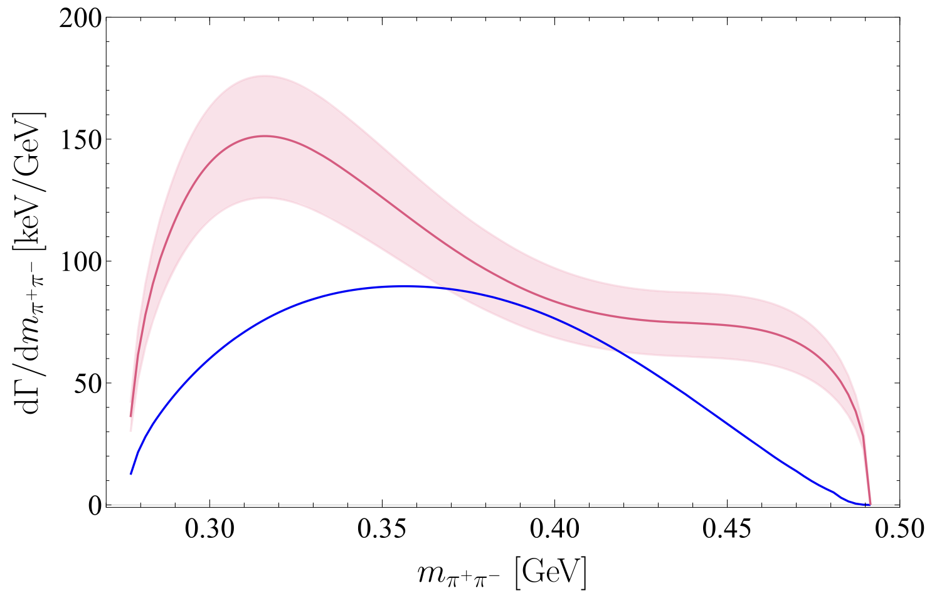

Naïve models
Model $f_{0}\left(500\right)+f_{0}\left(980\right)$ and $ππ$ K-matrix model cannot describe well
  Especially the data with $m\left(ππ\right)>390$ MeV
The model in paper Commun. Theor. Phys. 75 055203 cannot describe the data well either
  Detail implimentation in backup
Red: Hadronic molecule
Blue: Compact tetraquark

Slide 7
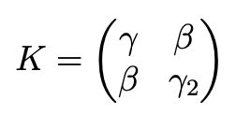
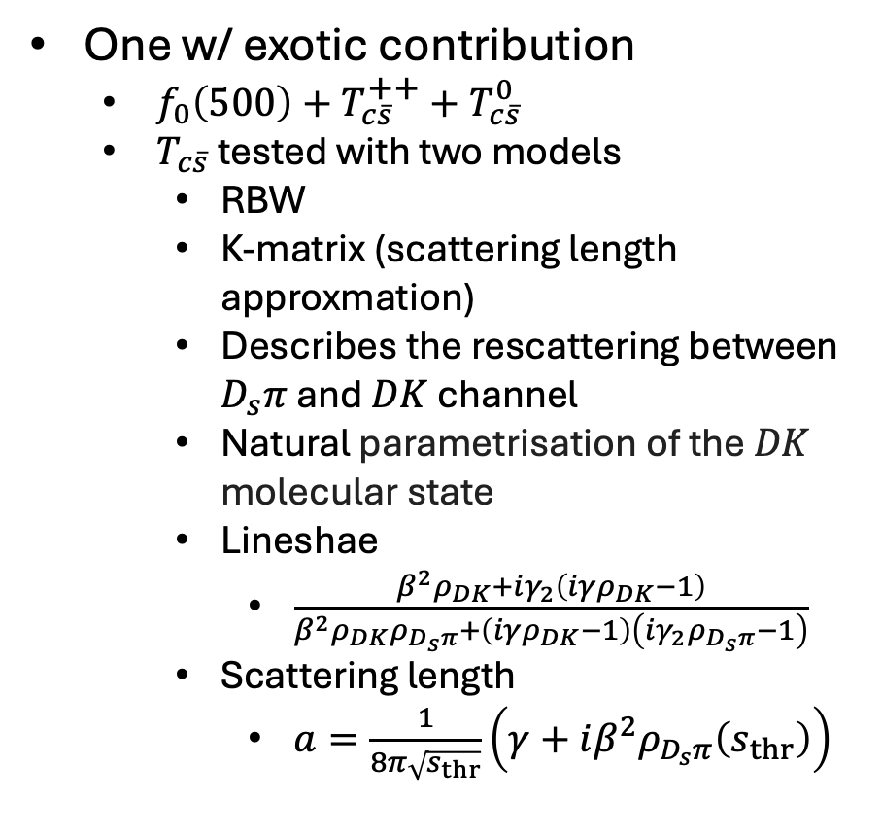
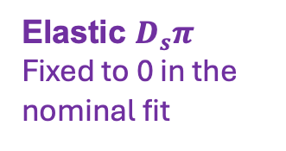
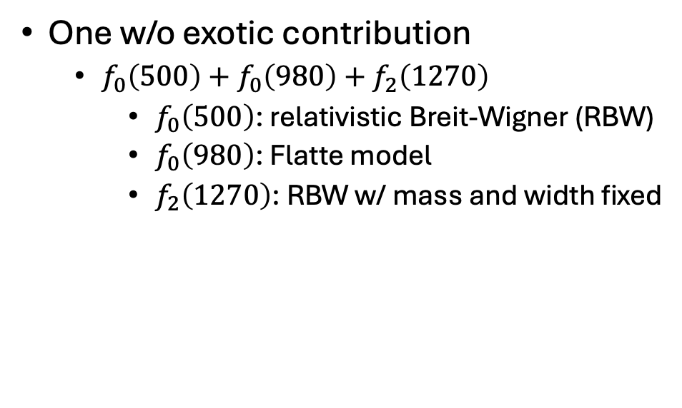


Two models describing data well
One w/o exotic contribution
  $f_{0}\left(500\right)+f_{0}\left(980\right)+f_{2}\left(1270\right)$
    $f_{0}\left(500\right)$: relativistic Breit-Wigner (RBW)
    $f_{0}\left(980\right)$: Flatte model
    $f_{2}\left(1270\right)$: RBW w/ mass and width fixed
One w/ exotic contribution
  $f_{0}\left(500\right)+T_{c\overline{s}}^{++}+T_{c\overline{s}}^{0}$
  $T_{c\overline{s}}$ tested with two models
    RBW
    K-matrix (scattering length approxmation)
    Describes the rescattering between $D_{s}π$ and $DK$ channel
    Natural parametrisation of the $DK$ molecular state
    Lineshae
      $\frac{β^{2}ρ_{DK}+iγ_{2}\left(iγρ_{DK}−1\right)}{β^{2}ρ_{DK}ρ_{D_{s}π}+\left(iγρ_{DK}−1\right)\left(iγ_{2}ρ_{D_{s}π}−1\right)}$
    Scattering length
      $a=\frac{1}{8π\sqrt{s_{thr}}}\left(γ+iβ^{2}ρ_{D_{s}π}\left(s_{thr}\right)\right)$
Elastic $DK$
$$DK↔D_{s}π$$
Elastic $D_{s}π$
Fixed to 0 in the nominal fit
$ρ$ contribution is not significant in both models

Slide 8
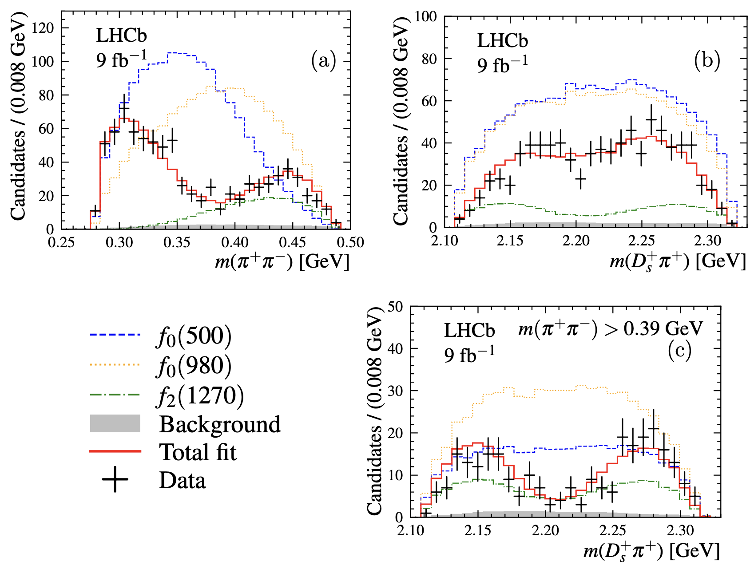
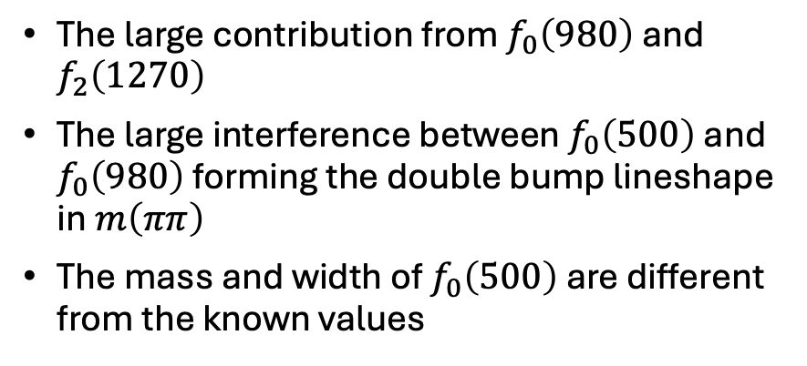

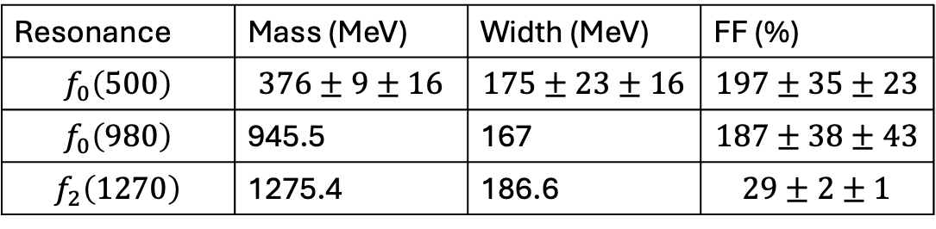
Model $f_{0}\left(500\right)+f_{0}\left(980\right)+f_{2}\left(1270\right)$
The large contribution from $f_{0}\left(980\right)$ and $f_{2}\left(1270\right)$
The large interference between $f_{0}\left(500\right)$ and $f_{0}\left(980\right)$ forming the double bump lineshape in $m\left(ππ\right)$
The mass and width of $f_{0}\left(500\right)$ are different from the known values
Resonance | Mass (MeV) | Width (MeV) | FF (%)
$$f_{0}\left(500\right)$$ | $$376±9±16$$ | $$175±23±16$$ | $$197±35±23$$
$$f_{0}\left(980\right)$$ | 945.5 | 167 | $$187±38±43$$
$$f_{2}\left(1270\right)$$ | 1275.4 | 186.6 | $$29±2±1$$

Slide 9
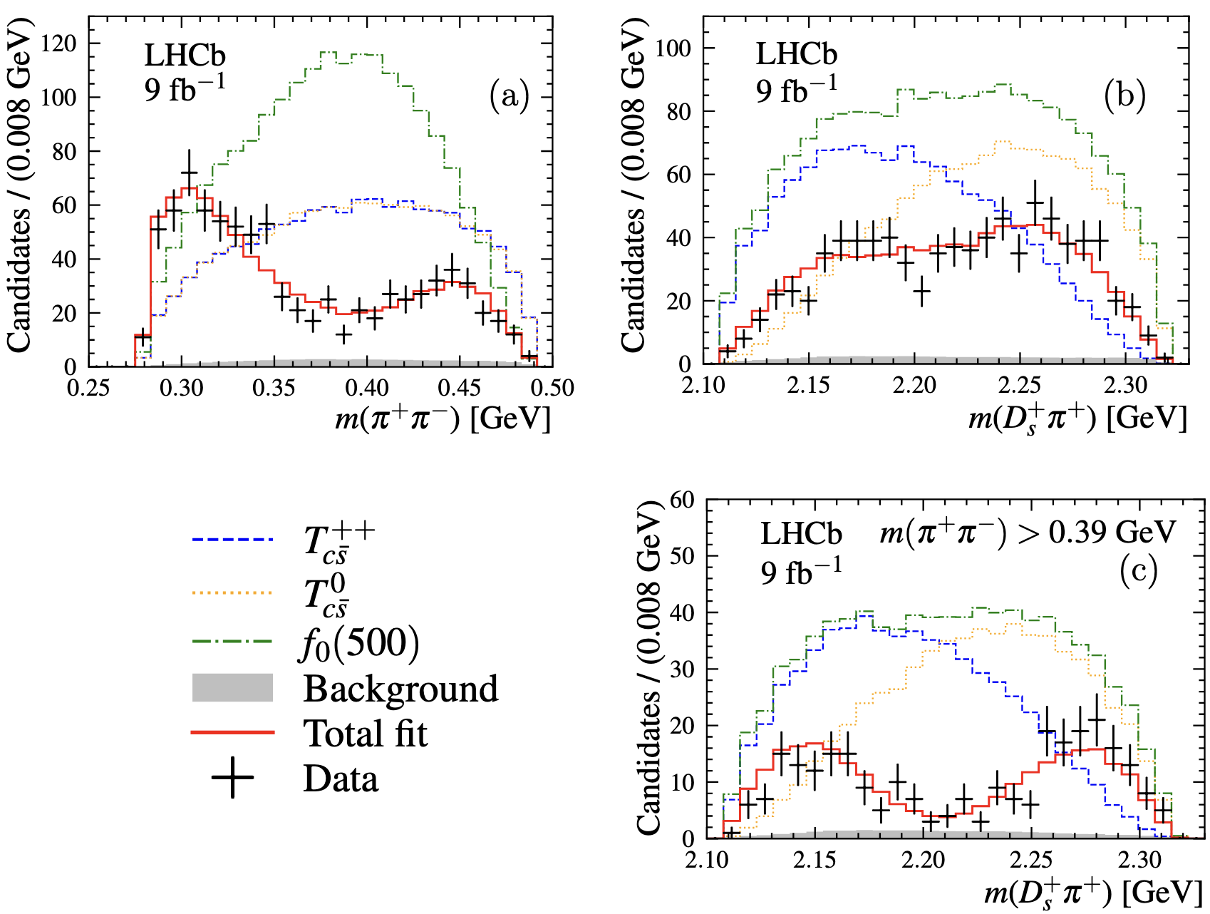

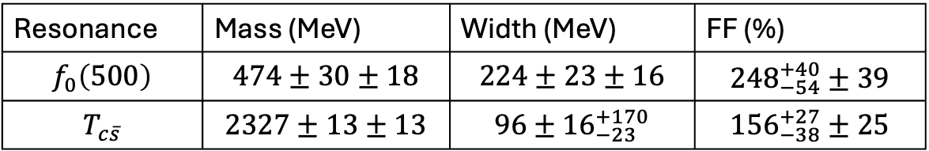
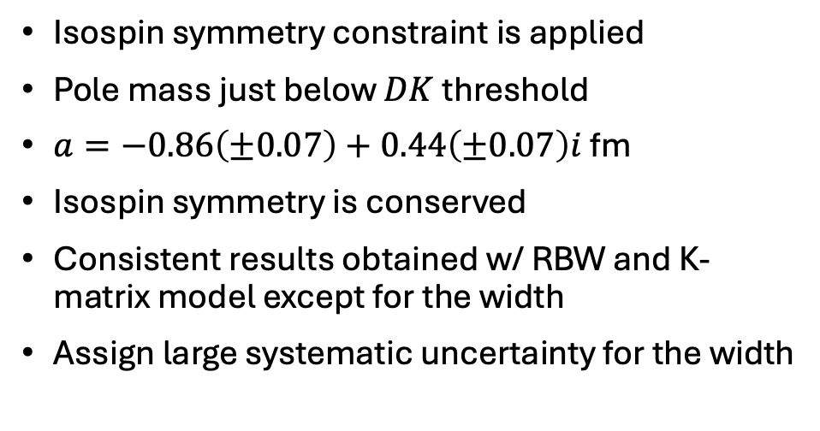
Model $f_{0}\left(500\right)+T_{c\overline{s}}^{++}+T_{c\overline{s}}^{0}$
Isospin symmetry constraint is applied
Pole mass just below $DK$ threshold
$a=−0.86\left(±0.07\right)+0.44\left(±0.07\right)i$ fm
Isospin symmetry is conserved
Consistent results obtained w/ RBW and K-matrix model except for the width
Assign large systematic uncertainty for the width
Resonance | Mass (MeV) | Width (MeV) | FF (%)
$$f_{0}\left(500\right)$$ | $$474±30±18$$ | $$224±23±16$$ | $${248}_{−54}^{+40}±39$$
$$T_{c\overline{s}}$$ | $$2327±13±13$$ | $$96±{16}_{−23}^{+170}$$ | $${156}_{−38}^{+27}±25$$

Slide 10
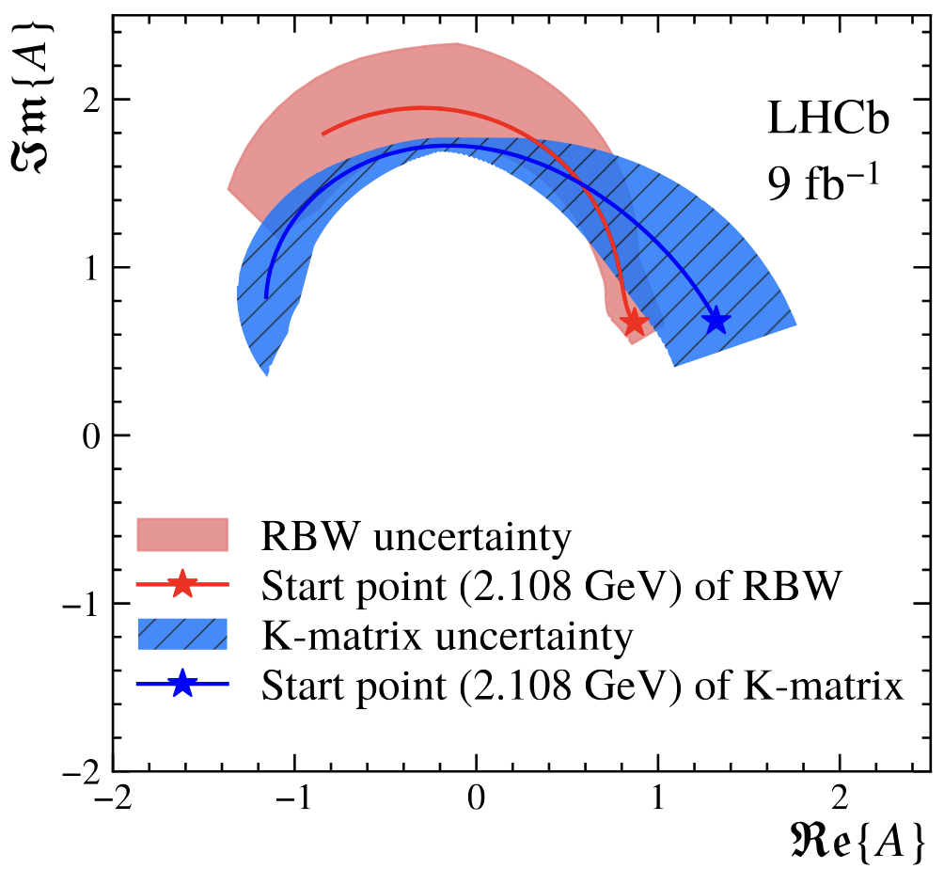
Model $f_{0}\left(500\right)+T_{c\overline{s}}^{++}+T_{c\overline{s}}^{0}$
Isospin symmetry constraint is applied
Pole mass just below $DK$ threshold
$a=−0.86\left(±0.07\right)+0.44\left(±0.07\right)i$ fm
Isospin symmetry is conserved
Consistent results obtained w/ RBW and K-matrix model except for the width
Assign large systematic uncertainty for the width
Resonance | Mass (MeV) | Width (MeV) | FF (%)
$$f_{0}\left(500\right)$$ | $$474±30±18$$ | $$224±23±16$$ | $${248}_{−54}^{+40}±39$$
$$T_{c\overline{s}}$$ | $$2327±13±13$$ | $$96±{16}_{−23}^{+170}$$ | $${156}_{−38}^{+27}±25$$

Slide 11
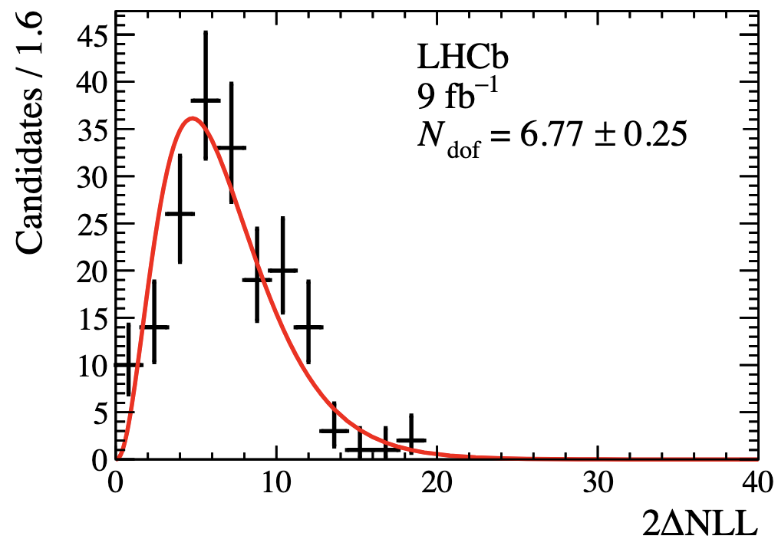
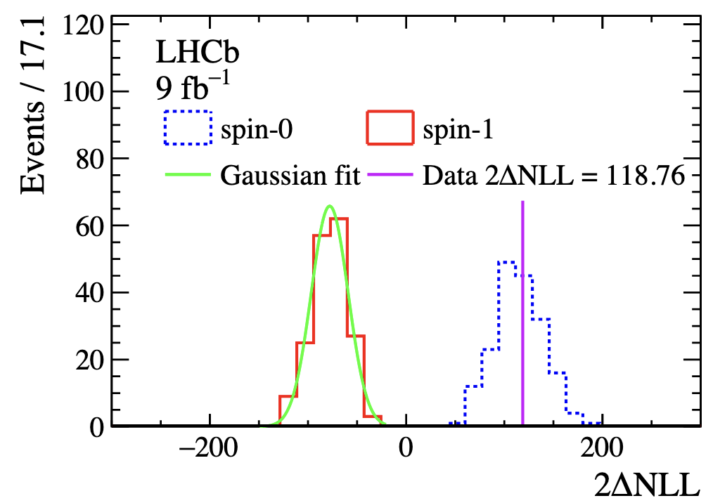

Model $f_{0}\left(500\right)+T_{c\overline{s}}^{++}+T_{c\overline{s}}^{0}$
Generate pseudoexperiments to estimate the significance
Significance over $f_{0}\left(500\right)+f_{0}\left(980\right)$ model is larger than 10 $σ$
$J^{P}$ favours $0^{+}$

Slide 12
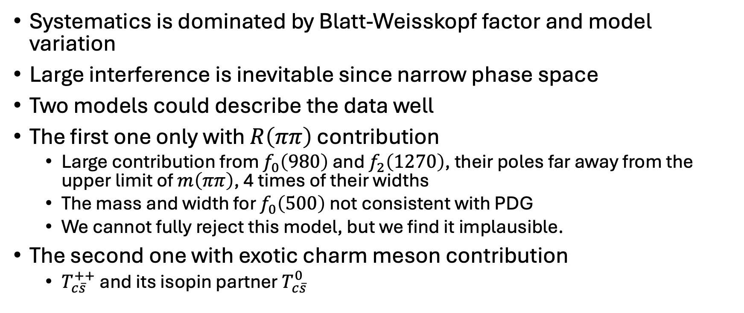
Some discussion
Systematics is dominated by Blatt-Weisskopf factor and model variation
Large interference is inevitable since narrow phase space
Two models could describe the data well
The first one only with $R\left(ππ\right)$ contribution
  Large contribution from $f_{0}\left(980\right)$ and $f_{2}\left(1270\right)$, their poles far away from the upper limit of $m\left(ππ\right)$, 4 times of their widths
  The mass and width for $f_{0}\left(500\right)$ not consistent with PDG
  We cannot fully reject this model, but we find it implausible.
The second one with exotic charm meson contribution
  $T_{c\overline{s}}^{++}$ and its isopin partner $T_{c\overline{s}}^{0}$

Slide 13
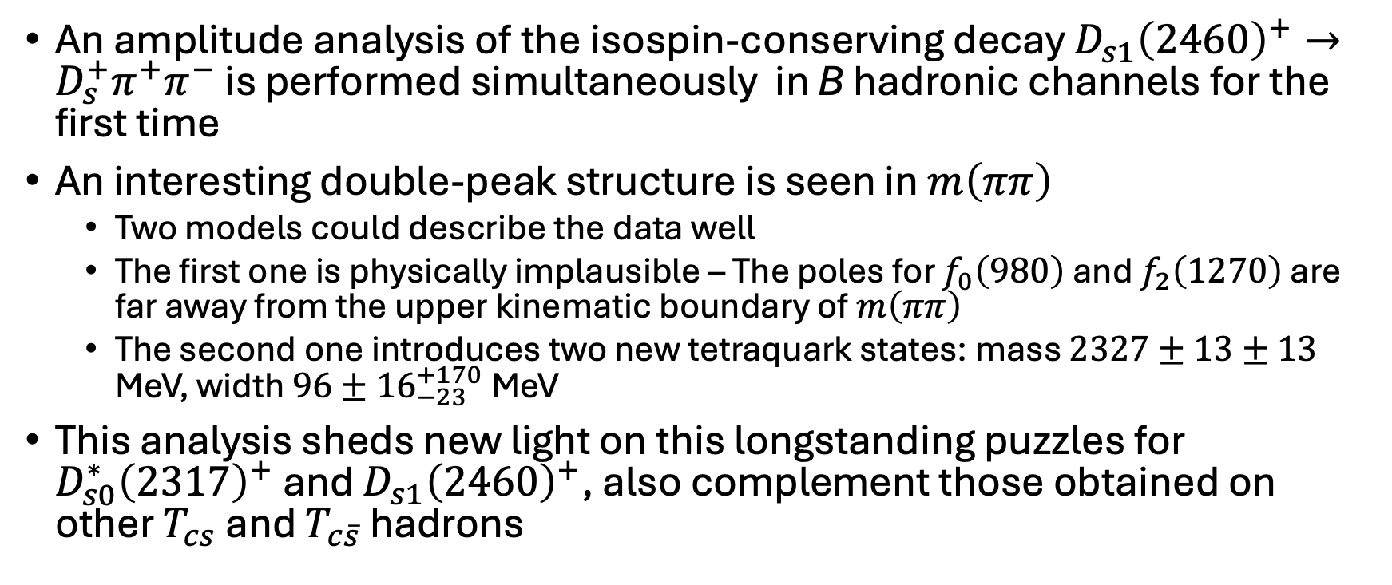
Summary
An amplitude analysis of the isospin-conserving decay $D_{s1}{\left(2460\right)}^{+}→D_{s}^{+}π^{+}π^{−}$ is performed simultaneously in B hadronic channels for the first time
An interesting double-peak structure is seen in $m\left(ππ\right)$
  Two models could describe the data well
  The first one is physically implausible – The poles for $f_{0}\left(980\right)$ and $f_{2}\left(1270\right)$ are far away from the upper kinematic boundary of $m\left(ππ\right)$
  The second one introduces two new tetraquark states: mass $2327±13±13$ MeV, width $96±{16}_{−23}^{+170}$ MeV
This analysis sheds new light on this longstanding puzzles for $D_{s0}^{∗}{\left(2317\right)}^{+}$ and $D_{s1}{\left(2460\right)}^{+}$, also complement those obtained on other $T_{cs}$ and $T_{c\overline{s}}$ hadrons
Thank you!

Slide 14
Backup slides

Slide 15
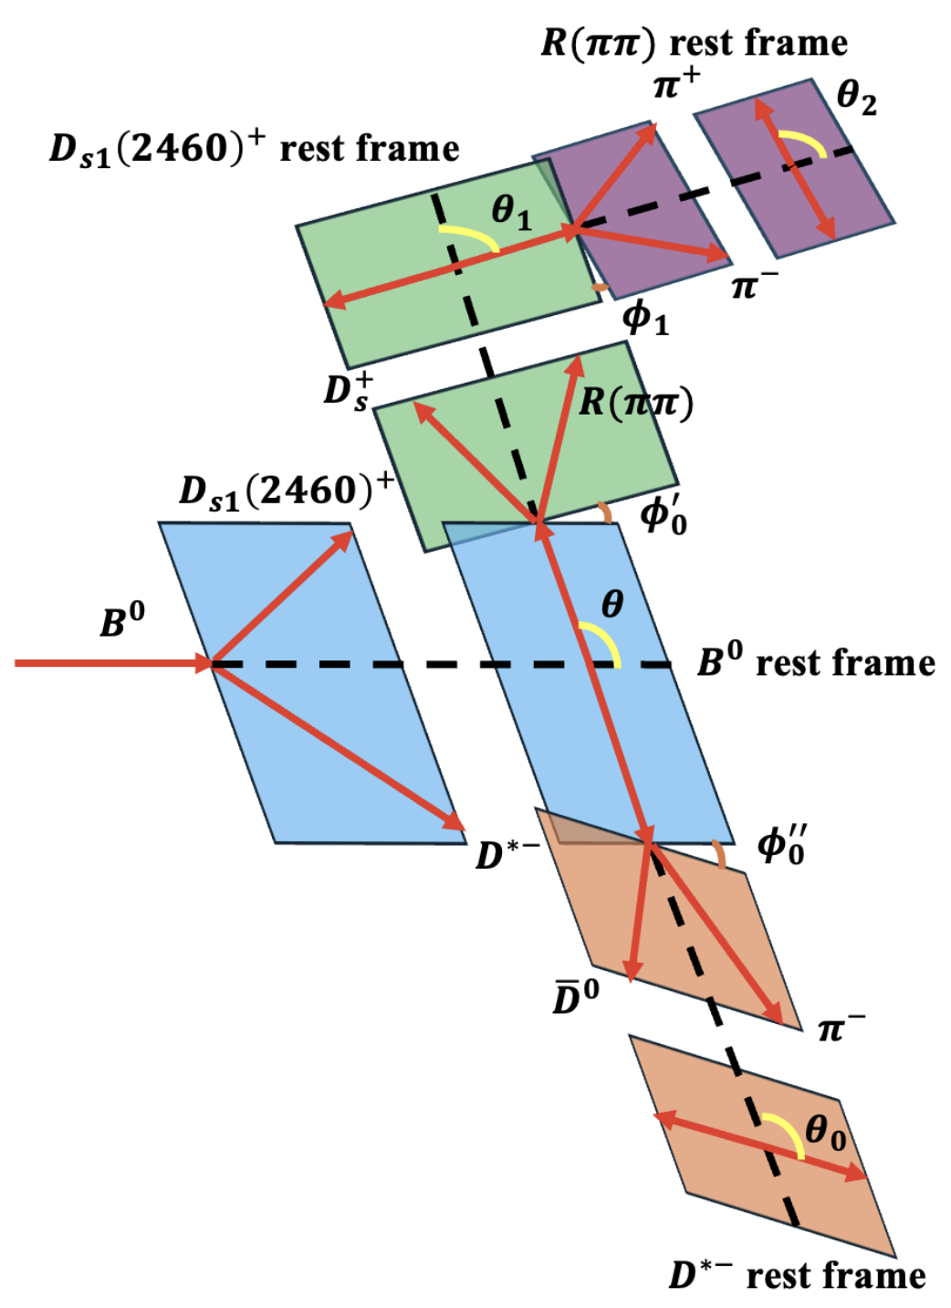
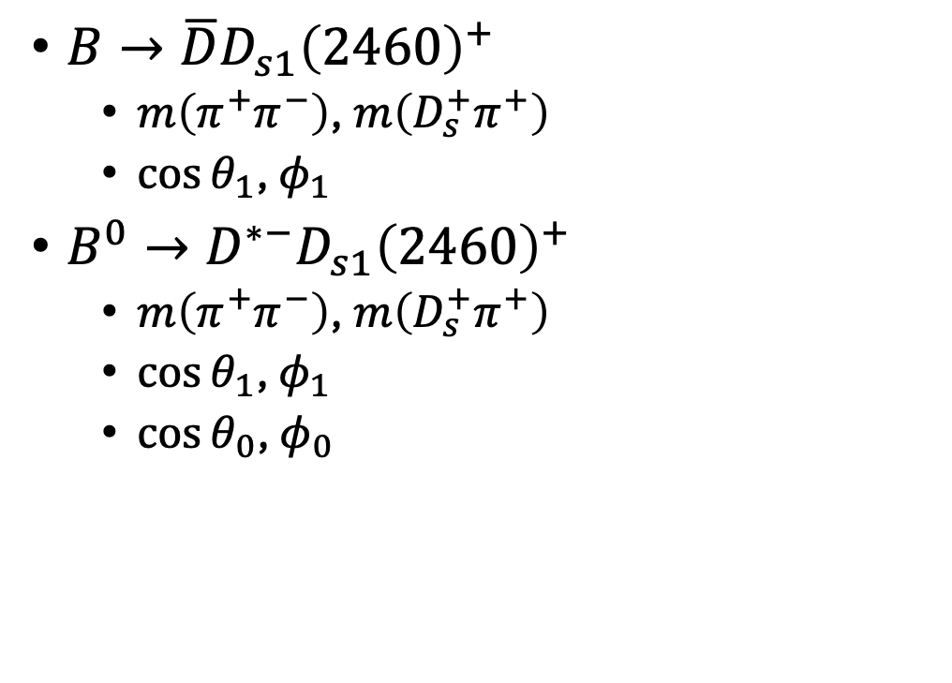

Kinematics of $B→{\overline{D}}^{\left(∗\right)}D_{s1}{\left(2460\right)}^{+}$
$B→\overline{D}D_{s1}{\left(2460\right)}^{+}$
  $m\left(π^{+}π^{−}\right)$, $m\left(D_{s}^{+}π^{+}\right)$
  $\cos{θ_{1}}$, $φ_{1}$
$B^{0}→D^{∗−}D_{s1}{\left(2460\right)}^{+}$
  $m\left(π^{+}π^{−}\right)$, $m\left(D_{s}^{+}π^{+}\right)$
  $\cos{θ_{1}}$, $φ_{1}$
  $\cos{θ_{0}}$, $φ_{0}$

Slide 16
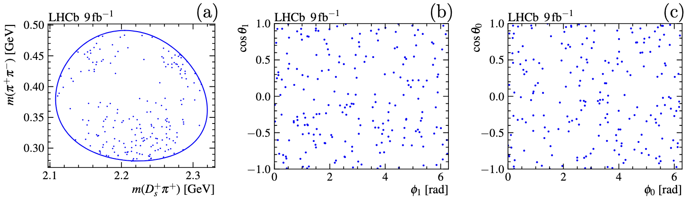
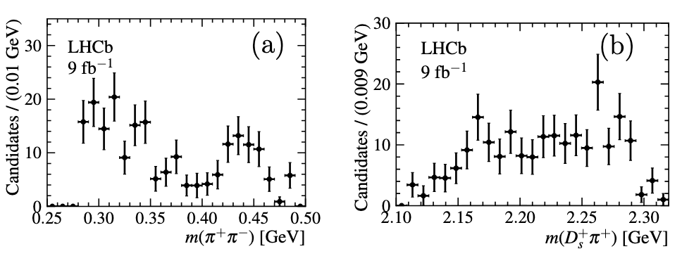
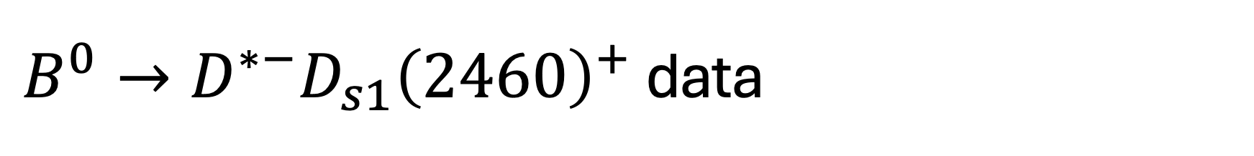
$B^{0}→D^{∗−}D_{s1}{\left(2460\right)}^{+}$ data

Slide 17
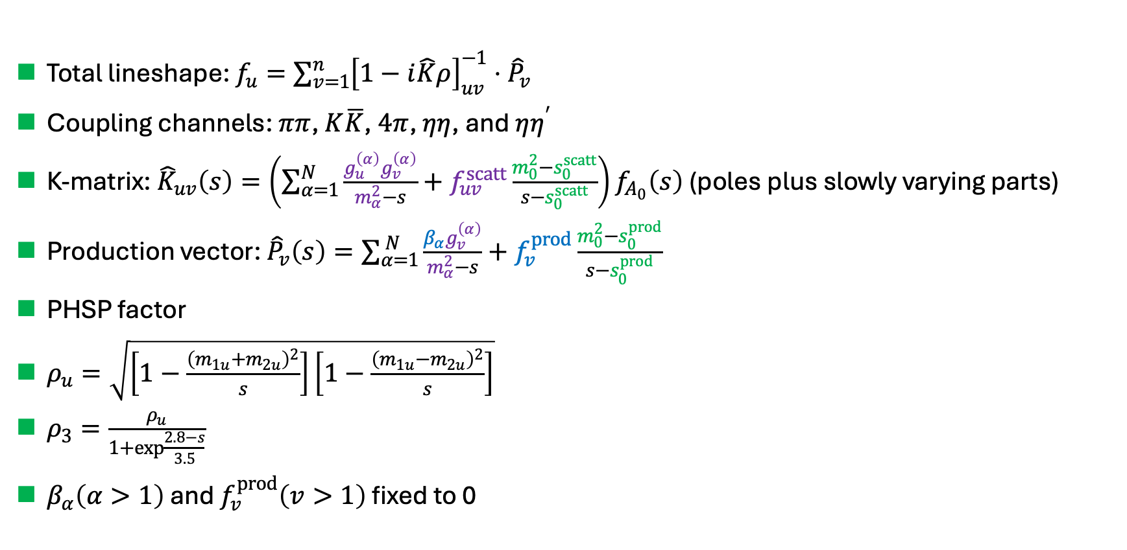
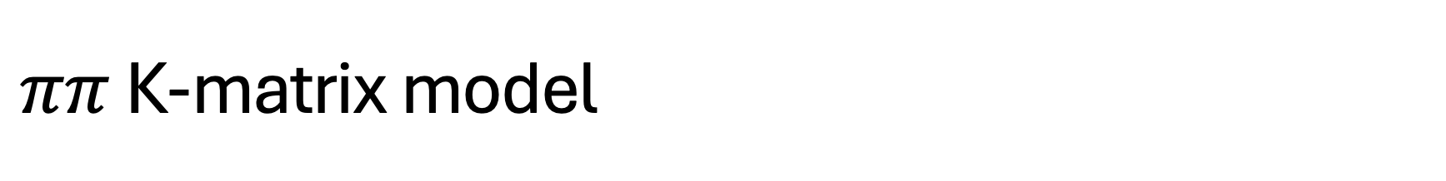
$ππ$ K-matrix model
Total lineshape: $f_{u}=\sum_{v=1}^{n}{{\left[1−i\hat{K}ρ\right]}_{uv}^{−1}⋅{\hat{P}}_{v}}$
Coupling channels: $ππ$, $K\overline{K}$, $4π$, $ηη$, and $ηη^{′}$
K-matrix: ${\hat{K}}_{uv}\left(s\right)=\left(\sum_{α=1}^{N}{\frac{g_{u}^{\left(α\right)}g_{v}^{\left(α\right)}}{m_{α}^{2}−s}+f_{uv}^{scatt}}\frac{m_{0}^{2}−s_{0}^{scatt}}{s−s_{0}^{scatt}}\right)f_{A_{0}}\left(s\right)$ (poles plus slowly varying parts)
Production vector: ${\hat{P}}_{v}\left(s\right)=\sum_{α=1}^{ N}{\frac{β_{α}g_{v}^{\left(α\right)}}{m_{α}^{2}−s}+f_{v}^{prod}}\frac{m_{0}^{2}−s_{0}^{prod}}{s−s_{0}^{prod}}$
PHSP factor
$ρ_{u}=\sqrt{\left[1−\frac{{\left(m_{1u}+m_{2u}\right)}^{2}}{s}\right]\left[1−\frac{{\left(m_{1u}−m_{2u}\right)}^{2}}{s}\right]}$
$ρ_{3}=\frac{ρ_{u}}{1+\exp{\frac{2.8−s}{3.5}}}$
$β_{α}\left(α>1\right)$ and $f_{v}^{prod}\left(v>1\right)$ fixed to 0

Slide 18
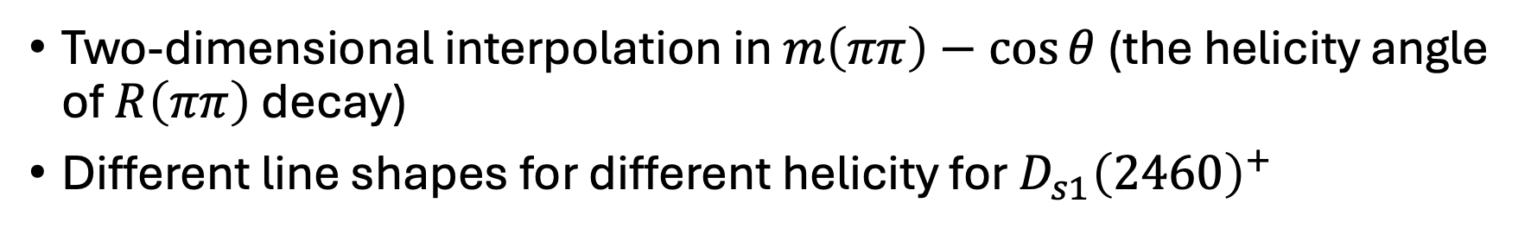
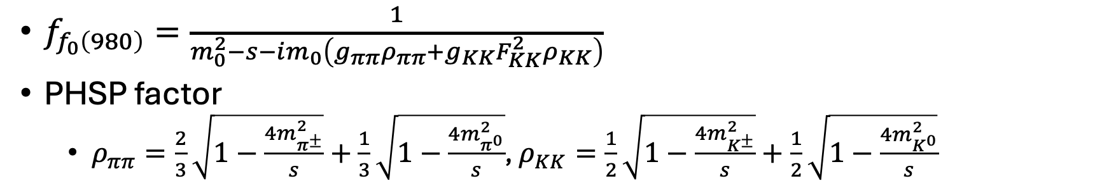
Model in paper Commun. Theor. Phys. 75 055203
Two-dimensional interpolation in $m\left(ππ\right)−\cos{θ}$ (the helicity angle of $R\left(ππ\right)$ decay)
Different line shapes for different helicity for $D_{s1}{\left(2460\right)}^{+}$
Flatte model
$f_{f_{0}\left(980\right)}=\frac{1}{m_{0}^{2}−s−im_{0}\left(g_{ππ}ρ_{ππ}+g_{KK}F_{KK}^{2}ρ_{KK}\right)}$
PHSP factor
  $ρ_{ππ}=\frac{2}{3}\sqrt{1−\frac{4m_{π^{±}}^{2}}{s}}+\frac{1}{3}\sqrt{1−\frac{4m_{π^{0}}^{2}}{s}}$, $ρ_{KK}=\frac{1}{2}\sqrt{1−\frac{4m_{K^{±}}^{2}}{s}}+\frac{1}{2}\sqrt{1−\frac{4m_{K^{0}}^{2}}{s}}$

Slide 19
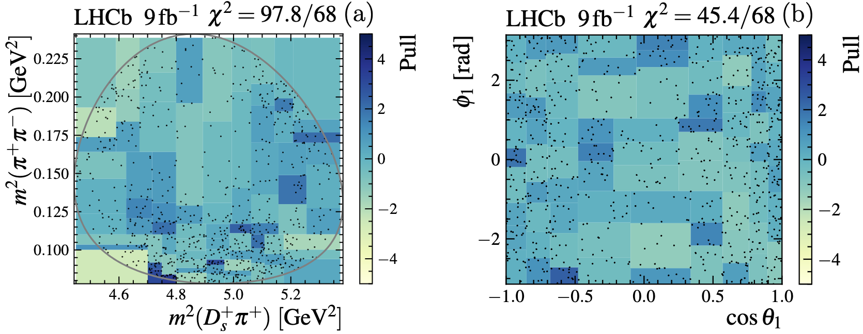
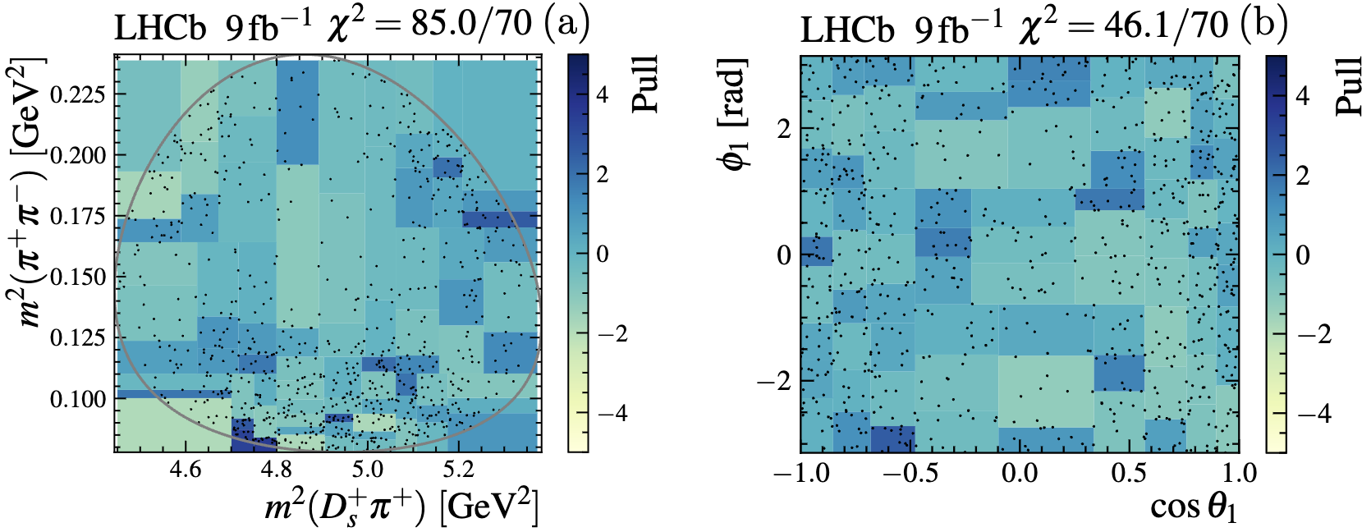
Fit goodness

