Slide 1
Observation of γγ$→$ττ in pp collisions and constraint on tau g-2 at CMS
Zongsheng He
Peking University
on behalf of the CMS Collaboration
CLHCP, 2024, Qingdao
Nov-15th, 2024
zongsheng.he@cern.ch
CLHCP 2024

Slide 2
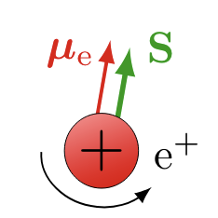
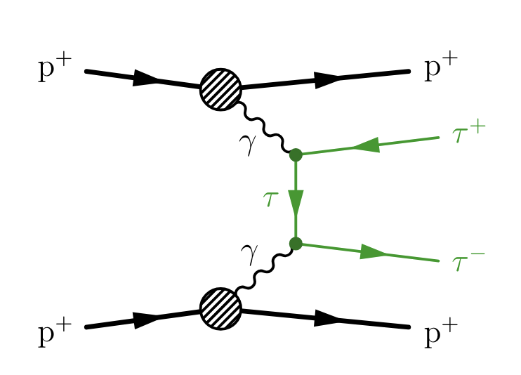
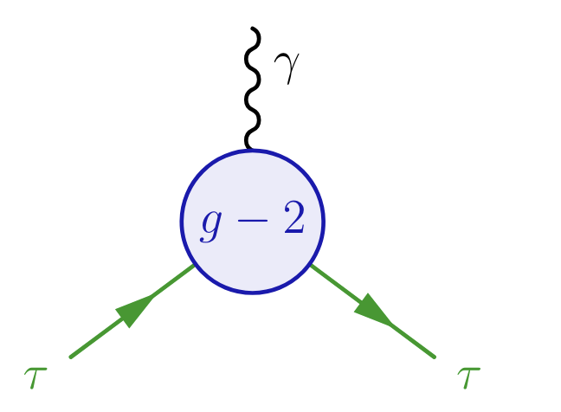
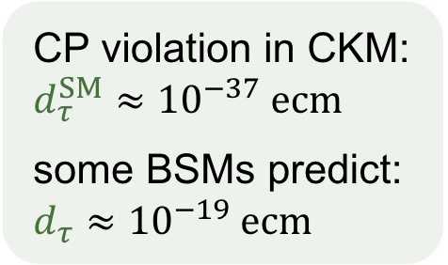
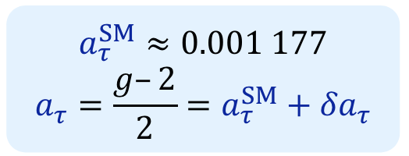
Anomalous Magnetic Moments of Lepton
$$μ_{l}=g_{l}\frac{e}{2m_{l}}S_{l}$$
$$a_{l}=\frac{g_{l}−2}{2}$$
Measurements of a_{e} agree with SM with 12 significant digits.
Measurements of a_{μ} appear in longstanding tension with theoretical predictions.
Many BSMs predict the enhancement of τ because of its larger mass $\frac{m_{τ}^{2}}{m_{μ}^{2}}≈$280
a_{τ} & d_{τ}
Constraints on electromagnetic moments a_{τ} & d_{τ} with form factors ( DELPHI & ATLAS HIN ) or SMEFT (CMS pp(this study) & CMS HIN)
CLHCP 2024

Slide 3
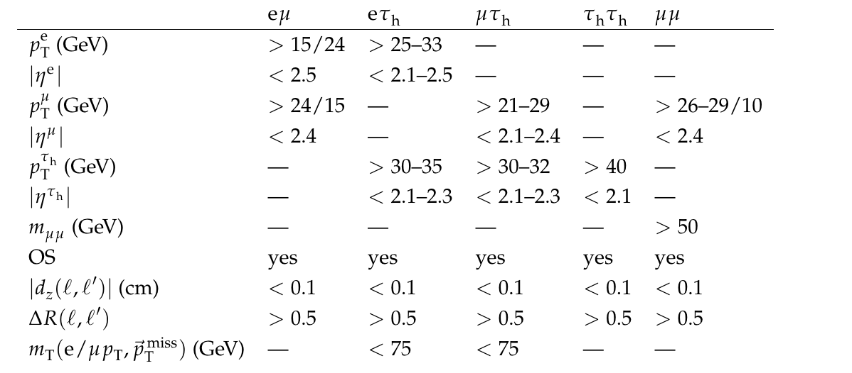
Analysis Overview
CMS Run II data (pp collisions, $\sqrt{s}$=13TeV,138 fb⁻¹)
Four final states: $eμ, eτ_{h}, μτ_{h}, τ_{h}τ_{h}$
Use μμ events($Z→μμ, γγ→μμ$) to measure corrections to simulations
simulated backgrounds: Drell-Yan, Di-boson, Top quark
data-driven methods to estimate QCD and W+jets background
Basic selection
Exclusive selection:
Acoplanarity A = $1−\frac{|ΔΦ|}{π}$,A<0.015
$N_{tracks}=0,1$ in the 0.1 cm width window of the di-τ vertex (N_{tracks}:number of extra charged tracks)
CLHCP 2024

Slide 4
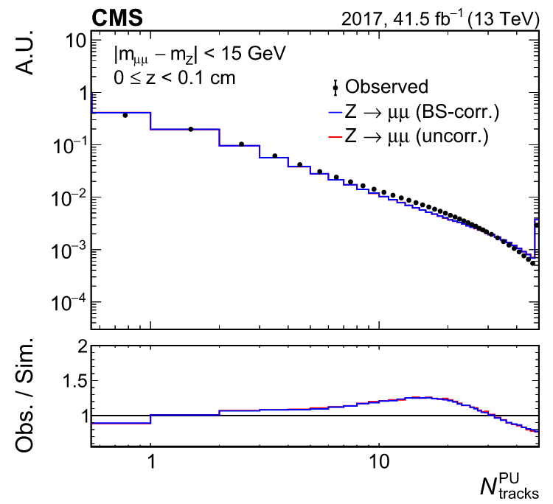
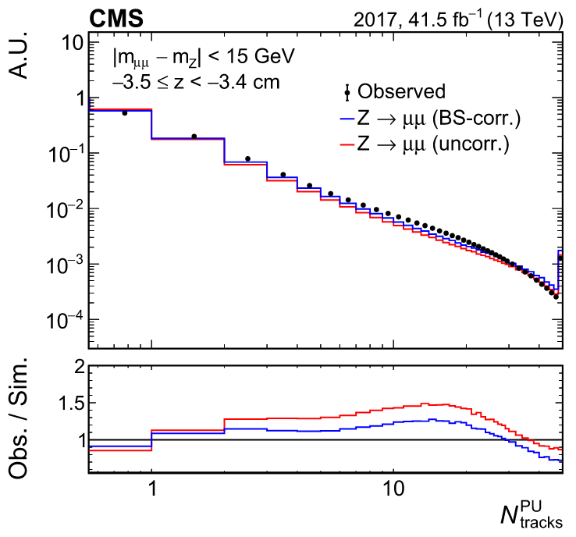
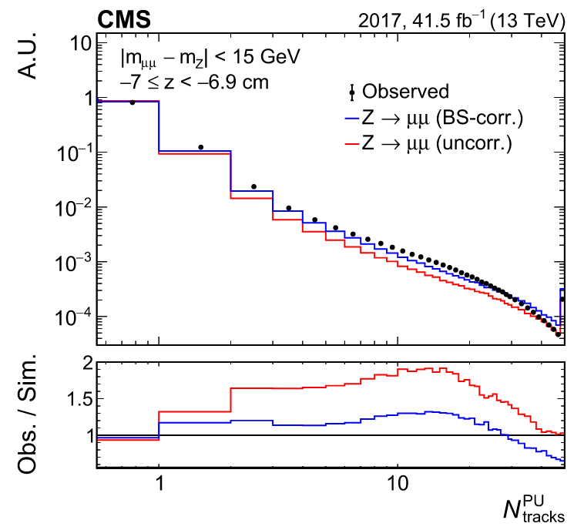
Pileup Track Multiplicity Correction
windows far from the di-μ vertex
discard the tracks from hard scattering interactions
Applied on all simulated processes
CLHCP 2024

Slide 5
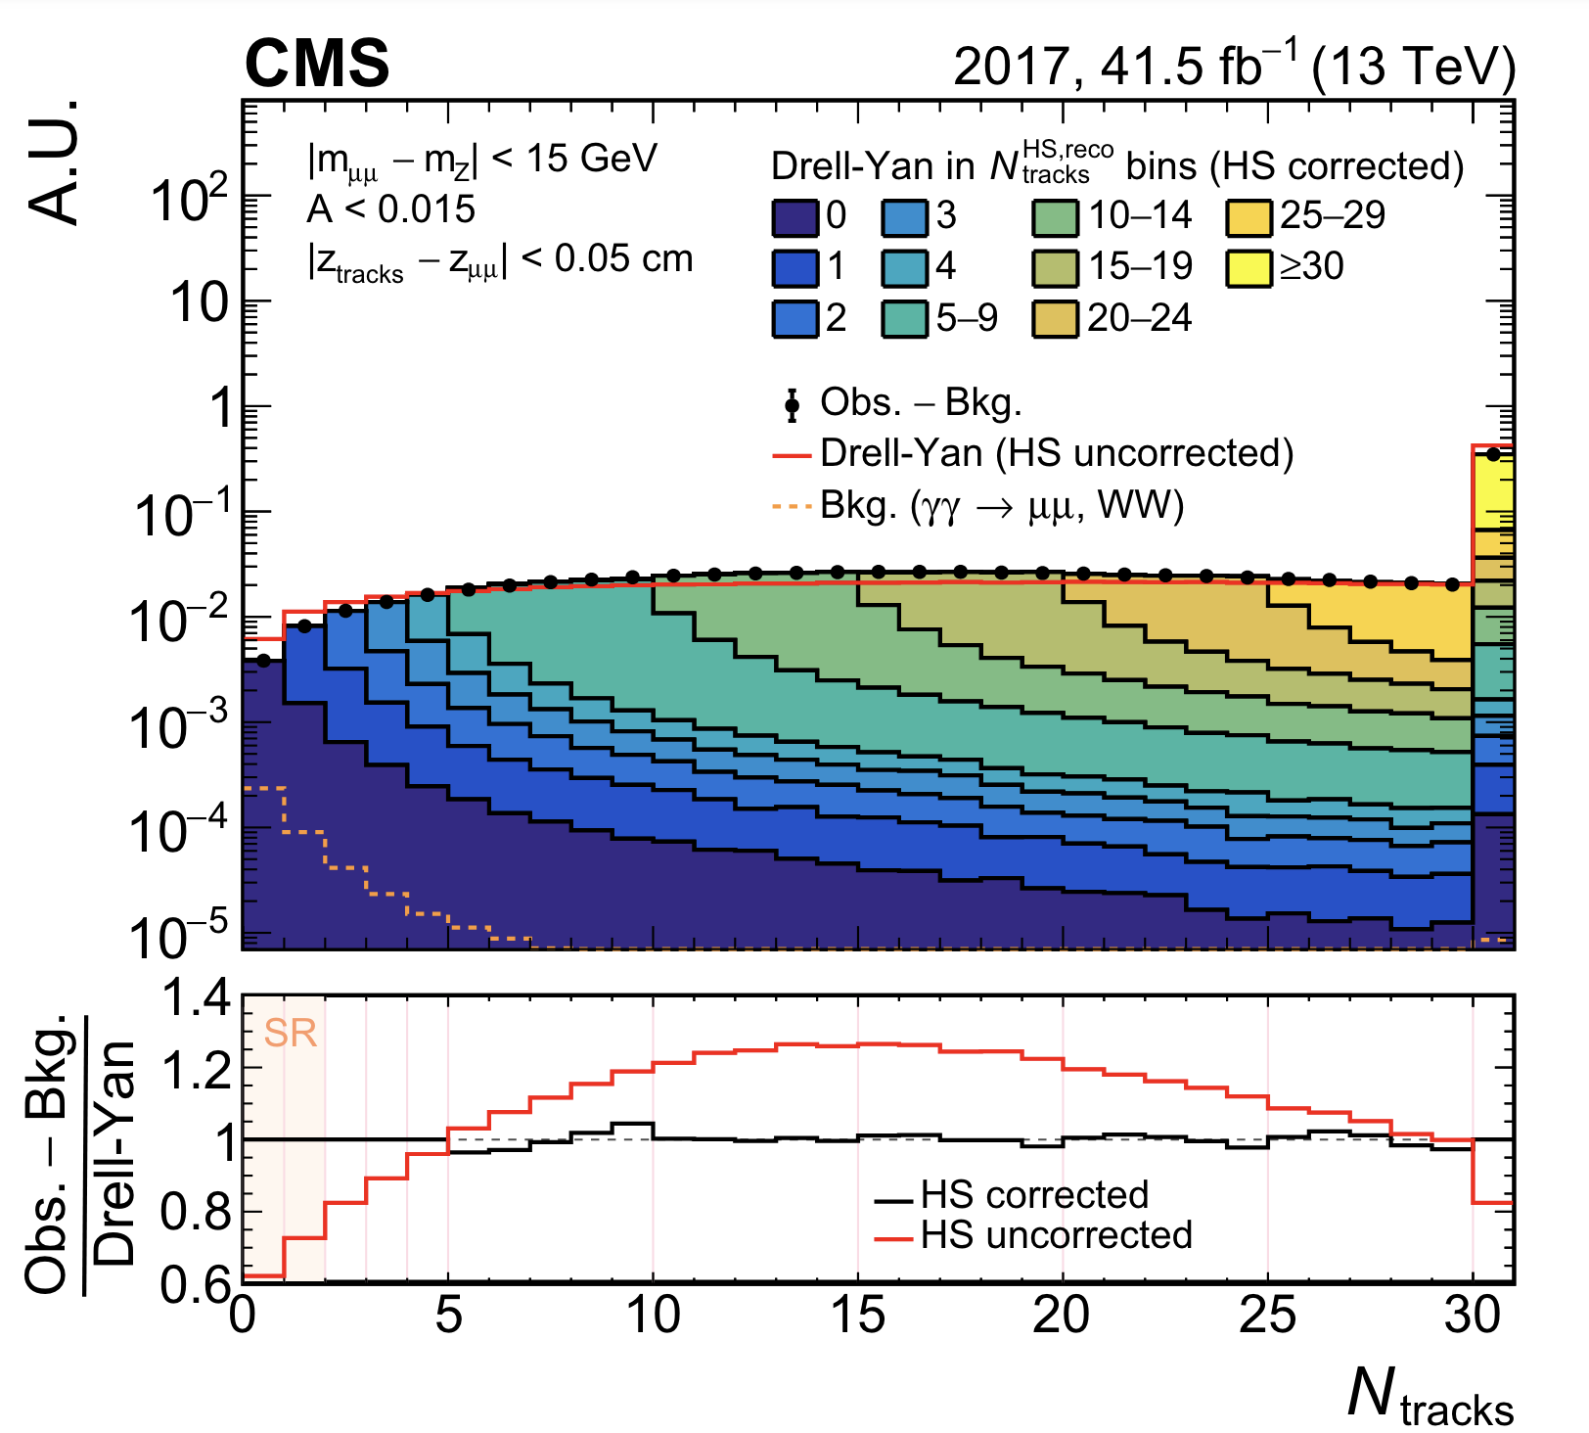
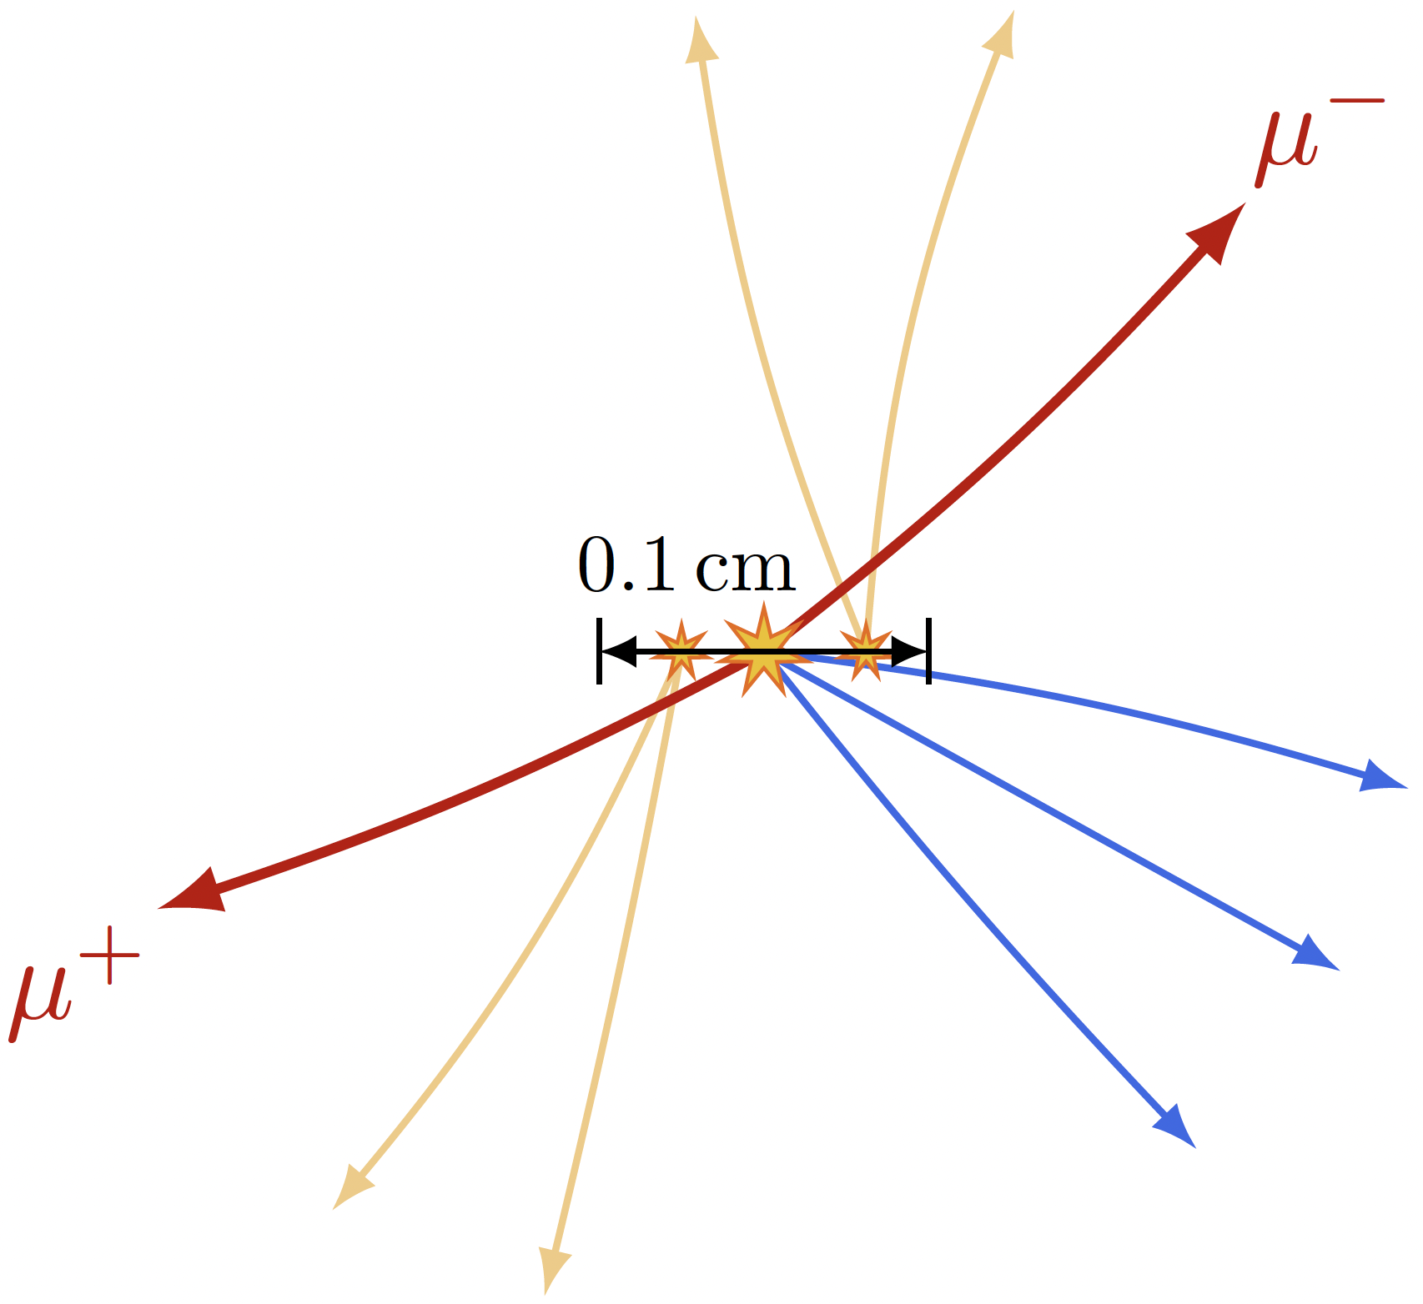
Hard Scattering Track Multiplicity Correction
$$N_{tracks}=N_{tracks}^{PU}+N_{tracks}^{HS}$$
The reweighting factors for each DY component with a given number of $N_{tracks}^{HS}$ is determined iteratively by matching the simulation to the observed data, starting from events with $N_{tracks}$ = 0, to which only the simulated component with $N_{tracks}^{HS}$ = 0 contributes.
Applied on all Drell-Yan and di-boson processes
CLHCP 2024

Slide 6
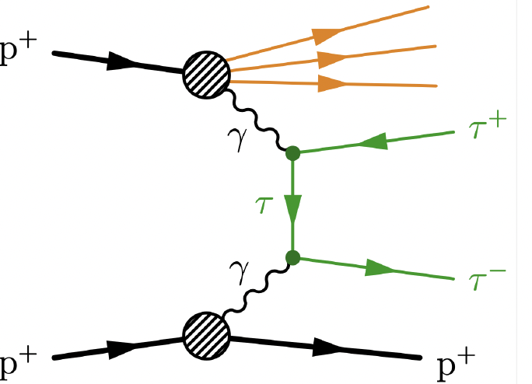
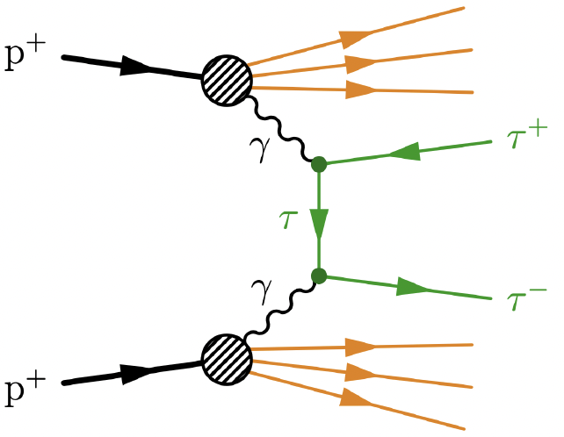
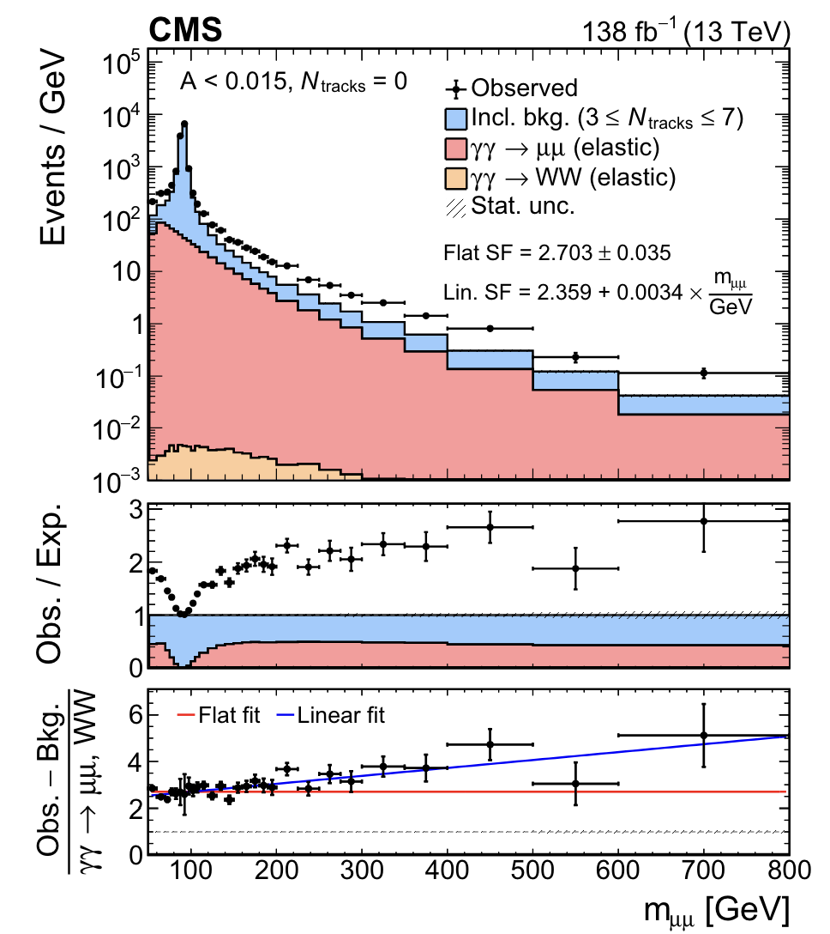
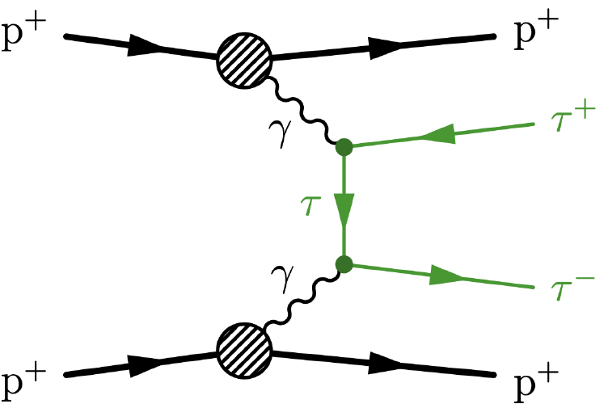
Photon-induced Process Correction
elastic
semi-dissociative
fully-dissociative
gammaUPC
scaling factor = $\frac{(N_{elastic}+N_{semi−dissociative}+N_{fully−dissociative })}{{[N}_{elastic}]}$
scaling factor = $\frac{N\left(obs\right)−N(inclusive background)}{N\left(γγ→μμ\right)+N(γγ→WW)}$
Applied on all $γγ→ee/μμ/ττ/WW$ in the SR
CLHCP 2024
Notes:
要把inclusive background从nTrk=3～7取形状要说一下

Slide 7
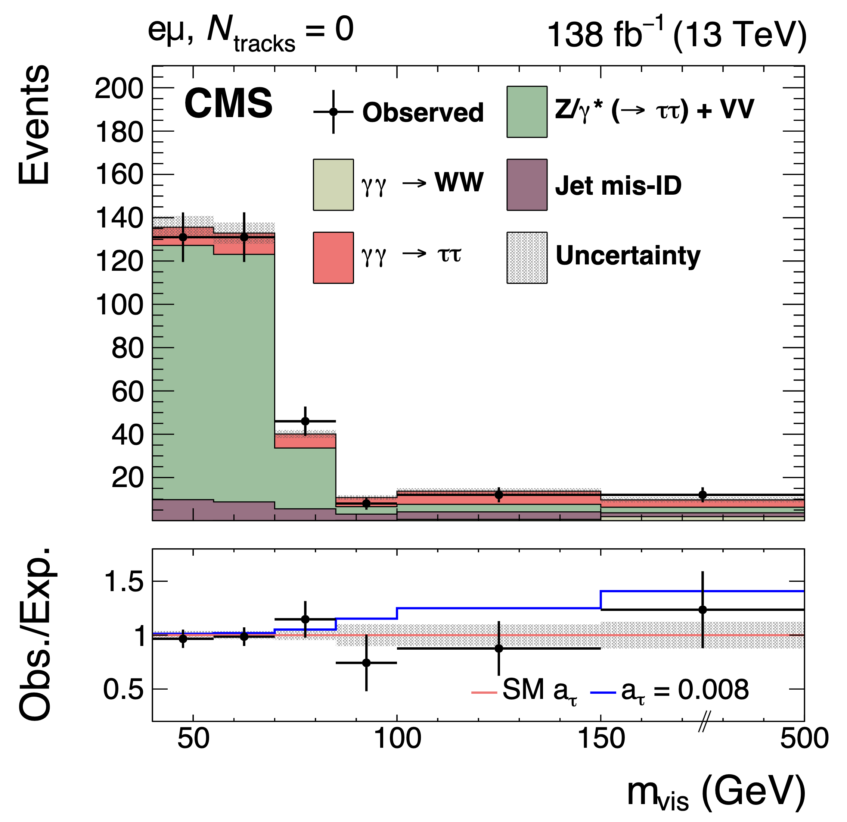
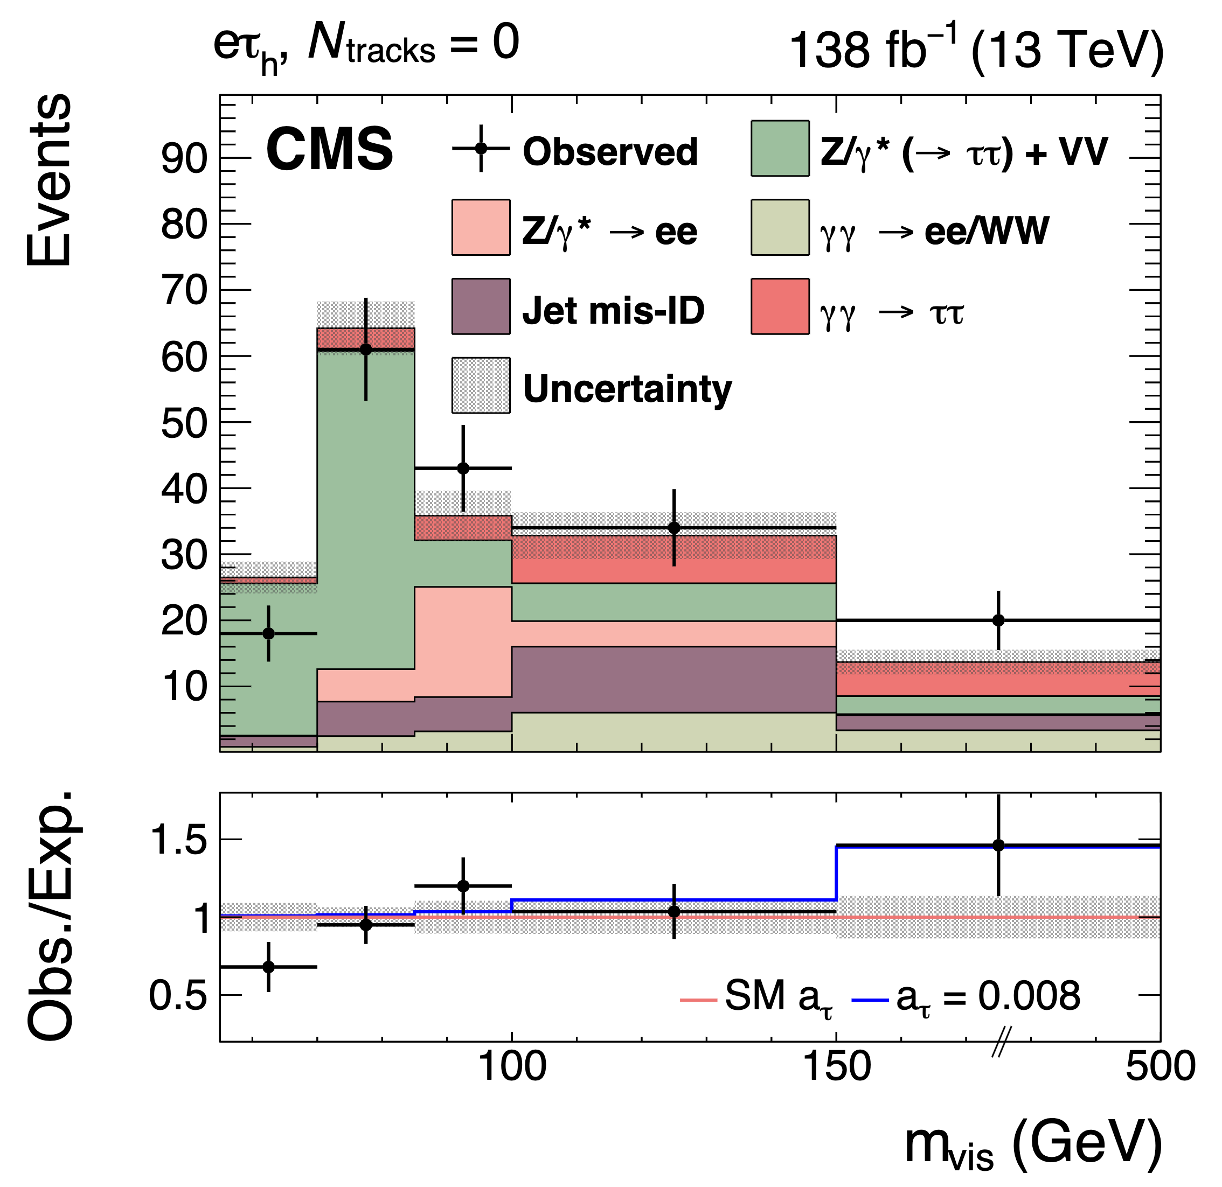
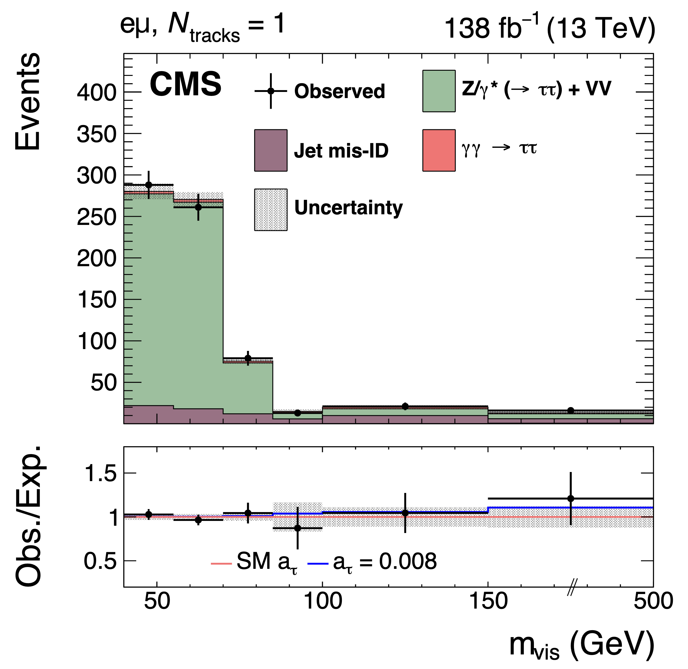
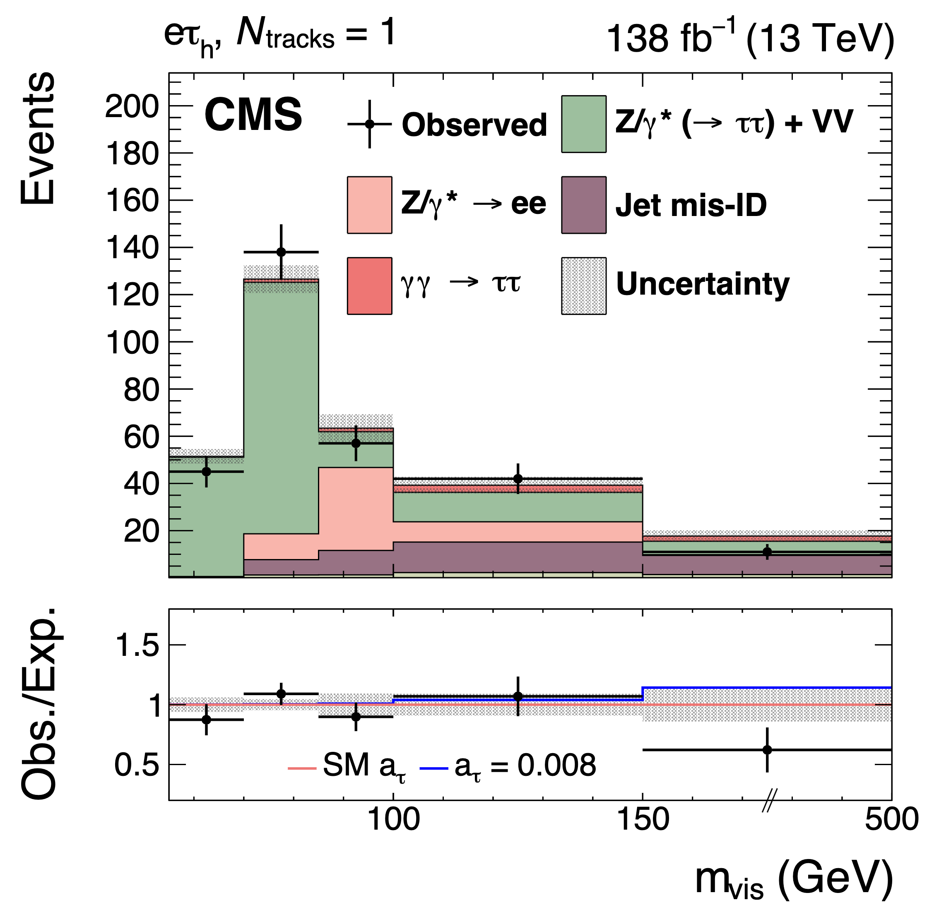
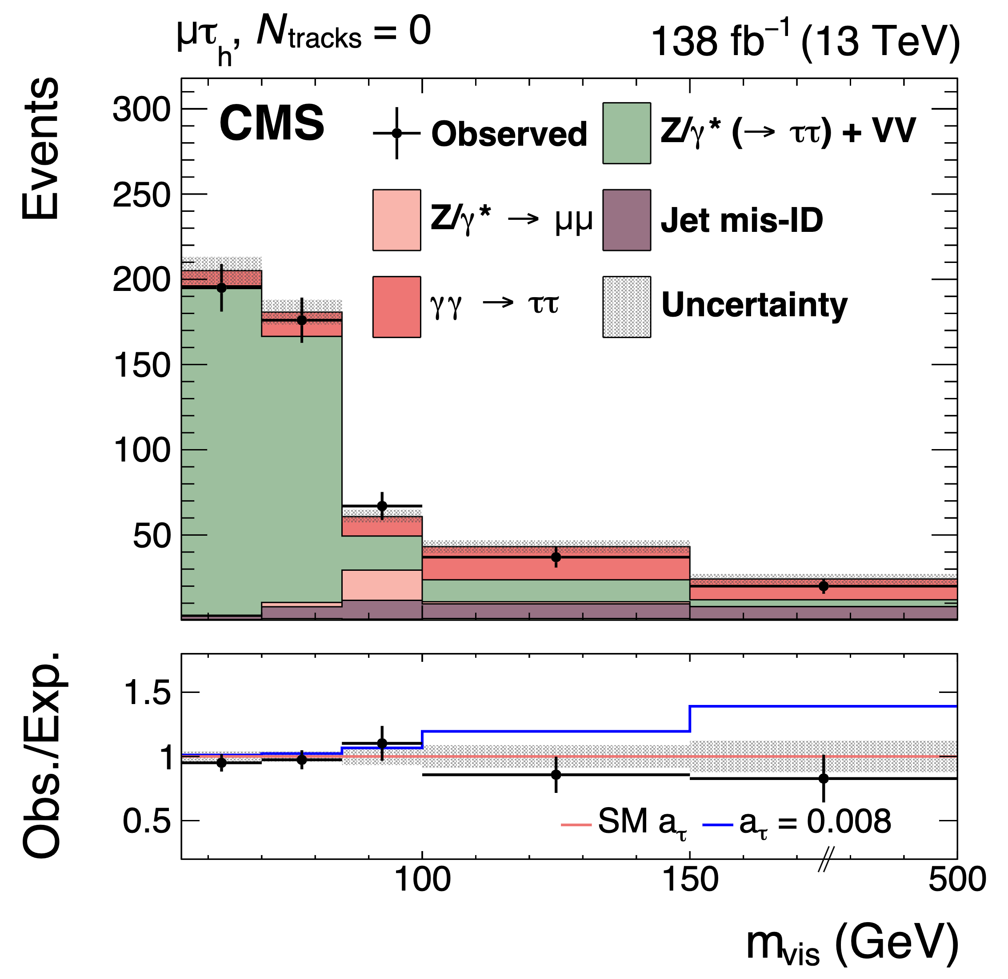
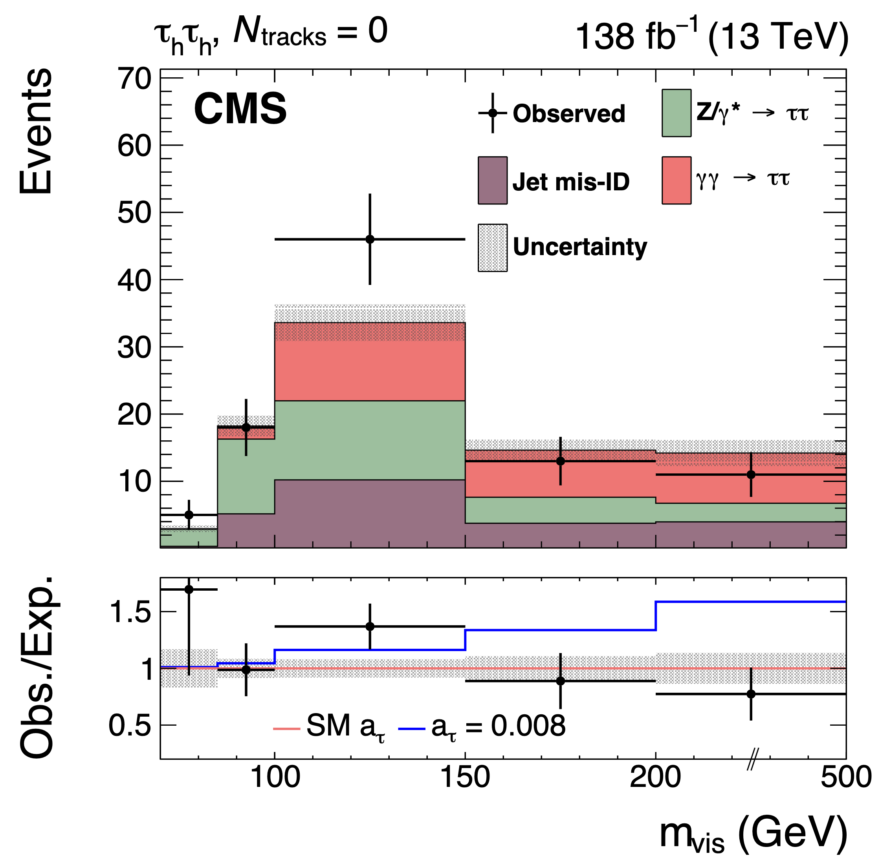
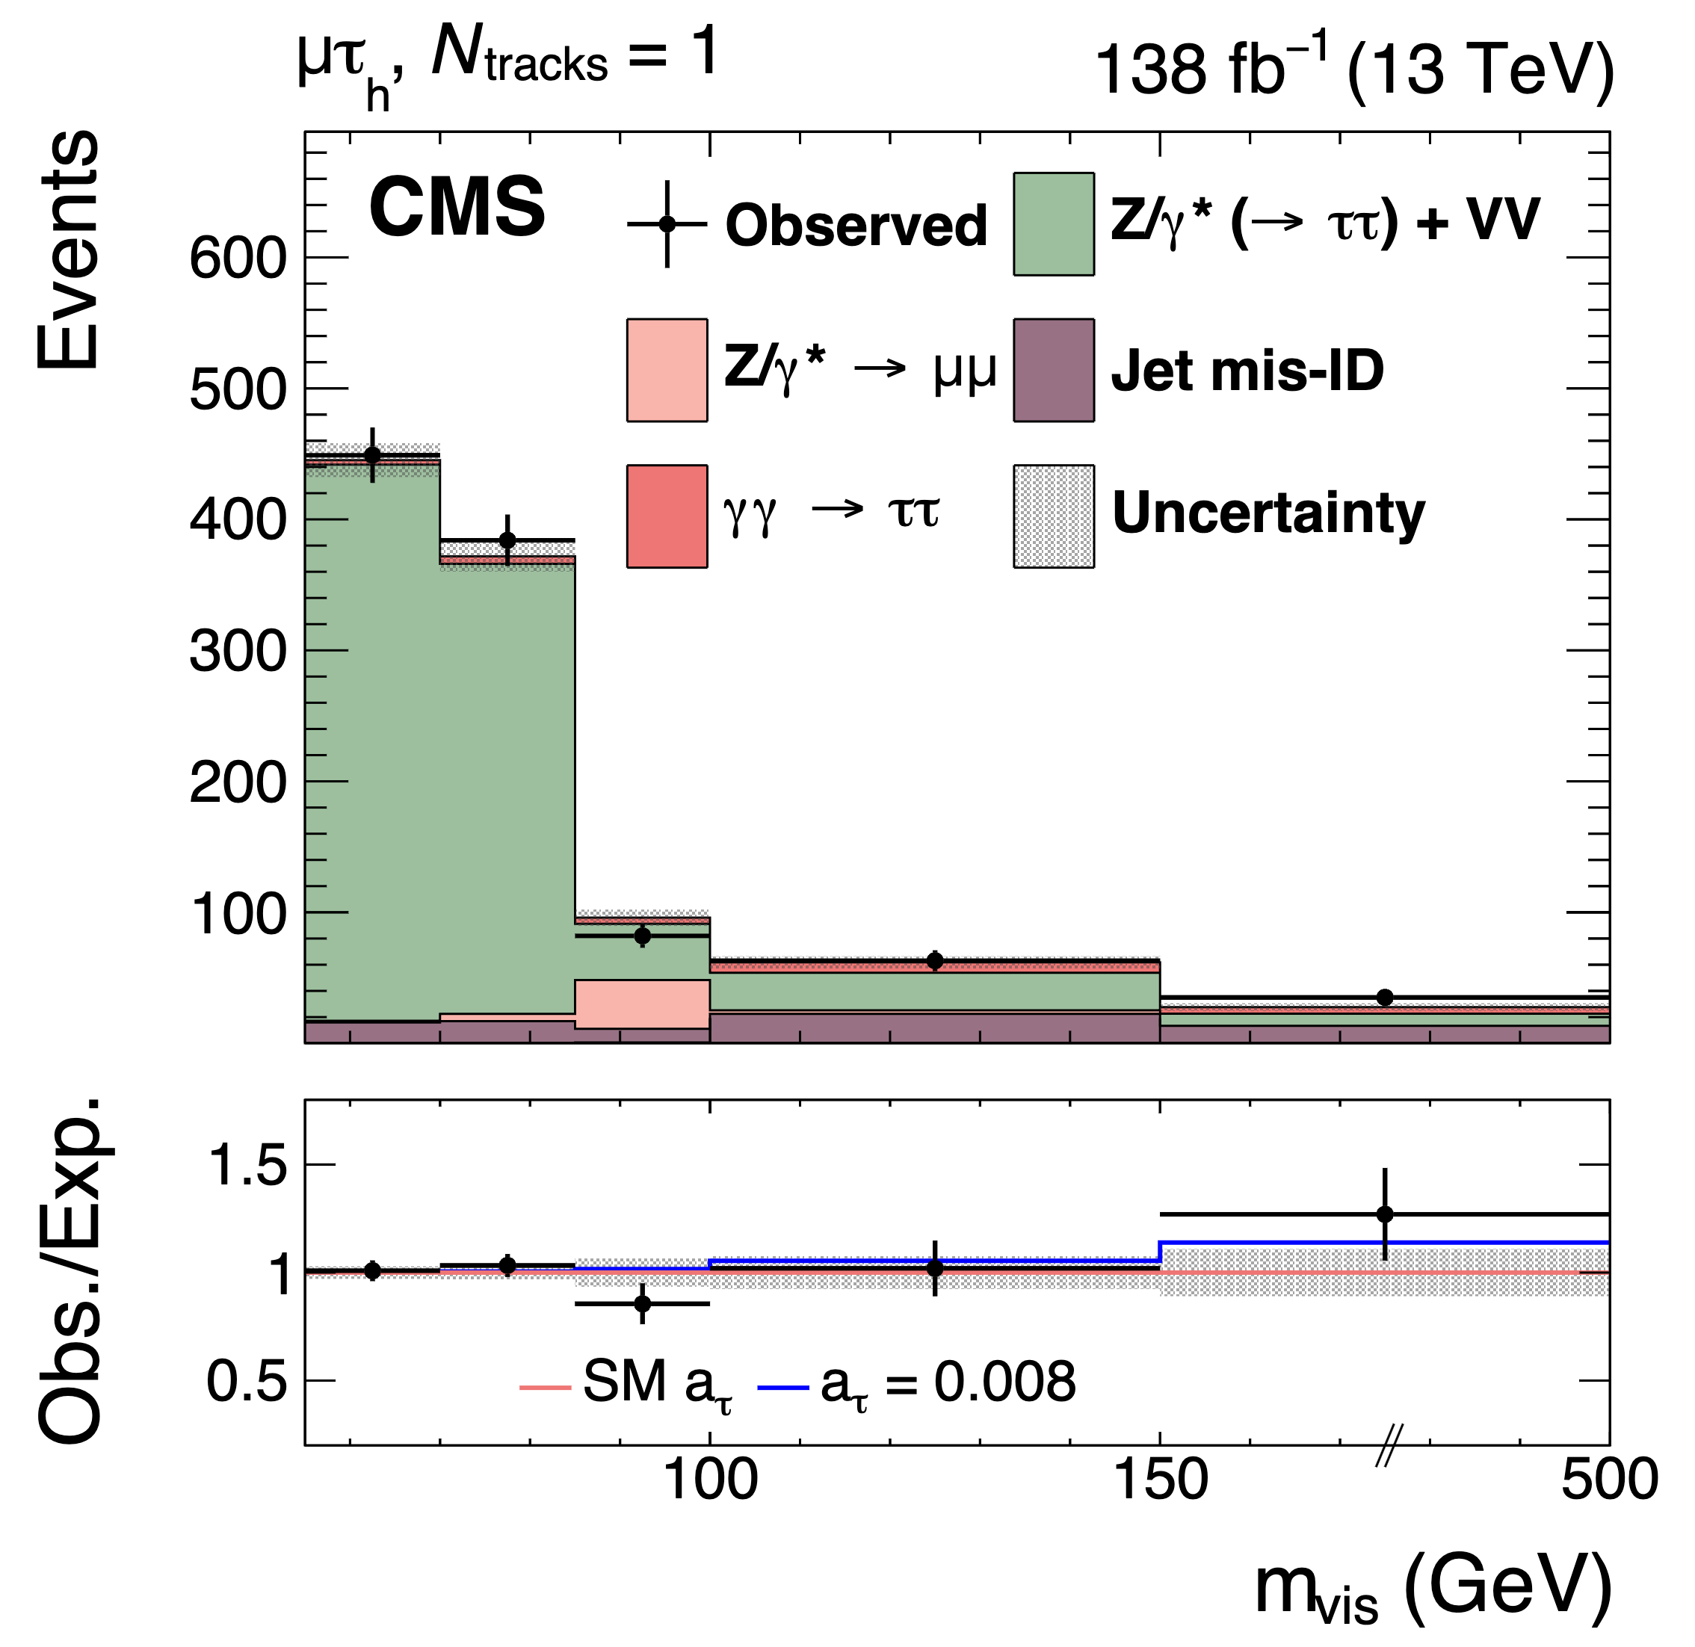
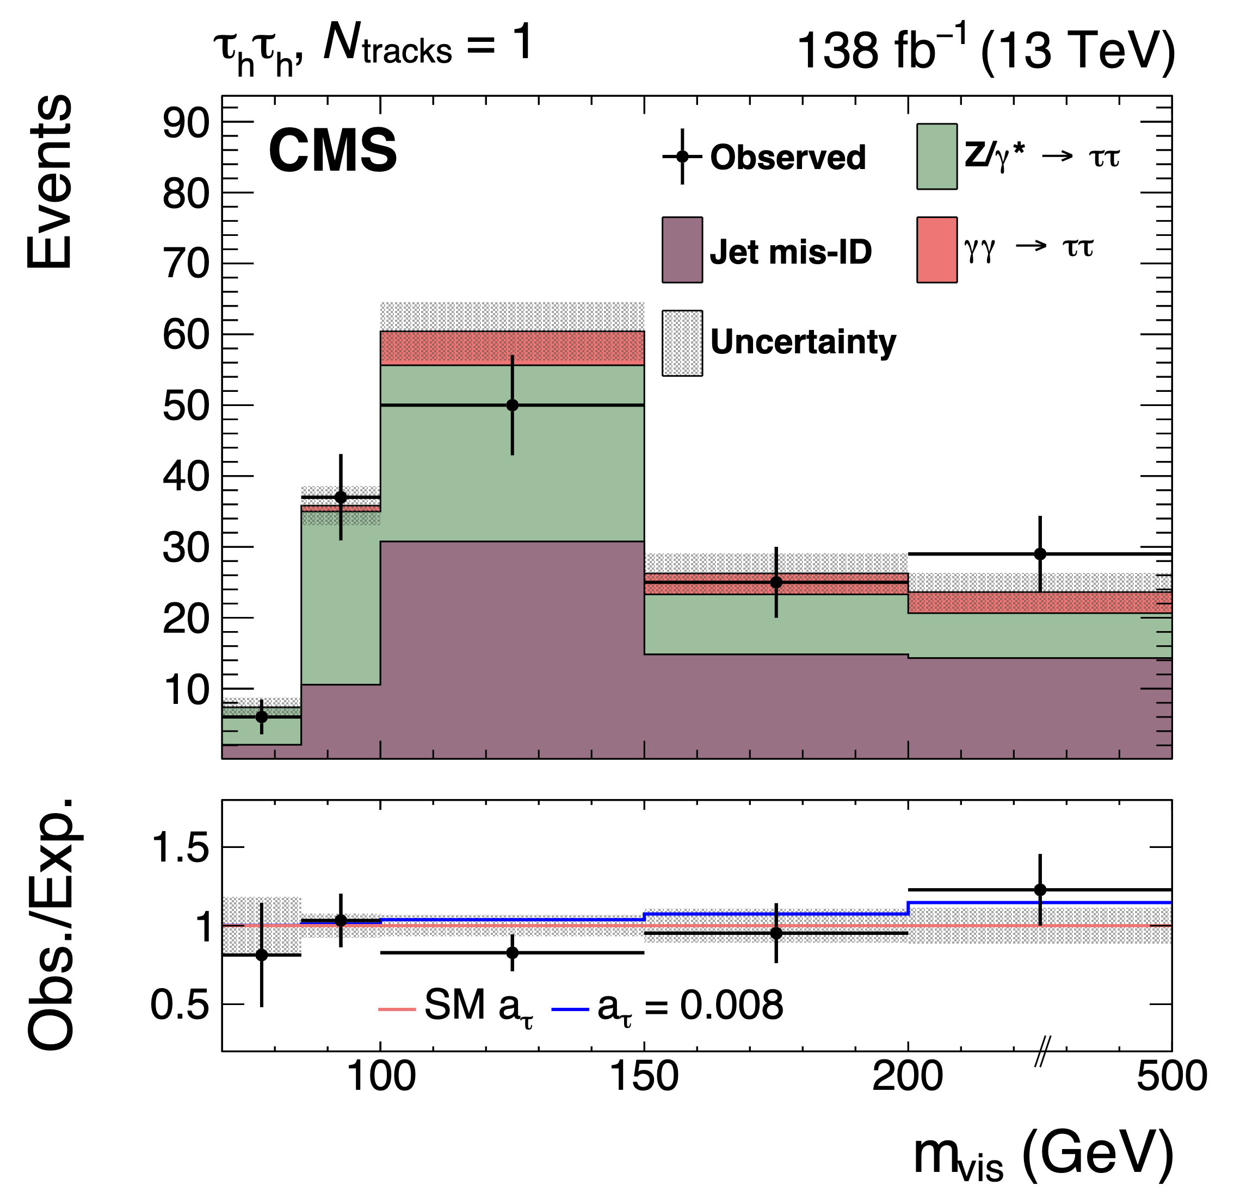
m_{vis} distribution
CLHCP 2024

Slide 8
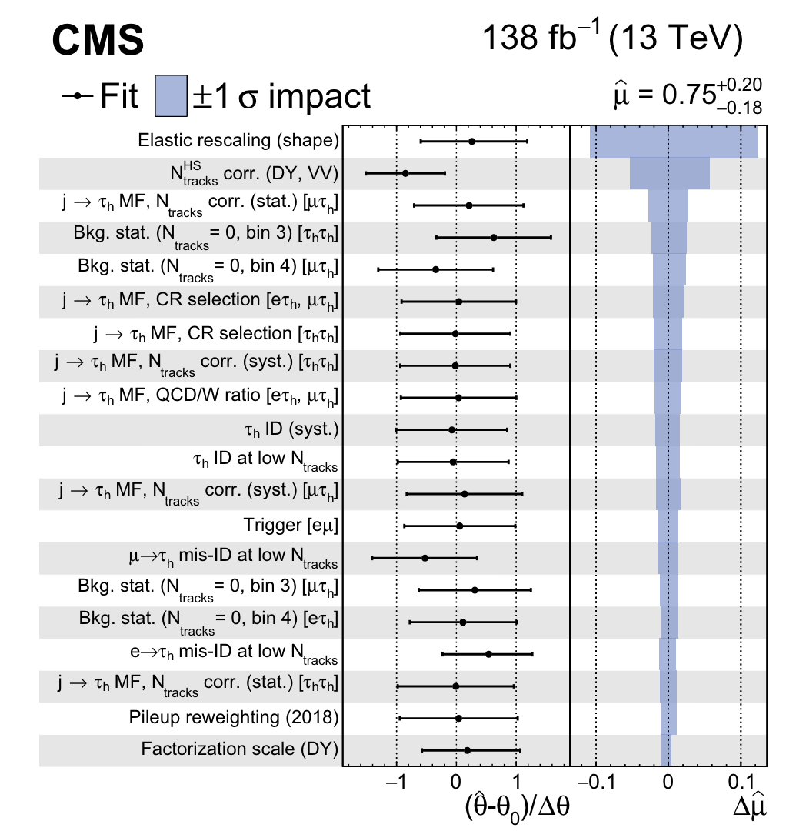
Systematic Uncertainties
shape uncertainty of the elastic rescaling: the difference between the flat factor and the linear factor
16%
uncertainty of the $N_{tracks}^{HS}$ correction is taken to have the same magnitude as the relative fraction of $γγ→μμ/WW$ in the correction derived region
7%
CLHCP 2024

Slide 9
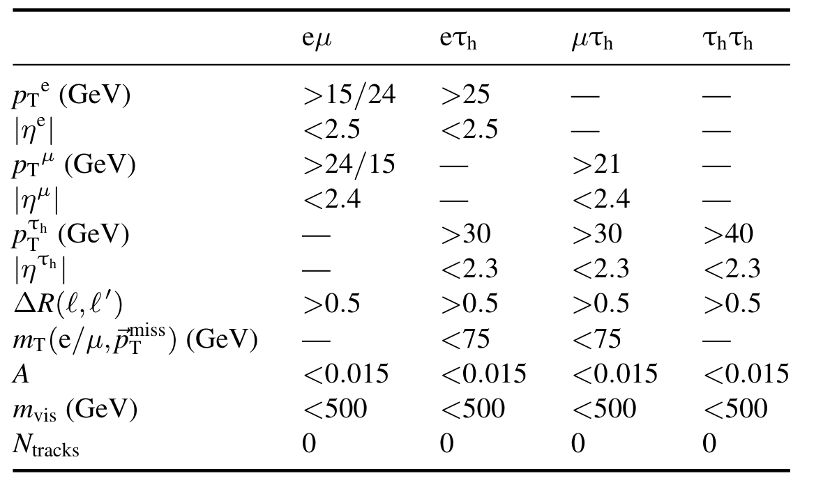
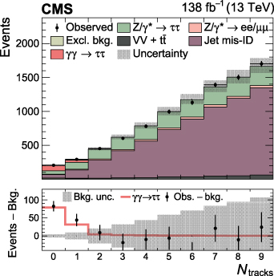
First Observation of $γγ→ττ$ in pp collisions
6.5σ expected, 5.3σ observed
Based on $m_{vis}$ distribution for 4 final states with nTrk=0,1 concerning the gammaUPC elastic prediction rescaling factor.
Measured fiducial cross section: $σ_{obs}^{fid}={12.4}_{−3.1}^{+3.8}$fb
CLHCP 2024

Slide 10
EFT Interpretation
Deviations of $a_{τ}$ & $d_{τ}$ from the SM can be parameterized in terms of a BSM lagrangian with dim-6 operators with new physics scale Λ:
$ℒ_{BSM}=\frac{C_{τB} }{Λ^{2}}{\overline{L}}_{L}σ^{μν}τ_{R}HB_{μν}+\frac{C_{τW} }{Λ^{2}}{\overline{L}}_{L}σ^{μν}τ_{R}σ^{i}HW_{μν}^{i}+h.c.$
$δa_{τ}$ and $δd_{τ}$ are linearly dependent on the complex Wilson coefficients:
$$δa_{τ}=\frac{2m_{τ}}{e}\frac{\sqrt{2}ν}{Λ^{2}}Re[cosθ_{W}C_{τB}−sinθ_{W}C_{τW}]$$
$$δd_{τ}=\frac{\sqrt{2}ν}{Λ^{2}}Im\left[\cos{θ_{W}C_{τB}}−sinθ_{W}C_{τW}\right]$$
Simplify by setting $C_{τγ}=cosθ_{W}C_{τB}−sinθ_{W}C_{τW}$
CLHCP 2024

Slide 11
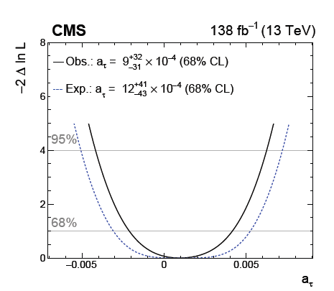
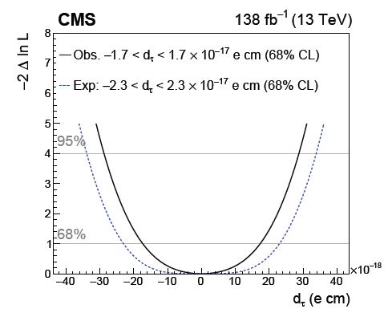
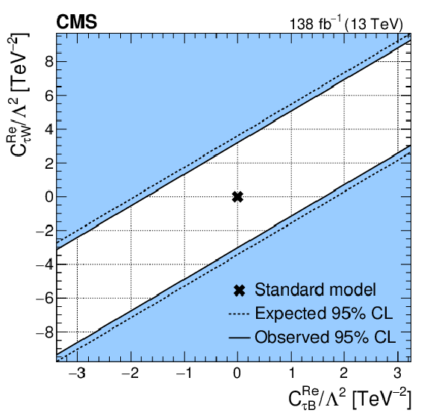
Constraints on a_{τ} and d_{τ}
${δa}_{τ}=\frac{2m_{τ}}{e}\frac{\sqrt{2}v}{Λ^{2}}\text{Re}\left[\cos{θ_{W}}C_{τB}−\sin{θ_{W}}C_{τW}\right]$ ${δd}_{τ}=\frac{\sqrt{2}v}{Λ^{2}}\text{Im}\left[\cos{θ_{W}}C_{τB}−\sin{θ_{W}}C_{τW}\right]$
real part:
imaginary part:
CLHCP 2024

Slide 12
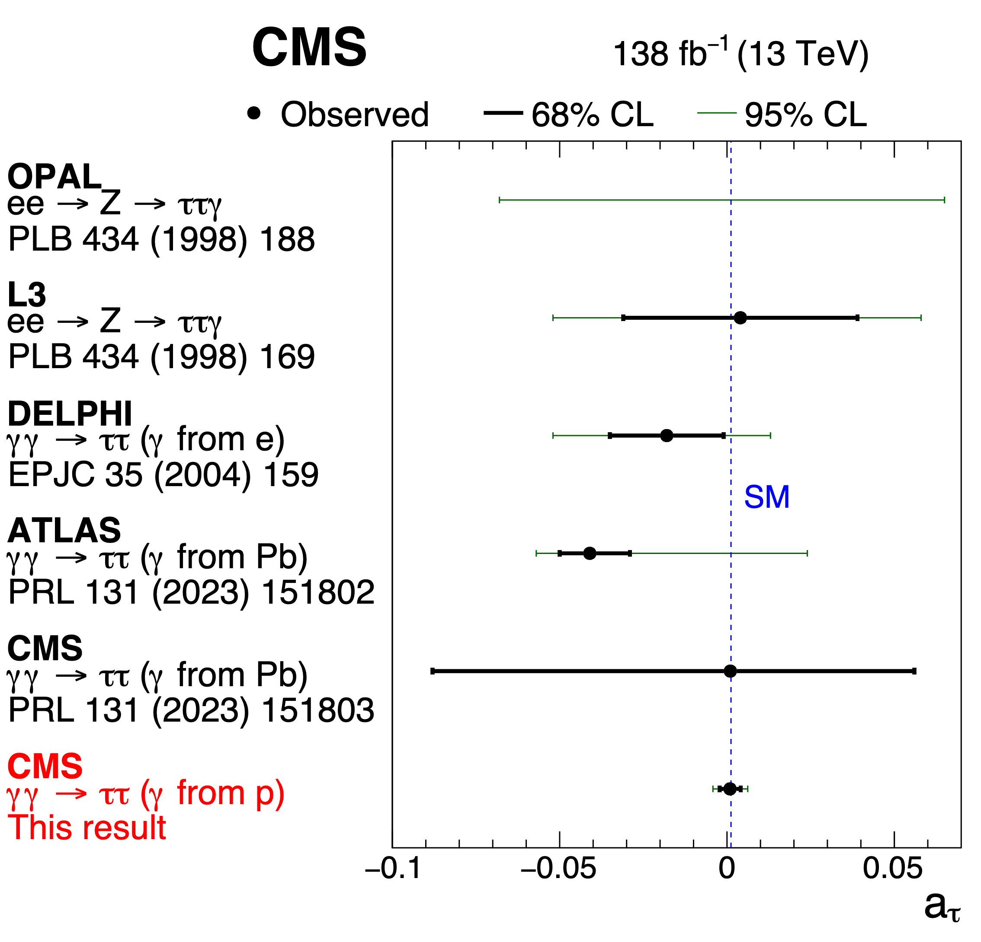
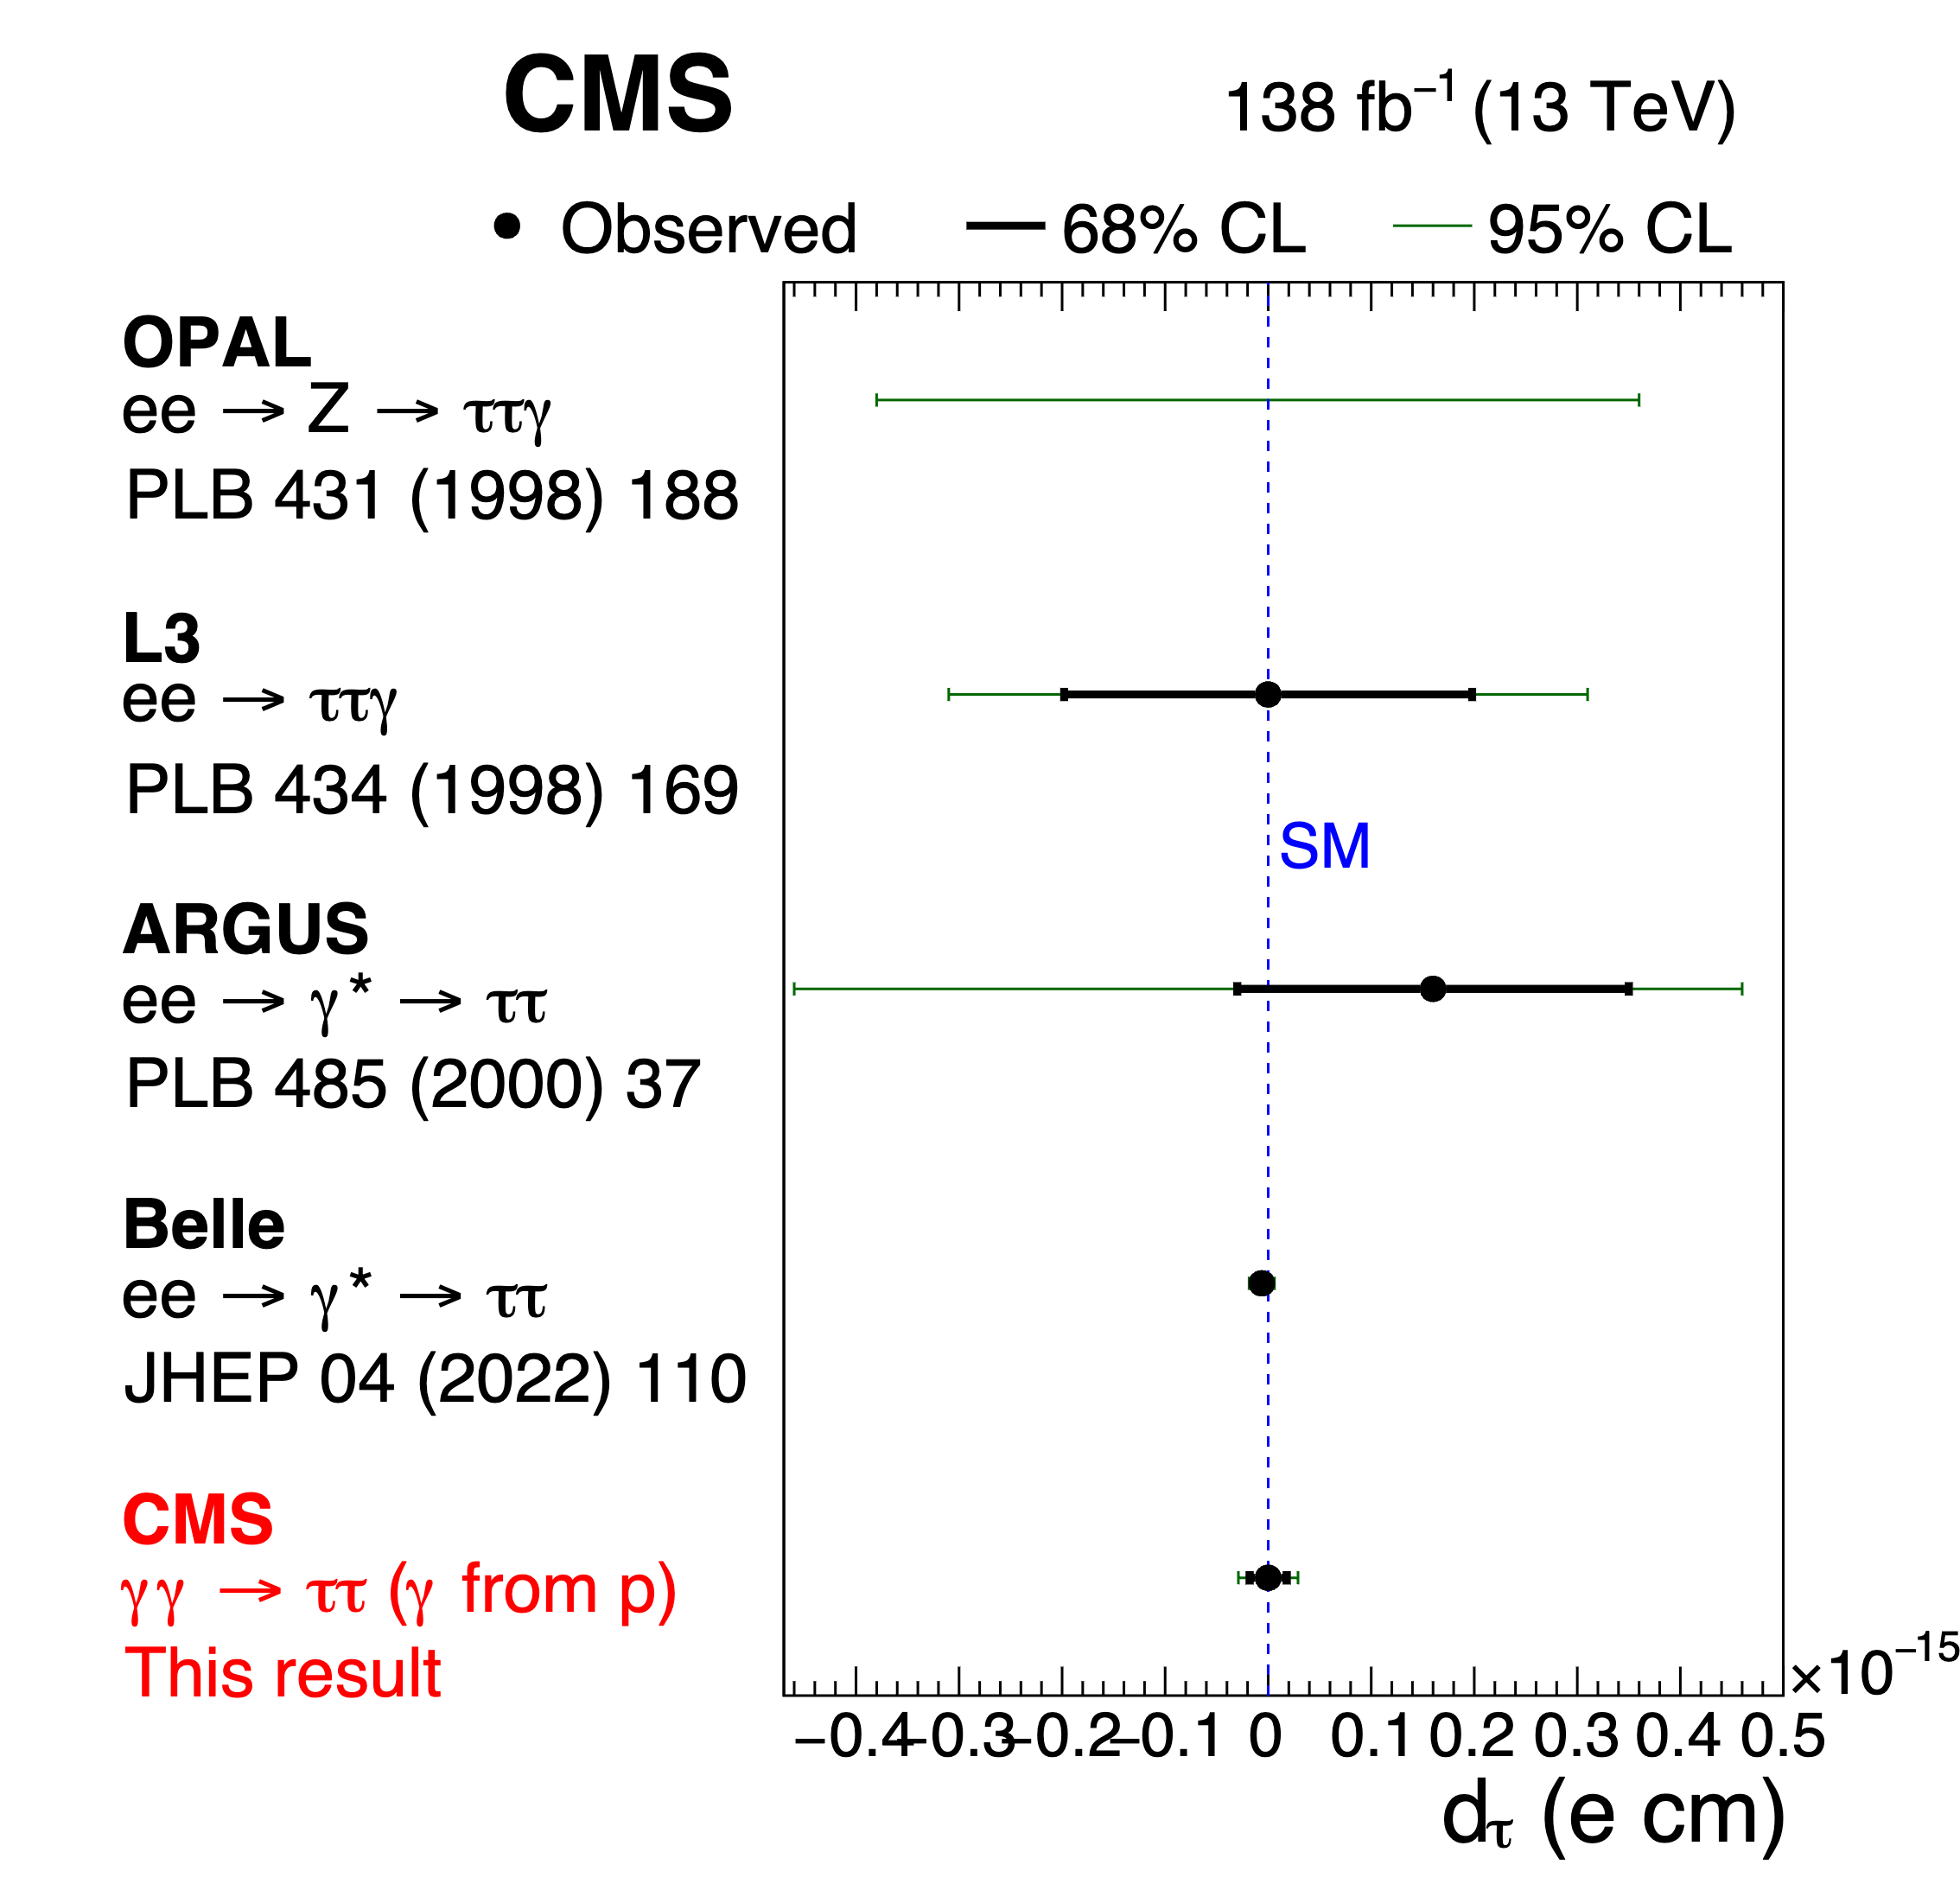
Comparison to Previous Results
$$d_{τ}=(−0.62±0.63)×{10}^{−17}ecm$$
$$a_{τ}={0.0009}_{−0.0031}^{+0.0032}$$
$$d_{τ}=(−0.0±1.7)×{10}^{−17}ecm$$
Large improvement over LEP and LHC HIN, 3 times larger than the Schweiger term
Approaching Belle precision(extrapolated from q²>0), at q²$≈$0
CLHCP 2024

Slide 13
Summary
The CMS Collaboration has first observed $γγ→ττ$ process in pp collisions with 5.3σ
These events were used to constrain the τ electromagnetic moments with an EFT approach
${−0.0042<a}_{τ}<0.0062$ at 95% CL
$−1.7×{10}^{−17}$ecm<d_{τ}<$1.7×{10}^{−17}$ecm
Improving previous constraints on a_{τ} by a factor of ~5 (PDG:-0.052<a_{τ}<0.013 at 95% CL) and approaching the precision of the Schwinger term(0.00116)
The constraints on d_{τ} is approaching to Belle
CLHCP 2024

Slide 14
Thanks for listening!
CLHCP 2024

Slide 15
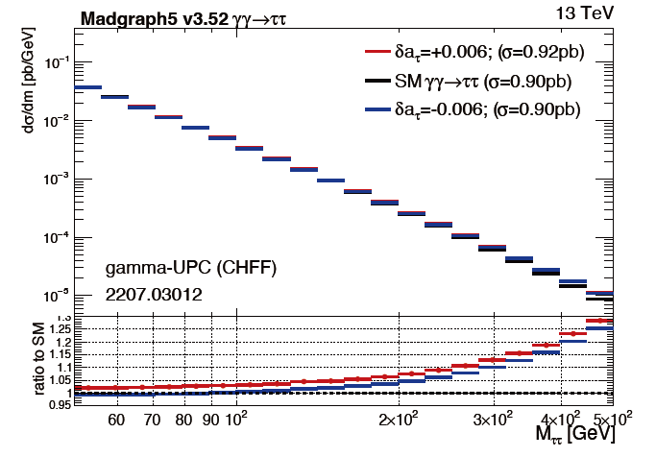
backup BSM effect
CLHCP 2024

Slide 16
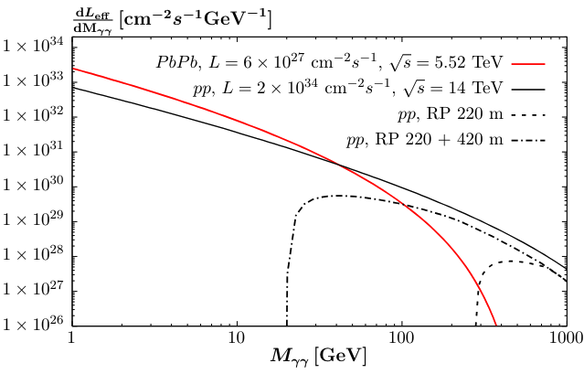
backup Electromagnetic ultra-peripheral collisions(UPC)
provide a pure QED(electrodynamics) environment
$σ\left(γγ\right)∝Z^{4},σ(γγ)∝\log^{3}{(\sqrt{S})}$, much larger luminosities of pp collisions than PbPb collisions
quasi-real photon,$q^{2}≈0$
max(longitudinal) γ energies$E_{γ}≈$80GeV(PbPb),2.5TeV(pp)
much larger BSM effect on larger $m_{ττ}$
process signature:
-opposite sign(OS) $τ_{}^{±}τ_{}^{∓}$
-back-to-back in azimuthal plane: $\left|ΔΦ\right|≈π$
-low activity around ττ vertex
CLHCP 2024

Slide 17
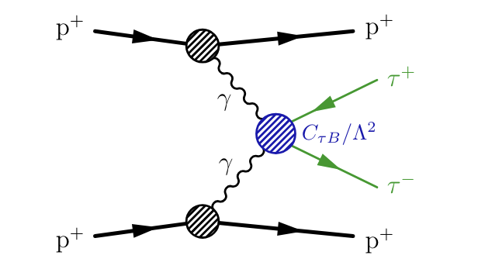
backup Signal Simulation pp
only elastic events are generated using gammaUPC, data-driven method to include the dissociative component and SUPERCHIC for cross-check
a_{τ} & d_{τ} interpretation using the EFT approach with the SMEFTsim package, simplifying with $C_{τW}$=0 since the linear combination of $C_{τB}$ and $C_{τW}$:
$$δa_{τ}∝\frac{Re\left[C_{τB}\right]}{Λ^{2}},δd_{τ}∝\frac{Im[C_{τB}]}{Λ^{2}}$$
elastic semi-dissociative fully-dissociative
CLHCP 2024

Slide 18
backup Acoplanarity Correction pp
$$A=1−|\frac{φ}{π}|$$
The correction is derived as a function of acoplanarity by fitting the data/MC ratio.
It is kept constant above 0.35.
It modifies the Drell-Yan normalizations in various $p_{T}$ ranges (the corrections are different in different $p_{T}$ ranges), but keeps the overall Drell-Yan normalization constant.
CLHCP 2024

Slide 19
backup Beam Spot Correction pp
CLHCP 2024

Slide 20
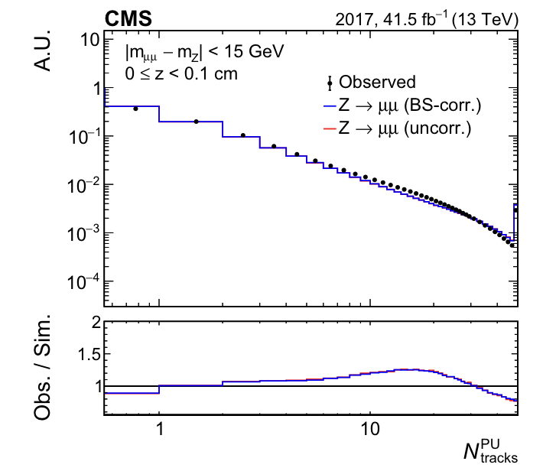
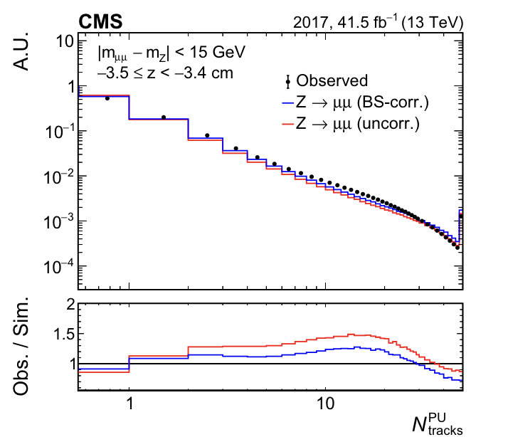
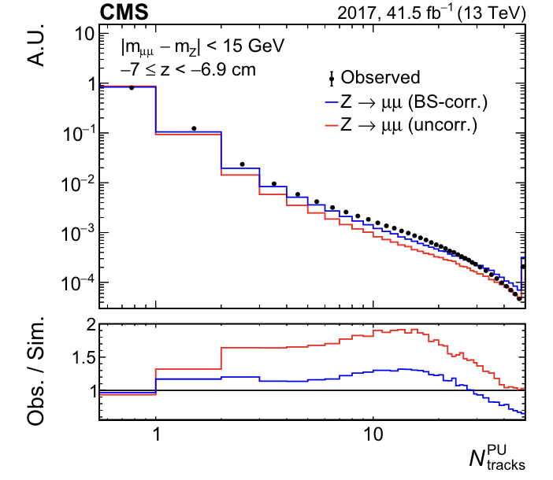
backup Pileup Track Multiplicity Correction
windows far from the di-μ vertex to discard the tracks from the hard scattering interactions in $|m_{μμ}−m_{Z}|$<15GeV
CLHCP 2024

Slide 21
backup Photon-induced Process Correction pp
scan a_{τ} & d_{τ} values through matrix element reweightging in two independent 1D grids of 100 points for $C_{τB}$:
$$Re\left[C_{τB}\right]∈\left[−40,40\right],Im\left[C_{τB}\right]∈[−40,40]$$
result independent from of choice of $Λ$, $C_{τB}$ & $C_{τW}$ scale with $Λ^{2}$, but we fix $Λ$=2TeV in event generation
CLHCP 2024

Slide 22
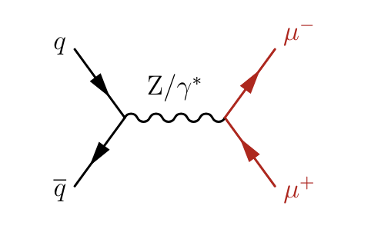
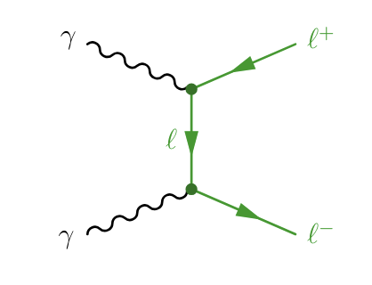
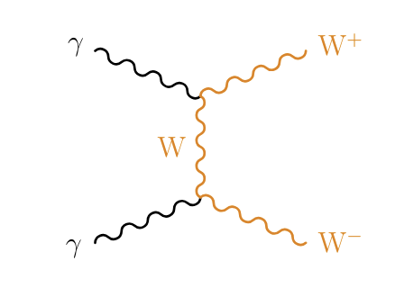
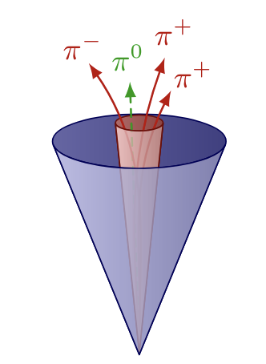
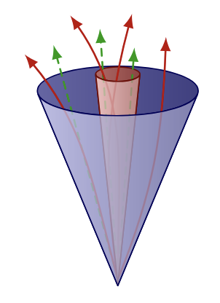
backup Backgrounds pp
MC simulation
-Drell-Yan($Z/γ^{∗}→ll$):dominant at low mass
-exclusive $γγ→ee,μμ,WW$ production
-inclusive WW production(small)
data-driven: misidentified hadronic jets
-$j→τ_{h}$:$eτ_{h}$,$μτ_{h}$,$τ_{h}τ_{h}$ channels
-$j→e/μ$:$eμ$ channels
hadronic $τ_{h}$ jet
hadronic quark/gluon jet
CLHCP 2024

Slide 23
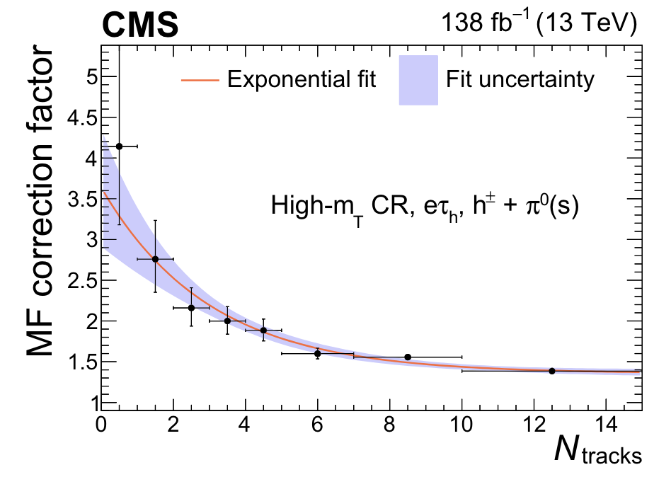
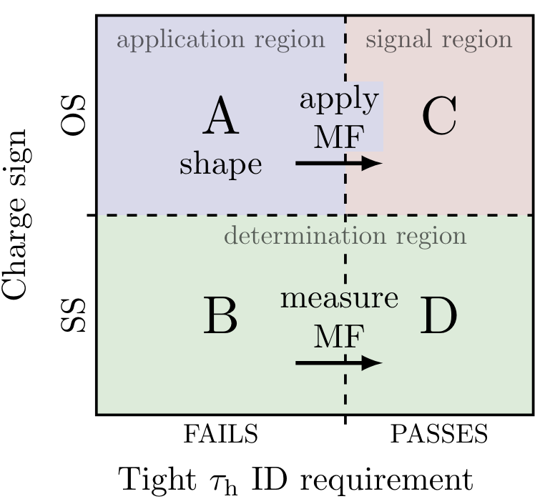
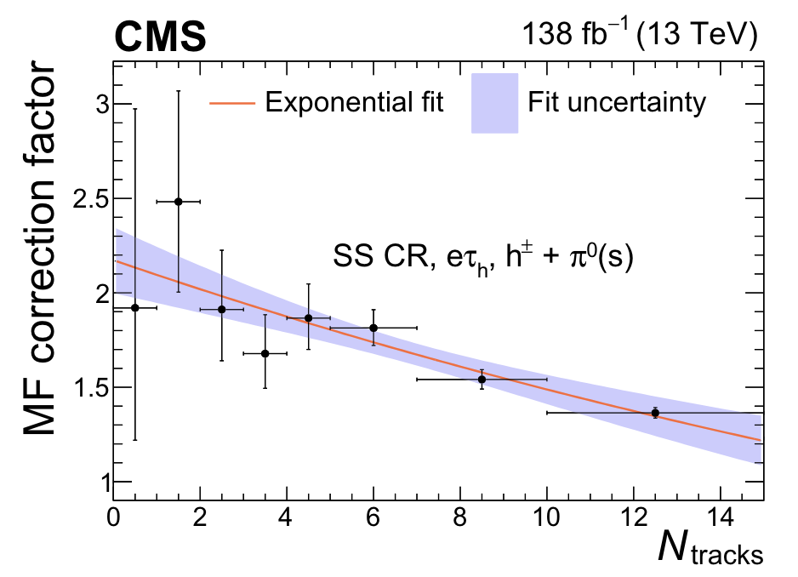
Misidentified τ_{h} Background
MFs measured in separate CRs
-W+jets:$m_{T}$>75GeV
-QCD:SS, $m_{T}$<75GeV
CLHCP 2024

Slide 24
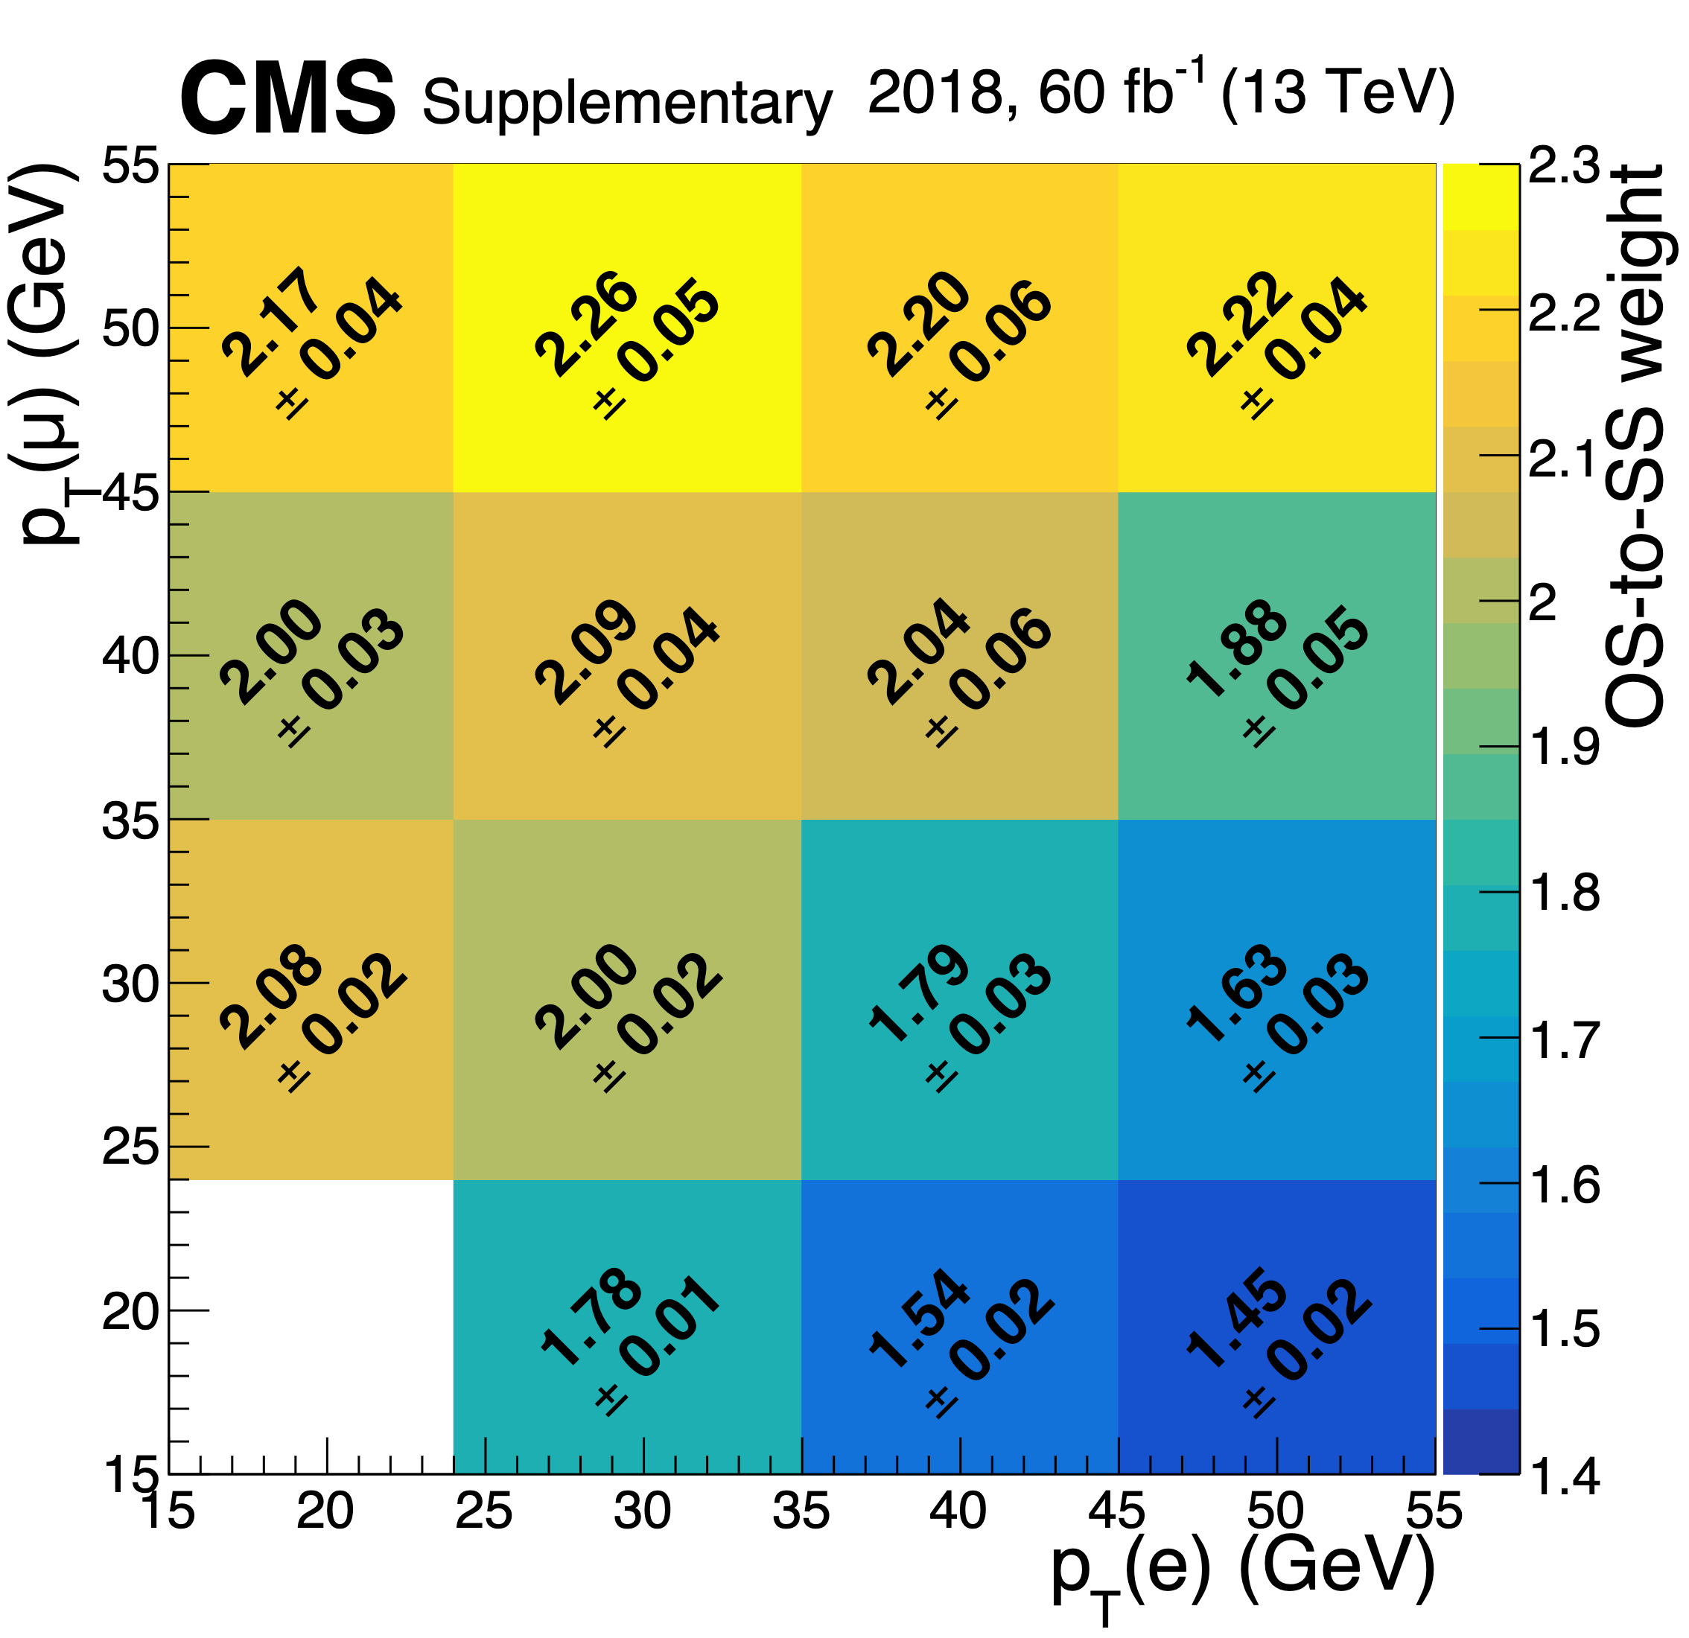
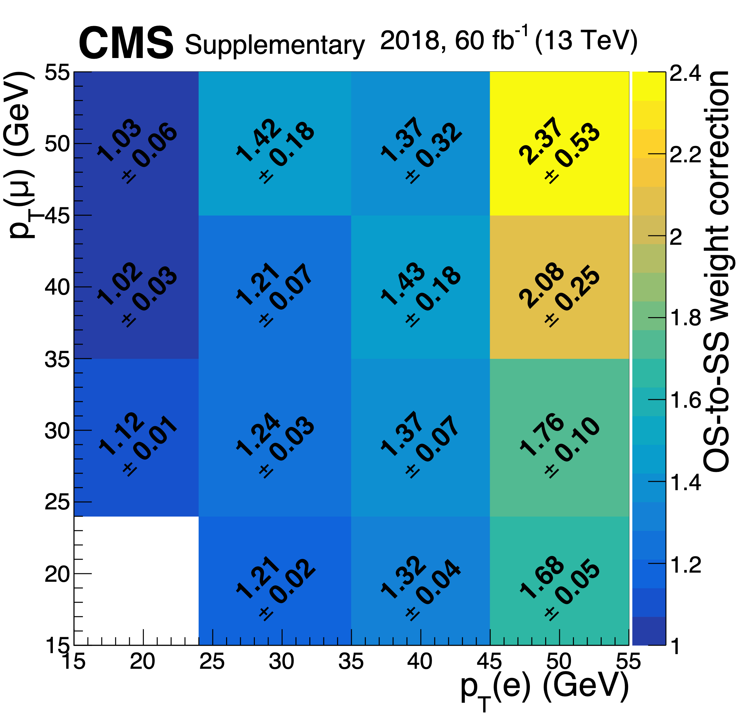
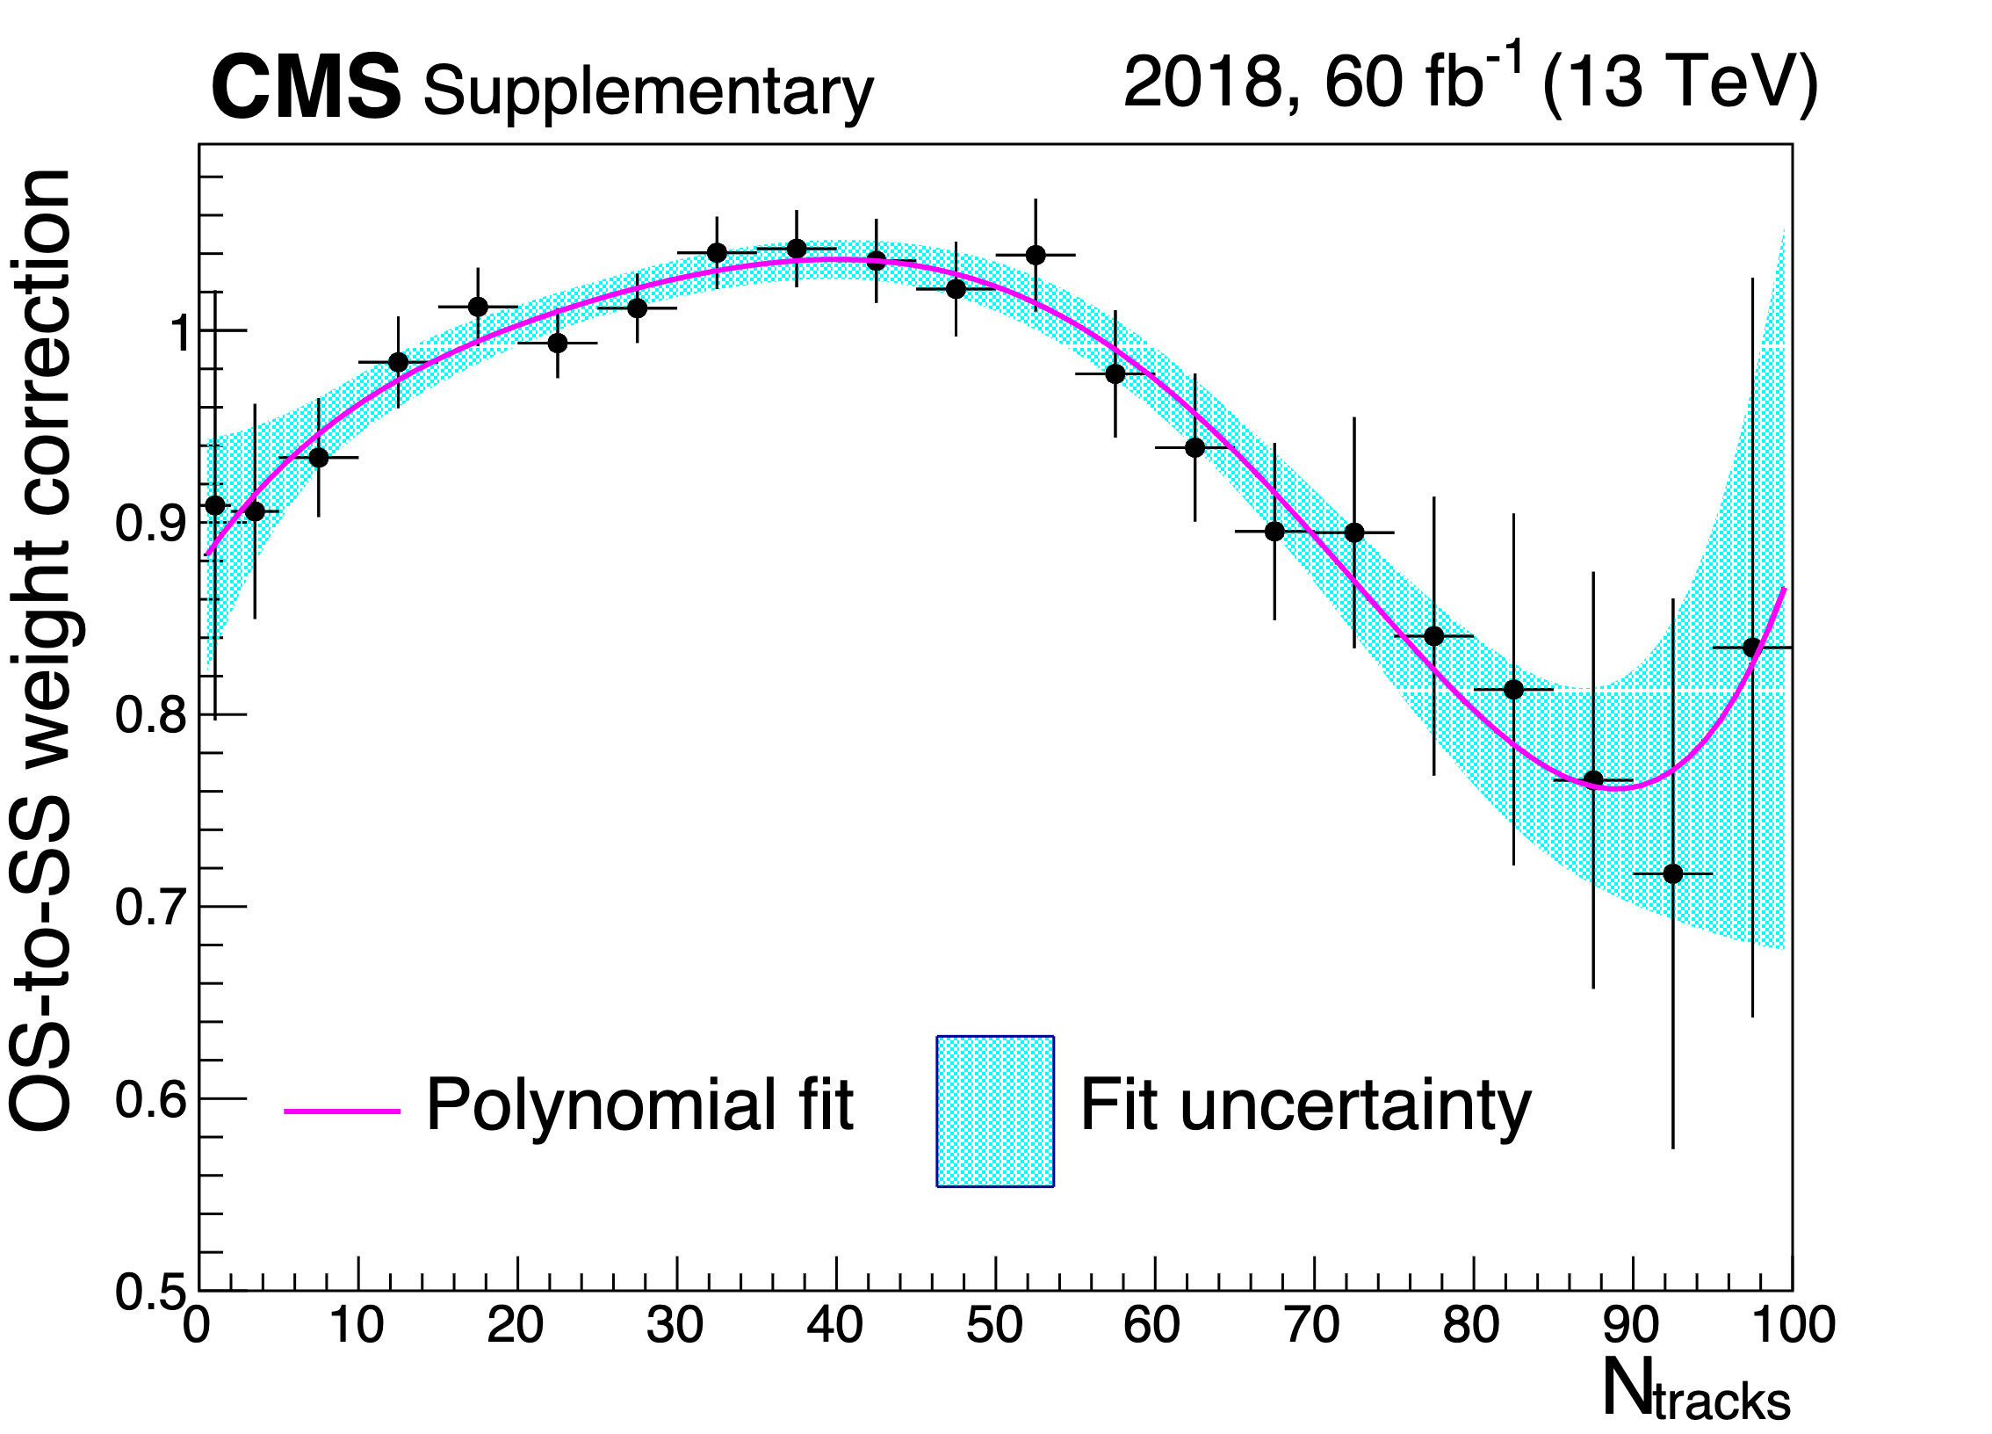
backup jet fake eμ background pp
reweigh SS events with SF made of 3 multiplicative terms
OS/SS SF measured in events with anti-isolated μ
correction for μ inverted isolation
N_{tracks} corretions
Anti-isolated the μ to get the OS-to-SS as fake factors
Anti-isolated the e with isolated μ and anti-isolated μ to correct the effect of the shift of the μ isolation
Derive the $N_{tracks}$ dependence of the OS-to-SS
CLHCP 2024

Slide 25
backup Leading Systematics on the signal significance pp
shape uncertainty of the elastic rescaling: the difference between the flat factor and the linear factor
uncertainty of the $N_{tracks}^{HS}$ correction is taken to have the same magnitude as the relative fraction of $γγ→μμ/WW$ in the correction derived region.
$N_{tracks}$ extrapolation of the jet$→τ_{h}$ MF estimate jet mis-ID background(up to ~20%)
Real and fake $τ_{h}$idenfication (at low $N_{tracks}$)
CLHCP 2024

Slide 26
backup nTrk=0 pp
CLHCP 2024

Slide 27
backup nTrk=1 pp
CLHCP 2024

Slide 28
backup selection criteria for fiducial cross section
CLHCP 2024

Slide 29
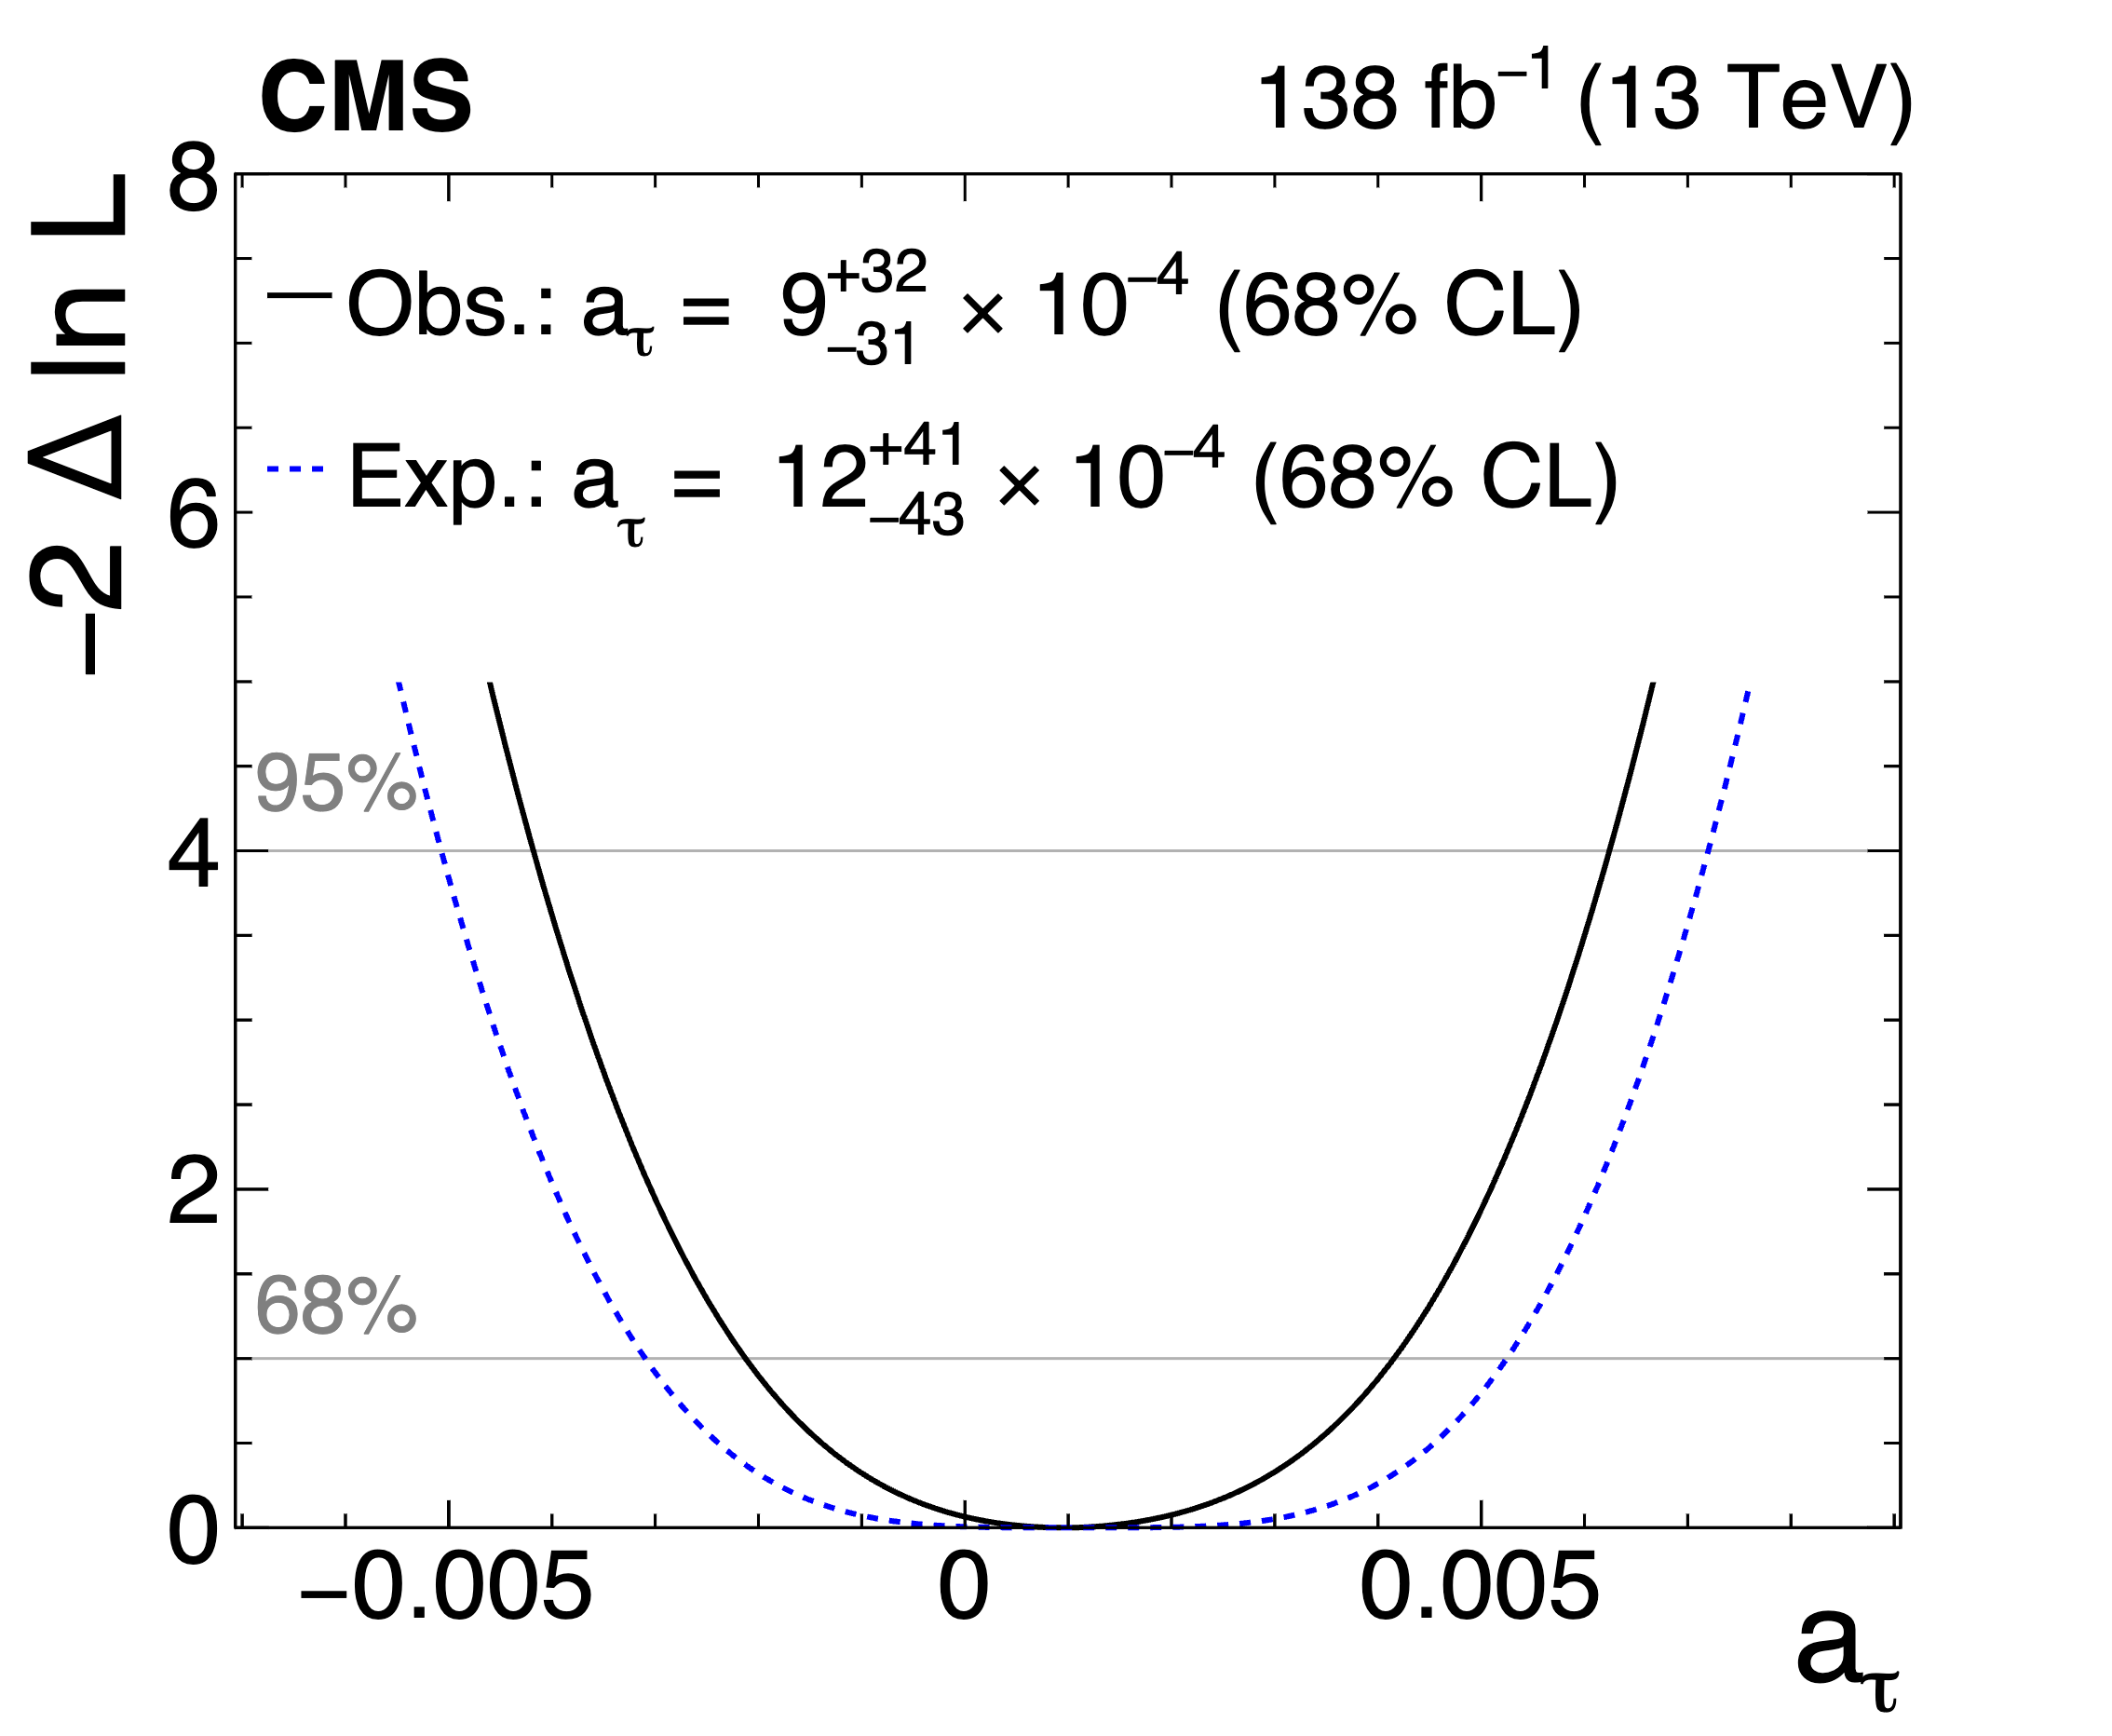
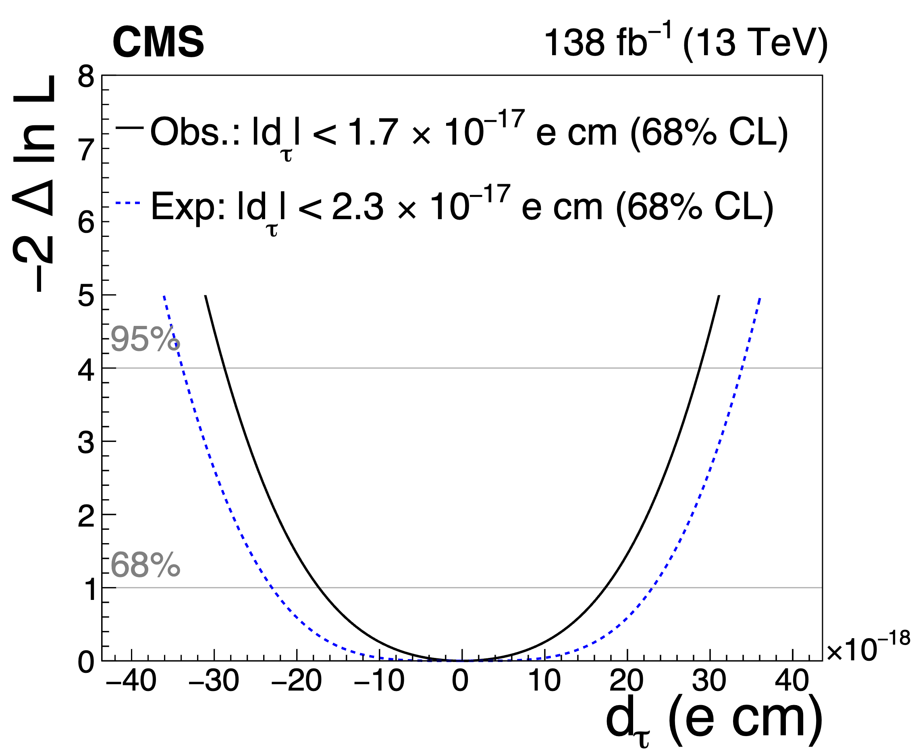
backup Constraints on a_{τ} and d_{τ}
Dirac
a_{τ}=0
Schwinger
a_{τ}=0.00116
SM
a_{τ}=0.00118
CLHCP 2024

