Slide 1
Measuring the proton structure using the electroweak productions at hadron colliders
Zihan Zhao
University of Science and Technology of China
CLHCP | 15th Nov 2024

Slide 2
Significance of proton structure at high-energy scale
Pure physics of the structure of the proton
A global test for QCD
Initial state description for hadron experiments
Flavor asymmetry: $\overline{u},\overline{d}, s(\overline{s})$
Intrinsic heavy quark?
High-energy scale: negligible interactions between partons
→$\text{(}\text{proton}\text{ + }\text{X}\text{)}=\sum{({parton}_{i}\text{ + }X_{i})}$
perturbative QCD calculation, $α_{s} \text{determination}⋯$
PDF: leading systematic in many important topics:
$sinθ_{W}^{eff}$, $m_{W}$, Higgs differential, $Z^{′}, W′$…

Slide 3
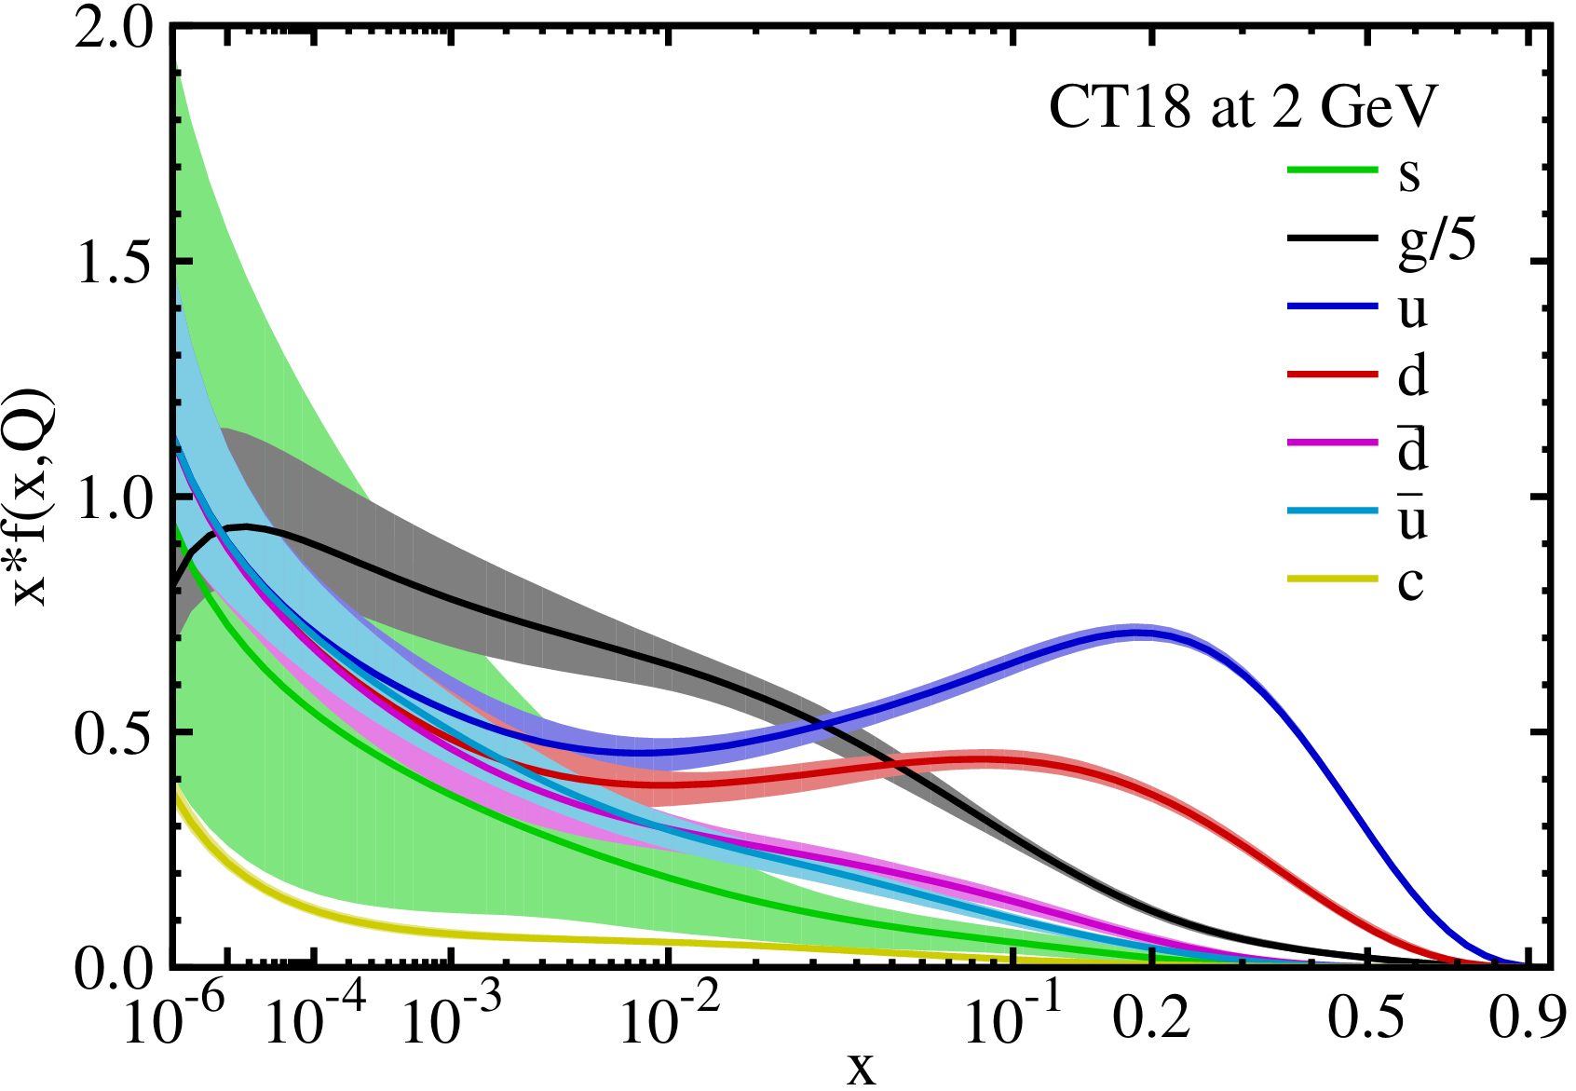
Proton structure study and PDF global analysis
Better experimental measurements
Better QCD global fit
Better proton structure study
Non-perturbative parameterization at low Q:
e.g.
$$u\left(x\right), \overline{u}\left(x\right), d\left(x\right), \overline{d}\left(x\right), s\left(x\right),\overline{s}\left(x\right), g(x)$$
Experimental measurements:
fit for the non-perturbative part
fit
Perturbative QCD calculation:
Evolution to high Q
post-fit
not a direct reflection
of experiments
$$c\left(x\right), \overline{c}\left(x\right), b\left(x\right), \overline{b}\left(x\right)…$$
Other assumptions:
sum rules
SM assumptions
$$\int{u−\overline{u}}=2,\int{d−\overline{d}}=1,\int{q_{s,c,b}−{\overline{q}}_{s,c,b}}=0$$
$\overline{u}=\overline{d}$ at $x→$ 0
$…$

Slide 4
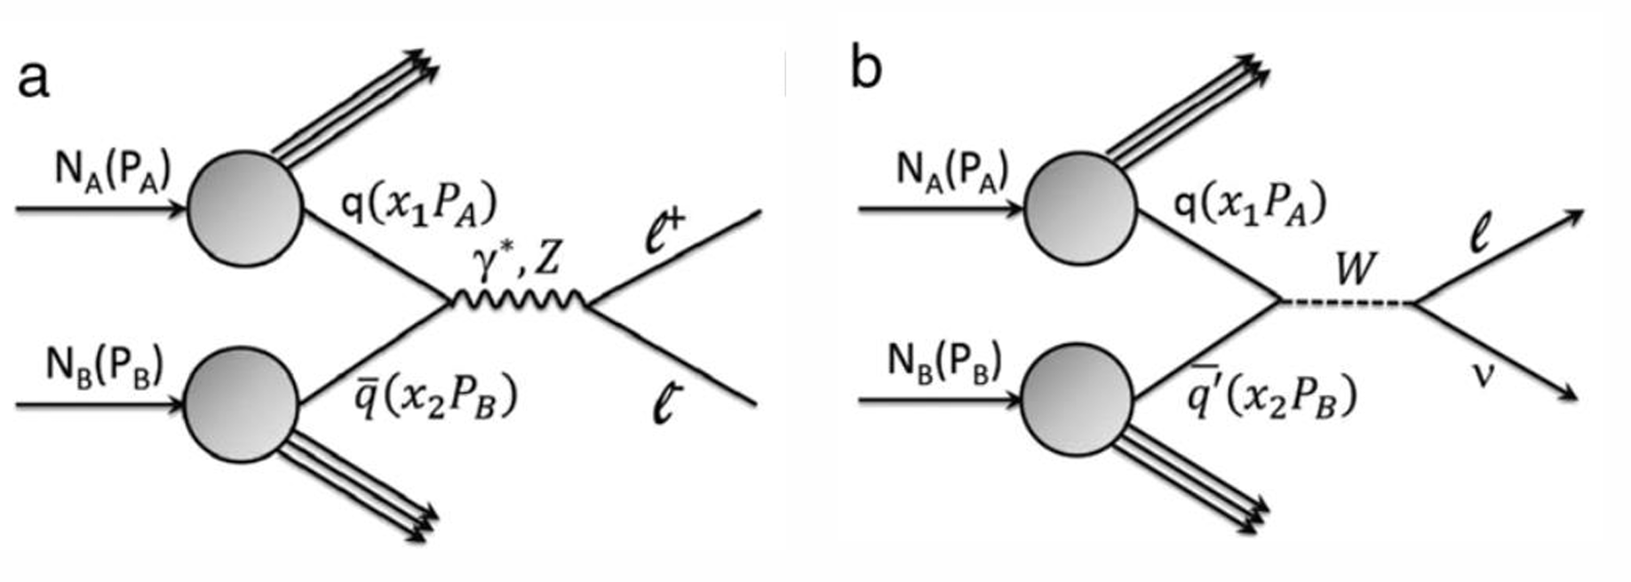
Better experimental measurements
Previous experiments for high-energy scale proton structure:
cross-section measurements (DIS, Drell-Yan…)
flavor information mixing
New measurements:
asymmetries due to electroweak interaction → different quark densities individually
(non-flavor: without big fragmentation uncertainty)
provide distinct information
lower the mixing → closer to individual determination of each parton
DIS
Drell-Yan

Slide 5
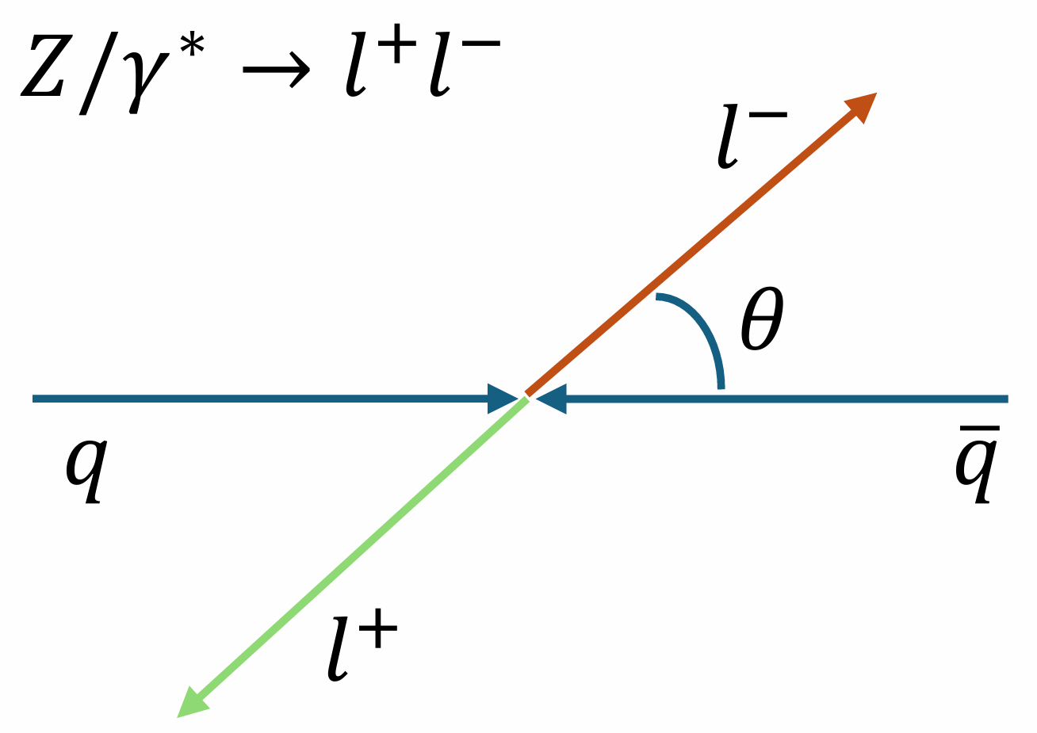
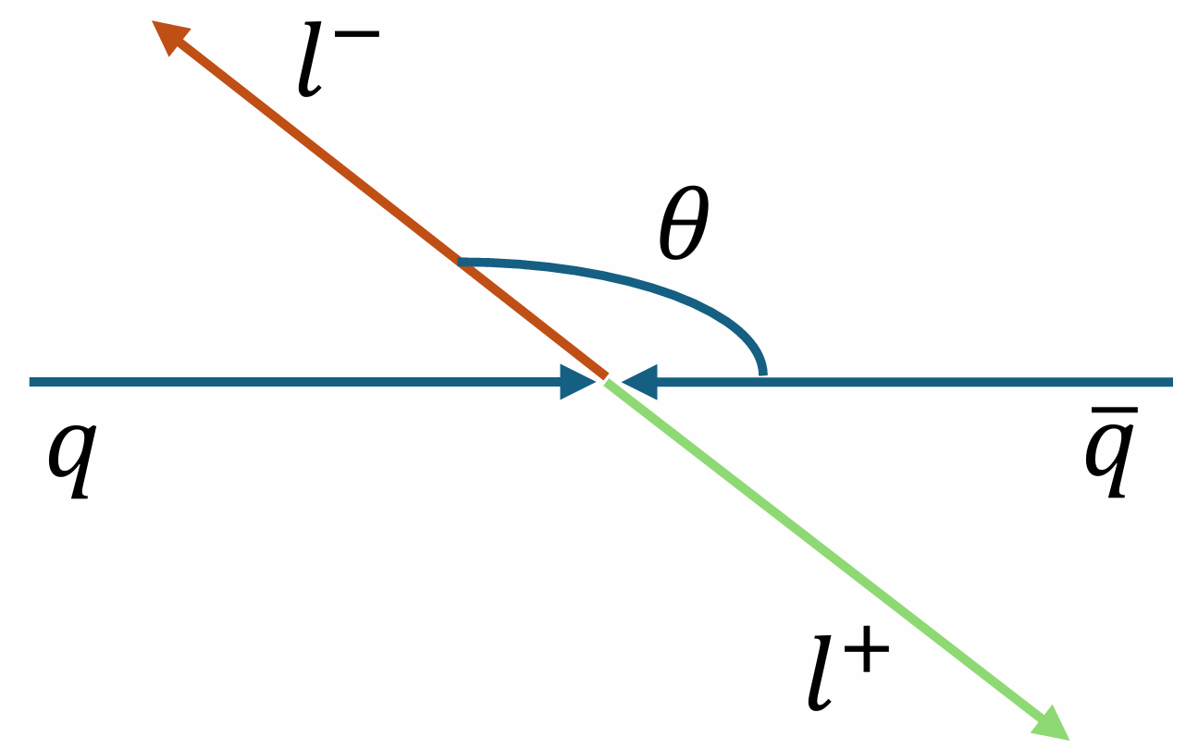
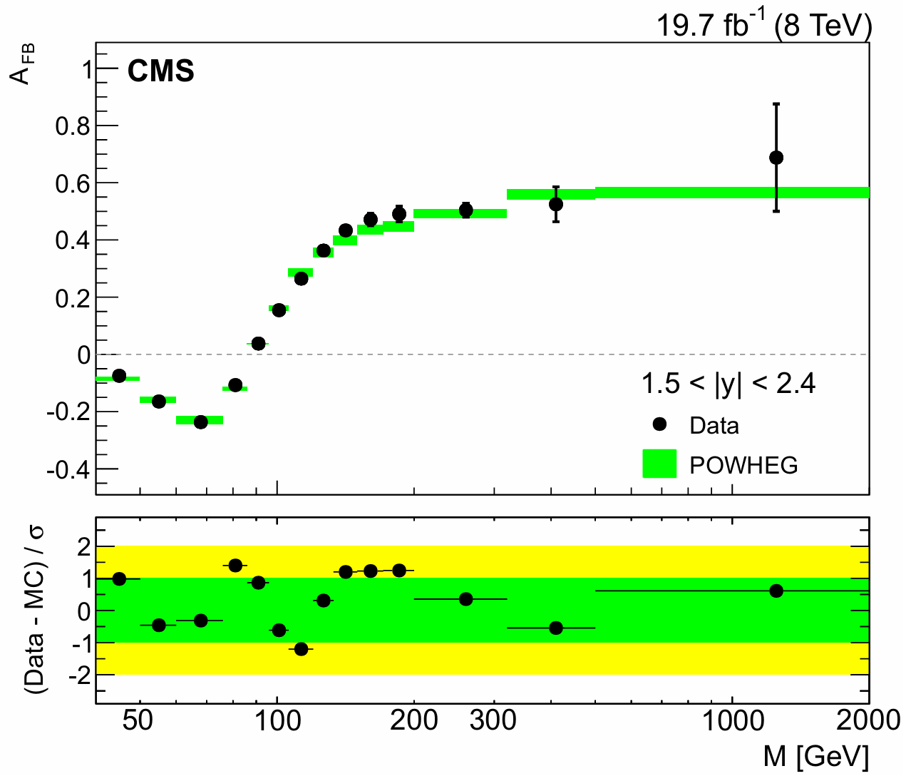
A new measurement of up and down quark structure of proton
Forward-Backward Asymmetry, $A_{FB}$
$$hh(q\overline{q})→Z/γ^{∗}→l^{+}l^{−}$$
Forward: $cosθ>0$
Backward: $cosθ<0$
$$A_{FB}=\frac{N_{F}−N_{B}}{N_{F}+N_{B}}$$
Originate from the electroweak symmetry breaking
Observed as a function of dilepton mass $→$

Slide 6
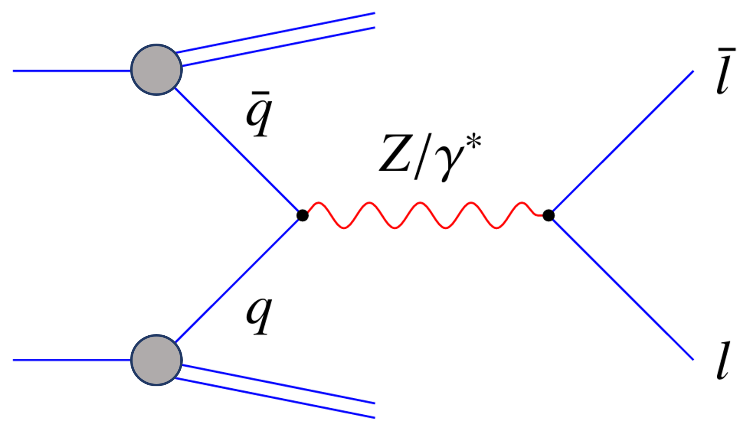
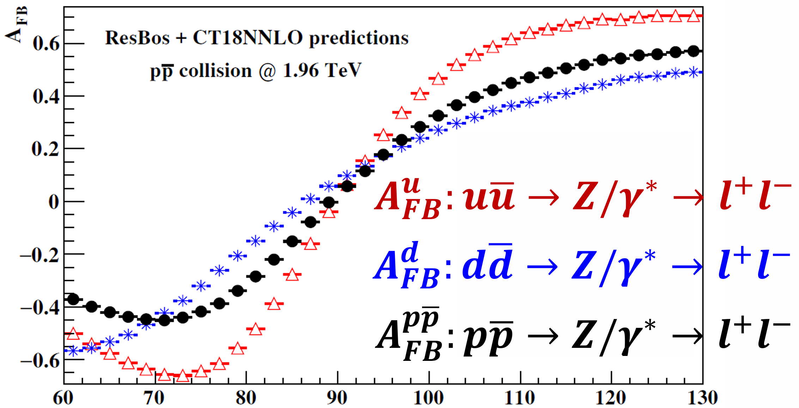
A new measurement of up and down quark structure of proton
provide distinct $u, d$ quark information
Phys. Rev. D 106, 033001 (2022)
$A_{FB}$ at hadron colliders:
parity violation in the electroweak interaction, also depends upon the proton structure
$A_{FB}^{u}$ ($u\overline{u}, c\overline{c}$ initial states) differs from $A_{FB}^{d}$ ($d\overline{d}, s\overline{s}, b\overline{b}$ initial states)
The observed $A_{FB}^{p\overline{p}(or pp)}$ is a combination of $A_{FB}^{u}$ and $A_{FB}^{d}$, where their weights reflect the up and down quark information separately.
proton
(or antiproton)
proton
proton structure
electroweak parity violation

Slide 7
A new measurement of up and down quark structure of proton
Phys. Rev. D 106, 033001 (2022)
Electroweak asymmetry of the hard process $u\overline{u}→Z/γ^{∗}→l^{+}l^{−}$ and $d\overline{d}→Z/γ^{∗}→l^{+}l^{−}$
Proton structure parameters
$C_{u},P_{u}(C_{d}, P_{d})$ has no down(up) quark densities (except for a normalized total cross-section).
$p\overline{p}$ collider (Tevatron)
predominant by $u_{v}$ and $d_{v}$
$$P_{u}≈\frac{u_{v}^{2}}{σ_{total}}$$
$$P_{d}≈\frac{d_{v}^{2}}{σ_{total}}$$
$$R≡\frac{P_{u}}{P_{d}}≈\frac{u_{v}^{2}}{d_{v}^{2}}$$
(just an approximation, not used in real calculation)

Slide 8
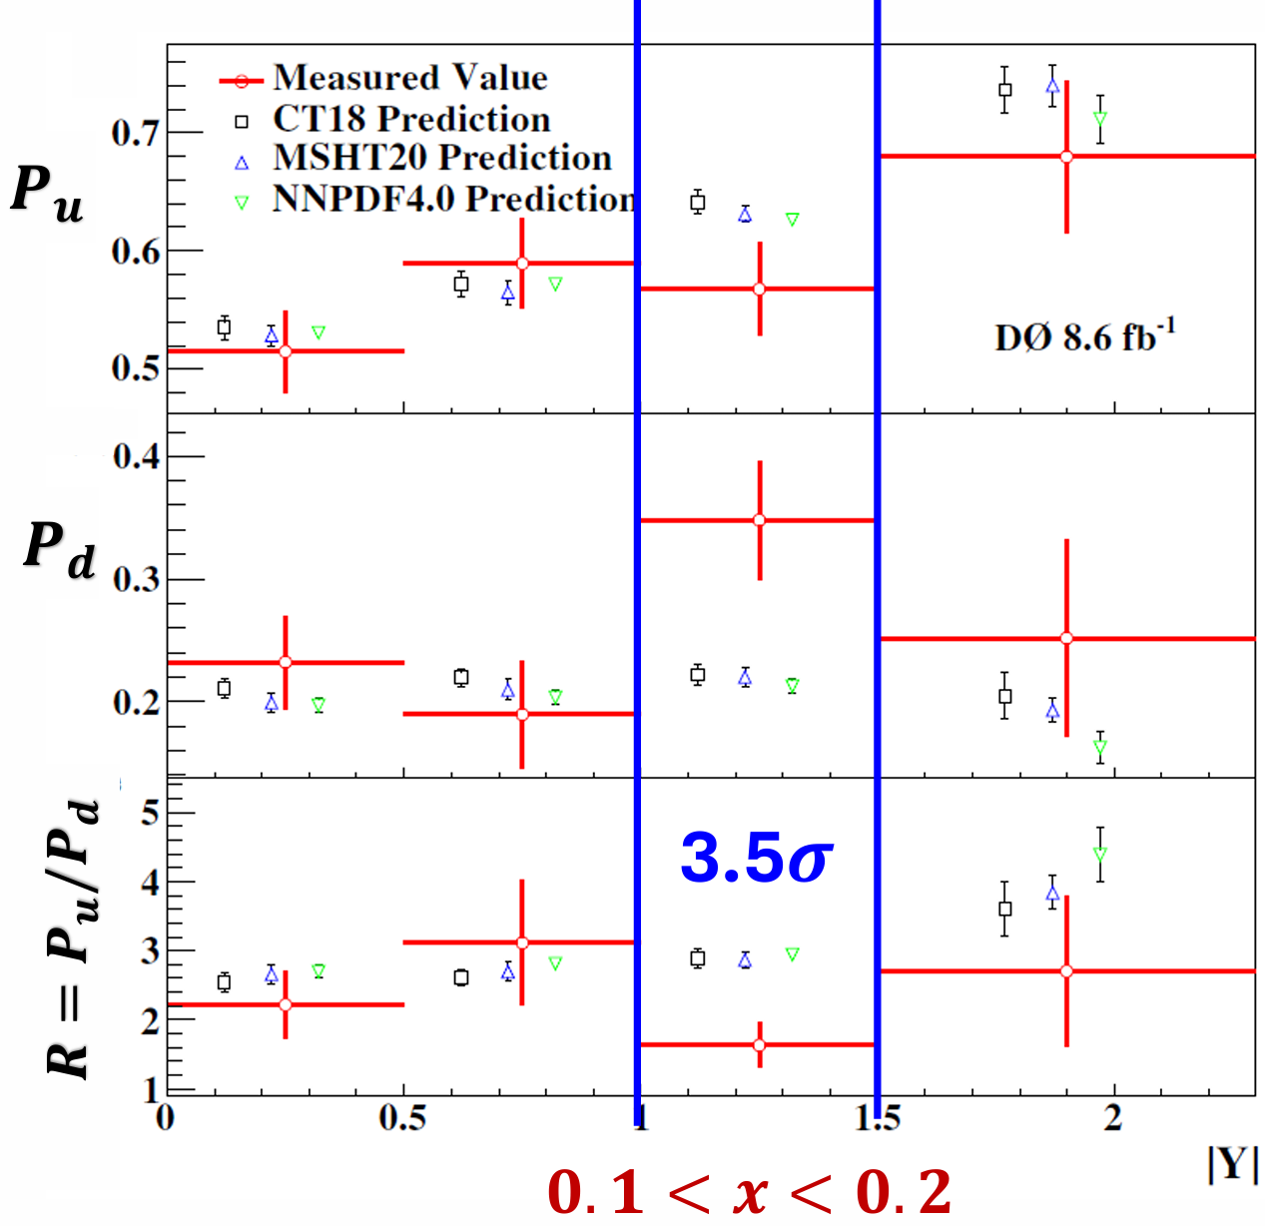
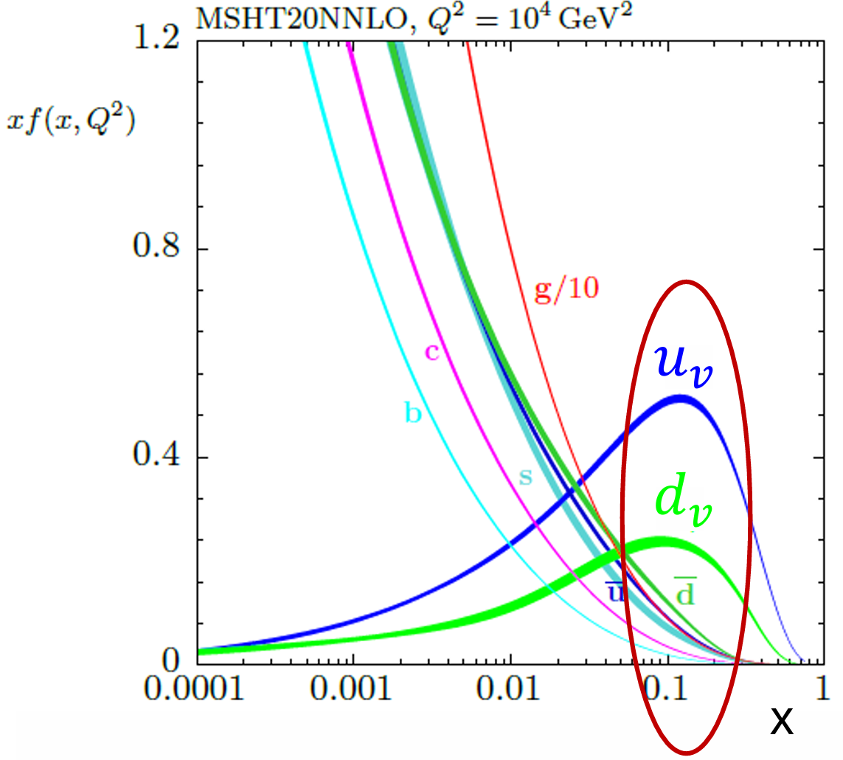
A new measurement of up and down quark structure of proton
$p\overline{p}$ collider (Tevatron)
D0 1.96TeV $ee+μμ A_{FB}$ 8.6${fb}^{−1}$
Phys. Rev. D 110, 091101 (2024)
The largest deviation locates in $\left|y_{Z}\right|=\left[1, 1.5\right]$,
which is the peak region of $u_{v}$ and $d_{v}$ quark parton density distributions.

Slide 9
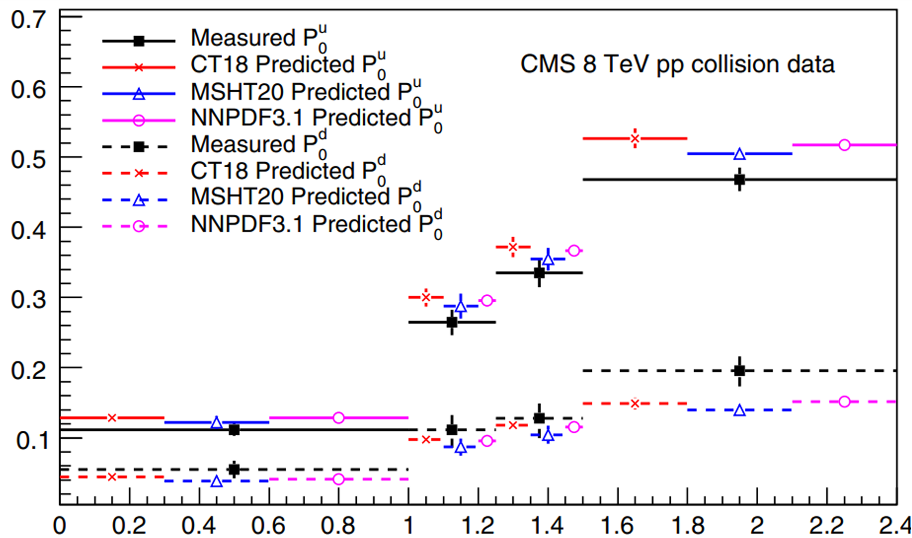
A new measurement of up and down quark structure of proton
$pp$ collider (LHC)
CMS 8TeV $ee+μμ$ $A_{FB}$ 20${fb}^{−1}$
Phys. Rev. D 107, 054008 (2023)
$$P_{u}≈\frac{u\left(x_{L}\right)\overline{u}\left(x_{S}\right)−u\left(x_{S}\right)\overline{u}\left(x_{L}\right)}{σ_{total}}$$
$${0.05<x}_{L}<0.1$$
$$0.001< x_{S}<0.002$$
$$P_{d}≈\frac{d\left(x_{L}\right)\overline{d}\left(x_{S}\right)−d\left(x_{S}\right)\overline{d}\left(x_{L}\right)}{σ_{total}}$$
A tendency for $P_{u}$ to be lower and $P_{d}$ to be higher than prediction.
ongoing measurement at LHC using ATLAS Run2 data

Slide 10
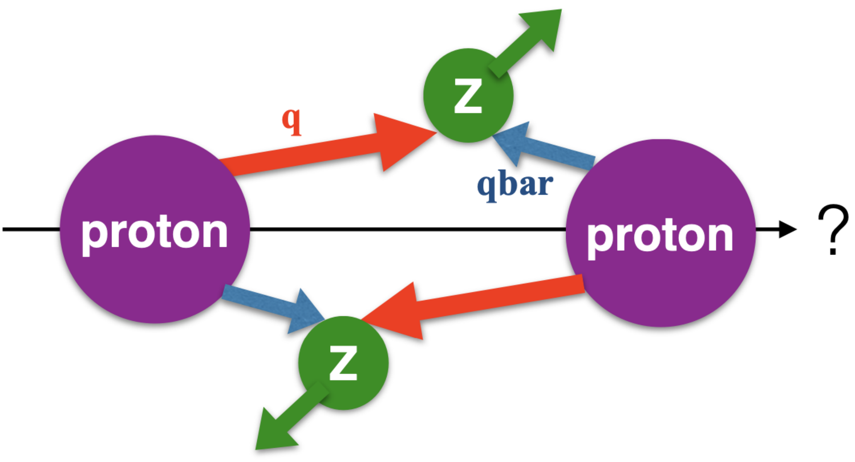
A new measurement of $x_{Large}$ and $x_{Small}$ quark structure of proton
provide distinct large and small $x$ region quark information
$$x= \frac{\sqrt{Q_{T}^{2}+M^{2}}}{\sqrt{s}}∙e^{±Y}$$
$$x_{L} \sim 𝓞\left({10}^{−2}\right) to 𝓞\left({10}^{−1}\right)$$
$$x_{S} \sim 𝓞\left({10}^{−4}\right) to 𝓞\left({10}^{−3}\right)$$
always one quark in $x_{L}$ region and the other in $x_{S}$ region at hadron collider
for a typical $q_{i}{\overline{q}}_{j}$ initial state, the observed cross-section is the mix of $q_{i}(x_{L}){\overline{q}}_{j}(x_{S})$ and ${\overline{q}}_{j}(x_{L})q_{i} (x_{S})$
distinguish the QCD in $x_{L}$ region and $x_{S}$ region
→ distinguish $q_{i}(x_{L}){\overline{q}}_{j}(x_{S})$ and ${\overline{q}}_{j}(x_{L})q_{i} \left(x_{S}\right)$

Slide 11
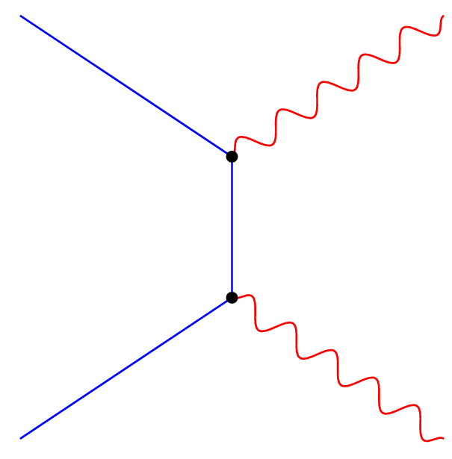
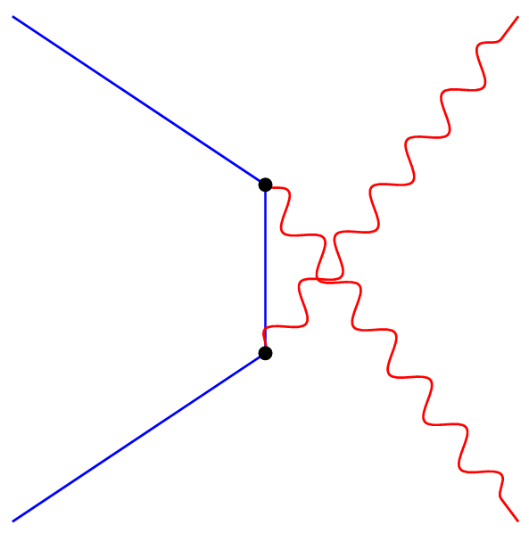
A new measurement of $x_{Large}$ and $x_{Small}$ quark structure of proton
provide distinct large and small $x$ region quark information
Phys. Rev. D 106, L051301 (2022)
Diboson productions and boost asymmetry
$Wγ, WZ,$and $W^{+}W^{−}$
dominant subprocess: u-channel and t-channel
comparison of the two bosons’ kinematics → comparison of the two quarks’ energies
The boost asymmetry in $VV′$ event can be defined as :

Slide 12
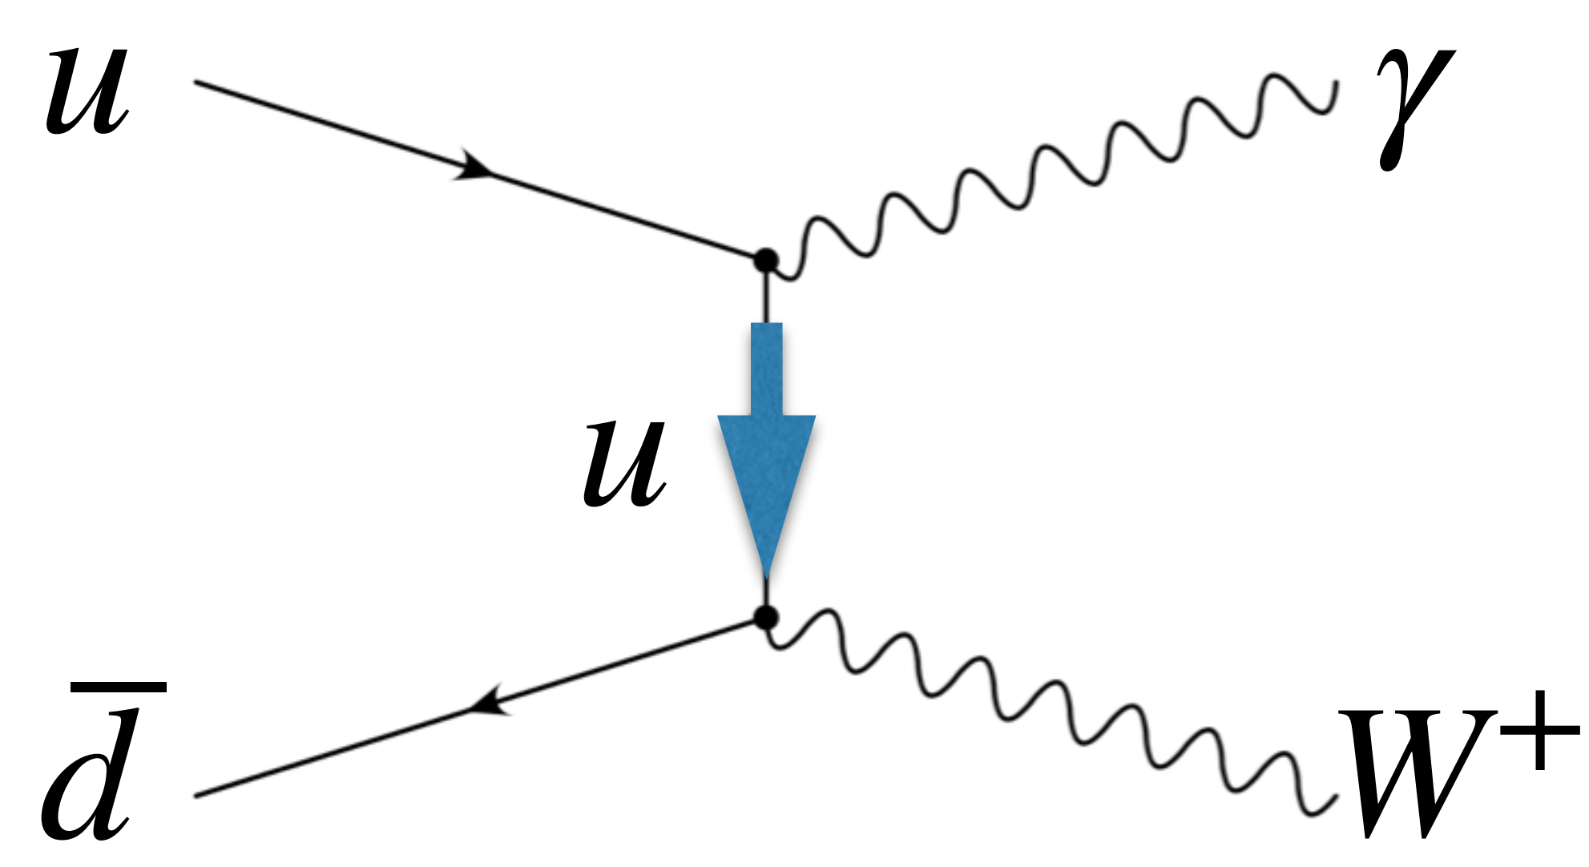
A new measurement of $x_{Large}$ and $x_{Small}$ quark structure of proton
The boost asymmetry in $W^{+}γ$ event can be defined as :
$A_{boost}^{W^{+}γ}$ represents to the difference between $u(x_{L})\overline{d}(x_{S})$ and $\overline{d}(x_{L})u(x_{S})$
Similarly the boost asymmetry in $W^{−}γ$event:
$A_{boost}^{W^{−}γ}$ represents to the difference between $\overline{u}(x_{L})d(x_{S})$ and $d(x_{L})\overline{u}(x_{S})$
$$u$$
$$γ$$
$$u$$
$$\overline{d}$$
$$W^{+}$$
ongoing measurement at LHC using ATLAS Run2 data

Slide 13
A new measurement of $x_{Large}$ and $x_{Small}$ quark structure of proton
 | $$|η_{γ}|>|η_{l}|$$ | $$\left|η_{γ}\right|<|η_{l}|$$
$$W^{+}γ$$ | $u(x_{L})\overline{d}(x_{S})$ | $$\overline{d}(x_{L})u(x_{S})$$
$$W^{−}γ$$ | $\overline{u}(x_{L})d(x_{S})$ | $d(x_{L})\overline{u}(x_{S})$
 | $$|η_{l^{+}}|>|η_{l^{−}}|$$ | $$\left|η_{l^{+}}\right|<|η_{l^{−}}|$$
$$W^{+}W^{−}$$ | $$u\left(x_{L}\right)\overline{u}\left(x_{S}\right)+\overline{d}\left(x_{L}\right)d(x_{S})$$ | $$\overline{u}\left(x_{L}\right)u\left(x_{S}\right)+d\left(x_{L}\right)\overline{d}(x_{S})$$
close to finish $WW$ measurement at LHC using ATLAS Run2 data

Slide 14
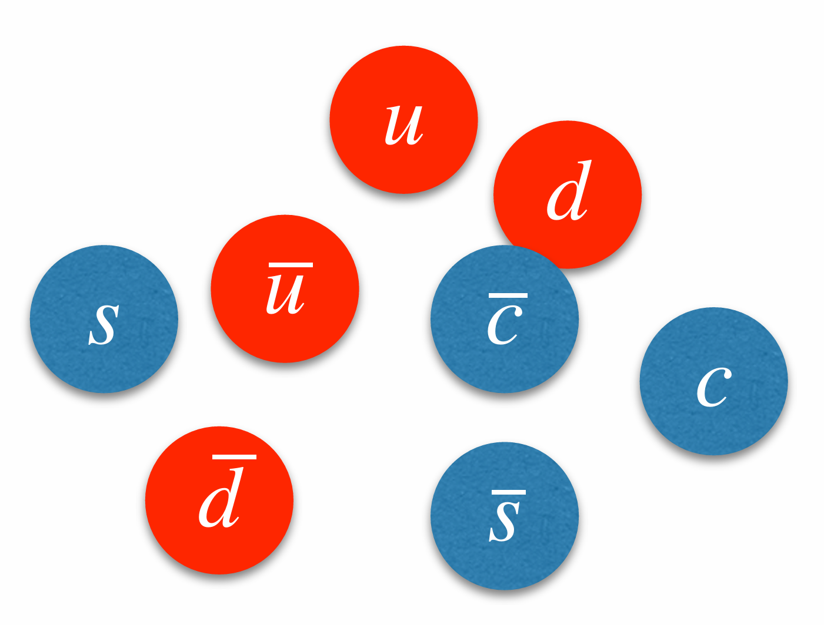
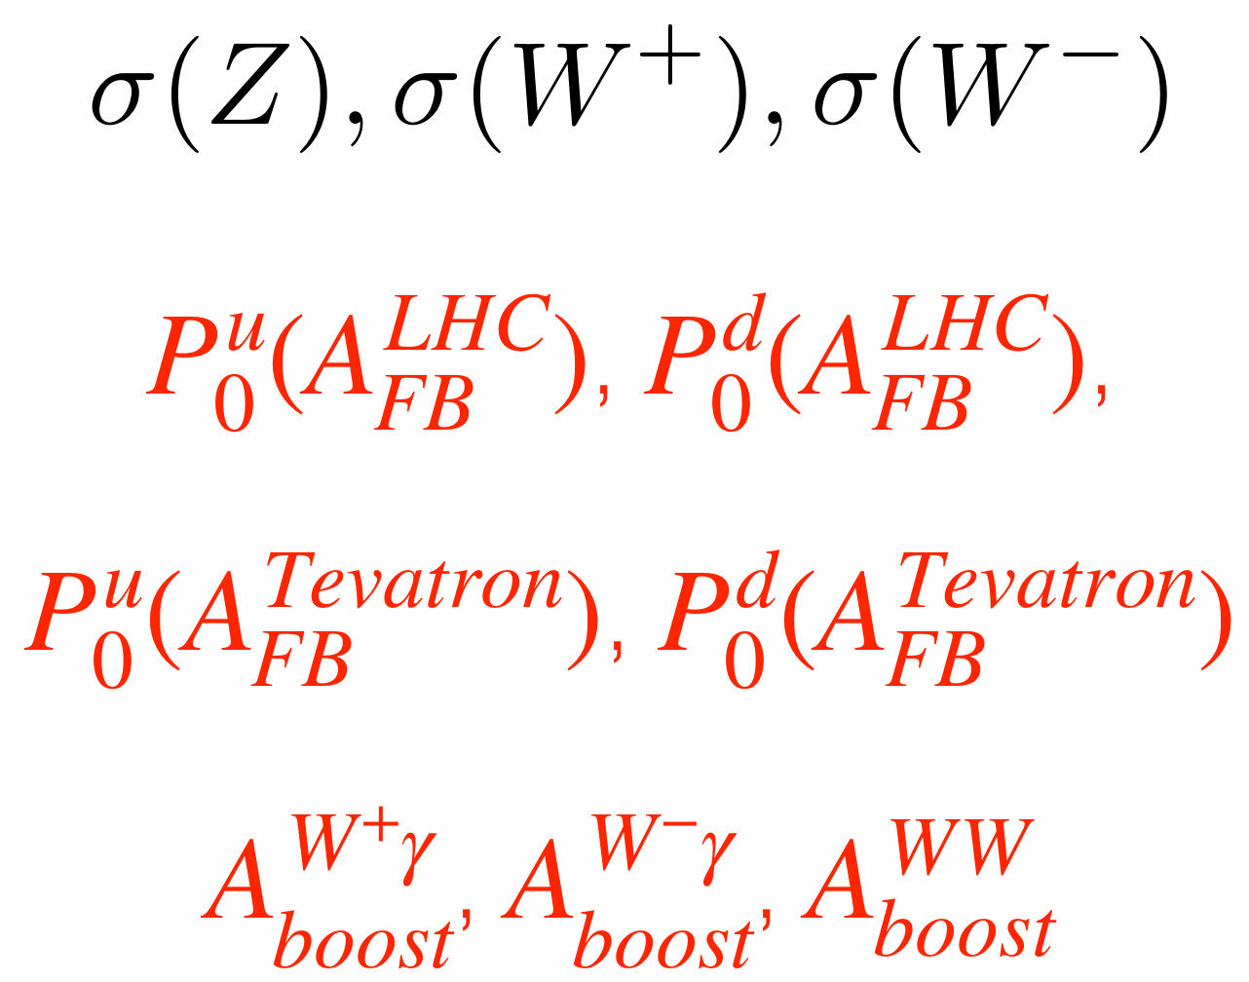
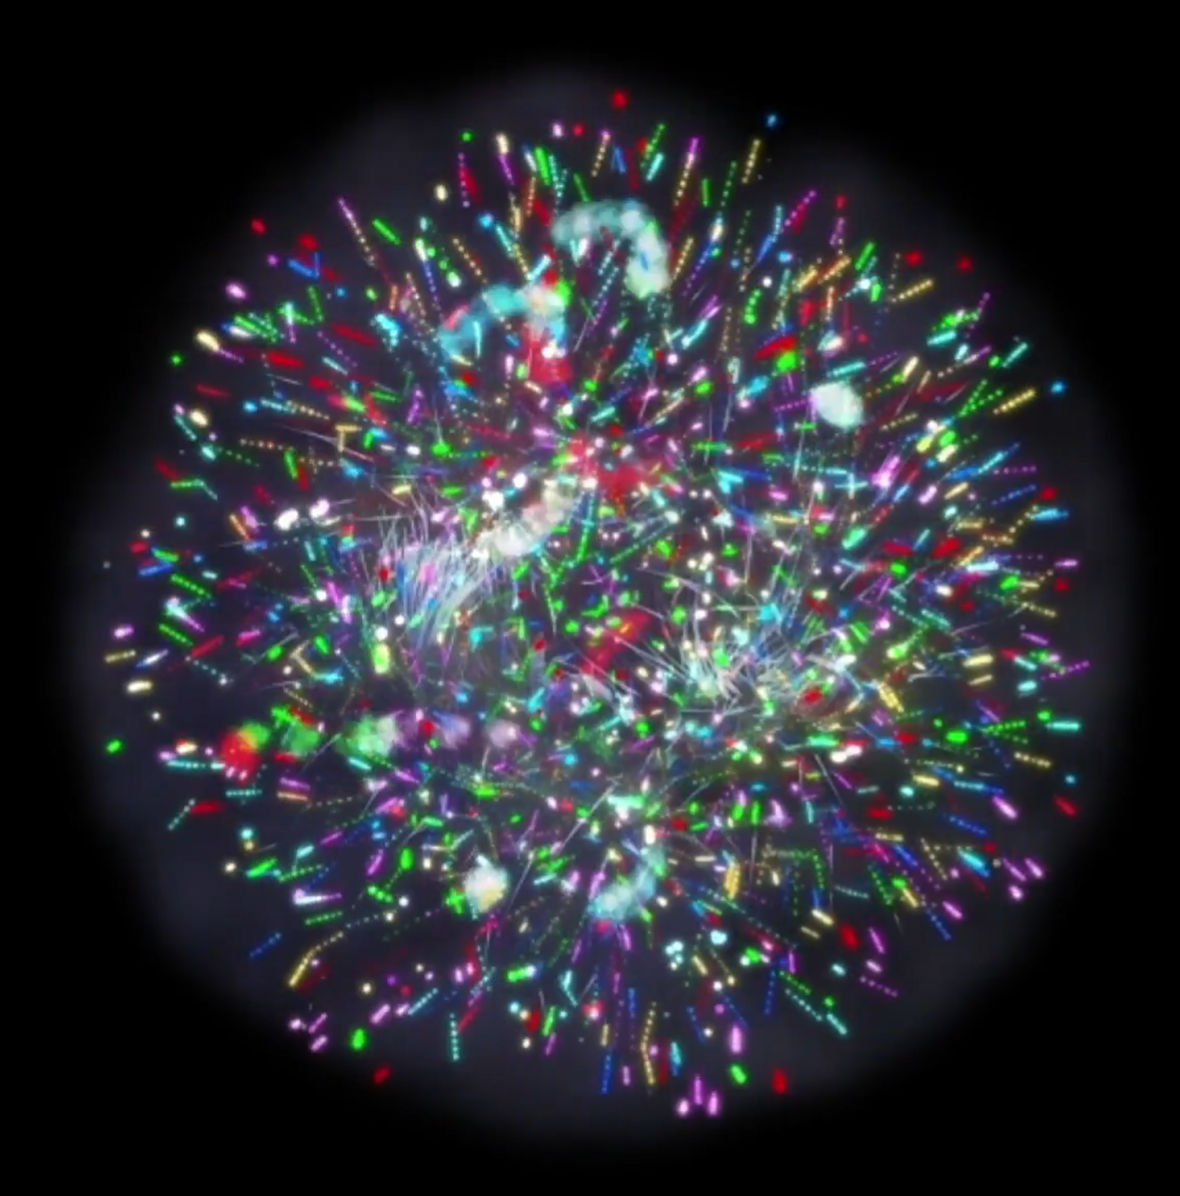
What is our long-term plan?
An independent full analysis of hadron collider data aims to determine a set of specific proton structure information.
tension between old DIS data and hadron collider data
$$x_{S}$$
$$x_{L}$$
$$x$$
${10}^{−5} {10}^{−4} {10}^{−3} {10}^{−2} {10}^{−1}$
？

Slide 15
Backup

Slide 16
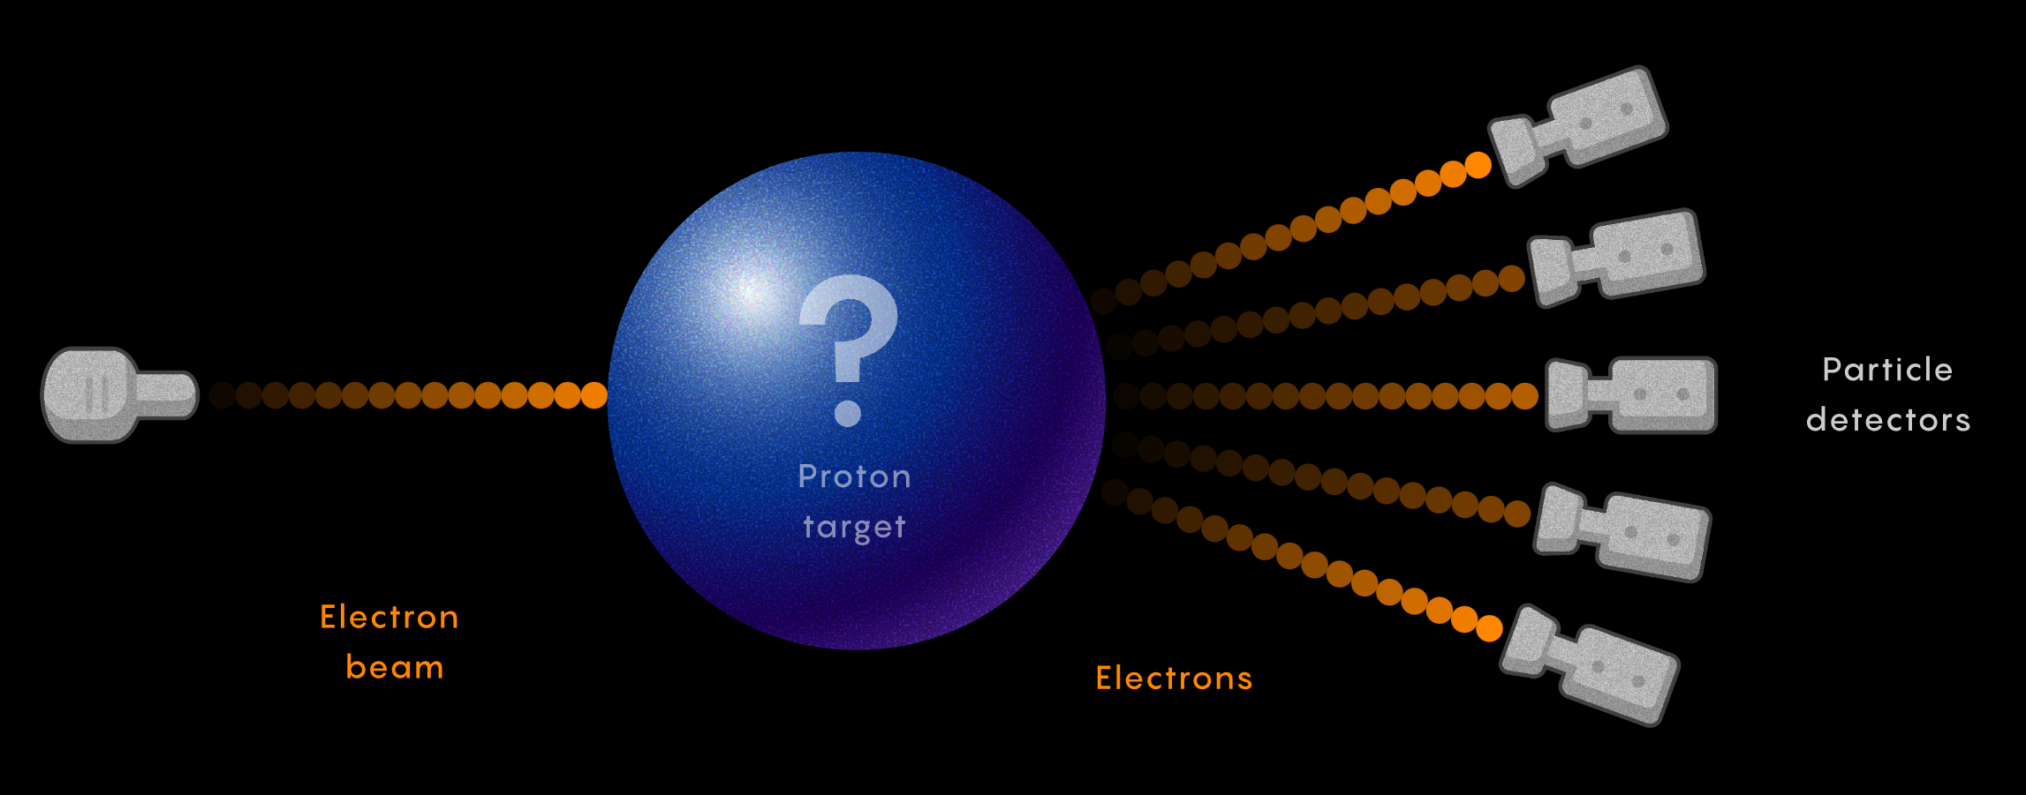
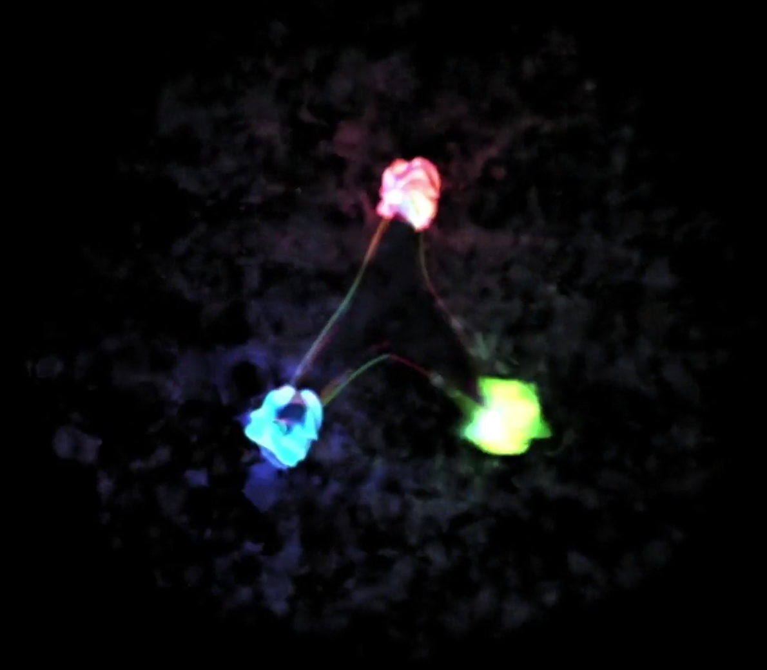
Exploring the proton structure
DIS, Drell-Yan, and SIDIS told us:
Quark model
Parton model
Cloud model

Slide 17
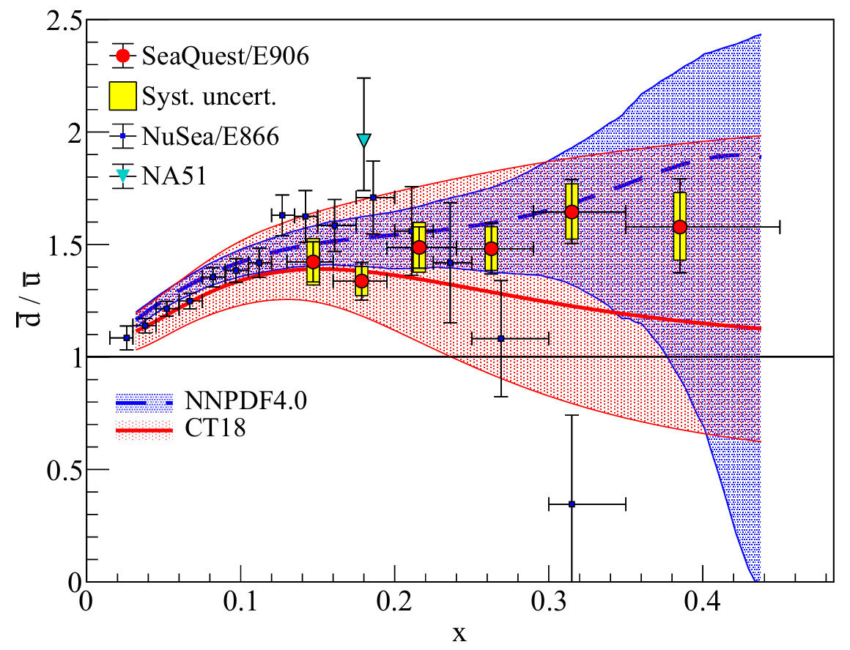
Physics of the proton structure
Main questions of proton structure:
Flavor asymmetry of $\overline{d}/\overline{u}$?
$s$ quark behavior and $s−\overline{s}$ asymmetry?
Intrinsic $c$ quark?
Meson cloud model
Chiral-quark model
Statistical model
Chiral-quark soliton model
Instanton model

Slide 18
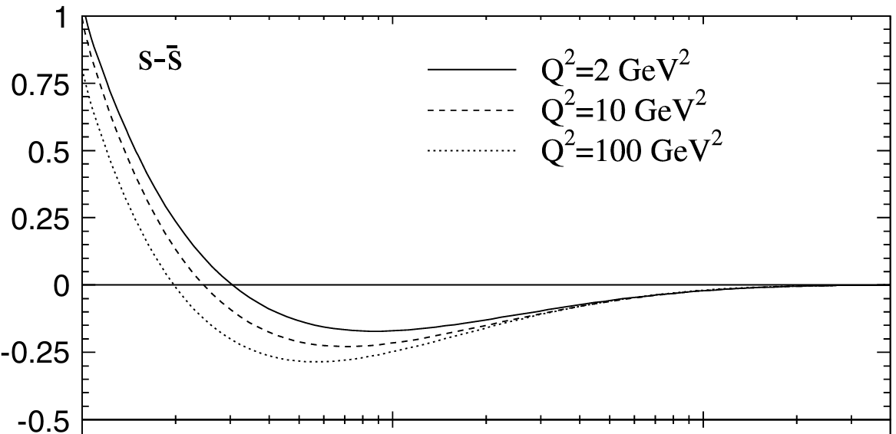
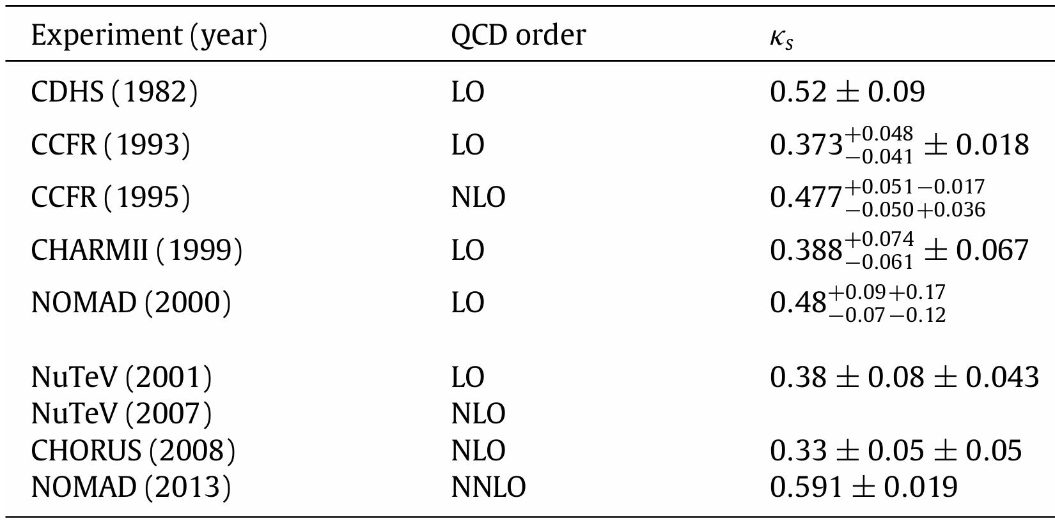
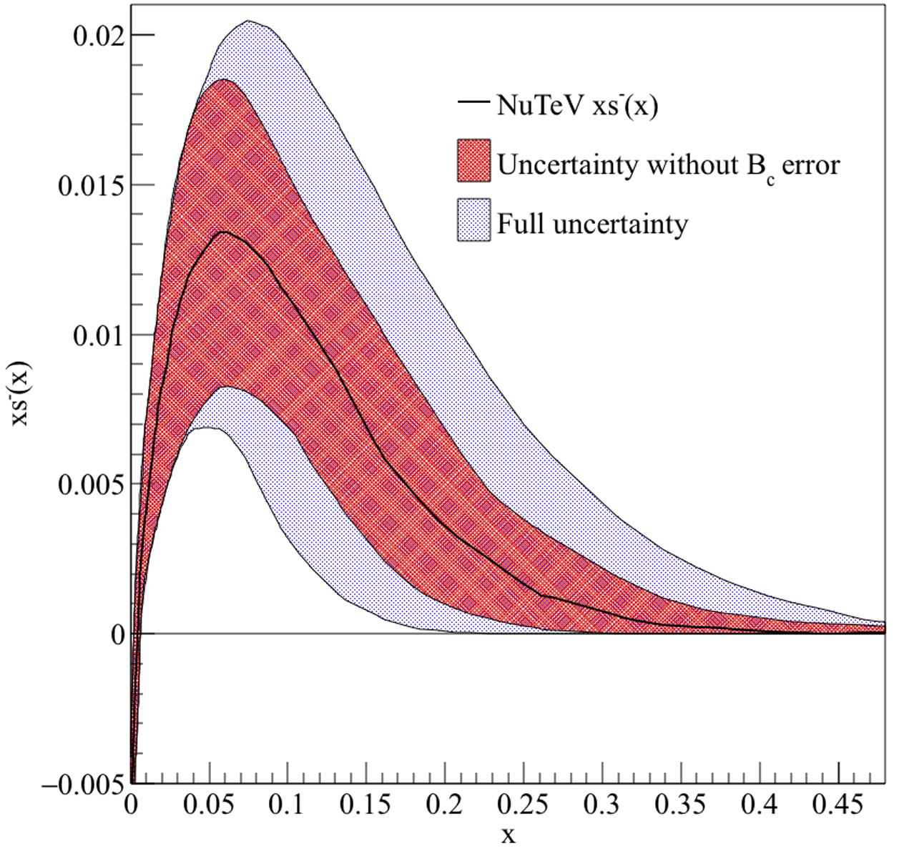
Physics of the proton structure
Main questions of proton structure:
Flavor asymmetry of $\overline{d}/\overline{u}$?
$s$ quark behavior and $s−\overline{s}$ asymmetry?
Intrinsic $c$ quark?
$\sim$[0.33, 0.59]
NNLO
QCD calculation
NuTeV

Slide 19
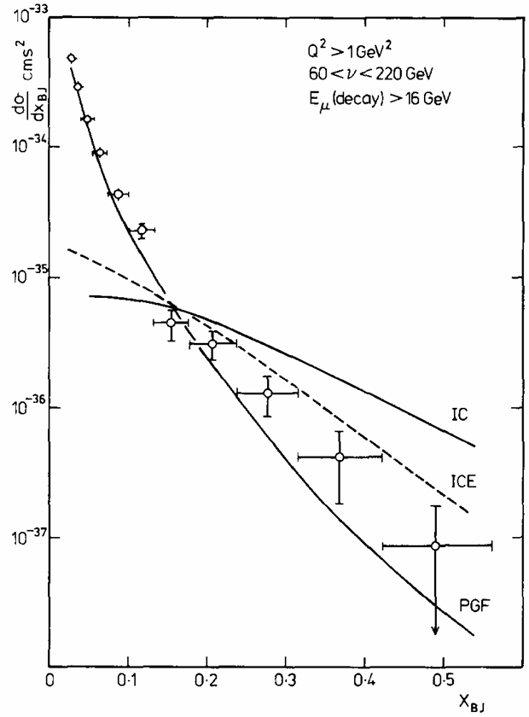
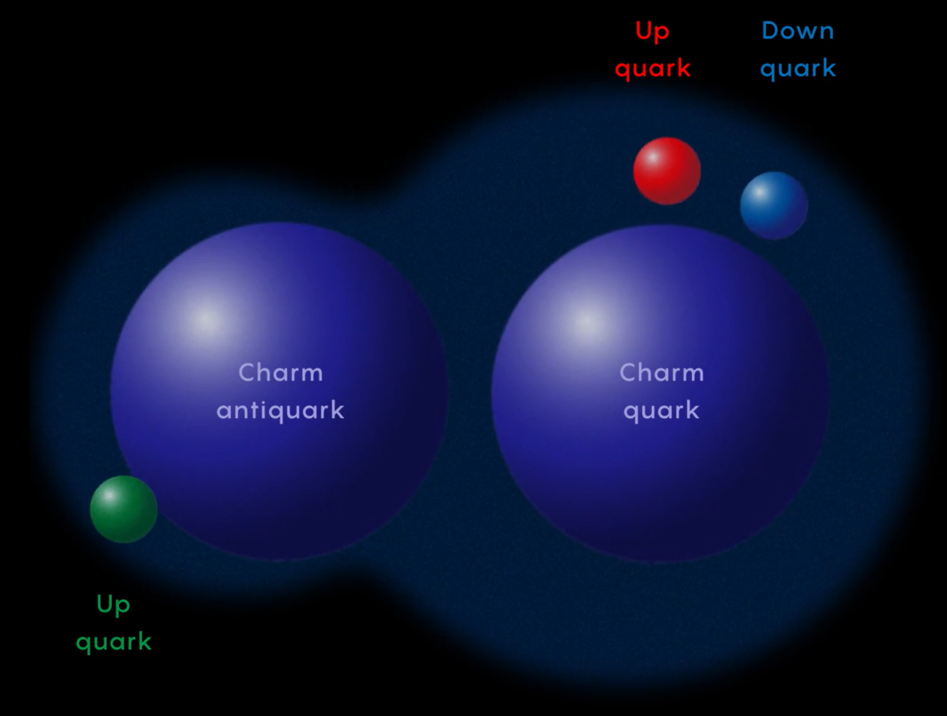
Physics of the proton structure
Main questions of proton structure:
Flavor asymmetry of $\overline{d}/\overline{u}$?
$s$ quark behavior and $s−\overline{s}$ asymmetry?
Intrinsic $c$ quark?
Intrinsic charm model
Intrinsic charm model with maximum $Q^{2}$ evolution
Photon-gluon fusion model

Slide 20
Proton structure study at hadron collider
Advantages of the hadron collider data:
large data sample size
covering a wide $x$ region
limited detector coverage: $𝒪({10}^{−5})\sim 𝒪({10}^{−1})$
sensitive to all kinds of quarks
$q\overline{q}$ initial state ($\overline{q}$ must be a sea quark in LHC)
a large contribution from sea quarks ($s\overline{s}, c\overline{c}$ > 20% in the Drell-Yan process at LHC)
$$x= \frac{\sqrt{Q_{T}^{2}+M^{2}}}{\sqrt{s}}∙e^{±Y}$$
proton
proton

Slide 21
Proton structure study at hadron collider
Advantages of the hadron collider data:
Large data sample size
covering a wide $x$ region
limited detector coverage: $𝒪({10}^{−5})\sim 𝒪({10}^{−1})$
sensitive to all kinds of quarks
$q\overline{q}$ initial state
a large contribution from sea quarks
A mix of large and small $x$ region quark information
$$x_{Large} \sim 𝓞\left({10}^{−2}\right) to 𝓞\left({10}^{−1}\right)$$
$$x_{Small} \sim 𝓞\left({10}^{−4}\right) to 𝓞\left({10}^{−3}\right)$$
A mix of all kinds of quark information: $u, d, \overline{u}, \overline{d}, s, c ⋯$
Few measurements are provided, which is far from enough to give conclusions on proton structure.
$$σ\left(Z\right), σ\left(W^{+}\right), σ(W^{−})$$
${10}^{−5} {10}^{−4} {10}^{−3} {10}^{−2} {10}^{−1}$
$$x$$

Slide 22
Proton structure study at hadron collider
Few measurements are provided, which is far from enough to give conclusions on proton structure.
What’s next?
Find new experimental observables to constrain proton structure information.
$$σ\left(Z\right), σ\left(W^{+}\right), σ(W^{−})$$
${10}^{−5} {10}^{−4} {10}^{−3} {10}^{−2} {10}^{−1}$
$$x$$

Slide 23
A new measurement of up and down quark structure of proton
Phys. Rev. D 106, 033001 (2022)
Average on M dependence

