Slide 1
Search for $B_{s}^{0}→μ^{+}μ^{−}γ$
Decay at LHCb
CLHCP2024
Xiangyu Wu ,Jike Wang
Wuhan University, Wuhan, China
2024/11/15
Notes:
Good afternoon, everyone. It's my pleasure to report the result of our analysis: Search for 𝐵_𝑠^0→𝜇^+ 𝜇^− 𝛾 Decay at LHCb

Slide 2
Motivation
PRD 97, 053007 (2018) PLB 521 (2001)
JHEP 11(2017) 184 JHEP 12(2021) 008
The target
The $B_{s}^{0}→μ^{+}μ^{−}γ$process is a powerful probe of SM, being sensitive to C7 , C9 and C10, While $B_{s}^{0}→μ^{+}μ^{−}$is only sensitive to C10.
The photon lifts the helicity suppression of $B_{s}^{0}→μ^{+}μ^{−}$, partially compensating for the additional QED interaction.
Notes:
For the Motivation of bs2mumugamma analysis
The $B_{s}^{0}→μ^{+}μ^{−}γ$process is a powerful probe of SM, being sensitive to C seven , C nine and C10, While $B_{s}^{0}→μ^{+}μ^{−}$is only sensitive to C10.
The photon lifts the helicity suppression of $B_{s}^{0}→μ^{+}μ^{−}$, partially compensating for the additional QED interaction.
We would like to find evidence for the existence of decay, or give upper limits for branching ratios.

Slide 3
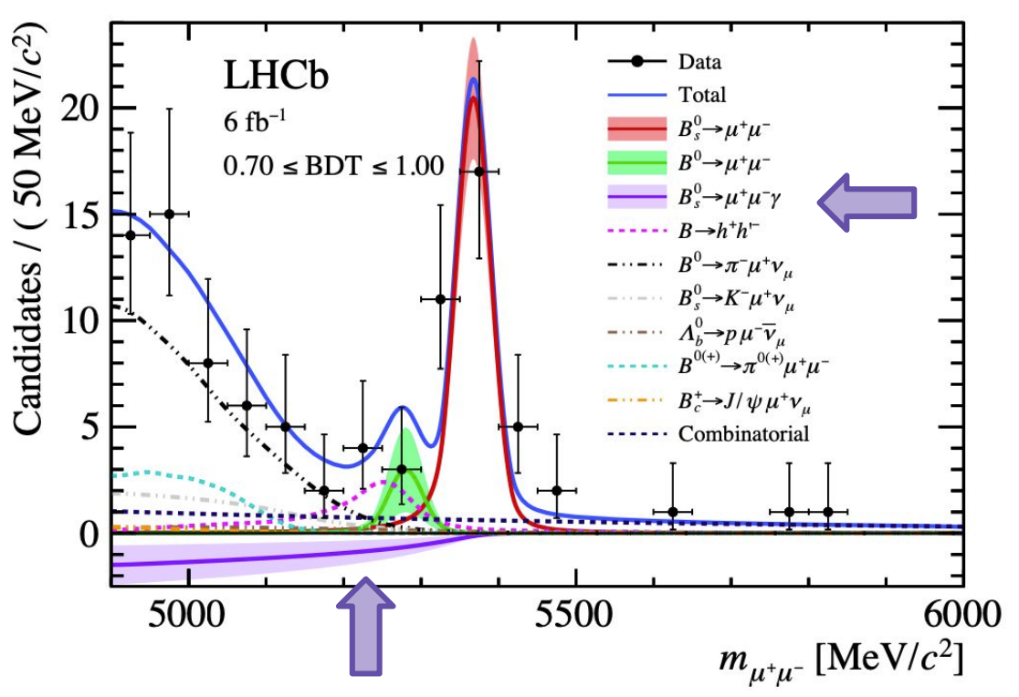
Methods
Phys. Rev. D 105 (2022) 012010
Two complementary methods:
Indirect: no 𝛾 reconstruction, $B_{s}^{0}→μ^{+}μ^{−}γ$is measured as a partially reconstructed background of $B_{s}^{0}→μ^{+}μ^{−}$. Limit CL from 2022:
BR($B_{s}^{0}→μ^{+}μ^{−}γ$)< 1.5(2.0) 10⁻⁹ at q> 4.9 GeV/c² at 90% (95%) CL
Only probes high q² region, missing possible new physics contributions
Direct: reconstruction of 𝛾, what we are presenting today
Blinded search: mass range: [3867 MeV/c² , 6867 MeV/c² ] , blind range: [5167 MeV/c2 , 5567 MeV/c2 ]
Full final state reconstruction, photon reconstruction worsen the resolution
Sensitive to low-q² region, therefore, to larger set of Wilson coefficients (C7, C9, C10)
Data: 6 fb⁻¹ of $\sqrt{s}=$13 TeV pp collected by LHCb during Run 2.
First direct search
First low-q² region search
Notes:
There are Two complementary methods :
First is indirect ,no gamma reconstruction .bs2mumugamma is measured as a partially reconstructed background of $B_{s}^{0}→μ^{+}μ^{−}$. The result is shown in the slide. This methods Only probes high q squared region.
Another is direct, reconstruction of 𝛾, what we are presenting today. We use blinded search and full final state reconstruction. there is the mass range and blind range. .It’s Sensitive to low-q² region, we ues all Run 2 data.

Slide 4
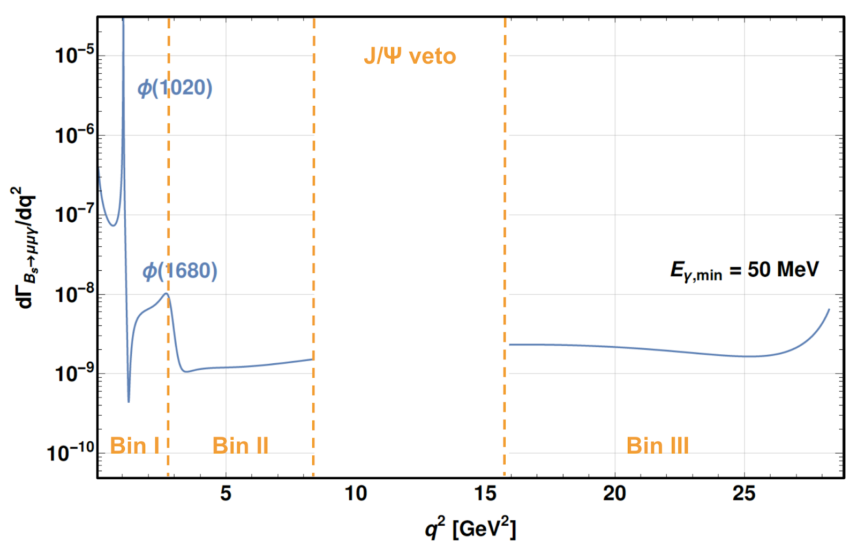
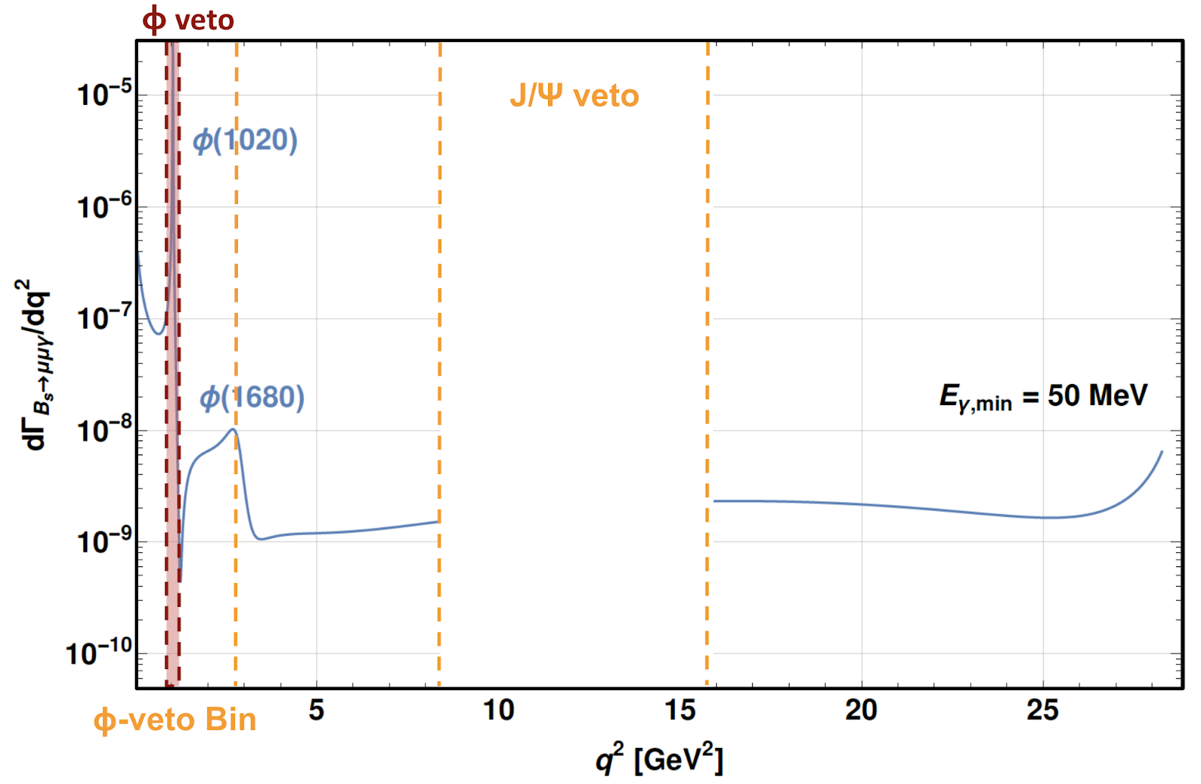
Strategy
q² bins: the analysis is performed in three regions of the dimuons invariant mass
JHEP 11 (2017) 184
CERN-THESIS-2020-303
Every study (fits, efficiencies, systematics, etc.) is done separately per data-taking year and merged at the end。
As result of discussion during the implication workshop (2022), Bin I is also studied with a veto on the ɸ resonance.
Bin ɸ-veto: 0.9896 < m(μμ)(GeV/c² ) < 1.0734 ; low-q² without ɸ
It has theoretical interest but less statistics (veto only)
Notes:
the analysis is performed in three regions of the dimuons invariant mass
Every study (fits, efficiencies, systematics, etc.) is done separately per data-taking year and merged at the end。
As result of discussion during the implication workshop, Bin I is also studied with a veto on the ɸ resonance.

Slide 5
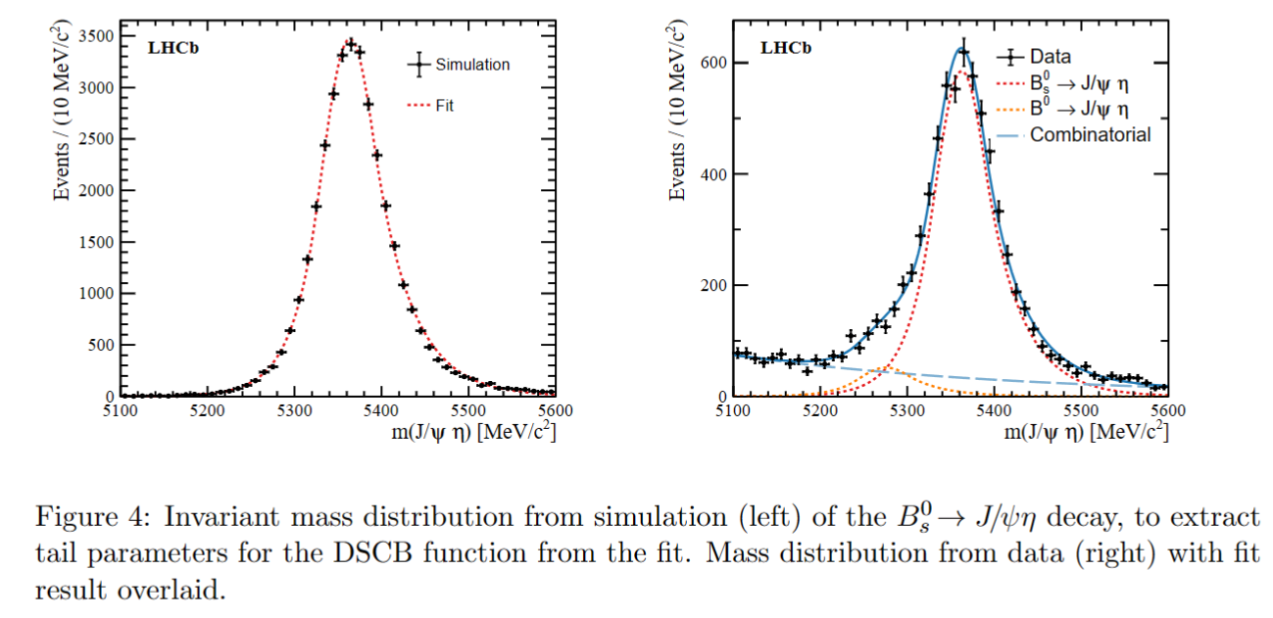
Strategy: Normalization channel
BsToMuMuGamma_paper
Normalization channel: B_{s}⁰ → J/ψ(→μμ) η(→𝛾𝛾)
Particle Data Group (lbl.gov)
High statistics.
A good selection efficiency.
Similar final state to the signal: allows uncertainties cancelations
The branching ratio of the normalization channel reads $ℬ$_{norm} = (9.3 ± 1.6) × 10⁻⁶
The fitted number of B_{s}⁰ → J/ψη events is N_{norm} = 5675 ± 113, where the uncertainty corresponds to the fit error:
Notes:
We use bs2J/psi eta as Normalization channel because it has High statistics ,a good selection efficiency and Similar final state to the signal ,which allows uncertainties cancelations.
The branching ratio of the normalization channel were obtained from references

Slide 6
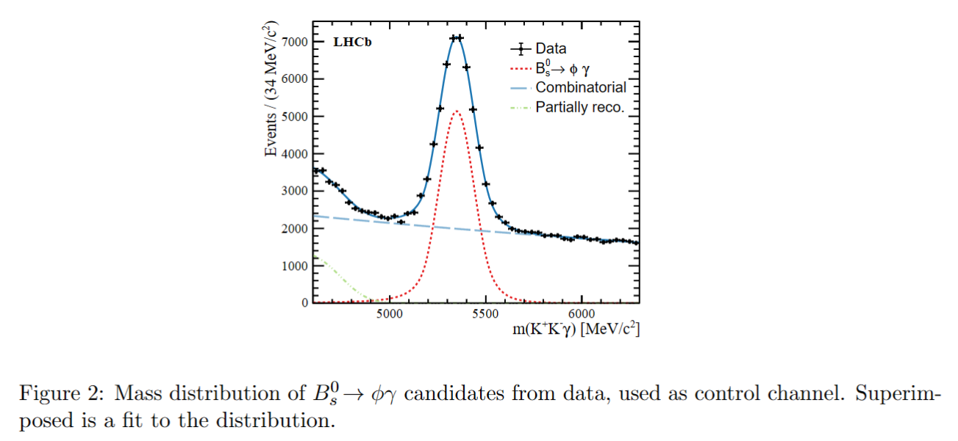
Strategy: Control channel
Control channel: B_{s}⁰ → Φ(→KK)𝛾
BsToMuMuGamma_paper_Figure 2
A three body decay and low-p_{T} photons.
To check the agreement between data and simulation.
Notes:
We use bs2 phi gamma as control channel . It’s a three body decay and low-pT photons. To check the agreement between data and simulation.

Slide 7
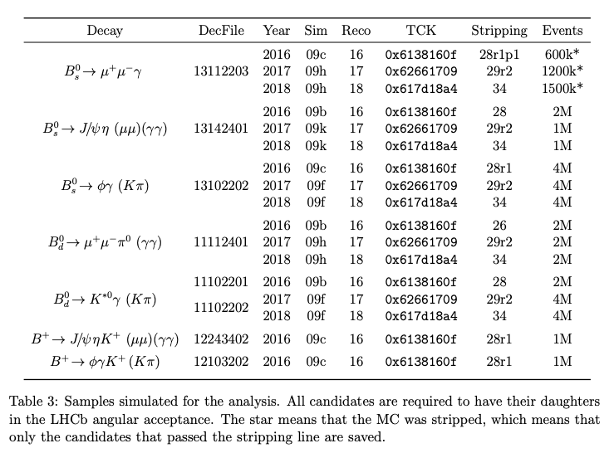
Data used in Ana。
Bs2mumugamma_NOTE Table 3
Notes:
Here list all the samples simulated for the ana.

Slide 8
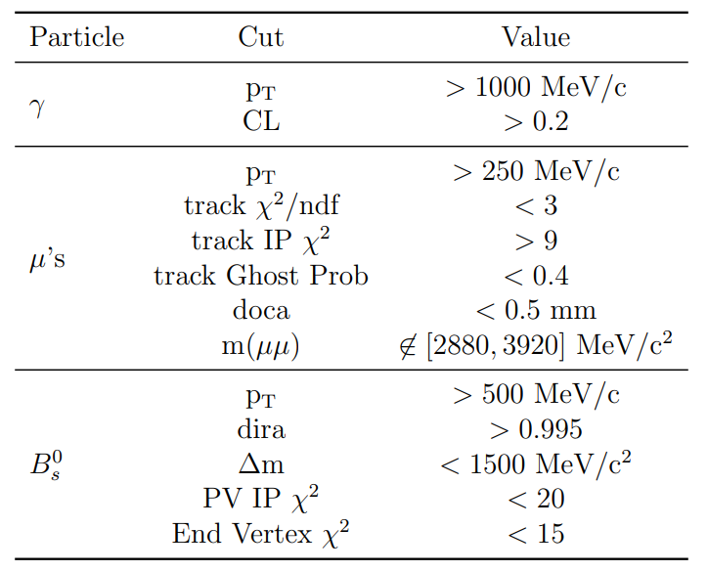
Stripping Line & Trigger
Bs2MuMuGammaLine
Bs2mumugamma_NOTE
Not available in Run 1
Trigger
Notes:
Some details about Bs2MuMuGammaLine and Trigger. These are not available in run1.

Slide 9
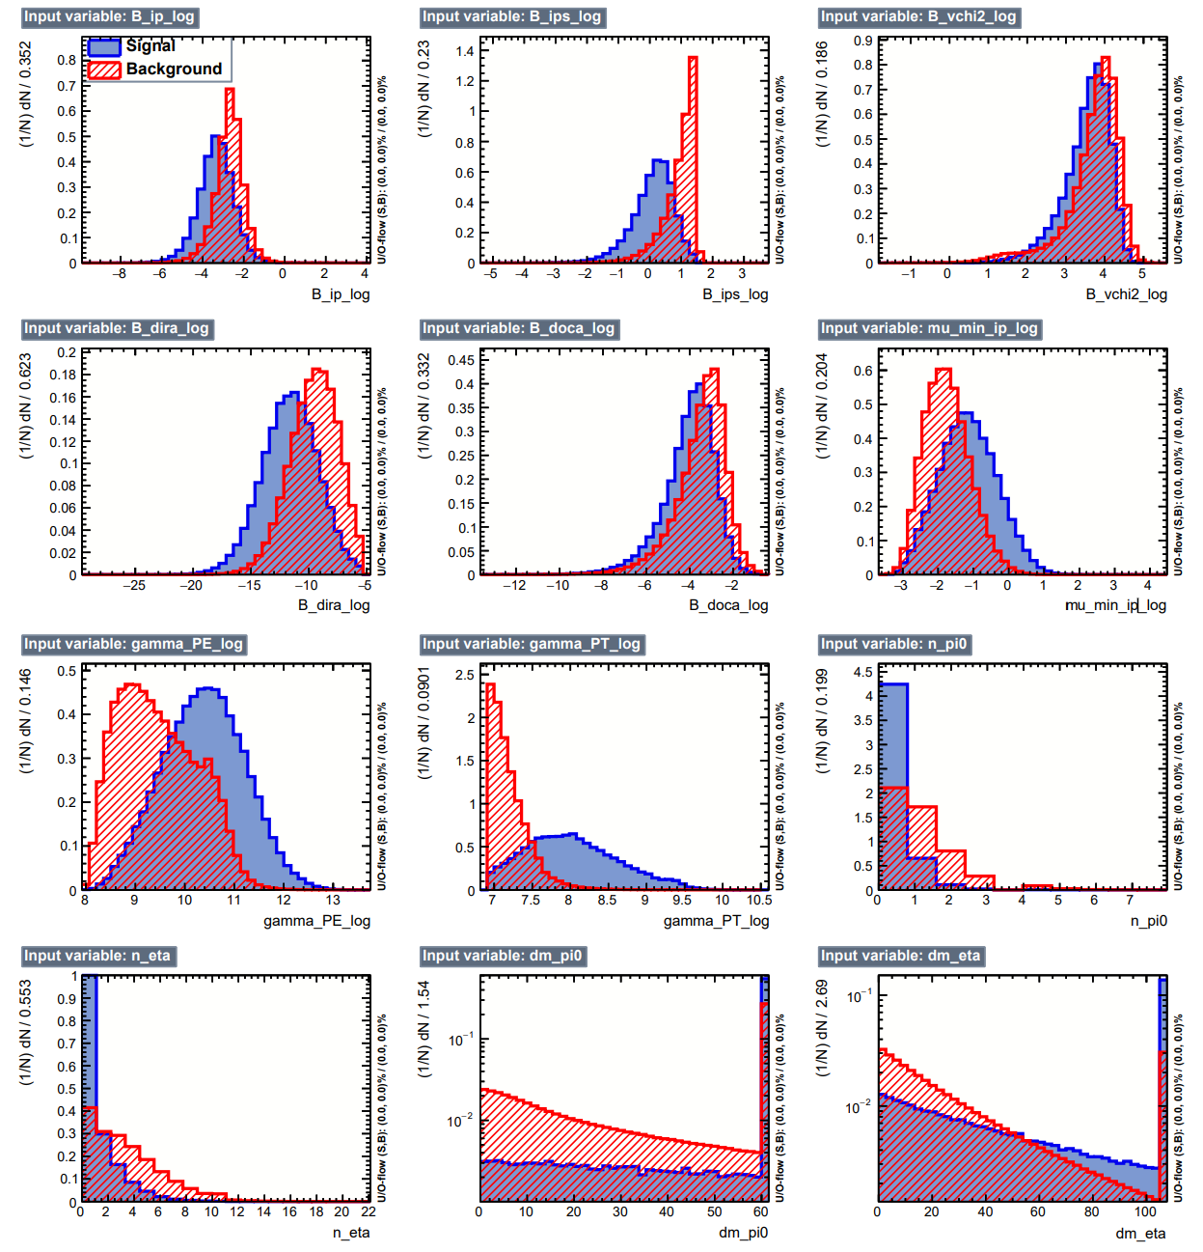
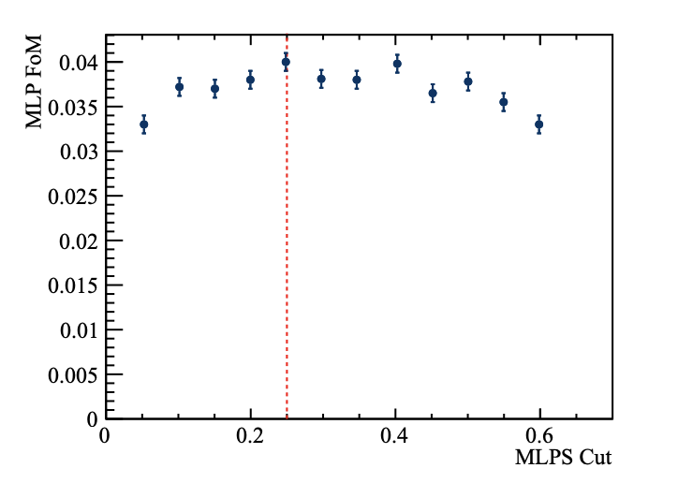
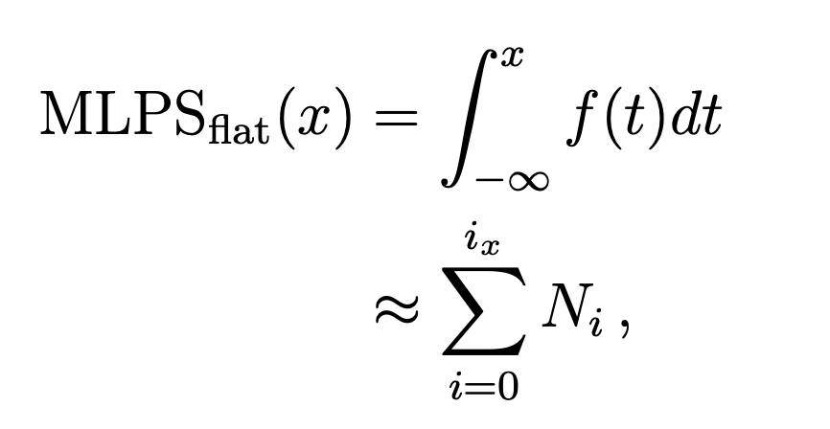
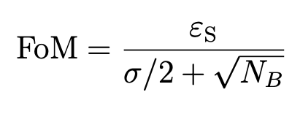
First MVA (MLP)
Signal simulation data side-bands
Aim: reduce the combinatorial background using geometrical variables.
Trained in data side-bands, below and above the 𝐵_{𝑠}⁰ mass:
[3867-5167] & [5567-6867] MeV/c2
MLP > 0.25
Signal eff at 75%
Notes:
The first MVA is to reduce the combinatorial background using geometrical variables
the first MVA analysis, resulted in the selection of a MLP greater than zero point two five cut

Slide 10
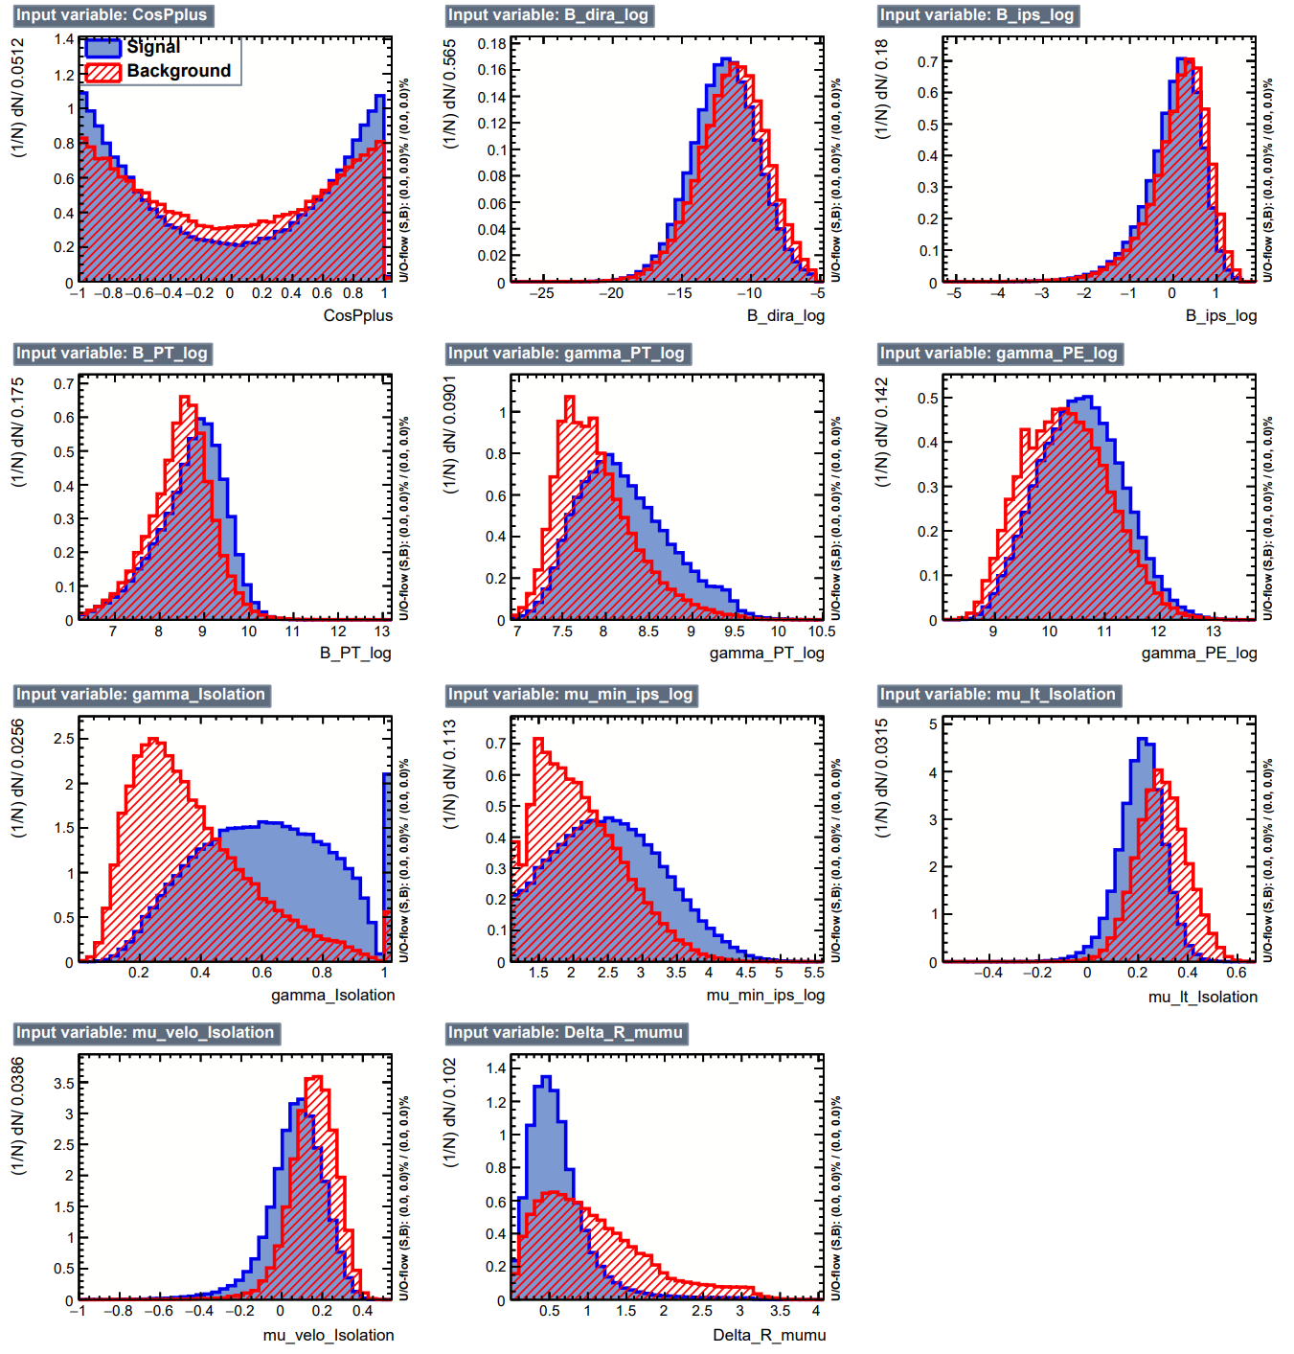
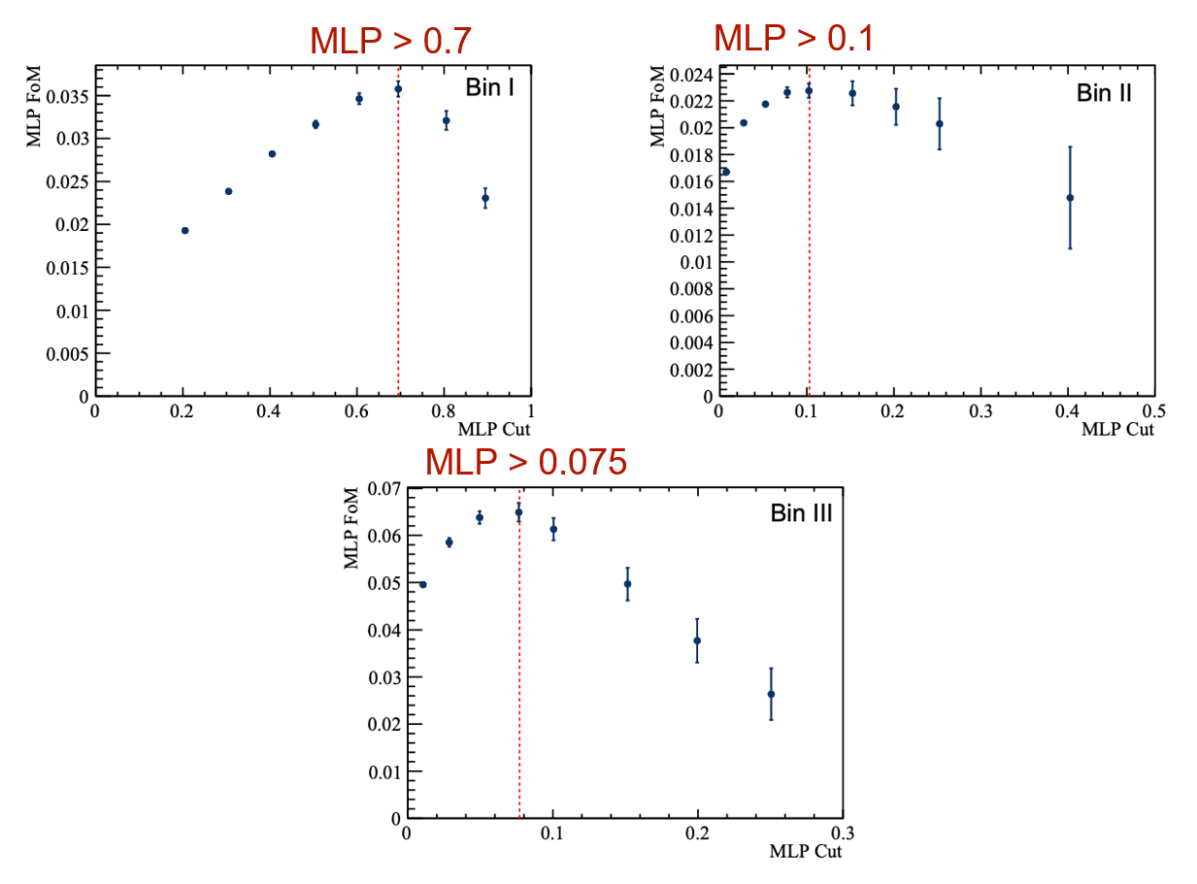
Second MVA (MLP)
Signal simulation data side-bands
Aim: reduce other backgrounds, exploiting the fact that the 3 objects of the signal are isolated.
Notes:
The second MVA reduce other backgrounds, ////exploiting the fact that the 3 objects of the signal are isolated. ˈaɪsəleɪtɪd
Finally, different cuts were used for the three bins, see the picture

Slide 11
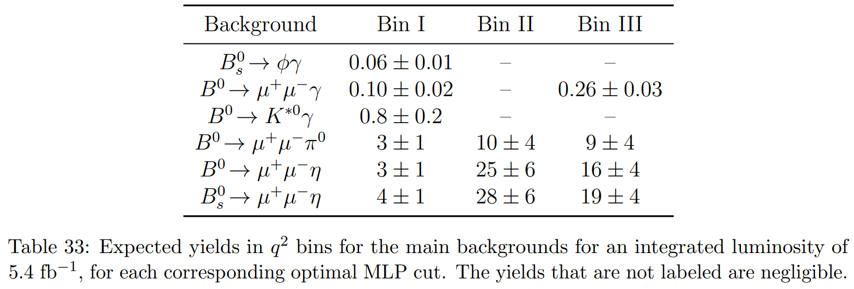
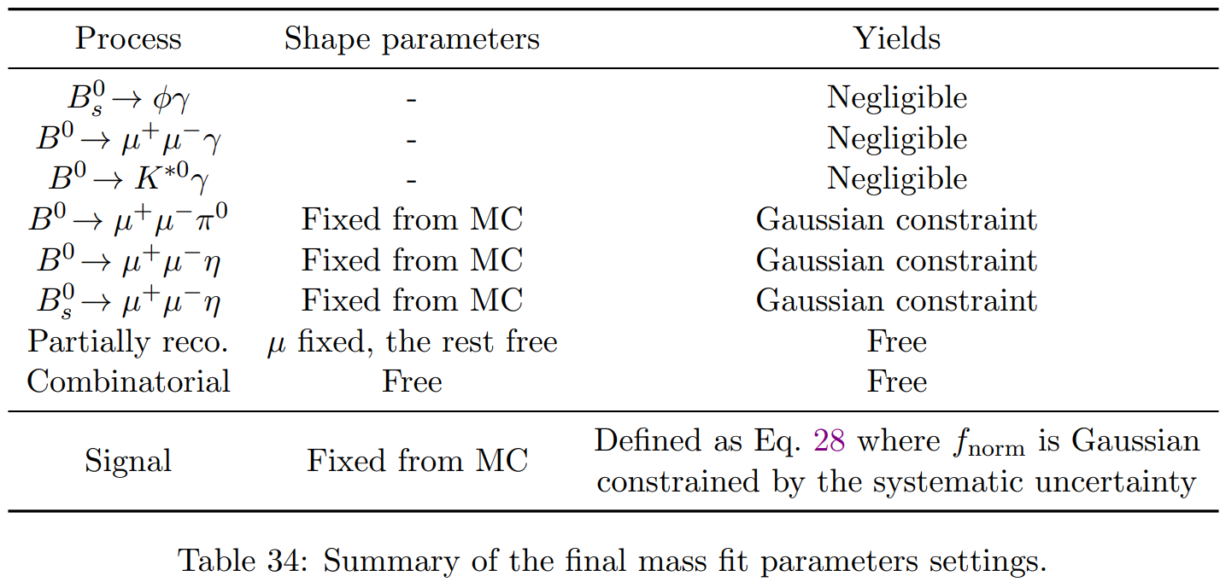
Total fit
Bs2mumugamma_NOTE
Notes:
Sum up our background yields and their shapes here.

Slide 12
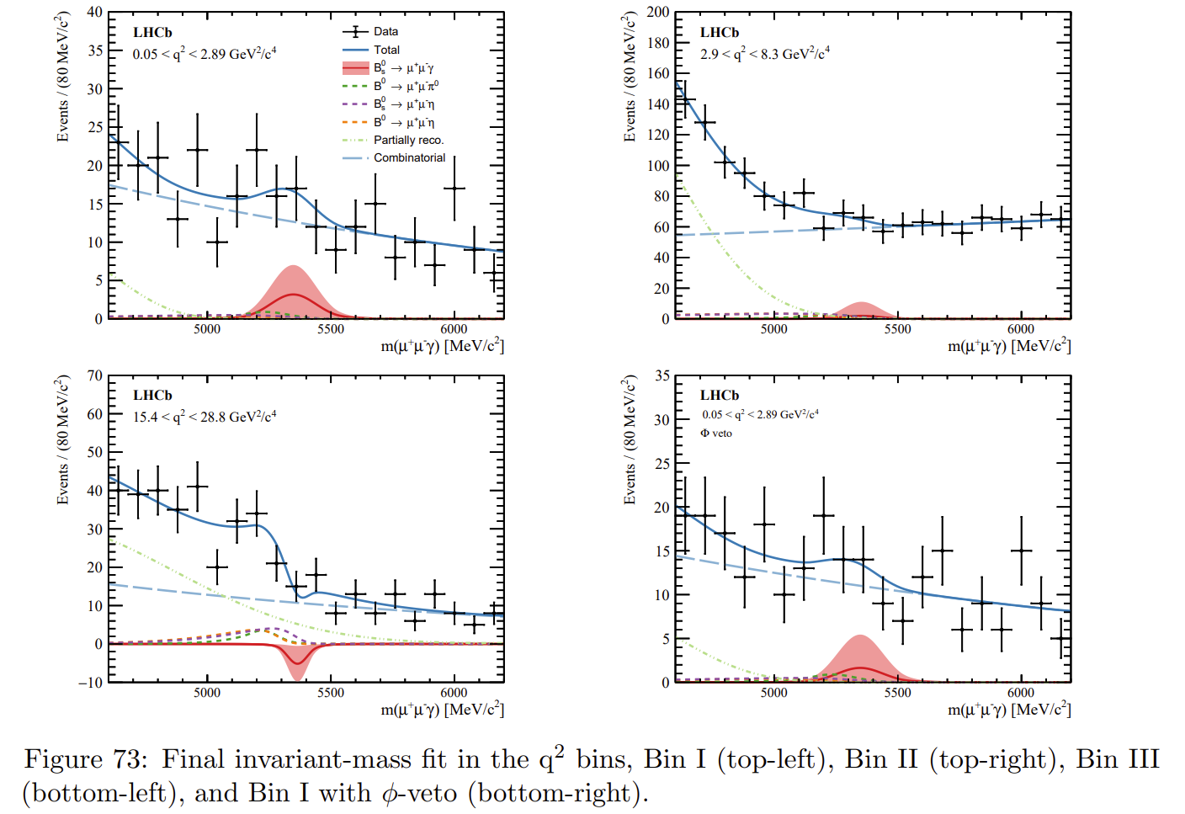
Total fit
Published on JHEP07(2024)101
No signal is found, will give an upper limit to the branching ratio
Notes:
The Run1 dataset is not used due to different trigger conditions

Slide 13
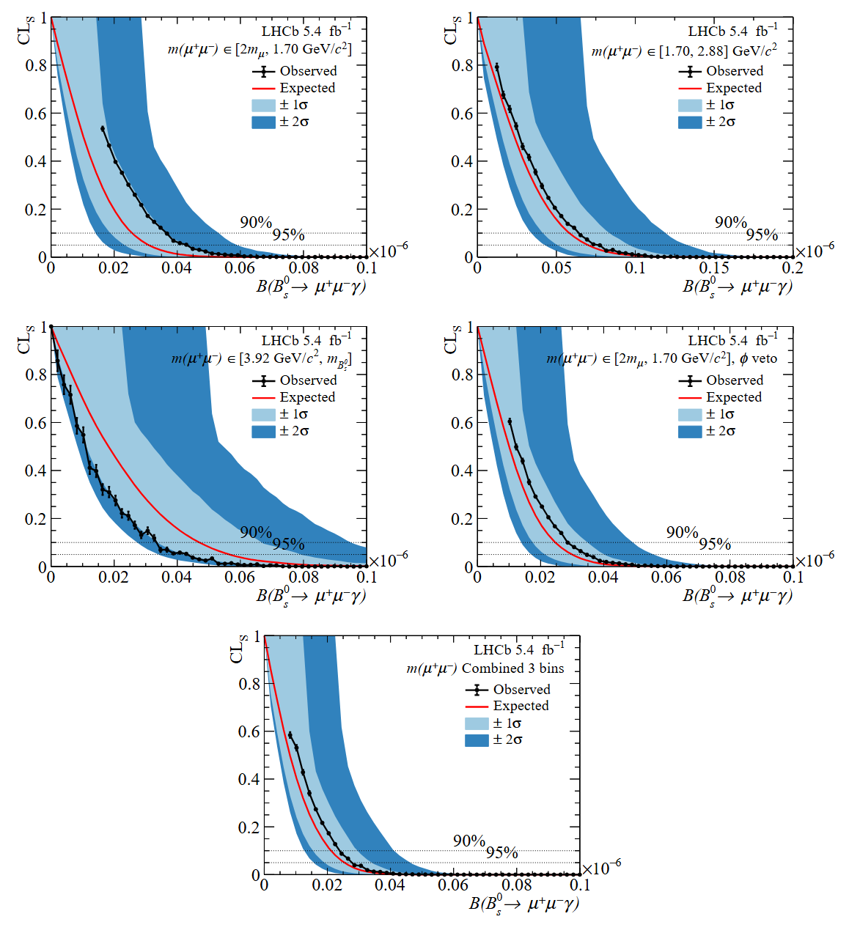
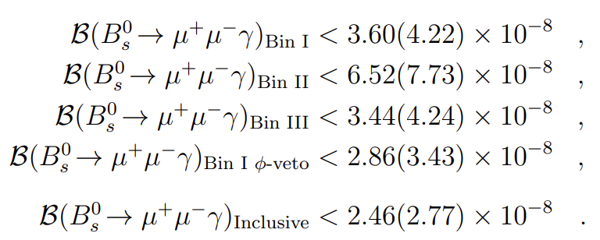
Results
Published on JHEP07(2024)101
limits on the branching fractions are found to be：
Indirect result :
BR($B_{s}^{0}→μ^{+}μ^{−}γ$)< 1.5(2.0) 10⁻⁹
at q> 4.9 GeV/c² at 90% (95%) CL
Phys. Rev. D 105 (2022) 012010
The statistical uncertainties are evaluated by repeating the fits with all nuisance parameters fixed to the values obtained in the standard fit, where all nuisance parameters are free to float within their constraints.
The systematic uncertainties are then computed by subtracting in quadrature the statistical uncertainties from the total ones.
Notes:
The Run1 dataset is not used due to different trigger conditions
Compare to Indirect

Slide 14
Thanks for listening
Notes:
The analytical work we carried out this time。。。。
Square of q
/ˈθiːəri/

Slide 15
The photon
CERN-LHCb-PUB-2015-016 $B_{S}^{0}→φγ$: LHCb-ANA-2014-102
Calorimeter photon: measures an energy deposit, the photon direction is only known approximatively.
Photon variables
gamma_CL: confident level, to separate from charged tracks, gamma_CL > 0.2
IsPhoton: to separate from $π^{0}$, IsPhoton > 0.6 || gamma_PT < 2000 MeV/c
Isolation: with respect to the other tracks in the $η−φ$ cone around the photon of 1 rad.
StdLoosePi02gg: container of $π^{0}$ candidates.
gamma_npi0: number of $π^{0}$ in StdLoosePi02gg sharing a photon with the candidate.
gamma_dmpi0: the smallest mass difference between the $π^{0}$ candidates and the $π^{0}$ PDG mass. If no $π^{0}$ can be reconstructed, gamma_npi0 = 0, gamma_dmpi0 is set to 60 MeV/c² (the size of the mass window in the StdLoosePi02gg container).
Same for $η$ gamma_neta0 and gamma_dmeta0, with StdLooseEta02gg.
Developed for
this analysis

Slide 16
The photon
CERN-LHCb-PUB-2015-016 $B_{S}^{0}→φγ$: LHCb-ANA-2014-102
Calorimeter photon: measures an energy deposit, the photon direction is only known approximatively.
Photon variables
gamma_CL: confident level, to separate from charged tracks, gamma_CL > 0.2
IsPhoton: to separate from $π^{0}$, IsPhoton > 0.6 || gamma_PT < 2000 MeV/c
Isolation: with respect to the other tracks in the $η−φ$ cone around the photon of 1 rad.
StdLoosePi02gg: container of $π^{0}$ candidates.
gamma_npi0: number of $π^{0}$ in StdLoosePi02gg sharing a photon with the candidate.
gamma_dmpi0: the smallest mass difference between the $π^{0}$ candidates and the $π^{0}$ PDG mass. If no $π^{0}$ can be reconstructed, gamma_npi0 = 0, gamma_dmpi0 is set to 60 MeV/c² (the size of the mass window in the StdLoosePi02gg container).
Same for $η$ gamma_neta0 and gamma_dmeta0, with StdLooseEta02gg.
Developed for
this analysis

Slide 17
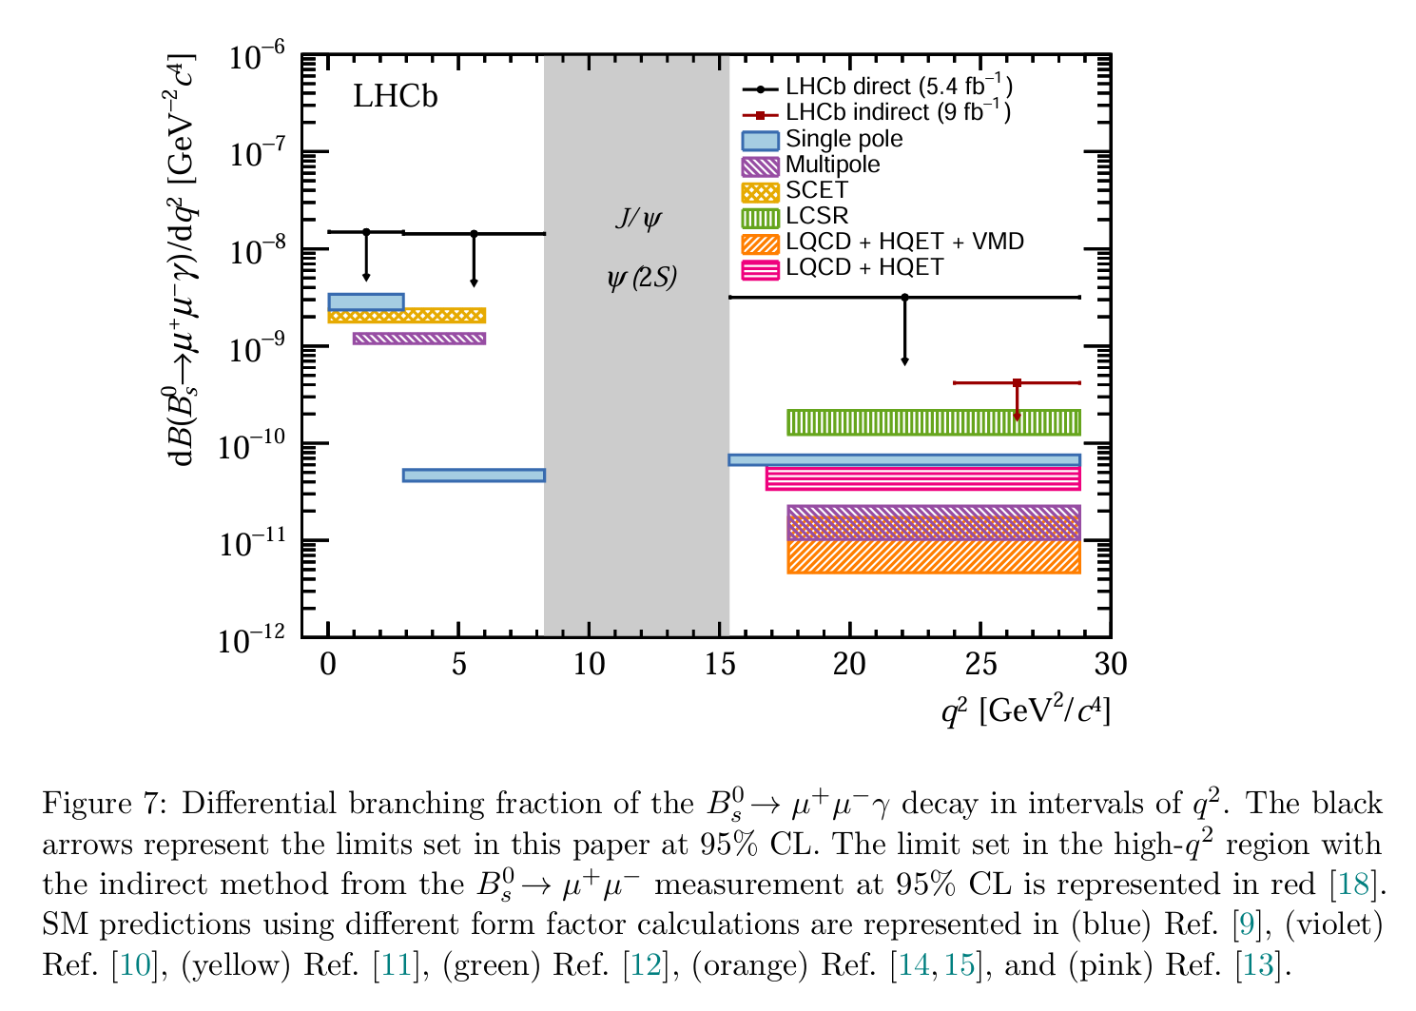
Conclusions

