Slide 1
Investigation of charm-quark hadronization into baryons
and its collision-system dependence with ALICE
$$\text{Fang} \text{Tao}$$ Central China Normal University, China
CLHCP 2024
Qingdao, Shandong

Slide 2
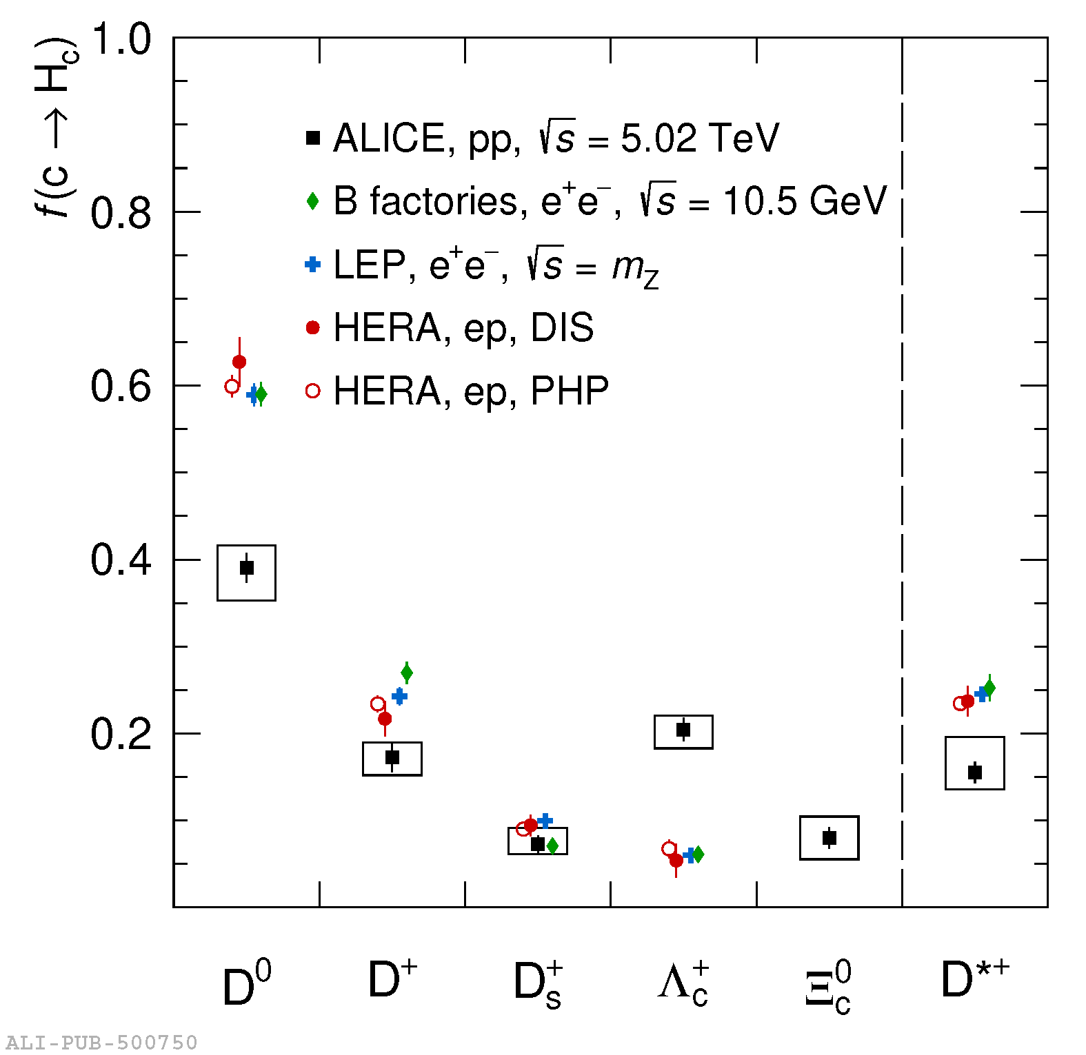
Probing charm hadronization
The production cross section of heavy-flavor hadrons is calculated through a convolution of three components within the pQCD framework.
$$σ_{AB→H }=PDF\left(x_{a},Q^{2} \right)PDF\left(x_{b},Q^{2} \right)⊗σ_{ab→q\overline{q}}\left(x_{a},x_{b},Q^{2}\right)⊗D_{q→H }(z=p_{H}/p_{q} ,Q^{2})$$
Parton distribution functions
Hard scattering
cross section
Fragmentation function
(hadronization)
Assumptions of Fragmentation Functions
It is generally assumed that the hadronization process is universal across different collision systems and energy levels.
Fragmentation functions are usually derived from electron-positron($e^{+}e^{−}$) or electron-proton($ep$) collisions.
Findings from the ALICE Experiment
While ALICE experiment found that a significantly larger fraction of charm quarks hadronized into baryons compared to what is observed in leptonic collisions.
This finding suggests that the hadronization process may depend on the collision system, challenging the assumption of universality.
Charm-quark fragmentation fractions into charm hadrons measured in pp collisions comparison with experimental measurements performed in leptonic collisions
tao.fang@cern.ch

Slide 3
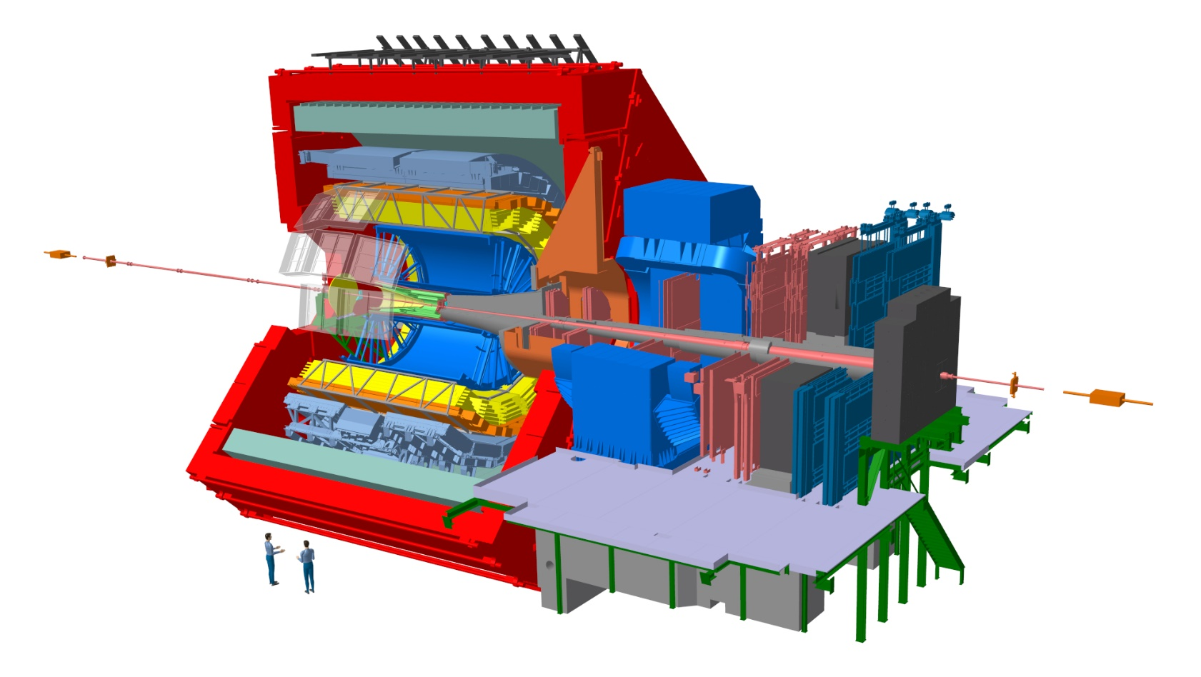
ALICE experiment in Run 2
Time Of Flight(TOF):
tracking, (particle Identification) PID via time-of-flight measurement
$\left|η\right|<\text{0.9}$
Time Projection Chamber(TPC):
tracking, PID via dE/dx
$\left|η\right|<\text{0.9}$
Inner Tracking System(ITS):
tracking, trigger, vertexing
$\left|η\right|<\text{0.9}$
V0:
trigger, multiplicity estimator
$2.8< \left|η\right|<\text{5.1 (}\text{V}\text{0}\text{A}\text{)}$
$−3.7< \left|η\right|<\text{−1.7 (}\text{V}\text{0}\text{C}\text{)}$
tao.fang@cern.ch

Slide 4
ALICE experiment in Run 3
The major upgrades for ALICE during Run 3
ITS: Using new ALPIDE pixel sensors, significantly enhancing resolution and track reconstruction efficiency.
TPC: Upgraded to GEM (Gas Electron Multiplier) technology, increases the TPC readout rate, allowing it to handle a Pb-Pb collision rate.
tao.fang@cern.ch

Slide 5
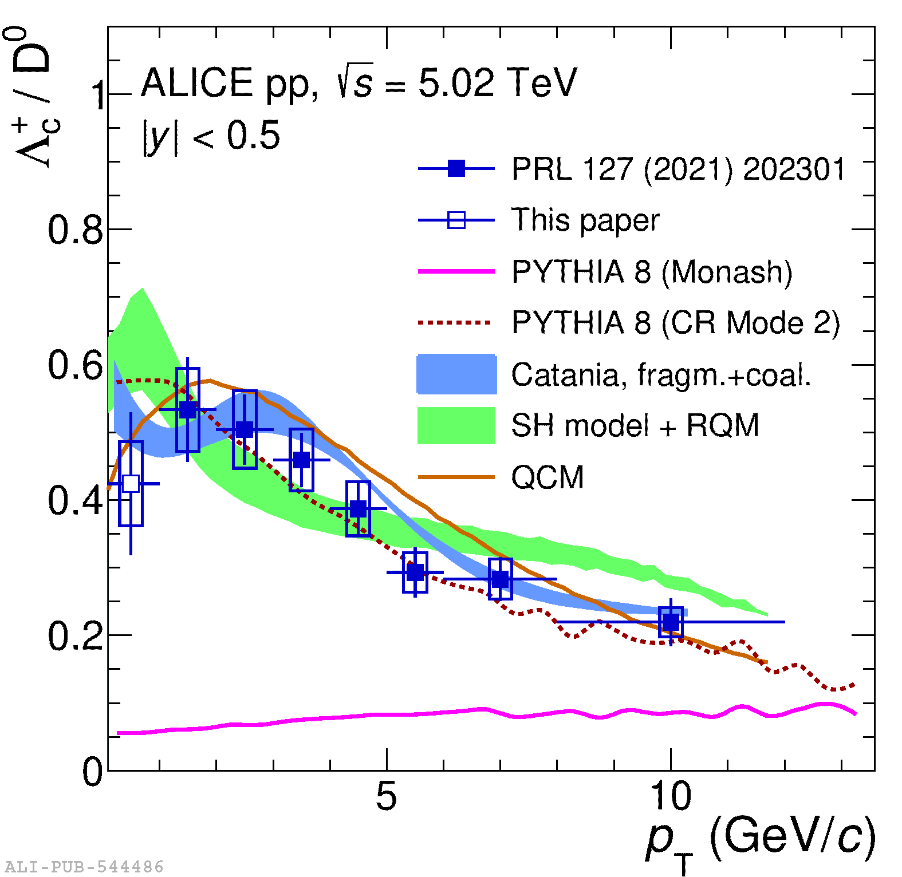
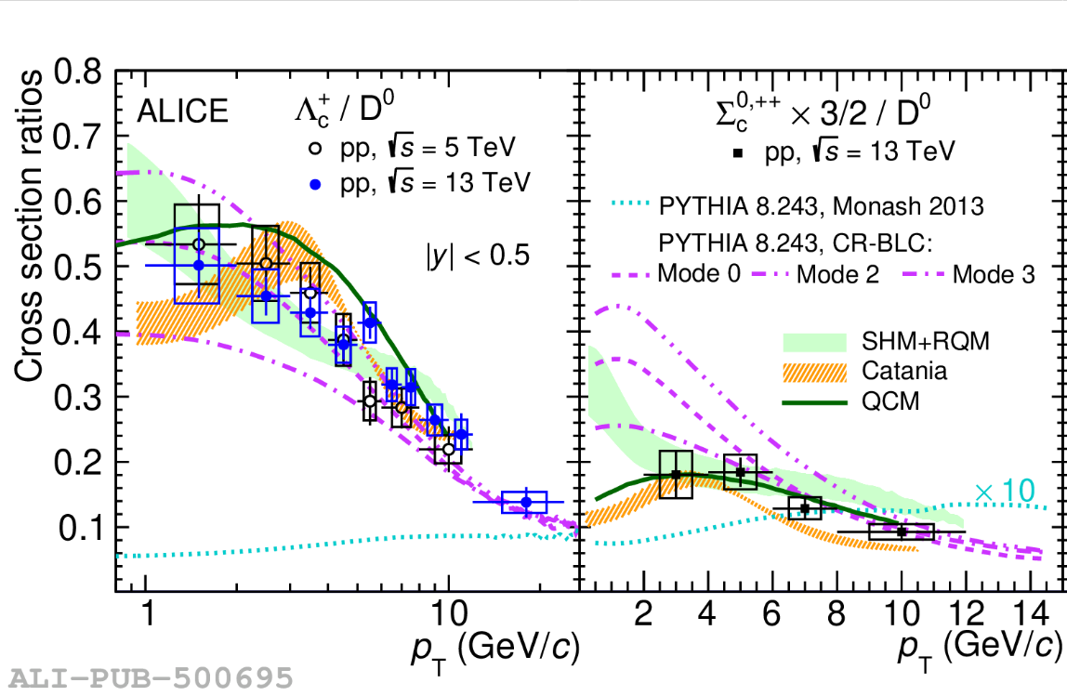
Measurements in pp collisions
PhysRevC.107.064901
u
$$Λ_{c}^{+}$$
u
$$D^{0}$$
$$∑_{c}^{0}$$
d
d
u
$$∑_{c}^{++}$$
c
c
d
u
PhysRevLett.128.012001
c
c
Baryon-to-Meson Ratio: The baryon-to-meson ratio shows a clear dependence on $p_{T}$, with enhanced at low and intermediate $p_{T}$.
Models Predictions: Models such as PYTHIA 8 Mode 2, Catania, QCM, and SHM+RQM successfully describe the observed data, providing insights into the hadronization process in these collisions
Monash Predictions: Underestimate the observed data based on charm-quark fragmentation processes measured in leptonic collisions
tao.fang@cern.ch

Slide 6
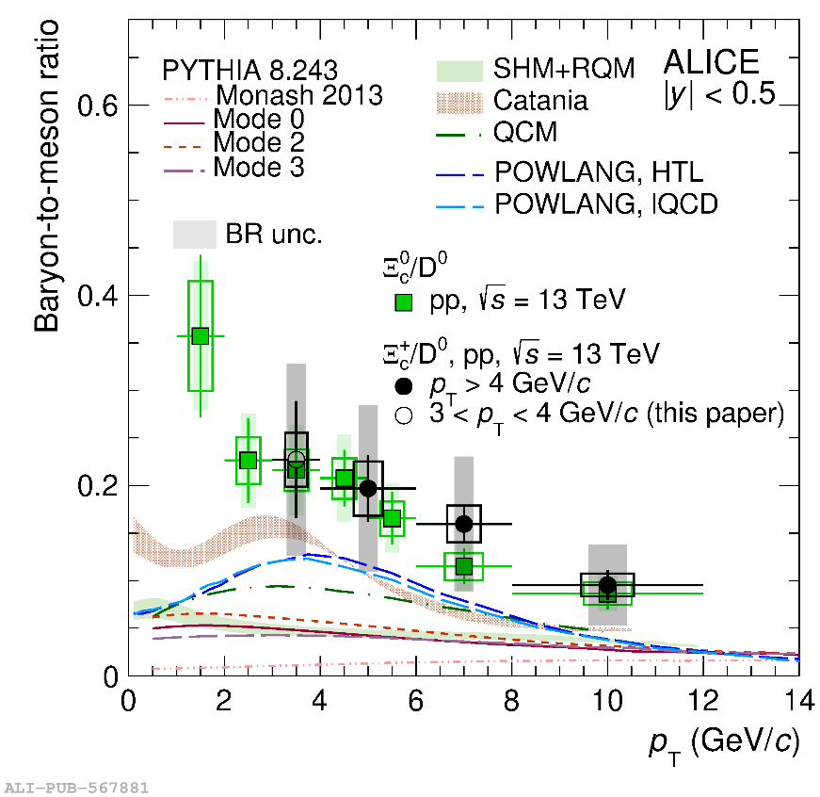
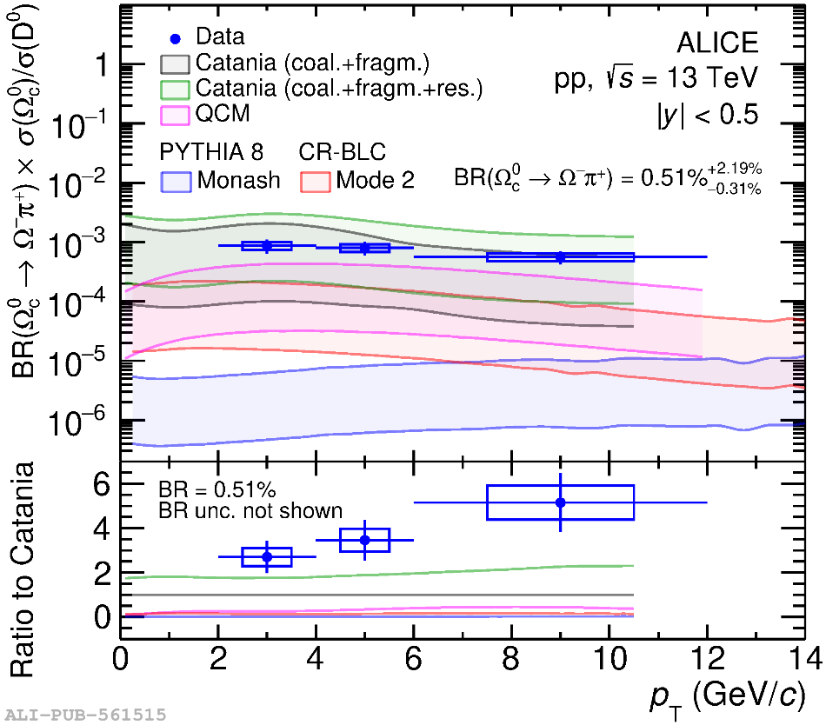
Measurements in pp collisions
s
$$Ξ_{c}^{+}$$
$$Ω_{c}^{0}$$
s
s
d
u
s
c
c
c
$$Ξ_{c}^{0}$$
JHEP12(2023)086
Phys.Lett.B 846 (2023) 137625
Strange-Charm Baryons: At low and intermediate $p_{T}$ show a clear enhancement.
Poor Model Descriptions: Most models tend to underestimate the experimental data, Catania model shows better agree with the data, whether coalescence also play a role in pp collisions?
tao.fang@cern.ch

Slide 7
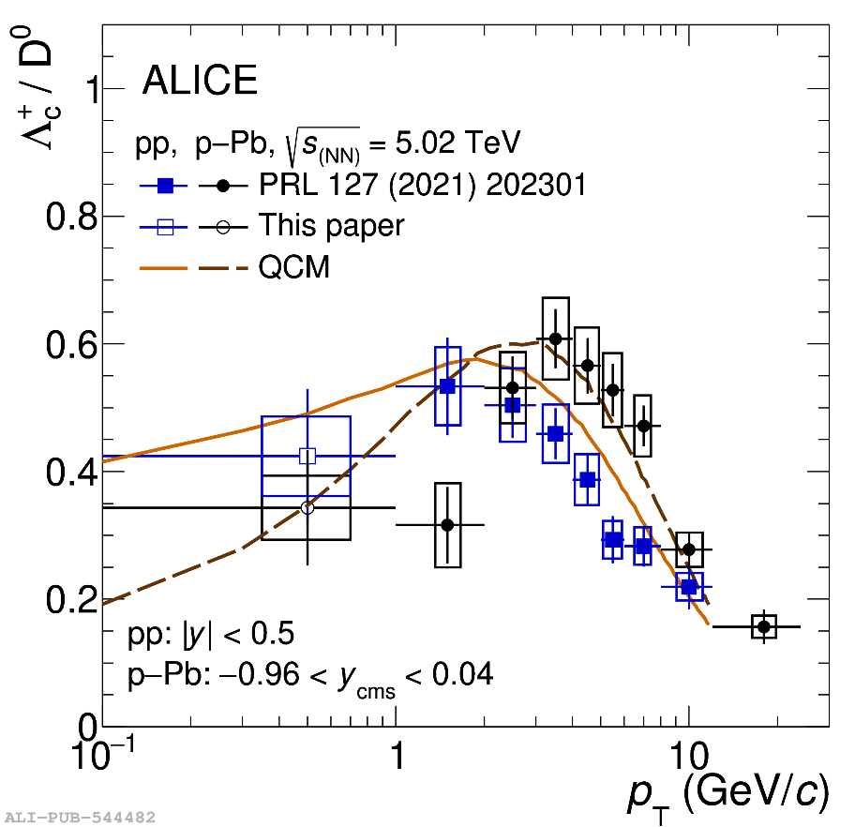
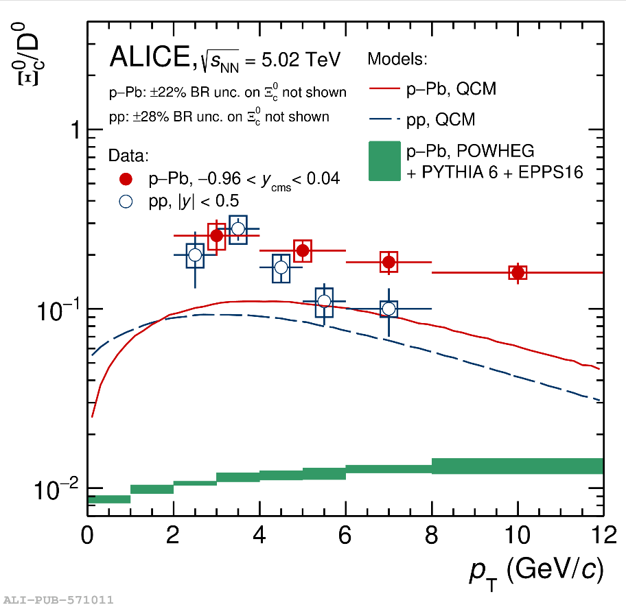
Measurements in p-Pb collisions
PhysRevC.107.064901
$$Λ_{c}^{+}$$
arxiv:2405.14538
s
u
d
d
c
$$Ξ_{c}^{0}$$
c
${Λ_{c}^{+}/D}^{0}$ ratio : similar enhancement in both pp and p-Pb collisions.
The shift of the peak distribution: peak shift toward higher values from pp to p-Pb collisions has been observed , may be due to the presence of radial flow.
The $Ξ_{c}^{0}/D^{0}$ ratio: in pp and p-Pb hints at a slightly decreasing trend with $p_{T}$, need higher precision to draw conclusions
Model Descriptions: QCM shown and they underpredict $Ξ_{c}^{0}$ cross section
tao.fang@cern.ch

Slide 8
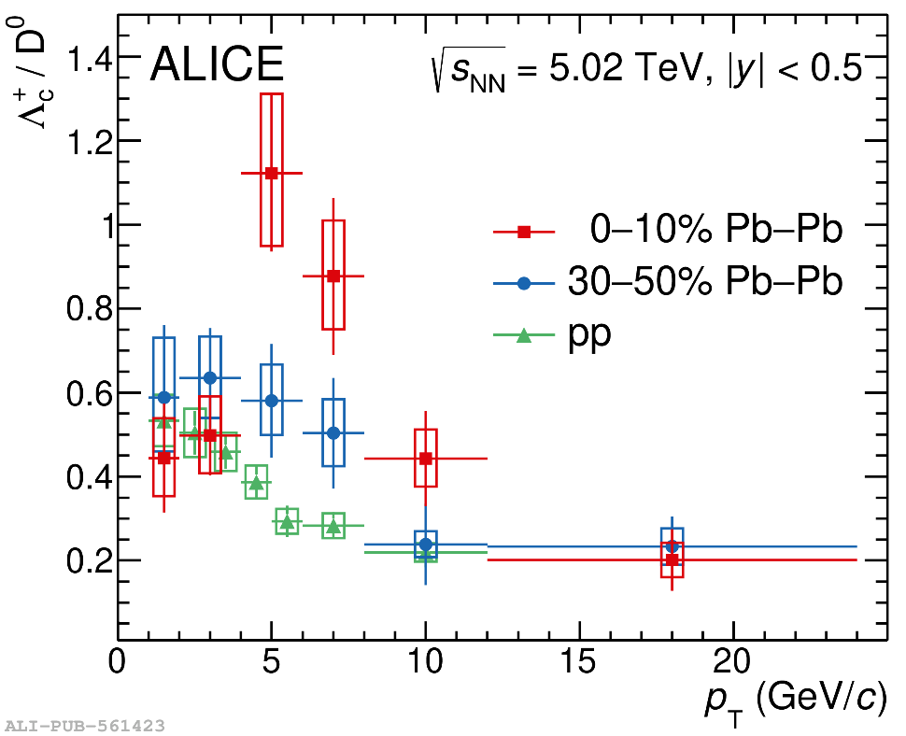
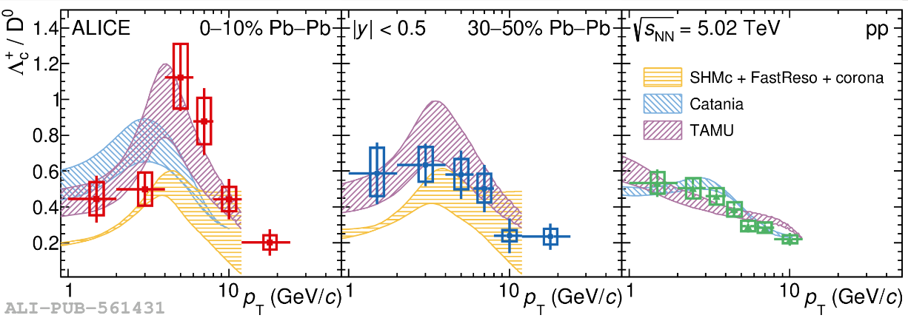
Measurements in Pb-Pb collisions
Phys.Lett.B.839 (2023) 137796
$$Λ_{c}^{+}$$
u
d
c
Phys.Lett.B.839 (2023) 137796
${Λ_{c}^{+}/D}^{0}$ Ratio from pp to Pb–Pb Collisions: The ${Λ_{c}^{+}/D}^{0}$ ratio increases when moving from pp to mid-central and central Pb–Pb collisions at intermediate $p_{T}$
Peak Magnitude and Position: The peak of the ratio increases in magnitude and shifts toward higher $p_{T}$values in Pb–Pb collisions. possibly resulting from recombination effects and/or radial flow
Theoretical Model: Theoretical calculations that incorporate both fragmentation and coalescence mechanisms are able to describe the measurements of the ${Λ_{c}^{+}/D}^{0}$ ratio
tao.fang@cern.ch

Slide 9
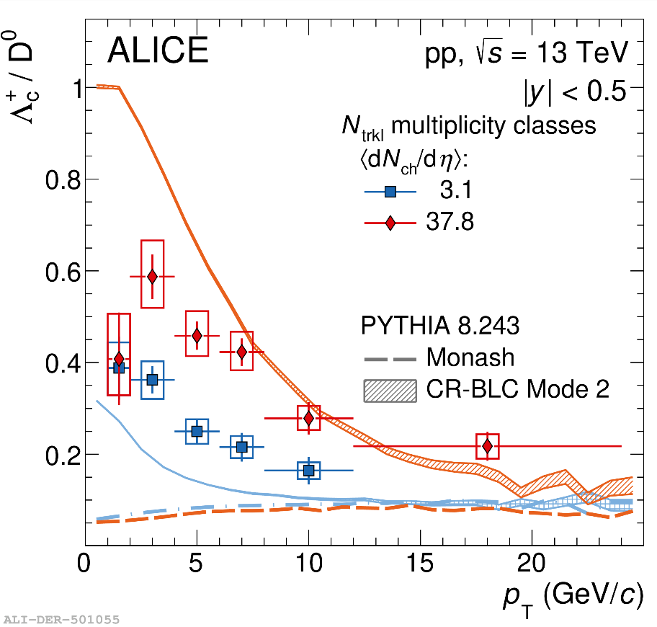
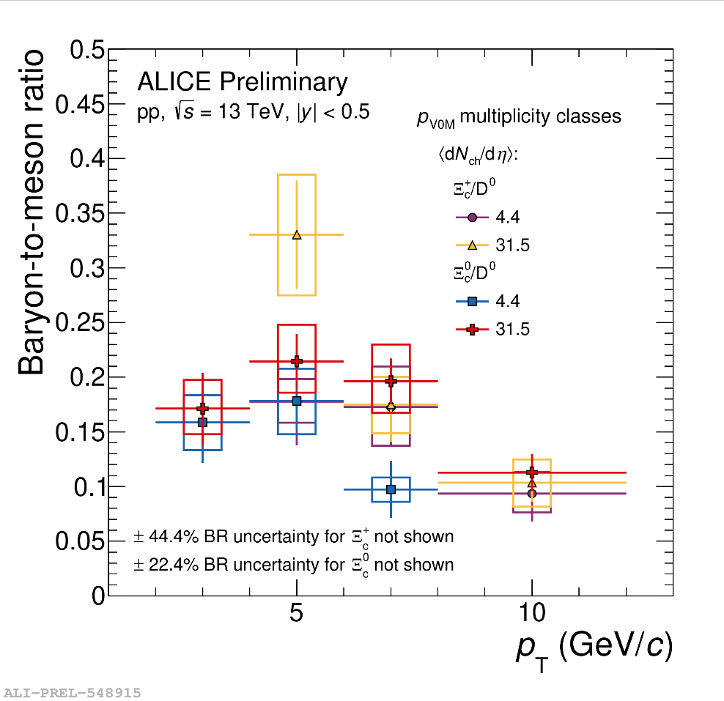
Event multiplicity dependence
$$Ξ_{c}^{0}$$
s
d
$$Λ_{c}^{+}$$
c
Phys.Lett.B 829 (2022) 137065
u
d
s
c
u
$$Ξ_{c}^{+}$$
c
Multiplicity-Dependent of the ${Λ_{c}^{+}/D}^{0}$ Ratio
The ${Λ_{c}^{+}/D}^{0}$ ratio showing a significant increase from the lowest to the highest multiplicity class, significance level 5.3$σ$
Mode 2 captures the trend but does not match the observed magnitude, PYTHIA 8 Monash model fails to describe the ratio.
The measured ratio in the lowest multiplicity interval is higher than what is observed in $e^{+}e^{−}$ collisions.
Multiplicity-Dependent dependence of $Ξ_{c}^{0}/D^{0}$ ratio
No multiplicity dependence of with the current large uncertainties
The measured ratio in the lowest multiplicity interval is higher than what is observed in $e^{+}e^{−}$ collisions.
tao.fang@cern.ch

Slide 10
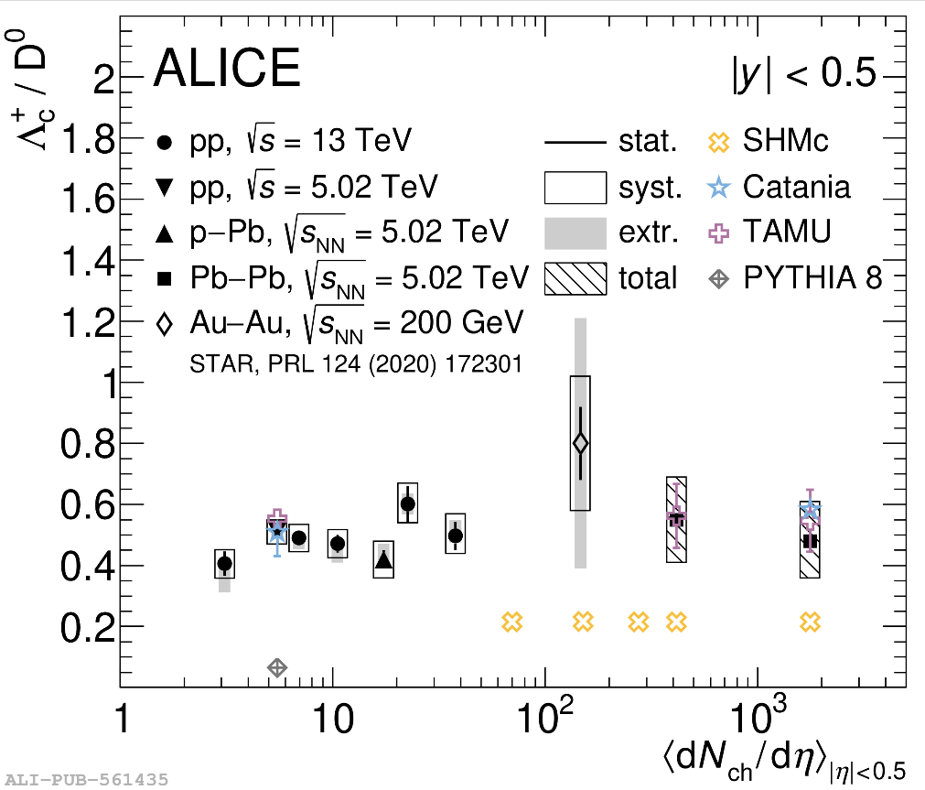
Event multiplicity dependence
$$Λ_{c}^{+}$$
Phys.Lett.B 839 (2023) 137796
u
d
c
No multiplicity dependence of $p_{T}$ integrated ratio within the uncertainties
Increase in baryon-to-meson ratio in the measured range Likely due to a redistribution between mesons and baryons, suggests that the rise in ratio is not absolute from the increase in baryon yield, but from a relative shift in the production balance between baryons and mesons
The $p_{T}$-integrated ${Λ_{c}^{+}/D}^{0}$ in central and mid-central Pb–Pb collisions with the same ratios observed in pp, p–Pb, and Au–Au multiplicities
tao.fang@cern.ch

Slide 11
Summary and outlook
Charm-quark hadronization is not universal across colliding system, there have additional mechanisms with respect to in leptonic collisions
Baryon-to-meson ratio: The greater enhancement observed at low and intermediate $p_{T}$ for larger collision systems, likely due to recombination effects and/or radial flow.
Strange-charm baryons: The observed enhancement suggests they form more readily through quark coalescence. However, large systematic uncertainties may limit understanding of the true enhancement magnitude.
tao.fang@cern.ch

Slide 12
Back up
tfang@cern.ch

Slide 13
Model
PYTHIA 8
Monash Tune: Using extensive experimental data (mainly from $e^{+}e^{−}$ and $pp$ collisions) to describe hadronization phenomena.
Mode 2: Consider the Coalescence Hadronization, better describing the yields of strange-charm baryons
SHM + RQM
Statistical Hadronization Model (SHM): All quarks reach thermal equilibrium and undergo hadronization to form the final hadronic states. heavy quarks hadronization follows a statistical distribution.
Relativistic Quark Model (RQM): Heavy quarks do not fully thermalize and can undergo coalescence, considers the relativistic kinematics of heavy quarks.
CATANIA
The CATANIA model incorporates multiple hadronization mechanisms to describe the transition of heavy quarks into heavy-flavor hadrons. Coalescence Hadronization and Fragmentation Hadronization
QCM
at the end of a collision, quarks can form hadrons through a process of "coalescence" (or recombination), rather than solely via fragmentation.
tao.fang@cern.ch

Slide 14
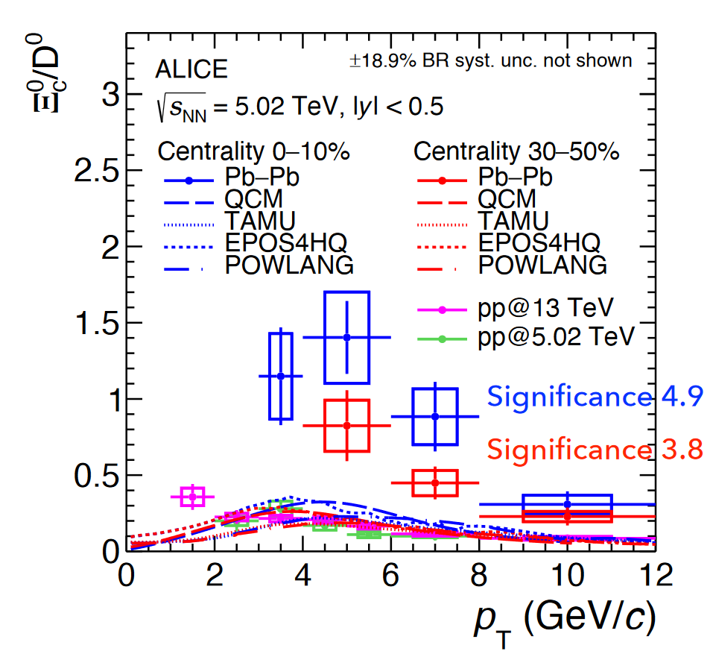
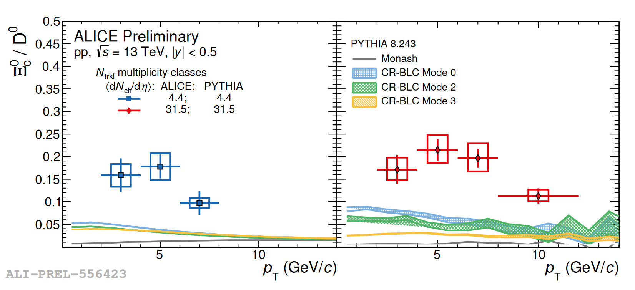
Measurements in Pb-Pb collisions
s
$$Ξ_{c}^{0}$$
d
c
[2.0𝝈, 3.3𝝈, 2.7𝝈, 2.1𝝈] enhancement (x4~10) for $Ξ_{c}^{0}/D^{0}$ in 0-10% Pb–Pb collisions w.r.t. pp collisions
[–, 2.4𝝈, 2.5𝝈, 2.0𝝈] enhancement (x3~6) for $Ξ_{c}^{0}/D^{0}$in 30-50% Pb–Pb collisions w.r.t. pp collisions
Poor Model Descriptions: significantly underestimated by PYTHIA 8 calculations
tao.fang@cern.ch

