Slide 1
Schedule, progress and plan
Mingyi Dong
2024.7.8

Slide 2
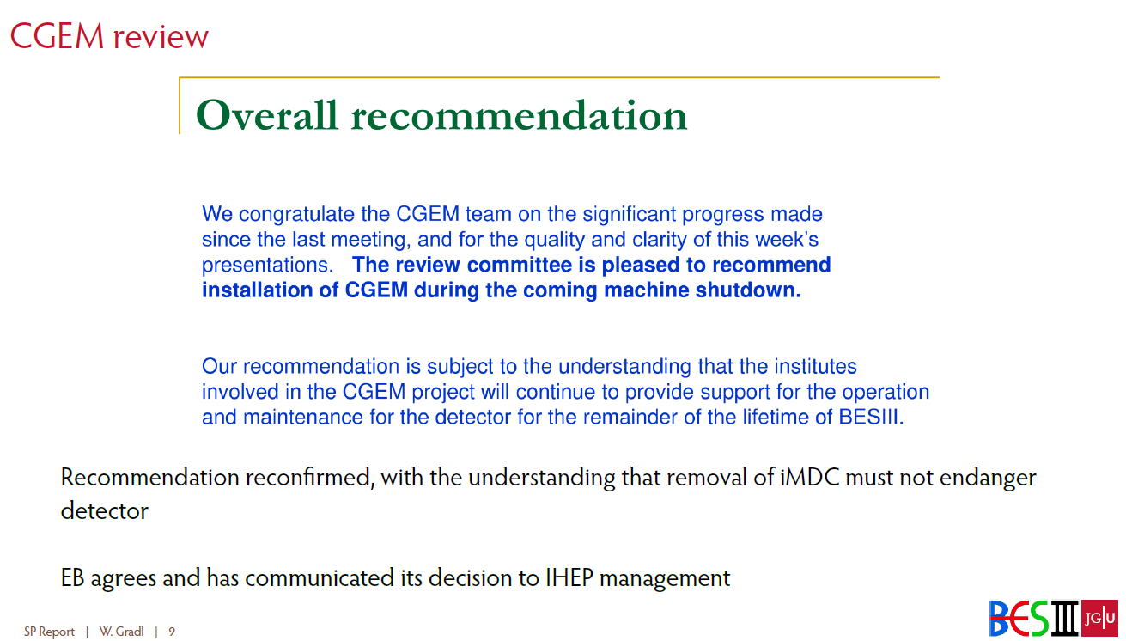
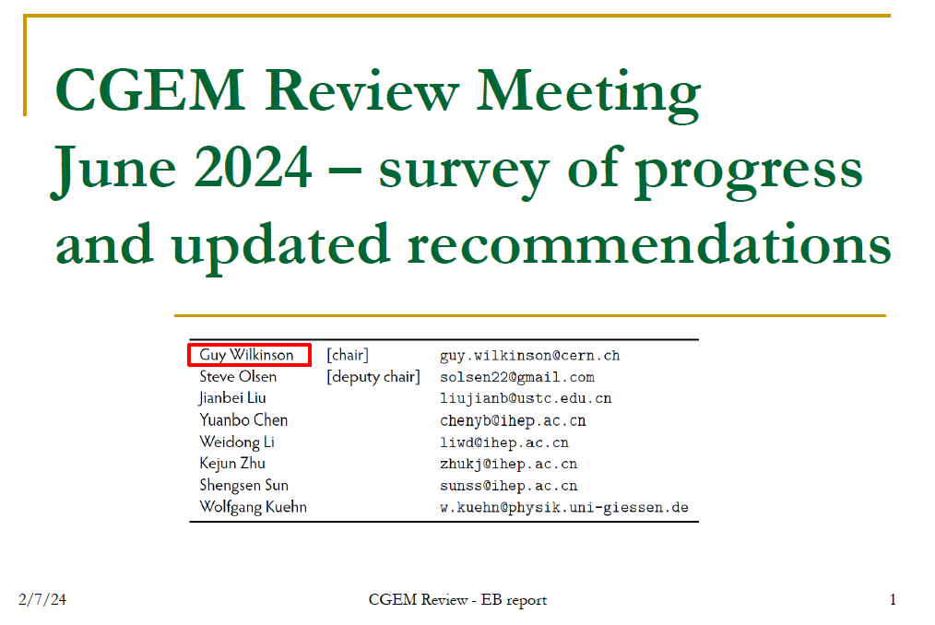
Inner Chamber Upgrade
CGEM workshop, Jun 28-29, 2024
https://indico.ihep.ac.cn/event/22837/
Collaboration Meeting in Summer 2024, Jul. 2 - 6, 2024, LNU
https://indico.ihep.ac.cn/event/22305/contributions/157677/attachments/79594/99329/besiii--closeout-summer-2024.pdf

Slide 3
Schedule (may be updated each week)
No. | tasks | Duration（day） | Start time and stop time | Sub-system involved
1 | Removal of equipment of machine |  | July 1- Aug. 6 | Utility, Small angle lum. Detector and ZDD, Beam pipe, slow control
2 | Pull-out of EEMC |  |  | Utility, EMC, TOF, MDC, MUC
3 | Removal of inner chamber（Operate simultaneously on both sides ） | 51 | Aug. 7- Sep.7 Sep.8- Sep. 28 | MDC, MDC electronics, Gas, Mechanics, Laser Alignment group, Trigger, DAQ, Slow control
4 | Installation of CGEM | 44 | Sep.29- Nov. 11 | CGEM group, MDC, MDC electronics, Gas, Mechanics, Laser Alignment group, Trigger, DAQ, Slow control
5 | Recover EEMC |  | Nov. 12-Dec.30 | Utility, EMC, TOF, MDC, MUC
6 | Recover equipment of machine |  |  | Utility, Small angle lum. Detector, ZDD, Beam pipe, slow control,
total |  | 180 days | July 1- Dec.30

Slide 4
Key tasks before extraction of iMDC and installation of CGEM
CGEM Mock-up insertion test (last week )
  Done, successful
Laser alignment preparation
  Discussed on last Friday
Extraction of the inner MDC is considered to be the most critical point. Continue inner chamber extraction test
  Preliminary discussion on cooling the connecting flange
Continue CGEM cosmic-ray test to gain more experience with the full detector
CGEM integrated and tested with BESIII DAQ, trigger, and slow control

Slide 5
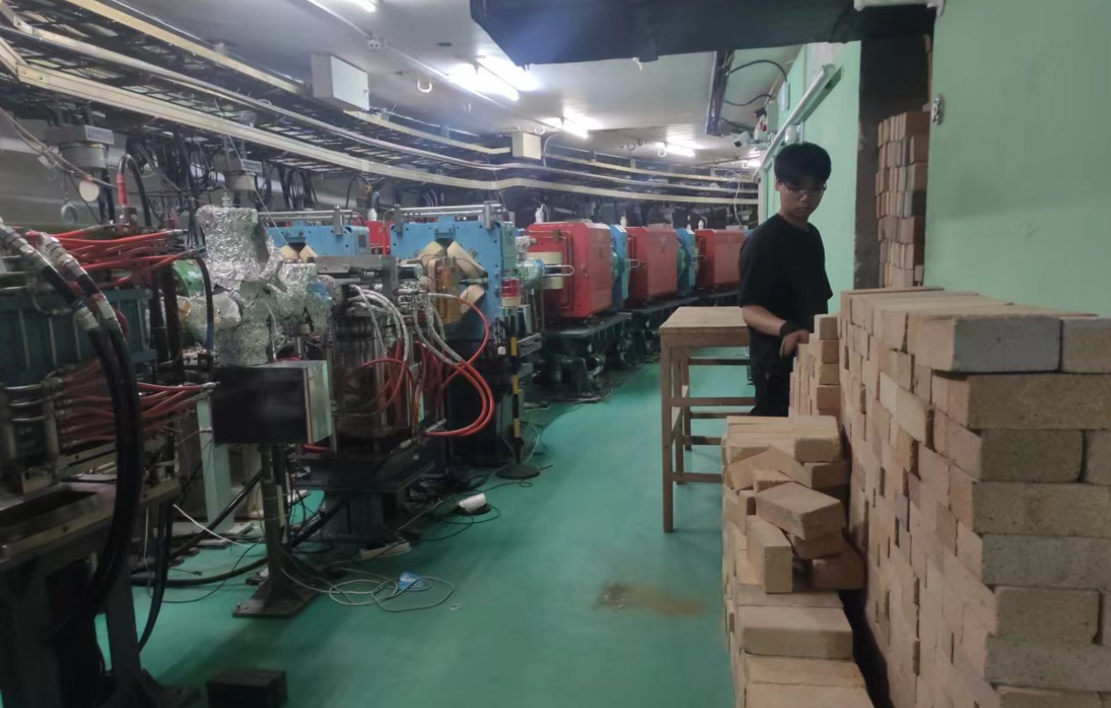
Progress in the experimental hall last week
Removed the shielding brick wall on east and west sides of IP area
Finished laser measurement of BESIII detector and IP area

Slide 6
Discussion on laser measurement during the upgrade of iMDC
时间：2024.7.5
地点：高能所3号厅207，106
参会人员：欧阳群，门玲鸰，付金煜，荆小平，马骁妍，董明义， Stefano
In order to accurately measure whether the step part of MDC has deformation after the extraction of iMDC, additional targets will be added on the connecting rings of the 3rd and 5th steps
The connecting blocks between first and second layer, as well as the connecting blocks between the second and third layers of the CGEM currently can not be measured by laser
The flange connecting CGEM and MDC needs to be individually measured with additional targets glued on it before fixed on the CGEM
The flange will be measured in the lab after fixed on the CGEM. and measure the outermost cylinder of CGEM can also be measured in the lab

Slide 7
Discussion on laser measurement during the upgrade of iMDC
Steps | Laser alignment | Targets will be used
1 | Initial measurement before extraction of the inner chamber, and after removing the shielding cover, inner chamber preamp and cables | Targets on the innermost layer of the large end plate Targets on the connecting rings of the 3rd and 5th steps Targets on inner chamber connection flange Targets on end plates of the inner chamber
2 | The alignment of the long rail before removing the inner chamber, and after installing all dismantling | Targets on the innermost layer of the large end plate Targets on the connecting rings of the 3rd and 5th steps Targets on the long axis close to the dismantling fixture
3 | Measurement after removing the inner chamber and installing the carbon fiber inner cylinder, as well as removing the outer chamber protect structure | Targets on the innermost layer of the large end plate Targets on the connecting rings of the 3rd and 5th steps Targets on inner chamber connection flange (only on the west end, targets on the east end have been removed)
4 | CGEM alignment during its installation | Targets on the innermost layer of the large end plate Targets on the connecting rings of the 3rd and 5th steps Targets on the CGEM outer cylinder
5 | Measurement after CGEM installation | Targets on the innermost layer of the large end plate Targets on the connecting rings of the 3rd and 5th steps Targets on flanges connecting CGEM and MDC Targets on inner chamber connection flange (new flange on east end)
Step 4 may not be necessary. CGEM has own alignment solution during installation, which has been validated through mock-up insertion test in hall 3

Slide 8
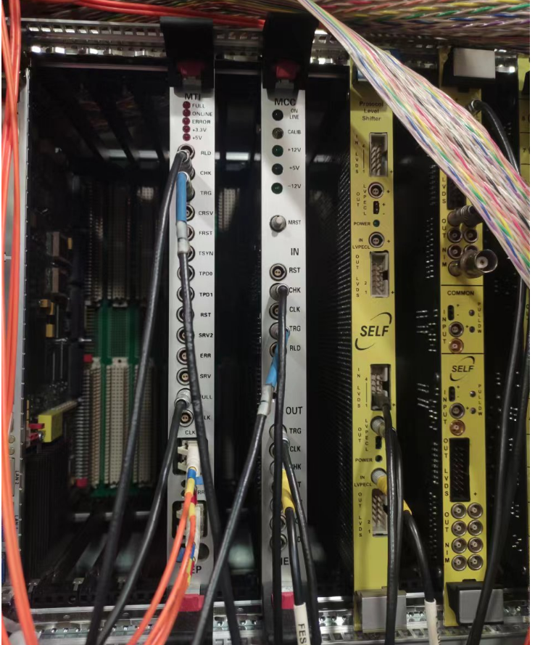
Discussion on CGEM Fast Control Signal and DAQ
On July 1,
Li Fei, Ji Xiaolu, Zhao Jingzhou, Dong Mingyi, Ouyang Qun, gg, Michela, Angelo
Discussion on the FCS interface between CGEM and BESIII, and feasibility of using fast signals from ZDD
If needed, can distribute the CGEM readout to two VME crates, thus helping with the data rate pressure
After the meeting, Jingzhou and Mingyi checked the ZDD system.
ZDD has two modules, MTI and MCC, receive fiber signal from trigger system (TRG, CLK, CHK), decode and convert into LVPECL level . For CGEM, it is possible to use this FCS with level conversion (need further discussion and test)

Slide 9
Insertion tests of CGEM Mock-up
Finished the insertion tests of CGEM Mock-up with updated legs in hall3 . The tests are successful. (see Stefano’s talk)

Slide 10
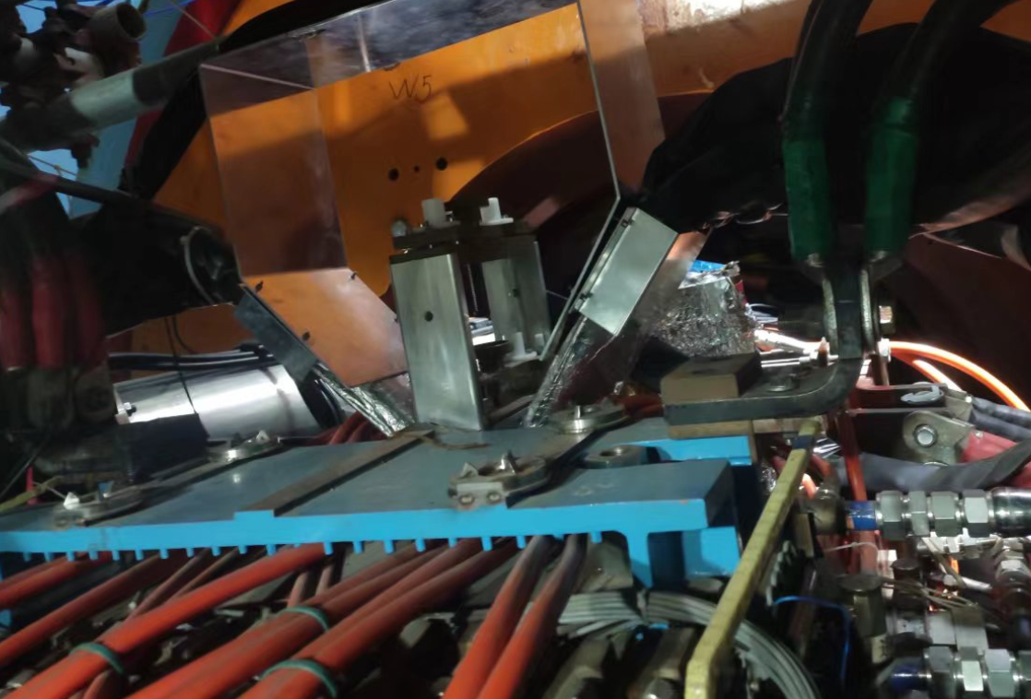
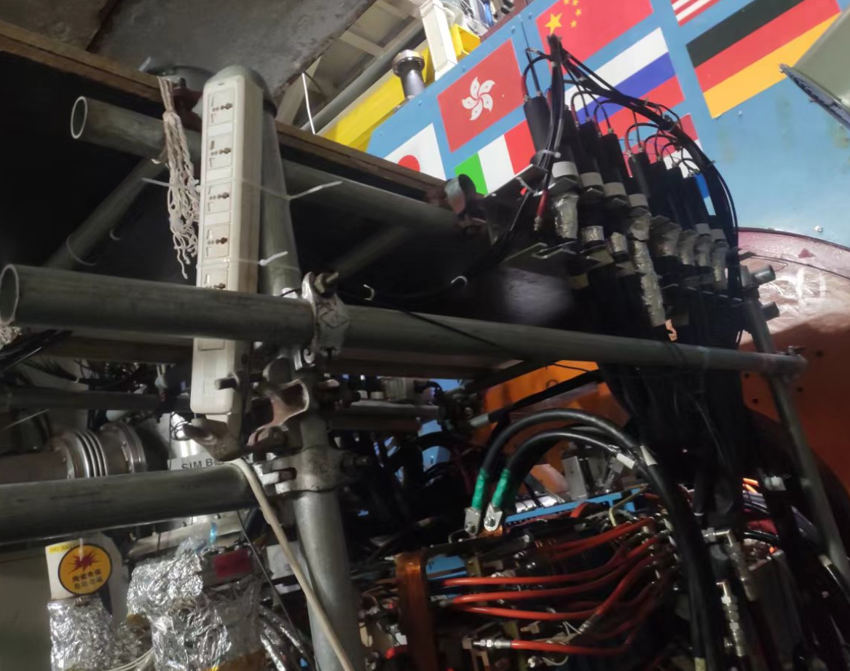
Details of plan for next week
 | Tasks | Time needed (day) | person in charge
1 | Remove the shielding concrete block covers on both sides | 2 | Facilities Operation group (Jing Xiaoping)
2 | Disconnect the connection of power and cooling system | 3-4 | Facilities Operation group (Jing Xiaoping)
3 | Remove the small angle luminosity detector and ZDD | 2 | Cai Xiao
4 | Remove the support structure for small angle luminosity detector and ZDD | 1 | Zheng Jianping
5 | Start removing magnets from IP area

