Slide 1
CEPC Silicon Tracker Progress Report
Qi Yan on behalf of the ITK+OTK Group
July 16, 2024, IHEP

Slide 2
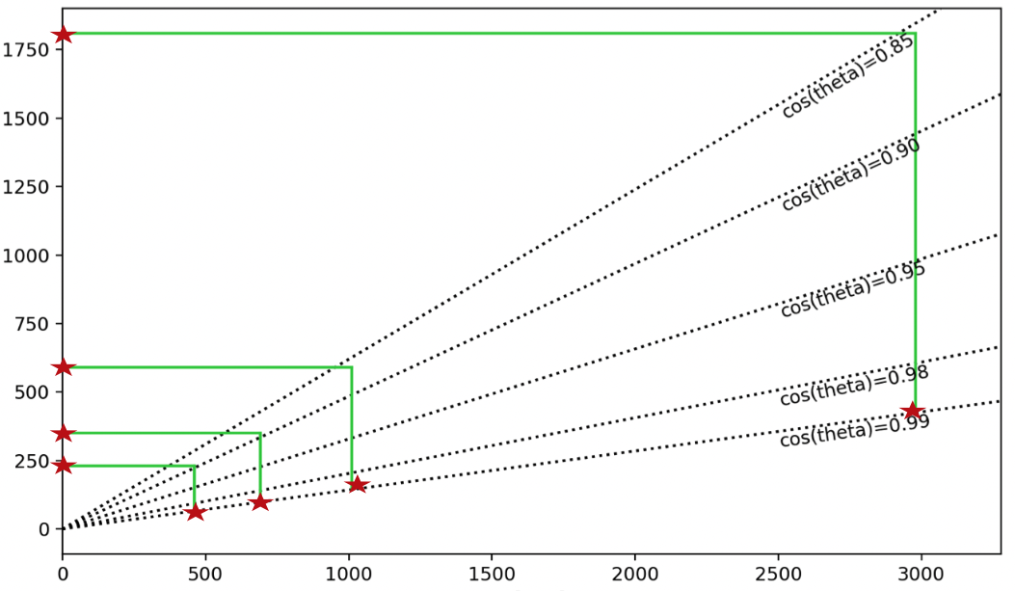
Status of the CEPC Inner Tracker (ITK) TDR
The design and development maturity of the Vertex, Inner Silicon Tracker (ITK), Time Projection Chamber (TPC), and Outer Silicon Tracker (OTK) detectors are far ahead of the Inner Silicon Tracker (ITK). The ITK lacks a baseline for the overall detector design scheme.
OTK
TPC
R [mm]
ITK
Vertex
Z [mm]

Slide 3
ITK Baseline Tasks
Sensor and module design (ladder/stave): Parameters and readout of sensor and module (Yang ZHOU, Mei ZHAO, Weiguo LU, Yiming LI, Xin SHI)
Barrel design (HVCMOS pixels) 2D and 3D layout of the barrel detector (Yiming LI, Qi YAN, Yihan ZHANG, Jinyu FU)
Endcap design (CMOS strips) 2D and 3D layout of the endcap detector (Xin SHI, Qi YAN, Shoudong LUO, Yihan ZHANG, Jinyu FU)
Design of 2d wire routing (bonding) scheme for endcaps (Yuxin CUI, Qi YAN)
Barrel and endcap counting rate (Li ZHAN, Qi YAN, Xin SHI)
Readout electronics design (Xiongbo YAN)
Power consumption and costs (Yiming LI, Xin SHI)
Mechanics and cooling design (Jinyu FU, Qi YAN, Yihan ZHANG, Shoudong LUO)
Implementation in MC simulation (Chengdong FU, Gang LI, Qi YAN)
Others

Slide 4
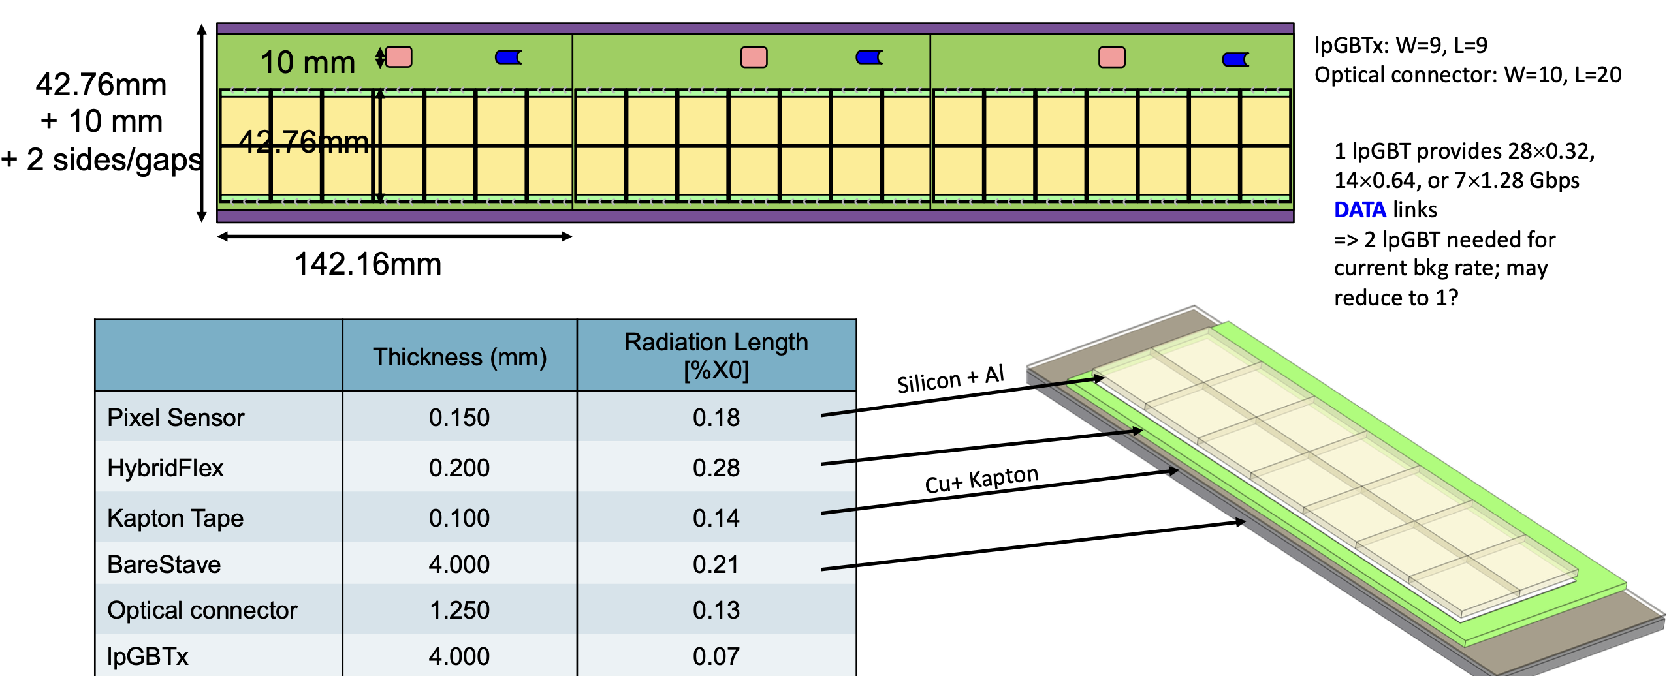
Latest Progress：ITK Barrel Sensor, Module, and Stave
stave
module
module (14 sensors)
need optimization
Yiming LI @ ITK+OTK meeting (2024.07.10)

Slide 5
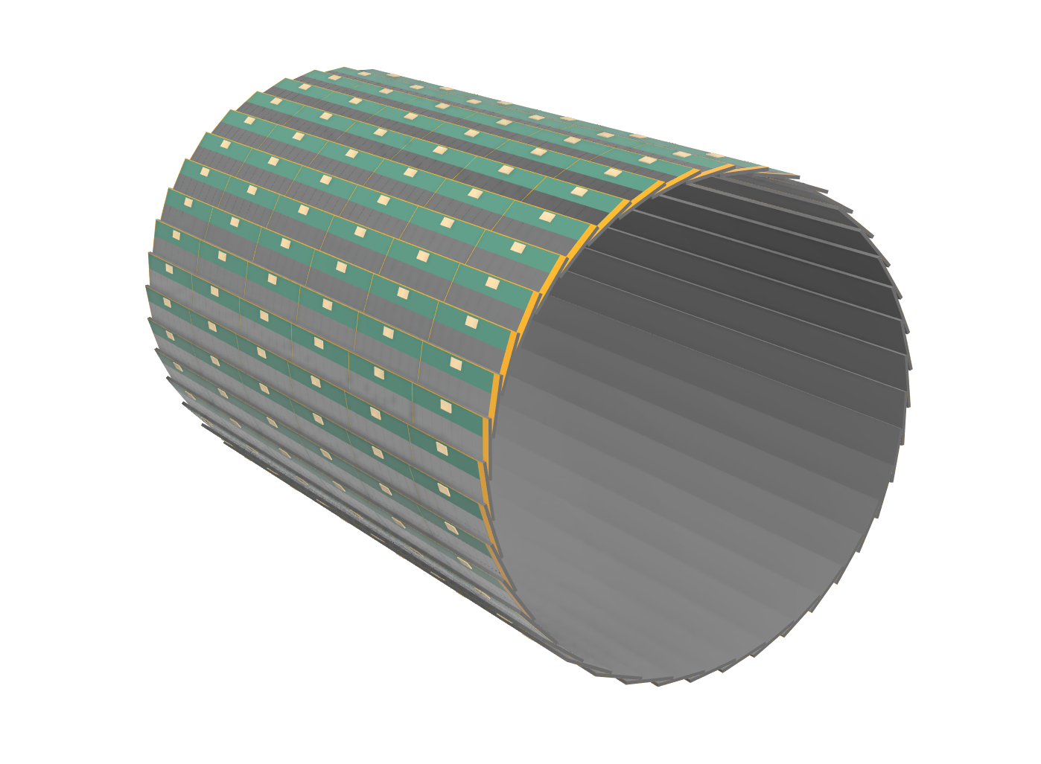
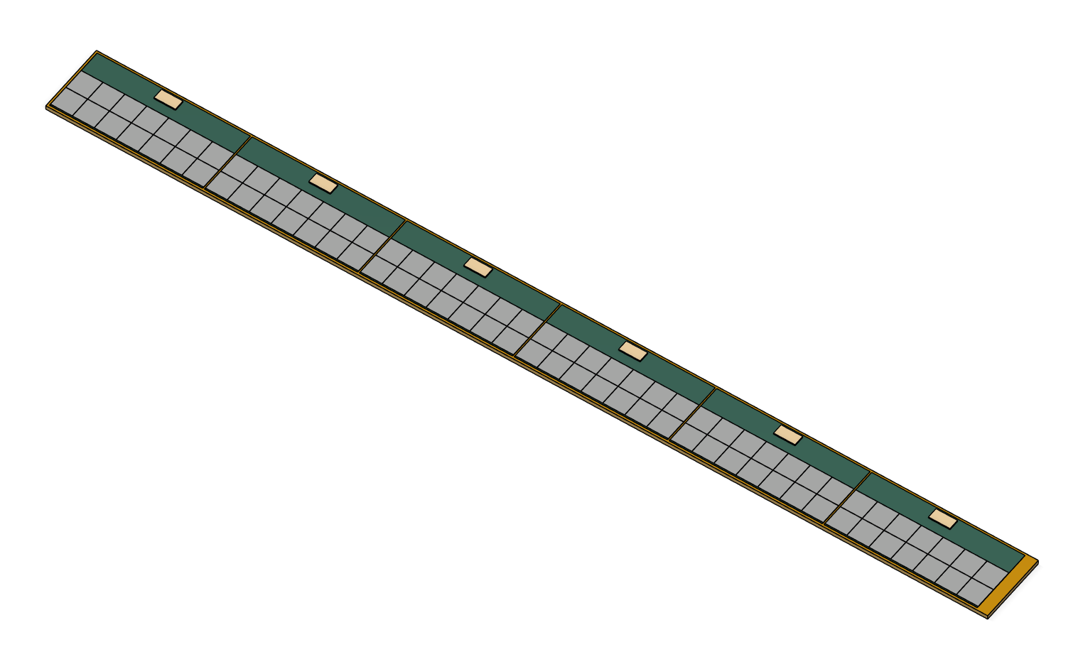
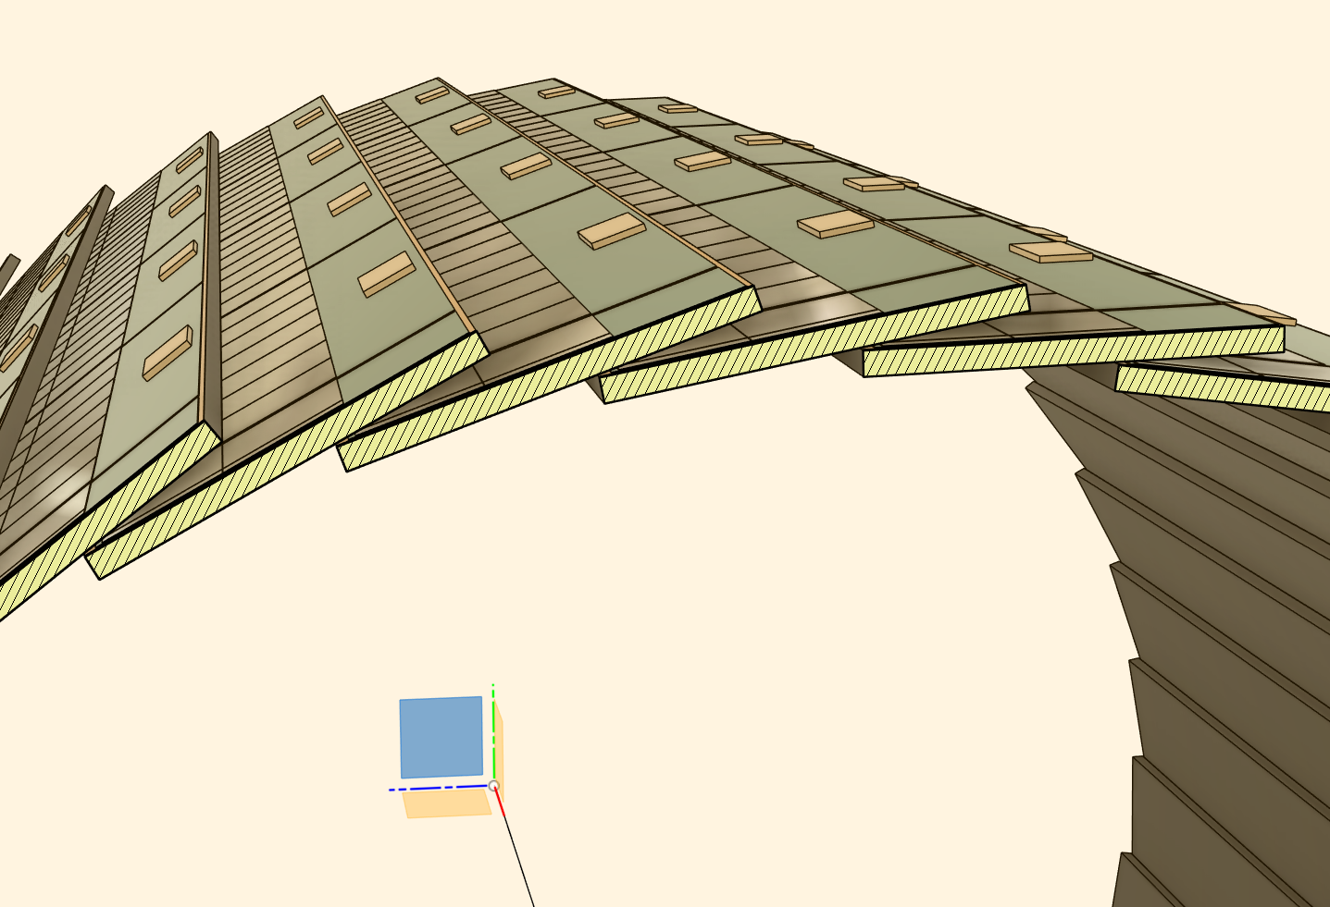
Latest Progress: ITK Barrel Design (One Barrel)
Qi YAN, Yihan ZHANG
one ITK barrel
one stave

Slide 6
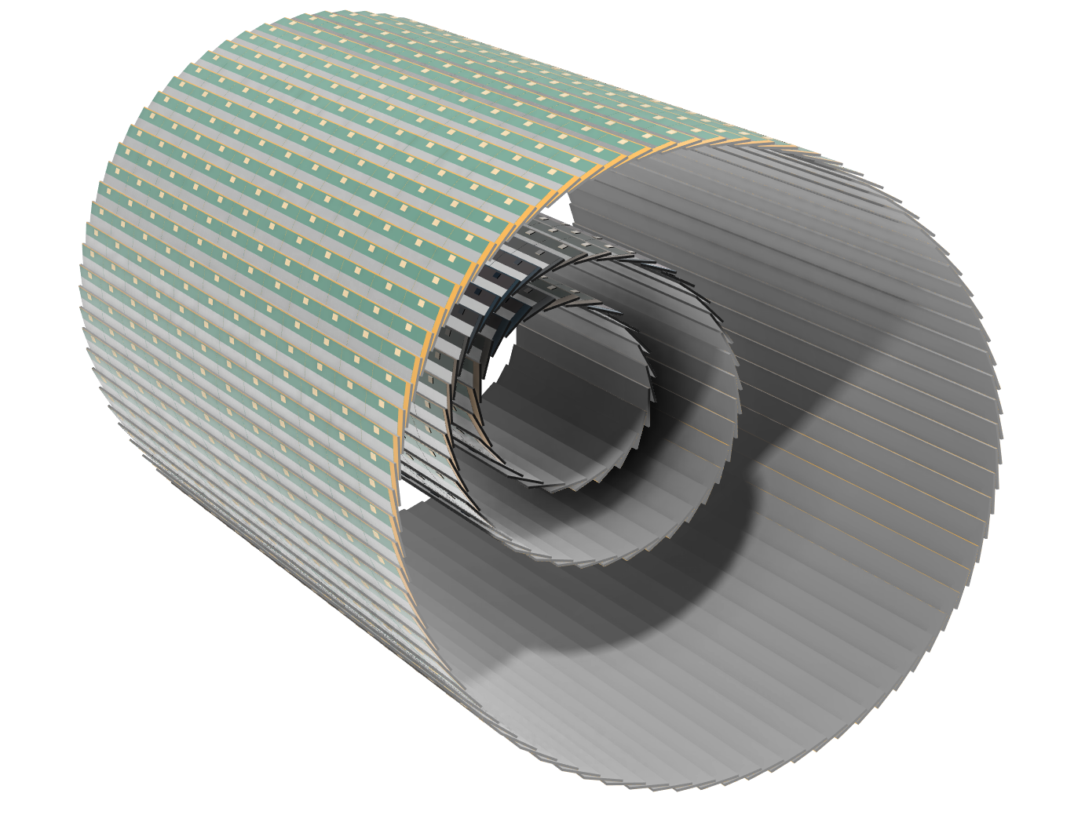
Latest Progress: ITK Barrel Design (Three Barrels)
Qi YAN, Yihan ZHANG
three ITK barrels

Slide 7
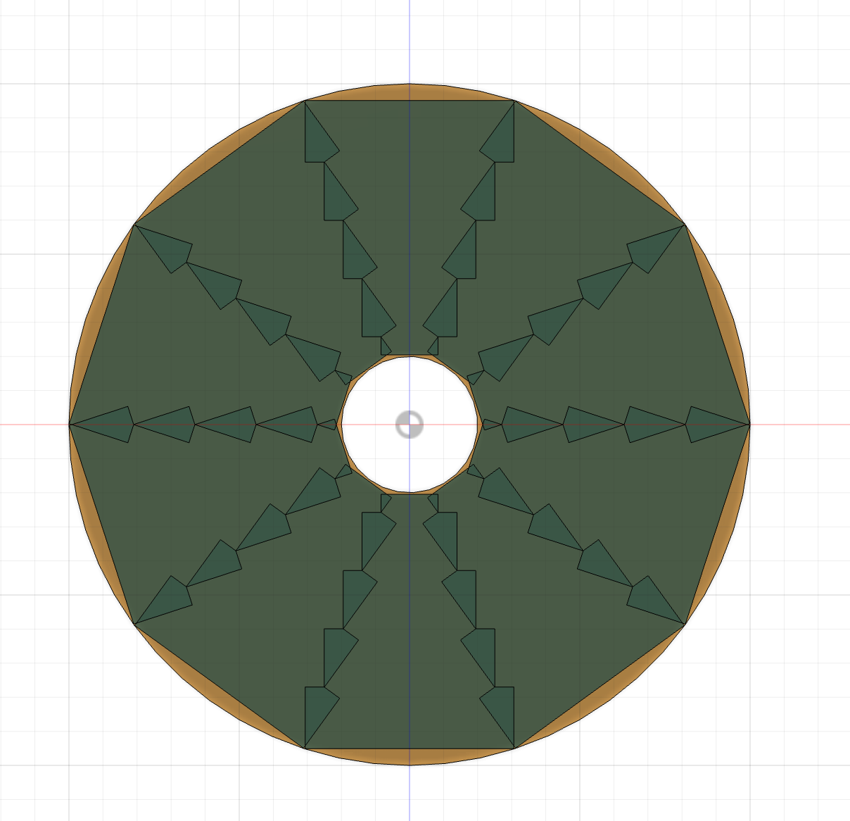
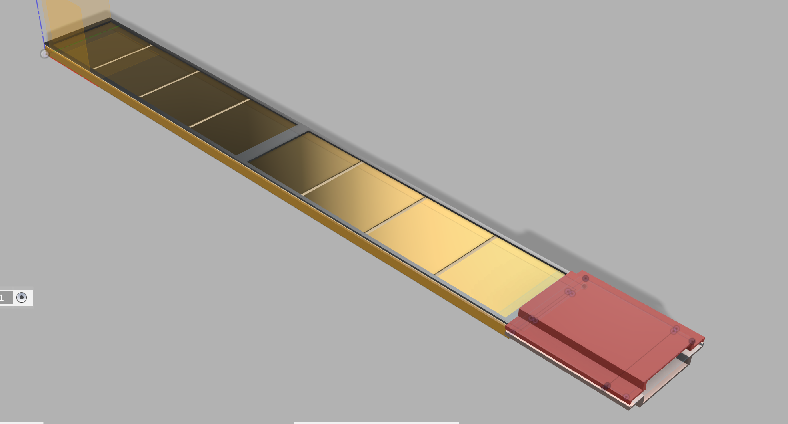
Latest Progress：ITK Endcap Design (Plan 1)
Qi YAN, Shoudong LUO
严琪、骆首栋
One endcap is divided into 10 sectors:
Each sector is entirely composed of rectangular ladders, with minimal overlapping between sectors.
sector overlap region

Slide 8
1: ladder
Qi YAN, Shoudong LUO
2: sector
3: endcap

Slide 9
Qi YAN, Shoudong LUO
Endcap plan 1 (a)
Endcap plan 1 (b)

Slide 10
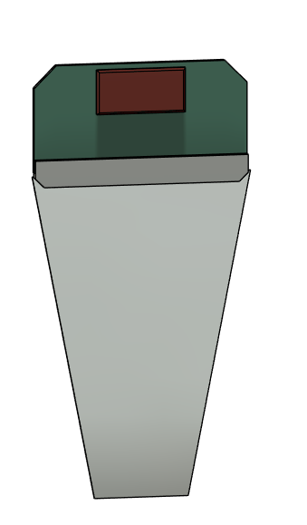
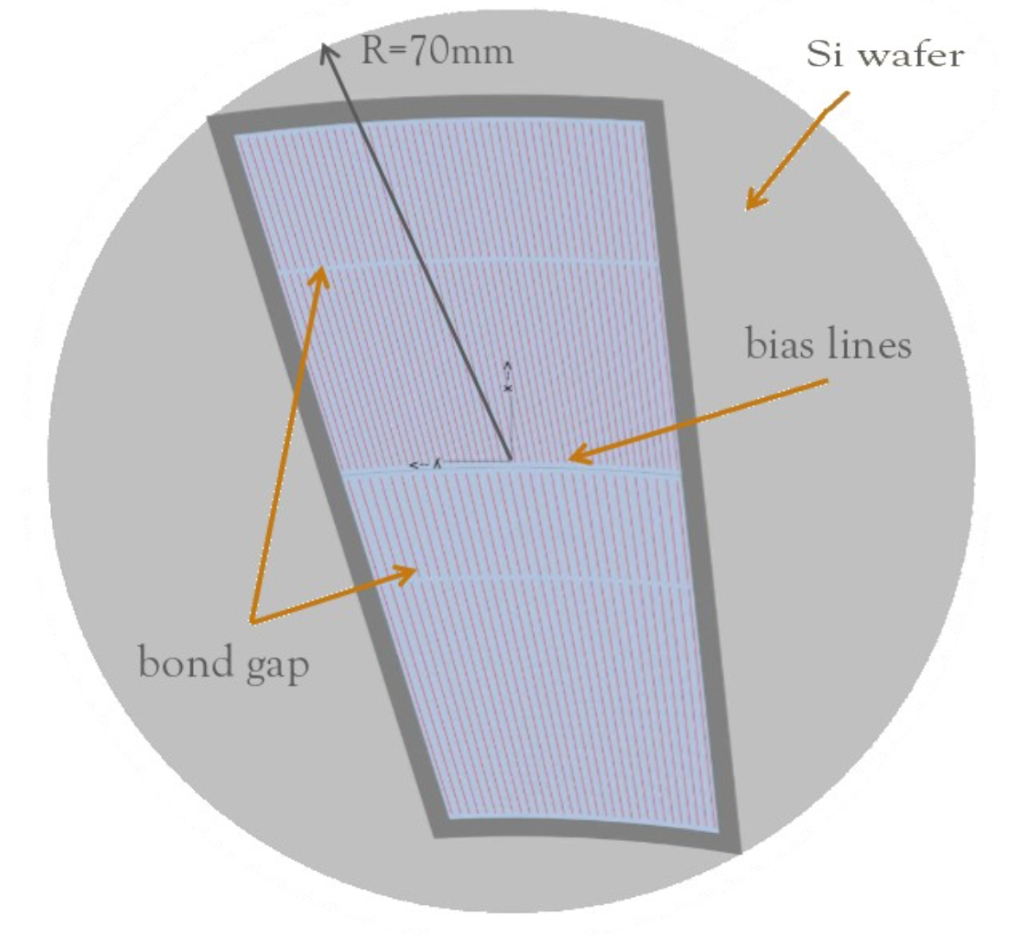
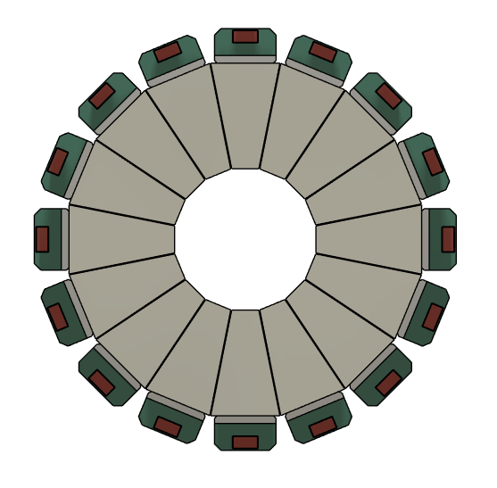
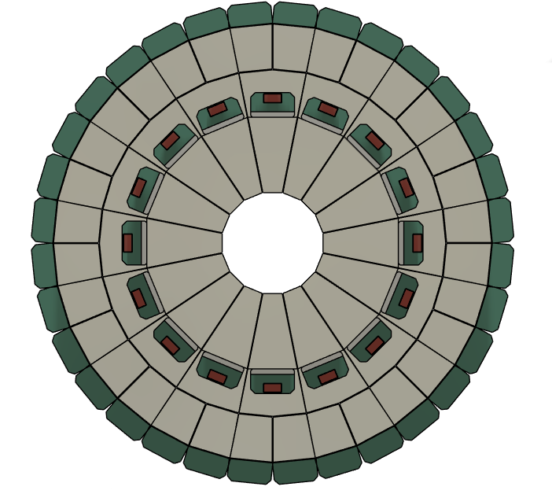
Latest Progress：ITK Endcap Design (Plan 2)
1: sensor
Qi YAN, Yihan ZHANG
2: ring
3: endcap
One endcap is divided into 3 rings :
Each ring is composed of annular segment sensors.

Slide 11
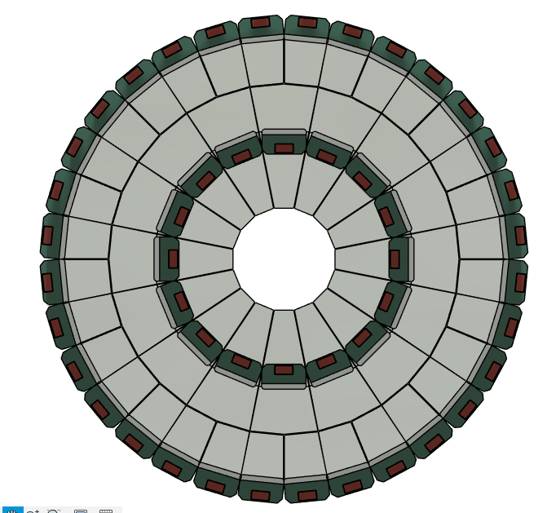
Qi YAN, Yihan ZHANG
Endcap front view
Endcap back view

Slide 12
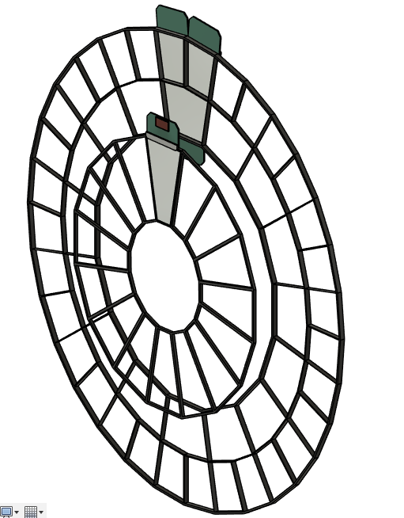
Mechanical Design of ITK Endcap (Plan 2)
Qi YAN, Yihan ZHANG

