Slide 1
Estimation Methods of Beam induced Backgrounds at the CEPC
Haoyu Shi
CEPC Detector Ref-TDR Meeting
16 July 2024

Slide 2
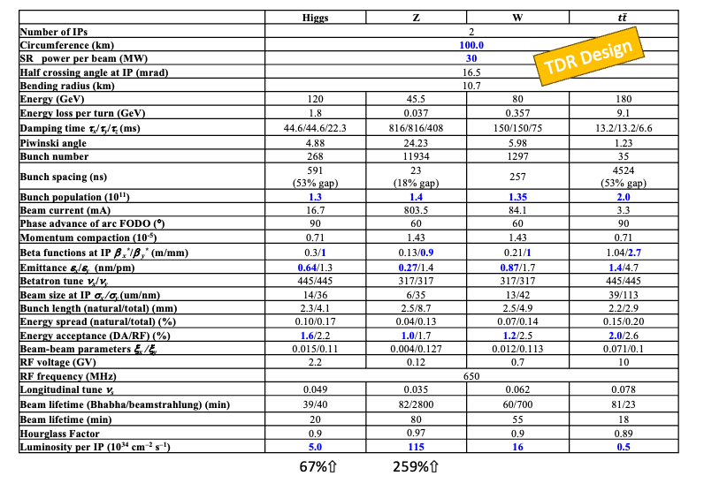
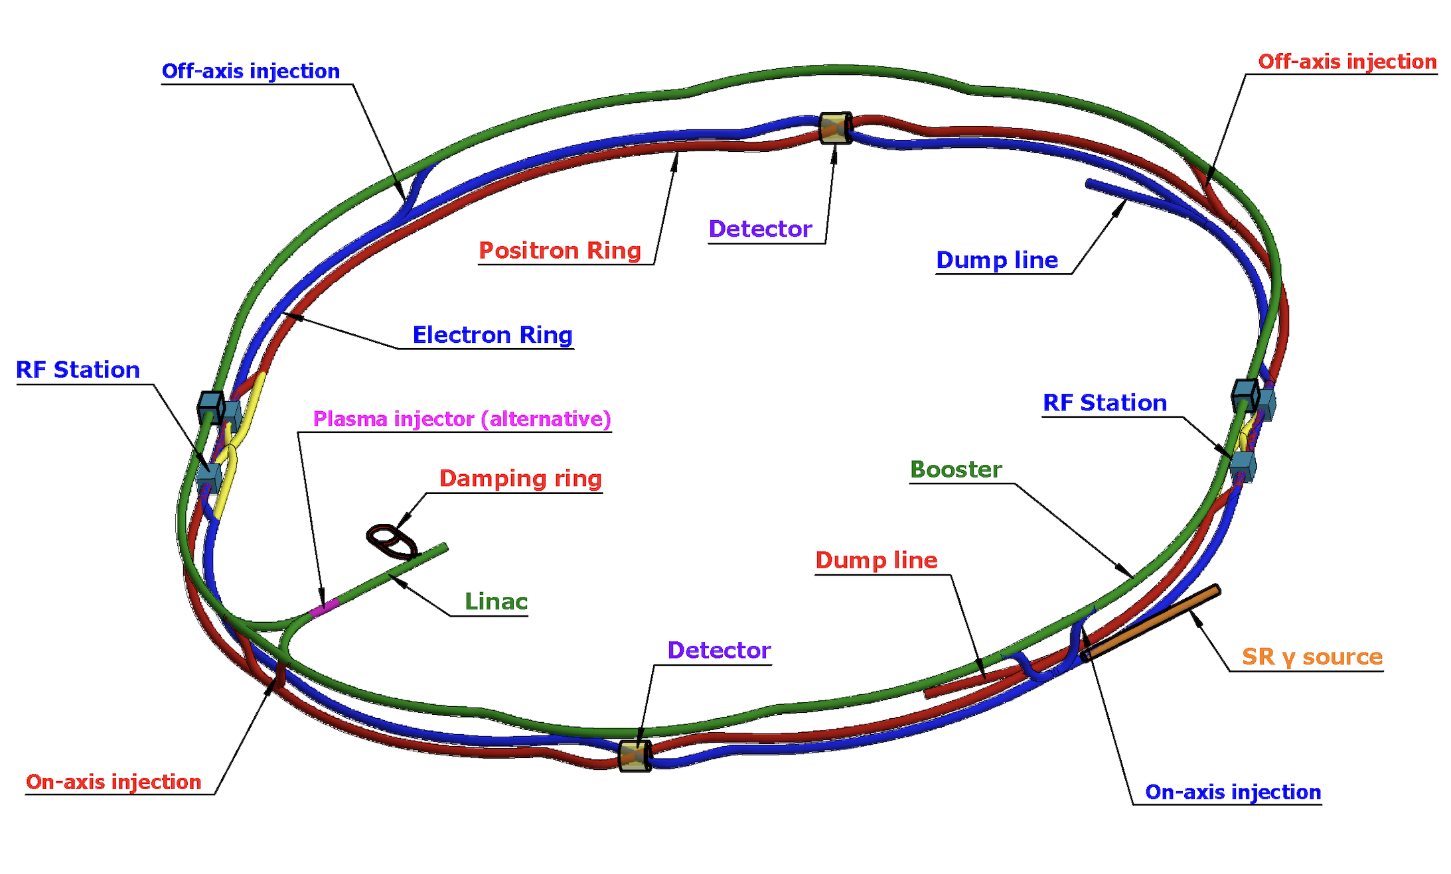
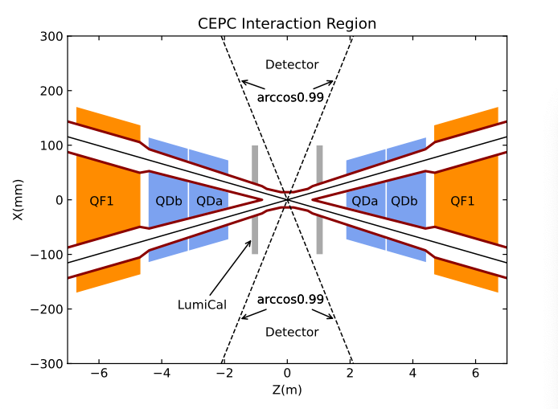
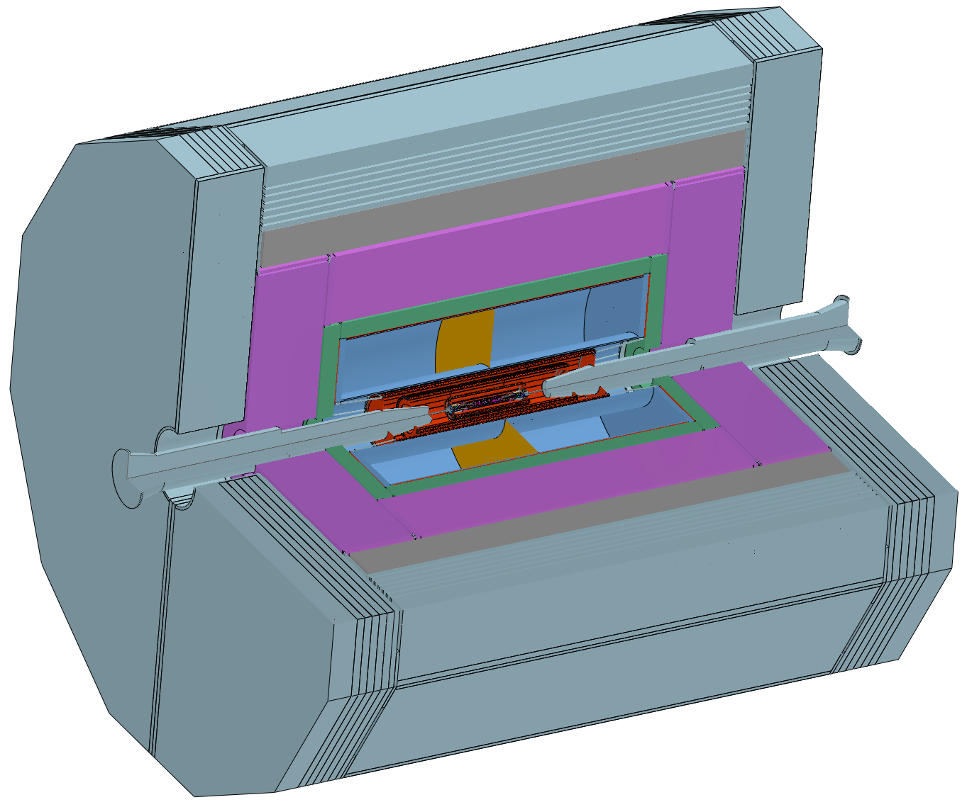
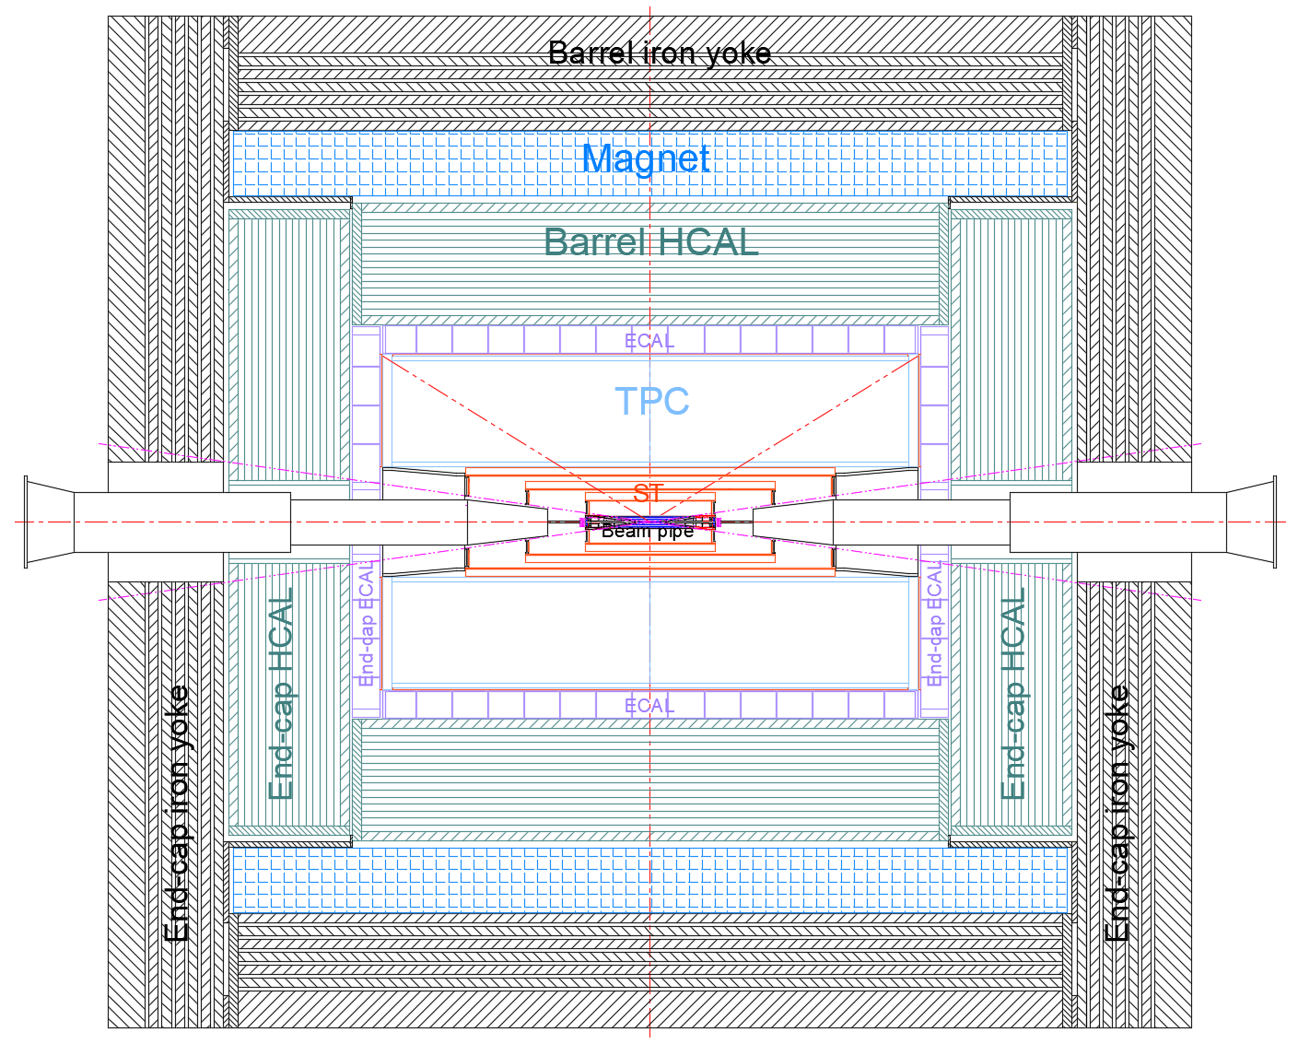
Inputs for BG Simulation
Acc-TDR
Det-Ref-TDR(on going)
  TDR_o1_v01
Ref-TDR

Slide 3
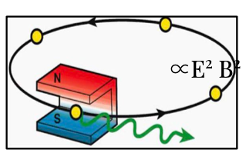
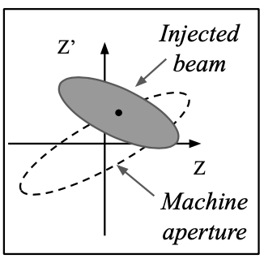
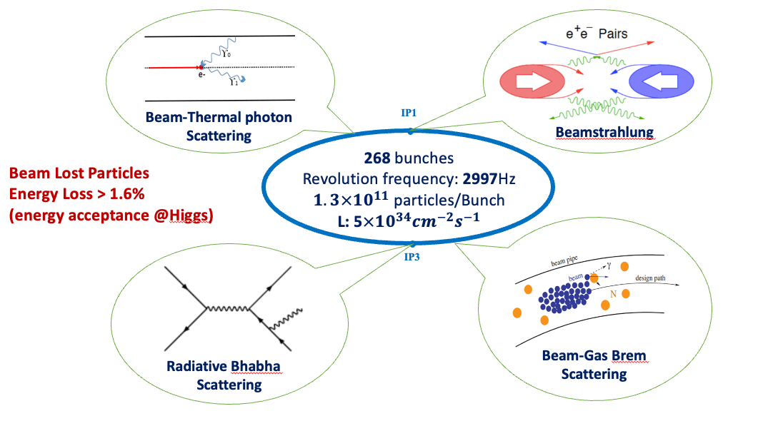
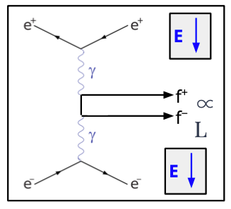
Background Estimation
Single Beam
  Touschek Scattering
  Beam Gas Scattering(Elastic/inelastic)
  Beam Thermal Photon Scattering
  Synchrotron Radiation
Luminosity Related
  Beamstrahlung
  Radiative Bhabha Scattering
Injection
A. Natochii
SR
A. Natochii
Pair Production
Photon BG
Beam Loss BG
Injection BG
Background | Generation | Tracking | Detector Simu.
Synchrotron Radiation | BDSim | BDSim/Geant4 | CEPCSW/FLUKA
Beamstrahlung/Pair Production | Guinea-Pig++ | SAD
Beam-Thermal Photon | PyBTH[Ref]
Beam-Gas Bremsstrahlung | PyBGB[Ref]
Beam-Gas Coulomb | BGC in SAD
Radiative Bhabha | BBBREM
Touschek | TSC in SAD
Validate when possible
Step by Step
Whole Procedure
Notes:
Implemented The superKEKB way of bg simulation

Slide 4
Generation/Tracking
One Beam Simulated for Single Beam
Simulate each background separately
Whole-Ring generation for single beam BGs
Multi-turn tracking(200 turns)
  Using built-in LOSSMAP
  SR emitting/RF on
  Radtaper on
  No detector solenoid yet
Luminosity: Pair/RBB
Single beam: including SR
Generate the initial distribution after scattering
Tracking when necessary
Normalize to Loss Distribution/Handle to Detector Simulation

Slide 5
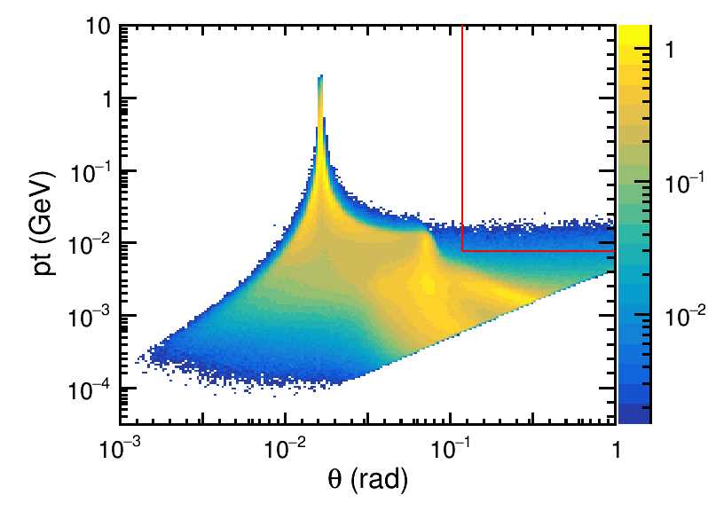
Pair Production(Beamstrahlung)
Luminosity related backgrounds
One of the dominant backgrounds at the CEPC, may lead to two different impacts:
  The impacts on detector, caused by the electrons/positrons produced by photons
  The impacts on accelerator components outside of the IR, caused by the photons directly.
Hard to mitigate
W. Xu
Parameter | Symbol | ILC-500 | CLIC-380 | CEPC-Z | FCC-Z | CEPC-W | FCC-W | CEPC-Higgs | FCC-Higgs | CEPC-top | FCC-top
Energy | E[GeV] | 250 | 190 | 45.5 | 45.5 | 80 | 80 | 120 | 120 | 180 | 182.5
Particles per bunch | N[1e10] | 3.7 | 2 | 14 | 24.3 | 13.5 | 29.1 | 13 | 20.4 | 20 | 23.7
Bunch Number |  |  |  | 11934 | 10000 | 1297 | 880 | 268 | 248 | 35 | 40
Bunch Length | sigma_z [mm] | 0.3 | 0.07 | 8.7 | 14.5 | 4.9 | 8.01 | 4.1 | 6.0 | 2.9 | 2.75
Collision Beam Size | sigma_x,y [um/nm] | 0.474/5.9 | 0.149/2.9 | 6/35 | 8/34 | 13/42 | 21/66 | 14/36 | 14/36 | 39/113 | 39/69
Emittance | epsilon_x,y [nm/pm] | 1e4/3.5e4 | 0.95e3/3e4 | 0.27/1.4 | 0.71/1.42 | 0.87/1.7 | 2.17/4.34 | 0.64/1.3 | 0.64/1.29 | 1.4/4.7 | 1.49/2.98
Betafunction | beta_x,y [m/mm] | 0.011/0.48 | 0.0082/0.1 | 0.13/0.9 | 0.1/0.8 | 0.21/1 | 0.2/1 | 0.3/1 | 0.3/1 | 1.04/2.7 | 1/1.6
Factor | [1e-4] | 612.7 | 6304.6 | 2.14 | 1.7 | 3.0 | 2.4 | 4.8 | 5.2 | 5.6 | 7.10
n_gamma |  | 1.9 | 4.34 | 1.0 | 1.36 | 0.45 | 0.59 | 0.4 | 0.64 | 0.22 | 0.26
Relative loss per particle | %/BX | 19.3 |  | 0.0041 | 0.0092 | 0.0067 | 0.0072 | 0.0096 | 0.0161 | 0.0062 | 0.0093
VXD

Slide 6
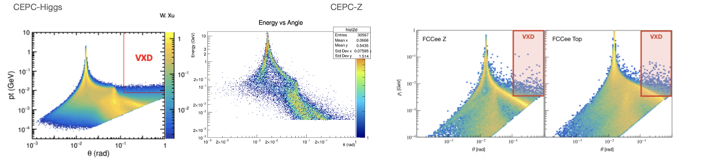
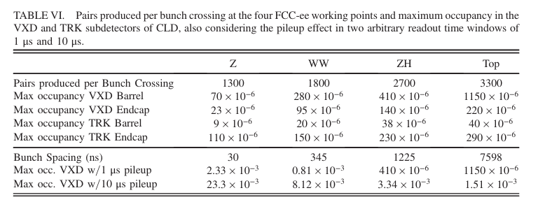
Pair Production -- Validation
FCC-Results

Slide 7
Beam Loss Particle
Back to CDR Phase, some fundamental work has been done, like the analysis of the energy spectra of beam loss particles, the effectiveness of the collimators(loss map turn by turn)…
Since TDR phase, the Collimators are always on
Background | Lifetime | Notes
Beam-Thermal Photon | 50.66h
Beam-Gas Bremsstrahlung | 221h | Mainly H₂, 1 nTorr
Beam-Gas Coulomb | 14.85h
Radiative Bhabha | 40min
Energy Spectra
Beam Lifetime @ Higgs
Notes:
需要补充的图片：
1、IR丢失里面的不同组分占比（Single Beam）
2、Higgs有无Collimator的对比
3、新的IR Loss Rate

Slide 8
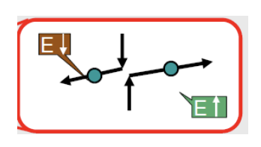

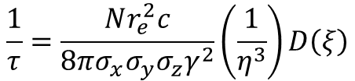
Touschek scattering
Intra-bunch Coulomb scattering
Beam particles
Rate $∝{\left(beam size\right)}^{−1}, E^{−2}$
Lifetime estimation:
Should not have huge impact on High Energy colliders like CEPC
  Also exists on linear colliders
$$\frac{1}{τ}=\frac{Nr_{e}^{2}c}{8πσ_{x}σ_{y}σ_{z}γ^{2}}\left(\frac{1}{η^{3}}\right)D\left(ξ\right)$$
Machine Name | Touschek Lifetime
BEPCII | 5.21h
SuperKEKB – HER – Phase 1 | ~ 3.1h
SuperKEKB – LER - Phase 1 | ~ 3.3h
LEP 1
CEPC – Higgs | 119h
Notes:
E^-3 in Hiro‘s talk, needs to be checked
三种唯象模型 in Teng‘s thesis

Slide 9
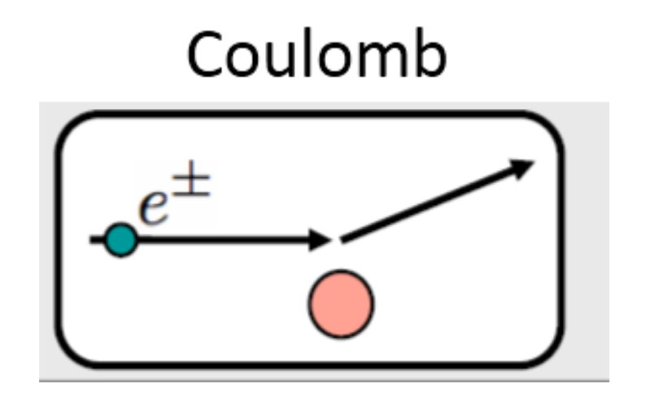


Beam Gas Scattering - elastic
Coulomb scattering with residual gas
Beam Particles(with orbit changing)
Rate $∝P, Z, T^{−1}, E^{−1}, R^{−2}$, related to beta function
Should also not have huge impacts on high energy colliders like CEPC, but decay slope slowly than touschek.
  Also exists at linear colliders
The small size of pipe radius will cause higher rates.
$$σ_{matt}=\frac{4πZ^{2}r_{e}^{2}}{γ^{2}}\left(\frac{1}{θ_{min}^{2}+θ_{1}^{2}}\right)=\frac{4πZ^{2}r_{e}^{2}}{γ}∙\frac{{192β}_{s}β_{max}}{192γR^{2}+β_{s}β_{max}Z^{2/3}}$$
$$\frac{1}{τ}=σρ_{gas}c=σc\frac{P}{k_{B}T}$$
Loss Pos @ CEPC-Higgs
IR: 2.6%
Machine Name | Beam Gas Coulomb Lifetime
BEPCII | 56.1h
SuperKEKB – HER – Phase 1 | ~ 5.4h
SuperKEKB – LER – Phase 1 | ~ 14.4h
LEP 1 | 430h
CEPC – Higgs | 27.99h
Loss turn @ CEPC-Higgs
Notes:
How to simulate the whole ring with different pressure?
H means beam pipe radius

Slide 10
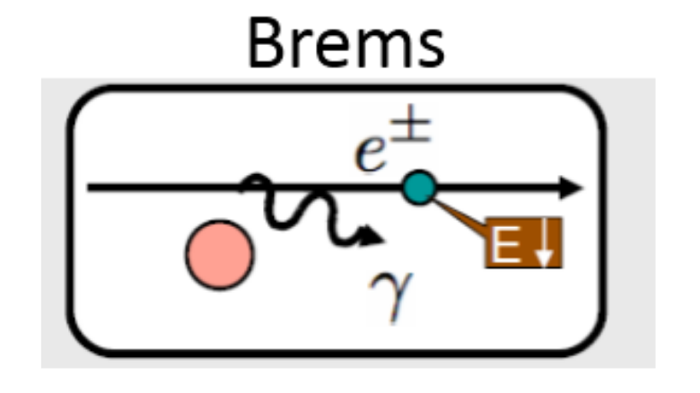



Beam Gas Scattering - inelastic
Bremsstrahlung between beam particles and residual gas
Beam particles(mainly) and photons
Rate $∝P, T^{−1}$, related to Z
Not depends on E, therefore, would be significant at high energy colliders like CEPC
  Also exists at linear colliders
$$σ_{brem}=4αr_{e}^{2}[\frac{4}{3}\left(ln\frac{1}{η}−\frac{5}{8}\right)F\left(Z\right)+\frac{1}{9}Z\left(Z+1\right)(ln\frac{1}{η}−1)]$$
$$\frac{1}{τ}=σρ_{gas}c=σc\frac{P}{k_{B}T}$$
Machine Name | Beam Gas Brems Lifetime
BEPCII | 50.7h
SuperKEKB – HER - Phase 1 | ~ 3.2h
SuperKEKB – LER – Phase 1 | ~ 3.9h
LEP 1
CEPC – Higgs | 248.90h
Loss Pos@ CEPC-Higgs
IR: 1.6%
Loss turn @ CEPC-Higgs

Slide 11
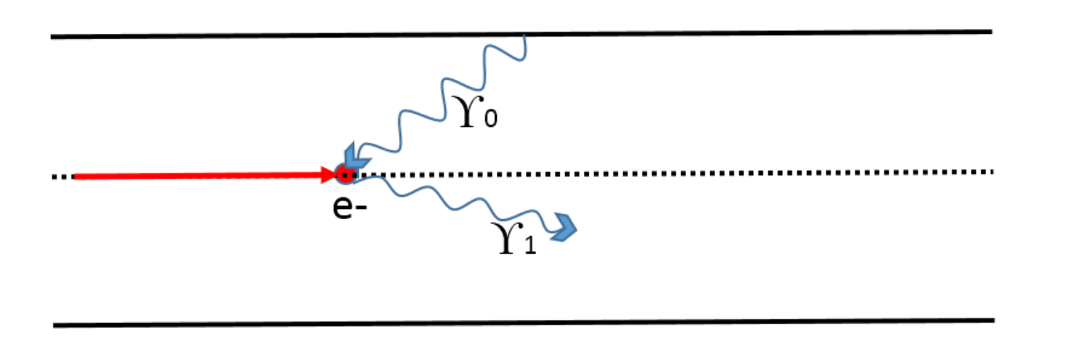
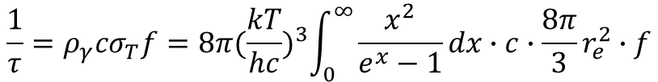

Beam Thermal Photon
Compton scattering between beam particles and thermal photons
Beam particles(mainly) and photons
Rate $∝ T^{3}, f;$ $f related to η^{−1}, E^{−1}$
Not depends on E(besides f), therefore would be significant at high energy colliders like CEPC
  Also exists at linear colliders
  For T=24$℃$, $ρ_{γ}=5.329×{10}^{14}m^{−3}$, <e>=0.07eV, $ρ_{γ}cσ_{T}$ is about 26.2h, f is the loss ratio which determined by experiment(or simulation)
  The energy of E would be increased as $γ^{2}$, <e> is ~550 MeV@Z, 3.86 GeV@Higgs, 8.7 GeV@ttbar
$$\frac{1}{τ}=ρ_{γ}cσ_{T}f=8π{(\frac{kT}{hc})}^{3}\int_{0}^{∞}{\frac{x^{2}}{e^{x}−1}dx}∙c∙\frac{8π}{3}r_{e}^{2}∙f$$
Loss Pos@ CEPC-Higgs
IR: 3.1%
 | Higgs | Z | ttbar | W
f | 0.51718 | 0.37238 | 0.5471725 | 0.47443
Beam Lifetime | 50.66h | 70.19h | 47.88h | 55.22h
Loss turn @ CEPC-Higgs
Notes:
截面和f都需要实验和模拟修正

Slide 12
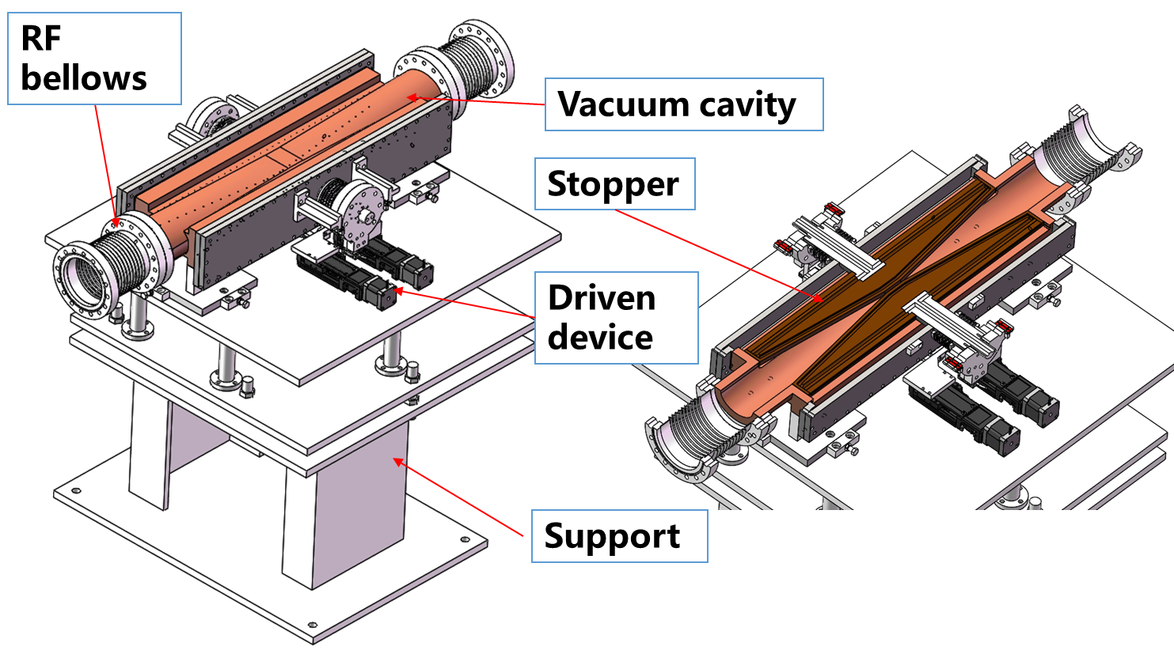
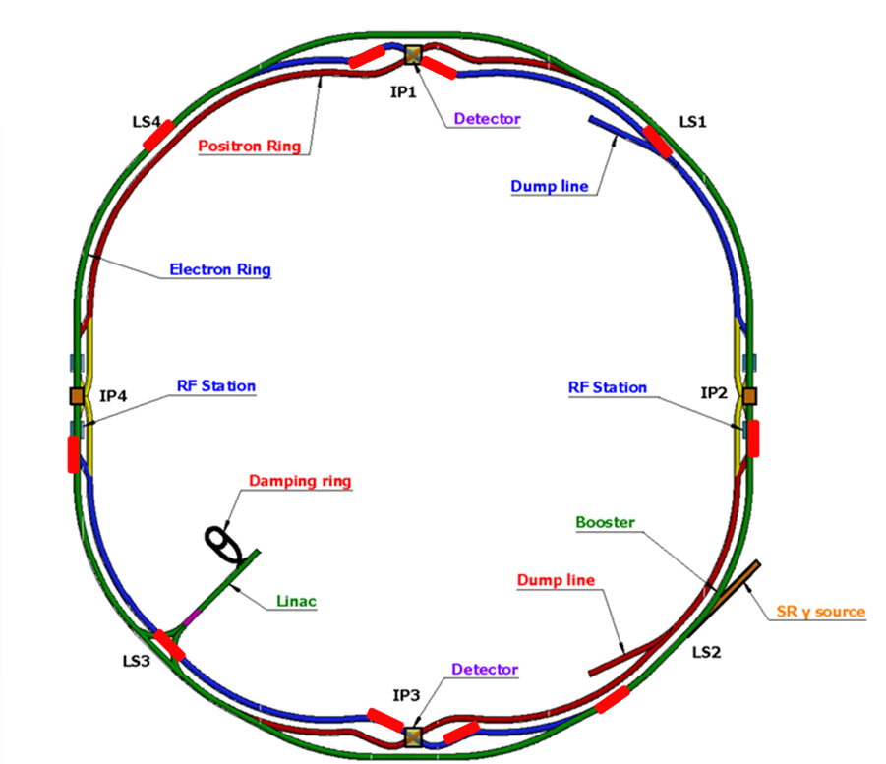
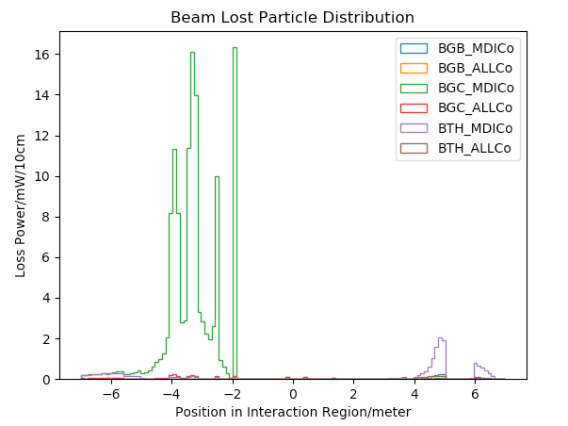
Mitigation of the BG - Collimator
Requirements:
  Beam stay clear region: 18 σ_{x}+3mm, 22 σ_{y}+3mm
  Impedance requirement: slope angle of collimator < 0.1
4 sets of collimators were implemented per IP per Ring(16 in total)
  2 sets are horizontal(4mm radius), 2 sets are vertical(3mm radius).
One more upstream horizontal collimator were implemented to mitigate the Beam-Gas background
A preliminary version of Collimator designed for Machine protection is finished. ~40 sets of collimators with 3mm radius are set alongside the ring.
H. Wang, P. Zhang
S. Bai, Y. Wang
~1/40x

Slide 13
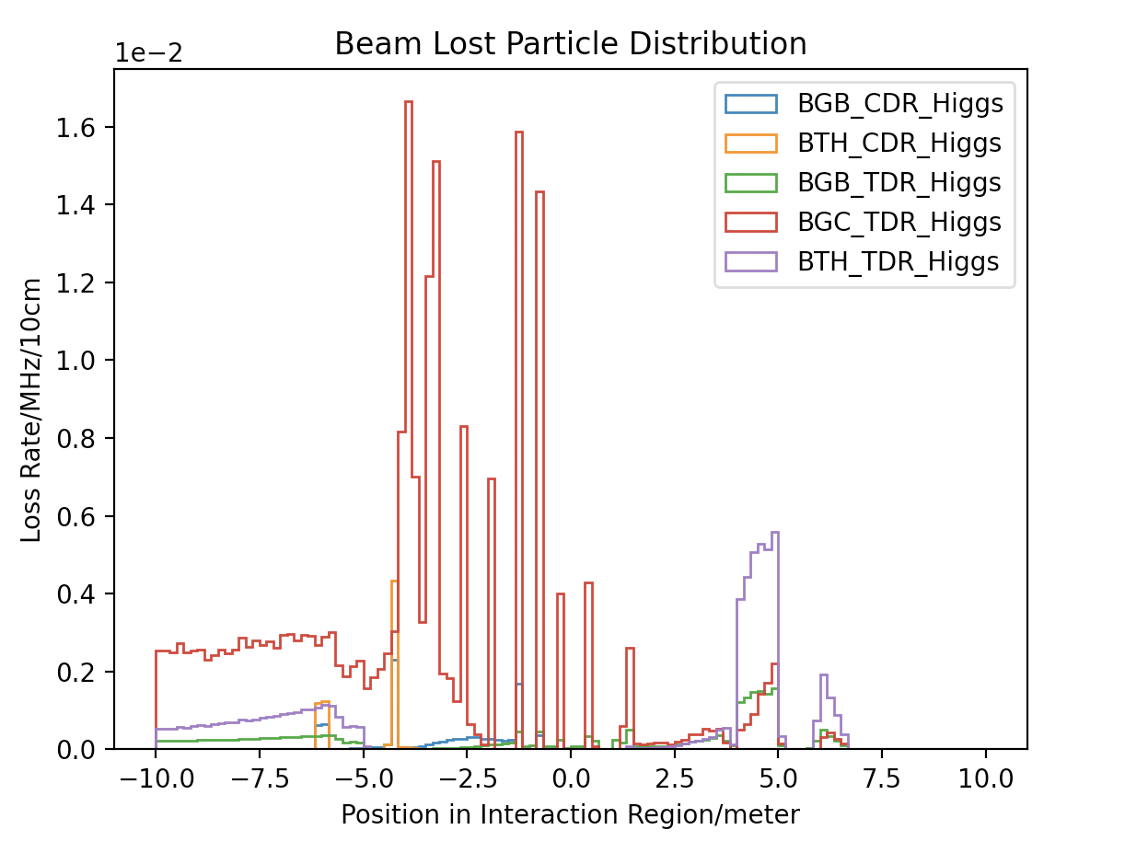
Loss Distribution
Errors implemented
  High order error for magnets
  Beam-beam effect
$$Loss Rate=\frac{Loss Number}{Loss Time}=\frac{Bunch number∗Particles per Bunch∗(1−e^{−1})}{Beam Lifetime}$$
～5x, especially upstream
@Higgs
@Z-pole
Preliminary
Preliminary

Slide 14
Estimation of Impacts in the IR
Noise on Detector(Backgrounds)
  Occupancy
  Estimate using the same tool with Physics simulation
Radiation Environment(Backgrounds + Signal)
  Radiation Damage of the Material(Detector, Accelerator, Electronics, etc…)
    Estimate using the same tool with physics simulation including the dose calculation
    Or FLUKA
  Radiation Harm of the human beings and environment
    Estimate using the same tool with physics simulation including the dose calculation
    Or FLUKA
Notes:
ATLAS, 90% Collision

Slide 15
Status – Beam Induced Backgrounds
Current Status towards Second Version(Based on CEPCSW):
  Input file(from generator or tracking tool) converted to ROOT format
  Get Hit distribution and Dose distribution at same time
    Hit in ROOT file, could be processed directly by detector designers and/or MDI group
    Dose in TXT file currently, will be processed by MDI group
  Time consuming, several min/particle with full detector
    Pairs with GeV energy, ~8s/particle
    Single BG at minutes level
    Could be speeded up with proper settings of threshold, still finding
    50 minutes/particle @ ATLAS Geant4 BG Simulation
  Geometry almost fixed. Ready to simulate.
  Debug could be performed together with simulation.

Slide 16
Status – Beam Induced Backgrounds
Current Status towards Second Version(Based on CEPCSW):
Background | Mode | Generation | Tracking | Noise Estimation | Rad. Da. Esti. | Rad. Env. Esti.
Synchrotron Radiation | Higgs | Testing | To do | To do | To do | To do
 | Z | To do | To do | To do | To do | To do
Beamstrahlung/Pair Production | Higgs | Done | - | Mass Pro. Done | Ready to Mass P | Ready to Mass P
 | Z | Done | - | Ready to Mass P | Ready to Mass P | Ready to Mass P
Beam-Thermal Photon | Higgs | Done | Done w.o. Sol | Ready to Mass P | Ready to Mass P | Ready to Mass P
 | Z | Done | Done w.o. Sol | Ready to Mass P | Ready to Mass P | Ready to Mass P
Beam-Gas Bremsstrahlung | Higgs | Done | Done w.o. Sol | Mass Producing | Ready to Mass P | Ready to Mass P
 | Z | Done | Done w.o. Sol | Ready to Mass P | Ready to Mass P | Ready to Mass P
Beam-Gas Coulomb | Higgs | Done | Done w.o. Sol | Ready to Mass P | Ready to Mass P | Ready to Mass P
 | Z | Done | Done w.o. Sol | Ready to Mass P | Ready to Mass P | Ready to Mass P
Radiative Bhabha | Higgs | Done | Doing | Code Ready | Code Ready | Code Ready
 | Z | Done | Doing | Code Ready | Code Ready | Code Ready
Touschek | Higgs | Done | Done w.o. Sol | Ready to Mass P | Ready to Mass P | Ready to Mass P
 | Z | Done | Done w.o. Sol | Ready to Mass P | Ready to Mass P | Ready to Mass P
Pair@Higgs: /cefs/higgs/shihy/tools/CEPCSW_Latest/CEPCSW/Test/Pair/0.root

Slide 17
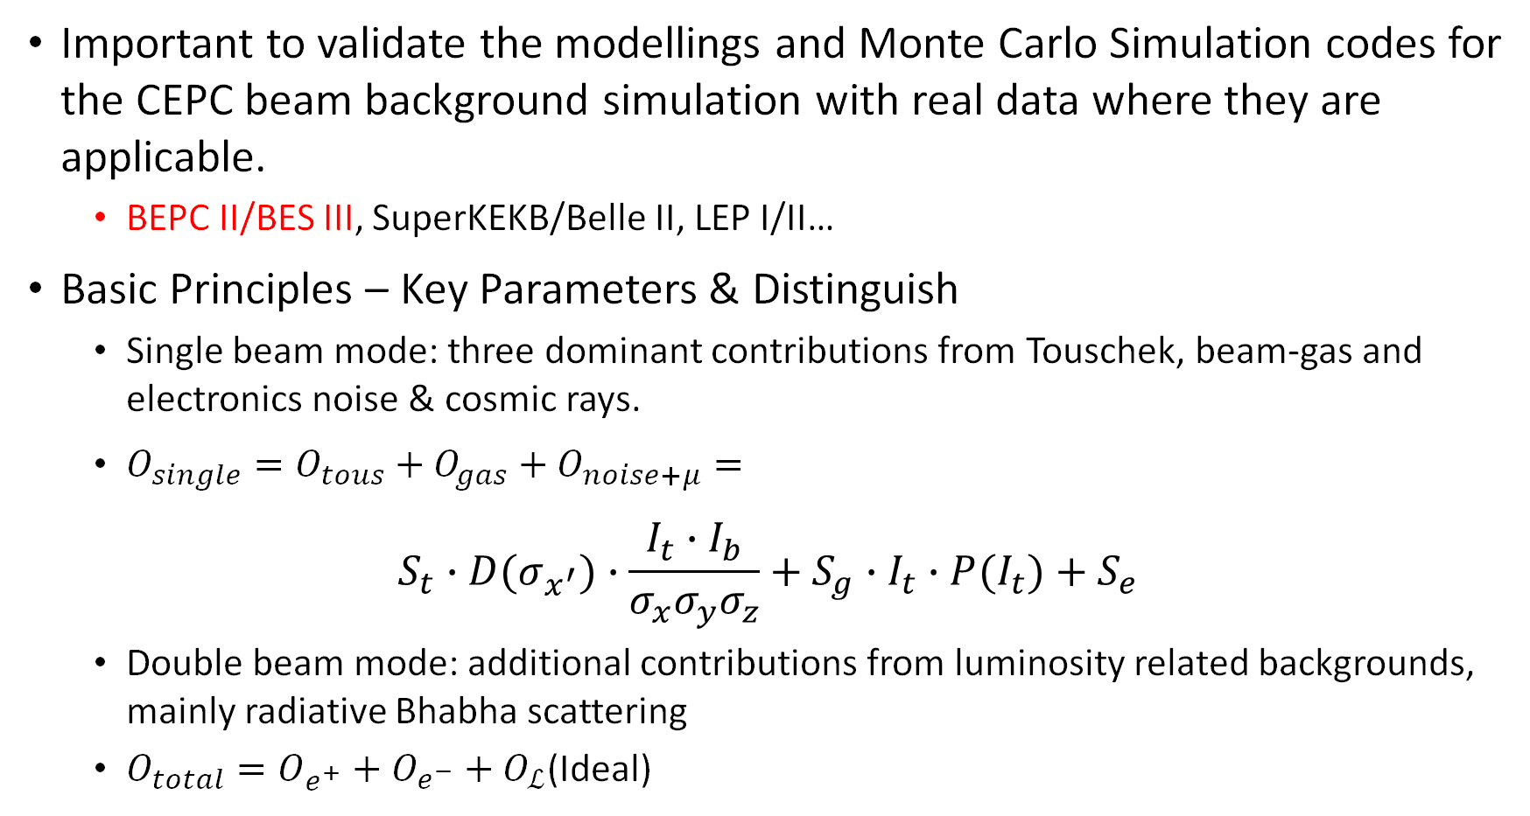
Benchmark – Experiments
Important to validate the modellings and Monte Carlo Simulation codes for the CEPC beam background simulation with real data where they are applicable.
  BEPC II/BES III, SuperKEKB/Belle II, LEP I/II…
Basic Principles – Key Parameters & Distinguish
  Single beam mode: three dominant contributions from Touschek, beam-gas and electronics noise & cosmic rays.
  $O_{single}=O_{tous}+O_{gas}+O_{noise+μ}=$
$$S_{t}∙D(σ_{x^{′}})∙\frac{{I_{t}∙I}_{b}}{{σ_{x}σ_{y}σ}_{z}}+S_{g}∙I_{t}∙P(I_{t})+S_{e}$$
  Double beam mode: additional contributions from luminosity related backgrounds, mainly radiative Bhabha scattering
  $O_{total}=O_{e^{+}}+O_{e^{−}}+O_{ℒ}$(Ideal)

Slide 18
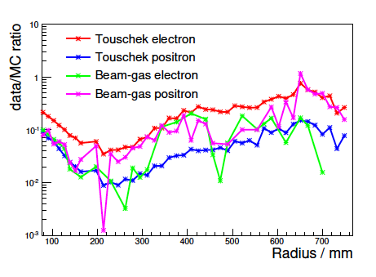
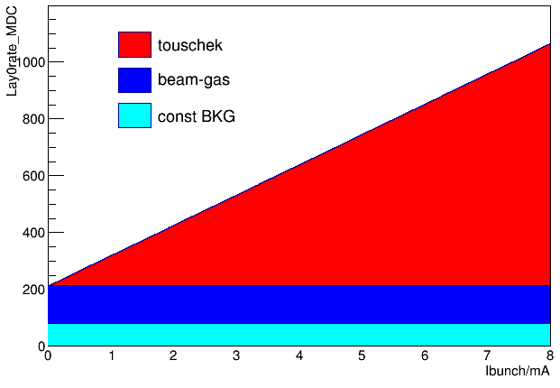
BESIII Benchmark
BG experiments on BEPCII/BESIII has been done several times.
  The experiment in 2021 separate the single beam BG sources, the data/MC ratio has been reduced.
H. Shi, B. Wang. H. Shi et.al
BG separation on 1st layer MDC
Data/MC radio improvements on 1st layer MDC
Data/MC radio in MDC

Slide 19
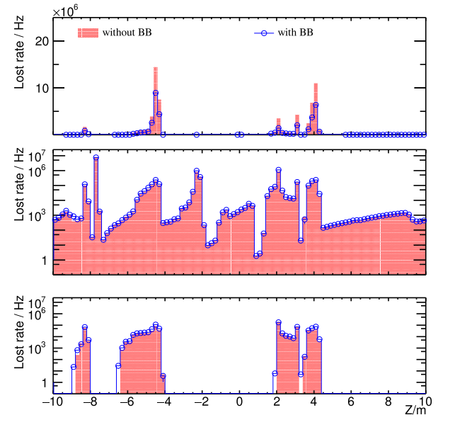
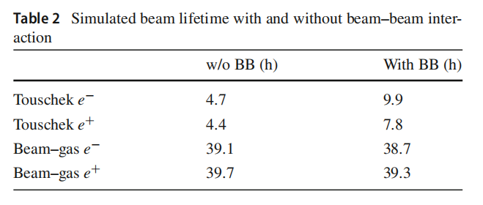
BESIII Benchmark – Beam-beam
Beam-beam could increase the touschek lifetime(decrease touschek rate)
Due to beam-beam, touschek rate could be decreased ~30%, and 15% in total at BESIII
We still have 1~2 order of magnitude differ between data/MC, plan to do more on BIIU

Slide 20
Backup

Slide 21
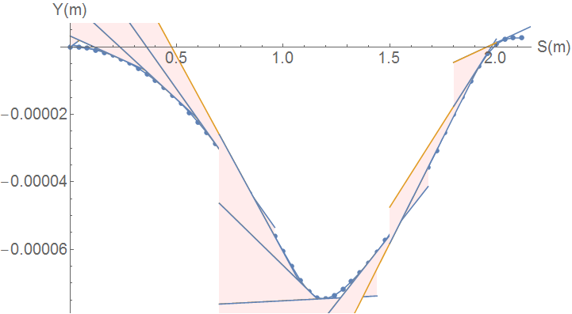
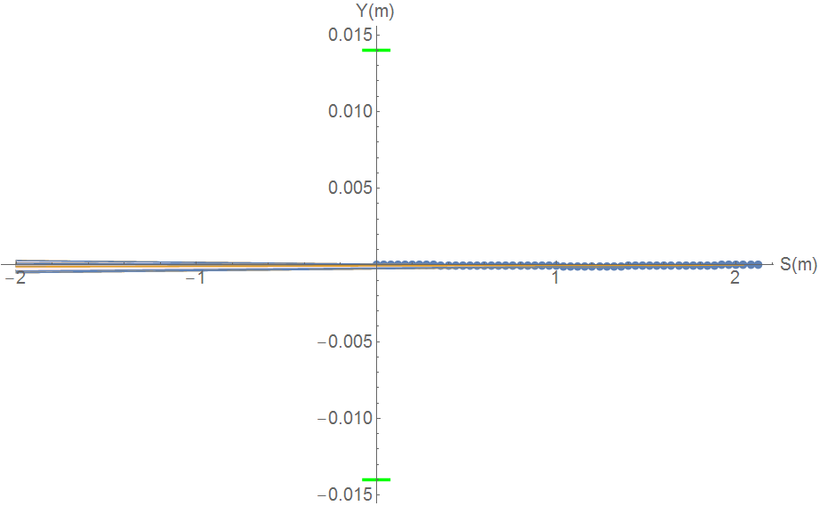
SR from solenoid combined field
S. Bai
Horizontal trajectory will couple to the vertical
Due to the sol+anti-sol field strength quite high, maximum~4.24T, transverse magnetic field component is quite high.
SR from vertical trajectory in sol+anti-sol combined field should be taken into account.
SR fan is focused in a very narrow angle from
-116urad to 131urad
SR will not hit Berryllium pipe, and no background to detector.
SR will hit the beam pipe ~213.5m downstream from IP
Water cooling is needed.
Maximum: 670keV
Maximum: 31W

Slide 22
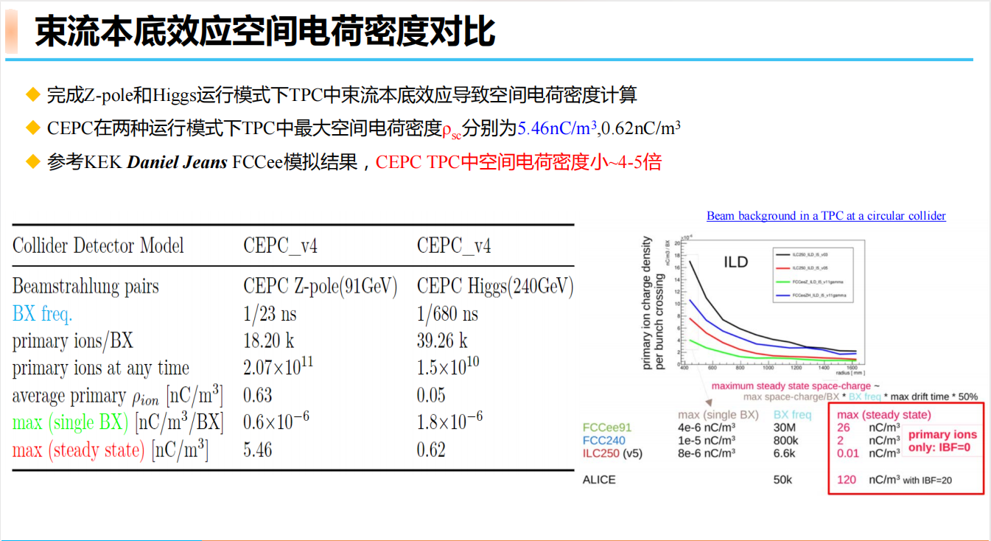
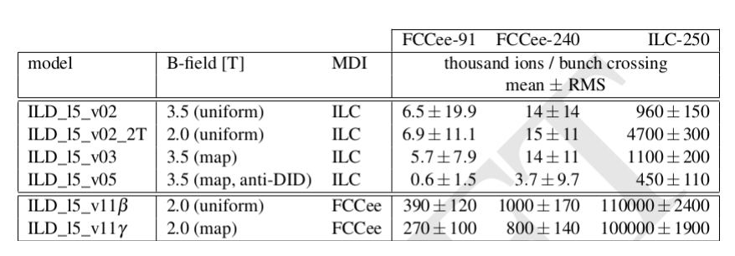
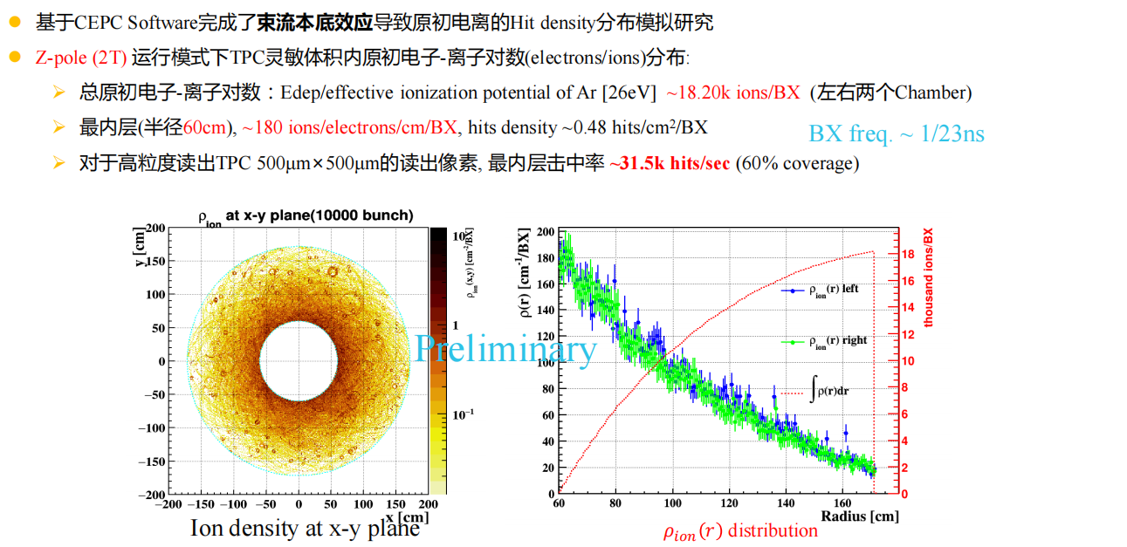
BG@TPC

