Slide 1
Cost and timeline
Miao He
July 2, 2024

Slide 2
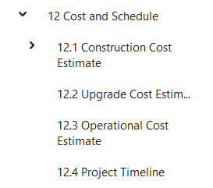
TDR outline: cost and timeline
Construction cost
Project timeline
Items
Management | General instruments and tools
 | Installation
 | Commissioning
 | Contingency
 | Indirect cost
Detector L2 system1
Detector L2 system2
…
Do we need this?
Similar section in CEPC TDR: accelerator
TDR
EDR
Production
Installation
Commissioning

