Slide 1
CEPC vertex detector
Zhijun Liang
(On behalf of the CEPC physics and detector group)
Institute of High energy physics, CAS

Slide 2
Content
Introduction
Requirements
Technology survey and our choices
Technical challenges
R&D efforts and results
Detailed design including electronics, cooling and mechanics
Readout electronics & BEC
Performance from simulation
Research team and working plan
Summary

Slide 3
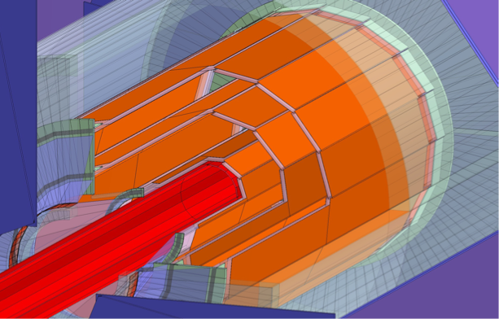
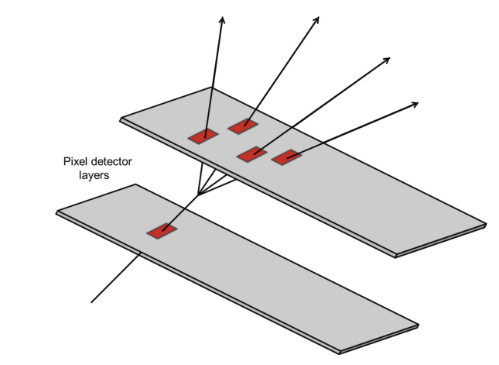
Introduction: vertex detector
Vertex detector is required for All four detector concept
Motivation:
  Aim for impact parameter resolution and vertexing capability
  For H → bb/ H → cc/ H → light quark or gluons analysis
  The observation H → cc or H → gg is important goal for CEPC

Slide 4
Vertex Requirement
  Vertex detector optimized for first 10 year of CEPC operation (ZH, low lumi-Z runs)
    ZH runs (240GeV) : Higgs factory
    Z pole running (low lumiosity Z , 20% of high lumi Z runs)
    Support high lumi Z as much as possible (not optimized for high lumi Z)
  Inner most layer (b-layer) need to be as close to beam pipe as possible
    Inner radius ~11mm
  Detector Cooling (<=40 mW/cm²) with air cooling
  High data rate: (especially at Z pole , 40MHz, 1Gbps per chip )
  Radiation level (~1Mrad per year in average)
  Low material budget (~0.05%X/X0 per layer)
  Spatial Resolution (3-5um)

Slide 5
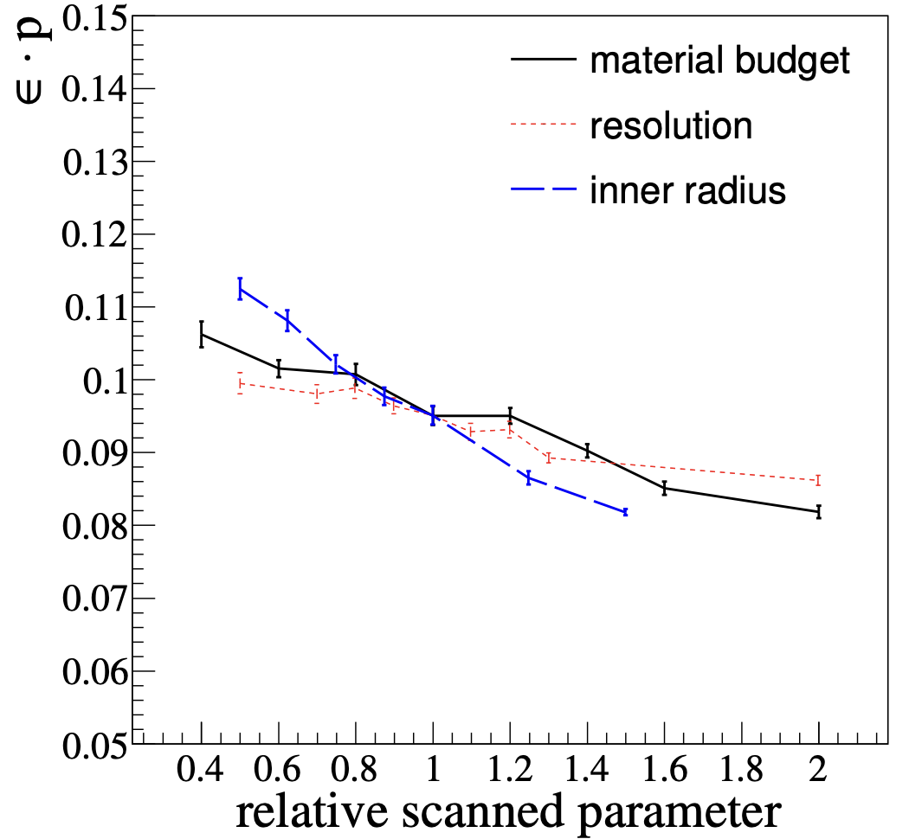
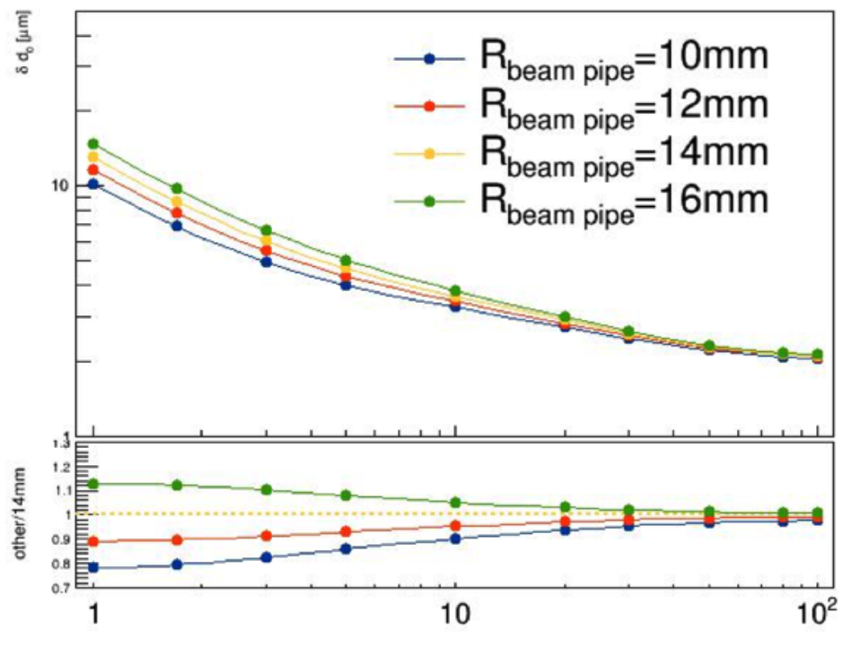
Vertex Requirement
1st priority: Small inner radius, close to beam pipe (11mm )
2nd priority: Low material budget <0.15% X0 per layer
^{3rd} priority: High resolution pixel sensor： 3~5 μm

Slide 6
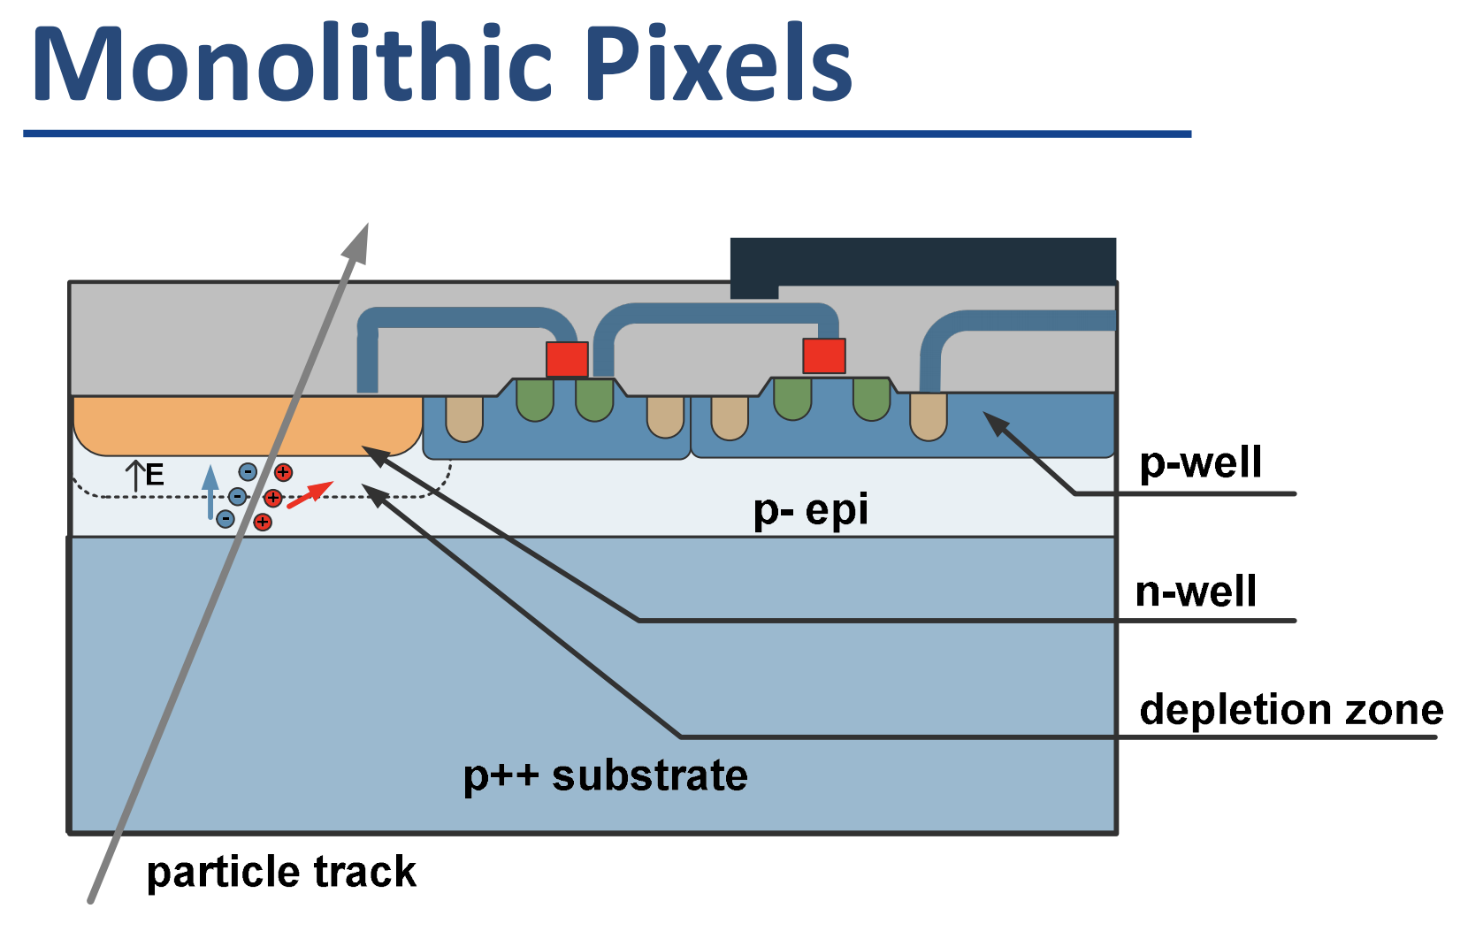
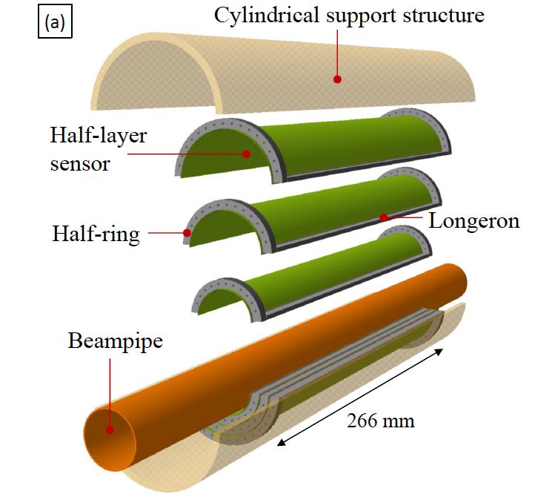
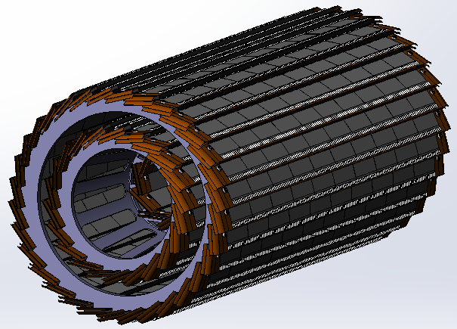
Technology survey and our choices
Vertex detector Technology selection
  Baseline: based on curved CMOS MAPS (Inspired by ALICE ITS3 design )
  Alternative: Ladder design based on CMOS MAPS
Monolithic active Pixel CMOS (MAPS)
Baseline: curved MAPS
Alternative: ladder based MAPS

Slide 7
Challenges
  CEPC b-layer radius (11mm) is smaller compared with ALICE ITS3 (18mm)
  High background data rate (~1Gbps per chip )
    especially challenging for curved MAPS without PCB metal line
  Power consumption (<=40 mW/cm²) in high datarate
    Feasibility of Air cooling

Slide 8
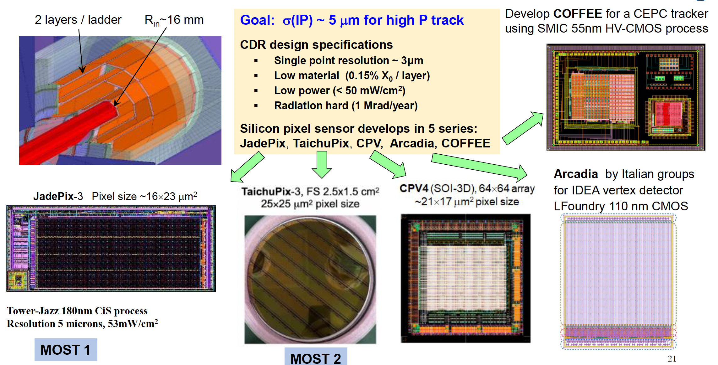
R&D efforts and results: Silicon Pixel Chips for Vertex Detector

Slide 9
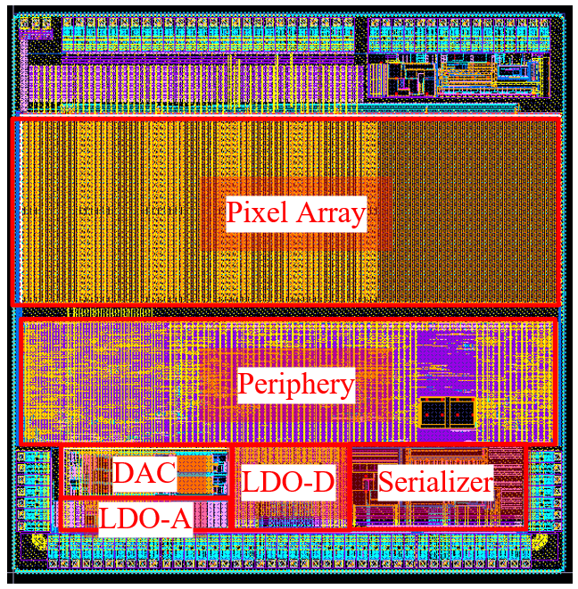
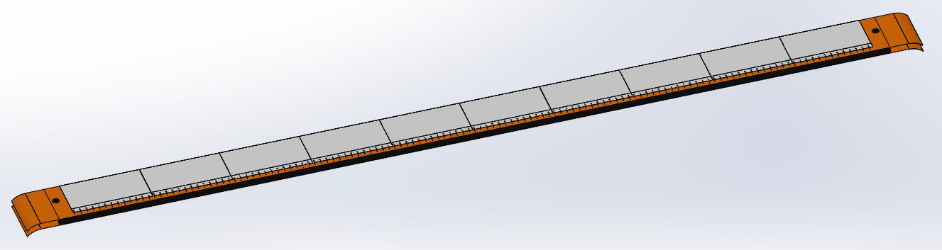

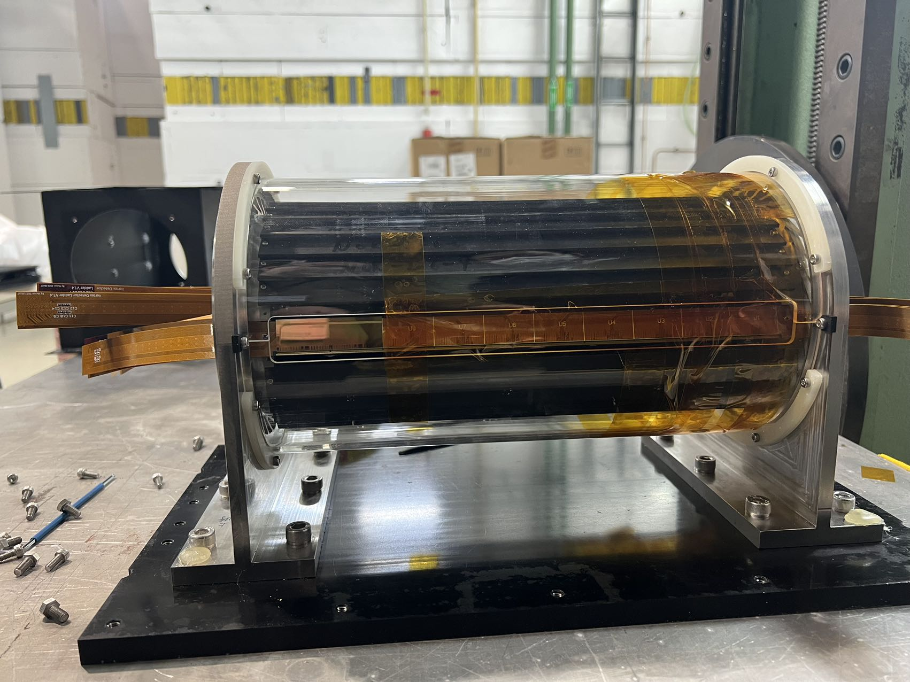
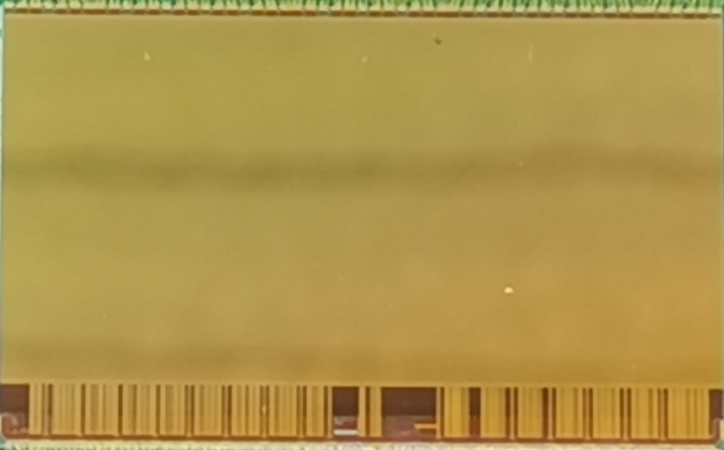
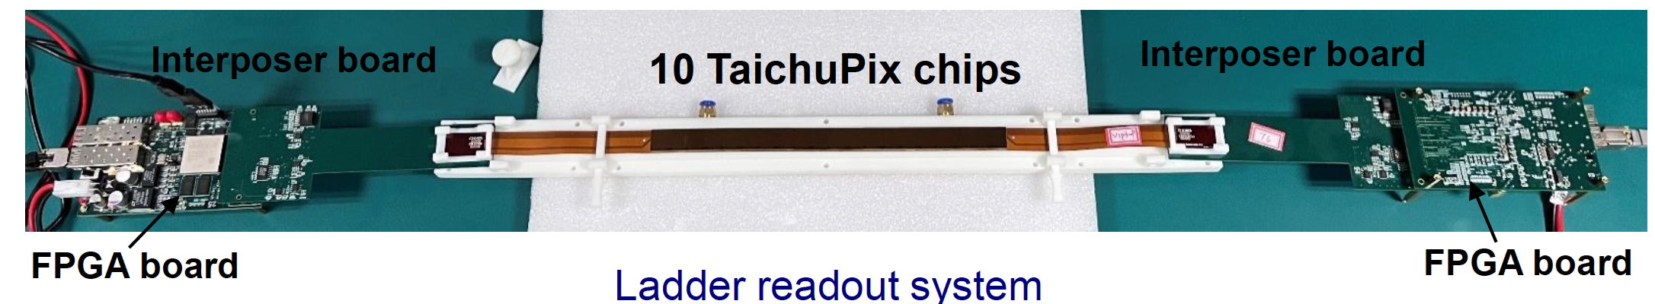
R&D efforts and results: CEPC vertex detector prototype R & D
CMOS Sensor chip development
Vertex detector prototype
Detector module
(Ladder) Prototyping

Slide 10
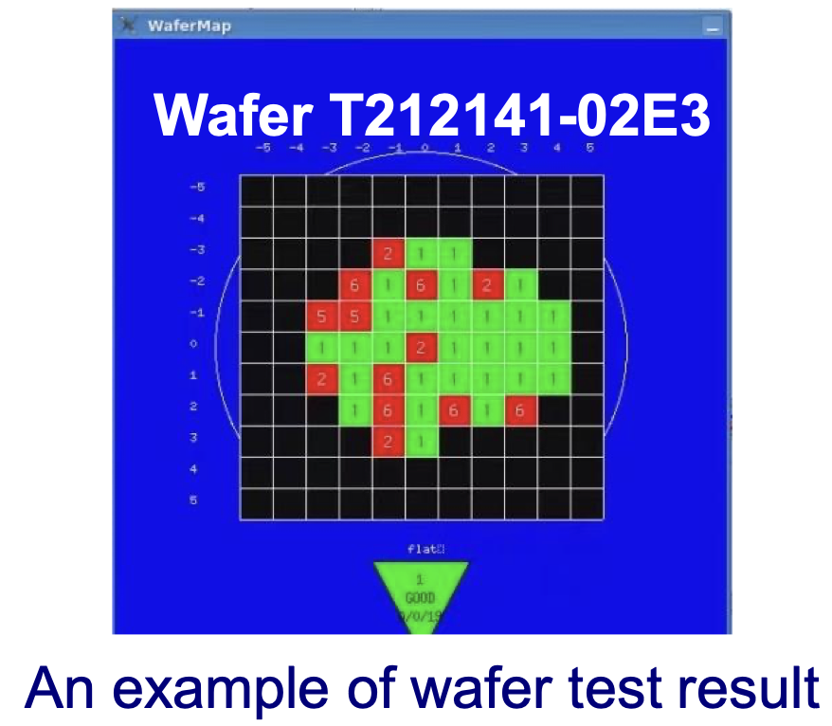
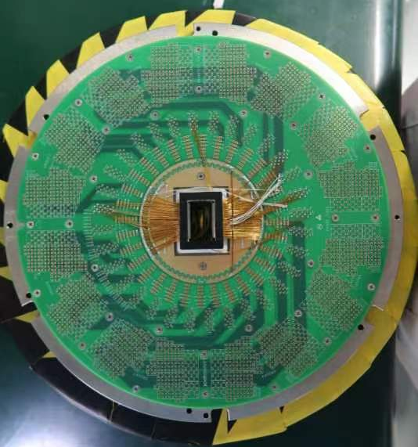
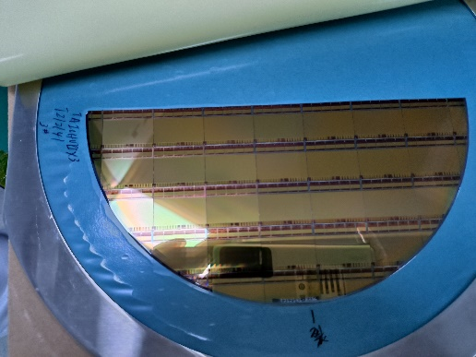
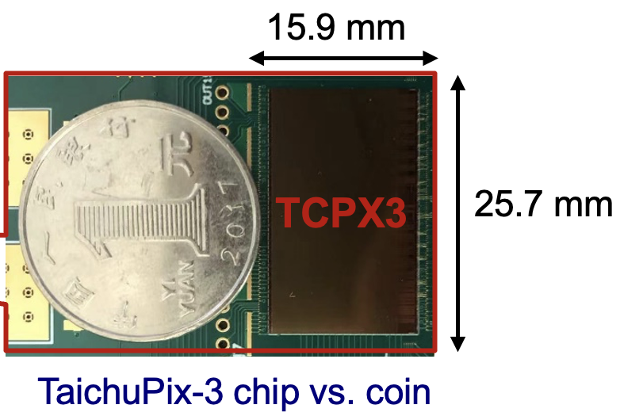
R&D efforts and results: Full-size TaichuPix3 (engineering run)
Developed the first full-size CMOS MAPS sensor
  Full size 1024×512 Pixel array, Chip Size：15.9×25.7mm
    25μm×25μm pixel size → high spatial resolution
    Process: Towerjazz 180nm CIS process
  Fast digital readout to cope with ZH and Z runs (support 40MHz clock)
    Column-drain readout for pixel matrix

Slide 11
R&D efforts and results: TaichuPix design
Pixel 25 μm × 25 μm
  Continuously active front-end, in-pixel discrimination
  Fast-readout digital, with masking & testing config. logic
Column-drain readout for pixel matrix
  Priority based data-driven readout
  Readout time: 50-100 ns for each pixel
2-level FIFO architecture
  L1 FIFO: de-randomize the injecting charge
  L2 FIFO: match the in/out data rate
  between core and interface
Trigger-less & Trigger mode compatible
  Trigger-less: 3.84 Gbps data interface
  Trigger: data coincidence by time stamp
  only matched event will be readout
Features standalone operation
  On-chip bias generation, LDO, slow control, etc

Slide 12
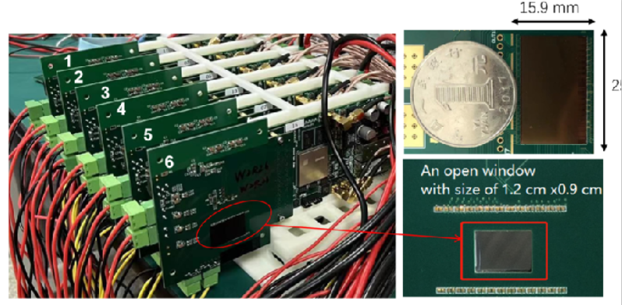
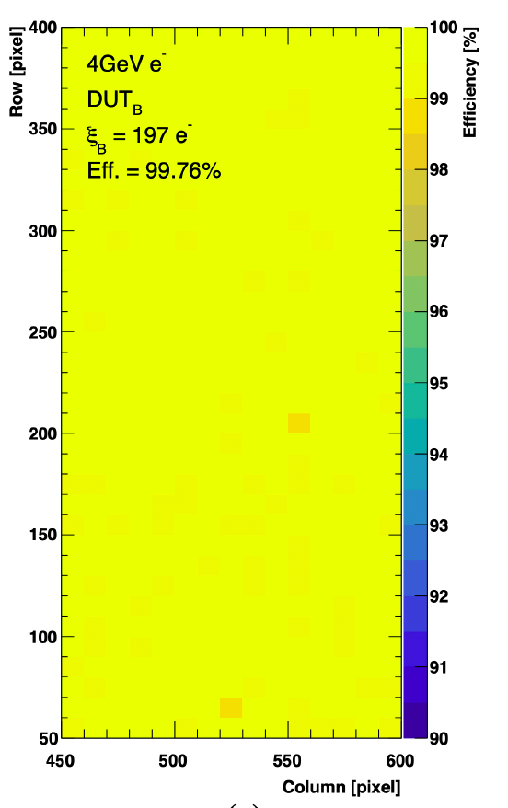
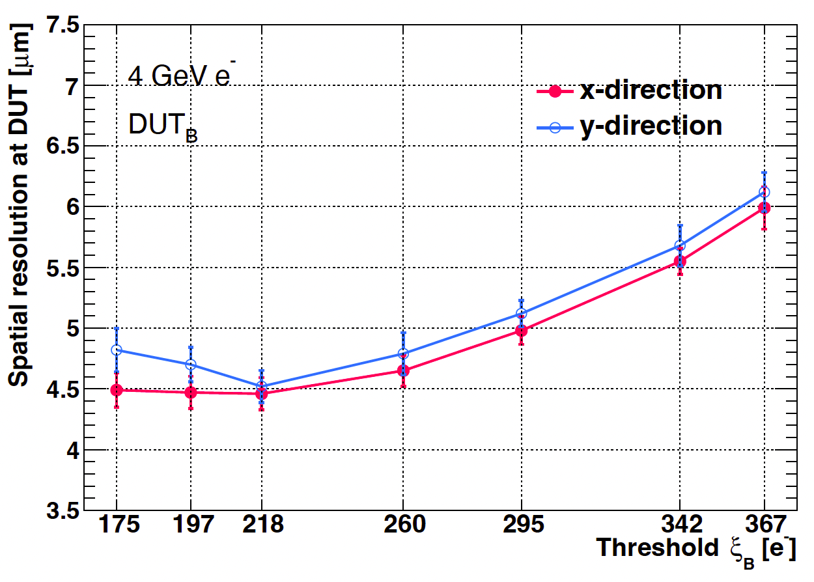
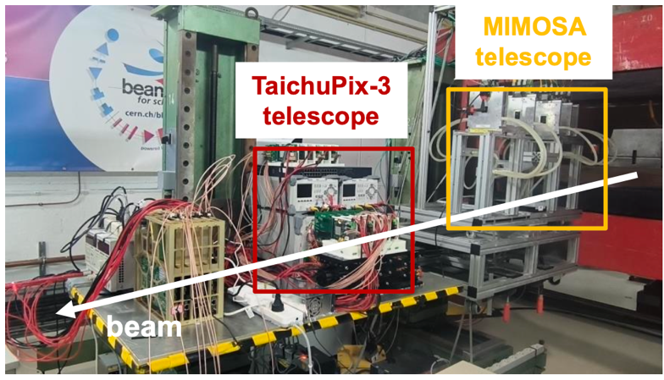
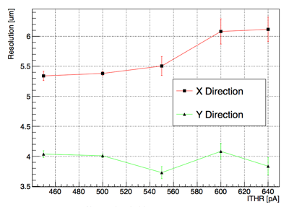
R&D efforts and results: Jadepix3/TaichuPix3 beam test @ DESY
Spatial resolution 4~5um, Efficiency >99%
TaichuPix3 efficiency
TaichuPix3 resolution
JadePix3 resolution
JadePix3
telescope
Collaboration with CNRS and IFAE in Jadepix/TaichuPix R & D

Slide 13
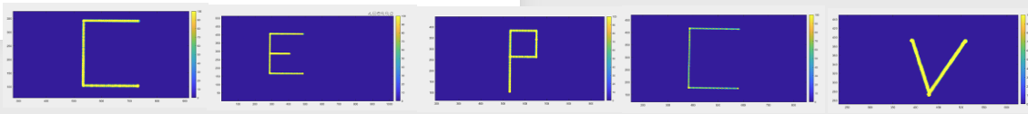
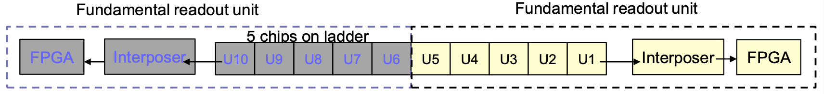
R&D efforts and results: ladder design
Completed detector module (ladder) design
  Detector module (ladder) = 10 sensors + readout board + support structure + control board
  Signal, clock, control, power, ground will be handled by control board through flexible PCB
  Functionality of a full ladder fundamental readout unit was verified with laser tests

Slide 14
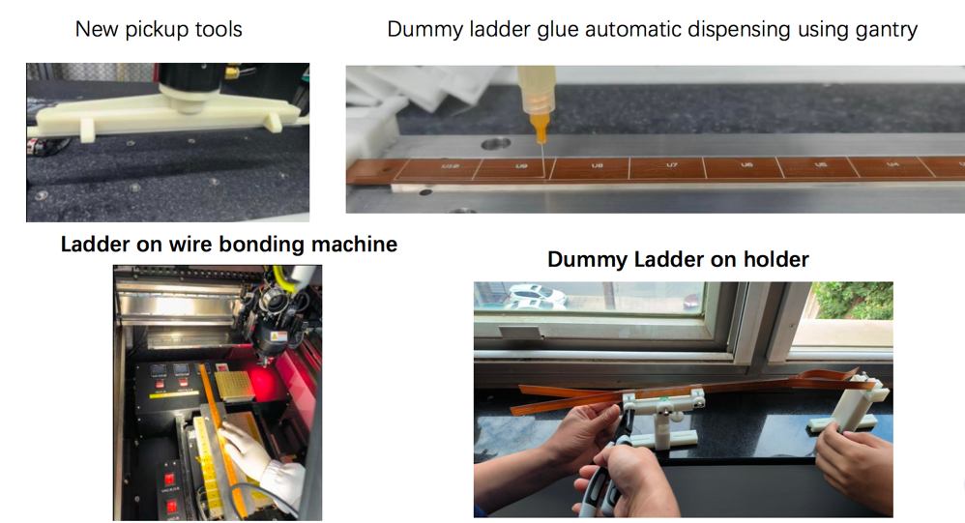
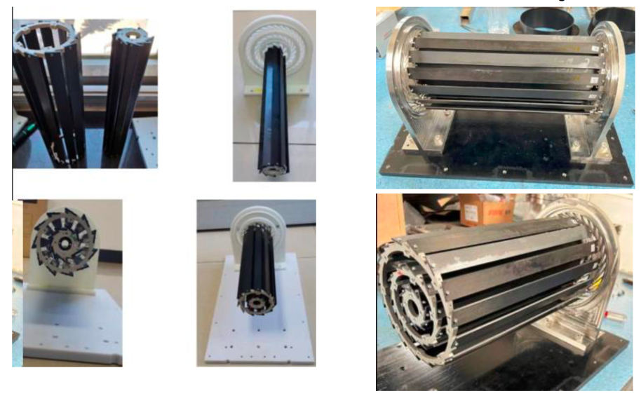
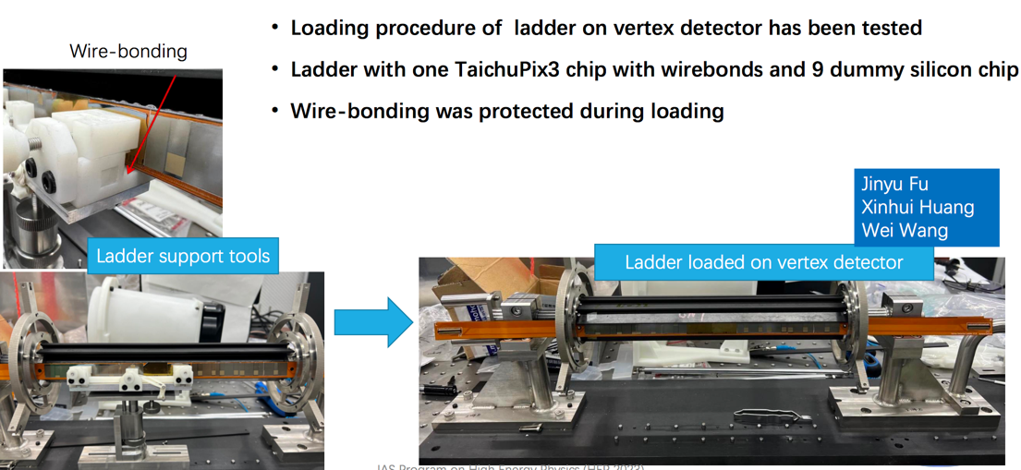
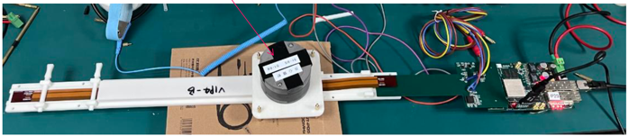
R&D efforts and results: TaichuPix3 vertex detector prototype
The first vertex detector (prototype) ever built in China

Slide 15
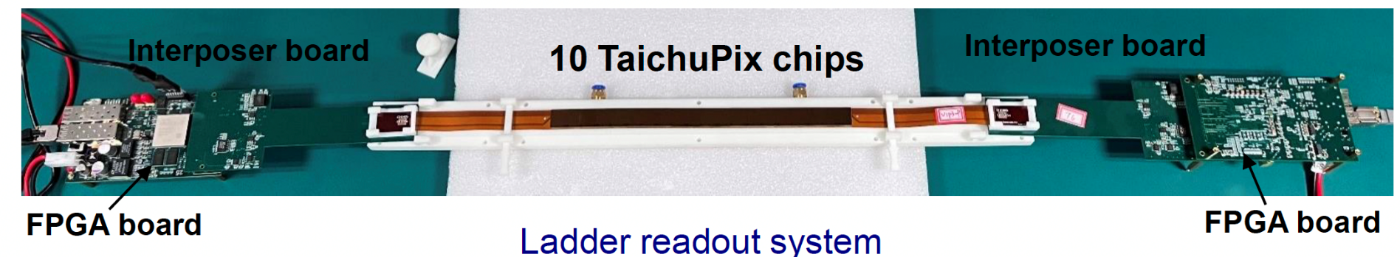
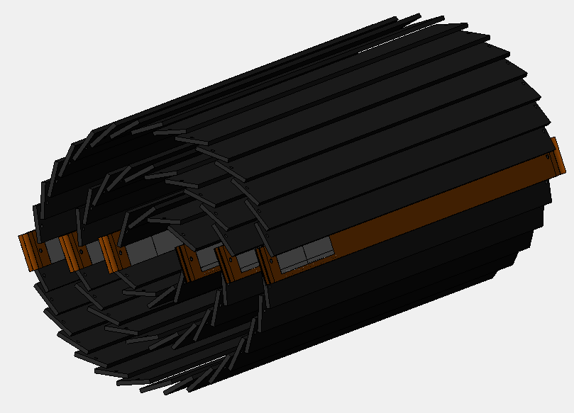
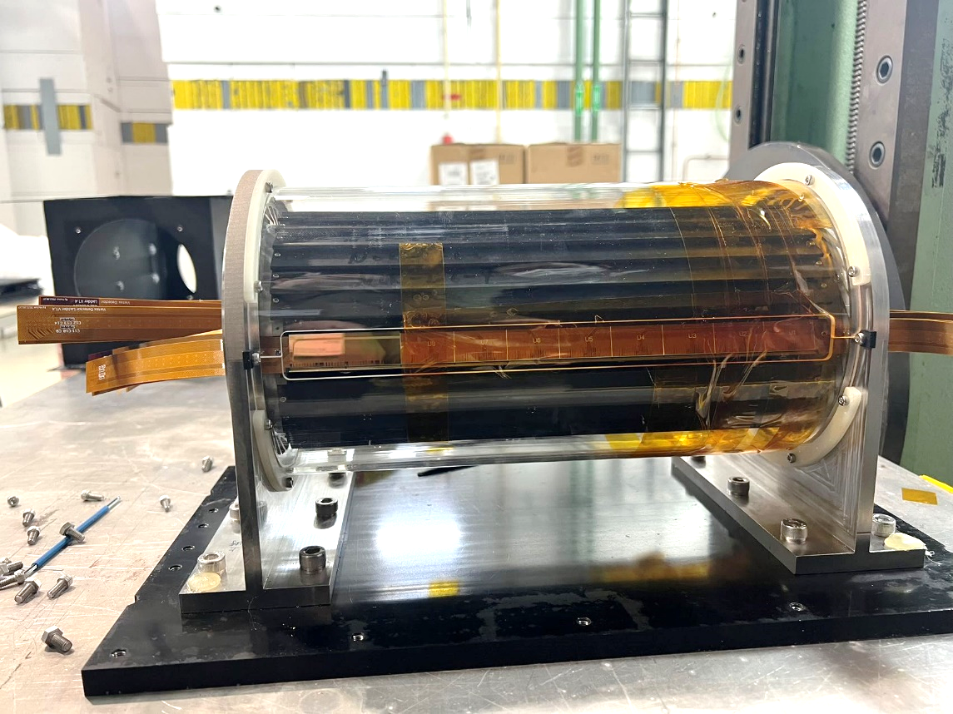
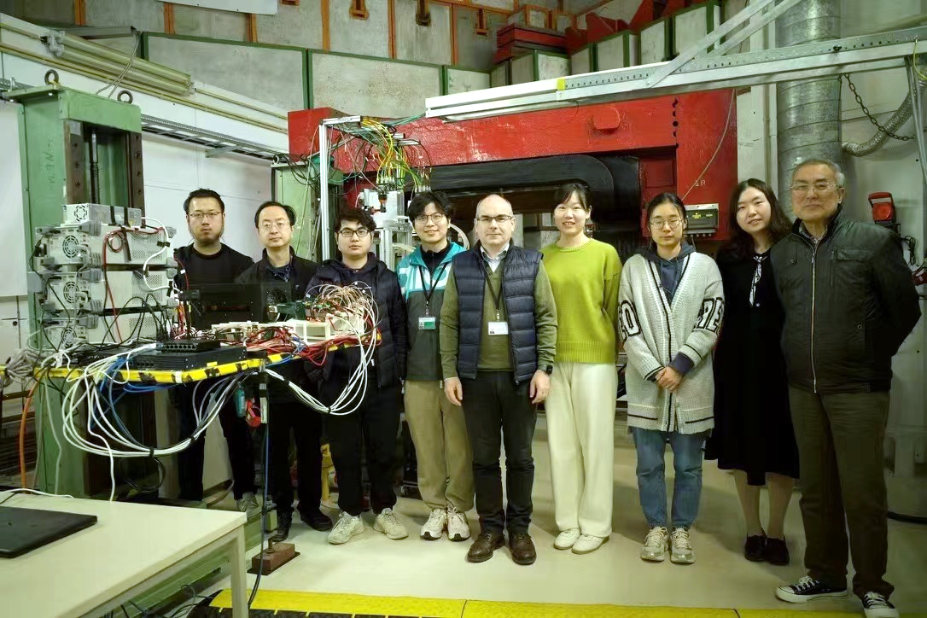
R&D efforts and results: vertex detector prototype beam test
TaichuPix-based prototype detector tested at DESY in April 2023
Spatial resolution ~ 4.9 μm
6 double-sided ladders

Slide 16
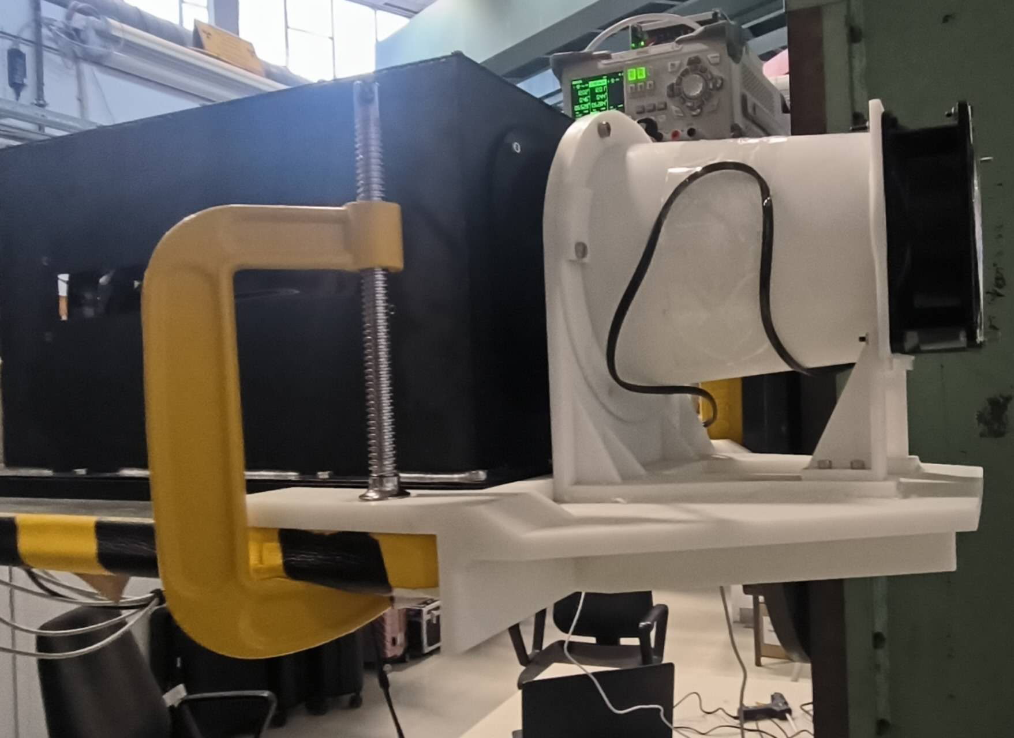
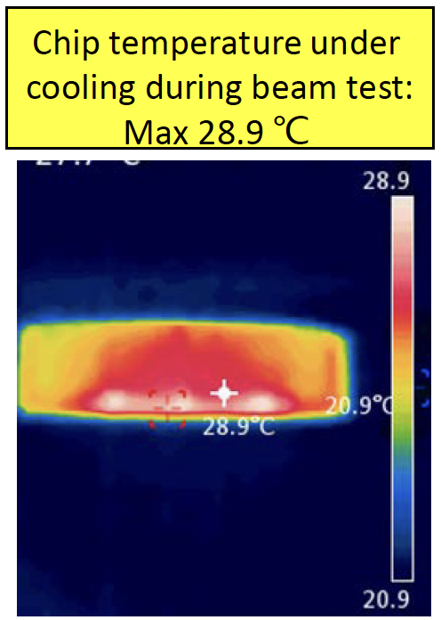
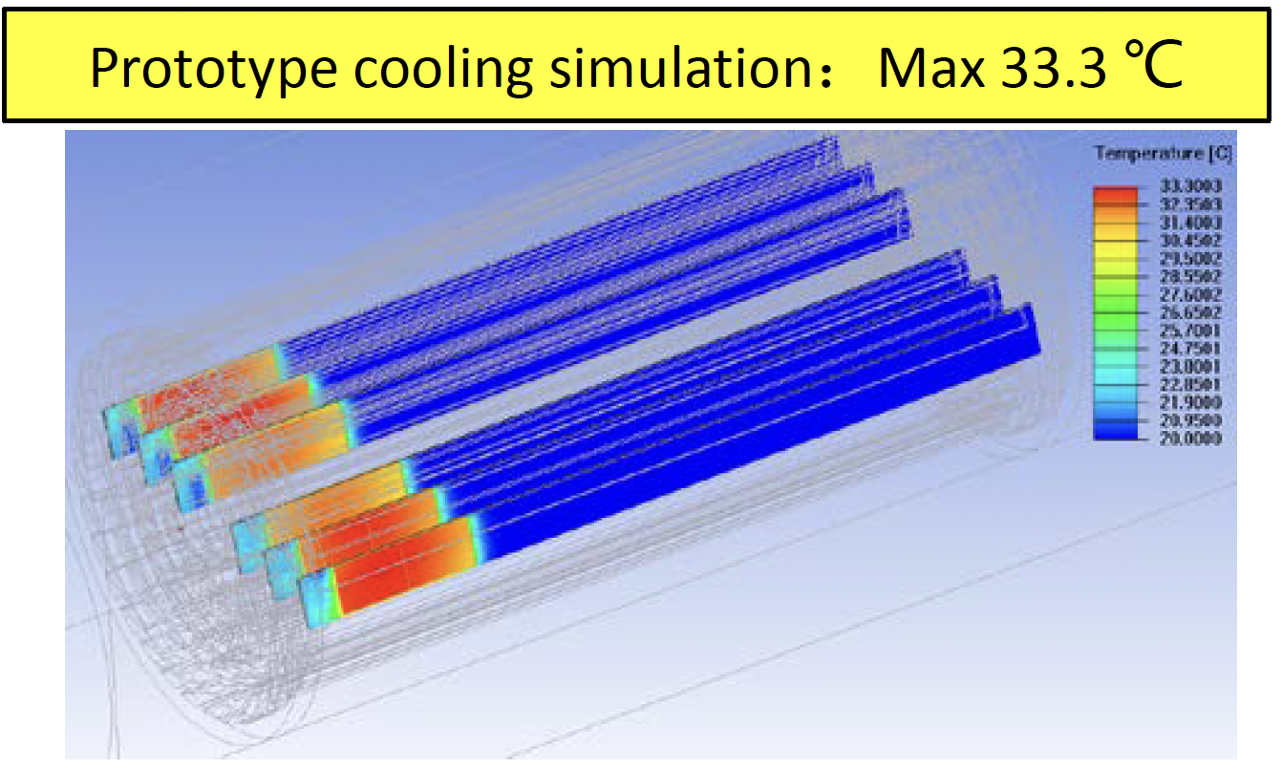
R&D efforts and results: Air cooling in vertex detector prototype
Dedicated air cooling channel designed in prototype.
  Measured Power Dissipation of Taichu chip: ~60 mW/cm² (17.5 MHz clock in testbeam)
  Before (after ) turning on the cooling, chip temperature 41 °C (25 °C)
    In good agreement to our cooling simulation
    No visible vibration effect in spatial resolution when turning on the fan

Slide 17
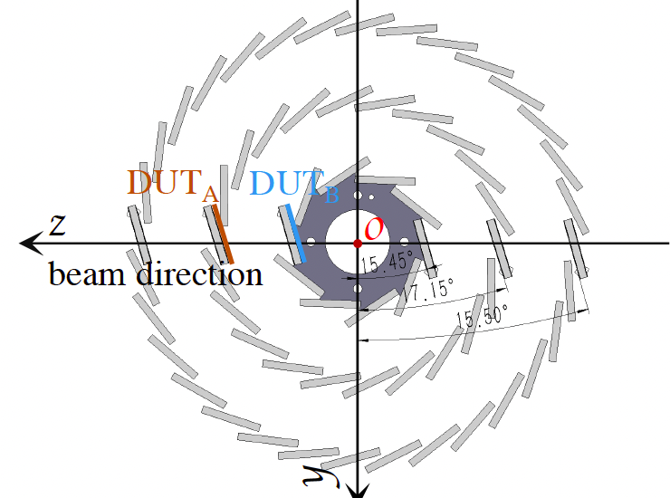
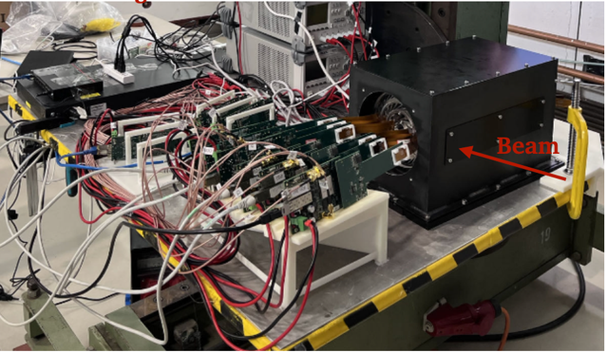
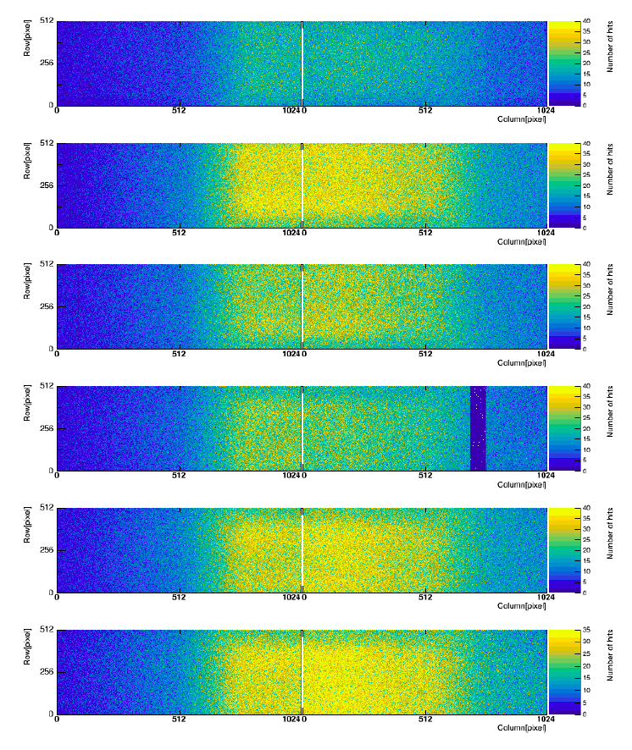
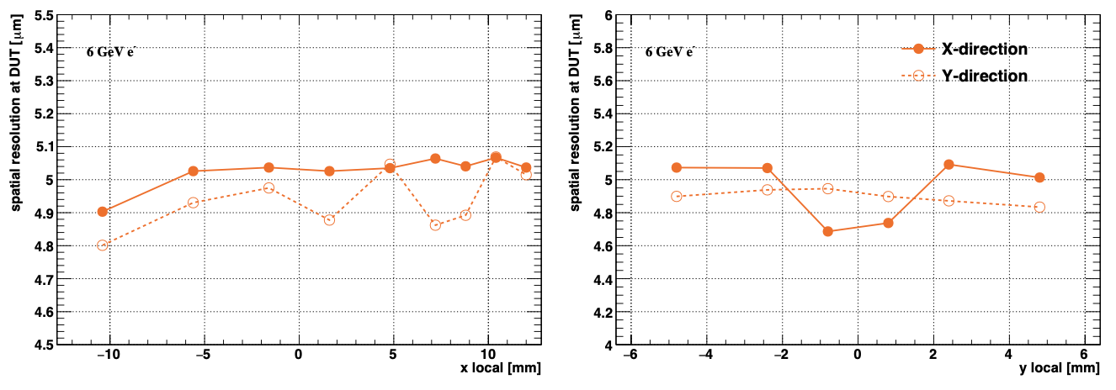
R&D efforts and results: vertex detector prototype beam test
Hit maps of multiple layers of vertex detector
Beam spot
Spatial resolution ~ 5 μm

Slide 18
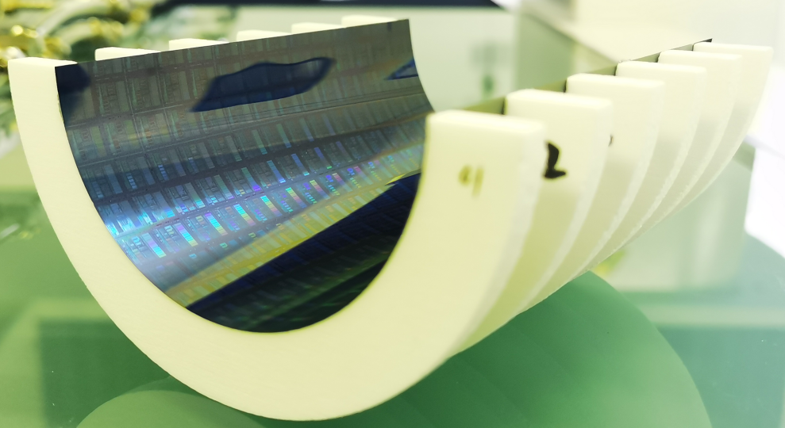
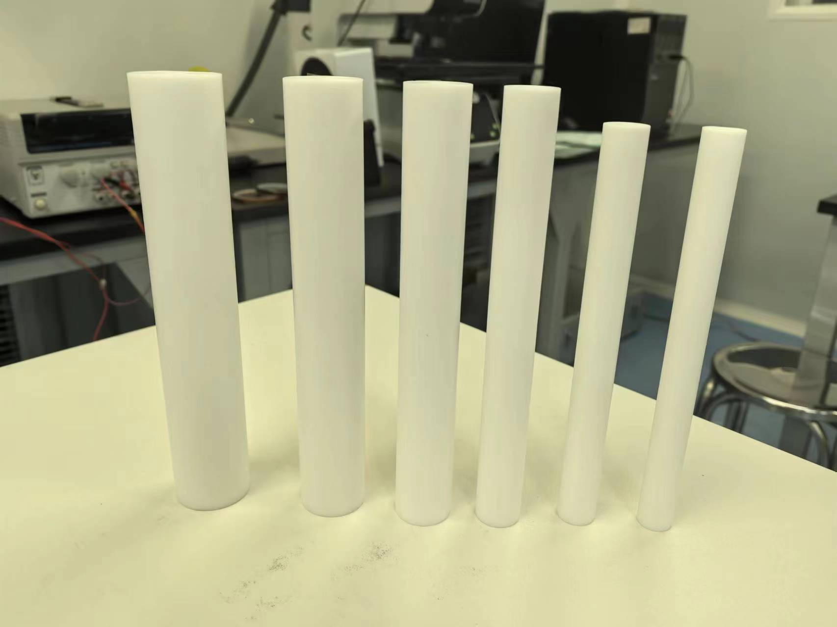
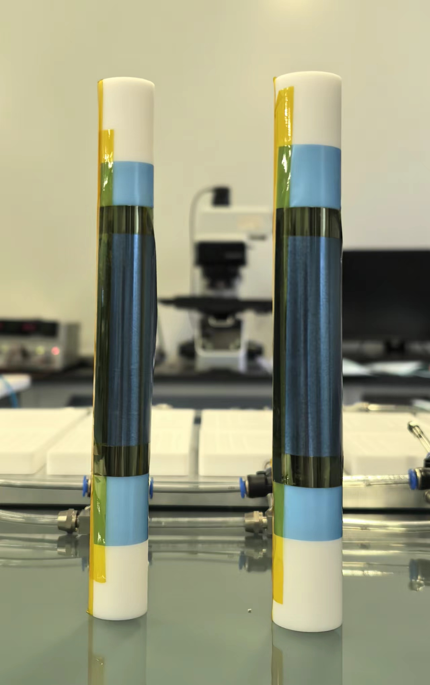
R&D efforts and results: R & D for curved MAPS
Baseline: curved MAPS, Inspired by ALICE ITS3 design
  Advantage: 3~5 times smaller material budget compared to alternative (ladder options)
Challenges
  CEPC b-layer radius (radius=11mm) smaller compared with ALICE ITS3 (radius=18mm)
  Feasibility study: Mechanical prototype with dummy wafer can curved to radius ~12mm
    Thinning wafer to 40um
12 mm
14 mm

Slide 19
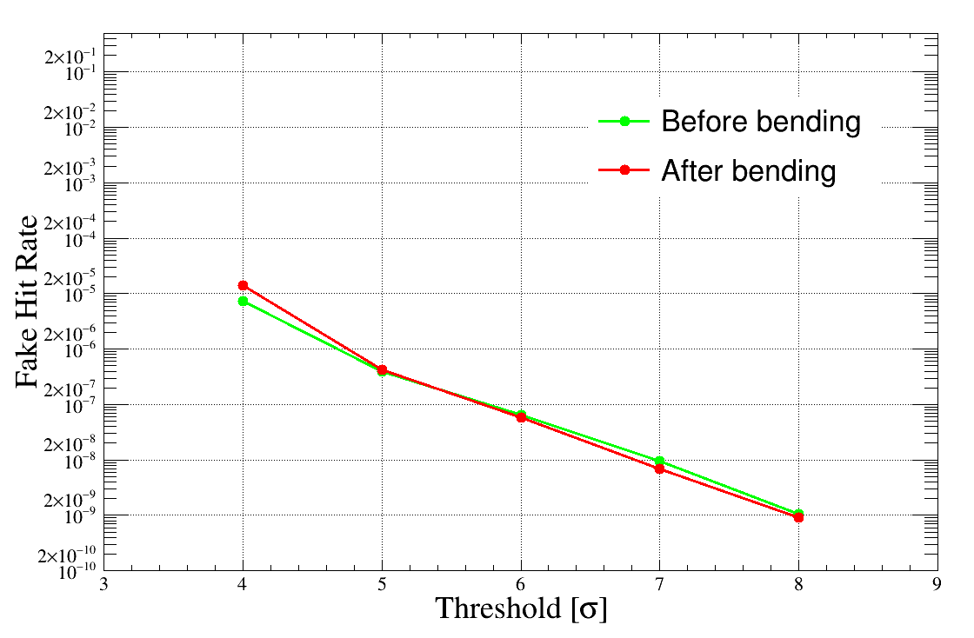
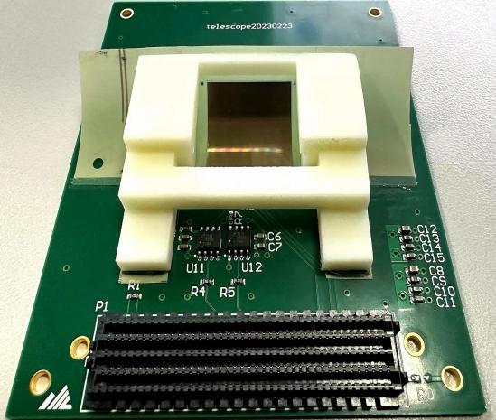
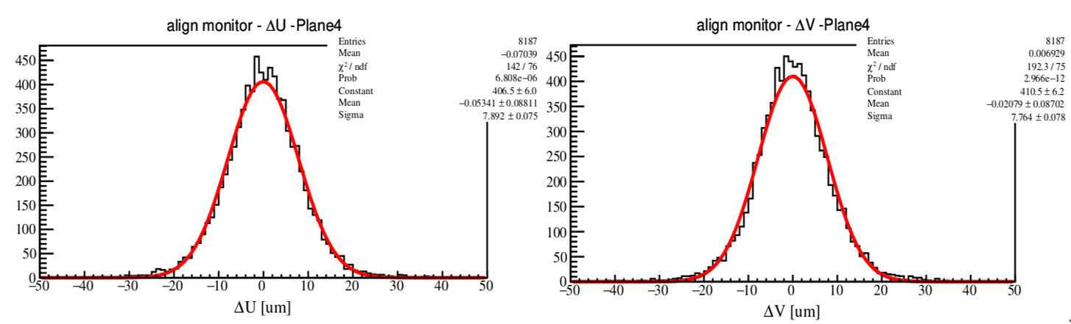
R&D efforts and results: Curved MAPS testbeam
R & D of curved maps with MIMOSA28 chip
  No visible difference in noise level or spatial resolution before/after bending
d1 = 25 mm
d2 = 30 mm
d₁
d₁
d₂
d₁
d₁
_{Beam}
Ref1
Ref2
Ref3
DUT
Ref4
Ref5
Trigger

Slide 20
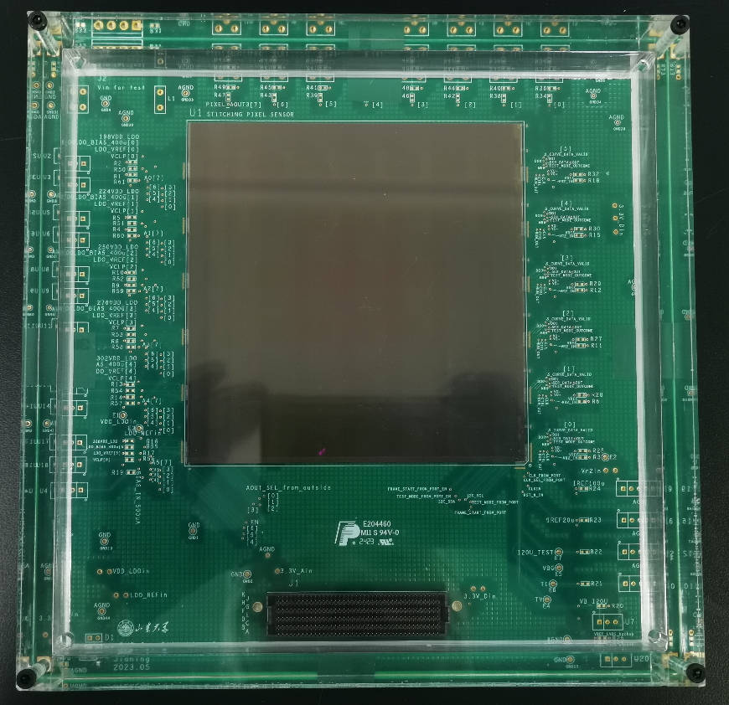
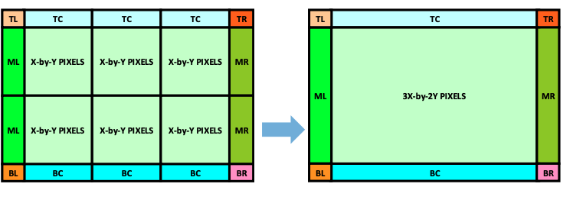
R&D efforts and results: R & D for curved MAPS
Stitching chip : 11 ×11 cm²
Stitching chip design
  350nm CIS technology Xfabs
  Wafer level size after stitching ~11 ×11 cm²
  reticle size ~2 ×2 cm²
  2D stitching
  Engineering run, chip under testing

Slide 21
Content
Introduction
Requirements
Technology survey and our choices
Technical challenges
R&D efforts and results
Detailed design including electronics, cooling and mechanics
Readout electronics & BEC
Performance from simulation
Research team and working plan
Summary

Slide 22
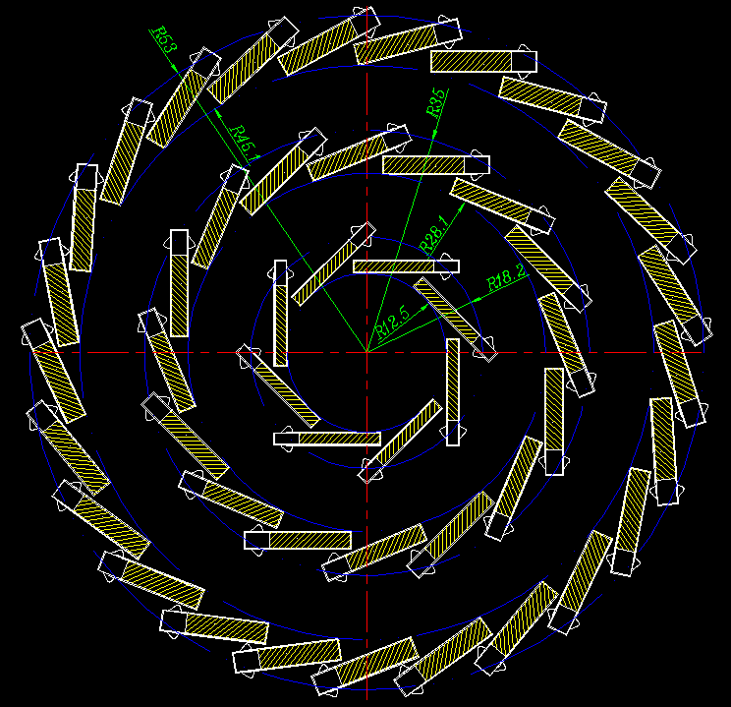
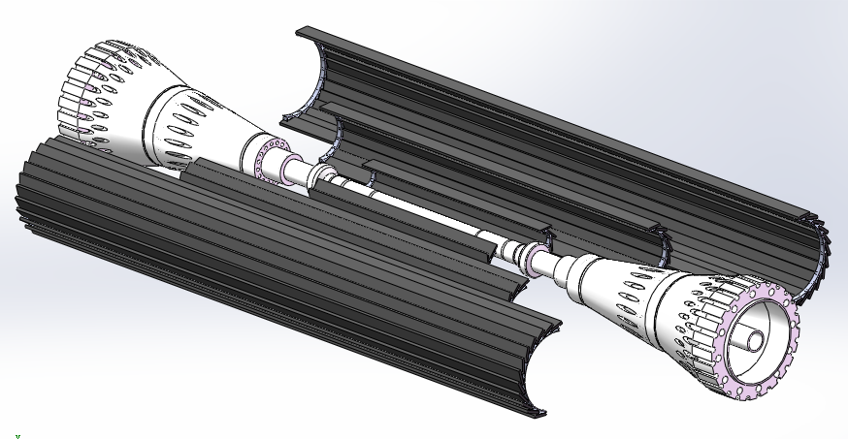
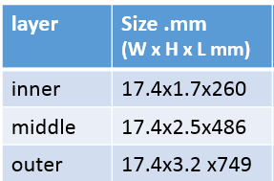


Vertex alternative : CMOS ladder
Alternative: CMOS chip with long ladder layout
  Long ladder design to cover cos θ<=0.991 (no endcap disk)
  3 double-side layer with ladders
  Aim to based on 65nm /55nm technology(<=40 mW/cm²)
Ladder support size
Material budget at
Φ =33 degree

Slide 23


Vertex baseline: bent MAPS
Layout:
  3 single layer of bent MAPS + 1 double layer ladder MAPS
    Material budget is a factor of 3 lower than alternative option
  Use single bent MAPS for Inner layer
    Bent MAPS can fit closer to beampipe
    Low material budget, Single layer easy for cooling
    Yield issue is not a problem for Inner layer
  Ladder design for outer layer
    No dead area in ladder design
    Less sensitive to Material in outer layer
Layer 2
Stitching layer | Radius | Length
Layer 1 | 11mm | 160mm
Layer 2 | 16.5 | 240mm
Layer 3 | 22mm | 320mm
Layer 1
Layer 3

Slide 24
Data rate estimation of CEPC VTX
 |  | Hit density (Hits/cm²/BX) | Bunch spacing (ns) | Hit rate (M Hits/cm²) | Hit Pix rate (M Px/cm²) | Hit rate/chip (MHz) | Data rate@triggerless (Gbps) | Pixel/bunch | FIFO Depth @3us rg latency | Data rate@trigger (Mbps)
CDR | Higgs | 2.4 | 680 | 3.53 | 10.59 | 34.62 | 1.1 | 23.5 | 103.9 | 105.28
 | W | 2.3 | 210 | 10.95 | 32.86 | 107.44 | 3.4 | 22.6 | 322.3 | 101.248
 | Z | 0.25 | 25 | 10 | 30 | 98.1 | 3.1 | 2.4 | 294.3 | 53.76
TDR | Higgs | 0.81 | 591 | 1.37 | 4.11 | 13.44 | 0.43 | 7.96 | 40.4 | <10
 | W | 0.81 | 257 | 3.16 | 9.45 | 30.90 | 0.98 | 7.96 | 92.8 | ~10
 | Z | 0.45 | 23 | 19.6 | 58.7 | 191.9 | 5.9 | 4.4 | 575 | 118
TDR raw hit density: Higgs 0.54，Z 0.3; Safety factor: TDR 1.5, CDR 10;
Cluster size: 3pixels/hit (@Twjz 180nm, EPI 18~25um)
Area: 1.28cm*2.56cm=3.27cm² (@pixel size 25um*25um)
Word length: 32bit/event (@Taichu’s scale, 512*1024 array)
Trigger rate：20kHz@CDR，120kHz@TDR estimated
  Trigger latency: 3us(very likely not enough), Error window: 7 bins
  FIFO depth: @3us * hit rate/chip
  Data rate=pixel/bunch*trigger rate*32bit*error window
WW runs and low Lumi Z runs (20% of high lumi Z)
Data rate @1Gbps per chip for simplicity
for triggerless

Slide 25
Chip design for TDR and power consumption
Based on Taichu/Jadepix prototype chip
  Fast priority digital readout to cope with 40MHz at Z pole
  65/55nm CIS technology
  Power consumption can reduced to 40mW/cm²
 | Matrix | Periphery | DataTrans. | DACs | Total Power
TaiChu3 prototype @ triggerless (CDR) | 304 mW | 135 mW | 206 mW | 10 mW | 655 mW
65nm for TDR @ 1 Gbps/chip (TDR LowLumi Z ) | 60 mW | 80 mW | 36 mW | 10 mW | 186 mW

Slide 26


Ladder Electronics
  Alternative: flexible PCB
    Signal, clock, control, power, ground will be handled by control board through flexible PCB
  Baseline: stitching and RDL metal layer on wafer to replace PCB
Alternative:
baseline: ITS3 like stitching and RDL layer on top

Slide 27



Vertex technologies: Cable and service
Limited space in MDI region for cable and service
  All fast signal transferred into optical fiber in service region
Example from ATLAS HGTD upgrade

Slide 28


Physics Performance: impact parameter resolution
Compared to long barrel design (alternative option)
  Stitching layout (baseline) replacing 1/2/3 layer of layer in ladder design (~30% improvement)

Slide 29
Research team and working plan
IHEP: overall intergration, chip design, detector assembly, electronics, offline
  Overall : Joao, Zhijun ,Ouyang Qun
  Mechnical: Jinyu Fu
  Electronics: Wei wei, Ying Zhang, Jun Hu, Yunpeng Lu , Yang Zhou, Xiaoting Li
  DAQ: Hongyu Zhang
  Detector assembly: Mingyi Dong
  Physics: Chengdong Fu, linghui Wu, Gang Li
ShanDong: chip design , Meng Wang, Liang Zhang, Jianing Dong
CCNU: chip design, ladder assembly, Xiangming Sun, Ping Yang
North West U. : Chip design Xiaoming Wei, Jia Wang, Yongcai Hu
Nanchang U. : chip design, Tianya Wu
Nanjing: irradation study: Ming Qi , Lei Zhang
IFAE: Chip design , Sebastian Grinstein, Raimon Casanova
IPHC/CNRS: chip design , Christine Hu, Yongcai Hu

Slide 30

Summary
1st full-size Prototype for CEPC vertex detector developed
Reference detector TDR under preparation, to be completed by the
mid-2025 for the proposal of China’s 15th 5-year plan.
We are active expanding international collaboration and explore synergies with other international projects (especially framework of DRD7 (electronics) and DRD8 (mechanics and integration) more than DRD3 (solid state detectors).
CEPC vertex conceptional design (2016)
CEPC vertex prototype (2023)

Slide 31

df

Slide 32


Slide 33


Slide 34





Highlights of CEPC machine detector interface (MDI)
The design based on Accelerator TDR has been done. The background simulation is performing.
The experiment at BEPCII has been done several times to validate the code.
The collaboration on beam induced background study between different groups has been formed.

Slide 35

Vertex detector sensor R&D timeline

Slide 36

The 4th Detector Concept
Excellent e/gamma energy resolution;
PID capability;
Better hadronic energy resolution;
Magnet in much reduced size.
BMR: 4% → 3%

Slide 37


Backup: Vertex alternative: expected performance

Slide 38


CEPC Detector Conceptual Designs
The 4th Detector Concept

Slide 39





CEPC physics program
An extremely versatile machine with a broad spectrum of physics opportunities
→ Far beyond a Higgs factory
Operation mode |  |  | ZH | Z | W⁺W⁻ | $$t\overline{t}$$
$$\sqrt{s} [GeV]$$ |  |  | ~240 | ~91.2 | ~160 | ~360
Run time [years] |  |  | 10 | 2 | 1 | 5
CDR (30 MW) |  | L / IP [×10³⁴ cm⁻²s⁻¹] | 3 | 32 | 10 | -
 |  | $\int{L dt}$ [ab⁻¹, 2 IPs] | 5.6 | 16 | 2.6 | -
 |  | Event yields [2 IPs] | 1×10⁶ | 7×10¹¹ | 2×10⁷ | ⁻
Run Time [years] |  |  | 10 | 2 | 1 | ~5
Latest | 30 MW | L / IP [×10³⁴ cm⁻²s⁻¹] | 5.0 | 115 | 16 | 0.5
 | 50 MW | L / IP [×10³⁴ cm⁻²s⁻¹] | 8.3 | 191.7 | 26.6 | 0.8
 |  | $\int{L dt}$ [ab⁻¹, 2 IPs] | 20 | 96 | 7 | 1
 |  | Event yields [2 IPs] | 4×10⁶ | 4×10¹² | 5×10⁷ | 5×10⁵
Huge measurement potential for precision tests of SM: Higgs, electroweak physics, flavor physics, QCD/Top
Searching for exotic or rare decays of H, Z, B and 𝜏, and new physics
CEPC community joined ECFA Phy focus
Both 50 MW and $t\overline{t}$ modes are currently considered as CEPC upgrades.

Slide 40
News from ICHEP2024: ALICE ITS3

Slide 41

News from ICHEP2024: Fcc-ee
df

Slide 42


Flex厚度和物质分布
4层柔性板基于国内Cu工艺（当前阶段）
6层柔性板基于国内Cu工艺（当前阶段）
国内工艺当前只能实现基于铜的PCB，如需采用铝材料，需要委托CERN进行加工（accessibility？）
Long barrel方案，同ladder芯片更多，需要更多层的PCB
  For Innermost：4层Flex（now：Cu based，proposed：Al based）
  For Middle & Outer：6层Flex（now：Cu based，proposed：Al based）
Proposed Double-sided ladder based on 铝

Slide 43

Ladder端部功耗分布
0.75W
0.193W
0.15W
1.2W
1.2W
DCDC:
50mmX20mm
lpGBT :
9mmX9mm
VTRX+:
10mmX20mm
DCDC:
50mmX20mm
DCDC：电源管理芯片
  TAICHU功耗0.8W（1.8V*0.42A）
  单个DCDC最多为10个TAICHU提供电源，效率按85%计算
  DCDC功耗为0.8*10*15% = 1.2W
  如果最外层需要20个芯片则需要2个DCDC
  lpGBT和VTRX+需要其他种类电源（1.2V，2.5V），总体功耗不高，~1W，则DCDC功耗为0.15W
lpGBT：数据汇总芯片
  0.75W@10.24Gb/s
VTRX+：光电转化芯片
  1发1收：0.193W（RX：2.5V*0.05A，TX：2.5V*0.02A，core：1.2V*0.015A）
说明：1：图中仅展示ladder一端一面，底面及ladder另一端有同样的配置
2：lpGBT及VTRX+的参数为CERN对应芯片手册得到，CEPC最终参数可能有所不同。
Ladder长度及端部器件位置，需结合机械及安装设计来调整

Slide 44


Issues of the dead area
From CERN-LHCC-2024-003/ALICE-TDR-021：Technical Design Report for the ALICE Inner Tracking System 3 - ITS3 A bent wafer-scale monolithic pixel detector
Sensitive area
dead area

