Slide 1



CEPC vertex Detector
Zhijun Liang
(On behalf of the CEPC physics and detector group)
Aug. 7th, 2024, CEPC Detector Ref-TDR Review

Slide 2
Content
Introduction
Requirements
Technology survey and our choices
Technical challenges
R&D efforts and results
Detailed design including electronics, cooling and mechanics
Readout electronics & BEC
Performance from simulation
Research team and working plan
Summary

Slide 3
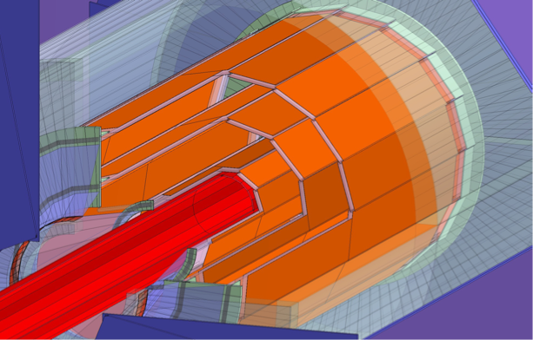
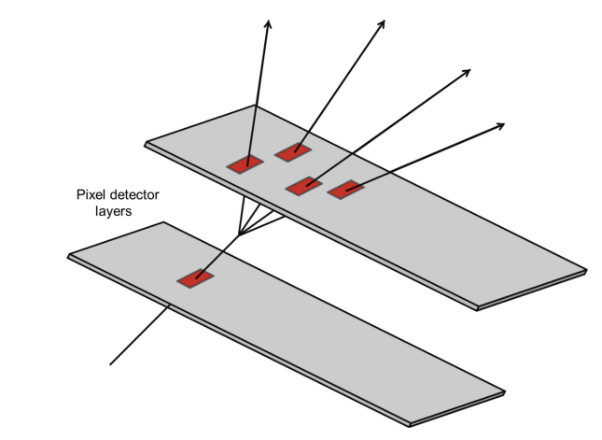
Introduction: vertex detector
Vertex detector optimized for first 10 year of CEPC operation (ZH, low lumi-Z runs)
Motivation:
  Aim for impact parameter resolution and vertexing capability
  For H → bb/ H → cc/ H → light quark or gluons analysis
  The observation H → cc or H → gg is important goal for CEPC

Slide 4
Vertex Requirement
  Inner most layer (b-layer) need to be as close to beam pipe as possible
    Challenges: b-layer radius (11mm) is smaller compared with ALICE ITS3 (18mm)
  Low material budget (~0.15%X/X0 per layer)
  Spatial Resolution (3-5um)
  Detector Cooling (<=40 mW/cm²) with air cooling
  High data rate: (especially at Z pole , 40MHz, 1Gbps per chip )
    Challenges: high data rate especially at Z pole
  Radiation level (~1Mrad per year in average)

Slide 5
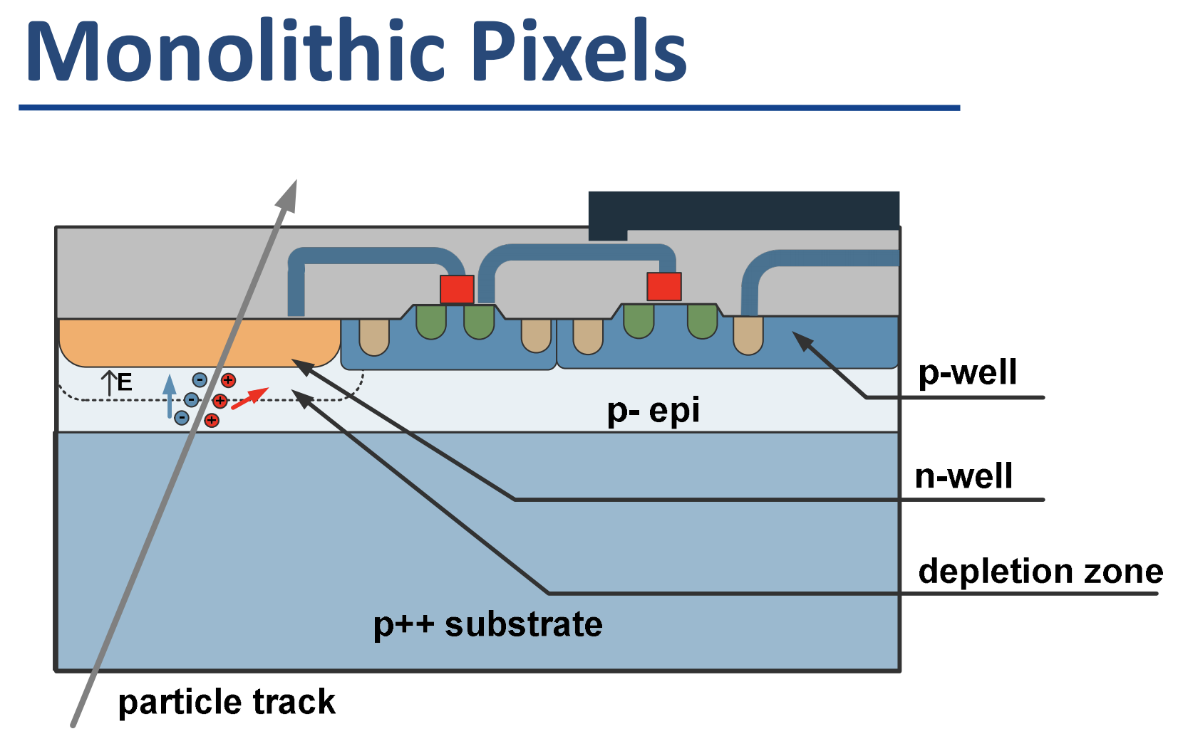
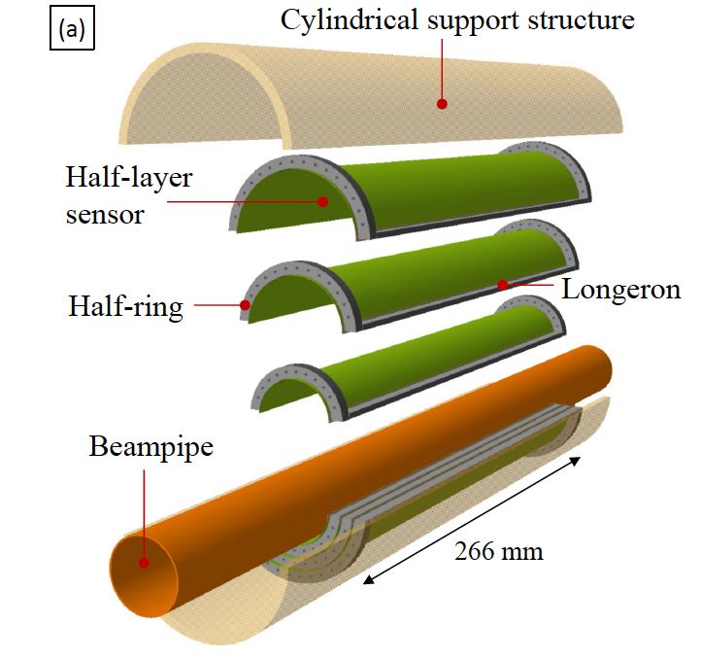
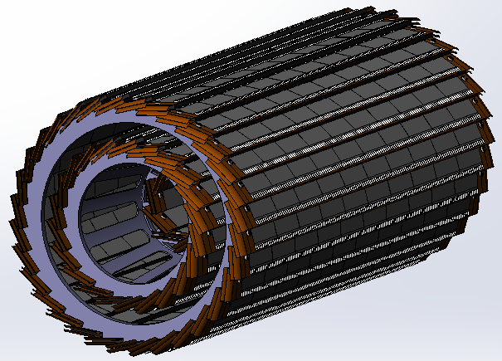
Technology survey and our choices
Vertex detector Technology selection
  Baseline: based on curved CMOS MAPS (Inspired by ALICE ITS3 design )
    Advantage: 3~5 times smaller material budget compared to alternative (ladder options)
  Alternative: Ladder design based on CMOS MAPS
Monolithic active Pixel CMOS (MAPS)
Baseline: curved MAPS
Alternative: ladder based MAPS

Slide 6
R&D status and final goal
 | Status | CEPC Final goal
CMOS chip technology | Full-size chip with TJ 180nm CIS | 65nm CIS
Detector integration | Detector prototype with ladder design | Detector with bent silicon design
Spatial resolution | 4.9 μm | 3-5 μm
Detector cooling | Air cooling with 1% channels (24 chips) on | Air cooling with full power
Bent silicon with radius | Bent Dummy wafer radius ~12mm | Bent final wafer with radius ~11mm
Stitching | 11*11cm stitched chip with Xfab 350nm CIS | 65nm CIS stitched sensor

Slide 7
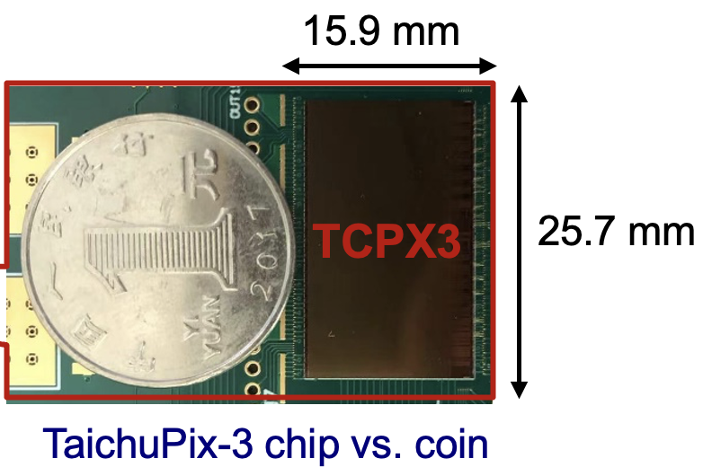
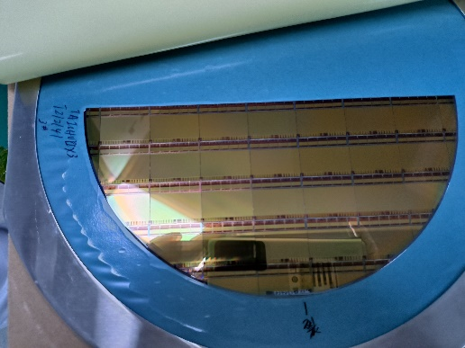
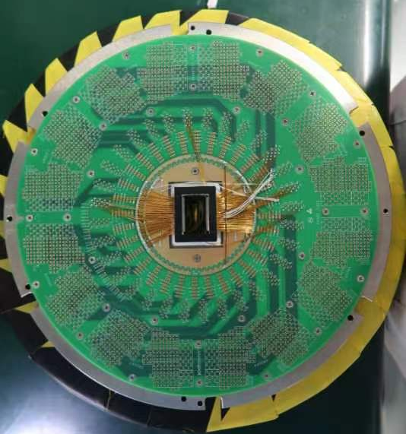
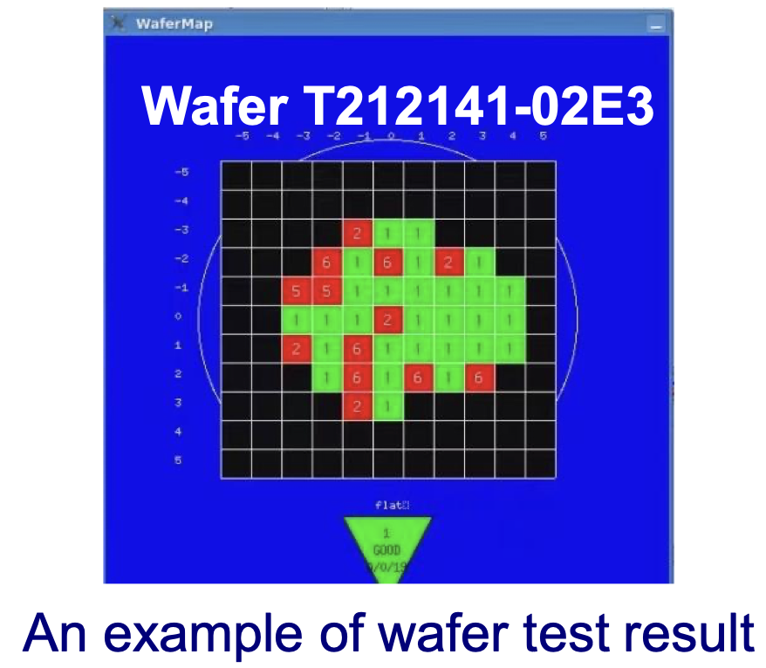
R&D efforts: Full-size TaichuPix3
Full size CMOS chip developed, 1st engineering run
  1024×512 Pixel array, Chip Size：15.9×25.7mm
  25μm×25μm pixel size with high spatial resolution
  Process: Towerjazz 180nm CIS process
  Fast digital readout to cope with ZH and Z runs (support 40MHz clock)
 | Status | CEPC Final goal
CMOS chip technology | Full-size chip with TJ 180nm CIS | 65nm CIS

Slide 8
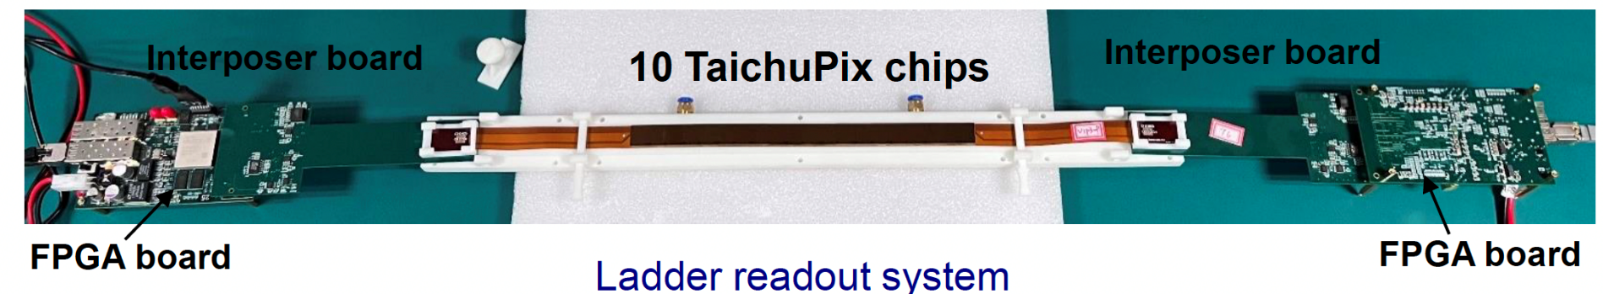
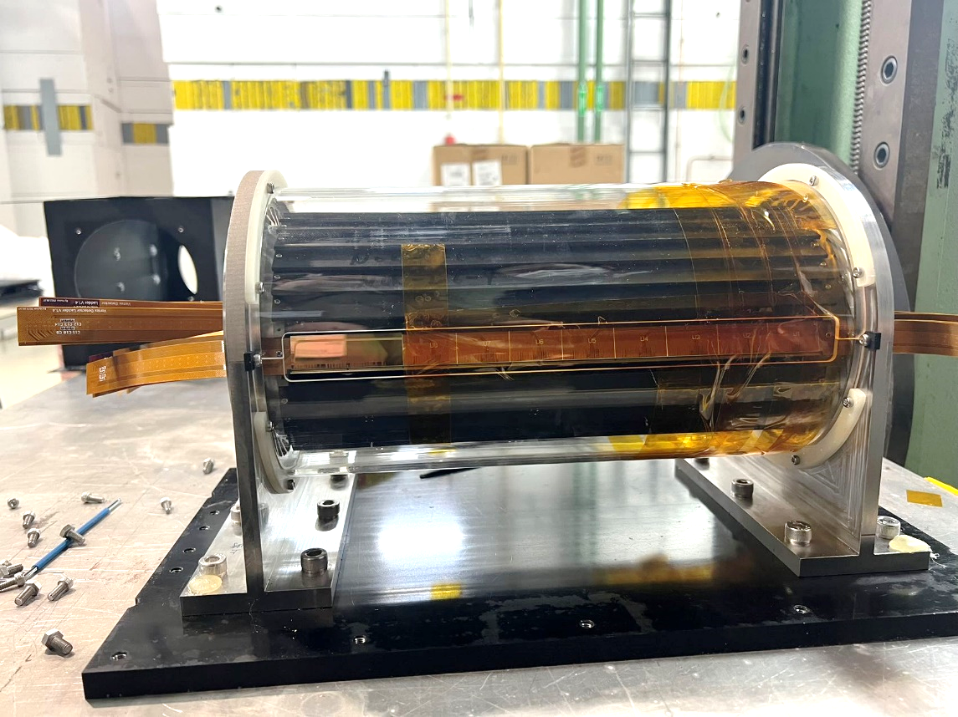
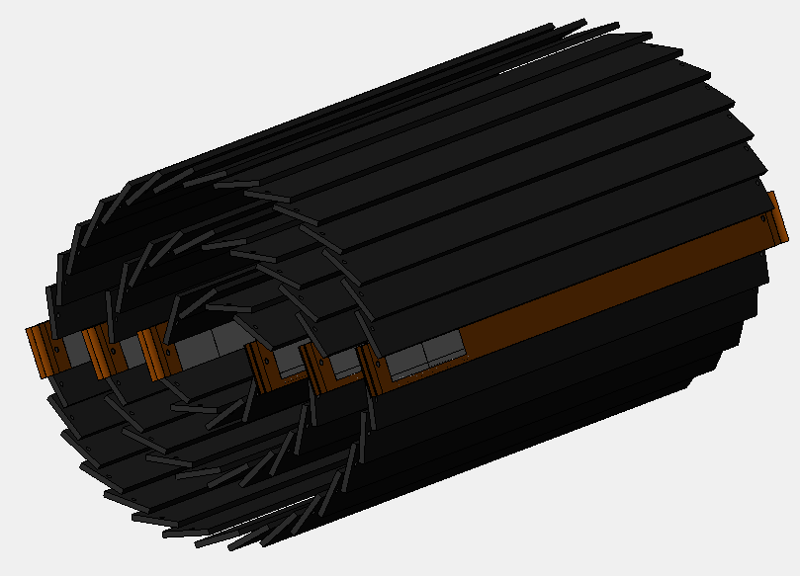
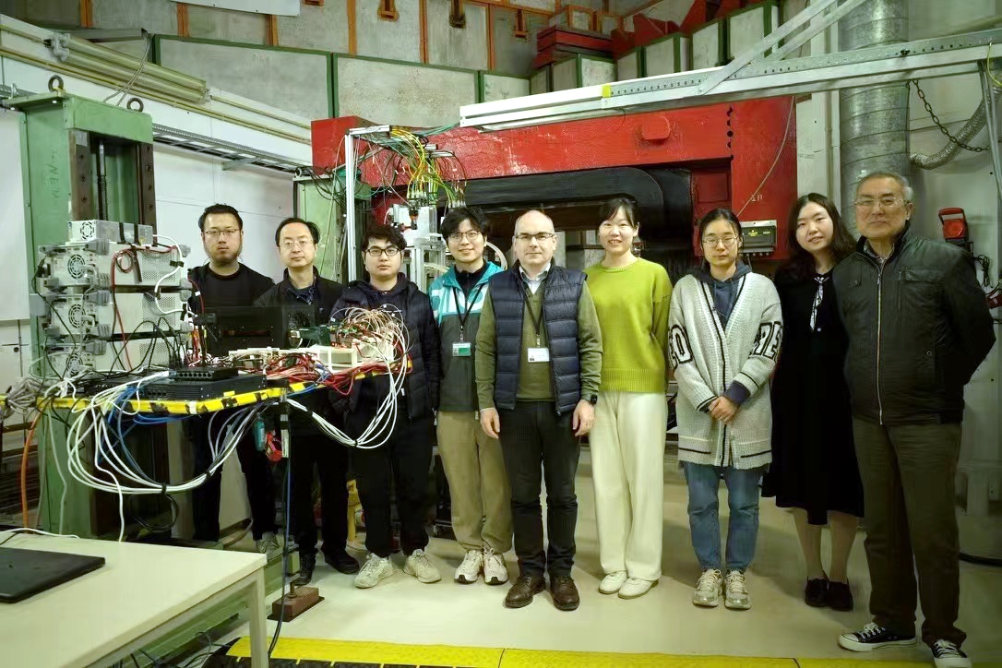
R&D effort: vertex detector prototype
TaichuPix-based prototype detector tested at DESY in April 2023
Spatial resolution ~ 4.9 μm
6 double-sided ladders
 | Status | CEPC Final goal
Detector integration | Detector prototype with ladder design | Detector with bent silicon design

Slide 9
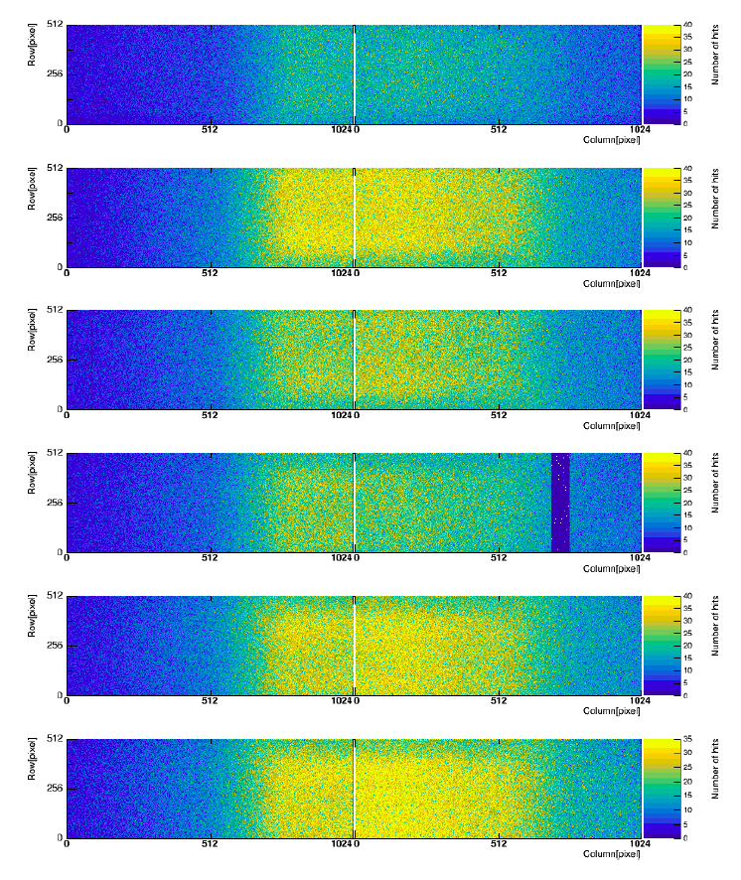
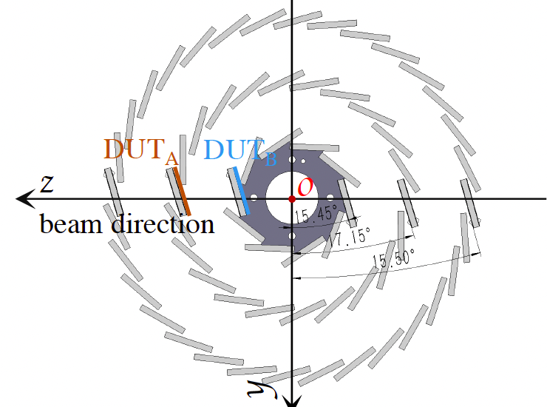
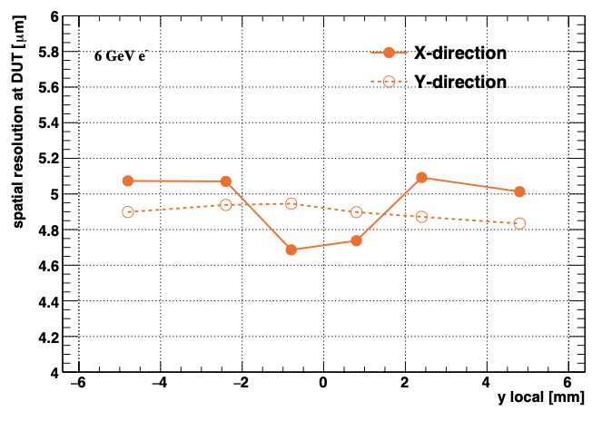
R&D efforts and results: vertex detector prototype beam test
Hit maps of multiple layers of vertex detector
Spatial resolution ~ 5 μm
Beam spot
 | Status | CEPC Final goal
Spatial resolution | 4.9 μm | 3-5 μm

Slide 10
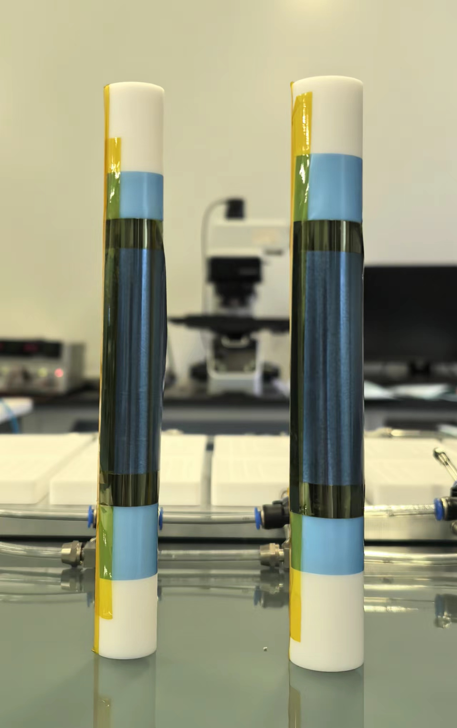
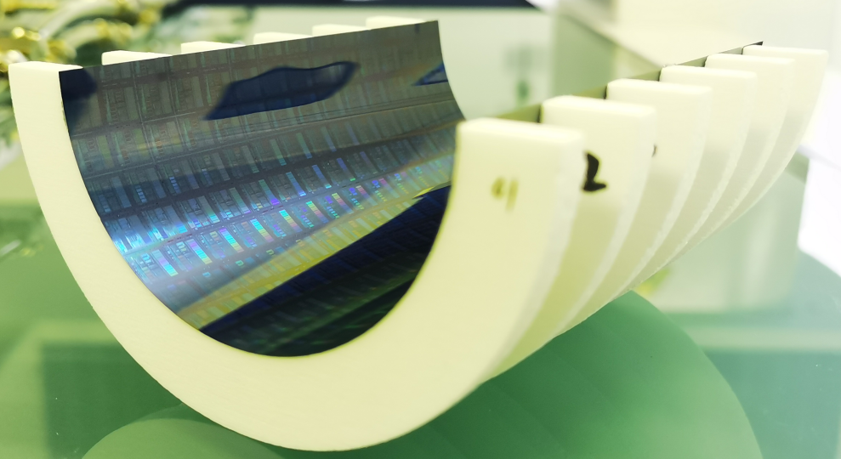
R&D efforts curved MAPS
  CEPC b-layer radius (11mm) smaller compared with ALICE ITS3 (radius=18mm)
  Feasibility study: Mechanical prototype with dummy wafer can curved to radius ~12mm
    Thinning wafer to 40um
12 mm
14 mm
 | Status | CEPC Final goal
Bent silicon with radius | Bent Dummy wafer radius ~12mm | Bent final wafer with radius ~11mm

Slide 11
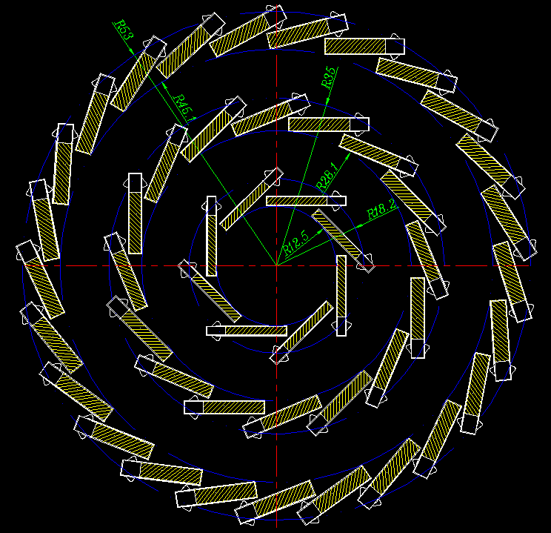
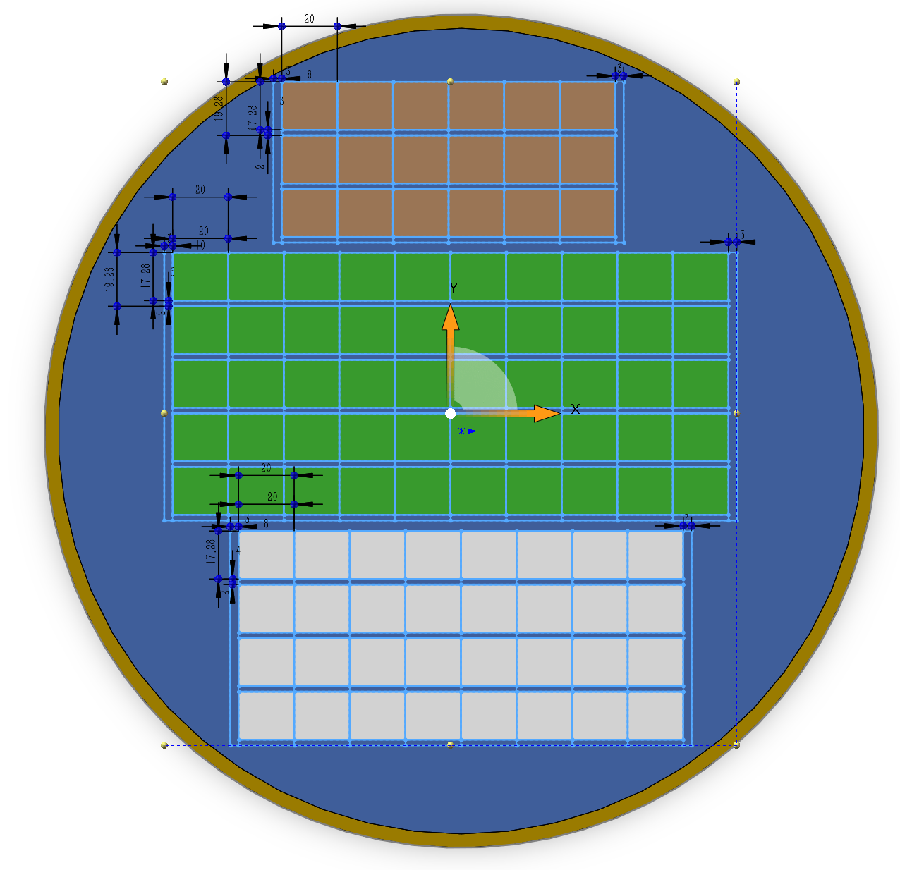
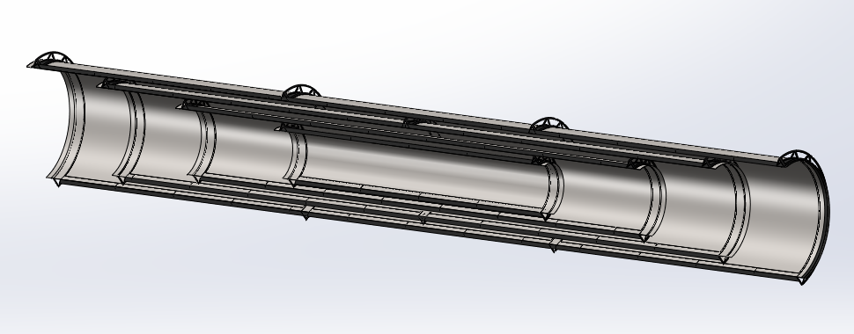
Vertex baseline: bent MAPS
  3 single layer of bent MAPS + 1 double layer ladder MAPS
    Material budget is a factor of 2 lower than alternative option
  Use single bent MAPS for Inner layer
    Low material budget 0.06%X0 per layer
  Ladder design for outer layer
    No dead area in ladder design
Stitching layer | Radius | Material
Layer 1 | 11mm | 0.06% X0
Layer 2 | 16.5mm | 0.06% X0
Layer 3 | 22mm | 0.06% X0
Layer 4 | 27.5mm | 0.06% X0
Layer 5/6 (Ladders) | 35-45mm | 0.5% X0
Total |  | 0.74% X0
Layer 2
Layer 4
Layer 3
Layer 1

Slide 12
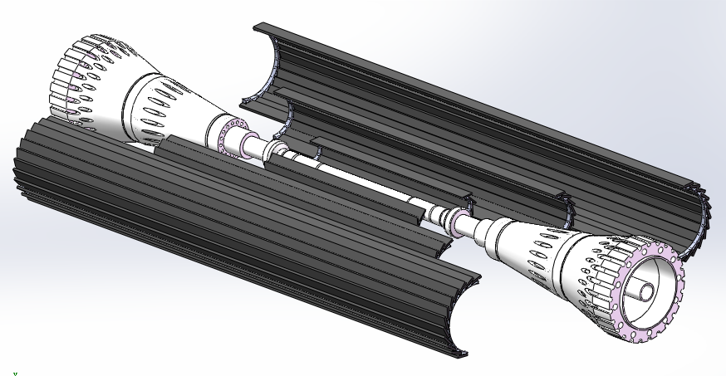
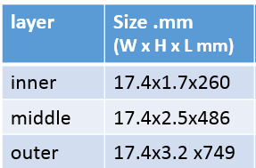
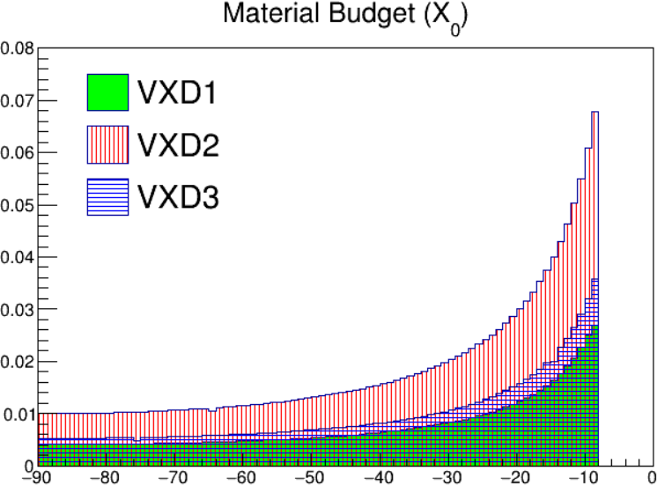
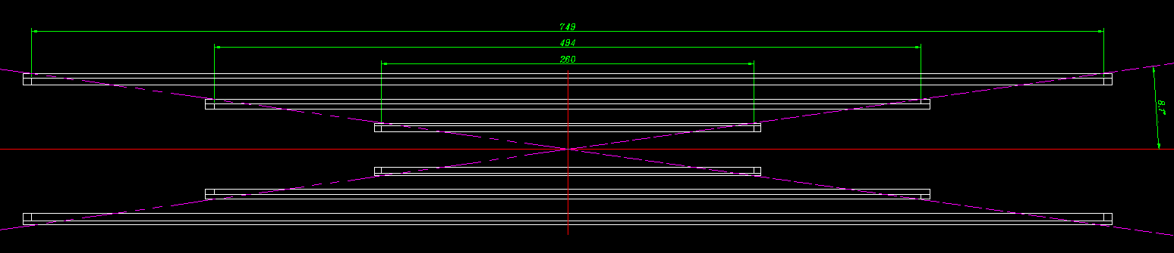
Alternative : CMOS ladder
Alternative: CMOS chip with long ladder layout
  Backup solution
  3 double-side layer with ladders
  Aim to based on 65nm /55nm technology(<=40 mW/cm²)
Ladder support size
Material budget at
Φ =33 degree

Slide 13
Data rate estimation of CEPC VTX
 |  | Hit density (Hits/cm²/BX) | Bunch spacing (ns) | Hit rate (M Hits/cm²) | Hit Pix rate (M Px/cm²) | Hit rate/chip (MHz) | Data rate@triggerless (Gbps) | Pixel/bunch | FIFO Depth @3us rg latency | Data rate@trigger (Mbps)
CDR | Higgs | 2.4 | 680 | 3.53 | 10.59 | 34.62 | 1.1 | 23.5 | 103.9 | 105.28
 | W | 2.3 | 210 | 10.95 | 32.86 | 107.44 | 3.4 | 22.6 | 322.3 | 101.248
 | Z | 0.25 | 25 | 10 | 30 | 98.1 | 3.1 | 2.4 | 294.3 | 53.76
TDR | Higgs | 0.81 | 591 | 1.37 | 4.11 | 13.44 | 0.43 | 7.96 | 40.4 | <10
 | W | 0.81 | 257 | 3.16 | 9.45 | 30.90 | 0.98 | 7.96 | 92.8 | ~10
 | Z | 0.45 | 23 | 19.6 | 58.7 | 191.9 | 5.9 | 4.4 | 575 | 118
TDR raw hit density: Higgs 0.54，Z 0.3; Safety factor: TDR 1.5, CDR 10;
Cluster size: 3pixels/hit (@Twjz 180nm, EPI 18~25um)
Area: 1.28cm*2.56cm=3.27cm² (@pixel size 25um*25um)
Word length: 32bit/event (@Taichu’s scale, 512*1024 array)
Trigger rate：20kHz@CDR，120kHz@TDR estimated
  Trigger latency: 3us(very likely not enough), Error window: 7 bins
  FIFO depth: @3us * hit rate/chip
  Data rate=pixel/bunch*trigger rate*32bit*error window
WW runs and low Lumi Z runs (20% of high lumi Z)
Data rate @1Gbps per chip for simplicity
for triggerless

Slide 14
Chip design for TDR and power consumption
Based on Taichu/Jadepix prototype chip
  Fast priority digital readout to cope with 40MHz at Z pole
  65/55nm CIS technology
  Power consumption can reduced to 40mW/cm²
 | Matrix | Periphery | DataTrans. | DACs | Total Power
TaiChu3 prototype @ triggerless (CDR) | 304 mW | 135 mW | 206 mW | 10 mW | 655 mW
65nm for TDR @ 1 Gbps/chip (TDR LowLumi Z ) | 60 mW | 80 mW | 36 mW | 10 mW | 186 mW

Slide 15
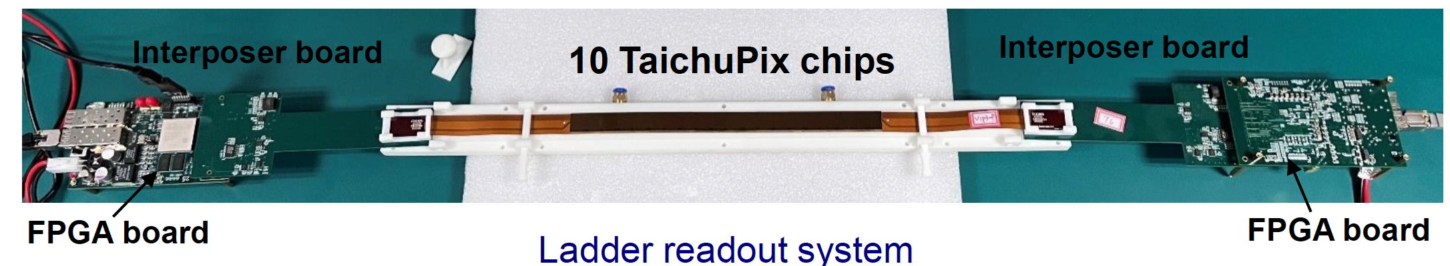
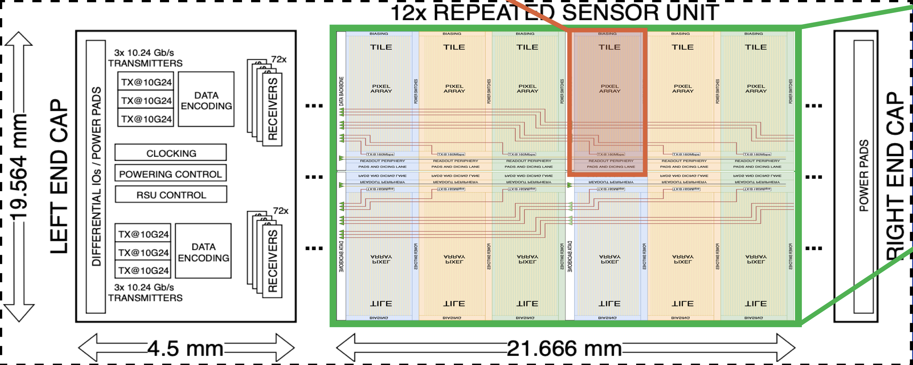
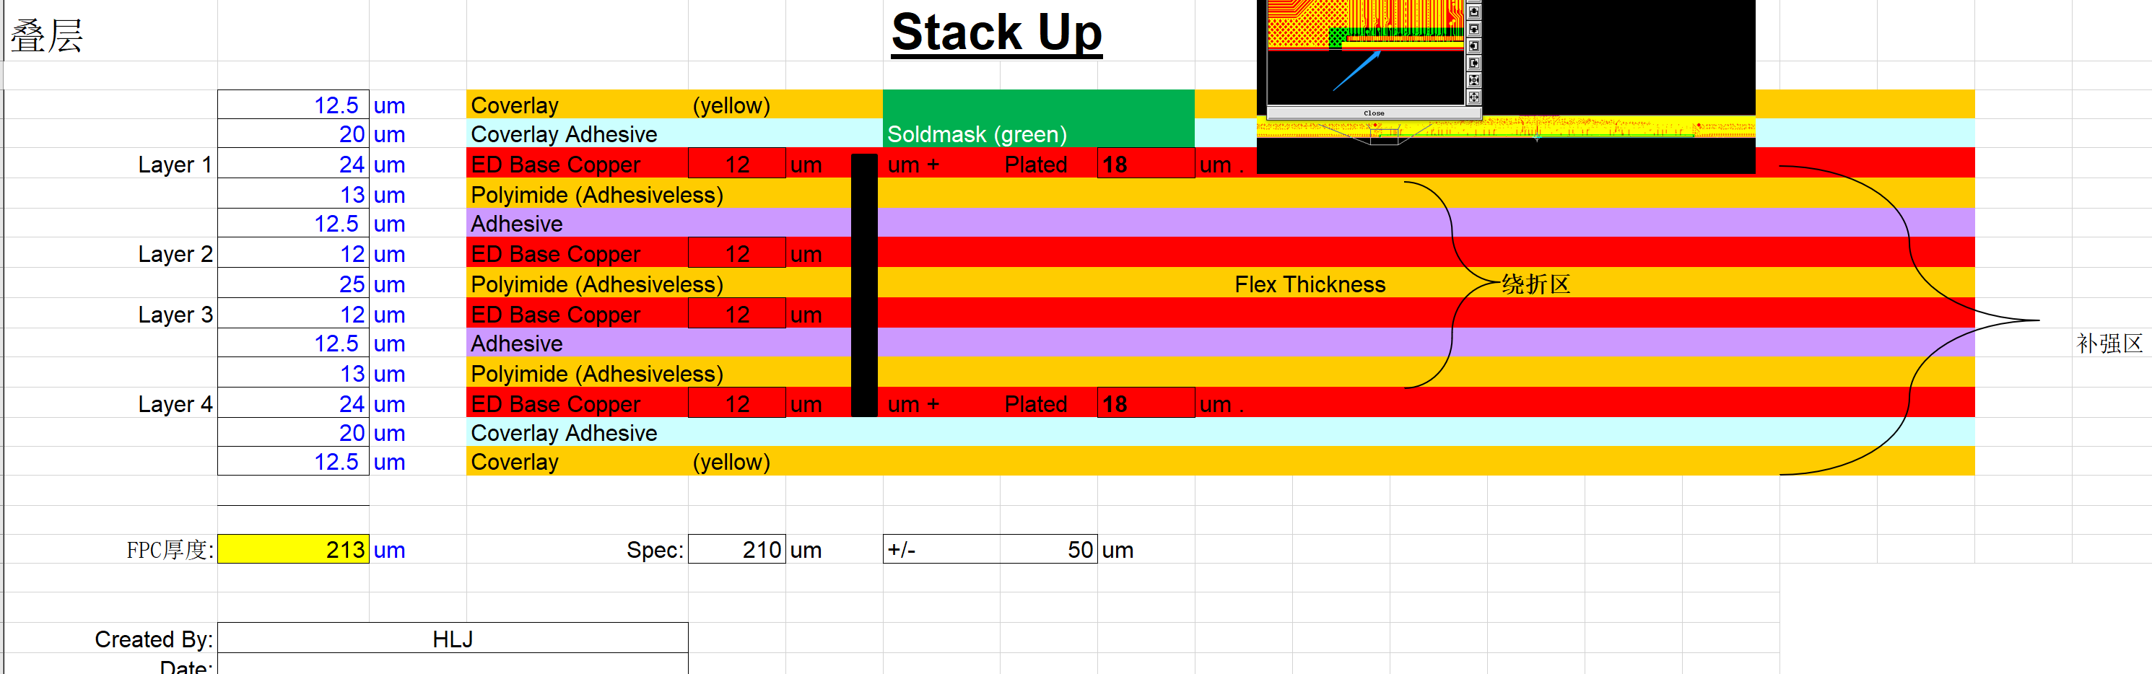
Ladder Electronics
  Alternative: flexible PCB
    Signal, clock, control, power, ground will be handled by control board through flexible PCB
  Baseline: stitching and RDL metal layer on wafer to replace PCB
Alternative: flexible PCB
baseline: ITS3 like stitching and RDL layer on bent MAPS

Slide 16
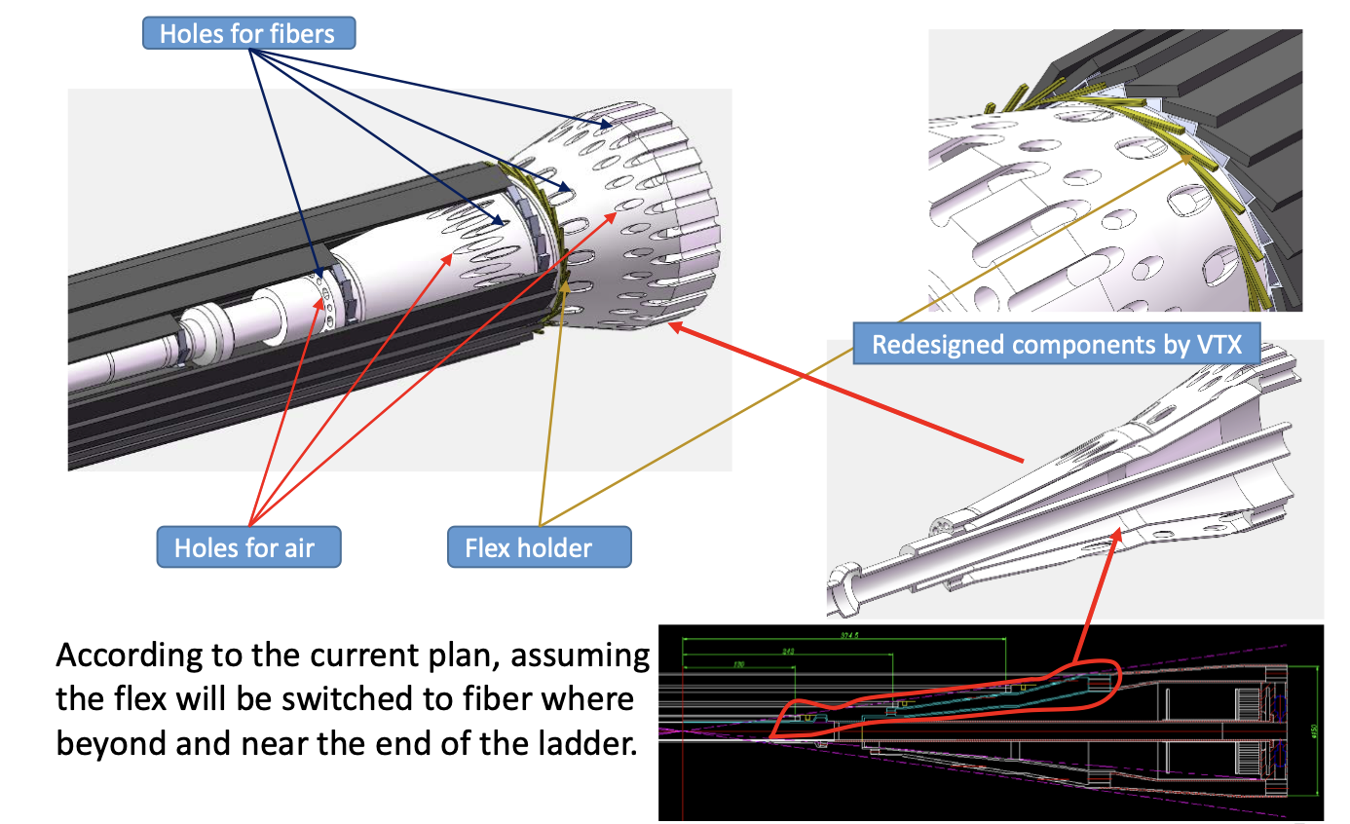
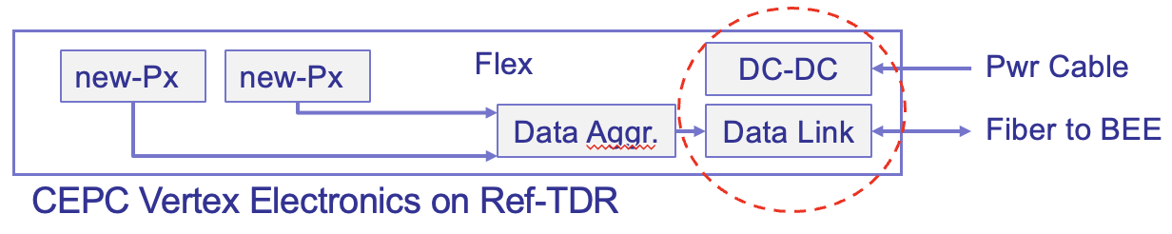
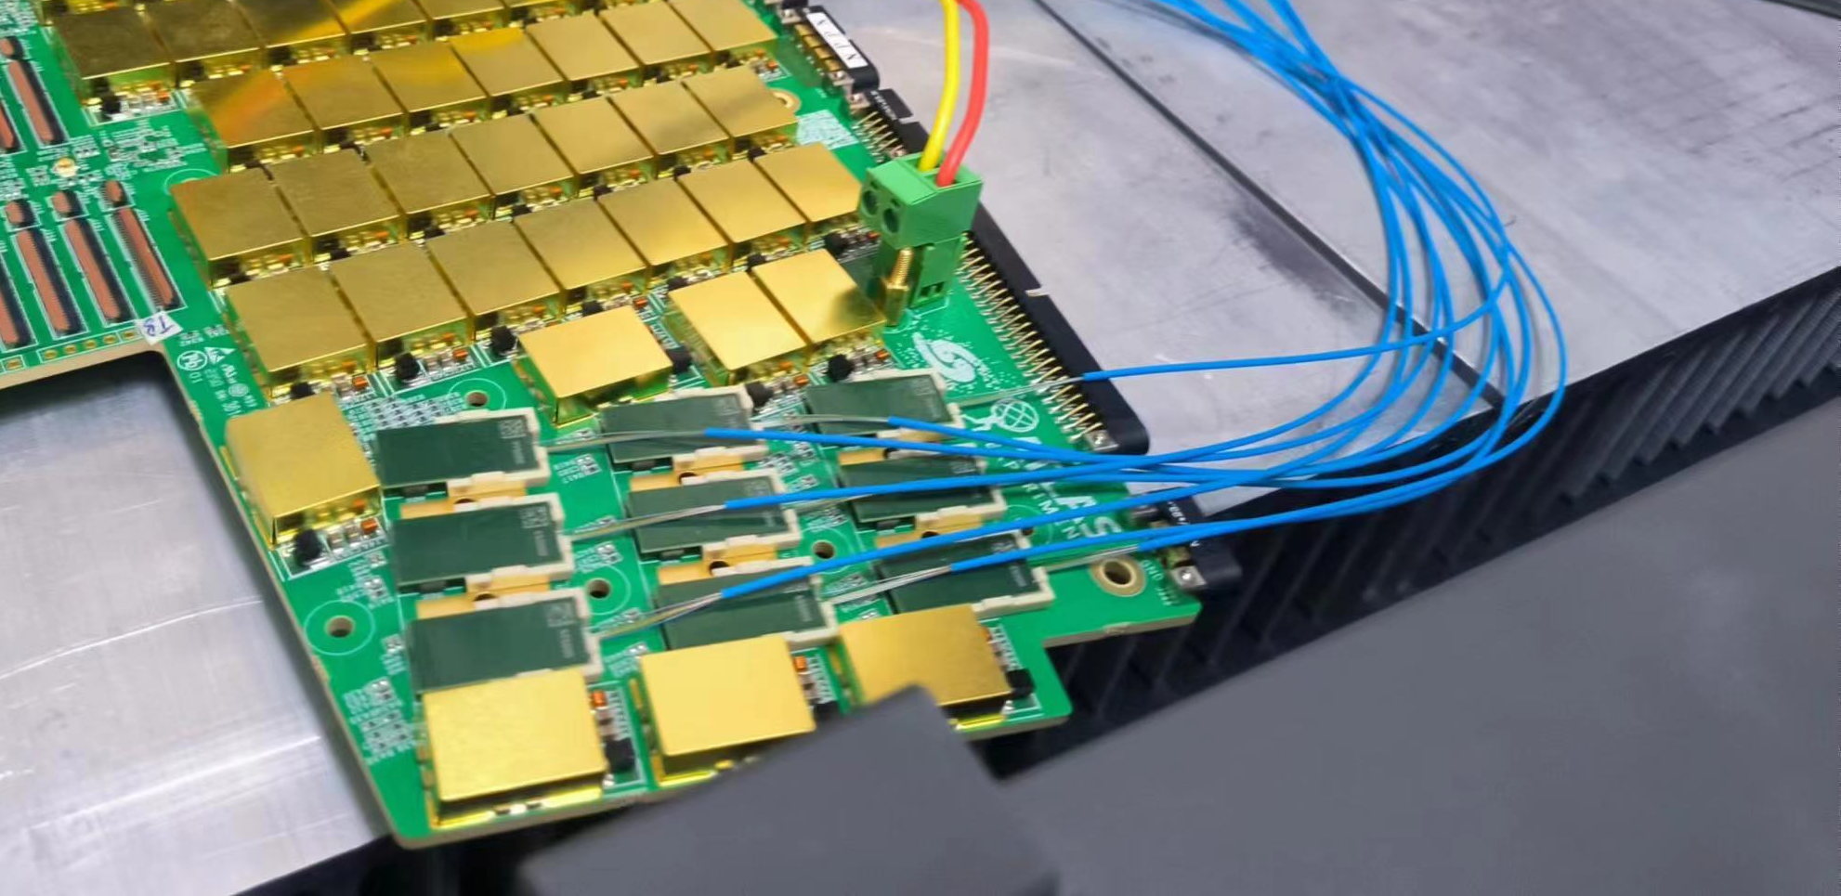
Vertex technologies: Cable and service
Limited space in MDI region for cable and service
  All fast signal transferred into optical fiber in service region
Example from ATLAS HGTD upgrade

Slide 17
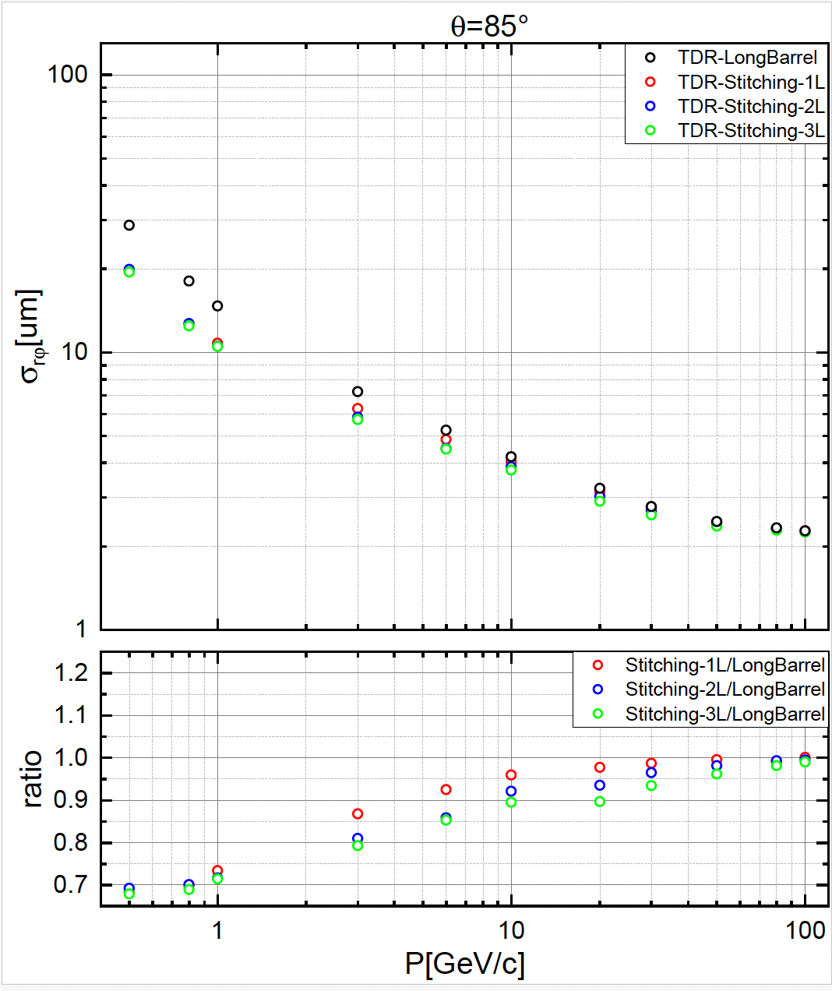
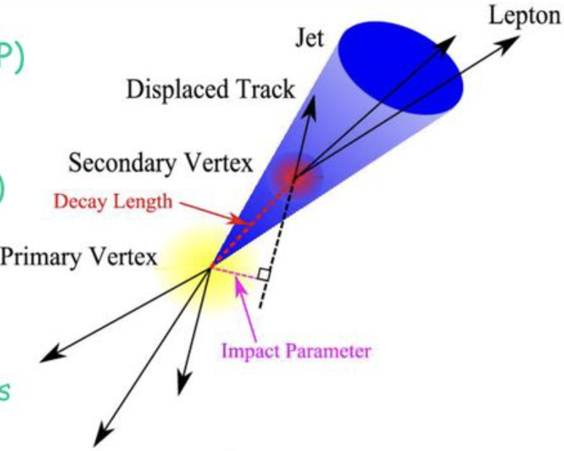
Physics Performance: impact parameter resolution
Compared to long barrel design (alternative option)
  Stitching layout (baseline) replacing 1/2/3 layer of layer in ladder design (~30% improvement)

Slide 18
Research team
IHEP: overall integration, chip design, detector assembly, electronics, offline
  15 faculty, 5 postdoc, 6 students
ShanDong U.: chip design (3 faculty, 1 postdoc, 3 students )
CCNU: chip design, ladder assembly (3 faculty, 1 postdoc, 5 students )
North West U. : Chip design (5 faculty, 2 postdoc, 5 students )
Nanchang U. : chip design, (1 faculty, 1 students)
Nanjing: irradation study: (2 faculty, 4 students)
IFAE: Chip design , Sebastian Grinstein et al (2 faculty, 1 student)
IPHC/CNRS: chip design , Christine Hu et al (5 faculty)

Slide 19
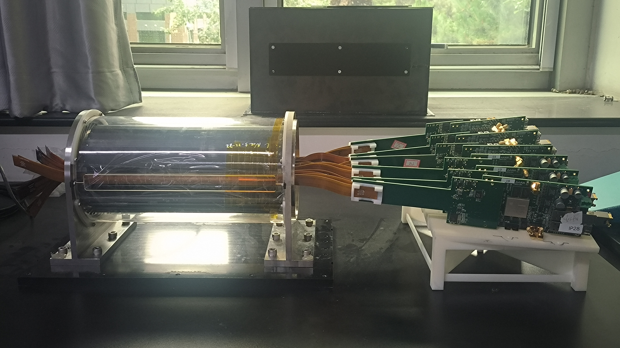

Summary
1st full-size Prototype for CEPC vertex detector developed
Reference detector TDR is in preparation, for 2025 for the proposal of China’s 15th 5-year plan.
We are active expanding international collaboration and explore synergies with other international projects (especially framework of DRD7 (electronics) and DRD8 (mechanics and integration) more than DRD3 (solid state detectors).
CEPC vertex conceptional design (2016)
CEPC vertex prototype (2023)

Slide 20
Summary: R&D status and final goal
 | Status | CEPC Final goal
CMOS chip technology | Full-size chip with TJ 180nm CIS | 65nm CIS
Detector integration | Detector prototype with ladder design | Detector with bent silicon design
Spatial resolution | 4.9 μm | 3-5 μm
Detector cooling | Air cooling with 1% channels (24 chips) on | Air cooling with full power
Bent silicon with radius | Bent Dummy wafer radius ~12mm | Bent final wafer with radius ~11mm
Stitching | 11*11cm stitched chip with Xfab 350nm CIS | 65nm CIS stitched sensor

Slide 21
Thank you for your attention!
Aug. 7th, 2024, CEPC Detector Ref-TDR Review

Slide 22
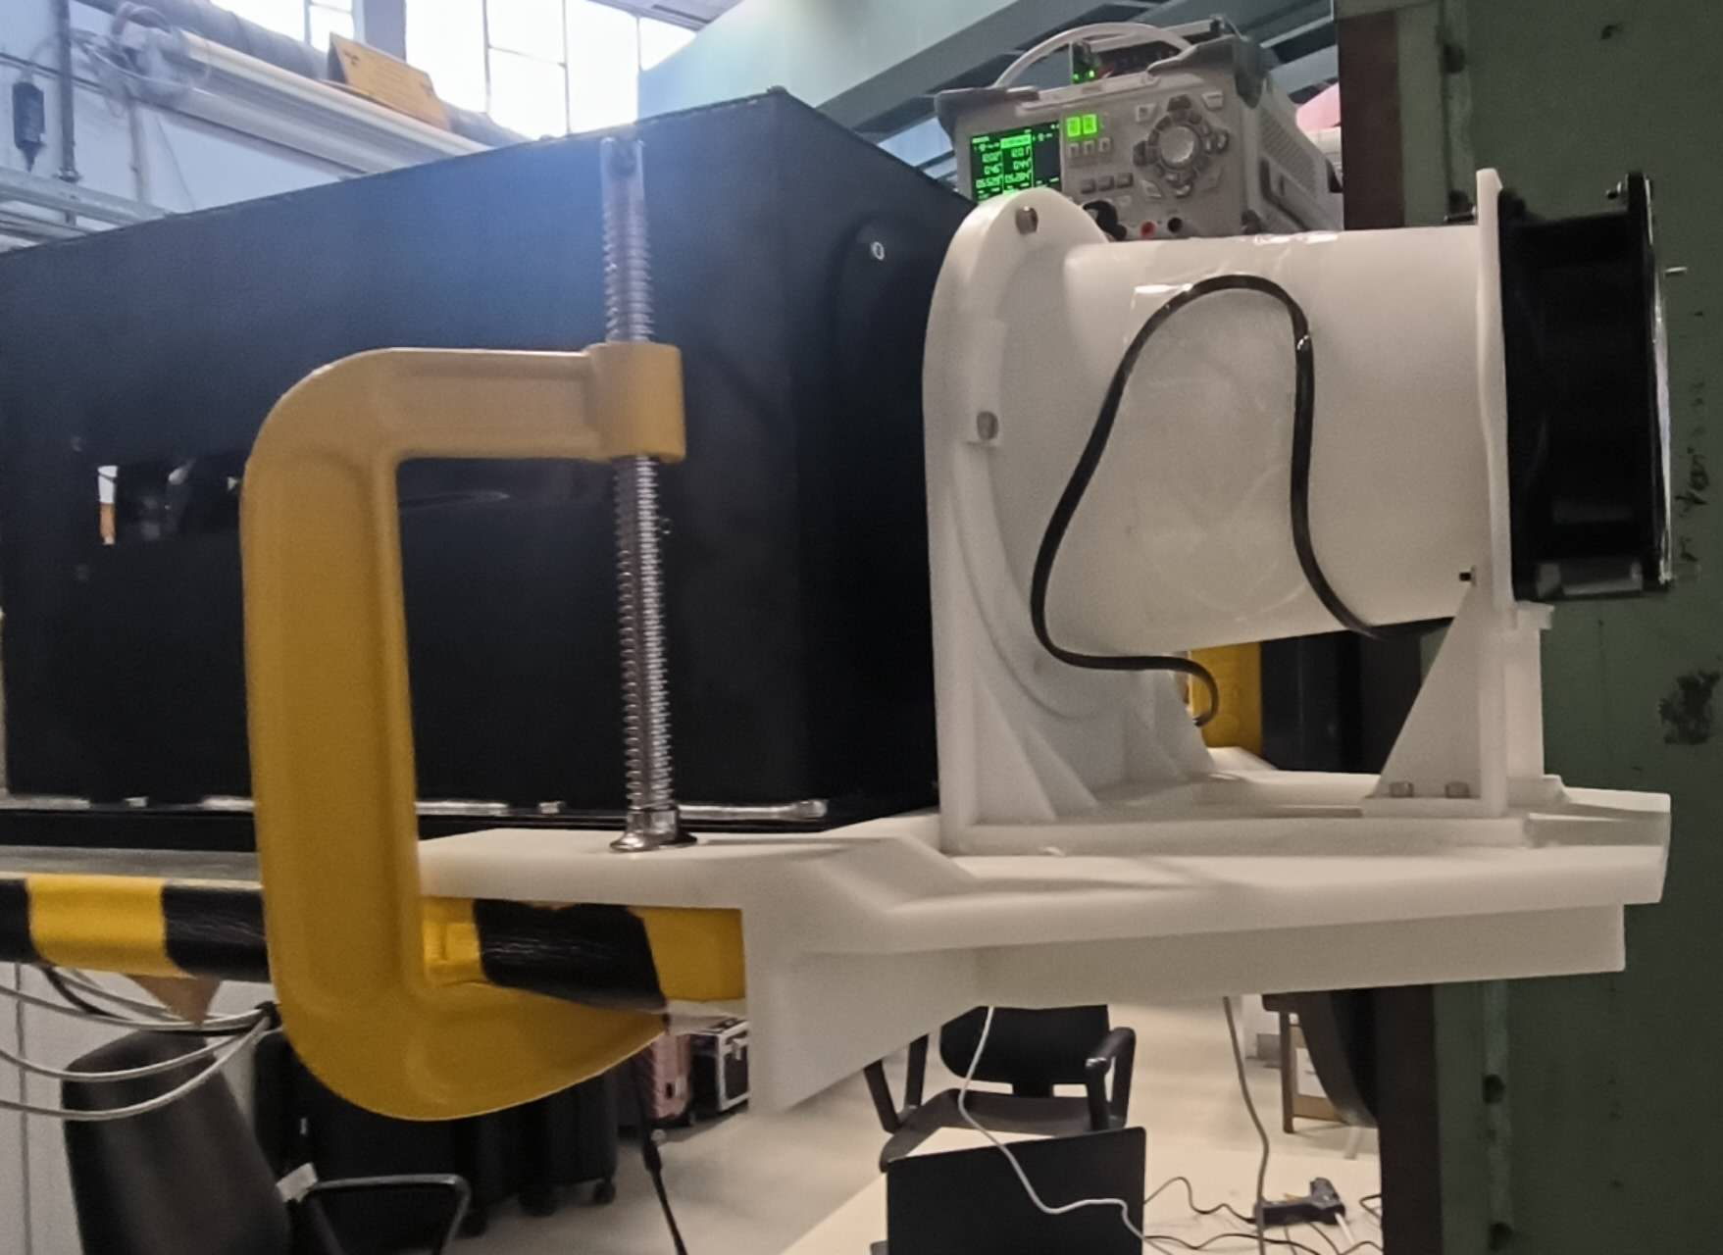
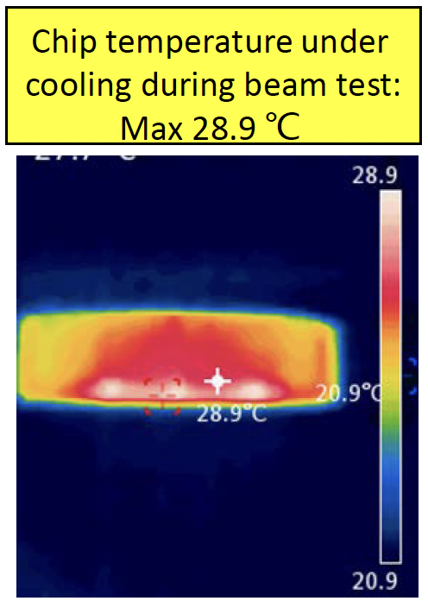
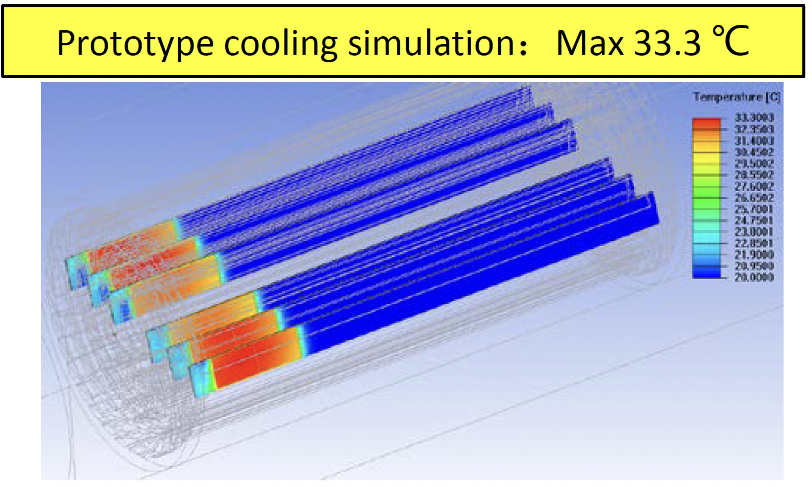
R&D efforts: Air cooling in vertex prototype
Dedicated air cooling channel designed in prototype.
  Measured Power Dissipation of Taichu chip: ~60 mW/cm² (17.5 MHz clock in testbeam)
  Before (after ) turning on the cooling, chip temperature 41 °C (25 °C)
    In good agreement to our cooling simulation
    No visible vibration effect in spatial resolution when turning on the fan

Slide 24
Vertex baseline: bent MAPS
  3 single layer of bent MAPS + 1 double layer ladder MAPS
    Material budget is a factor of 3 lower than alternative option
  Use single bent MAPS for Inner layer
    Bent MAPS can fit closer to beampipe
    Low material budget 0.06%X0 per layer
    (40um silicon + Al metal layer+ support )
  Ladder design for outer layer
    No dead area in ladder design
Stitching layer | Radius | Material
Layer 1 | 11mm | 0.06% X0
Layer 2 | 16.5mm | 0.06% X0
Layer 3 | 22mm | 0.06% X0
Layer 4 | 27.5mm | 0.06% X0
Layer 5/6 (Ladders) | 35-45mm | 0.5% X0
Total |  | 0.74% X0
Layer 2
Layer 4
Layer 1
Layer 3

Slide 25
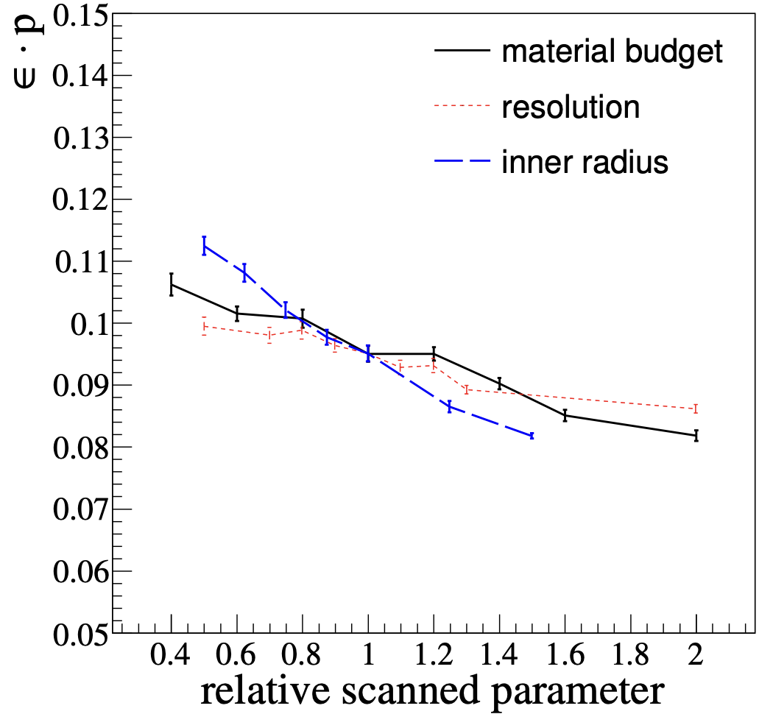
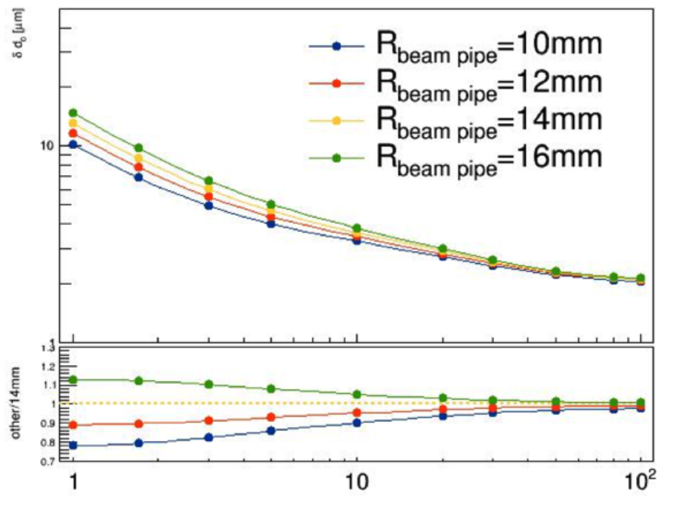
Vertex Requirement
1st priority: Small inner radius, close to beam pipe (11mm )
2nd priority: Low material budget <0.15% X0 per layer
^{3rd} priority: High resolution pixel sensor： 3~5 μm

Slide 26
Research team and working plan
IHEP: overall intergration, chip design, detector assembly, electronics, offline
  Overall : Joao, Zhijun ,Ouyang Qun
  Mechnical: Jinyu Fu
  Electronics: Wei wei, Ying Zhang, Jun Hu, Yunpeng Lu , Yang Zhou, Xiaoting Li
  DAQ: Hongyu Zhang
  Detector assembly: Mingyi Dong
  Physics: Chengdong Fu, linghui Wu, Gang Li
ShanDong U.: chip design , Meng Wang, Liang Zhang, Jianing Dong
CCNU: chip design, ladder assembly, Xiangming Sun, Ping Yang
North West U. : Chip design Xiaoming Wei, Jia Wang, Yongcai Hu
Nanchang U. : chip design, Tianya Wu
Nanjing: irradation study: Ming Qi , Lei Zhang
IFAE: Chip design , Sebastian Grinstein, Raimon Casanova
IPHC/CNRS: chip design , Christine Hu, Yongcai Hu

Slide 27
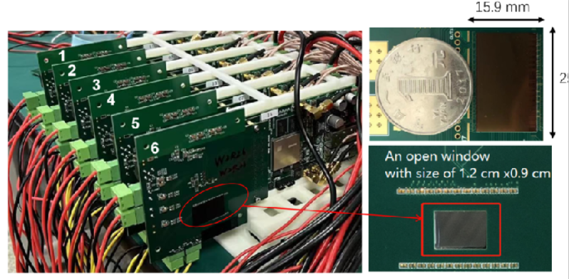
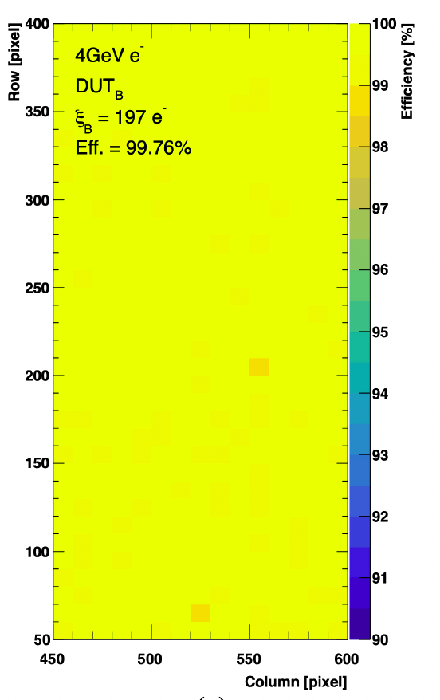
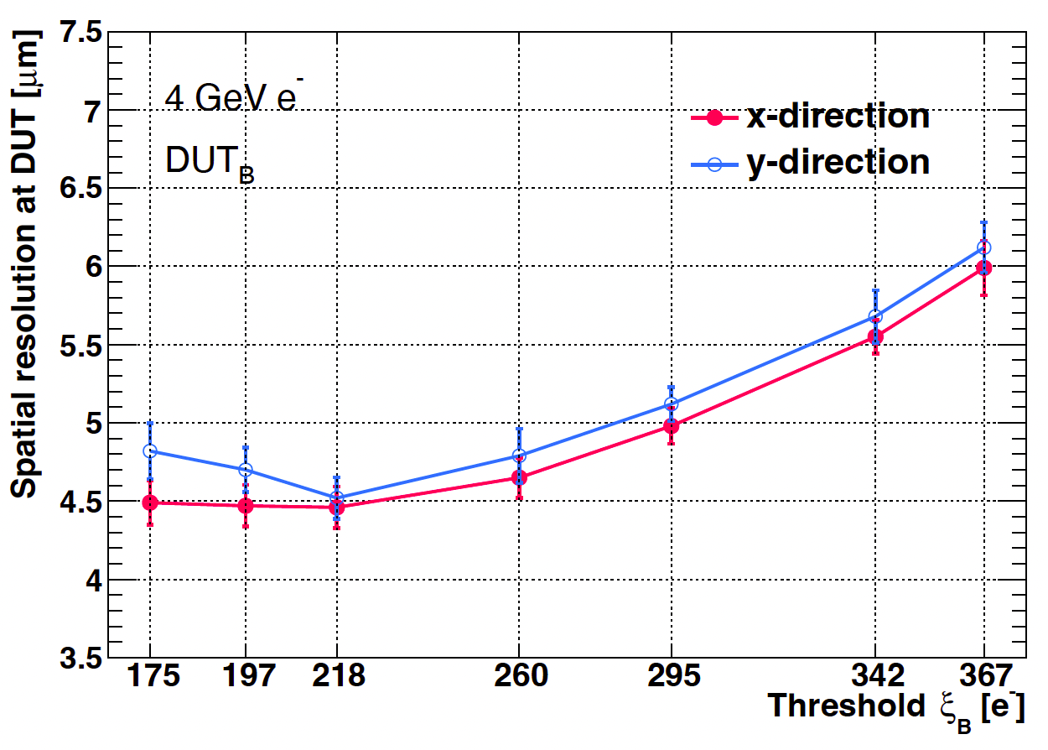
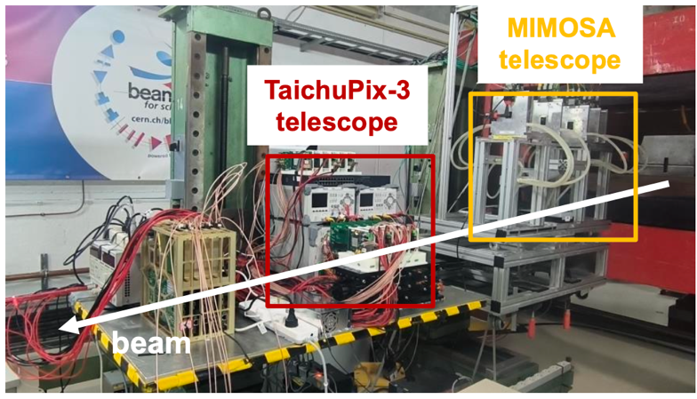
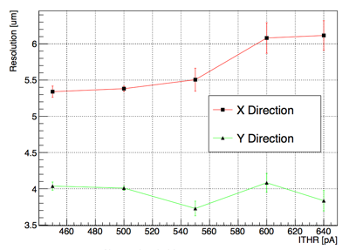
R&D efforts and results: Jadepix3/TaichuPix3 beam test @ DESY
Spatial resolution 4~5um, Efficiency >99%
TaichuPix3 efficiency
TaichuPix3 resolution
JadePix3 resolution
JadePix3
telescope
Collaboration with CNRS and IFAE in Jadepix/TaichuPix R & D

