Slide 1


CEPC Muon Detector
Xiaolong Wang
(for the Muon Detector Group)
Fudan University
Aug. 7th, 2024, CEPC Detector Ref-TDR Review

Slide 2
Content
Introduction
Requirements
Technology survey and our choices
Technical challenges
R&D efforts and results
Detailed design
Readout electronics
Performance from simulation
RPC related and testing
Research team and working plan
Summary

Slide 3
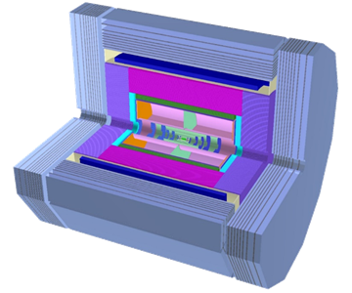
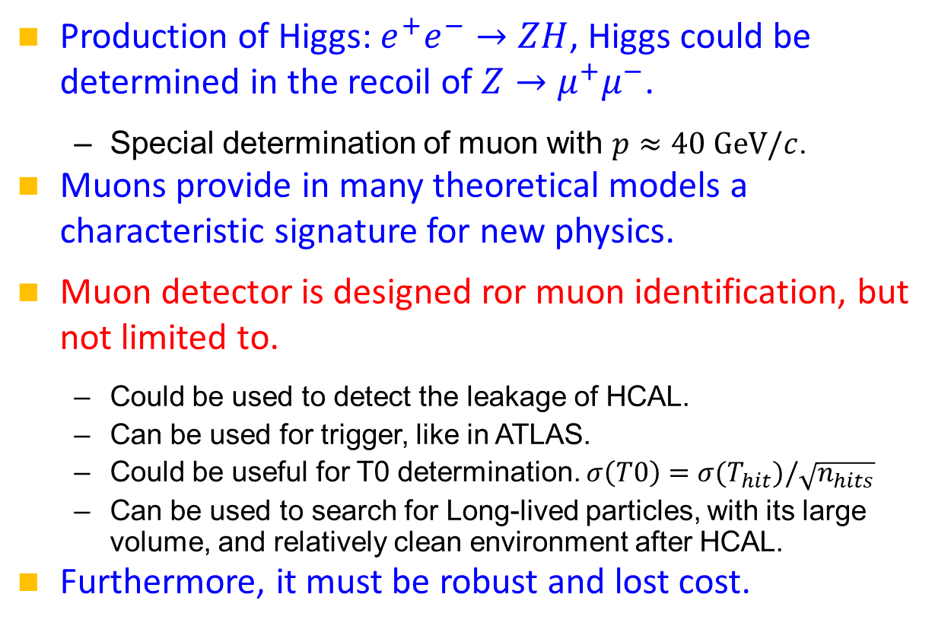
Introduction
Muon detector, the outmost detector with large volume.
Production of Higgs: $e^{+}e^{−}→ZH$, Higgs could be determined in the recoil of $Z→μ^{+}μ^{−}$.
  Special determination of muon with $p≈40 GeV/c$.
Muons provide in many theoretical models a characteristic signature for new physics.
Muon detector is designed ror muon identification, but not limited to.
  Could be used to detect the leakage of HCAL.
  Can be used for trigger, like in ATLAS.
  Could be useful for T0 determination. $σ\left(T0\right)=σ(T_{hit})/\sqrt{n_{hits}}$
  Can be used to search for Long-lived particles, with its large volume, and relatively clean environment after HCAL.
Furthermore, it must be robust and lost cost.
Barrel
Endcap
Endcap
We seek excellent performance from the muon detector!

Slide 4
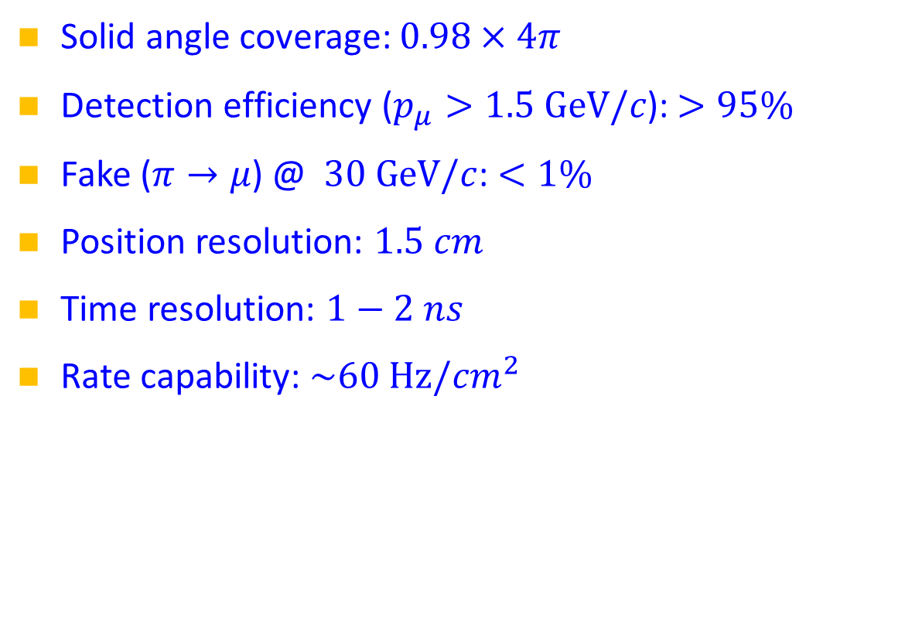
Requirement
Solid angle coverage: $0.98×4π$
Detection efficiency ($p_{μ}>1.5 GeV/c$): $>95\%$
Fake ($π→μ$) @ $30 GeV/c$: $<1\%$
Position resolution: $1.5 cm$
Time resolution: $1−2 ns$
Rate capability: $\sim 60 Hz/cm^{2}$
High efficiency
Low fake rate
Resolution due to the multiple scattering of muon
A typical time resolution of modern muon detector, and useful for trigger, T0 and background suppression.
Compatible with the high luminosity operation

Slide 5
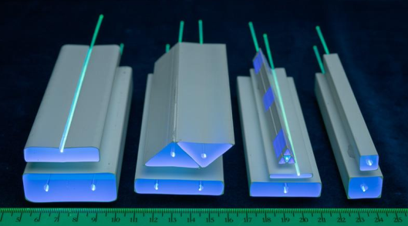
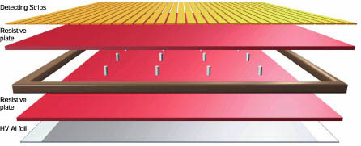
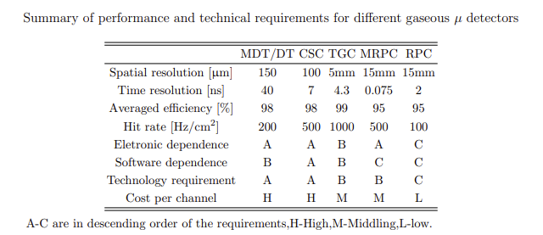
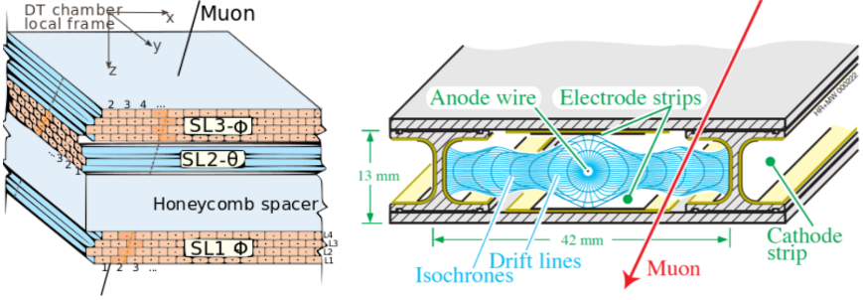
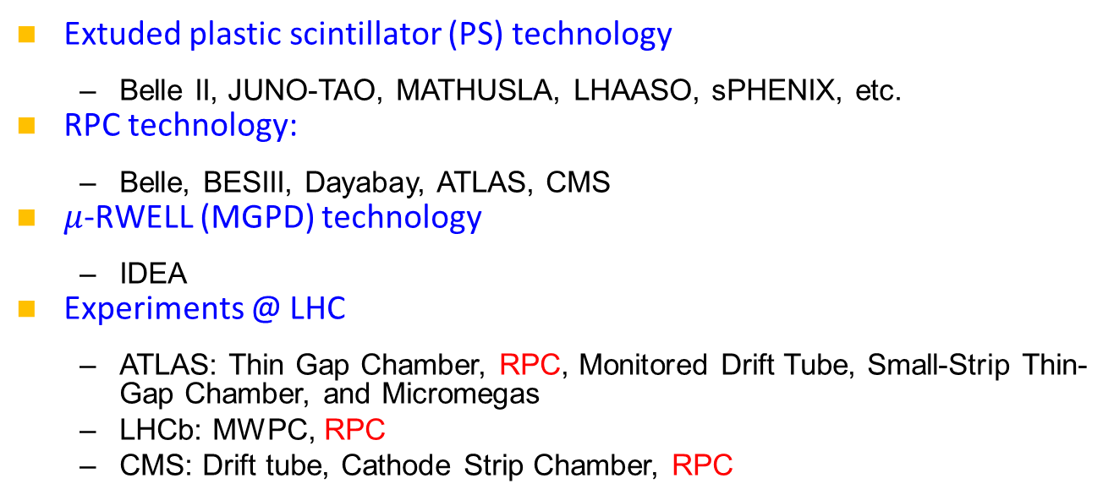
Technology survey and our choices
Extuded plastic scintillator (PS) technology
  Belle II, JUNO-TAO, MATHUSLA, LHAASO, sPHENIX, etc.
RPC technology:
  Belle, BESIII, Dayabay, ATLAS, CMS
$μ$-RWELL (MGPD) technology
  IDEA
Experiments @ LHC
  ATLAS: Thin Gap Chamber, RPC, Monitored Drift Tube, Small-Strip Thin-Gap Chamber, and Micromegas
  LHCb: MWPC, RPC
  CMS: Drift tube, Cathode Strip Chamber, RPC
Simple structure: PS bar, fiber, SiPM

Slide 6
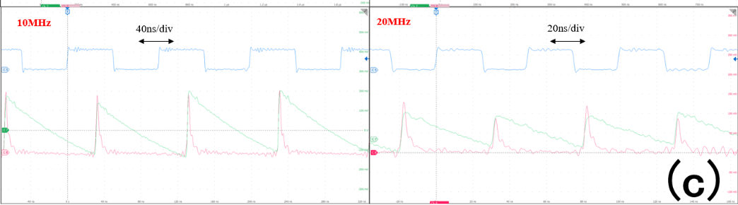
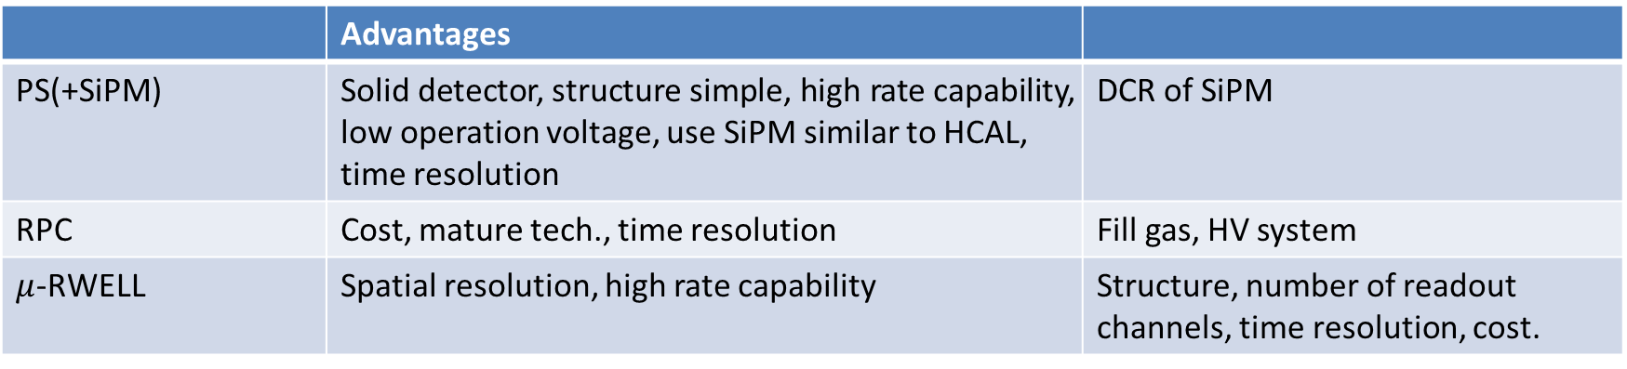
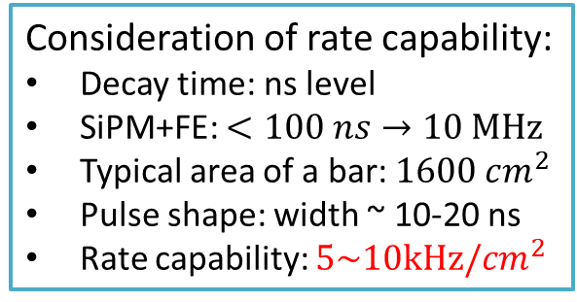
Comparisons
 | Advantages
PS(+SiPM) | Solid detector, structure simple, high rate capability, low operation voltage, use SiPM similar to HCAL, time resolution | DCR of SiPM
RPC | Cost, mature tech., time resolution | Fill gas, HV system
$μ$-RWELL | Spatial resolution, high rate capability | Structure, number of readout channels, time resolution, cost.
disadvantages
EPS and RPC have similar cost.
Consideration of rate capability:
Decay time: ns level
SiPM+FE: $<100 ns→10 MHz$
Typical area of a bar: $1600 cm^{2}$
Pulse shape: width ~ 10-20 ns
Rate capability: $5\sim 10kHz/cm^{2}$
Our choice: PS as the baseline option, RPC for comparison in R&D.
20MHz tested for SiPM+FEE with laser.

Slide 7
Main Technical Challenges
Long detector module: could be ~5m
How to achieve the efficiency and the time resolution required from a long PS bar?
  2.8 m bar has been used at Belle II;
  1.5 m bar has been tested in lab;
  It’s possible since Kuraray fiber has an attenuation length of 6.8 m.

Slide 8
R&D efforts and results
Simulation and software
Performance of PS bars
Front-end electronics
Prototype and CR testing
Published papers:
Design and performance of a high‑speed and low‑noise preamplifier for SiPM, Nucl. Sci. Tech. 34, 169(2023)
Design and test for the CEPC muon subdetector based on extruded scintillator and SiPM, JINST 19 P06020(2024)
8

Slide 9
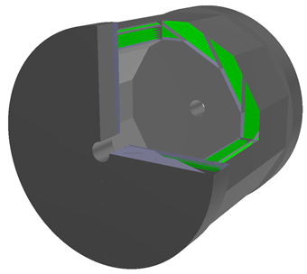
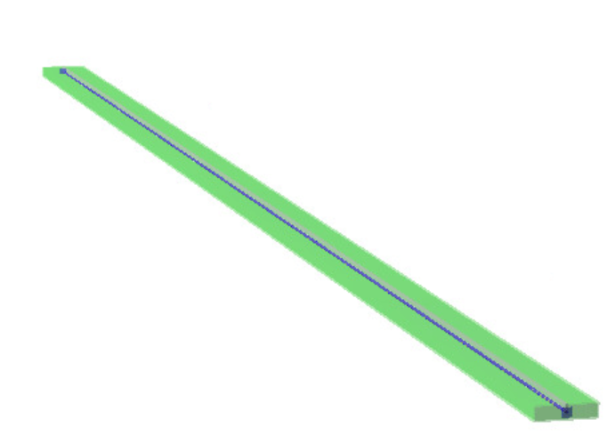
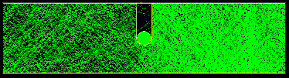
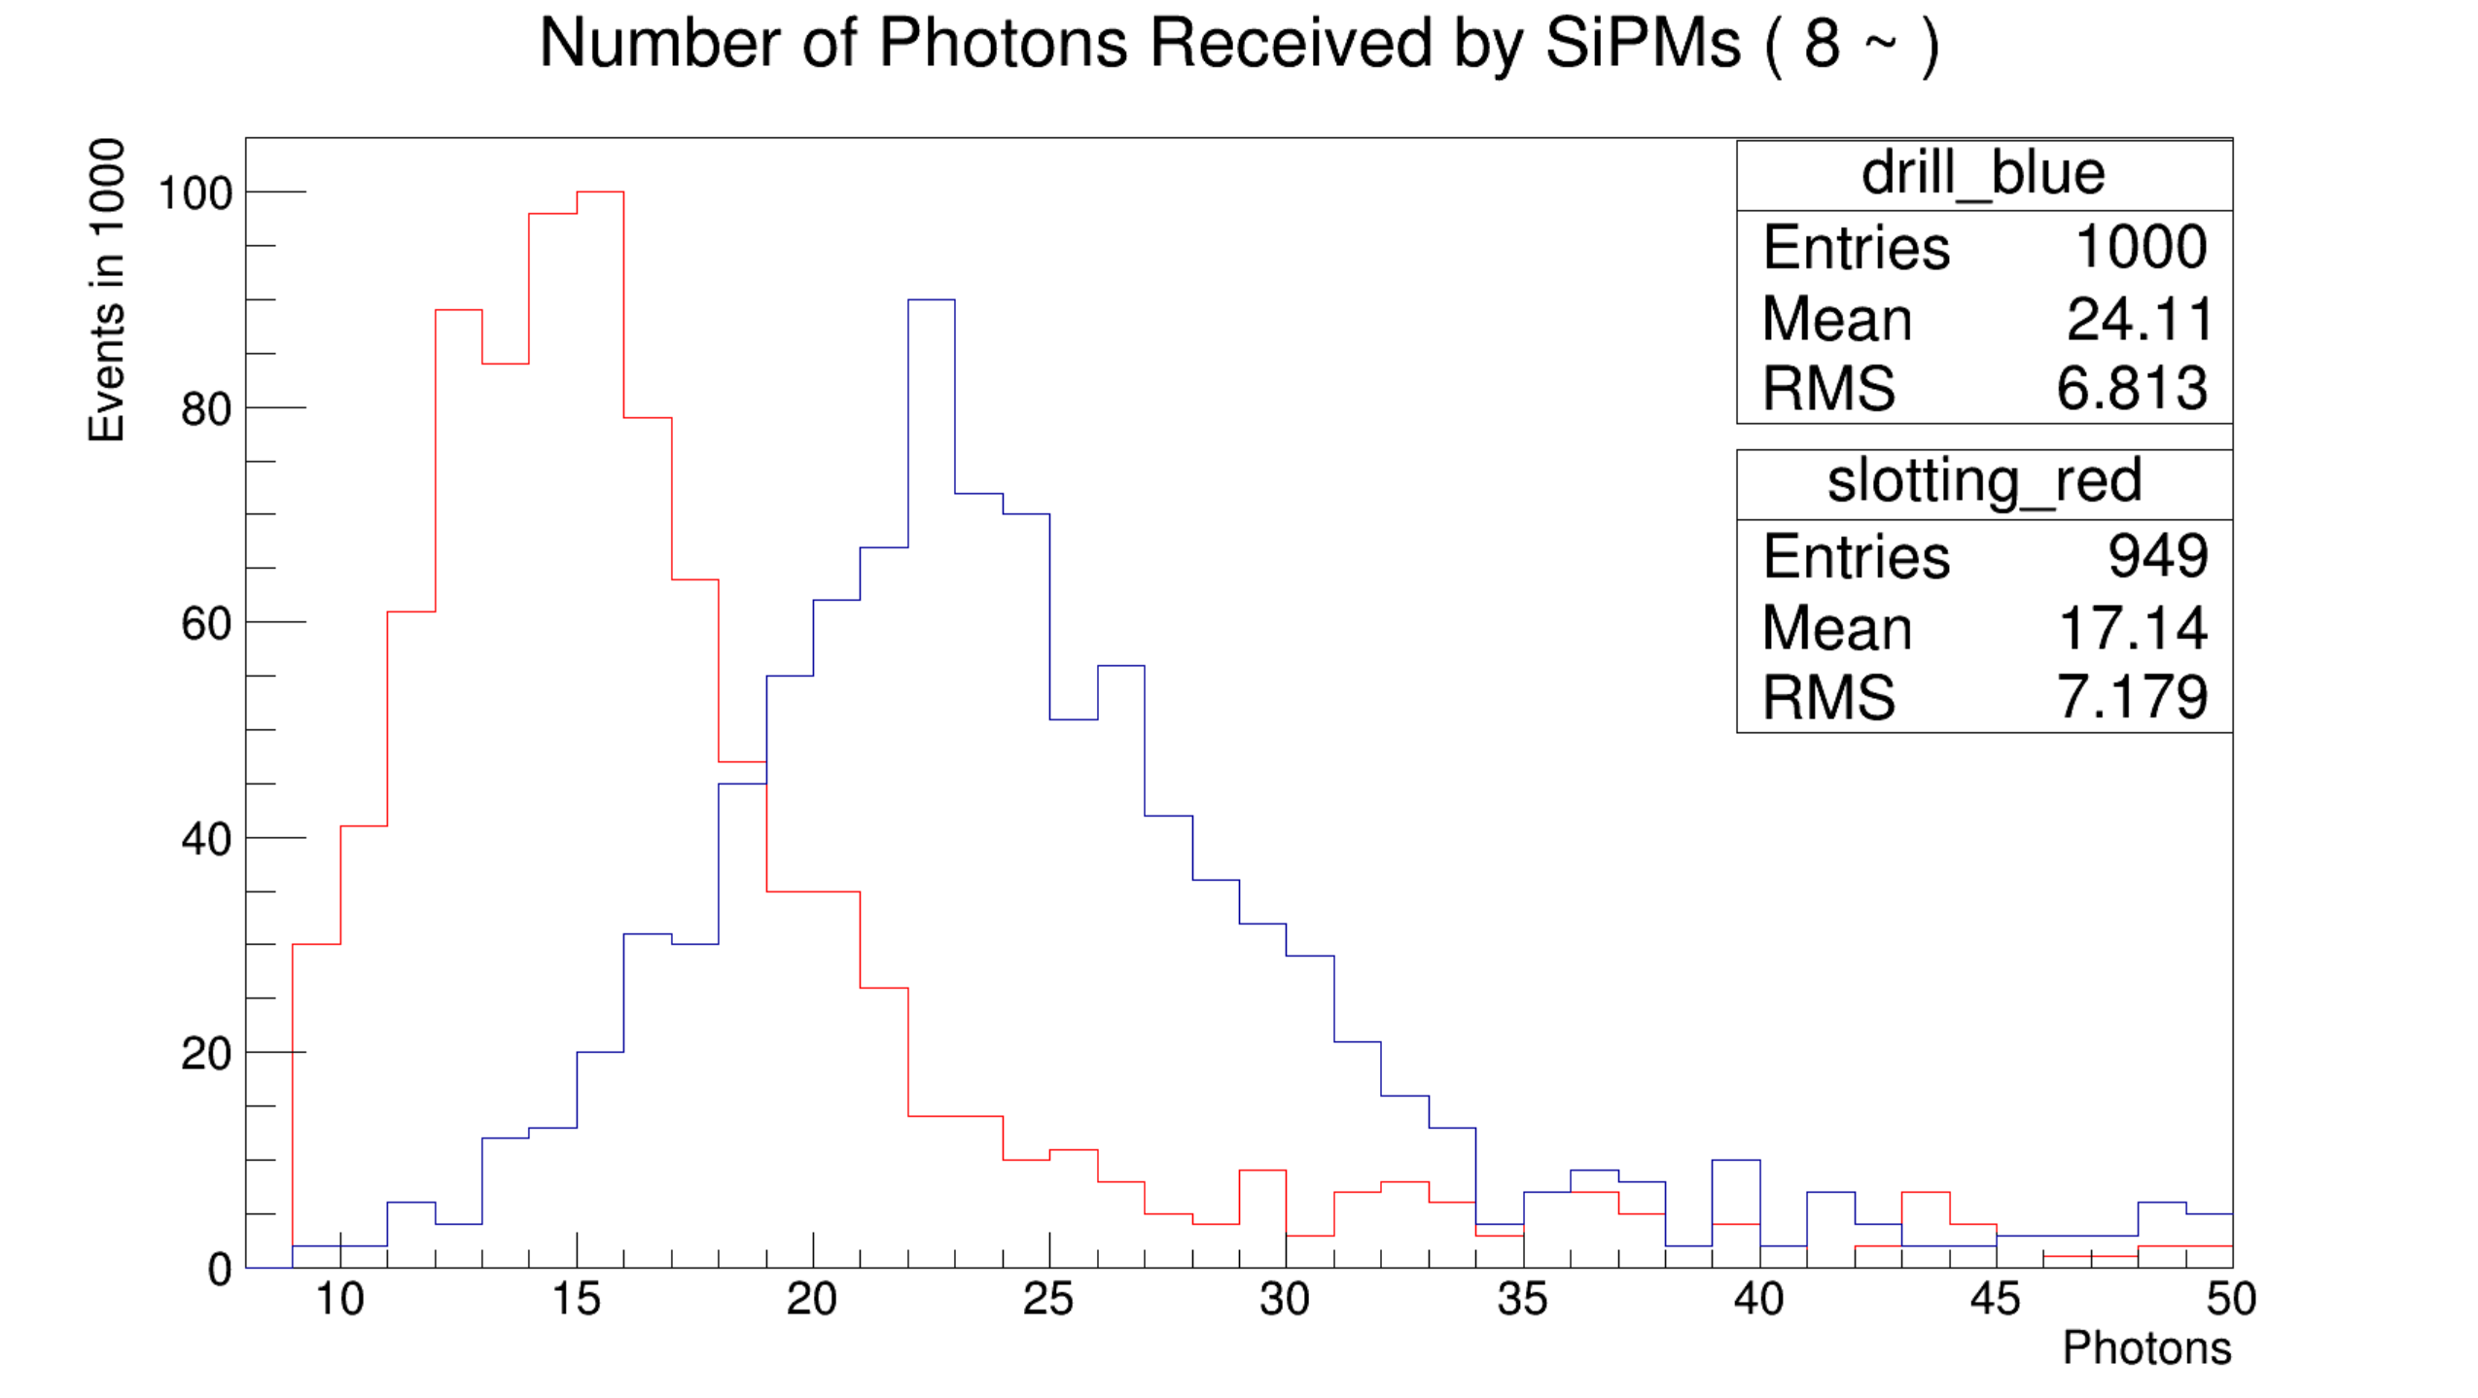
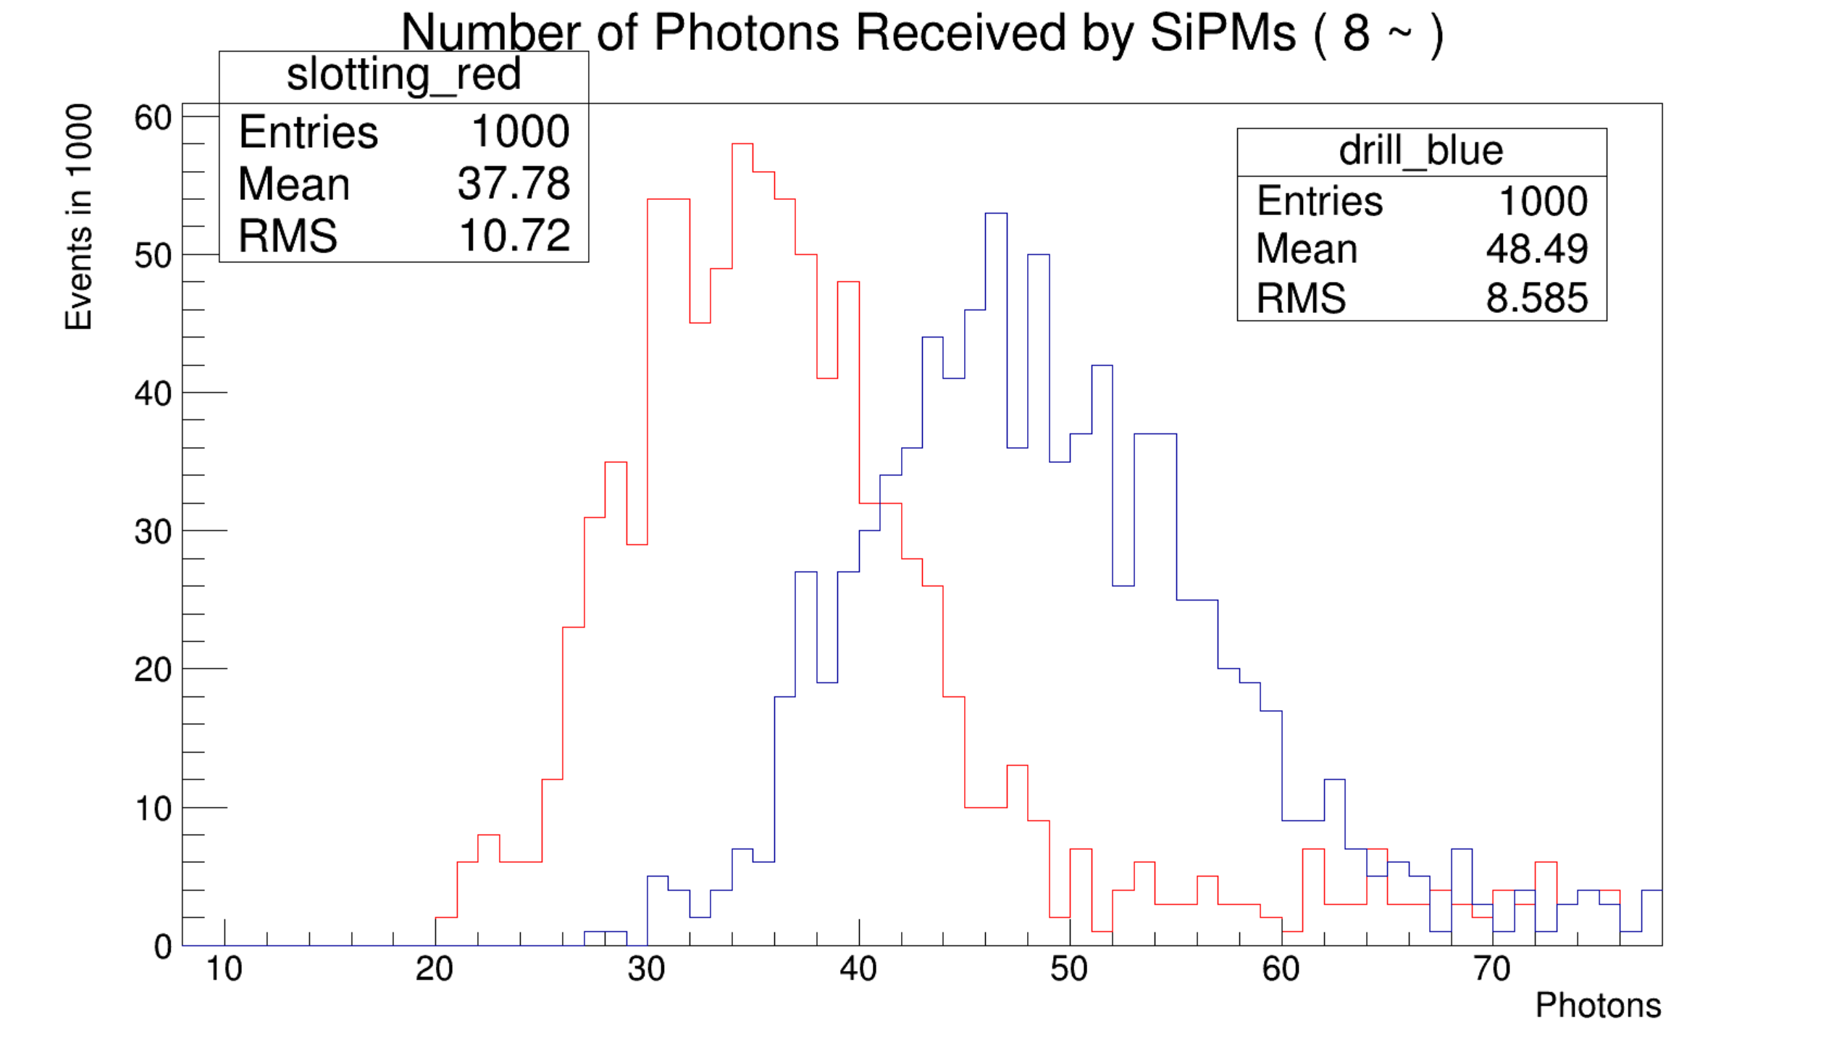
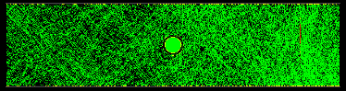
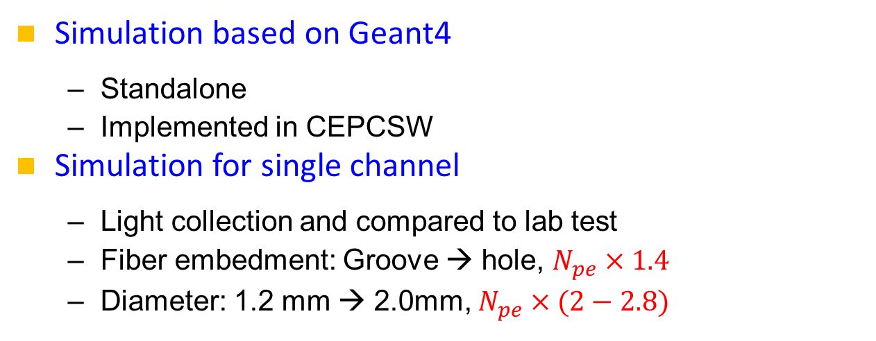
Simulation and software
Simulation based on Geant4
  Standalone
  Implemented in CEPCSW
Simulation for single channel
  Light collection and compared to lab test
  Fiber embedment: Groove → hole, $N_{pe}×1.4$
  Diameter: 1.2 mm → 2.0mm, $N_{pe}×(2−2.8)$
Simulation shows potential to increase the light yield by a factor of 2.8-3.9, which is helpful for building long detector module.
Geometry of endcaps is being modified.

Slide 10
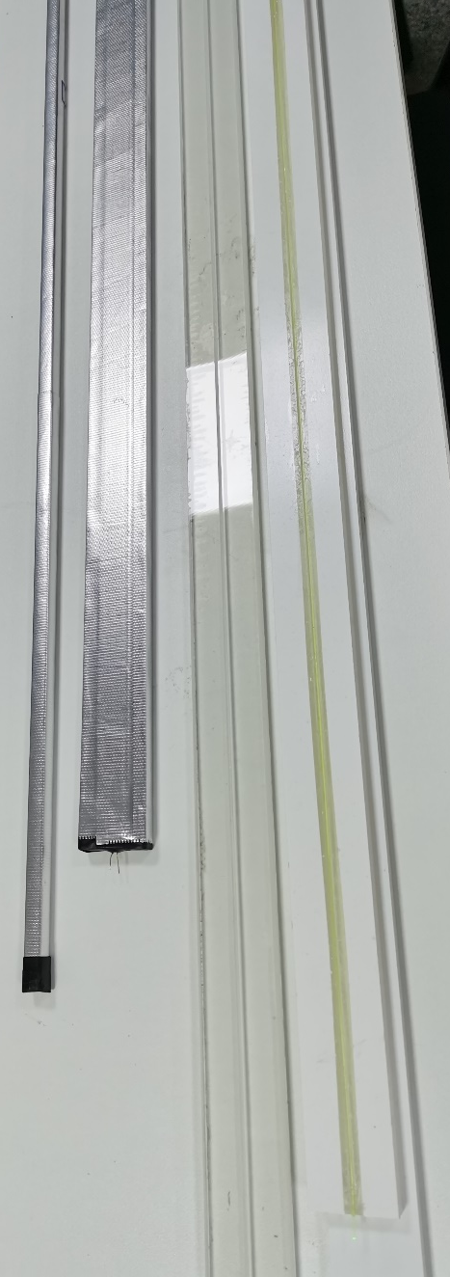
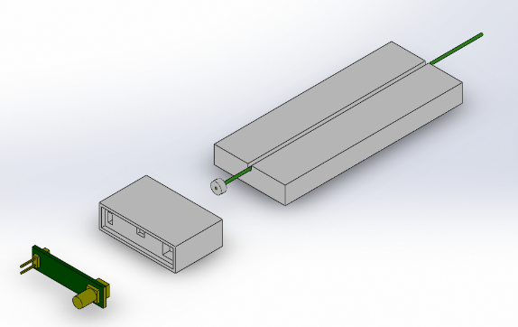
Performance of PS bars
PS bars made in GNKD company
  Increase the light yield;
  Develop/improve the reflection layer with Teflon;
  Strip production.
The quality of 1.5 m bars has achieved the required performance, which will be described later.
10

Slide 11
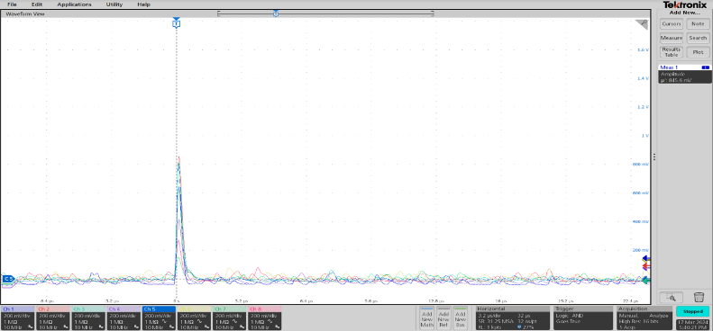
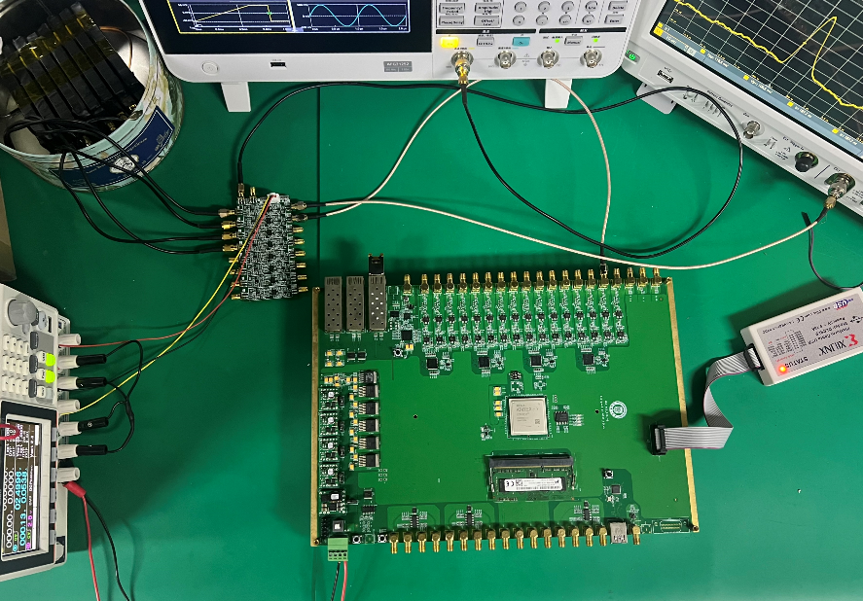
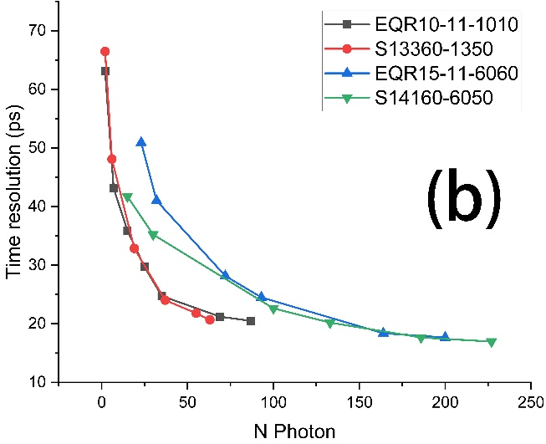
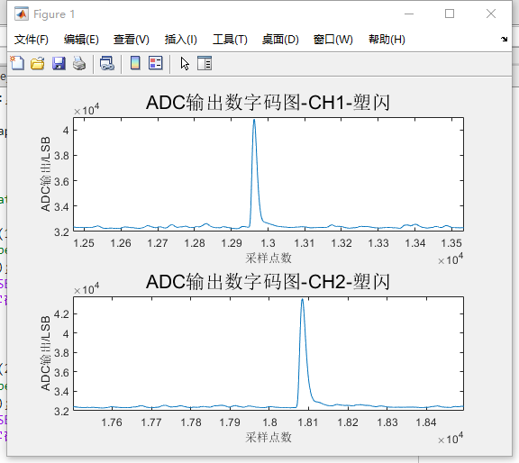
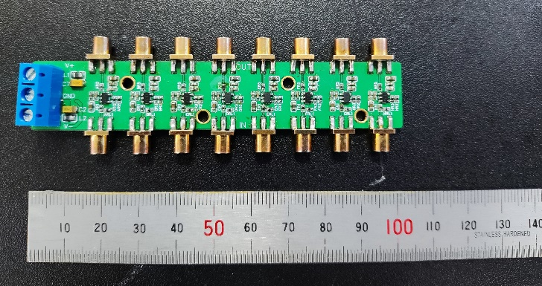
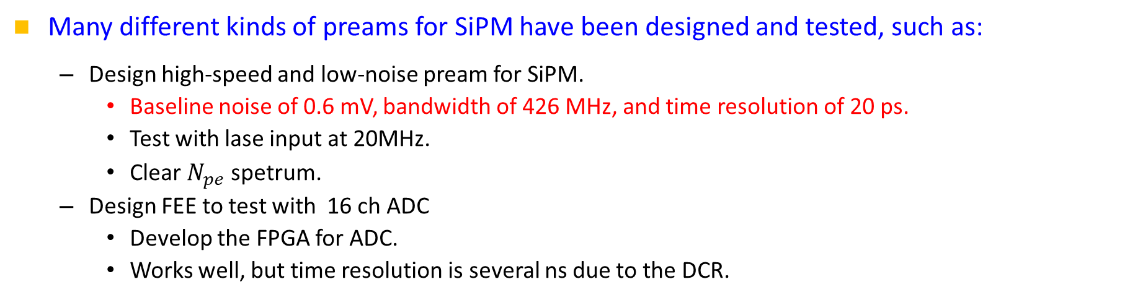
R&D for front-end electronics
Many different kinds of preams for SiPM have been designed and tested, such as:
  Design high‑speed and low‑noise pream for SiPM.
    Baseline noise of 0.6 mV, bandwidth of 426 MHz, and time resolution of 20 ps.
    Test with lase input at 20MHz.
    Clear $N_{pe}$ spetrum.
  Design FEE to test with 16 ch ADC
    Develop the FPGA for ADC.
    Works well, but time resolution is several ns due to the DCR.
ADC output signals of scintillators
8ch PS bars
preams
NST34,169(2023)
16 ch ADC (10-100 MSPS)

Slide 12
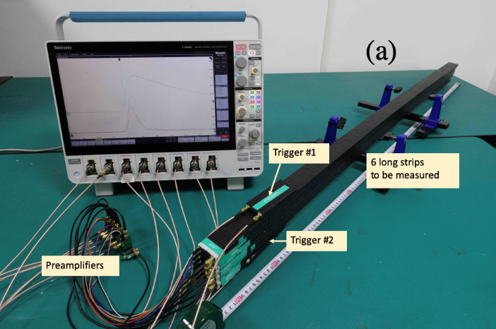
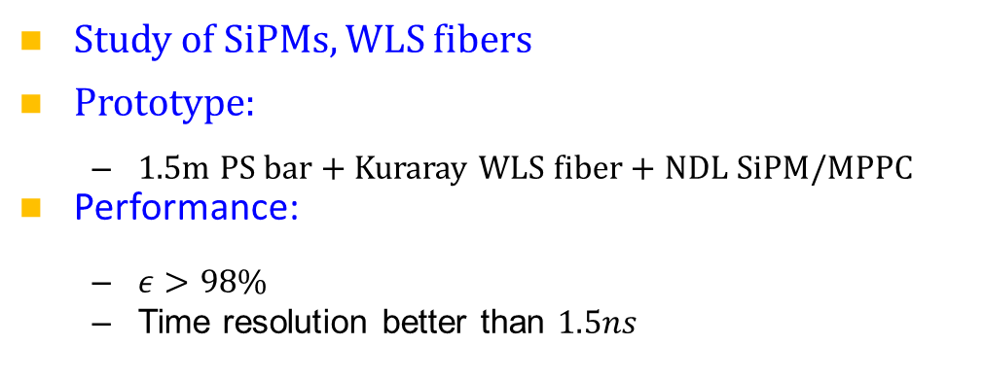
Prototype and CR test
Study of SiPMs, WLS fibers
Prototype:
  1.5m PS bar + Kuraray WLS fiber + NDL SiPM/MPPC
Performance:
  $ε>98\%$
  Time resolution better than $1.5ns$
JINST 19 P06020(2024)
12

Slide 13
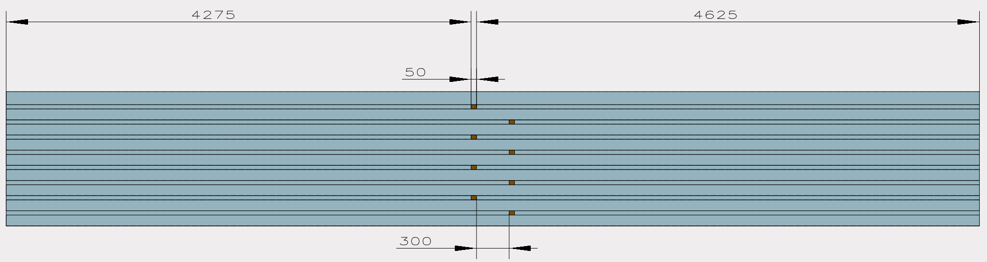
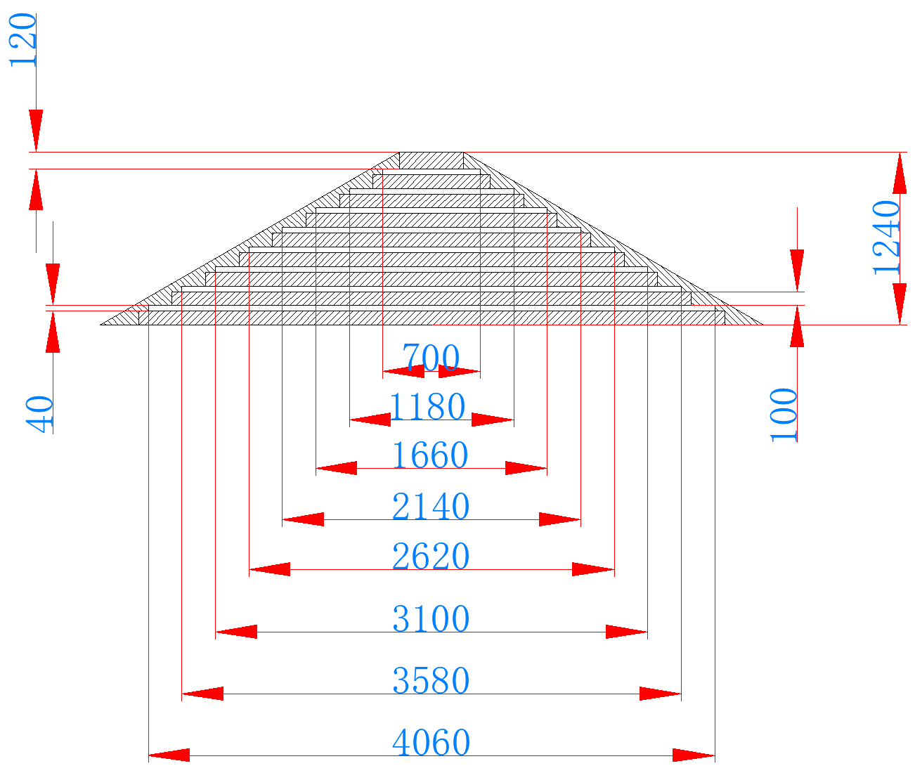
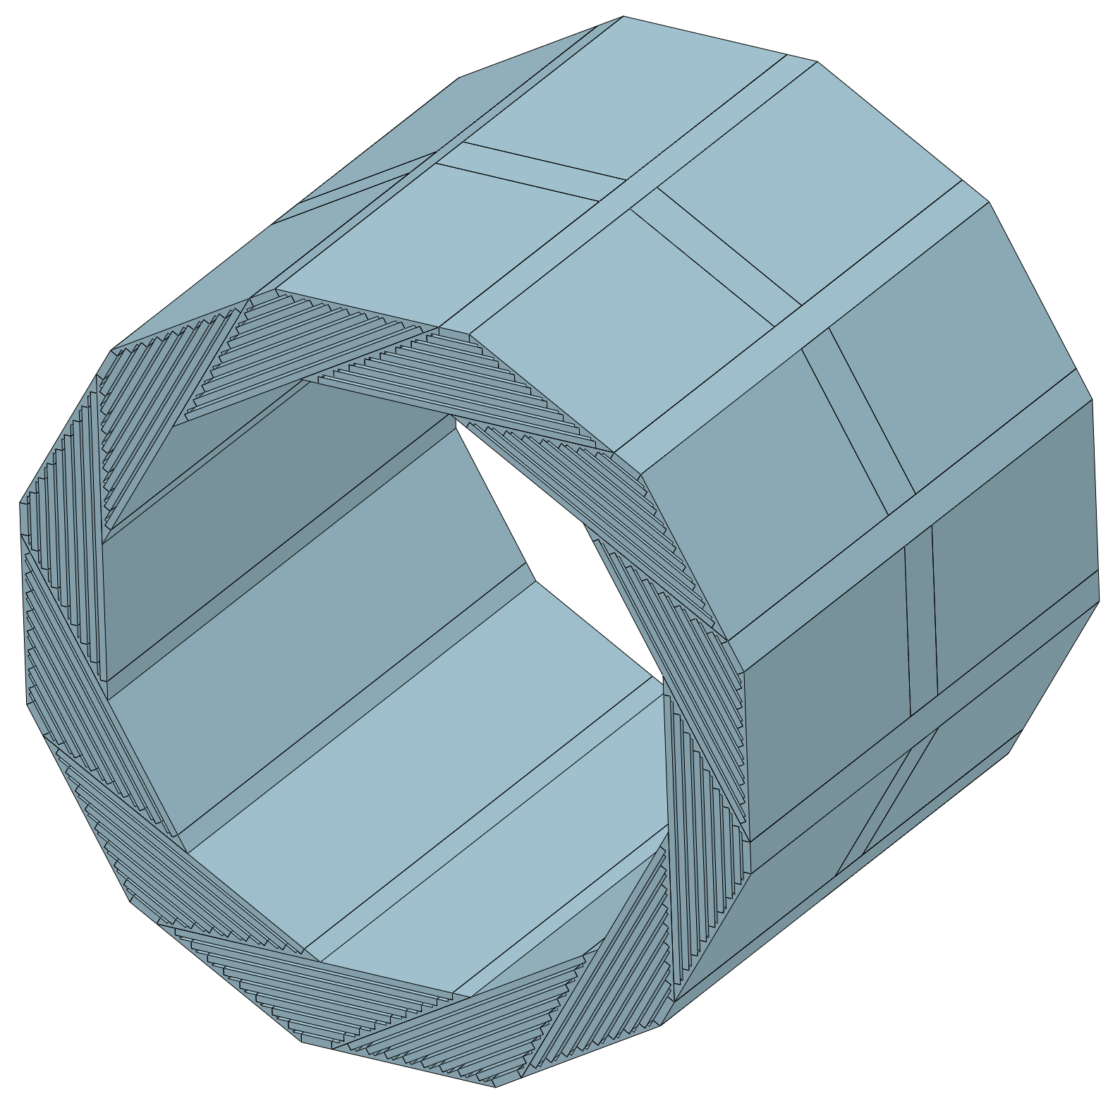
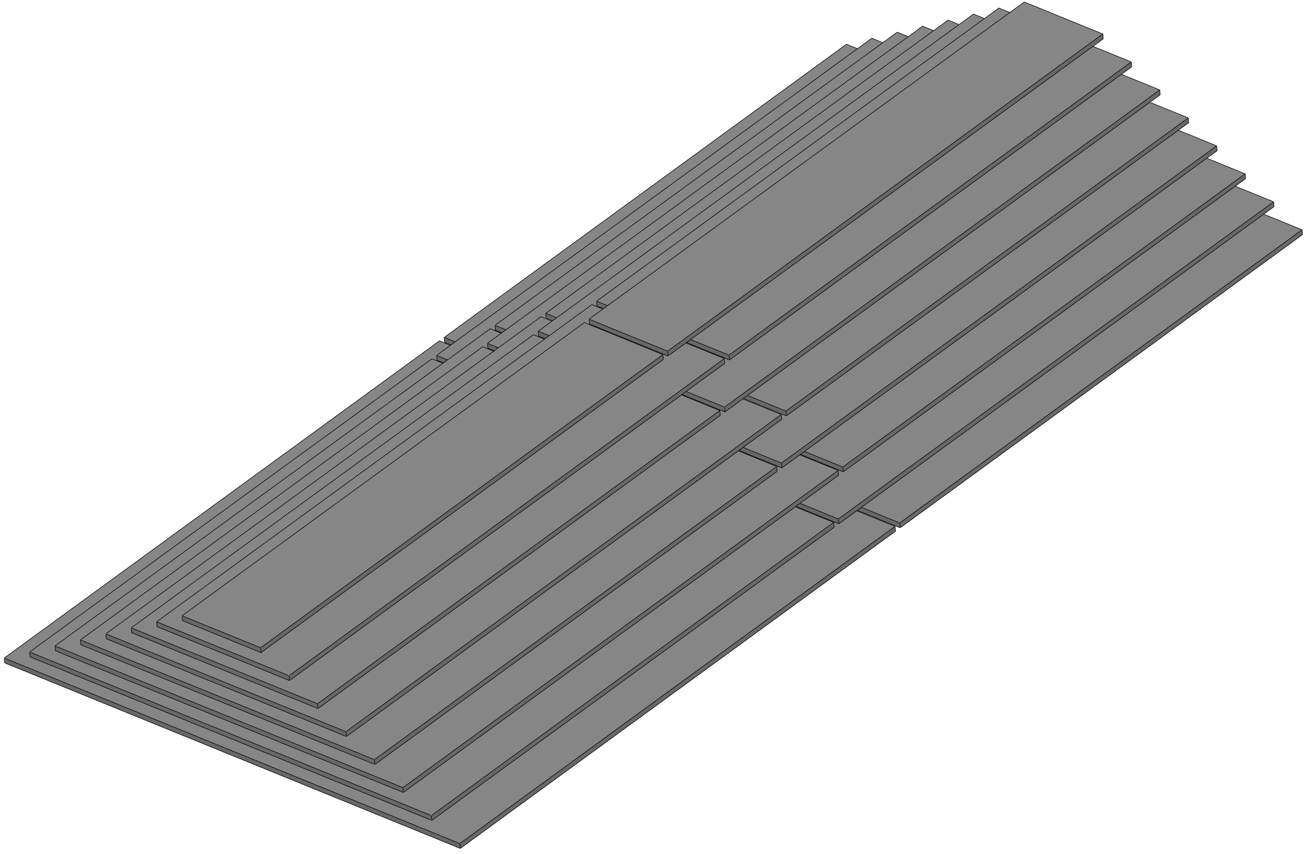
Detailed design - geometry
Geometry:
  Barrel: Helix dodecagon sectors
  Rectangle modules inserted in the gaps between iron plates
  Cable: towards the gaps between barrel and endcaps
L = 4.275m or 4.625m
cables
cables
Width from 0.7m to 4.06m
13

Slide 14
Detailed design - geometry
Geometry:
  Endcaps: inner and outer sectors
  High hit rates for the inner sectors
cables
14

Slide 15
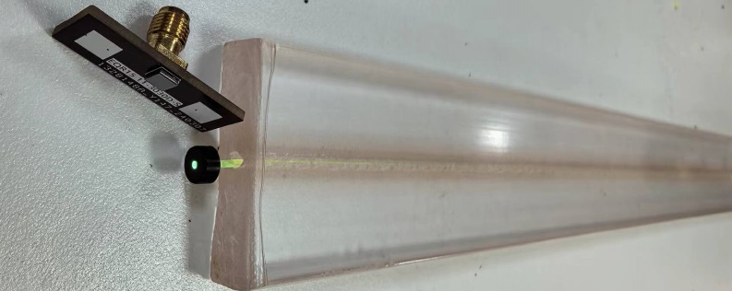
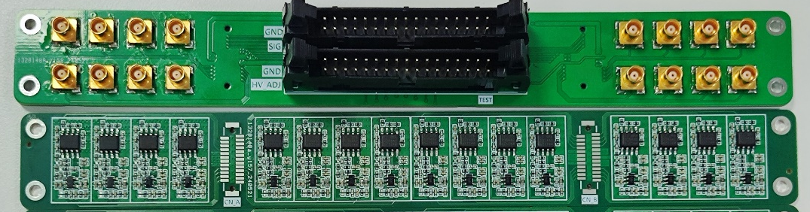
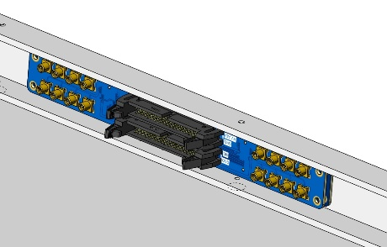
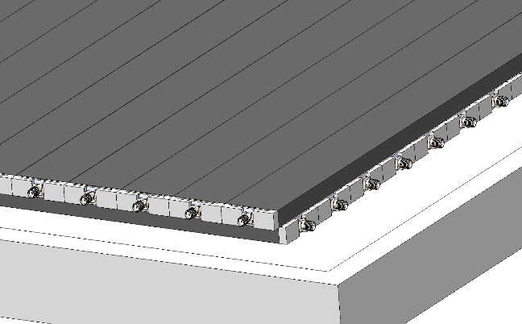
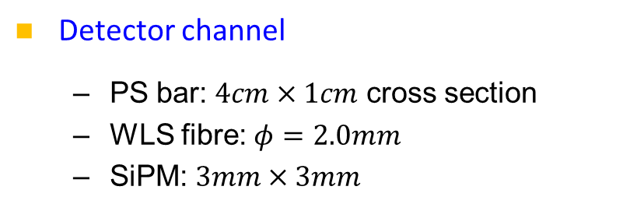
Detailed design – channel and module
Detector channel
  PS bar: $4cm×1cm$ cross section
  WLS fibre: $φ=2.0mm$
  SiPM: $3mm×3mm$
Detector module
  Superlayer with perpendicular channels
  Carriers for preams held at the frame
  Space between PS bars and aluminum layer is allowed for long cables.
Mechanics
  Aluminum frame, PS bars
R&D on the new production is ongoing
Goes to BEE with ribbon cables
Space covered by large area aluminum layer.
Carrier for the FEE, inside the module
superlayer

Slide 16
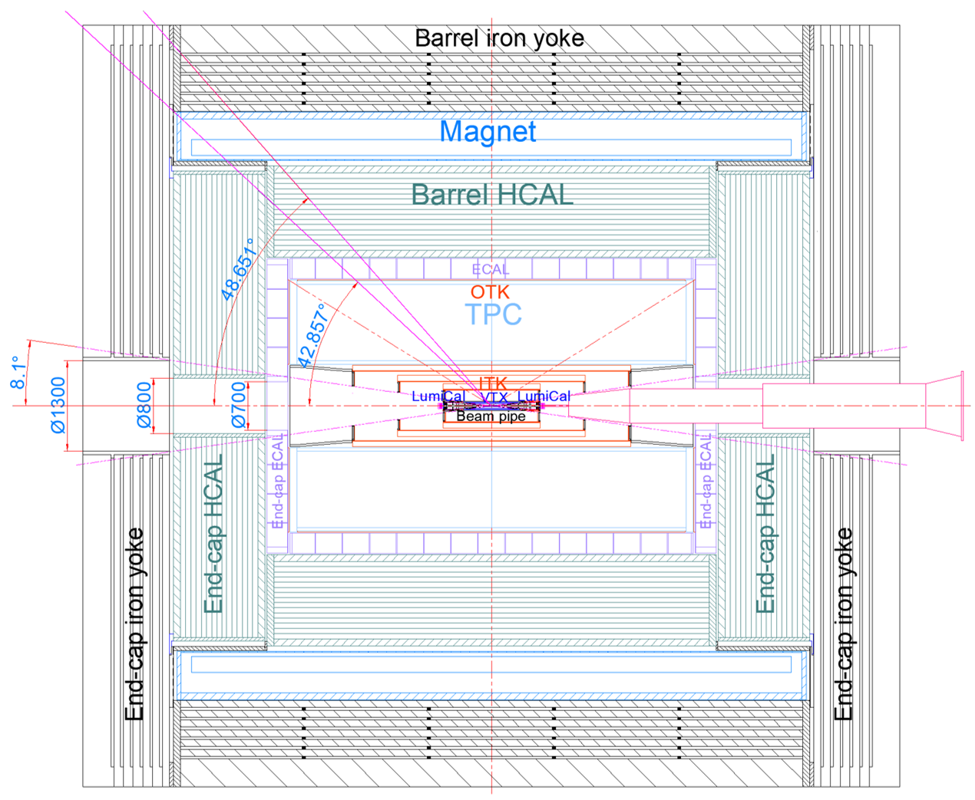
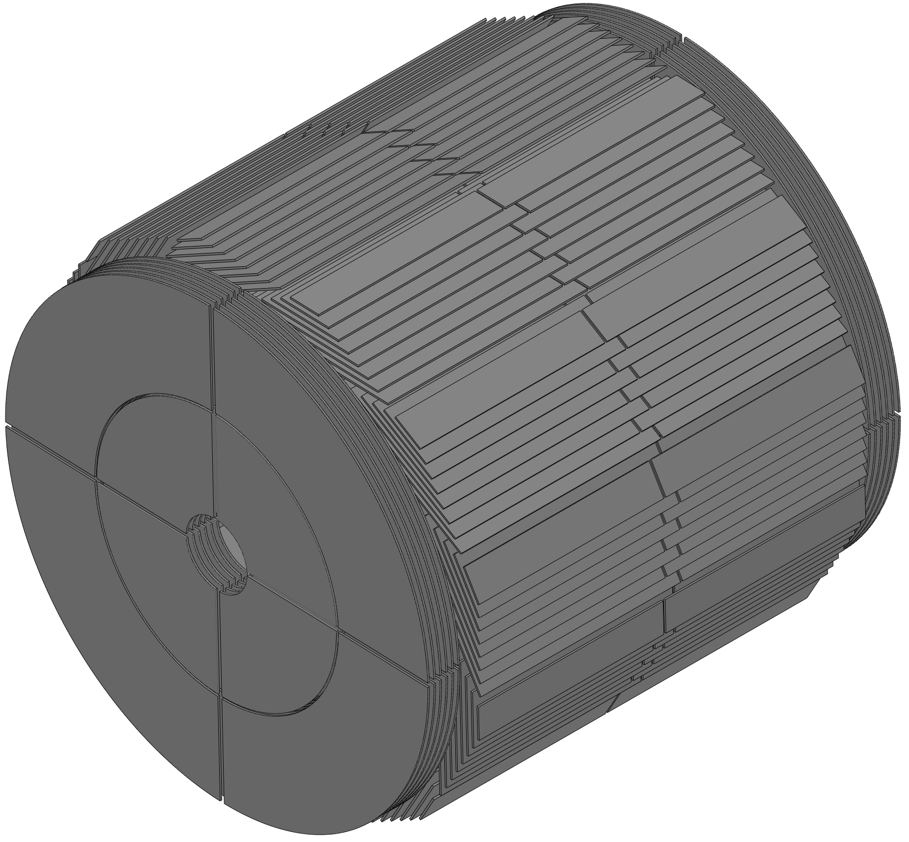
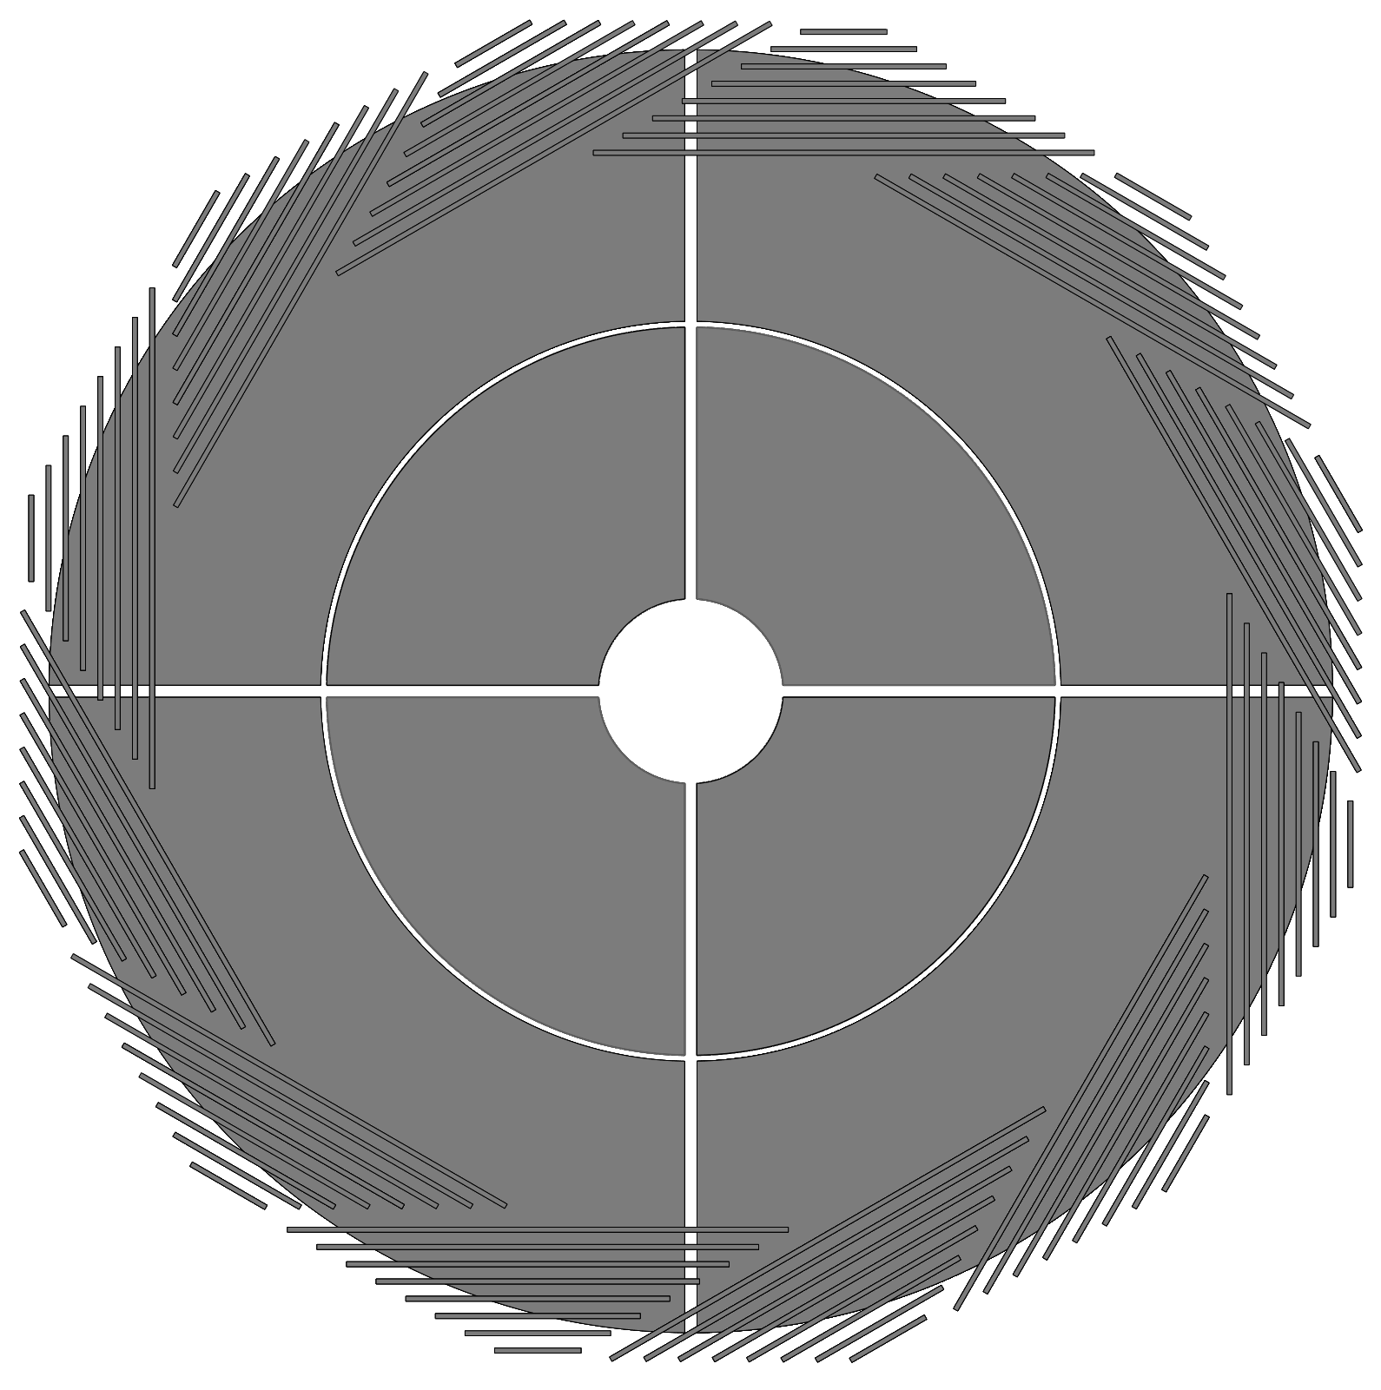
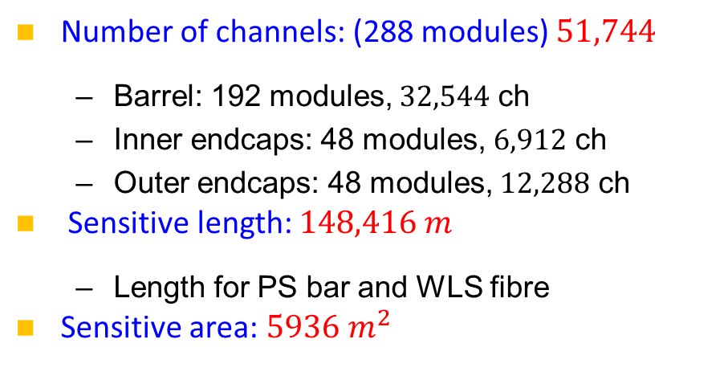
Detailed design including electronics and mechanics
Number of channels: (288 modules) $51,744$
  Barrel: 192 modules, $32,544$ ch
  Inner endcaps: 48 modules, $6,912$ ch
  Outer endcaps: 48 modules, $12,288$ ch
Sensitive length: $148,416 m$
  Length for PS bar and WLS fibre
Sensitive area: $5936 m^{2}$
Detection dead area: ~1.5%
No dead zone in the barrel, 0.07% from the cross in endcaps, and 1.4% due to the beampipe
16

Slide 17
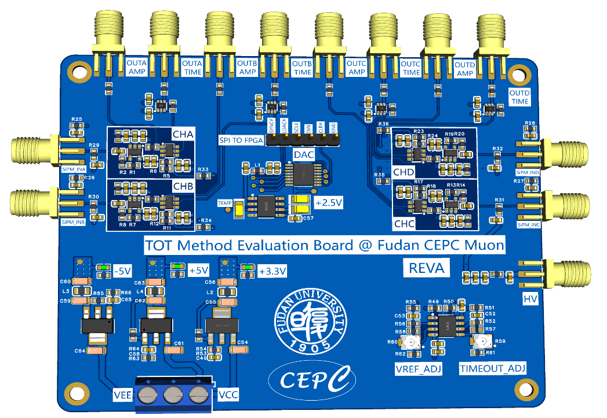
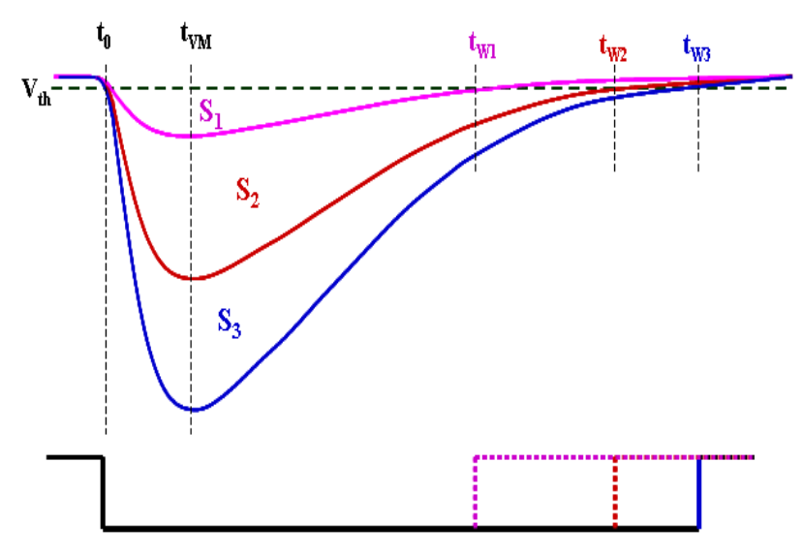
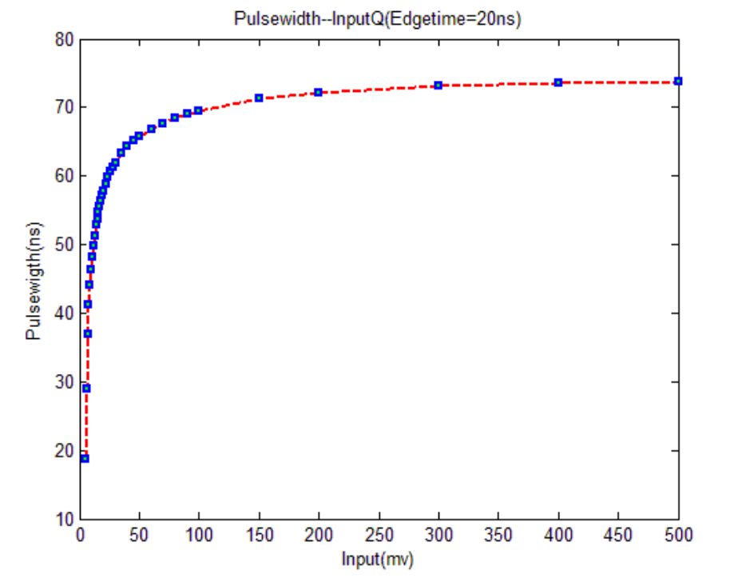
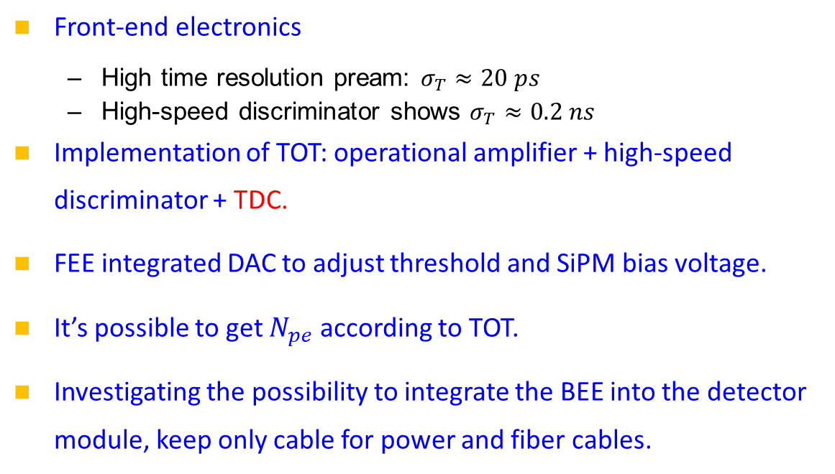
Readout electronics:
Time-over-threshold (TOT) scheme
OUT-TIME&OUT-AMP
Front-end electronics
  High time resolution pream: $σ_{T}≈20 ps$
  High-speed discriminator shows $σ_{T}≈0.2 ns$
Implementation of TOT: operational amplifier + high-speed discriminator + TDC.
FEE integrated DAC to adjust threshold and SiPM bias voltage.
It’s possible to get $N_{pe}$ according to TOT.
Investigating the possibility to integrate the BEE into the detector module, keep only cable for power and fiber cables.
8CH DAC AD5628
4CH For HV_ADJ
4CH For TH_ADJ
TO SiPM
TO SiPM
8CH DAC
HV-SiPM
POWER
SiPM
PreAMP
COMP
TDC
DAC

Slide 18
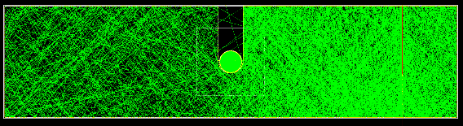
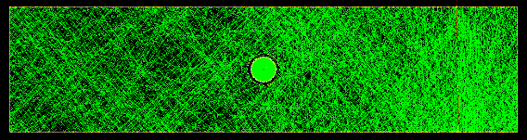
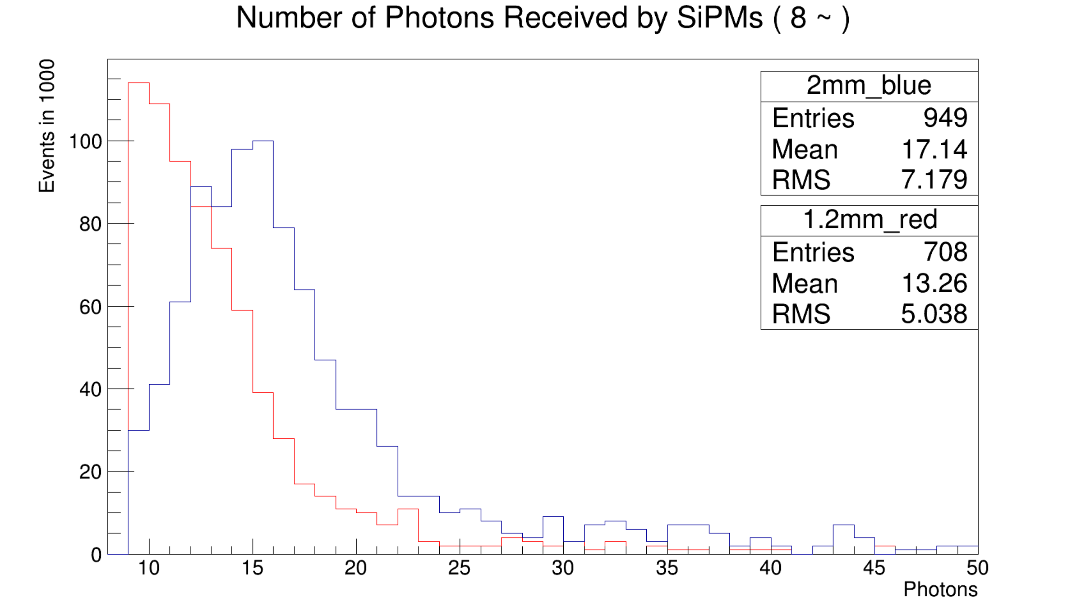
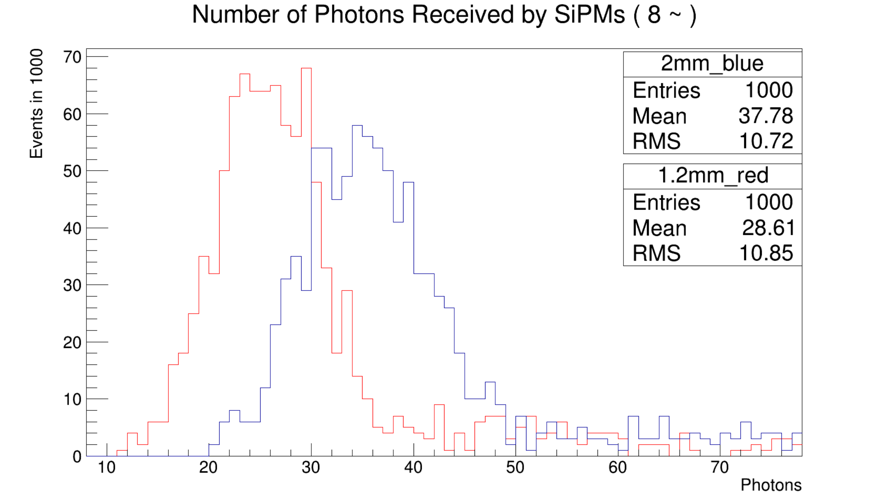
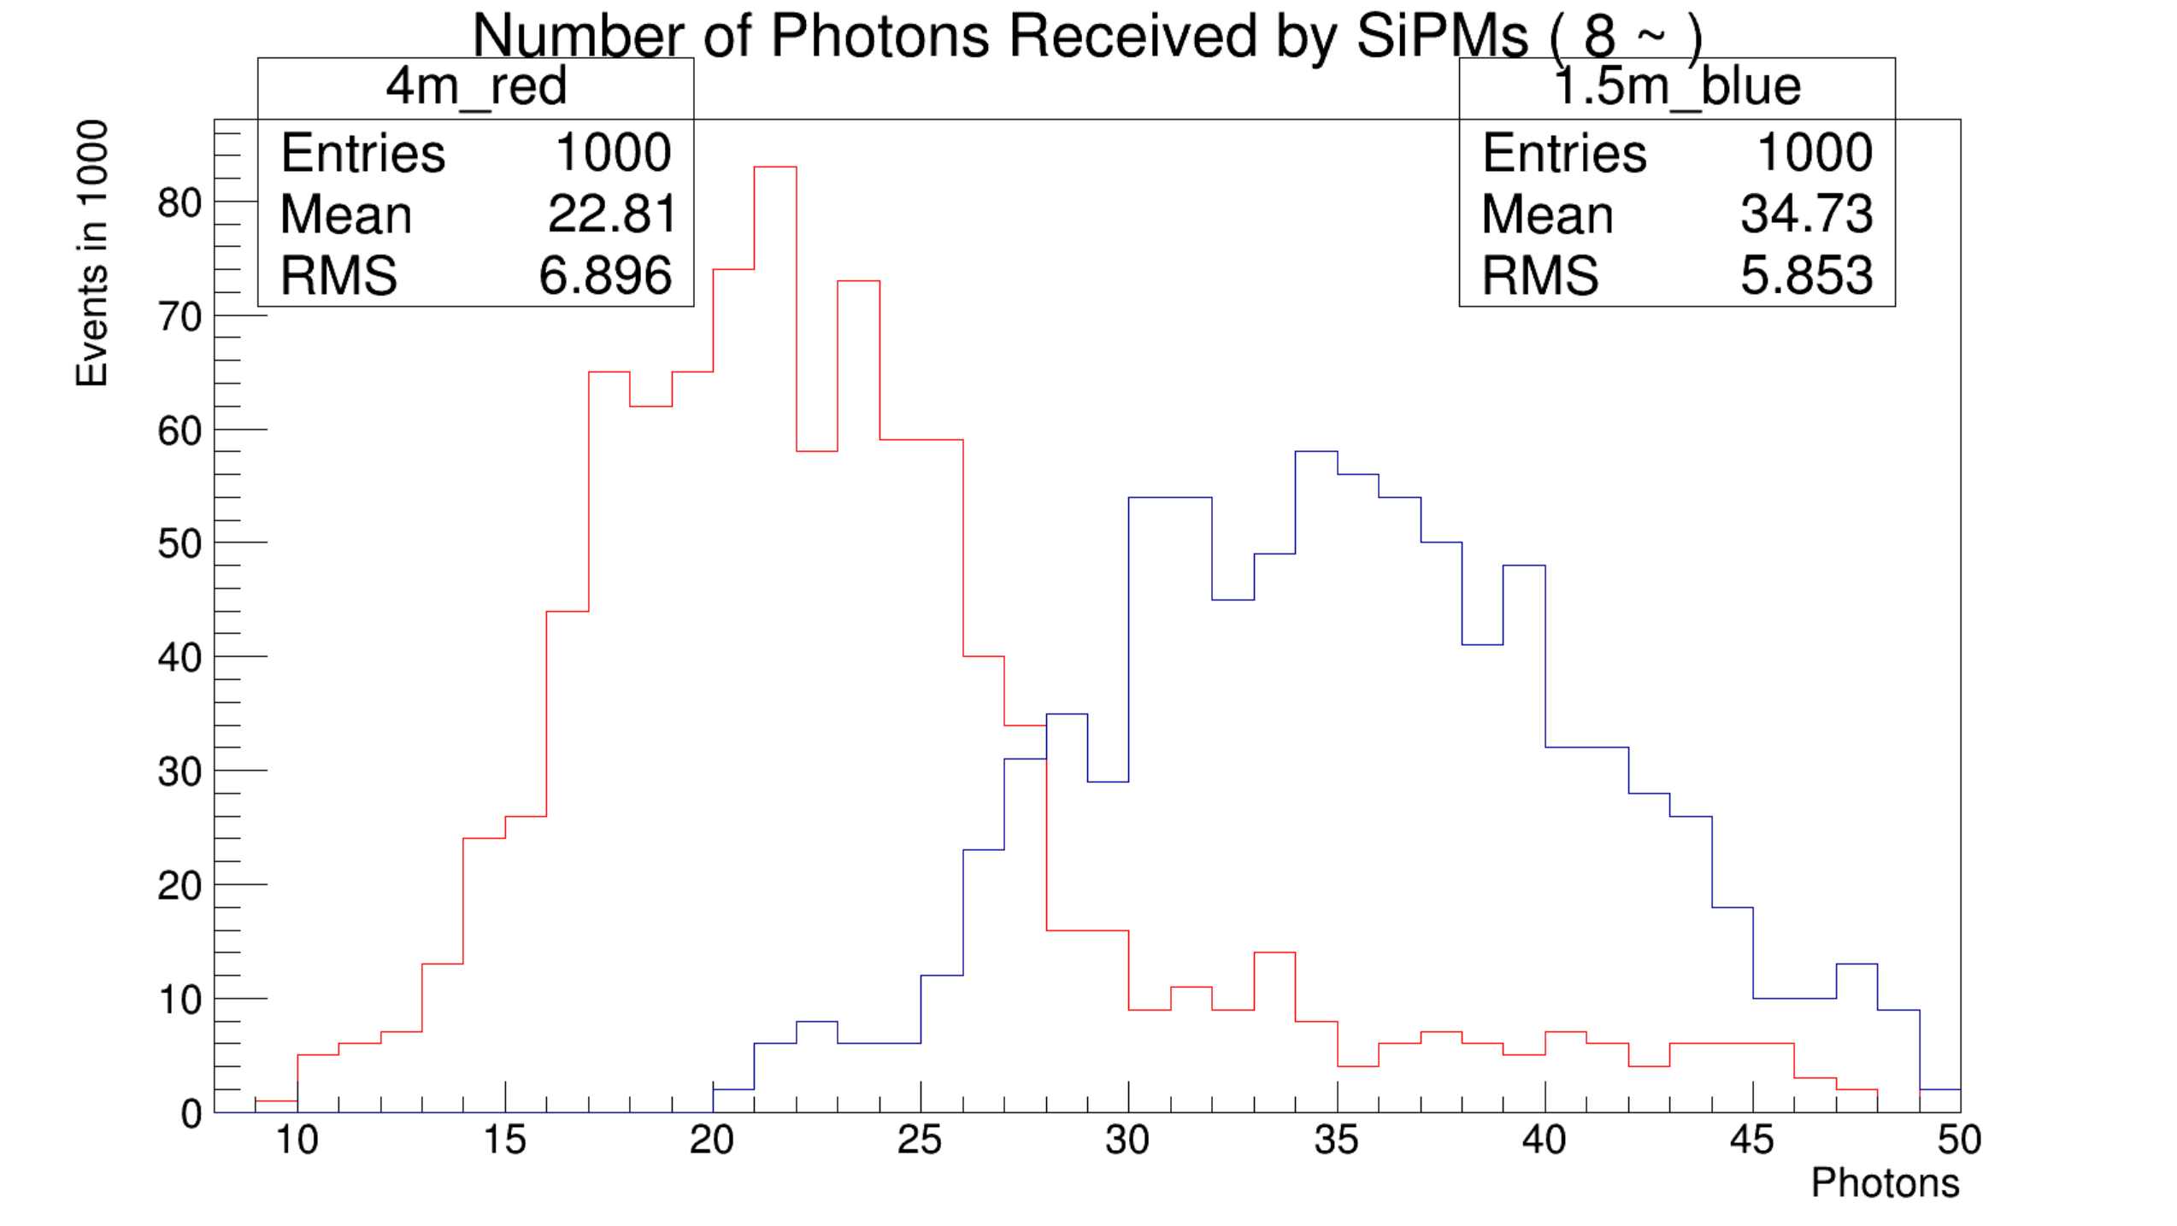


Geant4 simulation for performance
Reflection layer: $90\% → 98\%$
Scintillator for fiber: groove → hole
WLS fibre diameter: $1.2mm → 2.0 mm$
PS bar length: $1.5m vs. 4.0m$
Comparison of groove & hole (40 GeV mu-) (1.5m)
Comparison of 2mm & 1.2mm fibre (hole) (40 GeV/c) (1.5m)
90% reflection
98% reflection
JINST 19 P06020(2024), experimental measurements
Hamamastu MPPC
NDl SiPM
PS bar length
Muon momentum

Slide 19




RPC technology – BESIII MUC
Homemade Oil-free Bakelite RPC;
Gas mixture: Ar:R134a:ISO-B=50:42:8
First time successful mass production in China, bare chamber pass rate > 90%;
Good performance and keep running even now (>15years)!
Bare RPCs | $$1272 m^{2}$$
Box | 136
Readout strip & insulation materials | $$636 m^{2}$$
Electronics | 9152ch

Slide 20




RPC technology – Dayabay
Super module:
  Two layers of 2-D readout
  4-layer RPCs
Module size: $2.17m×2.20m×0.08m$
Module number: 194;
Bare RPC sizes: $1.0m×2.10m$, $1.1m×2.1m$
Bakelite plate size limitation: $2.4m×1.2m$!
Bare RPCs | $$3200 m^{2}$$
Box | 195
Readout strip & insulation materials | $$3200 m^{2}$$
Electronics | 6000ch

Slide 21





Ongoing test at SJTU
A prototype from ATLAS (upgrade).
Use R134a gas.
Efficiency curve of large RPC determined.
Fit to $ε=\frac{ε_{max}}{1+e^{λ×(HV_{50\%}−U)}}$
CR test
Signal window
We will perform the R&D focusing on glass with low resistance of ${10}^{10}Ωm$, which is available in China.

Slide 22
Research Team
Institutions and faculties/staff: 11
  Fudan University (FDU): Xiaolong Wang, Wanbing He, Weihu Ma
  Shanghai Jiaotong University (SJTU): Jun Guo, Liang Li
  IHEP: Zhi Wu, Yuguang Xie
  South China Normal University (SCNU): Hengne Li
  Nankai University: Minggang Zhao, Junhao Yin
  USST: Qibin Zheng
Task board:
  Overall: X.L. Wang
  Software and simulation: H.N. Li, L. Li, J.H. Yin, M.G. Zhao
  R&D on PS scheme: X.L. Wang, Z. Wu, W.B. He, W.H. Ma
  R&D on PRC scheme: J. Guo, Y.G. Xie
  Production and testing: Z. Wu, Y.G. Xie
  Electronics: X.L. Wang, Q.B. Zheng
Graduate students: ~15

Slide 23

Working plan
Improvement and optimization of PS bars
  Increase the light yield to reduce the weight of a long module
Electronic readout
  Study on the TOT scheme
  Implementation of the CEPC electronics frame
  An open question: how about integrating the BEE into the module, and try wireless like 5G/6G to avoid the troubles from long cables?
Build a prototype module and testing
  The performance of a module with a length of $5m$: efficiency, time resolution
Optimization of structure design
Software and simulation
  Algorithm for muon ID
  More physics performance study

Slide 24

Summary
Muon detector will be designed for muon ID, but not limited to.
Many R&D efforts have been performed: FEE, prototype, simulation, etc.
  Performance of a 1.5 m prototype: $ε>98\%$, $σ_{T}<1.5 ns$
Detailed design:
  Barrel: 8 layers, 2 long modules per layer, helix dodecagon
  Endcaps: 6 layers, 4 sectors per layer, two modules (inner and outer) per sector
  Large area modules with long PS bars.
  $51,744$ channels, $5936 m^{2}$ area, and $148,416 m$ long fibre, in total.
Work plan will focus on electronics, software and simulation for performance, prototype modules with long bars.

Slide 25

Thank you for your attention!
Aug. 7th, 2024, CEPC Detector Ref-TDR Review

Slide 26


Reference for endcaps
Structure of a module
Installation
Cables

Slide 27



Estimation of dead zone
The cross without detection
Width of the cross: $10 cm$
For beam pipe, $R=75cm$
Conclusion:
  There is no dead zone in the barrel.
  Due to the cross： $0.00214∗2.09829∗2/4π$=0.07%
  Due to the beam pipes： $2∗Ω_{1}=0.173$ ; $2∗\frac{Ω_{1}}{4π}=1.4\%$
Tracks passing 6, 7, or 8 layers.
6-layers: ~25%, 7-layers: ~50%, 8-layers: ~25%

Slide 28



Cost estimation – PS scheme
Unit: CNY
SiPM+FEE:
Number of detector channels: 51,744
  Endcaps:
    Inner modules: $72×2×4×6×2 = 6,912$
    Outer modules: $128×2×4×6×2 = 12,288$
  Barrel: $1356×2×12 = 32,544$
Cost: $51,744ch×80/ch = 4.14 M$
  SiPM: ￥50/ch
  Pream: ￥30/ch (could be ￥10)
PS + fibre
Sensitive length: 148,416 m
  Endcaps: $\left(154.83+343.73\right)×2×4×6×2 = 47861.76 m$
  Barrel: $4189.76×2×12 = 100,554.24 m$
Sensitive area: $5936.64 m^{2}$
Scintillator volume: $59.3664 m^{3}$
Cost for fibre: $148,416m×45/m = 6.68 M$
Cost for scintillator: $59.3664m^{3}×200/L = 11.87 M$
Total cost: $4.14+6.68+11.87= 22.69 M$
Consider 20% is for additional costs, like the module structure, wastage, etc.
$$22.69×1.2 = 27.228 M$$

Slide 29
CEPC RPC Muon cost
A previous estimation
Bare RPCs (Bakelite) | 5080 m^2 | 2200/m^2 | 11.18 +0.6 = 11.78M | From GNKD
Bare RPCs(glass) | 5080 m^2 | 1000/m^2 | 5.08+0.6=5.68M | Estimated
Box | 280 | 3500/module | 0.98 M | Estimated
Readout strip & insulation materials | 5080 m^2 | 1000/m^2 | 5.08 M | Ref to DYB
Subtotal |  |  | 17.84(Bakelite)/11.74(glass)
Electronics (discrete) | 31100 ch | ~200/ch | 6.22 M | From USTC
Electronics (ASIC) | 31100 ch | ~146.5/ch | 4.55M | From USTC
HV system |  |  | 1.5M | Estimated
Gas system |  |  | 1.0M | Estimated
Total | Bakelite RPC: 26.56M(discrete)/2.489(ASIC); Glass RPC: 20.46M(discrete)/18.79(ASIC)
RPC mass production condition
Vendor: GaoNengKeDi co.ltd only, currently; glass RPC no problem. A new clean room is needed. Raw materials are not an issue. (Bakelite, graphite, glass, glue, strips of insulation film, etc. )

Slide 30

Bakelite or glass?
Major factors for choosing glass:
Module size is too big, Bakelite bare chamber size limited in 2.3*1.1m (Bakelite plate 2.4*1.2m). Glass can be larger, 2.44*2.0m (2mm glass plate 2.44*2.0m) . Two workers can handle.
Much cheaper, float glass plate -2mm, 10.6/m^2, 21.2(double layer)/m^2 for glass RPC. So bare chamber cost should be much lower than the Bakelite one. (e.g, half or 1/3).
Strength and performance improved for glass, not fragile, bulk resistivity could be controlled to 0.1~1*10^12 Ωm*cm
Old data
For CEPC RPC, glass should be a better choice according to current survey in China.
But glass RPC option needs some R&Ds, rate capability and aging are the main issues.

