Slide 1
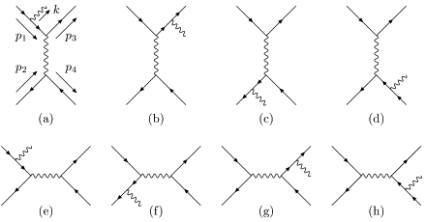
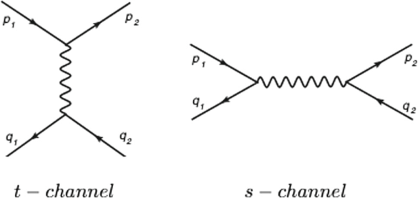
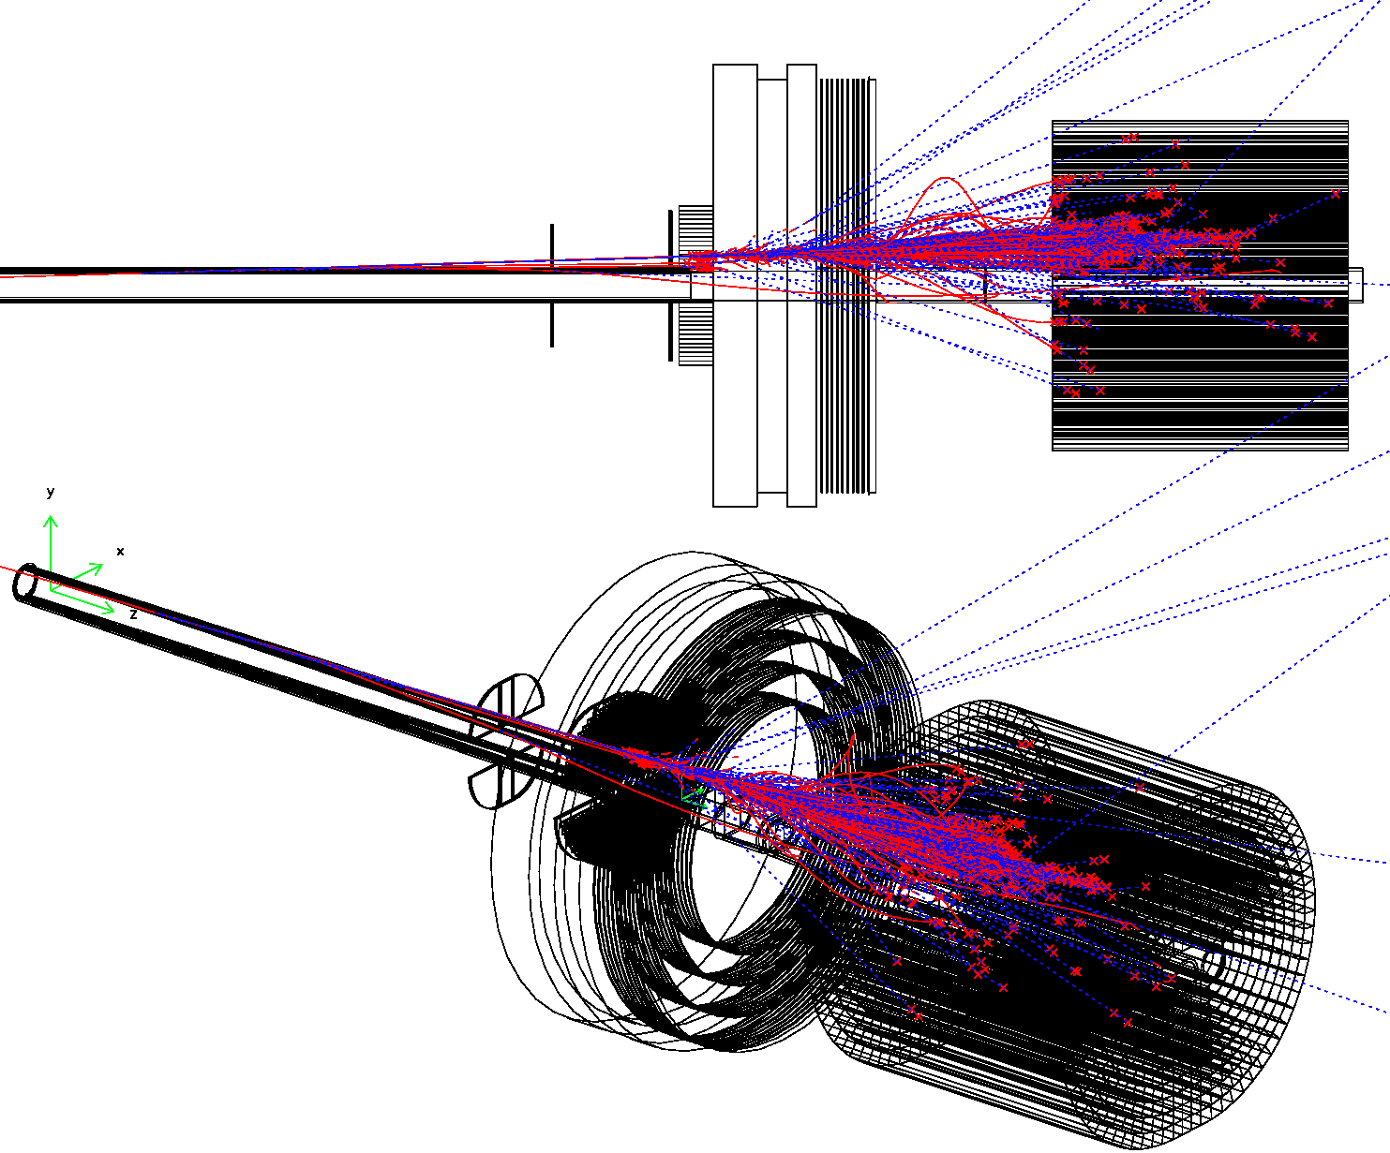
https://indico.phys.sinica.edu.tw/event/104/
Measuring QED radiative Bhabha
to 10⁻⁴ precision, for CEPC luminosity
2024.06.17
Suen Hou 侯書雲
Academia Sinica
suen@sinica.edu.tw
NLO LO
Outline
Theory, BHLUMI precision
CEPC LumiCal design
Radiative Bhabha measurement

Slide 2
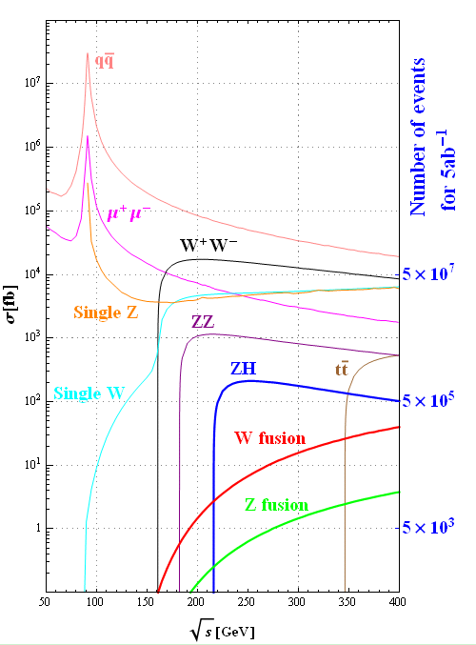
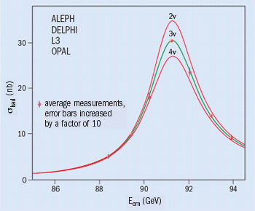
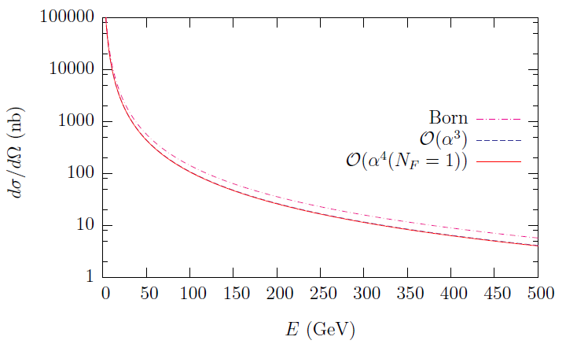
Physics goal at CEPC
Z-lineshape e⁺e⁻ → Z → qq‾
Luminosity by Bhabha e⁺e⁻ → e⁺e⁻
σ = 41 nb
M_{Z} = 91187.5 ± 2.1 MeV 2.3 × 10⁻⁵
G_{Z} = 2495.2 ± 2.3 MeV 1‰
N_{ν} = 2.9840 ± 0.0082
Precision luminosity 3‰
N_{ν} = 2.9840 ± 0.0082
2 November 2005
Bhabha
at θ= 5º
Bhabha generators
BHLUMI 4.04
S. Jadach [CPC 101 (1997) 229]
ReneSANCe 1.0.0
R.Sadykov [CPC 256 (2020) 107445]
NPB 716 (2005) 280

Slide 3
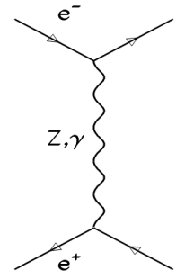
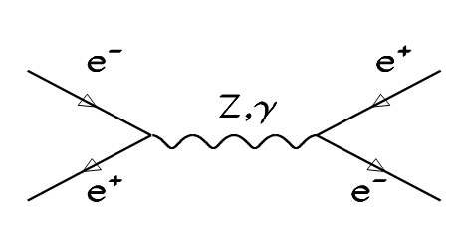
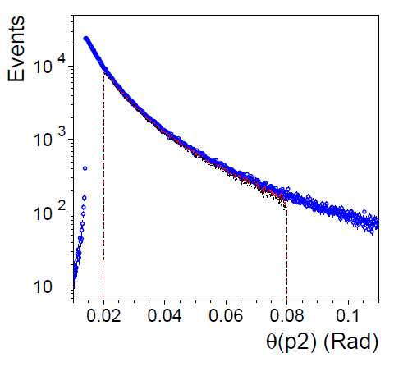
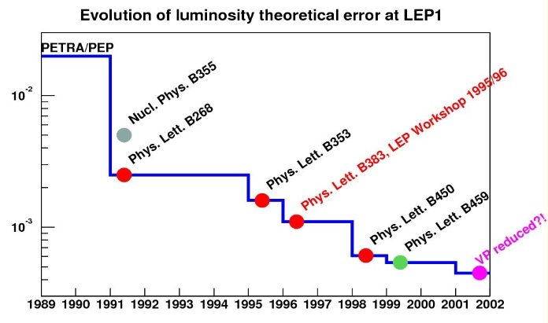
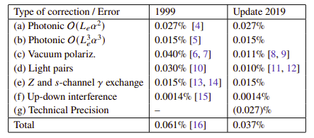
BHLUMI theoretical precision
e⁺e⁻ → e⁺e⁻ (γ)
BHLUMI 4.04
S. Jadach [CPC 101 (1997) 229]
1999 systematic 0.061 %
2019 systematic 0.037%
[arXiv:2211.14230]
[ PLB 803 (2020) 135319]

Slide 4
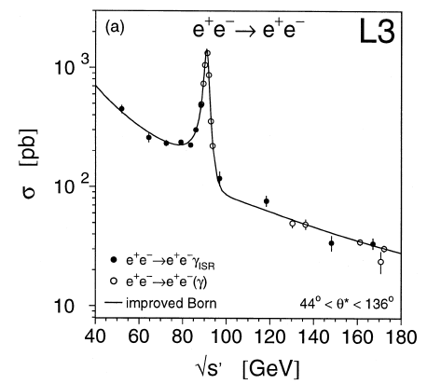
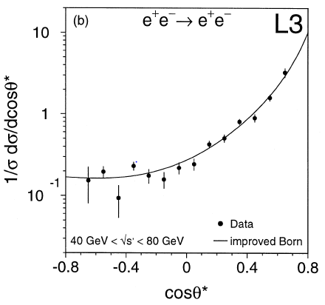
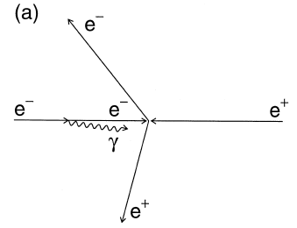
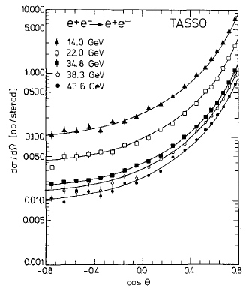
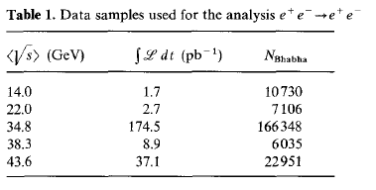
Bhabha measurements
e⁺e⁻ → e⁺e⁻ (γ)
L3 radiative Bhabha, ISR
Systematic error at ~1% level
√s= 50 ~ 170 GeV, 232 pb⁻¹ 2856 event
[PLB 439, 1998, 183]
TASSO Bhabha
Systematic error ~3%
√s = 12 ~ 47 GeV
[ ZPC 37, 1988, 171]

Slide 5
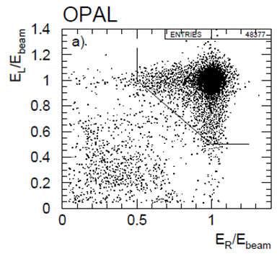
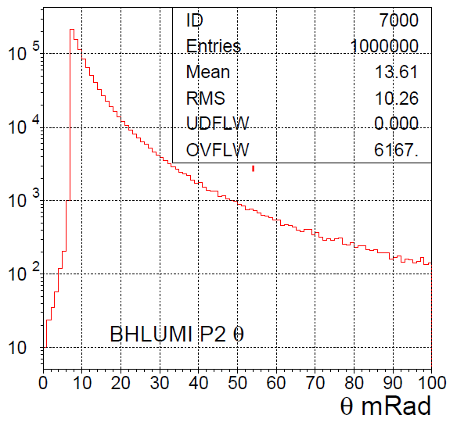
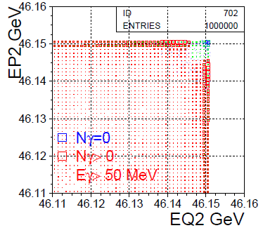
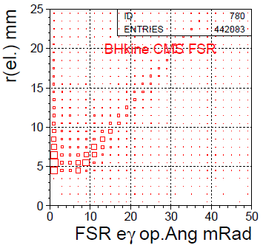
BHLUMI QED on e⁺e⁻ → e⁺e⁻(γ)
LEP forward detector
not capable of e/γ separation
LO Bhabha
BHLUMI e⁺e⁻γ prediction
E_{CMS} = 92.3 GeV θ = 10~80 mRad
e⁺e⁻ → e⁺e⁻ + Nγ → Eγ > 50MeV
Opening angle Ω(e,γ) vs. r(e)
increase w. electron θ
Photon (max. E) examined
NLO eeγ
BHLUMI generated
θ(e+)
BHLUMI E(γ) cut
E(e+) vs E(e-)
CMS frame
r(e±) to z-axis vs. Ω (e,γ)

Slide 6
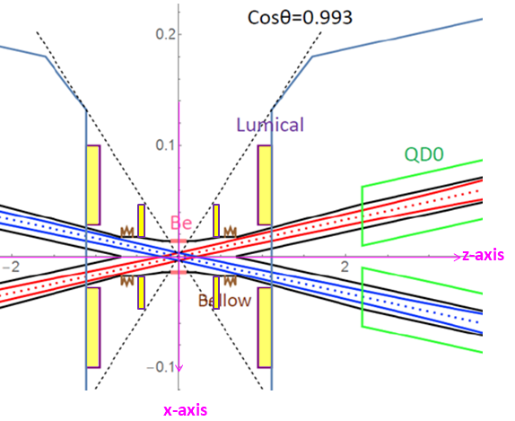
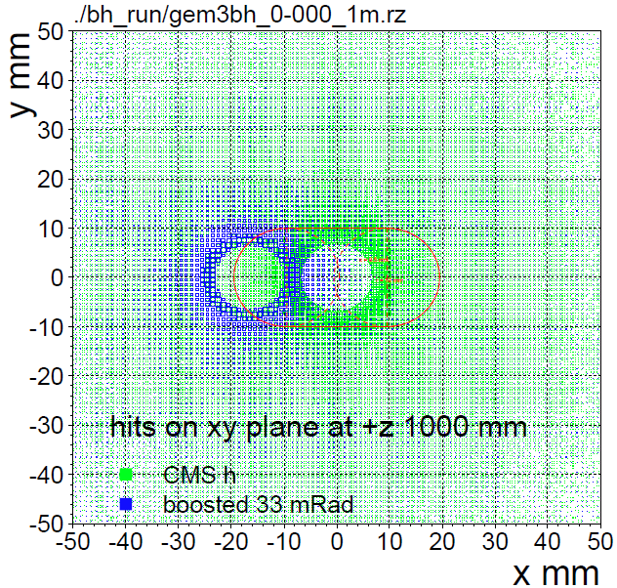
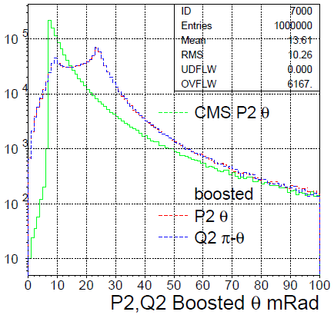
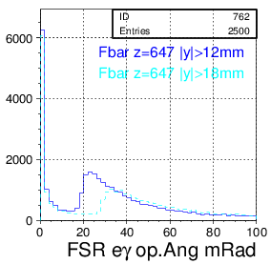
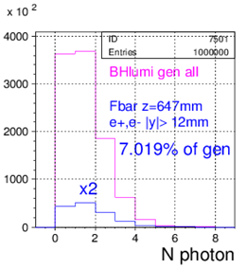
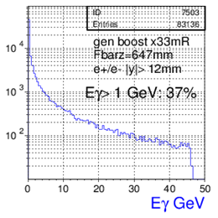
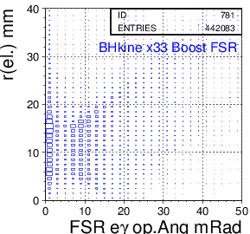
BHLUMI at CEPC boosted e⁺e⁻ → e⁺e⁻(γ)
E_{CMS} = 92.3 GeV, θ_{l}= 10~80 mRad
Boosted by beam crossing, 33 mRad
hit (x,y) distributions
generated @z=1m
boosted @z=1m
Scattered electron θ
CMS generated (θ>10mR)
x33mR boosted
LumiCal selection |y|>12 mm @z=647mm
FSR photons well seperated from electrons

Slide 7
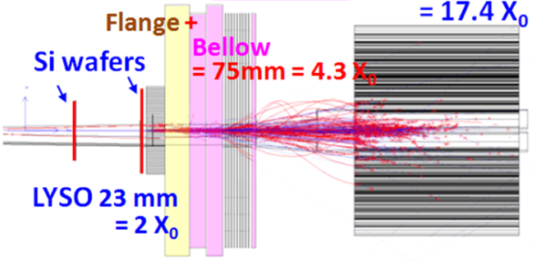
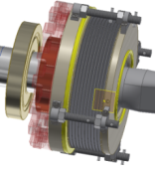
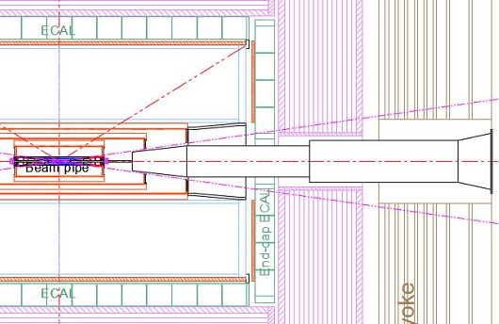
CEPC LumiCal design
L=2x10³⁶/cm²s¹ @Z-pole, goal is 10⁻⁴ systematics
ø 20 mm racetrack, beam-crossing: 33 mRad
IP bunch : σ_{x} σ_{y} σ_{z} = 6 μm, 35 nm, 9 mm
Bunch crossing: 23 ns
before Flange z = 560~700 mm
Low-mass window: Be 1mm thick
traversing @22 mRad traversing L= 45 mm,
= 0.13 X₀ (Be), 0.50 X₀ (Al)
Two Si-wafers for e± impact θ
2X₀ LYSO = 23 mm
behind Bellow z= 900~1100 mm
Flange+Bellow : ~60 mm, 4.3 X₀
17.4 X₀ LYSO 200 mm
Flange
Bellow
LumiCal volume

Slide 8
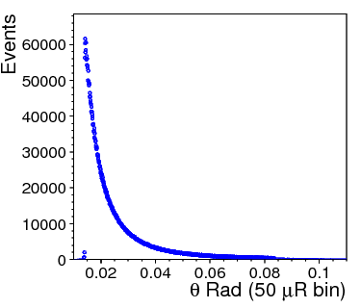
Bhabha counting to 10⁻⁴ precision
Event counting N = σ ∙ ∫L
Luminosity by detecting Bhabha events
a pair of back-back electrons,
precision θ on e,e(γ) in fiducial region
e⁺e⁻ →e⁺e⁻(γ)
Bhabha systematic error
δL/L ~ 2 δθ/θ_{min}
requiring δL/L = 10⁻⁴
at z = ±1 m, θ_{min} = 20 mRad
→ δθ = 1 μRad or dr = 1 μm
error due to offset on Z
→ 50 μm on Z eq. dr = δz x θ = 1 μm
Bhabha cross section
θ-angle distribution
detector spatial resolution
count Bhabha
in Fiducial region
Luminosity systematics
due to events in/out fiducial edge
offset on the mean of θ_{min}

Slide 9
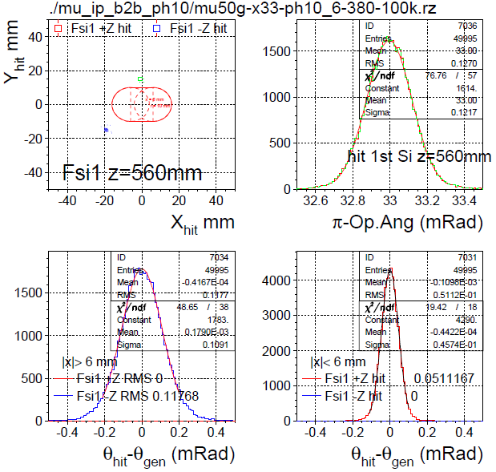
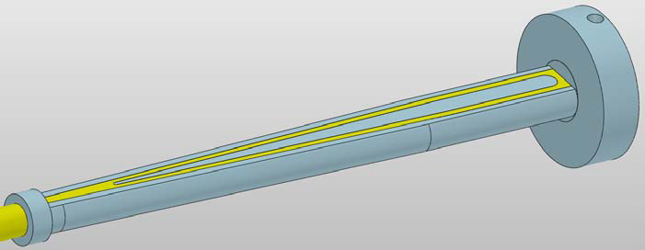
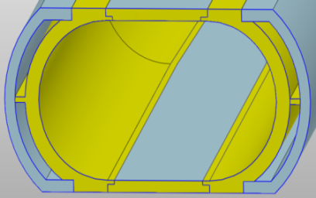
GEANT beampipe multiple scattering
IP spot (σ_{x},σ_{z})= (0,0) or (6,380μm) ← compatible
boost by 33 mRad beam crossing
50 GeV μ⁺, μ⁻
@ (θ= ± 30 mRad, φ = 1.0, 1.0+π Ra)
smearing at @z=560mm, 1st Si wafer
|x|< 6.0 mm, 1mm Be
low mass window σ(θ) = 46 μRad
|x|>6.0 mm 1mm Al pipe, σ(θ) = 109 μRad
back-to-back σ(Ω) = 122 μRad
1 mm Be thin pipe window
33mm = 0.09X₀ traversing @ 30mR
Al Be
Low-mass
window
Si det.
LYSO

Slide 10
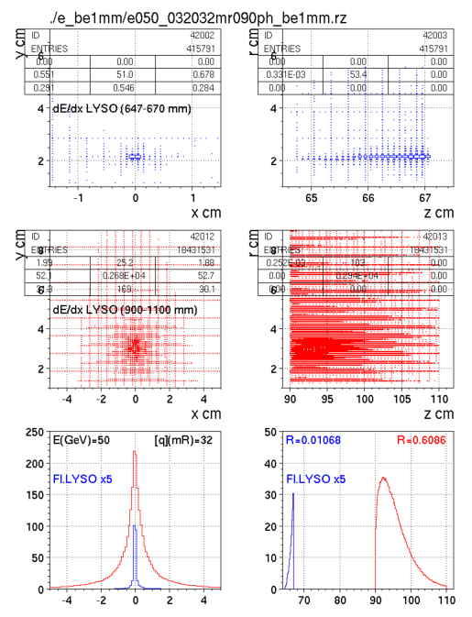
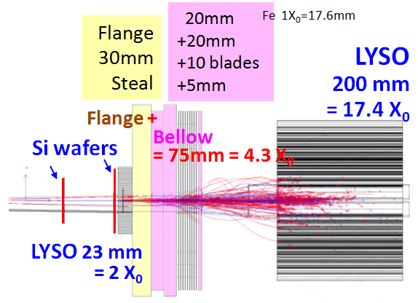
GEANT LumiCal electron shower
50 GeV electron @ θ = 32 mRad, φ=90º
2X0 LYSO + 4.3X0 Flange,Bellow
+ 17X0 LYSO
Shower deposition, by Sum(dE/dx)
in front LYSO: ~1.0 %
in back LYSO: ~ 61 %
2X₀
LYSO
y
x z
17X₀
LYSO
y
x z
deposit in Z
dis. in X
X cm z cm

Slide 11
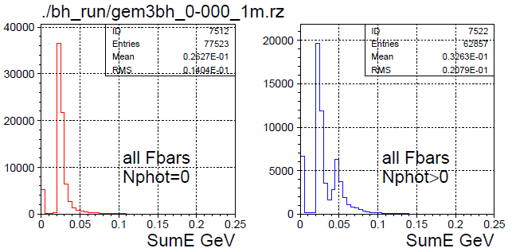
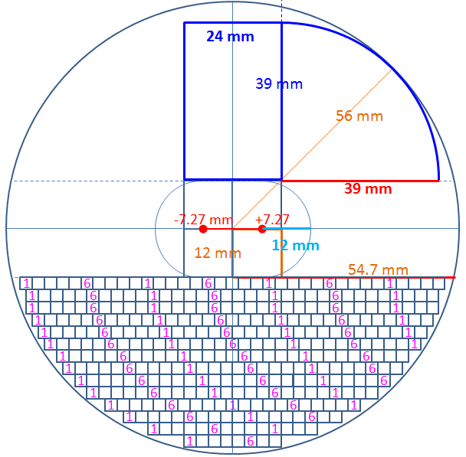
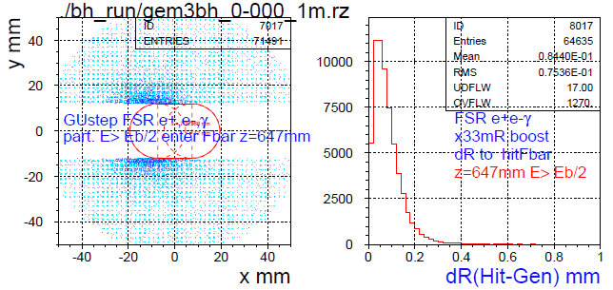
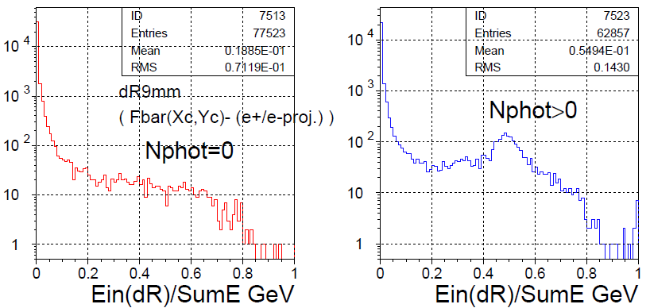
2X₀ LYSO for e⁺e⁻ → e⁺e⁻(γ)
LumiCal volume
Bhabha hits on LYSO |y|>12mm
incident particles are e±,(γ) and secondaries
GEANT sum dE/dx in each LYSO bars
3x3mm², 23 mm long, 2X₀
Deviation to e± truth (impact hit >Eb/2)
mostly < 0.2mm
Hit distributions in a Bar
distributed due to Bhabha θ, w./w.o. photon
sum dE/dx all LYSO bars (a plane)
e± one track : sumE min. 20 MeV
(e± + FSRγ) : two MIPs, sumE x2
Loop Bar Nγ=0 Nγ>0
sumE
GEANT hits E>Eb/2
33mRad boosted
On LYSO @647mm
dR to Truth
Nγ > 0
sumE(R<9mm)/sumE

Slide 12
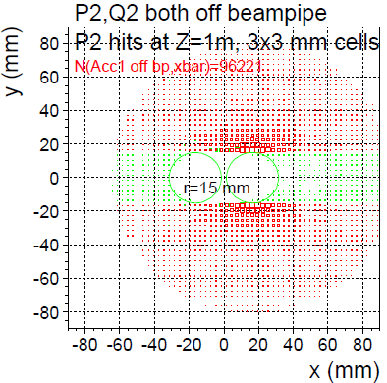
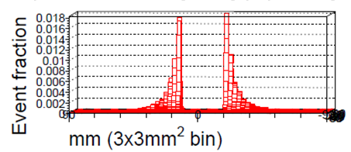
Bhabha event pile-up
BHLUMI acceptance
z = 1000 mm
High-Lumi Z L_{max}/IP = 115 x 10³⁴/cm²s
Bhabha both e⁺, e⁻ detected, X-sec = 246 nb
= (246x10⁻³³) x (115 x 10³⁴) /s = 115 kHz
Event rate / 25 ns bunch crossing
= 0.003 events /b.c.
Pile-up: next b.c., @adjacent cell
Pile-up Fraction = 0.018*6cells/2sides = 0.054
Pile-up rate = 0.003*0.054 = 1.6 x 10⁻⁴
LAB both e⁺, e⁻ detected
θ>15 mRad | θ>15mR & |y|>15mm
257.8 | 245.9
θ>25 mRad | θ>15mR & |y|>25mm
85.4 nb | 78.0 nb
θ>30 mRad | θ>30mR & |y|>30mm
54.9 | 49.1
racetrack
CDR
50 GeV e- shower in 3x3 mm² cells
event fraction /(cell of 3x3mm²)
maximum at beampipe edge = 0.018
LYSO signal overlap
25 ns

Slide 13
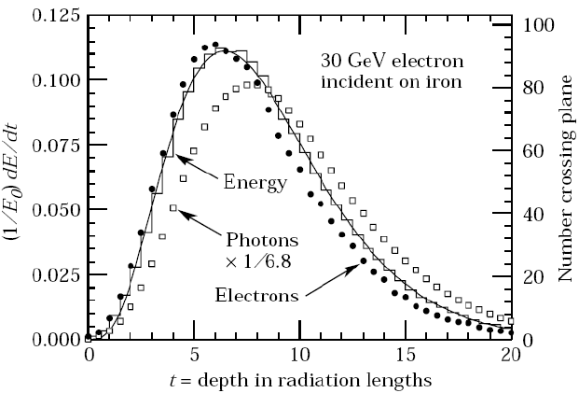
EM shower in PDG, GEANT simulation
GEANT3 parameters
agree with TestBeam
Beam-tests planning for LumiCal:
Si wafer + LYSO SiPM
100% quantum efficiency
for electron Multiple scattering, charged shower multiplicities
SiPM for photon counting in lateral X₀ layers
Energy profile
Particle flow
PDG lateral
shower profile
of EGS

Slide 14
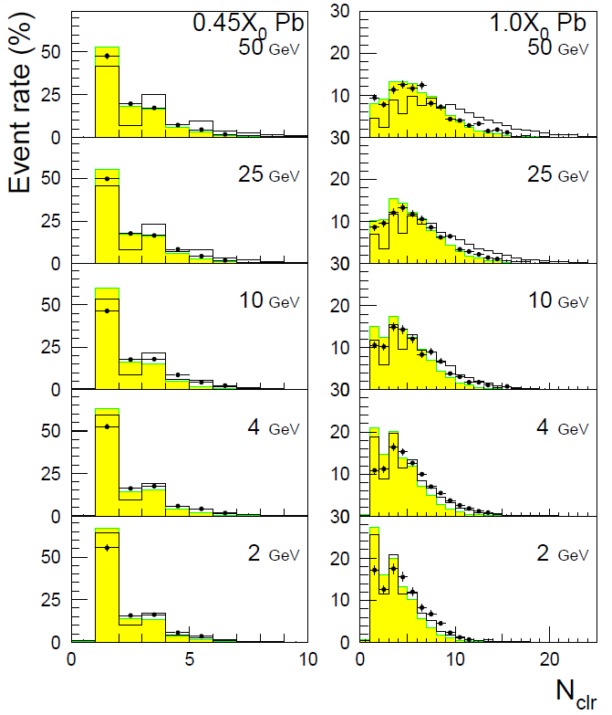
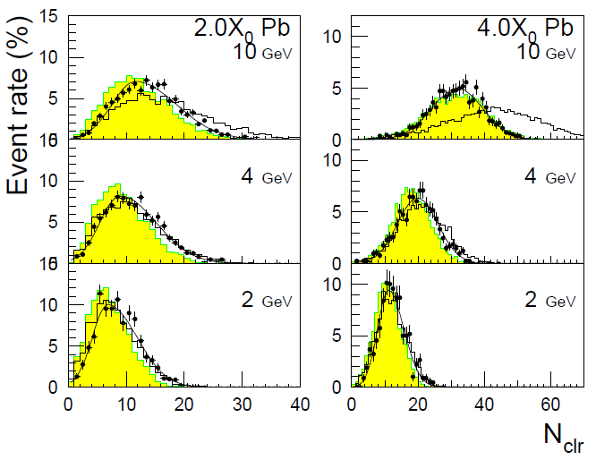
Electron shower multiplicity vs GEANT3
NIM A388 (1997) 135
Si-strip clusters eq. # ch. Particles
absorber
Electron traversing Si-det
Pb inserted for shower profile
Si-det
rec. cluster
data, MC
GEANT
# ch. particles

Slide 15
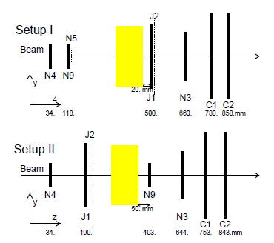
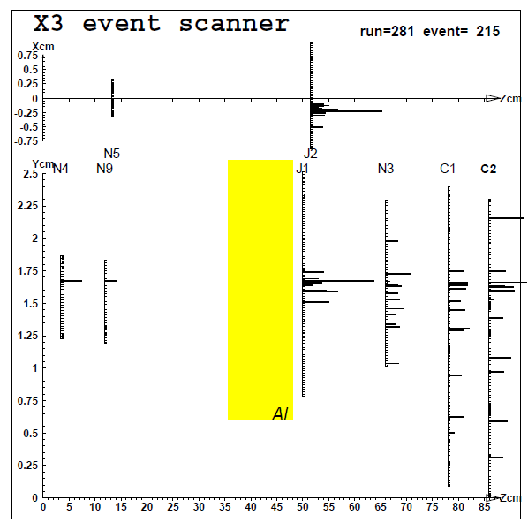
50 GeV Electron shower multiplicity
Charged shower particles, Si-det + Al absorber
– 50 GeV electrons @ CERN X3
– Si-strip 50um pitch 300um thick
– Al absorber to expand shower distribution
NIM A374 (1995) 157

Slide 16
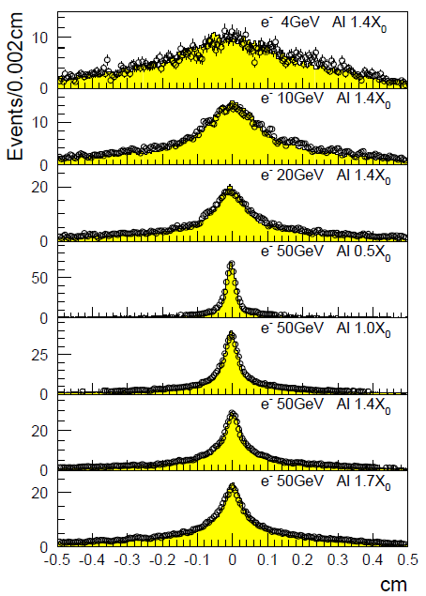
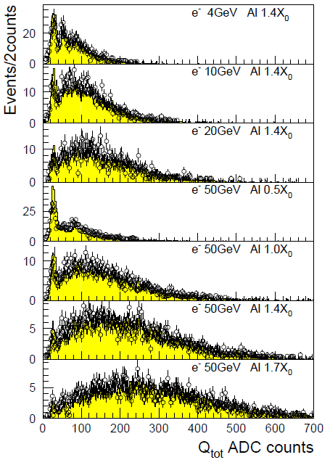
Electron shower profile vs GEANT3
GEANT3 simulation of traversing charged-particle
signal randomly from Landau of data, shared to 2 Si-strips
NIM A374 (1995) 157
Hits on N3

Slide 17
summary
Detecting Bhabha for QED/luminosity to 10⁻⁴
Det. Tech has advanced
100% Quan. Efficiently
Si-strip on electrons
SiPM on LYSO photons
Si-strip + LYSO (2X₀)
e/γ separation for Rad. Bhabha
Testbeam on e, γ to confirm
multiple scattering
preshower spectra

Slide 18
backup

Slide 19
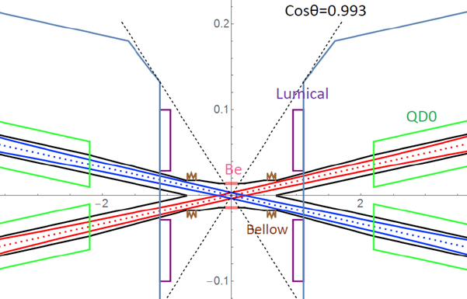
z-axis
x-axis

