Slide 1
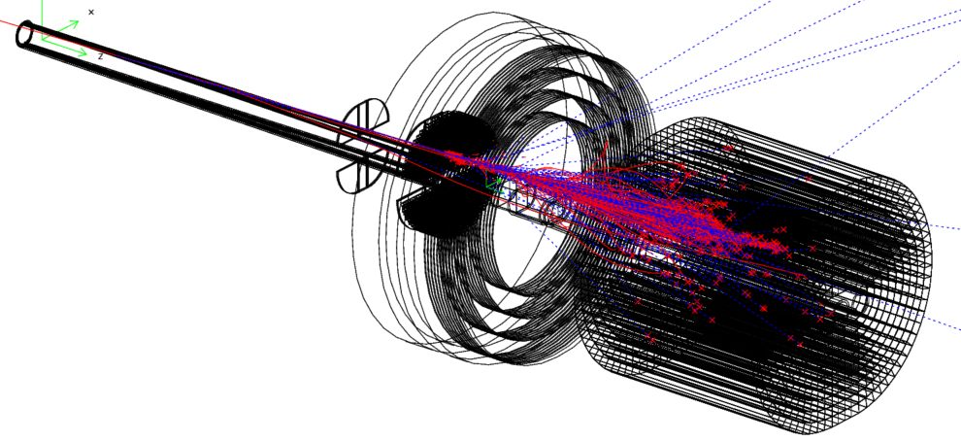
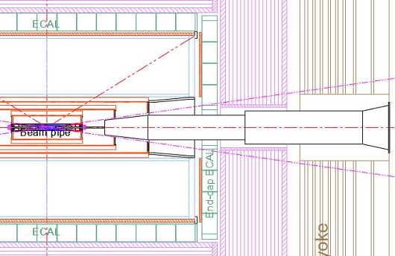
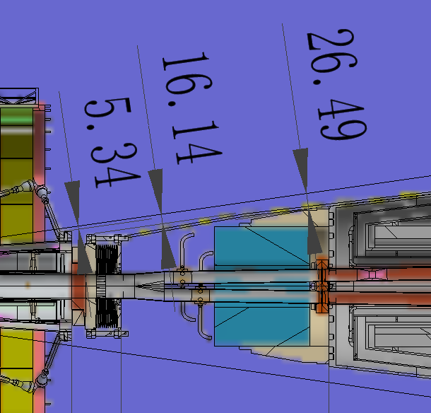
LumiCal to 10⁻⁴ systematics
LumiCal collab
高能所MDI
南京大学
吉林大学
中研院物理所
Outline
Bhabha basics and LumiCal evolution
LumiCal design with Racetrack beampipe
Systematics and NLO Bhabha measurement
TDAQ requirement
Suen Hou 侯书云
suen@sinica.edu.tw
2024/05/20
IP chamber flange
BPM & cable
Lumical
Cryostat

Slide 2
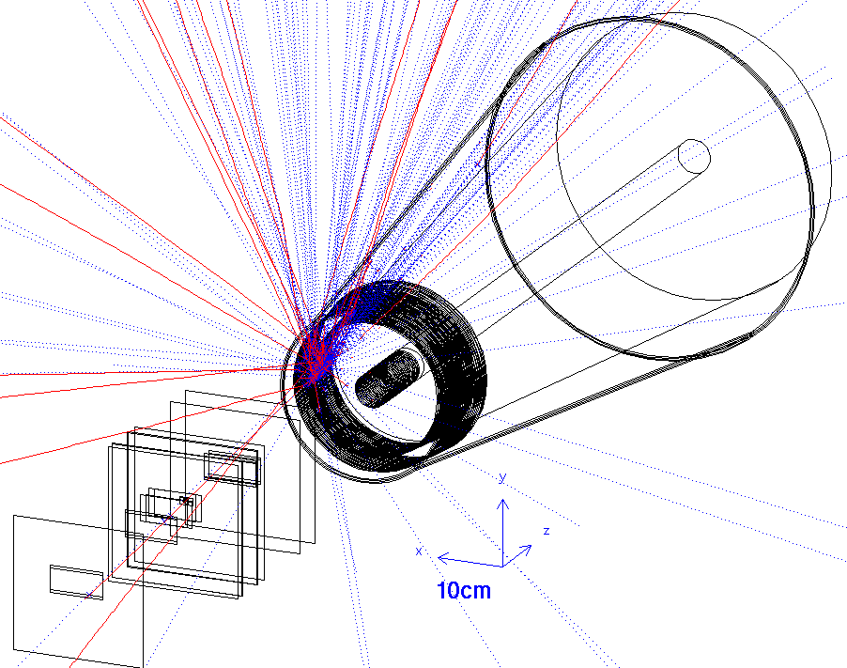
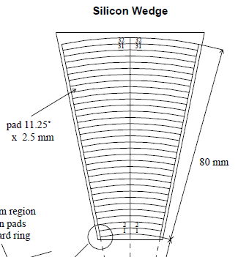
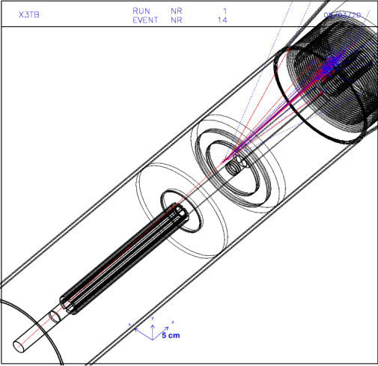
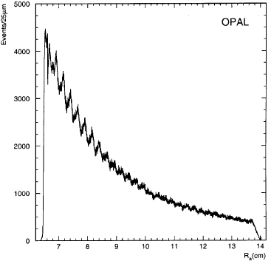
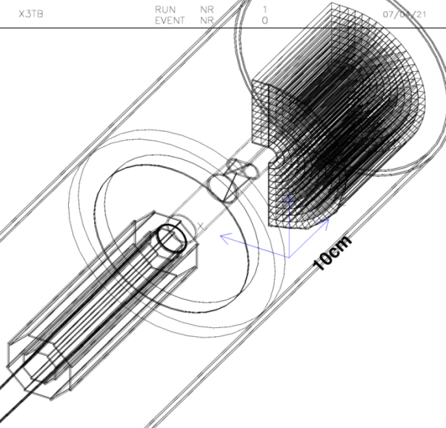
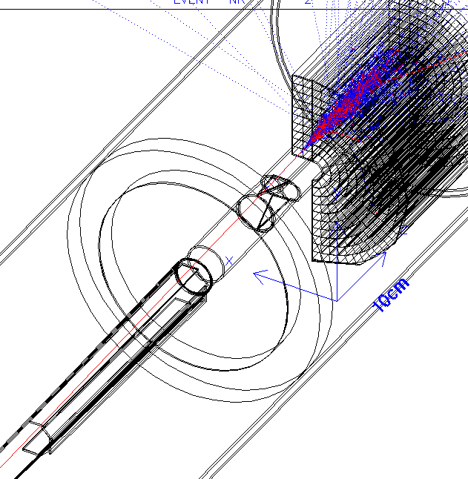
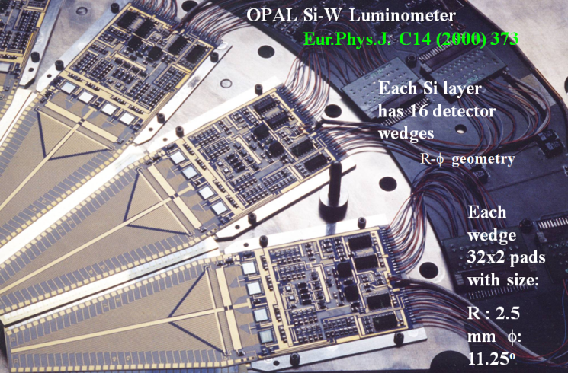
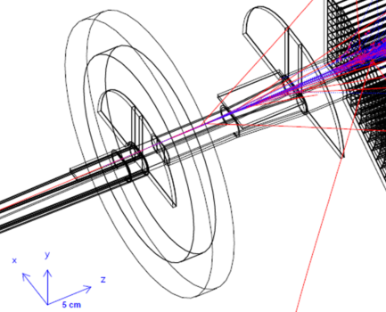
Bhabha @LEP CEPC LumiCal
OPAL Si-W
Fiducial 79 nB
Systematics 0.034%
EPJC 14 373 (2000)
Bhlumi 0.038%, FCCee → 0.01%
Jadach arXiv:1812.01004
ReneSANCe FCCee → 0.01%
CPC 256 107445
Evolution
CDR
Si wafer
2.5mm, 11.5º pitch
Hit average R
CDR
Ø 30mm pipe
Ø 30mm pipe
Ø 30mm
Horn
Ø 20mm
racetrack

Slide 3
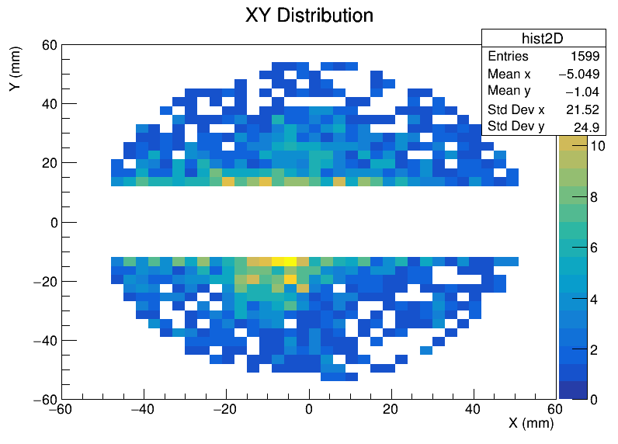
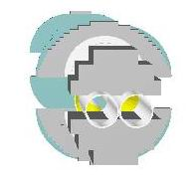
CEPCSW LumiCal implementing
CEPCSW GEANT4 implantation by JLU, NJU
MDI description, 33 mRad beam crossing
BHlumi Bhabha interface
X-check on GEANT tracking steering
Multiple-Scattering and Shower
Test-beam to confirm
南京大学
吉林大学
24 mm
39 mm
56 mm
-7.27 mm
39 mm
+x
+7.27
12 mm
12 mm
54.7 mm
1
1
6
6
1
1
6
6
1
1
6
6
1
1
1
1
6
6
1
1
6
6
1
1
6
6
1
1
1
1
1
6
6
1
1
6
6
1
1
6
6
1
1
1
1
1
6
6
1
1
6
6
1
1
6
6
1
1
1
6
6
1
1
6
6
1
1
6
6
1
1
1
6
6
6
1
1
1
6
6
6
1
1
1
6
6
6
1
1
1
6
6
6
1
1
1
6
6
6
1
1
1
6
6
6
1
1
1
1
1
6
6
6
1
1
1
6
6
6
1
1
1
1
6
6
1
1
6
6
1
1
1
6
6
1
1
1
6
6
1

Slide 4
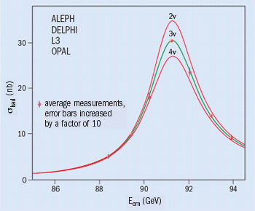
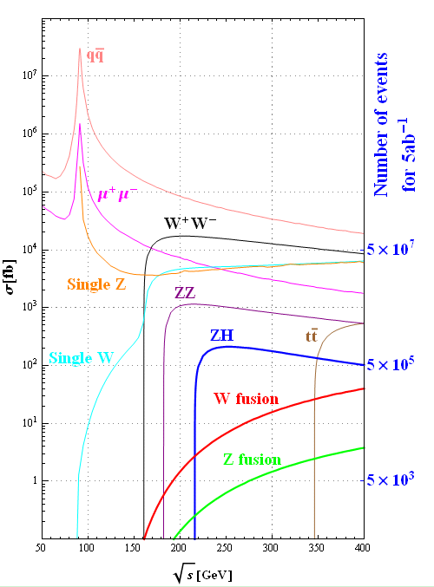
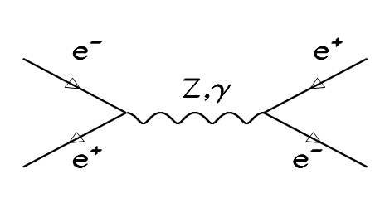
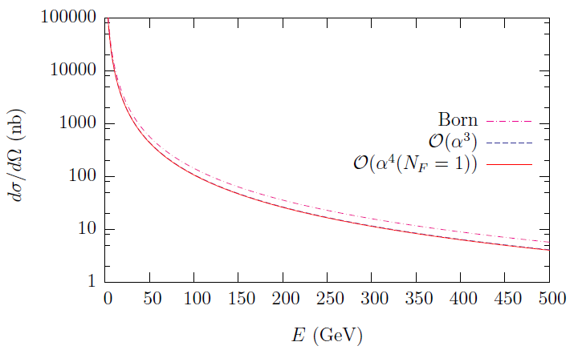
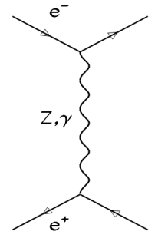
High-Lumi Z-pole Physics goal
Z-lineshape e⁺e⁻ → Z → qq‾
Luminosity by Bhabha e⁺e⁻ → e⁺e⁻
σ = 41 nb
M_{Z} = 91187.5 ± 2.1 MeV 2.3 × 10⁻⁵
G_{Z} = 2495.2 ± 2.3 MeV 1‰
N_{ν} = 2.9840 ± 0.0082
Precision luminosity 3‰
2 November 2005
hep-ph/0411321 NPB 716 (2005) 280
Bhabha
at θ= 5º

Slide 5
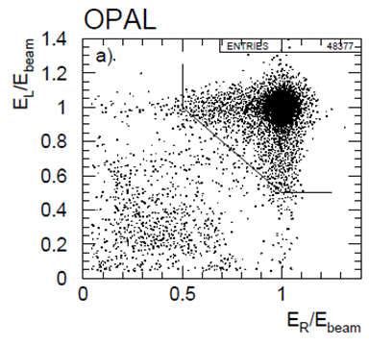
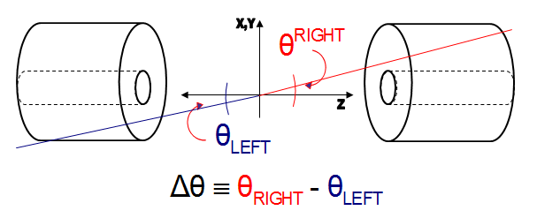
Luminosity by Bhabha elastic scattering
Physics events, e.g. Z-pole,
N = σ ∙ ∫L L: Luminosity of e⁺e⁻ collisions
Luminosity by counting Bhabha events
e⁺e⁻ → e⁺e⁻(γ) QED theo. precision < 0.1%
a pair of electrons, E(e±) = E_{beam}
back-to-back
precision θ of e, e(γ)
within fiducial region
LO Bhabha
NLO eeγ

Slide 6
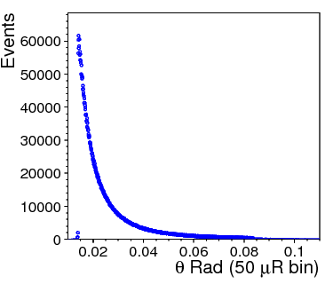
Luminosity to 10⁻⁴ precision
Observable cross section N = σ ∙ ∫L L: Luminosity of e⁺e⁻ collisions
Luminosity measured by counting Bhabha events, QED precision < 0.1%
a pair of back-back electrons,
precision θ on e,e(γ) in fiducial region
e⁺e⁻ → e⁺e⁻(γ)
Bhabha systematic error
δL/L ~ 2 δθ/θ_{min}
requiring δL/L = 10⁻⁴
at z = ±1 m, θ_{min} = 20 mRad
→ δθ = 1 μRad or dr = 1 μm
error due to offset on Z
→ Z eq. dr = δz x θ = 1 μm dz = 50 μm
Bhabha cross section
θ-angle distribution
Fiducial edge
systematics
count Bhabha
in Fiducial region
Luminosity systematics
due to events in/out fiducial edge
offset on the mean of θ_{min}

Slide 7
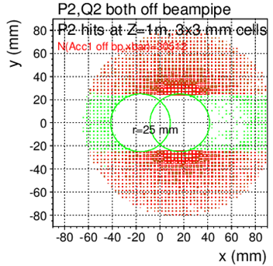
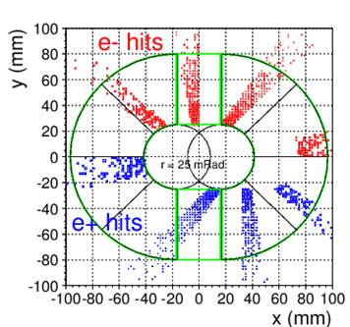
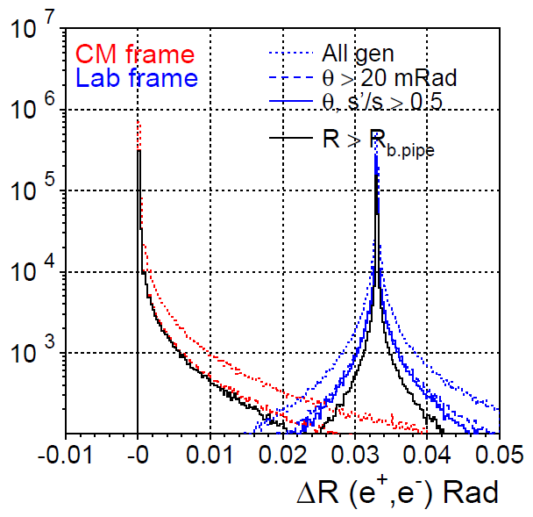
QED BHLUMI X-section
e⁺, e⁻ back-to-back Symmetric to out-going pipe center
Acceptance @z=1m
r>25 mm, |y|>25 mm
LAB frame
e⁺, e⁻ detected
@ Z=1000 mm
Multi. Scatt., rad. Bhabha,
→ wider back-back
at Z = 1000 mm
LAB ONE e⁺ or e⁻ detected |  | LAB both e⁺, e⁻ detected
θ>15 mRad | θ>15mR & |y|>15mm | θ>15 mRad | θ>15mR & |y|>15mm
395.3 | 255.9 | 257.8 | 245.9
θ>25 mRad | θ>25mR & |y|>25mm | θ>25 mRad | θ>15mR & |y|>25mm
133.5 nb | 81.8 nb | 85.4 nb | 78.0 nb
θ>30 mRad | θ>30mR & |y|>30mm | θ>30 mRad | θ>30mR & |y|>30mm
87.2 | 51.8 | 54.9 | 49.1
Open-angle –π,
of scattered e+ e-
racetrack
CDR

Slide 8
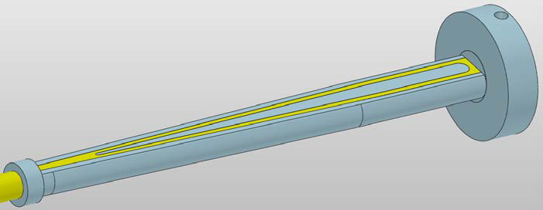
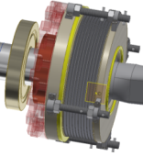
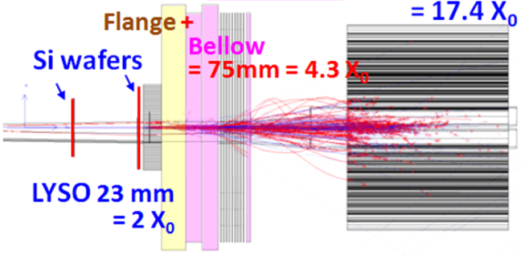
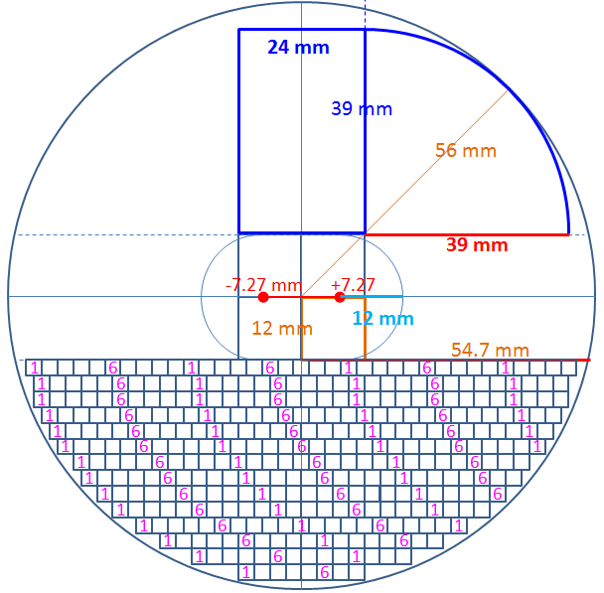
LumiCal before Flange
z = 560~700 mm
Beam-pipe low-mass window:
Be 1mm thick
traversing @22 mRad traversing L= 45 mm,
= 0.13 X₀ (Be), 0.50 X₀ (Al)
Two Si-wafers for e± θ position
2X₀ LYSO = 23 mm
LumiCal behind Bellow:
z= 900~1100 mm
Flange+Bellow : Fe ~75 mm = 4.3 X₀
17 X₀ LYSO 200 mm
LumiCal geometry
1mm Be
window
Flange
Bellow
LumiCal volume
Si wafer
LYSO
3×3 mm²

Slide 9
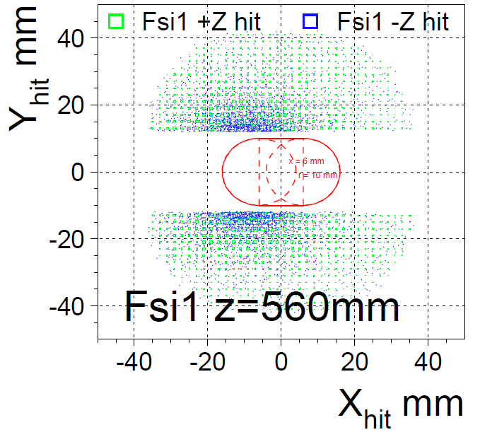
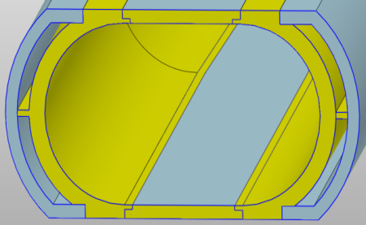
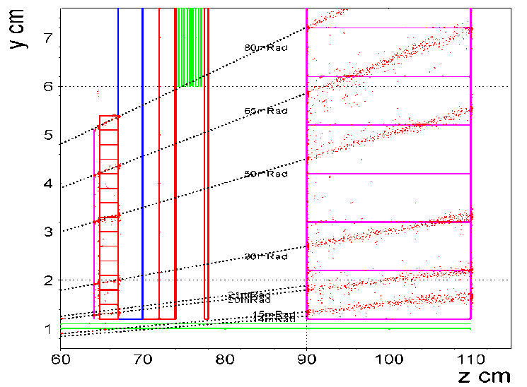
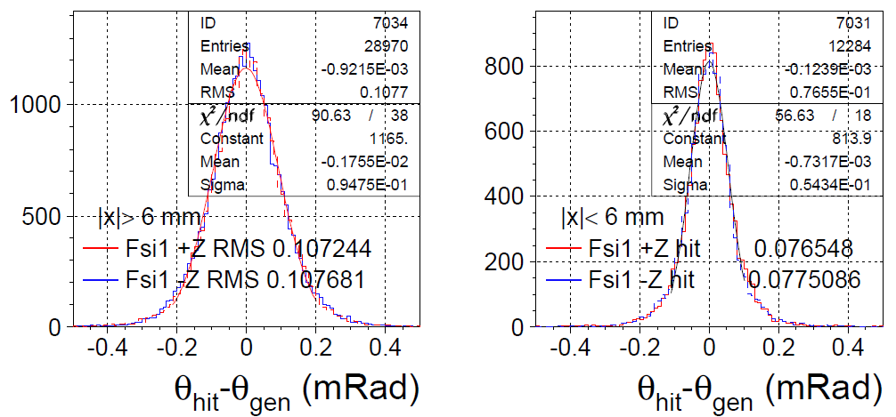
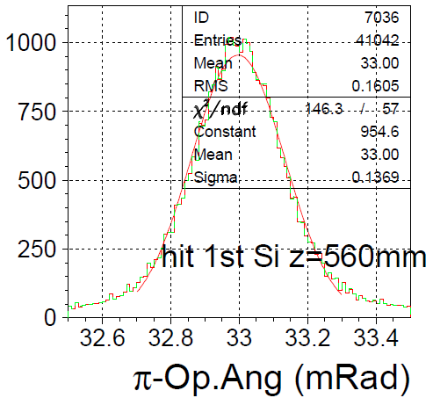
Electron hits on 1st Si-wafer
Be 1mm
IP (σ_{x},σ_{z}) = (6,380 μm)
50 GeV e⁺, e⁻
@ (θ= ± 30 mRad, φ = 1.0, 1.0+π Rad)
Si wafer @z=560mm
|x|<6.0 mm σ(θ) = 54 μR (1mm Be)
|x|>6.0 mm σ(θ) = 95 μR (1m Al pipe)
back-back Op.Ang σ(Ω) = 137 μR
NJU GEANT4 validation, test-beam preparation
Be(1mm): σ(θ) = 30 μR
Be(2mm): σ(θ) = 50 μR
➔ GEANT tracking steering, testbeam confirmation
Al Be
Low-mass
window
Be 1mm
e± GEANT hit – gen. |x|>6 hit – gen. |x|<6
e+,e- back-back angle

Slide 10
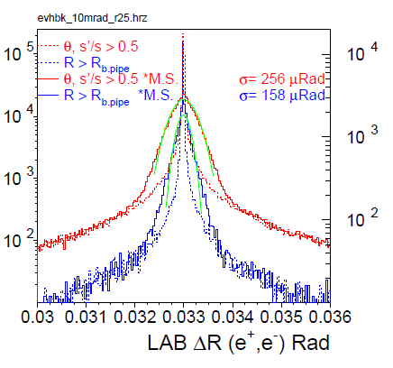
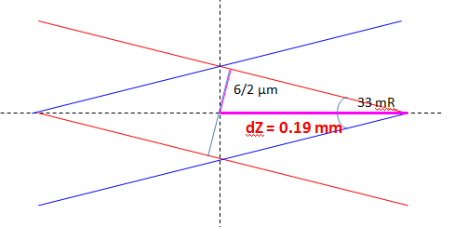
Smearing @ IP position
bunch size σ_{x} = 6 μm, σ_{z} = 9 mm
➔ IP spot, 33mRad Xing σ_{x} = 6 μm, σ_{z} = 380 μm
Z → e⁺, e⁻ at θ=30 mRad
smearing at @z=560mm
smeared width σ(θ) = 24 μRad
back-to-back σ(Ω) = 21 μRad
e⁺, e⁻ back-back angle
compare scattered e⁺, e⁻
θ , φ smeared 100 μR
IP collision spot
e⁺
e⁻
Si position detector
LYSO

Slide 11
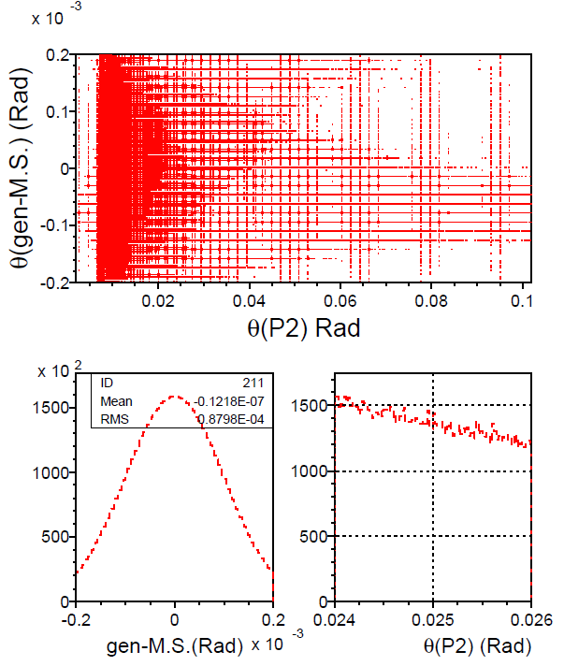
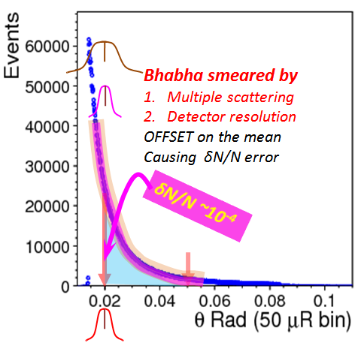
10⁻⁴ systematics, multiple scattering
BHLUMI smear θ’, φ’ of scattered e⁺, e⁻
Multi. Scatt. 100 μRad θ’= θ ∙ Gauss(100μR), φ’= φ ∙ Gauss(100μR)
δN/N systematics:
δN = #event deviation due to M.S.
M.S is Gaussian, Symmetric
at θ_{min}= 25 mRad, slope of Bbhabha
in neiboring 100 μRad bins to 25mR
δN(@25mR)/N(25-80 mR) <10⁻⁴
Θ =
25 mRad
10⁻⁴ is determined by survey of
the mean position

Slide 12
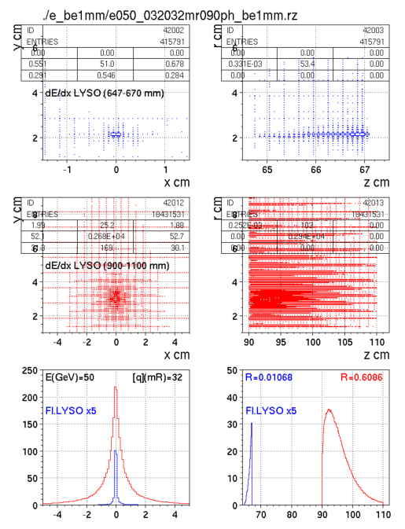
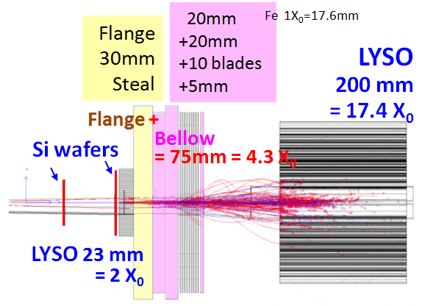
GEANT LumiCal electron shower
50 GeV electron @ θ = 32 mRad, φ=90º
2X0 LYSO + 4.3X0 Flange,Bellow
+ 17X0 LYSO
Shower deposition, by Sum(dE/dx)
in front LYSO: ~1.0 %
in back LYSO: ~ 61 %
2X₀
LYSO
y
x z
17X₀
LYSO
y
x z
deposit in Z
dis. in X
X cm z cm

Slide 13
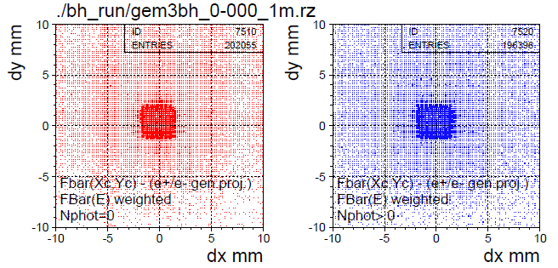
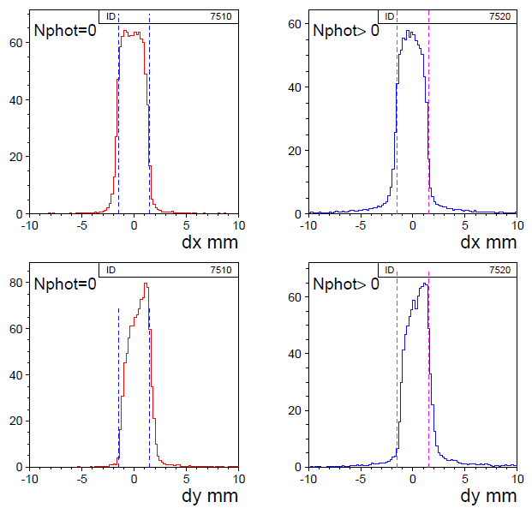
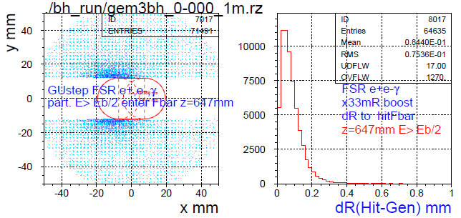
2X₀ LYSO bars observables, w. BHLUMI@Zpole
incident particles are e±,(γ) and secondaries
GEANT sum dE/dx in each LYSO bars
3x3mm², 23 mm long, 2X₀
Deviation to e± truth (impact hit >Eb/2)
mostly < 0.2mm
Hit distributions in a Bar
distributed due to Bhabha θ, w./w.o. photon
Loop Bars
Nγ=0 Nγ>0
GEANT hits E>Eb/2 dR to Truth Nγ > 0
On LYSO @647mm (boosted BHLUMI e±)

Slide 14
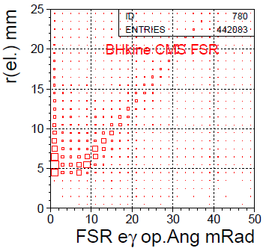
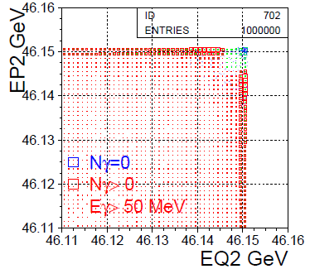
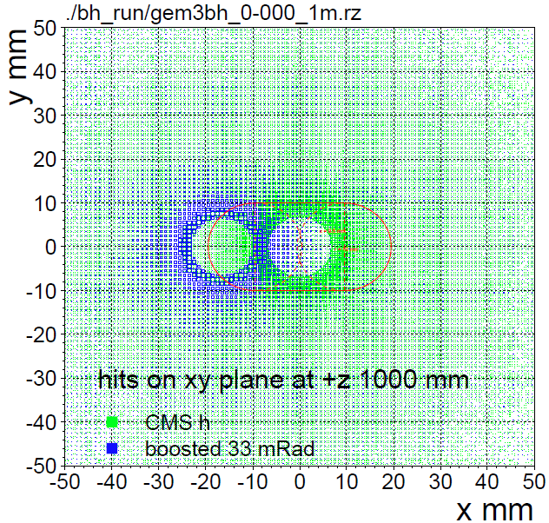
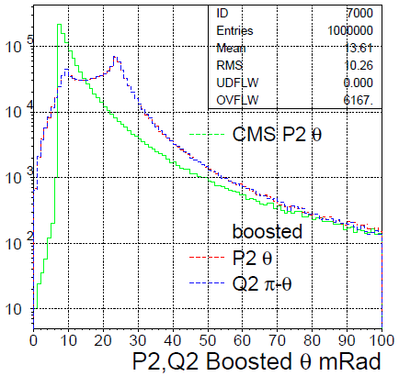
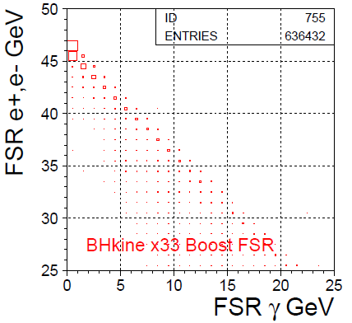
BHLUMI QED generator e⁺e⁻ → e⁺e⁻(γ)
E_{CMS} = 92.3 GeV θ_{l}= 10~80 mRad
Bhabha
e⁺e⁻ → e⁺e⁻ +Nγ → Eγ > 50MeV
Opening angle Ω(e,γ) vs. r(e)
increase w. electron θ
radiative Bhabha examined for
max. photon vs paired electron
CMS radius(e±) vs. Ω
E(e+) vs E(e-)
hit (x,y) distributions
generated @z=1m
boosted @z=1m
Scattered electron θ
CMS generated (θ>10mR)
x33mR boosted
Radiative Bhabha
E(e±) vs E(γ)

Slide 15
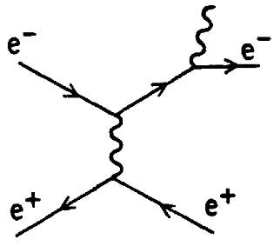
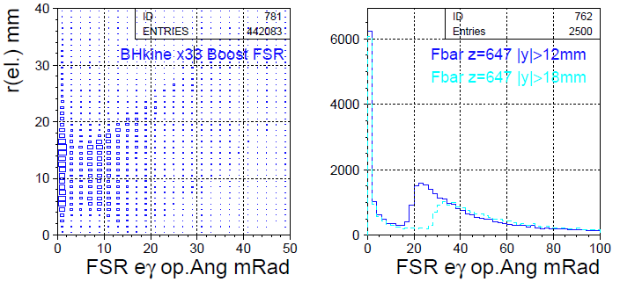
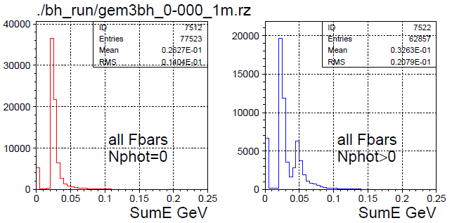
2X₀ LYSO observables for rad. Bhabha
γ
Ω(e± ,γ) Opening Angle
Increase w. electron θ
r > 12mm, Ω(e,γ) = 20 mRad (13mm@647)
e⁺e⁻ → e⁺e⁻γ
sum dE/dx all LYSO bars (a plane)
e± one track : sumE min. 20 MeV
(e± +γ) : two tracks, sumE x2
BHLUMI boosted
r(e±) vs. Ω
Opening angle Ω
|y|>12,18 mm
Loop Bars
Nγ=0 Nγ>0
sumE
Bhabha hits on LYSO |y|>12mm
BHLUMI ~80% having photons
sumE(R<9mm)/sumE

Slide 16
LumiCal components, electronics
Electronics preparation @NJU
Si tracking : σ_{r} ~ 5 μm,
test-beam Mult.Scatt. Validation
Crystal SiPM:
readout setup, mechanics
ATLAS ITk P2 wafer
SiPM readout
Si wafer

Slide 17
Bhabha pile-up rate @High-Lumi Z
c.f. LEP
L= 1x10³²
X-sec= 100nb
Rate= 10 Hz
High-Lumi Z (2021 design) L_{max}/IP = 115 x 10³⁴/cm²s
Bhabha both e⁺, e⁻ detected, X-sec = 100 nb
Event rate = (100x10⁻³³) x (115 x 10³⁴) /sec = 115 kHz
Event rate / 25 ns bunch crossing = 0.003 events /b.c.
Pile-up: next b.c., @adjacent cell in peak region
Pile-up Fraction = 0.018*6cells/2sides = 0.054
Pile-up event rate = 0.003*0.054 = 1.6 x 10⁻⁴ in 3x3 mm² cells
event fraction /(cell of 3x3mm²)
maximum at beampipe edge = 0.018
50 GeV e- shower in 3x3 mm² cells
LYSO signal overlap
25 ns

Slide 18
Z → qq‾ pile-up rate @High-Lumi Z
High-Lumi Z (2021 design) L_{max}/IP = 115 x 10³⁴/cm²s
Z → qq‾ , X-sec = 41 nb
Event rate = (41x10⁻³³) x (115 x 10³⁴) /sec = 47 kHz
bunch cross = 40 MHz
Event rate / 25 ns bunch crossing = 0.001 events /b.c.
next b.c. having a Z → qq‾
Pile-up rate 4π coverage ~ 1x 10⁻³
if BCID not identified
pileup of two 2-jets ➔ 4-jet
rare decay precision ~1x 10⁻³
25 ns

Slide 19
LumiCal Summary
Detector Si-strip + LYSO
AC-Lgad strip 5 μm resolution,
measuring 50 μm Mult.Scat.
Survey monitoring mean-on-error to better than 1 μm
Bhabha Fiducial precise to better than 10⁻⁴
DAQ SiPM MIP and Shower modes
MIP mode on front LYSO for e/γ layers,
Shower mode on long LYSO bars for electron Ebeam
pile-up veto high-lumi Z-pole 25 ns bunch crossing,
wave-form sampling bettering 40 MHz
Bhabha QED
measure NLO e⁺e⁻ → e⁺e⁻(γ)
against BHLUMI to 10⁻⁴

