Slide 1
arXiv: 2301.09475

Slide 2
- Motivation-
The electromagnetic spectral function is connected to dilepton production rate.
Among all the sources of dileptons in HIC experiments, Drell-Yan process is well understood in pQCD. Dileptons can also be produced from the decays of hadron resonances, for which the yield can be estimated experimentally by invariant mass analysis.
However, as the system cools down, it is expected that hadronic matter will be generated from QGP via a phase transition or crossover which has substantial contribution in the dilepton emission in the low invariant mass region.

Slide 3
- Formalism -
The emission rate of dileptons with four-momenta $q^{μ}=\left(q^{0},\vec{q}\right)$ per unit space-time four-volume can be written as
Spectral function
$m_{0}$: leptonic mass
The main task is to calculate the spectral function for $ρ^{0}$

Slide 4
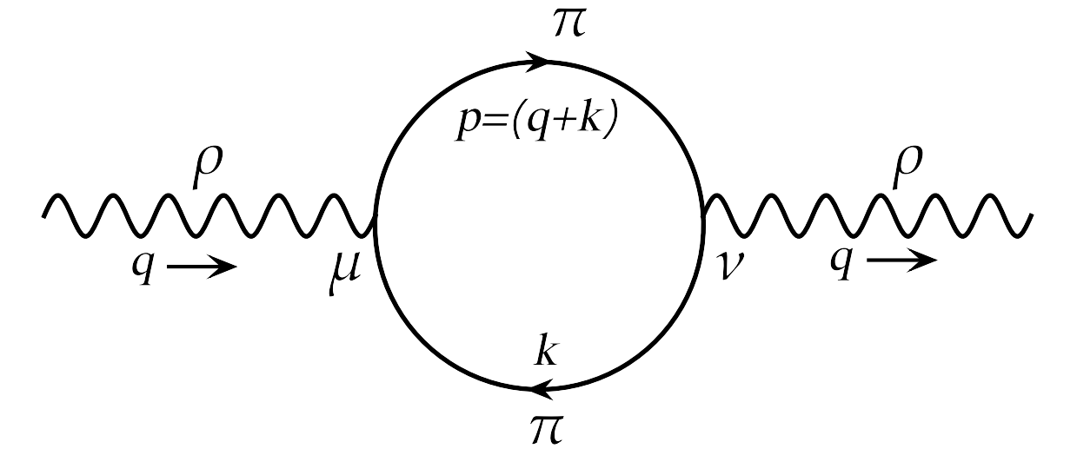
- $ρ$ Spectral Function and DPR at $eB=0$ -
Propagator of $ρ^{0}$ can be obtained from solving Dyson-Schwinger Equation
Bare $ρ^{0}$ propagator
Consider the effective theoretic Lagrangian
Tensor structure

Slide 5
- $ρ$ Spectral Function and DPR at $eB=0$ -
We get the thermal self-energy function
No Landau cut contribution at $eB=0$. (Imaginary invariant mass at $q^{0}<\left|\vec{q}\right|$)

Slide 6
- $ρ$ Spectral Function and DPR at $eB=0$ -
Decompose the self-energy tensor into independent covariants
with
so that the propagator can be written as
and the spectral function

Slide 7
- $ρ$ Spectral Function and DPR at none zero $eB$ -
General idea is same as $eB=0$ case
Pion propagator
Polarization function

Slide 8
- $ρ$ Spectral Function and DPR at none zero $eB$ -
Non-trivial Landau cut contribution appears.
Pion (Low Landau level)+$ρ^{0}$→Pion (High Landau level)

Slide 9
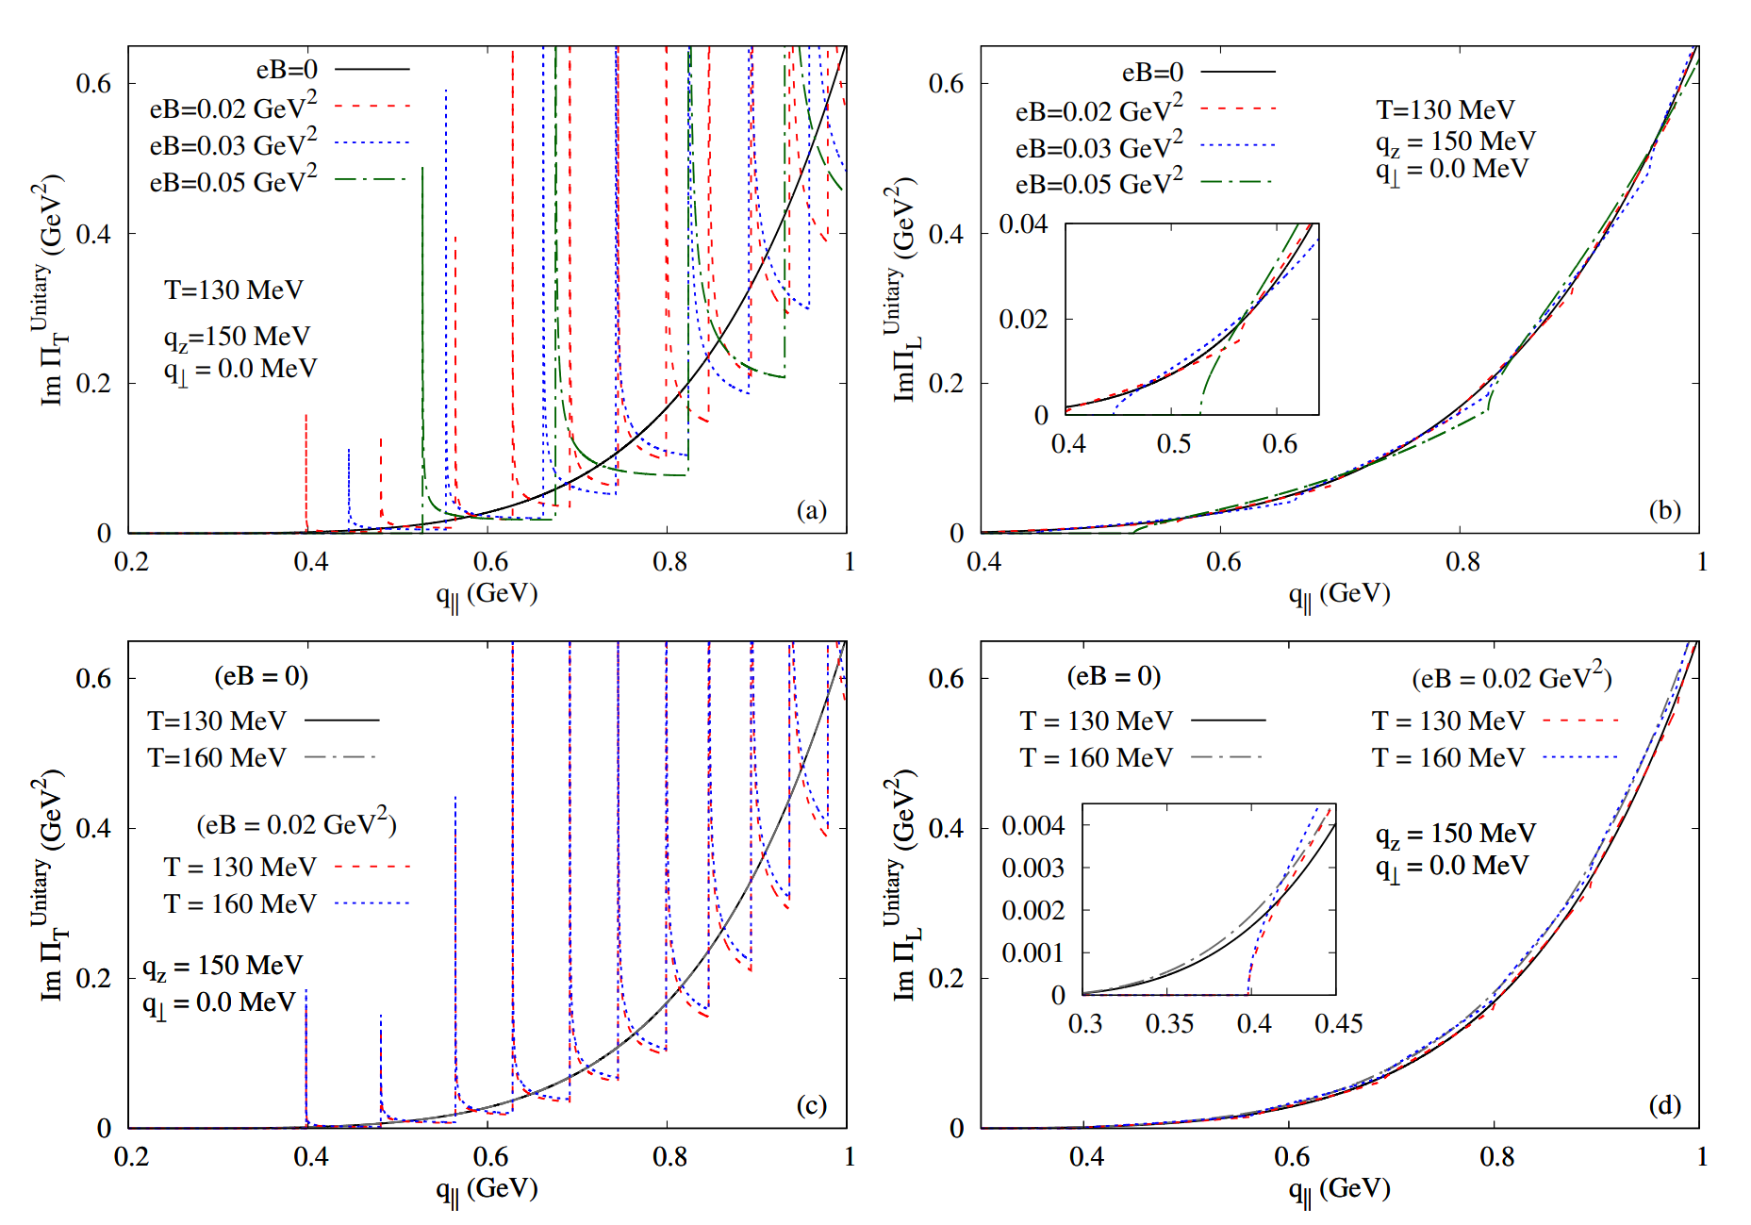
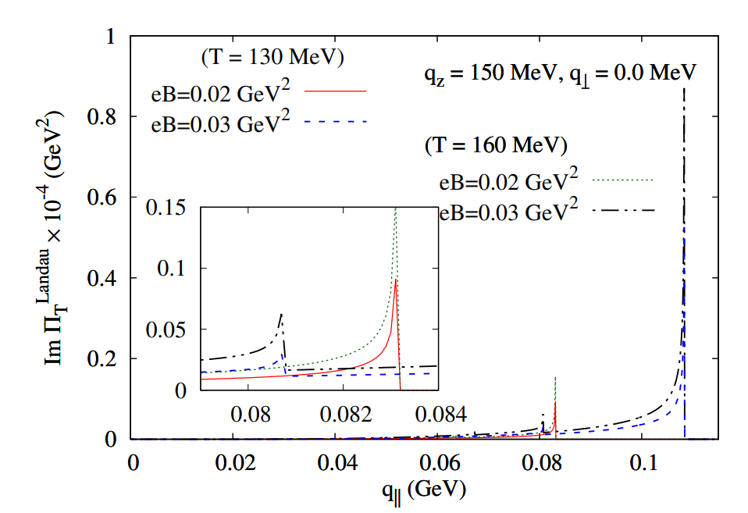
- Numerical Results -

Slide 10
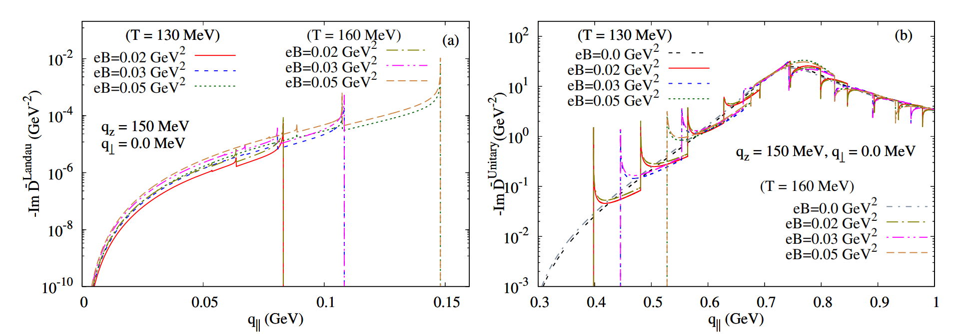
- Numerical Results -

Slide 11
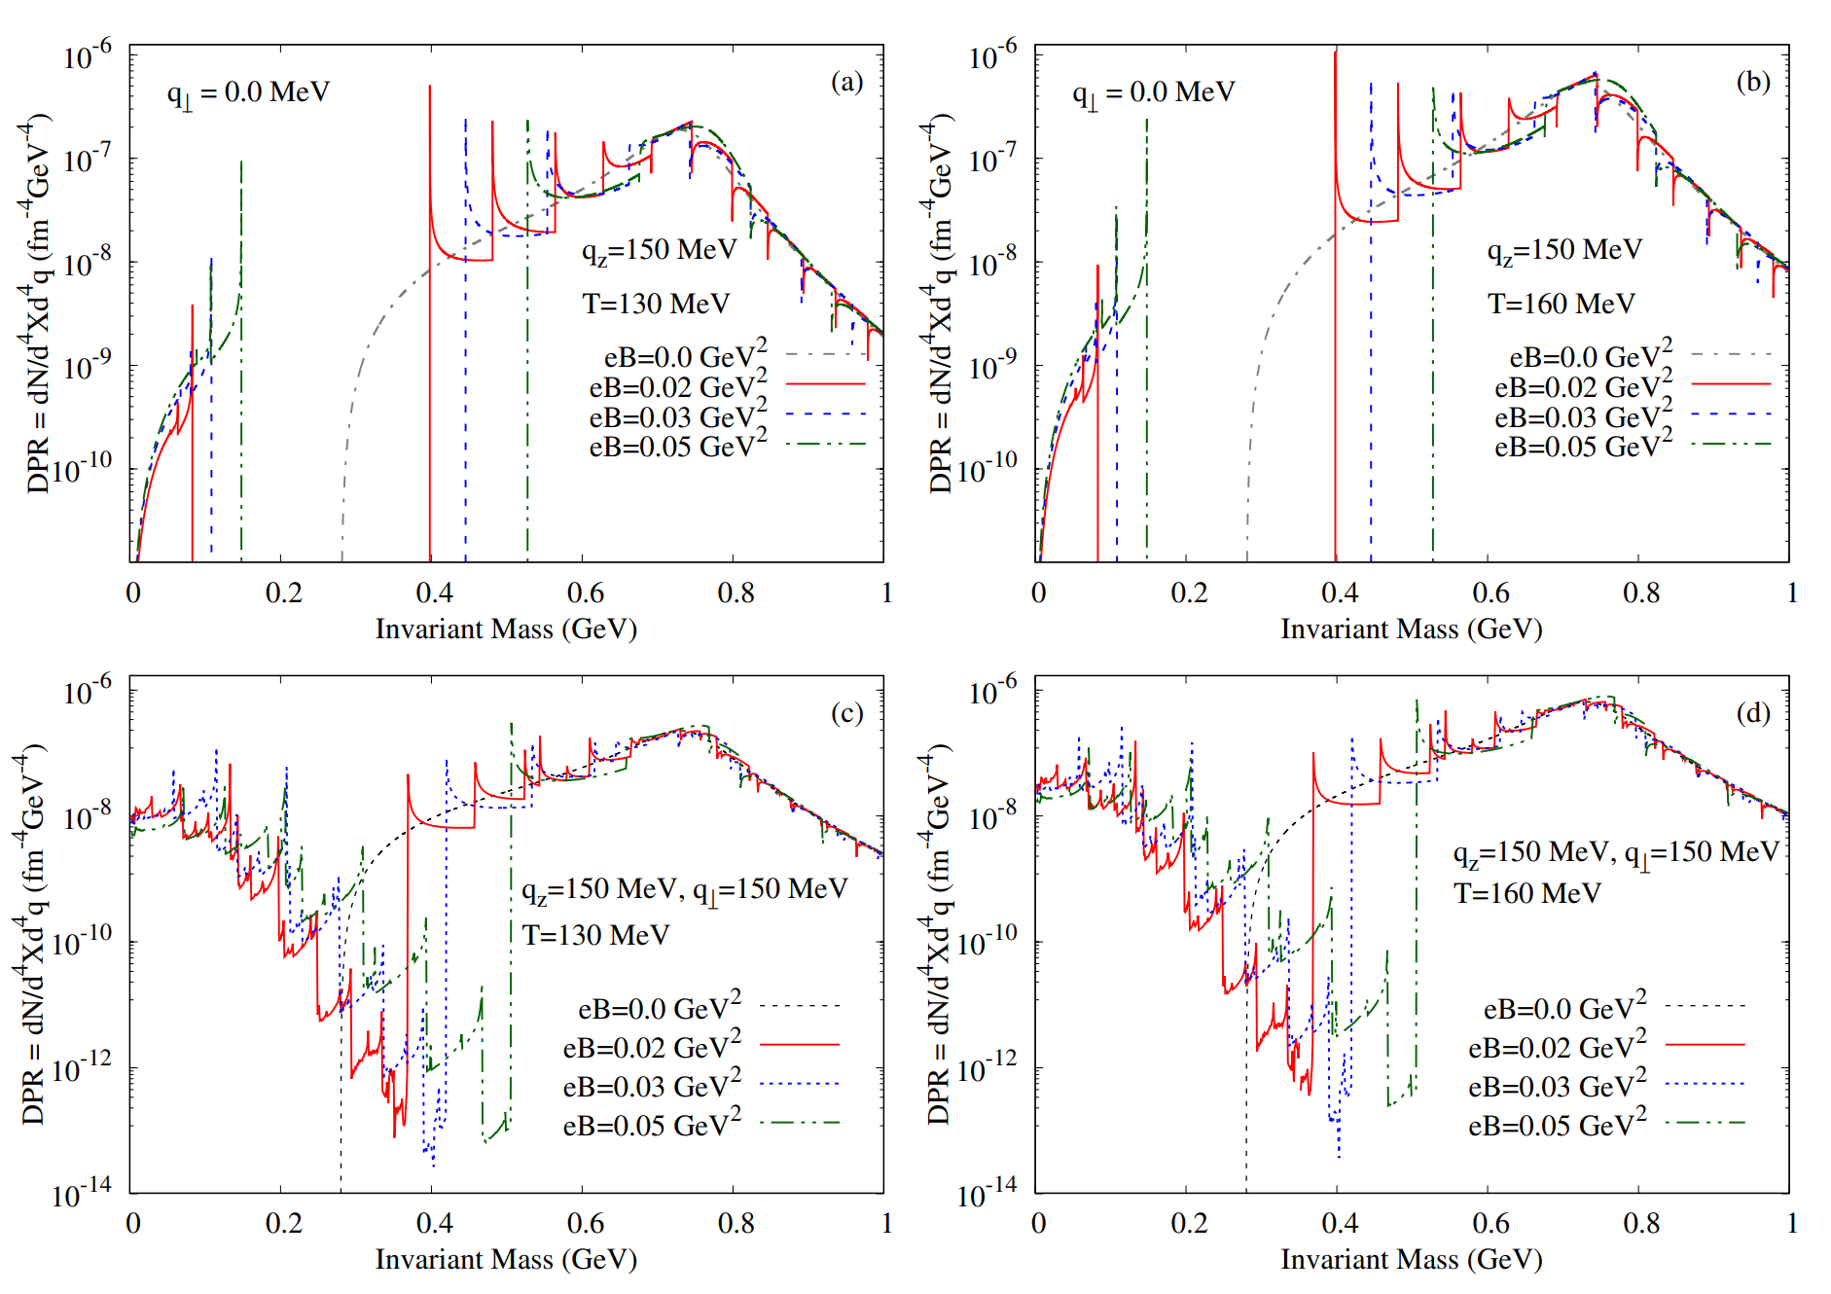
- Numerical Results -

Slide 12
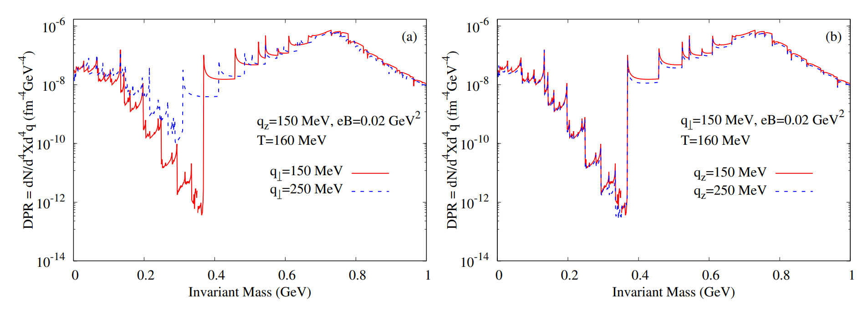
- Numerical Results -

