Slide 1
Spectral Functions for the Quark-Meson Model Phase Diagram from the Functional Renormalization Group Group meeting
Rui Wen
2024.7.12
arXiv:1311.0630 arXiv:1605.00771

Slide 2
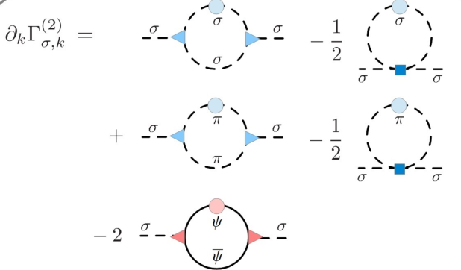
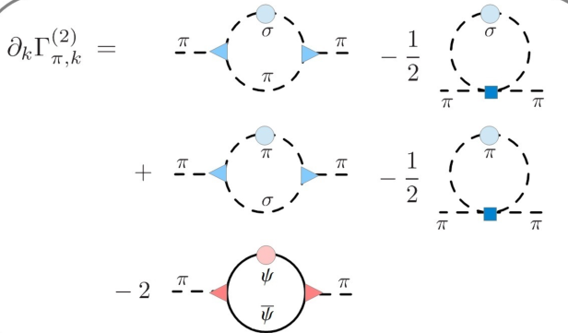
The 2-flavor quark meson model

Slide 3
two-step procedure for the analytic continuation from imaginary to real time
First exploit the periodicity of the bosonic and fermionic occupation numbers
In the second step, the retarded 2-point functions are then obtained from their Euclidean counterparts
arXiv:1605.00771
arXiv:1311.0630
the spectral function

Slide 4
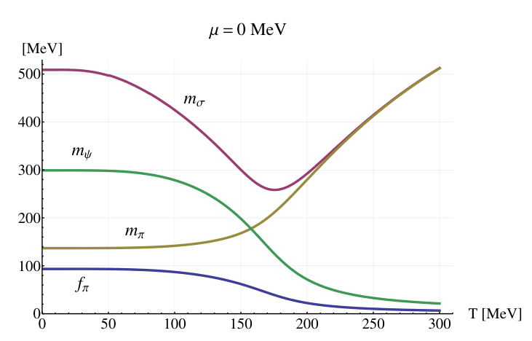
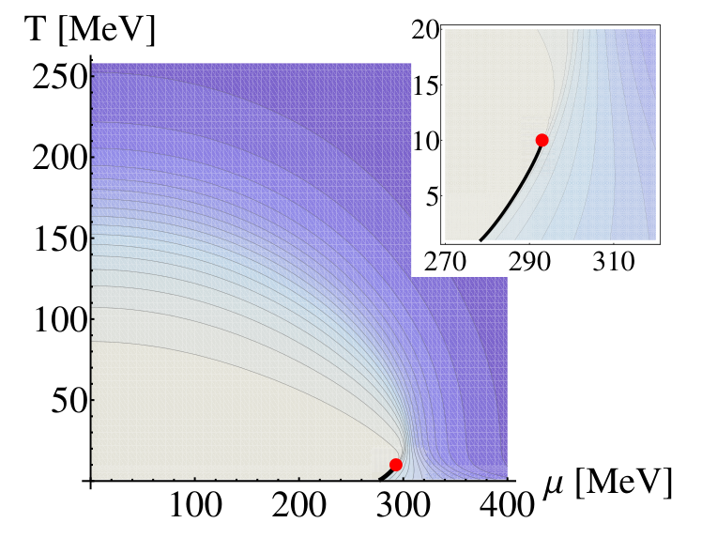
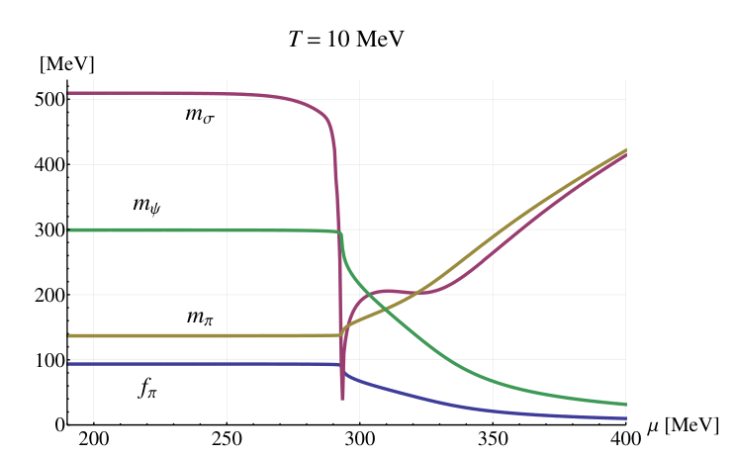
arXiv: 0403039

Slide 5
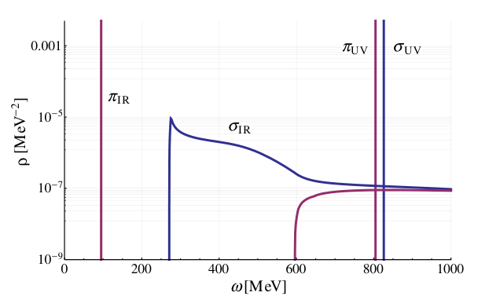
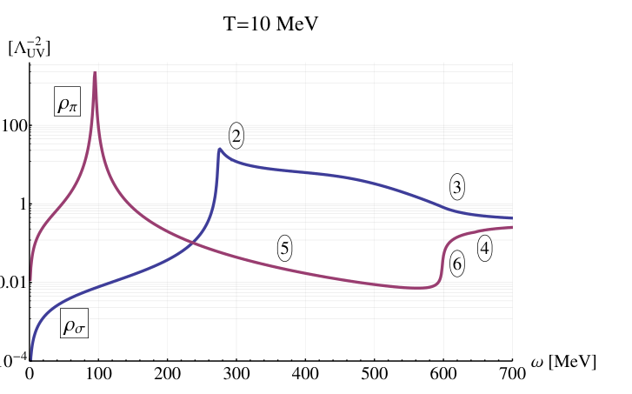
arXiv:1605.00771
arXiv:1311.0630
σ′ → σσ (1),
σ′ → ππ (2)
σ′ → ¯ψψ(3)
π′ → σπ (4)
π′π → σ (5)
π′ → ¯ψψ (6)

Slide 6
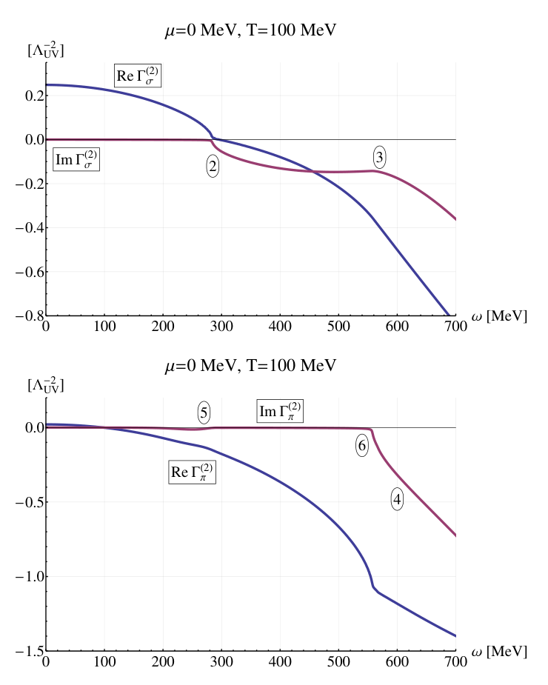
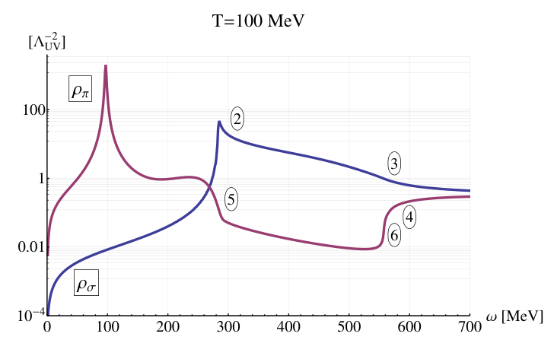
σ′ → σσ (1),
σ′ → ππ (2)
σ′ → ¯ψψ(3)
π′ → σπ (4)
π′π → σ (5)
π′ → ¯ψψ (6)
sigma pole 340 MeV

Slide 7
σ′ → σσ (1),
σ′ → ππ (2)
σ′ → ¯ψψ(3)
π′ → σπ (4)
π′π → σ (5)
π′ → ¯ψψ (6)

Slide 8
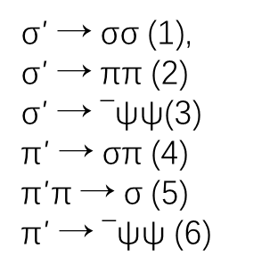
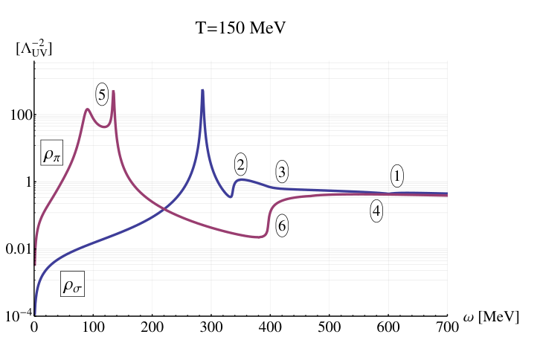
stable sigma meson 280MeV
pion pole

Slide 9
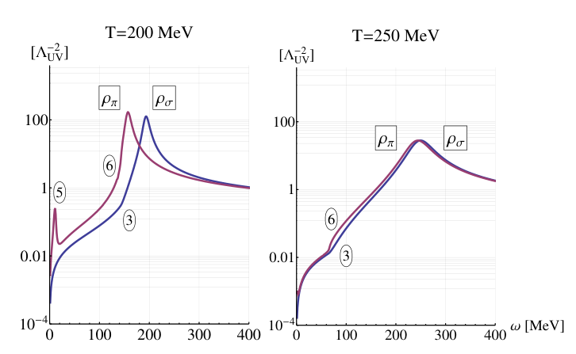
σ′ → σσ (1),
σ′ → ππ (2)
σ′ → ¯ψψ(3)
π′ → σπ (4)
π′π → σ (5)
π′ → ¯ψψ (6)
degenerate

Slide 10
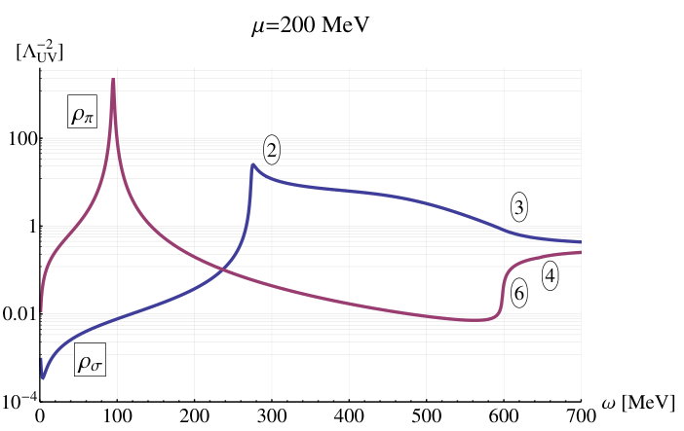
Finite chemical potential
σ′ → σσ (1),
σ′ → ππ (2)
σ′ → ¯ψψ(3)
π′ → σπ (4)
π′π → σ (5)
π′ → ¯ψψ (6)
Silver Blaze property

Slide 11
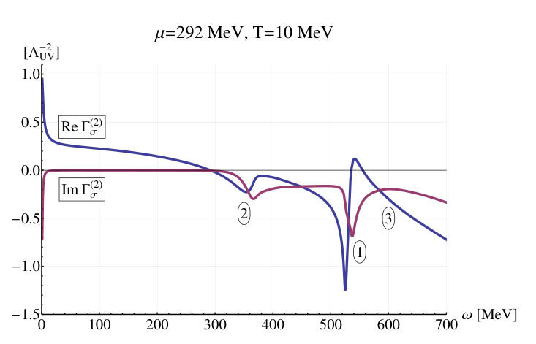
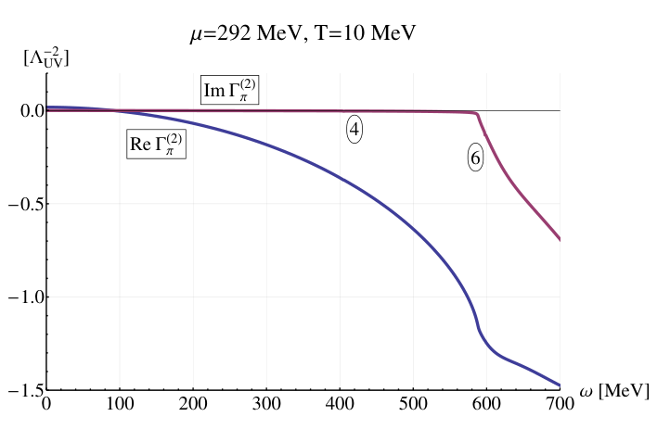
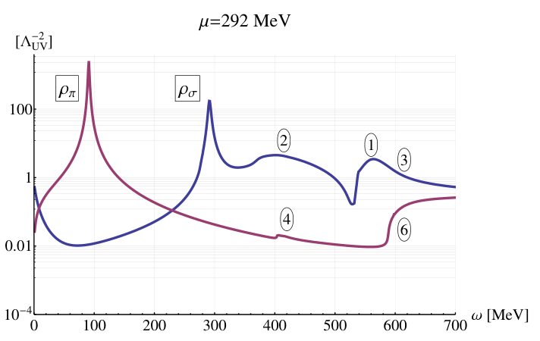
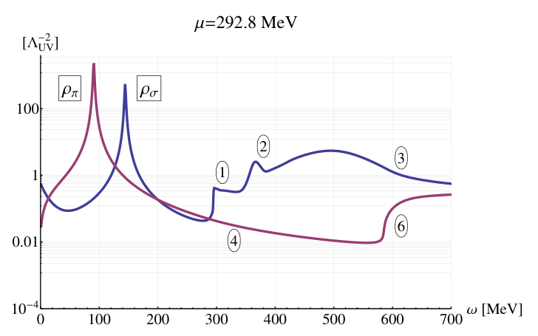
σ′ → σσ (1),
σ′ → ππ (2)
σ′ → ¯ψψ(3)
π′ → σπ (4)
π′π → σ (5)
π′ → ¯ψψ (6)
stable sigma meson

Slide 12
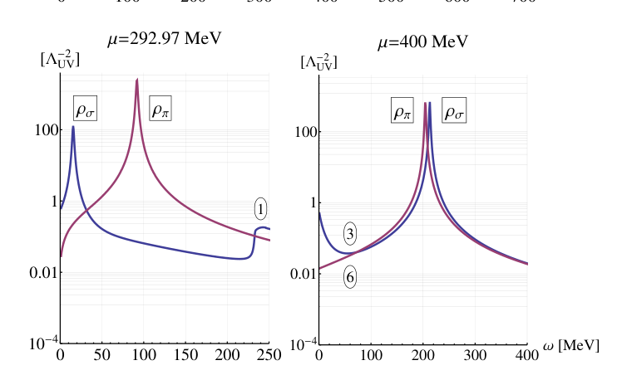
degenerate

Slide 13
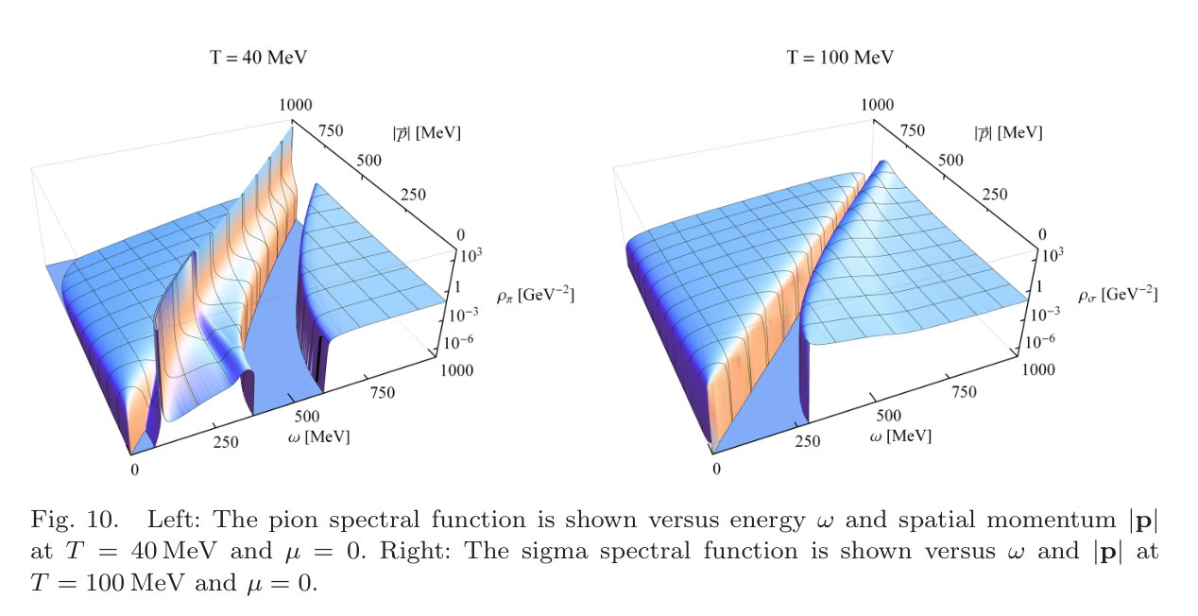
arXiv:1605.00771

Slide 14
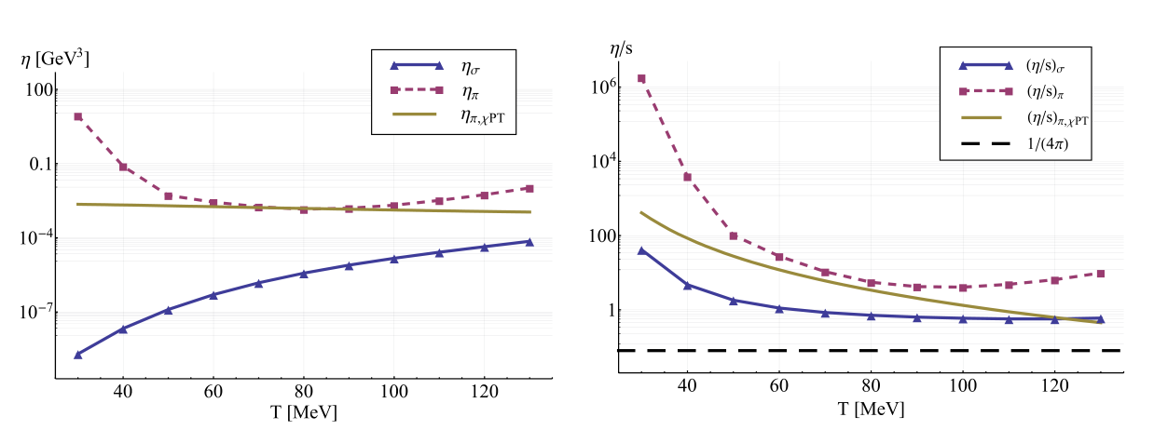
Shear Viscosity

