Slide 1
Progress and Plan
Mingyi Dong
2024.7. 29

Slide 2
Progress in the experimental hall last week
 | Tasks | Time needed (day) | person in charge | Status
1 | Remove the valve box of the accelerator superconducting magnet | 2 | Facilities Operation group (Jing Xiaoping) | East side: done West side : not yet
2 | Remove Q1A, Q1B, ISPB on east side; Move Q1A, Q1B, ISPB on west side away from the IP region | 2 | Facilities Operation group (Jing Xiaoping) | East side: pulled out West side: not yet
3 | Remove SCQ and its support structure on both side; | 2 | Facilities Operation group (Jing Xiaoping) | East side: pulled out West side: not yet
4 | Remove depleted uranium shield on both sides | 2 | Ji Quan, Du Junying, Facilities Operation group (Jing Xiaoping) | Not yet finished the preparation on east side
5 | Prepare support structure for removing beam pipe | 2 | Ji Quan, Zhang Yinhong, Facilities Operation group (Jing Xiaoping) | done

Slide 3
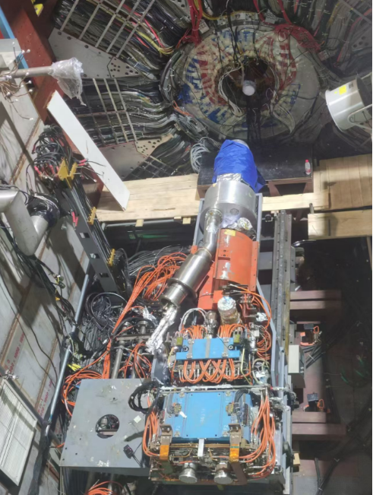
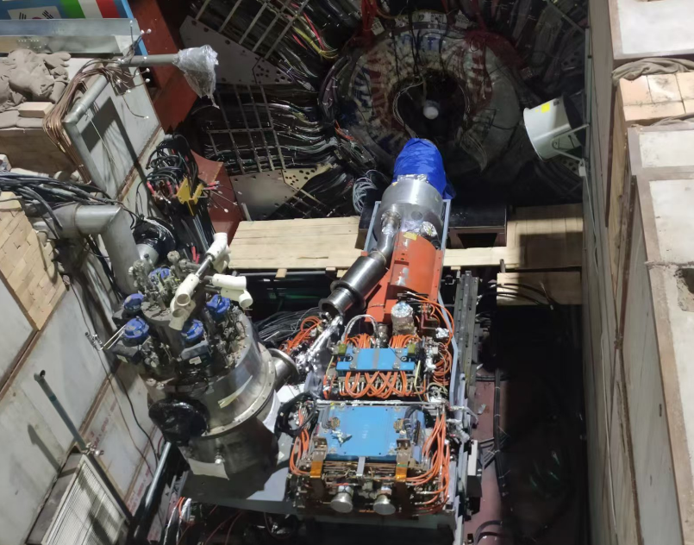
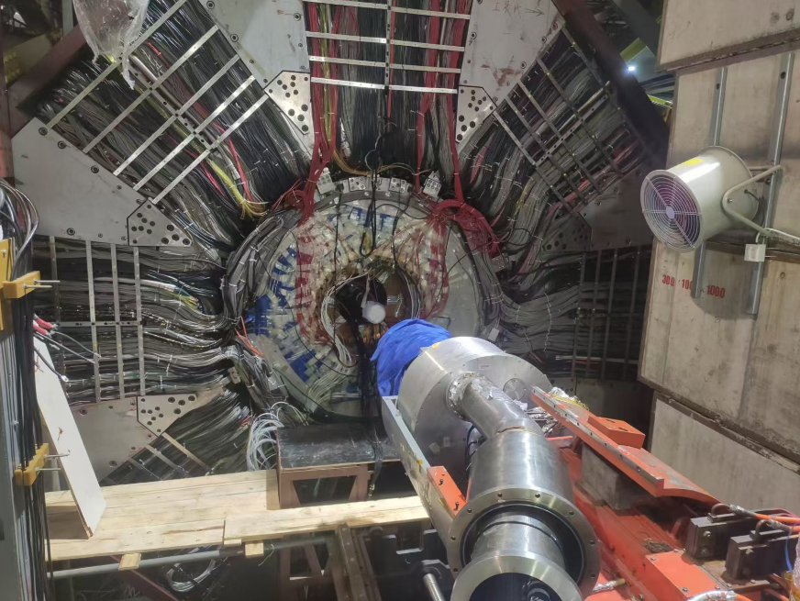
Removal of the equipment on both sides
Pulled out Q1A, Q1B, ISPB and SCQ on east side
Removed the valve box of the accelerator superconducting magnet on east side

Slide 4
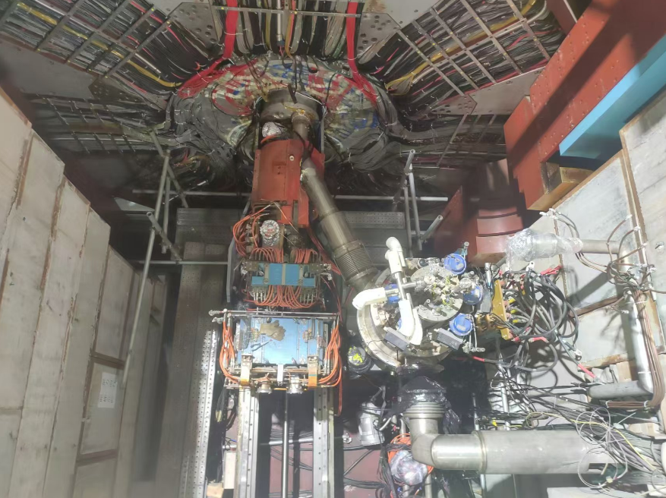
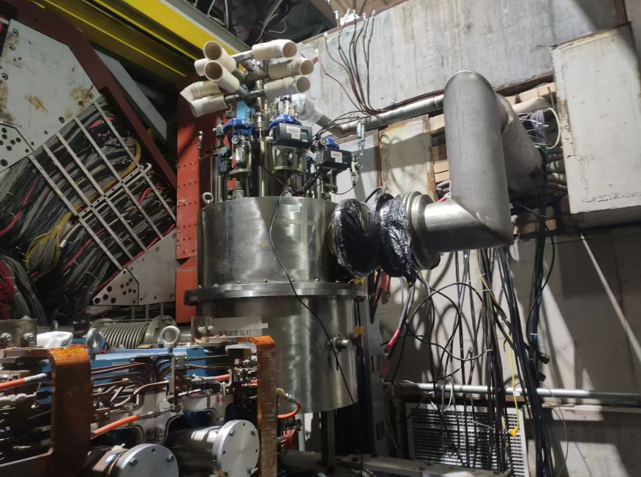
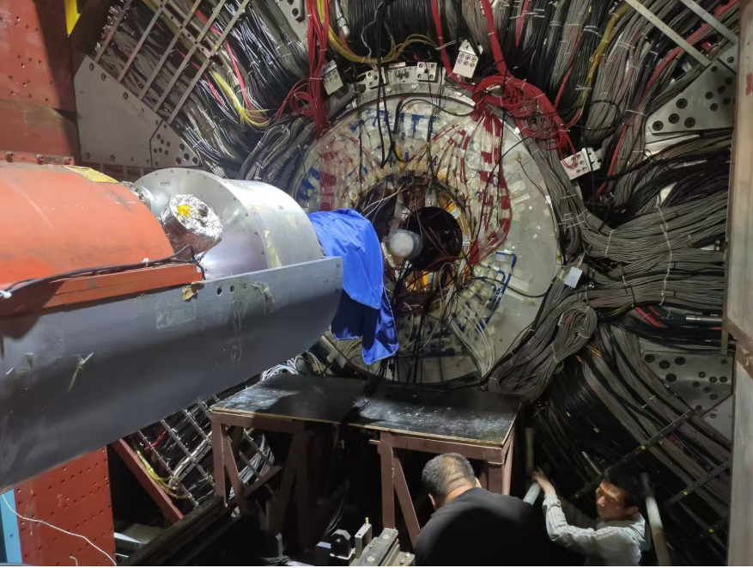
Opened the doors of BESIII
Finished the disconnection of the Valve box on west side
Finished the preparation of support structures for removing beam pipe

Slide 5
Plan for next week
 | Tasks | Time needed (day) | person in charge
1 | Remove the valve box on west side Move Q1A, Q1B, ISPB on west side away from the IP region | 2 | Facilities Operation group (Jing Xiaoping)
2 | Remove Q1A, Q1B, ISPB on east side; | 2 | Facilities Operation group (Jing Xiaoping)
3 | Remove SCQ and its support structure on both side; | 2 | Facilities Operation group (Jing Xiaoping)
4 | Remove depleted uranium shield on both sides | 2 | Ji Quan, Du Junying, Facilities Operation group (Jing Xiaoping)
5 | Remove beam pipe | 2 | Ji Quan, Zhang Yinhong, Facilities Operation group (Jing Xiaoping)

Slide 6
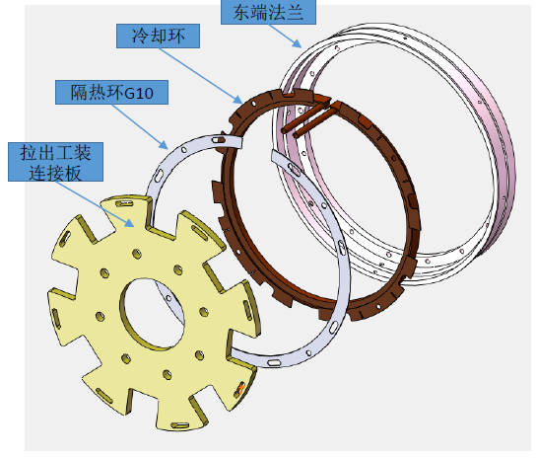
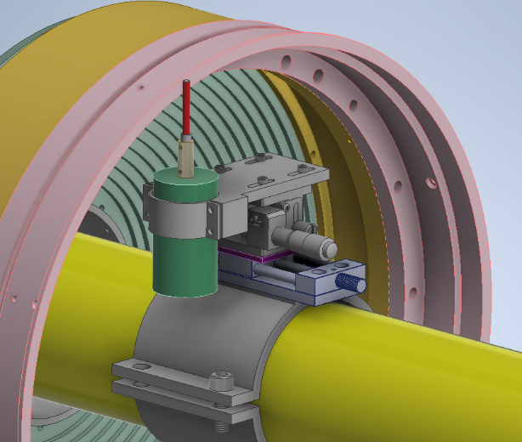
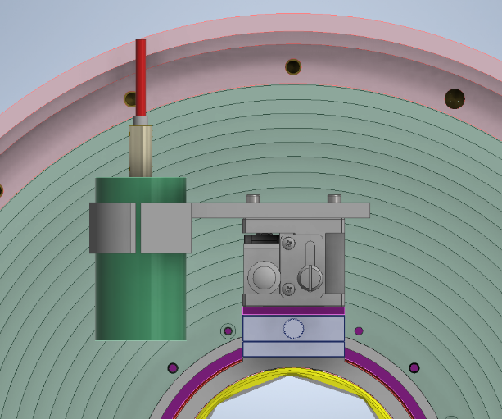
Preparation for tests of cooling and cutting the iMDC flange
The tools and jigs for cutting have been ready.
The tools for cooling are being prepared in the factory. Thermal conductive silicone and the chiller are ordered
Plan to have a review on August 12th

Slide 7
Backup

Slide 8
Schedule (may be updated each week)
No. | tasks | Duration（day） | Start time and stop time | Sub-system involved
1 | Removal of equipment of machine |  | July 1- Aug. 6 | Utility, Small angle lum. Detector and ZDD, Beam pipe, slow control
2 | Pull-out of EEMC |  |  | Utility, EMC, TOF, MDC, MUC
3 | Removal of inner chamber（Operate simultaneously on both sides ） | 51 | Aug. 7- Sep.7 Sep.8- Sep. 28 | MDC, MDC electronics, Gas, Mechanics, Laser Alignment group, Trigger, DAQ, Slow control
4 | Installation of CGEM | 44 | Sep.29- Nov. 11 | CGEM group, MDC, MDC electronics, Gas, Mechanics, Laser Alignment group, Trigger, DAQ, Slow control
5 | Recover EEMC |  | Nov. 12-Dec.30 | Utility, EMC, TOF, MDC, MUC
6 | Recover equipment of machine |  |  | Utility, Small angle lum. Detector, ZDD, Beam pipe, slow control,
total |  | 180 days | July 1- Dec.30

Slide 9
Key tasks before extraction of iMDC and installation of CGEM
CGEM Mock-up insertion test （Done, successful）
Laser alignment preparation
Extraction of the inner MDC is considered to be the most critical point. Continue inner chamber extraction test
Preliminary discussion on cooling the connecting flange
Continue CGEM cosmic-ray test to gain more experience with the full detector
CGEM integrated and tested with BESIII DAQ, trigger, and slow control

