Slide 1
Consideration for CMOS tracker readout
JIANG Xiaojie, LI Yiming, SHENG Shuqi, WANG Jianchun,
XU Zijun, ZHOU Yang
22 Jul 2024

Slide 2
Layout
Optimization ongoing; subject to change
https://indico.ihep.ac.cn/event/23036/attachments/80042/100091/geo_layout.pdf

Slide 3
Key Specifications for CMOS chip
Parameter | Requirement / expectation
Pixel size | 34 $×$ 150 $μm^{2}$
Chip size | ~ 2 $×$ 2 cm².
Array size | 512 rows $×$ 128 columns
Spatial resolution | < 10 $μm$
Timing resolution | ~3-5 ns
Power consumption | ~ 300 mW/cm². (aiming for 200)
Data size per hit | 42 bit (14b BXID*, 7b+9b address, 6b TOT, 5b fine TDC, 1 polarity*)
Event rate / chip | ??? (background?) up to 1.28 Gbps
LV | 1.2V
HV | ~150 V?
* To be reduced

Slide 4
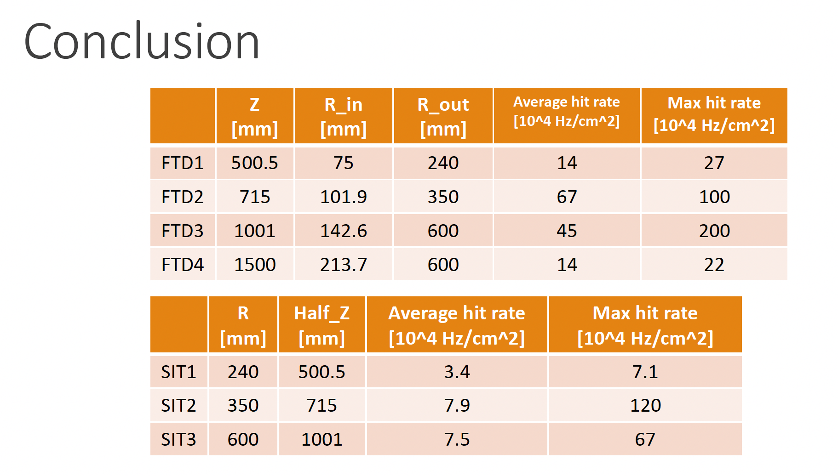
Background rate
Latest estimation from Zhan Li on 20 July
on Pair production only
Fixing previous estimation by merging steps in GEANT4 into single hits
Rate substantially dropped wrt bkg file provided by Haoyu in March
Assuming 42 bits/hit
Layer | Avg data rate [MHz/chip] | Max data rate [MHz/chip]
SIT1 / ITKB1 | 5.7 | 12
SIT2 / ITKB2 | 13 | 202
SIT3 / ITKB3 | 13 | 113
640 MHz /chip is enough

Slide 5
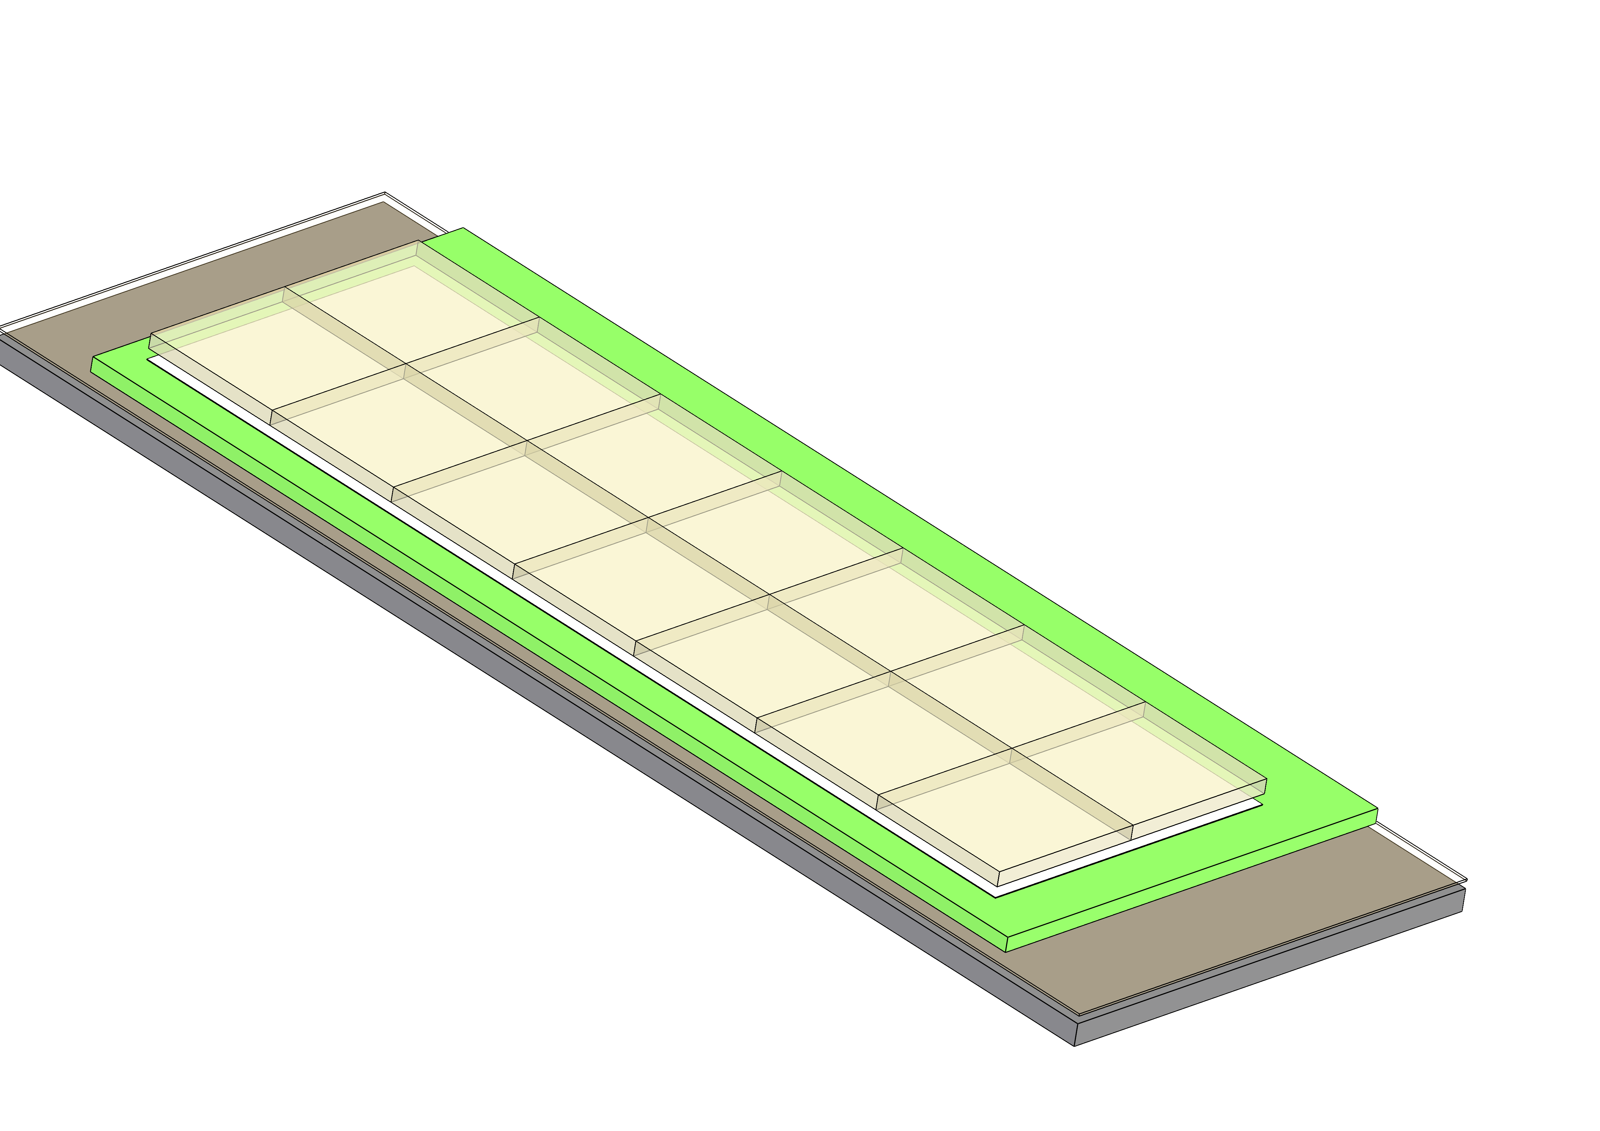
Module concept (as proposed 05 July)
10 mm
lpGBTx: W=9, L=9
Optical connector: W=10, L=20
42.76mm + 10 mm + 2 sides/gaps
42.76mm
1 lpGBT provides 28×0.32, 14×0.64, or 7×1.28 Gbps DATA links
=> 2 lpGBT needed for current bkg rate; may reduce to 1?
142.16mm
 | Thickness (mm) | Radiation Length [%X0]
Pixel Sensor | 0.150 | 0.18
HybridFlex | 0.200 | 0.28
Kapton Tape | 0.100 | 0.14
BareStave | 4.000 | 0.21
Optical connector | 1.250 | 0.13
lpGBTx | 4.000 | 0.07
Total |  | 1.01
Silicon + Al
Cu+ Kapton

Slide 6
Updated module concept
Key modification:
Moving PCB from below the chip to above
Common electronics & cables directly on top of PCB
Advantage
Chip in direct contact with supporting, better cooling
No need for inactive area to the side of module
Minimal changes (simplification) to stave design
Cooling for common electronics needs study
Now assuming 1 lpGBT / module, if all chips reach ~1Gbps more fibres needed
10 mm
42.76mm + 10 mm + 2 sides/gaps
42.76mm
142.16mm
Hybrid PCB
Power cable
42.76mm + 10 mm + 2 sides/gaps
142.16mm
Supporting & cooling to be optimized seperately
DCDC
Data aggregation
Optical convertor
Optical fibre
Transmission (GBTx like)

Slide 7
Barrel arrangement & counts
Layer | Modules/stave | Staves/layer | Modules/layer
B1 | 7 | 40 | 280
B2 | 10 | 58 | 580
B3 | 14 | 96 | 1344
* Numbers given by Qi & Yihan at 19th July rTDR tracker meeting
In total 2204 modules, 30856 chips needed
Total data rate for the whole barrel?
Assuming 640MHz/chip => upper limit 19.7 Tbps
Assuming dominated by background, 2$×$ Zhan’s estimation (P4): ~0.7 Tbps
Total power: ~2.65 kW for sensors, ?? For common electronics?

Slide 8
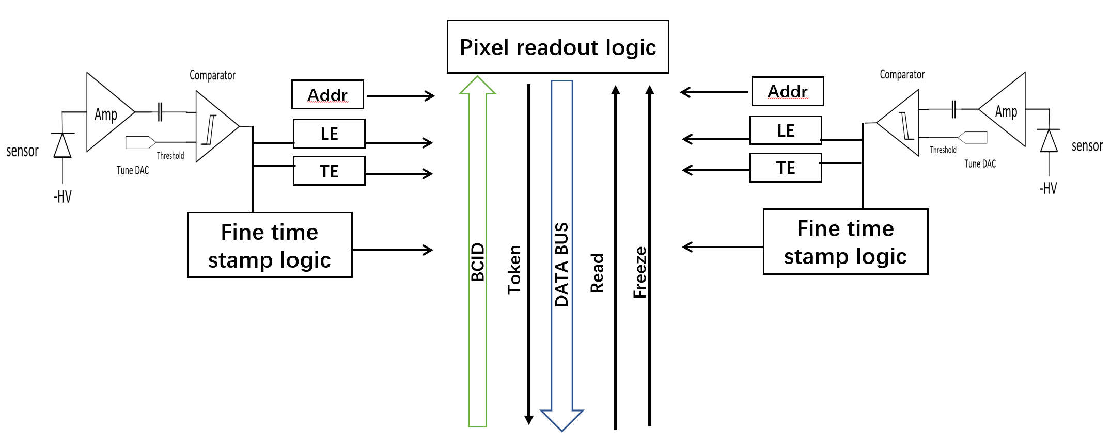
Front-end electronics
Pixel matrix:
512 rows
64 double columns
LE: Leading edge
TE: Tailing edge
Double column schematics: two pixels
Digital process & data formation
DACs for biasing
R/O
controller
......
R/O
controller
Periphery & IOs
40 MHz
PLL
FIFO and FSM
Schematic of a HV pixel sensor
640 MHz
serializer
I²C slow control
LVDS
Up to 1.28Gbps

Slide 9
Electronics design
Module
12V
DC convertor
1.2/?? V
Front-end
HVCMOS
chips
BEE
HVCMOS
chips
Clock
HVCMOS
chips
Clock
HVCMOS
chips
Control
lpGBT (like)
Data
Control
Data
HV
HV system

Slide 10
Cost estimation
Category 类别 | Item 名称 | Total (10k CNY) 小计（万元） | Unit cost (CNY) 单价（元） | Unit 单位 | Quantity 数量 | Note 备注
Sensor chip | Sensor chip | 1278 | 18,000 | Wafer | 710 | 3.3 MCNY for NTO + 18k/wafer; assume 50% yield
Common electronics | Hybrid PCB | 154 | 700 | Piece | 2204
 | Optical fibre | 44 | 200 | 20m | 2204
 | Optical connector | 441 | 2,000 | Piece | 2204
 | PCB connector | 22 | 100 | Piece | 2204
 | Power cable | 88 | 400 | 20m | 2204
Total |  | 2027
Note:
cost on mechanical support and cooling not considered yet
Assuming 2 fibre/module in innermost layer TO DO!

Slide 11
backup

