Slide 1
Capping the positivity cone in SMEFT
——洪东宇
中国科学技术大学
Based on 2404.04479
With 王卓辉, 周双勇
第四届量子场论及其应用研讨会
2024/11/18 广州

Slide 2
Introduction
Effective Field Theories (EFTs) play a central role in modern particle physics and cosmology.
$$ℒ_{EFT}=ℒ_{0}+\sum_{d>4}{\frac{1}{Λ^{d−4}}\sum_{i}{C_{i}^{(d)}𝒪_{i}^{(d)}}}$$
The EFTs coefficients can not take arbitrary values if we assume the high energy UV theory having causality, unitarity ……
High energy UV theory
Basic assumptions
Low energy EFTs
Positivity bounds
Dispersion relations

Slide 3
Ingredients to Prove Positivity Bounds
Locality
Unitarity
Analyticity
Polynomially bounded
Froissart-Martin bound
$$\lim_{s→∞}\left|M(s,t)\right|<Cs^{1+ε(t)}$$
$$ε\left(t\right)<1$$
Analytic in the complex Mandelstam plane.
Implied by causality.
$$S^{+}S=I$$
Optical theorem
$$0≤Imρ_{l}≤2$$

Slide 4
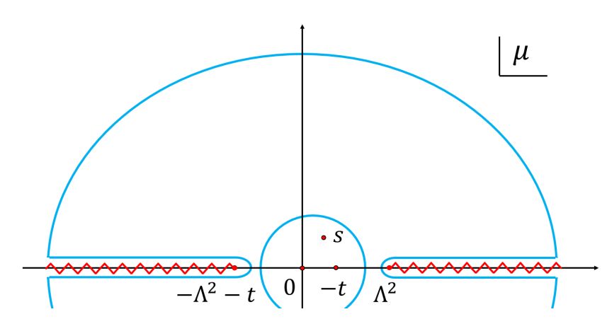
Dispersion Relation
$$\sum_{EFT poles}{Res\frac{M(μ,t)}{μ−s}=\int_{C}{\frac{dμ}{2πi}}}\frac{M\left(μ,t\right)}{μ−s }$$
Twice subtraction
$$\sum_{EFT poles}{Res\frac{M(μ,t)}{μ−s}}=b_{0}\left(t\right)+\int_{Λ^{2}}^{+∞}{\frac{dμ}{π}\left(\frac{s^{2}}{μ^{2}(μ−s) }+\frac{u^{2}}{μ^{2}(μ−u)}\right)}ImM\left(μ,t\right)$$
Sum rules
Crossing symmetry
𝑀(𝑠,𝑡)=𝑀(𝑡,𝑢)=𝑀(𝑠,𝑢)
Partial wave expand
$$M\left(μ,t\right)∼∑ρ_{l}(μ)$$
Null constraints
Langrangian symmetry
Notes:
左边是低能, 右边是高能

Slide 5
Positivity Bounds
$$M\left(s,t\right)⊃a_{2,0}s^{2}+a_{2,1}s^{2}t$$
Sum rules and null constraints
$a_{2,0}=16\int_{Λ^{2}}^{+∞}{dμ\sum_{l}{\left(2l+1\right)}}Imρ_{l}\left(μ\right)\frac{2}{μ^{3}}$
$a_{2,1}=16\int_{Λ^{2}}^{+∞}{dμ\sum_{l}{\left(2l+1\right)}}Imρ_{l}\left(μ\right)\frac{2l\left(l+1\right)−3}{μ^{4}}$
$0=16\int_{Λ^{2}}^{+∞}{dμ\sum_{l}{\left(2l+1\right)}}Imρ_{l}\left(μ\right)……$
Semidefinite Program
$$x_{1}\frac{2}{μ^{3}}+x_{2}\frac{2l\left(l+1\right)−3}{μ^{4}}+∑x_{i}\{null constraints\}_{i}≥0,$$
$$for even l and μ≥Λ$$
$$x_{1}a_{2,0}+x_{2}a_{2,1}+∑x_{i}∙0≥0$$
SDPB package
Tolley, Wang, Zhou, 2011.02400
Caron-Huot, Duong, 2011.02957
$$16\int_{Λ^{2}}^{+∞}{dμ\sum_{l}{\left(2l+1\right)}}Imρ_{l}\left(μ\right)$$

Slide 6
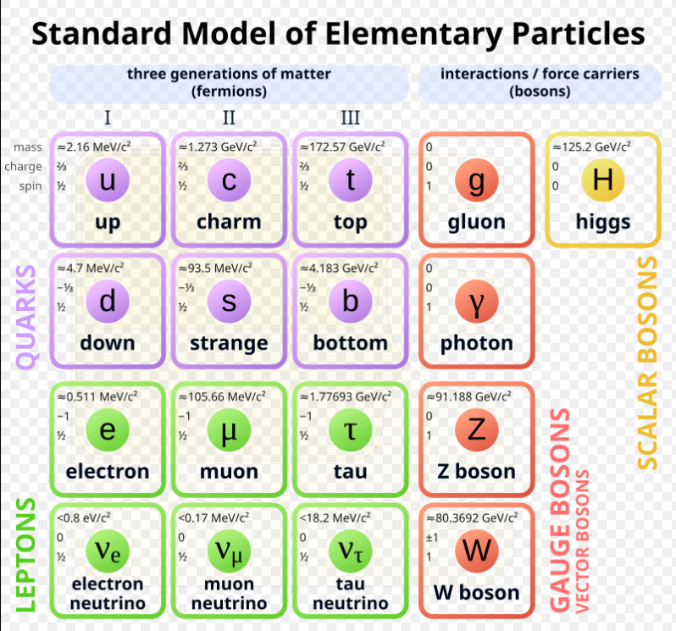
Standard Model EFT(SMEFT)
$$ℒ_{SM}+\sum_{n>4}{\frac{1}{Λ^{d−4}}\sum_{i}{C_{i}^{(d)}𝒪_{i}^{(d)}}}$$
An extension of SM
No new particles
Encode the SM measurements
Notes:
对于这么多粒子可以想象可能的算符也会是非常多, 对应的系数空间也会是非常大.

Slide 7
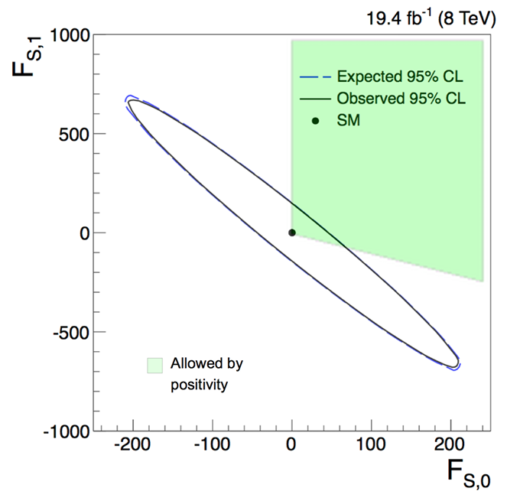
Positivity Bounds on SMEFT
Vector boson scattering
Electroweak symmetry breaking
2% allowed space of 18 quartic gauge couplings
Fermi scattering
Flavor-conserving $→$ positive coefficient
Exclude some operators in $μ→3e$ (targeted by Mu3e)
Higgs scattering
Dim-8 operators
$C_{2}≥0, C_{1}+C_{2}≥0, C_{1}+C_{2}+C_{3}≥0$
Zhang, Zhou, 1808.00010
Remmen, Rodd, 2004.02885
Zhang, Zhou, 1808.00010
Remmen, Rodd, 1908.09845
Notes:
这个过程正由Mu3e这个实验进行测量.

Slide 8
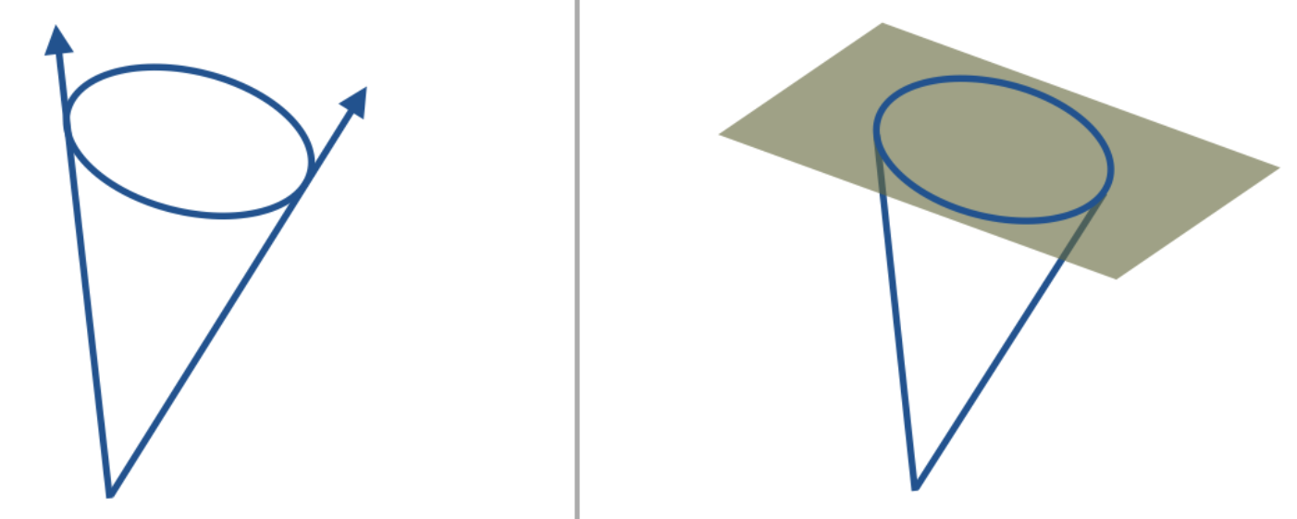
Capped Positivity Cone
We will use two side of the unitarity conditions.
$$Imρ_{l}(s)≥0 ⇒ ∑c_{ij} a_{ij}≥0$$
$$0≤Imρ_{l}(s)≤2 ⇒ 0≤∑c_{ij} a_{ij}≤constant$$
Discretize the integral
$\int{dμ Imρ_{l}(μ)……⇒\sum{\frac{1}{n} Imρ_{l,n}}}…$
$Ma$ximum $g∼\sum_{l,n}{Imρ_{l,n}…}$
Unitarity conditions
$S^{+}S=Ι ⇒\left(Ι−iT^{+}\right)\left(Ι+iT\right)=Ι$
$ImT≽0, 2I−ImT≽0$
Chen, Mimasu, Wu, Zhang, Zhou, 2309.15922
DYH, Wang, Zhou, 2404.04479

Slide 9
Reducing Partial Wave Amplitudes
Higgs $H=\frac{1}{\sqrt{2}}\left({φ_{1} \atop φ_{2}}\right)$
SU(2)
symmetry
$$ρ_{l}^{s}\left(μ\right)=ρ_{l}^{1\overline{1}2\overline{2}}\left(μ\right)$$
$$ρ_{l}^{t}\left(μ\right)=ρ_{l}^{12\overline{12}}\left(μ\right)$$
$$ρ_{l}^{u}\left(μ\right)=ρ_{l}^{1\overline{2}2\overline{1}}\left(μ\right)$$
$$ij→kl$$
$4^{4}=256 ρ_{l}^{ijkl}(s)$
crossing symmetry
SU(2) symmetry
$$M^{i\overline{j}k\overline{l}}\left(s,t\right)=δ_{i\overline{j}}δ_{k\overline{l}} f\left(s,t\right)+δ_{i\overline{l}}δ_{\overline{j}k} f(u,t)$$
Crossing symmetry
$$ρ_{l}^{ijkl}\left(s\right)={\left(−1\right)}^{l}ρ_{l}^{ijlk}(s)$$

Slide 10
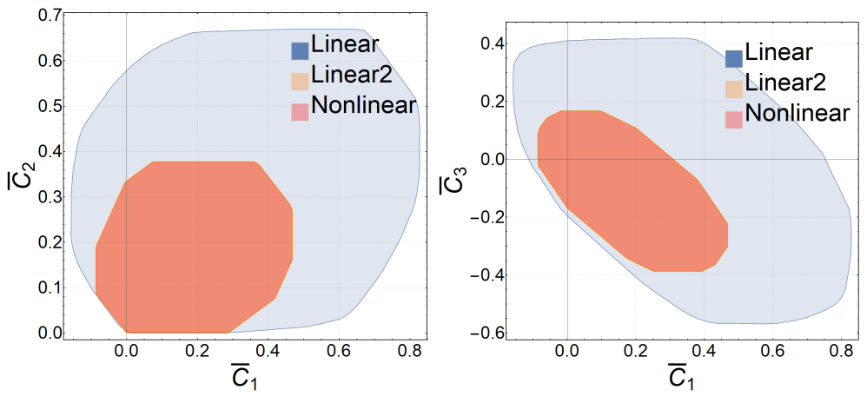
Bounds on Dim-8 Higgs Operators
$$L_{SMEFT}⊃ C_{1} \left(D_{µ}H^{†}D_{ν}H\right)\left(D^{ν}H^{†}D^{μ}H\right)$$
$$+C_{2} \left(D_{µ}H^{†}D_{ν}H\right)\left(D^{μ}H^{†}D^{ν}H\right)+C_{3}\left(D_{µ}H^{†}D^{μ}H\right)\left(D^{ν}H^{†}D_{ν}H\right)$$

Slide 11
Vs Perturbative Unitarity Bounds
Almeida, Eboli and Gonzalez–Garcia
2004.05174

Slide 12
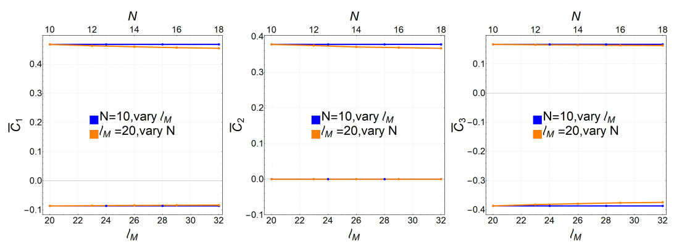
Convergence

Slide 13
Linear Unitarity vs Nonlinear Unitarity
$ℤ_{2}$ bi-scalar theory
Nonlinear unitarity conditions
$$ρ_{l}^{1111}ρ_{l}^{2222}≥{\left(ρ_{l}^{1122}\right)}^{2}$$
$$\left(2−ρ_{l}^{1111}\right)\left(2−ρ_{l}^{2222}\right)≥{\left(ρ_{l}^{1122}\right)}^{2}$$
Coefficients
$$g_{1,0}^{a}∼ρ_{l}^{1111}, g_{2,0}^{b}∼ρ_{l}^{1122}+{\left(−1\right)}^{l}ρ_{l}^{1212}$$

Slide 14
Thanks！

Slide 15
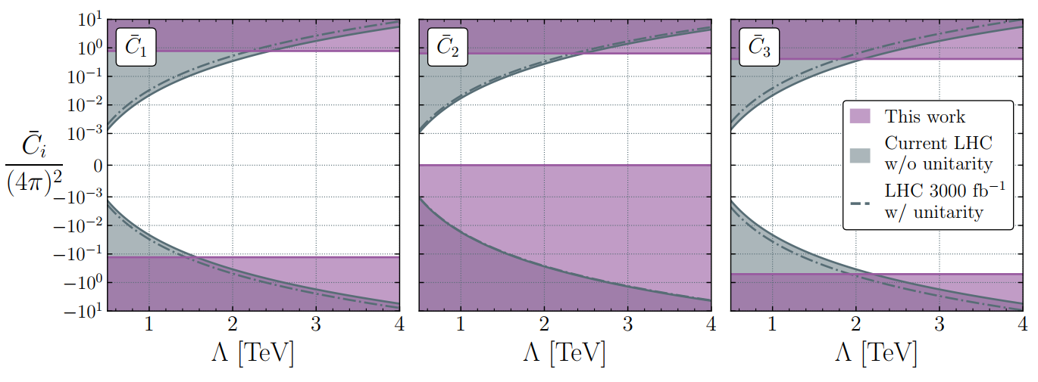
Comparison with Other Bounds
Chen, Mimasu, Wu, Zhang, Zhou, 2309.15922
DYH, Wang, Zhou, 2404.04479

