Slide 1
Discontinuities of banana integrals in dispersion relation representation
陈绪梁 (中山大学)
Based on CPL 41 (2024) 111101 (陈绪梁、杨鹏飞、陈伟 )
第四届量子场论及其应用研讨会 2024.11.19 广州

Slide 2
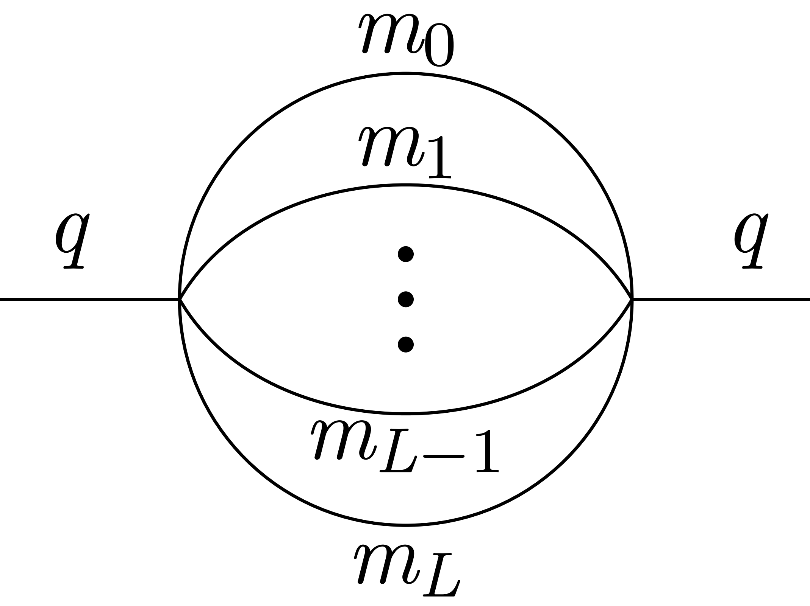
背景
许多费曼积分都可以用MPLs (multiple polylogarithms)来表示，而MPLs是一类理解的比较好的特殊函数，因此超越MPLs的积分开始受到关注
Bourjaily, et al 2203.07088 Snowmass 2021
多圈含质量的香蕉积分 (banana/sunrise integrals) 是一类超越MPLs的费曼积分
QCD Sum Rule几乎所有领头阶的费曼图都是香蕉积分，并且需要计算
含高幂次传播子的积分
积分的discontinuities (或虚部)
QCD Sum Rule中的重夸克传播子：
$S_{ij}\left(p\right)=\frac{i\left(\hat{p}+m\right)δ^{ij}}{p^{2}−m^{2}}−\frac{ig_{s}}{4}G_{μν}\frac{\left(\hat{p}+m\right)σ^{μν}+σ^{μν}\left(\hat{p}+m\right)}{{\left(p^{2}−m^{2}\right)}^{2}}+\frac{iδ^{ij}}{12}\left\langle g_{s}^{2}G^{2}\right\rangle \frac{mp^{2}+m^{2}\hat{p}}{{\left(p^{2}−m^{2}\right)}^{4}}+⋯$

Slide 3
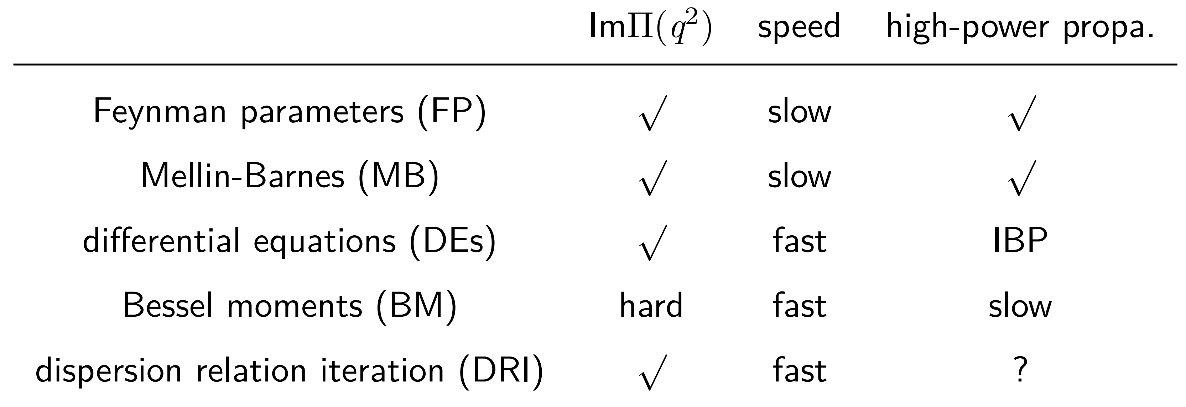
背景
为何不用IBP?
QCD Sum Rule实际上只需要计算一类积分，但IBP会产生许多不同积分家族的主积分
多夸克态的研究中会出现圈数较高的积分(六夸克态对应5圈)，此时IBP的效率较低
各类积分方法的比较：

Slide 4
色散关系迭代法
香蕉积分定义: ($D=2$)
$B_{n_{0}n_{1}⋯n_{L}}\left(q^{2};m\right)=\int{\prod_{i=1}^{L}{\left(\frac{d^{D}k_{i}}{𝕚π^{D/2}}\frac{1}{𝒟_{i}^{n_{i}}}\right)}}\frac{1}{𝒟_{0}^{n_{0}}}$
$$𝒟_{i}=k_{i}^{2}−m_{i}^{2}, k_{0}≡q−\sum_{i=1}^{L}{k_{i}}$$
色散关系(DR) :
$B\left(q^{2}\right)=\int_{s_{N}}^{∞}{ds}\frac{ρ\left(s\right)}{s−q^{2}}$ , $ρ\left(s\right)≡π^{−1}ImB\left(s\right)$
${\left(s−q^{2}\right)}^{−1}$ 具有传播子的形式，且$ρ\left(s\right)$不含圈动量.
DRI: 计算一圈后使用色散关系，${\left(s−q^{2}\right)}^{−1}$可以参与下一圈积分 E. Remiddi and L. Tancredi NPB 907, 400 (2016)

Slide 5
色散关系迭代法
一圈 : $ρ_{11}（s;m_{0},m_{1}）=2λ_{1}^{−1/2}$
$λ\left(x,y,z\right)=x^{2}+y^{2}+z^{2}−2xy−2yz−2xz$ , $λ_{n}≡λ\left(s_{n},s_{n−1},m_{n}^{2}\right)$
两圈:
$ρ_{111}\left(s_{2};m\right)=−\int_{m_{01}^{2}}^{s_{2\overline{2}}^{2}}{ds_{1}}\frac{4}{\sqrt{λ_{1}λ_{2}}}=−\int_{m_{01}^{2}}^{s_{2\overline{2}}^{2}}{ds_{1}}\frac{4}{\sqrt{\left(s_{1}−m_{01}^{2}\right)\left(s_{1}−m_{0\overline{1}}^{2}\right)\left(s_{1}−s_{2\overline{2}}^{2}\right)\left(s_{1}−s_{22}^{2}\right)}}$
$m_{ij}≡m_{i}+m_{j},s_{ij}≡\sqrt{s_{i}}+m_{j},s_{i\overline{j}}≡\sqrt{s_{i}}−m_{j}$
显然是个椭圆积分
$L$圈: $ρ_{1^{L}}\left(s_{L};m\right)={\left(−1\right)}^{L−1}2^{L}\prod_{i=2}^{L}{\left(\int_{m_{0⋯\left(i−1\right)}^{2}}^{s_{i\overline{i}}^{2}}{\frac{ds_{i−1}}{\sqrt{λ_{i}}}}\right)\frac{1}{\sqrt{λ_{1}}}}$

Slide 6
Generalized dispersion relation
对于高幂次传播子的积分，直接使用色散关系会导致错误的结果
考虑积分 $B_{2,1}\left(q^{2}\right)=\int{\frac{d^{2}k}{iπ}}\frac{1}{{\left[{\left(q−k\right)}^{2}−1\right]}^{2}\left(k^{2}−1\right)}$
$$π^{−1}ImB_{2,1}\left(s\right)=2{\left(s−4\right)}^{−\frac{3}{2}}s^{−\frac{1}{2}}$$
使用色散关系:
$B_{2,1}\left(q^{2}\right)=2\int_{4}^{∞}{ds}\frac{1}{s−q^{2}}{\left(s−4\right)}^{−\frac{3}{2}}s^{−\frac{1}{2}}$
收敛的积分算出了发散的结果！

Slide 7
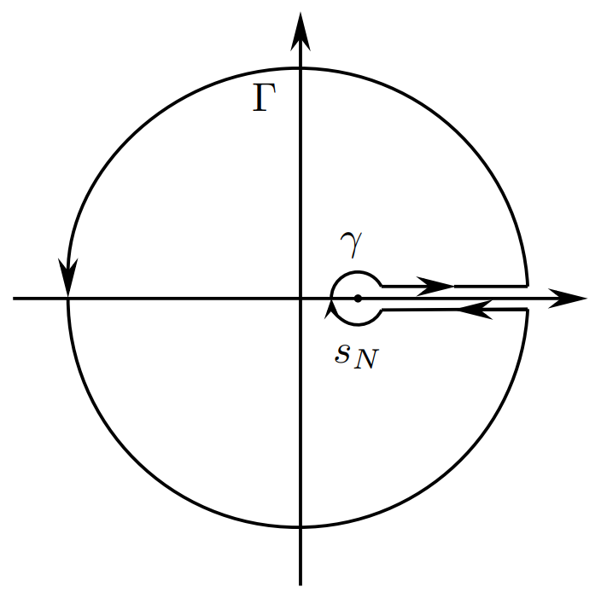
Generalized dispersion relation
推导色散关系时考虑小圆 $γ$ 的贡献 : J. S. Toll (1956), P. Bargiela 2403.18047
$Π\left(q^{2}\right)=\sum_{i=0}^{n_{Γ}−1}{\frac{{\left(q^{2}−a\right)}^{i}{\left.{\left[{\left(q^{2}−s_{N}\right)}^{n_{γ}}Π\left(q^{2}\right)\right]}^{\left(i\right)}\right|}_{q^{2}=a}}{Γ\left(i+1\right){\left(q^{2}−s_{N}\right)}^{n_{γ}}}}+\int_{s_{N}}^{∞}{\frac{ds}{π}}\frac{ImΠ\left(s\right)}{s−q^{2}}{\left(\frac{q^{2}−a}{s−a}\right)}^{n_{Γ}}{\left(\frac{s−s_{N}}{q^{2}−s_{N}}\right)}^{n_{γ}}$
得到Generalized dispersion relation (GDR)
使用GDR 得到:
$B_{2,1}\left(q^{2}\right)=\frac{2}{q^{2}−4}+2\int_{4}^{∞}{ds}\frac{1}{s−q^{2}}\left(\frac{q^{2}}{s}\right)\left(\frac{s−4}{q^{2}−4}\right){\left(s−4\right)}^{−\frac{3}{2}}s^{−\frac{1}{2}}$
与Bessel/Hankel moments(见附录)和Mellin-Barnes方法的数值结果一致
现在色散关系迭代法可以推广到任意香蕉积分

Slide 8
香蕉积分与椭圆积分
椭圆积分： ($y=\sqrt{c_{4}x^{4}+c_{3}x^{3}+c_{2}x^{2}+c_{1}x+c_{0}}$)
$I_{m}=\int{dx}\frac{x^{m}}{y}$， $J_{k}=\int{dx}\frac{1}{{\left(x−h\right)}^{k}y}$
任意椭圆积分都可以被$I_{0},I_{1},J_{1}$表示
这一性质被用于研究两圈香蕉积分 E. Remiddi and L. Tancredi NPB 925, 212 (2017)
三圈的香蕉积分是否仍有类似的性质？
需要定义类似于椭圆积分的特殊函数

Slide 9
p-DOBIs
将DOBIs参数化可以定义特殊函数p-DOBIs ($a_{n}$是参数)：
$I_{k_{1}}^{a_{1}}\left(s_{2};m\right)=\int_{m_{01}^{2}}^{s_{2\overline{2}}^{2}}{ds_{1}}{\left(λ_{1}λ_{2}\right)}^{−\frac{1}{2}}{\left(s_{1}−a_{1}\right)}^{k_{1}}$
$I_{k_{1},⋯,k_{n}}^{a_{1},⋯,a_{n}}\left(s_{n+1};m\right)=\int_{m_{0⋯n}^{2}}^{s_{\left(n+1\right)\overline{\left(n+1\right)}}^{2}}{ds_{n}}λ_{n+1}^{−\frac{1}{2}}{\left(s_{n}−a_{n}\right)}^{k_{n}}I_{k_{1},⋯,k_{n−1}}^{a_{1},⋯,a_{n−1}}\left(s_{n};m\right)$
p-DOBIs之间存在大量等式
三圈等质量的情形，p-DOBIs可以被五个“主积分”表示，例如：
$I_{−1,3}^{0,1}=\frac{1}{2}\left(4s_{3}−s_{3}^{2}\right)I_{−1,1}^{0,1}+\frac{3}{2}s_{3}I_{−1,2}^{0,1}+\frac{1}{2}\left(s_{3}^{2}+8s_{3}+32\right)I_{0,0}^{0,1}−\frac{1}{2}\left(11s_{3}+24\right)I_{1,0}^{0,1}+4I_{1,1}^{0,1}$
$$I_{1,2}^{0,1}=\frac{1}{4}\left(4s_{3}−s_{3}^{2}\right)I_{−1,1}^{0,1}+\frac{s_{3}}{4}I_{−1,2}^{0,1}+\frac{5}{4}\left(s_{3}^{2}+8s_{3}+32\right)I_{0,0}^{0,1}−\frac{1}{4}\left(2s_{3}^{2}+39s_{3}+120\right)I_{1,0}^{0,1}+\frac{3s_{3}+16}{2}I_{1,1}^{0,1}$$
可以应用到三圈不等质量的情形

Slide 10
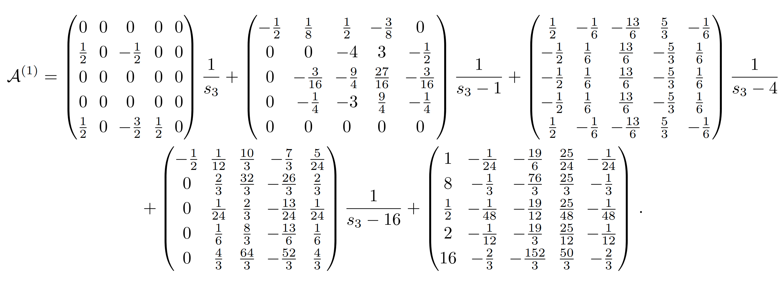
p-DOBIs
p-DOBIs的导数依然是p-DOBIs，因此可以得到关于主积分的微分方程组$\frac{d}{ds_{3}}\vec{I}=A^{\left(1\right)}\vec{I}$
$\vec{I}=\{I_{−1,1}^{0,1}\left(s_{3}\right),I_{0,0}^{0,1}\left(s_{3}\right),I_{1,0}^{0,1}\left(s_{3}\right),I_{1,1}^{0,1}\left(s_{3}\right),I_{−1,2}^{0,1}\left(s_{3}\right)\}$
这一性质可以用来计算对应的Picard-Fuchs算符

Slide 11
关于GDR和p-DOBIs的猜想
用GDR计算 $ρ_{211}\left(s_{2};1,1,1\right)$ 得到:
$ρ_{211}\left(s_{2};1,1,1\right)=2ρ_{11}\left(s_{2};2,1\right)+\int_{4}^{∞}{ds_{1}}\frac{4}{s_{1}}ρ_{21}\left(s_{1};1,1\right)ρ_{11}\left(s_{2};2,1\right)−\int_{4}^{s_{2\overline{2}}^{2}}{ds_{1}}ρ_{21}\left(s_{1};1,1\right)ρ_{11}\left(s_{2};\sqrt{s_{1}},1\right)$
后两项都是发散的，但是会互相抵消
猜想：可以从色散关系迭代产生的项（蓝框）直接得到$ρ_{211}\left(s_{2};1,1,1\right)$
用p-DOBIs表示最后一项:
$−\int_{4}^{s_{2\overline{2}}^{2}}{ds_{1}}ρ_{21}\left(s_{1};1,1\right)ρ_{11}\left(s_{2};\sqrt{s_{1}},1\right)=−4I_{−1}^{4}\left(s_{2}\right)$
使用p-DOBIs 之间的恒等式: divergent p-DOBIs = finite p-DOBIs + boundary term
$$I_{−1}^{4}\left(s_{2}\right)=\frac{1}{2\left(s_{2}−1\right)\left(s_{2}−9\right)}\left[I_{2}^{4}\left(s_{2}\right)−\left(s_{2}−5\right)I_{1}^{4}\left(s_{2}\right)−{\left.\frac{\sqrt{λ_{1}λ_{2}}}{\left(s_{1}−4\right)}\right|}_{s_{1}=4}^{s_{1}=s_{2\overline{2}}^{2}}\right]$$
直接去掉边界项就是结果:
$ρ_{211}\left(s_{2};1,1,1\right)=\frac{−2}{\left(s_{2}−1\right)\left(s_{2}−9\right)}\left[I_{2}^{4}\left(s_{2}\right)−\left(s_{2}−5\right)I_{1}^{4}\left(s_{2}\right)\right]$
这一猜想对$ρ_{211}\left(s_{2};1,2,3\right)$、 $ρ_{311}\left(s_{2};1,1,1\right)$、$ρ_{2111}\left(s_{3};1,1,1,1\right)$也成立

Slide 12
小结
原则上色散关系迭代法可以计算任意香蕉积分
高幂次传播子的积分使用色散关系出现发散时，应考虑小圈的贡献或使用GDR
三圈情形，p-DOBIs可以视为香蕉积分的主积分
关于GDR和p-DOBIs的猜想如果正确，可以提高色散关系迭代法的计算速度
Thanks!

Slide 13
Appendix
Bessel moments representation holds when $q^{2}<m_{0⋯L}^{2}$:
$B_{1^{L}}\left(q^{2};m\right)=\int_{0}^{∞}{dr}\frac{r}{2}J_{0}\left(r\sqrt{−q^{2}}\right)\prod_{i=0}^{L}{\left(−2K_{0}\left(m_{i}r\right)\right)}$
where $J_{0}\left(x\right)$ is the first kind Bessel function, $K_{0}\left(x\right)$is the second kind modified Bessel function.
Hankel moments representation holds when $q^{2}>0$ :
$B_{1^{L}}\left(q^{2};m\right)=−\int_{0}^{∞}{dr}\frac{r}{2}J_{0}\left(r\sqrt{q^{2}}\right)\prod_{i=0}^{L}{\left(iπH_{0}^{\left(2\right)}\left(m_{i}r\right)\right)}$
where $J_{0}\left(x\right)$ is the first kind Bessel function, $H_{0}^{\left(2\right)}\left(x\right)$is the second kind Hankel function.
For $0<q^{2}<m_{0⋯L}^{2}$, two representation give the same result.

Slide 14
Appendix
If the corresponding Picard-Fuchs operator is known, the Picard-Fuchs equation can be solved with method of Frobenius.
Picard-Fuchs operator for 3-loop banana integral $I_{1111}\left(x\right)$ ($x=p^{2}/m^{2}$) ($D=2$) :
And $ImI_{1111}$ satisfies the homogeneous equation

