Slide 1
CEPC vertex detector towards TDR
Zhijun Liang,
On behalf of CEPC vertex working group

Slide 2
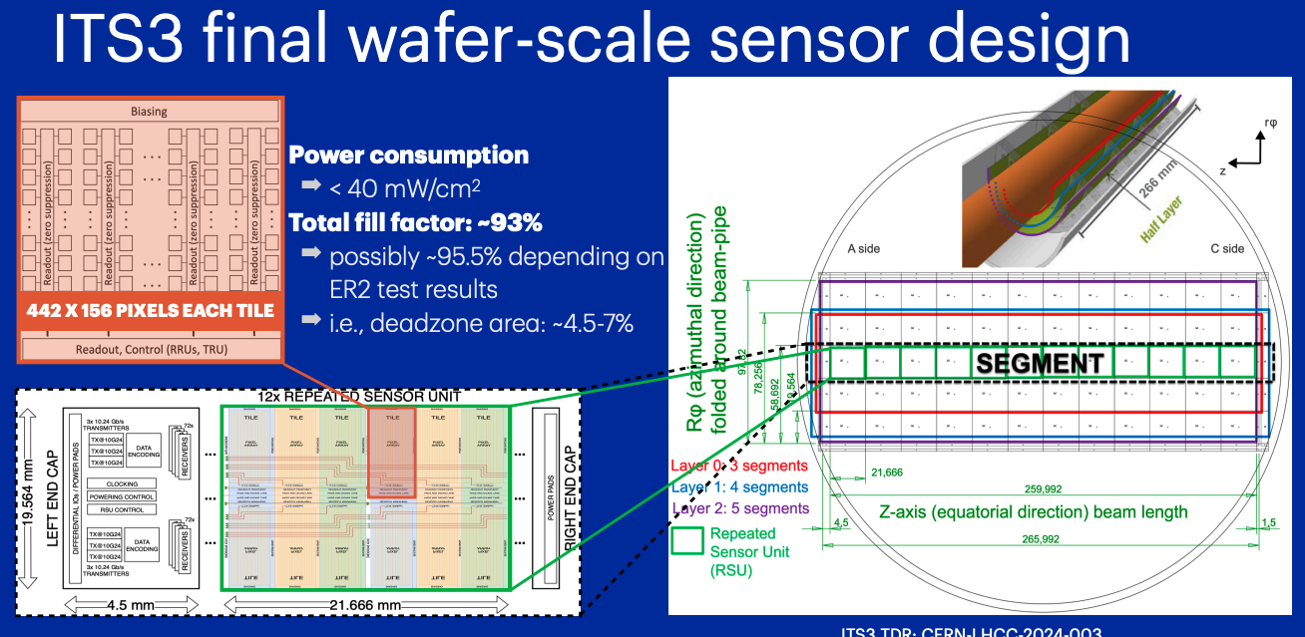
News from ICHEP2024: ALICE ITS3

Slide 3
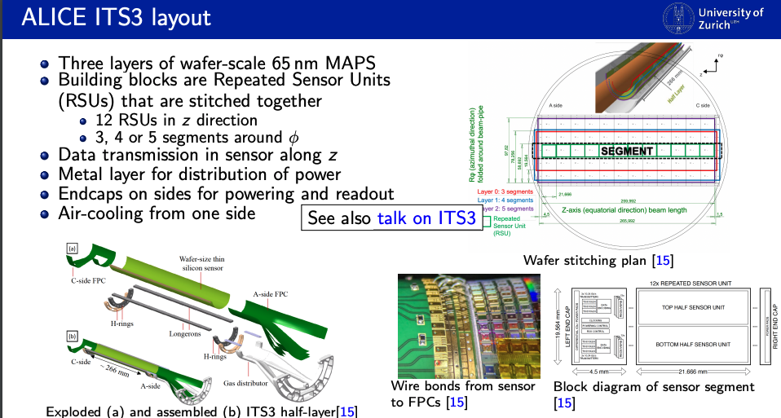
News from ICHEP2024: ALICE ITS3
df

Slide 4
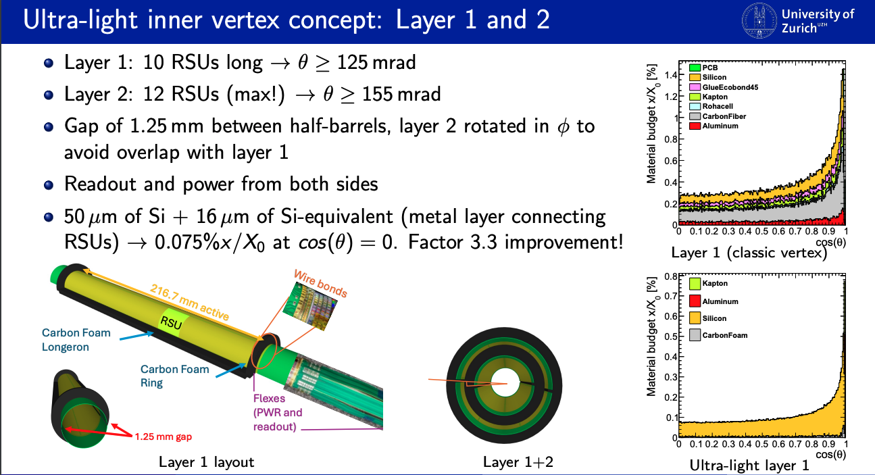
News from ICHEP2024:
df

Slide 5
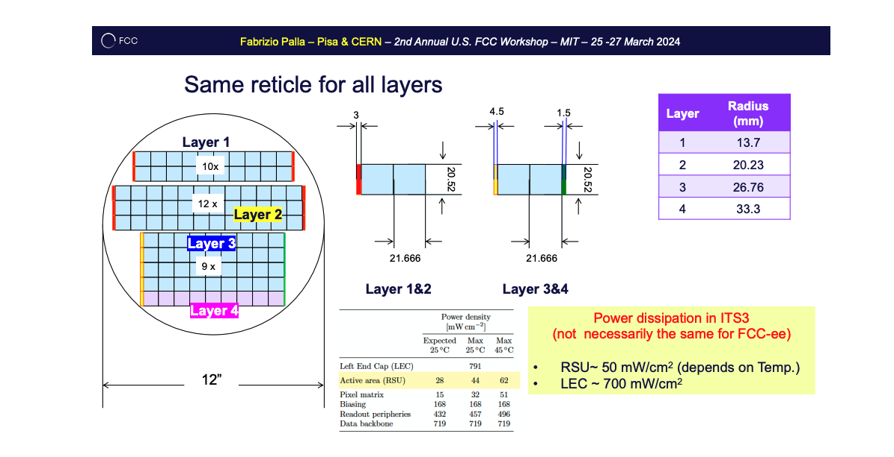
News from ICHEP2024:
df

Slide 6
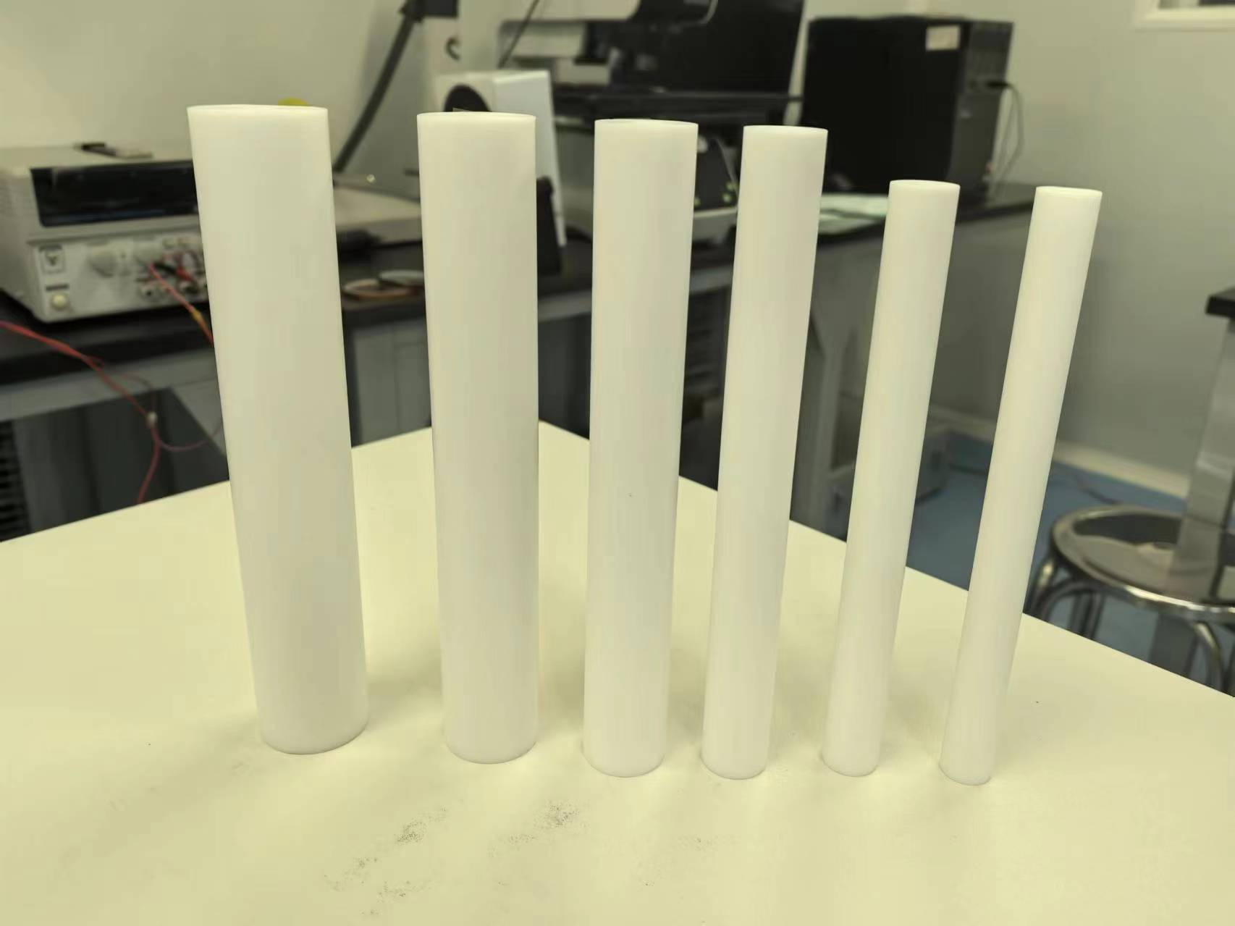
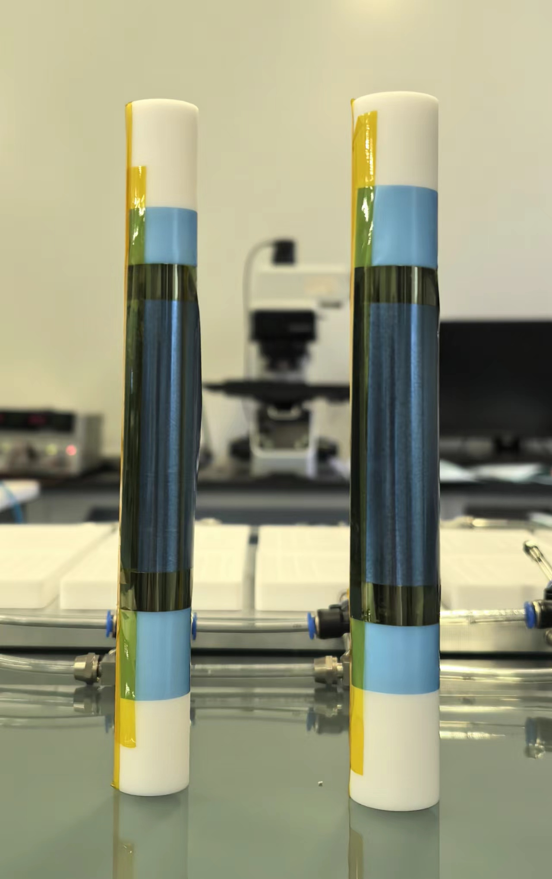
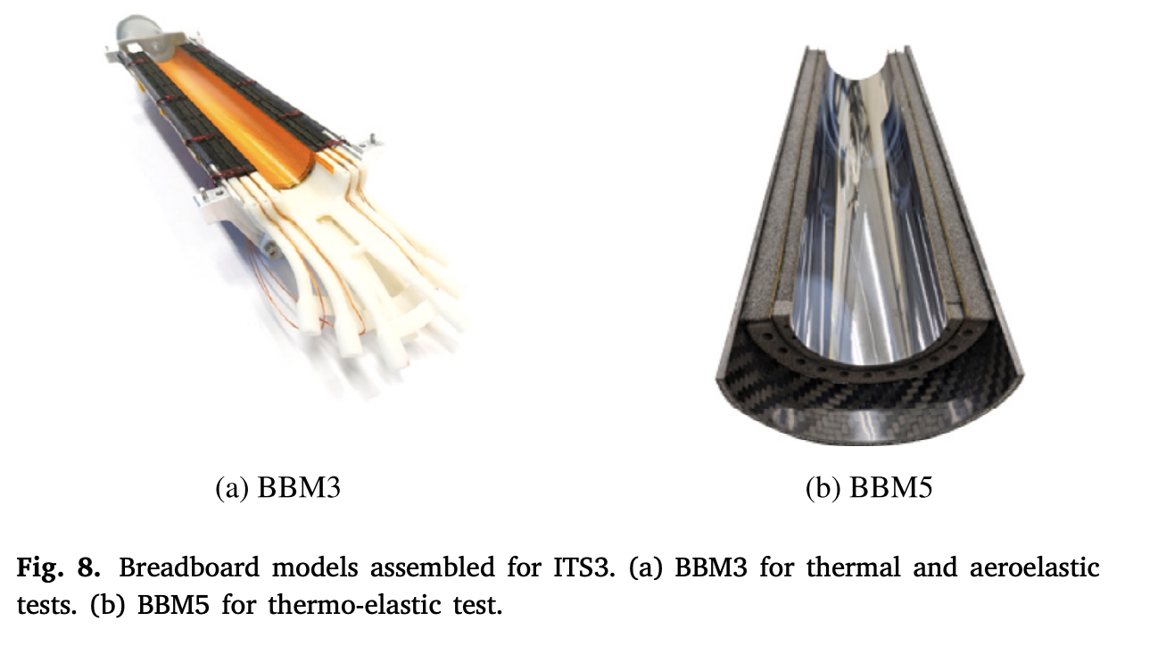
Switching to Stitching baseline:
Quick from Christine Guo
  Mechanics is very challenging, more prototyping study is needed
    CEPC vertex inner Radius 11mm → 30 um thick sensor ?
    ALICE ITS3 vertex inner Radius : 18mm → 40-50um thick sensors
  Major question last week TDR meeting:
    Curved silicon design can bent into R=11mm ?
      Mingyi is working on that, expect results in 2~3 weeks
    Would Curved silicon design with R=18mm good enough for CEPC ?
12 mm
14 mm

Slide 7
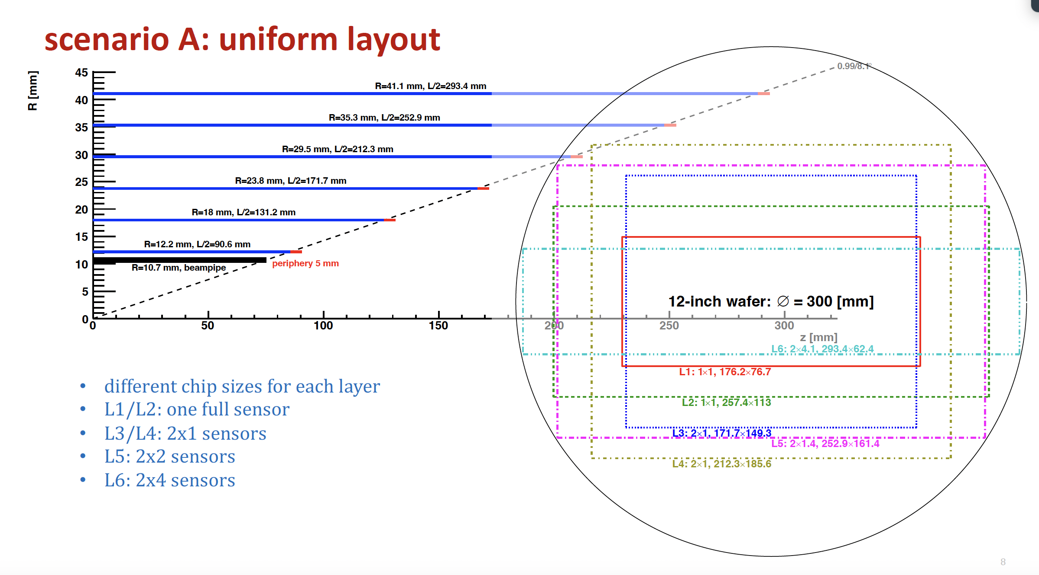

Slide 8
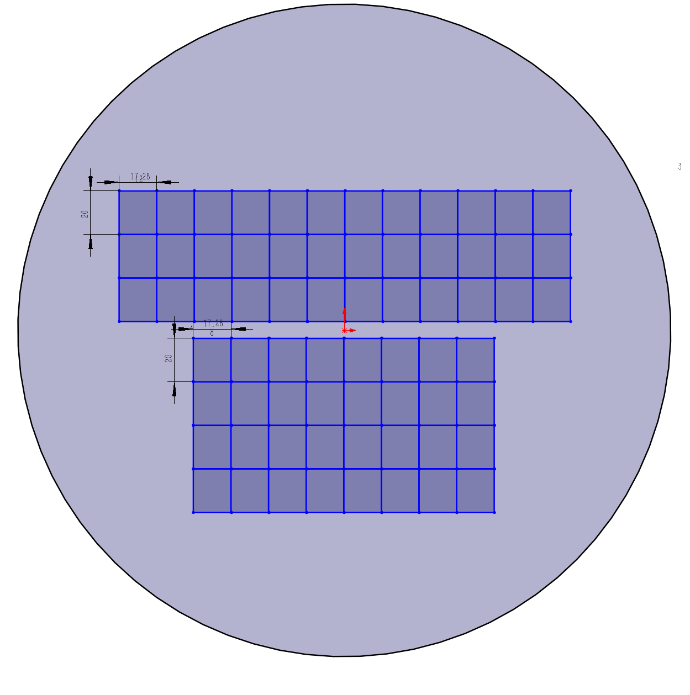
Layout optimization
R1=11mm, L1=160mm ;
  Single chip dimension: 17.278*20 mm (X=8, Y=2)
R2=16.5mm, L2=240mm ;
  X=6, Y=3
R3=22mm, L3= 320mm
  X=8, Y=4
R4= 27.5mm , L4 = 390
  Difficult to fit into one wafer ?

Slide 9
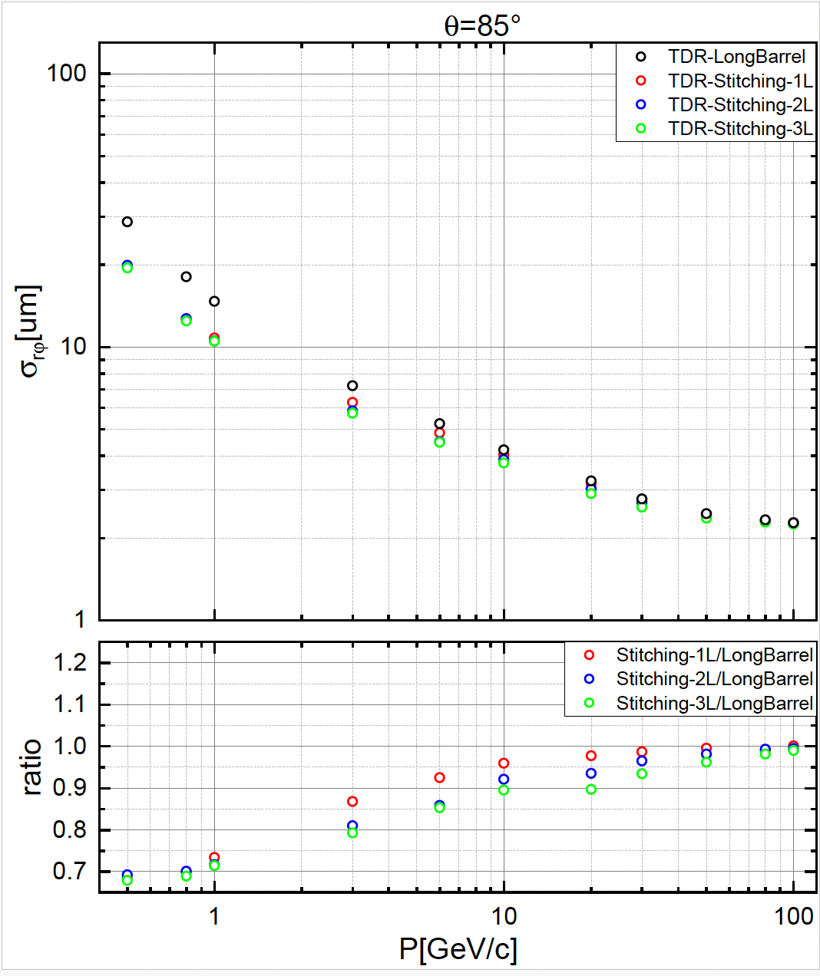
Outer layer : layer 5/ layer 6 needs stitching
No significance difference from stitching layout and ladder layout in for layer 5/6
Keep ladder layout for layer 5/6 ?

Slide 10
Backup

Slide 11
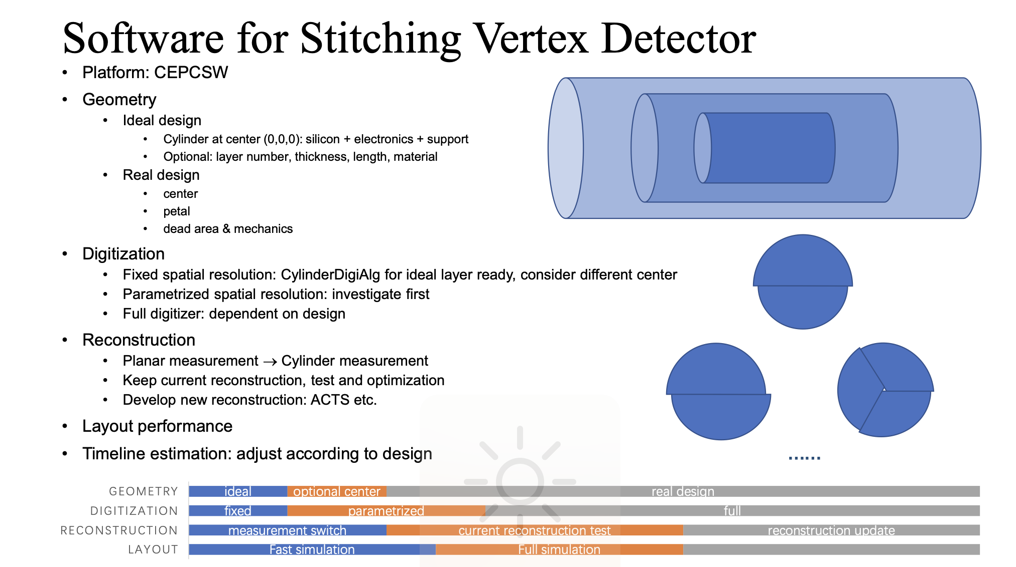
Stitching layout in CEPCSW
CEPCSW needs some development for stitching layout , need one month
Short-term Solution for stitching layout:
  Remove all the support material, only keep 50um silicon in ladder layout

Slide 12
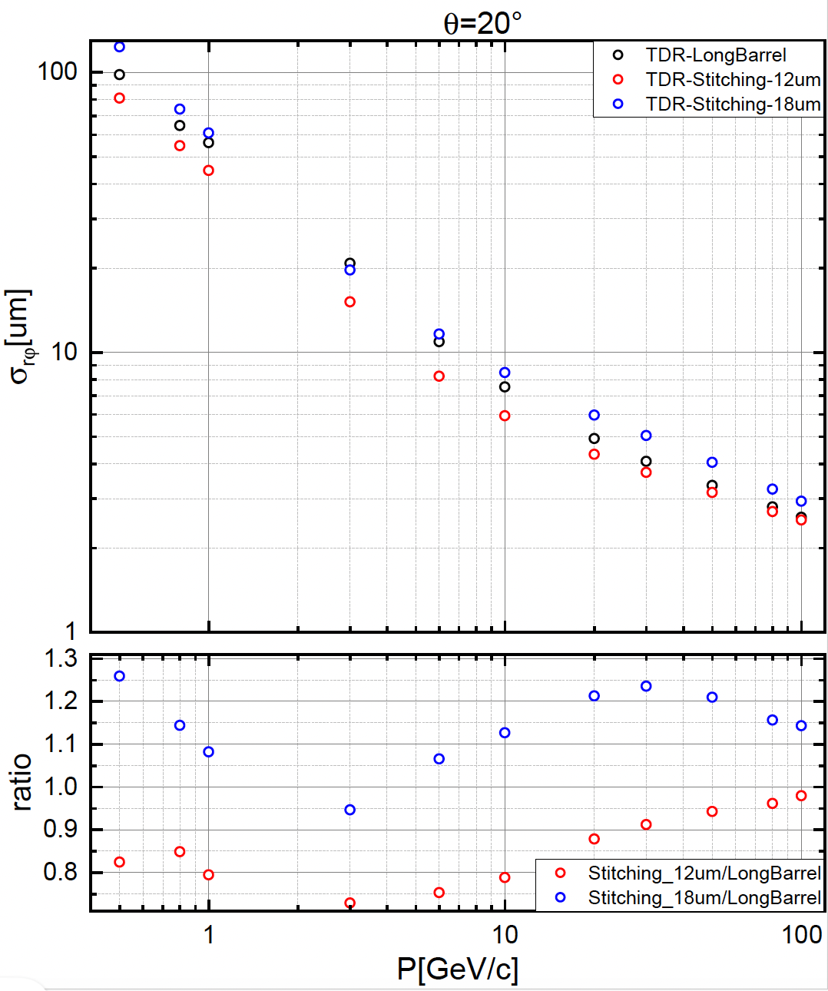
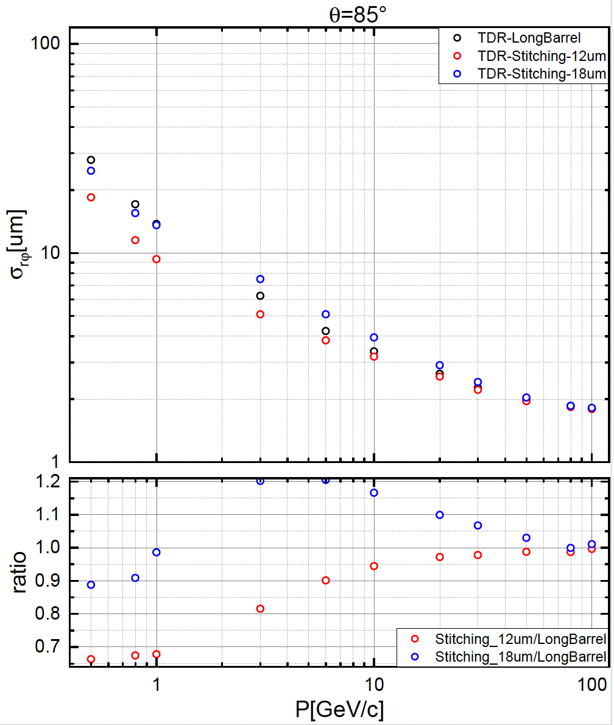
Stitching layer vs CMOS ladder design (CEPCSW)
Bent silicon with R= 12mm: improved 20-30% wrt ladder design (R=12mm)
Bent silicon with R= 18mm: 10-25% worse wrt ladder design in barrel (R=12mm)

Slide 13
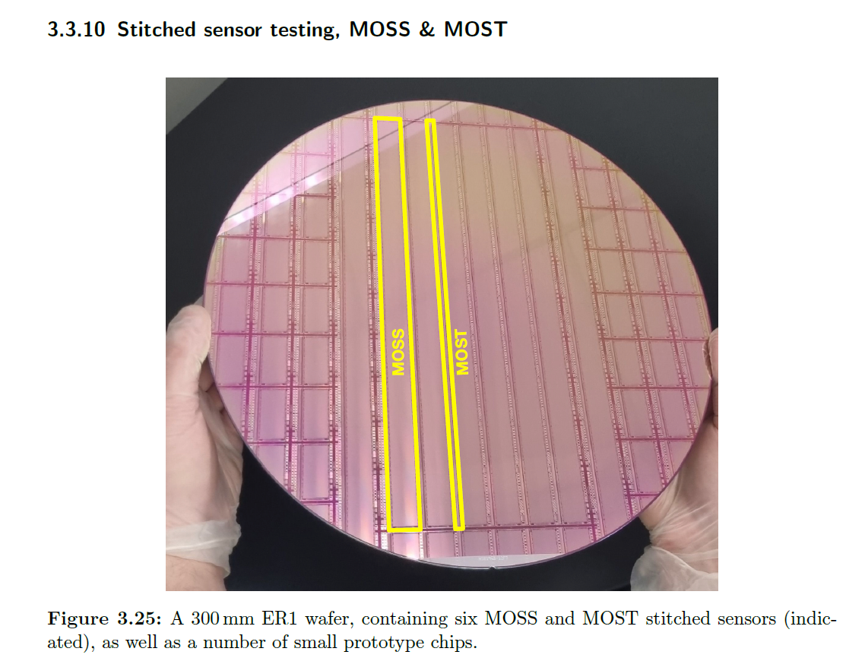
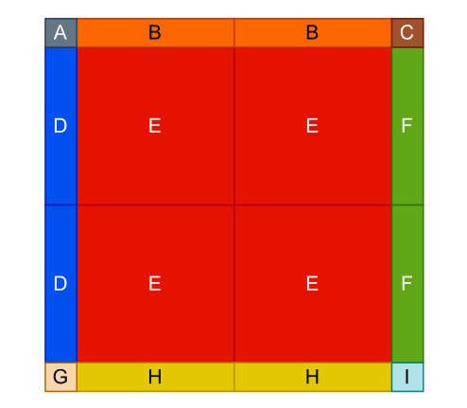
Electronics : stitching issue
Need to check the dead area , how large is this area?
  Worse case is 250um dead area (~1% dead region)
250um
250um
250um
100% sensitive area is too ideal & impossible
Stitching area is inevitable!
& can not be covered by the module at the same layer
= dead area have to exist (but normal chip can avoid)

Slide 14
backup

Slide 15
Preliminary outline for Vertex section @ referenece TDR
3. Vertex detector (Zhijun & Meng Wang)
a. Requirements (position and vertex) Zhijun , Manqi
b. Technology survey and our choices (both baseline & backup options), Zhijun & Meng
c. R&D efforts and results
→CMOS Stitching: Meng Wang
→ CMOS normal chip: Zhijun, Wei Wei, Yupeng
d. Detailed design including electronics, cooling and mechanics
→ Layout: Zhijun & Meng Wang
→ CMOS sensor design: Wei Wei，Ying Zhang, Yunpeng
→Cooling and mechanics: Jinyu Fu
e. Readout electronics & BEC
→Background estimation : Haoyu Shi
→ Data rate and readout scheme: Jun Hu, Wei Wei
f. Performance from simulation (impact parameters). Chengdong Fu

Slide 16
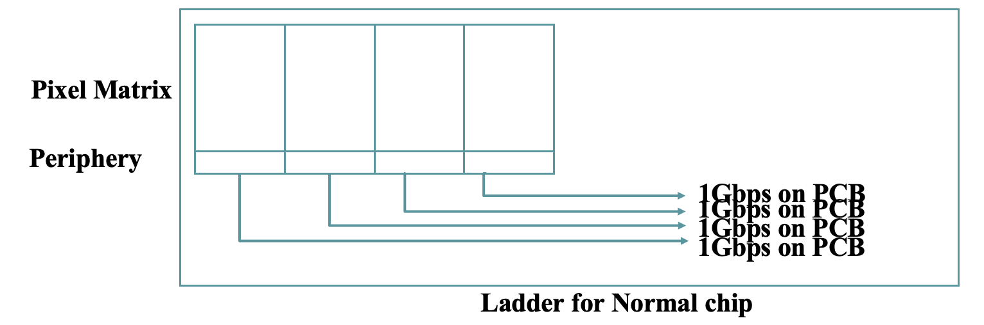
Electronics: data rate
Background and Data rate
  Meng Wang, Haoyu, Weiwei and I have some follow up discussion
  Haoyu will update with CEPCSW, need to compare with Fcc-ee
    Hit pattern per event, total number of hits per event
    Hit density per cm² per event

Slide 17
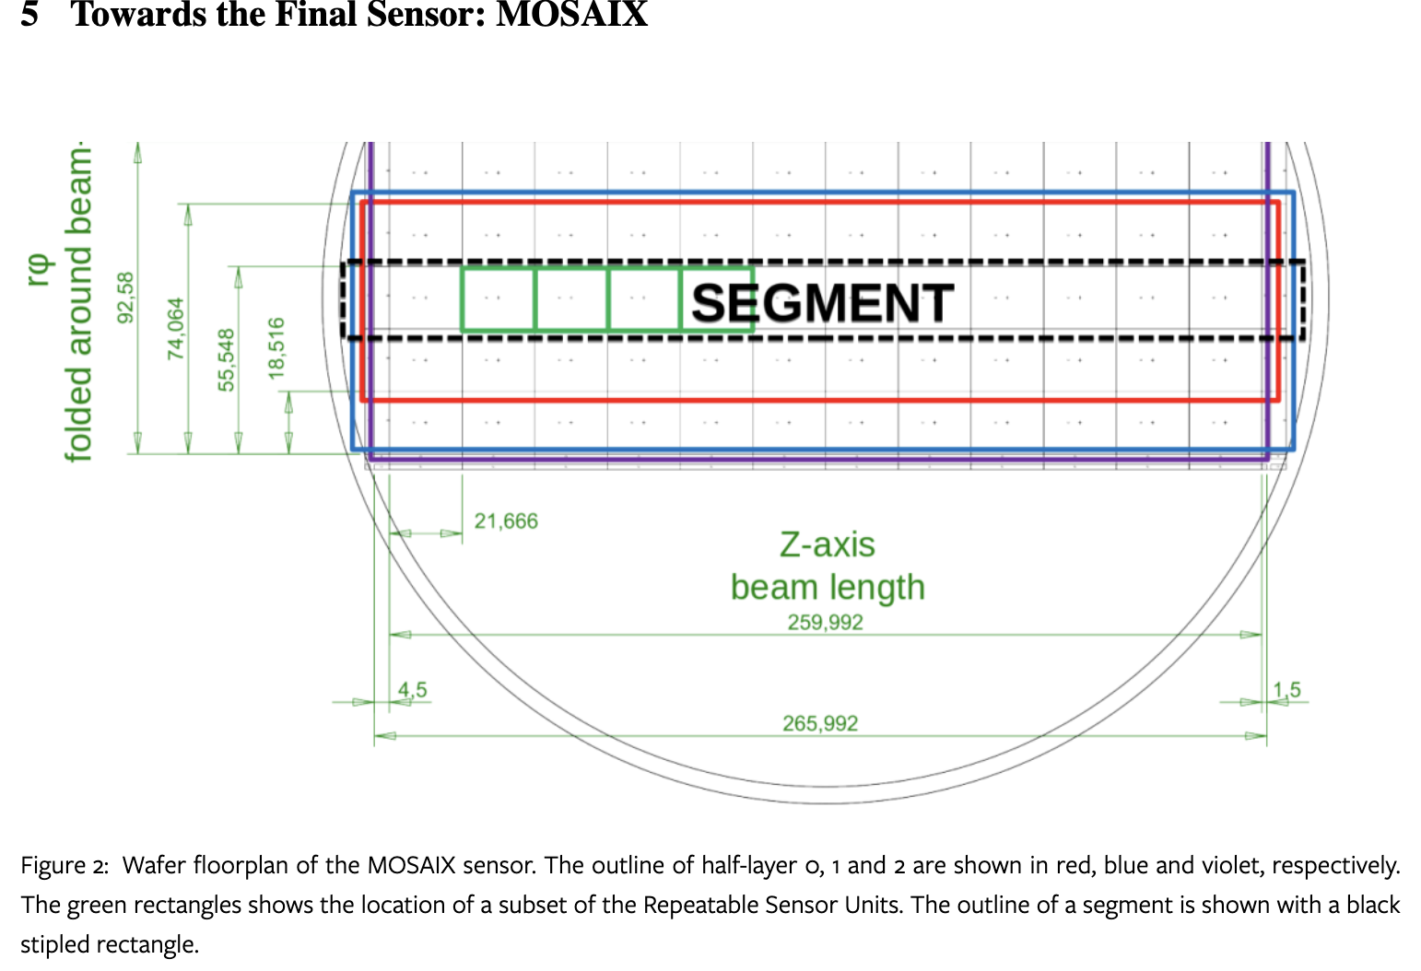
df

Slide 18
Draft agenda of Rehearsal and Formal Meeting with IDRC Chair
1. Rehearsal at 9am on July 27 (Sat.) at 多学科122
https://indico.ihep.ac.cn/event/22992/
2. Formal meeting with IDRC chair, at 9am on Aug. 7 (Wed.) at 多学科122
https://indico.ihep.ac.cn/event/22993/
Each talk has 20 mins + 10 mins discussion. Please prepare your talks in advance.

Slide 19
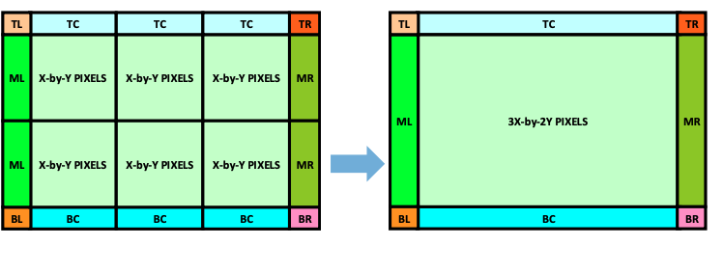
Preliminary thoughts
On chip & dimension
  NX+2Y scheme:
    Challenging but DO-able
    Inner layer VTX, a half layer: total data rate 10Gbps at one end on one “chip”
    Actually no fundamental change of chip, but save the mechanical
  NX+MY (M>2) scheme:
    Too ideal ☹ ☹ ☹
    Data transmission, power distribution, timing… all with big issues
    But maybe possible for outer-most layer – data rate greatly decreased
On mechanical
  Overall mechanical is easier than the normal scheme
  But dead area seems inevitable on the same layer and not small
Rough estimation
  Innermost layer: NX+2Y of (1024row*512col) can be bent to be a semi-circle

Slide 20
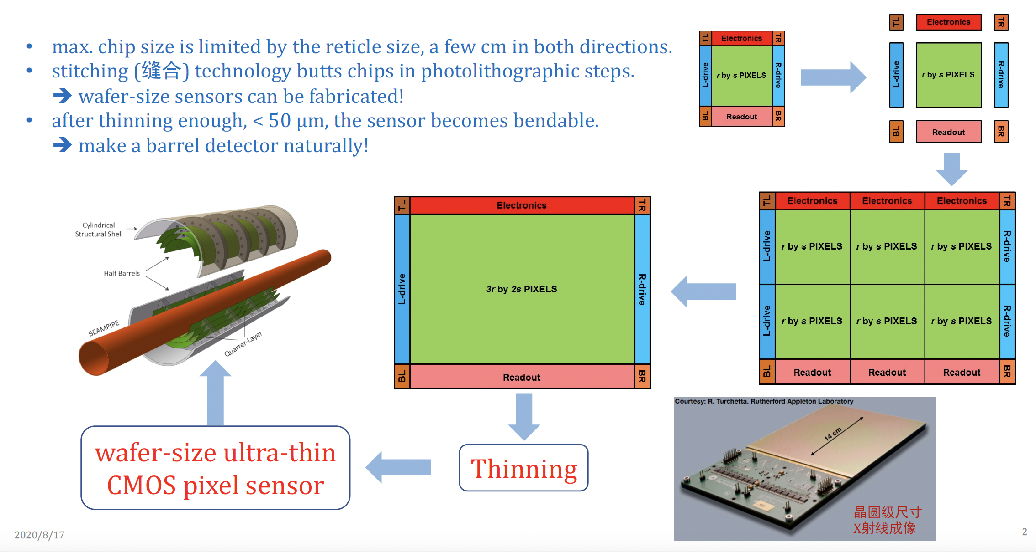
What is stitching? (from Meng Wang)
df

Slide 21
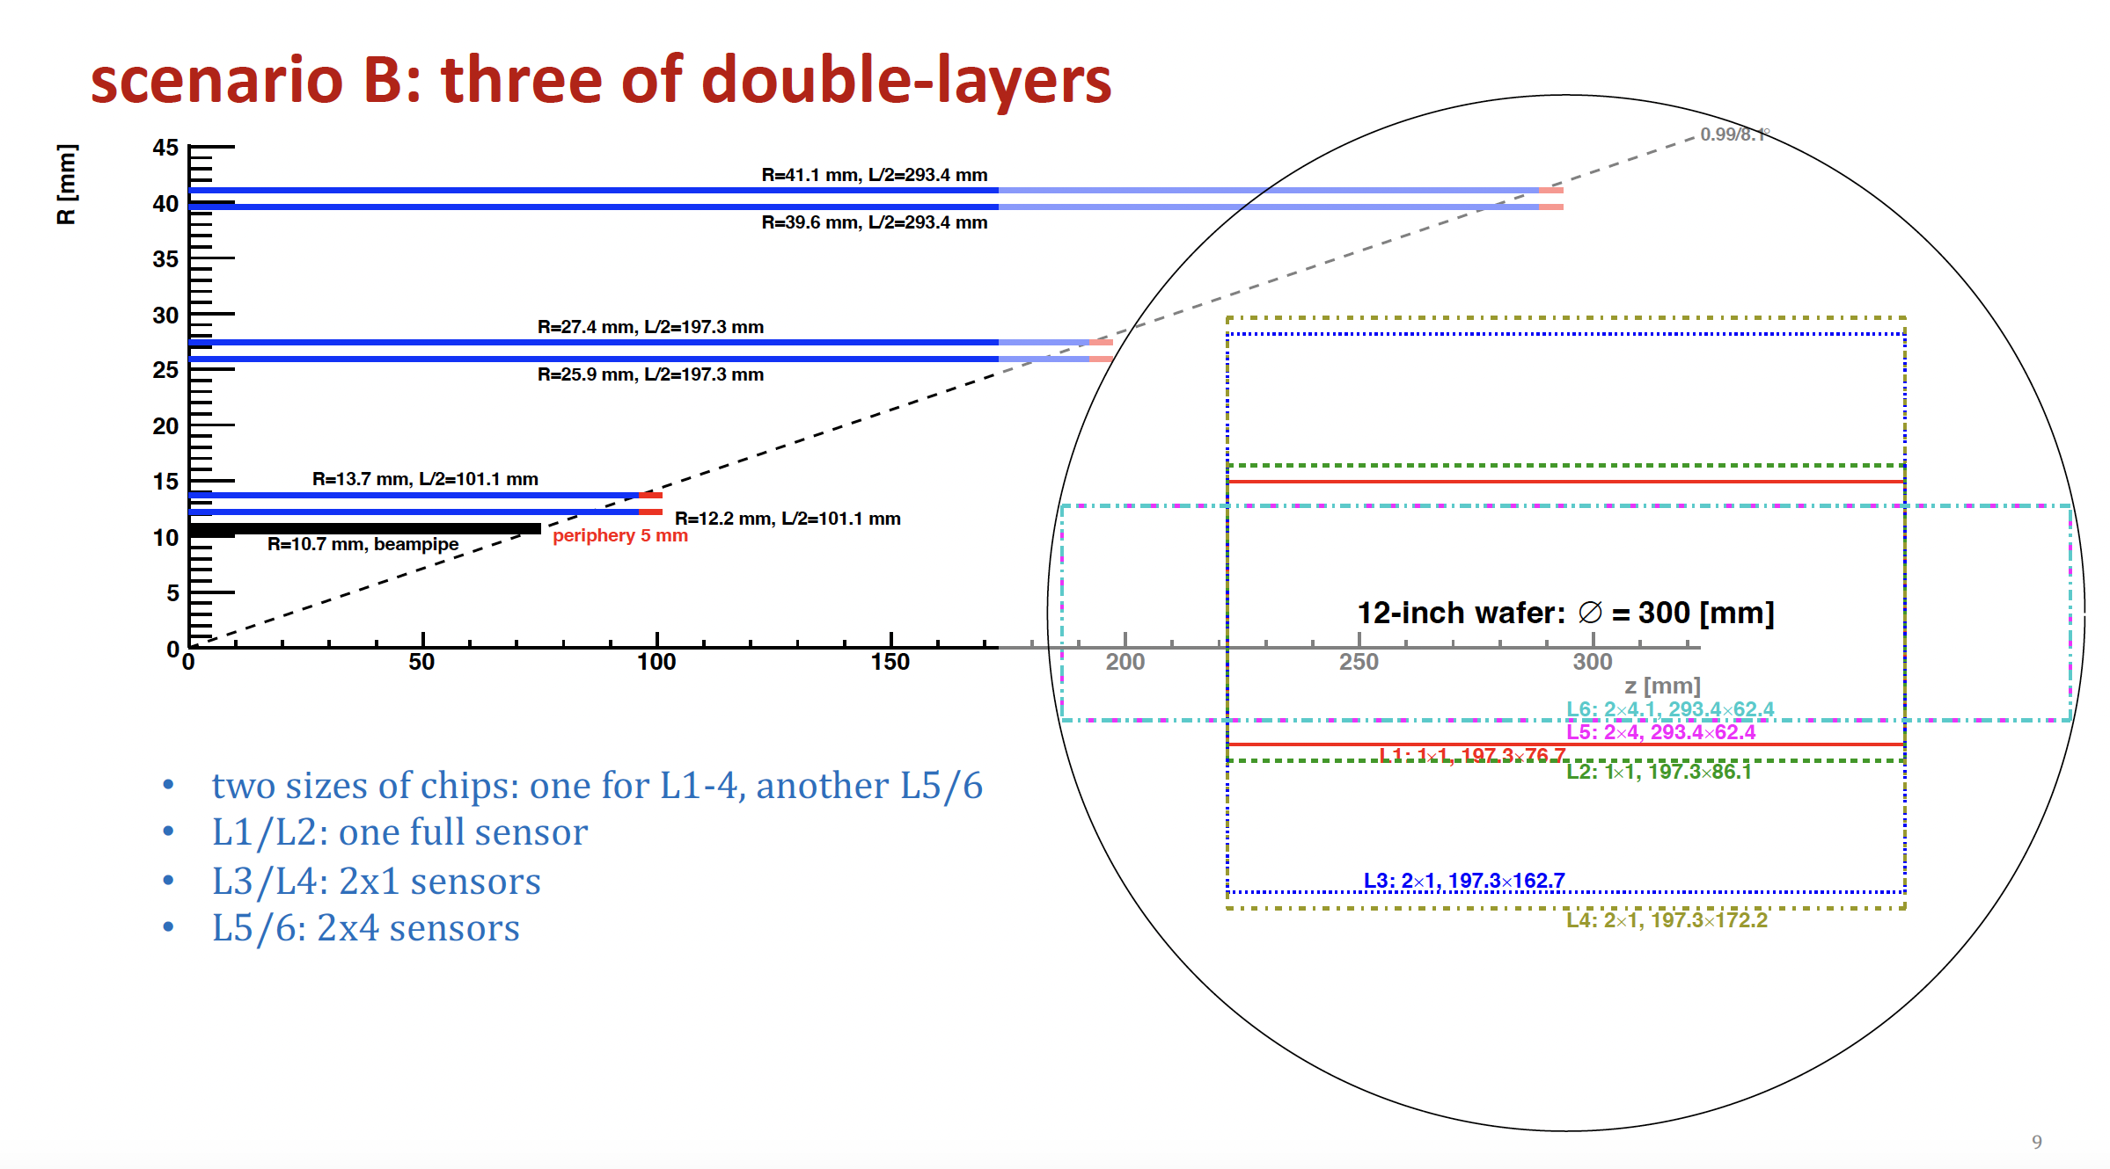
Top focus on stitching
Inner layer : background , data rate, power consumption
Middle layer and outter layer:
  refine stitching proposal and estimate yield, power consumption

Slide 23
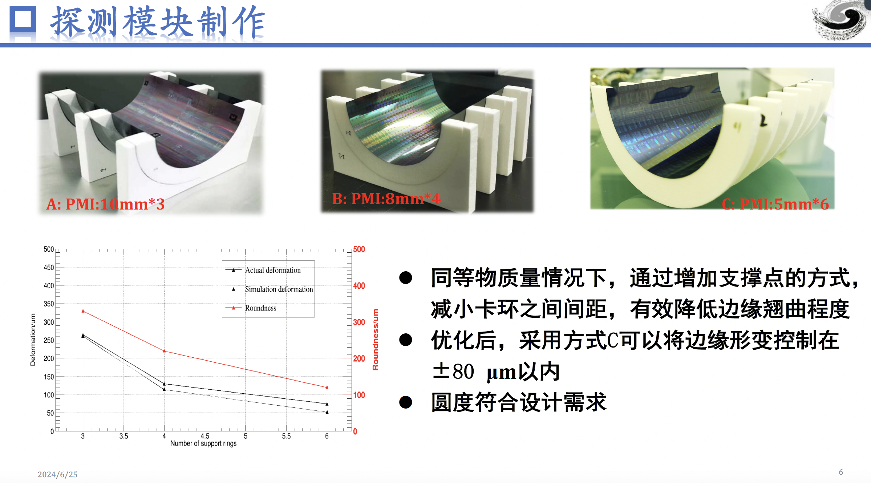

Slide 24
Data rate estimation of CEPC VTX
 |  | Hit density (Hits/cm²/BX) | Bunch spacing (ns) | Hit rate (M Hits/cm²) | Hit Pix rate (M Px/cm²) | Hit rate/chip (MHz) | Data rate@triggerless (Gbps) | Pixel/bunch | FIFO Depth @3us rg latency | Data rate@trigger (Mbps)
CDR | Higgs | 2.4 | 680 | 3.53 | 10.59 | 34.62 | 1.1 | 23.5 | 103.9 | 105.28
 | W | 2.3 | 210 | 10.95 | 32.86 | 107.44 | 3.4 | 22.6 | 322.3 | 101.248
 | Z | 0.25 | 25 | 10 | 30 | 98.1 | 3.1 | 2.4 | 294.3 | 53.76
TDR | Higgs | 0.81 | 591 | 1.37 | 4.11 | 13.44 | 0.43 | 7.96 | 40.4 | 213.9？
 | W | 0.81 | 257 | 3.16 | 9.45 | 30.90 | 0.98 | 7.96 | 92.8 | 213.9？
 | Z | 0.45 | 23 | 19.6 | 58.7 | 191.9 | 5.9 | 4.4 | 575 | 118
TDR raw hit density: Higgs 0.54，Z 0.3; Safety factor: TDR 1.5, CDR 10;
Cluster size: 3pixels/hit (@Twjz 180nm, EPI 18~25um)
Area: 1.28cm*2.56cm=3.27cm² (@pixel size 25um*25um)
Word length: 32bit/event (@Taichu’s scale, 512*1024 array)
Trigger rate：20kHz@CDR，120kHz@TDR estimated
  Trigger latency: 3us(very likely not enough), Error window: 7 bins
  FIFO depth: @3us * hit rate/chip
  Data rate=pixel/bunch*trigger rate*32bit*error window
Assume data rate @1Gbps per chip for low lumi Z (20% of high lumi Z)
for triggerless

Slide 25
Issue of stitching for large pixel matrix
Pixel Matrix
Periphery
1Gbps on PCB
1Gbps on PCB
1Gbps on PCB
1Gbps on PCB
Ladder for Normal chip
Normal chip
Transmission:
  Each chip has a dedicated data transmission path for 1Gbps
  The transmission path is on PCB (ideal transmission line, high signal quality)
Buffering:
  On Periphery (on chip), for high hit rate

Slide 26
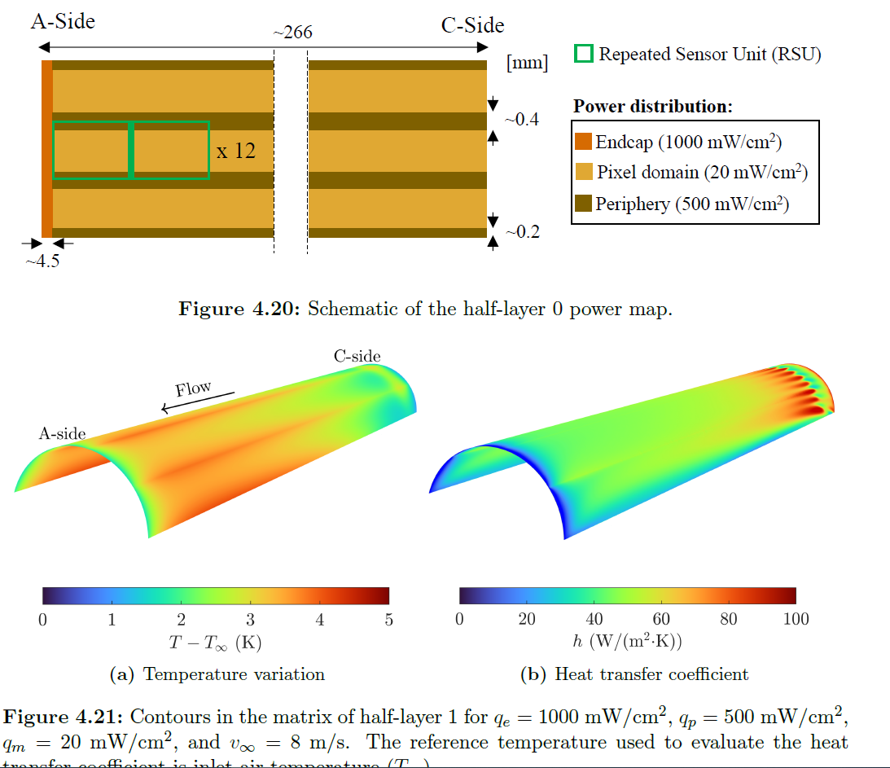
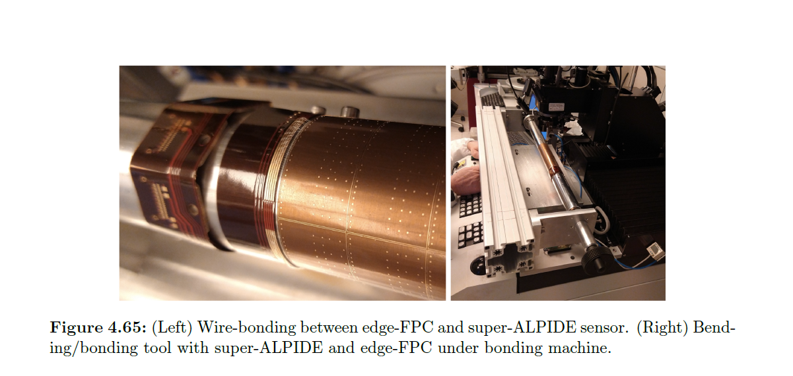
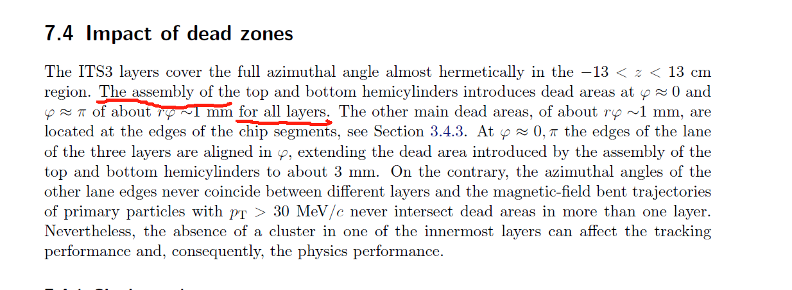
Issues of the dead area

Slide 27
Preliminary outline for Vertex section @ referenece TDR
3. Vertex detector (Zhijun & Meng Wang)
a. Requirements (position and vertex) Zhijun , Manqi
b. Technology survey and our choices (both baseline & backup options), Zhijun & Meng
c. R&D efforts and results
→CMOS Stitching: Meng Wang
→ CMOS normal chip: Zhijun, Wei Wei, Yupeng
→ SOI: YunPeng
d. Detailed design including electronics, cooling and mechanics
→ Layout: Zhijun & Meng Wang
→ CMOS sensor design: Wei Wei，Ying Zhang, Yunpeng
→Cooling and mechanics: Jinyu Fu
e. Readout electronics & BEC
→Background estimation : Haoyu Shi
→ Data rate and readout scheme: Jun Hu, Wei Wei
f. Performance from simulation (impact parameters). Chengdong Fu

Slide 28
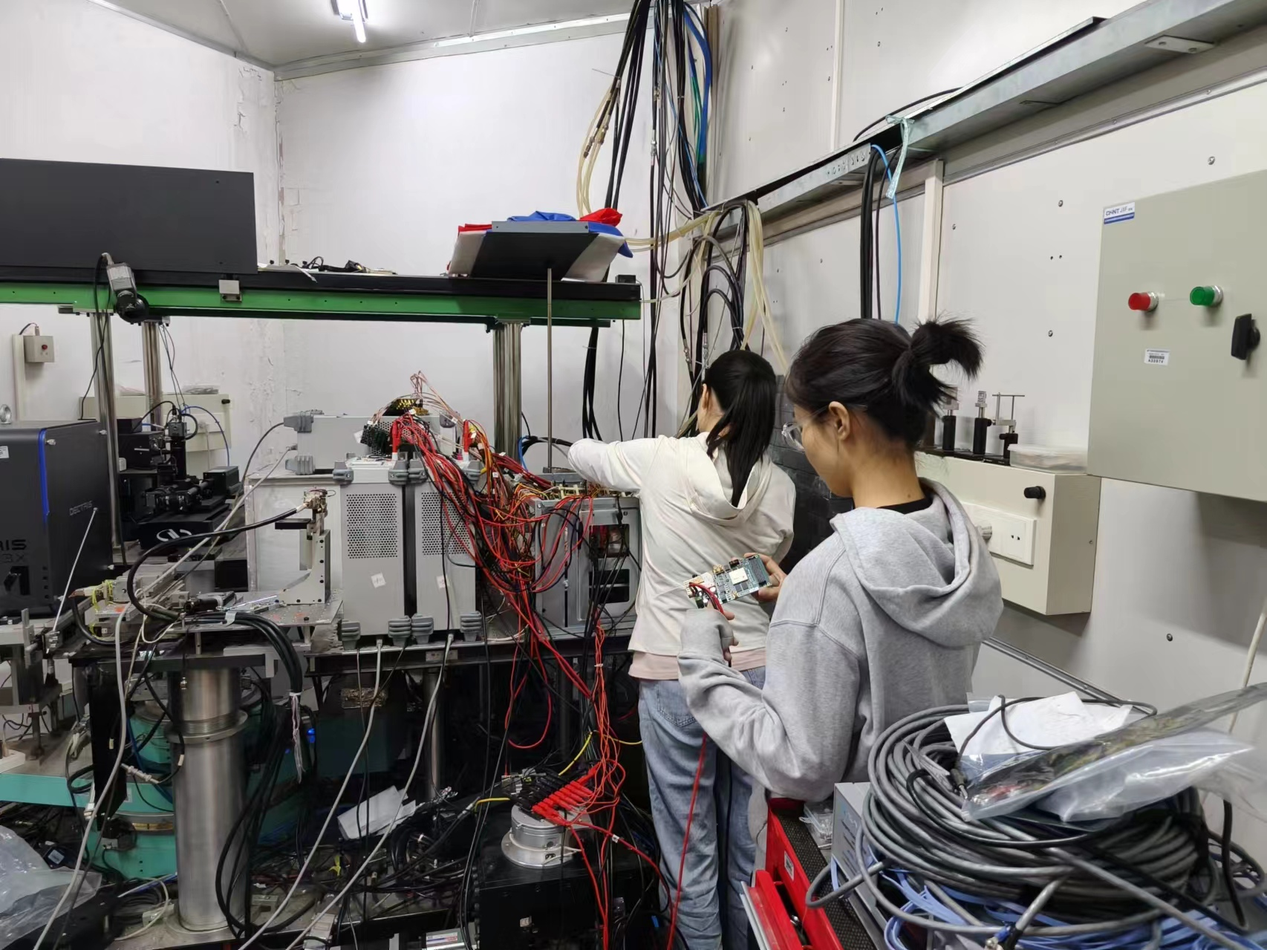
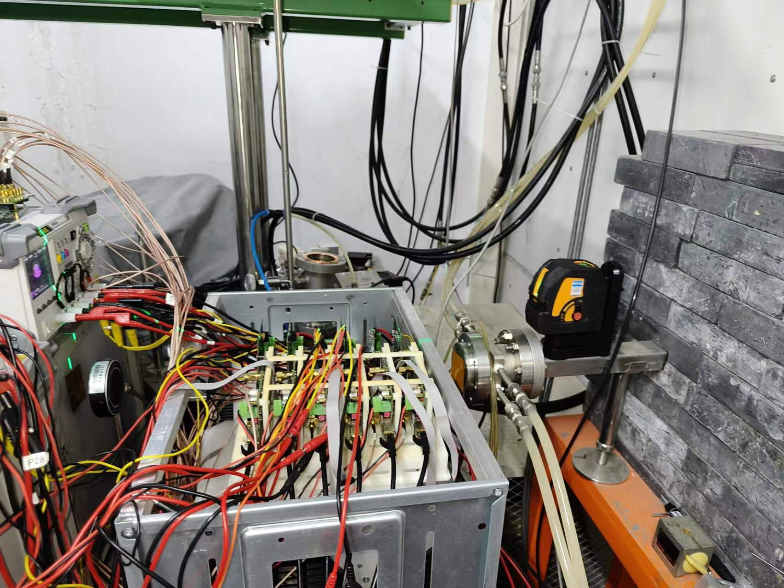
Testbeam in BSRF for vertex sensor digitization model
Testbeam in BSRF from June 1st to July 1st
Try to test different incident angle from 8° - 90°
  In last test beam at DESY, incident angle is about 70-90°
  Cluster size, efficiency vs incident angle

Slide 29
News about TJ65nm CMOS design
Got design Kit for TJ 65nm technology. (Ying Zhang, Wei wei)
  Pixel cell dimension study
  Power consumption
Problem
  Design kit was N type low resistivity wafer
  → should be p type high resistivity Epi wafer

Slide 30
Issue of stitching for large pixel matrix
Periphery
Periphery
Pixel Matrix
Pixel Matrix
Pixel Matrix
???
Pixel Matrix
Periphery
Pixel Matrix
Periphery
NX+2Y: still have Periphery region, for buffering & data transmission, almost the same as the normal chip scheme
NX+MY: the inner Pixel Matrix with no support of buffering & data link, can only go through others. Data rate accumulation effect reveals

Slide 31
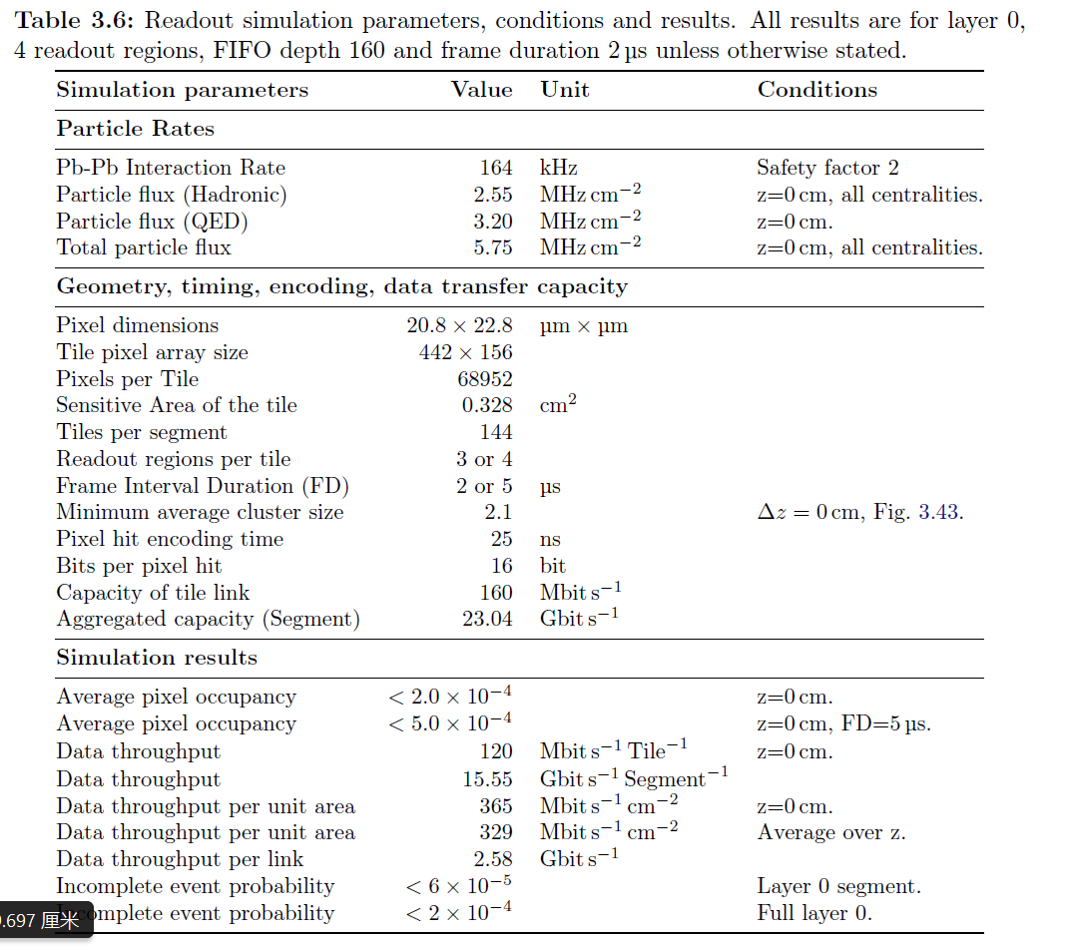
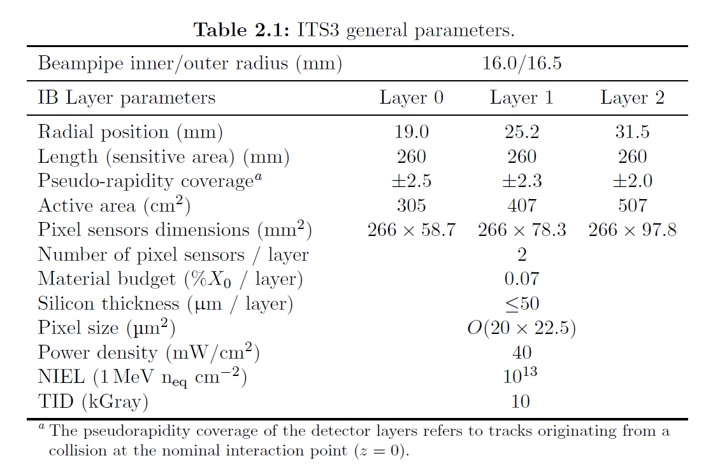
ALPIDE parameters
From CERN-LHCC-2024-003/ALICE-TDR-021：Technical Design Report for the ALICE Inner Tracking System 3 - ITS3 A bent wafer-scale monolithic pixel detector

Slide 32
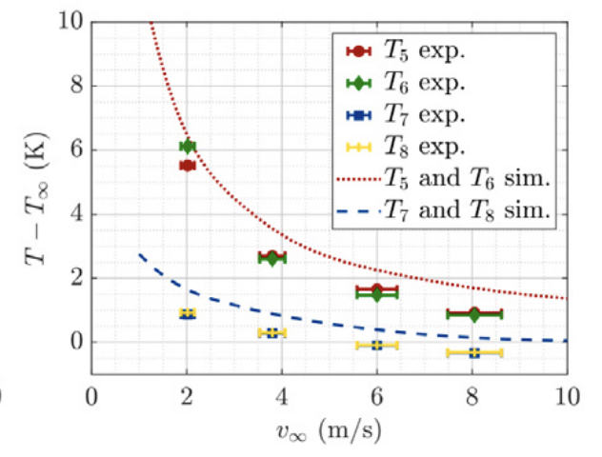
Switching to Stitching baseline:
Quick from Christine Guo
  Mechanics is very challenging, more prototyping study is needed
    CEPC vertex inner Radius 11mm → 30 um thick sensor ?
    ALICE ITS3 vertex inner Radius : 18mm → 40-50um thick sensors
  Power consumption and cooling is key issue
    ITS3 7mW/cm²
    If Temperature difference is too large >5C, sensor is likely to crack
Temperature difference in ITS3

