Slide 1
Development of a vertex detector prototype for the CEPC
Zhijun Liang
(On behalf of the CEPC physics and detector group)
Institute of High energy physics, CAS
42nd International Conference on High Energy Physics
Prague, July 17–24, 2024

Slide 2
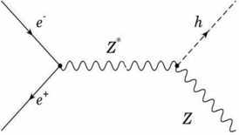
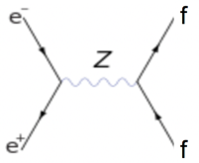
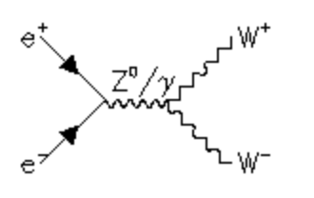
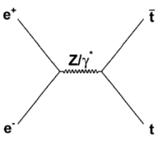
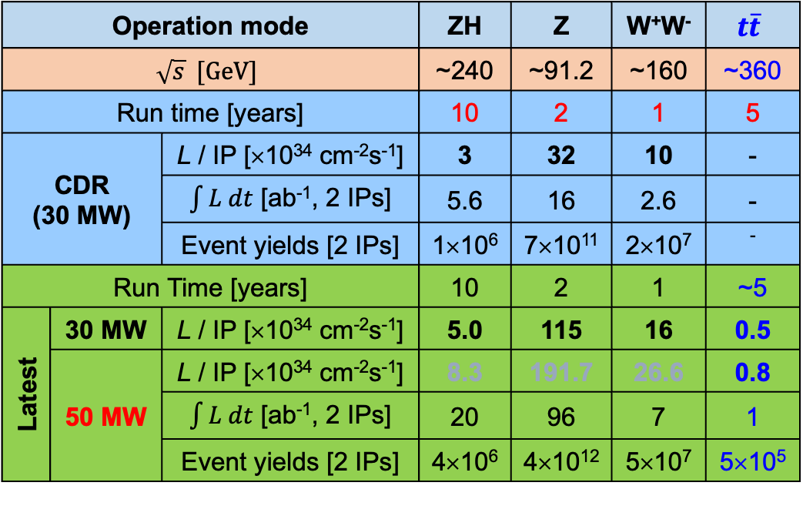
CEPC physics program
An extremely versatile machine with a broad spectrum of physics opportunities
→ Far beyond a Higgs factory
Operation mode |  |  | ZH | Z | W⁺W⁻ | $$t\overline{t}$$
$$\sqrt{s} [GeV]$$ |  |  | ~240 | ~91.2 | ~160 | ~360
Run time [years] |  |  | 10 | 2 | 1 | 5
CDR (30 MW) |  | L / IP [×10³⁴ cm⁻²s⁻¹] | 3 | 32 | 10 | -
 |  | $\int{L dt}$ [ab⁻¹, 2 IPs] | 5.6 | 16 | 2.6 | -
 |  | Event yields [2 IPs] | 1×10⁶ | 7×10¹¹ | 2×10⁷ | ⁻
Run Time [years] |  |  | 10 | 2 | 1 | ~5
Latest | 30 MW | L / IP [×10³⁴ cm⁻²s⁻¹] | 5.0 | 115 | 16 | 0.5
 | 50 MW | L / IP [×10³⁴ cm⁻²s⁻¹] | 8.3 | 191.7 | 26.6 | 0.8
 |  | $\int{L dt}$ [ab⁻¹, 2 IPs] | 20 | 96 | 7 | 1
 |  | Event yields [2 IPs] | 4×10⁶ | 4×10¹² | 5×10⁷ | 5×10⁵
Huge measurement potential for precision tests of SM: Higgs, electroweak physics, flavor physics, QCD/Top
Searching for exotic or rare decays of H, Z, B and 𝜏, and new physics
CEPC community joined ECFA Phy focus
Both 50 MW and $t\overline{t}$ modes are currently considered as CEPC upgrades.

Slide 3
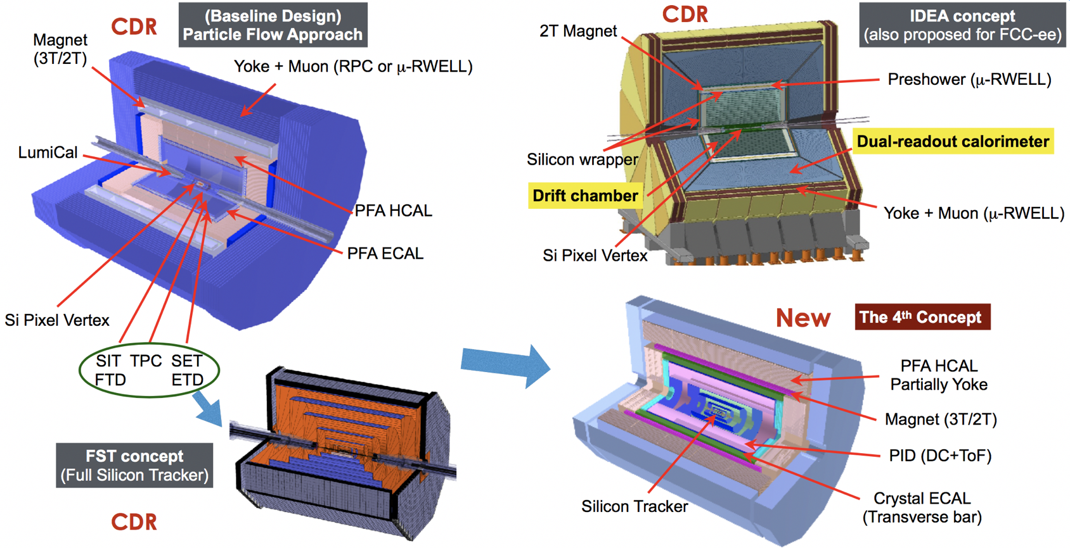
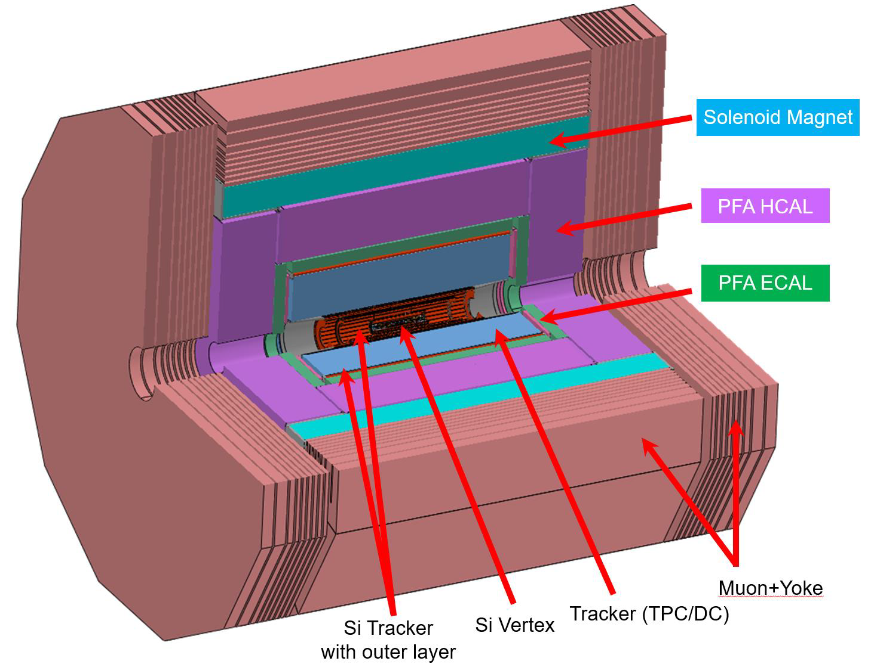
CEPC Detector Conceptual Designs
The 4th Detector Concept

Slide 4
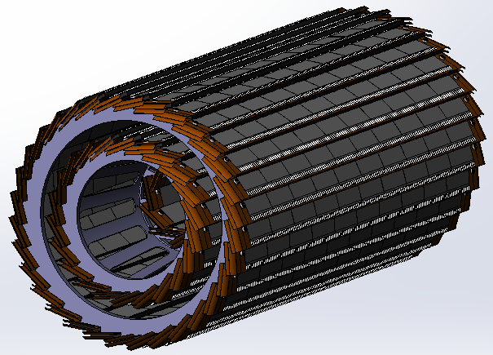
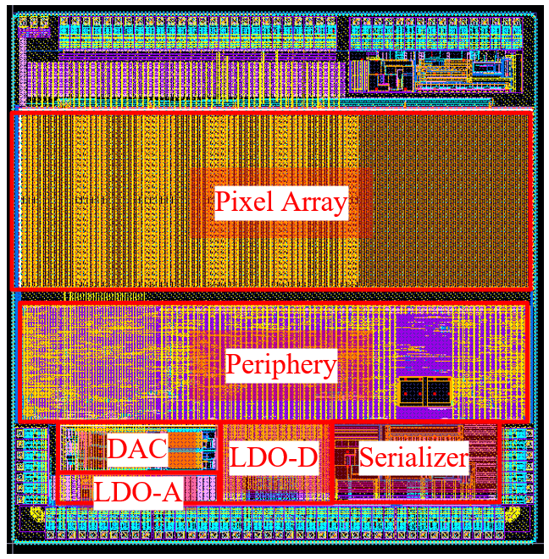
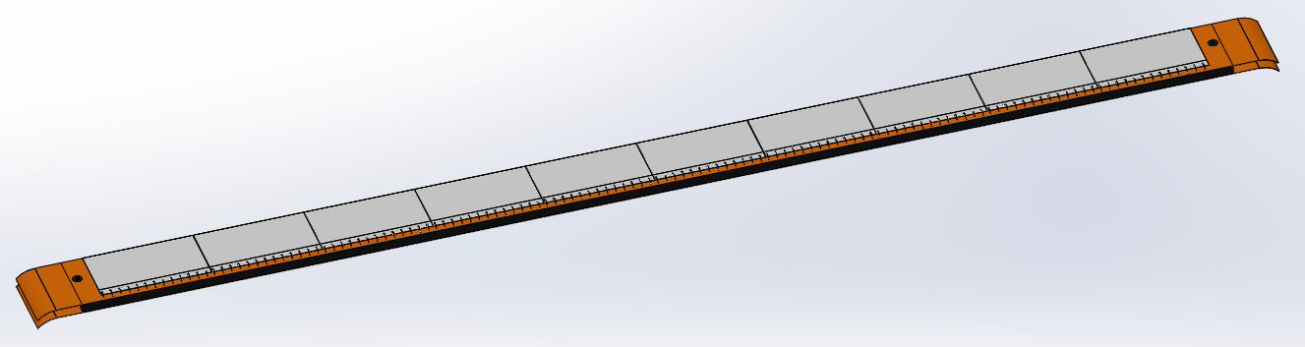

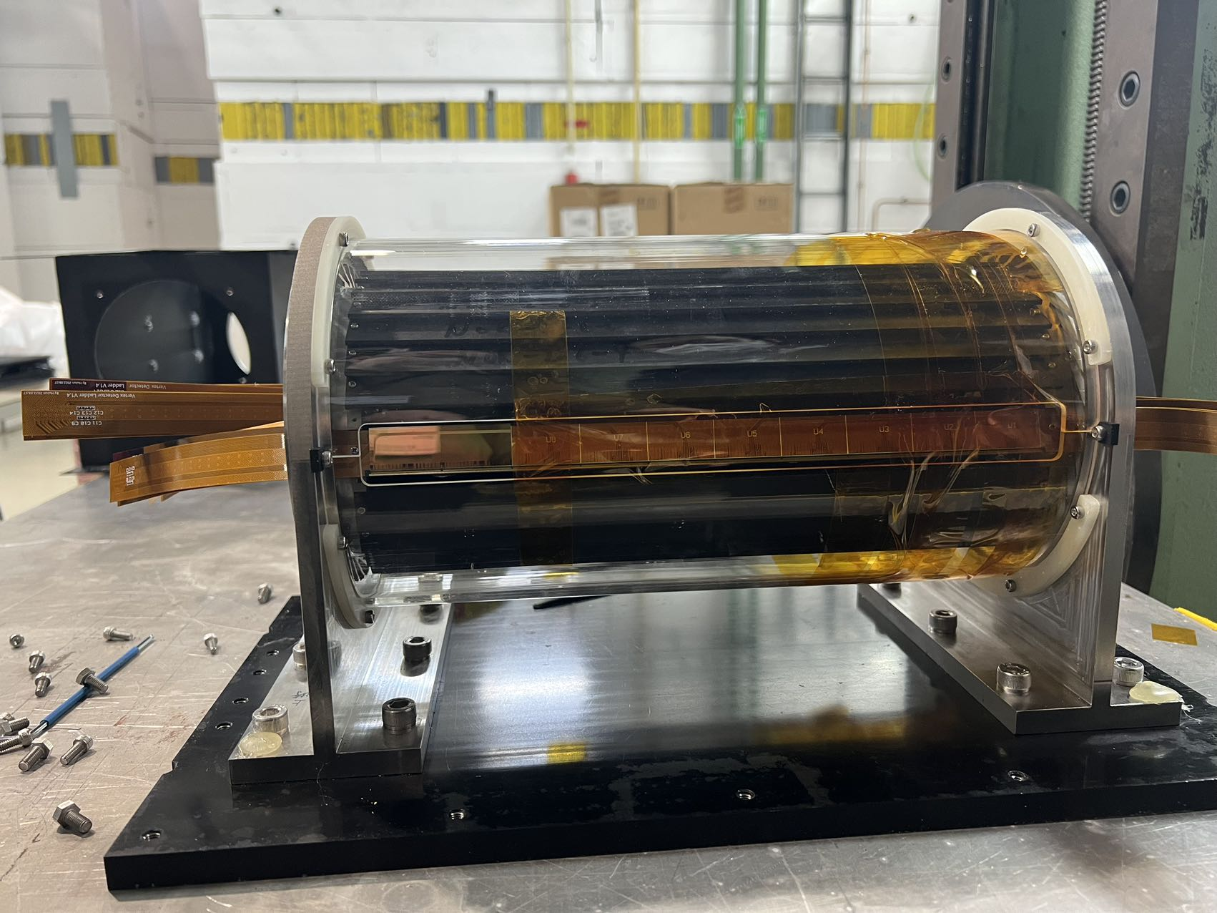
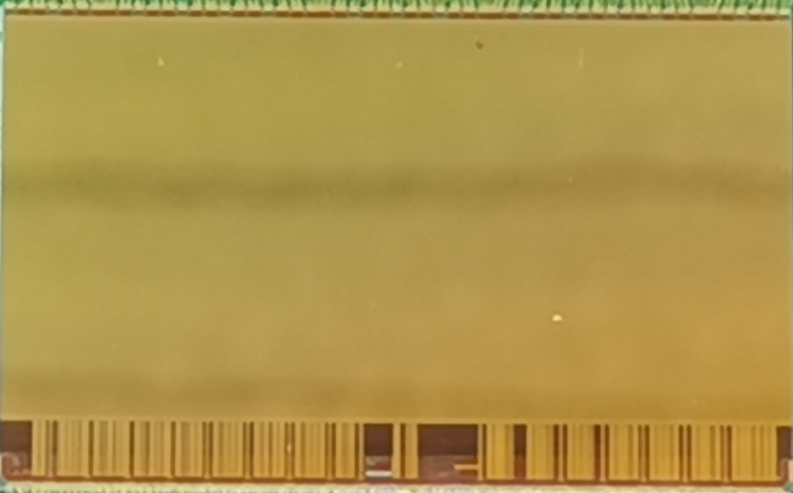
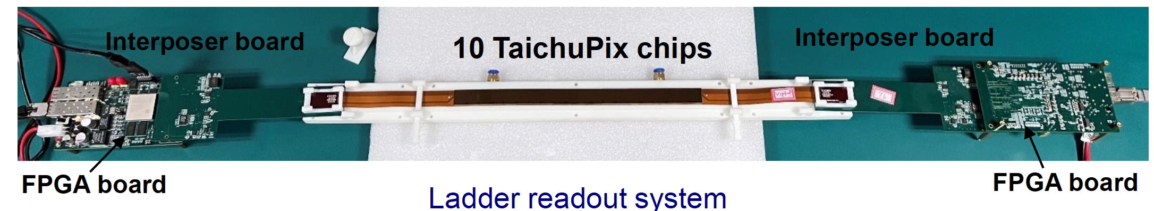
Overview of CEPC vertex detector prototype R & D
CMOS Sensor chip development
Vertex detector prototype
Detector module
(Ladder) Prototyping

Slide 5
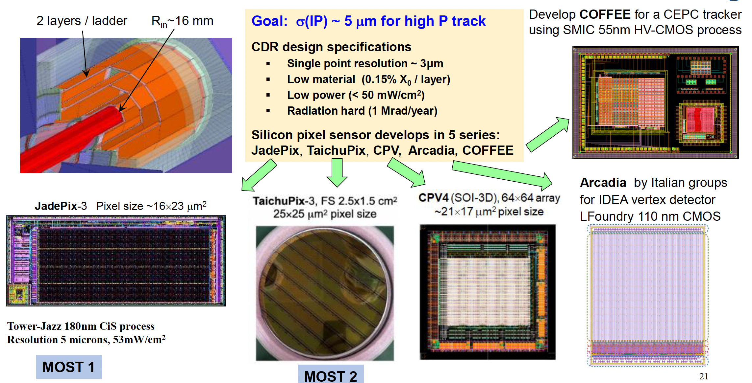
Silicon Pixel Chips for Vertex Detector

Slide 6
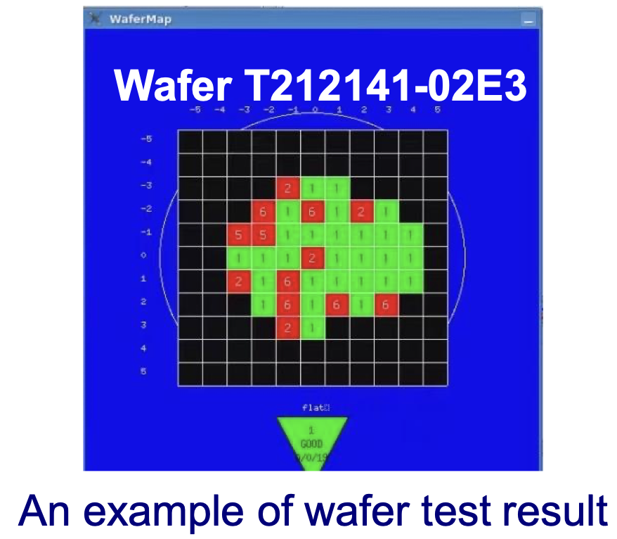
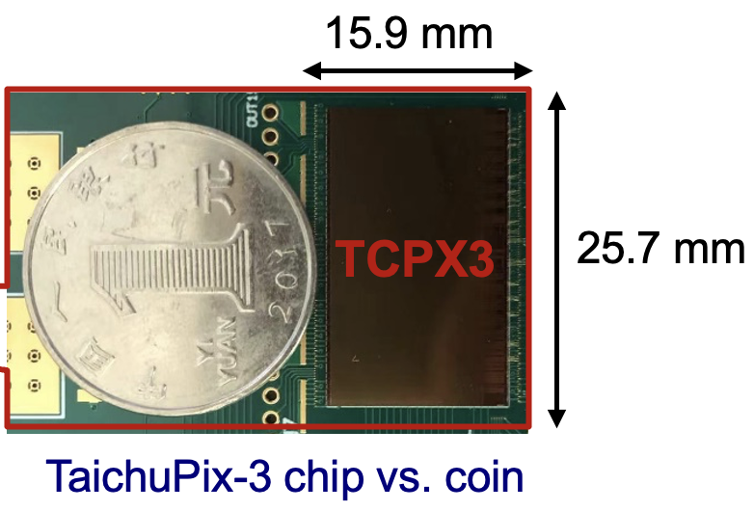
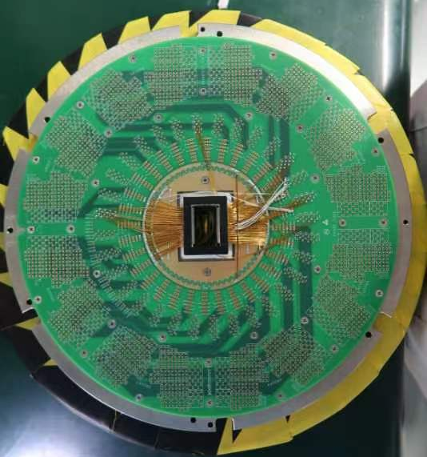
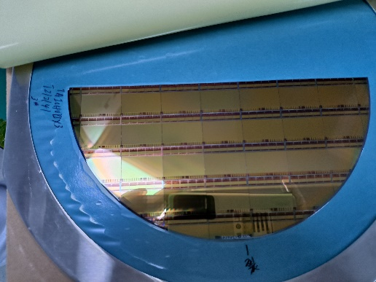
Full-size TaichuPix3 (engineering run)
Developed the first full-size CMOS pixel sensor
  Full size 1024×512 Pixel array, Chip Size：15.9×25.7mm
    25μm×25μm pixel size → high spatial resolution
    Process: Towerjazz 180nm CIS process
  Fast digital readout to cope with ZH and Z runs (40MHz clock)

Slide 7
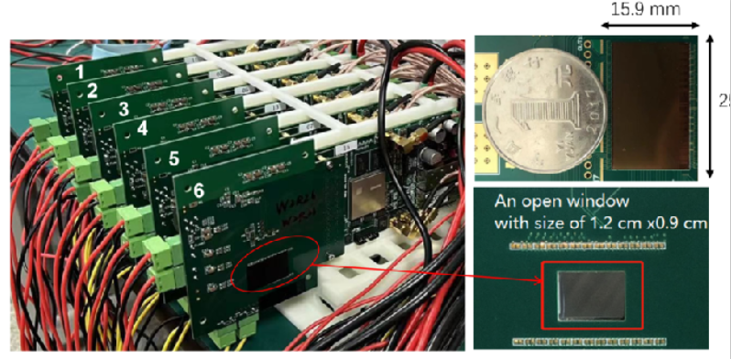
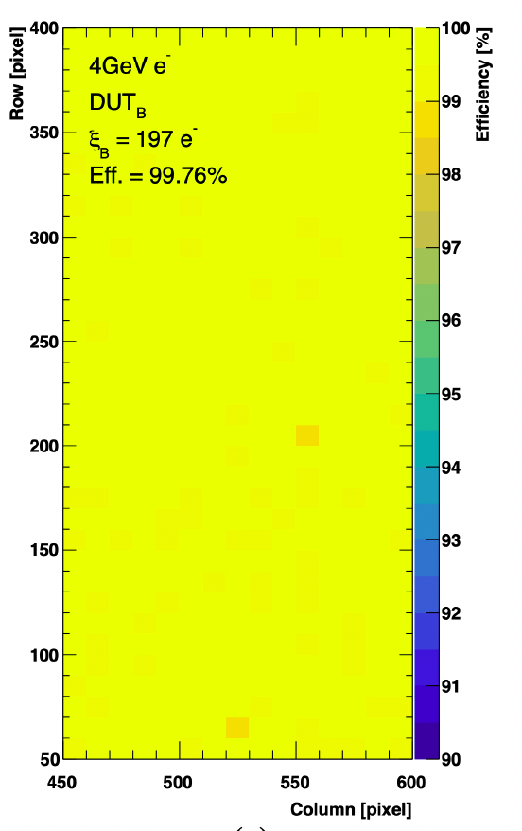
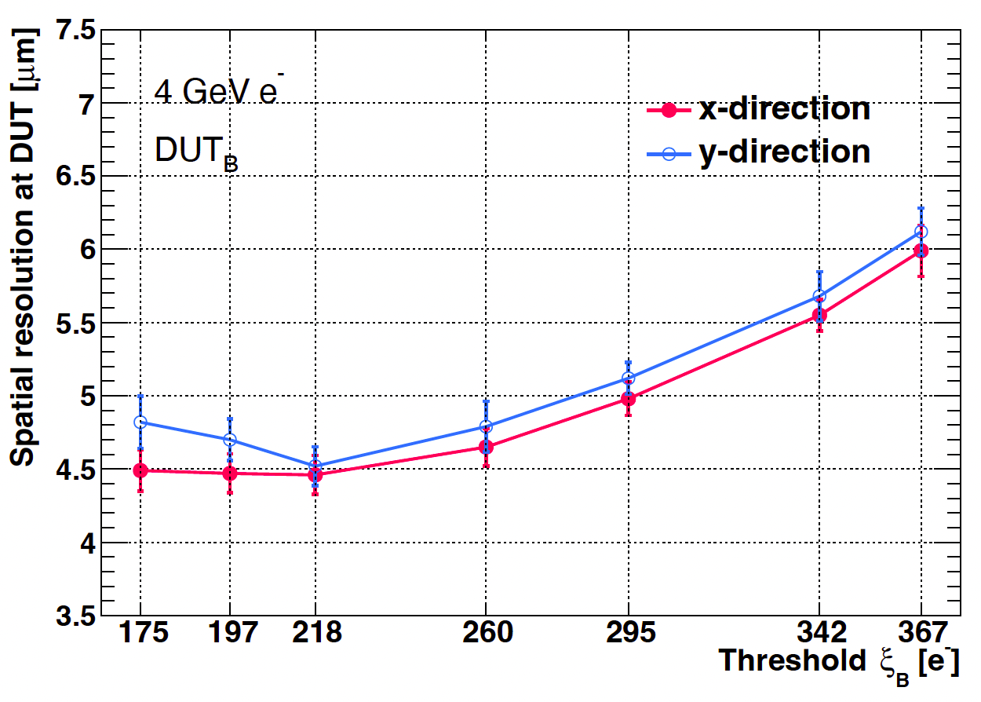
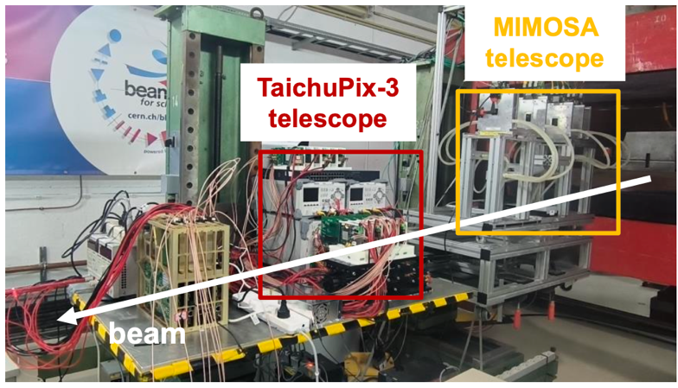
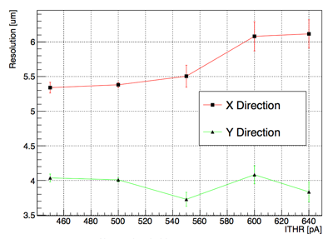
Jadepix3/TaichuPix3 beam test @ DESY
Spatial resolution 4~5um, Efficiency >99%
TaichuPix3 efficiency
TaichuPix3 resolution
JadePix3 resolution
JadePix3
telescope
Collaboration with CNRS and IFAE in Jadepix/TaichuPix R & D

Slide 8
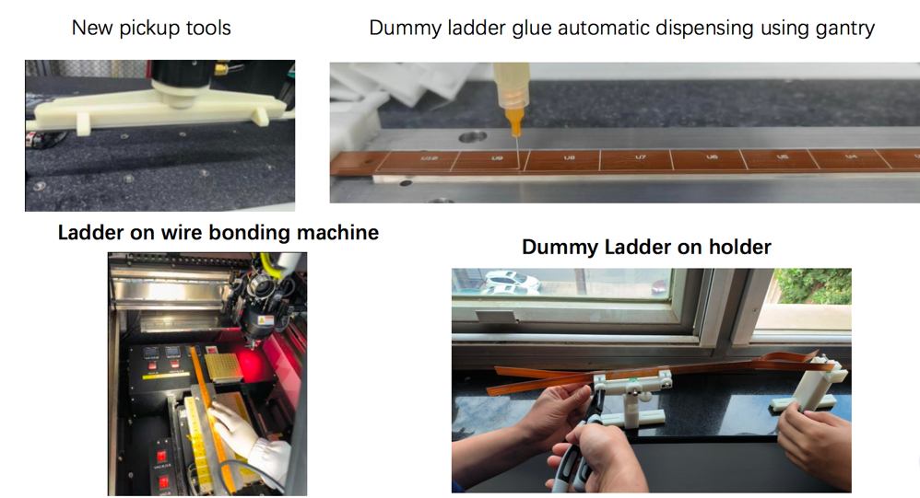
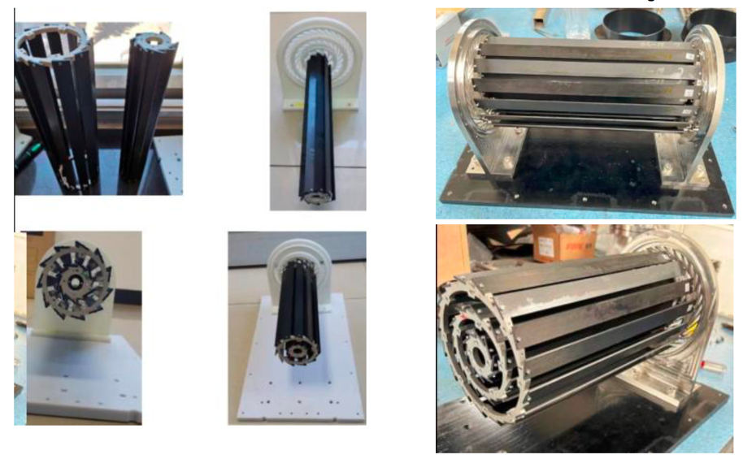
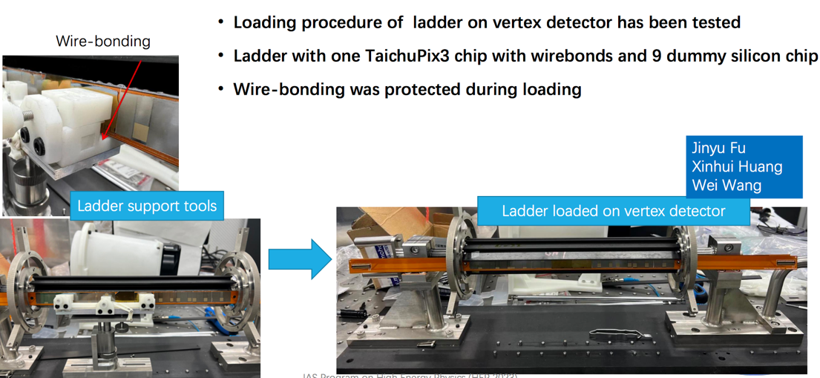
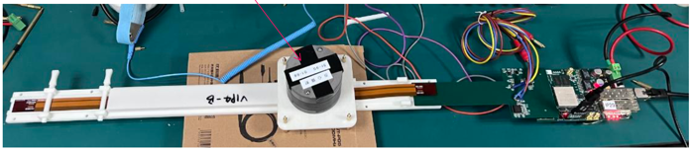
TaichuPix3 vertex detector prototype
The first vertex detector (prototype) ever built in China

Slide 9
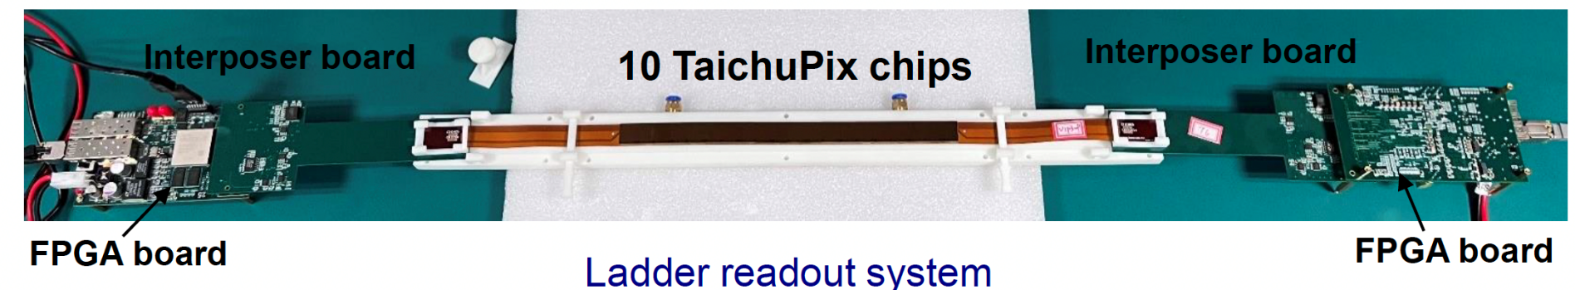
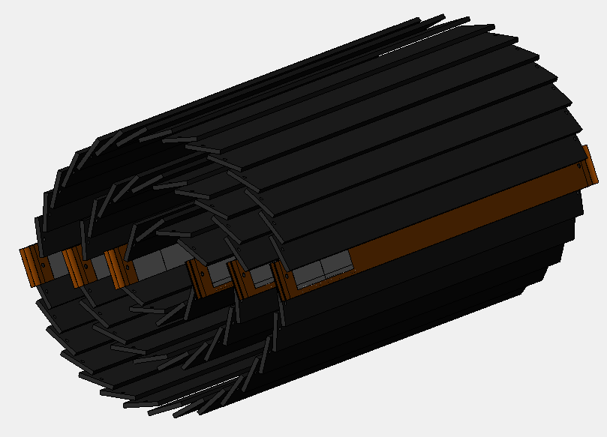
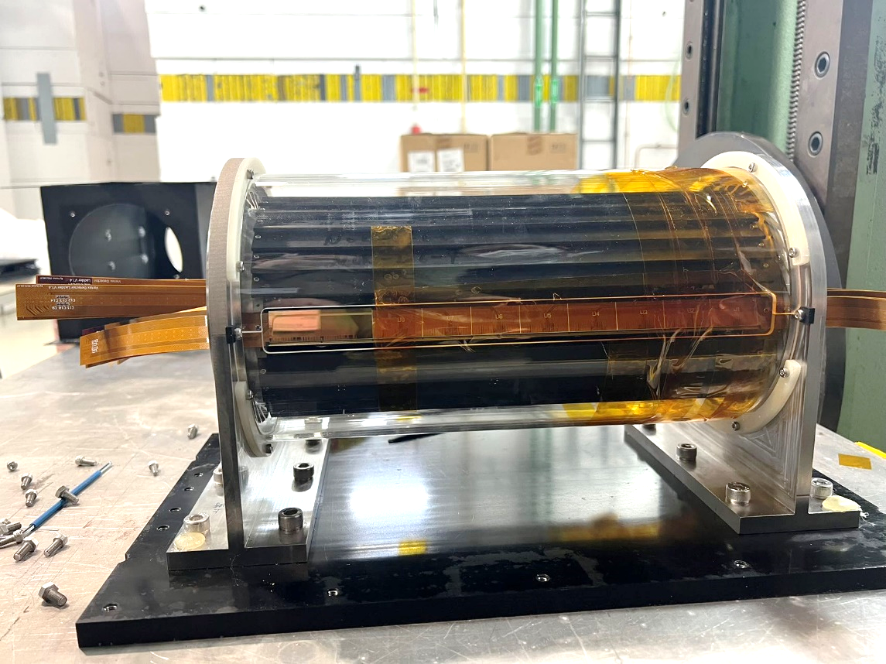
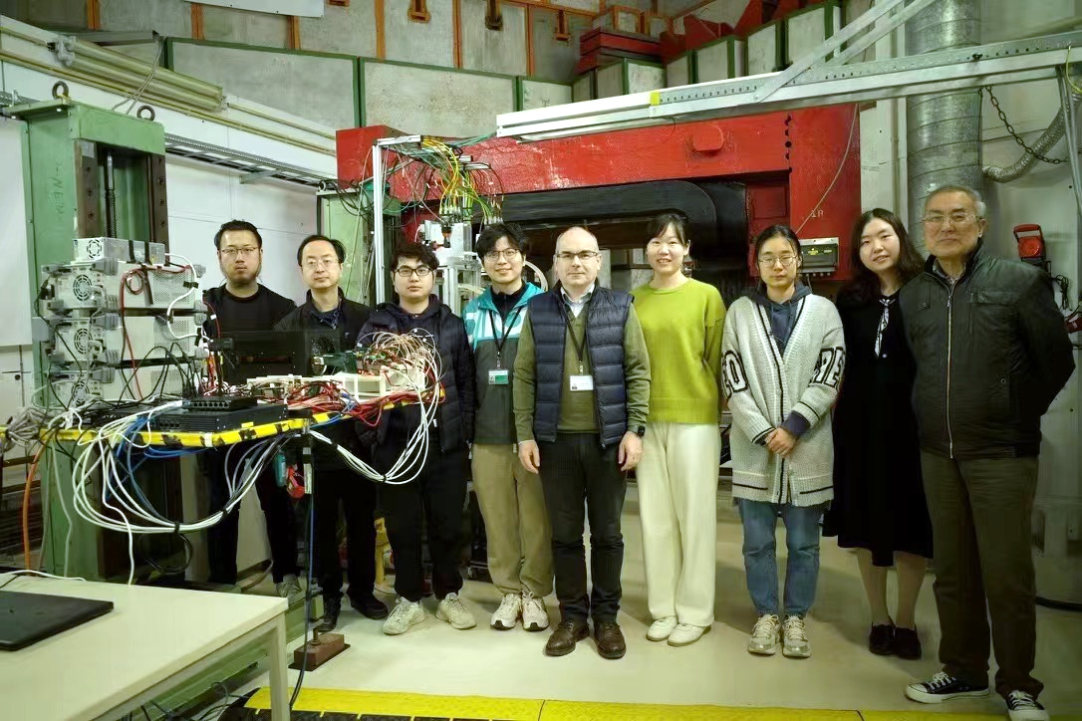
TaichuPix3 vertex detector prototype beam test @ DESY
TaichuPix-based prototype detector tested at DESY in April 2023
Spatial resolution ~ 4.9 μm
6 double-sided ladders

Slide 10
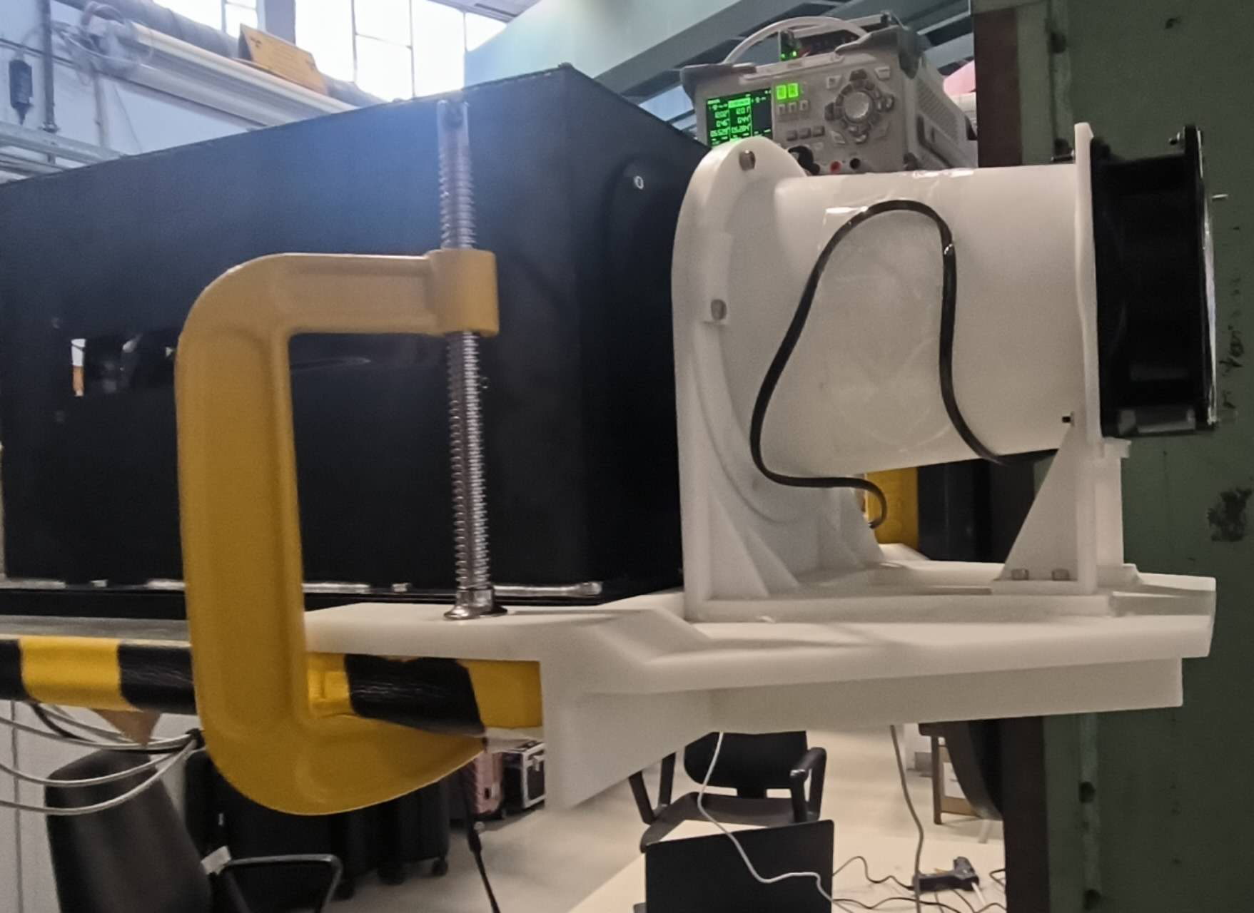
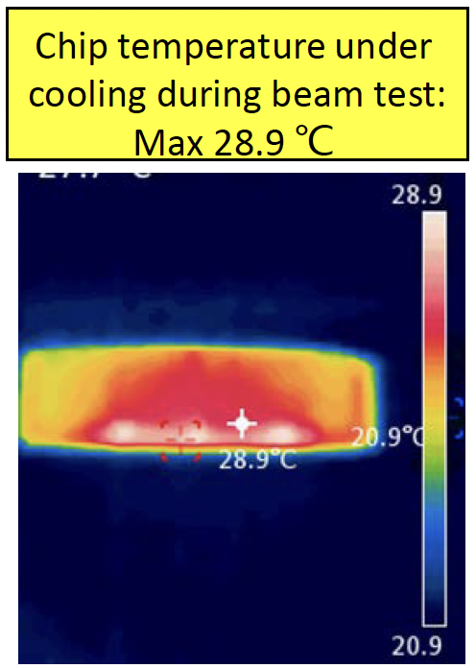
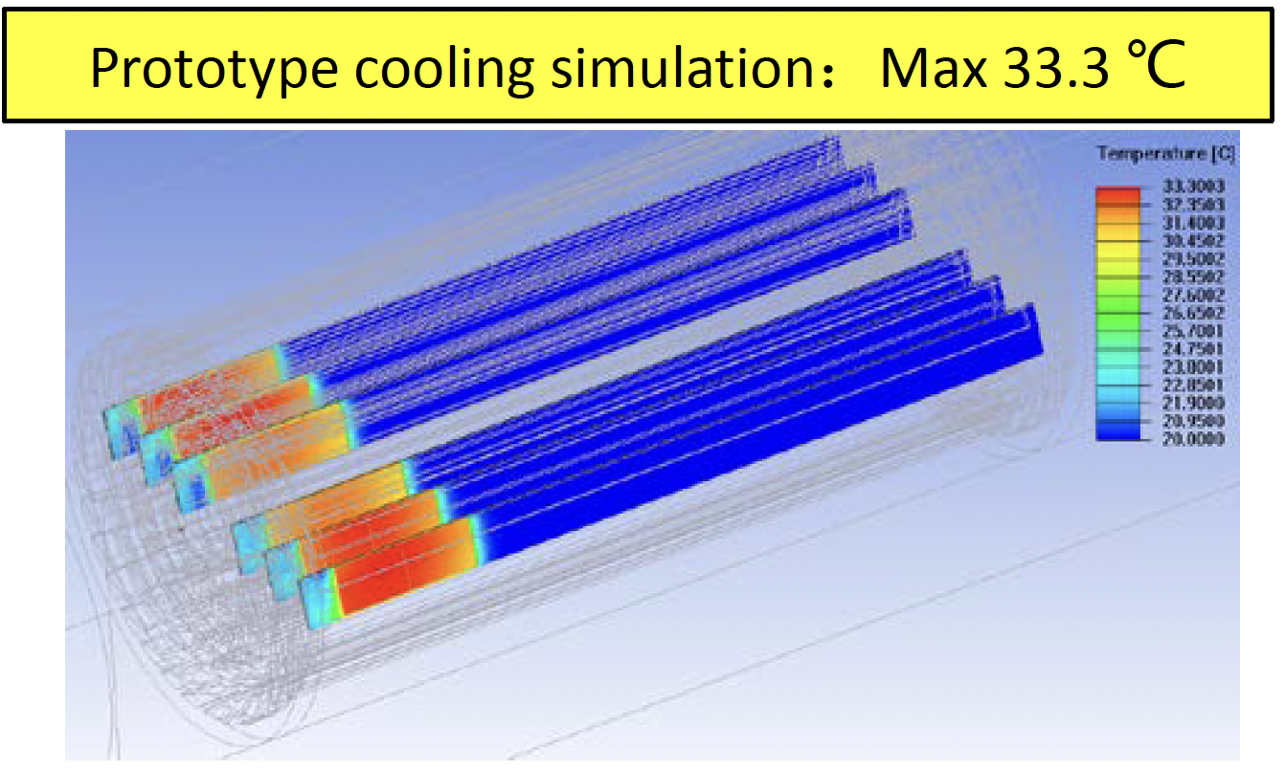
Air cooling in vertex detector prototype
Dedicated air cooling channel designed in prototype.
  Measured Power Dissipation of Taichu chip: ~60 mW/cm² (17.5 MHz clock in testbeam)
  Before (after ) turning on the cooling, chip temperature 41 °C (25 °C)
    In good agreement to our cooling simulation
    No visible vibration effect in spatial resolution when turning on the fan

Slide 11
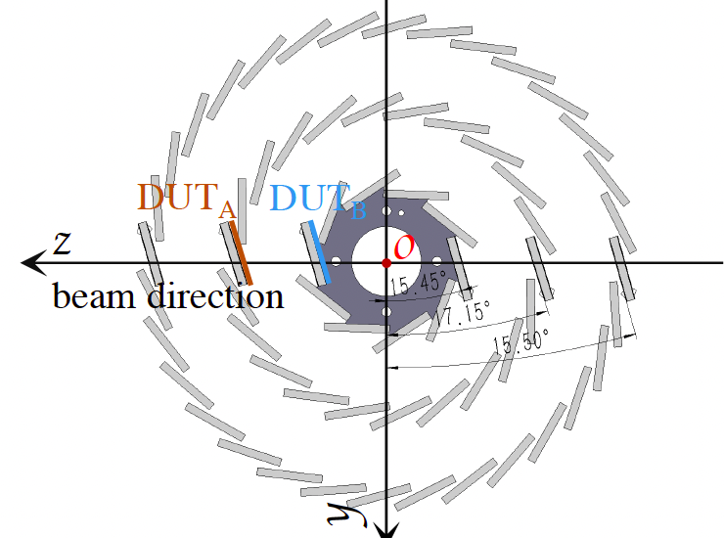
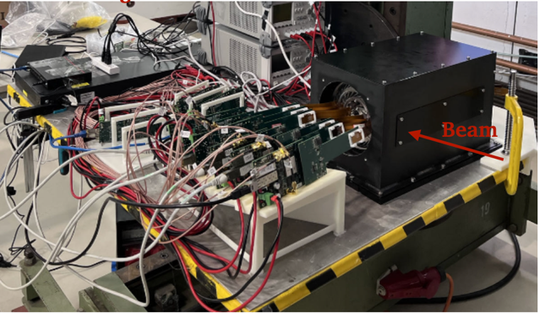
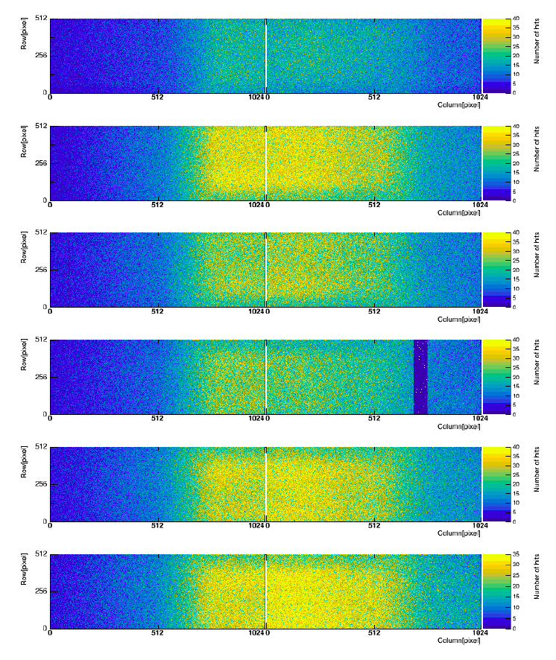
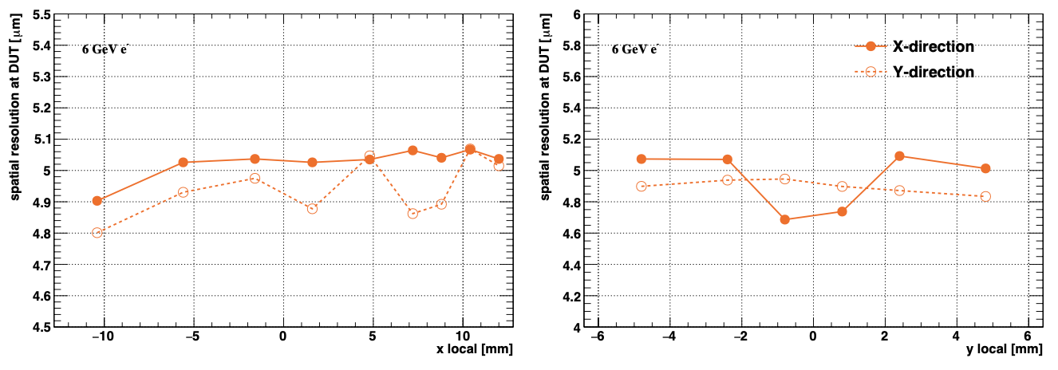
TaichuPix3 vertex detector prototype beam test @ DESY
Hit maps of multiple layers of vertex detector
Beam spot
Spatial resolution ~ 5 μm

Slide 12
From detector prototype to reference TDR
Reference detector TDR for CEPC under preparation, to be completed by the mid-2025 for the proposal of China’s 15th 5-year plan.
Vertex detector Technology selection
  Baseline: based on curved MAPS (Inspired by ALICE ITS3 design )
  Alternative: Ladder design based on MAPS ( prototype like design)
Challenges
  Closer to beam pipe (radius~11mm, High background rate (at Z pole , 40MHz, 1Gbps per chip )
  Detector Cooling (<=40 mW/cm²) with air cooling
  Radiation level (~1Mrad per year in average)
  Low material budget (~0.05%X/X0 per layer)
  Spatial Resolution (3-5um)

Slide 13
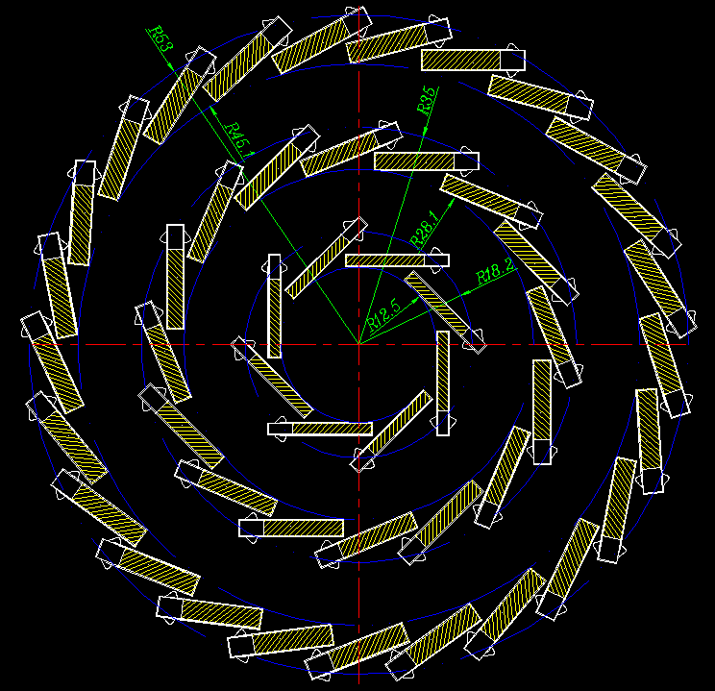
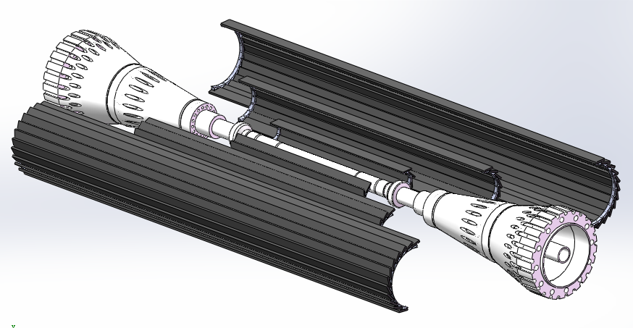
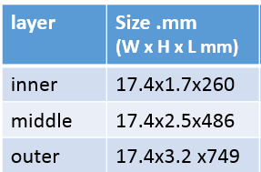
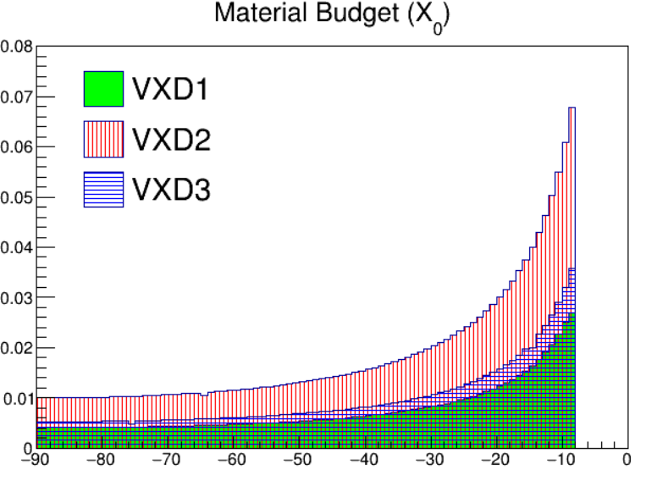
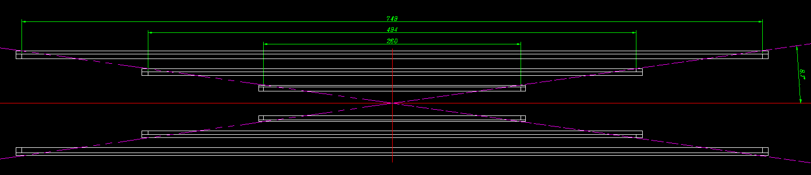
Vertex technologies: alternative
Alternative: CMOS chip with long ladder layout
  Long ladder design to cover cos θ<=0.991 (no endcap disk)
  3 double-side layer with ladders
  Aim to based on 65nm /55nm technology(<=40 mW/cm²)
Ladder support size
Material budget at
Φ =33 degree

Slide 14
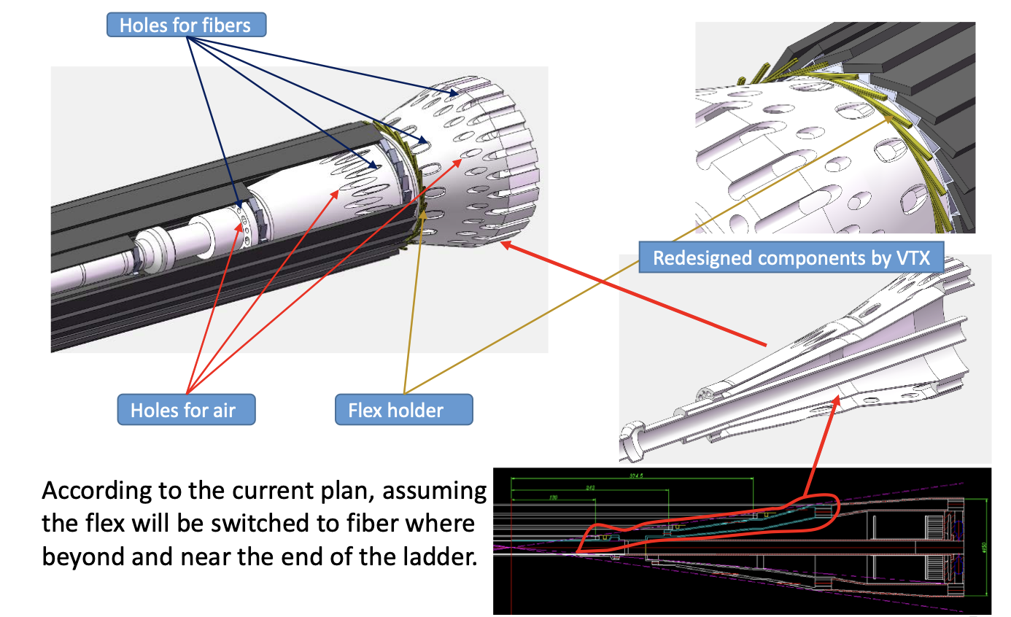
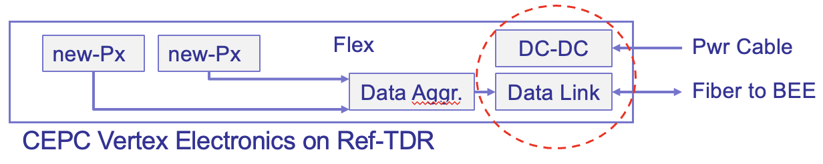
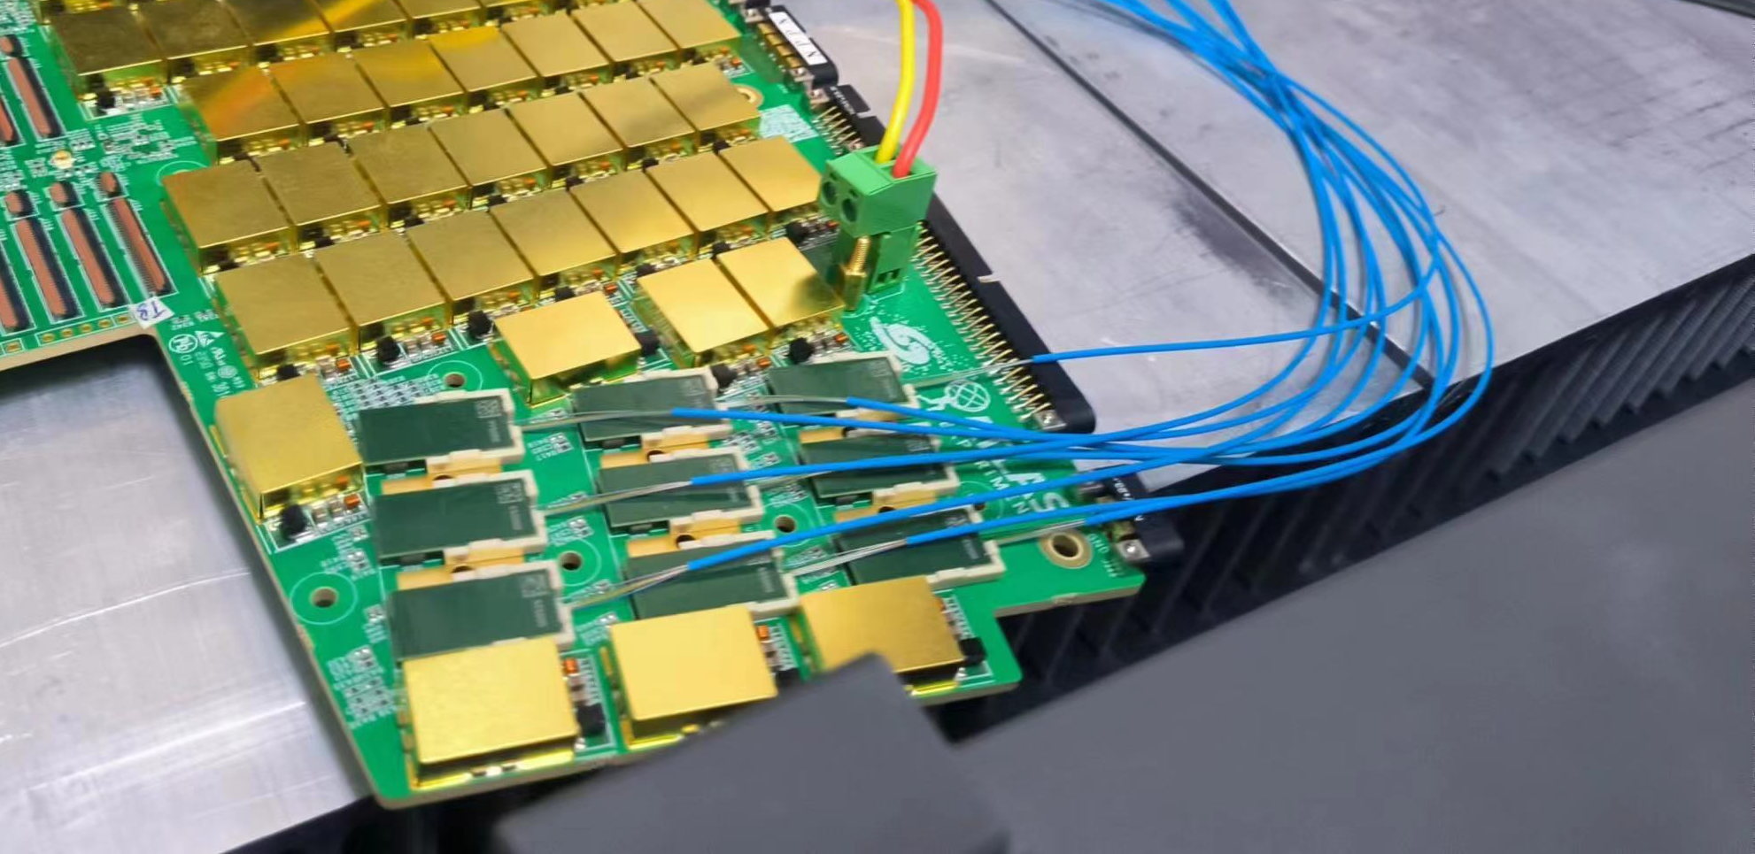
Vertex technologies: Cable and service
Limited space in MDI region for cable and service
  All fast signal transferred into optical fiber in service region
Example from ATLAS HGTD upgrade

Slide 15
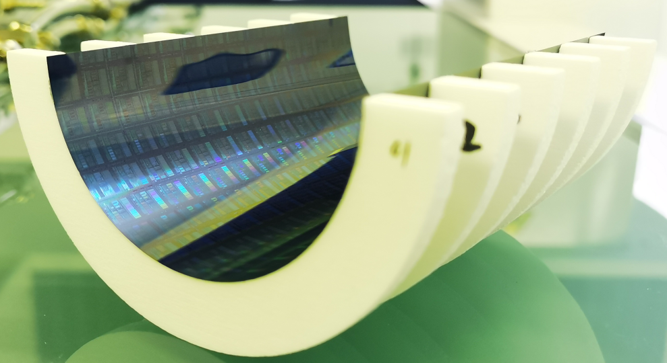
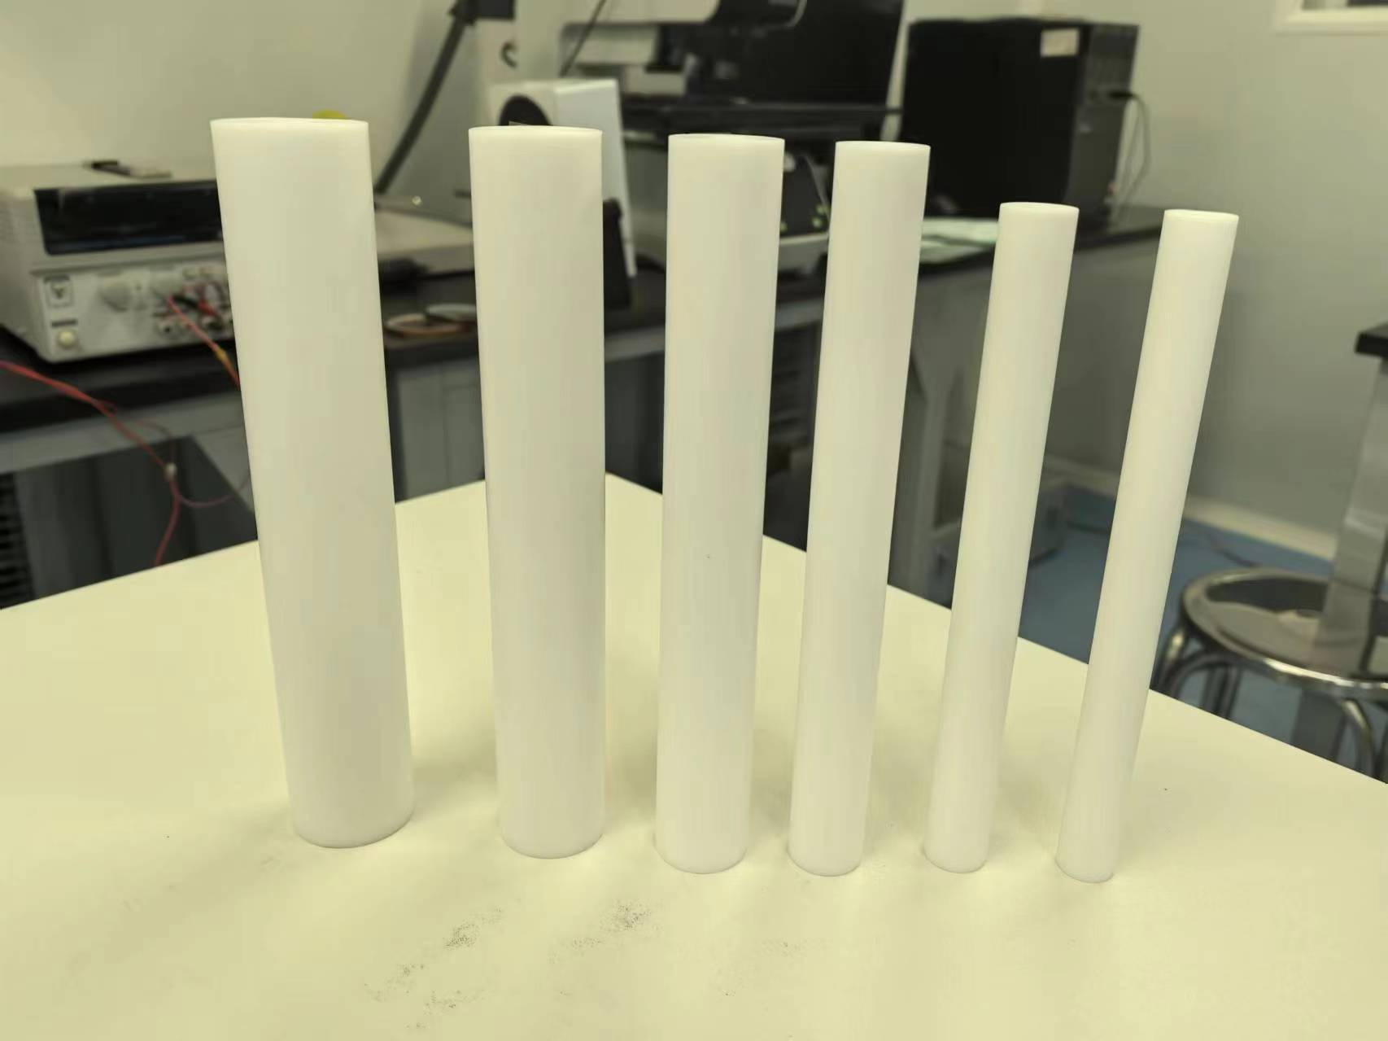
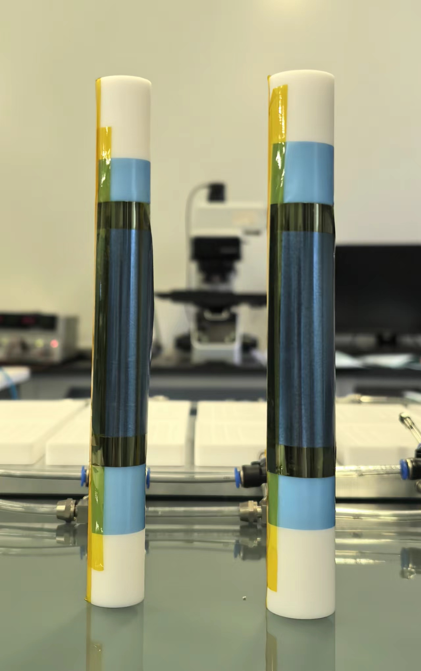
Vertex baseline for CEPC reference TDR: curved MAPS
Baseline: curved MAPS, Inspired by ALICE ITS3 design
  Advantage: 3~5 times smaller material budget compared to alternative (ladder options)
Challenges
  CEPC b-layer radius (radius=11mm) smaller compared with ALICE ITS3 (radius=18mm)
  Feasibility study: Mechanical prototype with dummy wafer can curved to radius ~12mm
12 mm
14 mm

Slide 16
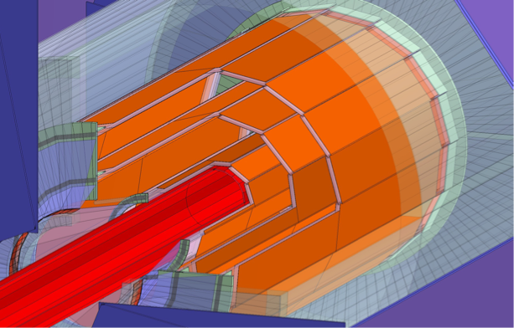

Summary
1st full-size Prototype for CEPC vertex detector developed
Reference detector TDR under preparation, to be completed by the
mid-2025 for the proposal of China’s 15th 5-year plan.
It is important to expand international collaboration and explore synergies with other international projects (especially framework of DRD7 (electronics) and DRD8 (mechanics and integration) more than DRD3 (solid state detectors).
CEPC vertex conceptional design (2016)
CEPC vertex prototype (2023)

Slide 17
TaichuPix design
Pixel 25 μm × 25 μm
  Continuously active front-end, in-pixel discrimination
  Fast-readout digital, with masking & testing config. logic
Column-drain readout for pixel matrix
  Priority based data-driven readout
  Readout time: 50-100 ns for each pixel
2-level FIFO architecture
  L1 FIFO: de-randomize the injecting charge
  L2 FIFO: match the in/out data rate
  between core and interface
Trigger-less & Trigger mode compatible
  Trigger-less: 3.84 Gbps data interface
  Trigger: data coincidence by time stamp
  only matched event will be readout
Features standalone operation
  On-chip bias generation, LDO, slow control, etc

Slide 18


Slide 19


Slide 20





Highlights of CEPC machine detector interface (MDI)
The design based on Accelerator TDR has been done. The background simulation is performing.
The experiment at BEPCII has been done several times to validate the code.
The collaboration on beam induced background study between different groups has been formed.

Slide 21


CMOS MAPS sensors development
All developed with TowerJazz CIS 180 nm process
Design finalized, to be taped off
Full-size chips produced and tested

Slide 22

Vertex detector sensor R&D timeline

Slide 23

The 4th Detector Concept
Excellent e/gamma energy resolution;
PID capability;
Better hadronic energy resolution;
Magnet in much reduced size.
BMR: 4% → 3%

Slide 24


Backup: Vertex alternative: expected performance

