Slide 1
统计方法和分析工具
第一讲：简介/ROOT框架
国科大科创培训 2024
宋昀轩（瑞士洛桑联邦理工学院）

Slide 2
培训目的
科研成果
专业技能
基本技能
新想法
专业技能：专业基础知识和专业相关领域前沿
基本技能：计算机 和 英语
新想法：科学思维方式 和 独立思考能力
了解物理研究中各种常用的计算机系统与工具
准确快捷地将想法付诸实施：计算物理学
充分熟悉和掌握必要的计算机工具，使之成为将来科研上的利器

Slide 3



Analysis Tools in Physics Research
实验
实验数据获取
数据分析
结果展示
实验模拟
理论
模型计算
结果展示
数据拟合
通过学习对各种物理分析工具的学习，了解和熟悉对物理研究中的数据分析方法的应用和理解。

Slide 4
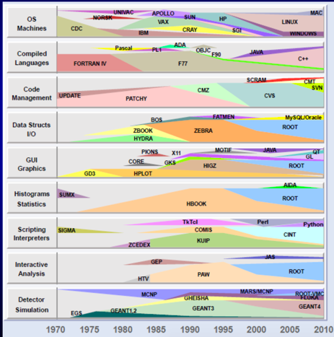
高能物理与核物理中主要软件使用率
Linux/Mac/Win
C++/Fortran/JAVA
CVS/SVN/CMT
ROOT/MySQL
ROOT/GL/QT
ROOT
CINT/Python/Perl
ROOT
GEANT4/FLUKA/…

Slide 5
需要掌握的基本知识
5
概率论与数理统计：
随机变量及概率分布、大数定理和中心极限定理、样本及分布、参数估计、小信号测量、假设检验、贝叶斯统计
计算机使用及编程语言：
Linux使用、文本编辑工具、Shell脚本语言、GCC编译器使用、程序开发与测试、C++语言基本语法、对象与类、其他程序语言
实验统计分析方法及工具：
    统计分析工具ROOT框架、ROOT的数据管理、数据图形表达、直方图分析、数据拟合、统计检验、多变量分析技术及工具TMVA
蒙特卡洛模拟：
    蒙特卡洛模拟原理和方法、物理事件产生器（如PYTHIA模拟）、探测器模拟原理、方法和对象、GEANT模拟软件框架和流程
    粒子物理实验软件与分析框架系统：
    大科学装置实验软件框架；实验数据流系统

Slide 6
你能(应)学到什么
基本的概率统计知识
实验数据的存储和读取
实验数据分析和提纯
数据信号成份测量和拟合
数据统计分析和检验
分析结果表达

Slide 7
知识准备与学习材料
7
Basics:
  Statistics
  Linux：any Linux introductory book
  C++：good C++ book
References:
  朱永生,《实验数据分析（上、下册）》, 科学出版社
  朱永生，《实验数据多元统计分析》, 科学出版社
  “The ROOT Users Guide”, http://root.cern.ch
  RooFit Users Manual
  RooStats Tutorial
  Minuit Reference Manual
  TMVA User Guide
请关注微群中公布的分享链接内的学习材料。

Slide 8
学习方式
8
课堂讲授 + 习题操作 + 作业讨论
多问多讨论，不要自己闷头搞
（高手请忽略~）
自学操作: 非常重要
以ROOT分析框架的学习为主线，熟悉Linux操作系统和C++的相关内容。

Slide 9
教学服务器
9
提供Linux环境用于课上演示，上机操作练习和科研实践
login.lzuhep.lzu.edu.cn（校园网内登录，IP随时可能会变动，注意课程网站上的通知。）
  ssh USERNAME@ login.lzuhep.lzu.edu.cn
登陆方式：ssh + scp; 提供Windows下登陆软件 XManager(推荐)
科创计划2020>软件>Xmanager.Enterprise.5.0.0436.rar
课上所有示例均在/home/KeChuang18/中
个人目录：/home/${用户名}

Slide 10
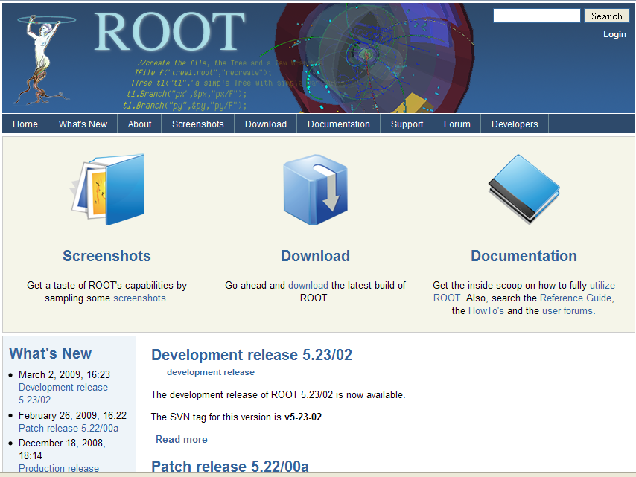
ROOT分析框架简介

Slide 11
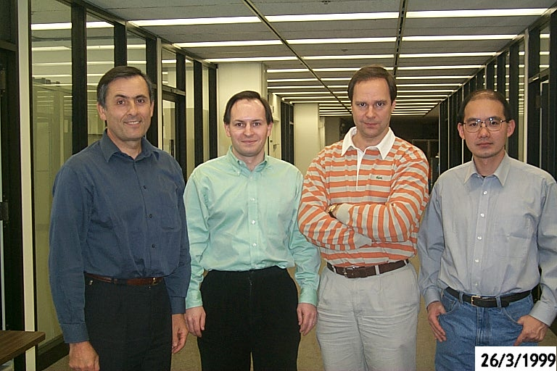
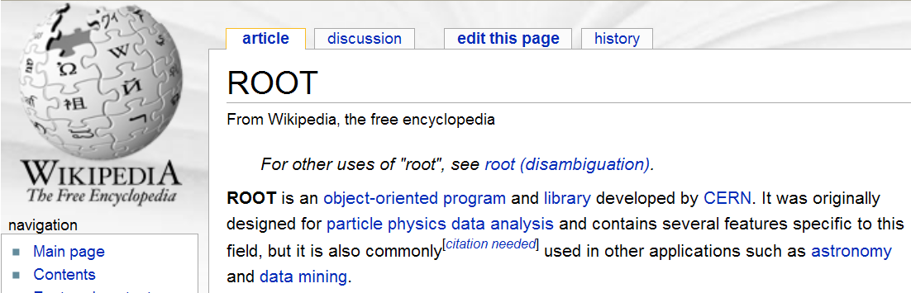
What is ROOT
An Object-Oriented Data Analysis Framework aimed at solving the data analysis challenges of (high energy) particle physics.
一个基于面向对象设计的数据分析软件框架
Rene Brun
Fons Rademakers
Notes:
11

Slide 12
History and future of ROOT
November 29, 1995: ROOT Version 0.04 Released
April 25, 1997: ROOT Version 1.00 Released
October 30, 1998: New ROOT version 2.00/13.
June 8, 2001: Official Release of ROOT Version 3.01
December 15, 2010: Pro, version 5.28/00
December 2, 2011, Production release 5.32/00
February 24, 2014, Patch release 5.34/17
March 24, 2015, Patch release 5.34/36 (2016-04-05)
Now: ROOT Version 6! Pro, version 6.14/00 (2020-06-13)
for future high luminosity experiments!
Compatible with new C++ features
Use a new interpreter cling, and back-compatible with CINT
On the way to ROOT 7!
release early and release often

Slide 13
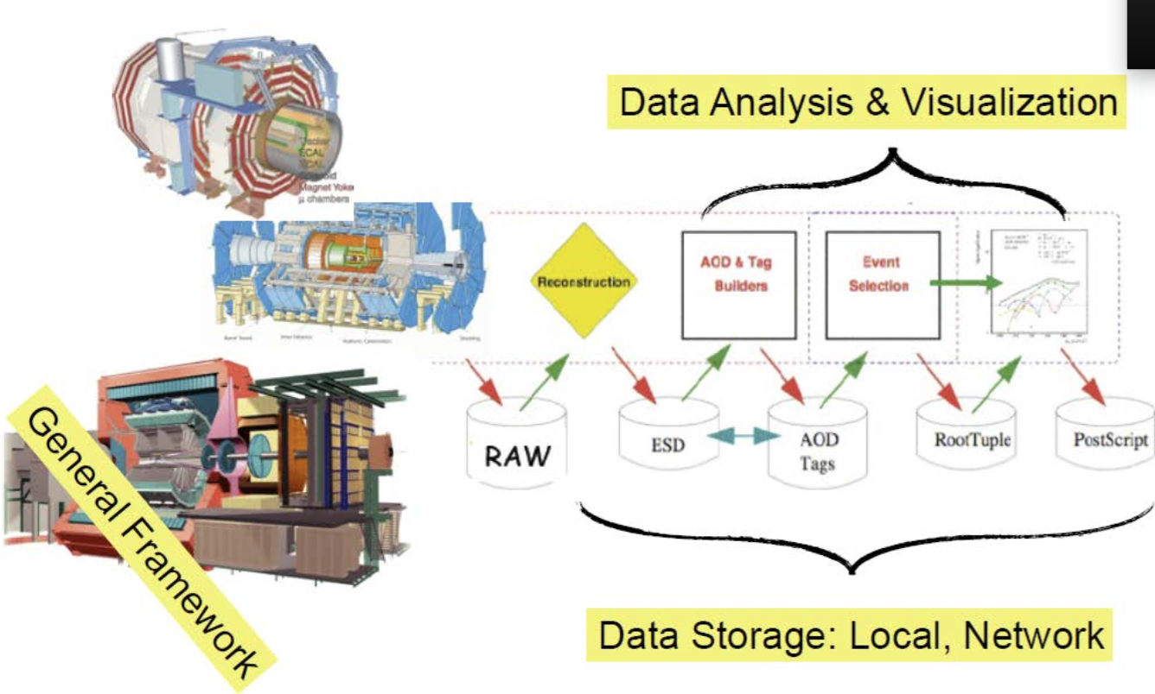
ROOT在高能物理中的应用领域

Slide 14
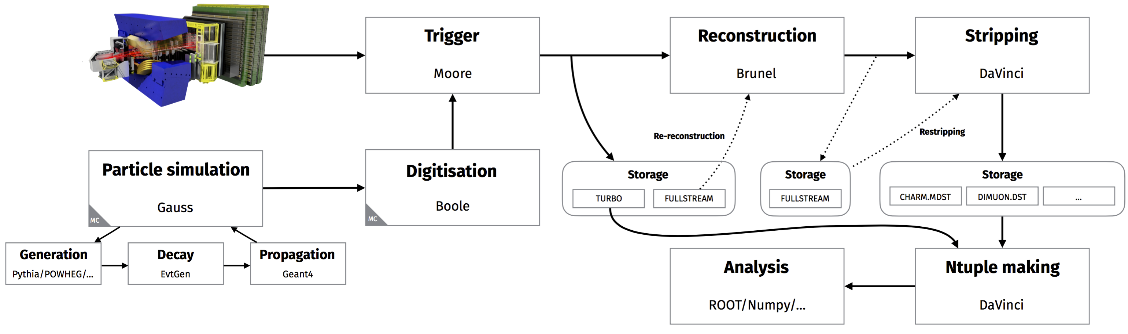
ROOT在高能物理中的应用领域

Slide 15
ROOT中的主要服务和工具
Histogramming, Fitting, Statistics
Graphics (2D, 3D)
I/O to file or socket: specialized for histograms, Ntuples (Trees)
Collection Classes and Run Time Type Identification
User Interface
  GUI: Browsers, Panels, Tree Viewer
  Command Line interface: C++ interpreter CINT
  Script Processor (C++ compiled ⬄ C++ interpreted)

Slide 16
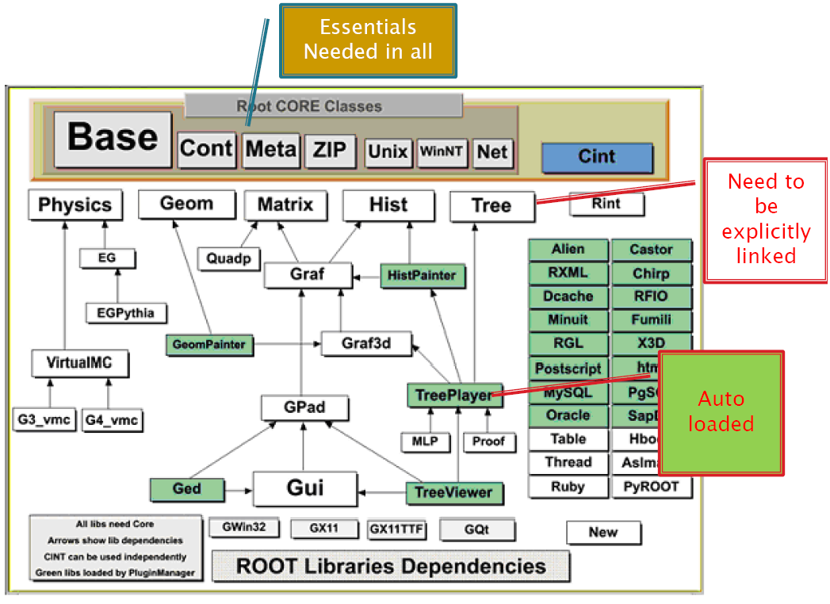
The Libraries
Over 350 classes!!!
Special purpose libraries:
EG, Physics…
ref: http://root.cern.ch/root/html/ClassIndex.html.
Notes:
There are several ways to use ROOT, one way is to run the executable by typing root at the system prompt another way is to link with the ROOT libraries and make the ROOT classes available in your own program. The libraries are designed and organized to minimize dependencies, such that you can include just enough code for the task at hand rather than having to include all libraries or one monolithic chunk.
The core library (libCore.so) contains the essentials; it needs to be included for all ROOT applications.In the diagram, you see that libCore is made up of Base classes, Container classes, Meta information classes, Networking classes, Operating system specific classes, and the ZIP algorithm used for compression of the ROOT files.
The CINT library (libCint.so) is also needed in all ROOT applications, but libCint can be used independently of libCore, in case you only need the C++ interpreter and not ROOT. That is the reason these two are separate.
A batch program, one that does not have a graphic display, which creates, fills, and saves histograms and trees, only needs the core (libCore and libCint), libHist and libTree. If other libraries are needed ROOT loads them at runtime. For example if the TreeViewer is used, libTreePlayer and all the libraries the TreePlayer box has an arrow to, are loaded also. In this case: GPad, Graf3d, Graf, HistPainter, Hist, Tree, and Proof. The difference between libHist and libHistPainter is that the former needs to be explicitly linked and the latter will be loaded automatically at runtime when needed. In the diagram, the dark boxes outside of the core are automatically loaded libraries, and the light colored ones are not automatic. Of course, if one wants to access an automatic library directly, it has to be explicitly linked also.

Slide 17
更多ROOT组件
The packages provided by ROOT include those for
  histogramming and graphing to visualize and analyze distributions and functions,
  curve fitting (regression analysis) and minimization of functionals,
  statistics tools used for data analysis,
  matrix algebra,
  four-vector computations, as used in high energy physics,
  standard mathematical functions,
  multivariate data analysis, e.g. using neural networks,
  image manipulation, used e.g. to analyze astronomical pictures,
  access to distributed data (in the context of the Grid),
  distributed computing, to parallelize data analyses,
  persistence and serialization of objects, which can cope with changes in class definitions of persistent data,
  access to databases,
  3D visualizations (geometry)
  creating files in various graphics formats, like PostScript, JPEG, SVG,
  interfacing Python and Ruby code in both directions,
  interfacing Monte Carlo event generators.

Slide 18
Getting Information
ROOT website: http://root.cern.ch
You can find ROOT user references and guides there.
Class Reference Guide: http://root.cern.ch/root/html/ClassIndex.html
Forums and archives: http://root.cern.ch/phpBB3
$ROOTSYS/tutorials: contains many example scripts. They assume some basic knowledge of C++ and ROOT
copy them to your home directory and try!
$ROOTSYS/test: a set of examples that represent all areas of the framework and a gold mine
to learn some advanced examples!

Slide 19
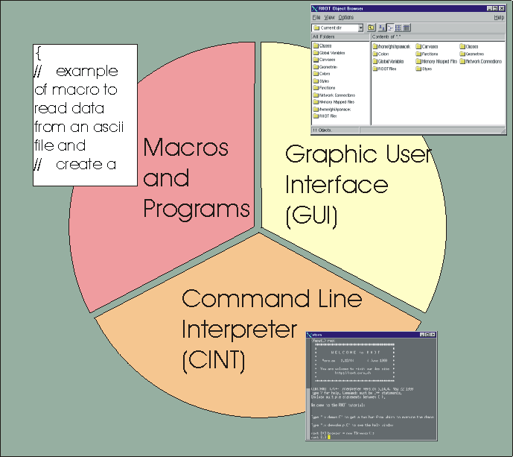
Three User Interfaces
GUI
windows, buttons, menus
Root Command line
CINT (C++ interpreter)
Macros, applications, libraries (C++ compiler and interpreter)

Slide 20
配置ROOT环境
登录服务器后，默认可以使用ROOT，但版本较低
可以通过执行如下命令使用ROOT
  alias setroot6='source /cvmfs/sft.cern.ch/lcg/app/releases/ROOT/6.22.06/x86_64-centos7-gcc48-opt/bin/thisroot.sh'
  可以把以上做一个alias命令，存到个人目录下~/.bashrc中
然后在终端命令行上直接运行: root

Slide 21
Start and Quit ROOT
> root -h
Usage: root [-l] [-b] [-n] [-q] [file1.C ... fileN.C]
Options:
-b : run in batch mode without graphics
-n : do not execute logon and logoff macros as
specified in .rootrc
-q : exit after processing command line script files
-l : do not show the image logo (splash screen)
To start ROOT, you can type root at the system prompt. This starts up CINT, the ROOT command line C/C++ interpreter, and it gives you the ROOT prompt (root[0]).
To quit ROOT, type .q at the ROOT prompt
It is possible to launch ROOT with some command line options, as shown below:

Slide 22
Command-Line Interface
a powerful C/C++ interpreter giving you access to all available ROOT classes, global variables, and functions via the command line.
By typing C++ statements at the prompt, you can create objects, call functions, execute scripts, etc.
root[] 1+sqrt(9)
(const double)4.00000000000000000e+00
root[] for (int i = 0; i<2; i++) cout << "Hello" << i << endl
Hello 0
Hello 1

Slide 23
Command-Line Interface
different types of commands:
  CINT commands start with “.”
  SHELL commands start with “.!” for example:
  C++ commands follow C++ syntax (almost: not standard C++ )
  Multi-line Commands: put the multi-line commands in the double curly brackets { }.
root[] .?//this command will list all the CINT commands
root[] .L <filename> //load [filename]
root[] .x <filename> //load and execute [filename]
root[] .! ls
root[] TBrowser *b = new TBrowser()
Root[] tb = new Tbrowser()
Use double-<Tab>-click to search for the complement:
to find List of Methods and Parameters

Slide 24
CINT Commands
[expression] evaluates the expression
  root[3] 3*4
  (int)12
.files show loaded source files
.class [name] show class definition
.g prints all objects in the root session
.ls ls on current directory
.pwd list the current directory, canvas and style.
.q quit root session
Unix-like I/O redirection (semicolon ; is required before > or >>)
Use ? to get help on all ‘‘raw'' interpreter commands
Use @ to abort a multi-line command

Slide 25
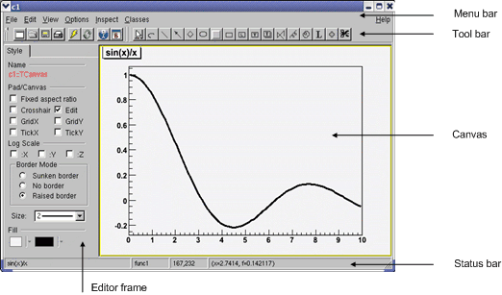
GUI Interface
root[] TF1 f1("func1","sin(x)/x",0,10)
root[] f1.Draw()
<TCanvas::MakeDefCanvas>: created default TCanvas with name c1
Save to a “.C” file: you can add new object such as line, arrow, on the plot by modifying the generated “.C” file.

Slide 26
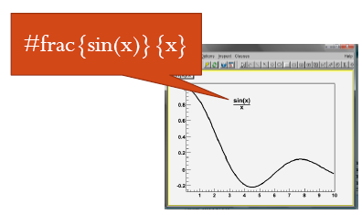
Fast Generate Your Macro Code
Save the plot to a file named ‘c1.C’
{
//=========Macro generated from canvas: c1/c1
//========= (Fri Mar 21 08:10:57 2008) by ROOT version5.18/00
TCanvas *c1 = new TCanvas("c1", "c1",423,36,699,534);
c1->Range(-1.119108,-0.4477822,11.24013,1.22563);
c1->SetBorderSize(2);
c1 >SetFrameFillColor(0);
c1->TF1 *func1 = new TF1("func1","sin(x)/x",0.1,10);
func1->SetFillColor(19);
func1->SetFillStyle(0);
func1 >SetLineWidth(3);
func1->func1->Draw("");
TPaveText *pt = new TPaveText(0.01,0.9401777,0.1371429,0.995,"blNDC");
pt->SetName("title");
pt->SetBorderSize(2);
pt->SetFillColor(19);
TText *text = pt->AddText("sin(x)/x");
pt->Draw();
tex = new TLatex(0.261097,0.768812,“#frac{sin(x)}{x}");
tex->SetLineWidth(2);
tex->Draw();
c1->Modified();
c1->cd();
c1->SetSelected(c1);
c1->ToggleToolBar();
}
Add these three lines to put a math formula on the plot and re-run the macro c1.C

Slide 27
Start ROOT from $ROOTSYS/Tutorials
execute root under $ROOTSYS/tutorials, the following information appears when root is up:
Also you can try: root <filename.C> to check the separate macro outputs.
“grep” those macros to find what you need
More tutorials at http://root.cern.ch/root/html/index.html
> root
...
Welcome to the ROOT tutorials
Type ".x demos.C" to get a toolbar from which to execute the demos
Type ".x demoshelp.C" to see the help window
==> Many tutorials use the file hsimple.root produced by hsimple.C
==> It is recommended to execute hsimple.C before any other script
root[0].x demos.C
...
Root[1].q

Slide 28
grep使用
一种强大的文本搜索工具，它能使用简单字符串/正则表达式搜索文本，可以用于查找例程寻求帮助。如：
查找fit目录中使用TF1类的例程
grep ”TF1” $ROOTSYS/tutorials/fit/*.C
查找所有目录中使用TF1类的例程
grep –r ”TF1” $ROOTSYS/tutorials/fit
查找roofit例程中的gauss函数使用（”-w”表示查找单词）
grep –rw ”gauss” $ROOTSYS/tutorials/roofit
查找忽略大小写查找
grep –rwi ”gauss” $ROOTSYS/tutorials/roofit
以某些首字母开头字符串查找
grep –r ”gauss.*” $ROOTSYS/tutorials/roofit
ref: http://man.chinaunix.net/newsoft/grep/open.htm

Slide 29
The ROOT Script Processor
Un-named Scripts: script1.C
root[] .x script1.C <enter>
Named Scripts: script2.C
{
#include <iostream.h>
cout << " Hello" << endl;
float x = 3.; float y = 5.; inti = 101;
cout <<" x = "<<x<<" y = "<<y<<" i = "<<i<< endl;
}
#include <iostream.h>
int run(int j=10)
{
cout << " Hello" << endl;
float x = 3.; float y = 5.; int i= j;
cout <<" x = "<< x <<" y = "<< y <<" i = "<< i << endl;
return 0;
}

Slide 30
The ROOT Script Processor
root [] .L script2.C
root [] .func
...
script2.C2:7 0 public: int run(int j=10);
root [] run(<tab>
int run(int j = 10)
root [] run()
Hello
x = 3 y = 5 i = 10
(int)0
root [] run(1)
Hello
x = 3 y = 5 i = 1
(int)0
Change the function name to the script prefix name:
int run(int j=10) ➔ int script2(int j=10)
then you can execute the macro via:
root[] .x script2.C(8)

Slide 31
Object definition in CINT Script
// file name: draw.C
void draw(){
TF1 f("f","sin(x)",0,20);
f.Draw();
}
local variable/object is destroyed when the function exits.
modified ones:
// file name: draw2.C
void draw(){
TF1 *f=new TF1("f","sin(x)",0,20);
f->Draw();
}
// file name: draw3.C
{
TF1 f("f","sin(x)",0,20);
f.Draw();
}
what the difference?

Slide 32
ROOT主要内容
ROOT框架简介
如何运行/退出ROOT程序
ROOT界面使用介绍和使用
课后阅读：
  ROOT User Guide 第一章和第二章
  科创计划2020 >ROOT >ROOTUsersGuideA4-v5.34.pdf
  To be familiar with the jargon words,
  To see what ROOT can do
  To feel ROOT’s power
  推荐同学在本机上Mac/Linux安装高版本ROOT v6.32!

Slide 33
课下练习
Linux一些简单使用
  简单Linux命令： cd, ls, cp, mv, rm, ...
  vi使用
结合user guide运行tutorials内的程序
读懂以下两个C++例程，并尝试运行：
$ROOTSYS/tutorials/graphs/graph.C
$ROOTSYS/tutorials/foam/foam_kanwa.C
多用多练多问

Slide 34
Tips:小技巧
将下面一句加到个人主目录下~/.bashrc中（如果没有，自己目录下建一个）
alias rt='root –l’
保存后，命令行运行 source ~/.bashrc
使用rt打开ROOT时，不显示logo

