Slide 1
统计方法和分析工具
第五讲：ROOT, ROOFIT等工具
钱文斌，傅金林（中国科学院大学）

Slide 2
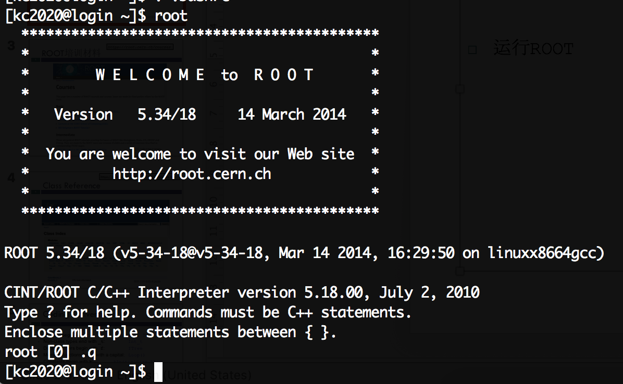
在科创服务器上加载ROOT环境
在个人主目录下，在.bashrc文件中加入如下命令：
source /data/lzuhep/sw/root_v5.34.18/bin/thisroot.sh
export PATH=/cvmfs/common.ihep.ac.cn/software/hepjob/bin/:/cvmfs/container.ihep.ac.cn/bin/:$PATH
运行
> hep_container shell SL6
> root –l

Slide 3
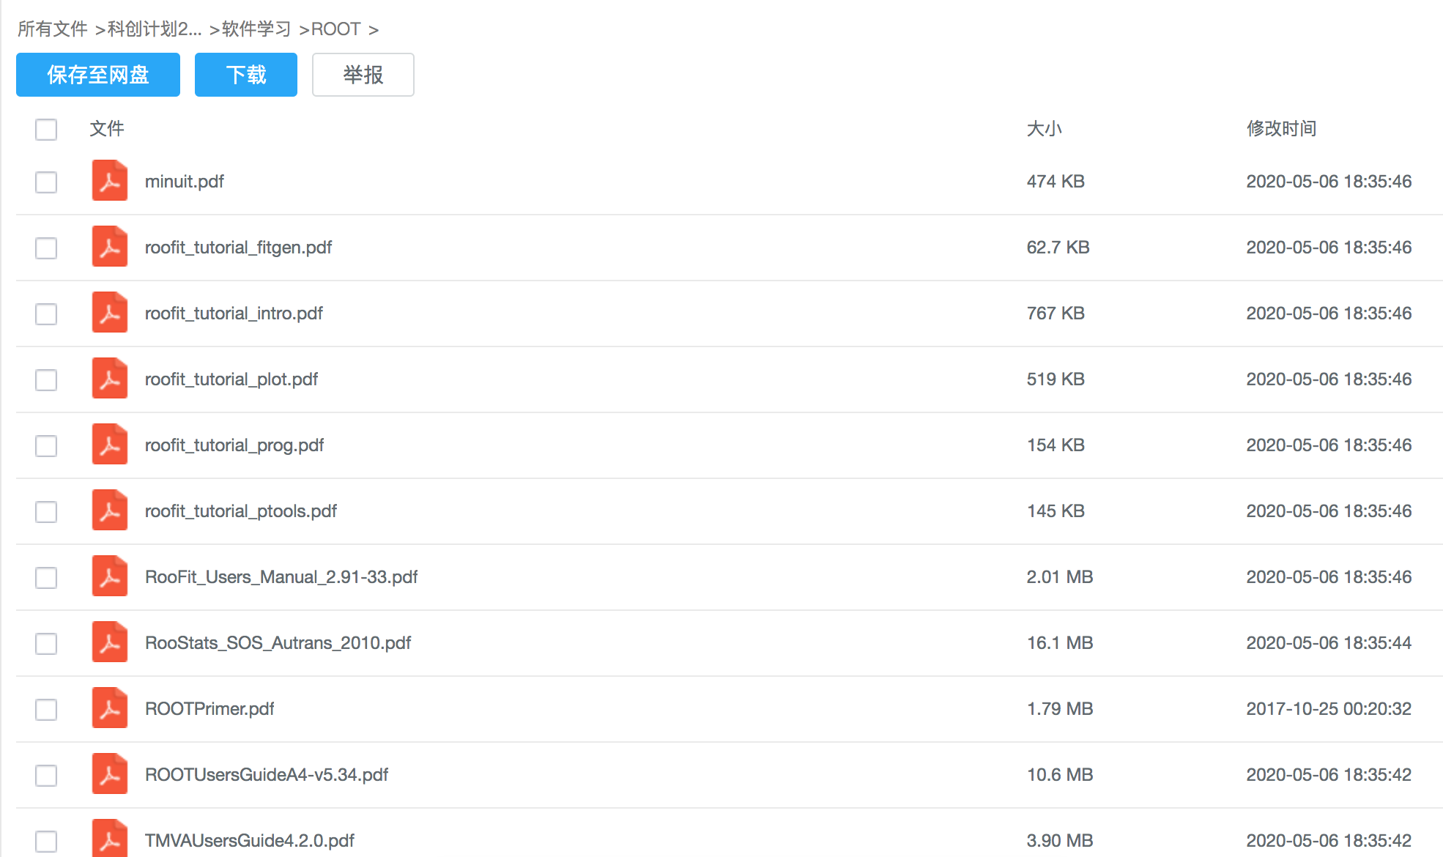
https://pan.cstcloud.cn/web/share.html?hash=hSY5FZOQ8o#

Slide 4
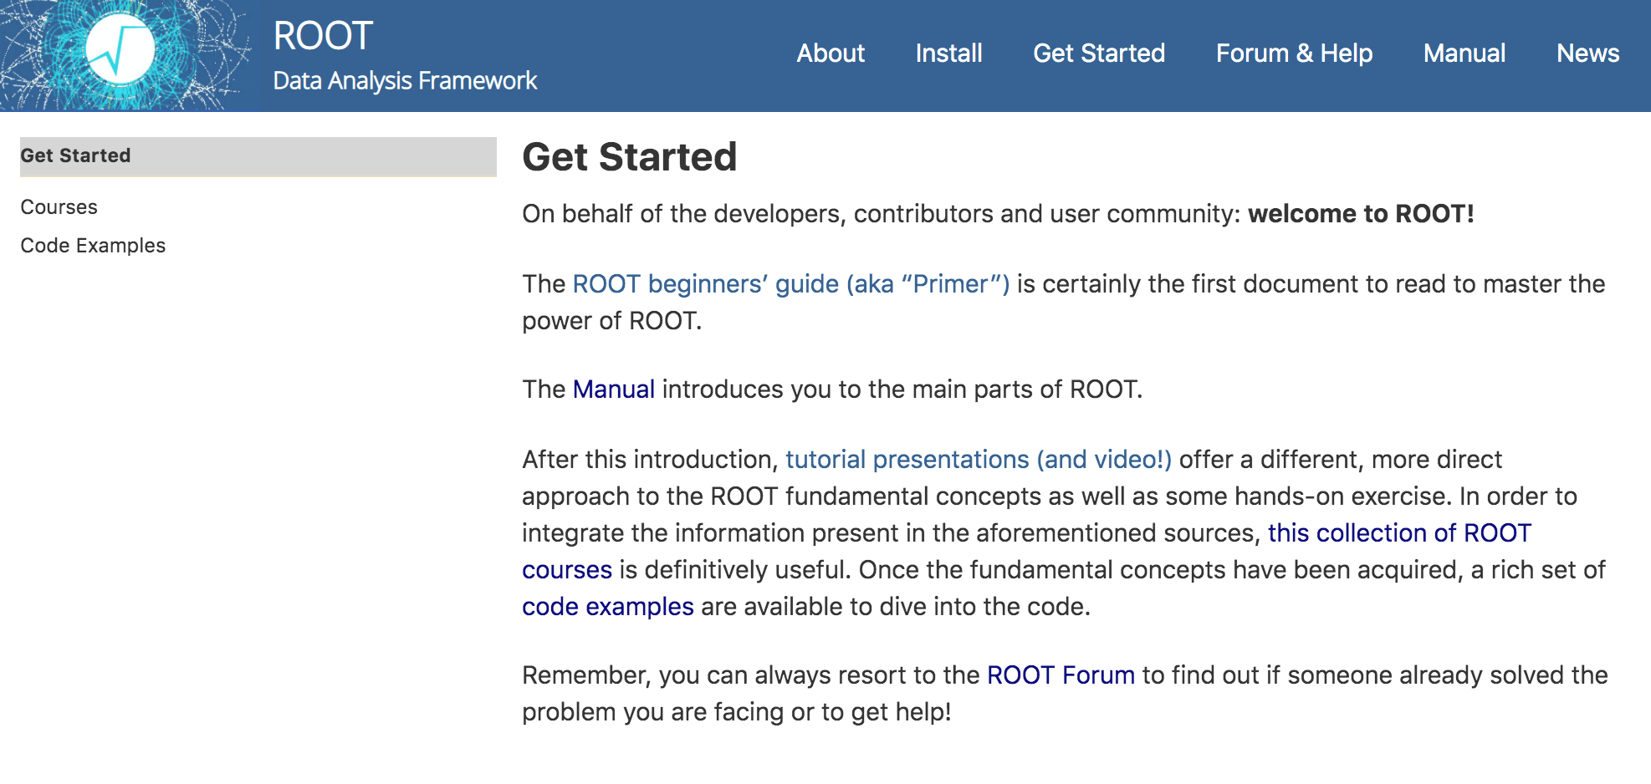
ROOT培训材料
https://root.cern/get_started/
https://root.cern/root/htmldoc/guides/users-guide/ROOTUsersGuide.html
https://root.cern/doc/master/group__Tutorials.html

Slide 5
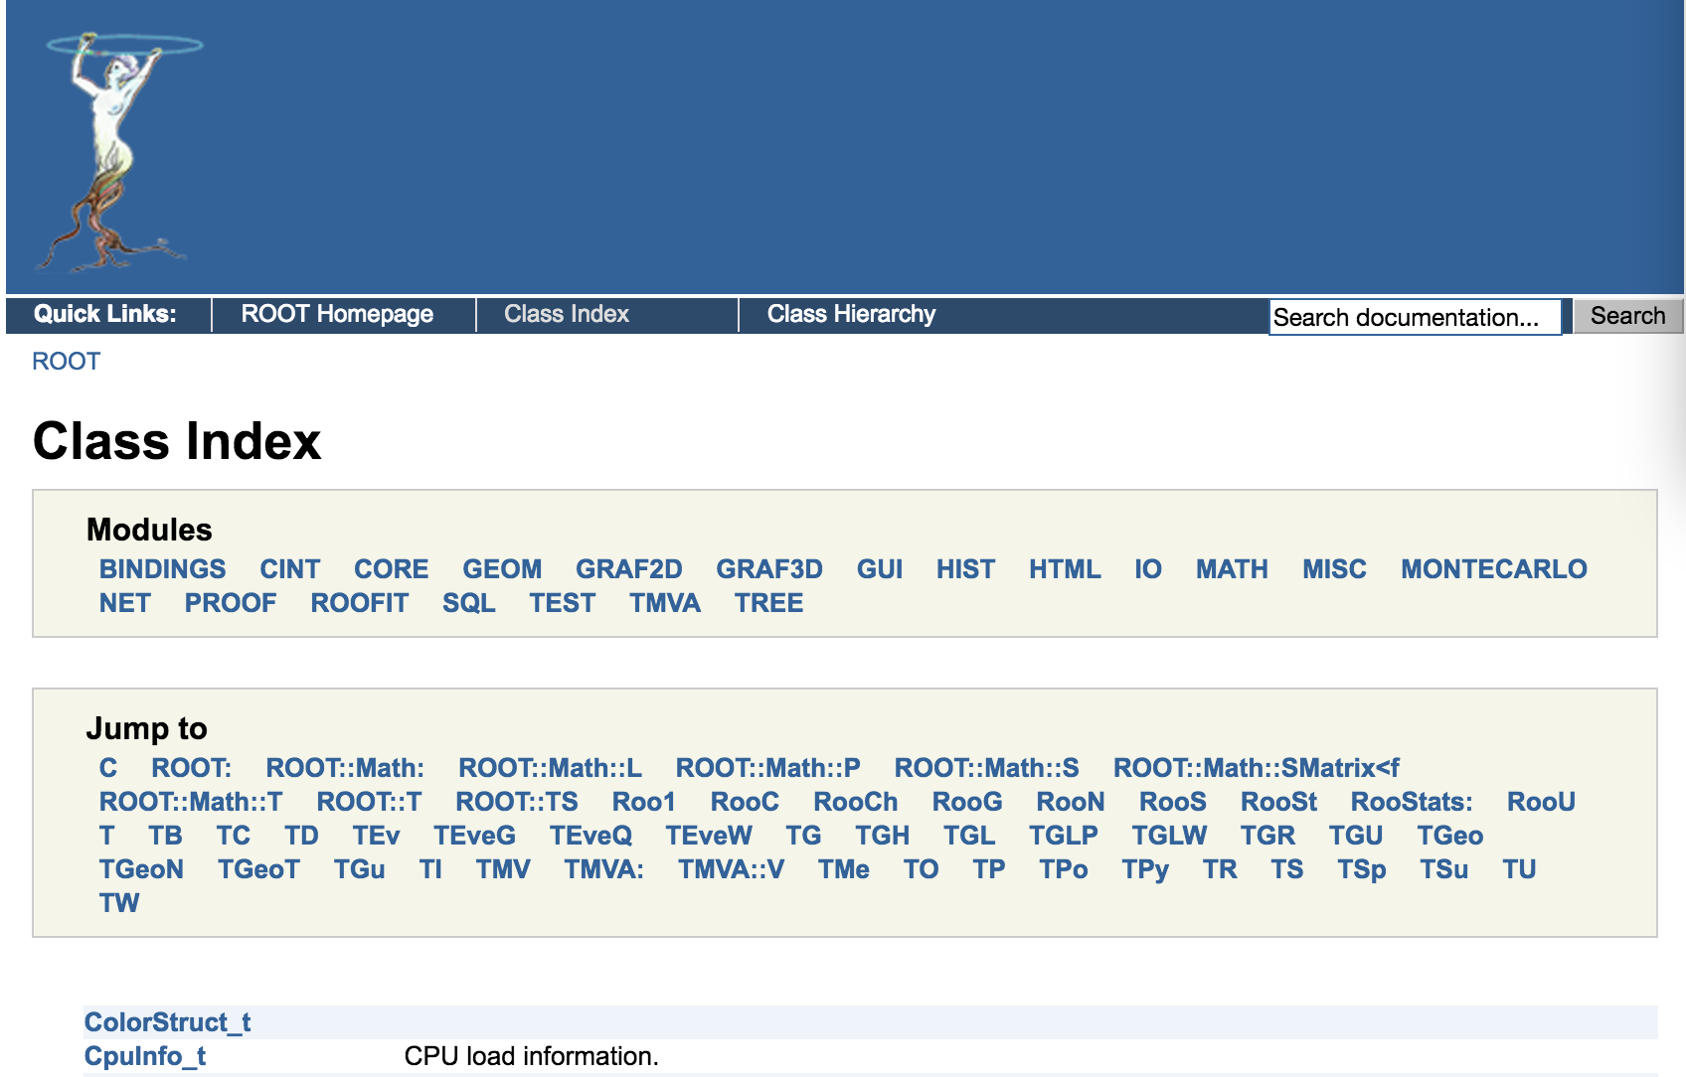
Class Reference
https://root.cern.ch/root/html534/ClassIndex.html

Slide 6
Coding Conventions
Classes begin with T: TF1, TH1F, TTree
Non-class types end with _t: Int_t
Data members begin with f: fTree
Member functions begin with a capital: Loop()
Constants begin with k: kInitialSize, kRed
Global variables begin with g: gROOT, gSystem, gStyle
Static data members begin with fg: fgTokenClient
Enumeration types begin with E: EColorLevel
Locals and parameters begin with a lower case: nbytes
Getters and setters : SetLast(), GetFirst()
to understand the code better and quicker

Slide 7
Machine Independent Types
Char_t Signed Character 1 byte
Short_t Signed Short integer 2 bytes
Int_t Signed integer 4 bytes
Long64_t Portable signed long integer 8 bytes
Float_t Float 4 bytes
Double_t Float 8 bytes
Bool_t Boolean (0=false, 1=true)
...

Slide 8
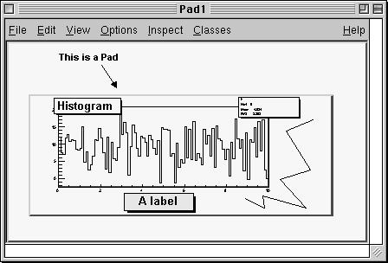
Canvas and Pad
Graphical Containers
A pad (class TPad) is a graphical container in the sense it contains a linked list of pointers to the holding objects, like histograms, arrows and even other pads (sub-pads).
A Canvas (class TCanvas) is a special kind of Pad
The Global Pad gPad: pointing to the active pad

Slide 9
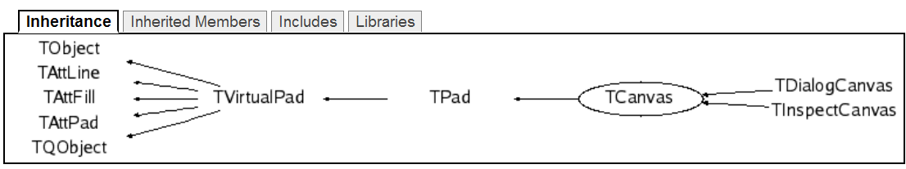
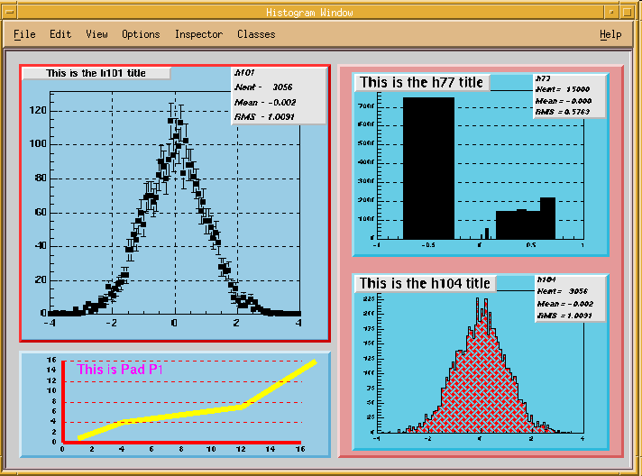
Canvas and Pad

Slide 10
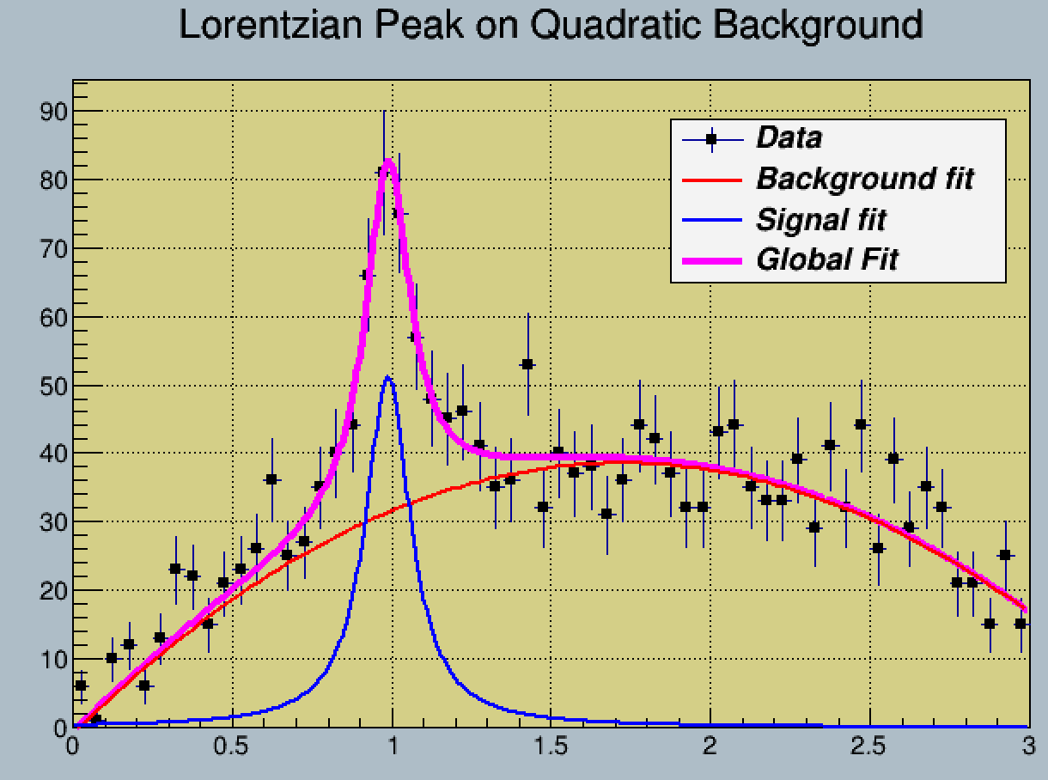
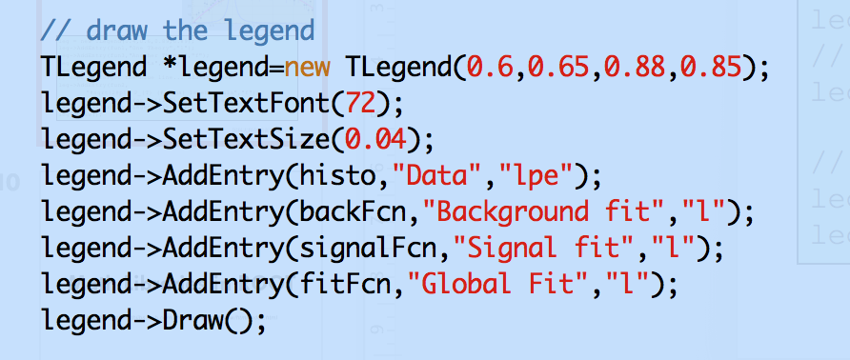
TLegend
tutorials/fit/FittingDemo.C

Slide 11
Math Libraries in ROOT
http://project-mathlibs.web.cern.ch/project-mathlibs/sw/html/index.html

Slide 12
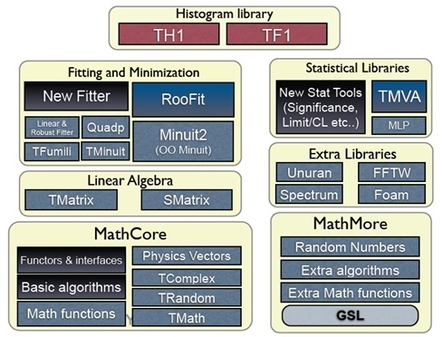
Math Libraries

Slide 13
TMath
In the namespace, TMath a collection of free functions is provided for the following functionality:
  numerical constants (like π, e, h, etc.);
  elementary and trigonometric functions;
  functions to find min and max of arrays;
  statistic functions to find mean and rms of arrays of data;
  algorithms for binary search/hashing sorting;
  special mathematical functions like Bessel, Erf, Gamma, etc.;
  statistical functions, like common probability and cumulative (quantile) distributions
For more details, see the reference documentation of TMath at https://root.cern.ch/root/html534/TMath.html

Slide 14
Random Number Generators
4 different classes exist: TRandom, TRandom1, TRandom2 and TRandom3. All they implement a different type of random generators.
  TRandom Simple Random number generator (periodicity=10**9)
  TRandom1 Ranlux Random number generators with periodicity >10**14
  TRandom2 Random number generator with periodicity of 10**26
  TRandom3 Random number generator: Mersenne Twistor {large period of about 10**6000, relatively fast (only two times slower than TRandom, but two times faster than TRandom2)}
TRandom3 is the recommended random number generator, and it is used by default in ROOT using the global gRandom object.

Slide 15
Random Number Distributions
see: $ROOTSYS/tutorials/math/testrandom.C
The TRandom base class provides functions:
  -Exp(tau) -Integer(imax)
  -Gaus(mean,sigma) -Rndm()
  -Uniform(x1) -Landau(mpv,sigma)
  -Poisson(mean) -Binomial(ntot,prob)...
More information is available in the reference documentation for TRandom.
Random numbers distributed according to a user defined function, in a limited interval, or to a user defined histogram, can be generated in a very efficient way using TF1::GetRandom() or TH1::GetRandom().

Slide 16
MathCore
examples: $ROOTSYS/tutorials/math
Library with the basic Math functionality
build-able as a standalone library
  no dependency on others ROOT packages
  no external dependency
Main content of MathCore:
  Basic and commonly used mathematical functions
    Special and statistics (pdf, cdf) functions
  Interfaces to function and algorithm classes
    Basic implementation of some numerical algorithms
  3D and LorentzVectors
  Random numbers
http://seal.web.cern.ch/seal/MathLibs/MathCore/html/index.html

Slide 17
MathMore
examples: $ROOTSYS/tutorials/math
http://seal.web.cern.ch/seal/MathLibs/MathMore/html/index.html
Library with extra mathematical functionalities
Current content:
  C++ interface to functions and algorithms from the Gnu Scientific Library (GSL)
Mathematical functions implemented using GSL
Algorithms currently present:
  adaptive numerical integration, derivation, root finders, interpolation,1D minimization
repository for needed and useful extra Math functionality
  could include other useful math libraries

Slide 18
Physics Vectors
The physics vector classes describe vectors in three and four dimensions and their rotation algorithms. The classes were ported to ROOT from CLHEP. see:
http://wwwinfo.cern.ch/asd/lhc++/clhep/manual/UserGuide/Vector/vector.html
To use the physics vector classes you need to load the Physics library:
  TVector3: a general three-vector, which may be expressed in Cartesian, polar, or cylindrical coordinates.
  TLorentzVector is a general 4-vector class, which has either the description of position and time (x, y, z, t) or momentum and energy (px, py, pz, E).
  TRotation is a class describing a rotation of a TVector3 object.
  TLorentzRotation is a class to describe the Lorentz transformations including Lorentz boosts and rotations.
gSystem.Load("libPhysics.so");

Slide 19
Trees

Slide 20
Why Should You Use a Tree?
to store large quantities of same-class objects
ROOT has designed the TTree and TNtuple classes
  The TTree class is optimized to reduce disk space and enhance access speed
  A TNtuple is a TTree that is limited to only hold floating-point numbers
  a TTree can hold all kind of data, such as objects or arrays in addition to all the simple types.
When using a TTree, objects are collected and written a bunch at a time, where the TTree takes advantage of compression
  reduce the header of each object
  optimize the data access

Slide 21
Examples for Writing and Reading Trees
examples: $ROOTSYS/tutorials/tree
  tree1.C:a tree with several simple (integers and floating point) variables.
  Copy tree1.C to your own working directory
  Do one of the below ways to run the code
// These examples can be run in many different ways:
// way1: .x tree1.C using the CINT interpreter
// way2: .x tree1.C++ using the automatic compiler interface
// way3: .L tree1.C or .L tree1.C++, then execute functions tree1()

Slide 22
Write a TTree object
void tree1w(){
//create a Tree file tree1.root
//create the file, the Tree and a few branches
TFile f(“tree1.root”,“recreate”);
TTree t1(“t1”,“a simple Tree with simple variables”);
Float_t px, py, pz; Double_t random; Int_t ev; t1.Branch(“px”,&px,“px/F”);
t1.Branch(“py”,&py,“py/F”);
t1.Branch(“pz”,&pz,“pz/F”);
t1.Branch(“random”,&random,“random/D”);
t1.Branch(“ev”,&ev,“ev/I”);
//fill the tree
for (Int_t i=0;i<10000;i++) {
gRandom->Rannor(px,py);
pz = px*px + py*py;
random = gRandom->Rndm();
ev = i;
t1.Fill();
}
//save the Tree header. The file will be automatically closed
//when going out of the function scope
t1.Write();
}

Slide 23
Tree and Memory
Each Node is a branch in the Tree
Memory
0
T.GetEntry(6)
1
2
3
4
5
6
7
8
9
10
11
12
13
14
15
16
17
T.Fill()
18
T

Slide 24
Display the TTree
> root tree1.root
root [0] .ls
TFile** tree1.root
TFile* tree1.root
KEY: TTree t1;1 a simple Tree with simple variables
root [1] t1->ls()
TFile** staff.root
TFile* staff.root
KEY: TTree t1;1 a simple Tree with simple variables
root [2] t1->StartViewer()
root [3] t1->Print()//Print the Tree Structure
root [4] t1->Show(10)//access entry 10 of a tree
root [5] t1->Scan("px:py:pz") //Scan the Variable(s) of the Tree
root [6] t1->Draw("px") // plot a variable in histogram
root [6] t1-> MakeSelector() // create a class for complicated analysis

Slide 25
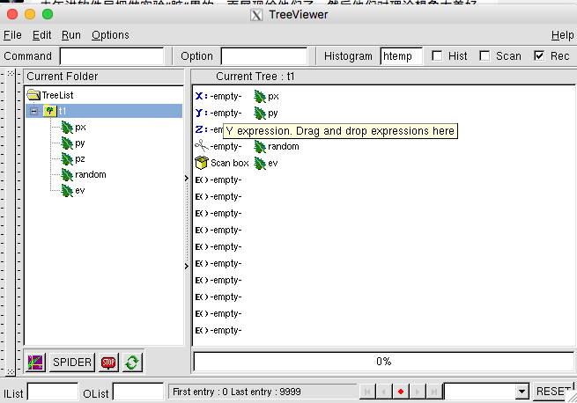
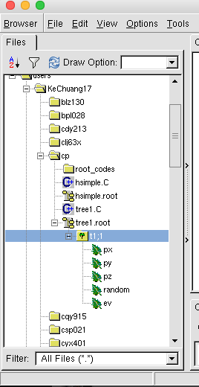
The Tree Viewer
root[] TFile f(“tree1.root")
root[] t1->StartViewer() //invoke the viewer by the TTree object name
//or
root[] TBrowser a //double click the root file to open

Slide 26
Setting Branches
The class for a branch is called TBranch.
  If two variables are independent, and the variables will not be used together, they should be placed on separate branches.
  If the variables are related, such as the coordinates of a point, it is most efficient to create one branch with both coordinates on it.
A variable on a TBranch is called a leaf (TLeaf).
Branches of the same TTree can be written to separate files
To add a TBranch to a TTree, call the method TTree::Branch()
A branch can hold an entire object, a list of simple variables, contents of a folder, contents of a TList, or an array of objects.

Slide 27
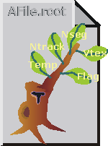
a Branch to Hold a List of Variables
to save is a list of simple variables
tree->Branch("Ev_Branch",&event,"temp/F:ntrack/I:nseg:nvtex:flag/i");
Branch Name
a string describing the leaf list
event is a structure with one float and three integers and one unsigned integer
the address from which the first variable is to be read
Each leaf has a name and a type (default: float) separated by a "/" and separated from the next leaf by a ":"
<Variable>/<type>:<Variable>/<type>
The type can be omitted and if no type is given, the same type as the previous variable is assumed.
"ntrack/I:nseg:nvtex"

Slide 28
Symbols Used for the Type
C: a character string terminated by the 0 character
B: an 8 bit signed integer
b: an 8 bit unsigned integer
S: a 16 bit signed integer
s: a 16 bit unsigned integer
I: a 32 bit signed integer
i: a 32 bit unsigned integer
L: a 64 bit signed integer
l: a 64 bit unsigned integer
F: a 32 bit floating point
D: a 64 bit floating point
If the type consists of two characters, the number specifies the number of bytes to be used. The line describes ntrack to be written as a 16-bit integer (rather than a 32-bit integer):
ntrack/I2

Slide 29
a Branch to Hold an Array
With TTree::Branch() method, you can also add a leaf that holds an entire array of variables.
To add an array of floats, use the f[n] notation when describing the leaf.
To add an array of variable length
Float_tf[10];
tree->Branch("fBranch",f,"f[10]/F");
{
TFile *f = new TFile("peter.root","recreate");
Int_t nPhot;
Float_t E[500];
TTree* nEmcPhotons = new TTree("nEmcPhotons","EMC Photons");
nEmcPhotons->Branch("nPhot",&nPhot,"nPhot/I");
nEmcPhotons->Branch("E",E,"E[nPhot]/F");
}
example: $ROOTSYS/tutorials/tree/tree2.C

Slide 30
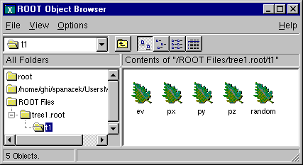
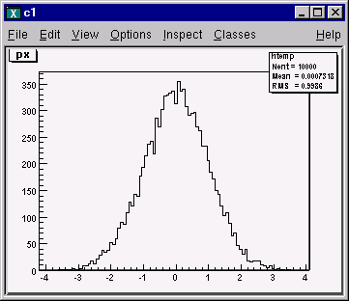
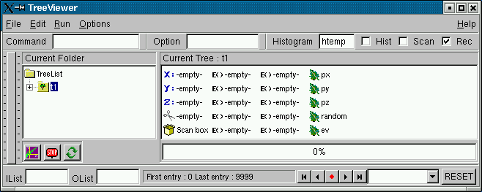
Operating the Tree
Filling the Tree
  call the TTree::Fill() method to fill all branches in the tree
  call the TBranch::Fill() method to fill branches one by one
Viewing the Tree

Slide 31
Reading the Tree
tree1r(): function in tree1.C
GetEntry(): a specific entry can be read into the variables
Float_t px;
t1->SetBranchAddress("px",&px);
void tree1r(){
  TFile *f = new TFile(“tree1.root”);
  TTree *t1 = (TTree*)f->Get(“t1”);
  Float_t px, py, pz;
  Double_t random;
  Int_t ev;
  t1->SetBranchAddress(“px”,&px);
  t1->SetBranchAddress(“py”,&py);
  t1->SetBranchAddress(“pz”,&pz);
  t1->SetBranchAddress(“random”,&random);
  t1->SetBranchAddress(“ev”,&ev);
  //read all entries and fill the histograms
  Long64_t nentries = t1->GetEntries();
  for (Long64_t i=0;i<nentries;i++) {
    t1->GetEntry(i);
  cout<< px << " : " << py << " : " << pz <<endl;
  }
}

Slide 32
Adding a Branch with a Array
tree2w() in tutorials/tree/tree2.C
typedef struct {
  Float_tvect[7];
  Float_tgetot;
  Float_tgekin;
  Float_tvout[7];
  Int_t nmec;
  Int_t lmec[MAXMEC];
  Int_t namec[MAXMEC];
  Int_t nstep;
  Int_t pid;
  Float_tdestep;
  Float_tdestel;
  Float_tsafety;
  Float_tsleng;
  Float_tstep;
  Float_tsnext;
  Float_tsfield;
  Float_ttofg;
  Float_tgekrat;
  Float_tupwght;
} Gctrak_t;
//create a Tree file tree2.root
TFile f("tree2.root","recreate");
//create the file, the Tree
TTree t2("t2","a Tree ");
// declare a variable of the C structure type
Gctrak_t gstep;
t2.Branch("vect",gstep.vect,"vect[7]/F");
t2.Branch("getot",&gstep.getot,"getot/F");
...
t2.Branch("nmec",&gstep.nmec,"nmec/I");
t2.Branch("lmec",gstep.lmec,"lmec[nmec]/I");
...
for (Int_t i=0; i<10000; i++) {
...
t2.Fill();
}
//save the Tree. The file will be automatically closed when going out of the function scope
t2.Write();
}
C and C++ the array variable holds the address of the first element

Slide 33
Adding a Branch to an Existing Tree
void tree3AddBranch() {
TFile f("tree3.root","update");
Float_t new_v;
TTree *t3 = (TTree*)f->Get("t3");
TBranch *newBranch = t3-> Branch("new_v",&new_v,"new_v/F");
//read the number of entries in the t3
Int_t nentries = (Int_t)t3->GetEntries();
for (Int_t i = 0; i < nentries; i++){
new_v= gRandom->Gaus(0,1);
newBranch->Fill();
}
// save only the new version of the tree
t3->Write("",TObject::kOverwrite);
}
the tree is not read-only file
risk loosing the original tree with an unsuccessful modification
enlarges the tree and decreases the performance
ROOT offers the concept of friends for trees (and chains)

Slide 34
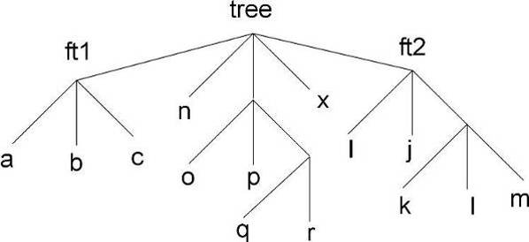
TTree::AddFriend
tutorials/tree/tree3.C
A tree keeps a list of friends
friendship means unrestricted access to the friends data :like adding another branch to the tree without taking the risk of damaging it.
use the TTree::AddFriend method
The TTree (tree) below has two friends (ft1 and ft2) and now has access to the variables a, b, c, i, j, k, l and m.

Slide 35
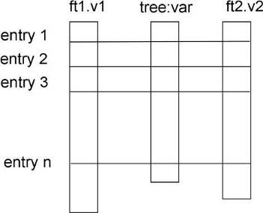
TTree::AddFriend
tutorials/tree/tree3.C
name of the ROOT file where the friend tree is saved
the tree name
tree.AddFriend("ft1","friendfile1.root");
tree.AddFriend("tree1 = tree","friendfile1.root");
when the friend tree has the same name as the original tree
To specify which tree to use in the TTree::Draw method, use the syntax:
If the variable name is unique, the tree or branch name can be omitted.
<treeName>.<branchname>.<varname>
The below commands generate a 3-d scatter plot of variable "var" in the TTree tree versus variable v1 in TTree ft1 versus variable v2 in TTree ft2.
tree.AddFriend("ft1","friendfile1.root");
tree.AddFriend("ft2","friendfile2.root");
tree.Draw("var:ft1.v1:ft2.v2");

Slide 36
Import an ASCII File into a TTree
Long64_t TTree::ReadFile(const char *filename,
const char *branchDescriptor)
If branchDescriptor is set to an empty string (the default), it is assumed that the Tree descriptor is given in the first line of the file with a syntax like A/D:Table[2]/F:Ntracks/I:astring/C.
Lines in the input file starting with "#" are ignored.
A TBranch object is created for each variable in the expression. The total number of rows read from the file is returned.
{
TH1F *h1 = new TH1F("h1","x distribution",100,-4,4);
TFile *f = new TFile("basic2.root","RECREATE");
TTree *T = new TTree("ntuple","data from ascii file");
Long64_t nlines = T->ReadFile("basic.dat","x:y:z");
T->Draw("x","z>2");
T->Write();
}
$ROOTSYS/tutorials/tree/basic2.C

Slide 37
Trees in Analysis
The methods TTree::Draw, TTree::MakeClass and TTree::MakeSelector are available for data analysis using trees.
  The TTree::Draw method is a powerful yet simple way to look and draw the trees contents. It enables you to plot a variable (a leaf) with just one line of code.
  The TTree::MakeClass creates a class that loops over the trees entries one by one. You can then expand it to do the logic of your analysis.
  The TTree::MakeSelector is the recommended method for ROOT data analysis, especially important for large data set in a parallel processing configuration

Slide 38
TTree:Draw()
Long64_t Draw(const char* varexp, const char* selection,
Option_t* option = "",
Long64_t nentries = 1000000000,
Long64_t firstentry = 0)
//root file from tree/staff.C:
TFile f ("staff.root");
T->Draw("Cost") //1-D plot
T->Draw("Cost:Age") //2-D plot
T->Draw("Cost:Age:Children") //3-D plot
The value of the selection is used as a weight when
filling the histogram: any C++ operator, and some
functions defined in TFormula can be used
Selection = "weight *(boolean expression)"
option is same as TH1::Draw method.

Slide 39
Using TCut Objects in TTree::Draw
A TCut is a specialized string object used for TTree selections.
Operators ” =, +=, +, *, !, &&, || ” are overloaded
TCut cut1 = "px<1"
TCut cut2 = "py>2"
//then
cut1 && cut2
//result is the string "(px<1)&&(py>2)"
root[] TCut c1 = "px > 0.3"
root[] TCut c2 = "py < -0.3"
root[] TCut c3 = c1 && c2
root[] t1.Draw("pz", c1)
root[] t1.Draw("pz", c1 || "px>0")
root[] t1.Draw("pz", c1 && c2)
root[] t1.Draw("pz", "random*(px > 0.3 && py < -0.3)")
random是Tree中的一个branch数据
这个例子里面，作为了一个weight因子；

Slide 40
Setting the Range in TTree::Draw
two more optional parameters: one is the number of entries and the second one is the entry to start with. For example, this command draws 1000 entries starting with entry 100:
TTree::Draw Examples:
Sec. 12.20 in the User Guide
https://root.cern/root/htmldoc/guides/users-guide/ROOTUsersGuide.html
myTree->Draw("Cost:Age", "","",1000,100);

Slide 41
Filling a Histogram
root[] TFile *f = new TFile("tree1.root")
root[] t1->Draw("px >> myHisto")
root[] myHisto->Print()
TH1.Print Name = myHisto, Entries= 10000, Total sum= 10000
//to append more entries to the histogram
root[] t1->Draw("py >>+ myHisto")
//To set the number of bins for a specific histogram
t1->Draw("px*px >> hsq(100,0,10)")
// plot px*px between 0 and 10 using 100 bins
t1->Draw("sqrt(px):py*py >> hsq2(50,0,10,50,0,3)")
// plot sqrt(px) against py*py 50 bins in x-direction and 50 bins in y-direction;
tree.Draw("sqrt(px)>>+hsq","py>0");
//will not reset hsq and continue filling the histogram

Slide 42
Using TTree::MakeClass
root[] .L libEvent.so // in $ROOTSYS/test
root[] TFile *f = new TFile("Event.root");
root[] f->ls();
TFile**Event.rootTTree benchmark ROOT file
TFile*Event.rootTTree benchmark ROOT file
KEY: TH1Fhtime;1 Real-Time to write versus time
KEY: TTree T;1An example of a ROOT tree
root[] T->MakeClass("MyClass")
Files: MyClass.h and MyClass.C generated from Tree: T
When you need to do some programming with the variable in the tree, use TTree::MakeClass
MyClass.h contains the class definition and MyClass.C contains the MyClass::Loop() method.
Modify MyClass::Loop to implement analysis: select entries, fill histograms, draw plots and output files.
Load MyClass and execute the Loop() function

Slide 43
Using TTree::MakeSelector
With a TTree to make a selector to process a limited set of entries: especially important in a parallel processing configuration where we can specify which entries to send to a processor.
  the TTree::MakeSelector method creates two files
  The TTree::Process method is used to specify the selector and the entries
TSelector::Begin() - this method is called every time a loop over the tree starts. This is a convenient place to create your histograms.
TSelector::Process() - it is called to process an event. It is the user's responsibility to read the TTree entries in memory, apply entry selections and fill the histograms.
TSelector::Terminate() - it is called at the end of a loop on a TTree. This is a convenient place to draw and fit your histograms.

Slide 44
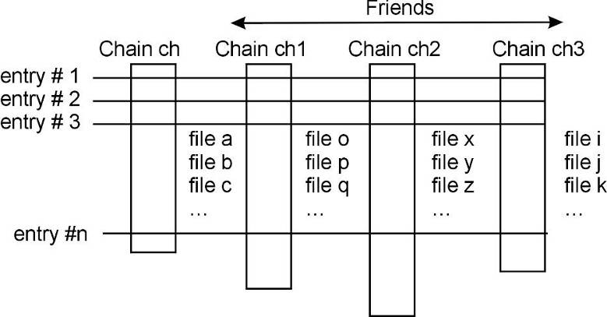
Chains
A TChain object is a list of ROOT files containing the same tree
TChain::AddFriend: A TChain has a list of friends similar to a tree
TChain chain("T");// name of the tree is the argument
chain.Add("file1.root");
chain.Add("file2.root");
chain.Add("file3.root");
chain.Draw("x");
// a chain with 20
// trees from 20 files
TChain ch("t");
TChain ch1("t1");
TChain ch2("t2");
TChain ch3("t3");
ch.AddFriend("t1")
ch.AddFriend("t2")
ch.AddFriend("t3")

Slide 45
ACLiC
The Automatic Compiler of Libraries for CINT
Instead of having CINT interpret your script, your scripts are compiled, linked and dynamically loaded using the C++ compiler and linker. The advantage of this is that your scripts will run with the speed of compiled C++ and that you can use language constructs that are not fully supported by CINT.
Usage:
  The + command rebuild the library only if the script or any of the files it includes are newer than the library.
root[] .L MyScript.C+
root[] .files
…
*file="/home/./MyScript_C.so“
//To ensure that the shared library is rebuilt you can use the ++ syntax:
root[] .L MyScript.C++

Slide 46


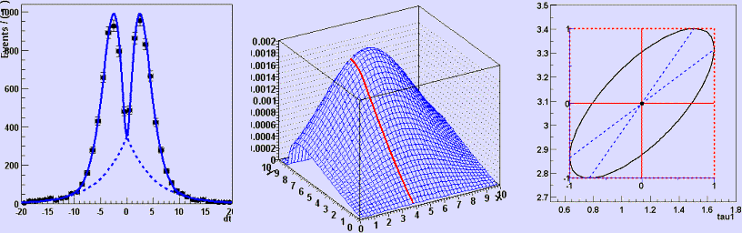
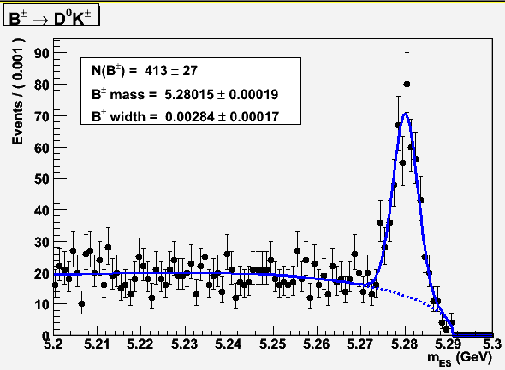
RooFit
A general purpose tool kit for data modeling
Wouter Verkerke (UC Santa Barbara)
David Kirkby (UC Irvine)

Slide 47
RooFit
The RooFit library provides a toolkit for modeling the expected distribution of events in a physics analysis. Models can be used to perform unbinned maximum likelihood fits, produce plots, and generate "toy Monte Carlo" samples for various studies.
RooFit is primarily designed as a particle physics data analysis tool, but its general nature and open architecture make it useful for other types of data analysis also.
The natural modeling language for a data statistics are probability density functions F(x;p) that describe the probability density: the distribution of observables x in terms of function in parameter p.
用户手册: RooFit_Users_Manual_2.91-33.pdf

Slide 48
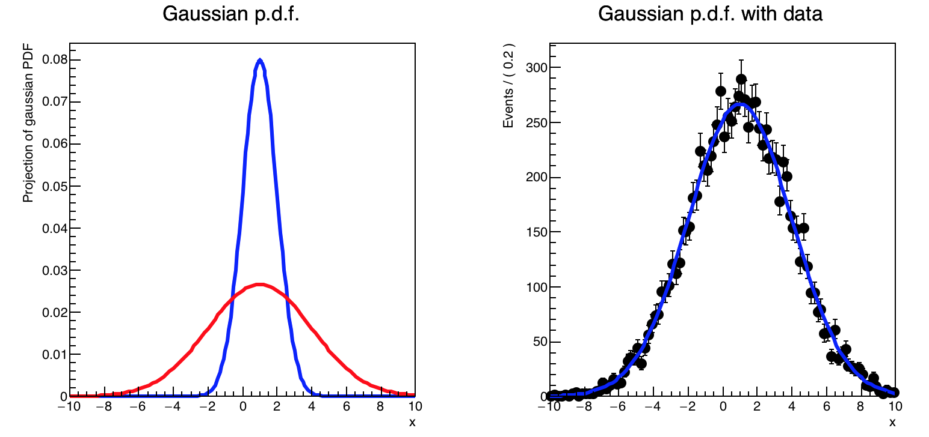
To Run RooFit
Tutorial macros are available in $ROOTSYS/tutorials/roofit/rf101_basics.C
  Try to execute and understand those macros!!!
  root[] .x rf101_basics.C

Slide 49
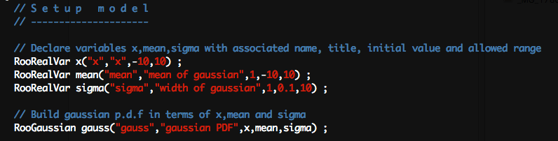
Setup model (function)
$ROOTSYS/tutorials/roofit/rf101_basics.C

Slide 50
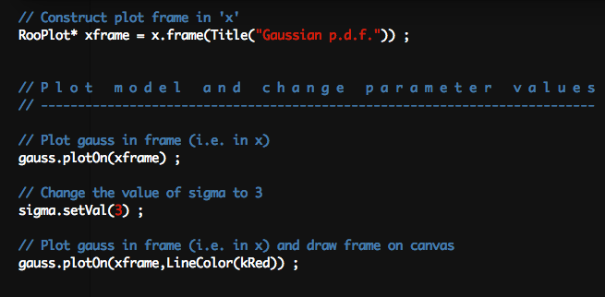
Plot the model (function)
$ROOTSYS/tutorials/roofit/rf101_basics.C

Slide 51
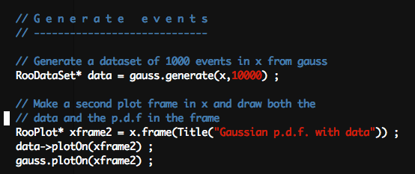
Generate MC samples and plot

Slide 52
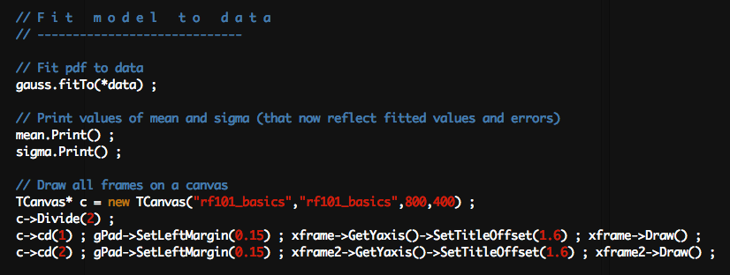
Fit to the MC sample and plot

Slide 53
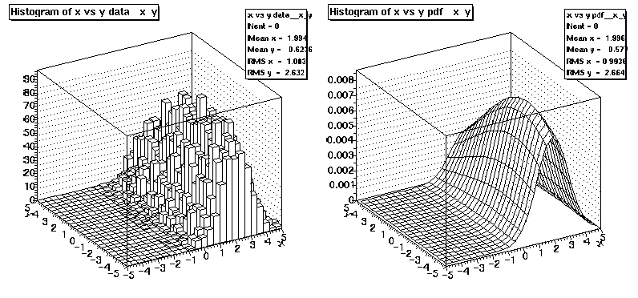
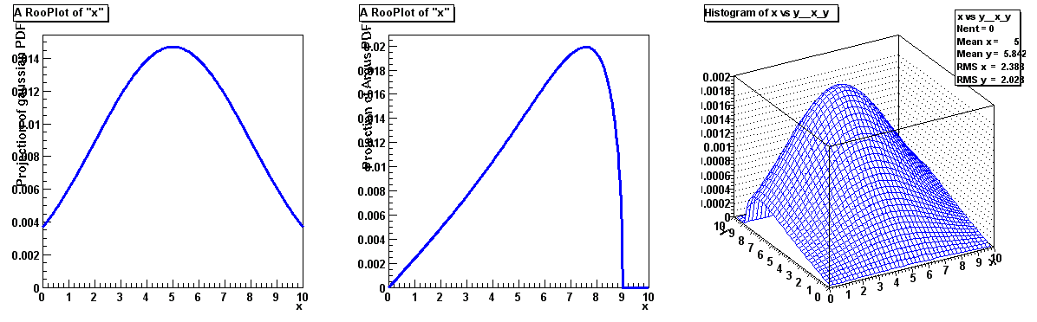
Data Modeling and Analysis
→
Distribution of observables x
→
Define data model
Probability density function F(x; p, q)
  Physical parameters of interest p
  Other parameters q to describe
  detector effect (resolution,efficiency,…)
  Normalized over allowed range of the
  observables x w.r.t the parameters p and q
→
→
→
→
→
→
→
→
→
Fit model to data
Determination of p,q
→
→

Slide 54
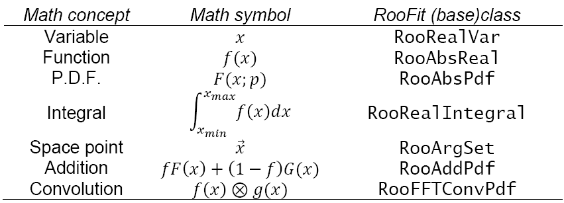
Design
All RooFit models always consist of multiple objects.
p.d.f.s are easily constructed in higher dimension and (unbinned) maximum likelihood parameter estimation technique is used.
  minimization of a RooFit calculated likelihood function by the ROOT implementation of MINUIT.

Slide 55
Data/Model language
Straightforward correlation between mathematical representation of formula and RooFit code
Math
RooGaussian g
RooFit
diagram
RooRealVar x
RooRealVar m
RooFormulaVar sqrts
RooRealVar s
RooFit
code
RooRealVar x(“x”,”x”,-10,10) ;
RooRealVar m(“m”,”mean”,0) ;
RooRealVar s(“s”,”sigma”,2,0,10) ;
RooFormulaVar sqrts(“sqrts”,”sqrt(s)”,s) ;
RooGaussian g(“g”,”gauss”,x,m,sqrts) ;

Slide 56
Data/Model language
All objects are self documenting
Associated data
Limits, units, plot labels,…
stored in object
Name – Unique identifier of object
Title – More elaborate
description of object
Initial range
Objects
representing
a variable
RooRealVar mass(“mass”,”Invariant mass”,5.20,5.30) ;
RooRealVar width(“width”,”B0 mass width”,0.00027,”GeV”);
RooRealVar mb0(“mb0”,”B0 mass”,5.2794,”GeV”) ;
RooGaussian b0sig(“b0sig”,”B0 sig PDF”,mass,mb0,width);
Initial value
Optional unit
Function
object
References to variables

Slide 57
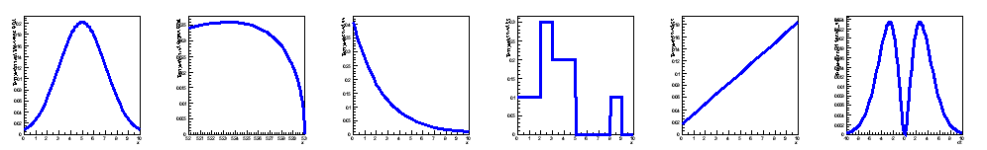
Modularity
RooFit provides a collection of standard PDF classes, e.g.
  Gaussian, Exponential, Polynomial (basic)...
  Argus, Crystal Ball, B-Decay, Breit-Wigner, Voigtian (physics inspired)
  Histogram, KEYS (non-parametric)
Generic expression based PDF also available:
  Based on TFormula
  Expression normalized via numeric integration
Easy for users to write/contribute new PDF/function classes
RooGenericPdf gp(“gp”,”Generic”,”exp(x*y+a)-b*x”, RooArgSet(x,y,a,b));

Slide 58
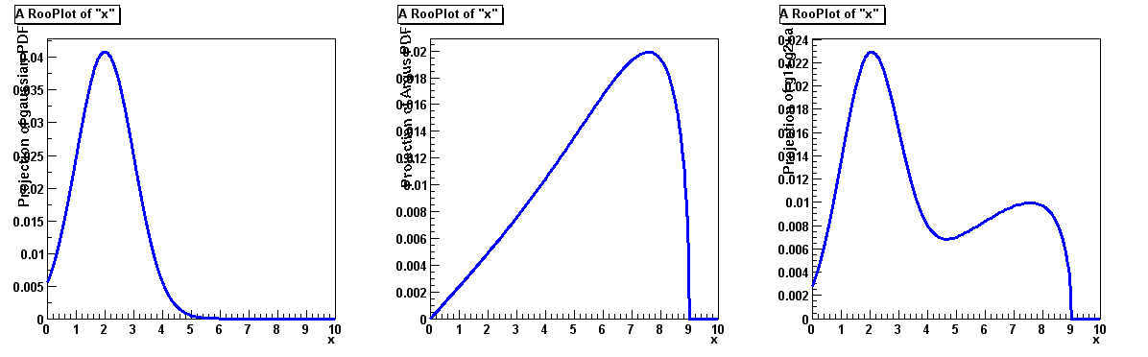
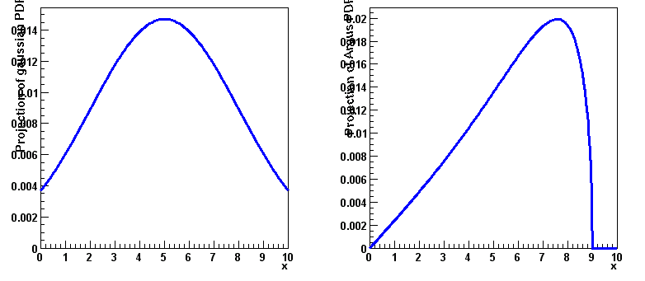
Modularity
Complex PDFs be can be trivially composed from basic PDFs
  Addition
  Multiplication
+
=
*
=

Slide 59
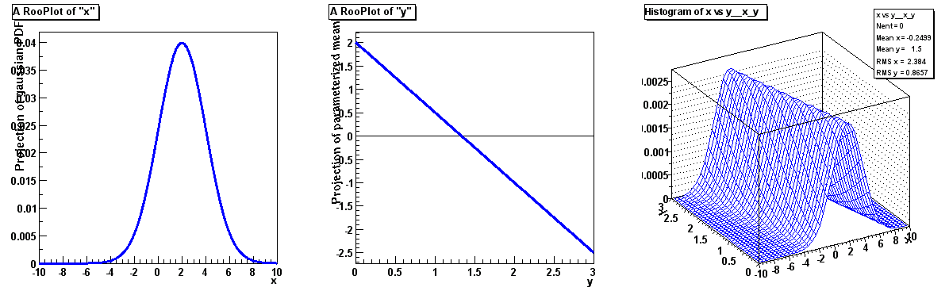
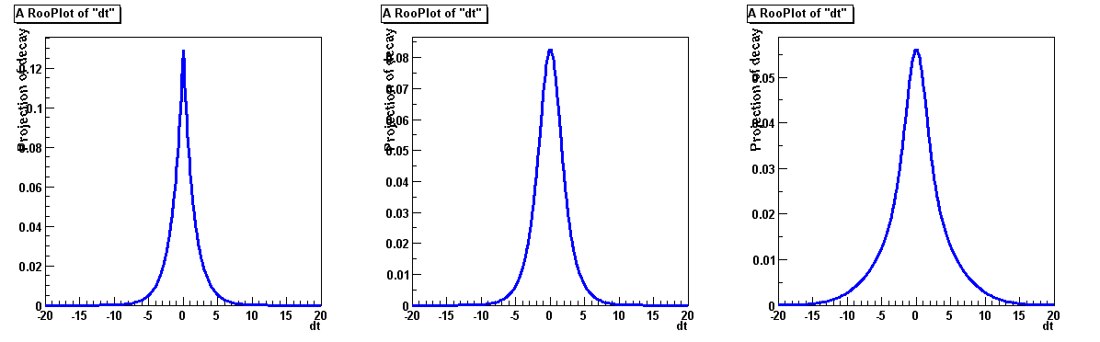
Modularity
  Composition (‘plug & play’)
  Convolution
&
=
g(x;m,s)
m(y;a₀,a₁)
g(x,y;a0,a1,s)
Possible in any PDF
No explicit support in PDF code needed
⊗
=

Slide 60
Datasets and Data Types
Unbinned
Weighted unbinned
Binned
x | y | z
1 | 3 | 5
2 | 4 | 6
1 | 3 | 5
2 | 4 | 6
x | y | z | wgt
1 | 3 | 5 | 0.11
2 | 4 | 6 | 0.75
1 | 3 | 5 | 0.30
2 | 4 | 6 | 0.92
RooDataSet
RooDataHist
Many RooFit methods
accept this abstract data
type → Use data set
types interchangeably
RooAbsData
Implemented with TTrees
Current row represented by set of RooFit value objects
Unlimited number of dimensions (also binned)
Dimensions may be mix of real,discrete,or string values
Import data from existing ROOT types:
  TTree, ASCII file →RooDataSet
  THx, RooDataSet→RooDataHist

Slide 61
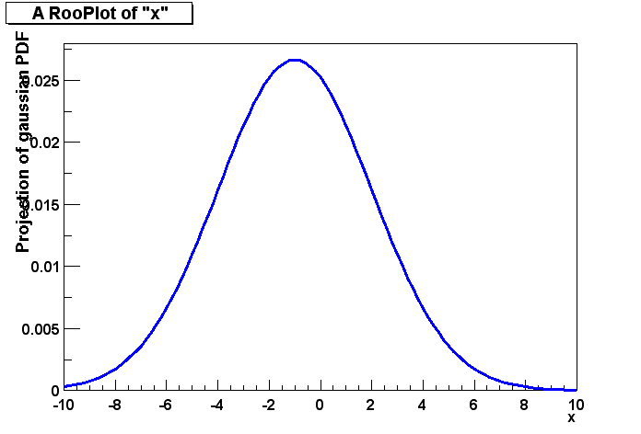
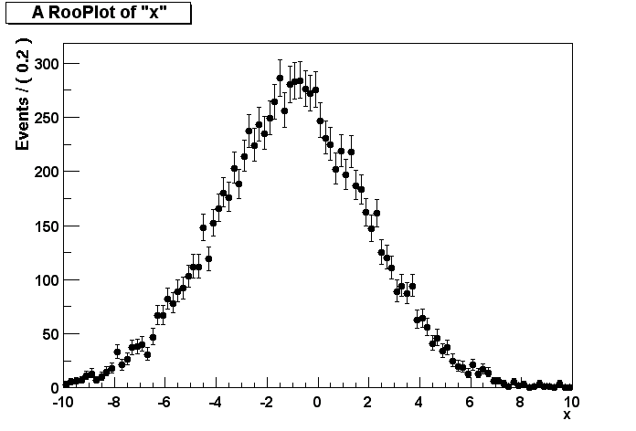
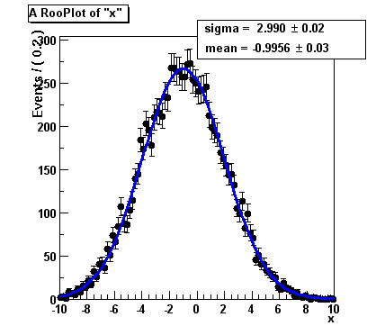
Fitting
Given any PDF, fitting is a 1-line operation
PDF
Dataset
fitResult stores snapshot of parameters,
correlation matrix etc…
Fit result reflected in parameters of gauss
fitResult = gauss.fitTo(data)
COVARIANCE MATRIX CALCULATED SUCCESSFULLY
FCN=25054.9 FROM HESSE STATUS=OK 10 CALLS69 TOTAL
EDM=3.65627e-06STRATEGY= 1ERROR MATRIX ACCURATE
EXT PARAMETERINTERNALINTERNAL
NO. NAMEVALUEERROR STEP SIZE VALUE
1mean-9.95558e-01 3.01321e-02 6.59595e-04-9.95558e-01
2sigma2.99001e+00 2.20203e-02 9.66748e-05 2.99001e+00
ERR DEF= 0.5
EXTERNAL ERROR MATRIX.NDIM=25NPAR=2ERR DEF=0.5
9.079e-04 -1.787e-05
-1.787e-054.849e-04
Fit

Slide 62
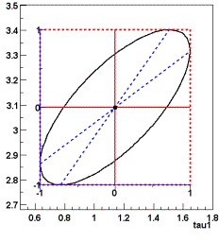
Fitting
RooFit provides out-of-the-box support for
  Unbinned maximum likelihood fit [ PDF & unbinned dataset ]
  Unbinned weighted maximum likelihood fit [ PDF & weighted unbinned dataset ]
  Binned maximum likelihood fit [ PDF & binned dataset ]
  Extended maximum likelihood fit (binned, unbinned, unbinned weighted)
  Binned chi-square fit [ PDF & binned dataset ]
  Support for other user-defined goodness-of-fit quantities
Easy to add additional terms to fit function
  Penalty terms, Lagrange multiplier etc.
Seamless integration of MINUIT with RooFit objects
  Interactive MINUIT sessions possible
  from ROOT command line (in C++)
  Full fit output, including correlation matrix,
  savable for easy access later
  Graphical analysis of correlation matrix elements
Notes:
Second bullet not clear

Slide 63
Event Generation
PDF
Given any PDF, Toy Monte Carlo
generation Is a 1-line operations
data = gauss.generate(x,1000)
Dataset

Slide 64
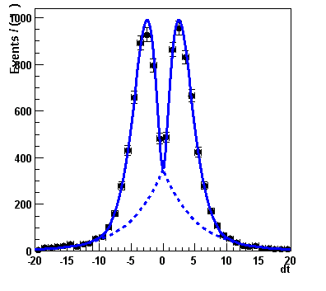
Plotting Support
Plot container class holds all elements of 1D plot together
  Histograms of datasets, PDF projections, text boxes, arrow,…
Created from variable object.
Remembers variable on x-axis
RooPlot* frame = dt.frame() ;
Curve always normalized to last plotted dataset in frame
data->plotOn(frame) ;
pdf->plotOn(frame) ;
For multi-dimensional PDFs:
appropriate 1-dimensional projection is automatically created:

Slide 65
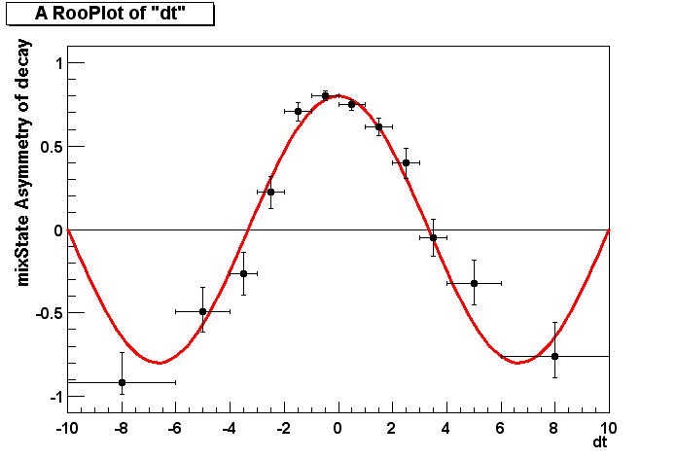
Plotting Support
Adaptive spacing of curve points to achieve 1‰ precision
Binomial errors on asymmetry histograms
Poisson errors on histogram
Easy plotting of summed PDF components
Variable bin sizes OK (contents will be adjusted, if necessary)

Slide 66
Data Fitting is Important
To extract the wanted information or physics results from the raw data.
To testify the consistency between the theoretical model and experimental measurement
The reliability of fitting results and the accuracy of error matrix needs effort to be justified for any fitting algorithm.
ROOT provides a wide variety of powerful fitting tools: MINUIT, RooFit, FUMILI, multi-variate analysis tools, and fitting alogrithms, like binned chi-square fit, (un)binned maximum likelihood fit, extended maximum likelihood fit.
RooFit is a very powerful set of statistical analysis toolkits. It is strongly recommended!!!

Slide 67
练习！
学习使用TTree的主要操作，以及和直方图结合操作
ROOFIT： 读懂$ROOTSYS/tutorials/roofit中rf101_basics.C、rf102_dataimport.C、 rf201_composite.C 三个例子。

