Slide 1
Detection of Microquasars at ultra-high energies by LHAASO
Cong Li, Z. Cao, R.Y. Liu, J. Li, K.Wang, R.Z.Yang, Y.H. Yu, S.Z. Chen, S.C. Hu,S.Q.Xi
2025.3.21
LHAASO Collaboration

Slide 2
Outline
Introduction
LHAASO
Recent results from LHAASO
Conclusion

Slide 3
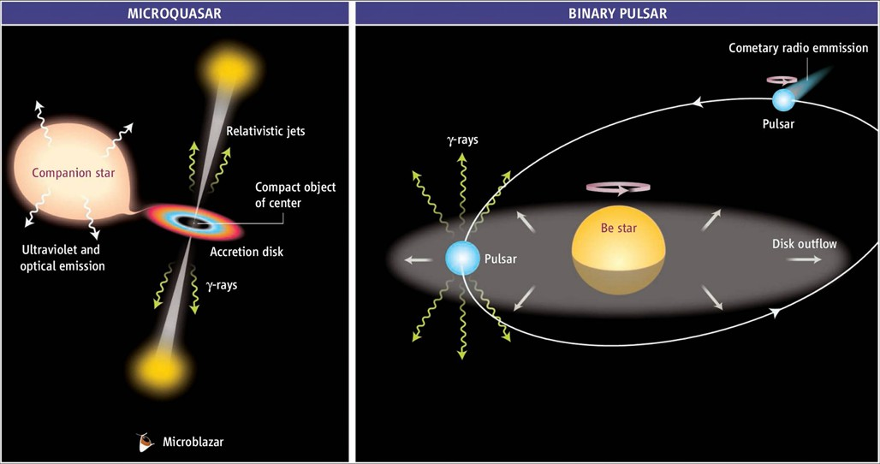
Binaries
Binaries provide us the opportunity to explore particle acceleration , radiation mechanisms, as well as accretion processes in extreme environments.
colliding-wind binary system

Slide 4
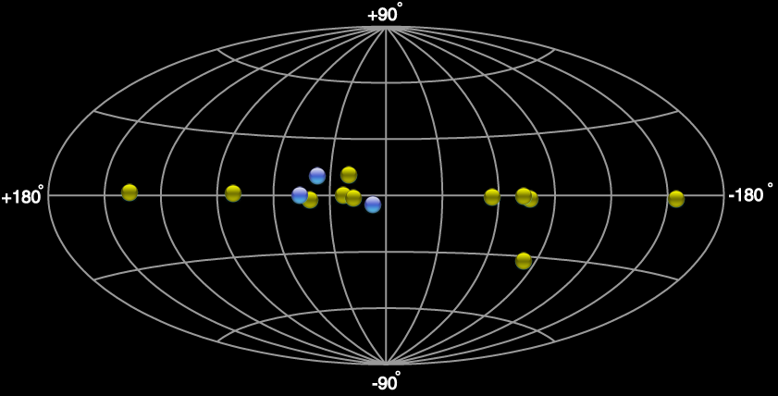
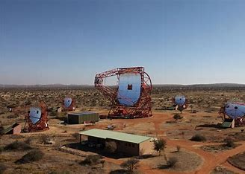
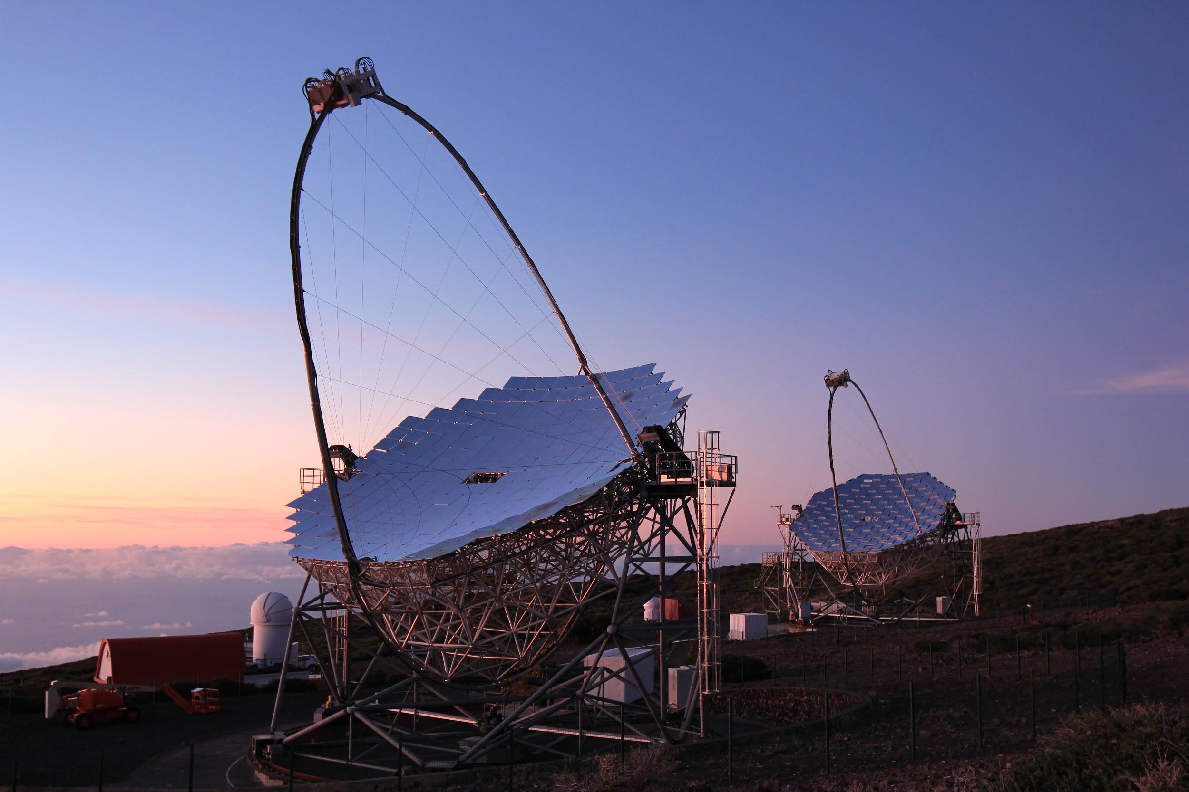
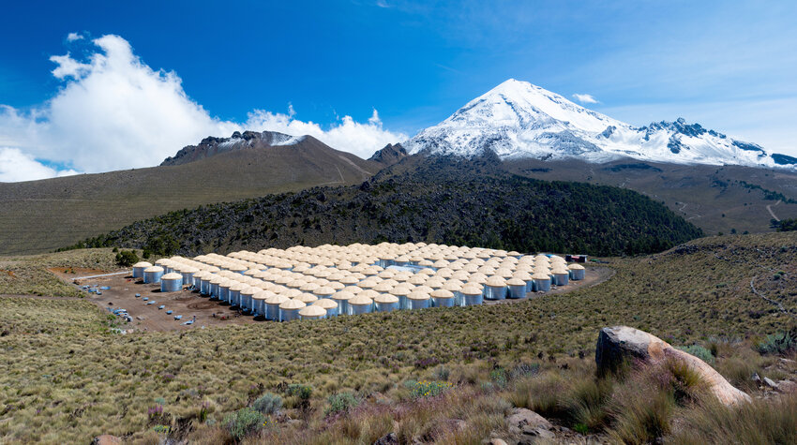
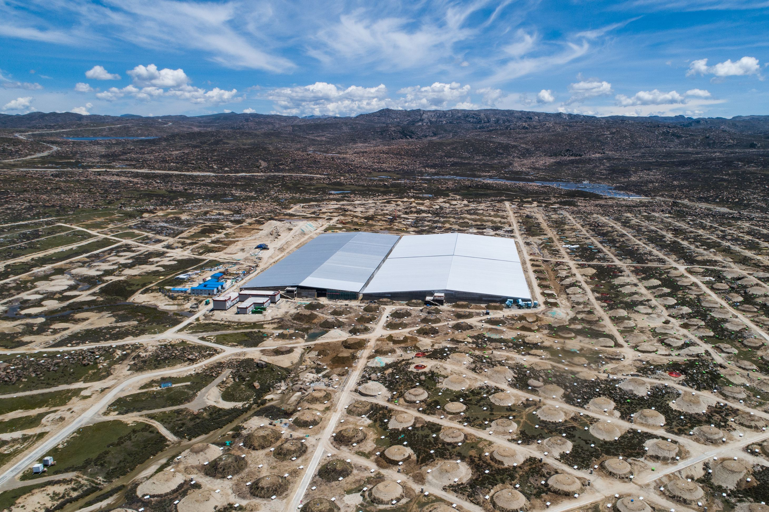
Binaries at TeVCat
Great advances has achieved benefitting from the development of detectors.
PSR?+Massive star: 8
Micro-quasars： 4
Others：Eta Carinae ..

Slide 5
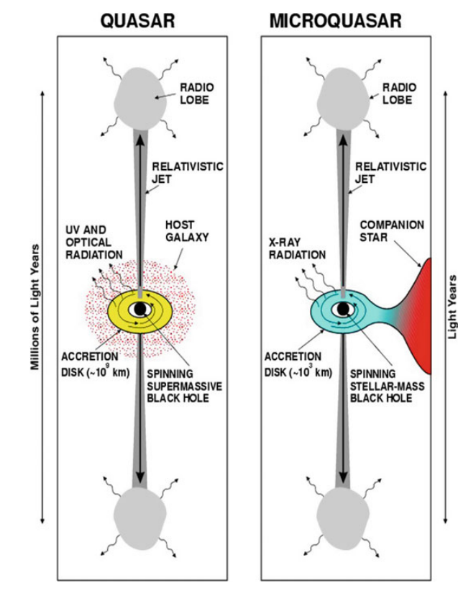
Microquasar
Microquasar has very similar properties as quasar. They both has jets, accretion disk and so on.
Unique characteristics for micro-quasar:
Companion star
Much smaller size
Closer distance
…
Orbital light curve..
Fast change of status..
Possible detection of UHE

Slide 6

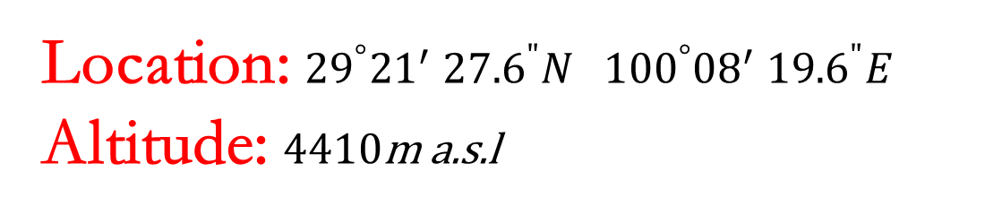
Location: ${29}^{°}{21}^{′}$ ${27.6}^{"}N{ 100}^{°}{08}^{′} {19.6}^{"}E$
Altitude: 4410m a.s.l

Slide 7
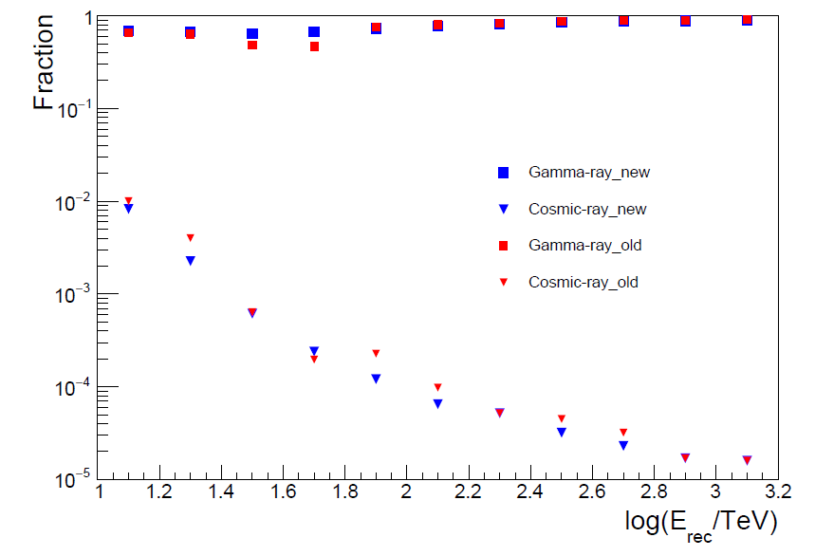
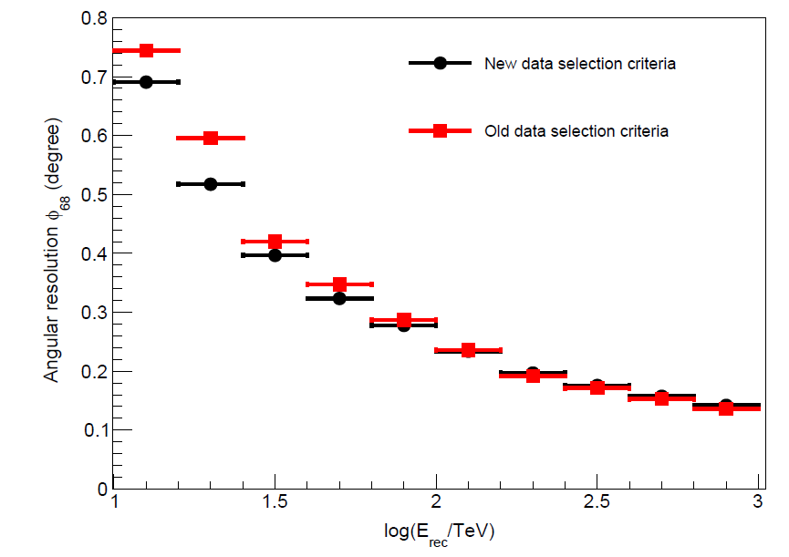

Performance of KM2A
Rejection power:1.e-4@100TeV
Psf:${0.25}^{0}$@100TeV
arXiv:2401.01038v2

Slide 8
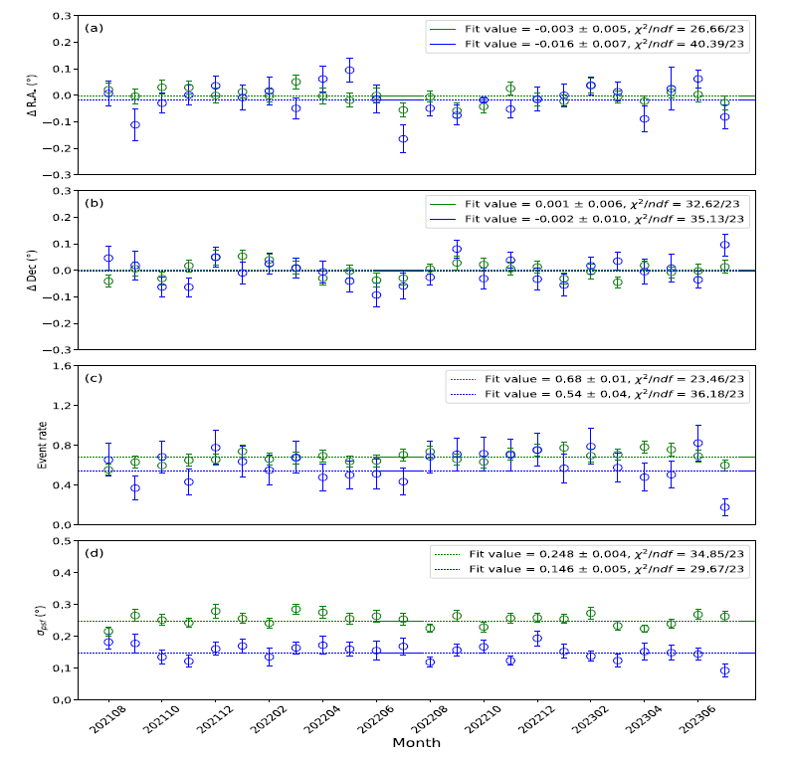
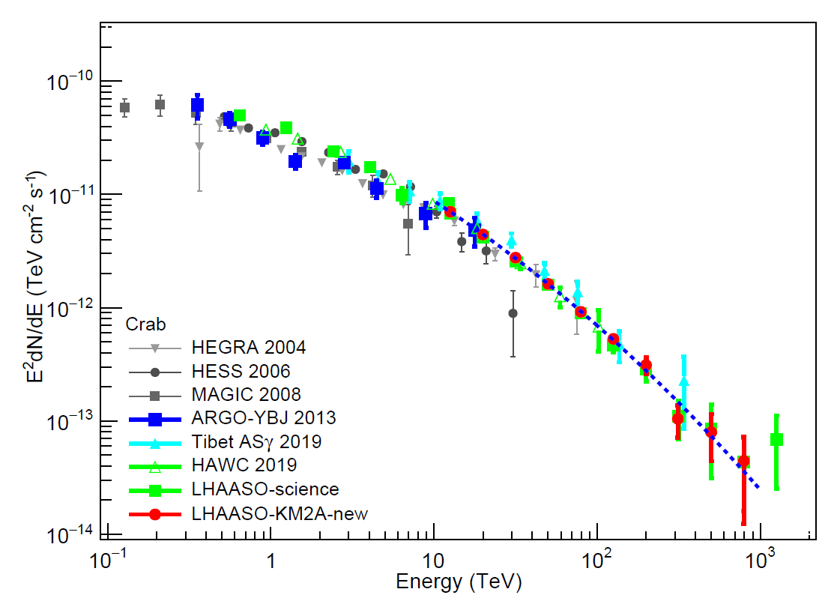
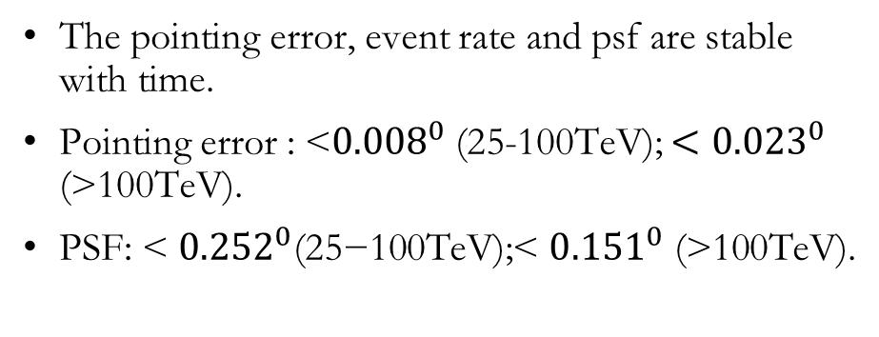
Calibration with Crab Nebula
The pointing error, event rate and psf are stable with time.
Pointing error : <${0.008}^{0}$(25-100TeV); ${<0.023}^{0}$ (>100TeV).
PSF: < ${0.252}^{0}\text{(25−100}\text{TeV}\text{);}$< ${0.151}^{0}$ (>100TeV).

Slide 9
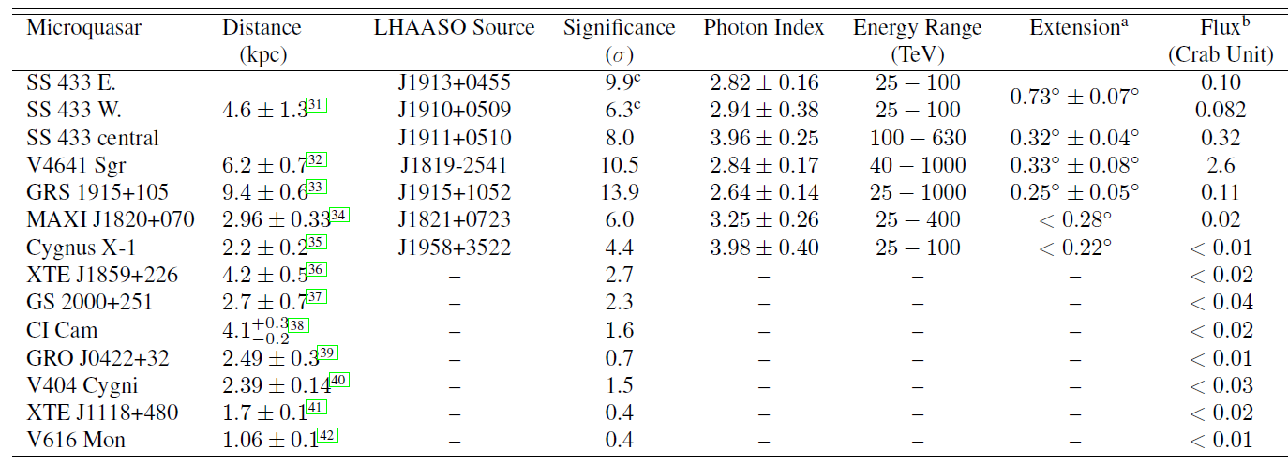
UHE emission around microquasars
Searched for UHE emission within the PSF around 12 microquasars. Positive signals were detected around 5 microquasars, suggesting possible associations.

Slide 10
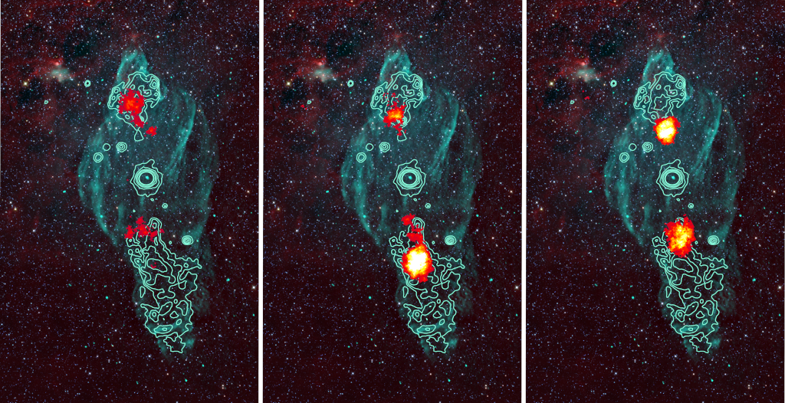
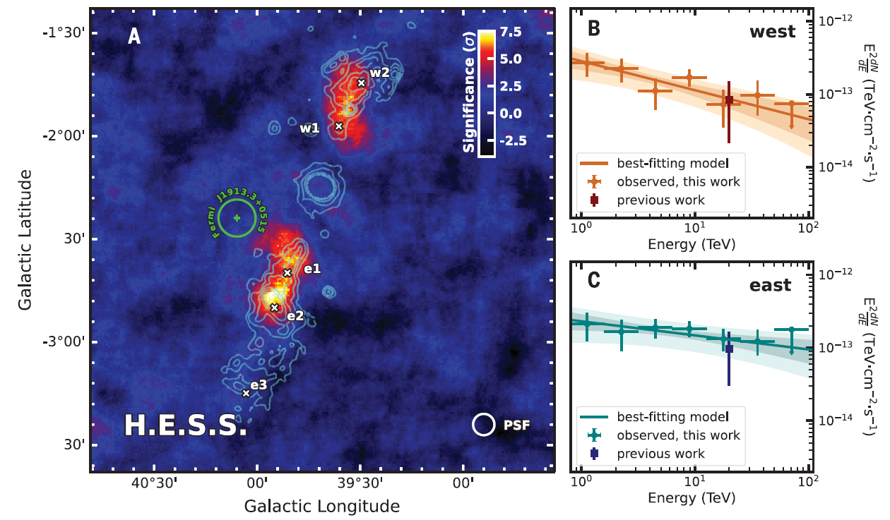
SS433
The compact object is likely a black hole and the companion star is a supergiant star. SS433 is located inside W50 nebula.
TeV emission from the jet lobs of SS433 was reported by HAWC；(Abeysekara et al. 2018).
Shift of position of TeV with energy was lately reported by HESS.
(H.E.S.S. Collaborationet al. 2024).

Slide 11
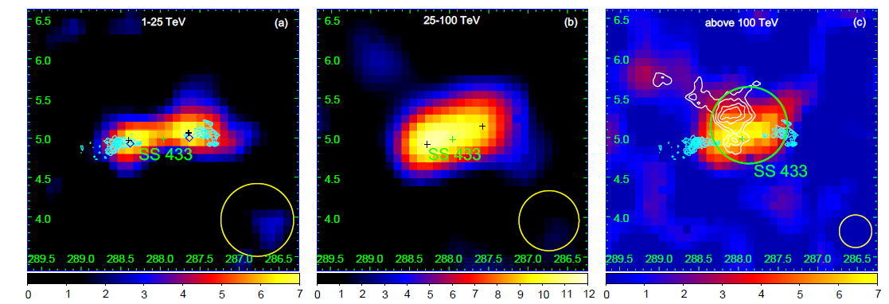
SS433
Detection of gamma-ray emission >100TeV with significance >5 sigma；
The UHE emission is partly overlapped with HI cloud at the same distance of SS433, indicating contribution from hadronic process.

Slide 12
GRS 1915+105
GRS 1915+105 hosts a K giant star in orbit around a black hole.
Observation were undertaken by HESS and MAGIC with a total live time of 24.1h and 22h, but no positive signal was detected.
95% upper limit by HESS:
I(>410 GeV) < 3.2 × 10^-13ph cm^-2s^-1
95% upper limit by MAGIC:
I(>250GeV)<1.17 × 10^-12 ph cm^-2 s^-1
A&A 508, 1135–1140 (2009)

Slide 13
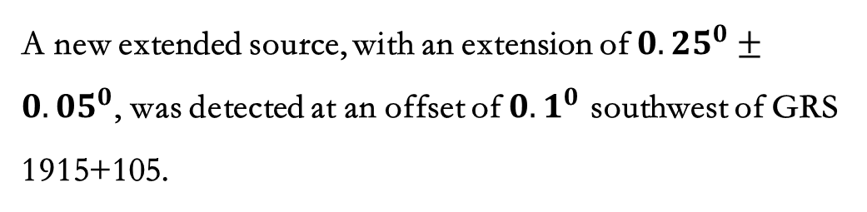
GRS 1915+105
A new extended source, with an extension of ${0.25}^{0}±{0.05}^{0}$, was detected at an offset of ${0.1}^{0}$ southwest of GRS 1915+105.
Other possible candidates:
Radio pulsar PSR J1914+1054g
Spindown luminosity: 4 × 10^35 ergs/s;
Age: 82kyr;
The larger offset, 0.26deg, making it unlikely the main contribution to LHAASO J1915+1052.
Supernova remnant (SNR) G045.7-00.4
No clear association between LHAASO J1915+1052 and CO at G045.7-00.4 distance.

Slide 14
GRS 1915+105
Best fitted by power-law:
Systematic errors:
Uncertainty from extension of nearby sources
Uncertainty of GDE flux

Slide 15
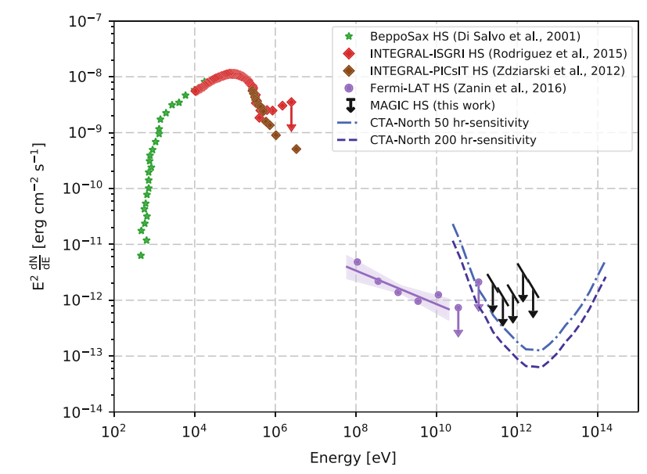
Cygnus X-1
Cygnus X-1 contains a black hole with a mass of more than 20 solar mass and a O9.7Iab supergiant.
MAGIC reported a fast-varying signal for 79 minutes at a significance of 4.1 sigma.
However, this result is not confirmed by future observations.
arXiv:1709.01725v1

Slide 16
Cygnus X-1
A point source is detected with significance of 4.4 sigma above 25 TeV.
The new source is at the direction of nebula probably inflated by the jet of BH.

Slide 17
Cygnus X-1
No variability is observed.

Slide 18
MAXI J1820+070
MAXI J1820+070 is a low-mass X-ray binary with a black hole as the compact object.
HESS,MAGIC and VERITAS monitored the source during 2018 outburst. A total of 59.5 hours were observed, but no positive signal was detected.
Upper limit at a level of 10^-12 ergs.cm^-2.s^-1 was set at TeV.
MNRAS 517, 4736–4751 (2022)

Slide 19
MAXI J1820+070
LHAASO source is at offset of 0.27◦ northeast of the BH, it is in alignment with the propagation direction of the receding ejecta, and no variability was detected .

Slide 20
MAXI J1820+070
Best fitted by power-law:

Slide 21
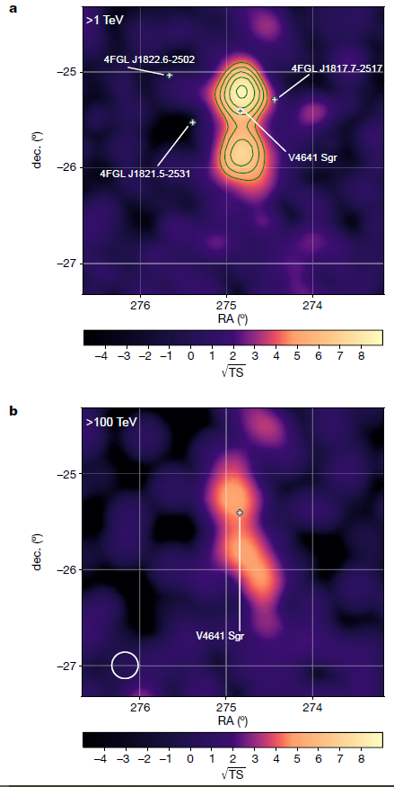
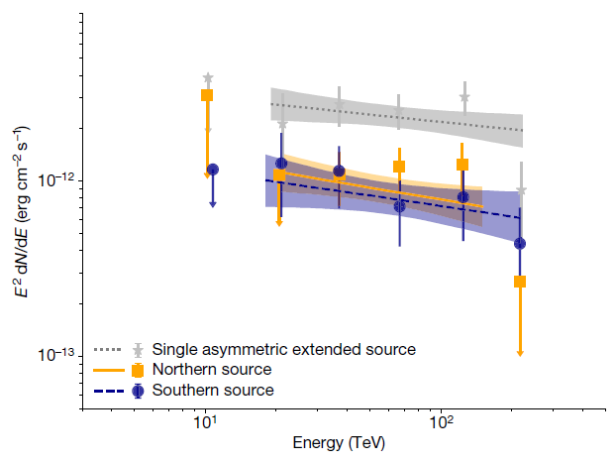

V4641 Sgr
（dec:${−25.4}^{0}$）
V4641 Sagittarii (V4641 Sgr) is a binary system containing a black
hole and B-type main-sequence companion star and has an orbital period of 2.8 days.
HAWC reported the detection of TeV emission around V4641 Sgr
(HAWC Collaboration 2024).

Slide 22
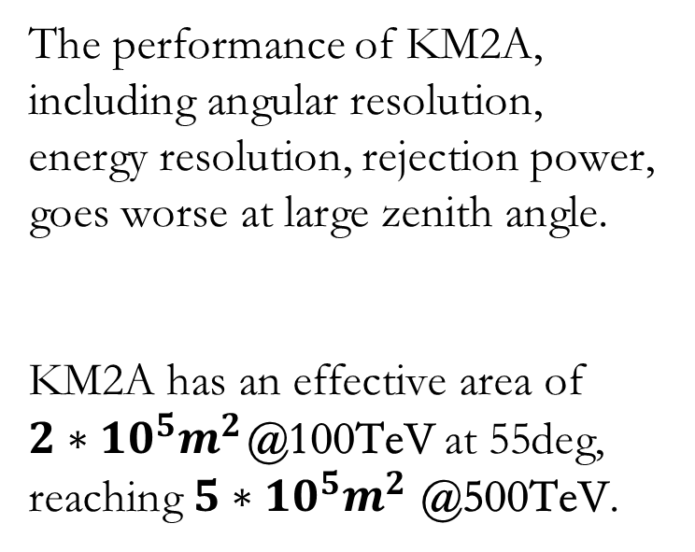
Performance of KM2A at large zenith angle
The performance of KM2A, including angular resolution, energy resolution, rejection power, goes worse at large zenith angle.
KM2A has an effective area of ${2∗10}^{5}m^{2}$@100TeV at 55deg,
reaching ${5∗10}^{5}m^{2}$@500TeV.

Slide 23


Performance of KM2A at large zenith angle
Zenith angle: ${50}^{0}$—${60}^{0}$
The results measured by different
zenith angle events are consistent.
Declination of Moon: ${−20}^{0}$—${−28}^{0}$

Slide 24
V4641 Sgr
A new extended source was detected around V4641 Sgr at an offset of 0.19deg.
The extension is 0.33◦ ± 0.08◦.
The improvement of TS is 13.9 using an asymmetric 2D Gaussian template, indicating a ellipse shape.
No other possible candidates.

Slide 25
V4641 Sgr
The flux is consistent with HAWC’s result around 100TeV, extending to ~800TeV.
The hard spectrum up to PeV favors a hadronic process, and the apparent protons reaches energy of ~10PeV.

Slide 26
Other microquasars
No significant signal was detected from other microquasars（<3 sigma）

Slide 27
Other microquasars
Upper limit at :~ ${10}^{−14}ergs∗{cm}^{−2}∗s^{−1}$@100TeV

Slide 28
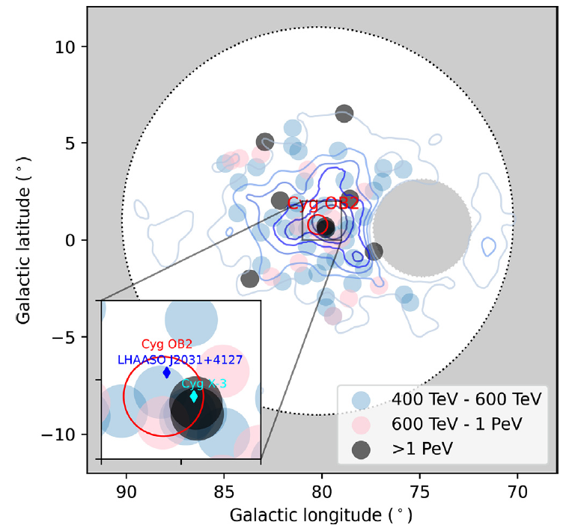
UHE emission from the central binary system?
Detection of UHE emission from the binary system will
provide unambiguous evidence for particle acceleration around
microquasar.
It will also help to explore the physical process happened at the
base of jet and around the BH.
From previous work, 7 out of the 66 photons with energy >400 TeV and 2 out of 8 with energy > 1PeV are located inside a compact region with a radius of about 0.5 degree. This excess in the core region is about 5–10 times higher than expectation of bubble.
Science Bulletin 69

Slide 29
Conclusion and prospects
UHE emission around 4 microquasars were detected by LHAASO, suggesting microquasars are powerful accelerators and may contribute to cosmic rays around PeV.
More detailed studies is needed for each source to reveal the properties.
Is there UHE emission from central binary?

Slide 30
Thanks !
licong@ihep.ac.cn

