Slide 1
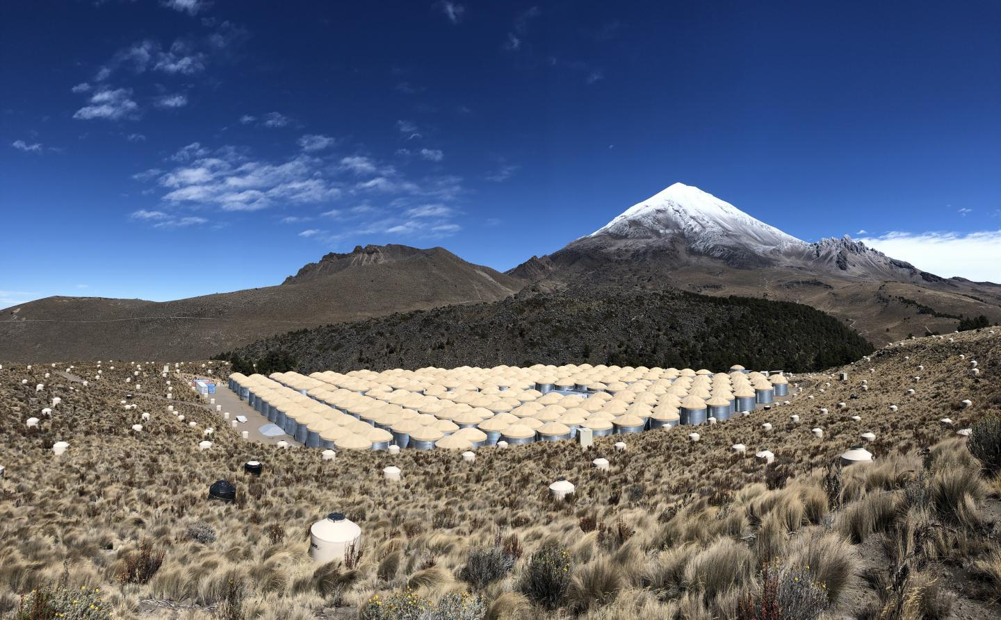


On behalf of the HAWC Collaboration
Sabrina Casanova, IFJ-PAN Krakow
Micro-quasar detections with HAWC
Second LHAASO Symposium Hong Kong 20-25 March 2025
Notes:
When we started with HAWC we had no idea how many different sources and new source classes we would have discovered…some ideas where to look for where o be found for instance in Felix’s book (Felix knows that ) but reality passed by far our more optimistic predictions !
I started with the newest results and going to the oldest
NEW SOURCE CLASSES

Slide 2

Outline
HAWC Observatory
HAWC general talk on Tuesday
HAWC micro-quasars
  SS 433
  V4641 Sgr
LS 5039
Conclusions and Outlook

Slide 3
HAWC is located on the flanks of the Sierra Negra volcano near Puebla
HAWC altitude : 4100 meters above the sea level

Slide 4
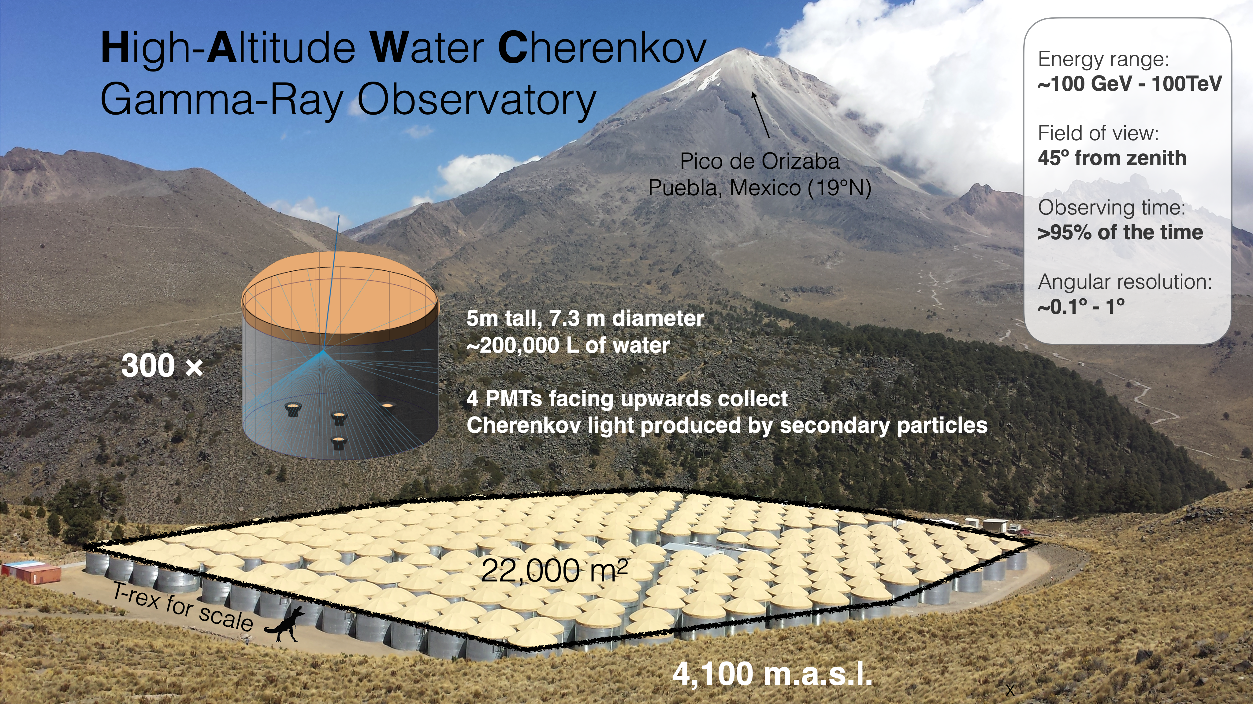
Inaugurated March 2015.
Instantaneous FOV 2sr
Daily FOV 8sr (66% of the sky)
Energy range: 100s GeV to 100s TeV
Observing >95% of the time
Angular resolution 0.2º – 1º
345 outriggers since 2018
Notes:
Wide FoV (45 deg), limited by thickness of the atmosphere and geometrical effective area
High duty cycle. Tanks are light tight
Modular. Running since 2015
Cherenkov light in water, instead or air
The detector is fully efficient above 1 TeV. Might detect lower energy photons when they fluctauate to interact deeper than usual in the atmosphere

Slide 5
Looking for binaries with HAWC

Slide 6
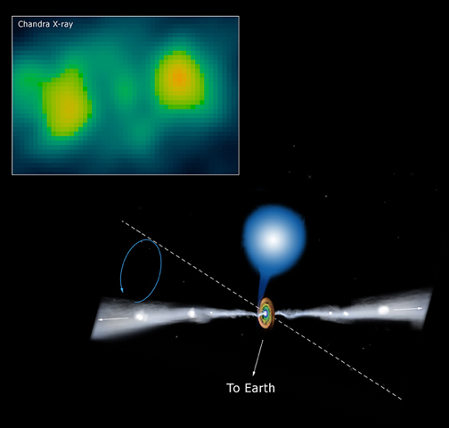

SS433 Lobes
Binary observed in radio-X-rays
Supergiant > 10 $M_{∘}$ and 8 $M_{∘}$compact object, BH or NS
Accretion believed to be super Eddington
10³⁹⁻⁴⁰ erg/s barion-loaded jets terminate at 40 pc distance in W50 nebula and produce western and eastern X-ray lobes
Jet speed roughly c/4
Particle acceleration & GeV-TeV radiation predicted at
Hegra 2005

Slide 7
SS-433 Lobes with HAWC
Nature, HAWC Coll 2018
The first micro-quasar HAWC detected
1017 days of HAWC observations
Post-trial 5.4 σ
Emission coincident with e1 and w1
Notes:
Spatial and spectral fits to SS 433 are performed in a semicircular region of interest (RoI) designed to mask out diffuse emission from the Galactic Plane. The RoI also removes significant spatially extended emission from the nearby γ-ray source MGRO J1908+06. The spatial distribu- tion and spectrum of γ rays from MGRO J1908+06 are fit using an electron diffusion model 23, and point-like sources centered on e1 and w1 are fit on top of this extended emission. As a system- atic check, the regions are also fit using X-ray spatial templates and extended Gaussian functions. Neither improves the statistical significance of the fits. Upper limits on the angular size of the emission regions are 0.25◦ for the east hotspot and 0.35◦ for the west hotspot at 90% confidence.
3
Given the distance to the source of 5.5 kpc, this corresponds to a physical size of 24 pc and 34 pc, respectively. The constraint is tighter on the eastern hotspot due to its higher statistical significance.
The VHE γ-ray flux is consistent with a hard E−2 spectrum, though current data from HAWC
are not of sufficient significance to constrain the spectral index. Therefore we report the flux of both
hotspots at 20 TeV, where systematic uncertainties due to the choice of spectral model are mini-
mized and the sensitivity of HAWC is maximized. At e1, the VHE flux is 2.4+0.6(stat.)+1.3(syst.)× −0.5 −1.3
10−16 TeV−1 cm−2 s−1, and at w1 the flux is 2.1+0.6(stat.)+1.2(syst.) × 10−16 TeV−1 cm−2 s−1. −0.5 −1.2
HAWC detects γ rays from the interaction regions up to at least 25 TeV. The energies of these γ rays are a factor of three to ten higher than previous measurements from microquasars 24,25. Since most γ-ray telescopes are optimized for measurements below 10 TeV, this may explain why these photons were not observed in previous observational campaigns.

Slide 8
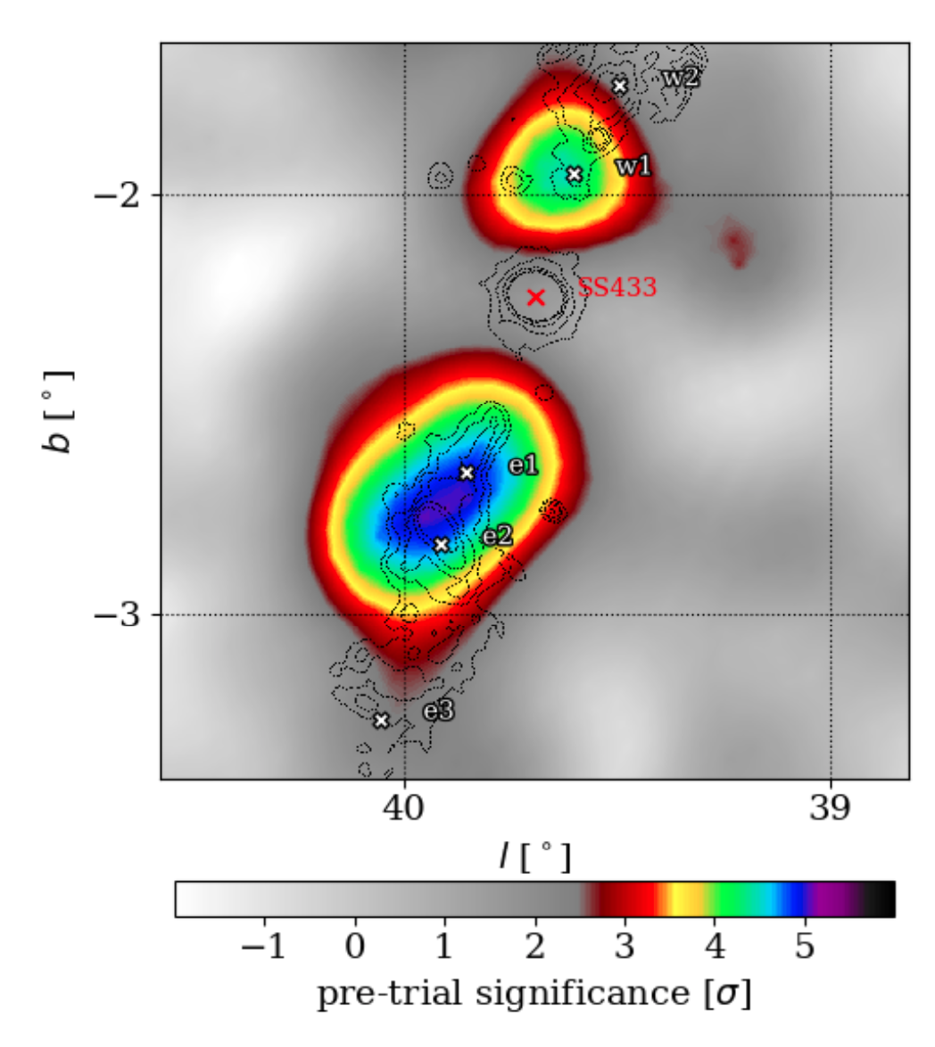
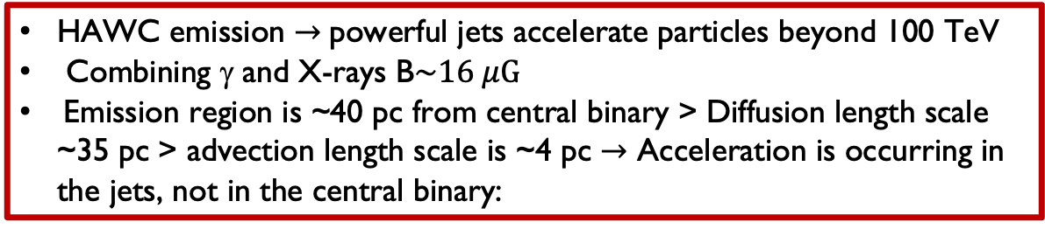
SS-433 lobes with HAWC
HAWC Coll Nature 2018
HAWC emission $→$powerful jets accelerate particles beyond 100 TeV
Combining γ and X-rays B$\sim 16 μG$
Emission region is ~40 pc from central binary > Diffusion length scale ~35 pc > advection length scale is ~4 pc $→$ Acceleration is occurring in the jets, not in the central binary:
Energy Budget :
~0.5% of jet power into electron acceleration
~100% of jet energy over 30000 years lifetime of SS 433 for accelerating protons of at least 250 TeV if n=0.1 cm⁻³
Nature, HAWC Coll 2018
May 2022
Notes:
Leptonic model does a good job of explaining the gamma ray emission, requires ~0.5% of jet power going into electron acceleration.
In hadronic-only scenario protons of at least 250 TeV produce gamma in proton-proton interaction and secondary leptons radio and X-rays via synchrotron radiation.
Energy budget of 3 X 1050 erg ~100% of jet energy over 30000 year lifetime of SS 433 must go into accelerating protons to explain the observed gamma-ray emission. But do we really know the local gas density ?
Acceleration is occurring in the jets, not in the central binary:
1. Emission region is ~40 pc from central binary.
2. Diffusion length scale is ~35 pc at these energies, assuming ISM
^{diffusion} ^{coefficient}
Advection length scale is ~4 pc.
Spatial and spectral fits to SS 433 are performed in a semicircular region of interest (RoI) designed to mask out diffuse emission from the Galactic Plane. The RoI also removes significant spatially extended emission from the nearby γ-ray source MGRO J1908+06. The spatial distribu- tion and spectrum of γ rays from MGRO J1908+06 are fit using an electron diffusion model 23, and point-like sources centered on e1 and w1 are fit on top of this extended emission. As a system- atic check, the regions are also fit using X-ray spatial templates and extended Gaussian functions. Neither improves the statistical significance of the fits. Upper limits on the angular size of the emission regions are 0.25◦ for the east hotspot and 0.35◦ for the west hotspot at 90% confidence.
3
Given the distance to the source of 5.5 kpc, this corresponds to a physical size of 24 pc and 34 pc, respectively. The constraint is tighter on the eastern hotspot due to its higher statistical significance.
The VHE γ-ray flux is consistent with a hard E−2 spectrum, though current data from HAWC
are not of sufficient significance to constrain the spectral index. Therefore we report the flux of both
hotspots at 20 TeV, where systematic uncertainties due to the choice of spectral model are mini-
mized and the sensitivity of HAWC is maximized. At e1, the VHE flux is 2.4+0.6(stat.)+1.3(syst.)× −0.5 −1.3
10−16 TeV−1 cm−2 s−1, and at w1 the flux is 2.1+0.6(stat.)+1.2(syst.) × 10−16 TeV−1 cm−2 s−1. −0.5 −1.2
HAWC detects γ rays from the interaction regions up to at least 25 TeV. The energies of these γ rays are a factor of three to ten higher than previous measurements from microquasars 24,25. Since most γ-ray telescopes are optimized for measurements below 10 TeV, this may explain why these photons were not observed in previous observational campaigns.
The γ rays detected by HAWC are produced by radiative or decay processes from much higher energy particles. The detection yields important information about the mechanisms and sites of particle acceleration, the types of particles accelerated (e.g., protons or electrons), and the radiative processes which produce the spectrum of emission from radio to VHE γ rays. Two scenarios for explaining the HAWC observations of the e1 and w1 regions can be tested. The first is that protons are primarily responsible for the observed γ rays. Protons must have an energy of at least 250 TeV to produce 25 TeV γ rays through hadronic collisions with ambient gas. Proton- proton collisions yield π0 particles which decay to VHE γ rays, and π± particles which decay to the secondary electrons and positrons responsible for radio to X-ray emission via synchrotron radiation. This scenario is of particular interest because there is spectroscopic evidence for ionized nuclei in the inner jets of SS 433 8, 26 . The alternative scenario requires electrons of at least 130 TeV to up-scatter the low-energy photons from the cosmic microwave background (CMB) to 25 TeV γ rays. In this case, the radio to X-ray emission is dominated by synchrotron radiation from this same population of electrons in the magnetized plasma of the jets and lobes.
The fact that the VHE emission is detected along a line of sight nearly orthogonal to the jet axis means that charged particle trajectories become isotropic before they interact to produce the γ rays. The embedded magnetic fields in the VHE regions can easily deflect the accelerated particles because their typical gyroradii are much smaller than the size of the emission regions, ∼ 30 pc. The jets are only mildly relativistic, so the emission from the interaction regions will have a negligible Doppler beaming effect and remain nearly isotropic.
The flux of VHE γ rays observed by HAWC makes the proton scenario for SS 433 unlikely,
because the total energy required to produce the highly relativistic protons is too high. The jets
of SS 433 are known to be radiatively inefficient, with most of the jet energy transformed into
the thermal energy of W50 16,27 rather than particle acceleration. We model the primary proton
spectrum as a power law with an exponential cutoff, dN/dE ∝ E−2 exp (−E /1 PeV). If we ppp
assume 10% of the jet kinetic energy converts into accelerated protons, and the ambient gas density is 0.05 cm−3 16,27, then the resulting flux of γ rays from proton-proton collisions is much less than the observed γ-ray flux, as shown in the dash-dotted line of Fig. 2. In fact, for a target proton density as large as 0.1 cm−3 in the e1 region 16, 27 , the total energy of the proton population needs to
be ∼ 3×1050 erg to explain the observed γ rays, assuming an E−2 spectrum. This is comparable to γ
the total jet energy available during the presumed 30,000-year lifetime of SS 433 2. Furthermore, because the synchrotron emission from secondary electrons from charged pion decay is always lower than the γ-ray flux from π0 decay, and the observed X-ray flux is higher than the γ-ray flux, the X-rays cannot originate solely from secondary electrons. Finally, the proton scenario requires that the protons remain trapped in the region observed by HAWC for the lifetime of SS 433 2. This means the protons must diffuse very slowly, with a diffusion coefficient ∼ 1/1000 of the typical value of the interstellar medium (ISM) DISM ≈ 3 × 1028(E/3 GeV)1/3 cm2 s−1 28. This value, comparable to the theoretical Bohm limit, is very small but not impossible. Given the uncertainties in the historical jet flux, the ambient particle density, and the radiative efficiency, we cannot exclude the possibility that some fraction of the γ-ray flux is produced by protons. However, we do rule out the possibility that the VHE γ rays are entirely produced by protons.
Highly relativistic electrons, on the other hand, can produce γ rays much more efficiently, primarily via inverse Compton scattering of CMB photons to γ rays. The inverse Compton losses due to up-scattering of infrared and optical photons are suppressed due to the Klein-Nishina effect and are thus dominated by scattering of CMB photons 29. In this scenario, the ratio of the VHE
γ-ray to X-ray fluxes constrains the energy density in the magnetic field compared to the energy density in CMB photons. We have modeled the broadband spectral energy distribution (SED) of the eastern emission region 15′ to 33′ from the center of SS 433. The solid and dashed lines in Fig. 2 show the SED of a leptonic model for e1 produced by an injected flux of relativistic electrons with an energy spectrum dN/dE ∝ E−α exp (−E/Emax) in a magnetic field of strength B. We use the parameters α = 1.9, Emax = 3.5 PeV, and B = 16 μG (see the methods section). The estimate of the magnetic field strength is consistent with the equipartition of energy between the relativistic electrons and magnetic fields, which is common in astrophysical systems 16. The required total energy budget for relativistic electrons is three orders of magnitude lower than the total jet energy.
The maximum electron energy of ∼ 1 PeV has significant implications for electron accel- eration sites and acceleration mechanisms in SS 433. SS 433 is distinguished from other binary systems with relativistic objects because it realizes a supercritical accretion of gas onto the cen- tral engine 2. Powerful accretion flows and the inner jets near the compact object have there- fore been proposed as possible acceleration sites of relativistic particles 26. However, the obser- vation from HAWC suggests that ultra-relativistic electrons are not accelerated near the center of the binary. If electrons were accelerated in the central region, they would have cooled by the time they reached the sites of observed VHE emission. Due to their small gyroradii, high- energy electrons may transport in a magnetized medium via diffusion or advection. The distance traveled via diffusion within the cooling time of an electron of energy E is rd = 2√Dtcool ≈ 36 pc (E/1 PeV)−1/3(B/16 μG)−1, using the diffusion coefficient typical of the ISM 28. This distance would be even smaller for diffusion coefficients lower than the typical ISM value. Sim- ilarly, the distance traveled by electrons being advected with the jet flow is radv = 0.26c · tcool ≈ 4 pc (E/1 PeV)−1(B/16 μG)−2 for a jet velocity of 0.26c. Both distance scales are smaller than the 40 pc distance between the binary and e1, indicating the electrons are not accelerated near the center of the system.
Instead, the highly energetic electrons in SS 433 are likely accelerated in the jets and near the VHE γ-ray emission regions. This presents a challenge to current acceleration models. For example, particle acceleration may be driven by the dissipation of the magnetic fields in the jets, but above several hundred TeV the electron acceleration time exceeds the electron cooling time, assuming a 16 μG magnetic field. Thus the system does not appear to have sufficient acceleration power, unless there are very concentrated magnetic fields along the jets. If instead particle accel- eration is driven by standing shocks produced by the bulk flow of the jets, it is possible to reach PeV energies if the size of the acceleration region is larger than the electrons’ gyroradii. However, shocks in the interaction regions are not currently resolved by X-ray or γ-ray measurements.
Studies of microquasars such as SS 433 provide valuable probes of the particle acceleration mechanisms in jets, since these objects are believed to be scale models of the much larger and more powerful jets in active galactic nuclei (AGN) 30. AGN are the most prevalent VHE extragalactic sources and are believed to be the sources of the highest energy hadronic cosmic rays. While AGN are not spatially resolved at VHE energies, with this observation we have identified a VHE source in which we can image particle acceleration powered by jets. Future high-resolution VHE observations of SS 433 are possible with pointed atmospheric Cherenkov telescopes to better localize the emission sites, and further high-energy measurements with HAWC will record the spectrum at high energies and better constrain the maximum energy of accelerated particles.

Slide 9
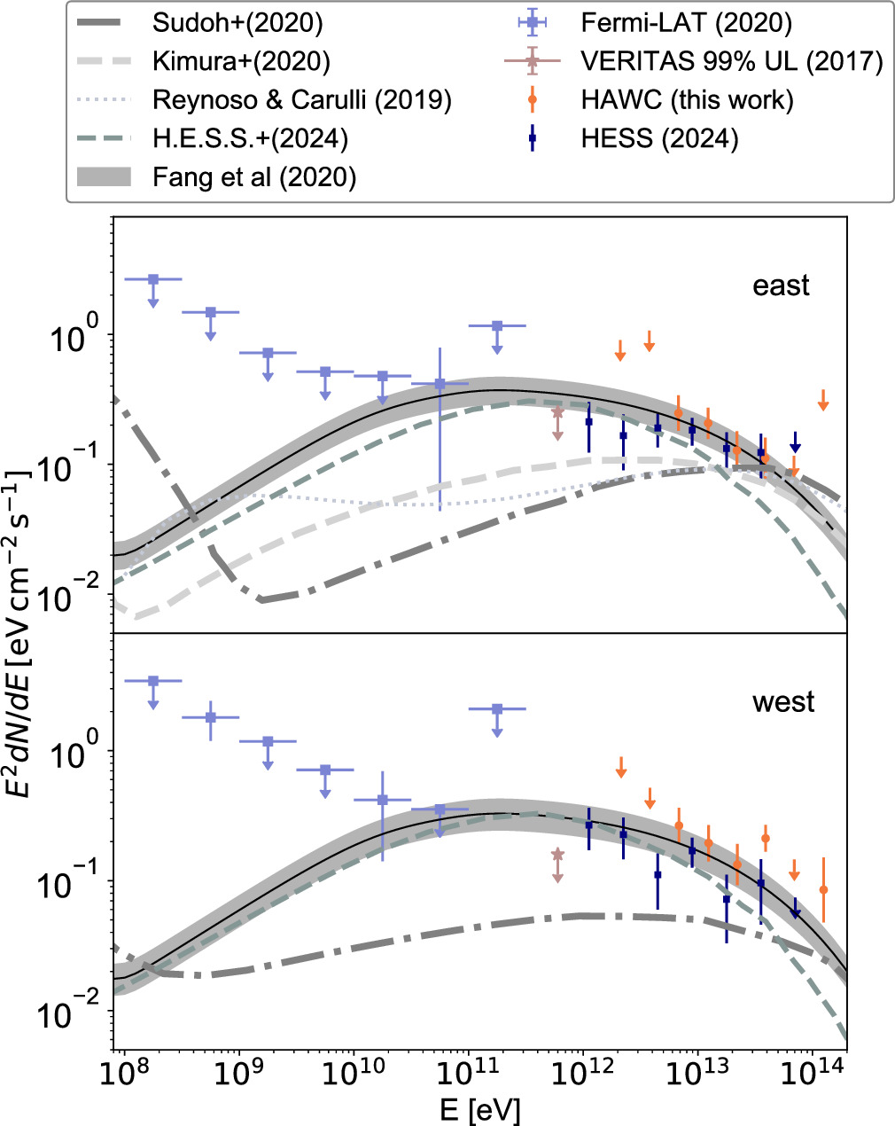
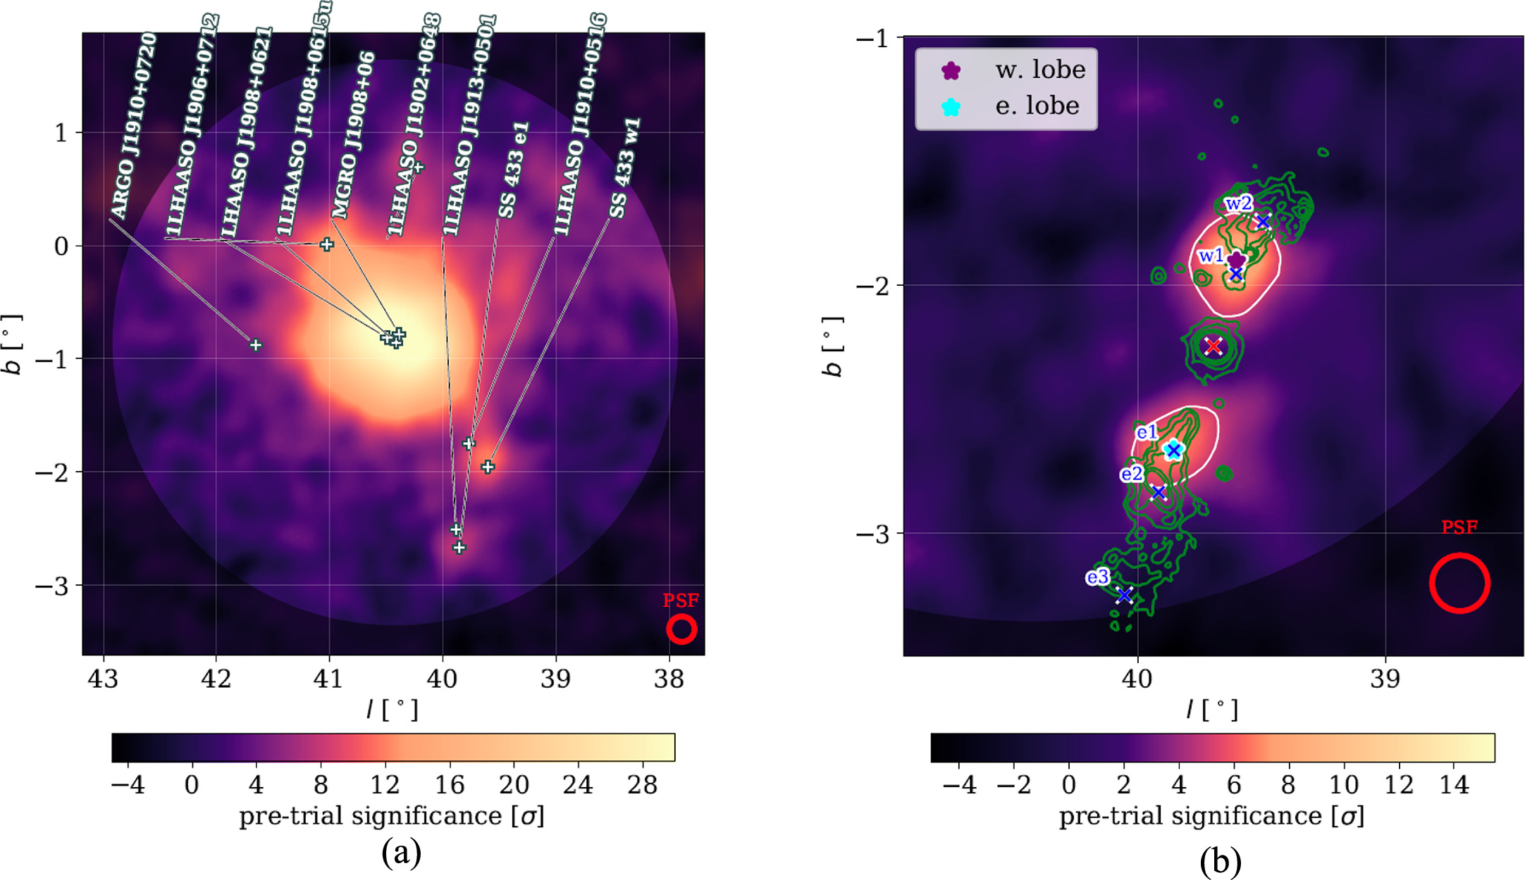
SS 433 lobes again
Spectra of the lobes
HAWC ApJ 2024
1922 days of data
Better Reconstruction
Increased significance
Individual lobe analysis and spectra
Notes:
Figure 1. Significance maps above 1 TeV. (a) A pretrial significance map of the SS 433 region with labels from A. A. Abdo et al. (2007), B. Bartoli et al. (2013), A. U. Abeysekara et al. (2018), and Z. Cao et al. (2021, 2024). (b) A pretrial significance map zoomed in closely around SS 433. The map shows excess after the model fit but only removes background sources for the visualization of the SS 433 jet lobes. The green contour lines indicate the observational results from ROSAT (W. Brinkmann et al. 1996), and the white contour lines are the 5σ contour lines as observed by this work. The X-ray emission regions "e1," "e2," and "e3" for the east lobe and "w1" and "w2" for the west lobe have also been indicated (S. Safi-Harb & H. Ögelman 1997). The red cross marks the known location of the binary SS 433. The purple and cyan stars indicate the best-fit locations from this work. The red ring in each panel indicates the angular resolution.

Slide 10
SS 433 energy - dependent morphology
HESS Coll Science 2024
Already discussed by Laura

Slide 11
Hard Xray obs of the inner eastern lobe of W50
Safi-Harb+22
Red: radio (Dubner et al. 1998); green: optical (Boumis et al. 2007); yellow: soft X-rays (0.5–1 keV); magenta: medium energy X-rays (1–2 keV); cyan: hard X-ray emission (2–12 keV).
Notes:
We present a broadband X-ray study of W50 (the “Manatee” nebula), the complex region powered by the microquasar SS 433, that provides a test bed for several important astrophysical processes. The W50 nebula, a Galactic PeVatron candidate, is classified as a supernova remnant but has an unusual double-lobed morphology likely associated with the jets from SS 433. Using NuSTAR, XMM-Newton, and Chandra observations of the inner eastern lobe of W50, we have detected hard nonthermal X-ray emission up to ∼30 keV, originating from a few- arcminute-sized knotty region (“Head”) located 18′ (29pc for a distance of 5.5kpc) east of SS433, and constrained its photon index to 1.58 ± 0.05 (0.5–30 keV band). The index gradually steepens eastward out to the radio “ear” where thermal soft X-ray emission with a temperature kT ∼ 0.2 keV dominates. The hard X-ray knots mark the location of acceleration sites within the jet and require an equipartition magnetic field of the order of 12 μG. The unusually hard spectral index from the “Head” region challenges classical particle acceleration processes and points to particle injection and reacceleration in the subrelativistic SS 433 jet, as seen in blazars and pulsar wind nebulae.
Figure 1. Multiwavelength image of the W50 nebula. Red: radio (Dubner et al. 1998); green: optical (Boumis et al. 2007); yellow: soft X-rays (0.5–1 keV); magenta: medium energy X-rays (1–2 keV); cyan: hard X-ray emission (2–12 keV). The eastern lobe X-ray image highlights the XMM-Newton data presented in this work (with the brightening at the edge of the FoV cropped here to highlight the source emission). The western lobe X-ray image shows only partial Chandra coverage of part of the nebula (Moldowan et al. 2005); additional X-ray observations of this and other regions are currently being carried out and will be presented in future work.

Slide 12
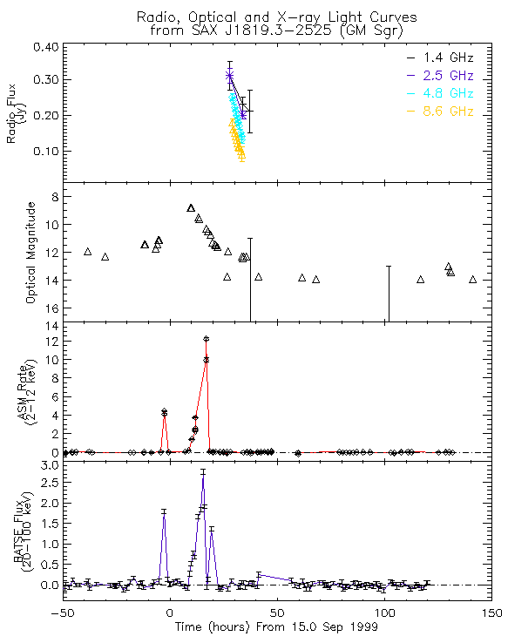
V4641 Sgr
Transient X-ray binary first detected flares in 1999
X-ray flux reached 12.2 Crab in 8 hr
Arcsec radio jets inclined < 16º (VLA)
Low Mass Xray Binary :Black-hole 6.4 M⊙ - B-star companion 2.9 M⊙
Orbital period 2.8 d, distance 6.2 kpc
Super-Eddington accretion – L_{Eddington} ~ 10³⁹erg
Superluminal jets - apparent expansion speed 9.5c
Luminous Jet-like radio structure of 0,25” within 1 day after an X-ray burst in 1999 (VLA)
Long time monitoring by MAXI
MAXI LONG TERM
OBSERVATIONS
Notes:
Very Large Array (VLA) radio observations obtained within a day of the X-ray flare resolved a bright jet-like radio structure 0.25 arcsec in length (Hjellming et al. 2000)
Radio observations follow up the X-ray outburst
X-ray observations are focus on the X-ray outbursts
geometric information for the system
Mass, disk inclination, jet inclination, distance...
Possible Microblazar with a relativistic jet moving close to the line of sight( θjet<12∘; fromOroszetal.2001)

Slide 13
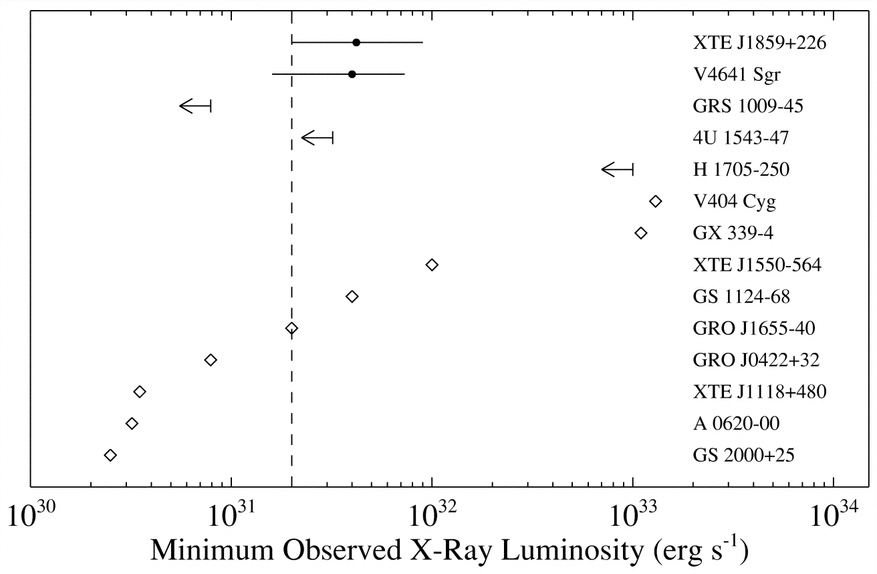
Chandra Observations of V4641 Sgr in quiescent state
Tomsick et al, 2003
X-ray observations focused on X-ray outbursts happening roughly every two years
What about quiescent state ?
Quiescent state 0.3- 8 keV luminosity
4.0 × 10³¹ (d/7 kpc)² ergs s⁻¹ (Tomsick+2003)
In optical wavelengths V4641 Sgr 85%
quiescent state and 15% active state
(MacDonald+2014)

Slide 14
VHE Photons coincident with V4641 Sgr
HAWC, Nature 2024
30pc
55pc
2400 days obs
High zenith angle for HAWC - 45º off zenith
8.8σ above 1 TeV and 5.2σ above 100 TeV
Notes:
Based on a systematic multi-source analysis method on a 3◦ radius region of interest (ROI) around the gamma-ray emission, the excess may be either described as two point-like sources or one extended source with an asymmetric Gaussian distribution (see details in Methods). The current statistics do not allow us to distinguish between the two spatial models. When adopting a two-point-source model, the northern source and southern source are detected at 8.1σ and 6.7σ, respectively The 95% upper limits on the extensions of the two sources are found to be 0.17◦ and 0.23◦, respectively, when fitting a Gaussian spatial template to the data around each source over the entire energy range. HAWC PSF above 30 TeV
In the analysis, we used a circular ROI with a radius of 3◦, centered at R.A. = 274.92◦,
300 Dec. = −25.82◦. To explore gamma-ray emission within the ROI, we conducted a systematic
301 multi-source analysis method which is inspired by the Fermi-LAT38. As the latitude of the center
302 of the ROI is 5◦ away from the Galactic plane, background emission due to the Galactic diffuse
303 emission and unresolved sources on the Galactic plane is negligible. Additionally, because the
304 source is so isolated, unlike SS 433 and other sources on the galactic plane that could be affected
305 by galactic diffuse emission, it serves as an excellent laboratory for studying the source emis-
306 sion independently. Therefore, we begin with a model consisting of a single point source and a
307 simple-power-law spectral assumption. Then, we add point sources until there is no excess with
308 significance greater than 4σ. Following this, we test the extension of each added point source se-
11
alt
309 quentially to obtain the best morphological description of the emission. We further explore two
310 distinct spectral models for the emission: the simple-power-law spectrum (dN/dE = N0(E/E0)α)
311 and the log-parabola spectrum (dN/dE = N0(E/E0)α−β log(E/E0)). The pivot energy, E0, is deter-
312 mined by minimizing the correlation between the flux normalization, N0, and the spectral index,
313 α. The pivot energy is fixed at 47 TeV for models with two sources while letting the other pa-
314 rameters float. Through this comprehensive multi-source analysis, we identified a model with two
315 point sources as the best model to describe the observed gamma-ray excess. Since this analysis
316 is for a targeted, specific region, we further explored several alternative models involving asym-
317 metric extended sources. A single asymmetric extended source model also provides a satisfactory
318 description of our data.

Slide 15
Spectra and morphology of the lobes
HAWC Collaboration, Nature 2024
Morphology: two sources (8,1 σ and 6.8 σ) or a roughly 70 pc extended one
PL spectra up to 220 TeV
No time flux variations
Notes:
Figure 2: Differential spectrum weighted by E2 for the northern and southern sources in a model with two point sources and for the asymmetric extended source in a model with a single asymmetric extended source. The shaded regions indicate the best-fit spectra and 1σ statistical uncertainties when fitting a single-power-law model to the data from 10 to >200 TeV. The markers correspond to the best-fit values and their 1σ statistical uncertainties obtained when fitting a single-power-law model to data in individual energy bins. The chosen energy range for plotting the spectrum is specified in Methods.
This analysis uses ∼2,400 days of data collected between 26 November, 2014 and 27 June,
281 2022, reconstructed using recently improved algorithms31. The HAWC data are binned according
282 to the fraction of available PMTs hit and reconstructed energy32; air-shower events with higher en-
283 ergies typically trigger more PMTs. Simultaneously, we differentiate between events with shower
284 cores landing exclusively on the array (on-array events) and those with cores landing off the array
285 (off-array events). Only on-array events are used in this work. Events with the highest fraction
286 of PMTs hit have the highest energies and the best angular resolutions, with values 0.18◦ (68%
287 containment radius) or better.
288 Likelihood analysis We performed a maximum-likelihood analysis using the HAWC plugin to
289 the Multi-Mission Maximum Likelihood (3ML) software framework 33,34,35 . This method obtains
290 the best-fit parameters via maximum likelihood for a model with a given spatial and spectral as-
291 sumption convolved with the detector response functions. The background is estimated by the
292 “direct integration” method36,37. For events with a larger fraction of PMT hits, we also used the
293 ’background randomization’ method (as described in 32 ) alongside ’direct integration’ to spatially
294 smooth the background.

Slide 16

Origin of the emission
Electrons of at least 200 TeV at the termination shocks
PeV protons at the termination shocks where jets impact ISM
yr
$$t_{esc≈}$$
Total budget in protons > 1 GeV if n = 1 cm⁻³
Notes:
Here DB(Ee) = RLc/3 is the Bohm dif- fusion coefficient and RL is the Larmor radius of the particle. Second, electrons at such high energies cool so quickly that they can barely travel over 100 pc. The cooling time is much shorter than the diffusion time, R2/(2D) ≈ 1,000/η years, in which R ≈ 100 pc, D(200 TeV) ≈ η1030 cm2 s−1 and η ≪ 1. For these evaluations, we have used a magnetic field strength comparable with that in the jets of SS 433 (ref. 1).
Size of the blogs 20 pc

Slide 17
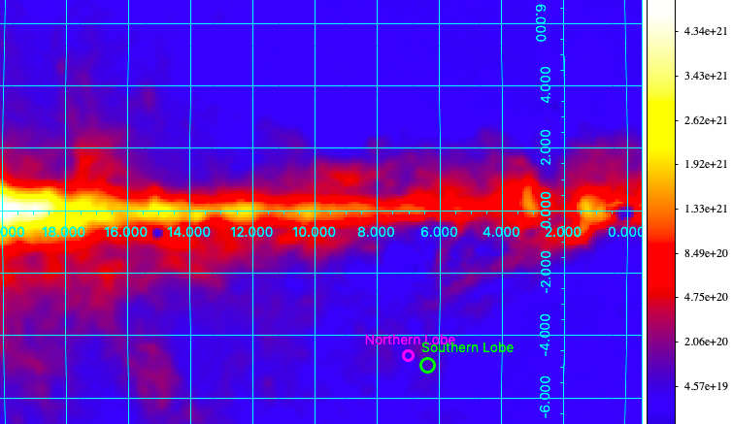
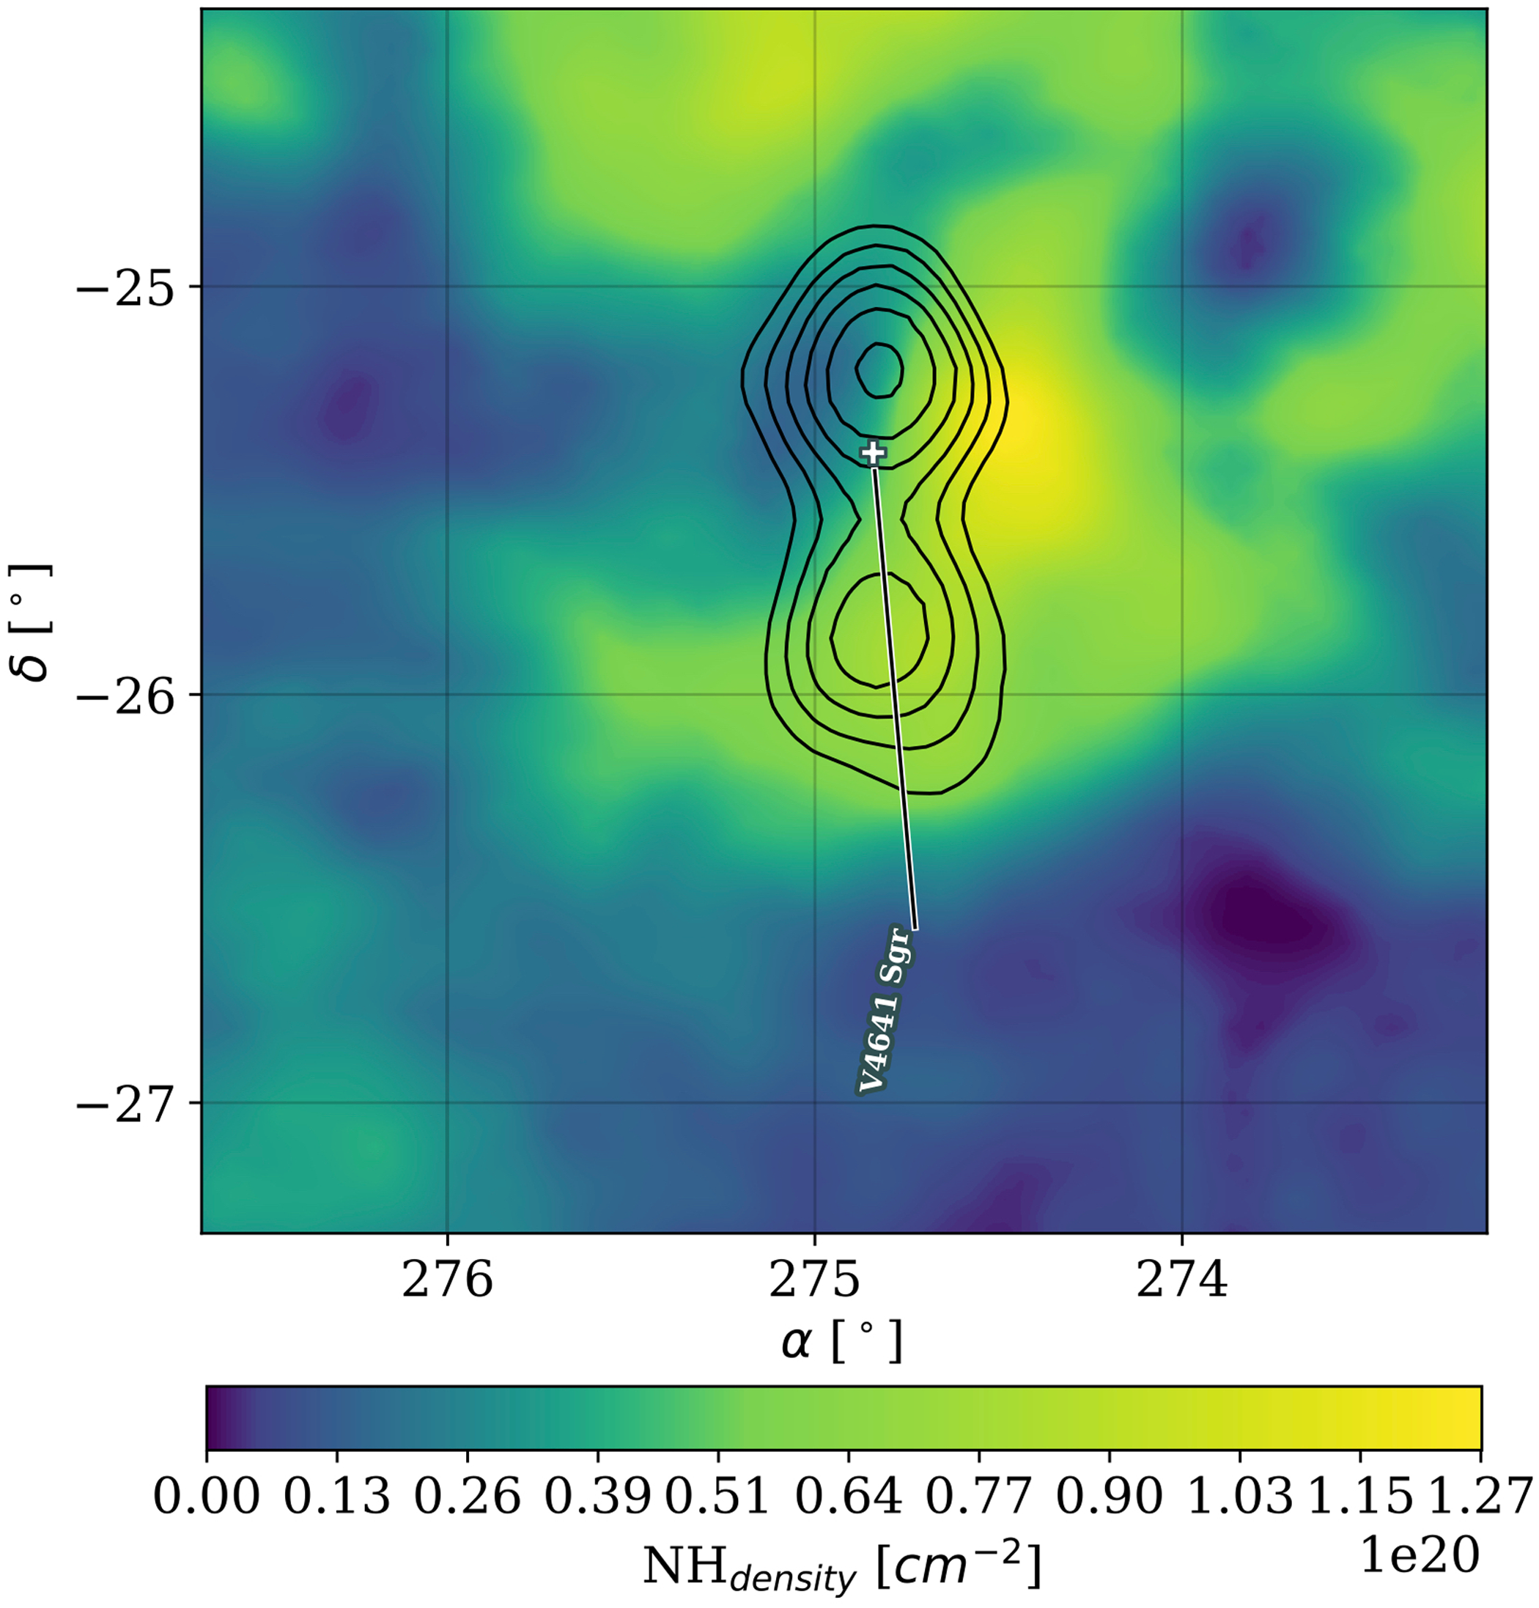
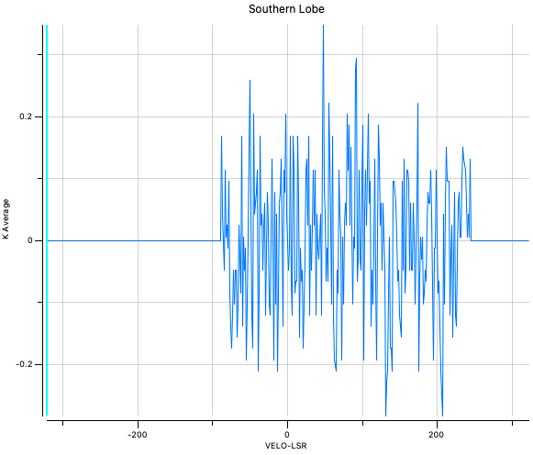
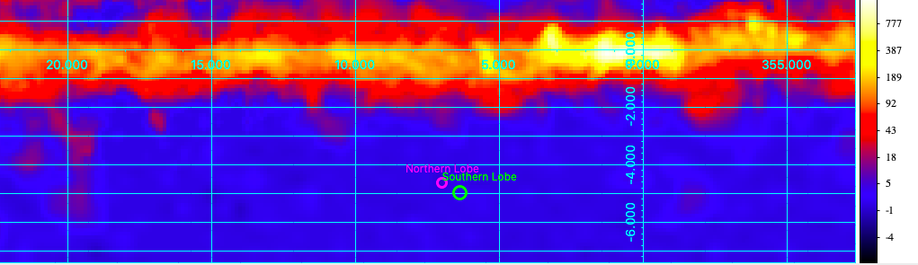
What about the gas density ?
HI from HI4PI
HAWC Collaboration, Nature 2024
H2 from Dame+2001

Slide 18
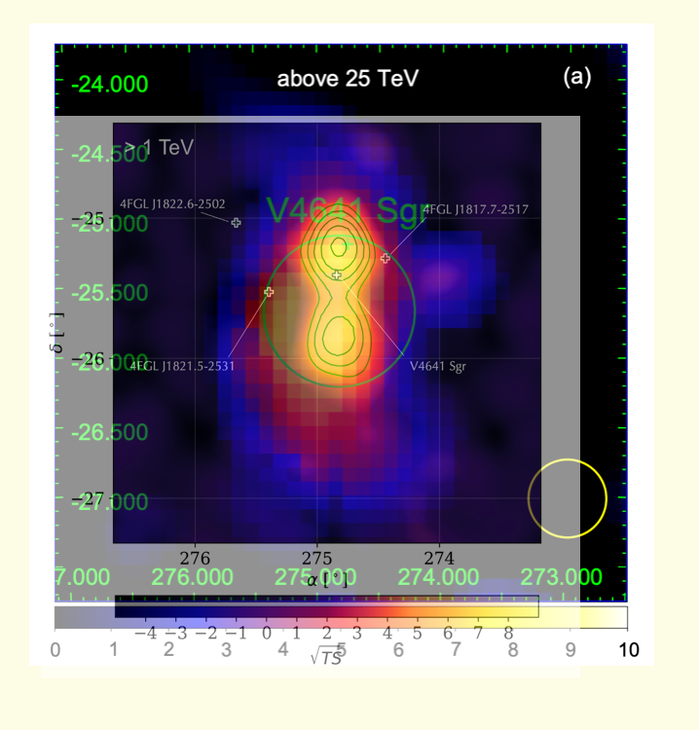
V4641 Sgr with
HESS and LHAASO
LHAASO 2024
800 TeV !
LHAASO 2024
HAWC contours
Photon energies close to 1PeV!

Slide 19
Observations & Observational Proposal
X-rays
MAXI/GSC announcement of renew BH activity AteL #16804
INTEGRAL obs from 2024-09-07 at 16:44 until 2024-09-08 at 22:16 UTC. AteL #16881
XRISM (ToO 12 ks on 2024-09-07 covering 60% UHE emission)
Nustar proposal (P.I. Kaya and Naomi)
Chandra proposal (P.I. Kaya and Naomi)
Radio Observations
Observations with APEX (P.I. Eduardo, Daniel)
Observations with Nobeyama (P.I. Naomi)

Slide 20
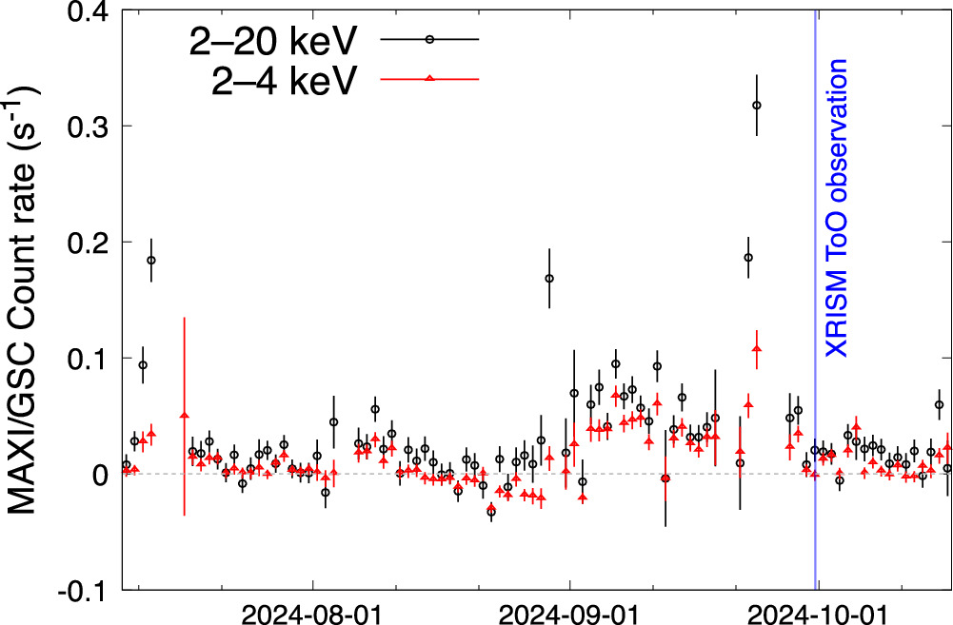
XRISM discovers extended X-ray emission
XRISM 12.2 ks
Susuki et al, 2025
Negroro et al, 2024
Extended emission either thermal
or non-thermal emission
If thermal constraint on gas density
Notes:
X-Ray Imaging and Spectroscopy Mission.
A 1.2–7.0 keV XRISM Xtend image with the regions for the spectral analysis. (b) Same with a course binning. (c) The image after the particle-background subtraction and vignetting correction and with the HAWC gamma-ray contours (>1 TeV; R. Alfaro et al. 2024) and the Xtend field of view (FoV) overlaid. The 68% containment circle of the point-spread function at 6.4 keV is shown as a reference. The images are shown on the Equatorial coordinates (J2000).

Slide 21
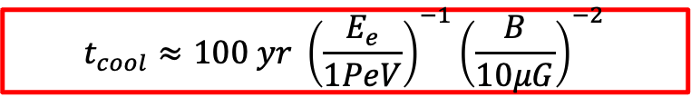
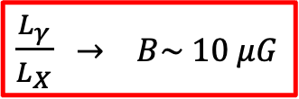
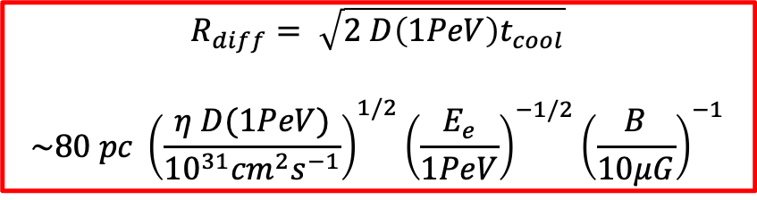
Extended Xray from V4641 Sgr region
$\frac{L_{γ}}{L_{X}}$ $→ B\sim 10 μG$
30 pc
$$t_{cool}≈100 yr {\left(\frac{E_{e}}{1PeV}\right)}^{−1}{\left(\frac{B}{10μG}\right)}^{−2}$$
$$R_{diff}= \sqrt{2 D\left(1PeV\right)t_{cool}}$$
$$\sim 80 pc {\left(\frac{η D(1PeV)}{{10}^{31}{cm}^{2}s^{−1}}\right)}^{1/2}{\left(\frac{E_{e}}{1PeV}\right)}^{−1/2}{\left(\frac{B}{10μG}\right)}^{−1}$$
Xray extension ~ (13± 5) pc $→ η < 1 or B >10 μG$
Susuki et al, 2025
Notes:
, (4–6) × 10−12 erg s−1 cm−2 (2–10 keV)

Slide 22
Summary of HAWC microquasars
Accretion
  SS 433 : likely super-Eddington
  V4641 Sgr: super-Eddington
Jets
  SS 433 : most powerful jets known in the Galaxy ~10³⁹⁻⁴⁰ erg/s
  V4641 Sgr : superluminal jets
BH activity
  SS 433 : persistent BH activity
  V4641 Sgr : powerful outbursts – intermittent BH activity ~ every 2 yr
Hard Spectra up to 100-200 TeVs
Morphology of the emission
  SS 433 : lobes
  V4641 Sgr : lobes or extended source ?
Similar acceleration locations
Origin of the emission
  SS 433 : sub-PeV electrons accelerated at termination shocks. Barion loaded jet, proton energy budget 3 x10⁵⁰ erg ~ 100% Edd
  V4641 Sgr : sub-PeV electrons accelerated at termination shocks – – Extension of diffuse Xray emission 10pc – Energy budget for hadronic emission : few objects as V4641 Sgr could explain the local PeV CR flux
Notes:
These are only ideas which would be nice to discuss

Slide 23
Accretion driven or interaction pulsar - star winds
Distance = 3.5 kpc
23 M_{o} O6.5V star and 3.7 M_{o} compact object
mildly eccentric 3.9 day orbit.
From radio to TeV energies. Flux and spectral modulation as a function of its orbital period.
LS 5039
Notes:
The LS 5039 light curve and spectra were modelled using a
simple leptonic model. The electrons are assumed to be accel-
erated efficiently in a small zone in the vicinity of the compact
object with a standard γ−p
e power law. Radiative losses due to
inverse Compton emission and synchrotron emission generate a
distinctive steady-state electron distribution in this environment
dominated by stellar photons. The distribution has a prominent
hardening between the energy at which inverse Compton losses
enter the Klein-Nishina regime (γKN ≈ 6 × 104 in LS 5039) and
the energy at which synchrotron losses take over (γS ≈ 107 for
a 1 G field). This is for instance the distribution found in the
vicinity of the pulsar wind shock but it applies equally well to
any leptonic model where particles are accelerated close to the
compact object. The magnetic field was allowed to vary as the
inverse of the orbital separation, as expected from a pulsar wind
nebula. The model has only three parameters: the intensity of the
magnetic field, the normalization of the electron distribution and
the slope p of the injected power-law γ−p
e .
The cutoff in the very high-energy gamma-ray spectrum is
very sensitive to the magnetic-field intensity, via the location of
γS in the electron distribution. Fitting the high-state spectrum
seen by HESS gives a rather constrained magnetic-field inten-
sity at periastron of 0.8 ± 0.2 G. This value compares well with
the values found using simple pulsar wind models that give 5
( ̇E36σ3)1/2R−1
11 G, where ̇E36 is the pulsar spindown power in
units of 1036 erg s1, σ3 is the ratio of magnetic to kinetic en-
ergy in the pulsar wind in units of 10−3, and R11 is the distance
of the shock to the pulsar in units of 1011 cm. Fitting the HESS
high-state spectrum also sets the injection slope to p = 2 ± 0.3,
close to the canonical value for shock acceleration. The normal-
ization of the electron distribution implies an injection rate of
1036 erg s−1 for a radiative zone of 3 1011 cm. These results are
remarkably consistent with the expectations for a pulsar wind
model.
The spectrum is also found to fit the EGRET observations
well, adding credence to this simple approach. The model pre-
dicts a strong variation in the GLAST band with a softening from
high to low flux below one GeV (where synchrotron emission
dominates the spectrum) but a hardening above a GeV (where
inverse Compton emission dominates the spectrum). The HESS
low-state spectrum has not been explained to satisfaction. The
model fits the EGRET measurements but produces too many
gamma rays at 5–10 TeV. A possible solution is a more complex
orbital phase-dependence of the electron distribution at selected
phases. Another solution is that the low-state spectrum corre-
sponds to phases of strong attenuation and that emission from the
created pairs contribute significantly to the spectrum. Additional
HESS observations near minimum flux would be welcomed.
The orbital modulation of the HESS emission is reproduced.
A well-defined peak is predicted between phases 0.7–0.9 for
which evidence may already be seen in the data. The light curve
at GLAST energies is anti-correlated with the HESS light curve
and has a peak at periastron, where the stellar photon density is
maximum, and a minimum at inferior conjunction because of the
anisotropic effects in inverse Compton scattering. The GLAST
spectrum below 1 GeV should be influenced by the tail of the
synchrotron emission from the highest-energy electrons. The
peak synchrotron emission is at about 100 MeV for maximally
accelerated electrons, regardless of magnetic field. Hence, if this
component is detected, it will provide evidence that electrons are
indeed accelerated with extreme efficiency in this source.
Similar results for the magnetic field intensity and particle
energy are found when a lower inclination is used, i.e. implying
a black hole compact object rather than a neutron star. In this
case, the emission is thought to arise from a relativistic jet pow-
ered by accretion onto the black hole. Within the assumptions
of this work on the particle distribution, it is difficult to argue
that a significant part of the emission occurs far along a jet since
this does not naturally reproduce either the spectrum or the light
curve measured by HESS. Most of the emission should still oc-
cur close to the compact object. However, unlike in the case of a
pulsar wind nebula, there are no independent theoretical expec-
tations in support of the magnetic-field intensity (certainly lower
than its equipartition value in the accretion flow) and particle en-
ergy that are derived. Therefore, the pulsar wind nebula model
appears to be favoured.
Despite the complexity of the phenomena involved in pulsar
wind nebula emission, it is found that the peculiar environment
of a gamma-ray binary, most prominently the enormous lumi-
nosity of the massive companion, severely constrains the num-
ber of degrees-of-freedom in the model. A simple model suffices
to reproduce most of the observations. The value of the magnetic
field at the shock is found to be tightly constrained by the HESS
observations to 0.8 ± 0.2 G and the injection spectrum slope to
p = 2 ± 0.3. These results confirm that gamma-ray binaries are
promising sources for studying the environment of pulsars on
very small scales.

Slide 24
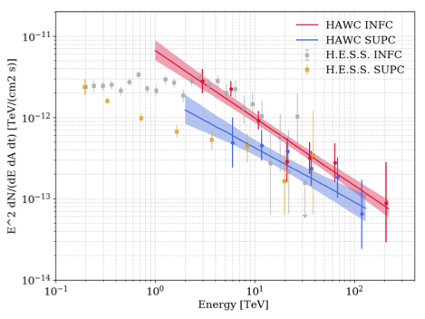

LS 5039 with HAWC
1910 days of data
Simultaneously likelihood fit with diffuse emission
and background sources
8 σ
PL preferred up to at least 100 TeV
~5σ modulation between 2 and 118 TeV $→$ likely the emission up to the highest energy originates close to the binary
HAWC 2025

Slide 25
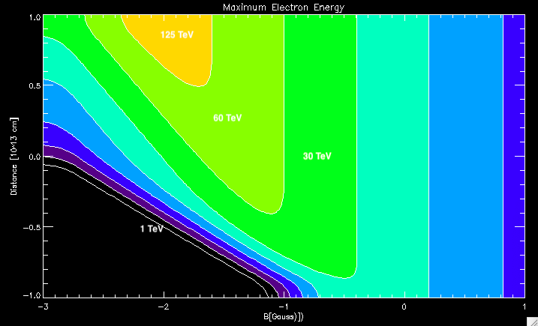
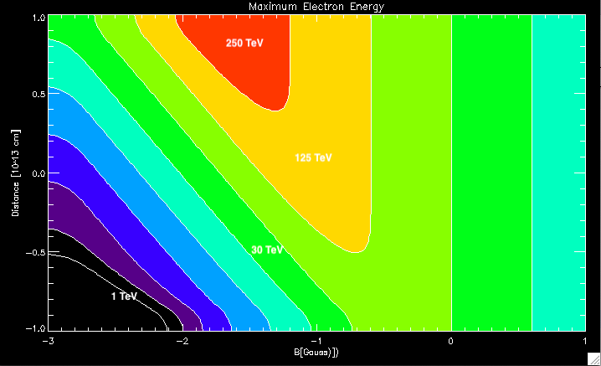




Maximum acceleration energy in LS 5039
$η$ = 10
$η$ = 1
HAWC emission detected up to 118 TeV $→$ B-field, acceleration efficiency and acceleration location in LS 5039
Difficult to accelerate electrons up to hundreds TeV within the binary
Maybe room for pp or pγ ?
$η$ $≳$ 10 B < 0.1 G d $≫$ 10¹³ cm
$η ∼$ 1 $→$B $≲0.1$ G

Slide 26
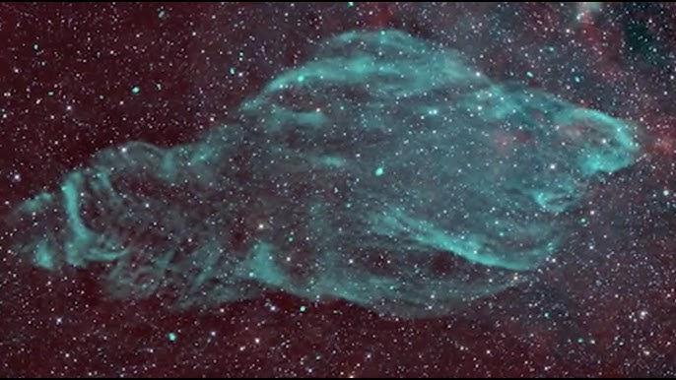
Summary and outlook
SS 433
Discovery of multi TeV gamma-rays from SS 433/W50
Extension of the spectra of SS 433 lobes up to 100 TeV
V4641 Sgr
Discovery of hundred TeV gamma-rays from V4641 Sgr
Multiwavelength analysis of V4641 Sgr ongoing – First discovery of extended emission with XRISM
LS 5039
Extension of the HESS modulated spectra up to 118 TeV
Many ongoing multiwavelength efforts. We have started understanding better emission mechanisms from these sources.

