Slide 1





Cosmic Ray Anisotropy
Paolo Desiati
desiati@wipac.wisc.edu
icecube.wisc.edu/~desiati
Paolo Desiati

Slide 2
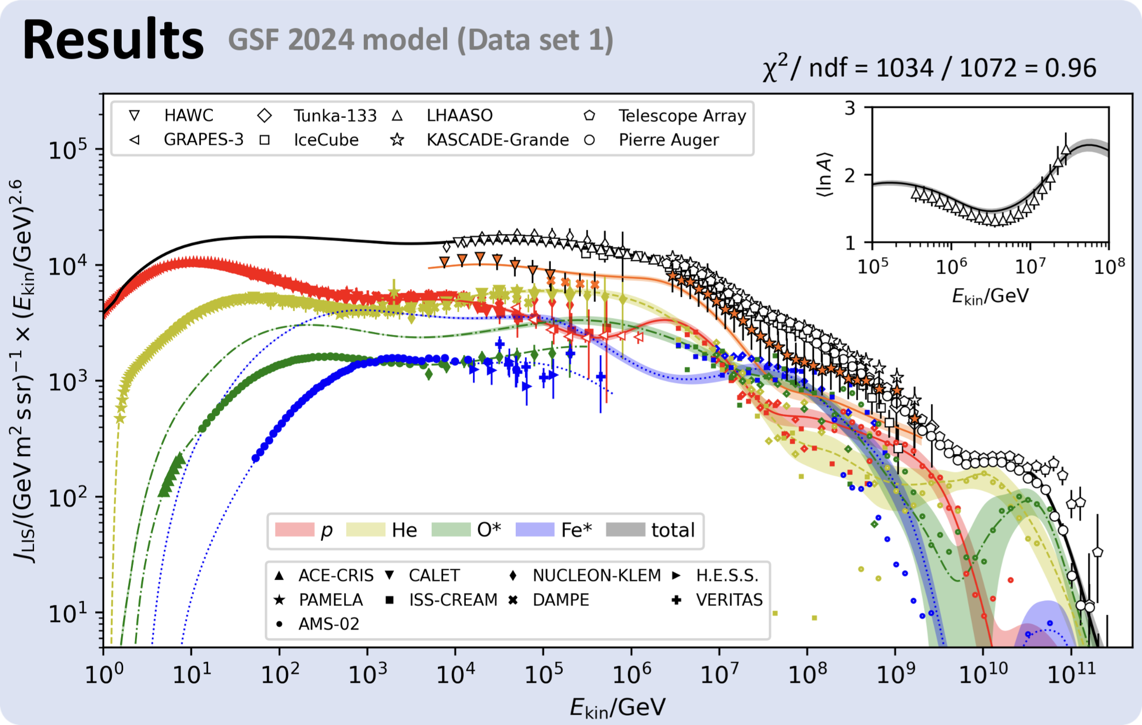
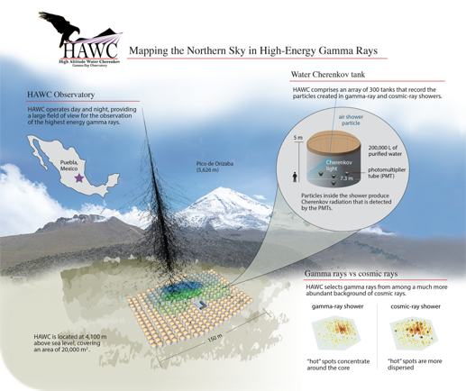
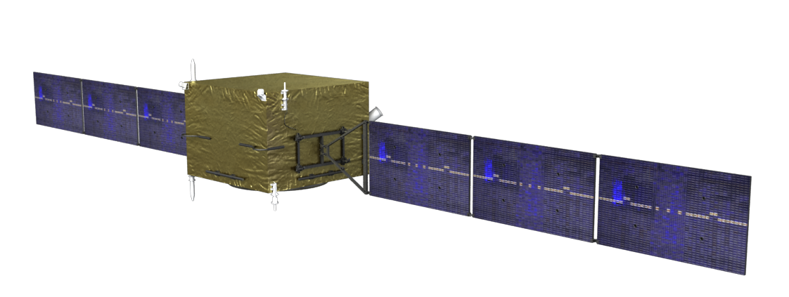
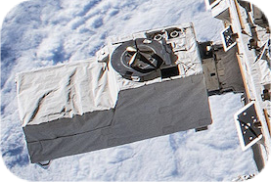
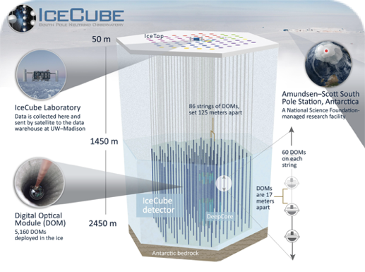
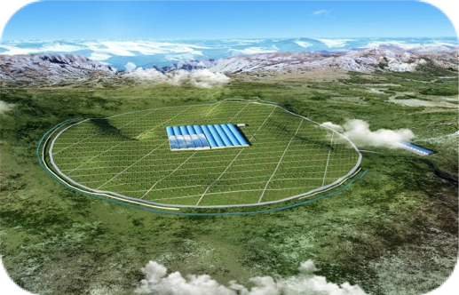
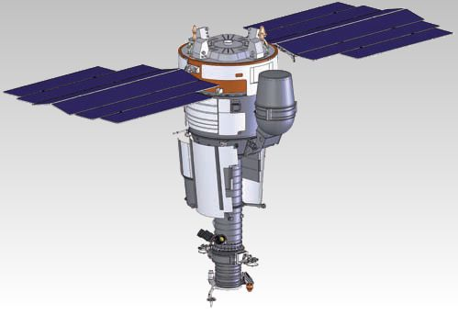
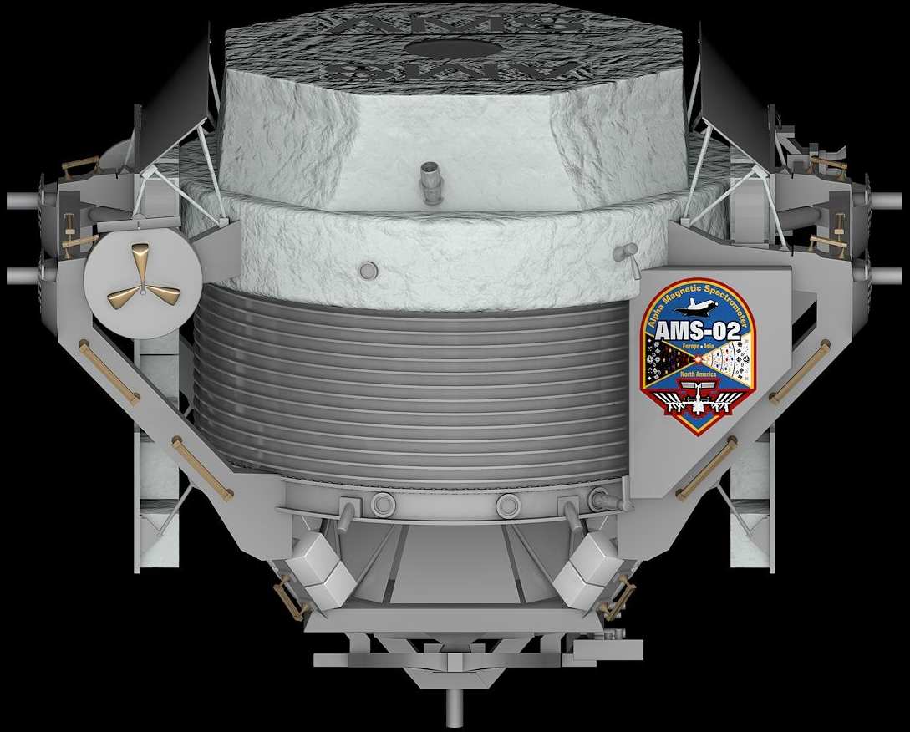
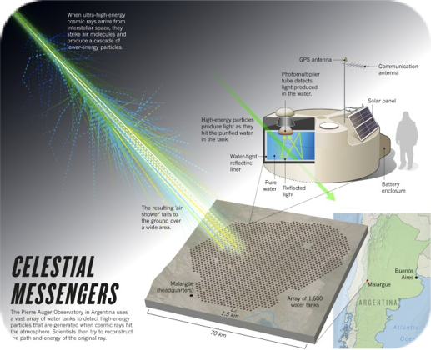
cosmic-ray energy spectrum
K. Fujisue, H. Dembinski, R. Engel, A. Fedynitch
Paolo Desiati

Slide 3
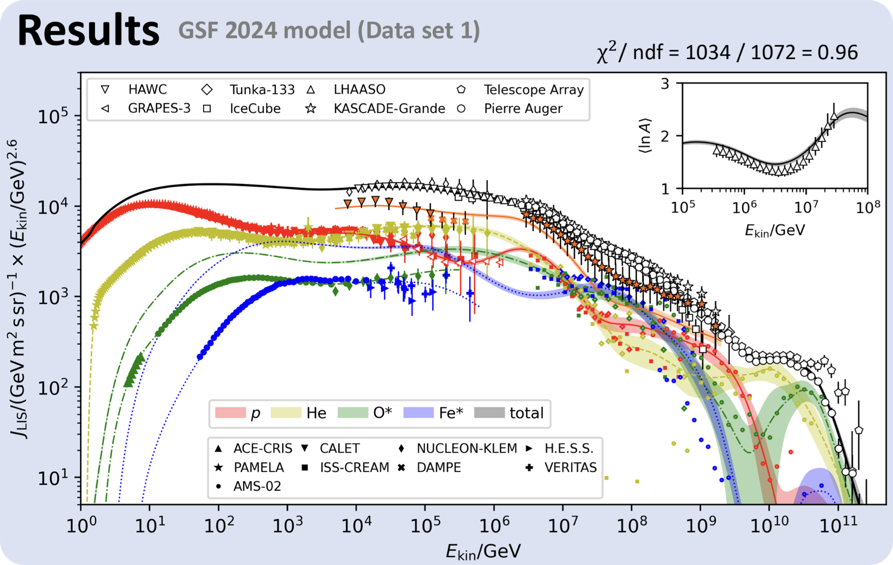
cosmic rays
2
  galactic origin below ~10⁸-10⁹ GeV
  spectral features from acceleration mechanisms & propagation effects
  source distribution in the Milky Way and our neighborhood
  magnetic field properties in galactic and local interstellar medium
  anisotropy
K. Fujisue, H. Dembinski, R. Engel, A. Fedynitch
Paolo Desiati

Slide 4
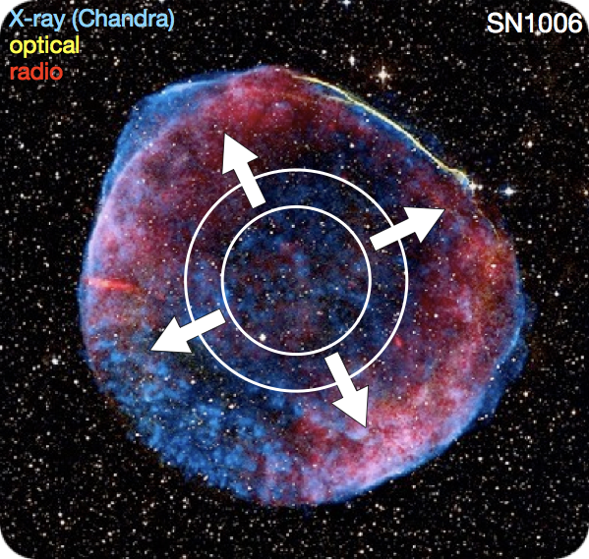
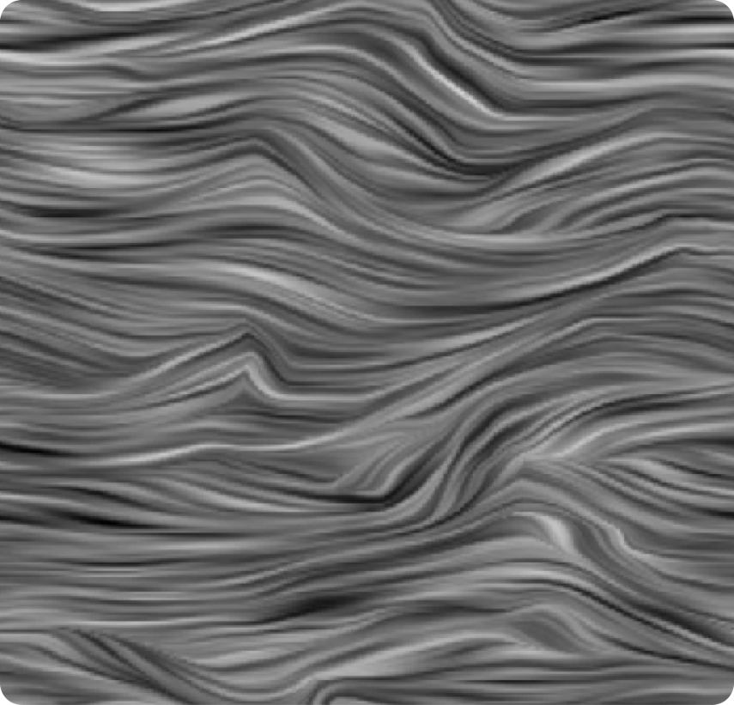
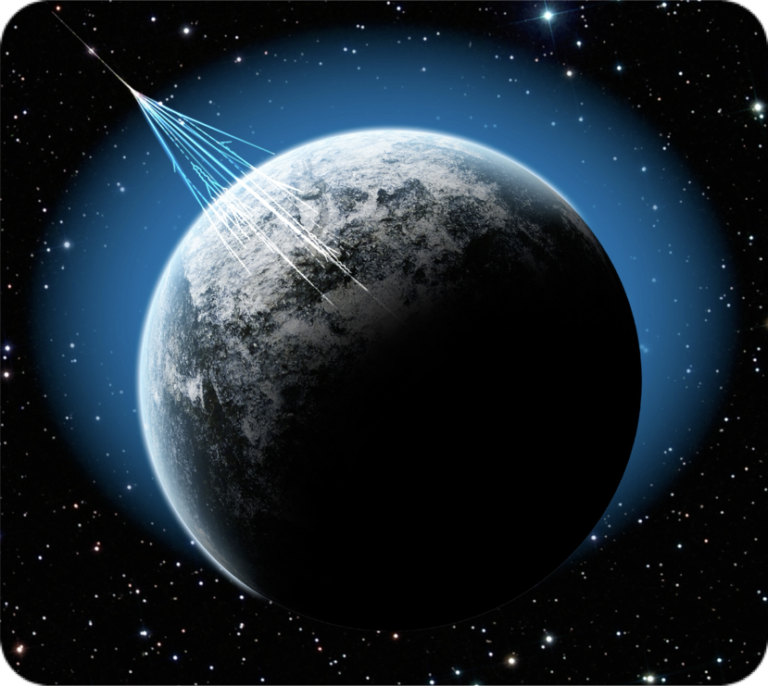
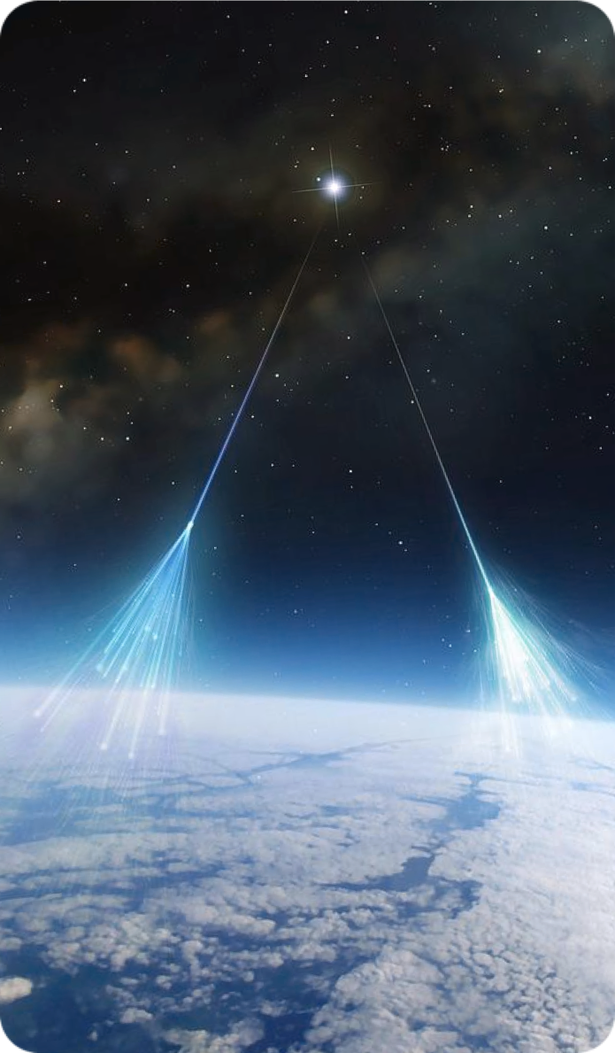
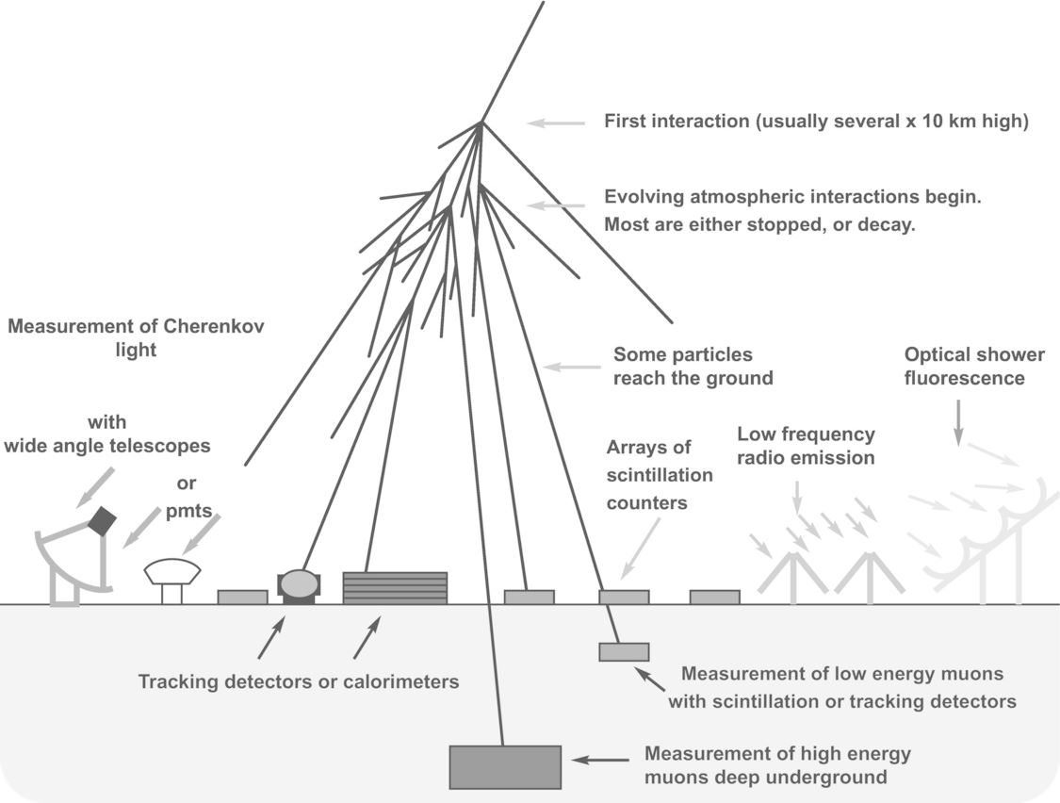
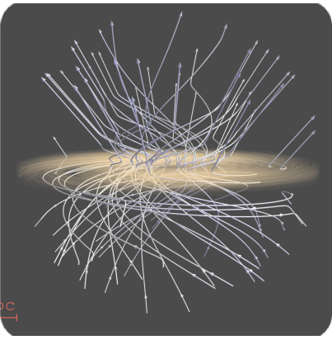
cosmic-ray's journey
accelerator
interstellar medium magnetic fields
Earth's atmosphere dynamic target
𝛾
𝛾
nuclear & hadronic
processes
ground-based
detection
propagation
ν
Glennys R. Farrar
Paolo Desiati

Slide 5
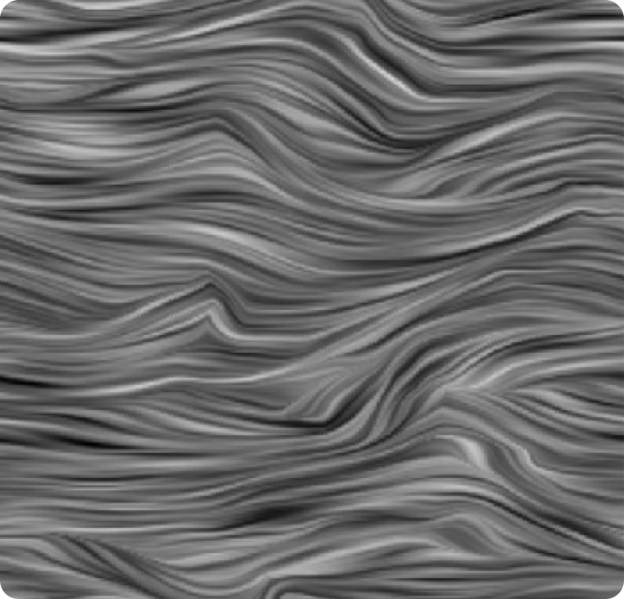
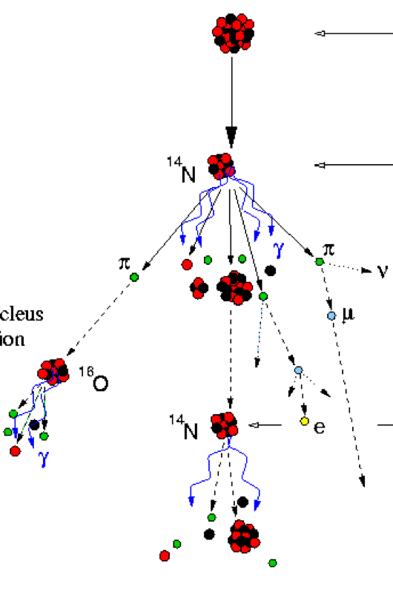
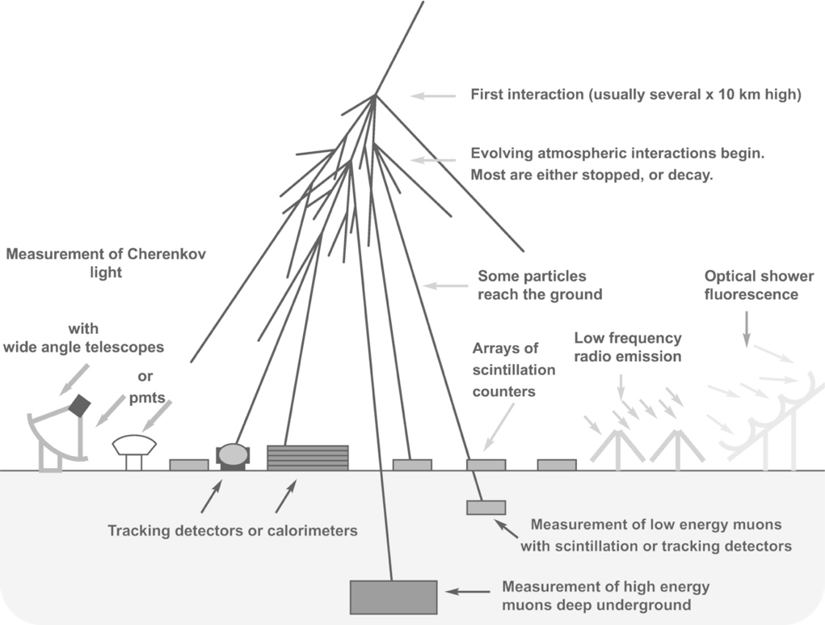
cosmic-ray detection
accelerator (?)
interstellar medium magnetic fields (?)
Earth atmosphere dynamic target
𝛾
𝛾
nuclear & hadronic
processes
propagation
ground-based
detection
ν
Glennys R. Farrar
Paolo Desiati

Slide 6
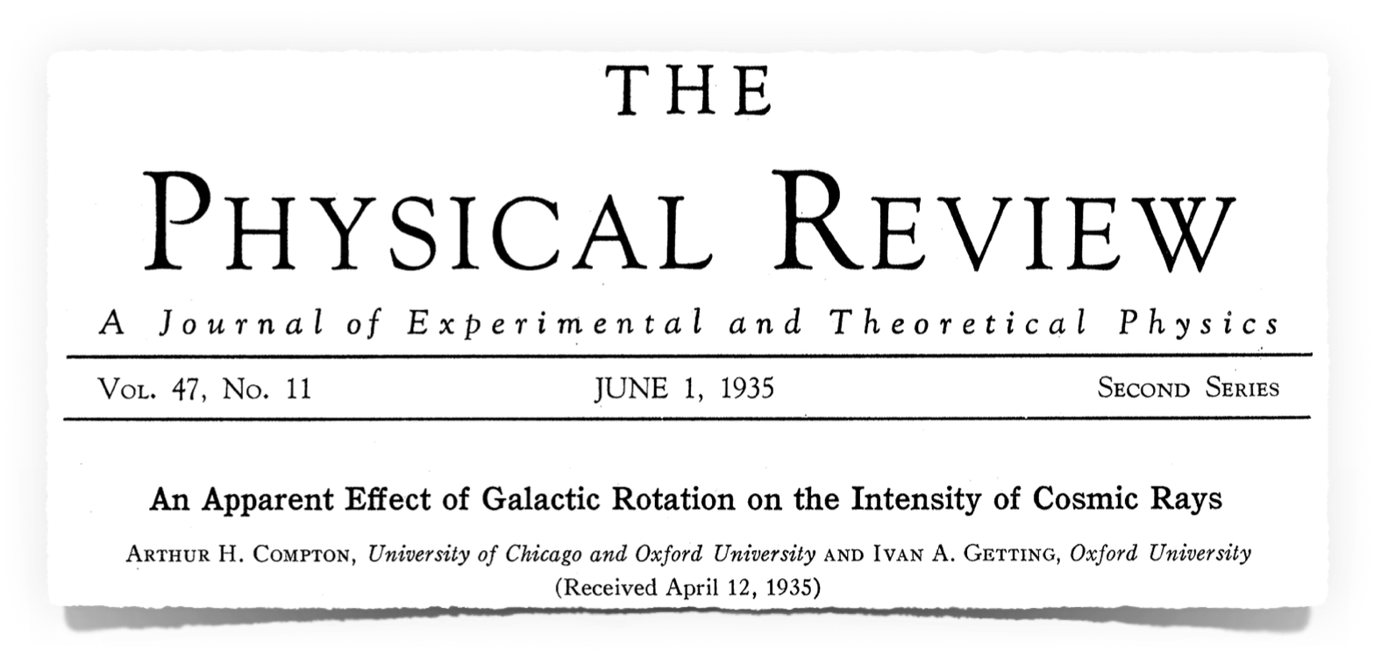
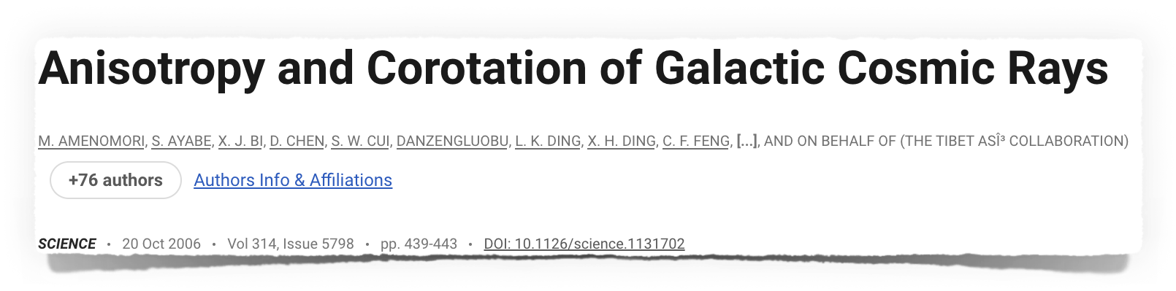


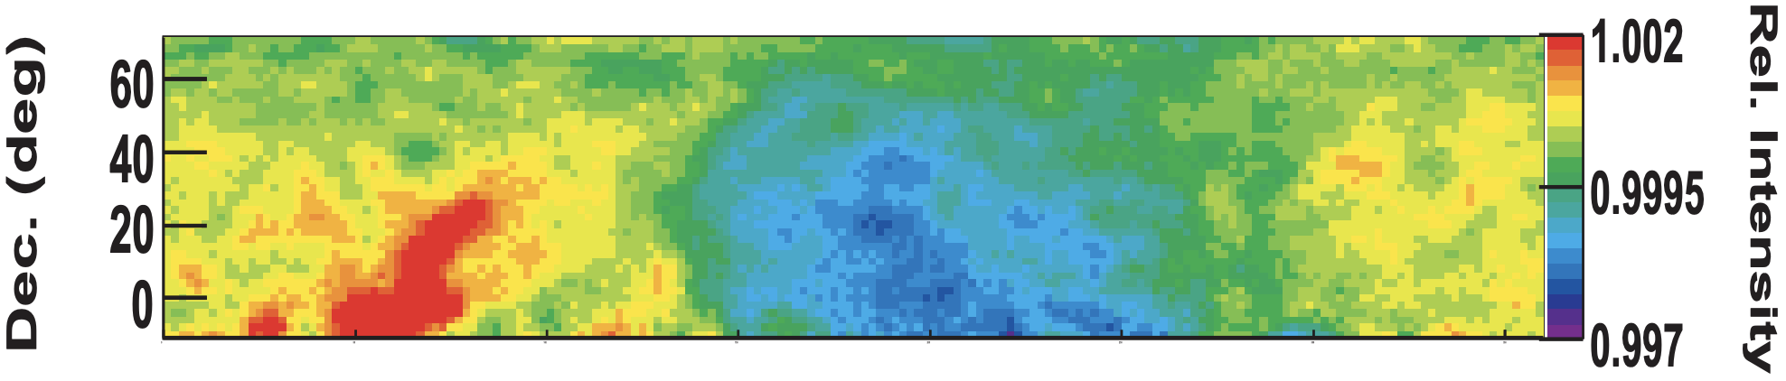

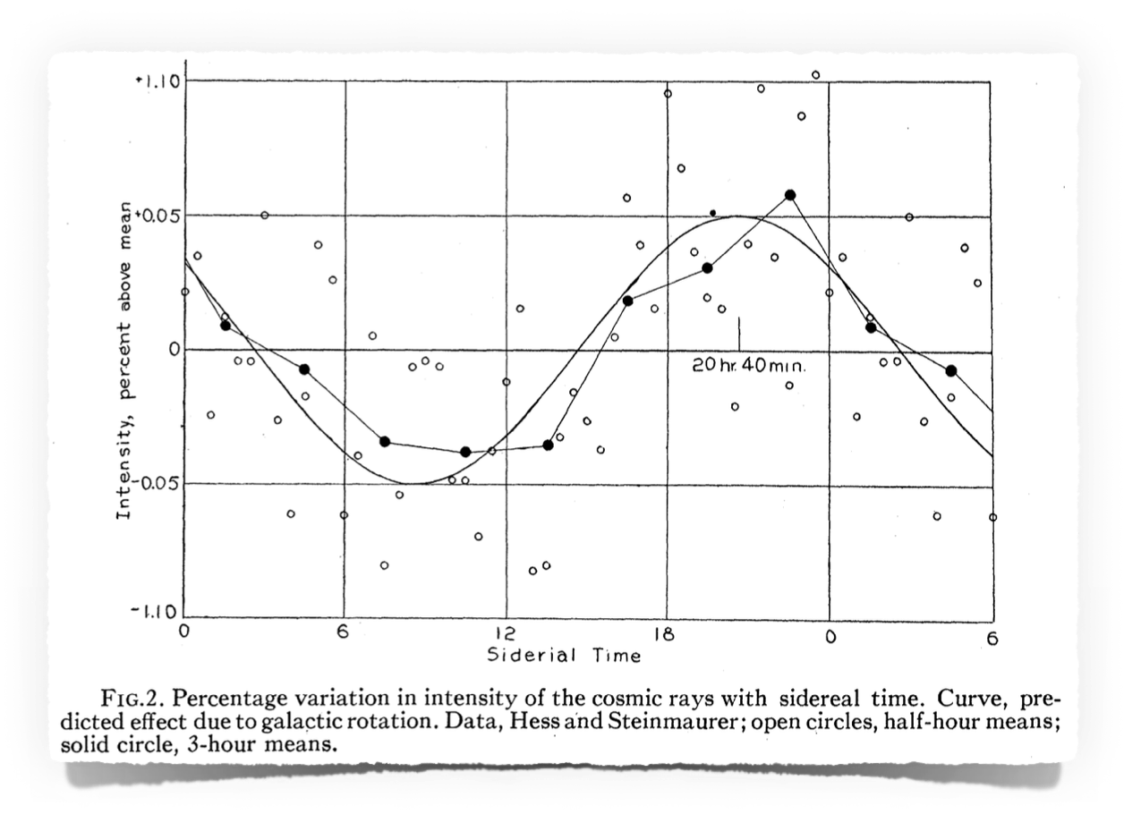
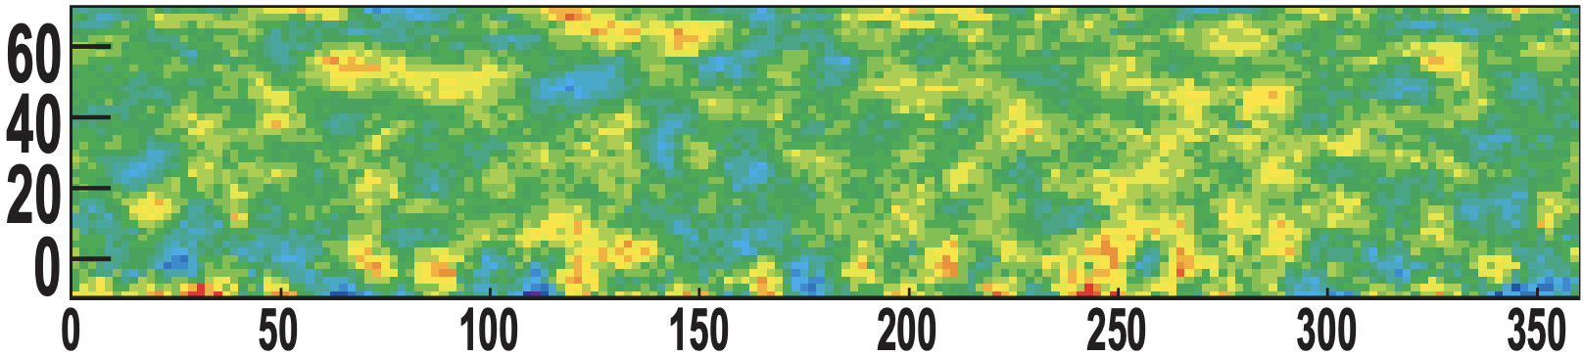
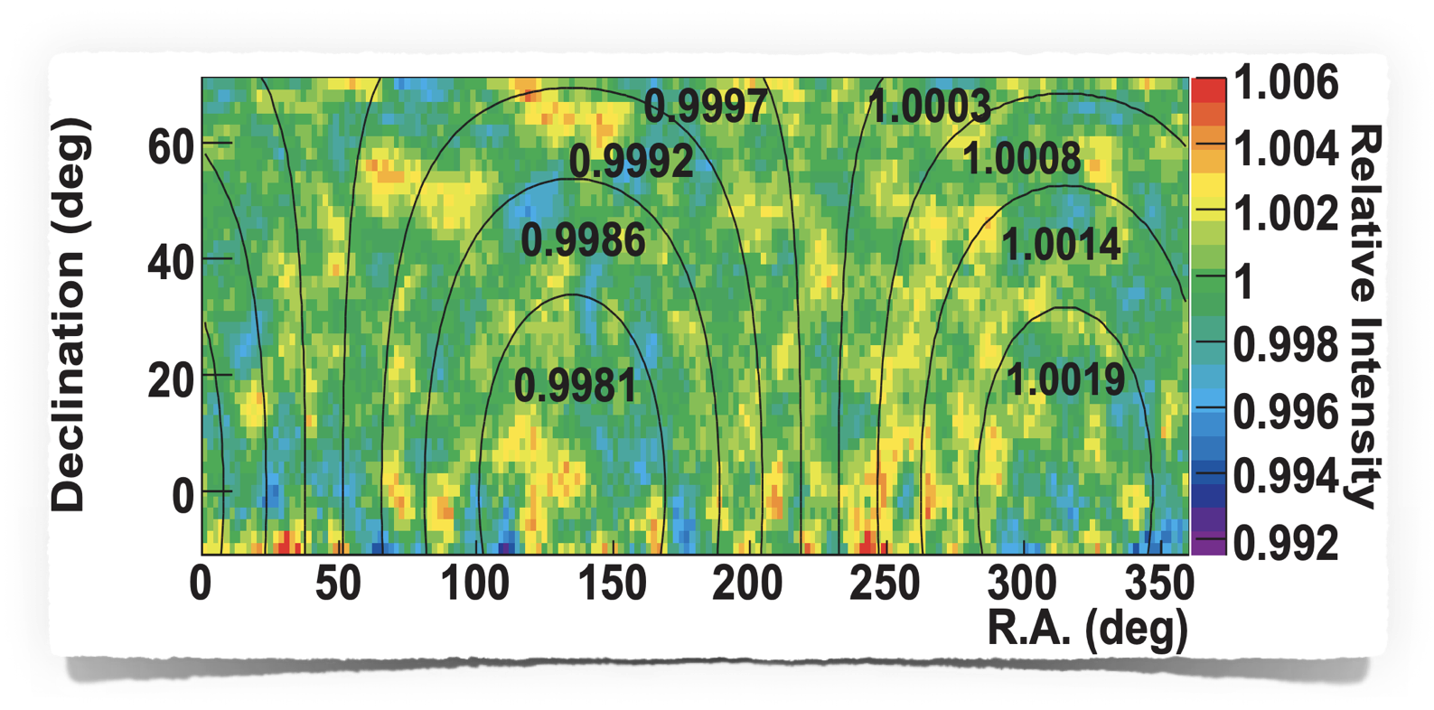
cosmic-ray anisotropy
12 TeV
Tibet AS𝛾
300 TeV
What does it take to provide interpretations that are as unbiased as possible?
Paolo Desiati

Slide 7
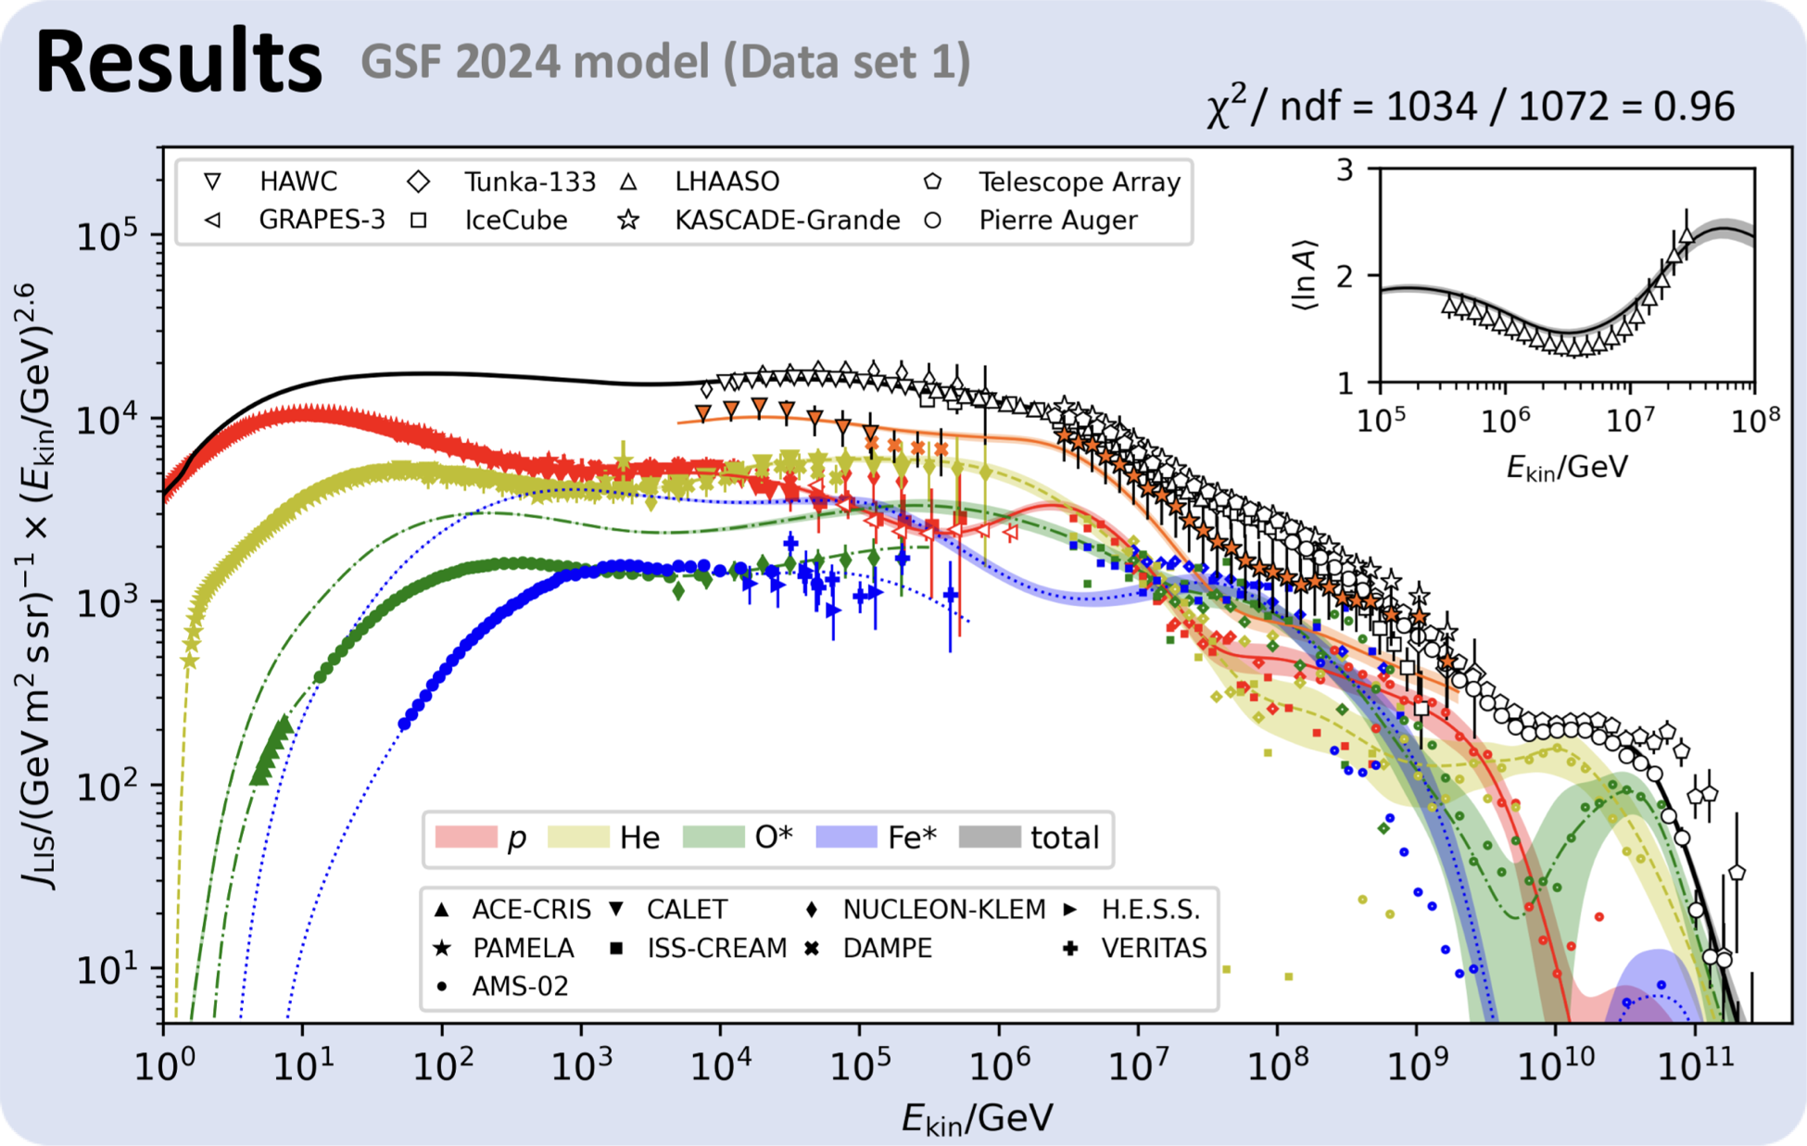
summary
energy range
1 TeV - 10 PeV
anisotropy ~10⁻³
Anisotropy observations
Dipole and medium-scale anisotropy
How do we make observations useful?
Need for multi-experiment observations
K. Fujisue, H. Dembinski, R. Engel, A. Fedynitch
Paolo Desiati

Slide 8
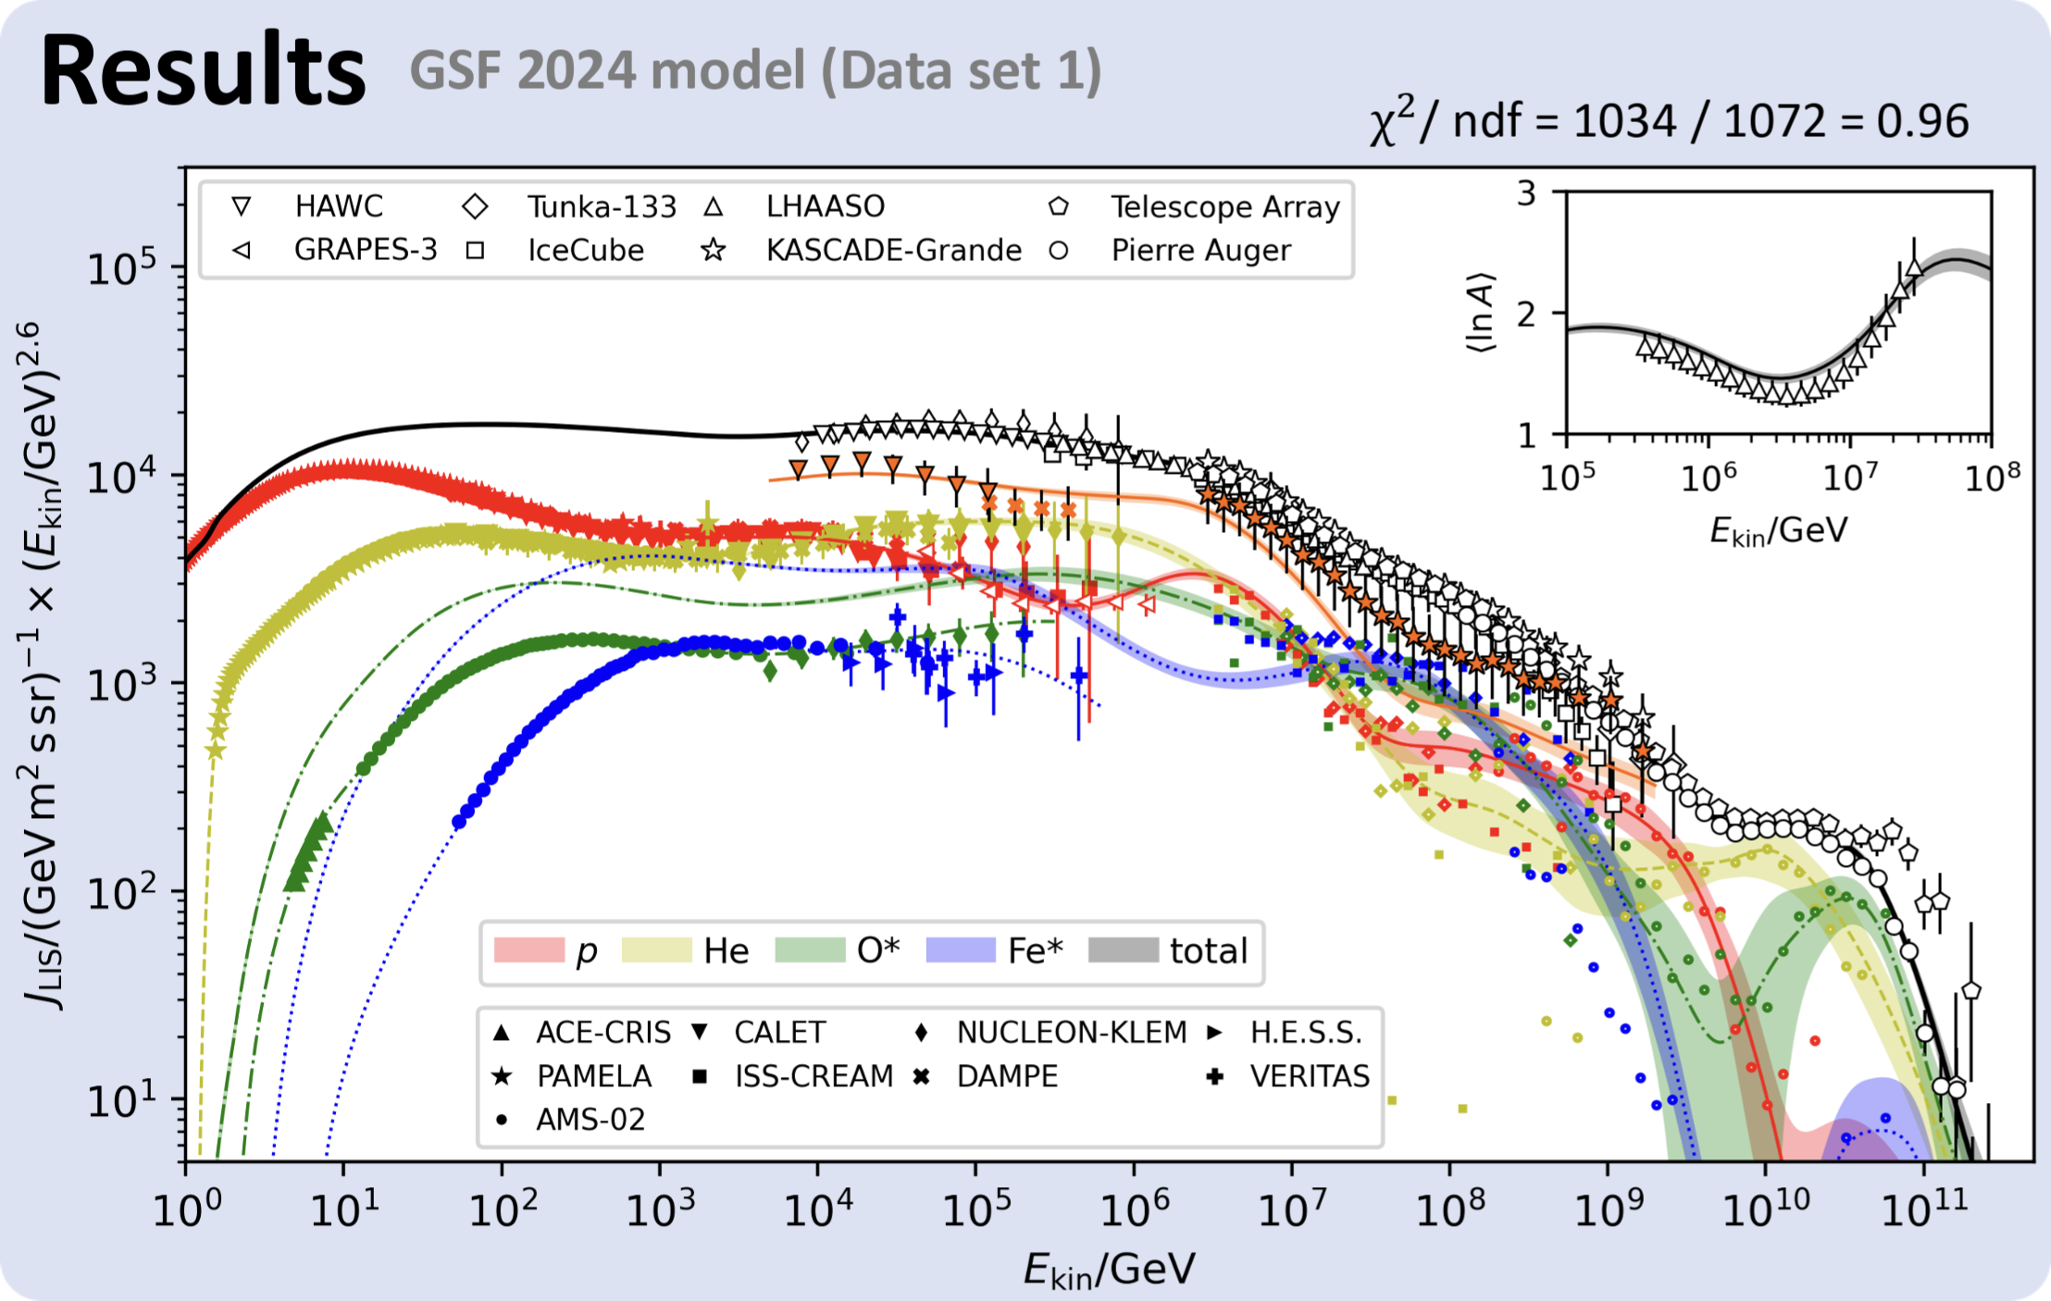
anisotropy measurements
energy range
1 TeV - 10 PeV
anisotropy ~10⁻³
K. Fujisue, H. Dembinski, R. Engel, A. Fedynitch
Paolo Desiati

Slide 9
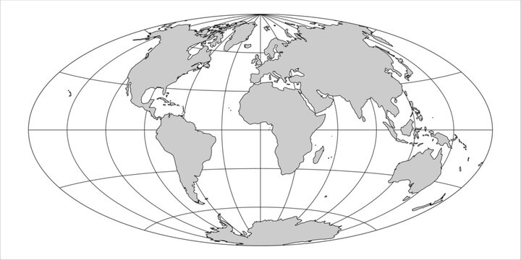
cosmic-ray experiments
TA
P-ONE
KASCADE
EAS-TOP
Km3NET
Tibet-AS𝛾
Baikal-GVD
Milagro
ARGO-YBJ
twenty years
of high statistics
anisotropy data
HAWC
LHAASO
SWGO
Super-K
Auger
IceCube
GRAPES-3
IceCube-Gen2
Paolo Desiati

Slide 10
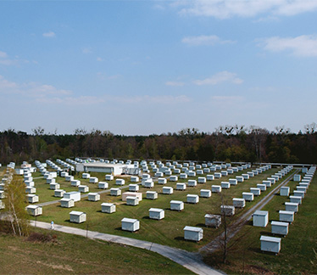
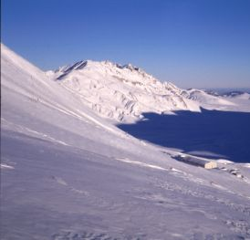
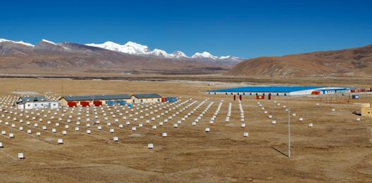
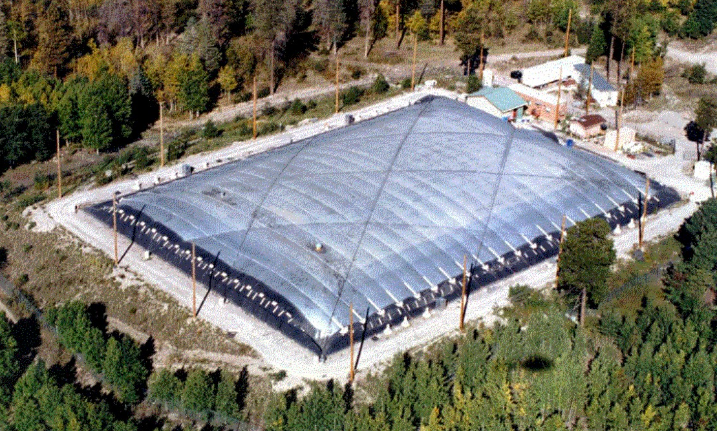
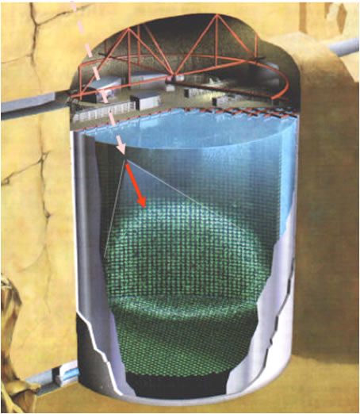
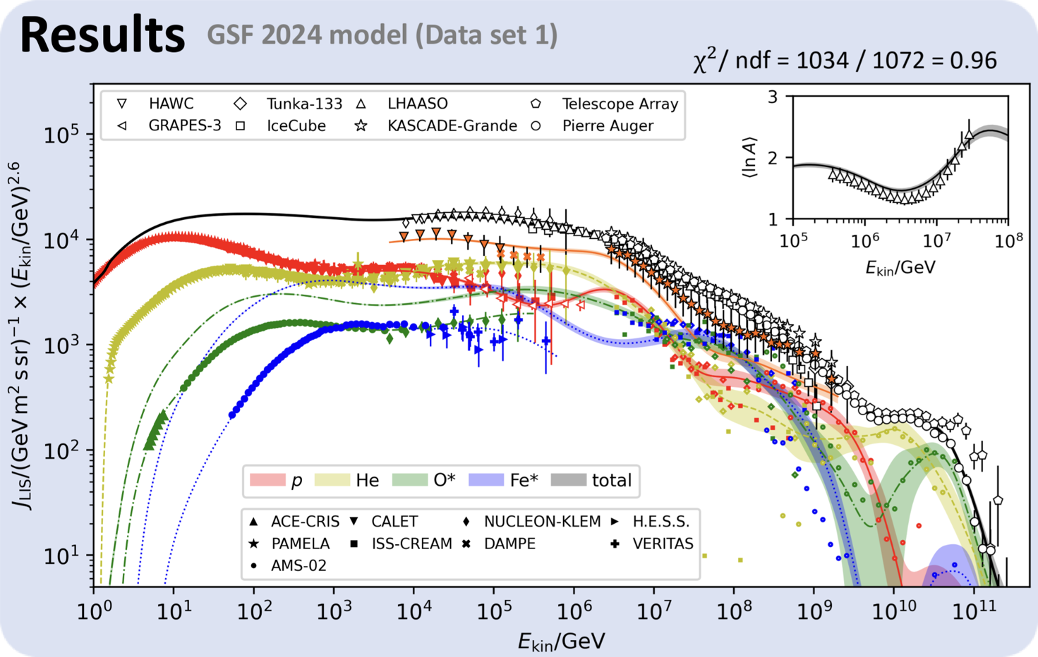
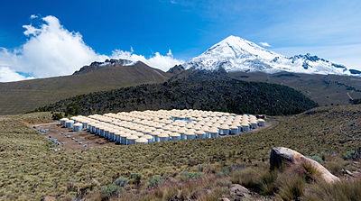
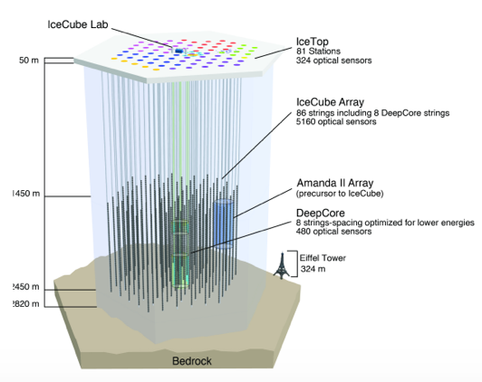
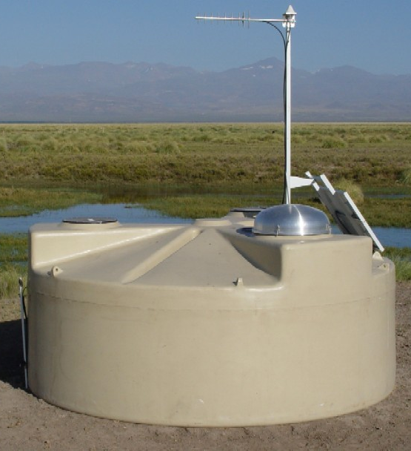
cosmic-ray anisotropy
twenty years
of high statistics
anisotropy data
KASCADE
EAS TOP
Tibet-AS / ARGO-YBJ
energy range
1 TeV - 10 PeV
LHAASO
Milagro
SuperK
HAWC
IceCube/IceTop
Auger
TA
K. Fujisue, H. Dembinski, R. Engel, A. Fedynitch
Paolo Desiati

Slide 11
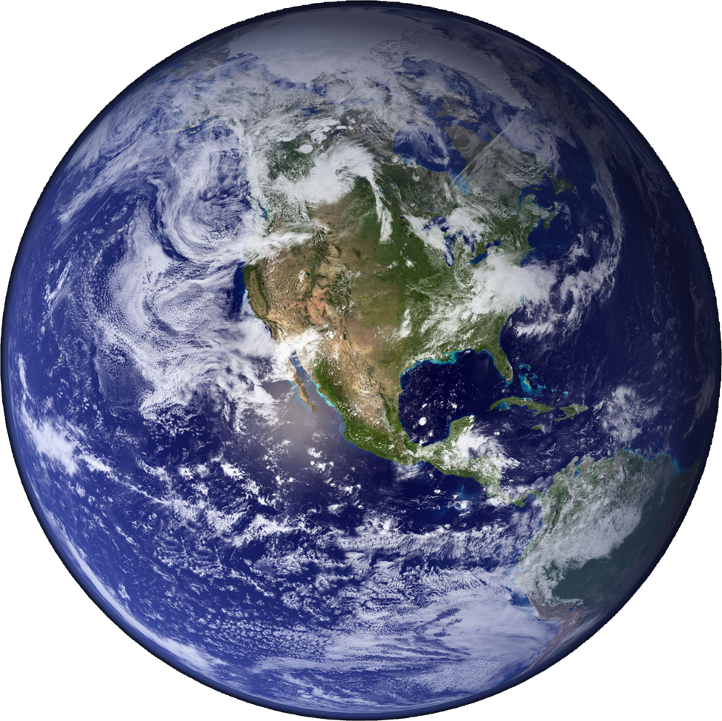
cosmic-ray anisotropy
ground-based experiment
field of view
ground-based experiment
polar view
ground-based experiment
field of view
Paolo Desiati

Slide 12
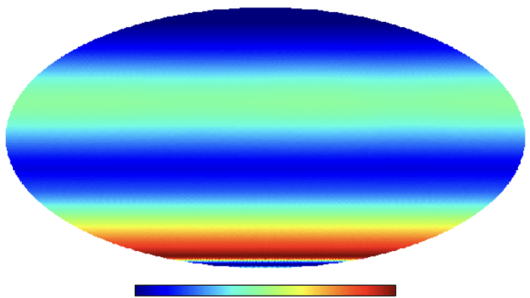
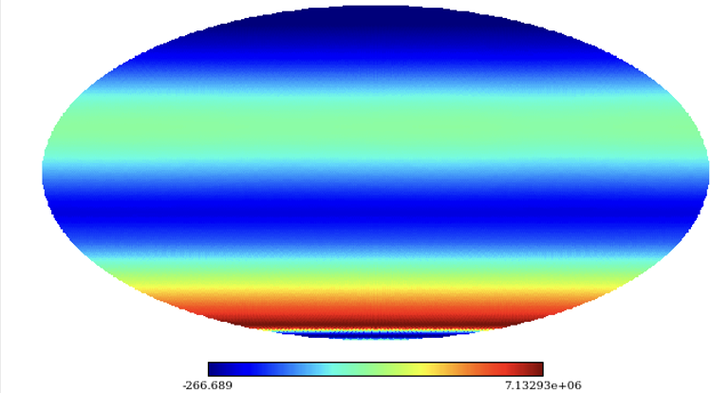
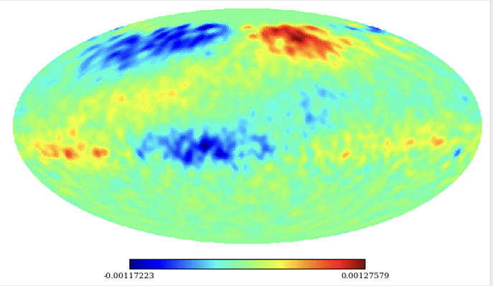
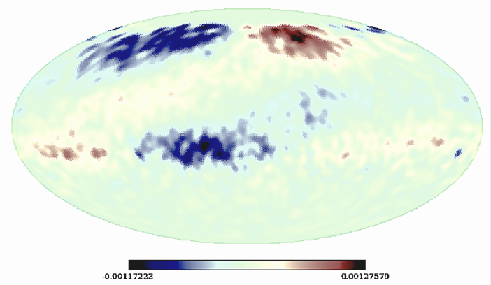
1
"Due to the small size of the anisotropies,
quantitative studies require careful separation
of detector effects from the observations."
how to measure anisotropy
$$N_{i}$$
Build a binned data map using the equatorial coordinates of the events
data count/pixel
$$⟨N_{i}⟩$$
Construct a reference map by integrating acceptance over 24 hours
Correlate pixels to increase sensitivity to different angular scales
(smoothing)
Time-scrambling
$$(θ,ϕ,t)→(α,δ)$$
$$(θ,ϕ,t^{′})→(α^{′},δ^{′})$$
isotropy count/pixel
Likelihood (Ahlers+, 2016)
$$λ=\frac{L(n|I,N,A)}{L(n|I^{(0)},N^{(0)},A^{(0)})}$$
$$δI(α,δ)_{i}$$
Calculate relative differences between data and reference with significance
$$δI(α,δ)_{i}=\frac{N(α,δ)_{i}-⟨N⟩(α,δ)_{i}}{⟨N⟩(α,δ)_{i}}$$
relative intensity
$$s_{i}$$
Calculate statistical significance for each pixel
$$s_{i}=\sqrt{2}{\left\{N_{i}log\left[\frac{1+α}{α}\left(\frac{N_{i}}{N_{i}+N_{0}}\right)\right]+N_{0}log\left[(1+α)\left(\frac{N_{0}}{N_{i}+N_{0}}\right)\right]\right\}}^{1/2}$$
significance
Li and Ma (1993)
Paolo Desiati

Slide 13
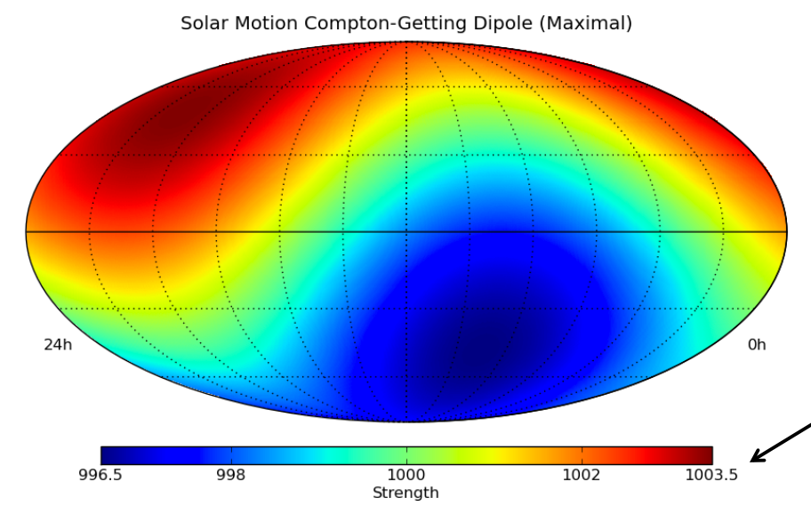
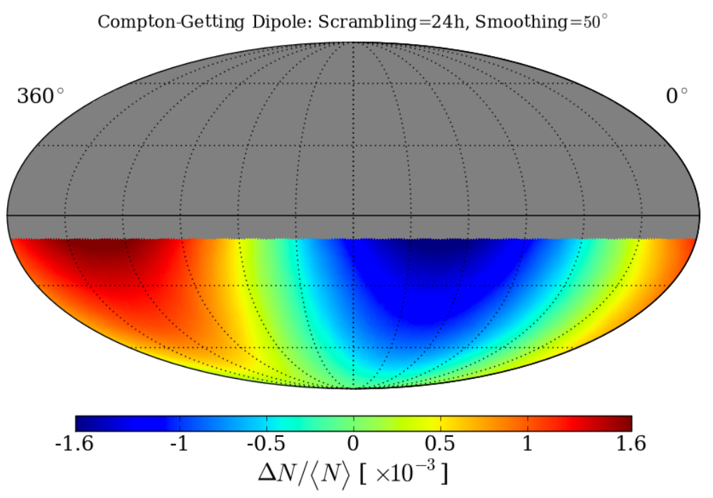
2
consequences of measuring anisotropy
$$N_{i}$$
The data-driven detection acceptance estimation "scrambles the event’s R.A. but not its declination, while keeping the events’ local coordinates constant."
This makes the relative intensity average on R.A. equal to zero
data count/pixel
$$⟨N_{i}⟩$$
isotropy count/pixel
measurement methods eliminate the vertical component of the dipole
$$δI(α,δ)_{i}$$
relative intensity
$$s_{i}$$
equatorial component of the dipole
significance
3
Paolo Desiati

Slide 14
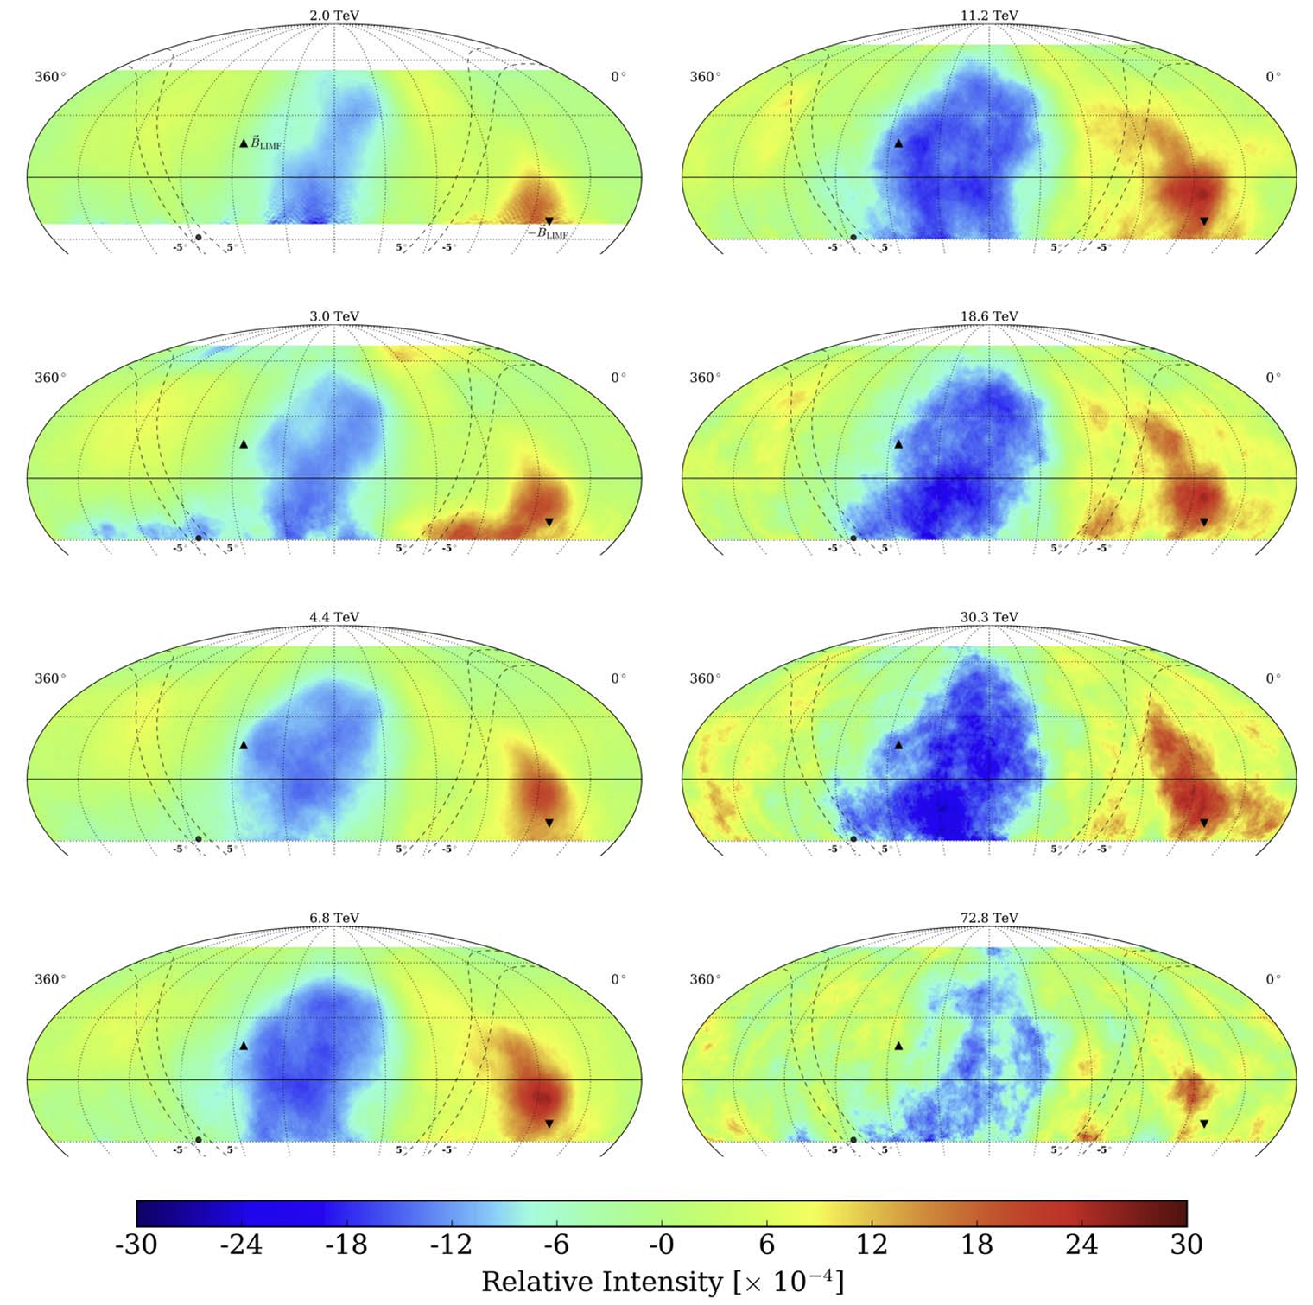
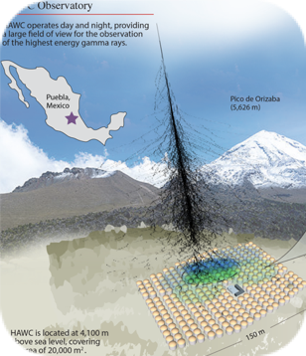
observed anisotropy
1
Energy ~ 1-10 TeV
2 TeV
3 TeV
4.4 TeV
6.8 TeV
HAWC
ApJ 865 57 (2018)
Paolo Desiati

Slide 15
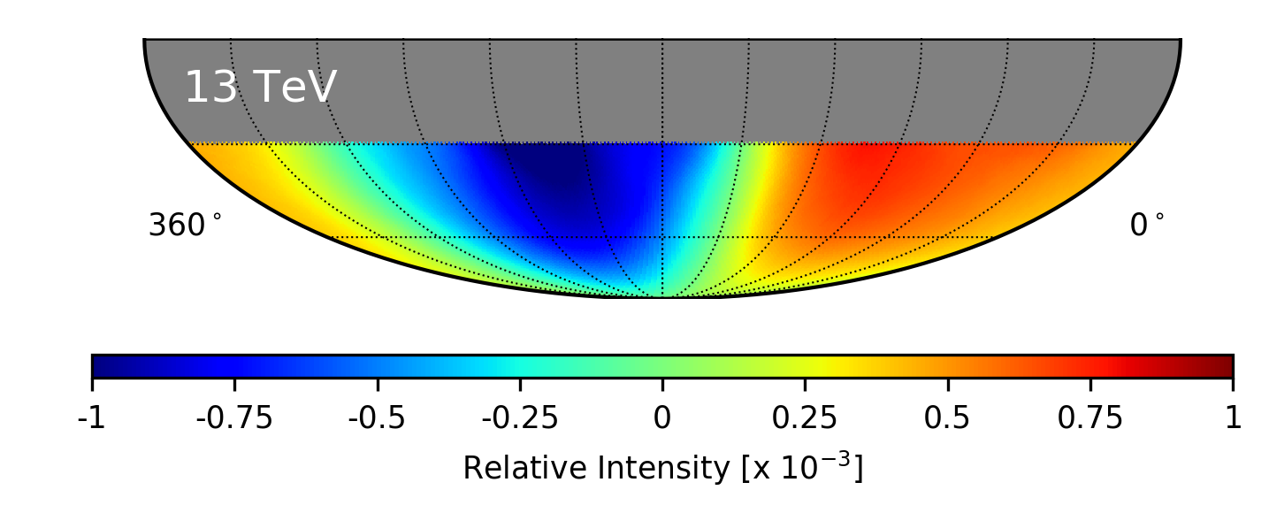
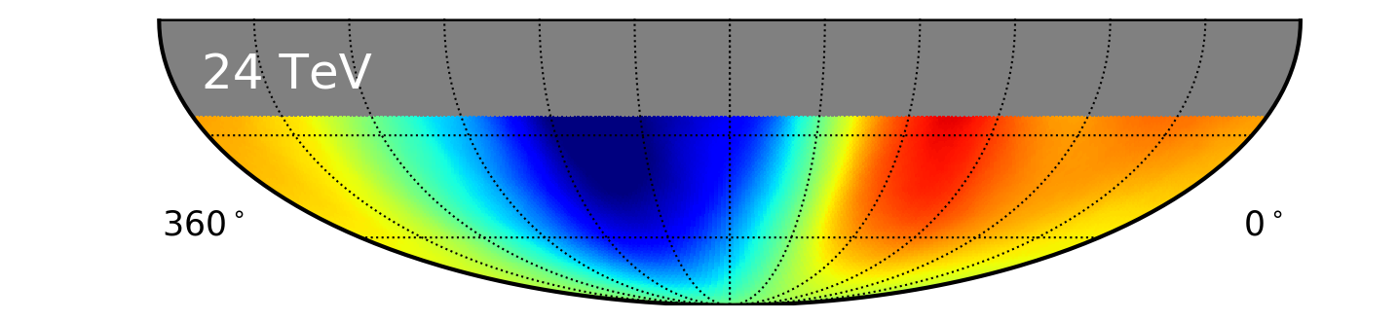
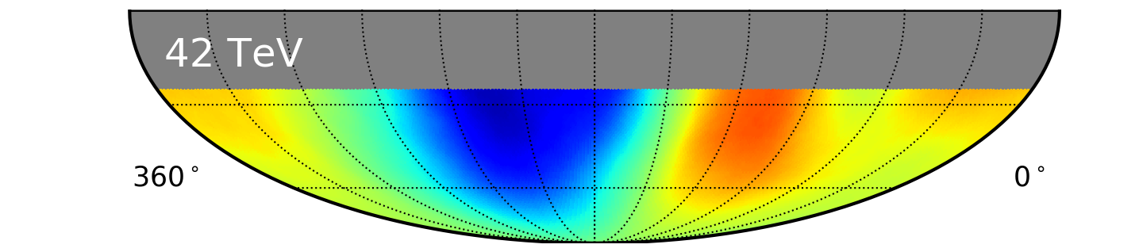
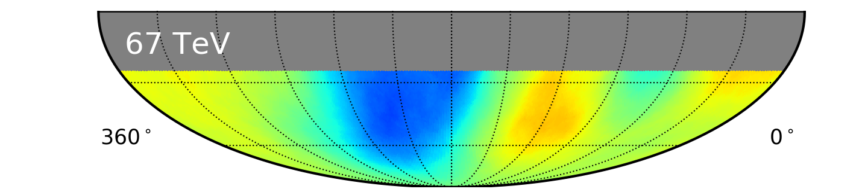

observed anisotropy
2
Energy ~ 10-100 TeV
13 TeV
11.2 TeV
24 TeV
18.6 TeV
42 TeV
30.3 TeV
IceCube
ApJ 981 182 (2025)
67 TeV
72.8 TeV
HAWC
ApJ 865 57 (2018)
Paolo Desiati

Slide 16




observed anisotropy
3
Energy ~ 100-1000 TeV
130 TeV
128 TeV
240 TeV
267 TeV
470 TeV
IceCube
ApJ 981 182 (2025)
LHAASO
PoS(ICRC2023)478
Paolo Desiati

Slide 17


observed anisotropy
4
Energy ~ 1-10 PeV
1.5 PeV
1 PeV
5.3 PeV
~10 PeV
IceCube
ApJ 981 182 (2025)
LHAASO
PoS(ICRC2023)478
Paolo Desiati

Slide 18







breaking down anisotropy
angular power spectrum
IceCube
ApJ 981 182 (2025)
decomposing the relative intensity sky map in Spherical Harmonics functions
Paolo Desiati

Slide 19



the dipole component
IceCube
ApJ 981 182 (2025)
decomposing the relative intensity sky map in Spherical Harmonics functions
equatorial component of the dipole
Paolo Desiati

Slide 20

large & small scale anisotropy
IceCube
ApJ 981 182 (2025)
decomposing the relative intensity sky map in Spherical Harmonics functions
equatorial component of the dipole
Paolo Desiati

Slide 21
large & small scale anisotropy
IceCube
ApJ 981 182 (2025)
large-scale anisotropy $(ℓ=1,2,3)$
decomposing the relative intensity sky map in Spherical Harmonics functions
small-scale anisotropy $(ℓ=6-11)$
equatorial component of the dipole
Paolo Desiati

Slide 22











interstellar magnetic fields
Unger & Farrar (2024)
regular
regular
magnetic field
Whirlpool Galaxy (M51) - SOFIA - NASA
halo
collisionless
scattering
spiral
pitch angle scattering
coherent structures
time variations
intermittent fields
time
magnetic superdiffusion
causes bouncing CRs to
parallel diffusion
coherent
structures
$$⟨\overset{⃗}{B}⟩$$
Planck Collaboration (2014)
anomalous diffusion
PD & Zweibel (2014)
mirror diffusion
Lazarian & Xu (2021)
Column density derived from submillimeter emission observed for a region in the Orion A molecular cloud using the
Herschel Space Observatory overlaid with plane-of-sky magnetic field topology using the Planck 353 GHz polarization
observations.
field line random walk
Xu & Yan (2013)
turbulence
superdiffusion
Lazarian & Vishniac (1999)
Giacalone & Jokipii (1999)
particles in Alfvénic turbulence
Soler (2019)
Paolo Desiati

Slide 23
cosmic-ray propagation
Unger & Farrar (2024)
regular
regular
magnetic field
Whirlpool Galaxy (M51) - SOFIA - NASA
halo
collisionless
scattering
spiral
pitch angle scattering
coherent structures
time variations
intermittent fields
time
magnetic superdiffusion
causes bouncing CRs to
parallel diffusion
coherent
structures
$$⟨\overset{⃗}{B}⟩$$
Planck Collaboration (2014)
anomalous diffusion
PD & Zweibel (2014)
mirror diffusion
Lazarian & Xu (2021)
Column density derived from submillimeter emission observed for a region in the Orion A molecular cloud using the
Herschel Space Observatory overlaid with plane-of-sky magnetic field topology using the Planck 353 GHz polarization
observations.
field line random walk
Xu & Yan (2013)
turbulence
superdiffusion
Lazarian & Vishniac (1999)
Giacalone & Jokipii (1999)
particles in Alfvénic turbulence
Soler (2019)
Paolo Desiati

Slide 24


dipole anisotropy component
1
Blasi & Amato (2012)
cylindrical Galaxy
Impossible to infer information on the global distribution of cosmic-ray sources in the Milky Way.
We may observe just a random instantiation of galactic contribution.
Local sources scenario may explain observations as a manifestation of our position in the Milky Way.
equatorial component of the dipole
spiral Galaxy
Cosmic ray propagation in magnetic turbulence is described as spatial diffusion, leading to a small dipole anisotropy.
Paolo Desiati

Slide 25


dipole anisotropy component
a local source
2
3
Equatorial Plane
Vela SNR as candidate of the local CR source responsible for the dipole anisotropy at 1–100 TeV.
Equatorial Plane
equatorial component of the dipole
Ahlers (2016)
Paolo Desiati

Slide 26




medium/small-scale anisotropy
fingerprint of local turbulence
1
2
Ahlers (2013) - Ahlers & Mertsch (2015)
López Barquero, PD+ (2016)
Bian, Giacinti, Reville (2025)
magnetic turbulence and
transition from diffusive to ballistic
"the existence of a global CR dipole moment necessarily generates a spectrum of higher multipole moments in the local CR distribution."
dipole energy dissipated to small angular scales
Long-baseline numerical calculation in
compressible MHD turbulence
(Cho & Lazarian, 2002)
injected dipole breaks down to small-scale anisotropy
saturation at the mean free path distance scale
long-baseline numerical calculation in synthetic turbulence
small-scale anisotropy as turbulence fingerprint
"The formation of the large-scale anisotropy is closely related to the surrounding magnetic field environment, in particular to the shape of the local magnetic flux tube containing the observer"
Paolo Desiati

Slide 27






our magnetic backyard
influence of the heliosphere
1
Schwadron, PD+ (2014)
10 TeV cosmic rays
Díaz Vélez & PD (2016)
HAWC-IceCube
ApJ 871 96 (2019)
laminar model of heliosphere
global properties of TeV CR propagation
TeV cosmic rays are affected by the
heliospheric magnetic bubble
Borovikov, Heerikhuisen, Pogorelov (2015)
numerical model of solar wind interacting with ISM
solving plasma MHD equations coupled with kinetic transport of neutral atoms
A dipole distribution injected in the ISM produces a complex anisotropy on Earth
Lazarian & PD (2010)
PD & Lazarian (2012)
Paolo Desiati

Slide 28



our magnetic backyard
influence of the heliosphere
2
3
Zhang+ (2014)
Zhang+ (2020)
(A)
Tibet-AS𝛾 relative intensity sky map from the at
4 TeV energy
Amenomori+ (2006)
numerically computed trajectory distribution at Erth after fit to Tibet-AS𝛾 data
inferred large-scale anisotropy in the ISM
without heliospheric influence
(B)
(C)
Paolo Desiati

Slide 29
how to make observations useful?
are anisotropy measurements good enough?
what about
experimental biases
instrumental resolutions
we need
multi-experiment observations
theorists - experimentalists collaboration
Paolo Desiati

Slide 30
now what?
are anisotropy measurements good enough?
what about
experimental biases
instrumental resolutions
and how to handle uncertainties on
heliosphere's modeling
Paolo Desiati

Slide 31





limited field of view
iterative maximum likelihood method
1
(Ahlers+, 2016)
relative
intensity
(Ahlers+, 2016)
relative
acceptance
total
#events
attenuation of large-scale structures exceeding
the size of the instantaneous field of view
when smaller than 24hr integrated field of view
iterative likelihood
maximization
HAWC measures 1/3 of dipole amplitude with 1st iteration only
and other standard methods
Paolo Desiati

Slide 32





limited field of view
correlation between multipole modes
2
let's inject a
tilted dipole anisotropy
this is the dipole seen
on northern hemisphere
this is the
reconstructed dipole
on northern hemisphere
equatorial component
this is the dipole seen
on southern hemisphere
this is the
reconstructed dipole
on southern hemisphere
equatorial component
dipole
dipole
~quadrupole
Paolo Desiati

Slide 33


limited field of view
correlation between multipole modes
3
HAWC-IceCube
ApJ 871 96 (2019)
Multipole components are subject to correlations
caused by partial sky coverage since there is a degeneracy between different ℓ-modes.
A pure dipole can result in an artificial quadrupole due to partial sky coverage.
Paolo Desiati

Slide 34


limited field of view
full-sky observations mitigate FOV bias
4
5
10 TeV
HAWC-IceCube
ApJ 871 96 (2019)
10 TeV
without ℓ = 1, 2, 3
Full sky measurements are the only way to recover the real anisotropy
loss of large-scale power leads to erroneous physical interpretations
Paolo Desiati

Slide 35



response function
resolutions and uniformities
IceCube
ApJ 981 182 (2025)
finite energy resolution
overlap between energy samples
HAWC-IceCube
ApJ 871 96 (2019)
uniform energy response function across the sky
otherwise results show mixed anisotropy structures from different energies at various declination bands
Paolo Desiati

Slide 36

mass composition
and rigidity scaling
observed cosmic rays have mixed mass composition: it's not only protons
different experiments have different mass sensitivities
3 TV
B(µG)
heliosphere by Pogorelov+
Díaz Vélez & PD
dipole component results from the combined mixed composition anisotropies which depends on energy
does anisotropy scale with rigidity, or does each species have its peculiar anisotropy?
Paolo Desiati

Slide 37

conclusions
Promote inter-experiment collaborations: not just stitching maps
Encourage collaborations with theorists/modelers
  how to understand and correctly use the observations
  how to prepare observations for the most appropriate model comparisons
Understand the role of the heliosphere < 100s TV
  develop models for interpreting cosmic rays
Paolo Desiati

Slide 38



experimental results
and how to make them useful
2
TeV CRs strongly influenced by the heliosphere
  heliosphere's size and length
  ISM magnetic field draping scale
  heliopause magnetic pressure / bow shock
experimental results on publications
  clear methods descriptions and systematics studies
encouraging inter-experiments collaborations
  provide unbiased results to theorists and modelers
Paolo Desiati

Slide 39


谢谢
Thank you
Paolo Desiati

Slide 40
additional slides
Paolo Desiati

Slide 41
cosmic-ray anisotropy
12 TeV
Tibet AS𝛾
300 TeV
What does it take to provide interpretations that are as unbiased as possible?
Paolo Desiati

Slide 42


where we are now
IceCube-Gen2
tech design report
Paolo Desiati

Slide 43


3
consequences of measuring anisotropy
HAWC
ApJ 865 57 (2018)
effect of the north-south blindness
Simulated dipole reconstructed with LLH method
Vertical dipole component cannot be measured (when using data-driven reference map estimation)
Iterative LLH method compensates for the limited field of view (light to dark red)
Geometric correction needed due to limited sky coverage
2
Paolo Desiati

Slide 44






4
measuring the dipole component
IceCube
ApJ 981 182 (2025)
relative intensity expanded in
spherical harmonic functions
with partial sky coverage the are correlated
except for the terms
we use these functions for a 2D fit of sky maps
to be compared with the standard 1D dipole fits
Paolo Desiati

Slide 45

5
measuring the dipole component
IceCube
ApJ 981 182 (2025)
for the dipole component this 1D function is
with geometric correction factor equal to
that depends on experiment's field of view in Dec.
Paolo Desiati

Slide 46


dipole anisotropy component
a local source
3
2
Qiao+ (2023)
alighment along the IBEX ISM magnetic field
equatorial component of the dipole
nearby source
background source
protons
all-CRs
illustration of the evolution of CR energy spectrum and anisotropy in the presence of a local source.
Paolo Desiati

Slide 47


dipole anisotropy component
a local source
4
2
Li+ (2024)
anisotropic diffusion
diffusion coefficient lower in inner halo
equatorial component of the dipole
Geminga
local source to determine spectral anomaly and counterbalance galactic anisotropy below 100 TeV energy scale
Paolo Desiati

Slide 48



medium/small-scale anisotropy
fingerprint of local turbulence
2
1
Kuhlen, Phan, Mertsch (2022)
Zhang & Liu (2024)
long-baseline numerical calculation in synthetic turbulence
angular power spectrum from "correlations of particles experiencing the same turbulent magnetic field."
uniform plasma convection gives rise to the Compton-Getting effect
turbulent plasma convection generates perturbations at various angular scales
"With the idea that particle distributional fluctuations can be related to fluid local nonuniformity, we have demonstrated that
turbulent convection may give rise to remarkable small-scale anisotropies of the distribution."
IceCube
ApJ 981 182 (2025)
Paolo Desiati

Slide 49

medium-scale anisotropy
fingerprint of local turbulence
3
1
Giacinti & Kirk (2017)
IceTop (2014)
propagation effects on anisotropic spectrum of Goldreich-Sridhar type Alfvén waves
isotropic distribution of fast magnetosonic modes with a power spectrum compatible with
Cho & Lazarian (2002)
isotropic diffusion (in QLT) generates a dipole anisotropy and cannot explain observations
400 TeV
IceTop (2014)
2 PeV
Paolo Desiati

Slide 50


our magnetic backyard
influence of the heliosphere
3
2
López Barquero + PD+ (2017)
forward propagation
injection @ 6000 AU - target @ 200 AU
takes into account pitch-angle ranges with trajectories bouncing back into space
uniform pitch-angle distribution redistributed into different angular components
particles injected in the region upstream of the ISM flow back-scatter into the downstream region due to the heliospheric magnetic bubble
Paolo Desiati

Slide 51



our magnetic backyard
influence of the heliosphere
4
Schwadron, PD+ (2014)
Paolo Desiati

Slide 52
limited field of view
5
4
HAWC
ApJ 871 96 (2019)
10 TeV
large scale anisotropy
diffusion in ISM turbulence
large coherent structures
small scale anisotropy
scattering in ISM turbulence/instabilities
within last mean free path
Bian, Giacinti, Reville (2025)
Paolo Desiati

Slide 53
limited field of view
6
4
HAWC
ApJ 871 96 (2019)
10 TeV
large scale anisotropy
diffusion in ISM turbulence
large coherent structures
small scale anisotropy
scattering in ISM turbulence/instabilities
within last mean free path
Ahlers (2013) - Ahlers & Mertsch (2015)
Paolo Desiati

Slide 54




observed anisotropy
spherical harmonic analysis
missing
vertical
component
(m = 0)
FoV bias
total angular power spectrum
ℓ>3 angular power spectrum
Paolo Desiati

Slide 55

time variations?
IceCube
ApJ 981 182 (2025)
Paolo Desiati

Slide 56


AMANDA + IceCube
NOT calendar years
AMANDA - 2000
AMANDA - 2001
AMANDA - 2002
AMANDA - 2003
AMANDA - 2004
AMANDA - 2005
AMANDA - 2006
IC22 - 2007
IC40 - 2008
IC59 - 2009
IC79 - 2010
IC86 - 2011
Paolo Desiati

Slide 57

AMANDA + IceCube
NOT calendar years
AMANDA - 2000
AMANDA - 2001
AMANDA - 2002
AMANDA - 2003
AMANDA - 2004
AMANDA - 2005
AMANDA - 2006
IC22 - 2007
IC40 - 2008
IC59 - 2009
IC79 - 2010
IC86 - 2011
Paolo Desiati

Slide 58


local interstellar magnetic field
Abeysekara et al., ApJ (2019) 871 96
Local Interstellar Magnetic Field
Paolo Desiati

Slide 59

The heliosphere
Heliospheric model by
Borovikov, Heerikhuisen, Pogorelov, 2015
Paolo Desiati

Slide 60




The heliosphere
Díaz Vélez & PD
draping of interstellar magnetic field magnetic mirror
10 TV particles can be trapped
residence time can reach ~20 years
strong heliospheric influence
cosmic rays distribution re-shaped when passing through the heliosphere
Heliospheric model by
Borovikov, Heerikhuisen, Pogorelov, 2015
Paolo Desiati

Slide 61



The heliosphere
Díaz Vélez & PD
10 TV
backward propagation
assume dipole pitch-angle distribution in the ISM
(isotropic diffusion)
strong heliospheric influence
observed distribution compatible with mostly dipolar CR density gradient in the ISM
isotropic pitch-angle diffusion
different distribution than the ISM
IceCube (2018)
Paolo Desiati

Slide 62



The heliosphere
Díaz Vélez & PD
300 TV
backward propagation
assume dipole pitch-angle distribution in the ISM
(isotropic diffusion)
no heliospheric influence
pitch-angle distribution in the ISM cannot be the same as that at 10 TV
pristine distribution from the ISM
IceCube (2018)
Paolo Desiati

Slide 63
future experiment
IceCube-Gen2
IceCube-Gen2
tech design report
Paolo Desiati

