Slide 1
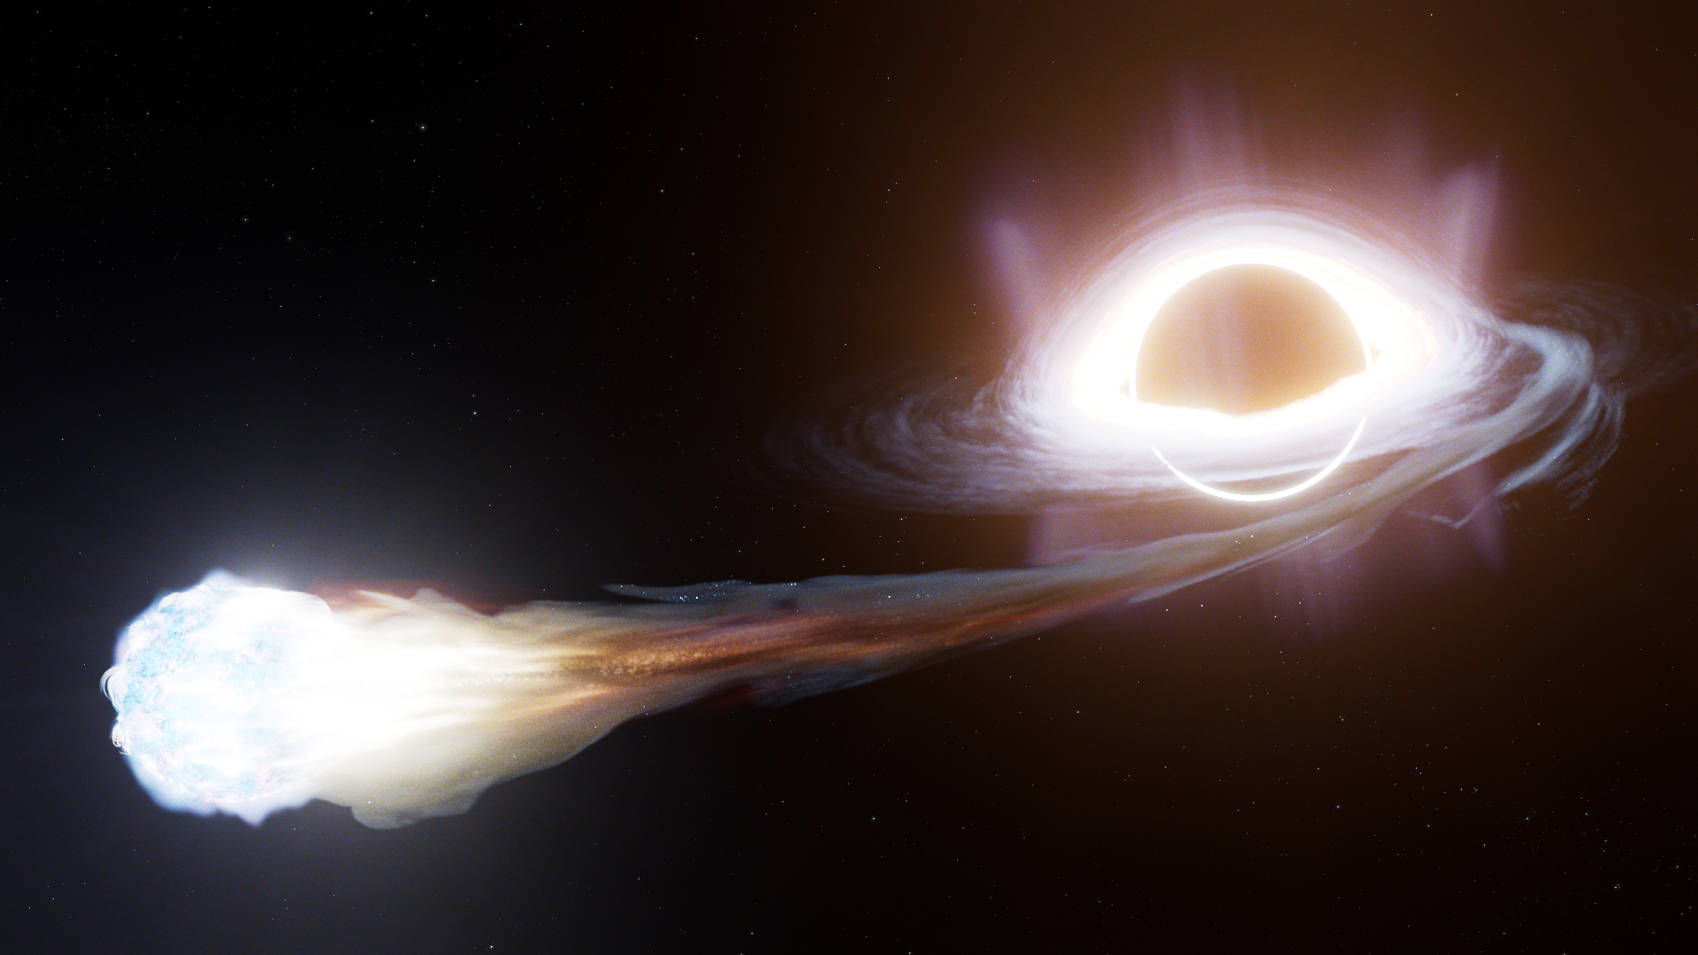
Super-Eddington Tidal Disruption Events as Cosmic Accelerators for High-Energy Cosmic Rays and Neutrinos
The 2nd LHAASO Symposium, CUHK, March 2025
Jane Lixin Dai 戴丽心
The University of Hong Kong
Tom Kwan, Tao Ji, Lars Thomsen, Ke Fang,
H. Feng, T. Fragos, E. Kara, J. McKinney, M. Middleton, E. Ramirez-Ruiz, C. Reynolds, N. Roth, A. Tchekhovskoy, F. Yuan
Image credit: STScI

Slide 2
Super-Eddington Accretion Flows (Winds) as Cosmic Accelerators for High-Energy Cosmic Rays and Neutrinos
The 2nd LHAASO Symposium, CUHK, March 2025
Jane Lixin Dai 戴丽心
The University of Hong Kong
Tom Kwan, Tao Ji, Lars Thomsen, Ke Fang,
H. Feng, T. Fragos, E. Kara, J. McKinney, M. Middleton, E. Ramirez-Ruiz, C. Reynolds, N. Roth, A. Tchekhovskoy, F. Yuan
Image credit: STScI

Slide 3
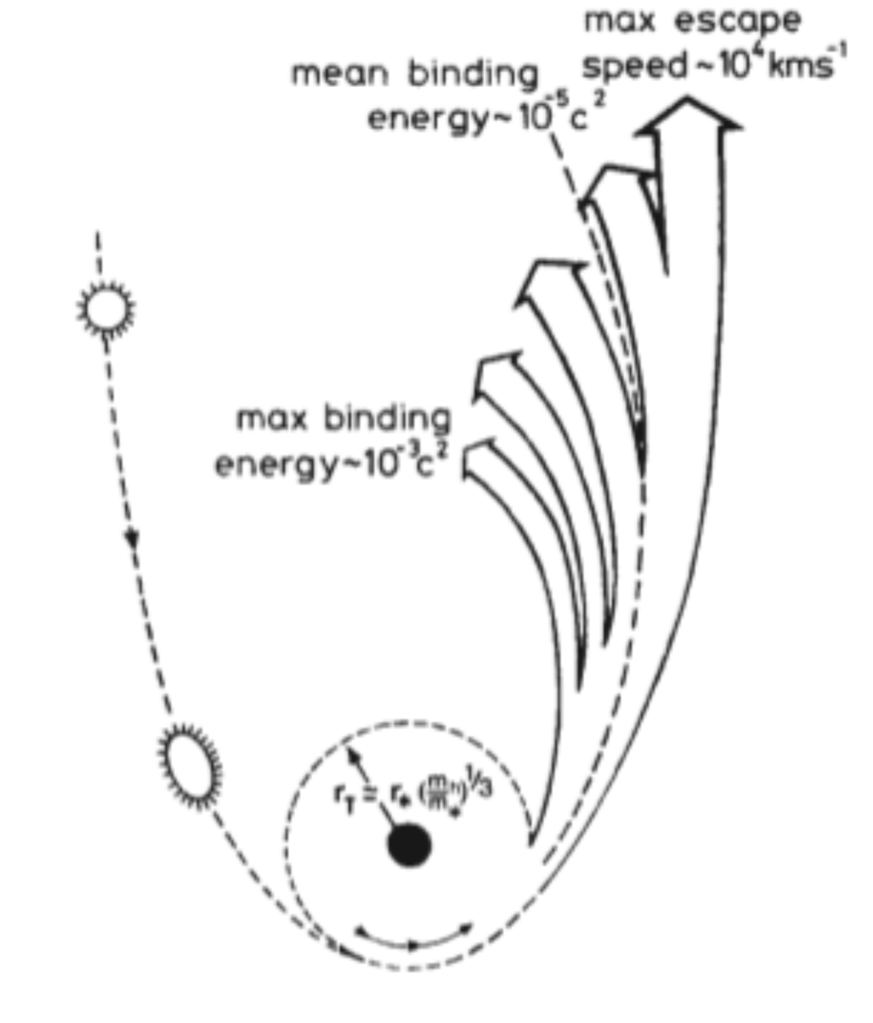
10-100 kpc
Tidal Disruption Event (TDE)
1 parsec
MBH tidal force > stellar self-gravity
Rees 1988
GM★ /R★² ≈ GMBH/RT² (R★ /RT)
Tidal Radius:
RT ≈ R★ (MBH / M★)^{1/3}

Slide 4

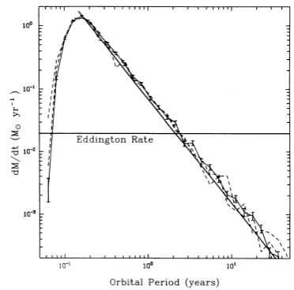
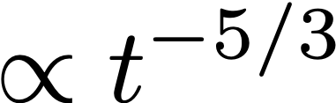
Stellar Debris Fallback
Stellar Disruption
super-Eddington
accretion
ε>0
ε=0
ε<0
Timescale: years
Rees 1988
Evans & Kochanek 1989; Phinney 1989; Lodato et al. 2009; Guillochon & Ramirez-Ruiz 2013; Tejeda et al. 2017; Golightly et al. 2019; Gafton & Rosswog 2019; Ryu et al. 2020

Slide 5
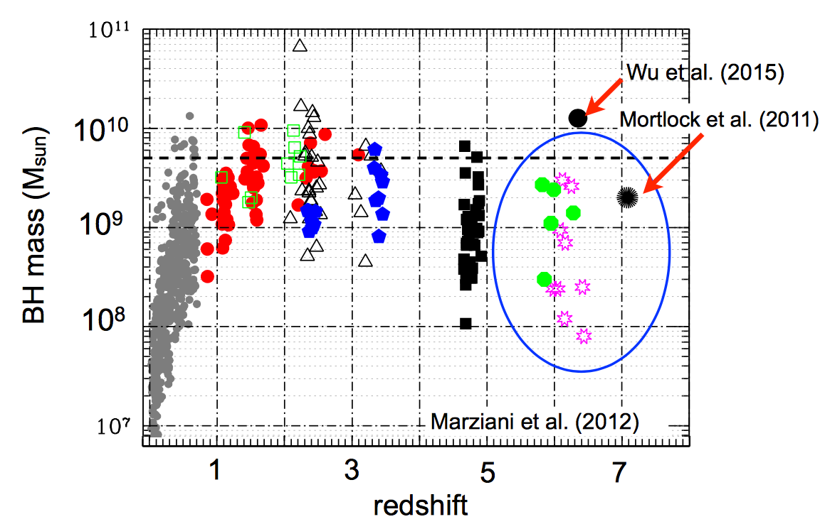
Super-Eddington Accreting BHs
TDEs
Dai et al. SSRv 2021
Ultra luminous X-ray sources & microquasars (SS433)
NLS1s & High-z AGNs (little red dots)

Slide 6




BH Super-Eddington Accretion - “Slim Disk” Theory
BH
Geometrically thick disk due to large radiation pressure
Photons trapped and advected in the inner disk
Inefficient radiation
Shakura & Sunyaev 1973, Begelman 1978, Abramowicz et al. 1988, Ulmer 1999, Poutanen et al. 2008

Slide 7
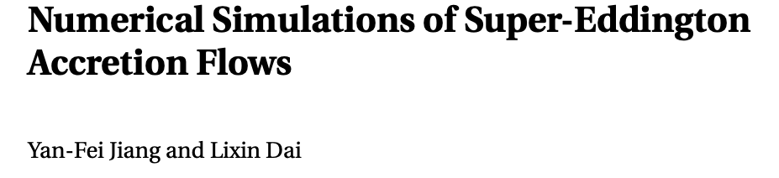
Jiang & Dai 2024 review
Very strong & geometrically thick winds are launched
Total radiative luminosity can largely exceed the Eddington luminosity (not just a beaming effect), especially due to fast wind and jet
Ohsuga et al. 2005, 2011; Jiang et al. 2014, 2018; McKinney et al. 2014, 2015; Sadowski et al. 2014, 2016; Dai et al. 2018; Thomsen, Kwan, Dai et al. 2022; Curd et al. 2019, 2023

Slide 8
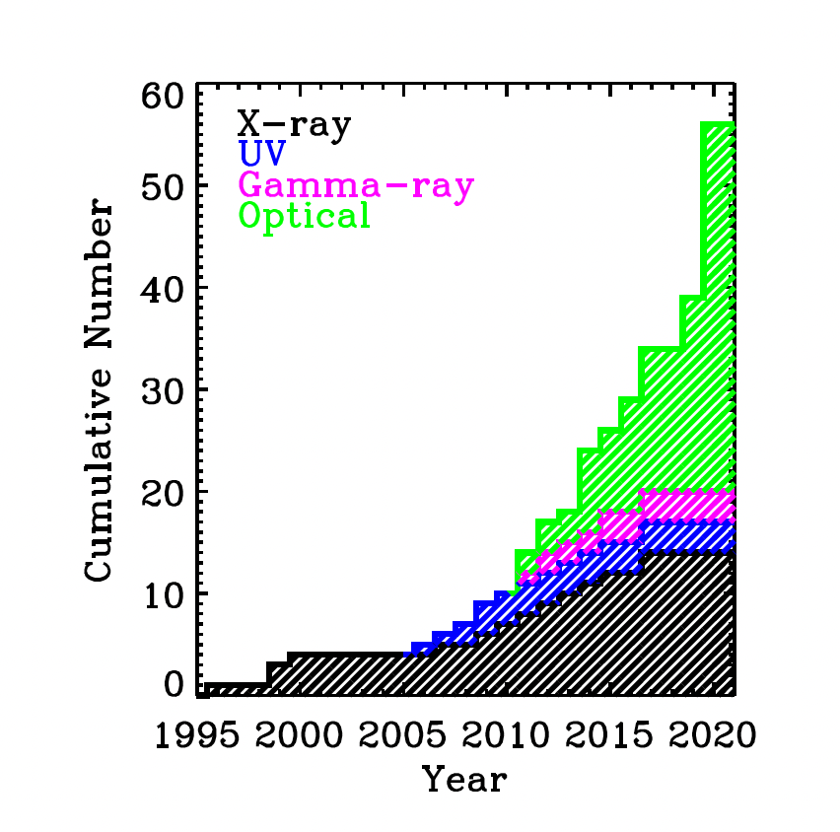
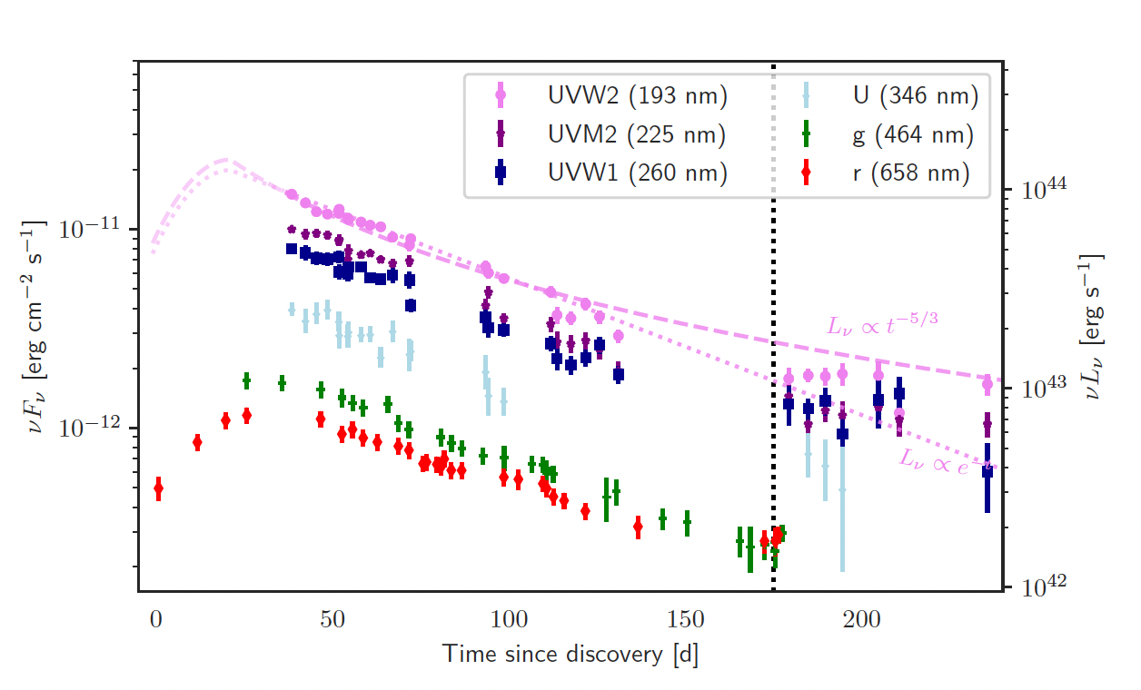
6 TDEs are possibly associated with neutrino detections!
Stein et al. 2021; Reusch et el. 2021; van Velzen et al. 2021; Jiang et al. 2023; Yuan et al. 2024
AT2019dsg
~100 TDEs, only 4 TDEs with relativistic jets
Most TDEs produce only optical or thermal X-ray emissions.

Slide 9
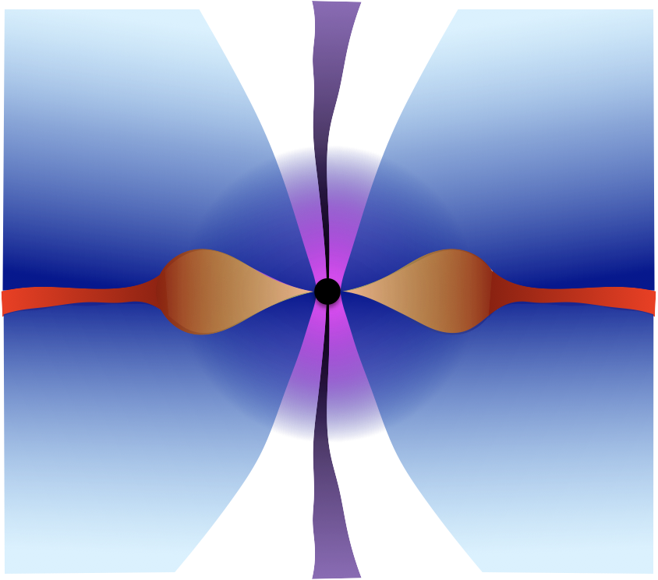
Possible sites for UHECRs and neutrinos production in TDEs/super-Eddington accreting BH systems:
Relativistic jet?
(The TDEs with neutrino associations don’t produce jets…)
Corona?
(Most X-ray TDEs don’t have coronae…)
Accretion flow?
Dai & Fang 2018
Also: Hayasaki & Yamazaki 2019; Murase 2020; Wu et al. 2022
Farrar & Gruzinov 2009; Farrar & Piran 2014; Wang et al. 2011; Wang & Liu 2016; Senno et al. 2017; Dai & Fang 2018; Biehl et al. 2018; Guepin et al. 2018; Hayasaki & Yamazaki 2019; Murase et al. 2020; Winter & Lunardini 2021; Wu et al. 2022…

Slide 10

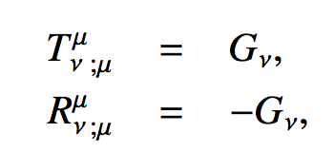

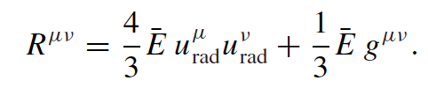
GRRMHD Simulations of Super-Eddington Accretion Flows
conservation of mass, energy, momentum & magnetic flux,
ideal MHD
3D full GR-Radiation-MHD code HARMRAD (Gammie et al. 03; McKinney et al. 12,14,15)
Radiation evolved simultaneously with gas, including scattering, absorption/emission (grey opacity), thermal Comptonization
Dai, McKinney, Roth et al. 2018
Thomsen, Kwan, Dai et al. 2022
Kwan, Dai et al. in prep
Ji, Kwan, Dai et al. in prep

Slide 11

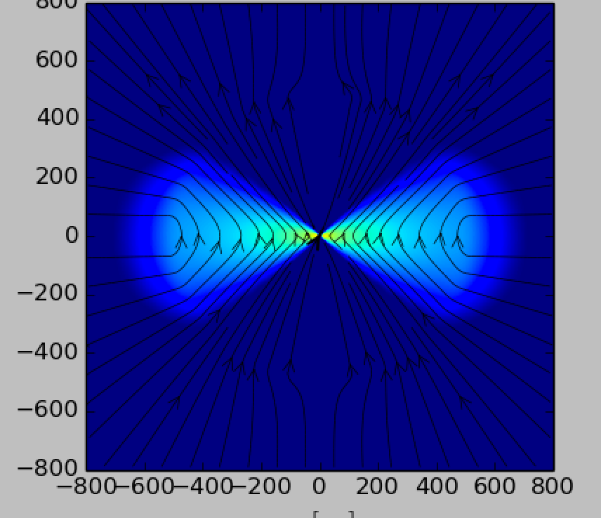
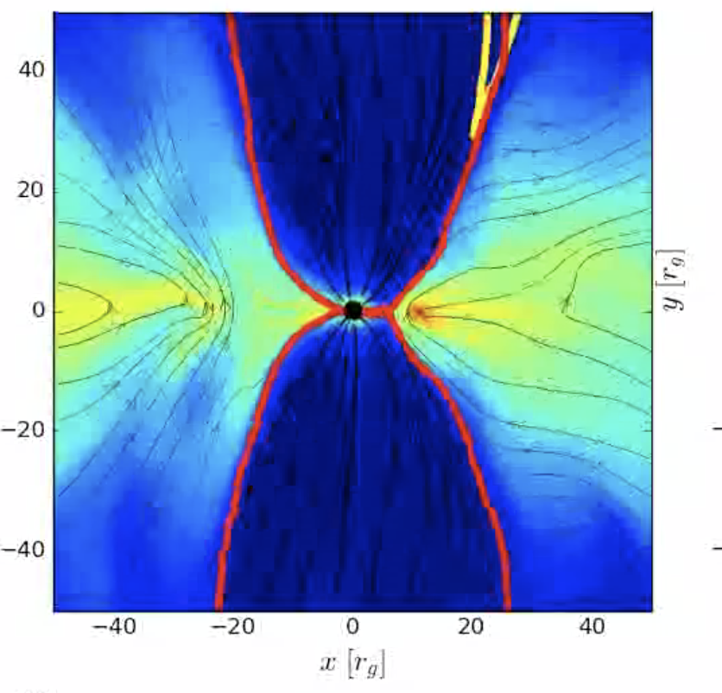

3D simulations of super-Eddington accretion flows around stellar-mass BHs (ULXs) and SMBHs (TDEs)
Supermassive & stellar-mass black holes with different masses, spins and accretion rates (20-30 each)
Poloidal B field, initial β~20-30
Simulation box size ~ 10000 Rg
Tom Man Kwan
PhD student
Highly magnetised disks (MAD)
Very large inflow (Req~100 Rg ) and outflow (Req>Rphotosphere) equilibriums
Tao Ji
MPhil student

Slide 12
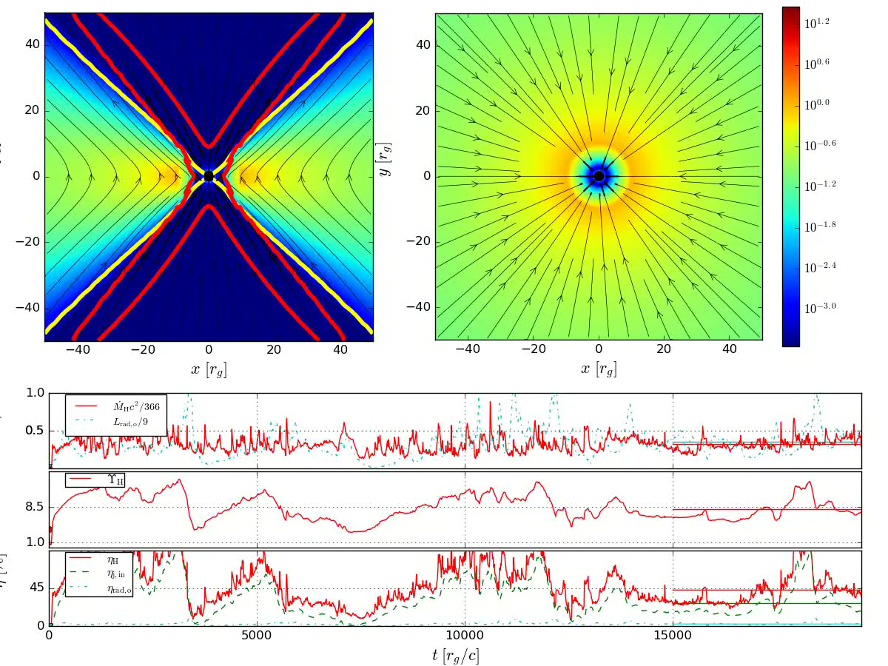
color:
gas density
black line:
magnetic field
red contour: jet
accretion rate
magnetic flux
efficiency
Dai, McKinney, Roth et al. 2018

Slide 13

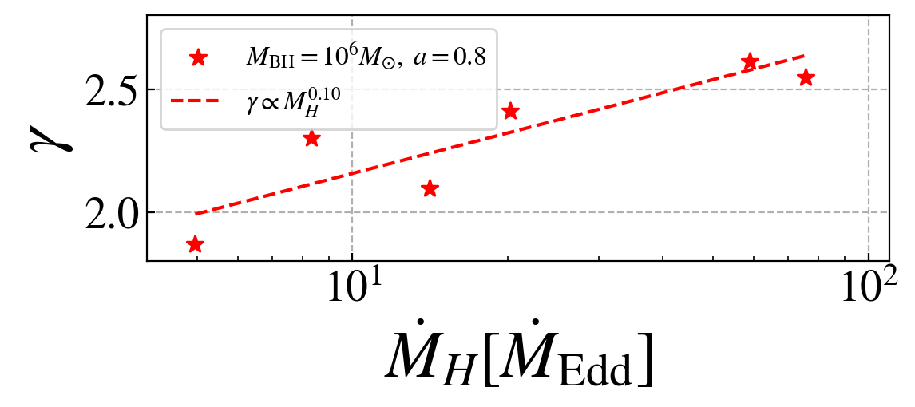
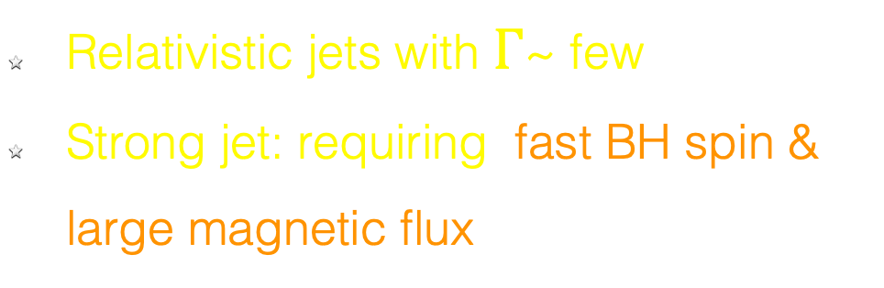
Relativistic Jets
Relativistic Jet:
spinning black hole + magnetic flux
Blandford & Znajek 1977
Relativistic jets with $Γ$~ few
Strong jet: requiring fast BH spin & large magnetic flux
Ji, Kwan, Dai et al. in prep

Slide 14
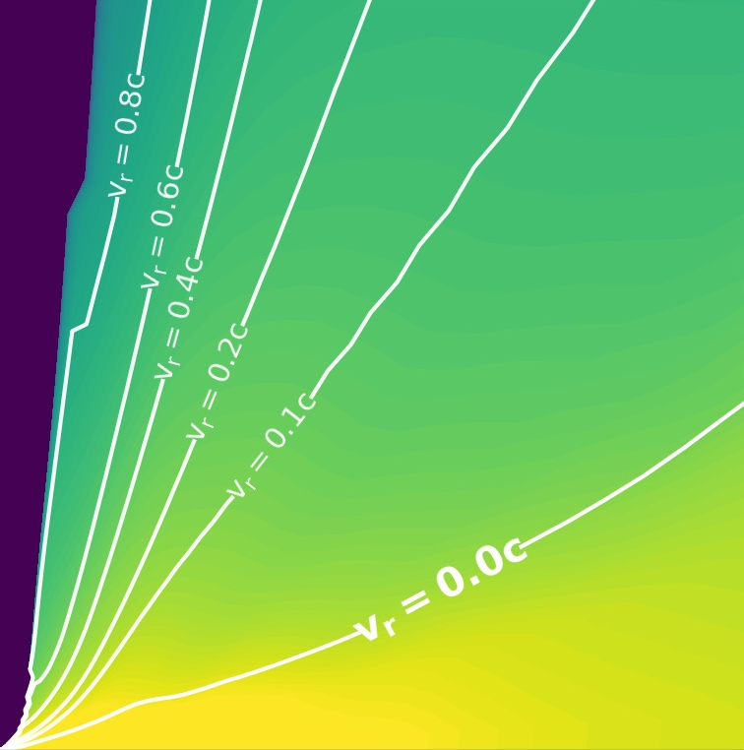
Super-Eddington Wind Structure
Ultra-fast outflow (UFO)
v ≳ 0.1c
SE winds cover a very large open angle.
SE winds ubiquitously carry a lot of mass and energy
fast wind
funnel
slow wind
slow wind
disk
disk

Slide 15
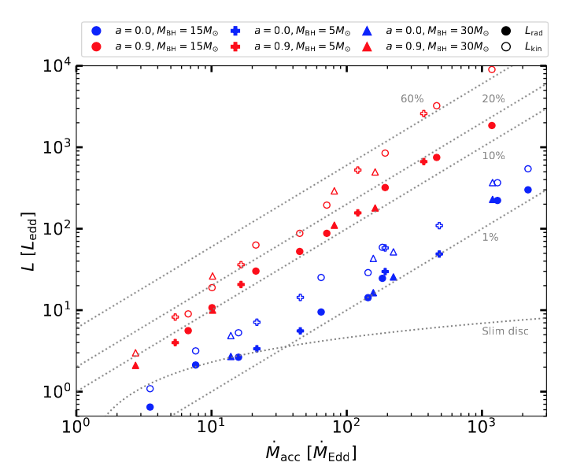
SE Wind Kinetic & Radiative Energy
Wind power scales with accretion rate
Wind power is sensitive to BH spin but not BH mass
Wind kinetic energy > radiative energy (both can be super-Eddington)
LK (TDE, 10⁶☉) ~ (1-10) LEdd ~ 10⁴⁴⁻⁴⁵ erg s⁻¹
LK (ULX, 10M☉) ~ (10-100) LEdd ~ 10⁴⁰⁻⁴¹ erg s⁻¹
Kwan, Dai et al. in prep

Slide 16


UHECR Energy Bucket
LK (TDE, 10⁶☉) ~ (1-10) LEdd ~ 10⁴⁴⁻⁴⁵ erg s⁻¹
LK (ULX, 10M☉) ~ (10-100) LEdd ~ 10⁴⁰⁻⁴¹ erg s⁻¹
$$E_{CR}∼eBRv_{w}/c∼e\sqrt{L_{B}v_{w}}/c$$
$$∼1PeV(L_{B}/{10}^{38}ergs^{−1})^{1/2}(v_{w}/0.01c)^{1/2}$$
Assuming LB= 0.01-0.1 LK, vw=0.01-0.1c:
SE SMBH (TDE):
ECR ~ 100 PeV-1 EeV
(sufficient for producing 1 PeV neutrino)
SE sBH (ULX):
ECR ~ 1-10 PeV

Slide 17
UHECR Energy Bucket
LK (TDE, 10⁶☉) ~ (1-10) LEdd ~ 10⁴⁴⁻⁴⁵ erg s⁻¹
LK (ULX, 10M☉) ~ (10-100) LEdd ~ 10⁴⁰⁻⁴¹ erg s⁻¹
$$E_{CR}∼eBRv_{w}/c∼e\sqrt{L_{B}v_{w}}/c$$
$$∼1PeV(L_{B}/{10}^{38}ergs^{−1})^{1/2}(v_{w}/0.01c)^{1/2}$$
Assuming LB= 0.01-0.1 LK, vw=0.01-0.1c:
SE SMBH (TDE):
ECR ~ 100 PeV-1 EeV
(sufficient for producing 1 PeV neutrino)
SE sBH (ULX):
ECR ~ 1-10 PeV
How does particle acceleration happen?
Turbulence?
Magnetic reconnection?
Shock with gas clouds?

Slide 18
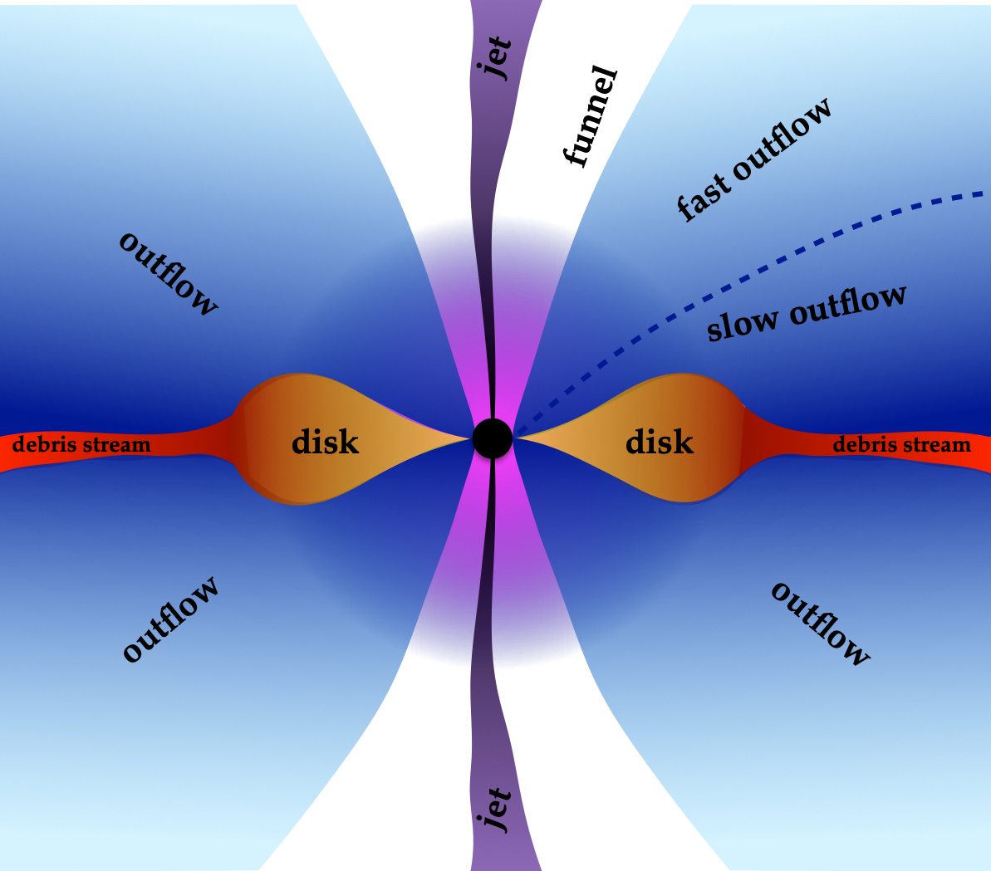
Possible sites for UHECRs and neutrinos production in super-Eddington accreting BH systems:
Relativistic jet? (Jetted TDEs, microquasars…)
Super-Eddington Wind:
ubiquitous, large kinetic energy reservoir, wide open angle
Corona?
(Uncertain if SE sources have strong coronae.)
Dai & Fang 2018
Dai et al. 2018
Thomsen et al. 2022
Lixin Dai: lixindai@hku.hk

