Slide 1

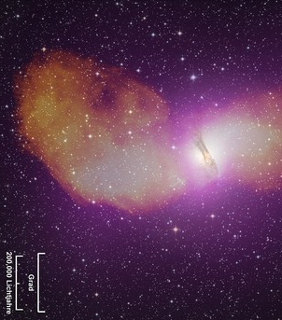
Gamma-Ray Emitting AGN:
A H.E.S.S. Perspective
0
Markus Böttcher
North-West University
Potchefstroom
South Africa

Slide 2
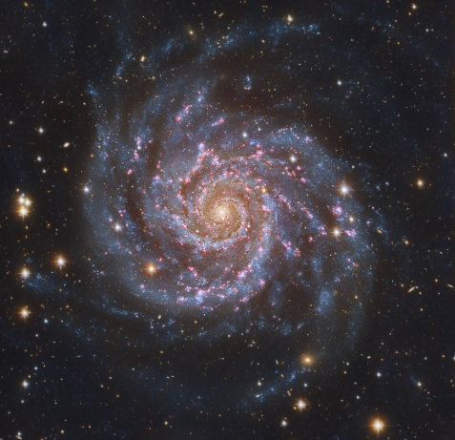
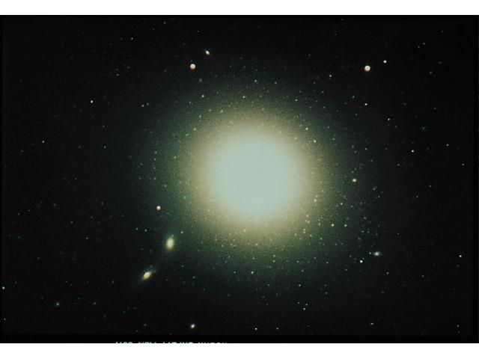
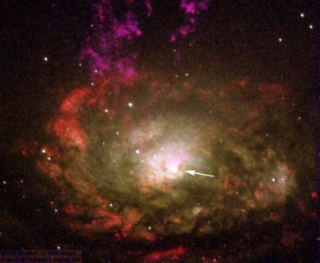
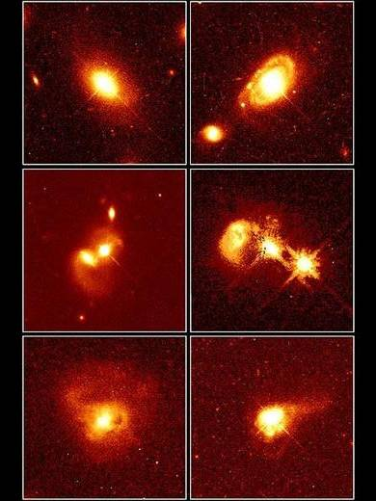
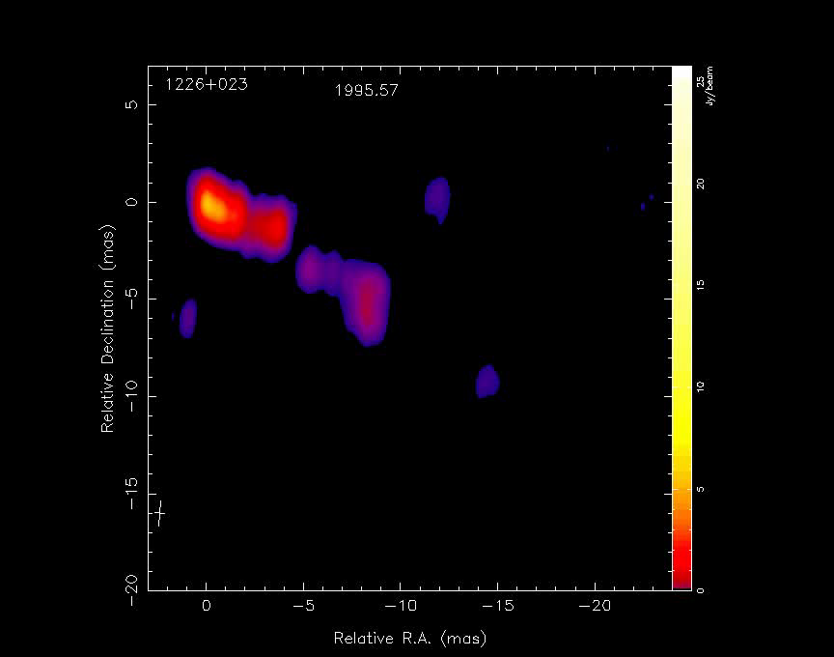
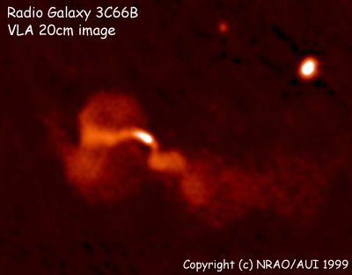
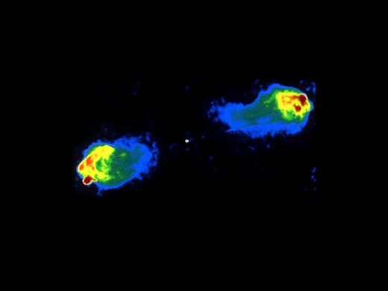
The AGN Zoo
Spirals
Ellipticals
Radio quiet
Radio quiet quasars
Radio loud
Seyferts
Radio spectrum
Flat Steep
Steep Spectrum Radio Quasars
Emission lines
Broad and narrow
Seyfert 1
Narrow
Seyfert 2
Radio galaxies
Blazars
Emission lines
FR I FR II
Weak/absent
BL Lac Objects
Strong
Flat Spectrum Radio Quasars

Slide 3
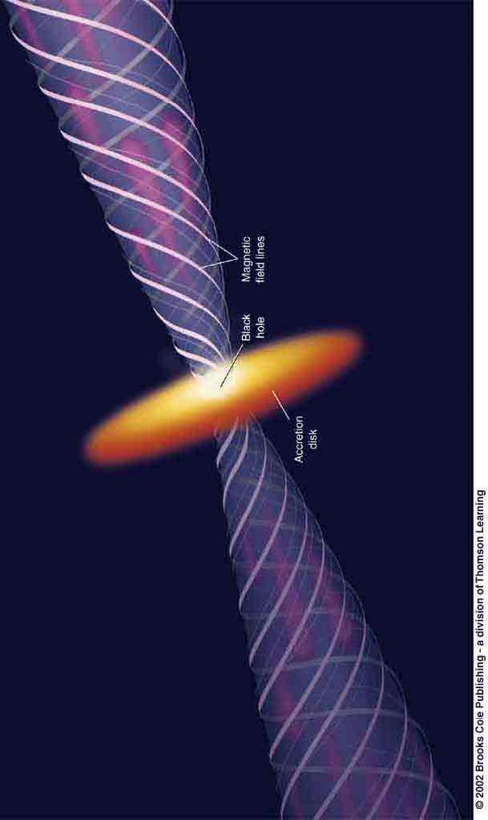
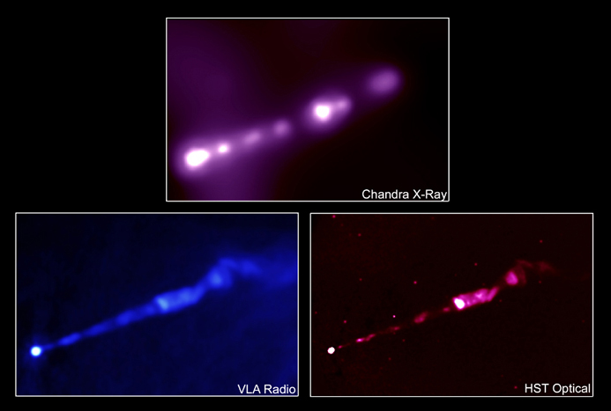
Types of radio-loud AGN and
AGN Unification
0
Observing direction
M87 → Shicong Hu, Sunday
Radio Galaxy:
Powerful radio lobes at the end points of the jets, where kinetic jet power is dissipated. Only 6 VHE-detected

Slide 4
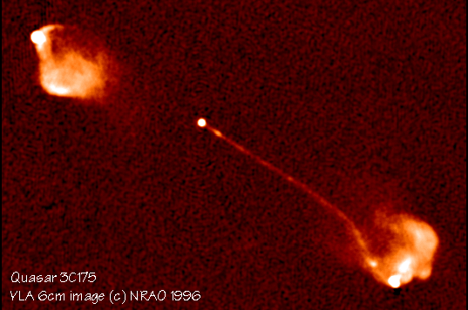
Types of radio-loud AGN and
AGN Unification
0
Flat-Spectrum Radio Quasar or BL Lac object
Emission from the jet pointing towards us is Doppler boosted compared to the jet moving in the other direction (“counter jet”).
Dominant extragalactic γ-ray source class (HE and VHE)
Observing direction

Slide 5
Blazars
0
Class of AGN consisting of BL Lac objects and gamma-ray bright quasars with relativistic jets pointing close to our line of sight
Rapidly (often intra-day) variable
Strong gamma-ray sources
Radio knots often with superluminal motion
Radio and optical (and X-ray?) polarization

Slide 6
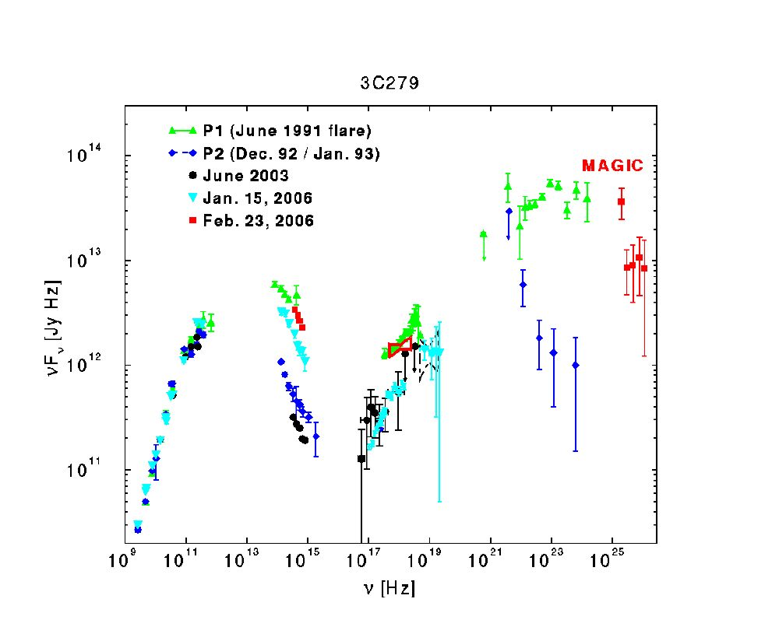
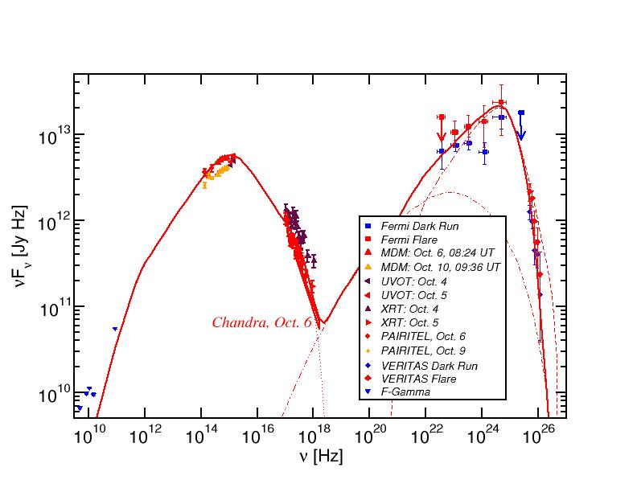
Blazar Spectral Energy Distributions (SEDs)
3C66A
Non-thermal spectra with two broad bumps:
Low-energy (probably synchrotron):
radio-IR-optical(-UV-X-rays)
High-energy (X-ray – γ-rays)

Slide 7
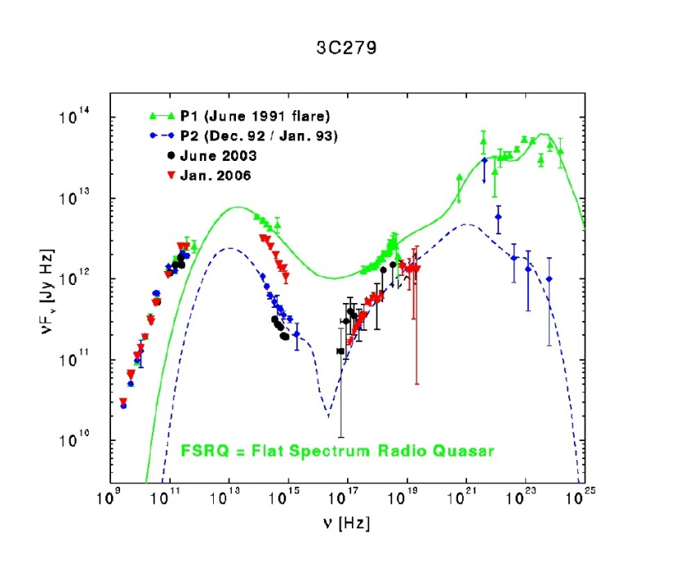
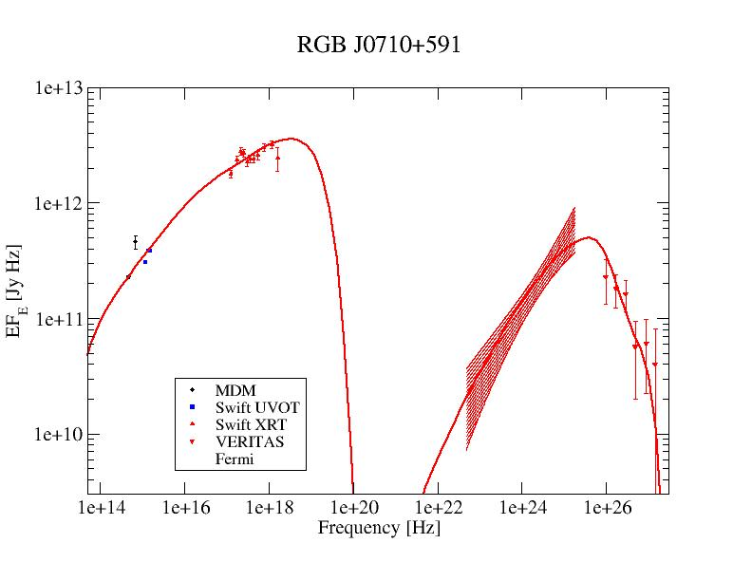
Blazar Classification
0
3C66A
Only ~ 10 VHE-detected LSP blazars
Majority of VHE-detected AGN
(Abdo et al. 2011)
(Acciari et al. 2009)
(Hartman et al. 2000)
High-Synchrotron Peaked (HSP): High-frequency peaked BL Lacs (HBLs):
Low-frequency component from radio to UV/X-rays,
ν_{sy} > 10¹⁵ Hz
often dominating the total power
High-frequency component from hard X-rays to high-energy gamma-rays
Low-Synchrotron Peaked (LSP): Quasars (FSRQs)/ Low-frequency peaked BL Lac Objects (LBLs)
Low-frequency component from radio to optical/UV,
ν_{sy} ≤ 10¹⁴ Hz
High-frequency component from X-rays to γ-rays, often dominating total power
Intermediate-Synchrotron Peaked (ISP): Intermediate BL Lacs (IBLs):
Peak frequencies at IR/Optical and GeV gamma-rays,
10¹⁴ Hz < ν_{sy} ≤ 10¹⁵ Hz
Intermediate overall luminosity
Sometimes γ-ray dominated

Slide 8
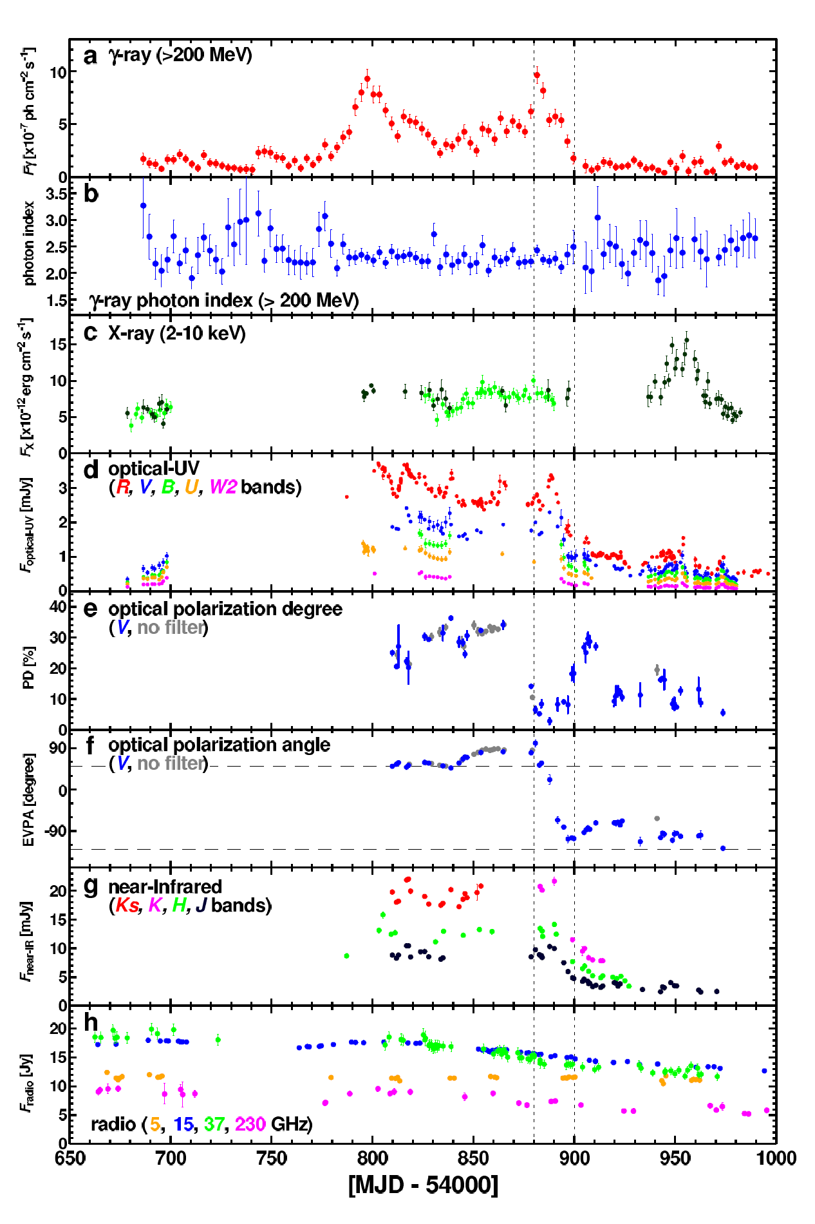
Flux and Polarization Variability
Multi-wavelength variability on various time scales (months – minutes)
Sometimes correlated, sometimes not
(3C279: Abdo et al. 2010)

Slide 9
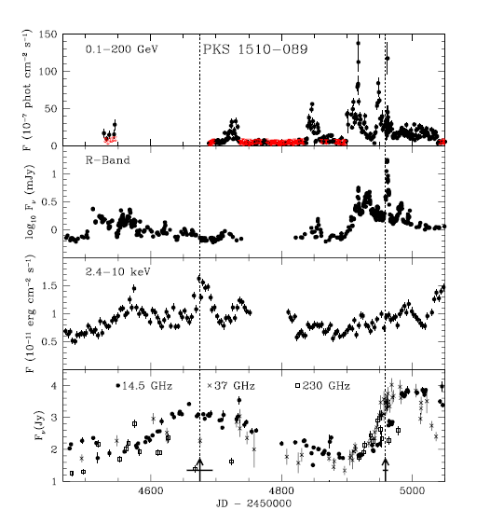
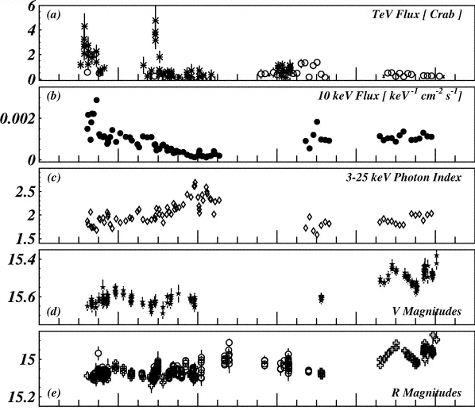
Multiwavelength Variability
Multi-wavelength variability on various time scales (months – minutes)
Sometimes correlated, sometimes not
1ES 1959+650 (2002)
PKS 1510-089 (2008 - 2009)
(Krawczynski et al. 2004)
(Marscher al. 2010)

Slide 10
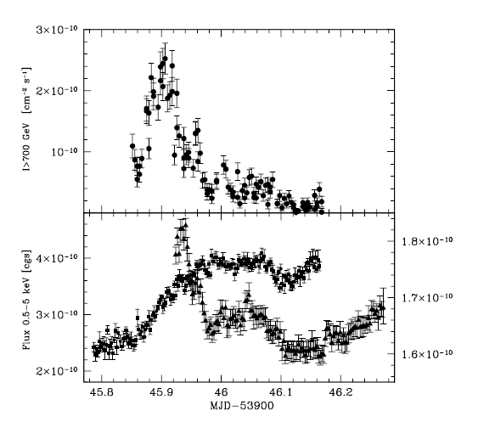
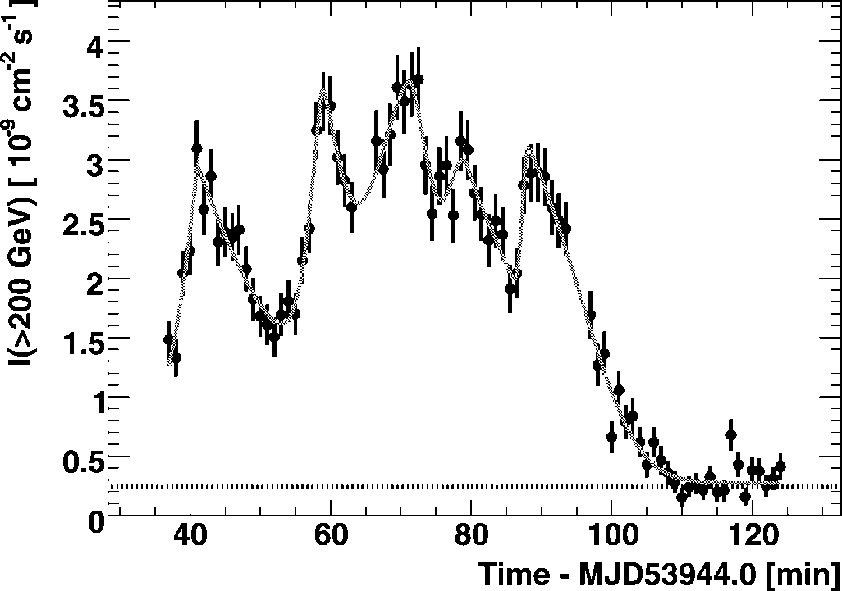
Blazar Variability:
PKS 2155-304
0
VHE γ-rays
VHE γ-rays
Optical
X-rays
(Aharonian et al. 2007)
(Costamante et al. 2008)
Short variability time scale combined with large apparent luminosity
Relativistic beaming / Doppler boosting
Emission from the jet directed towards us.

Slide 11
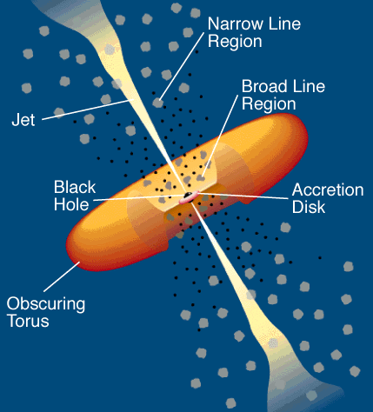
Leptonic Blazar Model
0
Synchrotron emission
Injection, acceleration of ultrarelativistic electrons
Relativistic jet outflow with Γ ≈ 10
νF_{ν}
Q_{e} (γ,t)
γ^{-q}
ν
γ₁
γ₂
γ
Compton emission
Radiative cooling ↔ escape =>
νF_{ν}
γ^{-q} or γ⁻²
Q_{e} (γ,t)
ν
γ^{-(q+1)}
Seed photons:
Synchrotron (within same region [SSC] or external sources, e.g., accretion disk, BLR, dust torus (EC = External Compton)
γ₁
γ_{b}
γ₂
γ
γ_{b}:
τ_{cool}(γ_{b}) = τ_{esc}
γ_{b}
γ₁
γ₂

Slide 12
Hadronic Blazar Models
0
Injection, acceleration of ultrarelativistic electrons and protons
Proton-induced radiation mechanisms:
Relativistic jet outflow with Γ ≈ 10
νF_{ν}
γ^{-q}
ν
Q_{e,p} (γ,t)
Proton synchrotron
γ₁
γ₂
γ
pγ → pπ⁰ π⁰ → 2γ
Synchrotron emission of primary e⁻
pγ → nπ⁺ ; π⁺ → μ⁺ν_{μ}
μ⁺ → e⁺ν_{e}ν_{μ}
νF_{ν}
→ secondary μ-, e-synchrotron
ν
Cascades …

Slide 13
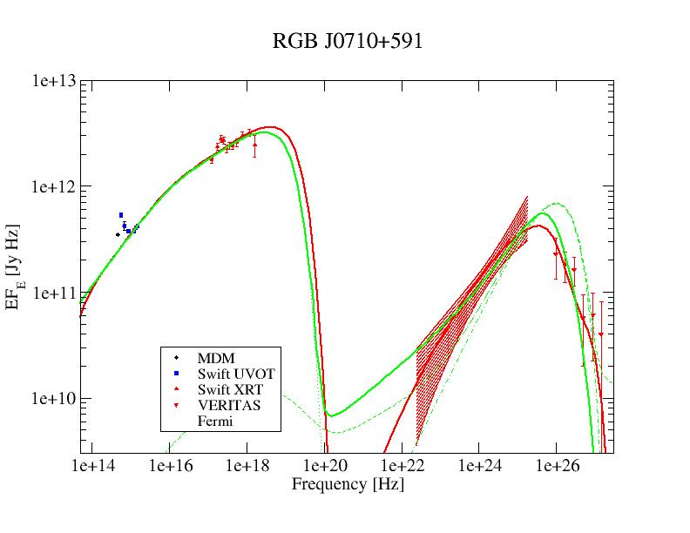
Lepto-Hadronic Model Fits to Blazar SEDs
(HBL)
Red = leptonic
Green = lepto-hadronic
In many cases, leptonic and hadronic models can produce equally good fits to the SEDs.
Possible Diagnostics to distinguish:
Neutrinos
Variability
Polarization

Slide 14
Recent highlights:
PKS 1510-089 in 2021 - 2022
One of only a handful of VHE-detected FSRQs (z = 0.36)
Regularly monitored by H.E.S.S.
Since 2021, coordinated with
SALT spectropolarimetry
observations
In July 2021: Abrupt transition
from very active γ-ray and
optical state to quiescence
in Fermi-LAT and optical
while X-ray and VHE γ-ray
fluxes stayed almost constant.
H.E.S.S.
Fermi-LAT
Swift-XRT
Optical
Optical ccolor (B-R)
SALT PD
SALT PA
(Aharonian et al. 2023)

Slide 15
Recent highlights:
PKS 1510-089 in 2021 - 2022
Single-zone model interpretation possible, in principle, but requiring very implausible parameter changes.
More plausible interpretation:
  Far zone (pc scales), responsible for X-ray and VHE γ-ray emission, not variable;
  Near zone (sub-pc), dominating IR – optical synchrotron and Fermi-LAT γ-rays, becoming inactive in July 2021.
  After July 2021: Optical dominated by accretion disk.
(Aharonian et al. 2023)

Slide 16
Recent highlights:
PKS 1510-089 in 2021 - 2022
SALT spectropolarimetry:
Before July 2021: Optical Polarization degree decreasing towards the blue → Jet synchrotron polarization diluted by the accretion disk
After July 2021: PD
consistent with interstellar
polarization only
→ Optical emission
dominated by the
accretion disk.
(Aharonian et al. 2023)

Slide 17
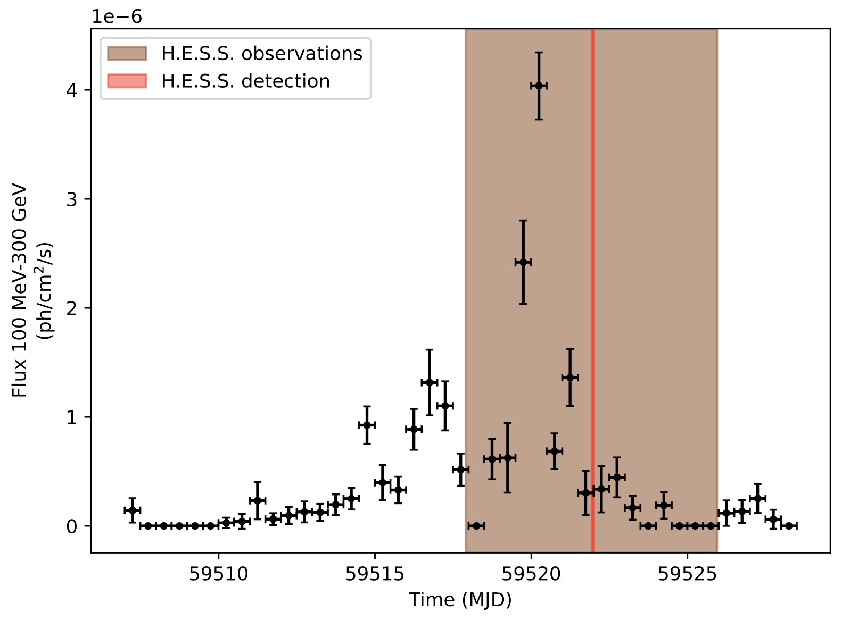
Recent highlights:
PKS 0346-27
October – November 2021
FSRQ at z = 0.991
H.E.S.S. ToO observations triggered by Fermi-LAT high state on 30 Oct. 2021
53 runs (~ 26 hours) of H.E.S.S. Observations between 30th Oct. and 29th Nov. 2021
Simultaneous coverage by Neil-Gehrels Swift (XRT + UVOT) and ATOM
H.E.S.S. detection only in one night (7.7 σ): 3rd Nov. 2021.
Detection announced in ATel #15020. – New blazar redshift record at the time.
(“beaten” by CTAO-LST-1 detection of OP 313 at z = 0.997)

Slide 18
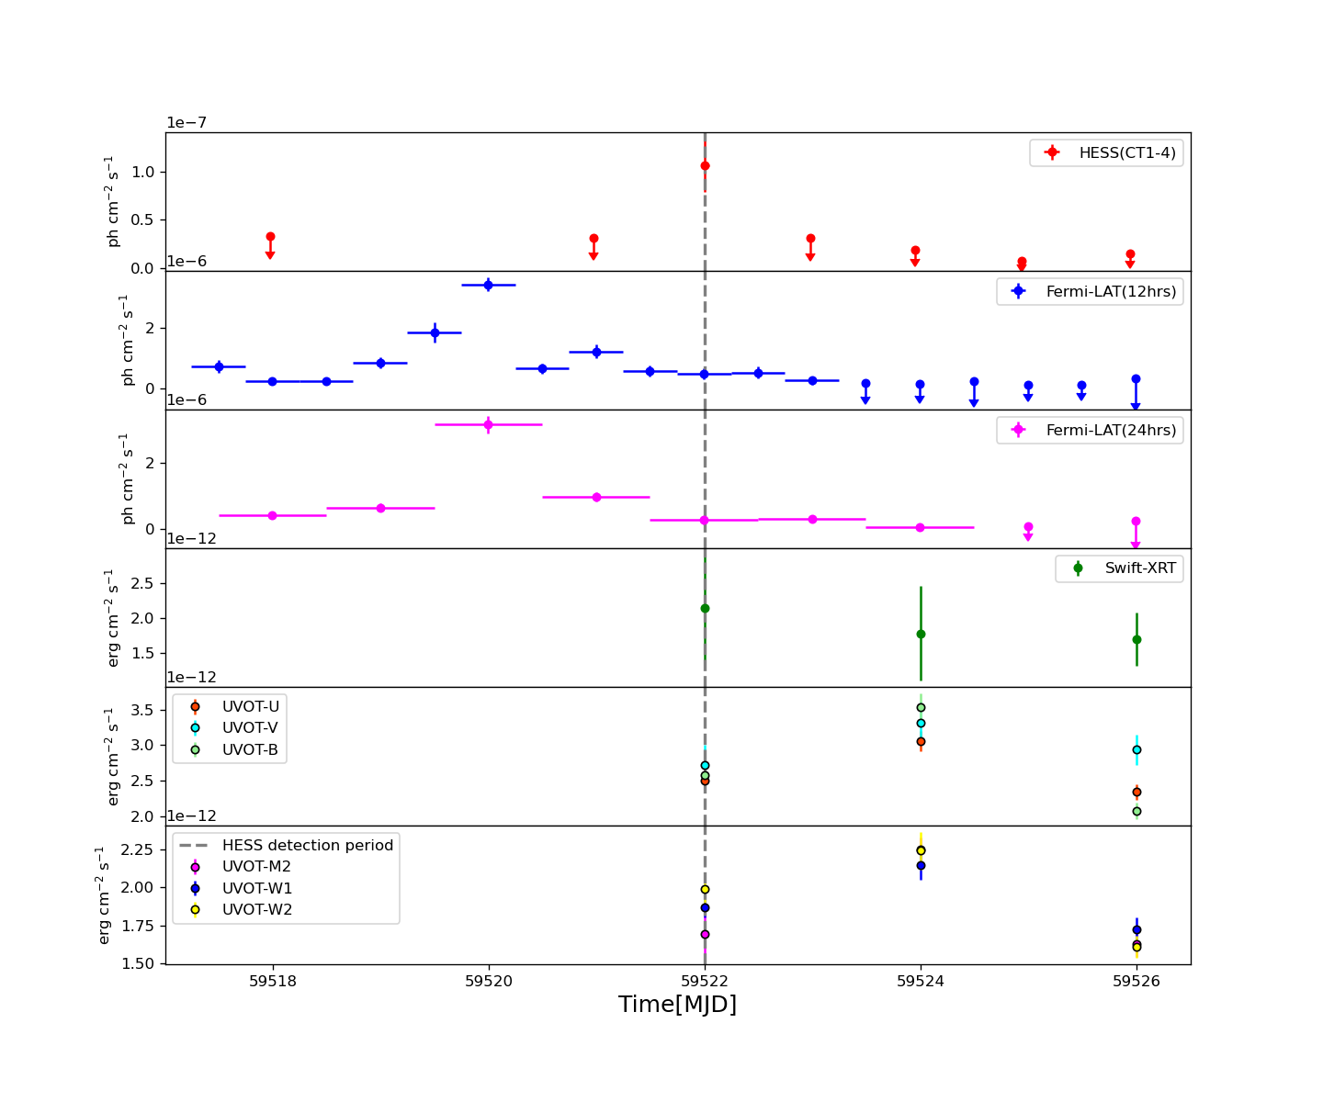
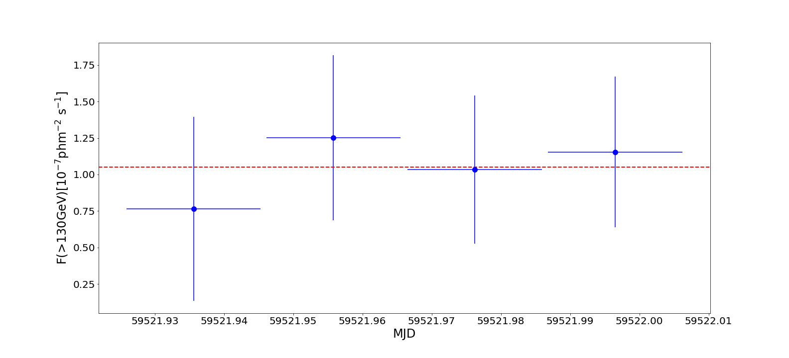
MWL light curves
Recent highlights:
PKS 0346-27
H.E.S.S. flare ~ 2 days delayed w.r.t. Fermi-LAT!
No evidence for significant activity in X-rays.
No evidence for intra-night variability.
Preliminary
Preliminary
>130 GeV

Slide 19
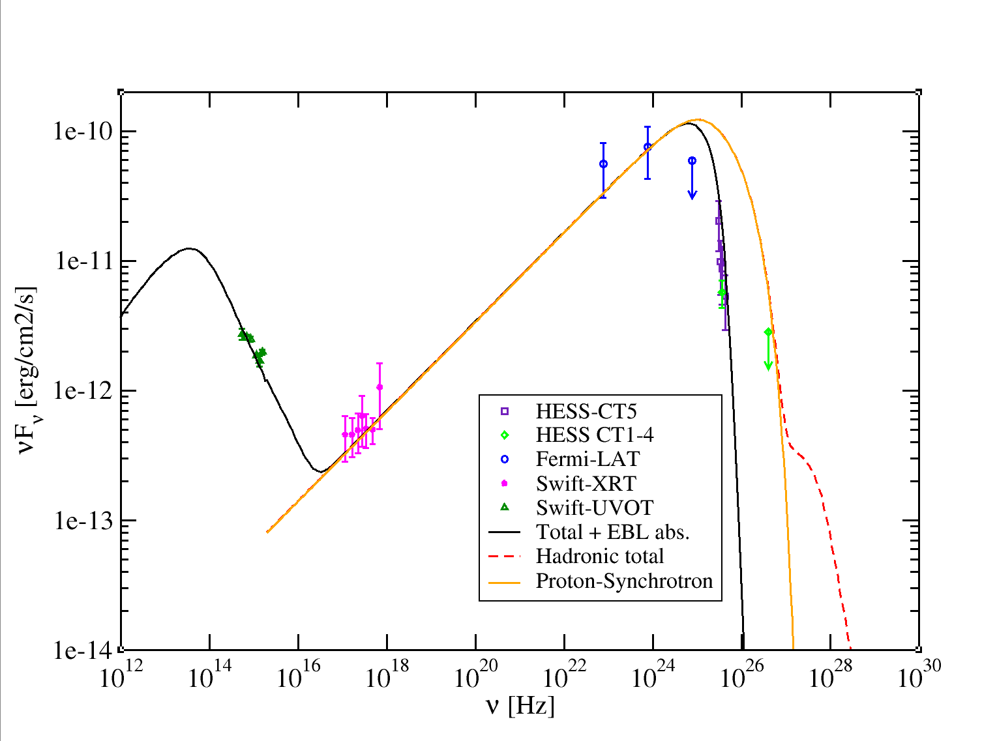
Recent highlights: PKS 0346-27
SED Modeling
Hadronic model SED fit
(Böttcher et.al, 2013)
Proton-synchrotron dominated high-energy emission
Preliminary
Lp = 1.1x10⁵⁰ erg/s
Le = 3.1x10⁴³ erg/s
LB = 8.4x10⁴⁷ erg/s
L_{Edd} = 2.5x10⁴⁶ erg/s
-> Requires highly super-Eddington jet power!
LB/Le = 2.7x10⁴
LB/Lp = 7.6x10⁻³
Le/Lp = 2.7x10⁻⁷
-> Proton dominated.
EBL absorption clearly significant, but can’t distinguish between 3 considered EBL models: Franceschini et al. (2008), Gilmore et al. (2009), Finke et al. (2010).
Leptonic fit not plausibly feasible due to drastically different optical vs. HE γ-ray spectra.

Slide 20
Interpretation H.E.S.S. vs. Fermi-LAT Delay
Recent highlights:
PKS 0346-27
H.E.S.S. flare ~ 2 days delayed w.r.t. Fermi-LAT!
Finite UHE proton acceleration time scale? – Not clear why the GeV flare subsides while the acceleration process is still active. – Narrow ultra-relativistic proton distribution?
Proton synchrotron mirror model (as suggested for 3C279 by Oberholzer 2023)? HE – VHE spectrum consistent with a single proton-synchrotron component…
Preliminary

Slide 21
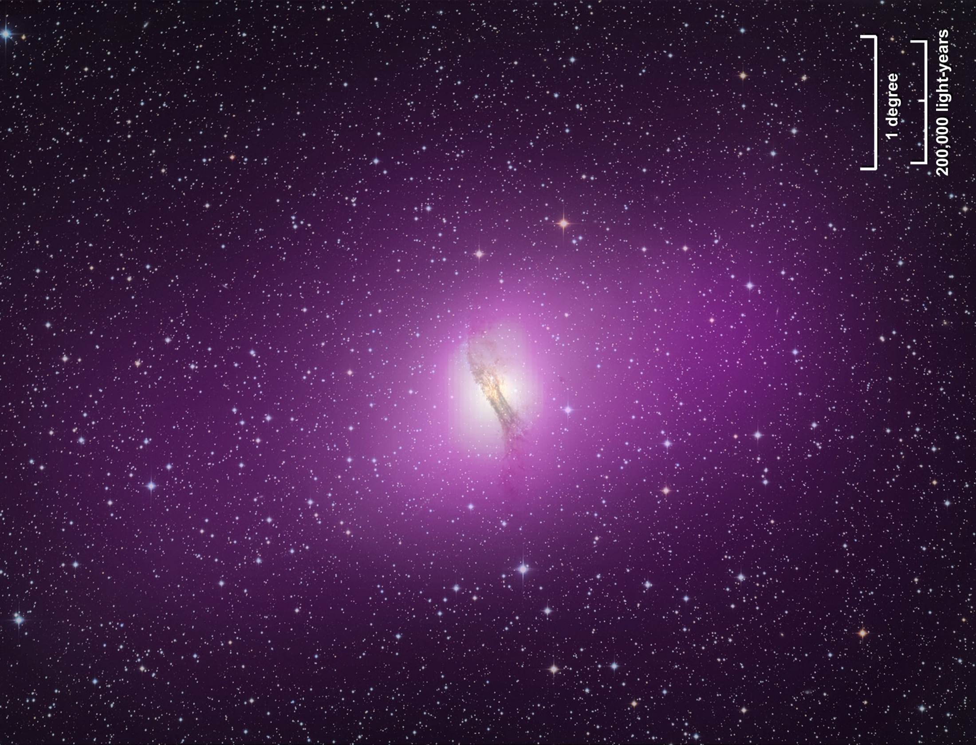
Centaurus A
Closest AGN to Earth (z = 0018; d = 3.8 Mpc)
Only extragalactic source spatially resolved in γ-rays
(both Fermi-LAT and H.E.S.S.)

Slide 22
H.E.S.S. Resolves Centaurus A
First spatially resolved extragalactic VHE γ-ray source
Fit with elliptical
Gaussian reveals
extension along the
radio jet direction
at 13.1 σ
Major axis:
(0.041 +/- 0.006)º
~ 2.2 kpc
Evidence for TeV
particle acceleration
at kpc scales!
(H.E.S.S. Collaboration: Abdalla et al. 2020, Nature)

Slide 23
M87
One of the closest AGN, at 16.8 +/- 0.8 Mpc, in the Virgo Cluster
Extensive co-ordinated MWL campaigns during EHT observations in 2017, 2018, and subsequent years, incl. H.E.S.S., MAGIC and VERITAS
(EHT MWL Science Working Group, ApJ, 2021)

Slide 24
M87 EHT MWL campaign 2018
First major VHE γ-ray flare since 2010
(previous flares seen in 2005, 2008, 2010)
(EHT MWL Science Working Group, 2024, submitted to A&A)

Slide 25
M87 Long-Term MWL lightcurve
γ-ray flares typically accompanied by X-ray flares of the core
(EHT MWL Science Working Group, 2024, submitted to A&A)

Slide 26
M87 VHE Morphology
(H.E.S.S.: Aharonian et al. 2023)
No extension of VHE emission measured (σ < 58” ~ 4.6 kpc).
Consistent with single emission region at the core.

Slide 27
PKS 0625-354
FR I (?) radio galaxy at z = 0.055 (220 Mpc)
TANAMI: Evidence for one-sided pc-scale jet + superluminal motion
H.E.S.S. I Observations in 2012: Detection at 6.1 σ
H.E.S.S. Significance Map
TANAMI: 8 GHz
(H.E.S.S.: Abdalla et al. 2018)
(TANAMI: Müller et al. 2013)
Strong X-ray variability
No evidence for pronounced variability in γ-rays in 2012

Slide 28
The Nature of PKS 0625-354
VHE-detected radio galaxies
Source Name | Type | Redshift
Cen A | FR I | 0.0018
M87 | FR I | 0.0044
NGC 1275 | FR I | 0.0176
IC 310 | FR I / BL Lac? | 0.0189
3C 264 | FR I | 0.0217
PKS 0625-35 | FR I / BL Lac? | 0.0549
By far the most distant VHE-detected radio galaxy
Renders interpretation with non-beamed emission scenarios difficult
TANAMI radio structure suggests blazar-like inner-jet orientation

Slide 29
PKS 0625-354:
Multi-Zone Leptonic Model
Extended Jet (Γ = 4.1) responsible for radio – IR
Small Blob (Γ = 10.4) responsible for UV – γ-rays
Blazar-like viewing angle (θ = 1º)
X-ray spectral variability
from changing electron
spectral index
γ-ray variability
suppressed by
Klein-Nishina
Jet in approx.
equipartition, with
P_{e} ~ P_{B} ~ 1.4×10⁴² erg/s
Blob strongly e⁻ dominated
Blob
Jet
(Abdalla et al. 2018a)

Slide 30
PKS 0625-354:
VHE γ-ray variability
Initially, no significant γ-ray variability detected, but 2018 campaign revealed flux decay on ~ 6 hr time scale.
(H.E.S.S.: Aharonian et al., A&A, 2024)
Opacity argument constrains θ_{v} < 10º
Further support for blazar-like inner-jet structure.

Slide 31
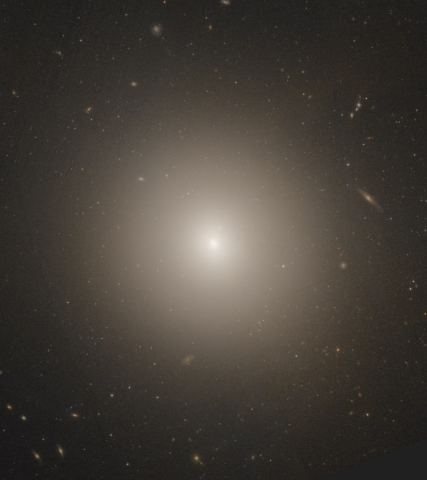
LHAASO Detection of NGC 4278
Elliptical galaxy at d_{L} = 16.4 Mpc (similar to M87), hosting a low-luminosity (L/L_{Edd} ~ 5∙10⁻⁶), LINER-type galaxy with a weak radio jet.
LHAASO VHE γ-ray source 0.03º from best-fit LHAASO position (1st LHAASO Source Catalog).
2 other AGN within the 90 % localization region, but SEDs inconsistent with LHAASO spectrum.
Evidence for variability on ~ months time scale.
(LHAASO collaboration: Cao et al. 2024)

Slide 32
LHAASO Detection of NGC 4278
VHE spectrum comparable to other (radio-loud) VHE AGN
If confirmed, by far the radio-faintest VHE AGN detected.
(LHAASO collaboration: Cao et al. 2024)

Slide 33
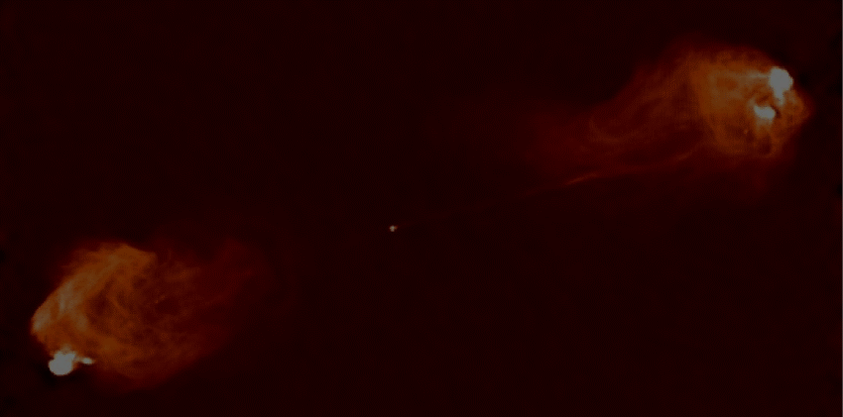

Summary
Mounting evidence for more than one high-energy emission region in γ-ray loud AGN
All VHE γ-ray detected AGN at z < 1.
So far all VHE-detected radio galaxies are FR I or uncertain type.
Cen A the only spatially resolved extragalactic source.
Rapid VHE variability seen in some radio galaxies supports blazar-like inner-jet structure.
NGC 4278 possibly the first radio-quiet, low-luminosity AGN detected in VHE γ-rays.

Slide 34
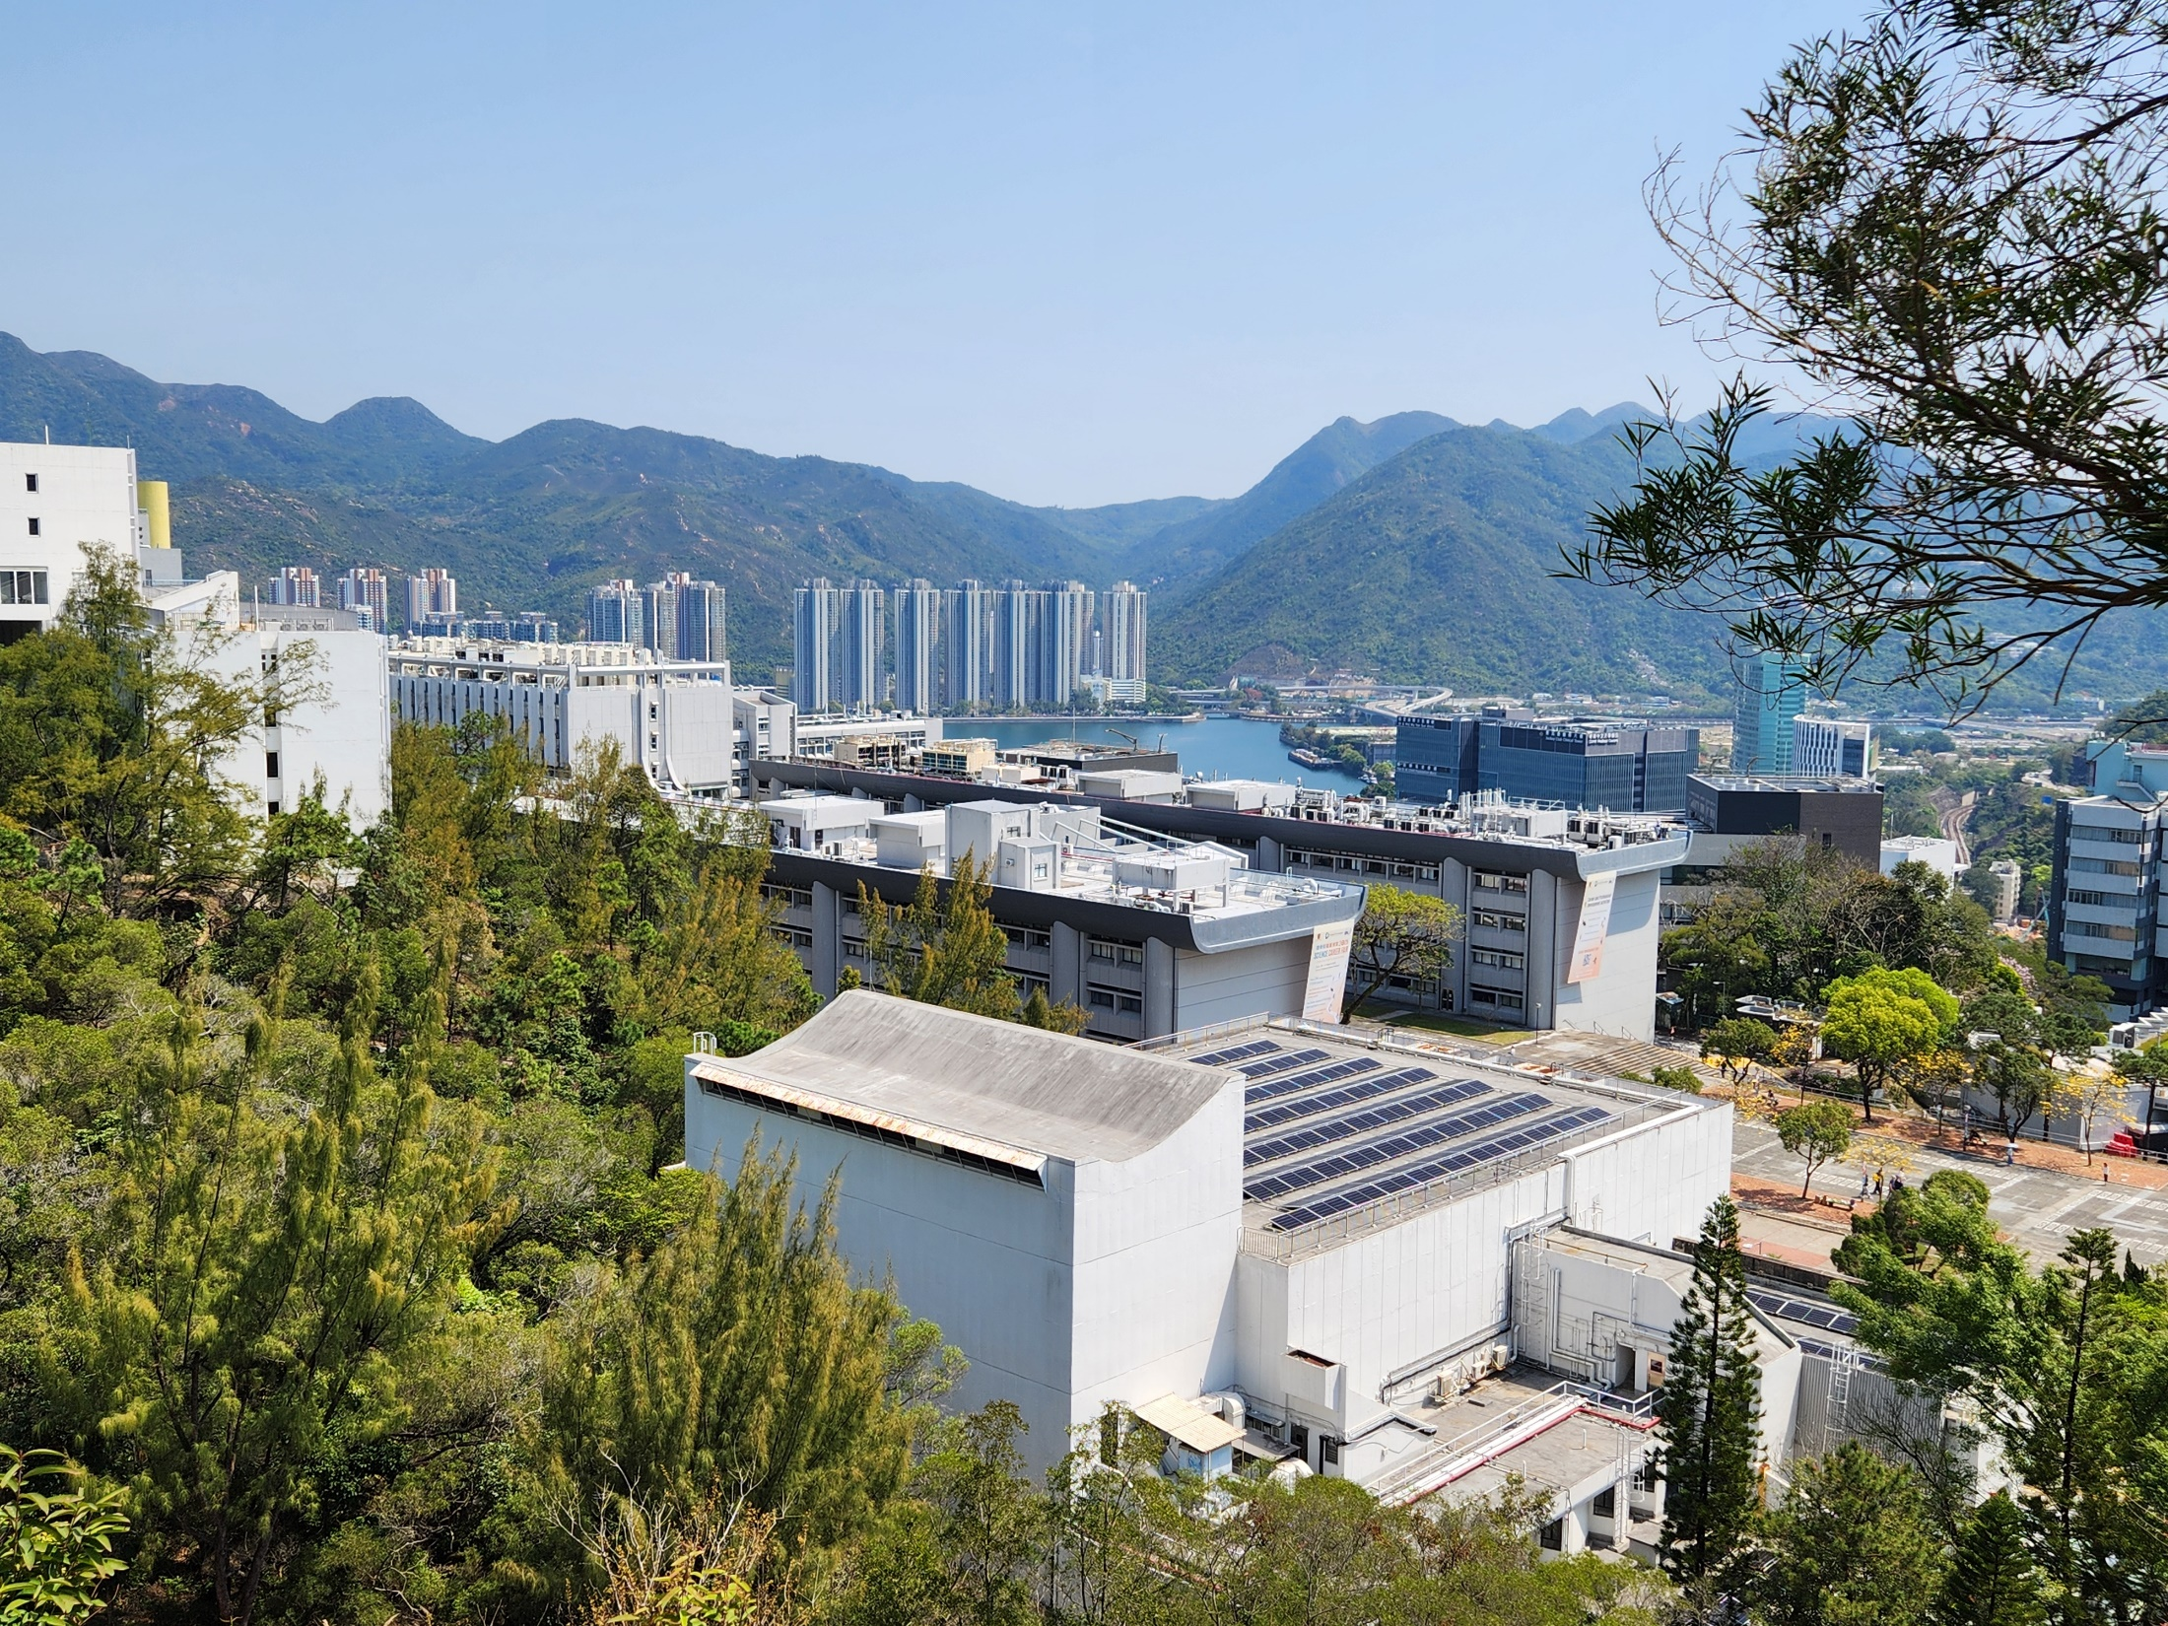
Thank you!

