Slide 1

large array of cherenkov telescopes (LACT): Status and prospects
Ruizhi Yang
on behalf of LACT Collaborations

Slide 2
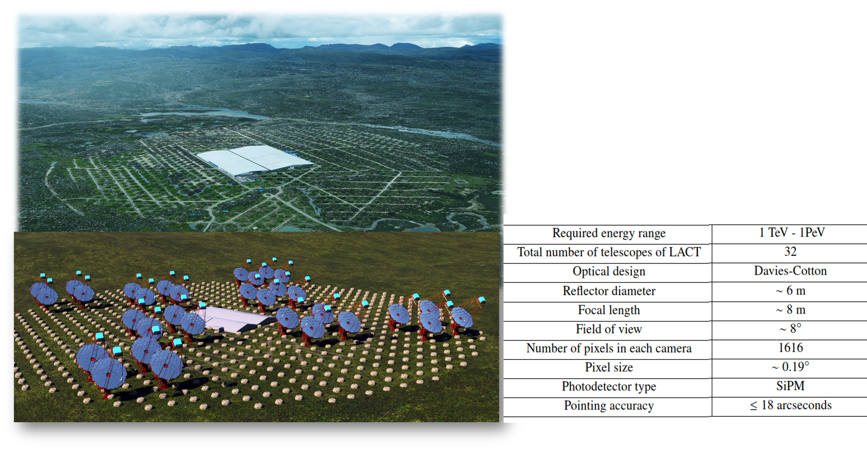
LACT
32 telescopes in LHAASO sites
6m Davis-Cotten type telescope
Synergy with LHAASO

Slide 3
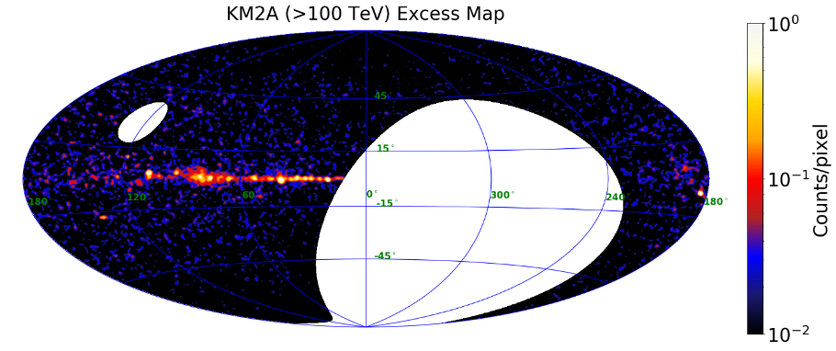
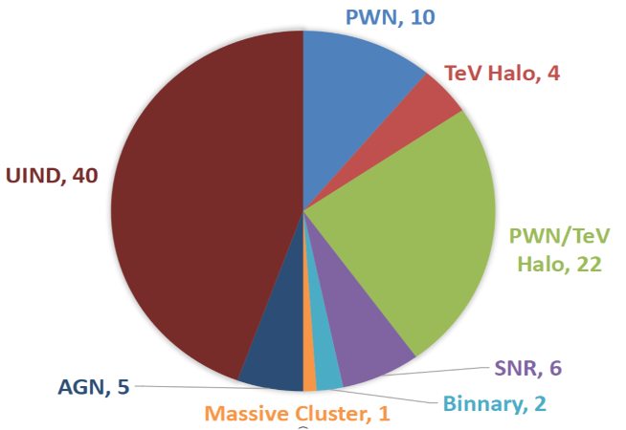
mOTIVATIONS
ﬁrst LHAASO catalog
• 90 VHE/UHE gamma-ray sources
• The number of UHE gamma-ray sources increased to 43，most are extended
• Associate with supernova remnants, pulsar wind nebulae, pulsar clouds, and massive star clusters and so on
Half of them unidentified

Slide 4
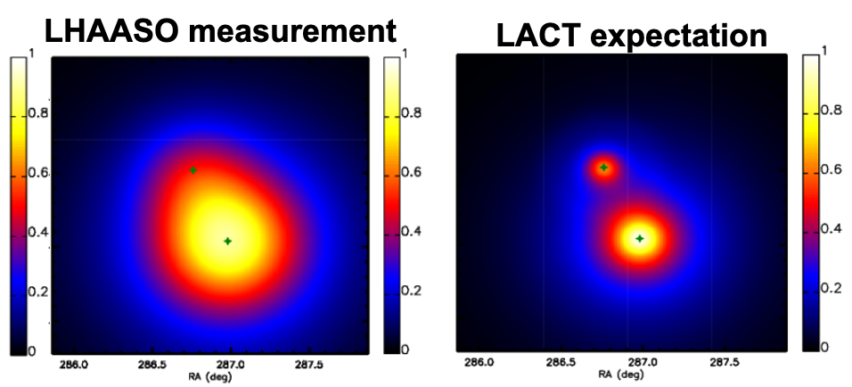
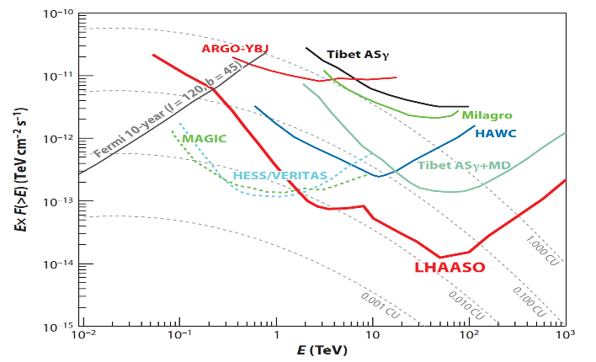
mOTIVATIONS
Limited angular resolution of LHAASO hinder morphological studies and identifications
IACTs are natural solutions
Effective synergy require similar sensitivities with LHAASO

Slide 5
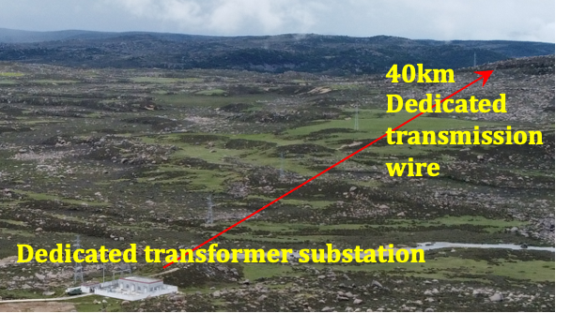
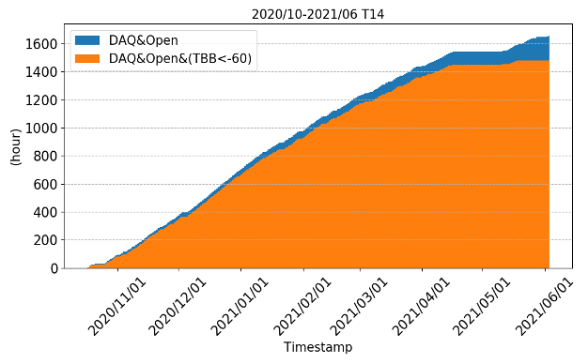
site
LHAASO site: good infrastructures (road, electricity, computing…)
Reasonable NSB rate: ~0.25 ph/m2/ns/deg2
Good weather in winter, annual exposure ~ 1400 hours

Slide 6
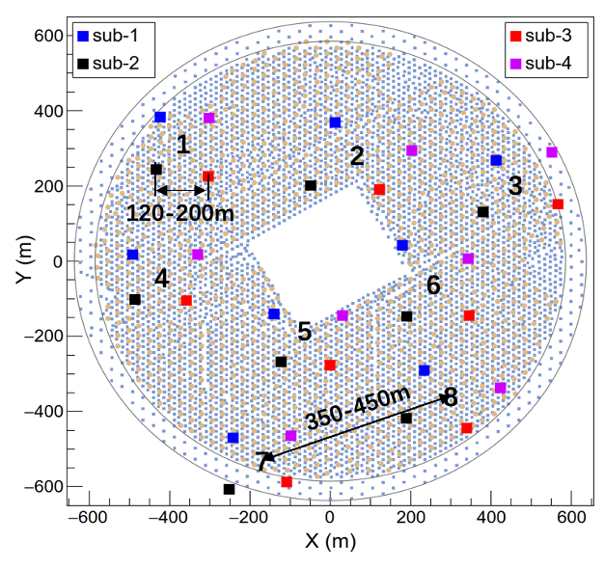
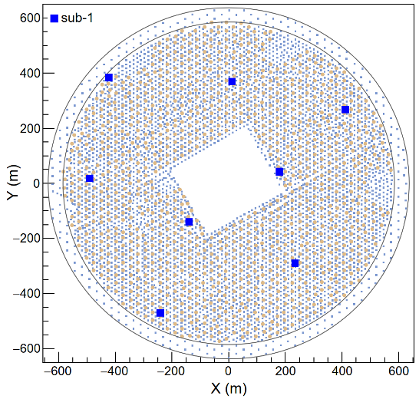
array layout
32 (8 X 4) telescopes in more than 1km^2 (in the gaps of KM2A MDs)
Flexible grouping for different observing mode

Slide 7
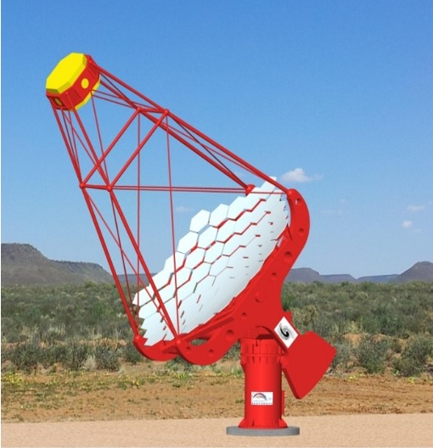
TELESCOPE
Davies-Cotton mirror
Alt-azimuth mount
SiPM camera
Readout electronics system
Slow control system
Data acquisition system
Calibration system

Slide 8
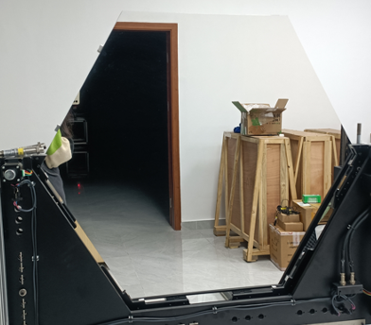
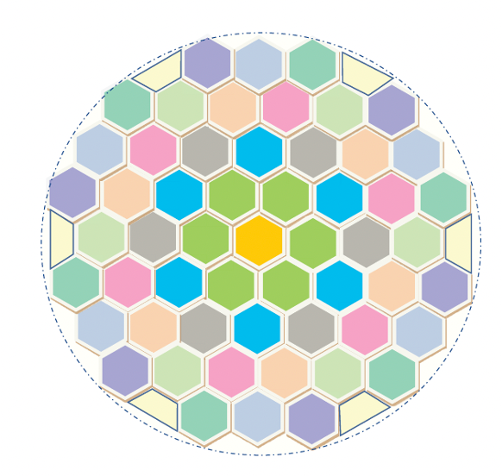
mIRRORS
•Consist of 54 hexagonal spherical mirror facets
•Diameter：~6 m
•Effect area：~24 ㎡
•Spot （80% energy）： <25.8 mm
•Curvature radius of facet: 16 m
Honeycomb sandwich structure mirror facet

Slide 9
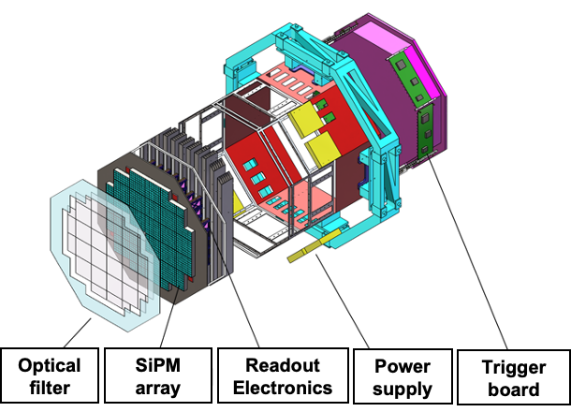
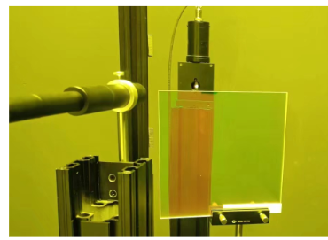
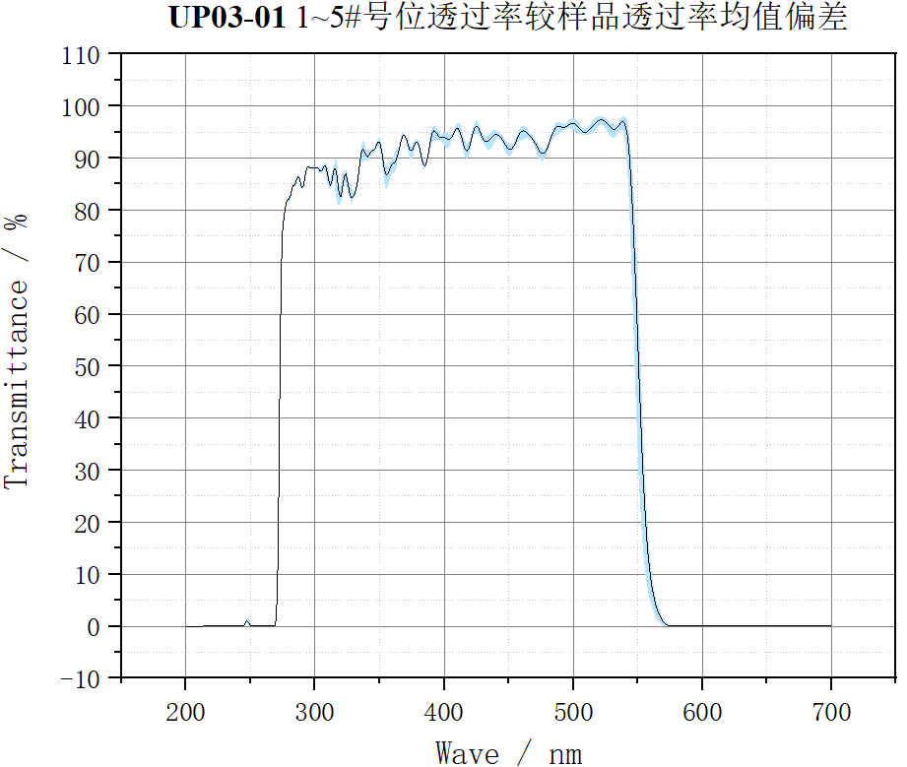
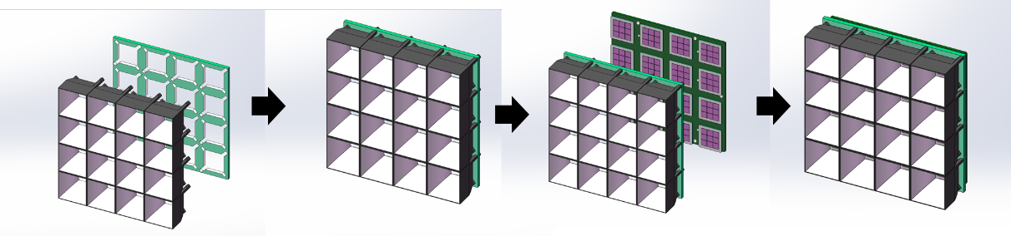
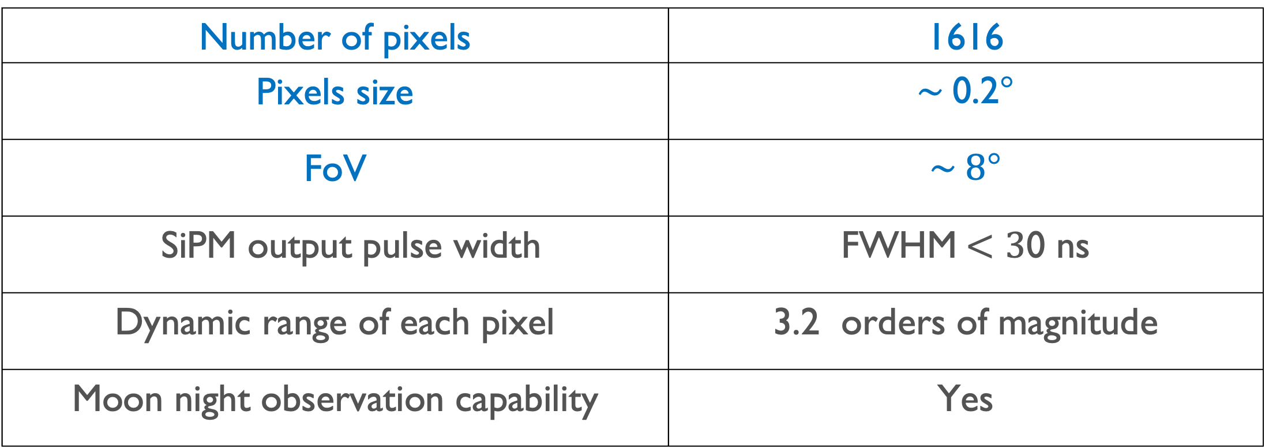
CAMERA
Number of pixels | 1616
Pixels size | $\sim$0.2°
FoV | $\sim 8$°
SiPM output pulse width | FWHM$<3$0 ns
Dynamic range of each pixel | 3.2 orders of magnitude
Moon night observation capability | Yes
SiPM and Winstone cone sub-array
Optical filter and performance

Slide 10
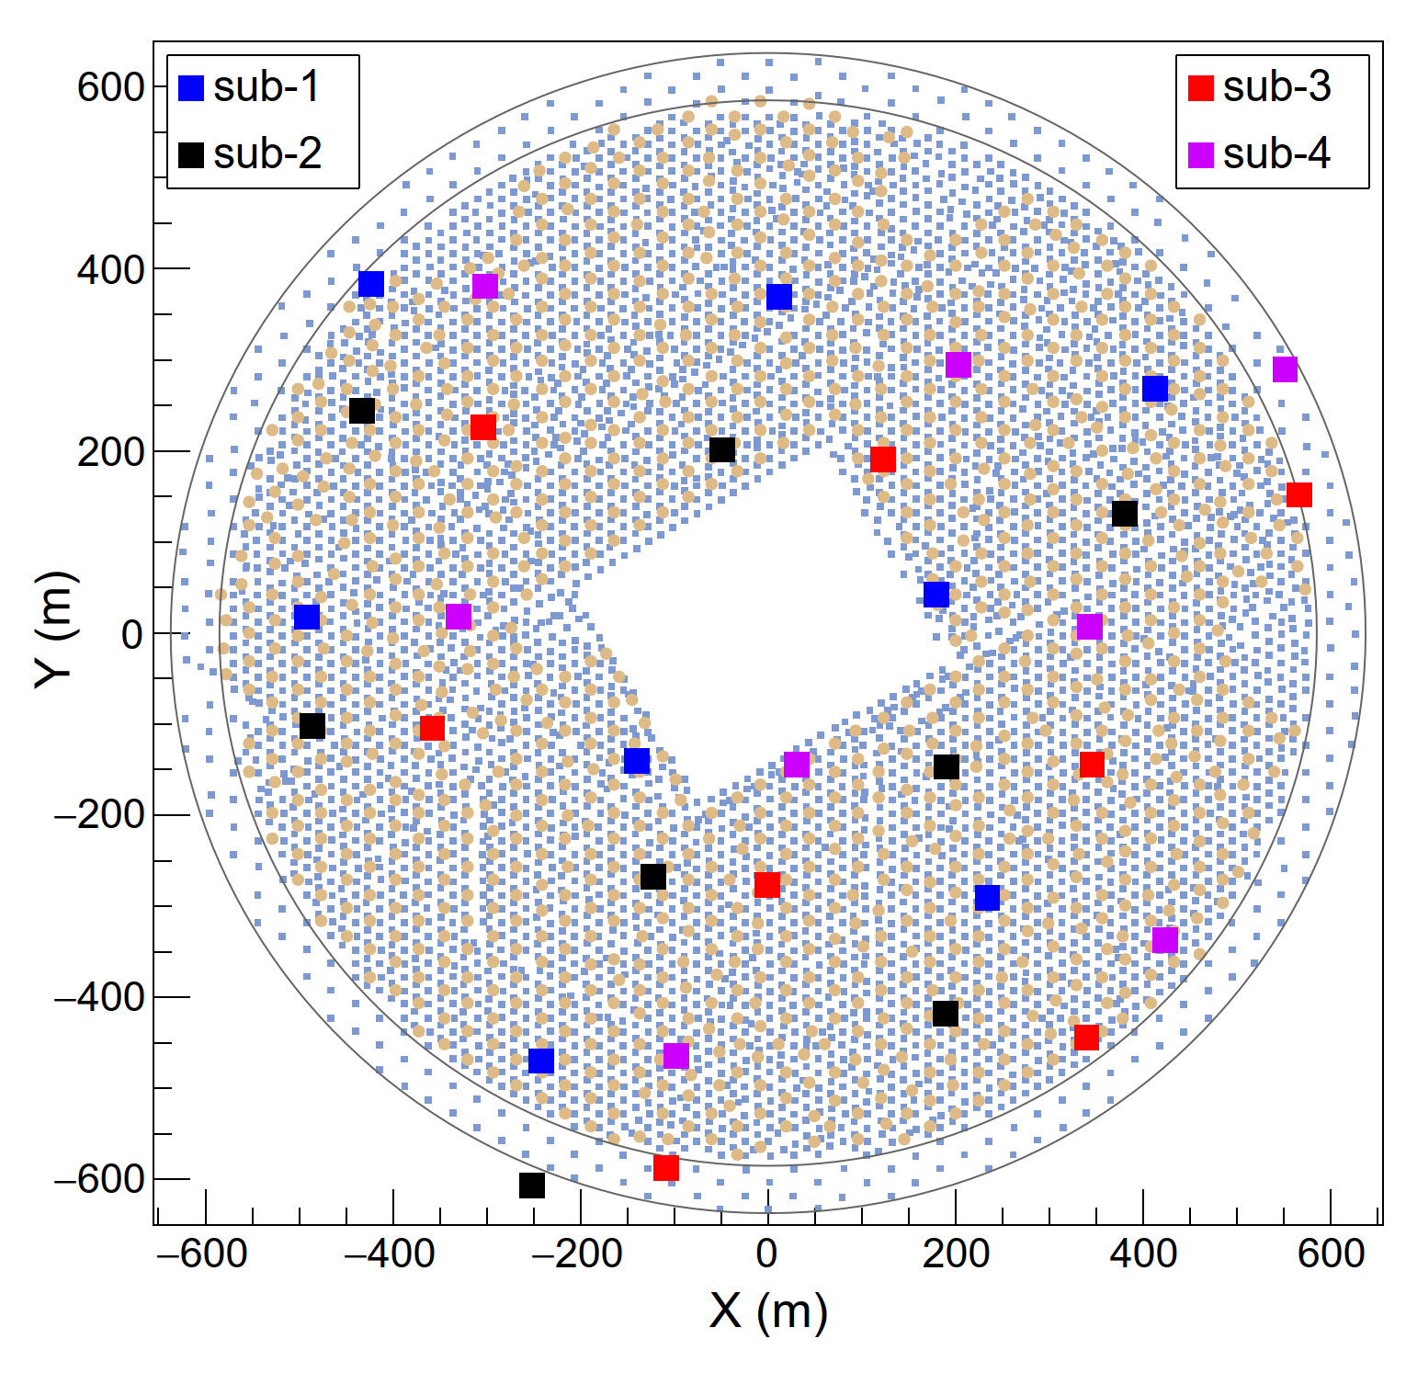
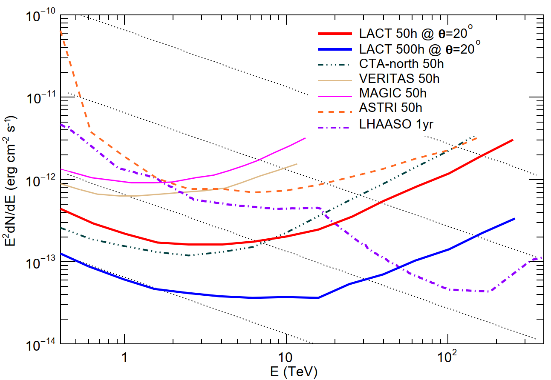
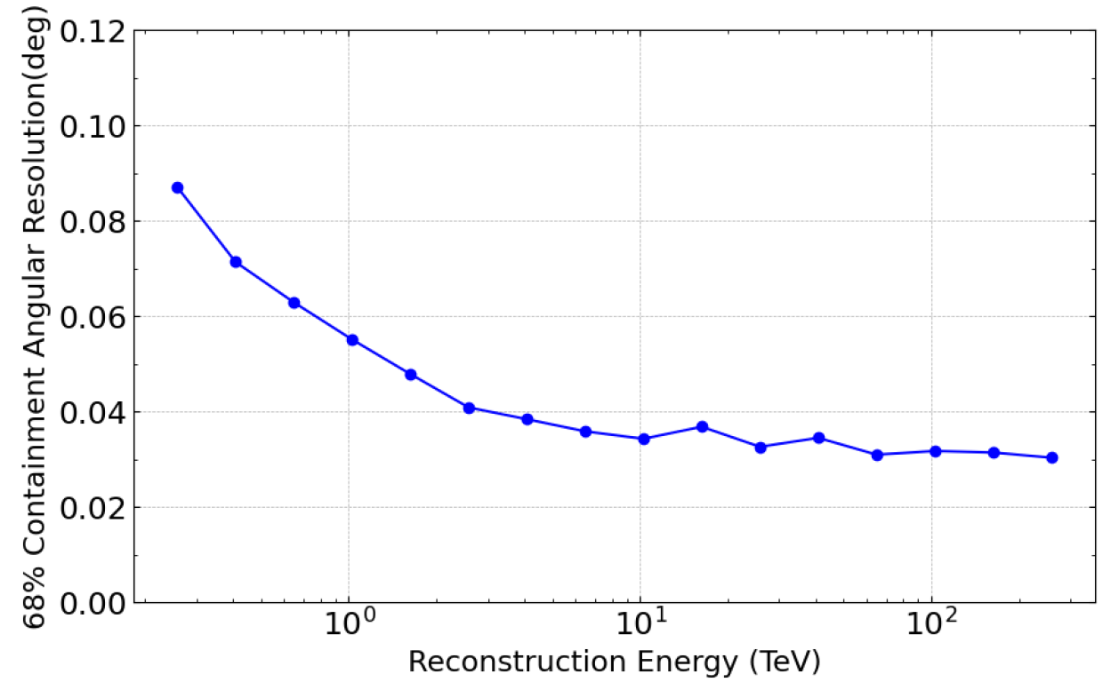
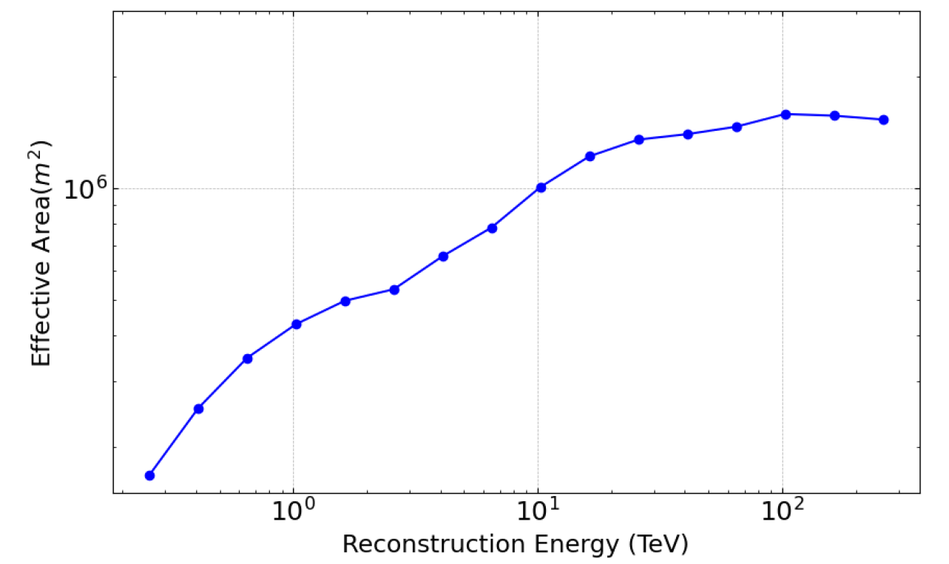
OBSERVATION MODE
(zenith<50°) observations for lower energy thresholds
Collection area: 1 km² @ 10TeV
Angular resolution:
<0.06° @ >1TeV
Threshold Energy: ~200GeV
1
2
3
120-200m
4
6
5
350-450m
8
7
Sensitivity of point source
1.6 km²
Zhang et.al.
Chinese Physics C,
49, 3,035001

Slide 11
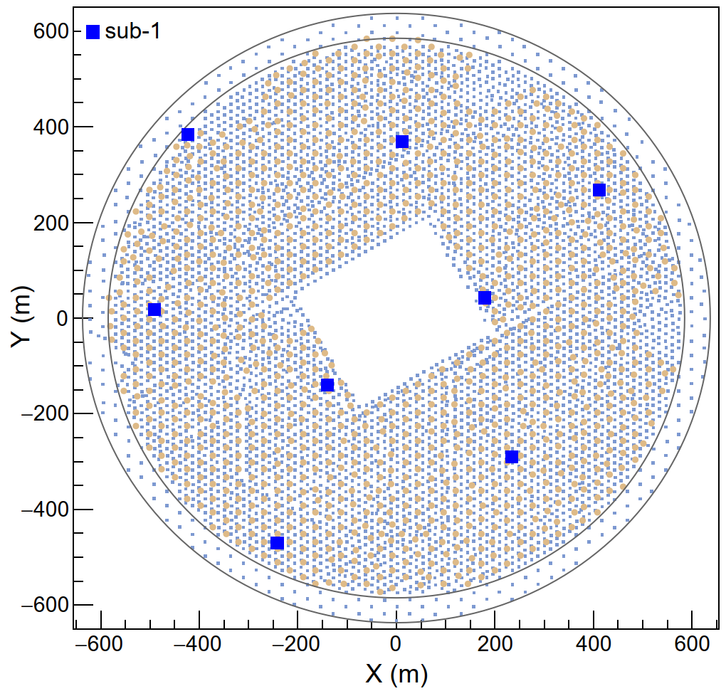
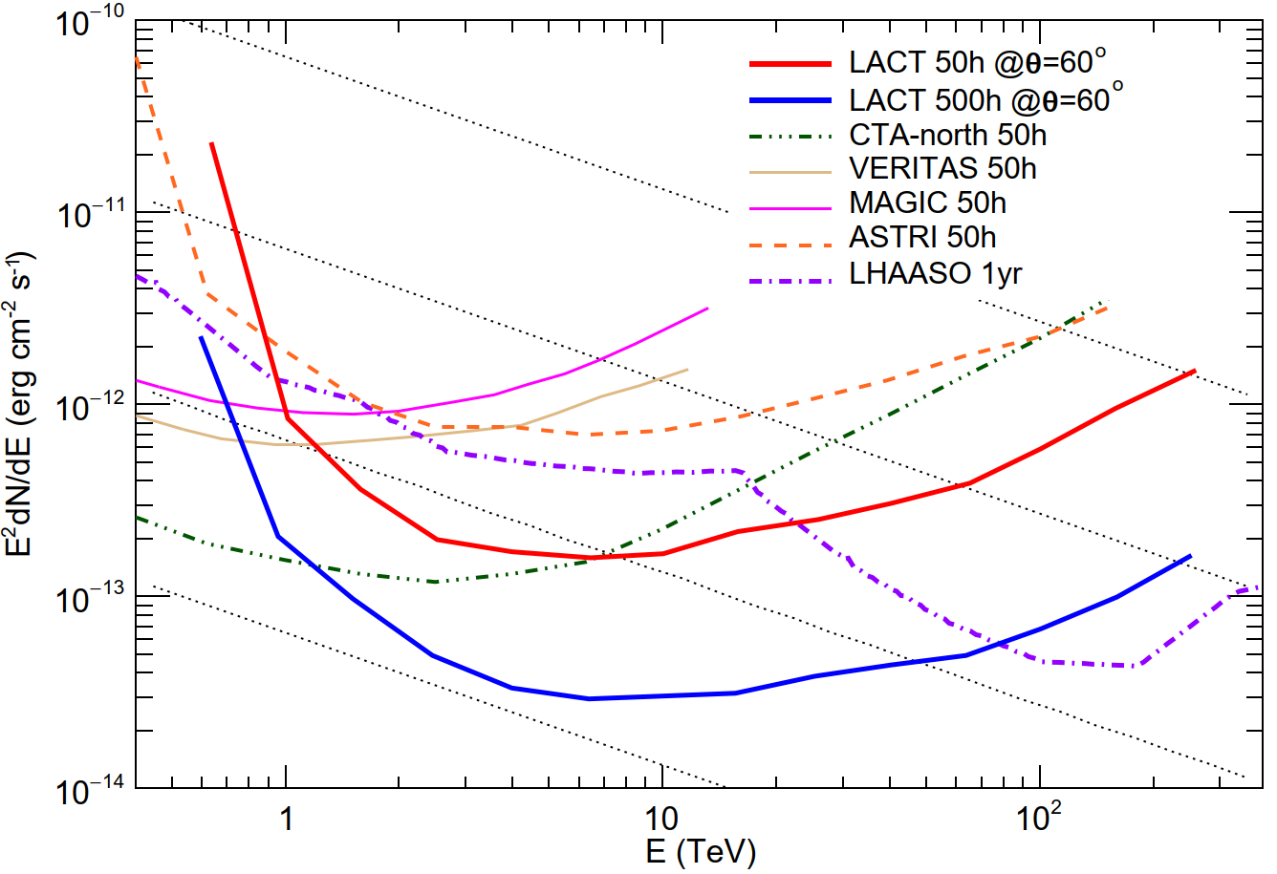
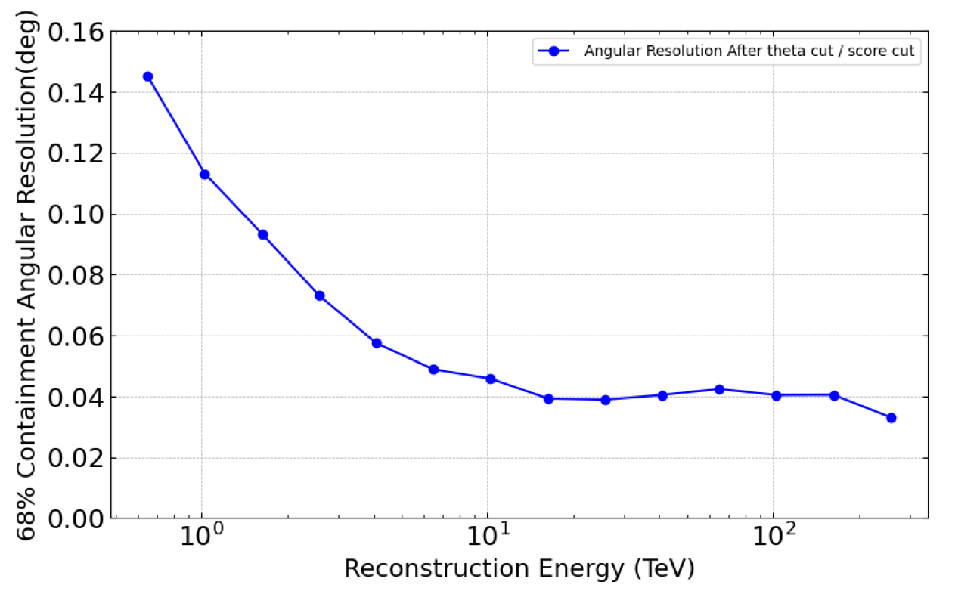
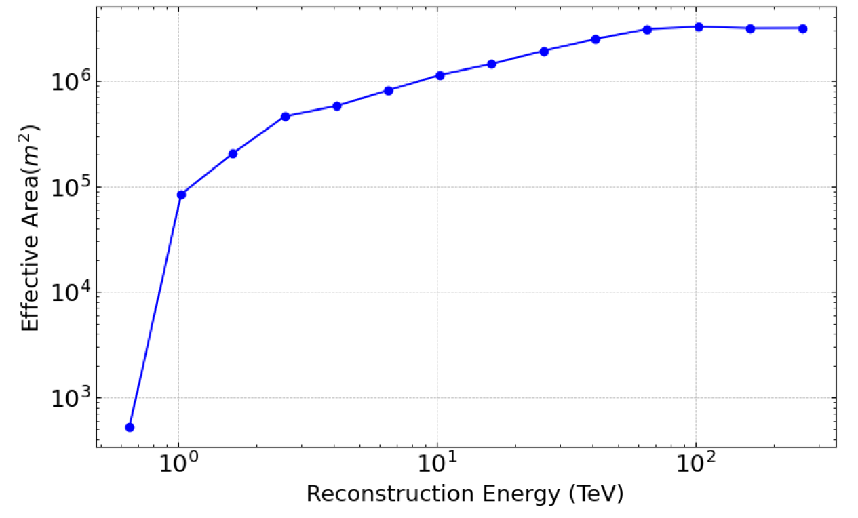
OBSERVATION MODE (large zenith angle)
(zenith>50°) observations for high energy band.
Collection area: 3 km² @ 10TeV
Angular resolution:
<0.06° @ >1TeV
Threshold Energy: ~1 TeV
8 telescopes: LACT has four sets of eight telescopes that can simultaneously observe four UHE sources
3 km²
Zhang et.al.
Chinese Physics C,
49, 3,035001

Slide 12
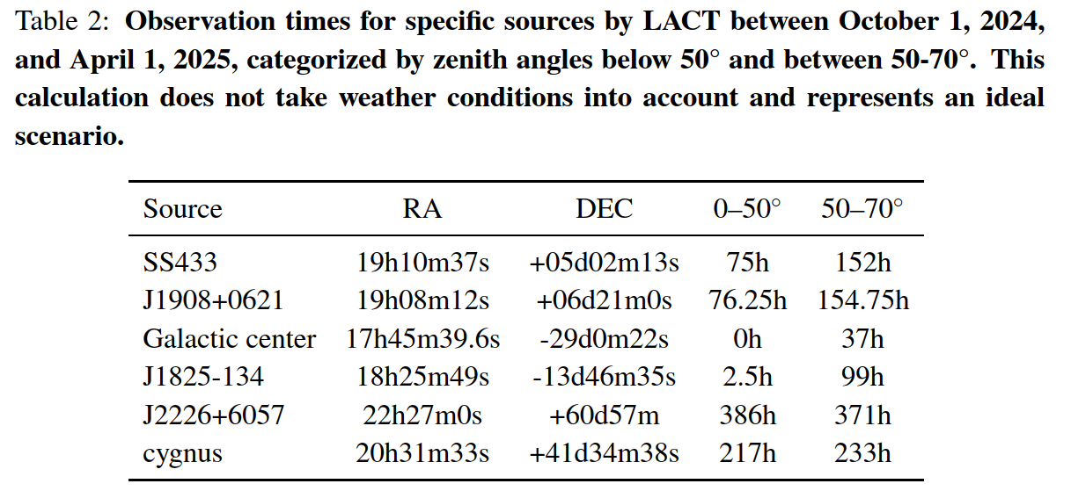
OBSERVATION MODE (large zenith angle)
Extend the FOV to include the most interesting sources

Slide 13
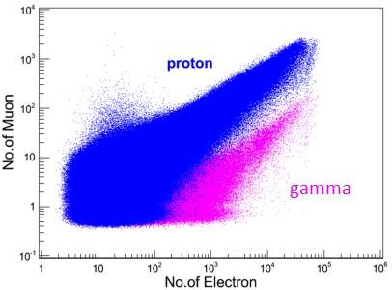
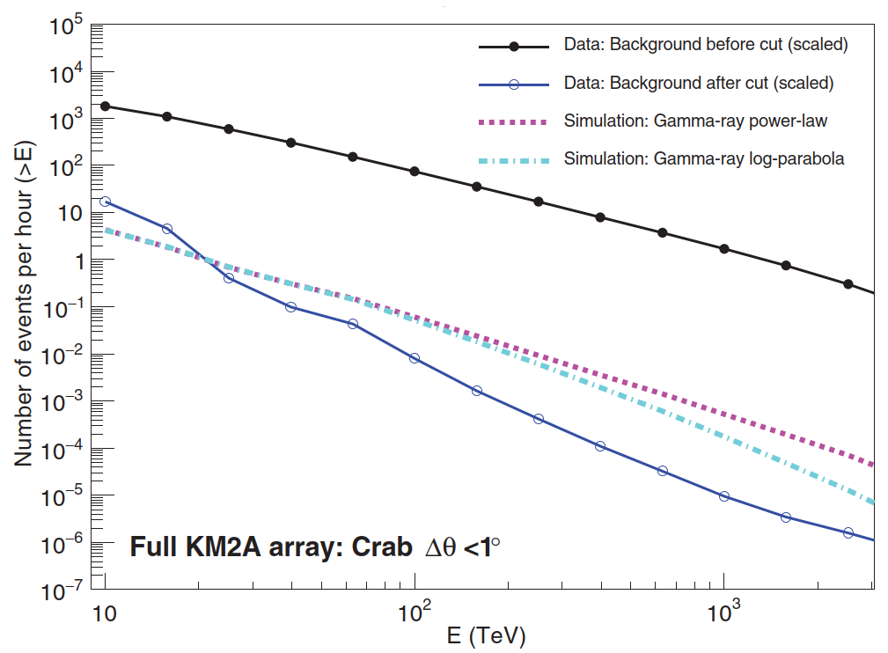
Muon information from LHAASO
Science 373, 425 (2021)

Slide 14
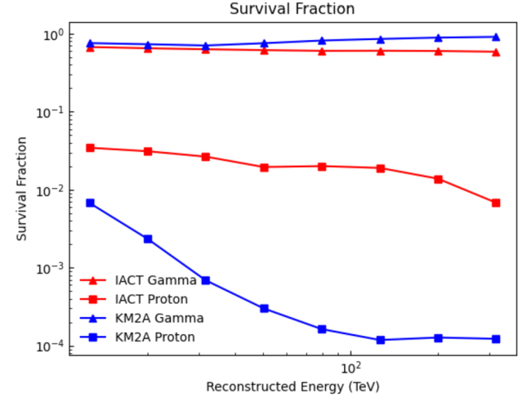
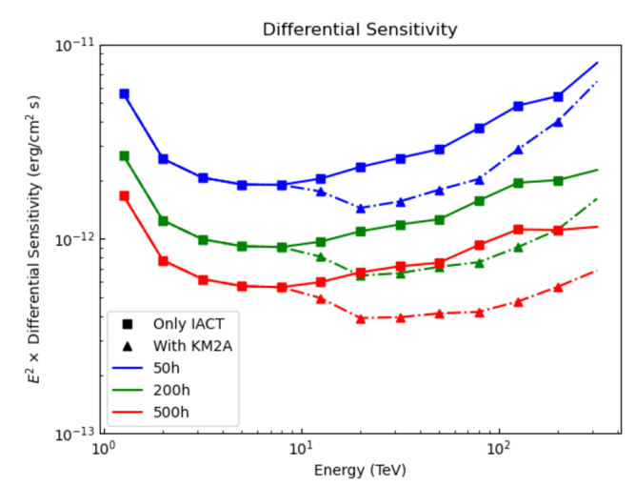
Muon information from LHAASO
The joint reconstruction of LACT and LHAASO muon detector array can increase the sensitivity of LACT by 1.6 times, especially for extended sources and long exposure time.
Results for 8 telescopes at 20 degree zenith angle, for extended sources
Zhang, et al., Journal of High Energy Astrophysics 43 (2024) 280–285

Slide 15
schedule
 | Construction plan | 2024 | 2025 |  | 2026 | 2027 | 2028
 |  | 1-12 | 1-7 | 8-12 | 1-12 | 1-12 | 1-12
1 | First telescope optimization and commissioning
2 | Second telescope construction and commissioning
3 | The next six telescopes construction and commissioning (total 8 tels)
4 | The full array complete the construction and commissioning (total 32 tels)

Slide 16
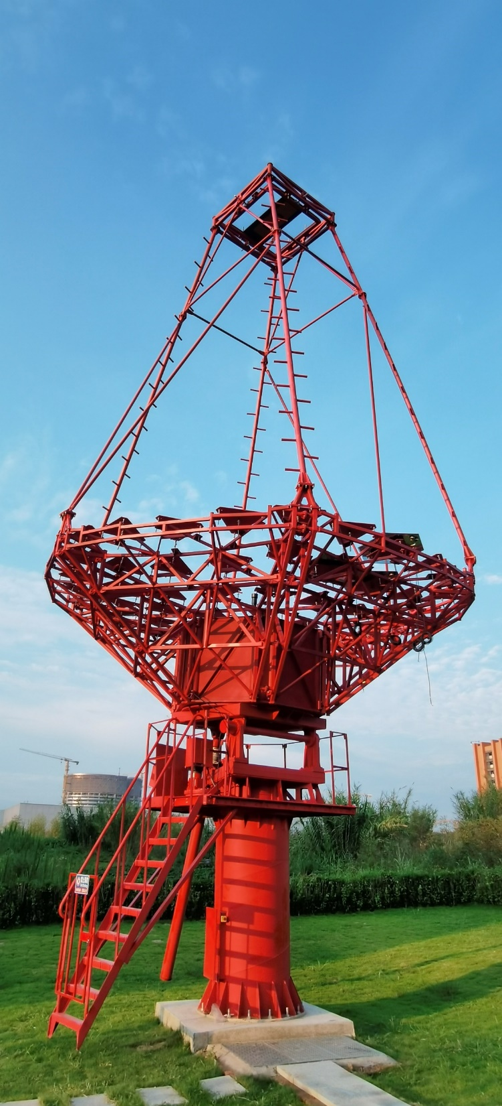
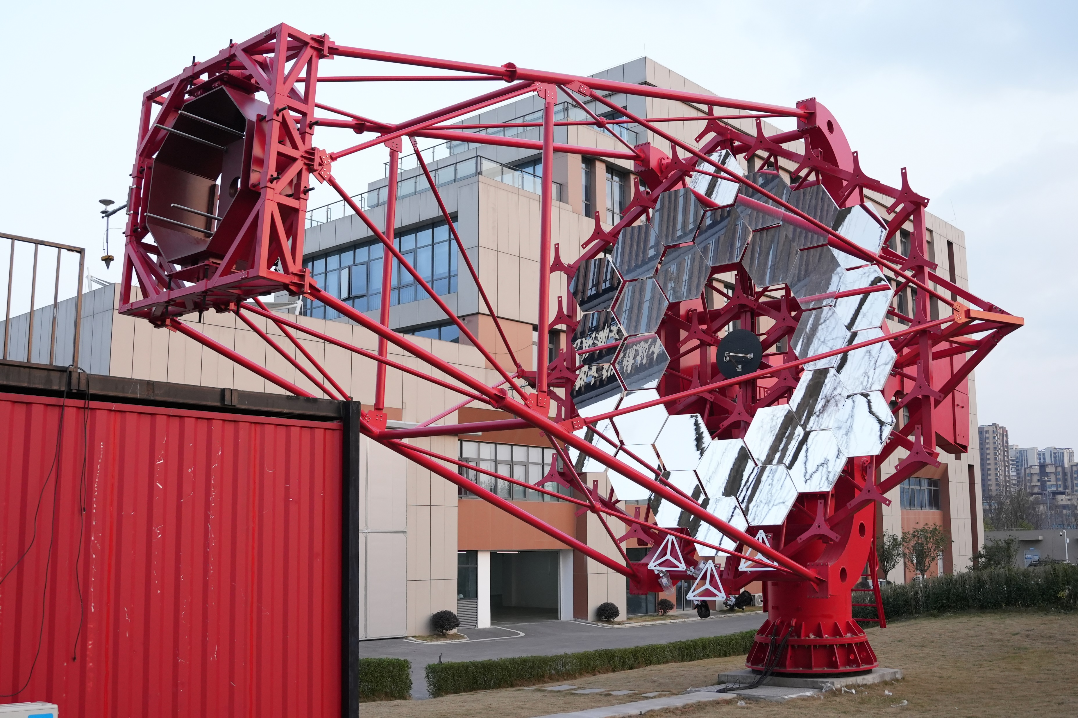
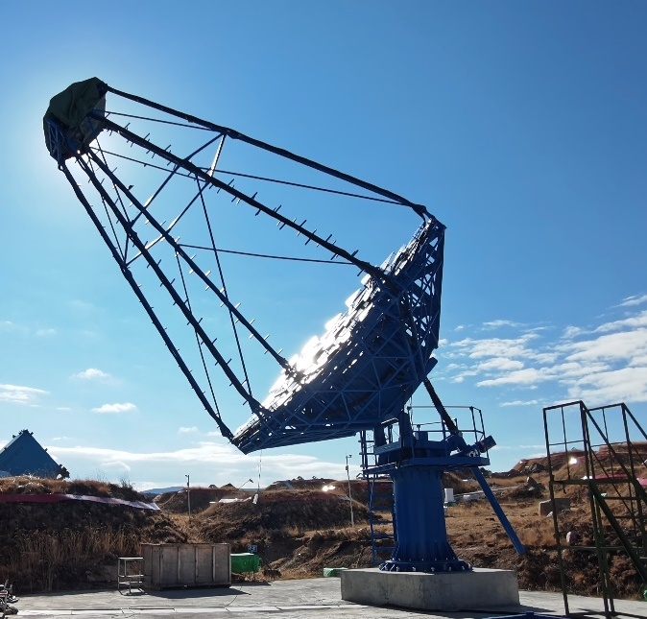
Prototypes

Slide 17
summaries
Next generation IACT: Large Array of Cherenkov Telescopes（LACT）
  32 telescopes in the LHAASO site
  LACT angular resolution: < 0.05° @ > 10 TeV
  Muon information from LHAASO： Joint reconstruction
  LZA mode: significant advantage in high altitude
Construction on-going
First telescope will start operating this October and 8 telescopes will be completed by 2026, and the full array will be completed by 2028

