Slide 1
Status and Prospects for the HUNT project
Speaker: Tian-Qi Huang^{1,2}
on be half of the HUNT Collaboration
¹ Institute of High Energy Physics, Chinese Academy of Sciences
² Tianfu Cosmic Ray Research Center
🤝
@ The Chinese University of Hong Kong

Slide 2
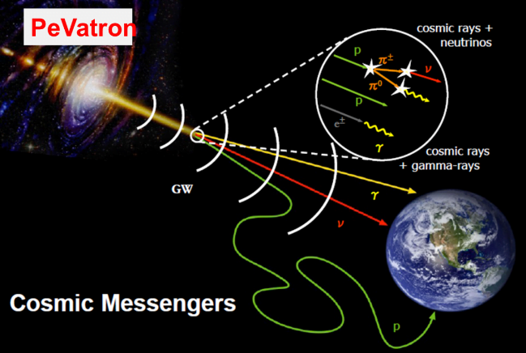
Scientific Goals
High-energy Underwater Neutrino Telescope (HUNT)
Researching the Galactic PeVatrons in the view of neutrinos
Resolving the high energy neutrino sky
Understanding the propagation mechanism of high energy cosmic-rays
Exploring the frontiers of neutrino physics and new physics
E_{γ}>100 TeV
LHAASO, 2024, ApJS
PeVatrons: accelerator of PeV cosmic-rays (e.g., electrons, protons)
1LHAASO catalog: 43 UHE gamma-ray sources (>4σ)

Slide 3
HUNT Sketch Map
~2300 strings
Length of string ~700 m
horizontal distance ~130 m
vertical distance ~30 m
~30 cubic kilometers
TeV – 100 PeV
Specifications:
Angular resolution: ~0.1° (tracks), <3°(cascades)
Energy resolution: ΔlogE~0.3(tracks), ΔE~10-30% (cascades)

Slide 4
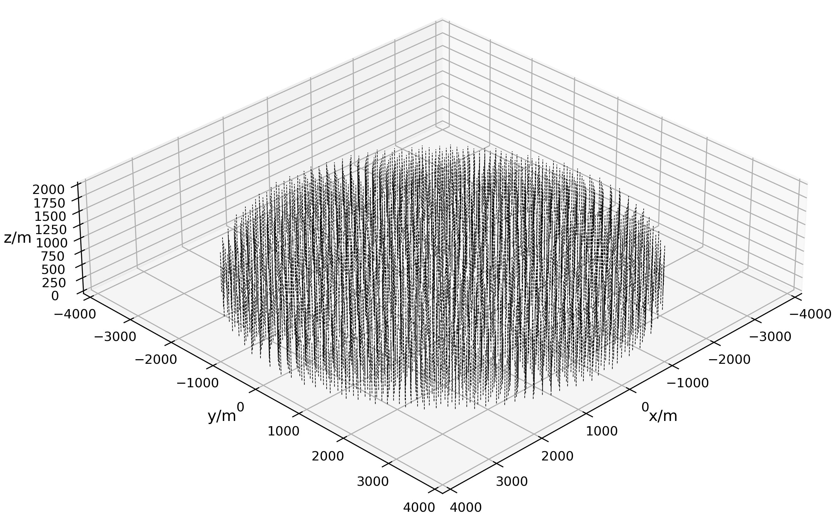
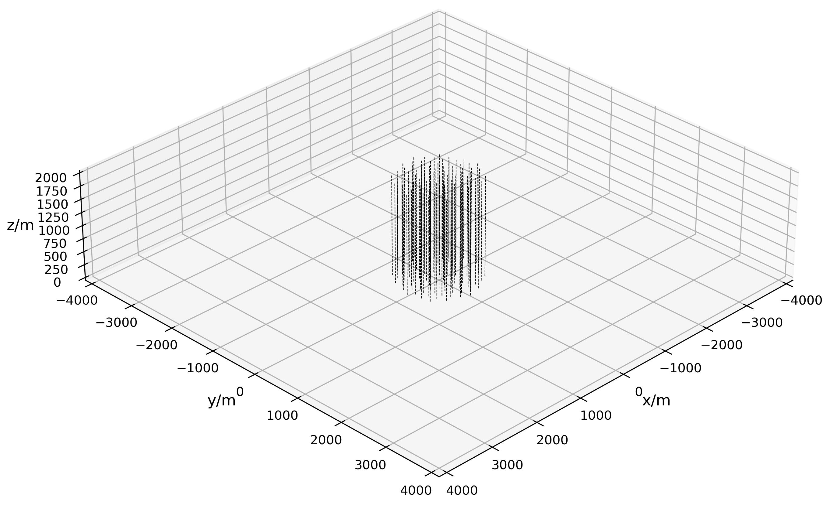
Configuration Design
Type 1
Height: 720 m
Radius: 3.8 km
2212-strings
1-cluster
Type 2
Height: 1890 m
Radius: 800 m
96-strings
9-clusters
×9
South China Sea (water depth ~ 3000 m)
Lake Baikal (water depth ~ 1300 m)
Notes:
vertical distance = 30 m

Slide 5
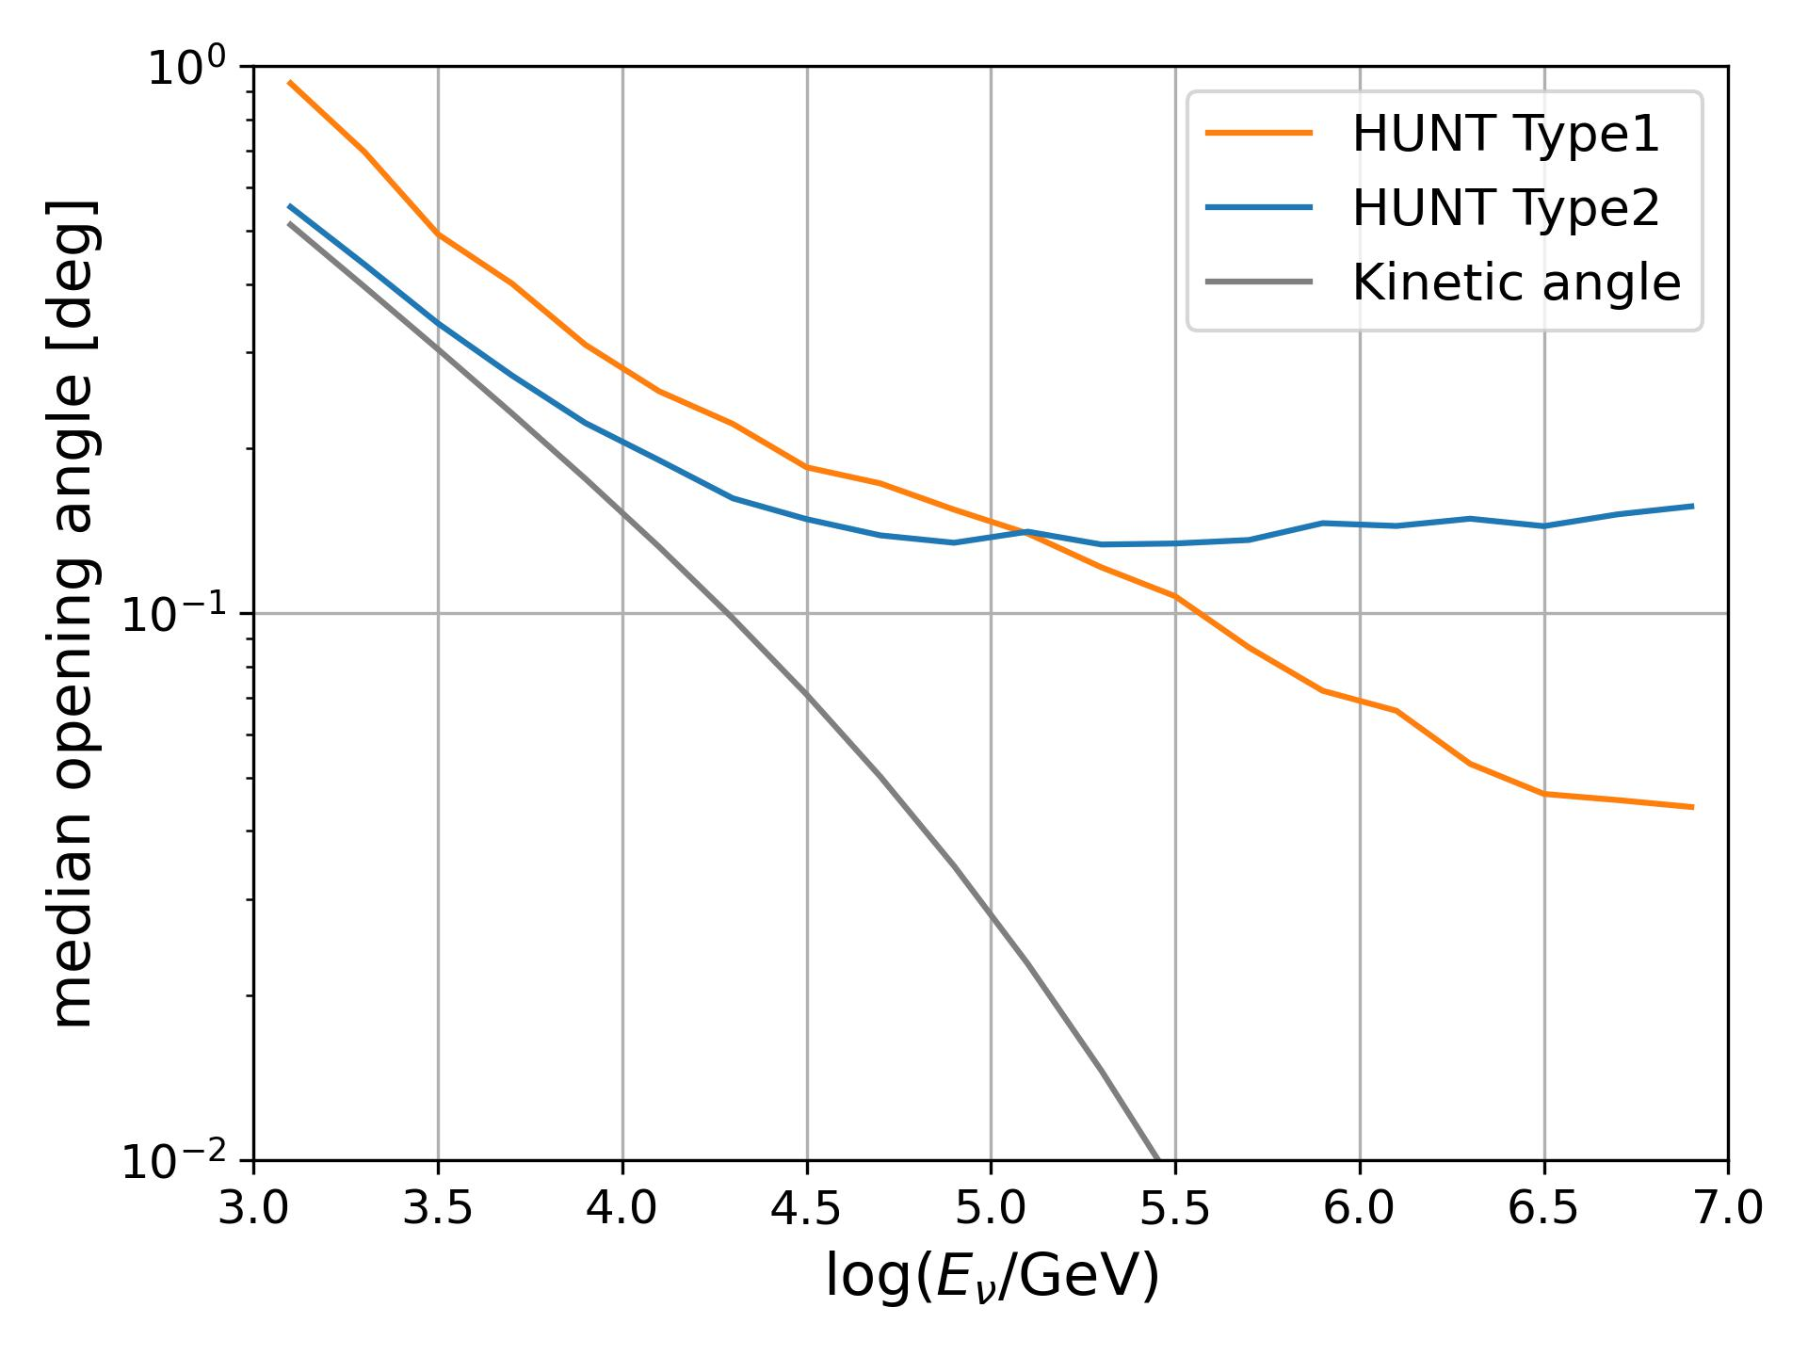
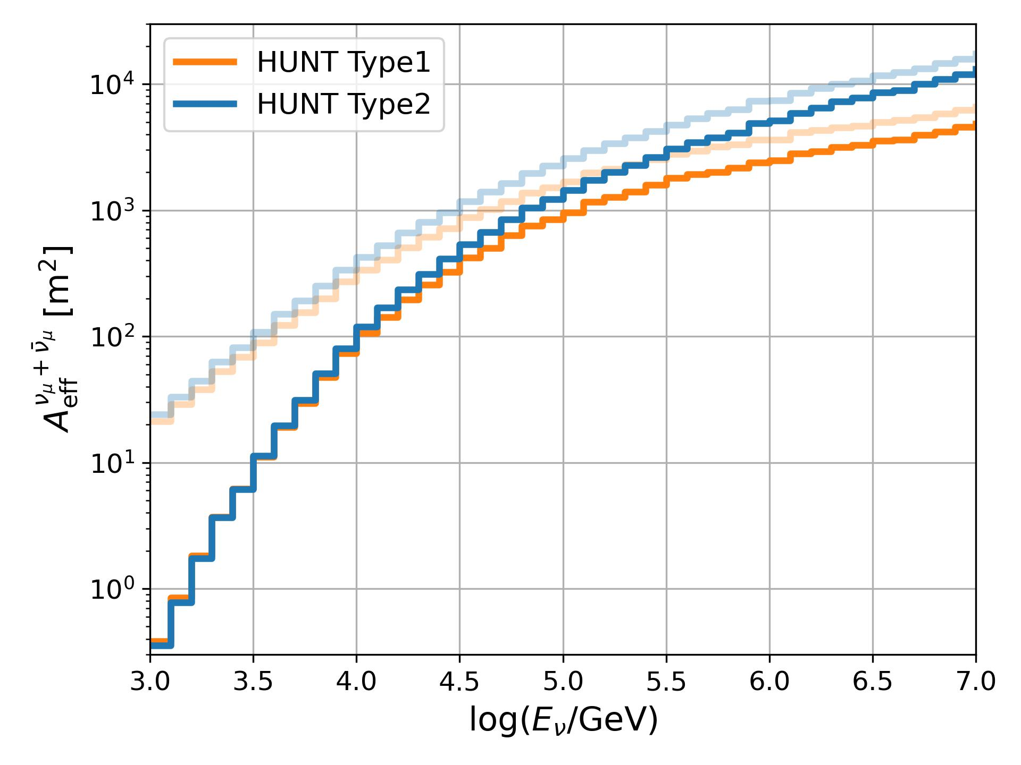
Angular resolution & Effective area
upgoing tracks
(zenith > 80 deg)
upgoing tracks
(zenith > 80 deg)
PRELIMINARY
PRELIMINARY
Notes:
Nhit >=7, Npe>=21

Slide 6
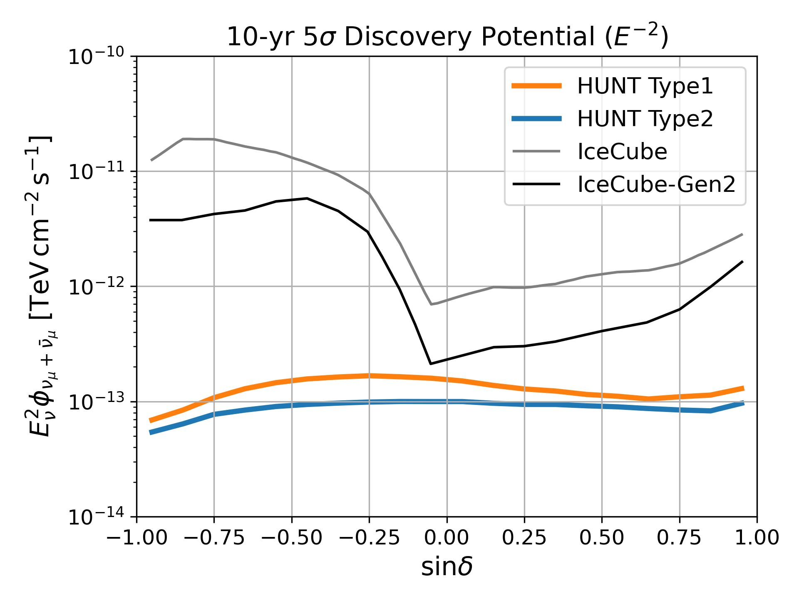
Discovery Potential
Background
Atmospheric neutrinos (MCEq)
Diffuse astrophysical neutrinos (dN/dE ~ E^{-2.37})
Binned Likelihood
$L=\prod{e^{−n_{s}S_{i}−n_{b}B_{i}}{(n_{s}S_{i}+n_{b}B_{i})}^{n_{i}}/n_{i}!}$
Spatial bin size ~${0.1}^{°}×{0.1}^{°}$ (HEALPix Nside = 512)
Energy bin size $∆\text{log}E_{rec}$=0.4
the energy resolution is assumed to be $∆\text{log}E_{rec}$=0.3
We approximate the median significance by replacing the data with the expectation values.
PRELIMINARY

Slide 7
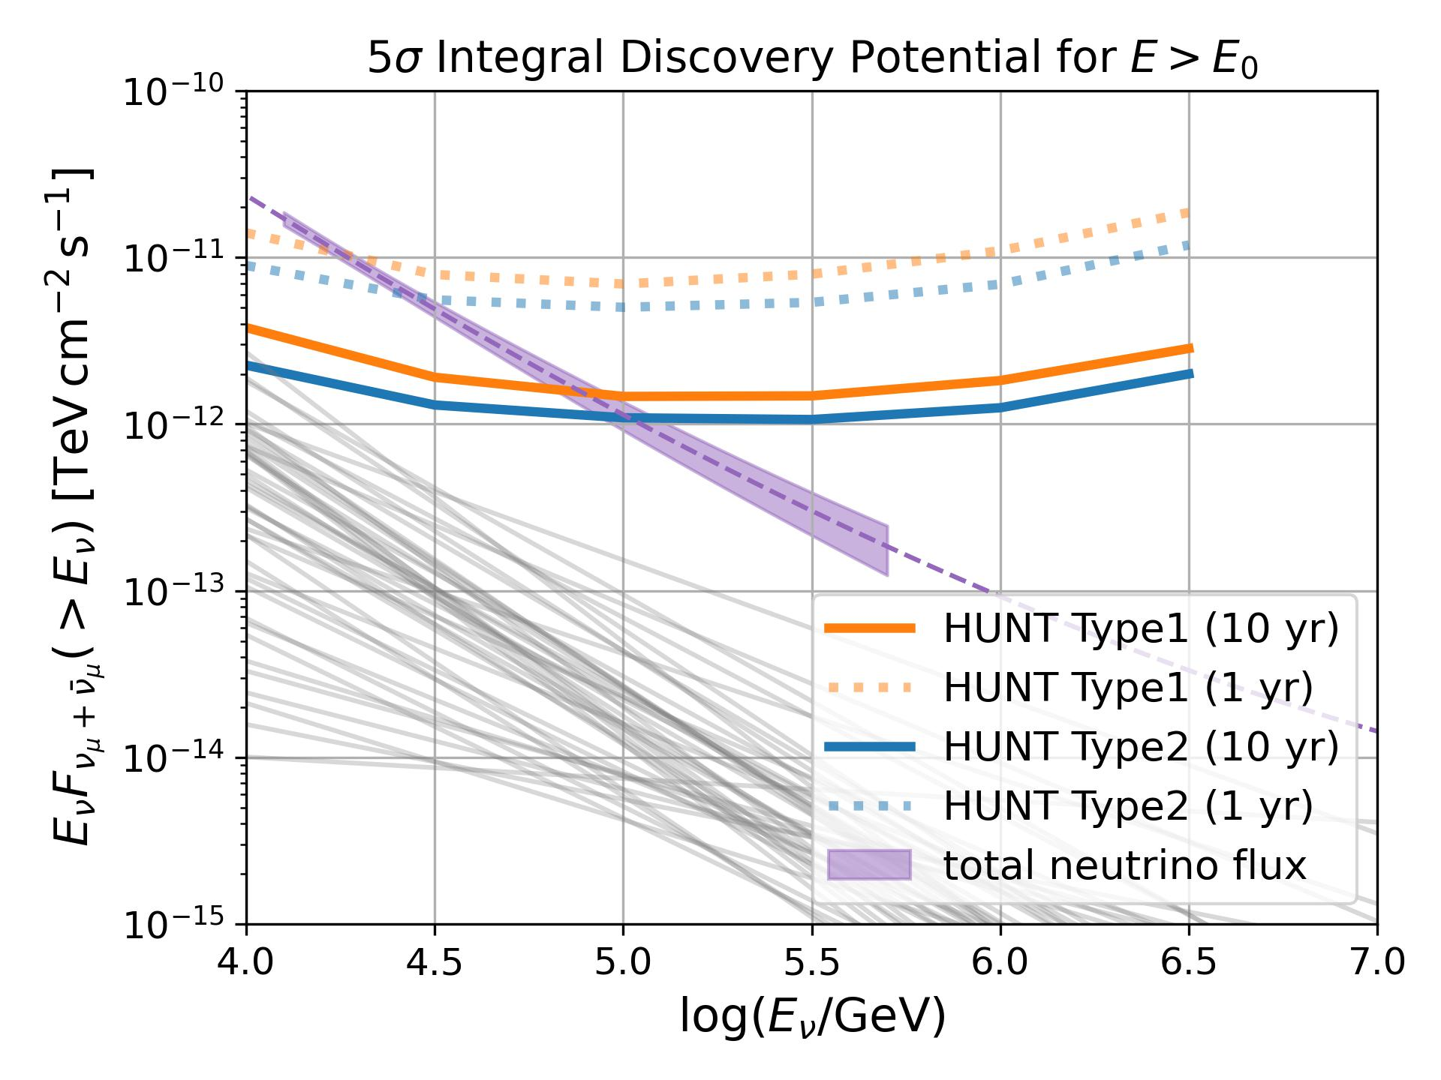
Discovery Potential | Stacking LHAASO sources
1LHAASO Catalog
43 sources with >4σ emission above 100 TeV
median spectral index 3.28
median source extension ${0.21}^{°}$
track angular resolution ${<0.2}^{°}$ ✅
Neutrino & Gamma-ray Relation
$J_{ν}\left(E_{ν}\right)={2J}_{γ}\left(E_{γ}\right)$
$E_{γ}=2E_{ν}$
PRELIMINARY

Slide 8
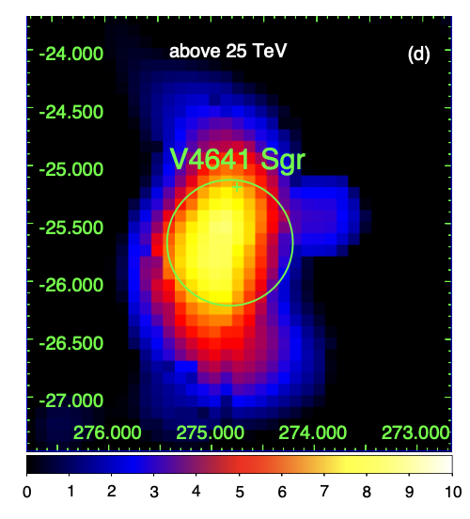
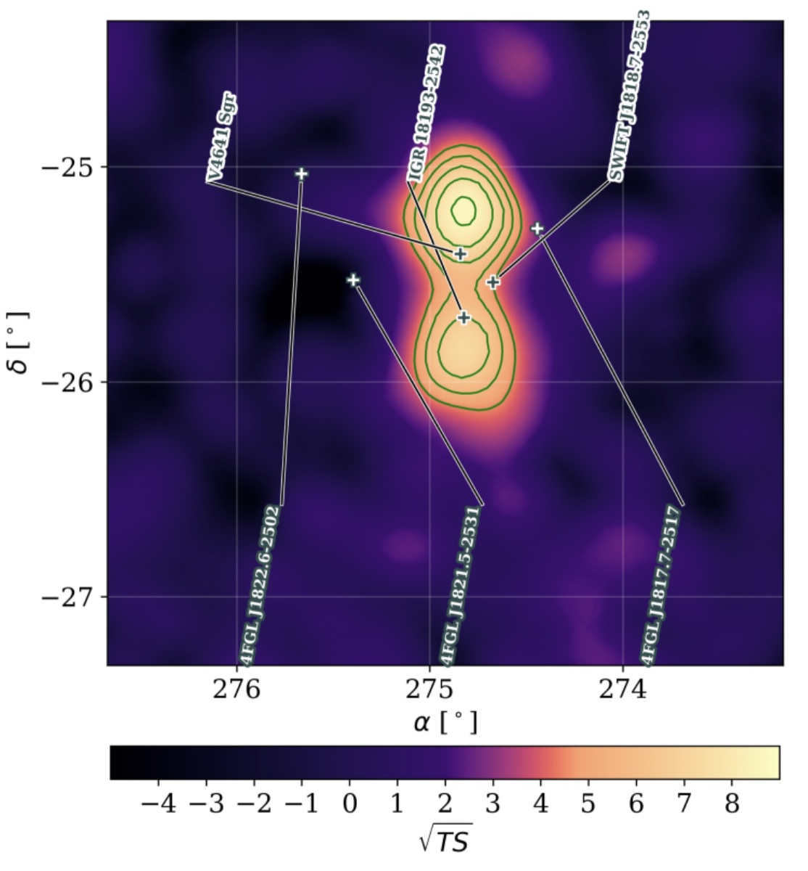
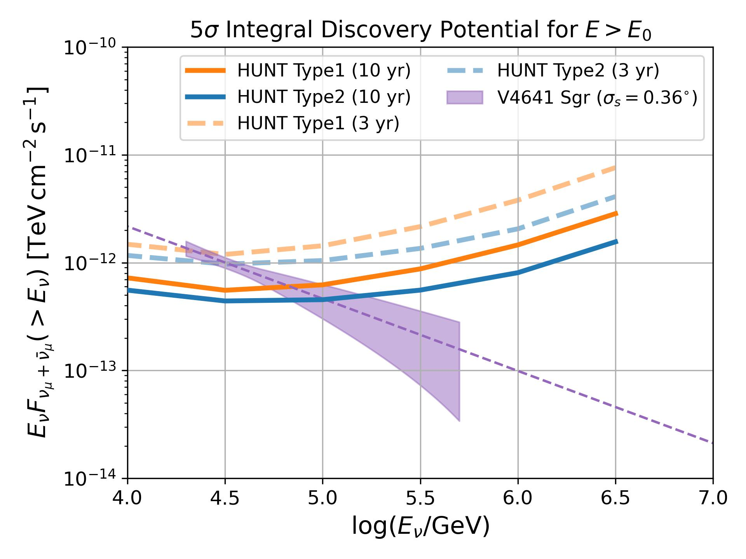
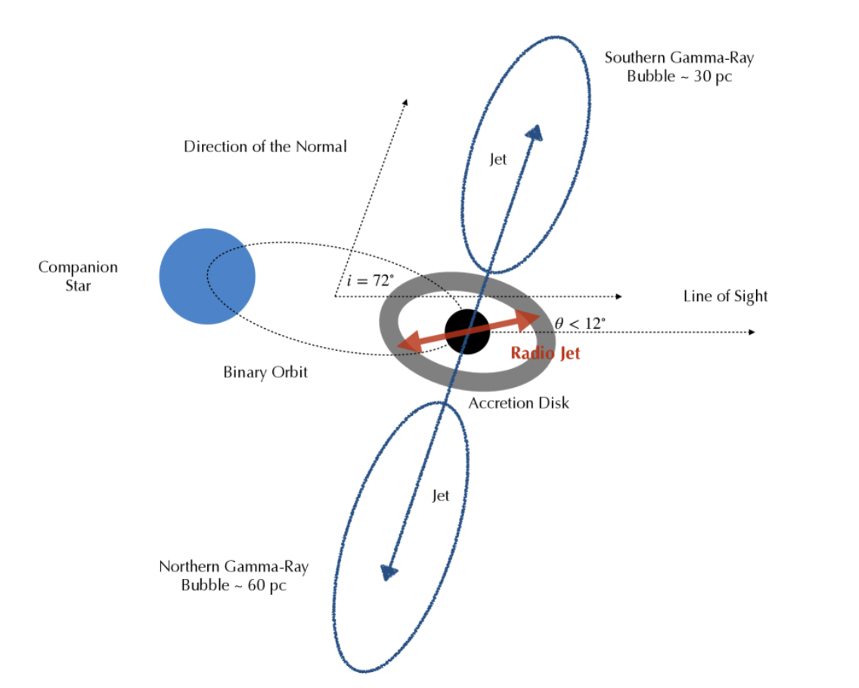
Discovery Potential | Microquasar
LHAASO, 2024, arXiv:2410.08988
Alfaro R., et al., 2024, Nature
PRELIMINARY

Slide 9
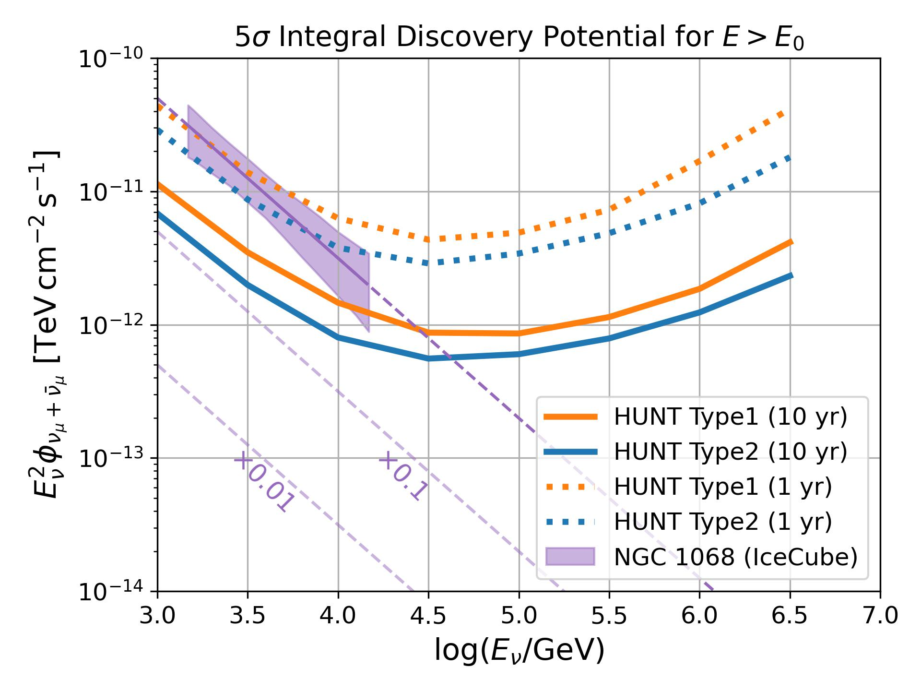
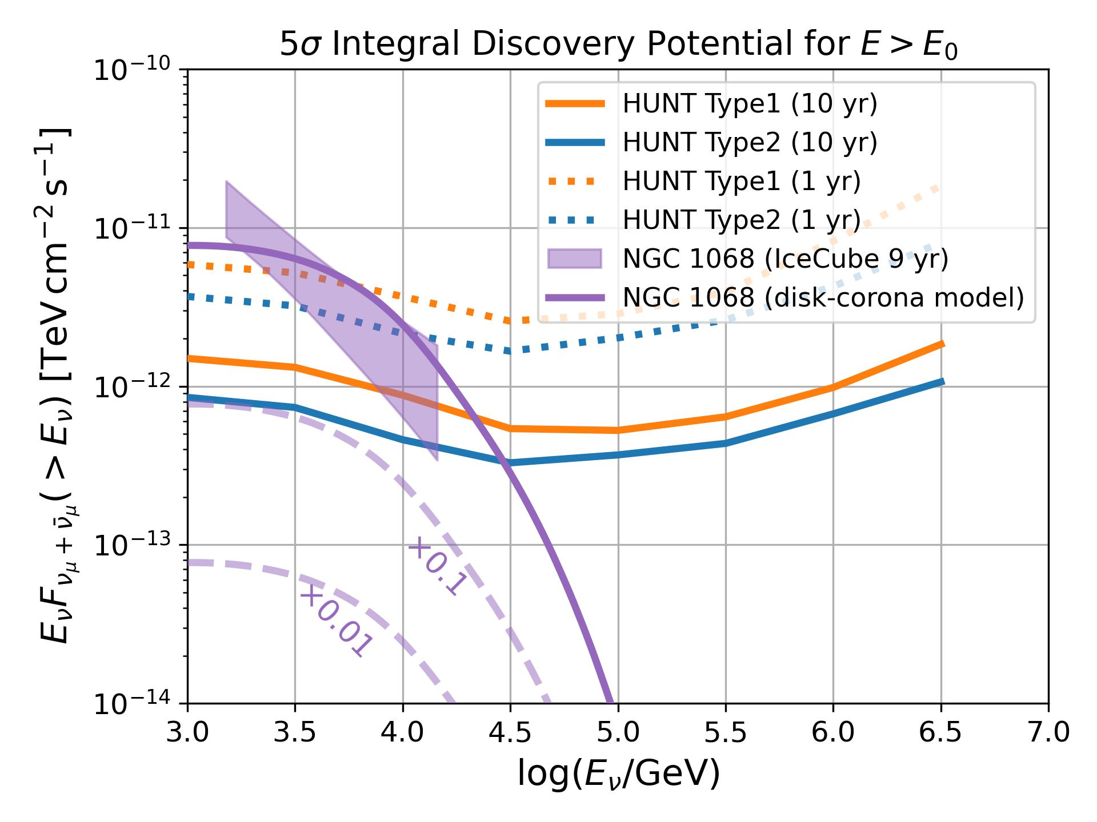
Discovery Potential | Seyfert Galaxies
PRELIMINARY
PRELIMINARY

Slide 10
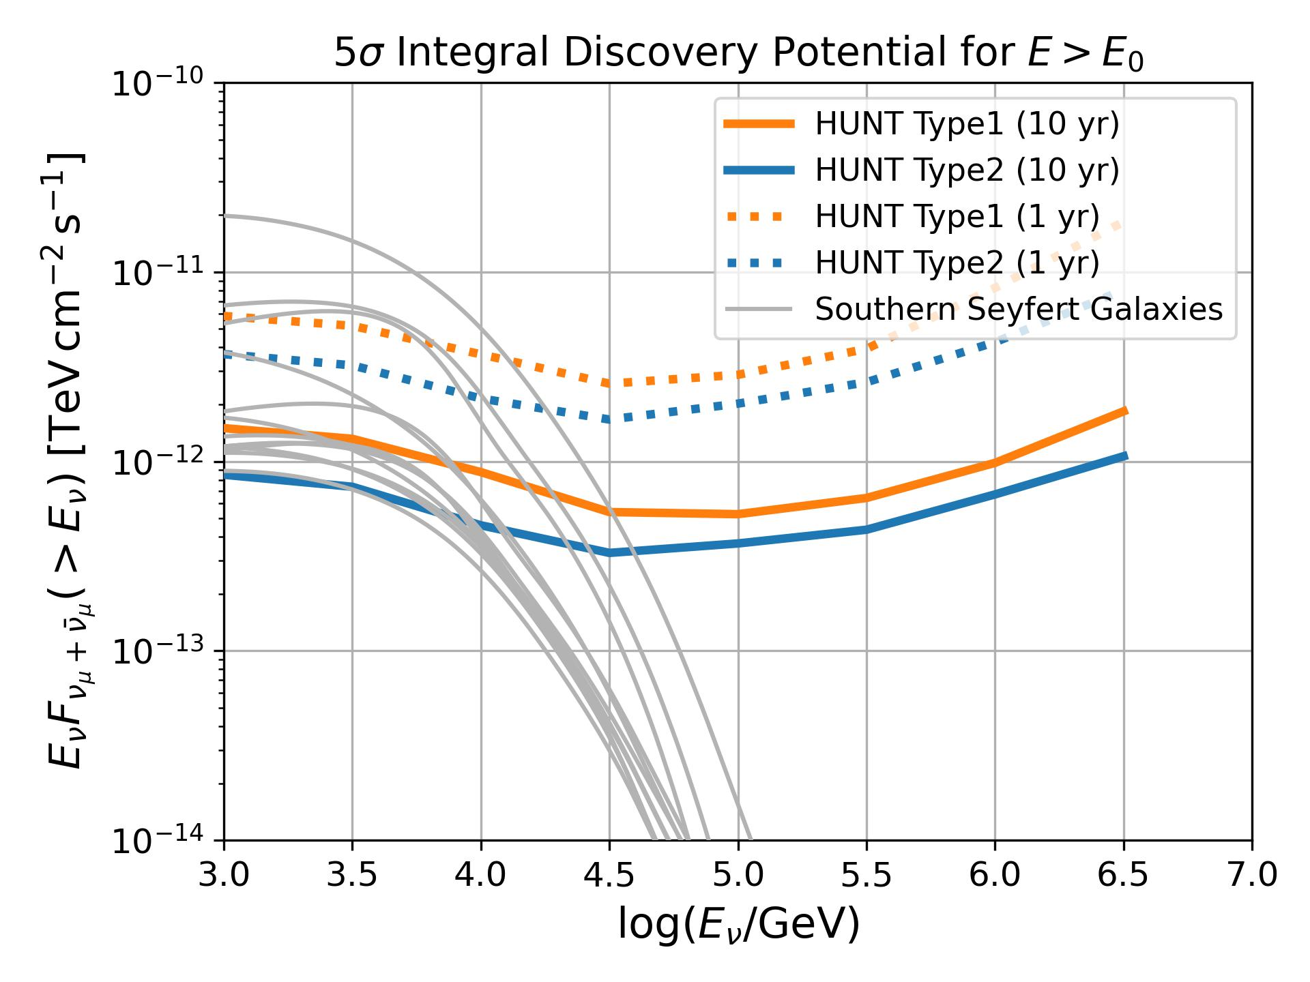
Discovery Potential | Seyfert Galaxies
disk-corona model
(Kheirandish, KM & Kimura 21 ApJ )
PRELIMINARY
PRELIMINARY
HUNT will discover tens of neutrino sources.

Slide 11
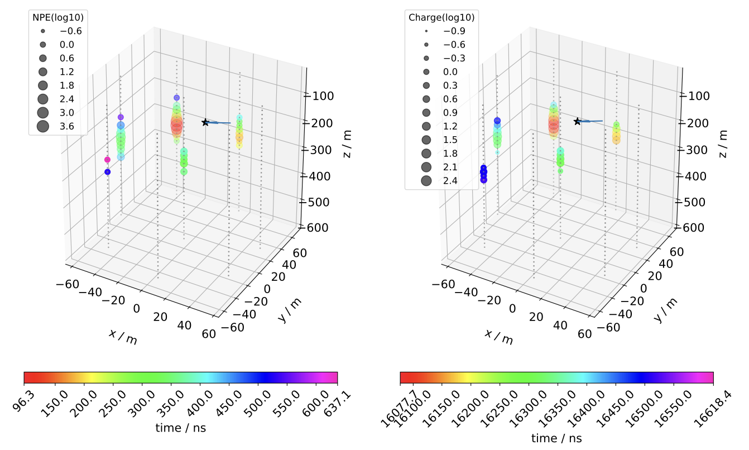
Geant4 simulation program
We simulated the 13 neutrino events observed by Baikal-GVD (Zike Wang, et al., 2024, ChPhC)
)
The linear fitting parameters are all close to 1, which shows that the detector simulation is basically correct and can be used for the simulation of HUNT experiment.

Slide 12
Geant4 simulation acceleration
G4DMT：GEANT4 Distributed Multiple Threads
Can call the performance of all CPUs to help simulate a primary particle.
G4ART: GEANT4 Accelerated Ray Tracing
Generation of Cherenkov light on GPU. GPU ray tracing. In order to further reduce the CPU computing load.
One electron (1 PeV)
default Geant4 takes 137 hours
1-core CPU
G4DMT + G4ART takes 410 seconds
32-core CPU, 4 GPUs
1200 times faster
Next Step
Further validation of the reliability of the acceleration libraries.
To compare the output of Geant4 when using and not using these acceleration libraries

Slide 13
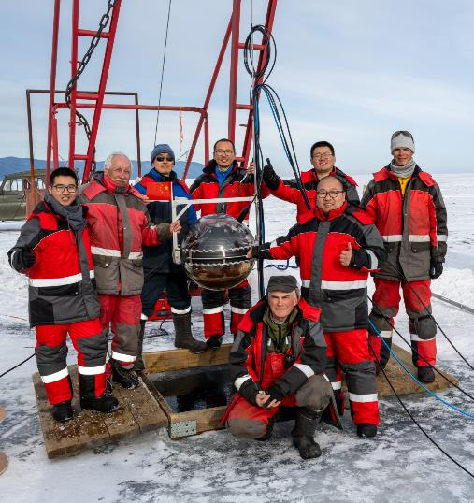
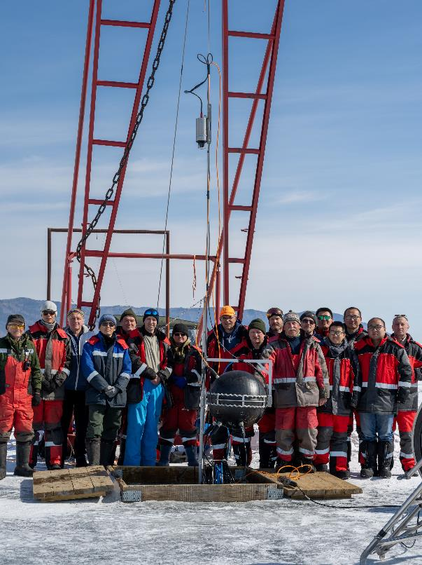
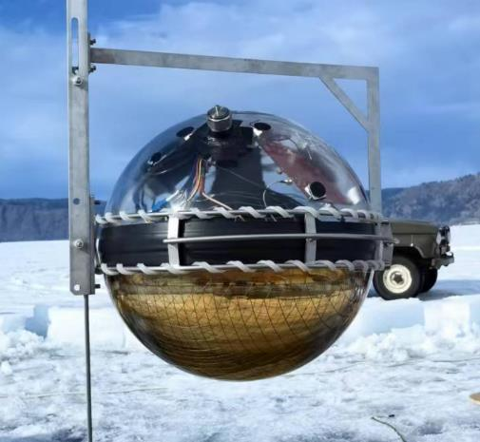
Prototype String @ Lake Baikal
12 OMs with 20-inch PMTs
4 LED calibration systems
120m
3m
228m
30m
340m
30m
~330m
Anchor
March 2024

Slide 14
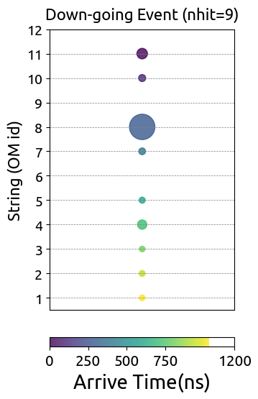
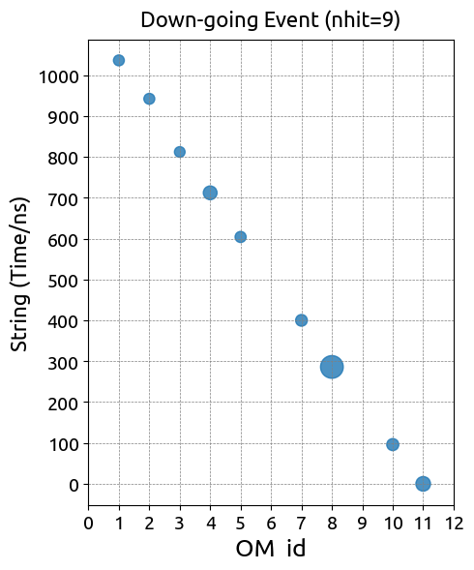
Prototype String @ Lake Baikal
Size of signal
Arrival time
Around 10 muon-like events (>=4 hits) per day.
Further analyses are on-going (e.g., reconstructing the muon direction)

Slide 15
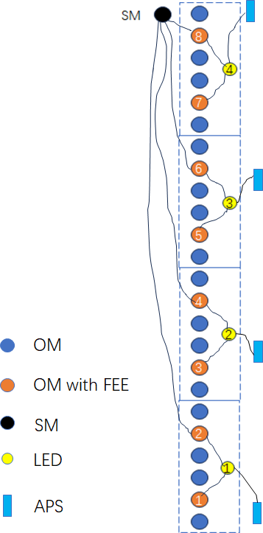
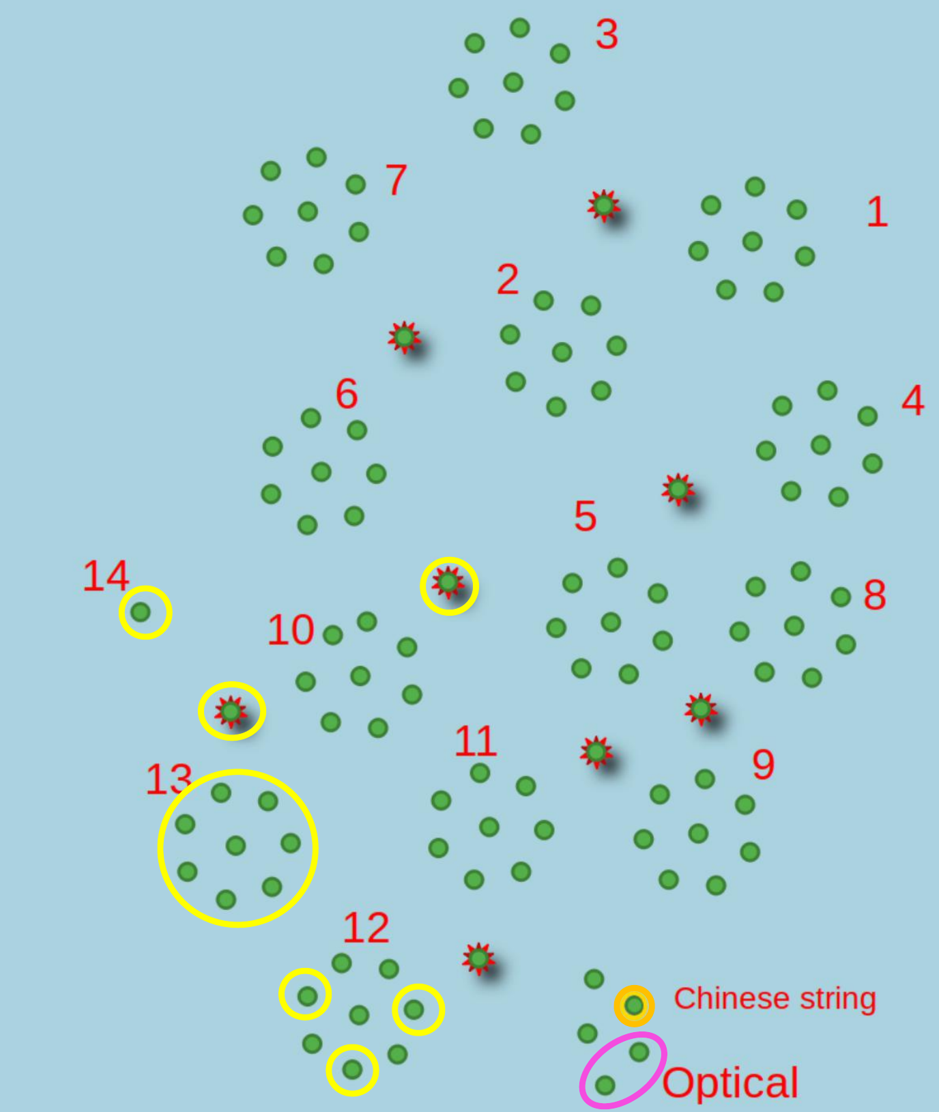
Prototype String @ Lake Baikal
We are going to deploy the other two strings (24 OMs) in Lake Baikal in
2025 completed
2026
~690m

Slide 16
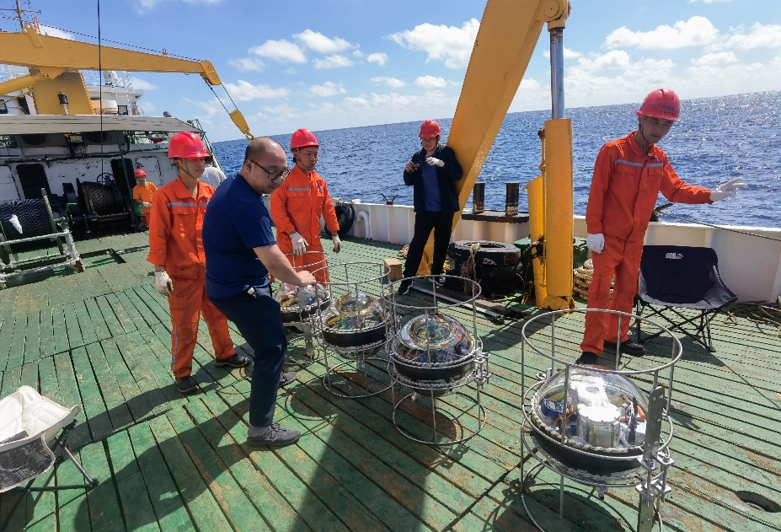
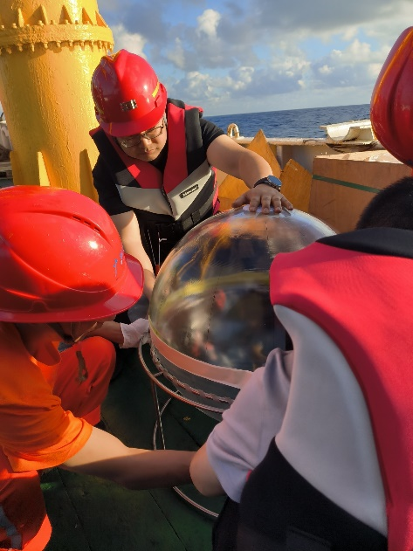
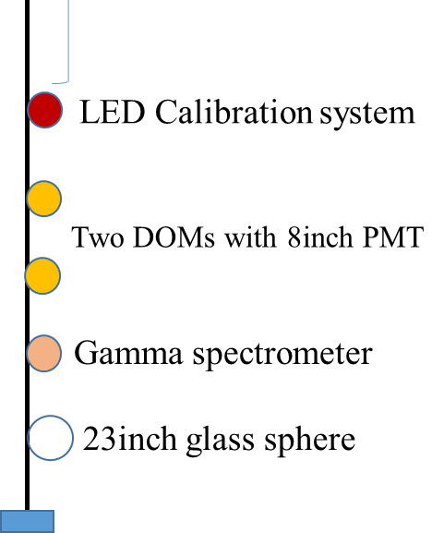
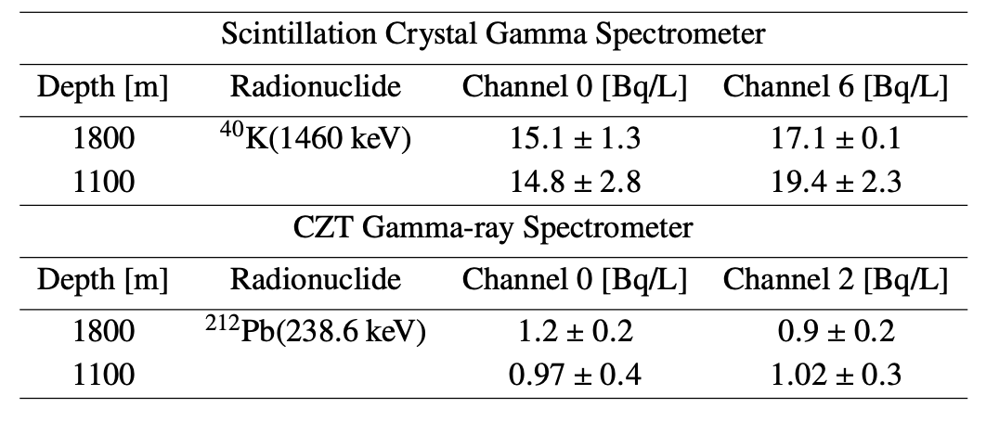
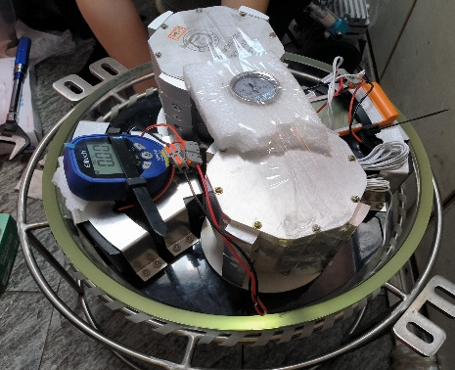
Pathfinder Experiment
Pathfinder Experiment Apparatus
Experimental Site
The water of Xisha Islands in South China Sea
Experimental Objectives
Test of long-distance LED calibration system
Time resolution 0.4 ns for bright pulses
Pressure resistance test of 23-inch glass sphere
In-situ measurement of gamma ray background
The radioactivity for ⁴⁰K and ²¹²Pb
2023.2
20 m
1,800m
1800 m (12.8 hours)
20 m
1100 m (5.5 hours)
1,800m
1,800m
Notes:
https://docushare.icecube.wisc.edu/dsweb/Get/Version-103436/IceCube%20performance.pdf

Slide 17
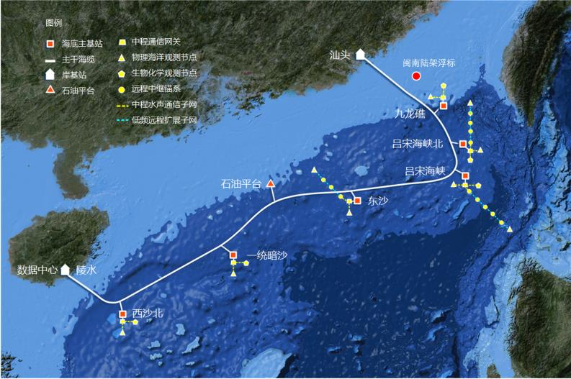
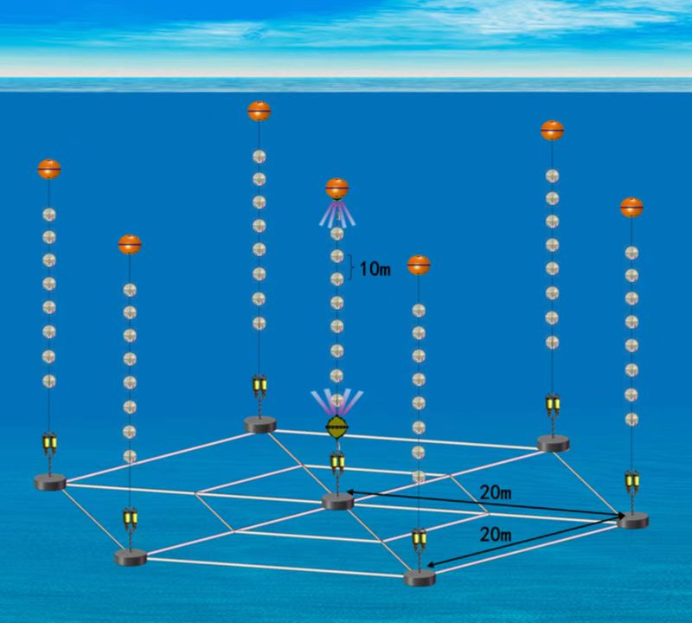
HUNT @ South China Sea
Long-term monitor string (Jan 2025)
4 OMs, vertical spacing 10 m
Seven-string array (2025)
Demonstrate the feasibility of the South China Sea plan for the HUNT project.
Measure the neutrino oscillation parameters.
HUNT project receives support from the South China Sea Observation Network.
Junction box
7strings，56 OMs

Slide 18
Summary
LHAASO has discovered tens of Galactic PeVatrons which are good candidates for high-energy neutrino astronomy.
HUNT will realize unprecedented potential in discovering the neutrino counterparts of Galactic PeVatrons and resolving the high-energy neutrino sky.
Prototype string in Lake Baikal has observed muon-like events. We are going to deploy two strings in 2025 and 2026.
The construction of seven-string array in South China Sea will start this year.

Slide 19
Back Up

Slide 20
Configuration Design
Lake Baikal
Height: 720 m
Radius: 3.8 km
2212-strings
1-cluster
South China Sea
Height: 1890 m
Radius: 800 m
96-strings
9-clusters
×9
South China Sea (water depth ~ 3000 m)
Lake Baikal (water depth ~ 1300 m)

Slide 21
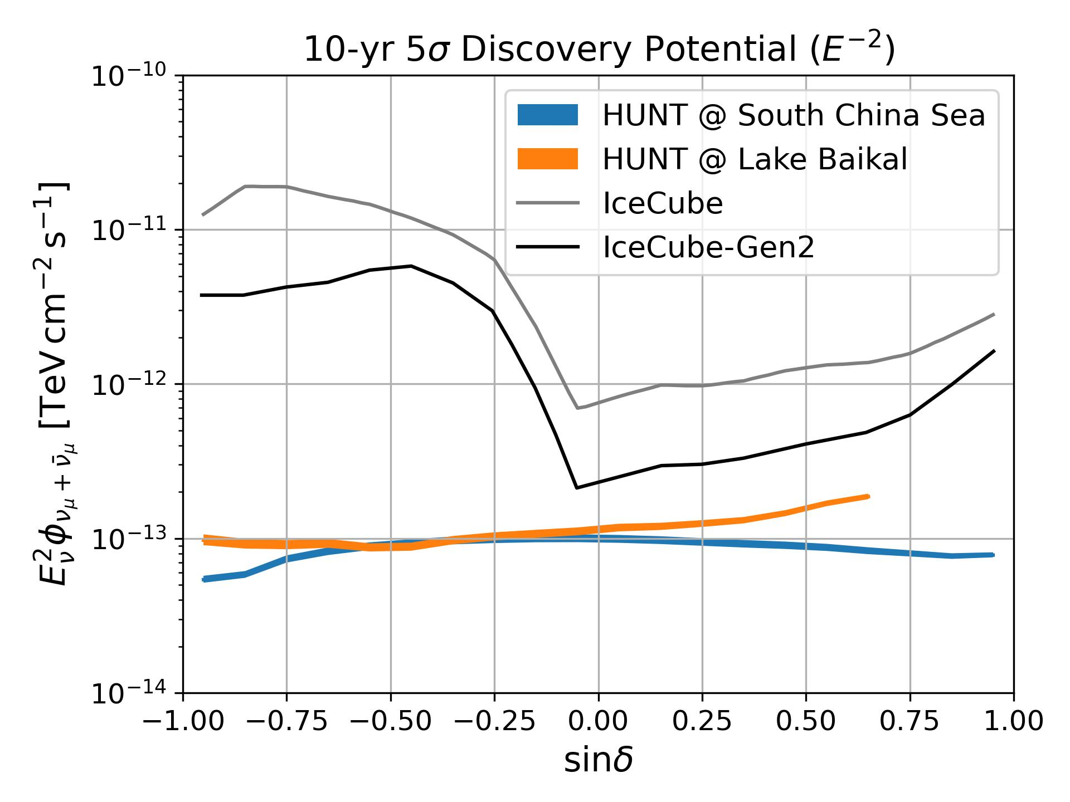
Discovery Potential
Background
Atmospheric neutrinos (MCEq)
Diffuse astrophysical neutrinos (dN/dE ~ E^{-2.37})
Binned Likelihood
$L=\prod{e^{−n_{s}S_{i}−n_{b}B_{i}}{(n_{s}S_{i}+n_{b}B_{i})}^{n_{i}}/n_{i}!}$
Spatial bin size ~${0.1}^{°}×{0.1}^{°}$ (HEALPix Nside = 512)
Energy bin size $∆\text{log}E_{rec}$=0.4
the energy resolution is assumed to be $∆\text{log}E_{rec}$=0.3
We approximate the median significance by replacing the data with the expectation values.
PRELIMINARY

Slide 22
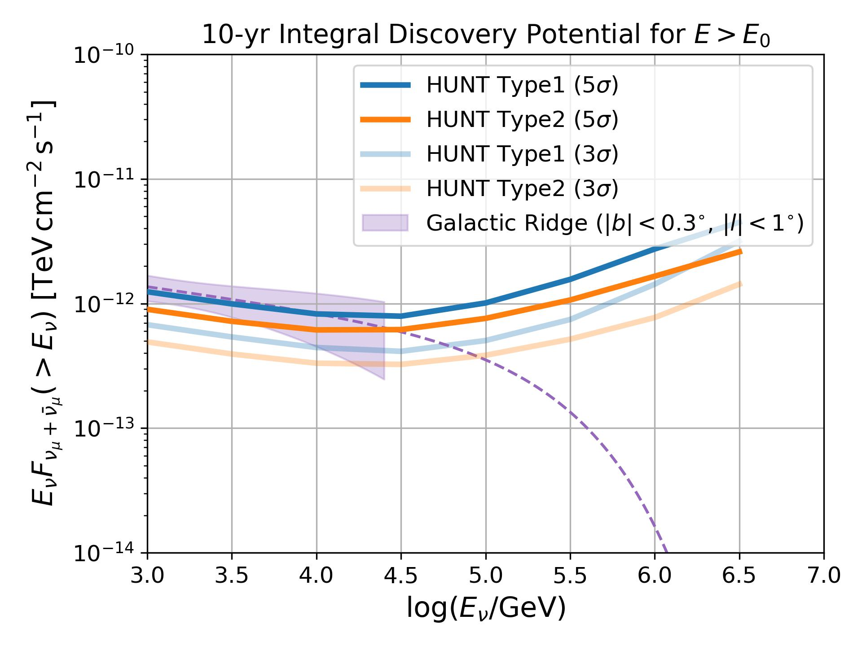
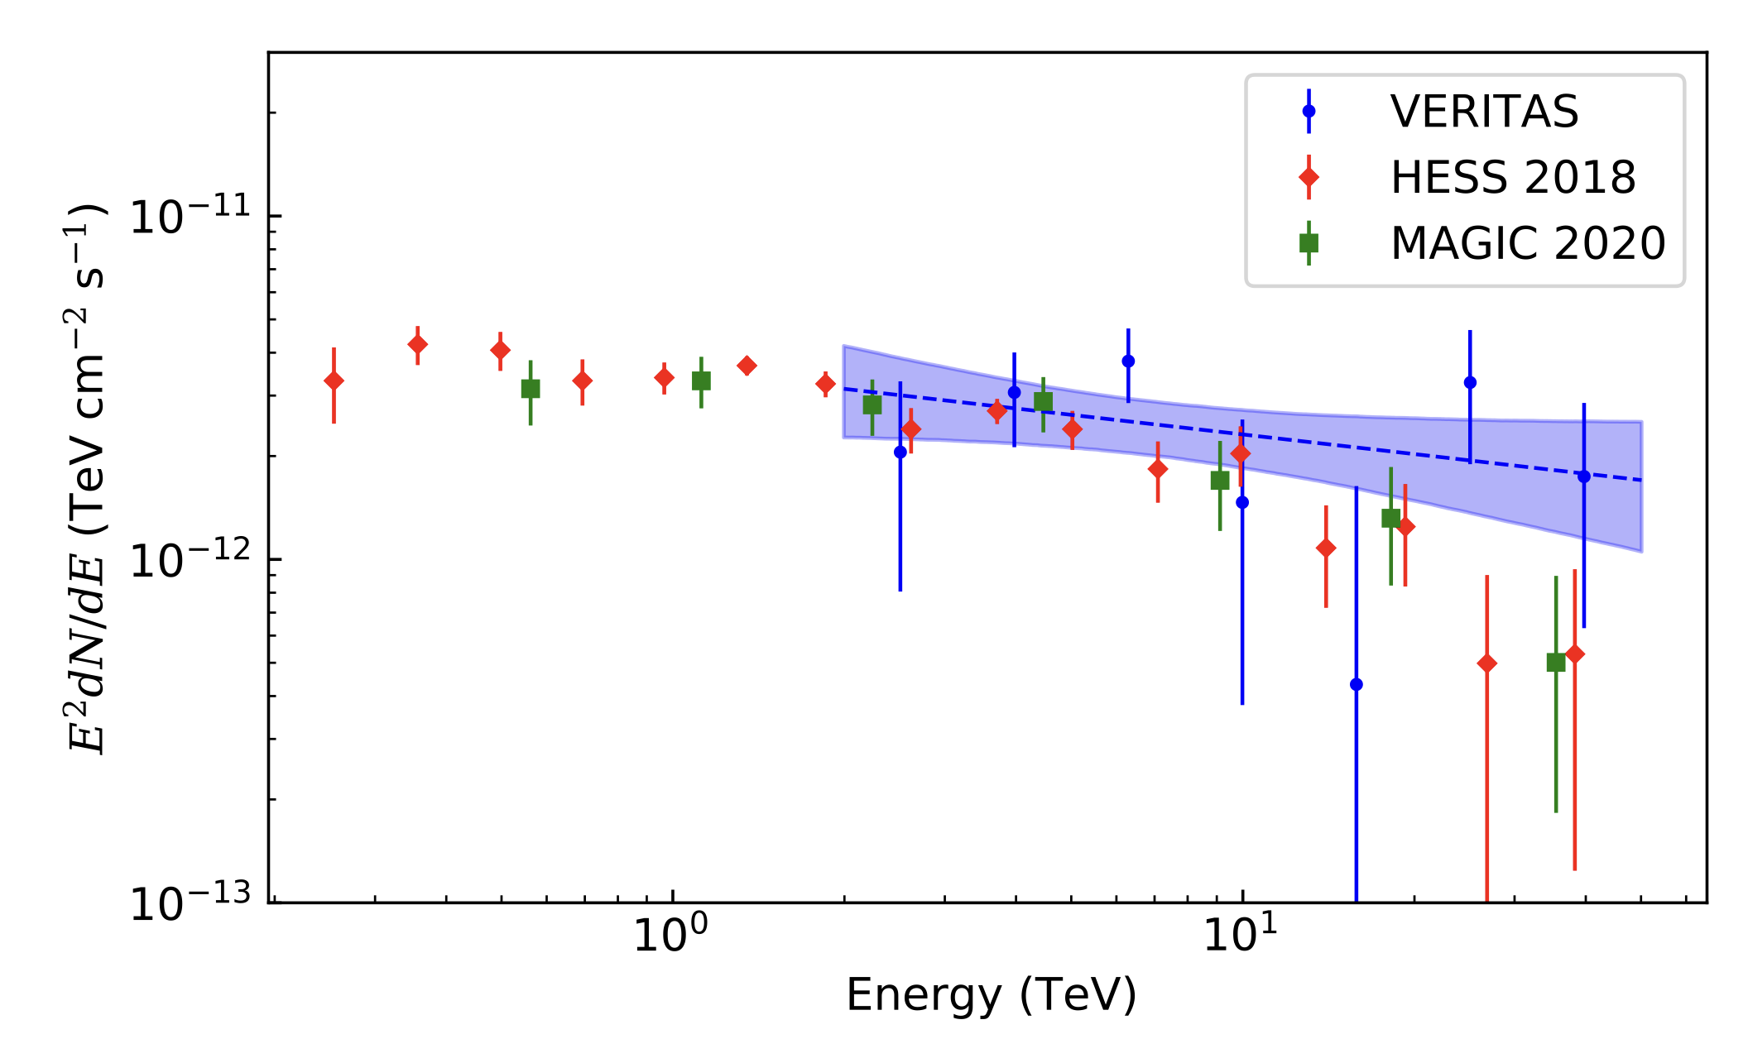
Discovery Potential | Galactic Ridge
Diffuse gamma-rays from Galactic ridge
E_{cut}=500 TeV
PRELIMINARY

Slide 23
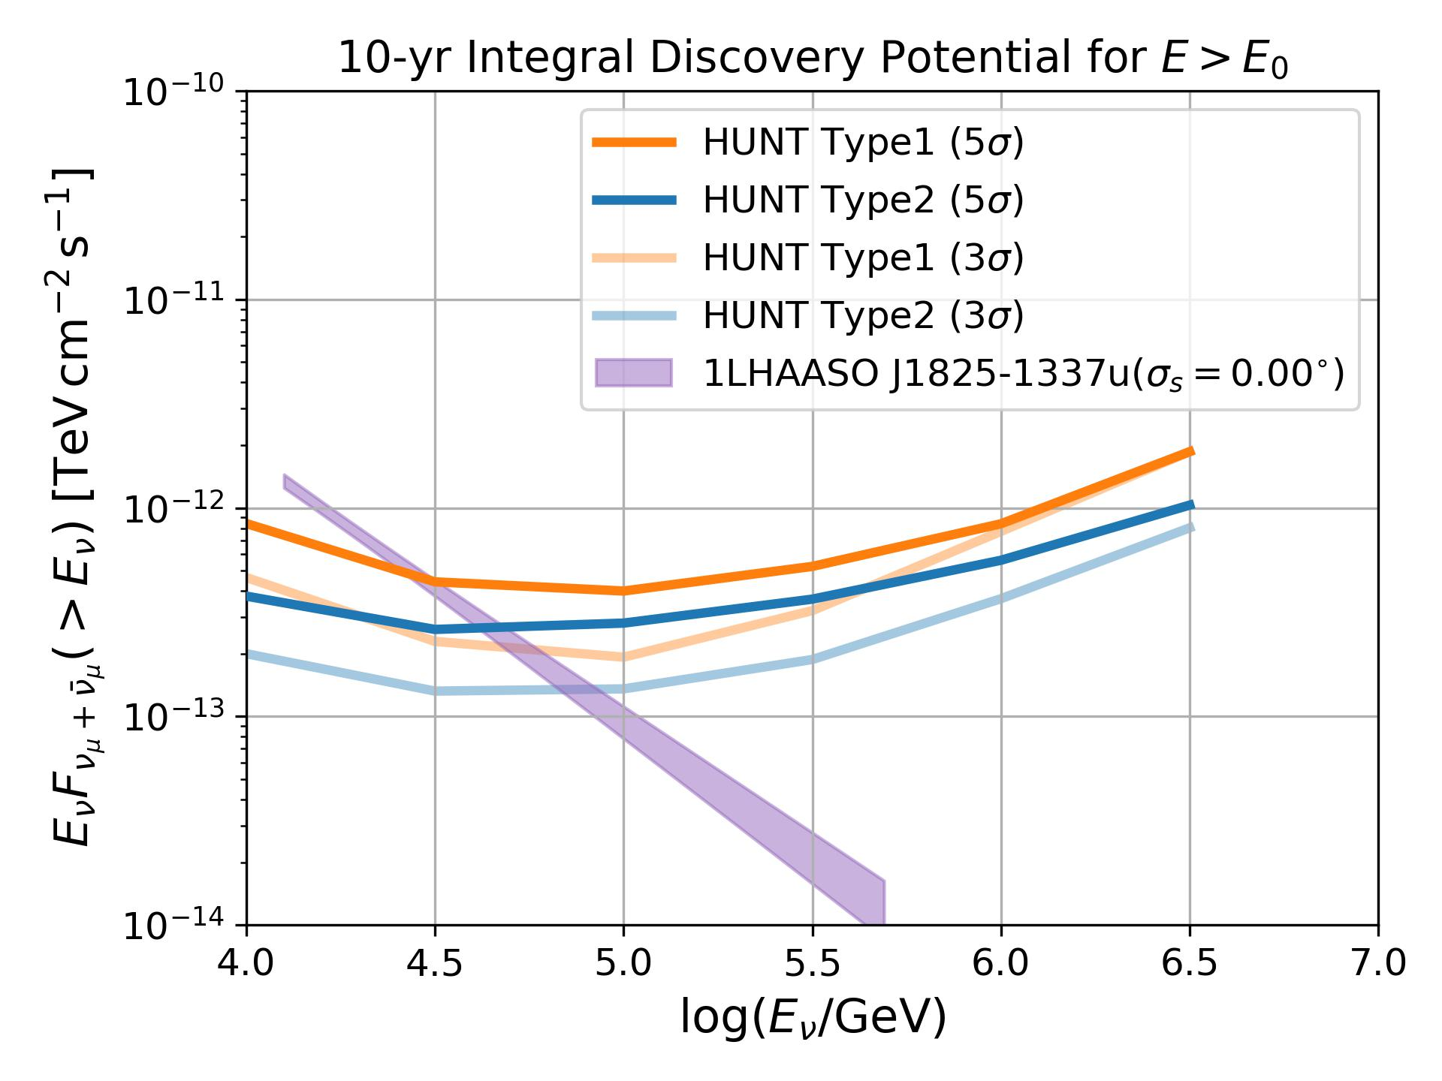
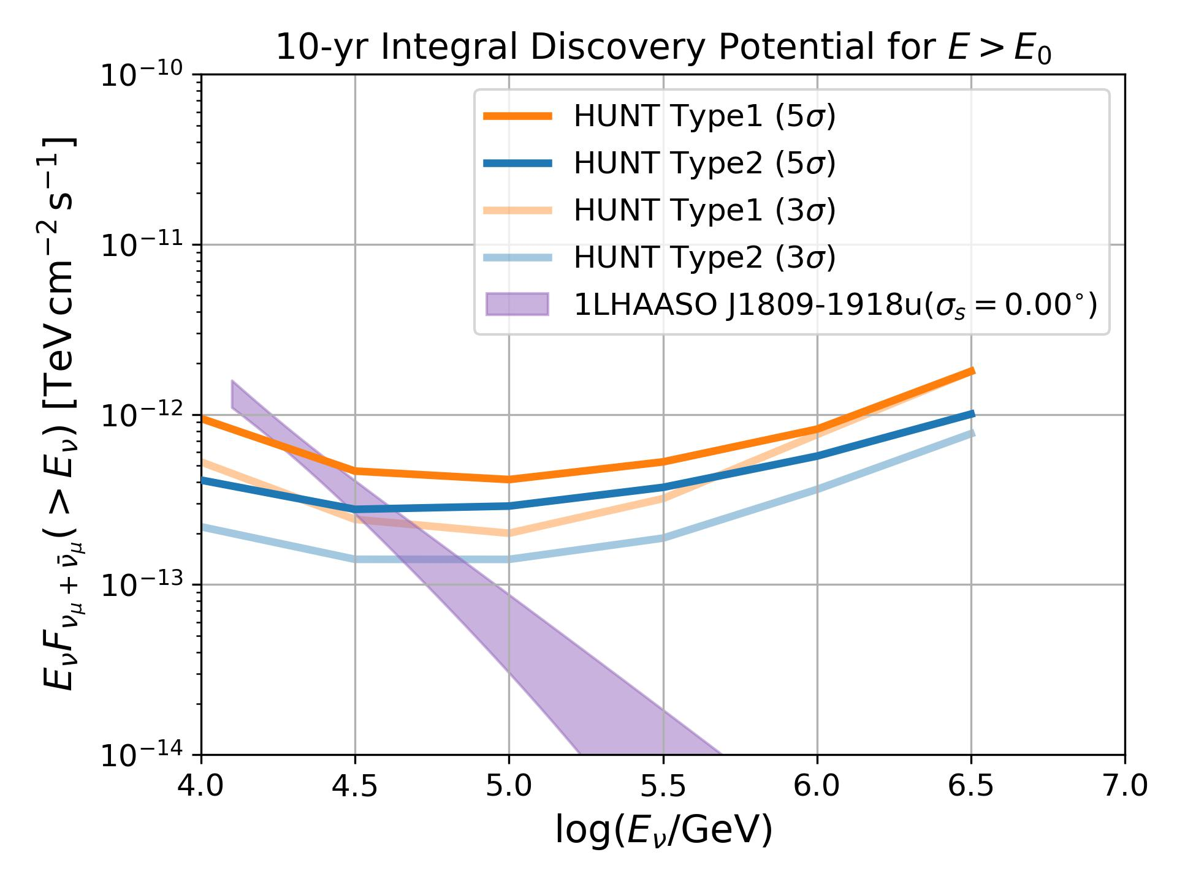
Discovery Potential | LHAASO PeVatrons
1LHAASO 1825-1337u
1LHAASO J1809-1918u
PRELIMINARY
PRELIMINARY

Slide 24
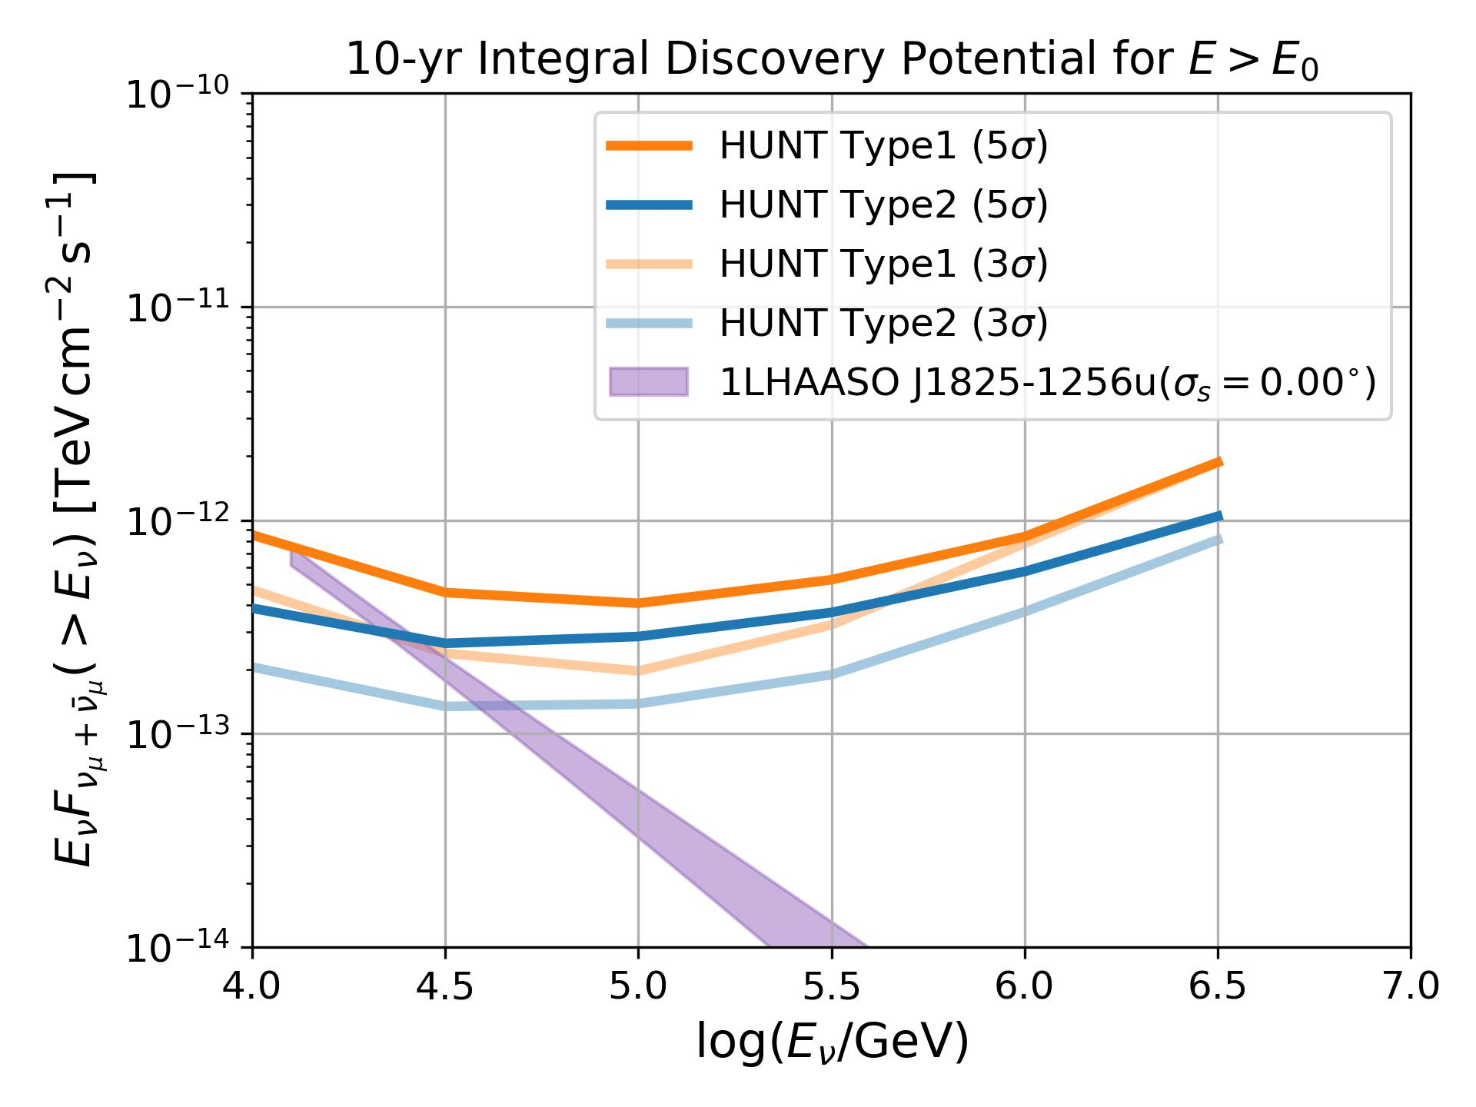
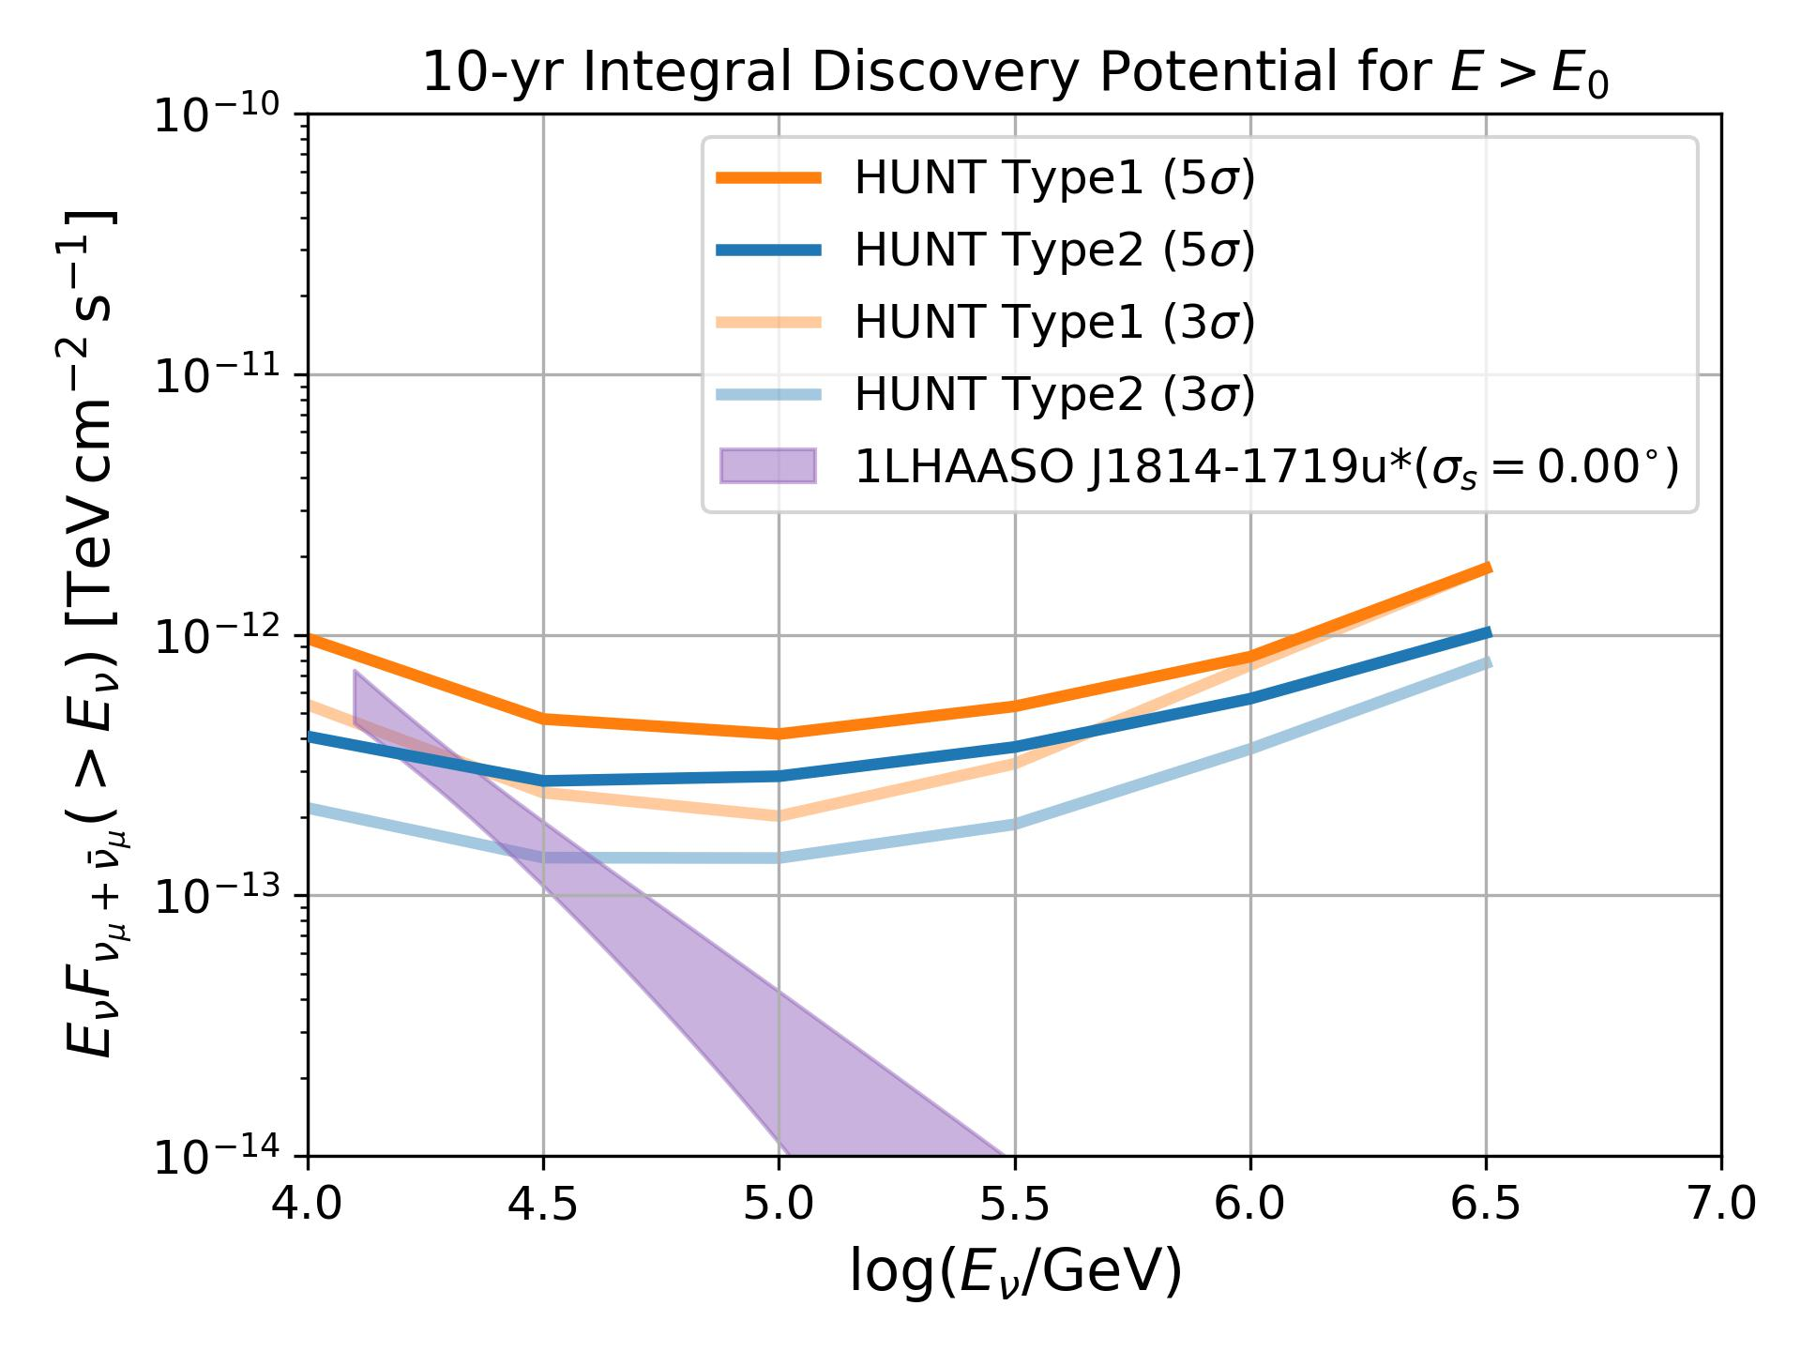
Discovery Potential | LHAASO PeVatrons
1LHAASO 1825-1256u
1LHAASO J1814-1719u*
PRELIMINARY
PRELIMINARY

Slide 25
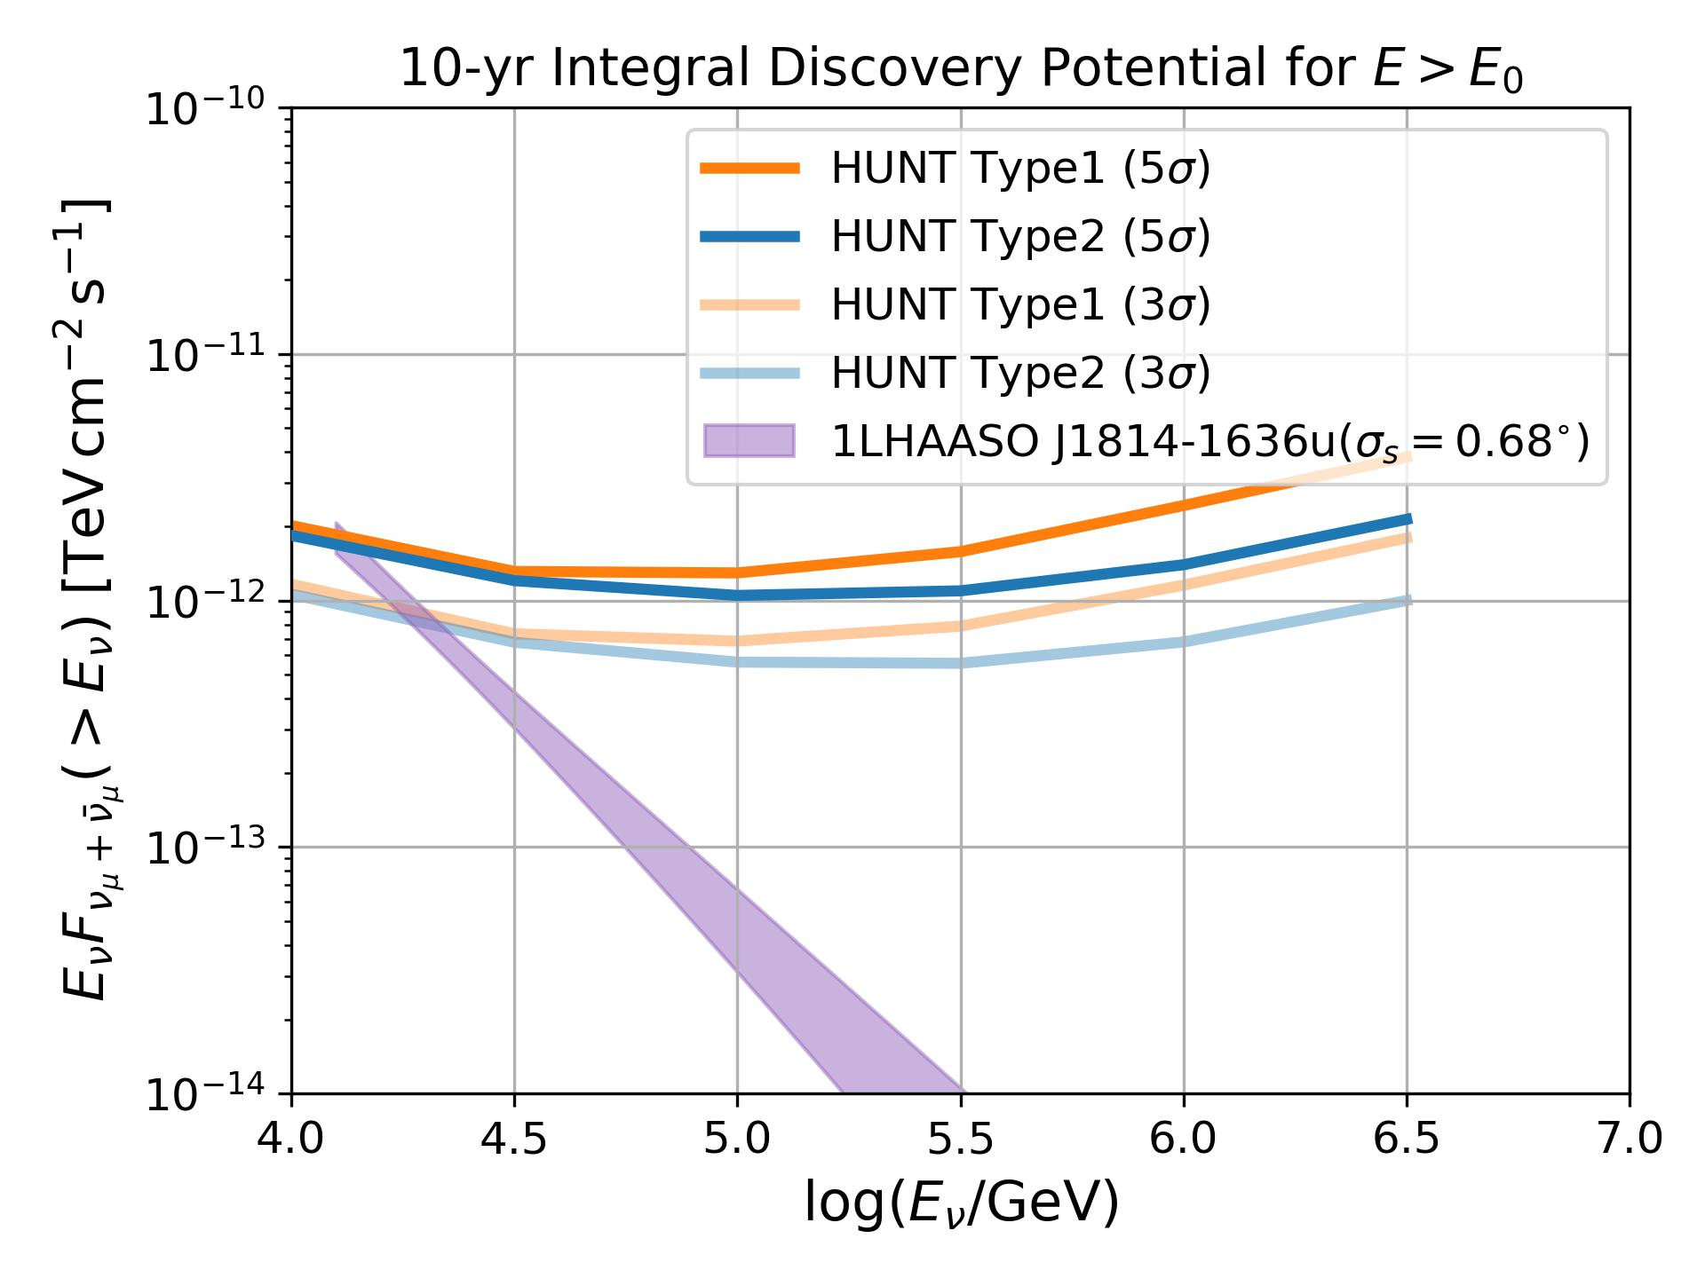
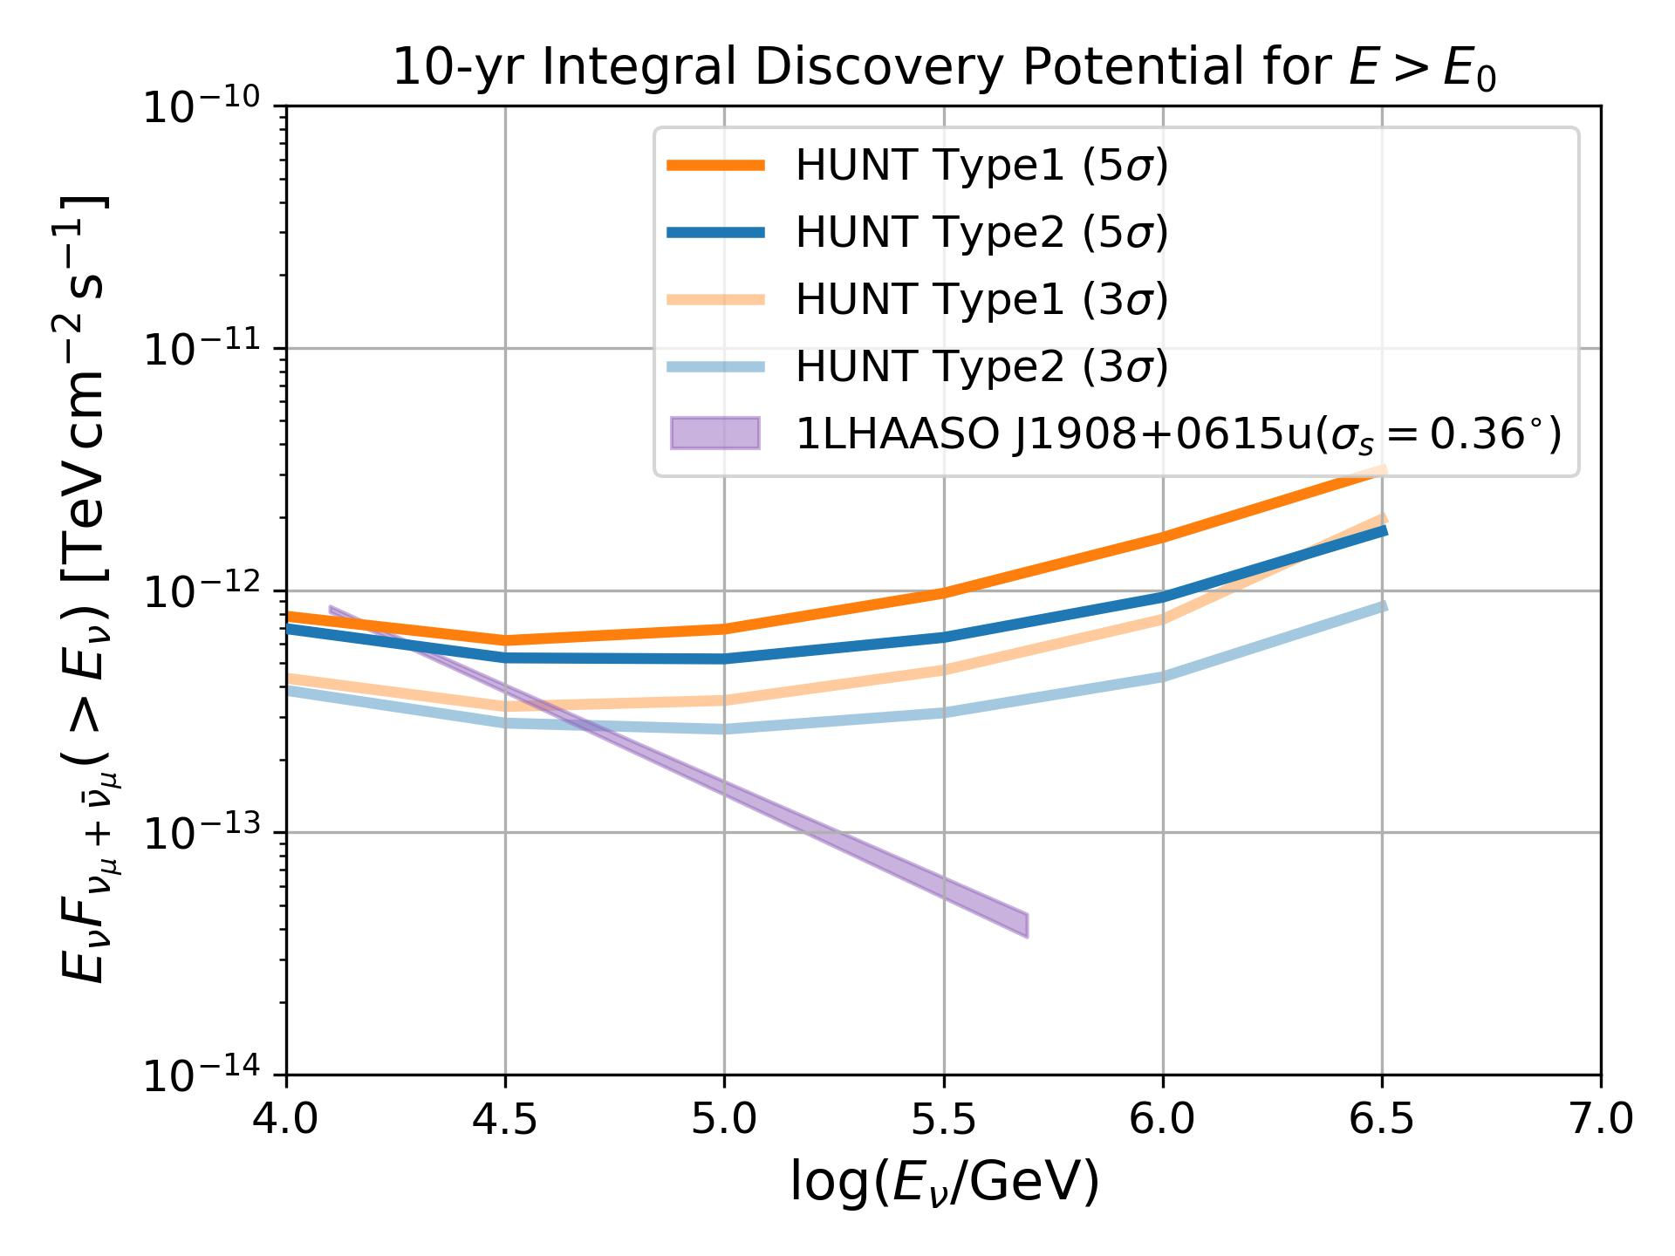
Discovery Potential | LHAASO PeVatrons
1LHAASO J1814-1636u
1LHAASO J1908+0615u
PRELIMINARY
PRELIMINARY

Slide 26
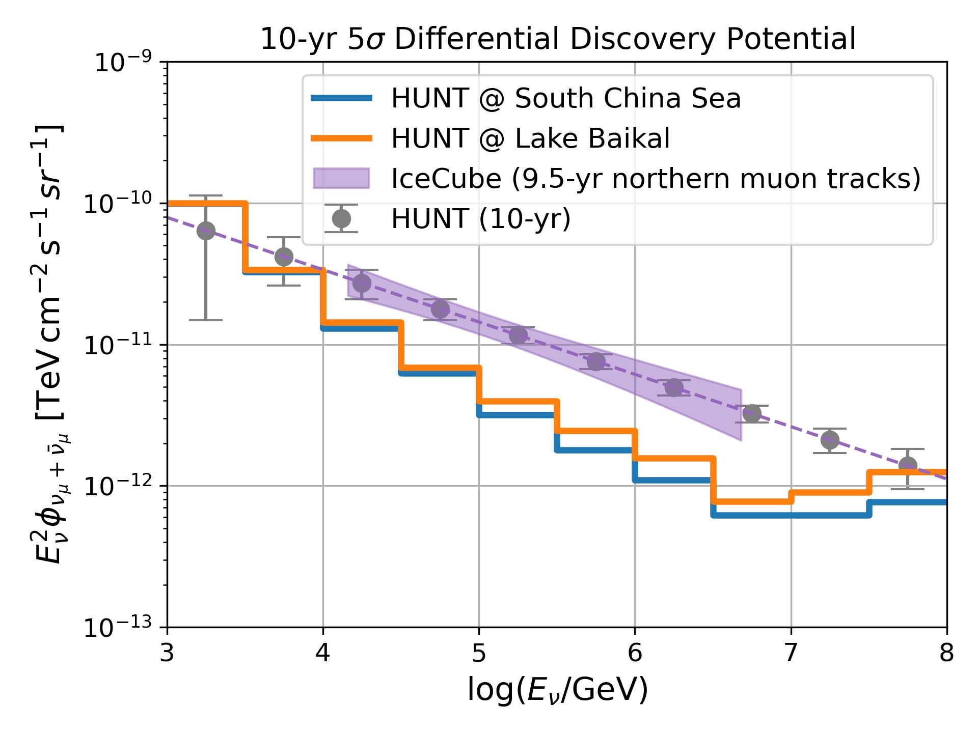
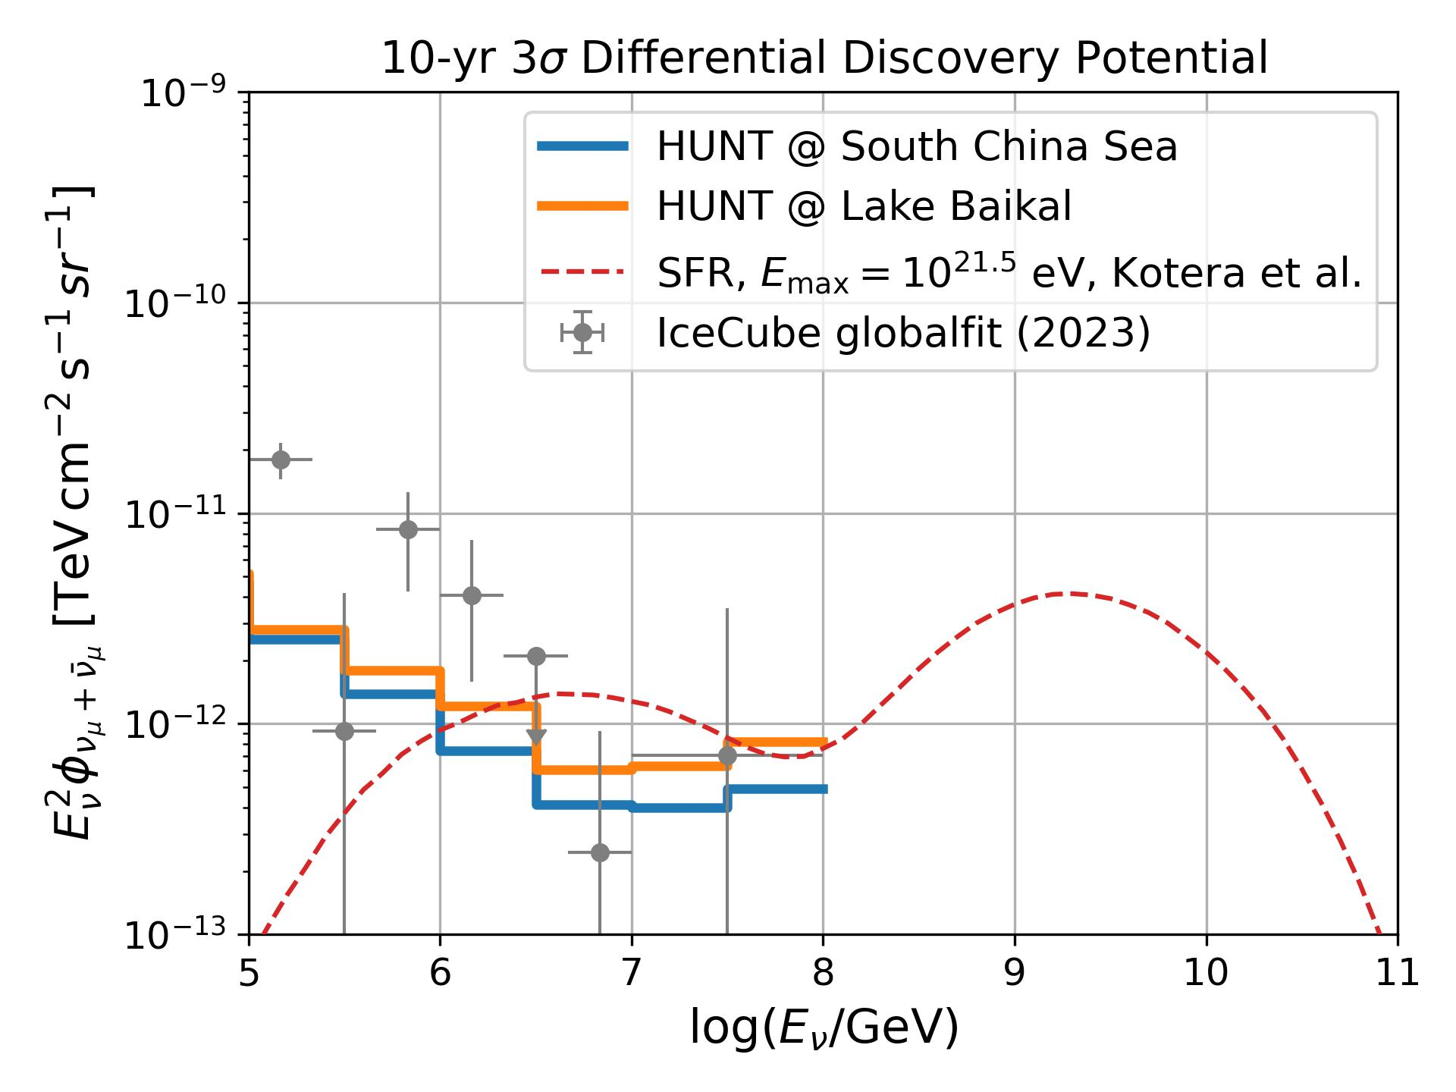
Discovery Potential | Diffuse neutrinos
PRELIMINARY
PRELIMINARY

