Slide 1
Long-term observation of UHE emission from Crab Nebula with LHAASO
Songzhan Chen, Junyang Zhang, Shaoqiang Xi
on behalf of the LHAASO collaboration
Institute of High Energy Physics(IHEP),CAS
The 2nd LHAASO symposium@Hong Kong (March 22, 2025)

Slide 2
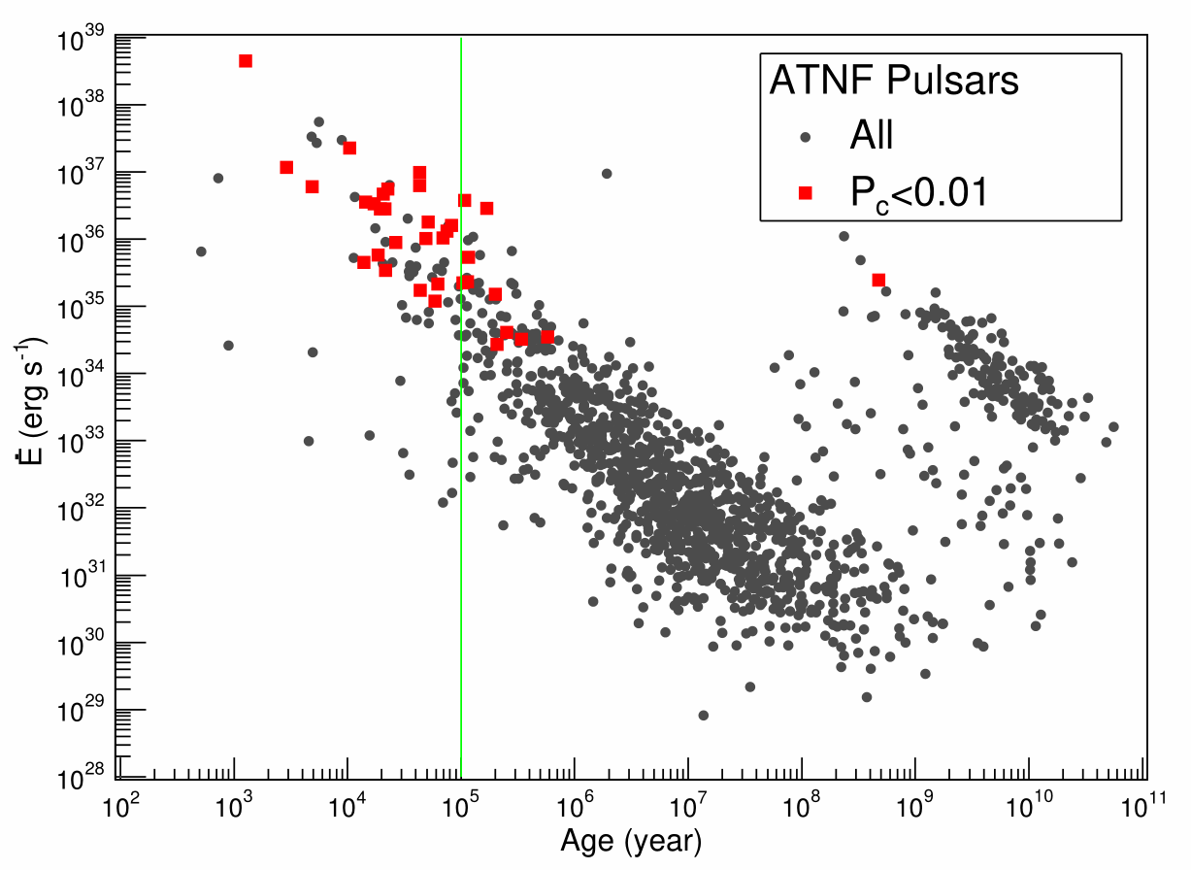
PWNs are dominate sources at VHE and UHE
35 1st LHAASO sources associate with pulsars.
22 out of 35 sources with UHE emission.
LHAASO coll. 2024

Slide 3
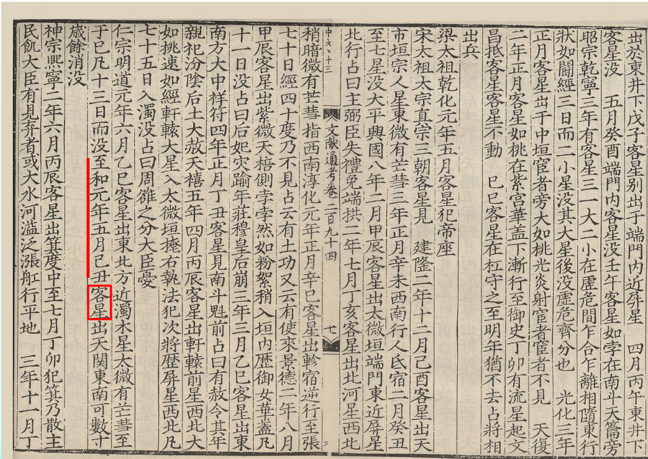
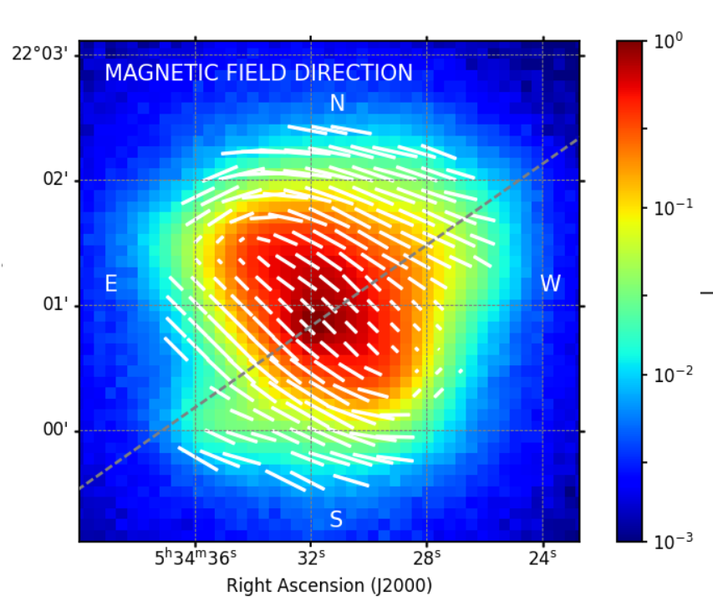
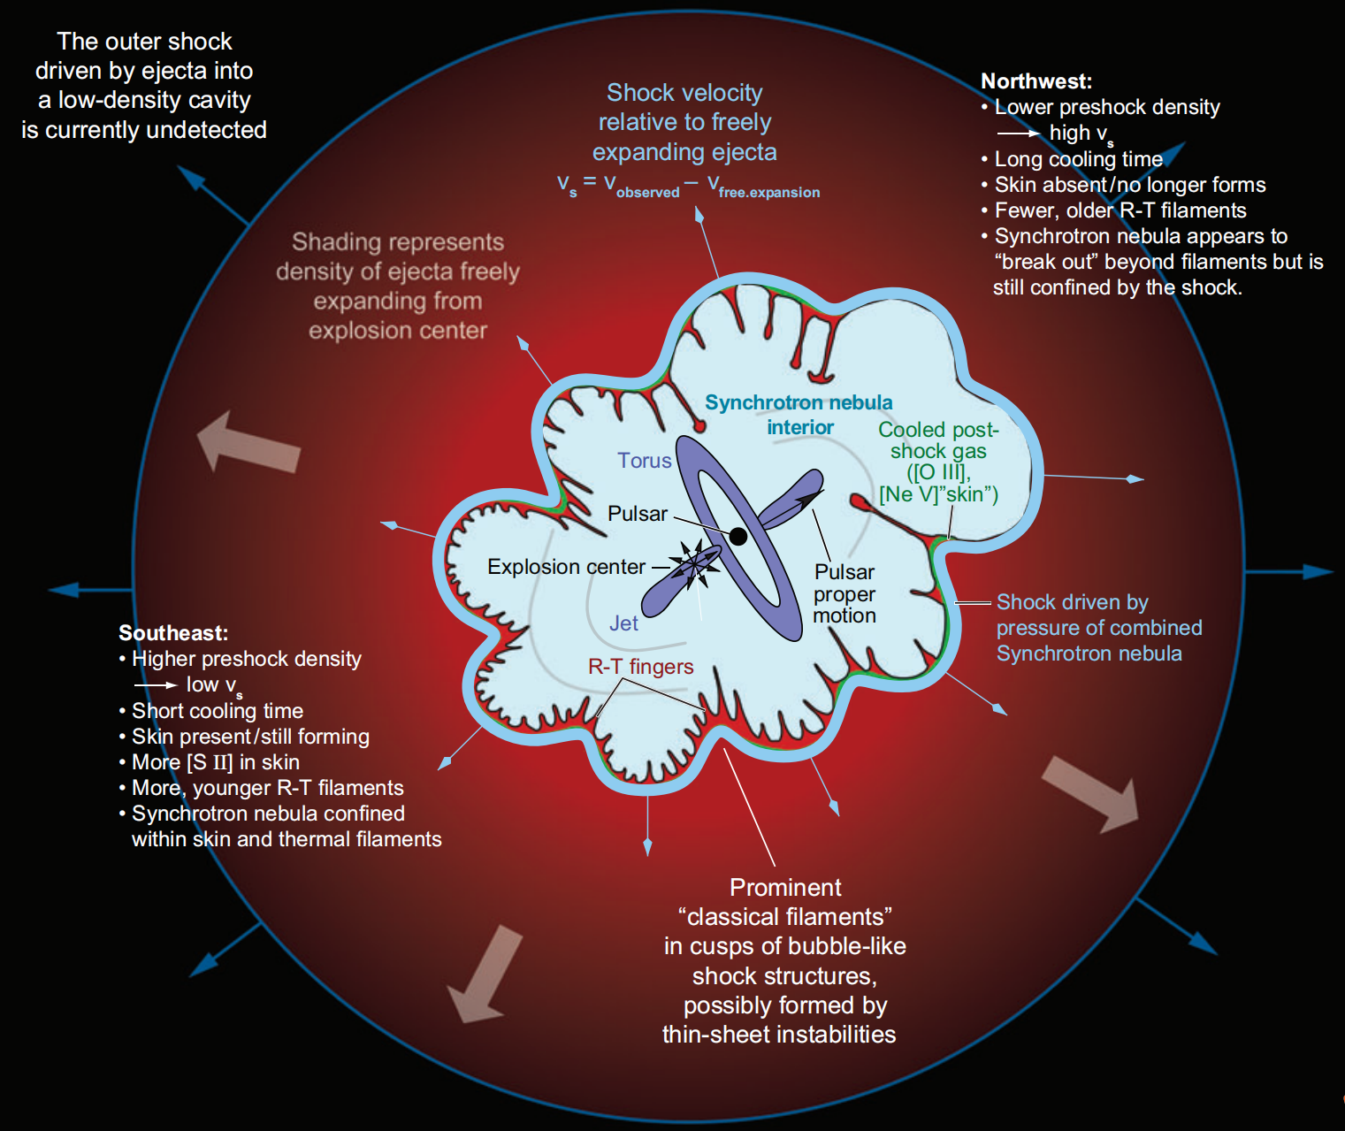
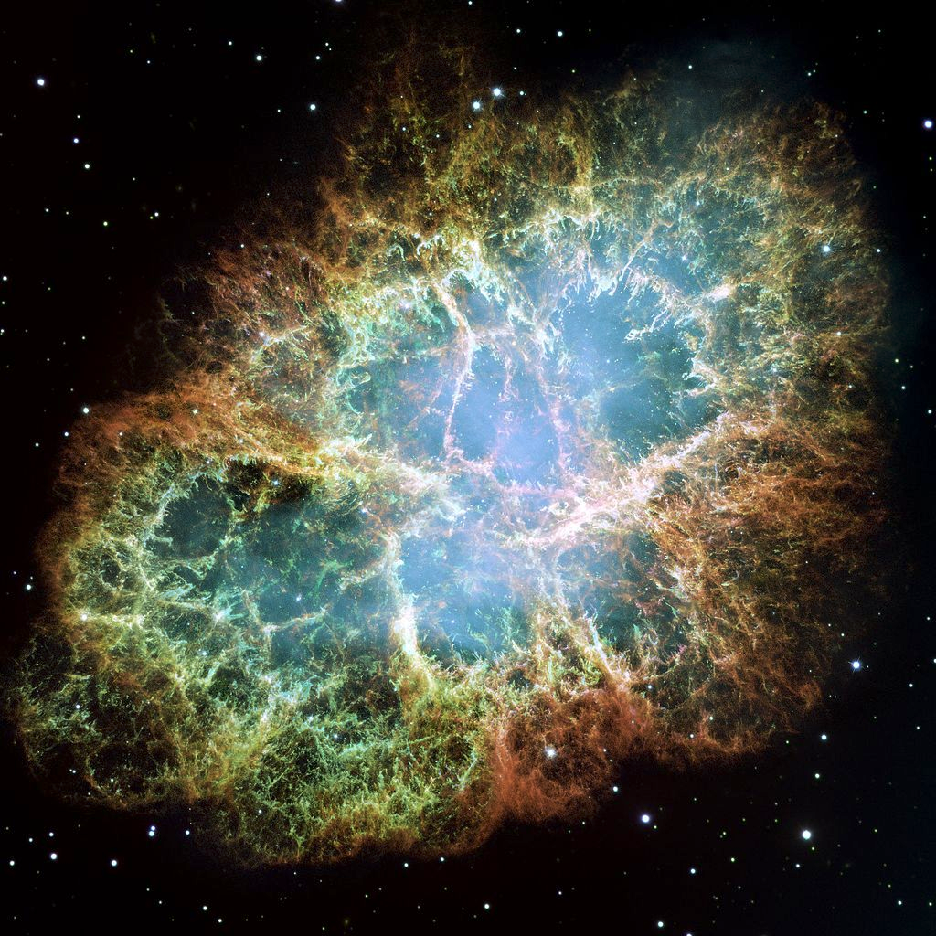
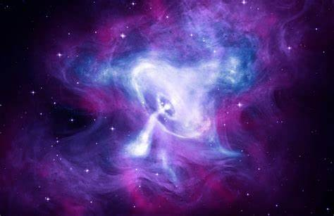
Crab Nebula: a unique case to explore PWN
The age and structure of Crab nebula is well measured.
SN@July,4th,1054
IXPE coll. 2022
Hester 2008

Slide 4
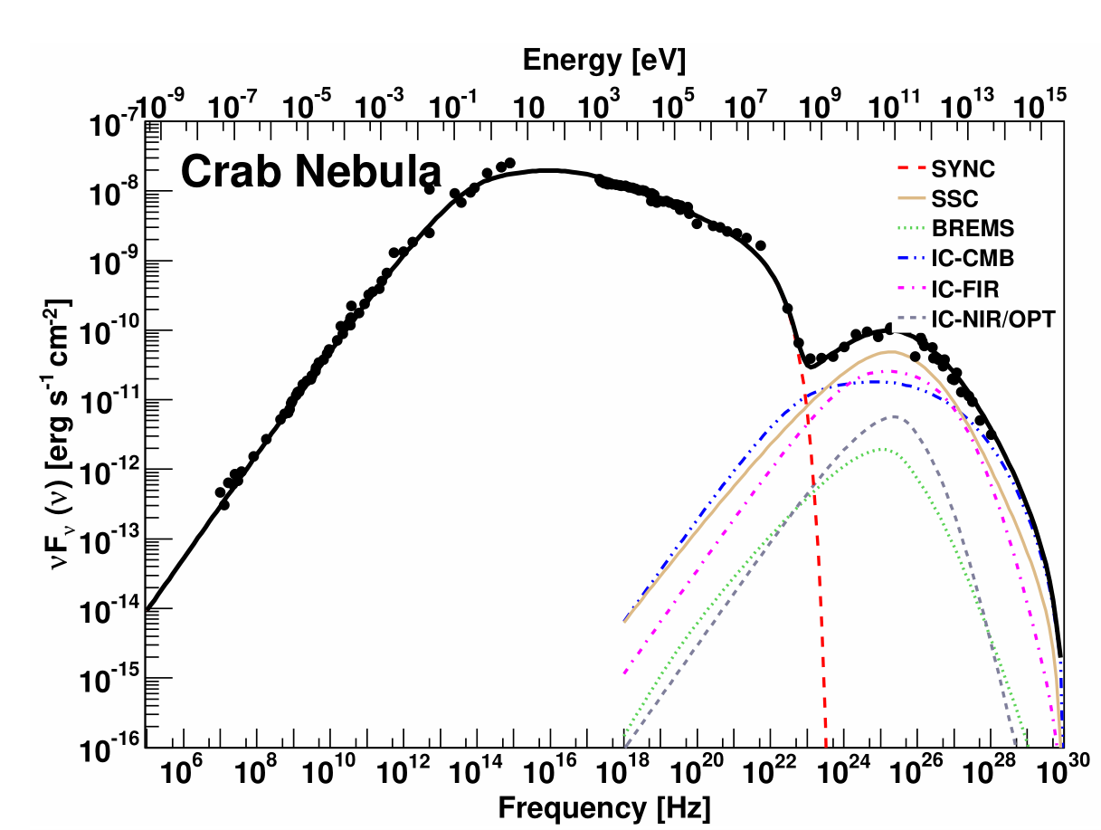
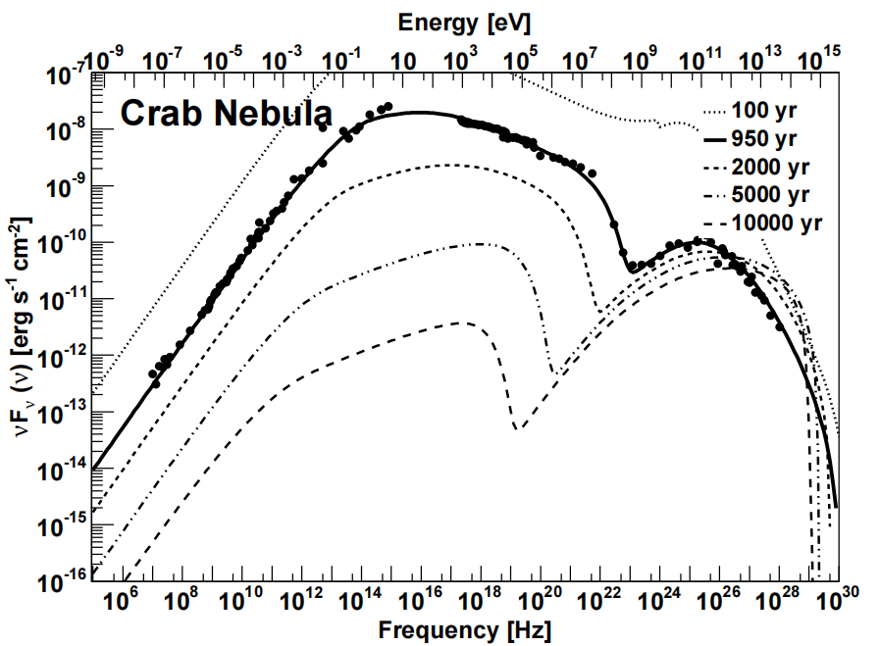
The Standard paradigm of PWN
Relativistic wind (e±) from central pulsar.
e± accelerated at terminal shock.
Torres et al. 2014

Slide 5
Surprise discoveries from Crab
1989
VHE emission
Whipple
2011
GeV flare
AGILE & Fermi
2021
1 PeV emission
LHAASO
2008
>25 GeV Pulsar
MAGIC
2011
>100 GeV Pulsar
VERITAS
2016
>1 TeV Pulsar
MAGIC
Unexpected results always come from what we think we know!

Slide 6
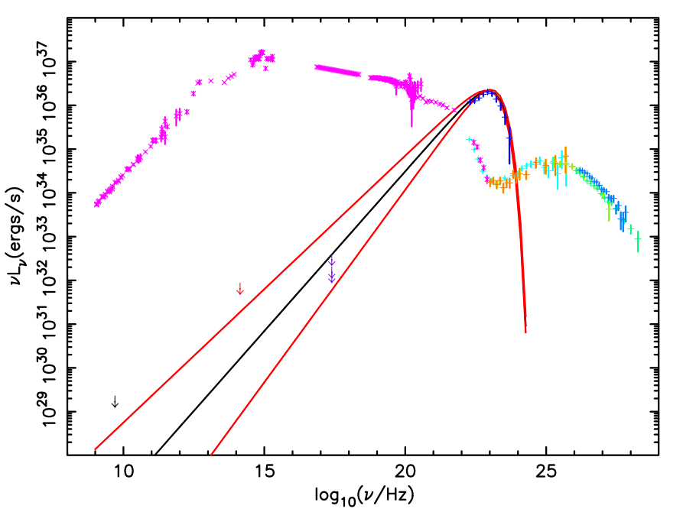
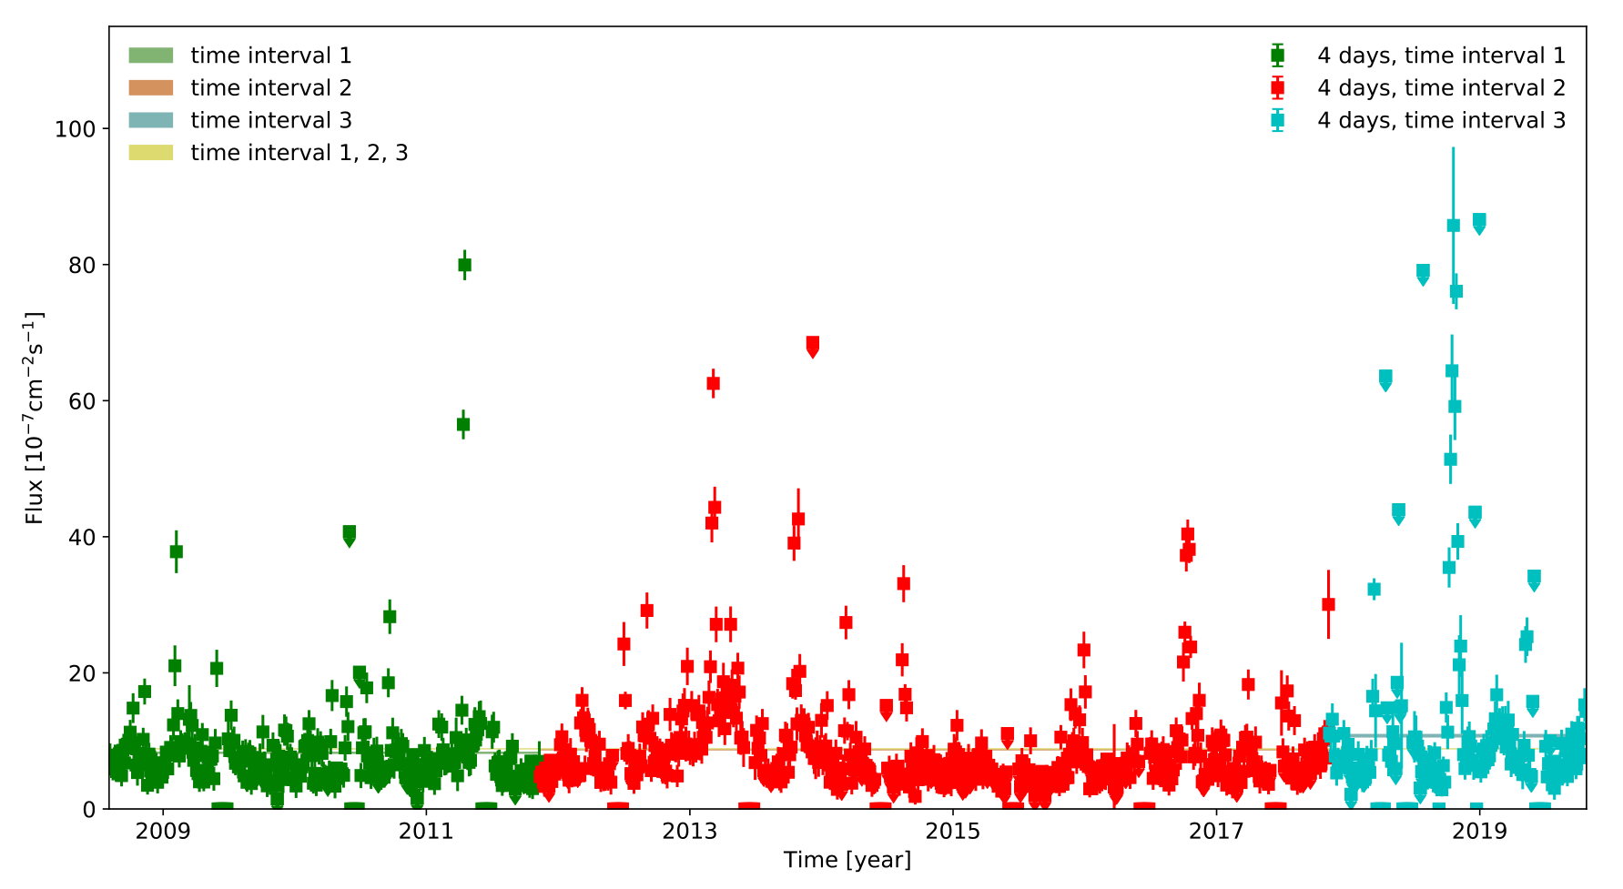
Crab flares
Flare rate: once per 1.5 years
Flux enhance factor：up to 30
Timescale：day to month
2011 April flare
Huang et al. 2021
Weisskopf et al. 2013

Slide 7
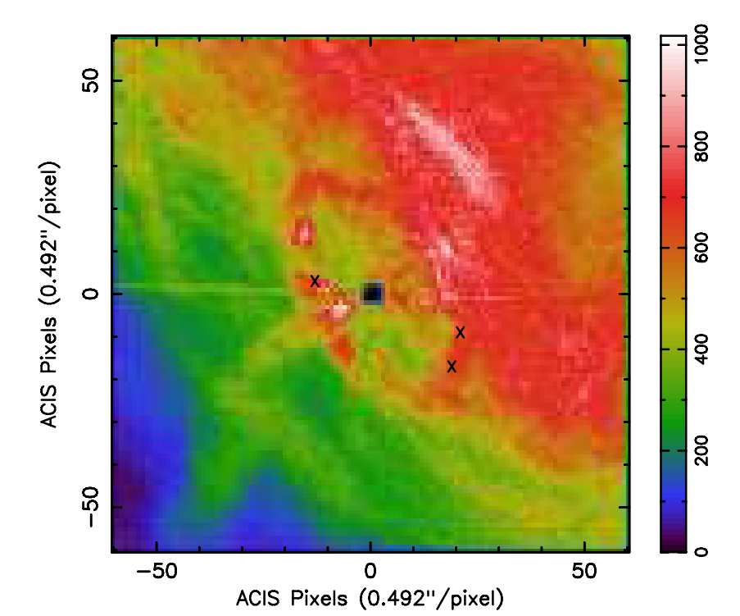
Questions about flares
Where does the flare emission come from?
  Inner knot region? No direct evidence
What produces the ﬂux variations?
  Turbulence?
  High energy fluctuation?
How were the emitting particles accelerated?
  Magnetic reconnection?
  Terminal shock?
Chandra X-Ray
Weisskopf et al 2013
More multiwavelength observations are needed!

Slide 8

Where is the IC component of the flare
Synchrotron radiation
  E_{syn}~B.E_{e}²
Same region
  B~0.1mG, E_{e} ~1-5PeV, E_{γ}~PeV
Different region
  B~x10, E_{e} ~x0.3, E_{γ}~x0.2
  B~x100, E_{e} ~x0.1, E_{γ}~x0.05
LHAASO coll. 2021
We need to monitor UHE for potential changes!

Slide 9
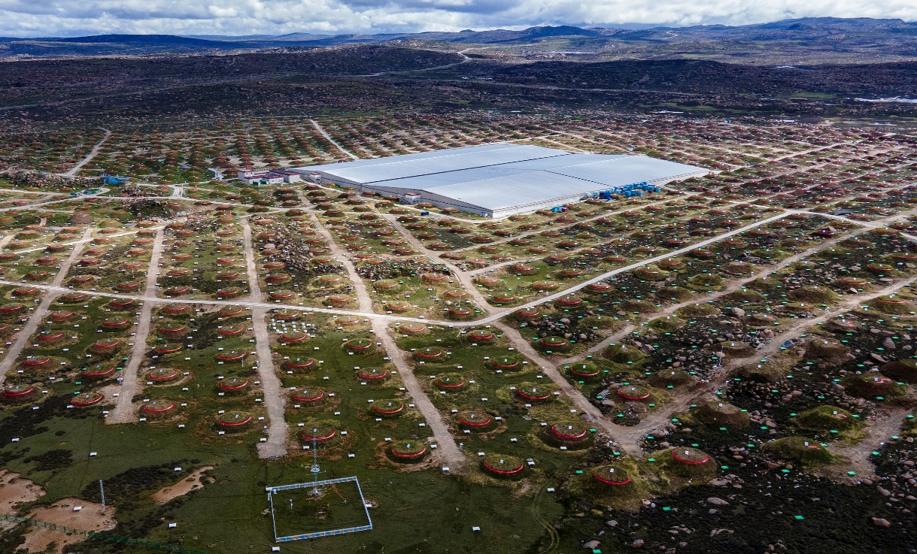
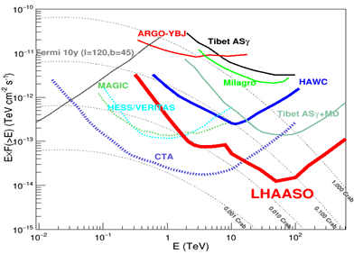
LHAASO detectors
LHAASO @4410 m
78000m² WCDA for 0.1-20 TeV γ-rays
1.3 km² KM2A for 4-10000 TeV γ-rays

Slide 10
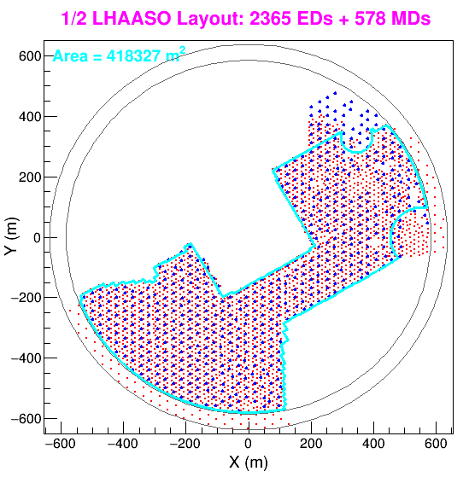
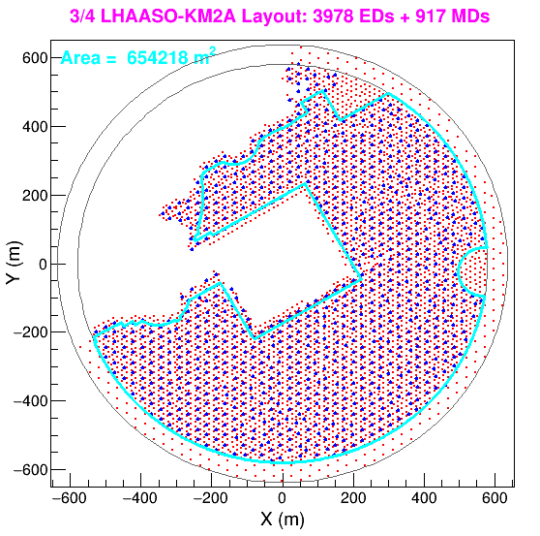
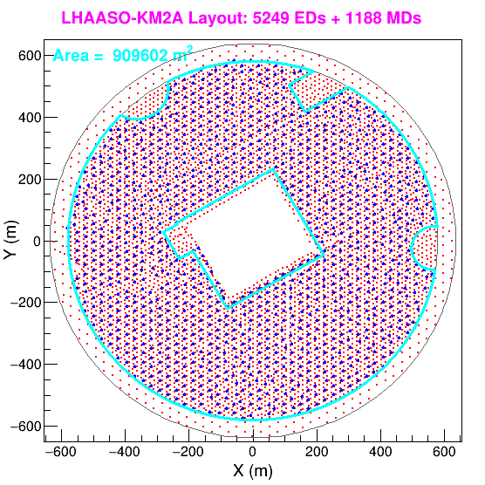
Evolution of the KM2A Array
½ KM2A
¾ KM2A
Full-KM2A
11 months
7.6 months
2019-12-27—2020-11-30
2020-12-01—2021-07-19
2021-07-20—>
Only events with core located inside blue lines region are used.

Slide 11
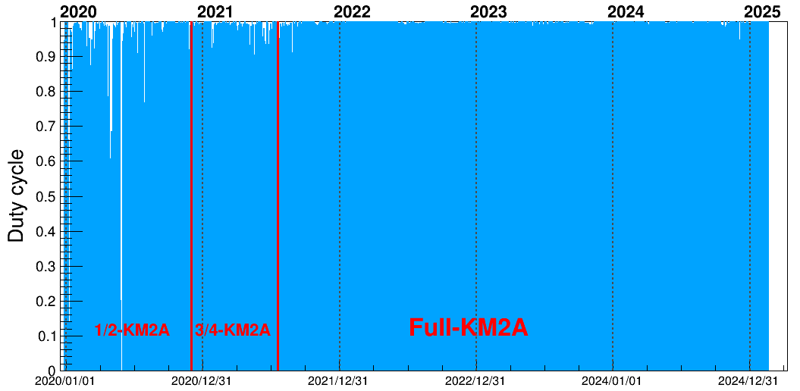
LHAASO-KM2A data
From 2019-12 to 2024-12
Effective data:1700+ days
Crab Nebula observation:13000+ hours

Slide 12
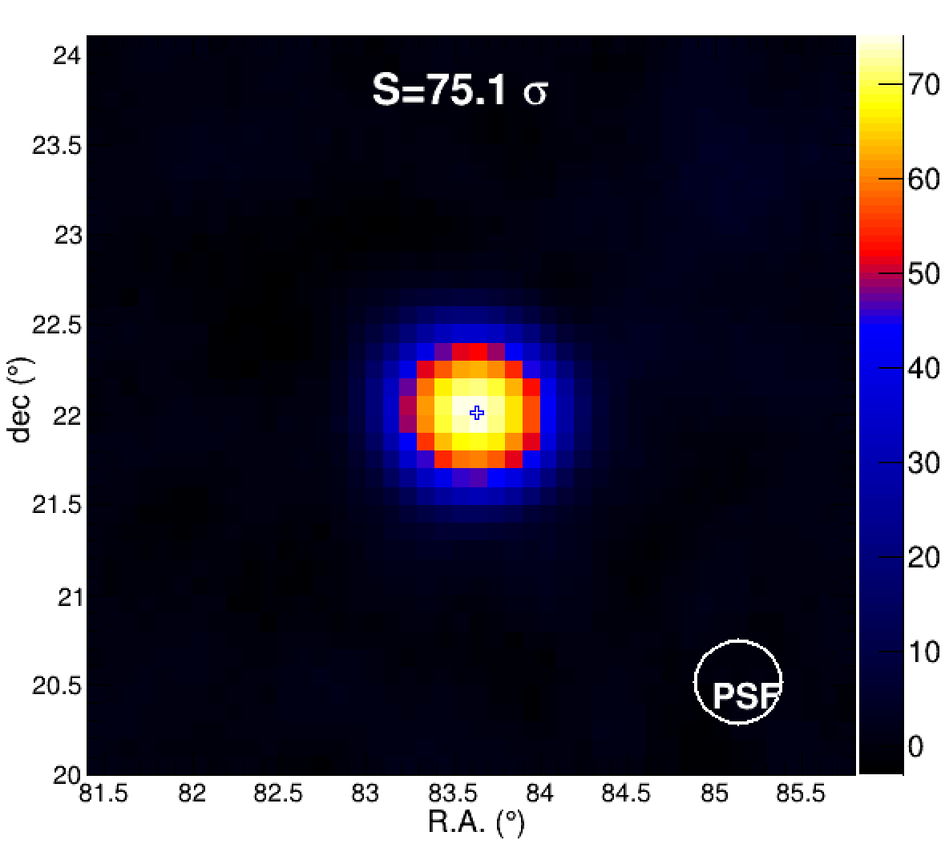
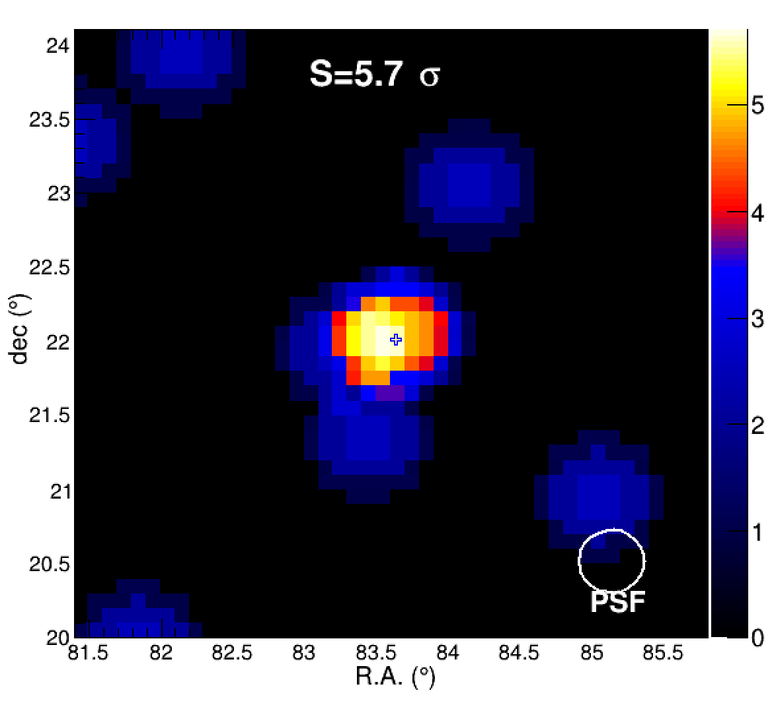
Significance maps around Crab
>1 PeV
4 photons
>100 TeV

Slide 13
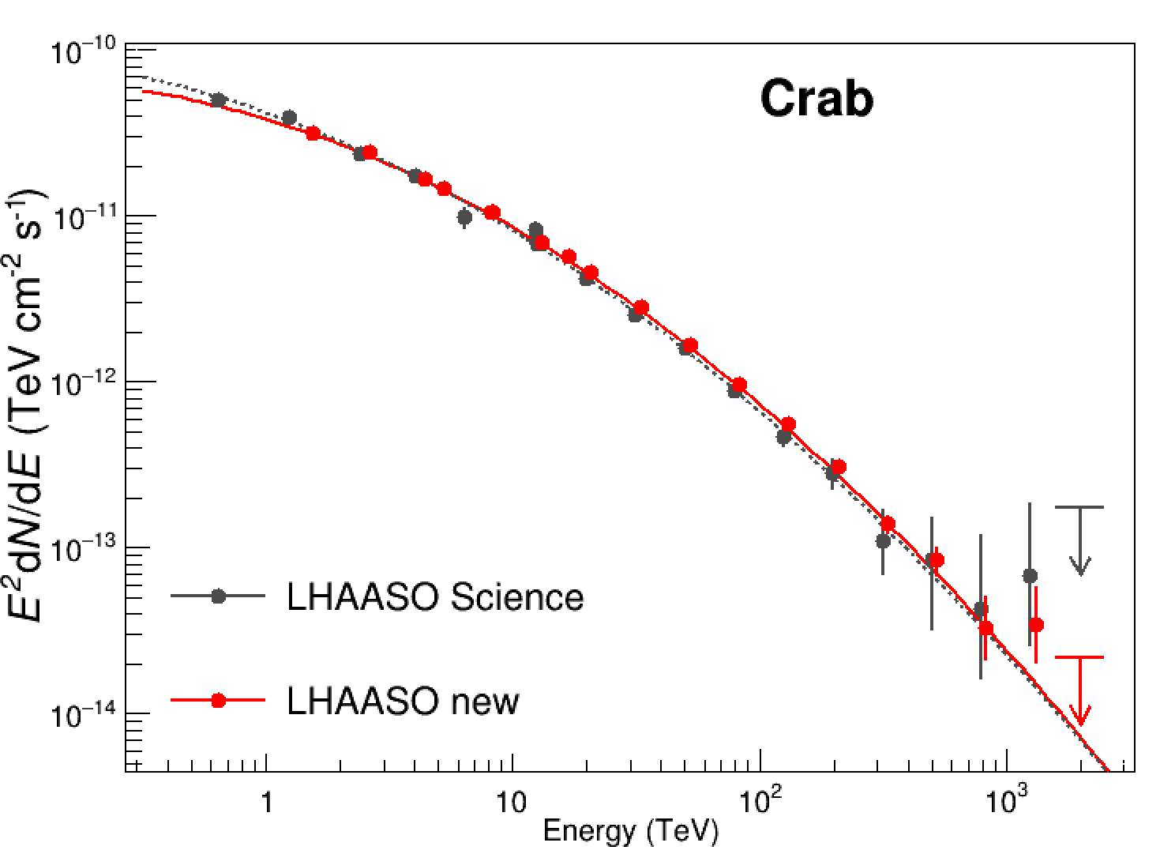
Updated SED
The Data enlarged by 9
The SED is consistent with previous measurement
Following the log-parabola function well
89 UHE
795 UHE

Slide 14
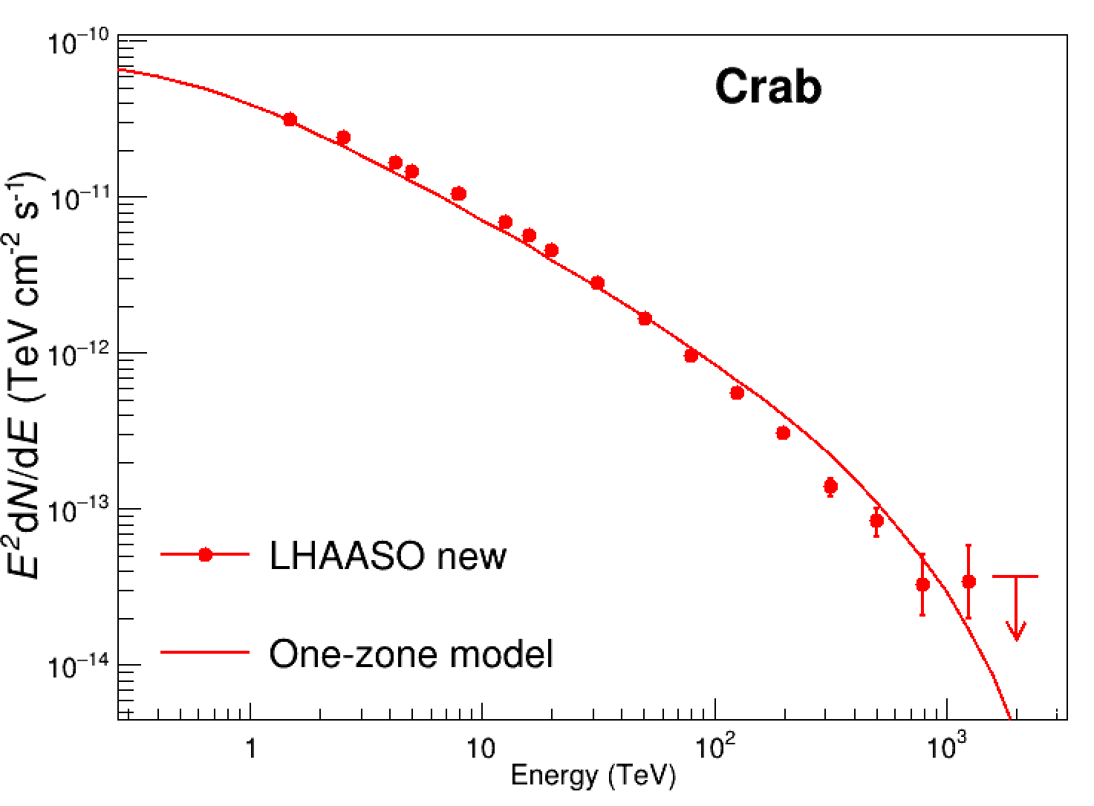
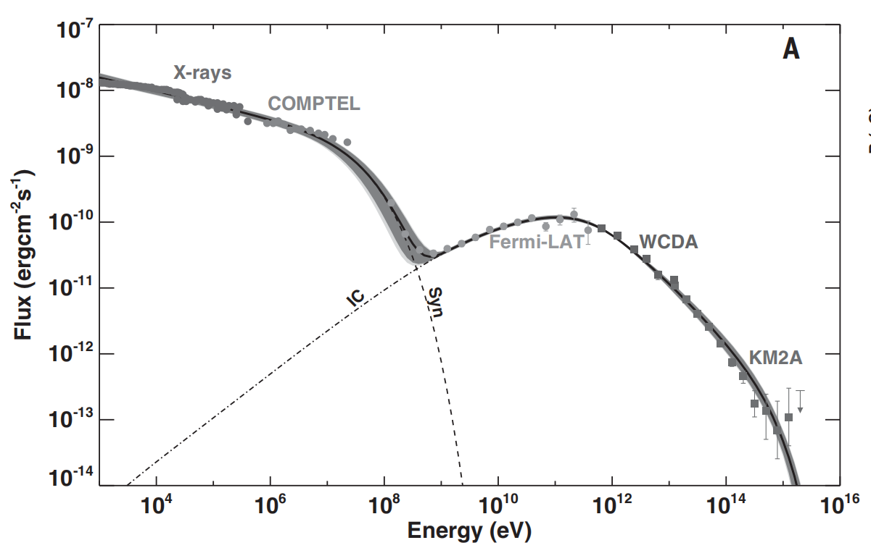
SED vs One zone model
The situation is similar
LHAASO coll. 2021

Slide 15
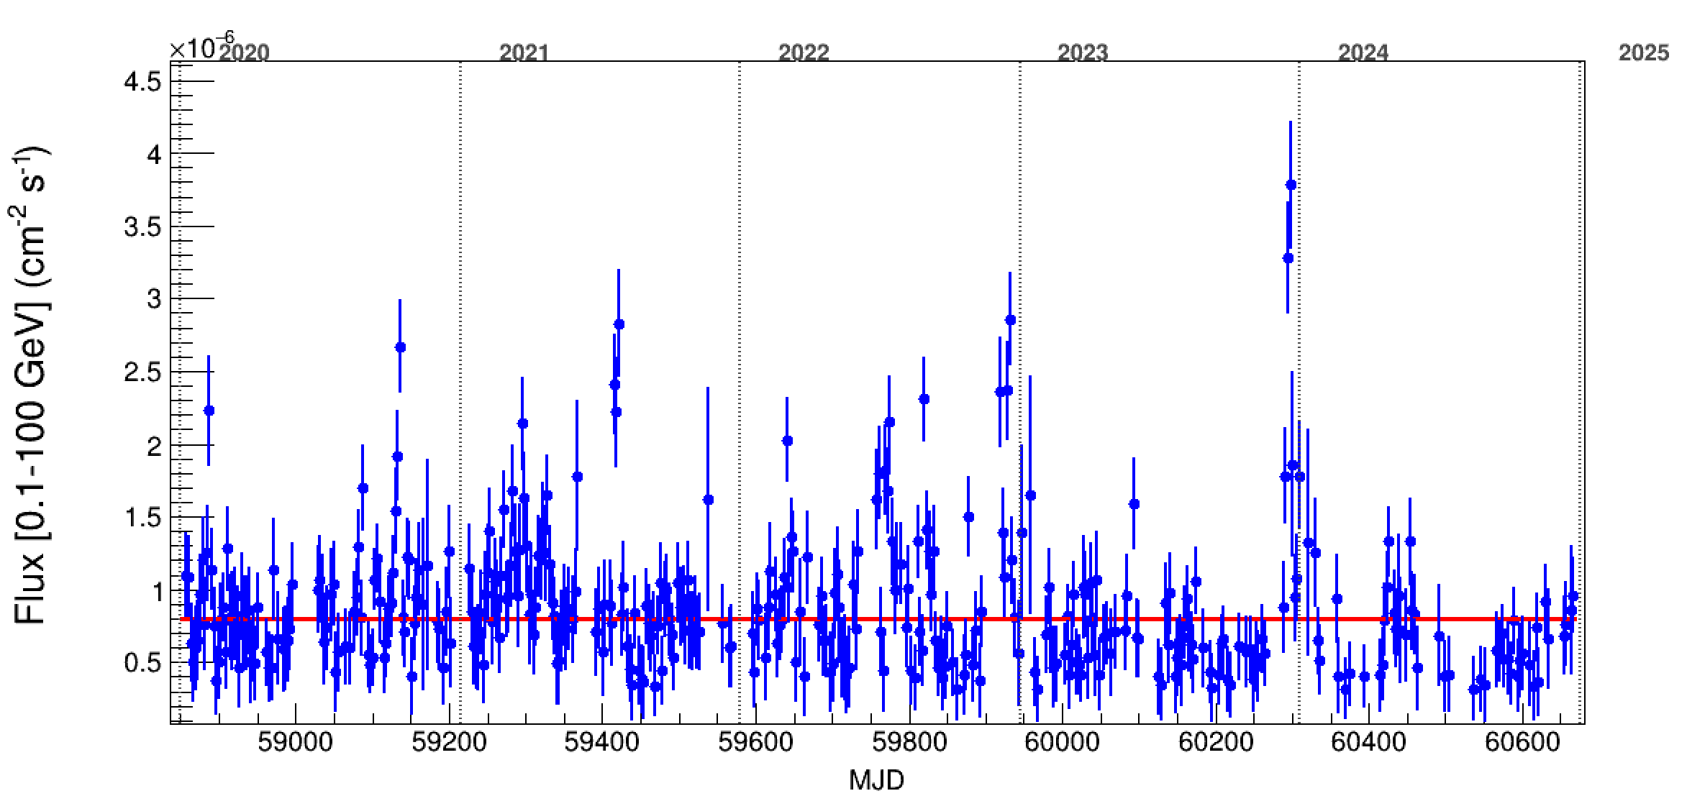
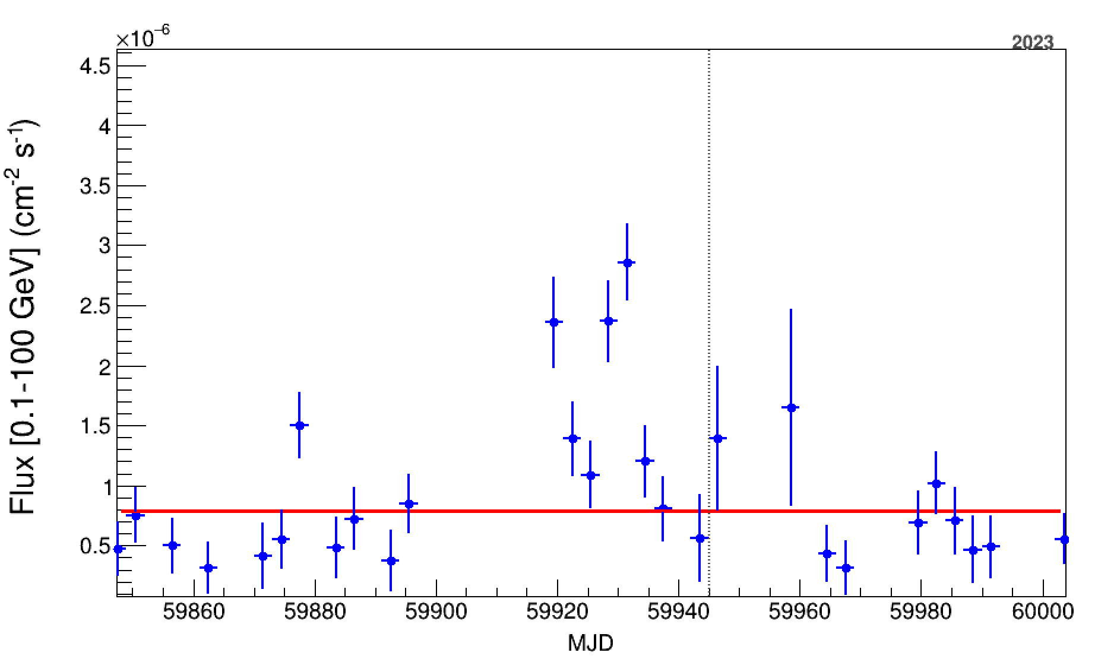
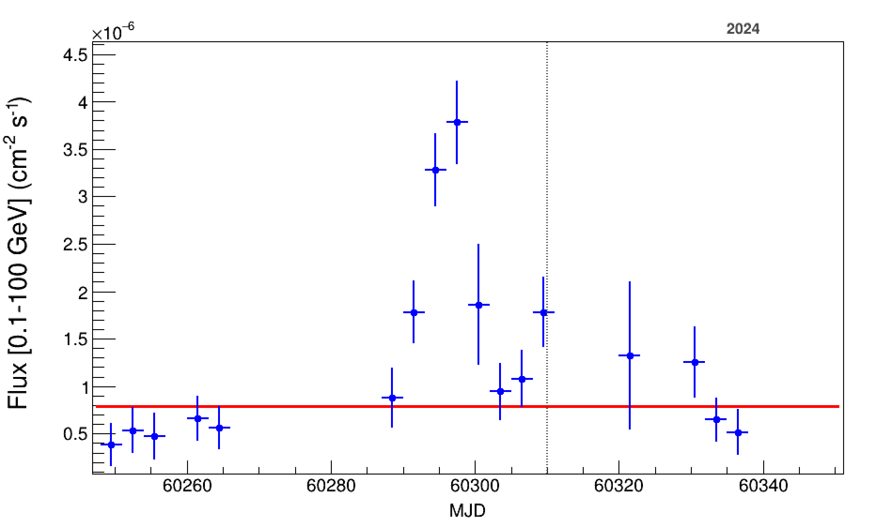
>0.1 GeV Light curve: Fermi-LAT
The flares is weak comparing to others!
The SED is similar with other flares!
2022 flare
~3
2023 flare
~4

Slide 16
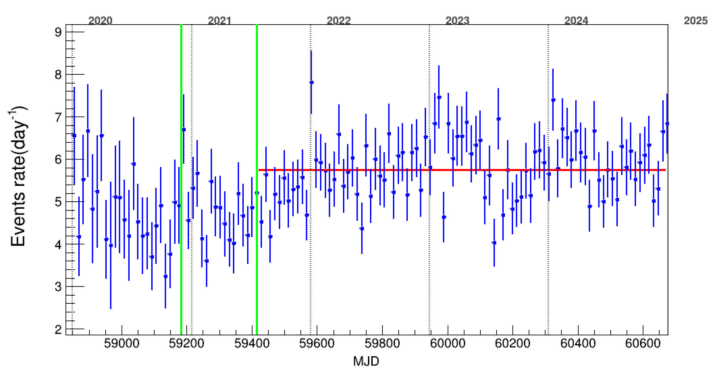
>25 TeV Light curve: LHAASO
5.7 events per day. No significant flare is detected up to now.
Fermi-LAT >0.1 GeV
1/2-KM2A
3/4-KM2A
Full-KM2A
LHAASO >25 TeV

Slide 17
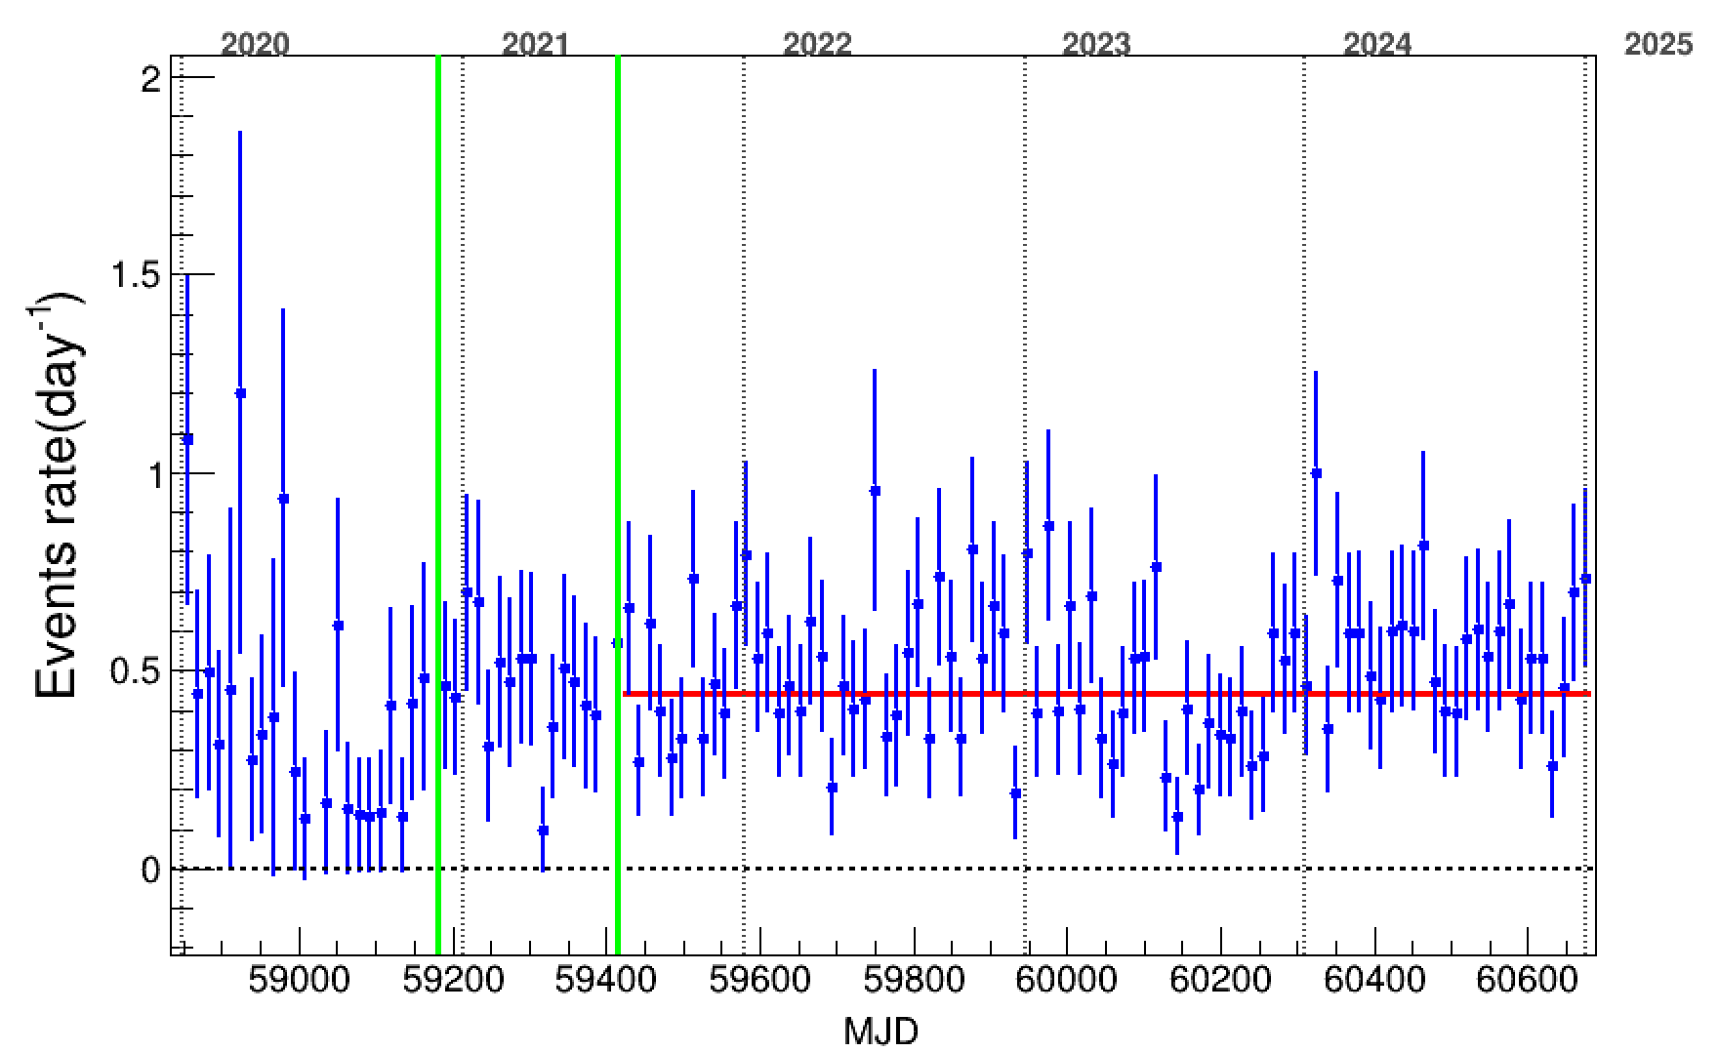
UHE Light curve: LHAASO
0.44 UHE events per day. No significant flare is detected up to now.
Fermi-LAT >0.1 GeV
Full-KM2A
LHAASO >0.1 PeV
1/2-KM2A
3/4-KM2A

Slide 18
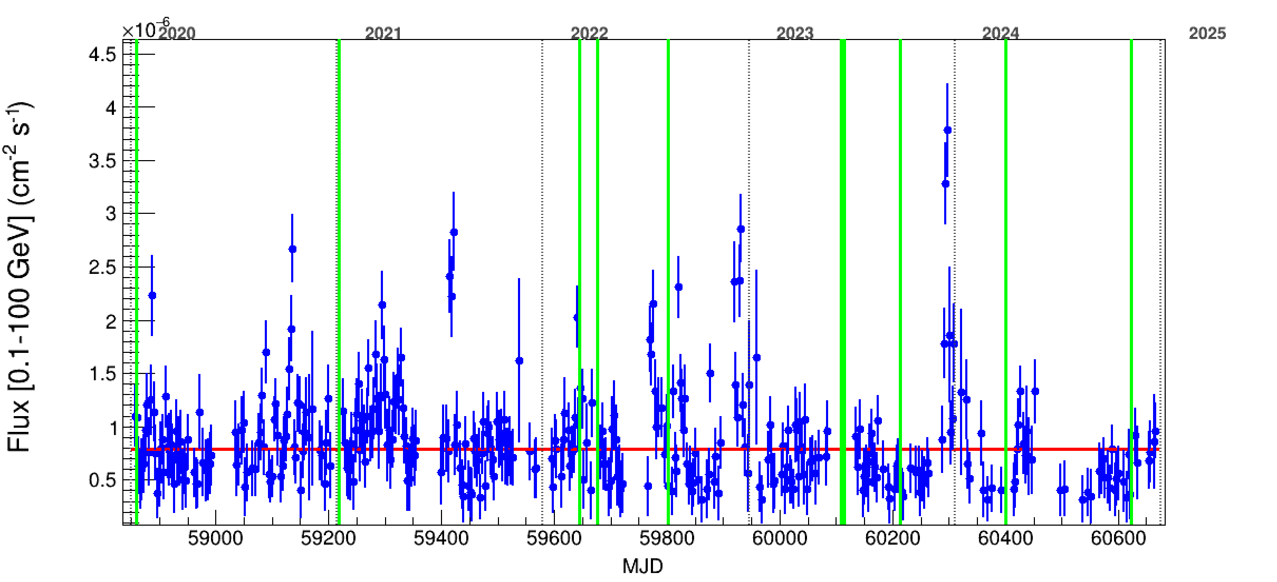
Top 10 photons Vs Fermi-LAT
No significant correlation is found
Fermi-LAT >0.1 GeV
LHAASO >0.6 PeV

Slide 19
Ability for flare detecting
>25 TeV, Icrab ~ 5.7 events per day
  1 day: 3 σ ~ 2.5 Icrab flare
  7 days: 3 σ ~ 1.5 Icrab flare
>100 TeV, Icrab ~ 0.44 events per day
  1 day: 3 σ ~ 9 Icrab flare
  7 days: 3 σ ~ 3 Icrab flare
A fast conclusion:
Similar flux enhancement at >25 TeV as GeV flare can be excluded.
The PeV photons is not due to GeV flare
This is consistent with that the magnetic field for flares is larger.

Slide 20
Summary
The PeV gamma-ray signal from Crab Nebula is significantly detected (5.7 sigma). They are not correlated with GeV flares.
The maximum energy photon increases from 1.1PeV to 1.4 PeV.
The updated SED is consist with previous result but with much better accuracy at UHE band. Lop-parabola SED function is favoured.
No >25TeV flux change during the GeV flares is found. This can give some information.

Slide 21
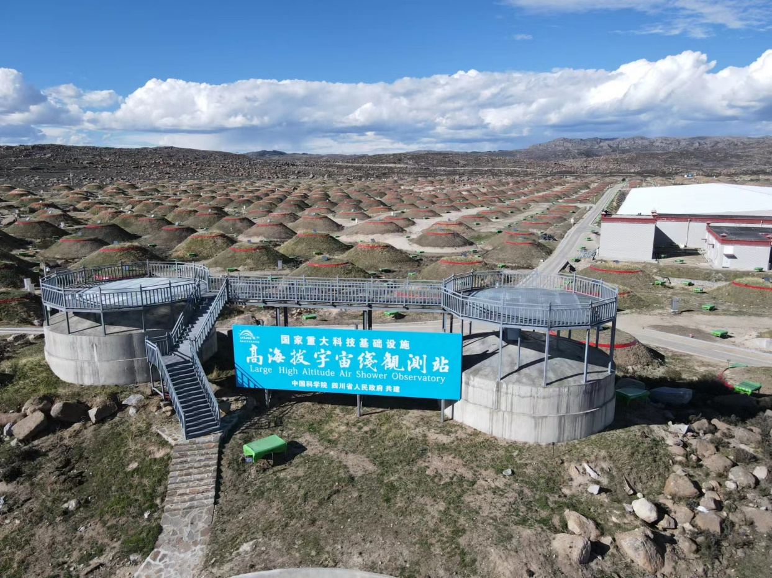
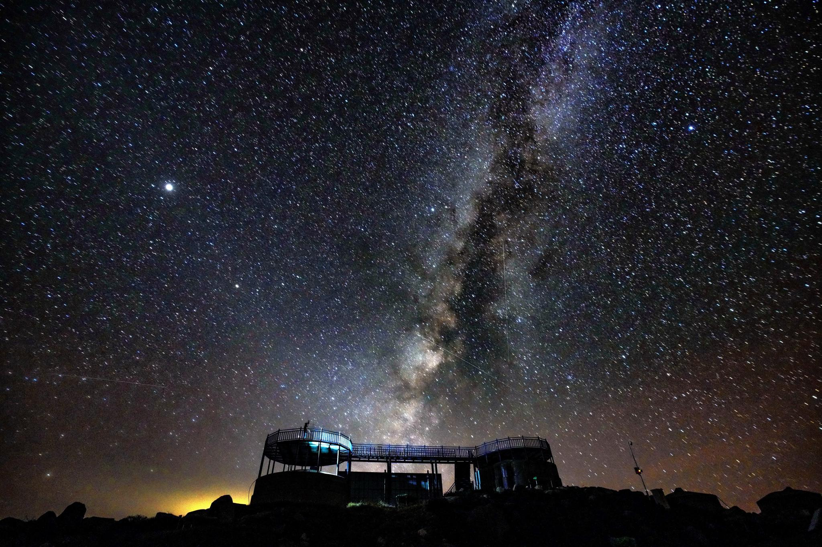
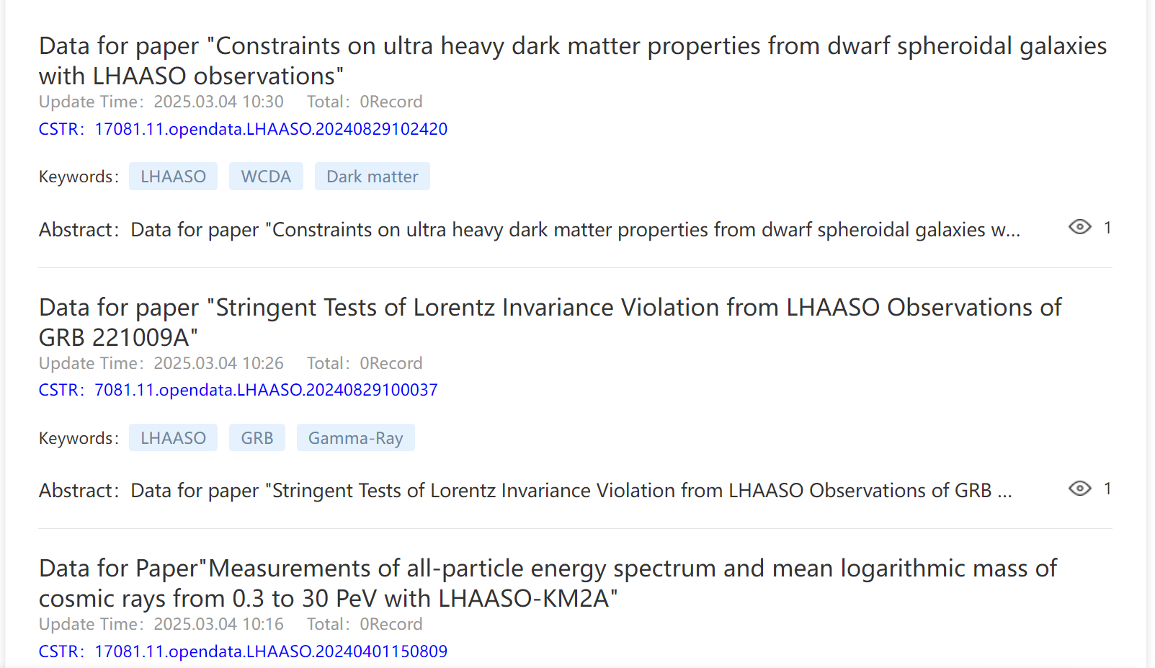
More LHAASO results can be found from：
http://english.ihep.cas.cn/lhaaso/
All the data for LHAASO papers can be found from:
https://www.nhepsdc.cn/resource/astro/lhaaso?ignoreheadhttps://www.nhepsdc.cn/resource/astro/lhaaso?ignorehead
Thank you!

