Slide 1
202407

Slide 2
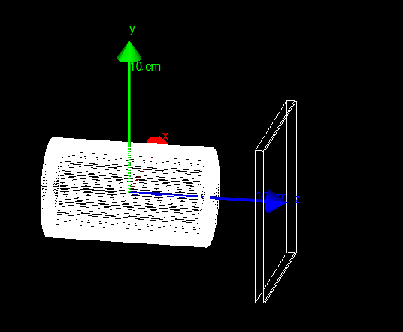
Simulation on BEPCII polarization measurement
Simulation layout:
10cm-long Iron beampipe (inner radius 2.8 cm), 1mm-thick glass-plate, 1cmto20cm-thick lead pre-shower, 20um-thick Si sensor.
Generator:
Based on Prof. Muchnoi’ s GitHub project.
Add dispersion & twiss paras. effects.
Beam polarization: 50% Laser polarization: 100%
Generate 100M events for each samples
Sample 1: beam 2.35 GeV, laser 515 nm;
Sample 2: beam 4.73 GeV, laser 515 nm;
Pre-shower
Glass plate
Si sensor
beampipe

Slide 3
Simulation & reconstruction
The truths of back-scattered photons (in 6D phase space) are recorded.
The positions at which back-scattered photons pass through the glass plate are recorded.
The energy depositions in Si sensor are recorded.
In reconstruction:
The pixel size is assumed to be 25x25um^2.
The number of scattered photon ~ Poisson distribution($μ\sim 200$)
If the energy deposition in one pixel is larger then 1440eV, the count in this pixel +1.
Fit procedure:
Based on Aurelian’s function.
Fit to the scattered photon positions on glass plate, or counts from Si sensor.

Slide 4
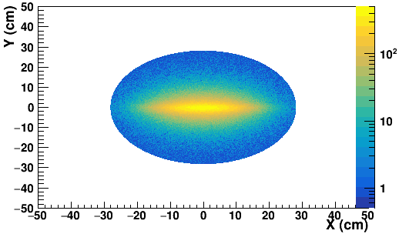
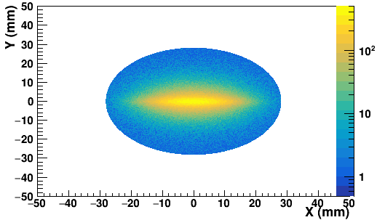
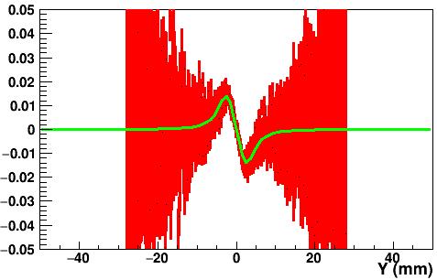
Sample 1: on glass plate
Left hand polarization and right hand polarization
Polarization: $49.9±0.4 \%$ on a 100x100 mm^2 area.

Slide 5
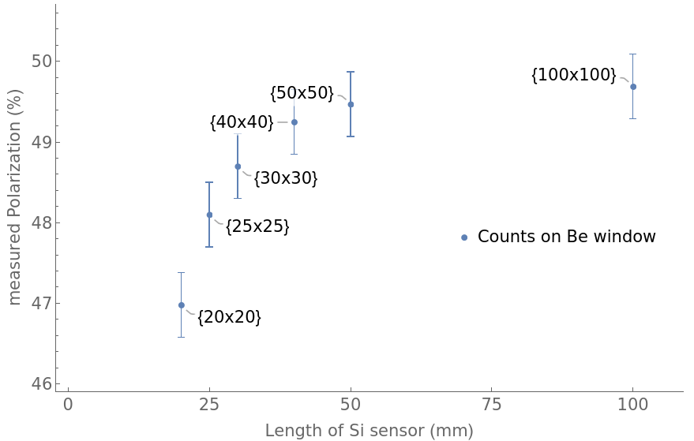
Sample 1: on glass plate
The fit result varies as the plate area changes.

Slide 6
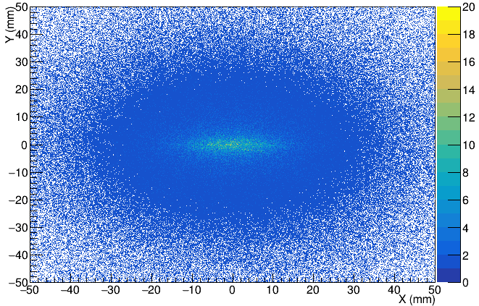
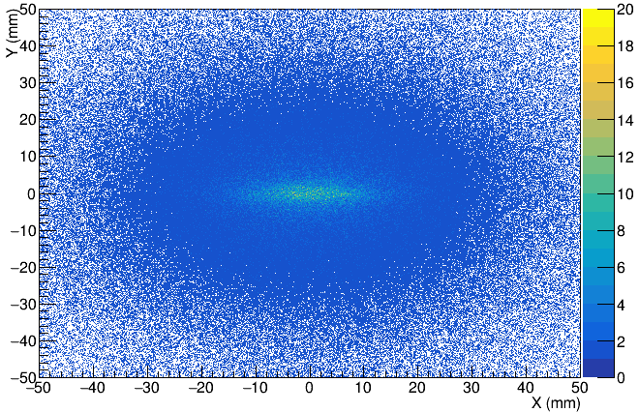
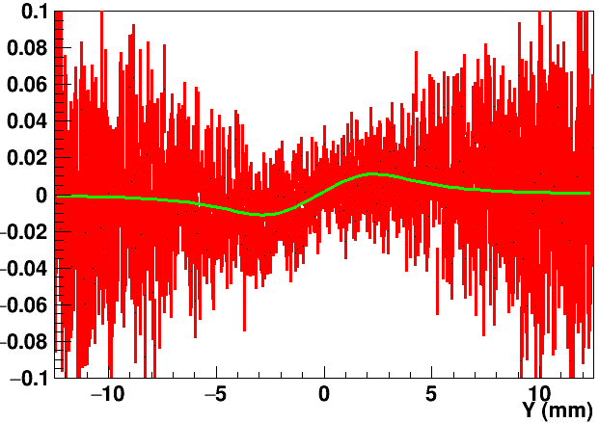
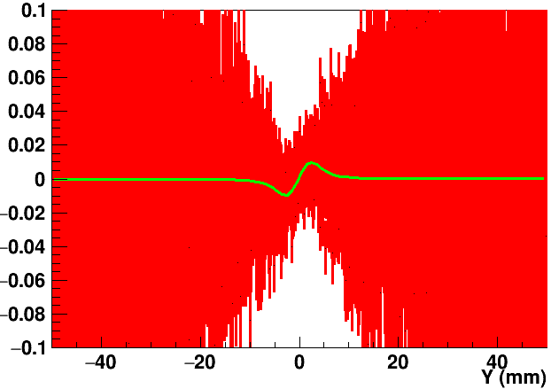
Sample 1: in si sensor
Left hand polarization and right hand polarization
Polarization:
$35.6±2.6 \%$ on a 100x100 mm^2 area.
$37.5±2. 8\%$ on a 25x25 mm^2 area.

Slide 7
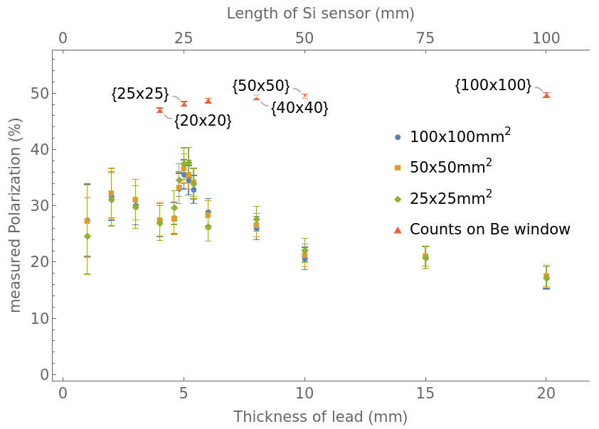
Sample 1: in si sensor
The fit result varies as area of the sensor and the thickness of pre-shower change.

Slide 8
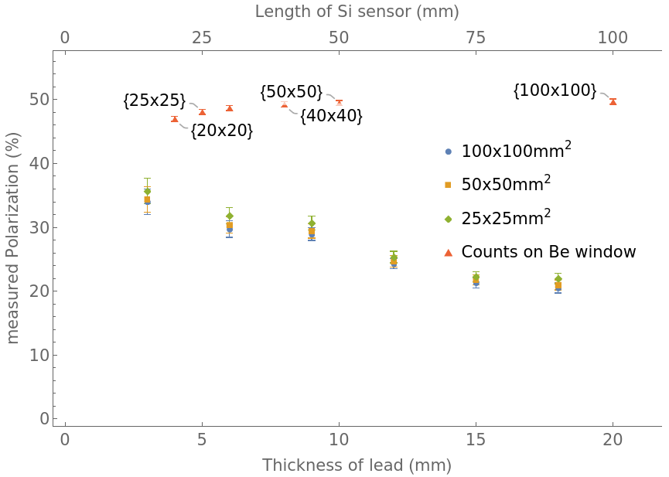
Sample 2: in si sensor
The fit result varies as area of the sensor and the thickness of pre-shower change.

Slide 9
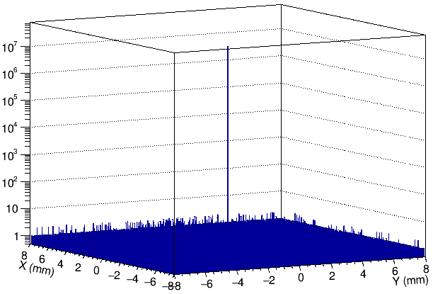
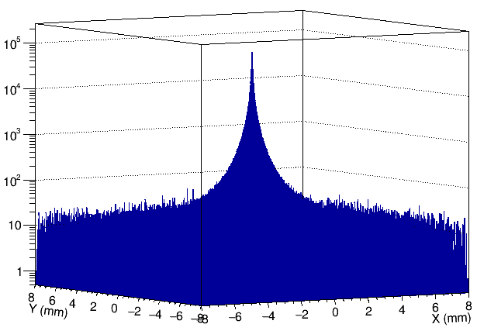
Discrepancy between truth and construction
Truth – simulated position on glass
Fit to “truth$⊗$discrepancy”
Truth – simulated position for each energy deposition step in Si sensor

Slide 10
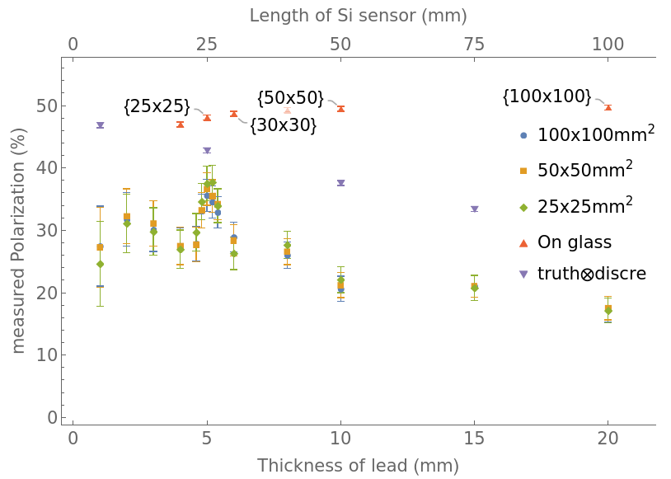
Fit to “truth$⊗$discrepancy”
The fit result varies as area of the sensor and the thickness of pre-shower change.

Slide 11
summary
Based on generator and Prof. Aurelian’s function, input/output check seems fine
Pre-shower and Si sensor enlarge the discrepancy between truth and“measurement”
Should be solved.

Slide 12
20240808 progress

Slide 13
Software scheme
Generation
Compton scattering generator
For each laser polarization, ${10}^{8}$ beam-laser collisions (serval-minute data taking)
For each laser polarization, 10^8 beam-laser collisions (serval-minute data taking)
Geant4 simulation
Reconstruction
In each pixel, count +1 if deposited energy >1.44 keV
Pseudo-measurement
Fit asymmetry pattern to obtain polarization
Pre-shower
Glass plate
Si sensor
beampipe

Slide 14
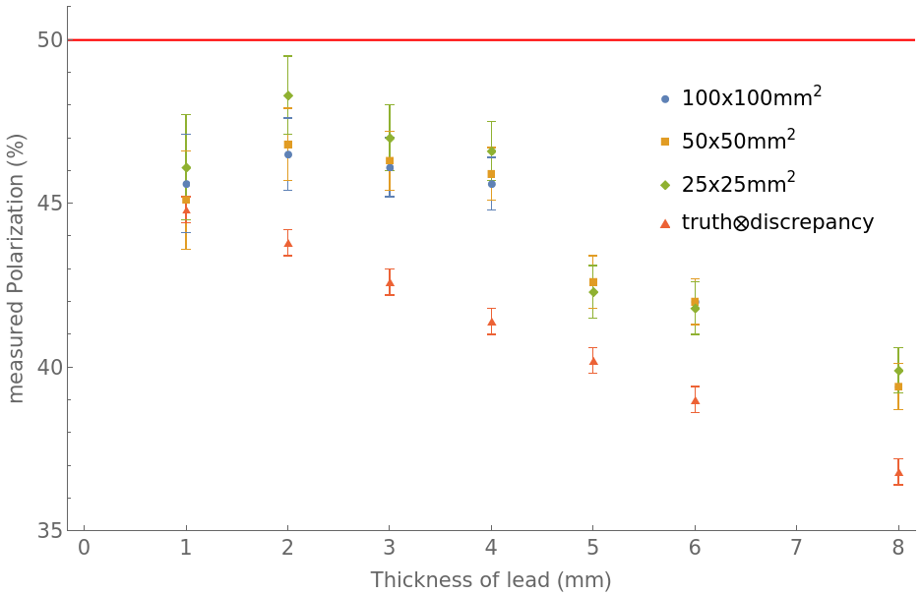
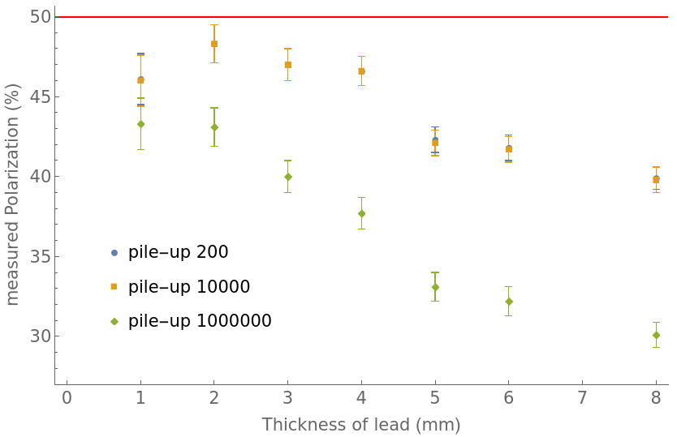
Fit results
Optimize thickness of pre-shower and sensor area.
2mm lead seems well
Pile-up events affect measurement.

Slide 15
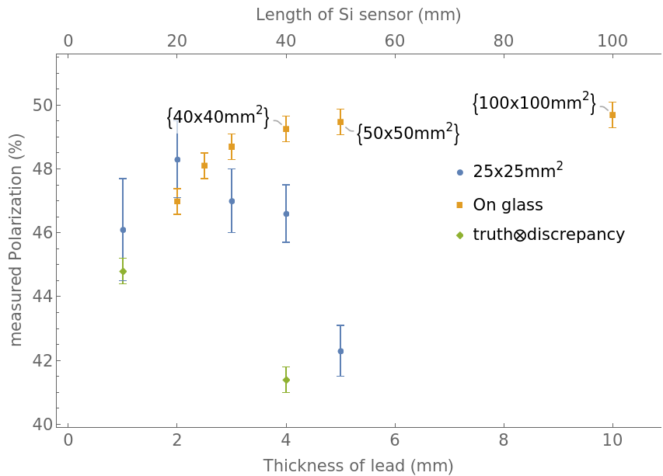
backup

Slide 16
Geant4 change-log
The production cuts (range cuts) are changed from 700 um (default) to 1 um for all material. Leads to the decreasing of energy thresholds for
Pb: 94.6 keV -> 1.2 keV Si: 5.9 keV -> 990 eV Fe: 17.2 keV -> 990 eV glass: 5.2 keV -> 990 eV

Slide 17
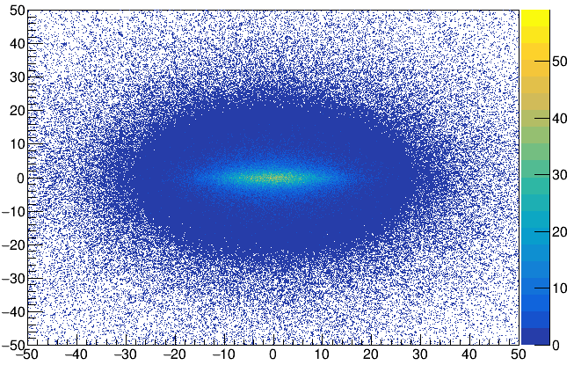
Bin maximum
10^8 events for each polarization data taking
In the bin with the highest number of events, one count is generated per $\frac{{10}^{8}}{max}$ events.
Qualitatively speaking, the pile-up event will affect the pattern when more than one count is generated, equally when pileup events are more than $\frac{{10}^{8}}{max}$ events .
 | 1mm | 2mm | 3mm | 4mm | 5mm | 6mm | 8mm
maximum | 59 | 97 | 122 | 148 | 168 | 185 | 211

