Slide 1


CEPC bunch spacing for different operation modes
Dou Wang, Xiaohao Cui, Cai Meng, Jie Gao
Jinhui Chen, Ge Lei, et al.
Aug. 29th, 2024, CEPC Day, IHEP.

Slide 2
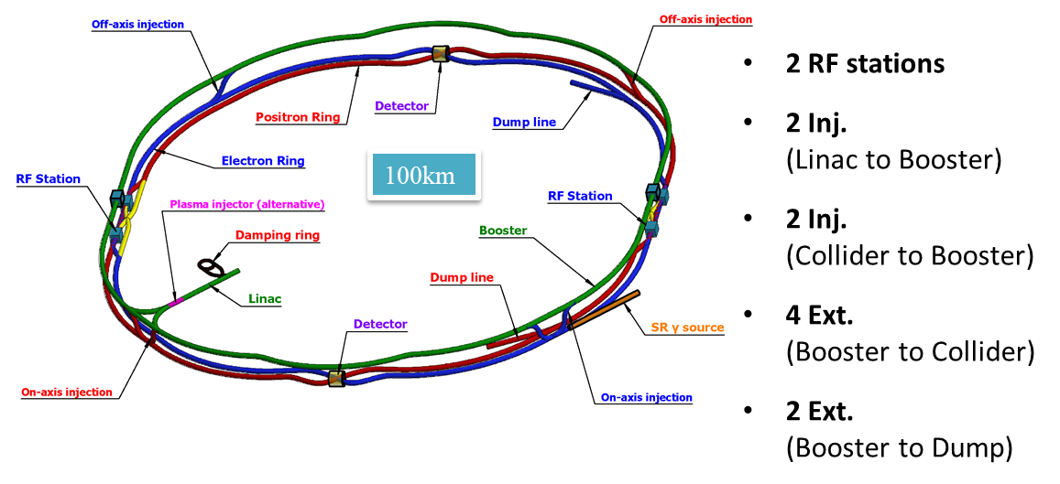
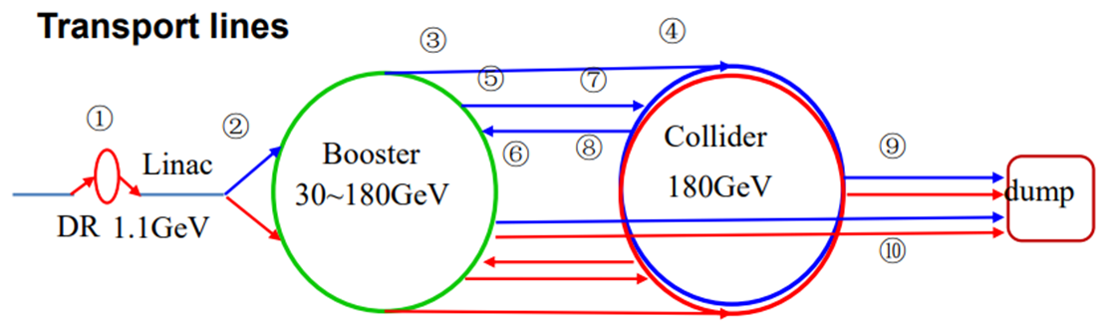
CEPC injection/extraction chain
Requirements in collider ring (30MW)
 | tt | H | W | Z
Energy (GeV) | 180 | 120 | 80 | 45.5
Beam lifetime (min) | 30 | 18 | 40 | 80
Bunch number | 35 | 268 | 1297 | 11934
Bunch population (×10¹¹) | 2.0 | 1.3 | 1.4 | 1.4
Interval for top up* (s) | 64 | 36 | 155 | 153
*Beam current in collider dacays by 3%.
Both top up injection and full injection from empty for the collider ring needs to be fulfilled.
Injection & extraction hardware should be compatible for four energy modes.
(to Dump)
10 injection/extraction systems

Slide 3
CEPC Bunch Spacing Requirement from detector
J. C. Wang
There are possible 3564 bunch positions in the circumference of an LHC ring, with 25 ns bunch spacing. Only ~80% (e.g. 2808) are filled in the “standard filling scheme”
The LHC experiments operate at 40 MHz (1/25ns), synchronized with the beam.
Most electronic components and detector technologies developed at CERN aim to serve the LHC experiments. Thus they are optimized to a base frequency of 40 MHz.
To avoid re-invention or re-optimization and allow maximal use of “commonly” available components, CEPC should set a similar base frequency, providing that the impact to the performance is under control.
The smallest clock period for CEPC accelerator is 7.69 ns (130 MHz) according to the accelerator side. For the Z mode, the bunch spacing was initially 15.4 ns (50MW). It was adjusted to 23.1 ns after a special joint accelerator and detector meeting in September 2021.
Thus the CEPC detector and electronics should be optimized to 43.3 MHz. The CERN electronic components, e.g. GBTx / lpGBT, work properly with small adjustments if necessary, according to CERN experts.
CEPC plans to operate in H, Z, W+W-, and ttbar modes with different bunch spacing, and could switch between different modes without hardware change.
Thus the bunch spacing of all modes need to be integer×23.1 ns.
A 43.3 MHz clock should be provided by the accelerator to the experiments, synchronized with the bunches. The detectors lock to this beam clock with PLL/DLL and sample signal at pre-fixed optimal phases.

Slide 4
CEPC frequency choice
f (MHz) |  | SHB1 | SHB2 | Linac_S | DR | Linac_C | Booster | Collider
CEPC | Baseline (thermal cathode gun) | 158.89 | 476.76 | 2860 | 650 | 5720 | 1300 | 650
 | Alternative (RF gun) | ⎯ | ⎯ | 2860 | 650 | 5720 | 1300 | 650
FCC | RF gun | ⎯ | ⎯ | 2800 | 400 | 5600 | 400 | 400
CEPC: greatest common divisor=130 MHz
Min bunch spacing @ rings: 7.6923ns
Bunch spacing @ Z: 7.6923×3=23.0769 ns
FCC: greatest common divisor=400 MHz
Min bunch spacing @ rings: 2.5 ns

Slide 5
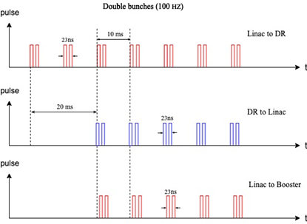
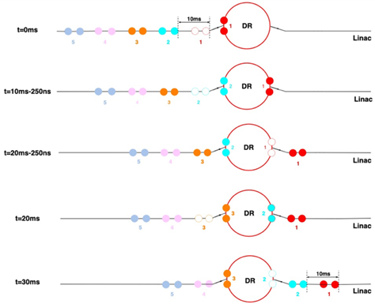
Bunch structure in Linac and DR
Bunch structure at Z is shown. Other modes are similar and straightforward.
Room temp. copper acc. structure for the Linac
Linac repetition rate: 100Hz
Single bunch scheme for tt, H and W
Double bunch scheme at Z pole
69ns
69ns
69ns

Slide 6
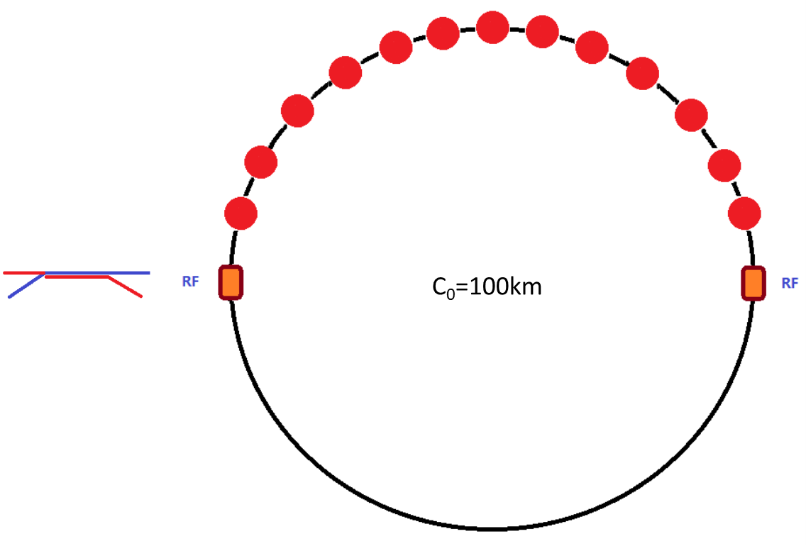
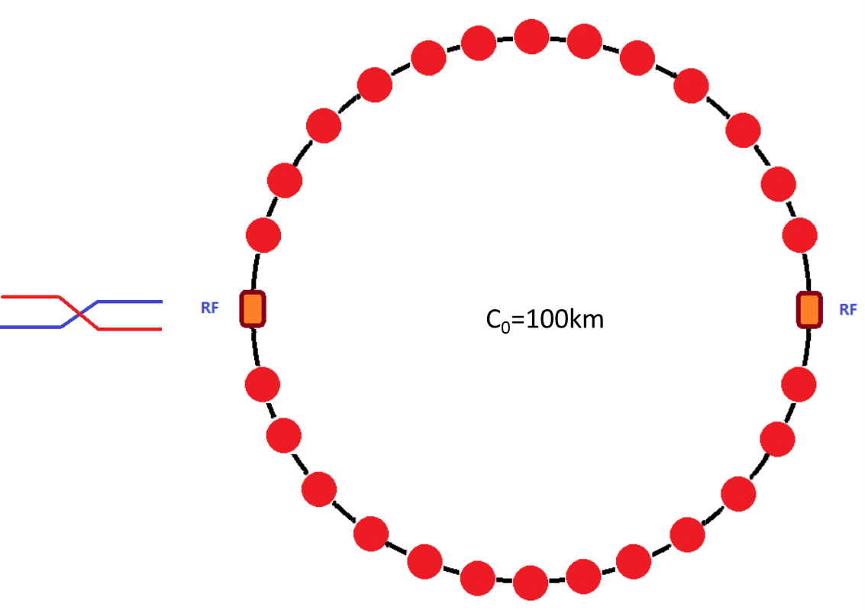
Bunch structure in Booster
tt
H
35 bunches
268 bunches
Train structure @Z
51 train
78 bunch/train
W
Z
1297 bunches
3978 bunches

Slide 7
Bunch structure in Collider
tt
H
35 bunches
268 bunches
Train structure @Z
153 train
78 bunch/train
W
Z
1297 bunches
11934 bunches

Slide 8
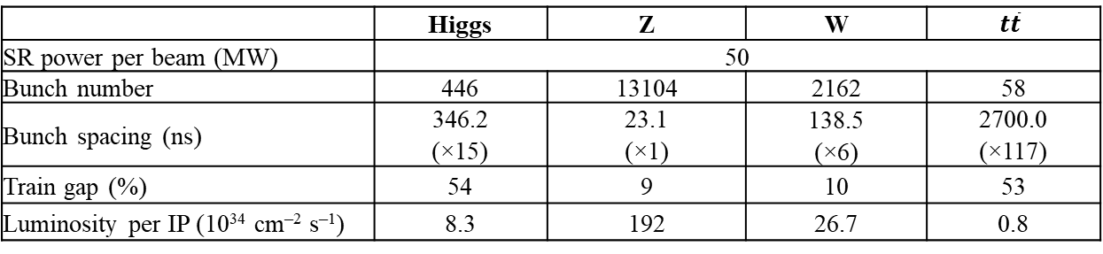
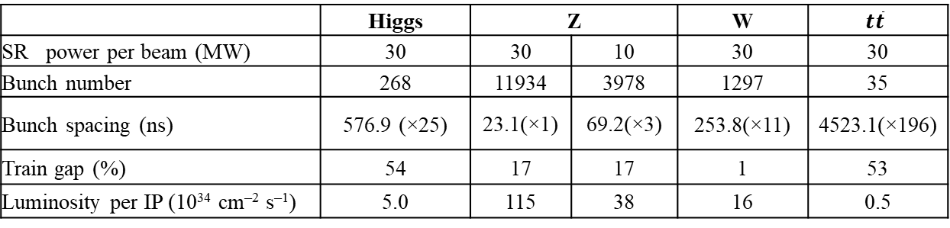
Bunch spacing for different operation modes
SR 30MW
 | Higgs | Z |  | W | $$t\overline{t}$$
SR power per beam (MW) | 30 | 30 | 10 | 30 | 30
Bunch number | 268 | 11934 | 3978 | 1297 | 35
Bunch spacing (ns) | 576.9 (×25) | 23.1(×1) | 69.2(×3) | 253.8(×11) | 4523.1(×196)
Train gap (%) | 54 | 17 | 17 | 1 | 53
Luminosity per IP (10³⁴ cm^{–2} s^{–1}) | 5.0 | 115 | 38 | 16 | 0.5
SR 50MW
 | Higgs | Z | W | $$t\overline{t}$$
SR power per beam (MW) | 50
Bunch number | 446 | 13104 | 2162 | 58
Bunch spacing (ns) | 346.2 (×15) | 23.1 (×1) | 138.5 (×6) | 2700.0 (×117)
Train gap (%) | 54 | 9 | 10 | 53
Luminosity per IP (10³⁴ cm^{–2} s^{–1}) | 8.3 | 192 | 26.7 | 0.8

Slide 9
Summary
The timing structure of CEPC for four energy modes and different injection scheme have been designed with the consideration of clock system, RF frequency choice, bunch pattern, injection hardware, etc.
Both top up injection and full injection from empty for the collider ring can be fulfilled.
The minimum bunch separation is determined by the frequency compatibility among different accelerator parts which is 7.6923ns.
-- Min bunch spacing @Z = 7.6923×3=23.0769 ns
-- Bunch spacing for tt, Higgs, and W is an integer multiple of 23.0769 ns
Accelerator people are willing to learn more detail of the timing issues of the detector.
The discussion about timing and filling scheme for CEPC is continuous.

Slide 10
Reference
Dou Wang, Xiaohao Cui, et al., “Problems and considerations about the injection philosophy and timing structure for CEPC”, International Journal of Modern Physics A (2022) 2246006
Dou Wang, “Problems and considerations about the timing & bunch pattern”, CEPC day, Aug. 2021
Cai Meng, “Timing and bunch pattern compatibility study for multi RF frequencies”, CEPC day, Jan. 2022
Cai Meng, “CEPC Linac injector design status”, CEPC2022 Workshop, Oct. 2022
Xiaohao Cui, “CEPC Transport lines and Timing”, CEPC2023 Workshop, Oct. 2023

Slide 11
Thank you for your attention

Slide 12
Back up

Slide 13
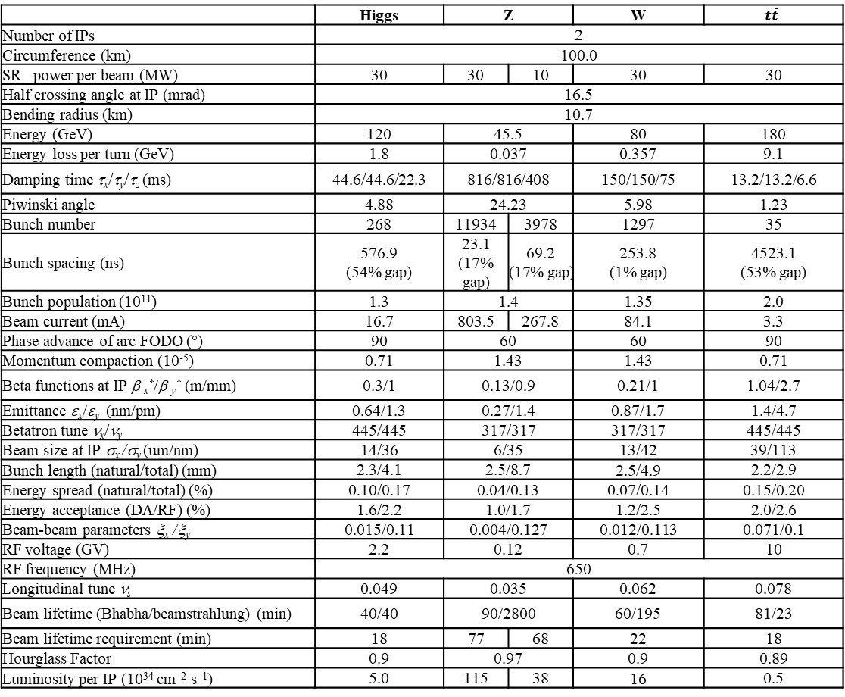
CEPC baseline parameters in TDR
 | Higgs | Z |  | W | $$t\overline{t}$$
Number of IPs | 2
Circumference (km) | 100.0
SR power per beam (MW) | 30 | 30 | 10 | 30 | 30
Half crossing angle at IP (mrad) | 16.5
Bending radius (km) | 10.7
Energy (GeV) | 120 | 45.5 |  | 80 | 180
Energy loss per turn (GeV) | 1.8 | 0.037 |  | 0.357 | 9.1
Damping time τ_{x}/τ_{y}/τ_{z} (ms) | 44.6/44.6/22.3 | 816/816/408 |  | 150/150/75 | 13.2/13.2/6.6
Piwinski angle | 4.88 | 24.23 |  | 5.98 | 1.23
Bunch number | 268 | 11934 | 3978 | 1297 | 35
Bunch spacing (ns) | 576.9 (54% gap) | 23.1 (17% gap) | 69.2 (17% gap) | 253.8 (1% gap) | 4523.1 (53% gap)
Bunch population (10¹¹) | 1.3 | 1.4 |  | 1.35 | 2.0
Beam current (mA) | 16.7 | 803.5 | 267.8 | 84.1 | 3.3
Phase advance of arc FODO (°) | 90 | 60 |  | 60 | 90
Momentum compaction (10⁻⁵) | 0.71 | 1.43 |  | 1.43 | 0.71
Beta functions at IP β _{x}*/β _{y}* (m/mm) | 0.3/1 | 0.13/0.9 |  | 0.21/1 | 1.04/2.7
Emittance ε_{x}/ε_{y} (nm/pm) | 0.64/1.3 | 0.27/1.4 |  | 0.87/1.7 | 1.4/4.7
Betatron tune ν_{x}/ν_{y} | 445/445 | 317/317 |  | 317/317 | 445/445
Beam size at IP σ_{x} /σ_{y} (um/nm) | 14/36 | 6/35 |  | 13/42 | 39/113
Bunch length (natural/total) (mm) | 2.3/4.1 | 2.5/8.7 |  | 2.5/4.9 | 2.2/2.9
Energy spread (natural/total) (%) | 0.10/0.17 | 0.04/0.13 |  | 0.07/0.14 | 0.15/0.20
Energy acceptance (DA/RF) (%) | 1.6/2.2 | 1.0/1.7 |  | 1.2/2.5 | 2.0/2.6
Beam-beam parameters ξ_{x} /ξ_{y} | 0.015/0.11 | 0.004/0.127 |  | 0.012/0.113 | 0.071/0.1
RF voltage (GV) | 2.2 | 0.12 |  | 0.7 | 10
RF frequency (MHz) | 650
Longitudinal tune ν_{s} | 0.049 | 0.035 |  | 0.062 | 0.078
Beam lifetime (Bhabha/beamstrahlung) (min) | 40/40 | 90/2800 |  | 60/195 | 81/23
Beam lifetime requirement (min) | 18 | 77 | 68 | 22 | 18
Hourglass Factor | 0.9 | 0.97 |  | 0.9 | 0.89
Luminosity per IP (10³⁴ cm^{–2} s^{–1}) | 5.0 | 115 | 38 | 16 | 0.5

Slide 14
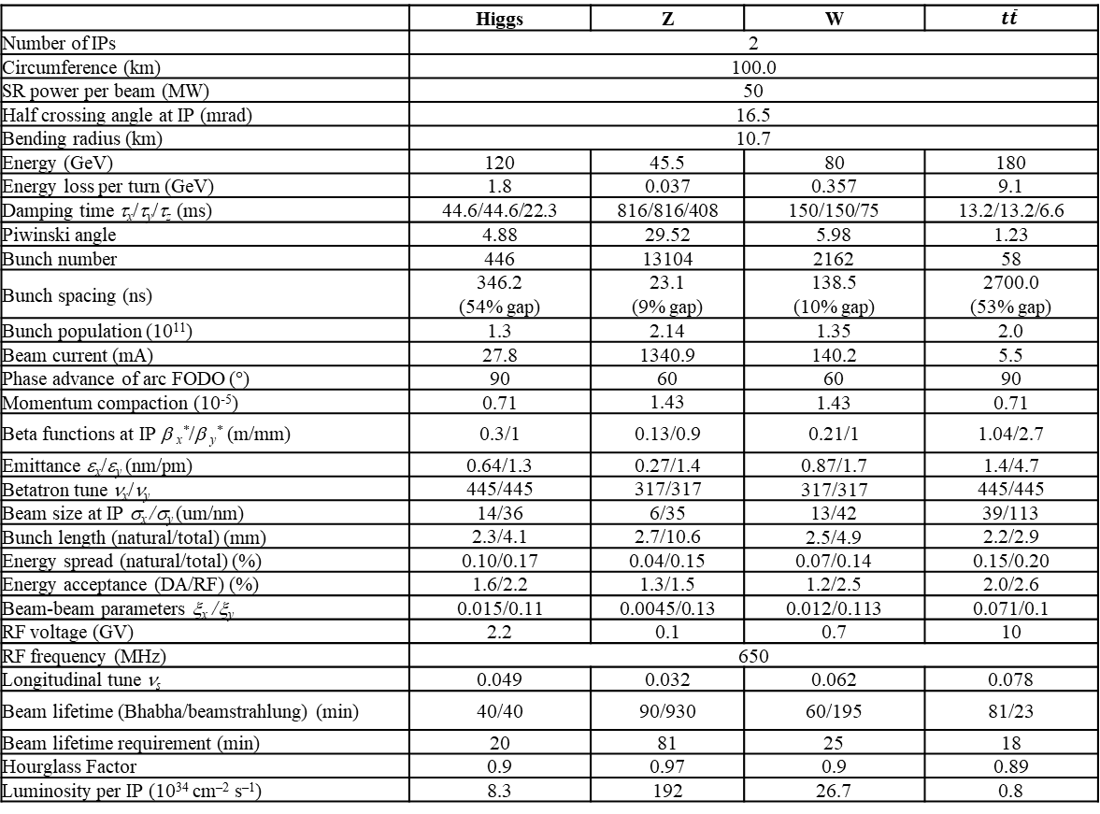
CEPC main parameters with 50 MW upgrade
 | Higgs | Z | W | $$t\overline{t}$$
Number of IPs | 2
Circumference (km) | 100.0
SR power per beam (MW) | 50
Half crossing angle at IP (mrad) | 16.5
Bending radius (km) | 10.7
Energy (GeV) | 120 | 45.5 | 80 | 180
Energy loss per turn (GeV) | 1.8 | 0.037 | 0.357 | 9.1
Damping time τ_{x}/τ_{y}/τ_{z} (ms) | 44.6/44.6/22.3 | 816/816/408 | 150/150/75 | 13.2/13.2/6.6
Piwinski angle | 4.88 | 29.52 | 5.98 | 1.23
Bunch number | 446 | 13104 | 2162 | 58
Bunch spacing (ns) | 346.2 (54% gap) | 23.1 (9% gap) | 138.5 (10% gap) | 2700.0 (53% gap)
Bunch population (10¹¹) | 1.3 | 2.14 | 1.35 | 2.0
Beam current (mA) | 27.8 | 1340.9 | 140.2 | 5.5
Phase advance of arc FODO (°) | 90 | 60 | 60 | 90
Momentum compaction (10⁻⁵) | 0.71 | 1.43 | 1.43 | 0.71
Beta functions at IP β _{x}*/β _{y}* (m/mm) | 0.3/1 | 0.13/0.9 | 0.21/1 | 1.04/2.7
Emittance ε_{x}/ε_{y} (nm/pm) | 0.64/1.3 | 0.27/1.4 | 0.87/1.7 | 1.4/4.7
Betatron tune ν_{x}/ν_{y} | 445/445 | 317/317 | 317/317 | 445/445
Beam size at IP σ_{x} /σ_{y} (um/nm) | 14/36 | 6/35 | 13/42 | 39/113
Bunch length (natural/total) (mm) | 2.3/4.1 | 2.7/10.6 | 2.5/4.9 | 2.2/2.9
Energy spread (natural/total) (%) | 0.10/0.17 | 0.04/0.15 | 0.07/0.14 | 0.15/0.20
Energy acceptance (DA/RF) (%) | 1.6/2.2 | 1.3/1.5 | 1.2/2.5 | 2.0/2.6
Beam-beam parameters ξ_{x} /ξ_{y} | 0.015/0.11 | 0.0045/0.13 | 0.012/0.113 | 0.071/0.1
RF voltage (GV) | 2.2 | 0.1 | 0.7 | 10
RF frequency (MHz) | 650
Longitudinal tune ν_{s} | 0.049 | 0.032 | 0.062 | 0.078
Beam lifetime (Bhabha/beamstrahlung) (min) | 40/40 | 90/930 | 60/195 | 81/23
Beam lifetime requirement (min) | 20 | 81 | 25 | 18
Hourglass Factor | 0.9 | 0.97 | 0.9 | 0.89
Luminosity per IP (10³⁴ cm^{–2} s^{–1}) | 8.3 | 192 | 26.7 | 0.8

Slide 15
Requirement of timing system
Gang Li, Ge Lei
Choose 130MHz as clock beat → minimum time separation=7.69ns (FPGA clock &EVG/EVR transmission can be realized)
Circumference of damping ring: (L*1000*10⁹/(3*10⁸))/(1000/650)=integer
Length of transfer line between DR and Linac: （（N*150+75+104*2-8.3）10⁹/(3*10⁸))/(1000/2860)=integer
104m →101.65m
Circumference of collider/booster: (L*1000*10⁹/(3*10⁸))/(1000/650)=integer
Length of transfer line between booster and collider: (L*10⁹/(3*10⁸))/(1000/650)=integer
252m or 246m

Slide 16
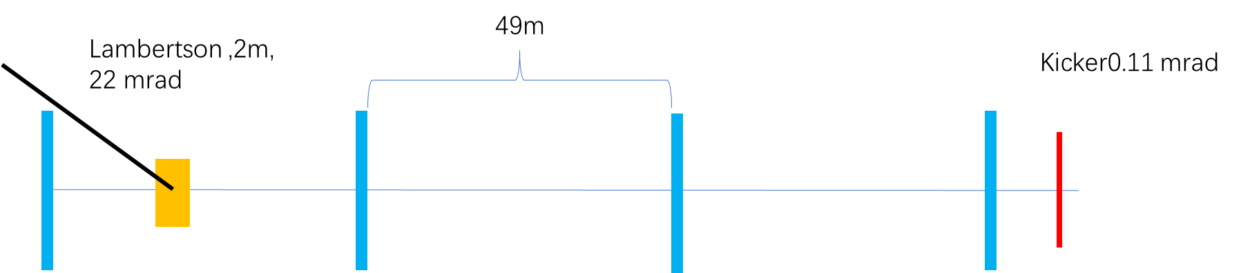
Injection to booster
Xiaohao Cui
Injection into the booster is a simple on-axis injection with 1 kicker
Bunches from the Linac will be in 100 Hz or 200 Hz
Booster Ring
T_{Linac}
T_{booster}
T_{Linac}=N*Turns+T_{booster}
Changing T_{Linac} slightly, we can fill the booster with any pattern we needed.

Slide 17
Injection to the collider
Xiaohao Cui
Considering the robustness of the design, the injection of the main collider ring is conventional off-axis injection. (Maybe an on-axis injection is needed for Higgs)
For tt, Higgs and W energy, injection into the collider is bunch by bunch; and for Z energy, injection is train by train.
Lamberson ，26 mrad
60m
26m
66m
68m
Bunch by bunch
Train by train
Kicker:
1000 Hz
1000 Hz
The kickers rise up, inject one bunch into the collider, and fall down. This process repeated in 1000 Hz, to inject all bunches into the ring.
The kickers rise up, stay there to inject a whole train into the collider, and fall down. This process repeated in 1000 Hz, to inject all bunches into the ring.

Slide 18
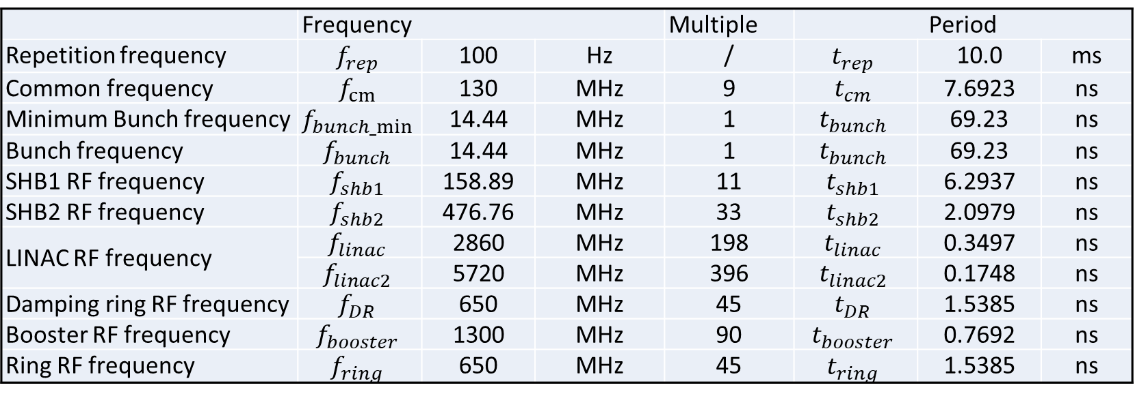
Timing consideration
Cai Meng
Frequency
  n=9, m1=11, m2=3, m3=6
  Divide the common frequency to 14.44MHz, then multiply to the corresponding RF frequency
  Frequency multiplication to 2860MHz, 5720MHz by common frequency
 | Frequency |  |  | Multiple | Period
Repetition frequency | $$f_{rep}$$ | 100 | Hz | / | $$t_{rep}$$ | 10.0 | ms
Common frequency | $$f_{cm}$$ | 130 | MHz | 9 | $$t_{cm}$$ | 7.6923 | ns
Minimum Bunch frequency | $$f_{bunch_min}$$ | 14.44 | MHz | 1 | $$t_{bunch}$$ | 69.23 | ns
Bunch frequency | $$f_{bunch}$$ | 14.44 | MHz | 1 | $$t_{bunch}$$ | 69.23 | ns
SHB1 RF frequency | $$f_{shb1}$$ | 158.89 | MHz | 11 | $$t_{shb1}$$ | 6.2937 | ns
SHB2 RF frequency | $$f_{shb2}$$ | 476.76 | MHz | 33 | $$t_{shb2}$$ | 2.0979 | ns
LINAC RF frequency | $$f_{linac}$$ | 2860 | MHz | 198 | $$t_{linac}$$ | 0.3497 | ns
 | $$f_{linac2}$$ | 5720 | MHz | 396 | $$t_{linac2}$$ | 0.1748 | ns
Damping ring RF frequency | $$f_{DR}$$ | 650 | MHz | 45 | $$t_{DR}$$ | 1.5385 | ns
Booster RF frequency | $$f_{booster}$$ | 1300 | MHz | 90 | $$t_{booster}$$ | 0.7692 | ns
Ring RF frequency | $$f_{ring}$$ | 650 | MHz | 45 | $$t_{ring}$$ | 1.5385 | ns

Slide 19
Timing consideration
Cai Meng
Parameter | Unit | High luminosity Z mode |  |  |  | Comments
 |  | 30MW |  | 50MW
 |  | Baseline scheme | RF gun scheme | Baseline scheme | RF gun scheme
Repetition frequency | Hz | 100
Common frequency | MHz | 130
Linac common frequency | MHz | 14.44 | 130 | 14.44 | 130
Bunch frequency | MHz | 14.44 | 43.33 | 7.22 | 65.00
SHB1 RF frequency | MHz | 158.89 | / | 158.89 | /
SHB2 RF frequency | MHz | 476.67 | / | 476.67 | /
LINAC RF frequency | MHz | 2860.00
 | MHz | 5720.00
Damping ring RF frequency | MHz | 650.00
Booster RF frequency | MHz | 1300.00
Ring RF frequency | MHz | 650.00
Bunch spacing @ Collider | ns | 23.08 | 23.08 | 15.38 | 15.38
Bunch spacing @ Linac | ns | 69.23 | 23.08 | 138.46 | 15.38
Injection scheme |  | bunch-by-bunch | pulse-by-pulse bunch-by-bunch | bunch-by-bunch | pulse-by-pulse bunch-by-bunch
Harmonic number |  | 45*(2k) + [10, 20, 40] | 5(2k)+ [2,4] | 45*(2k) + [10, 20, 40] | 5(2k)+ [2,4] | k is an integer
 |  | 45*(2k+1) + [5, 25] | 5(2k+1) + [1,3] | 45*(2k+1) + [5, 25] | 5(2k+1) + [1,3]
Bunch number per train |  | 6n | 2n | 18n | 2n | n is an integer

Slide 20
Timing consideration
Cai Meng
Parameter | Unit | High luminosity Z mode |  | Comments
 |  | Baseline scheme | RF gun scheme
Repetition frequency | Hz | 100
Common frequency | MHz | 130
Linac common frequency | MHz | 14.44 | 43.33
Bunch frequency | MHz | 14.44 | 43.33
SHB1 RF frequency | MHz | 158.89 | /
SHB2 RF frequency | MHz | 476.67 | /
LINAC RF frequency | MHz | 2860.00
 | MHz | 5720.00
Damping ring RF frequency | MHz | 650.00
Booster RF frequency | MHz | 1300.00
Ring RF frequency | MHz | 650.00
Bunch spacing@Collider | ns | 23.08 | 23.08
Bunch spacing@Linac | ns | 69.23 | 23.08 | 束测、LLRF
Injection scheme |  | bunch-by-bunch | pulse-by-pulse bunch-by-bunch
Harmonic number |  | 45*(2k) + [10, 20, 40] | 5(2k)+ [2,4] | k为整数
 |  | 45*(2k+1) + [5, 25] | 5(2k+1) + [1,3]
Bunch number per train |  | 6n | 2n | n为整数

Slide 21
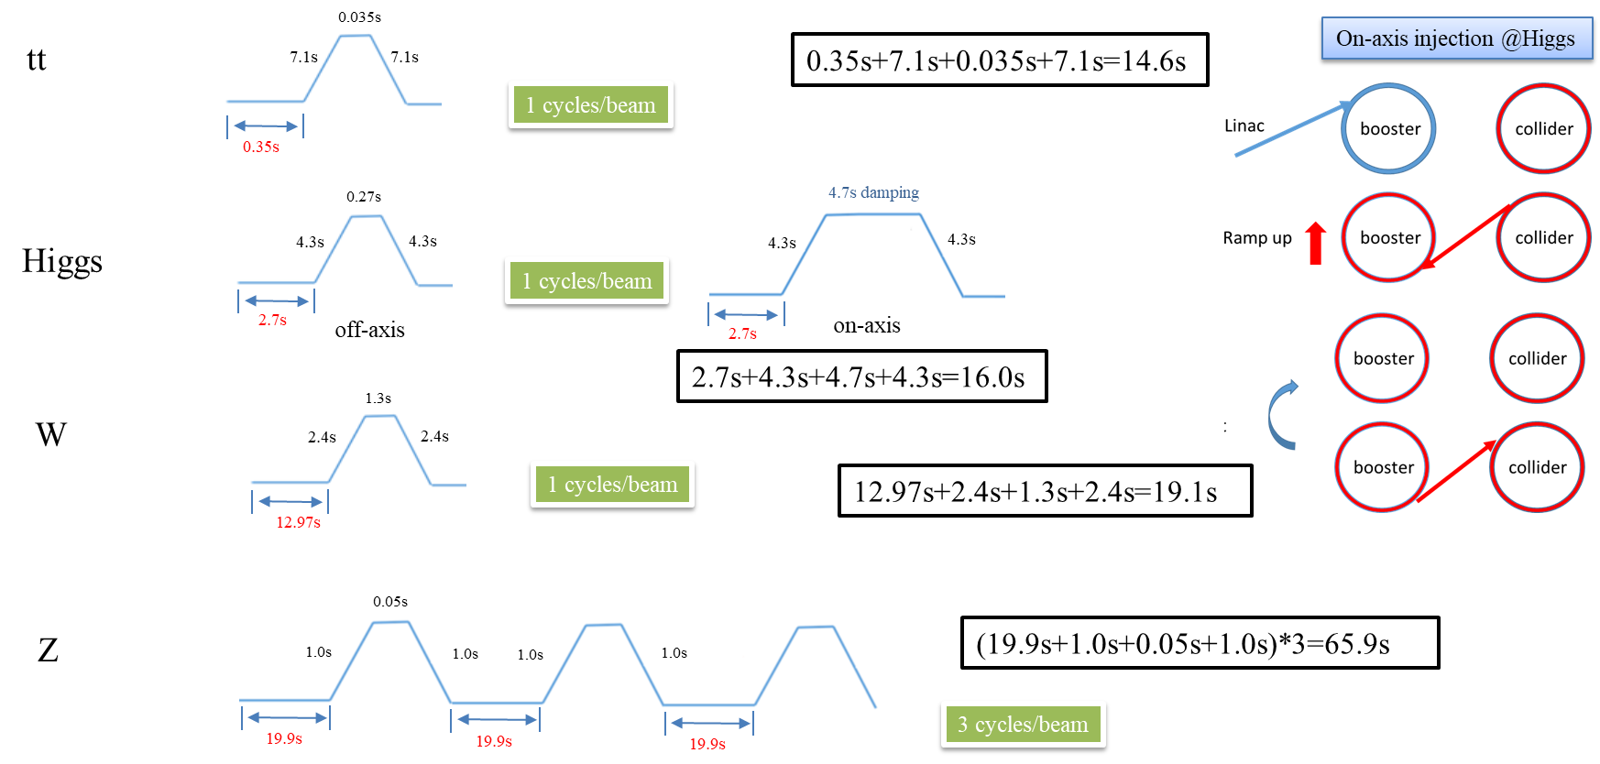
Timing structure for the CEPC Booster

Slide 22
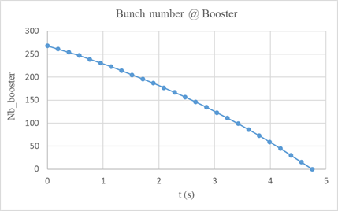
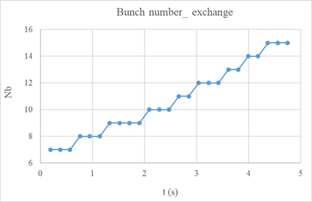
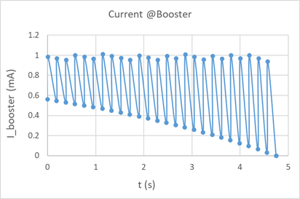
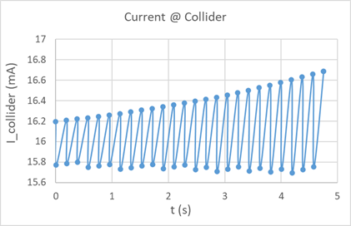
On-axis injection scheme from Booster to Collider @ Higgs

