Slide 1
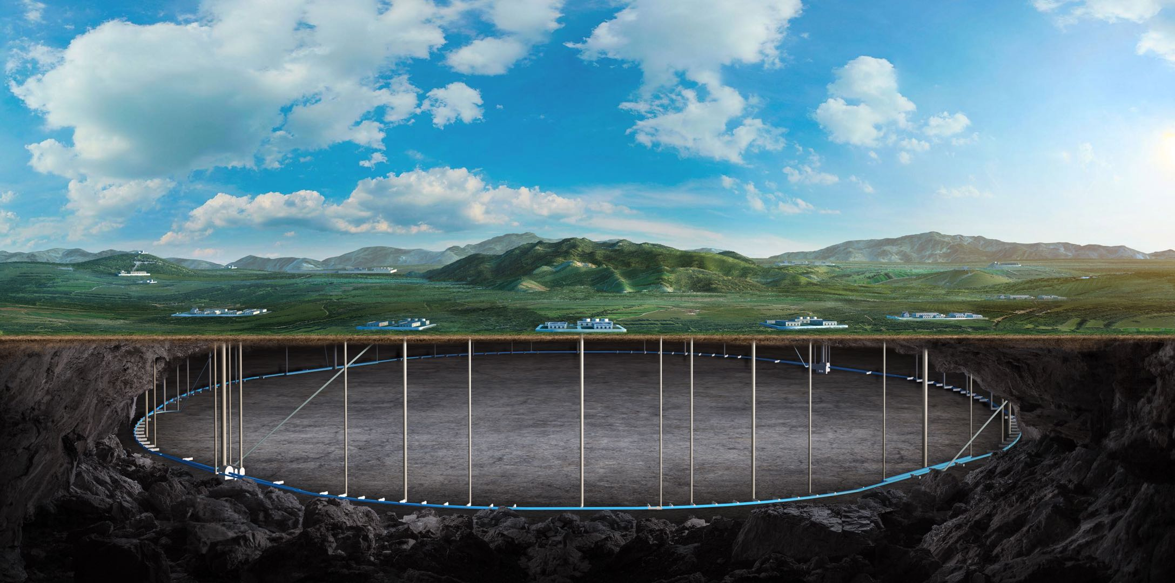
Review of the 2024 CEPC Mechanical Workshop
(Luoyang, Henan)
纪 全
Aug. 7th, 2024, CEPC Detector Ref-TDR Review

Slide 2
Content
会议目的 Purpose of the meeting
会前准备 Pre-meeting preparations
会议报告 Report on the meeting
会议讨论 Discussion at the end of the meeting
会后计划 Work plan after the meeting

Slide 3
Purpose of the meeting
1. Strengthen partnership with local governments and enterprises
in Henan Province
2. Comprehensively introduce CEPC and showcase the scientific charm
of large scientific facilities to CITIC Heavy Industry Machinery Co., Ltd
3. Enhance cooperation and understanding among CEPC systems

Slide 4
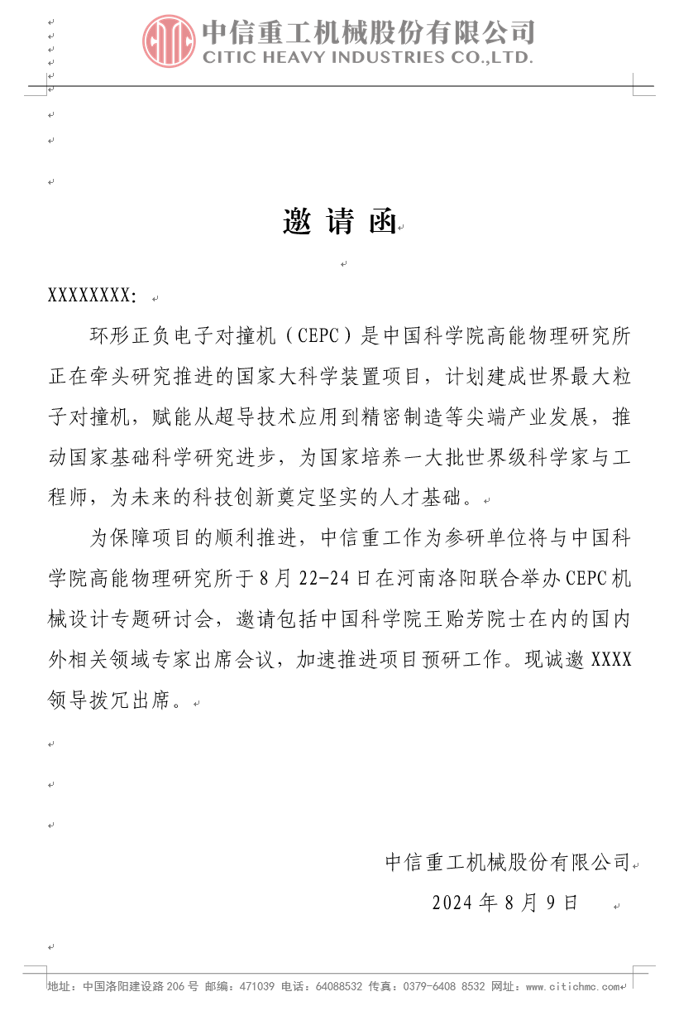
Pre-meeting preparations
CITIC Heavy Industry :
IHEP :
Meetings Group :
IEPH
纪 全
石澔玙
魏泽琪
CITIC Heavy Industry
尹国辉
申文涛
石如星
徐侠剑
李清林
寇艳芳
Responsible for
meeting arrangements
Responsible for peripheral publicity

Slide 5
Pre-meeting preparations
Report arrangement :
General introduction :
ACC --- 高 杰
Det --- 王建春
娄辛丑suggestion：CEPC promotional video
Accelerator sub-report :
Tunnel section :
王毅伟 --- ACC Physics
王海静 --- Mechanical overall
康 文 --- Magnet
马永胜 --- Vacuum chamber
MDI :
白莎, 石澔玙 --- Background
张祥镇, 杨啸辰 --- Cryostat
朱应顺 --- IR SC magnet
王小龙 --- Alignment
Detector sub-report :
Mechanical overall --- 纪全
Muon(Yoke) --- 王小龙,夏商
Magnet --- 宁飞鹏, 裴亚田, 侯治龙
HCAL --- 钱森, 裴亚田, 张俊嵩
ECAL --- 刘勇, 侯少静
TPC --- 祁辉荣, 张俊嵩
ITK(OTK) --- 严琪, 张奕晗, 骆首栋
VTX, LumiCAL, Beampipe --- 梁志均, 侯书云, 付金煜, 何龙岩
Electronics --- 魏微
Software --- 李卫东, 傅成栋, 林韬

Slide 6
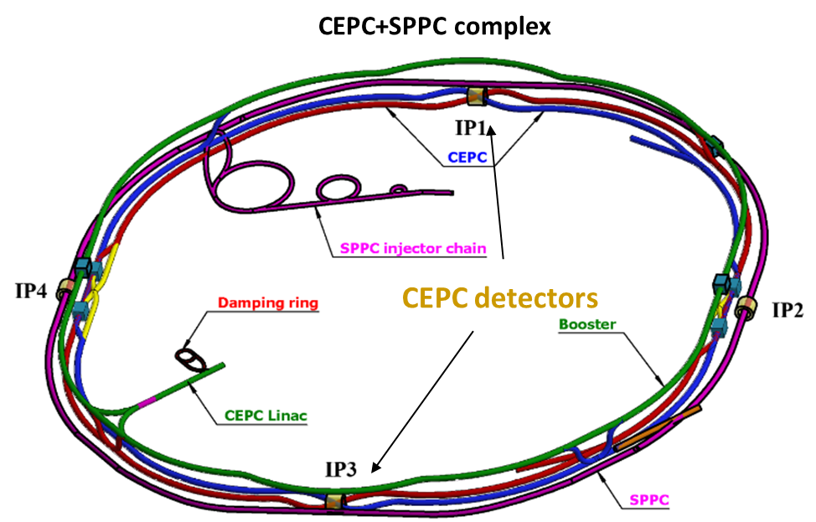
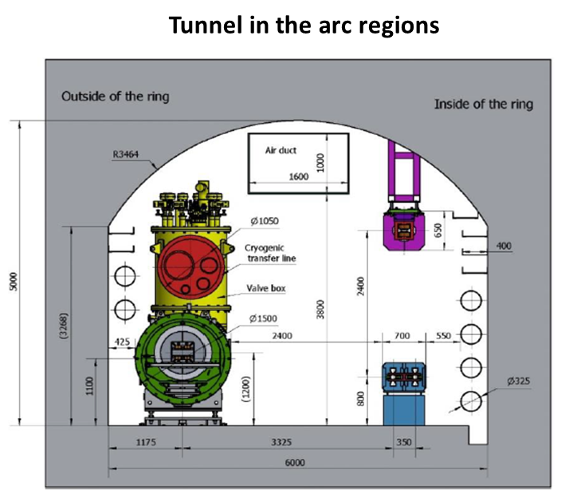
Report on the meeting
Reports on accelerators
1. Tunnel section (4-1):
王毅伟 - Physical design and requirements

Slide 7
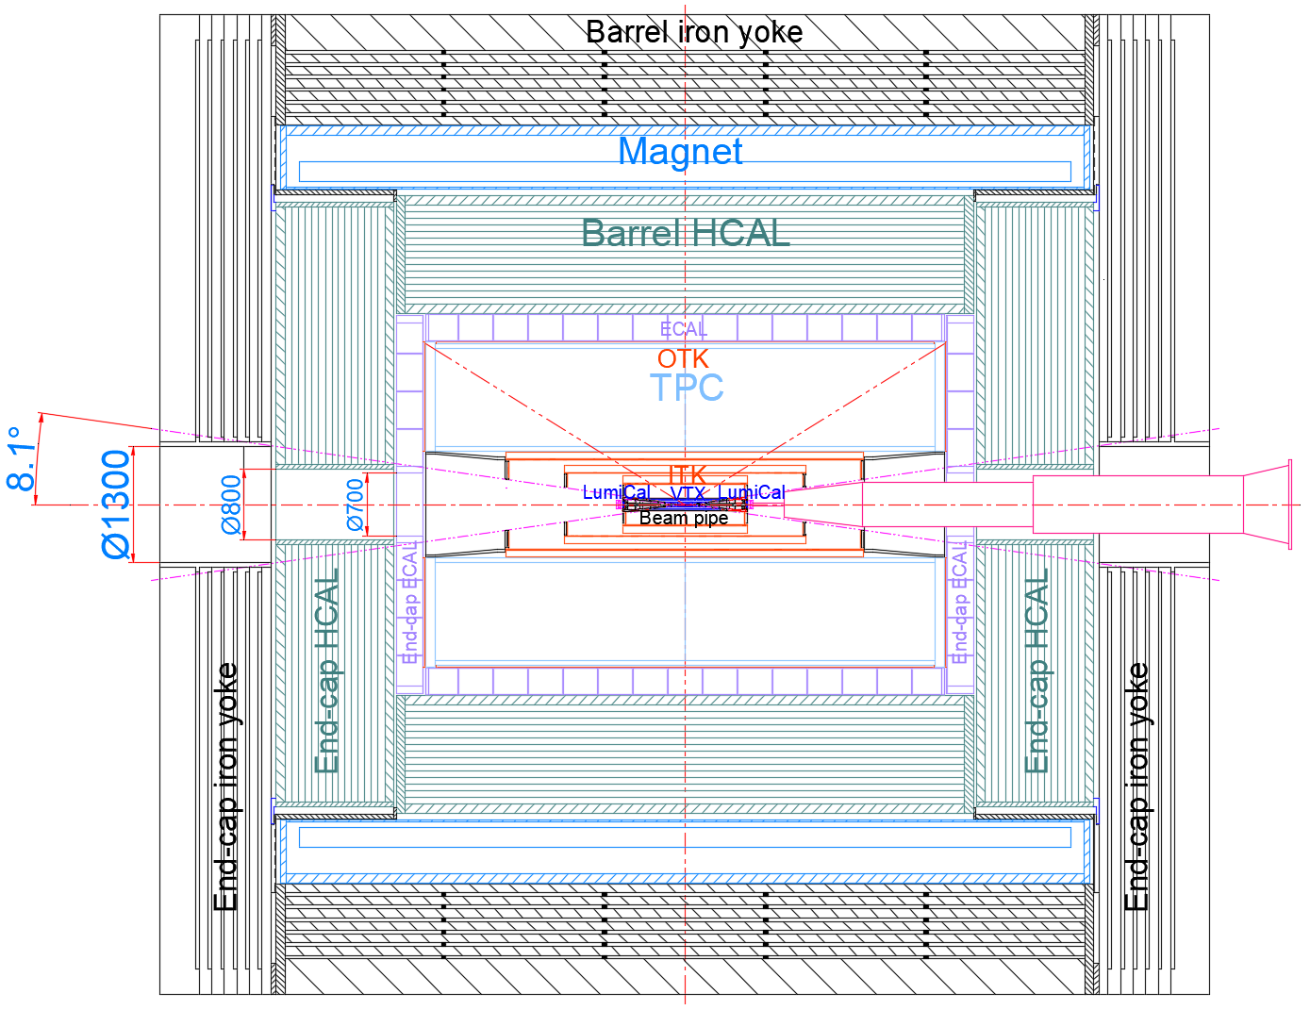
Report on the meeting
Reports on accelerators
1. Tunnel section (4-2):
王海静 - Overall mechanical design and requirements
1. Design of support and adjustment for tunnel equipment
Tunnel equipment :
Magnets
vacuum chamber
Beam Measurement Equipment
High-Frequency Module
2. MDI Design
Interface design between of the Acc and the Det
3. Collimator

Slide 8
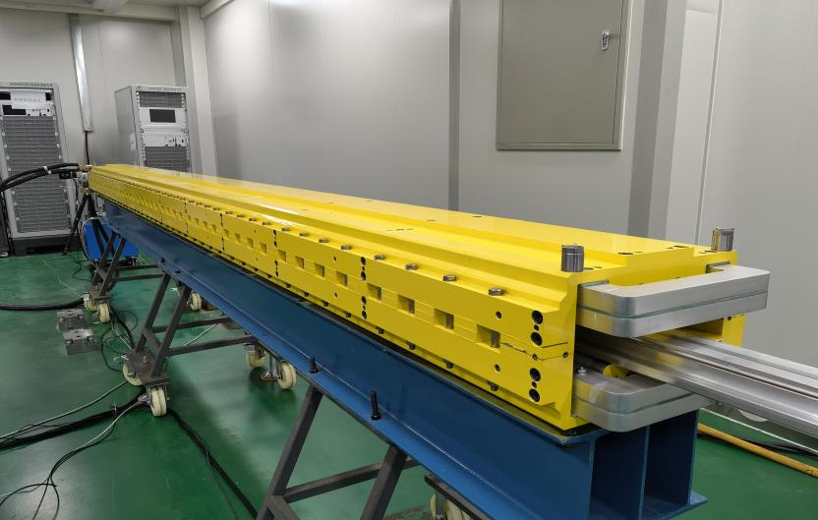
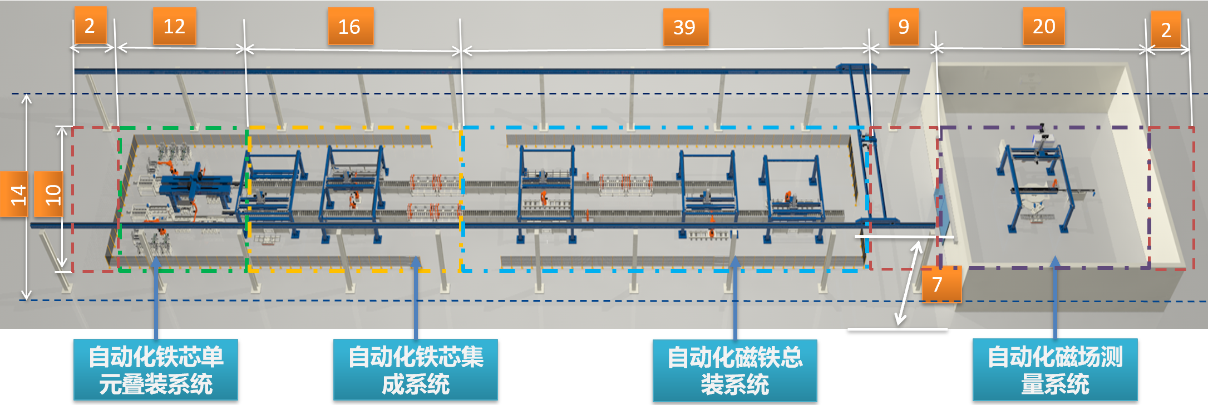
Report on the meeting
Reports on accelerators
1. Tunnel section (4-3):
康文 – Magnet Design
Dipole Magnet
Automated production line
总数量：20000 + 27000

Slide 9
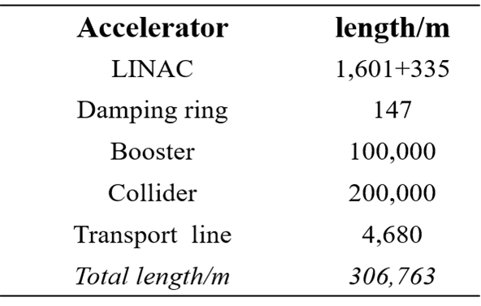
Report on the meeting
Reports on accelerators
1. Tunnel section (4-4):
马永胜 – Vacuum Design
Characteristic 1 : Huge quantity
Main processes :
NEG薄膜
烘烤
Production Line
Increase Efficiency
Characteristic 2 : high vacuum
Static pressure : 10⁻⁸ torr

Slide 10
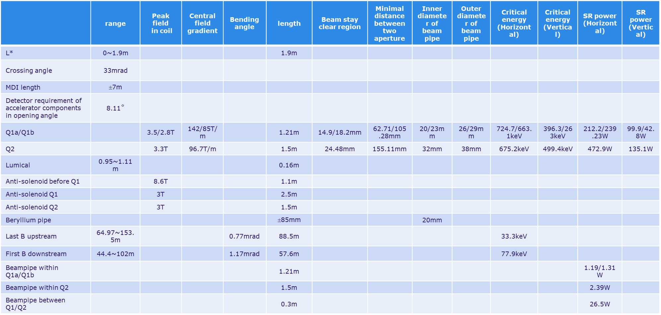
Report on the meeting
Reports on accelerators
2. MDI (4-1):
白莎 石澔玙 – Background, Heat load, Be pipe, Collimator, Fast Luminosity Detector,
Shield, SC Magnet, LumiCAL, BPM……
MDI Parameters

Slide 11
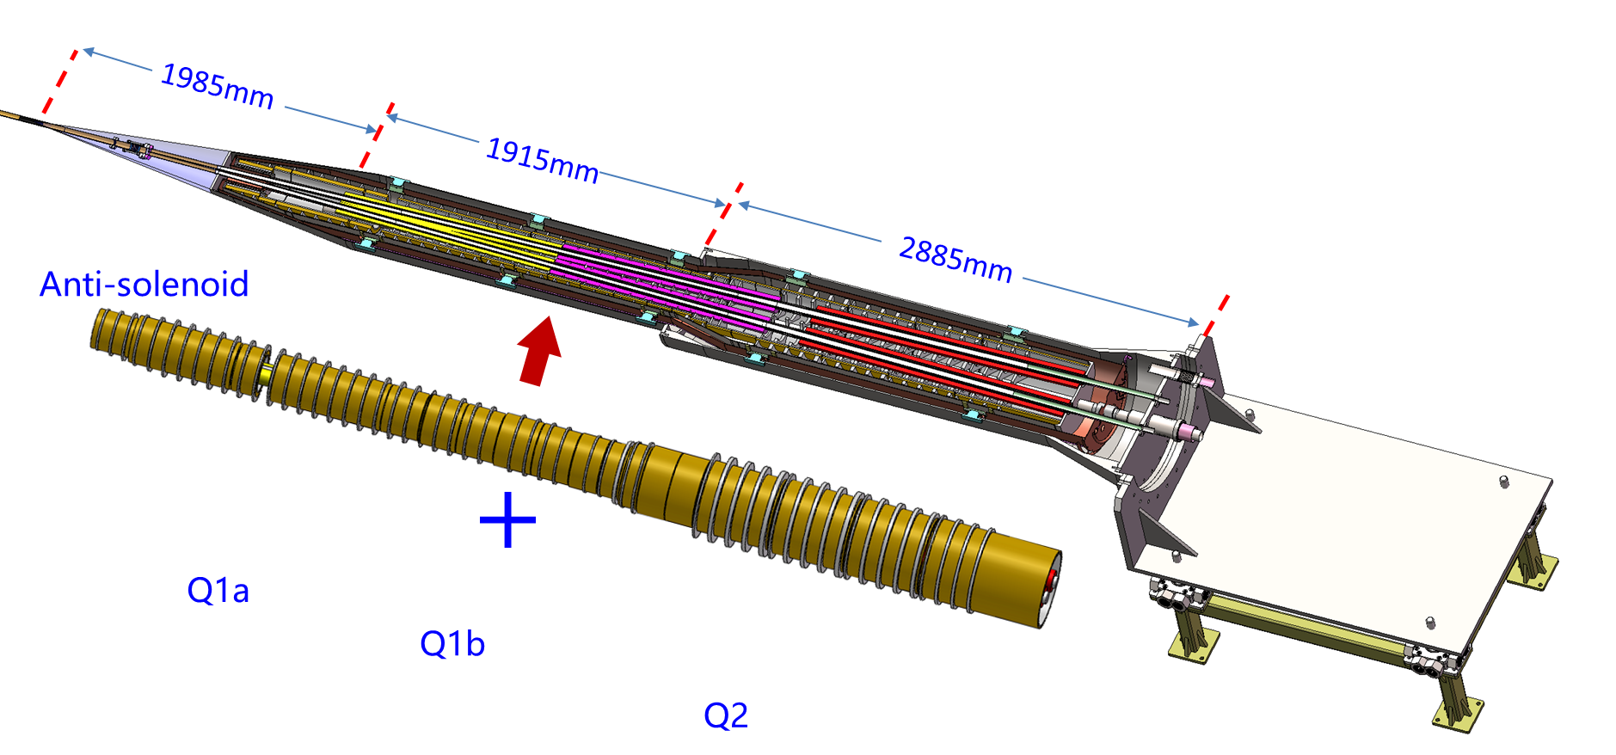
Report on the meeting
Reports on accelerators
2. MDI (4-2):
张祥镇 杨啸辰 – Cryostat
Structural design of the cryostat
Simulation
Current leads design
研究新的增强传热方案
探索固有无霜特性

Slide 12
Report on the meeting
Reports on accelerators
2. MDI (4-3):
朱应顺 – IR SC Magnet
Main parameters :
Length : ≈ 5600 mm
Diameter : ≈ 500 mm
Weight : ≈ 3 t
Difficulty：
Placement of four superconducting magnets in a narrow and elongated space

Slide 13
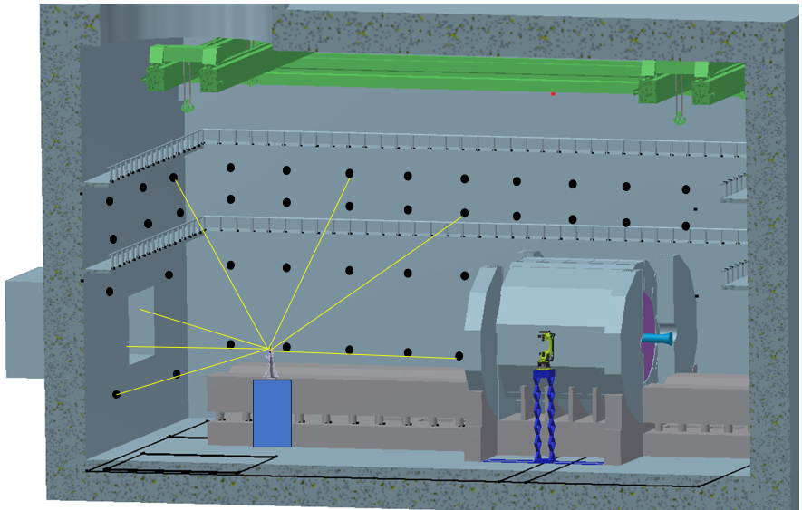
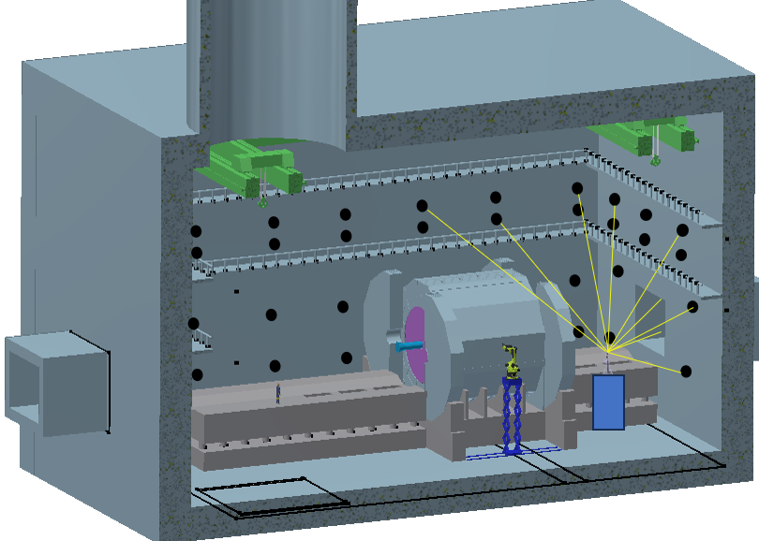
Report on the meeting
Reports on accelerators
2. MDI (4-4):
王小龙 – MDI Collimation Scheme
准直控制网
准直方案将会随着
探测器具体设计
探测器安装方案设计
不断更新和优化
激光跟踪仪
测量平台

Slide 14
Report on the meeting
Reports on detectors
1. Overall mechanical design
纪全 – Overall mechanical installation design of detectors
Suggestion : Prioritize pre installed point installation solutions

Slide 15
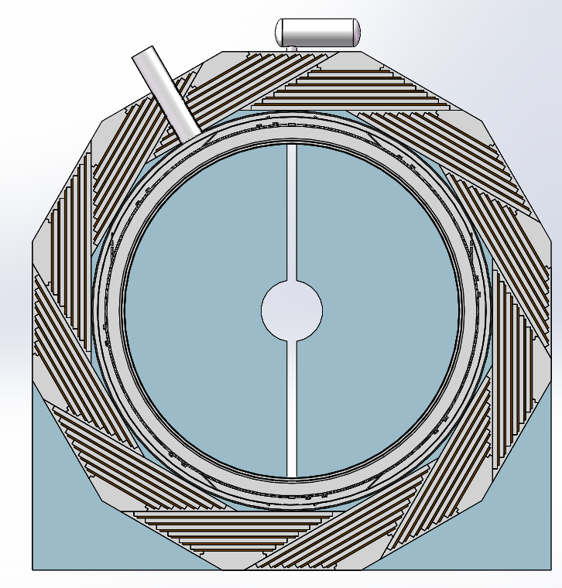
Report on the meeting
Reports on detectors
2. Muon, Yoke and Magnet
Design yoke iron based on the requirements of muon and magnet
轭铁(Muon : 王小龙)
中信重工 : 工艺可行性
夏商 : 过程变形控制
超导磁铁 : (宁飞鹏)
连接结构 : 裴亚田
内部支撑 : 侯治龙

Slide 16
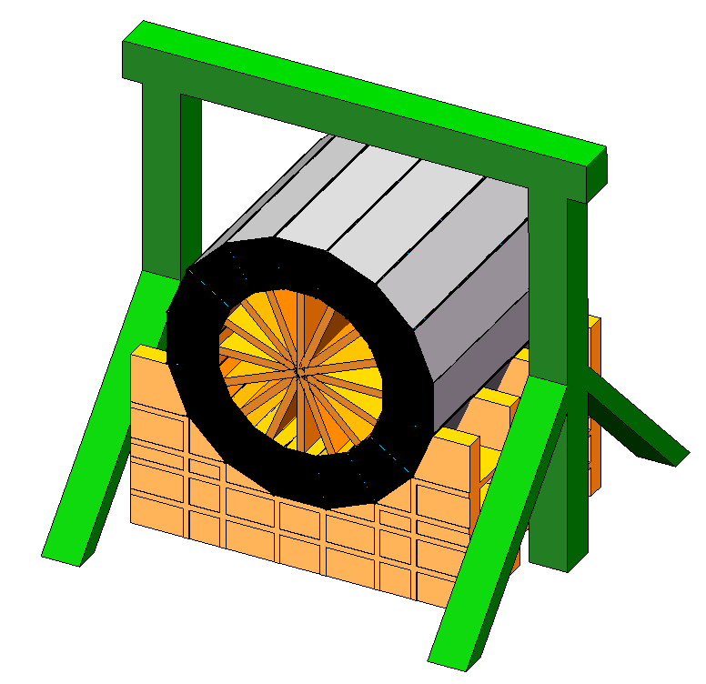
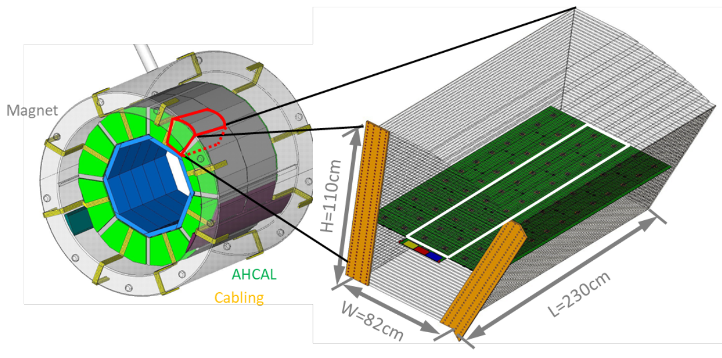
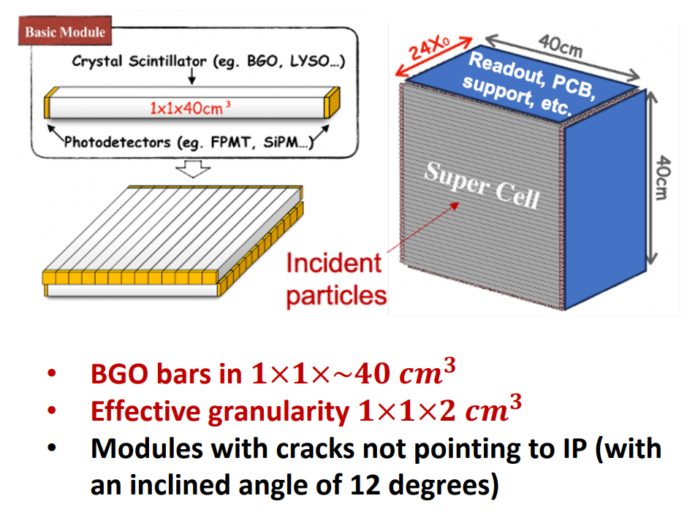
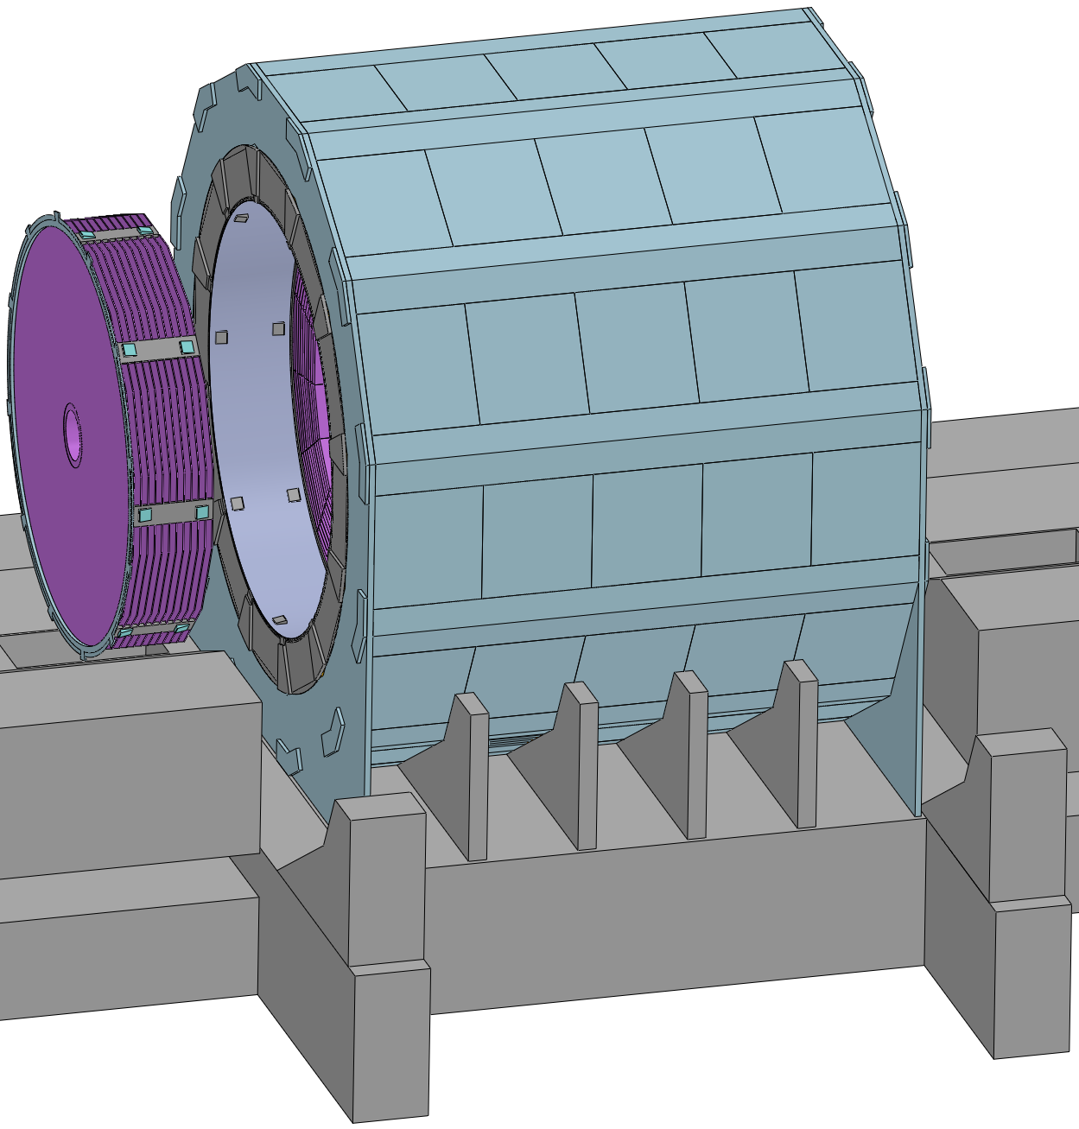
Report on the meeting
Reports on detectors
3. HCAL and ECAL (刘勇)
HCAL(钱森) Mechanical Design
裴亚田，张俊嵩
ECAL Mechanical Design
侯少静

Slide 17
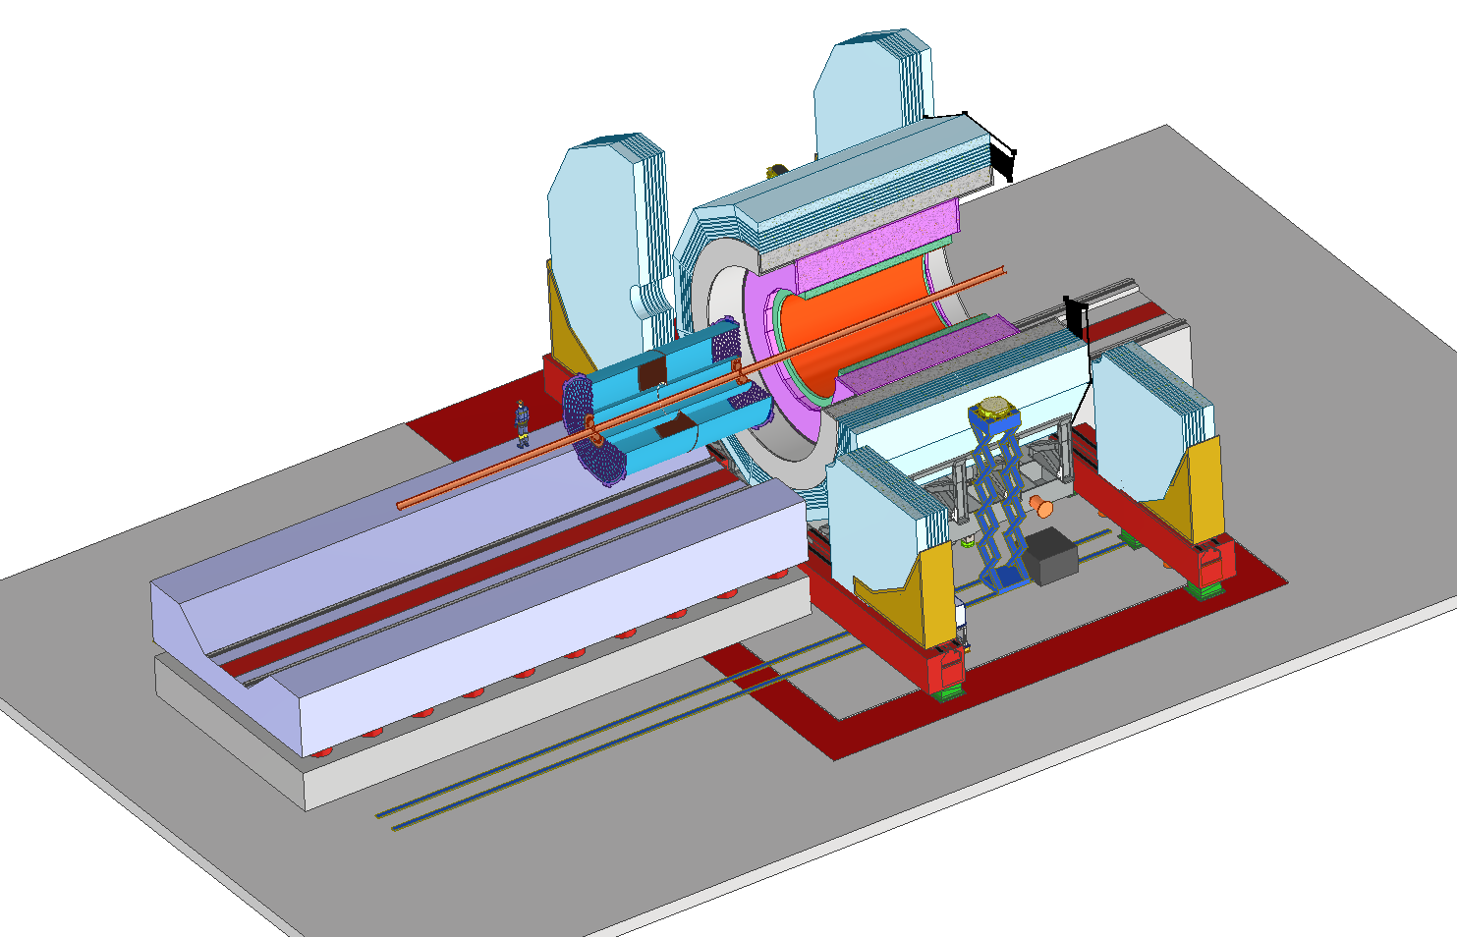
Report on the meeting
Reports on detectors
4. TPC (祁辉荣)
TPC Mechanical Design : 张俊嵩

Slide 18
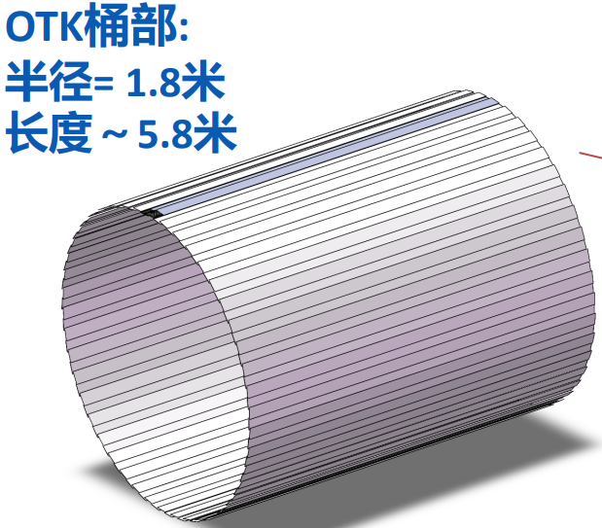
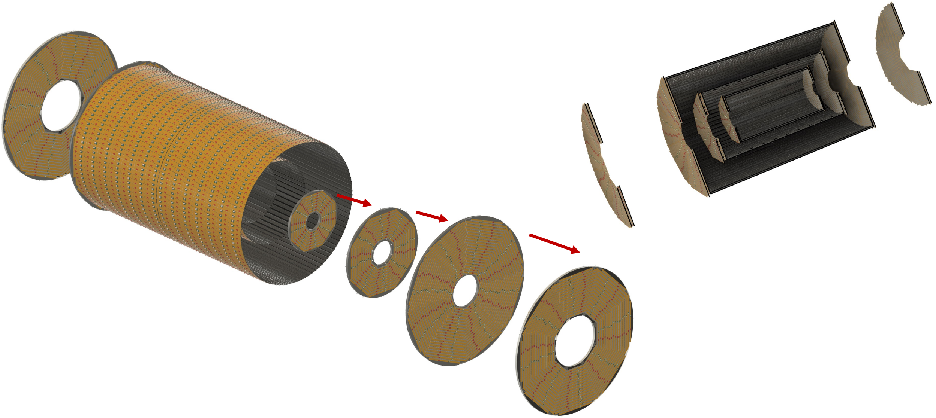
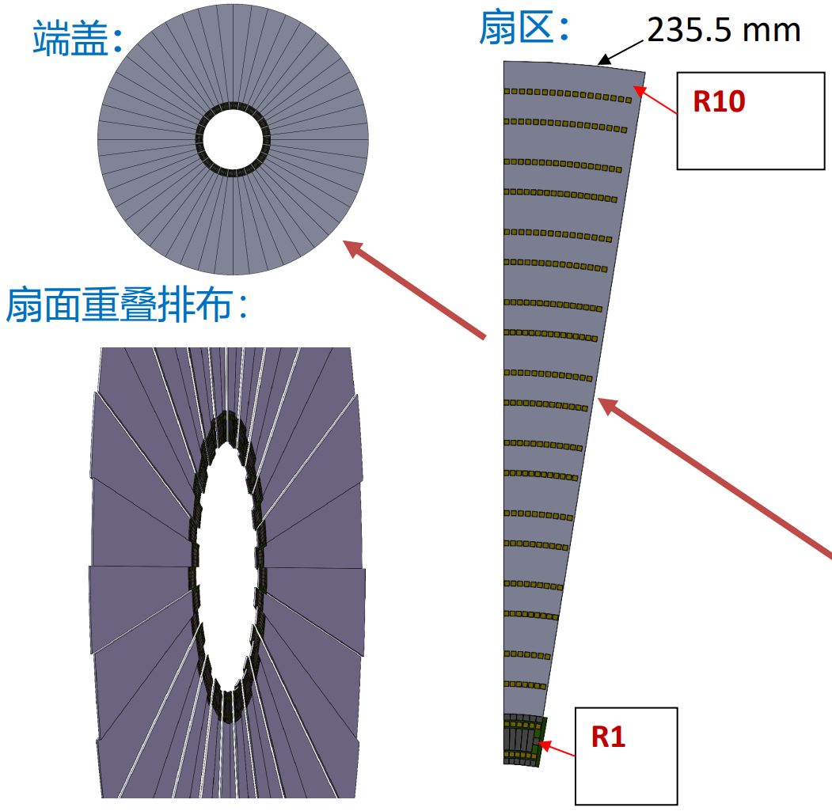
Report on the meeting
Reports on detectors
5. ITK and OTK (严琪)
ITK Mechanical Design : 张奕晗, 骆首栋

Slide 19
Report on the meeting
Reports on detectors
5. Vertex (梁志均)

Slide 20
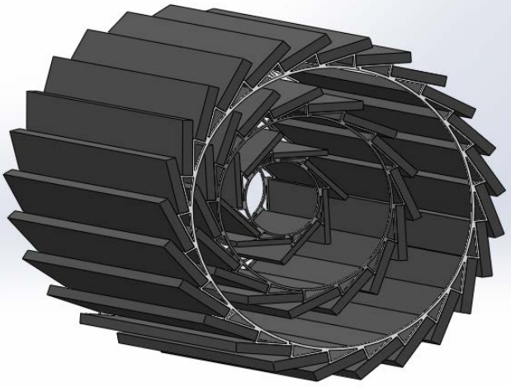
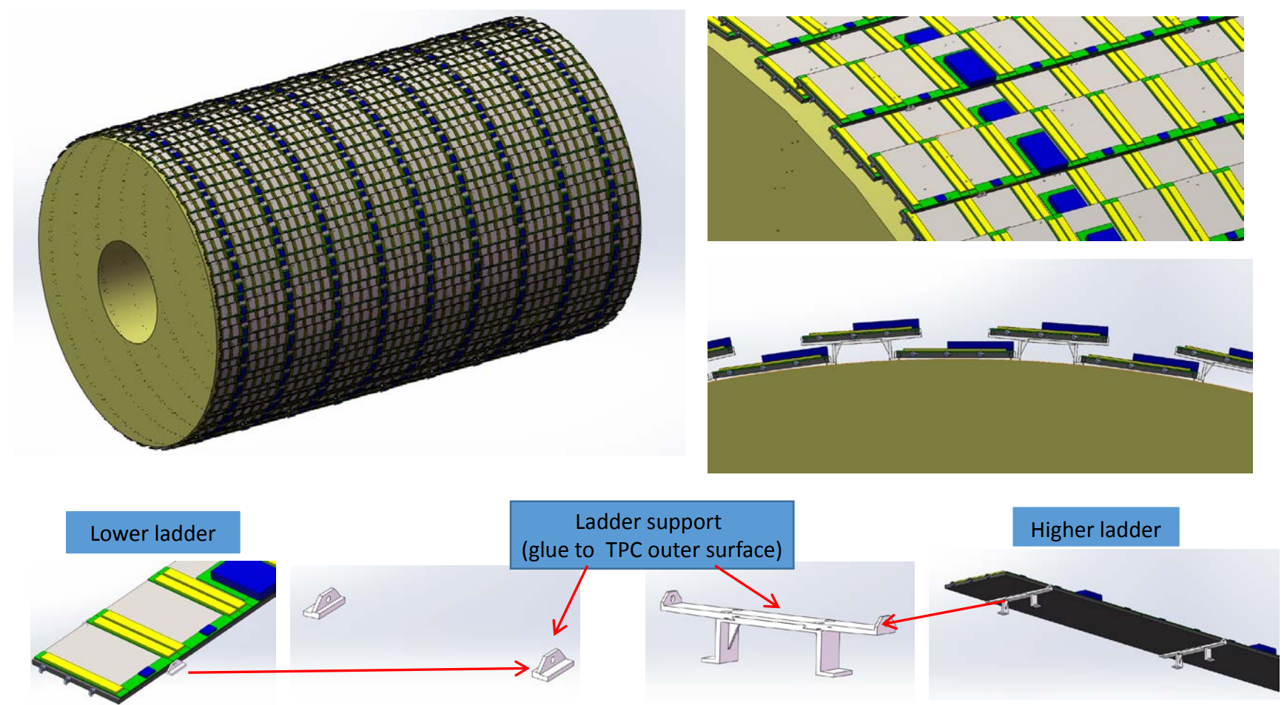
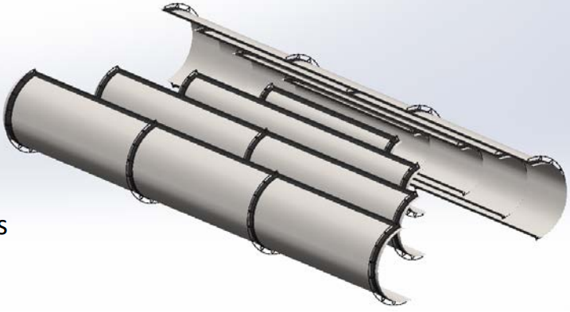
Report on the meeting
Reports on detectors
6. Mechanical design of OTK and Vertex (付金煜)
OTK
Vertex

Slide 21
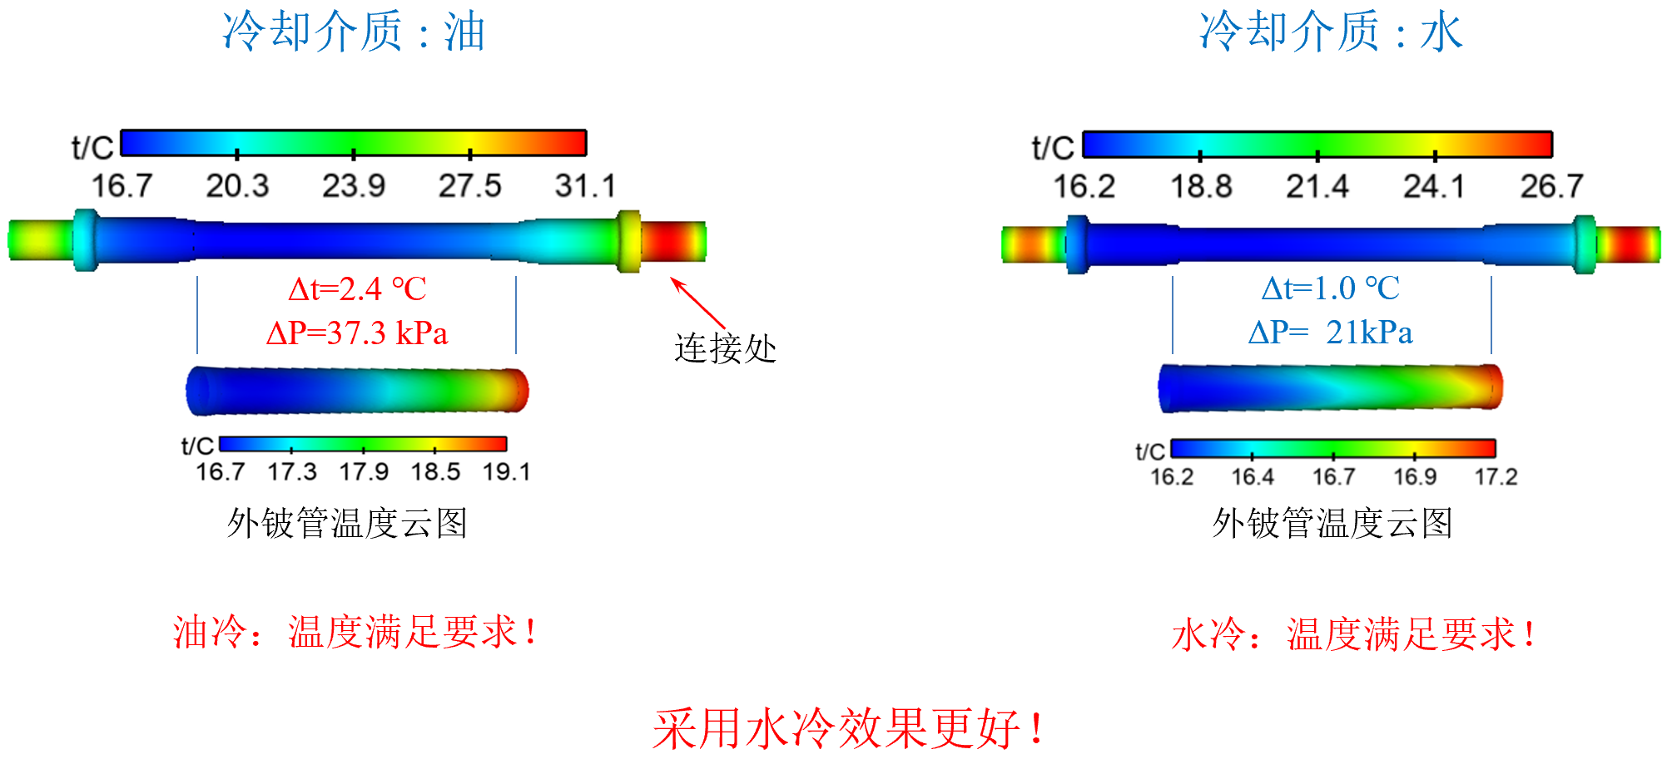
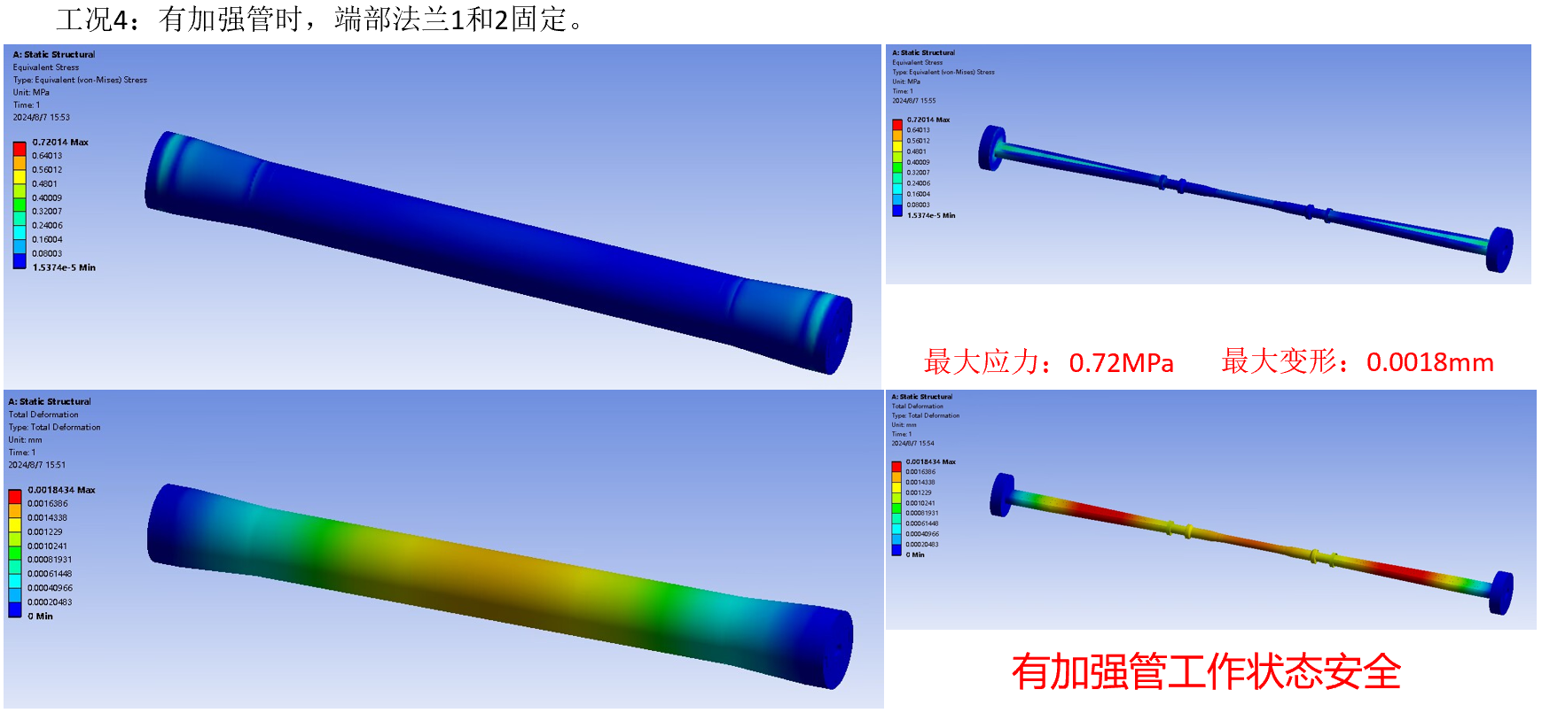
Report on the meeting
Reports on detectors
7. Mechanical design of beampipe(何龙岩)

Slide 22
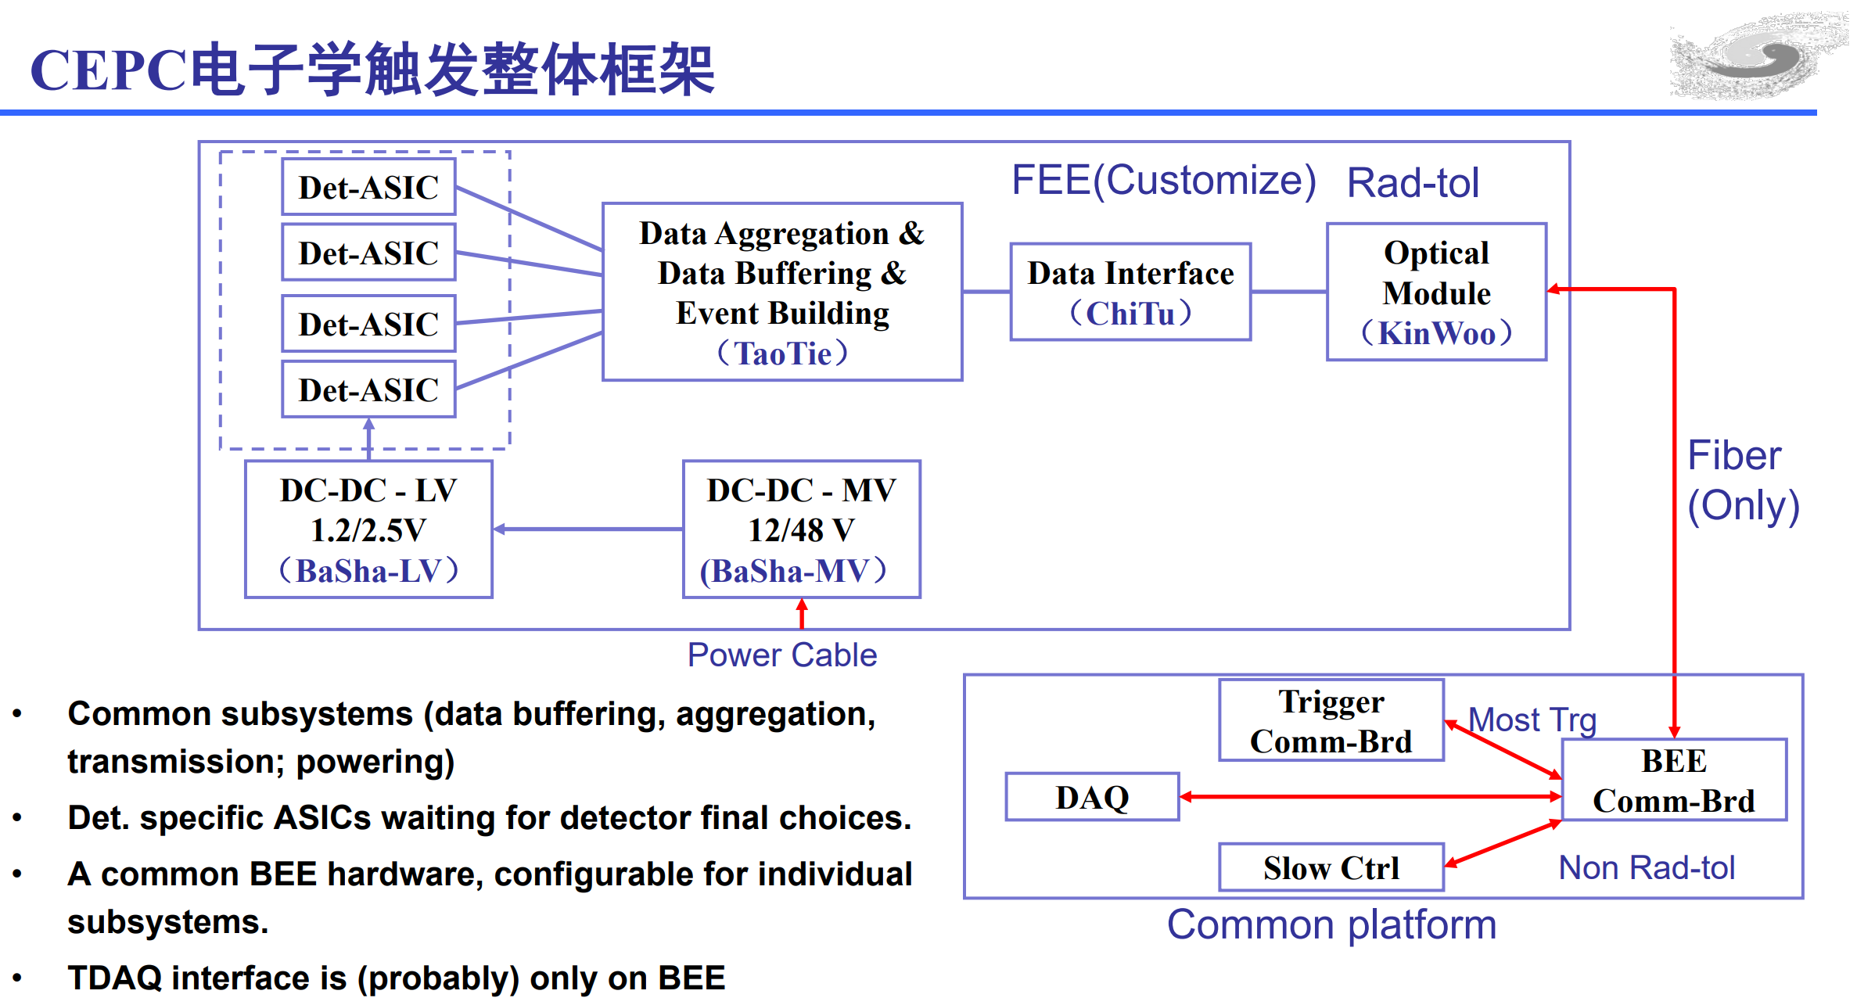
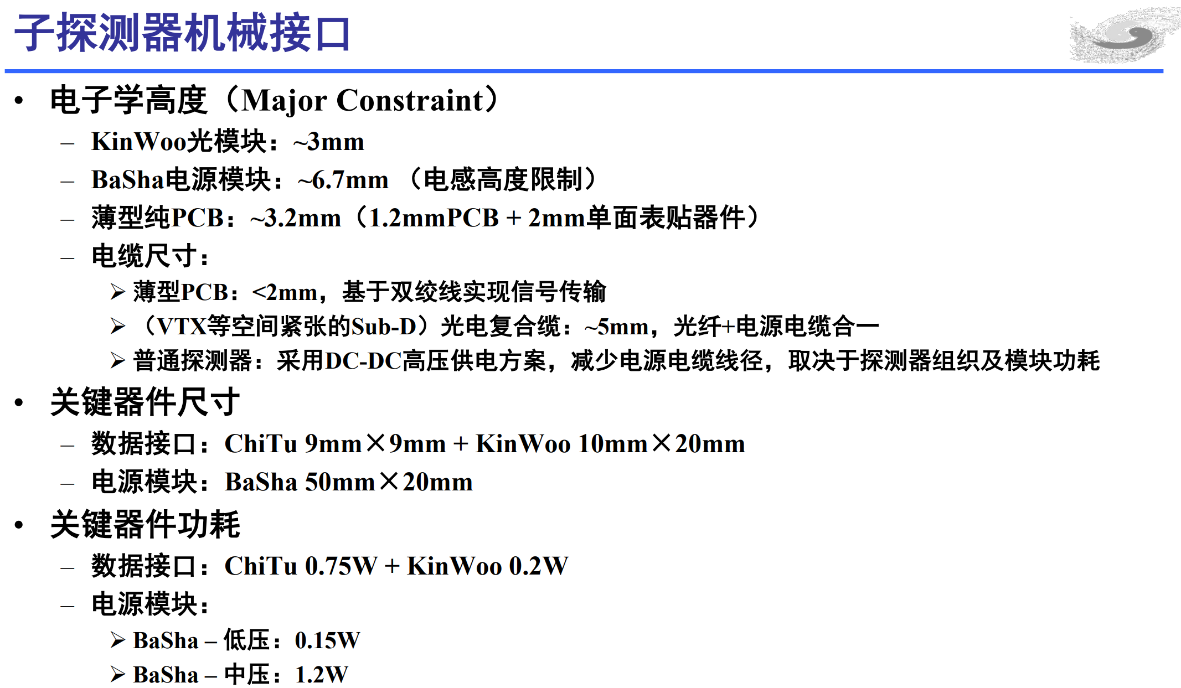
Report on the meeting
Reports on detectors
8. Electronics (魏微)
CEPC Electro-mechanical Interface Requirements and Considerations

Slide 23
Report on the meeting
Reports on detectors
9. Software (李卫东, 傅成栋, 林韬)

Slide 24
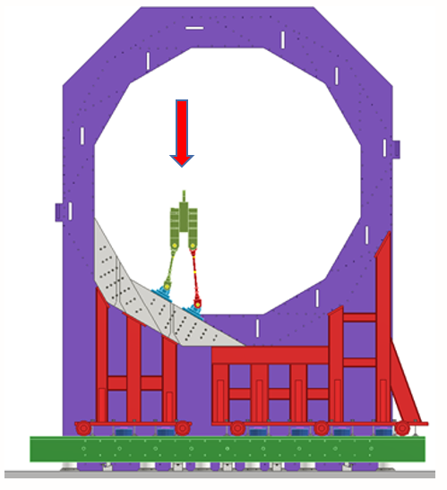
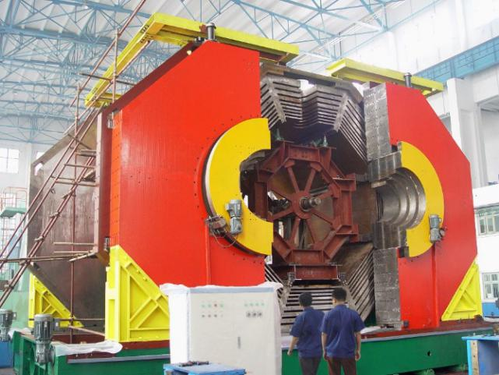
Report on the meeting
Reports on detectors
10. 轭铁“0”工装工艺研究 (中信重工徐侠剑)
BSEIII YOKE
CEPC YOKE

Slide 25
Discussion at the end of the meeting
1. Alignment precision during installation and positioning
2. Layout of detector experimental room and auxiliary room
3. Installation scheme of detectors

Slide 26
Discussion at the end of the meeting
1. Alignment precision during installation and positioning
 | Shape tolerance(mm) | Installation(mm) | Position(mm)
Yoke | ± 1 | None | None
Magnet | Outer: 0 to -5, Inner: 0 to +5 | None | ± 0.2
HCAL | Outer: 0 to -5, Inner: 0 t0 +5 | ± 2 | ± 0.5
ECAL | Outer: 0 to -5, Inner: 0 t0 +5 | ± 2 | ± 0.5
TPC | Outer: 0 to -2, Inner: 0 t0 +2 | ± 2 | ± 0.3
ITK | Outer: 0 to -2, Inner: 0 t0 +2 | ± 2 | ± 0.3
Beampipe | Outer: 0 to -0.3, Inner: 0 t0 +0.3 | ± 0.5 | ± 0.1
Note：
1. Using the shape dimensions of the yoke as the installation reference
2. Use the inner dimensions of the sub-detector as the installation reference
3. Parameter : Coaxiality

Slide 27
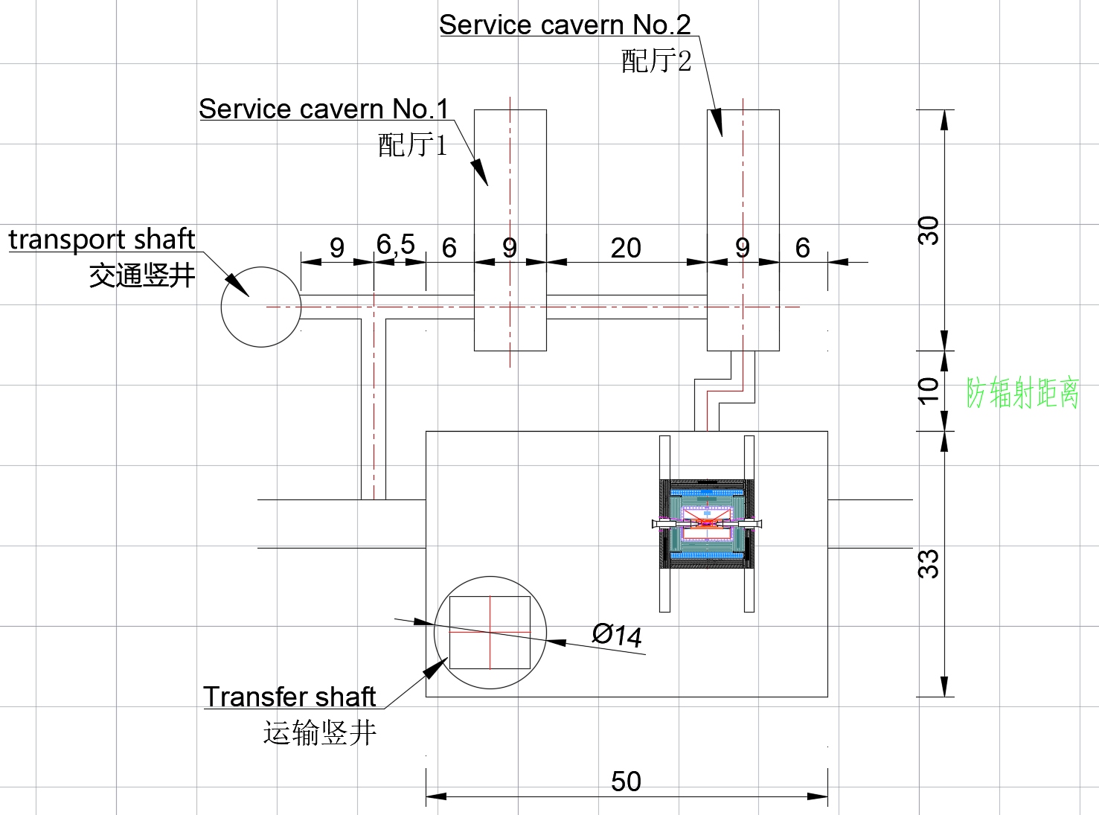
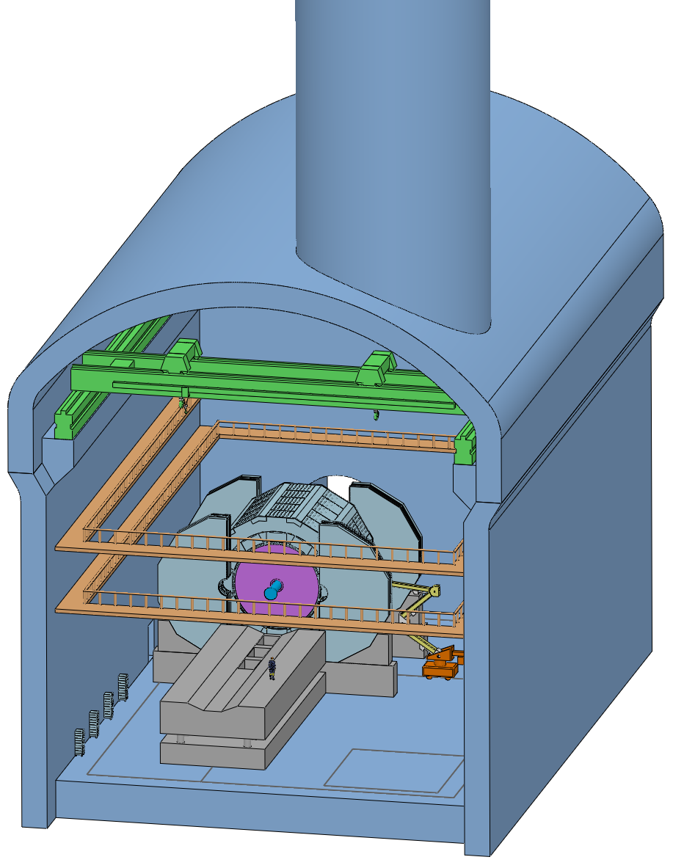
Discussion at the end of the meeting
2. Layout of detector experimental room and auxiliary room
Electronics (王铮, 魏微)
主厅机柜: 数量待定
配厅机柜: 数量待定
配厅占地面积: 1800 m²
Magnet(宁飞鹏)
配厅占地面积 : 60 m²
设备：超导电源、失超保护设备
冷却水等
其它
冷却系统
环境要求
电功率, 地线及其路径

Slide 28
Discussion at the end of the meeting
3. Installation scheme of detectors
Prioritize the installation scheme of pre-installation points for the detector
Common points of the two schemes :
The installation method of the sub-detectors is the same
Difference between the two schemes :
Installation scheme for the collision point : No need to move
Installation scheme for the pre-installation point : Moving from pre-installation point to collision point

Slide 29
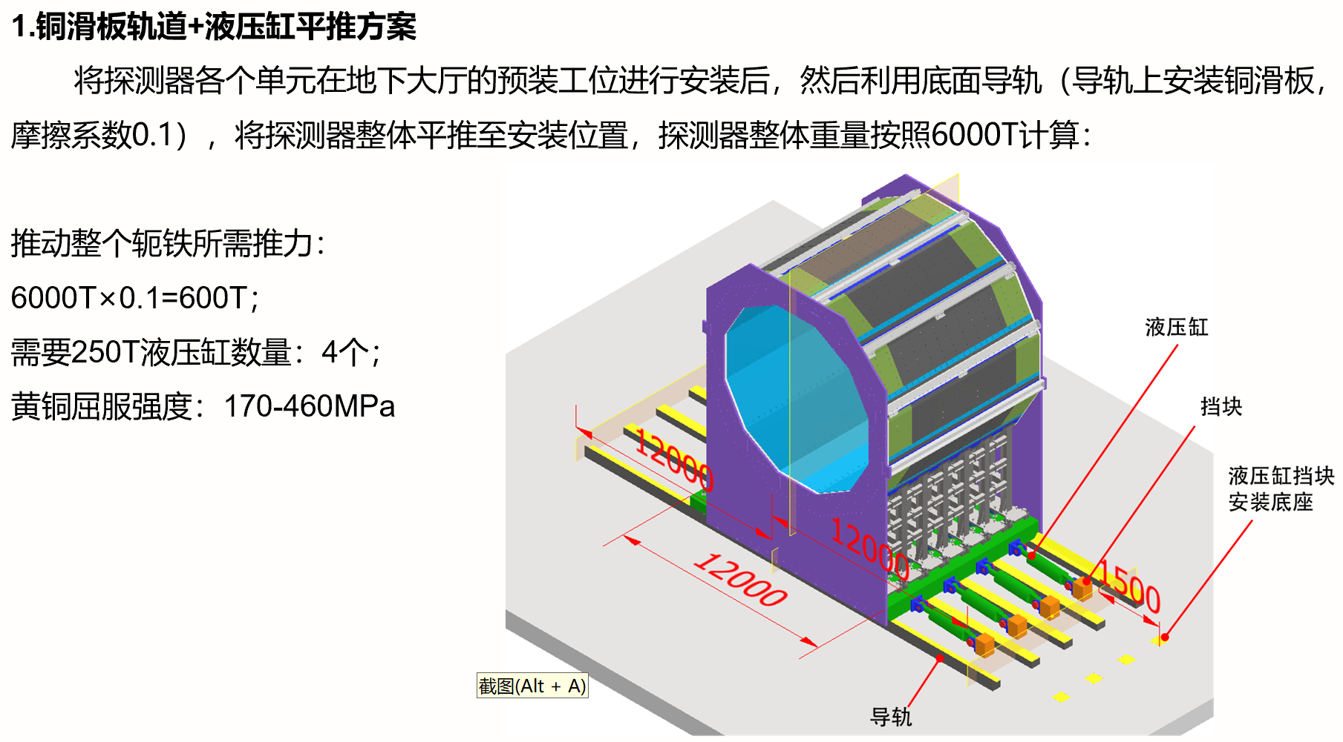
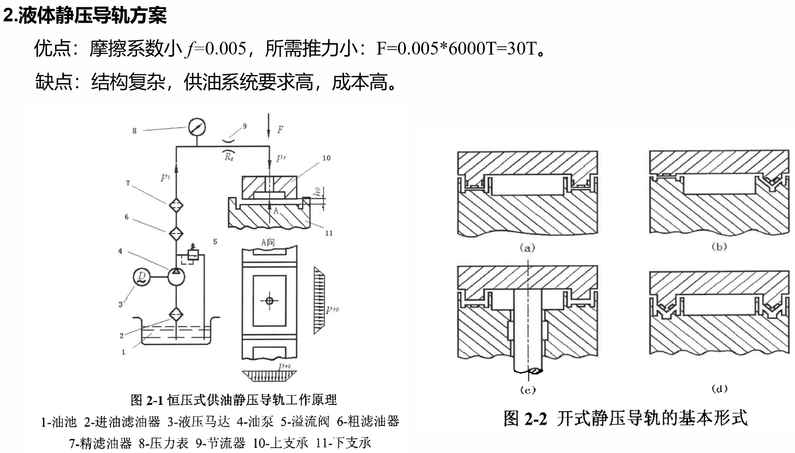
Discussion at the end of the meeting
3. Installation scheme of detectors
Characteristics of the pre-installation point installation scheme
1. Feasible mobile scheme
2. Reserve reasonable space
1.1 Feasible mobile scheme - 1
1.2 Feasible mobile scheme - 2
两个移动方案(中信重工)

Slide 30
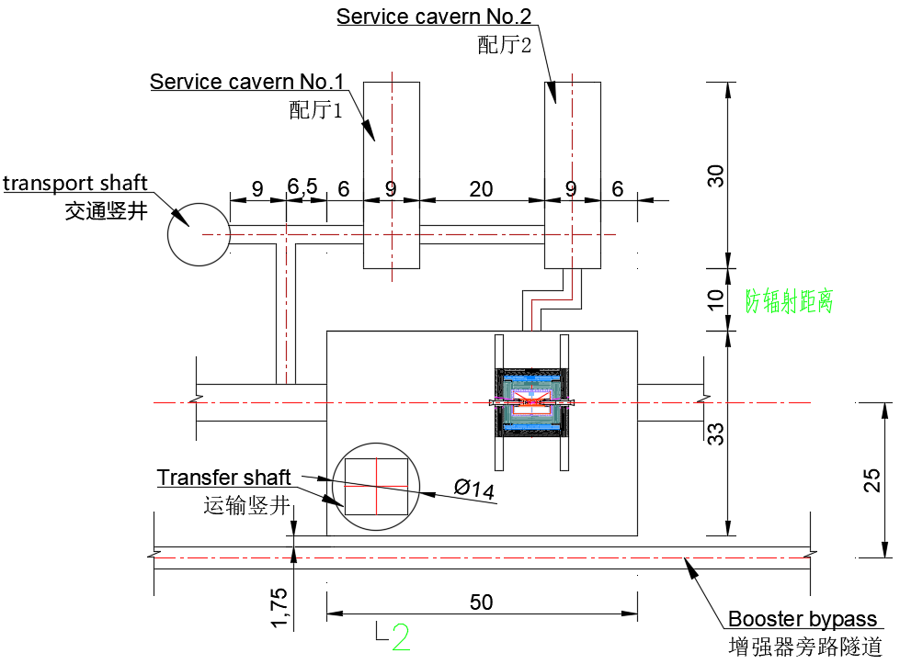
Discussion at the end of the meeting
3. Installation scheme of detectors
Characteristics of the pre-installation point installation scheme
1. Feasible mobile scheme
2. Reserve reasonable space
Difficulty :
Main room between the Service room and
the booster tunnel……
Optimization of the layout
Simultaneously installing detectors
at pre-installation points and collision points
within the same main room area

Slide 31
Work plan after the meeting
第0版的Baseline
第1版总图
子探测器之间的间隙 : 10 mm
MDI 的接口边界 : 锥角加阶梯孔
各子探测器的尺寸分布
电子学引线空间
仿真模拟和实际调研结合，验证10mm可行性
结合准直、安装和ACC Components，验证接口边界
细化子探测器结构和参数，验证尺寸分布合理性
优化引线空间，合理布置引线路径
各子探测器的连接结构
各子探测器的安装方案
各子探测器的机械组装、探测器组装最优可行性

Slide 32
Thank you for your attention!
Aug. 7th, 2024, CEPC Detector Ref-TDR Review

