Slide 1
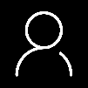
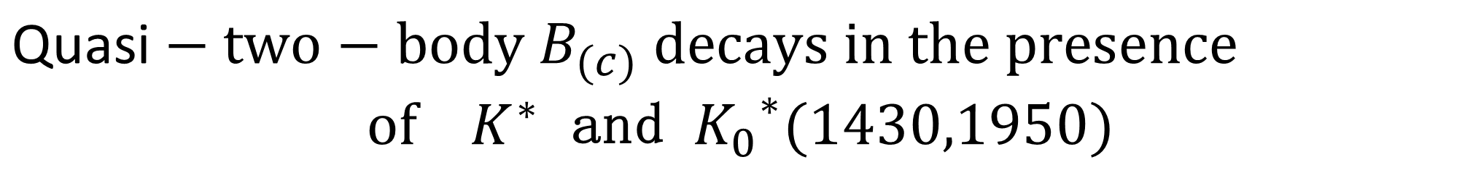
${\text{Quasi}−two−body B}_{(c)}$ $decays in the presence$
$of { K}^{∗}$ and ${K_{0}}^{∗}(1430,1950)$
张志清
河南工业大学
第六届粒子物理天问论坛@洛阳
2024年11月10日

Slide 2

Outline
01
Introduction
02
Framework$of the PQCD approach$
$${Quasi−two−body decays B}_{(s)}→K^{∗}γ→Kπγ$$
03
04
$${Quasi−two−body decays B}_{c}→K^{∗}P→KπP$$
05
$${Quasi−two−body decays B}_{c}→{K_{0}}^{∗}(1430,1950)D_{(s)}→KπD_{(s)}$$
06
02
Summary

Slide 3
01
Introduction
1. A lot of experimental studies on the three-body B meson decays have been performed in recent years.
2. Many new resonance states are observed in the invariant mass distribution of
three-body decays.
3. These decays involve much more complicated QCD dynamics compared with two-body decays.
4. Large direct CP asymmertries in localized regions of the phase space for three-body decays are observed.

Slide 4
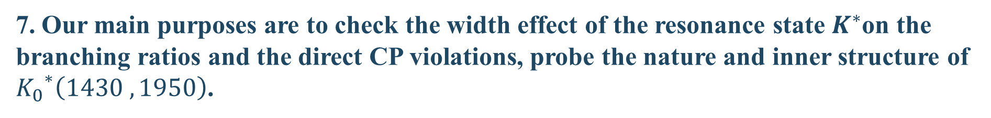
01
Introduction
5. When two particles move collinearly and the bachelor particle recoils back in the three-body decays, which can be considered as the quasi-two-body decays.
6. Based on the quasi-two-body mechanism, the two-meson distribution amplitudes
(DAs) are introduced into the PQCD approach.
7. Our main purposes are to check the width effect of the resonance state $K^{∗}$on the branching ratios and the direct CP violations, probe the nature and inner structure of ${K_{0}}^{∗}\left(1430 ,1950\right)$.

Slide 5



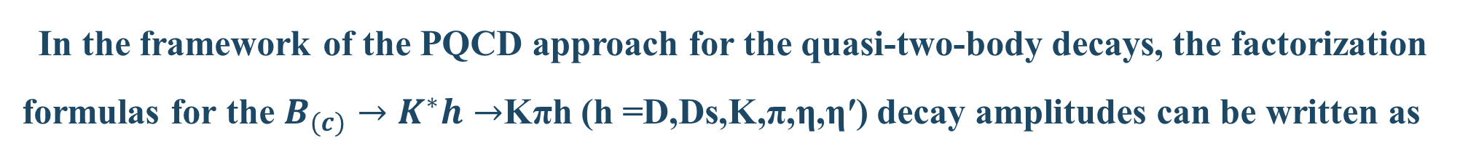
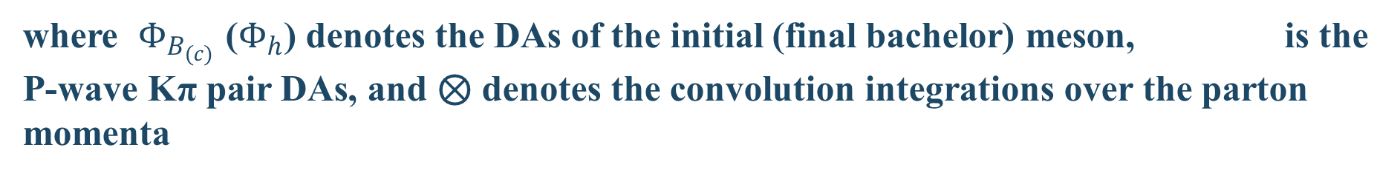
02
Framework$of$ t$he PQCD approach$
In the framework of the PQCD approach for the quasi-two-body decays, the factorization formulas for the $B_{(c)}→K^{∗}h→$Kπh (h =D,Ds,K,π,η,η′) decay amplitudes can be written as
where $Φ_{B_{(c)}}$ ($Φ_{h}$) denotes the DAs of the initial (final bachelor) meson, is the P-wave Kπ pair DAs, and ⊗ denotes the convolution integrations over the parton momenta
The nonperturbative dynamics are absorbed into those DAs.

Slide 6
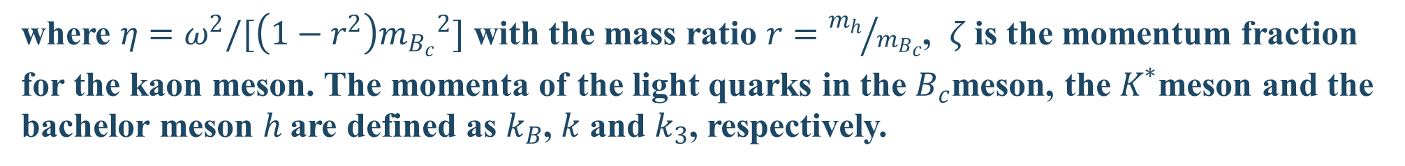
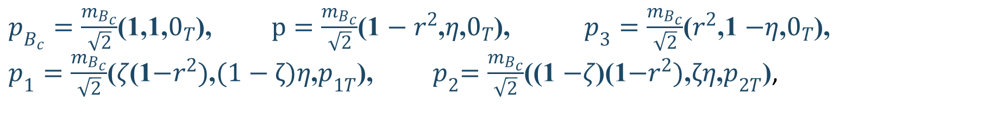
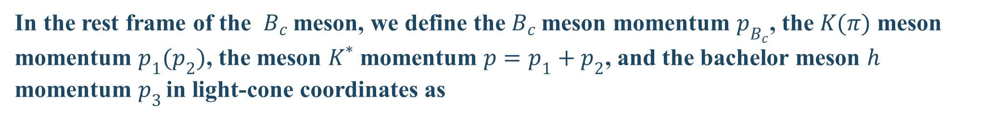

02
Framework$of$ t$he PQCD approach$
We take the quasi-two-body decays $B_{c}$ $→K^{∗}h→Kπh$ as examples to define the dynamical variables for the mesons and quarks
In the rest frame of the $B_{c}$meson, we define the $B_{c}$meson momentum $p_{B_{c}}$, the $K(π)$ meson
momentum $p_{1}{(p}_{2})$, the meson $K^{∗}$momentum $p=p_{1}+p_{2}$, and the bachelor meson $h$
momentum $p_{3 }$in light-cone coordinates as
$p_{B_{c}}=\frac{m_{B_{c}}}{\sqrt{2}}$(1,1,$0_{T}$), $p=\frac{m_{B_{c}}}{\sqrt{2}}$(1 $− r^{2}$,$η$,$0_{T}$), $p_{3}=\frac{m_{B_{c}}}{\sqrt{2}}$($r^{2}$,1 $−η$,$0_{T}$),
$p_{1}=\frac{m_{B_{c}}}{\sqrt{2}}$($ζ$(1$−r^{2})$,$(1−ζ)η$,$p_{1T}$), ${ p}_{2}=\frac{m_{B_{c}}}{\sqrt{2}}$((1 $−ζ$)(1$−r^{2})$,$ζη$,$p_{2T}$),
where $η=ω^{2}/[\left(1−r^{2}\right){m_{B_{c}}}_{}^{2}]$ with the mass ratio $r={m_{h}}/{m_{B_{c}}}$, $ζ$ is the momentum fraction
for the kaon meson. The momenta of the light quarks in the $B_{c}$meson, the $K^{∗}$meson and the
bachelor meson $h$are defined as $k_{B}$, $k$ and $k_{3}$, respectively.

Slide 7
02
Framework$of$ t$he PQCD approach$
If a hard amplitude develop an end-point singularity, $k_{T}$factorization should be employed,
where the transver momenta $k_{T }$of quark and gluon propergators are included.
When considering the radiative corrections to meson wave functions, the double logarithms
$\ln^{2}Pb$ are organzied into the Sudakov factor exp[-s(P,t)] by using the $k_{T}$-resumation.
The large double logrithmes $α_{s}\ln^{2}x$ appearing in the radiative corrections are organzied into a jet function by using the threshould resummation .

Slide 8


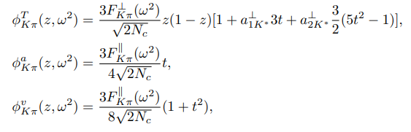

03
Quasi-two-body decays $B_{(s)}→K^{∗}γ→Kπγ$
In the PQCD approach, the main input parameters come from the wave functions of initial
and final mesons.

Slide 9
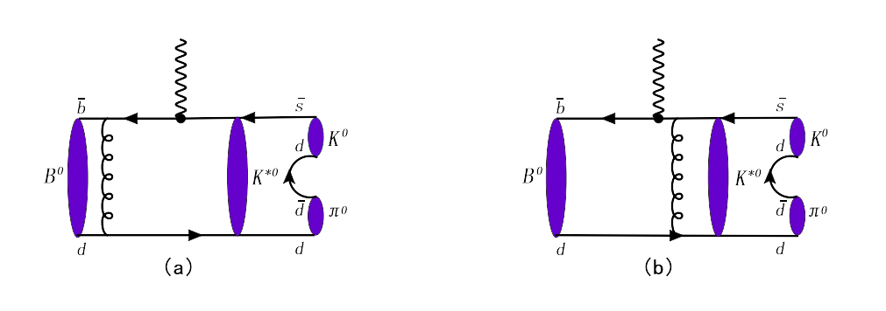
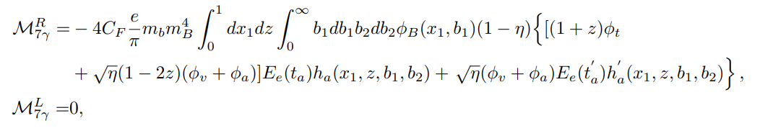
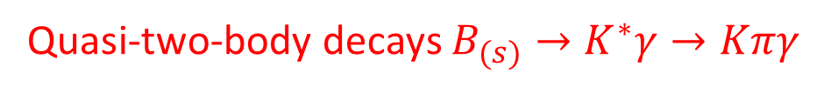
03
Quasi-two-body decays $B_{(s)}→K^{∗}γ→Kπγ$
（1）Feynman diagrams from the operator O_{7γ}

Slide 10
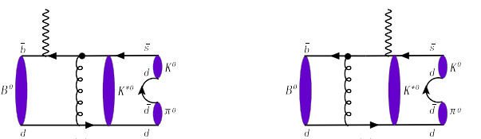
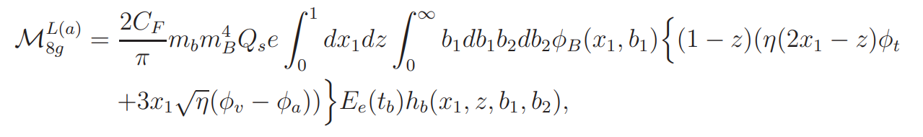
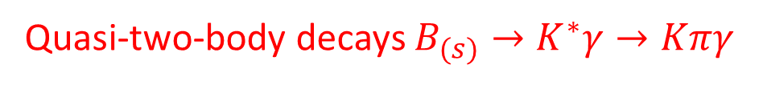
03
Quasi-two-body decays $B_{(s)}→K^{∗}γ→Kπγ$
（2）Feynman diagrams of chromomagnetic pengtuin opertor O_{8g,} where a hard gluon is emitted from the O_{8g} operator and photon is emitted via the bremsstrahlung of texternal quark lines.

Slide 11
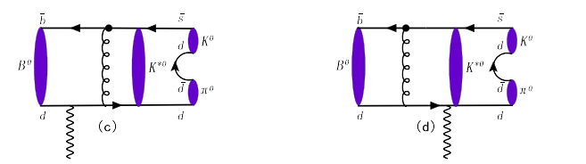

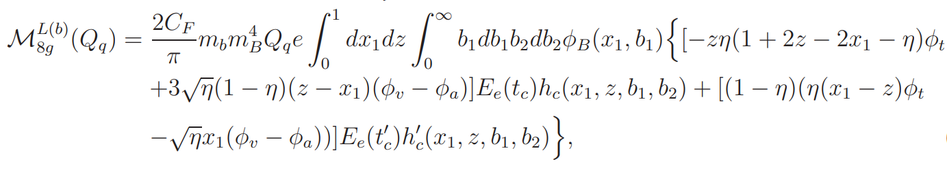

03
Quasi-two-body decays $B_{(s)}→K^{∗}γ→Kπγ$
（2） Feynman diagrams of chromomagnetic pengtuin opertor O_{8g,} where a hard gluon is emitted from the O_{8g} operator and photon is emitted via the bremsstrahlung of texternal quark lines.

Slide 12
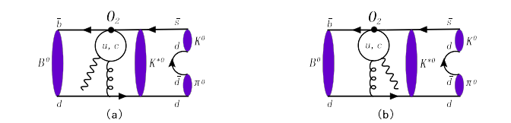
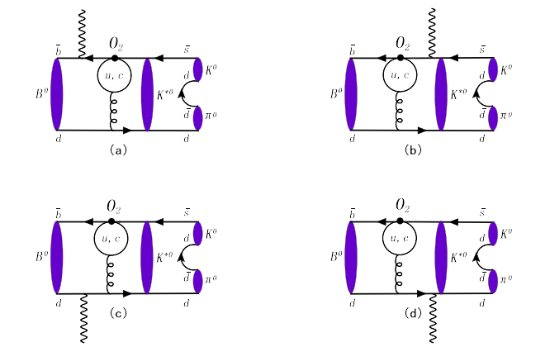
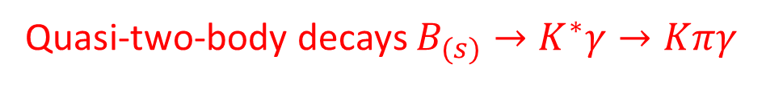
03
Quasi-two-body decays $B_{(s)}→K^{∗}γ→Kπγ$
（3）Quark-loop diagrams from the operator O₂ with the photon being emitted from the quark loop.
（4）Quark-loop diagrams from the operator O₂ with the photon being emitted from an external quark.

Slide 13
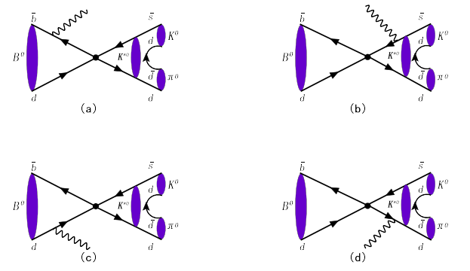
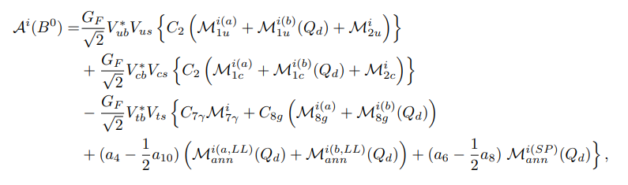

03
Quasi-two-body decays $B_{(s)}→K^{∗}γ→Kπγ$
（5）Annihilation diagrams by tree and penguin operators.
By combining these amplitudes from the different Feynman diagrams, one can get the total decay amplitdues for our considered decays ：
where i=R，L correspond to the contributions from the right-handed and left-handed photons, respectively.

Slide 14
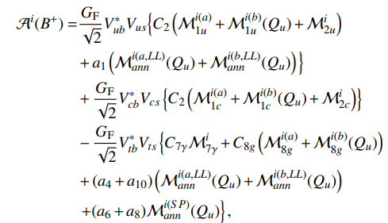


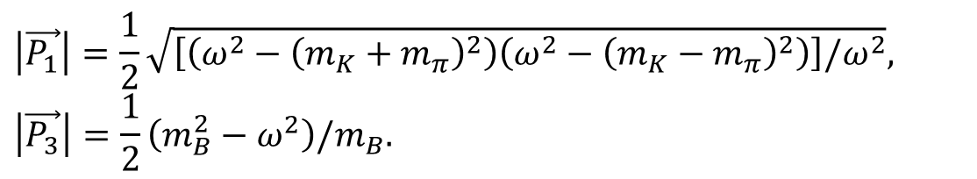
03
Quasi-two-body decays $B_{(s)}→K^{∗}γ→Kπγ$
Then the differential decay rate is written as
$$\frac{dℬ}{dω}=τ_{B}\frac{\left|\vec{P_{1}}\right|\left|\vec{P_{3}}\right|}{64π^{3}m_{B}^{3}}\sum_{i=R,L}{{\left|𝒜^{i}\right|}^{2}},$$
$$\left|\vec{P_{1}}\right|=\frac{1}{2}\sqrt{\left[\left(ω^{2}−{\left(m_{K}+m_{π}\right)}^{2}\right)\left(ω^{2}−{\left(m_{K}−m_{π}\right)}^{2}\right)\right]/ω^{2}},$$
$$\left|\vec{P_{3}}\right|=\frac{1}{2}\left(m_{B}^{2}−ω^{2}\right)/m_{B}.$$
where

Slide 15

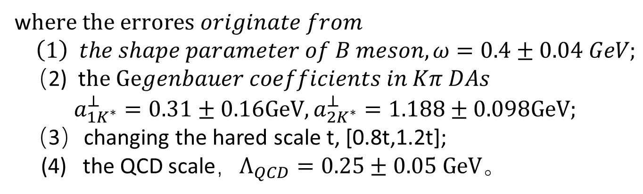
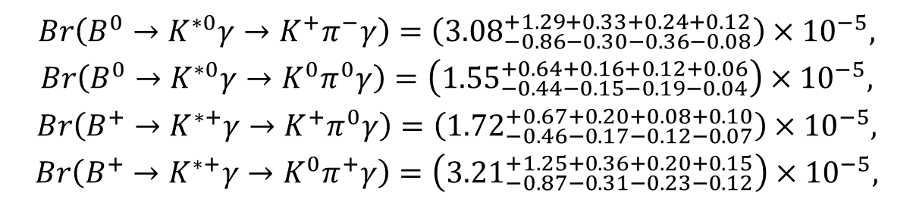
03
Quasi-two-body decays $B_{(s)}→K^{∗}γ→Kπγ$
Integrating$over the full kπ$ invariant mass region $m_{K}+m_{π}≤ω≤M_{B}$for the resonant components, we obtain the branching ratios form these quasi-two-body decays as
$$Br\left(B^{0}→K^{∗0}γ→K^{+}π^{−}γ\right)=\left({3.08}_{−0.86−0.30−0.36−0.08}^{+1.29+0.33+0.24+0.12}\right)×{10}^{−5},$$
$$Br\left(B^{0}→K^{∗0}γ→K^{0}π^{0}γ\right)=\left({1.55}_{−0.44−0.15−0.19−0.04}^{+0.64+0.16+0.12+0.06}\right)×{10}^{−5},$$
$$Br\left(B^{+}→K^{∗+}γ→K^{+}π^{0}γ\right)=\left({1.72}_{−0.46−0.17−0.12−0.07}^{+0.67+0.20+0.08+0.10}\right)×{10}^{−5},$$
$$Br\left(B^{+}→K^{∗+}γ→K^{0}π^{+}γ\right)=\left({3.21}_{−0.87−0.31−0.23−0.12}^{+1.25+0.36+0.20+0.15}\right)×{10}^{−5},$$
w$here the errores originate from$
$\left(1\right) the shape parameter of B meson, ω=0.4±0.04 GeV;$
（2) t$he Gegenbauer coefficients in Kπ DAs$
$$a_{1K^{∗}}^{⊥}=0.31±0.16GeV,a_{2K^{∗}}^{⊥}=1.188±0.098GeV;$$
（3）changing the hared scale t, [0.8t,1.2t];
(4) the QCD scale，$Λ_{QCD}=0.25±0.05 GeV。$
The last two errors characterizes the next-to-leading-order effects .

Slide 16

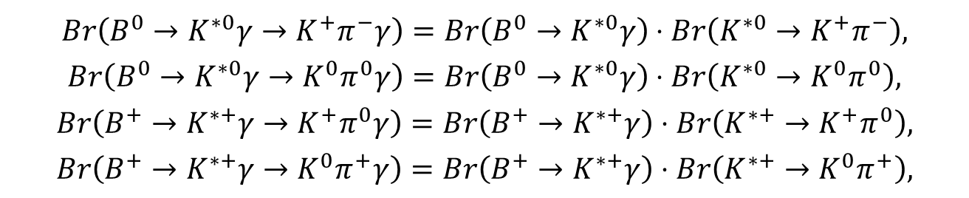
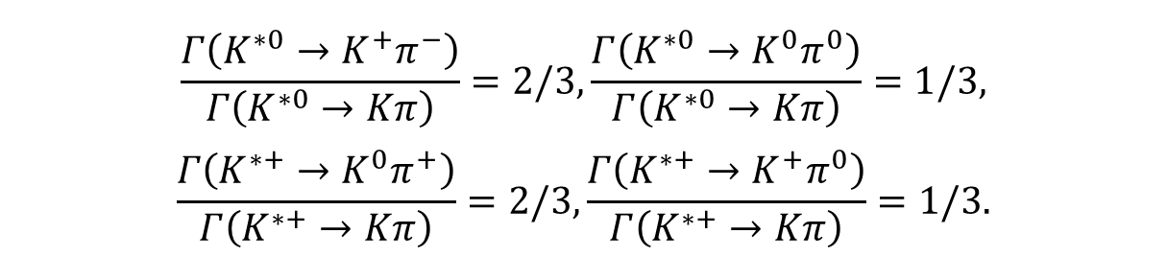
03
Quasi-two-body decays $B_{(s)}→K^{∗}γ→Kπγ$
Assuming the isospin conservation for the strong decays $K^{∗}→Kπ, one can obtain the$
$$following relations$$
$$\frac{Γ\left(K^{∗0}→K^{+}π^{−}\right)}{Γ\left(K^{∗0}→Kπ\right)}=2/3,\frac{Γ\left(K^{∗0}→K^{0}π^{0}\right)}{Γ\left(K^{∗0}→Kπ\right)}=1/3,$$
$$\frac{Γ\left(K^{∗+}→K^{0}π^{+}\right)}{Γ\left(K^{∗+}→Kπ\right)}=2/3,\frac{Γ\left(K^{∗+}→K^{+}π^{0}\right)}{Γ\left(K^{∗+}→Kπ\right)}=1/3.$$
Under the narrow width approximation, the branching of these quasi-two-body decays can be expressed as
$$Br\left(B^{0}→K^{∗0}γ→K^{+}π^{−}γ\right)=Br\left(B^{0}→K^{∗0}γ\right)⋅Br\left(K^{∗0}→K^{+}π^{−}\right),$$
$$Br\left(B^{0}→K^{∗0}γ→K^{0}π^{0}γ\right)=Br\left(B^{0}→K^{∗0}γ\right)⋅Br\left(K^{∗0}→K^{0}π^{0}\right),$$
$$Br\left(B^{+}→K^{∗+}γ→K^{+}π^{0}γ\right)=Br\left(B^{+}→K^{∗+}γ\right)⋅Br\left(K^{∗+}→K^{+}π^{0}\right),$$
$$Br\left(B^{+}→K^{∗+}γ→K^{0}π^{+}γ\right)=Br\left(B^{+}→K^{∗+}γ\right)⋅Br\left(K^{∗+}→K^{0}π^{+}\right),$$

Slide 17
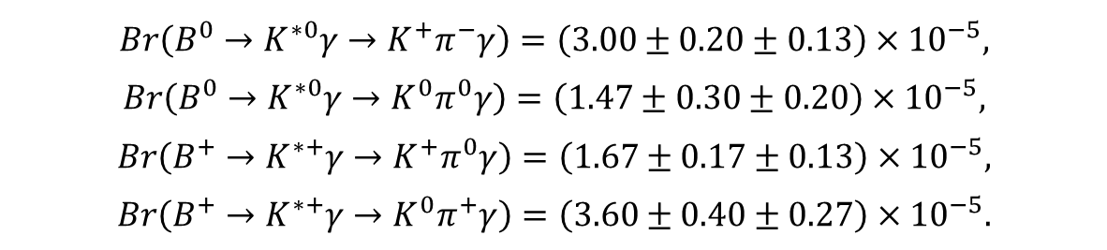
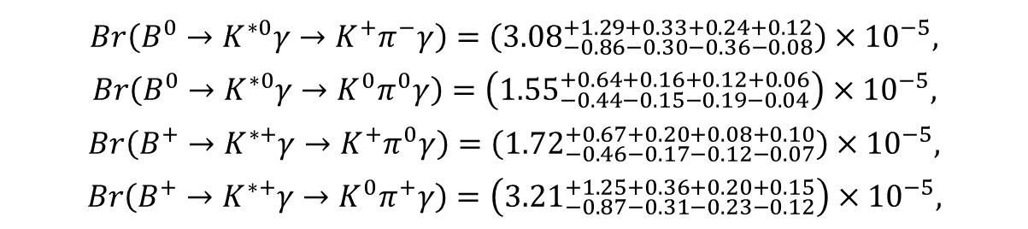
02
Quasi-two-body decays $B_{(s)}→K^{∗}γ→Kπγ$
Using the experimental data measured by Belle II, we can estimate the branching ratios of the quasi-two-body decays as following
$$Br\left(B^{0}→K^{∗0}γ→K^{+}π^{−}γ\right)=\left(3.00±0.20±0.13\right)×{10}^{−5},$$
$$Br\left(B^{0}→K^{∗0}γ→K^{0}π^{0}γ\right)=\left(1.47±0.30±0.20\right)×{10}^{−5},$$
$$Br\left(B^{+}→K^{∗+}γ→K^{+}π^{0}γ\right)=\left(1.67±0.17±0.13\right)×{10}^{−5},$$
$$Br\left(B^{+}→K^{∗+}γ→K^{0}π^{+}γ\right)=\left(3.60±0.40±0.27\right)×{10}^{−5}.$$
Comparing with our results
$$Br\left(B^{0}→K^{∗0}γ→K^{+}π^{−}γ\right)=\left({3.08}_{−0.86−0.30−0.36−0.08}^{+1.29+0.33+0.24+0.12}\right)×{10}^{−5},$$
$$Br\left(B^{0}→K^{∗0}γ→K^{0}π^{0}γ\right)=\left({1.55}_{−0.44−0.15−0.19−0.04}^{+0.64+0.16+0.12+0.06}\right)×{10}^{−5},$$
$$Br\left(B^{+}→K^{∗+}γ→K^{+}π^{0}γ\right)=\left({1.72}_{−0.46−0.17−0.12−0.07}^{+0.67+0.20+0.08+0.10}\right)×{10}^{−5},$$
$$Br\left(B^{+}→K^{∗+}γ→K^{0}π^{+}γ\right)=\left({3.21}_{−0.87−0.31−0.23−0.12}^{+1.25+0.36+0.20+0.15}\right)×{10}^{−5},$$
one can find that these estimates and our predictions are consistent well with each other.

Slide 18
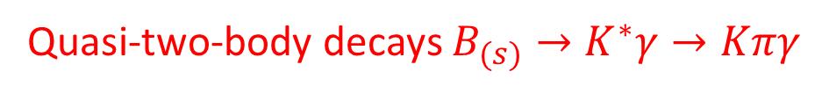

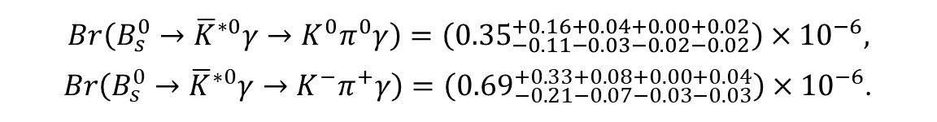
03
Quasi-two-body decays $B_{(s)}→K^{∗}γ→Kπγ$
$$Using the same Kπ DAs, we also calculate the branching ratios of the decays$$
$$B_{s}^{0}→{\overline{K}}^{∗0}γ→K^{0}π^{0}\left(K^{−}π^{+}\right)γ$$
$$Br\left(B_{s}^{0}→{\overline{K}}^{∗0}γ→K^{0}π^{0}γ\right)=\left({0.35}_{−0.11−0.03−0.02−0.02}^{+0.16+0.04+0.00+0.02}\right)×{10}^{−6},$$
$Br\left(B_{s}^{0}→{\overline{K}}^{∗0}γ→K^{−}π^{+}γ\right)=\left({0.69}_{−0.21−0.07−0.03−0.03}^{+0.33+0.08+0.00+0.04}\right)×{10}^{−6}$.
Under the isospin conservation and the narrow width approximation, One can get the branching ratios of corresponding two body decay
$Br(B_{s}→{\overline{K}}^{∗0}γ)={1.04}_{−0.34}^{+0.51}×{10}^{−6}$，
$$Br\left(B_{s}→{\overline{K}}^{∗0}γ\right)={1.05}_{−0.35}^{+0.50}×{10}^{−6}.$$
which are consistent with the result under the two-body framework
$Br\left({\overline{B}}_{s}^{0}→K^{∗0}γ\right)=\left({1.11}_{−0.32−0.12−0.07}^{+0.42+0.15+0.16}\right)×{10}^{−6}.$
These$decays are induced by the b→d transtion$，whose branching ratios are proportional to
$V_{tb}V_{td}^{∗}∼λ^{3} and expected to be suppressed by one order of magnitude relative those$
$induced by the b→s transition$.

Slide 19
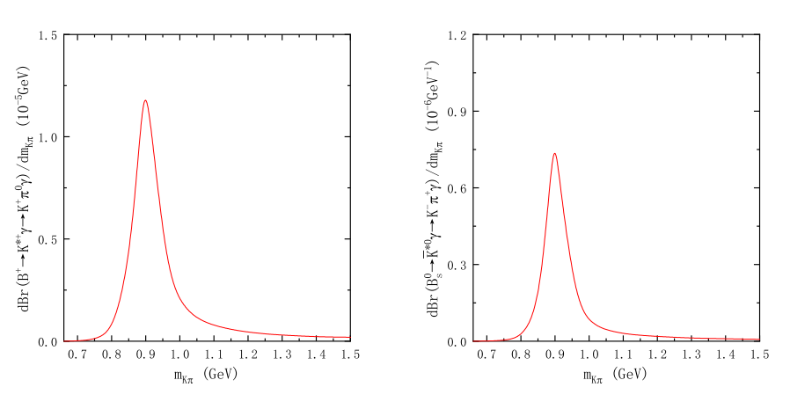

03
Quasi-two-body decays $B_{(s)}→K^{∗}γ→Kπγ$
The $ω$-dependences of decay spectra, where exhibit a maximum at the K$π$ invariant mass around 0.895 GeV.

Slide 20

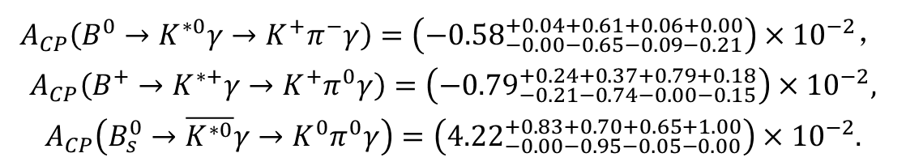
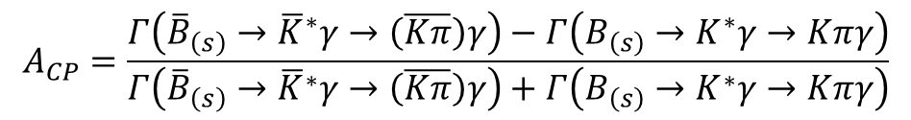
03
Quasi-two-body decays $B_{(s)}→K^{∗}γ→Kπγ$
The direct CP asymmetry of the is defined by
$$A_{CP}=\frac{Γ\left({\overline{B}}_{\left(s\right)}→{\overline{K}}^{∗}γ→\left(\overline{Kπ}\right)γ\right)−Γ\left(B_{\left(s\right)}→K^{∗}γ→Kπγ\right)}{Γ\left({\overline{B}}_{\left(s\right)}→{\overline{K}}^{∗}γ→\left(\overline{Kπ}\right)γ\right)+Γ\left(B_{\left(s\right)}→K^{∗}γ→Kπγ\right)}$$
The results are predicted as
$$A_{CP}\left(B^{0}→K^{∗0}γ→K^{+}π^{−}γ\right)=\left({−0.58}_{−0.00−0.65−0.09−0.21}^{+0.04+0.61+0.06+0.00}\right)×{10}^{−2}，$$
$$A_{CP}\left(B^{+}→K^{∗+}γ→K^{+}π^{0}γ\right)=\left({−0.79}_{−0.21−0.74−0.00−0.15}^{+0.24+0.37+0.79+0.18}\right)×{10}^{−2},$$
$$A_{CP}\left(B_{s}^{0}→\overline{K^{∗0}}γ→K^{0}π^{0}γ\right)=\left({4.22}_{−0.00−0.95−0.05−0.00}^{+0.83+0.70+0.65+1.00}\right)×{10}^{−2}.$$
The direct CP asymmetries of the B meson decays are given in PDG:

Slide 21
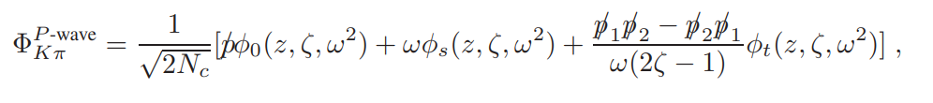
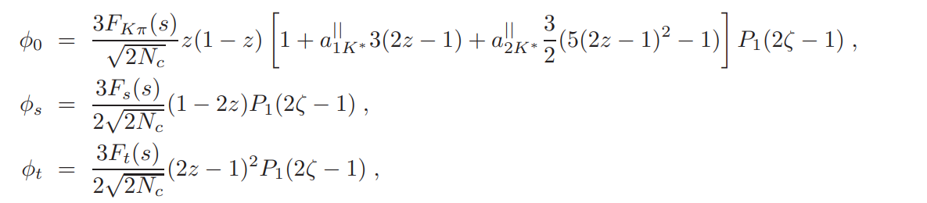

04
Quasi-two-body decays $B_{c}→K^{∗}h→Kπh (h=D,D_{s},K,π,η,η^{′})$
The P-wave K$π$pair DAs are defined as

Slide 22
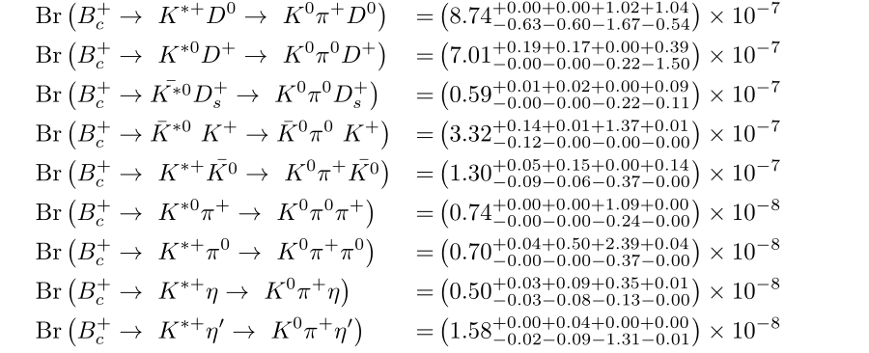



04
Quasi-two-body decays $B_{c}→K^{∗}h→Kπh (h=D,D_{s},K,π,η,η^{′})$
where the first error is from the $B_{c} meson shape parameter ω=1.0±0.1，$
the following errors come from the Gegenbauer coefficients in the K$π$ pair DAs
the last one is induced by the $QCD$scale

Slide 23
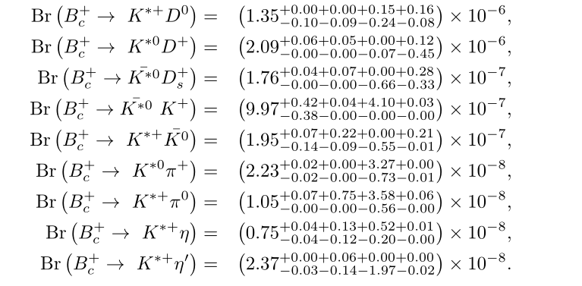
04
Quasi-two-body decays $B_{c}→K^{∗}h→Kπh (h=D,D_{s},K,π,η,η^{′})$
Using the narrow width approximation relation, the branching ratios of the relevant two-body
decays can be obtained as

Slide 24
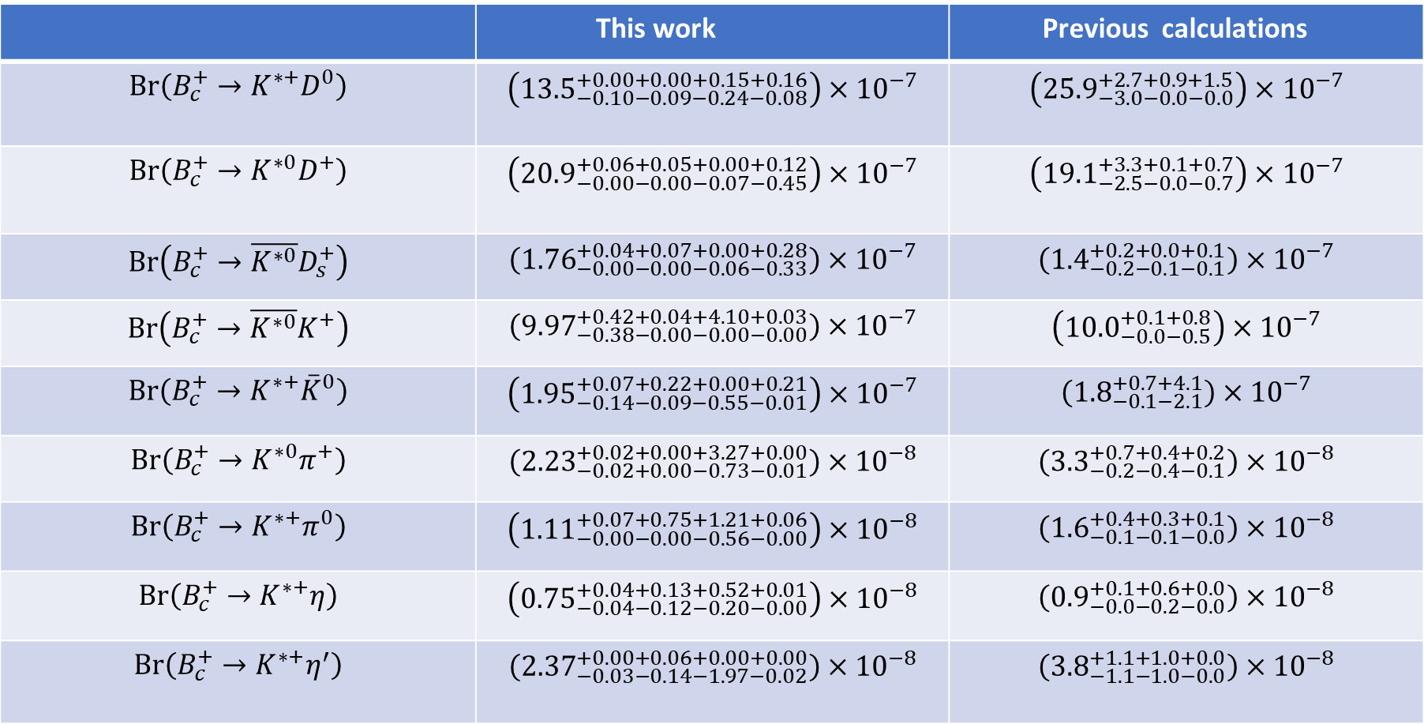
04
Quasi-two-body decays $B_{c}→K^{∗}h→Kπh (h=D,D_{s},K,π,η,η^{′})$
 | This work | Previous calculations
$$Br\left(B_{c}^{+}→K^{∗+}D^{0}\right)$$ | $$\left({13.5}_{−0.10−0.09−0.24−0.08}^{+0.00+0.00+0.15+0.16}\right)×{10}^{−7}$$ | $$\left({25.9}_{−3.0−0.0−0.0}^{+2.7+0.9+1.5}\right)×{10}^{−7}$$
$$Br\left(B_{c}^{+}→K^{∗0}D^{+}\right)$$ | $$\left({20.9}_{−0.00−0.00−0.07−0.45}^{+0.06+0.05+0.00+0.12}\right)×{10}^{−7}$$ | $$\left({19.1}_{−2.5−0.0−0.7}^{+3.3+0.1+0.7}\right)×{10}^{−7}$$
$$Br\left(B_{c}^{+}→\overline{K^{∗0}}D_{s}^{+}\right)$$ | $$\left({1.76}_{−0.00−0.00−0.06−0.33}^{+0.04+0.07+0.00+0.28}\right)×{10}^{−7}$$ | $$\left({1.4}_{−0.2−0.1−0.1}^{+0.2+0.0+0.1}\right)×{10}^{−7}$$
$$Br\left(B_{c}^{+}→\overline{K^{∗0}}K^{+}\right)$$ | $$\left({9.97}_{−0.38−0.00−0.00−0.00}^{+0.42+0.04+4.10+0.03}\right)×{10}^{−7}$$ | $$\left({10.0}_{−0.0−0.5}^{+0.1+0.8}\right)×{10}^{−7}$$
$$Br\left(B_{c}^{+}→K^{∗+}{\overset{‾}{K}}^{0}\right)$$ | $$\left({1.95}_{−0.14−0.09−0.55−0.01}^{+0.07+0.22+0.00+0.21}\right)×{10}^{−7}$$ | $$\left({1.8}_{−0.1−2.1}^{+0.7+4.1}\right)×{10}^{−7}$$
$$Br\left(B_{c}^{+}→K^{∗0}π^{+}\right)$$ | $$\left({2.23}_{−0.02+0.00−0.73−0.01}^{+0.02+0.00+3.27+0.00}\right)×{10}^{−8}$$ | $$\left({3.3}_{−0.2−0.4−0.1}^{+0.7+0.4+0.2}\right)×{10}^{−8}$$
$$Br\left(B_{c}^{+}→K^{∗+}π^{0}\right)$$ | $$\left({1.11}_{−0.00−0.00−0.56−0.00}^{+0.07+0.75+1.21+0.06}\right)×{10}^{−8}$$ | $$\left({1.6}_{−0.1−0.1−0.0}^{+0.4+0.3+0.1}\right)×{10}^{−8}$$
$$Br⁡\left(B_{c}^{+}→K^{∗+}η\right)$$ | $$\left({0.75}_{−0.04−0.12−0.20−0.00}^{+0.04+0.13+0.52+0.01}\right)×{10}^{−8}$$ | $$\left({0.9}_{−0.0−0.2−0.0}^{+0.1+0.6+0.0}\right)×{10}^{−8}$$
$$Br\left(B_{c}^{+}→K^{∗+}η^{′}\right)$$ | $$\left({2.37}_{−0.03−0.14−1.97−0.02}^{+0.00+0.06+0.00+0.00}\right)×{10}^{−8}$$ | $$\left({3.8}_{−1.1−1.0−0.0}^{+1.1+1.0+0.0}\right)×{10}^{−8}$$

Slide 25
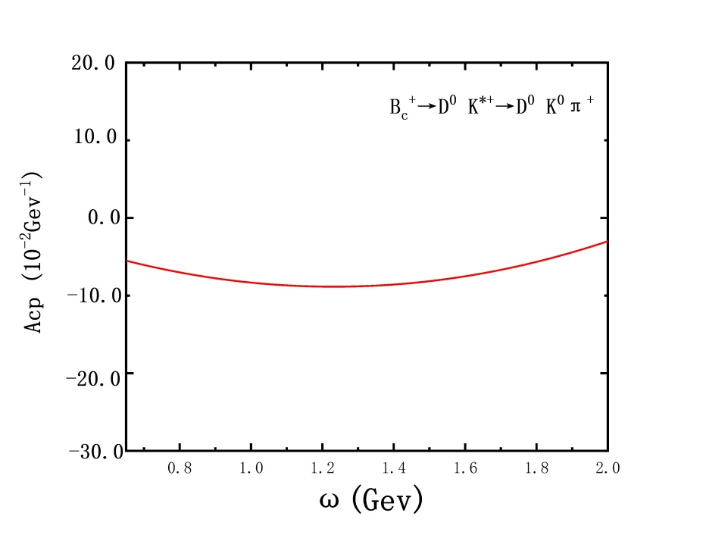
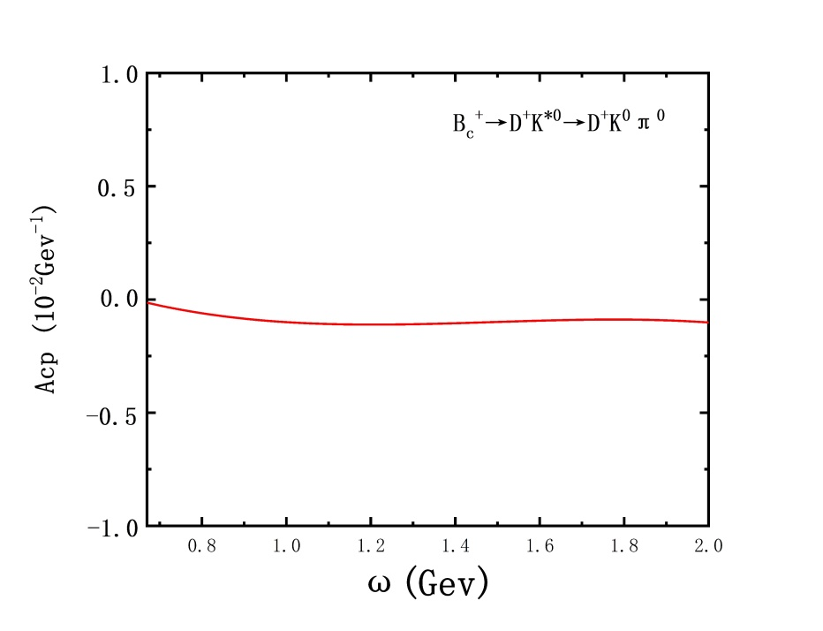
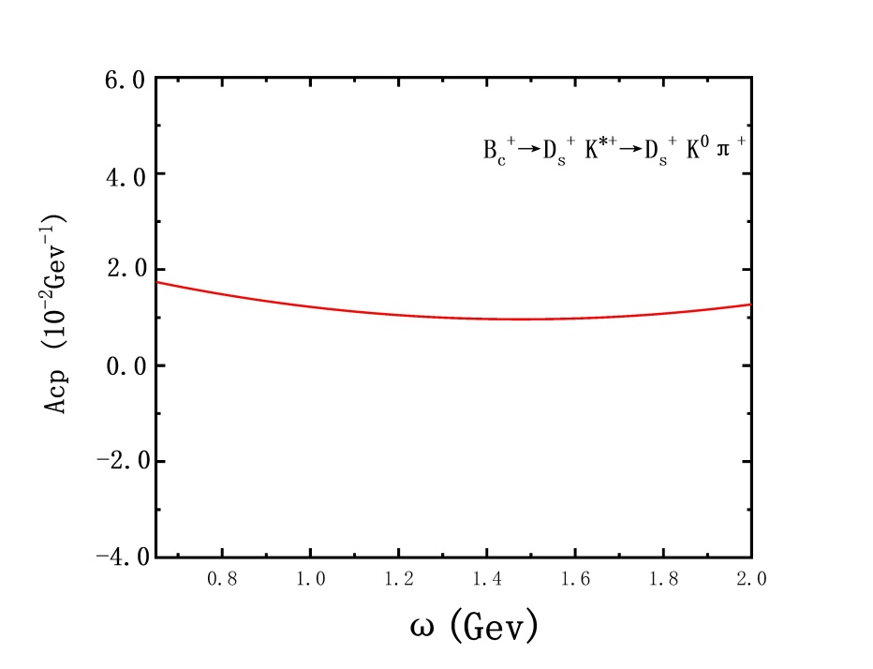
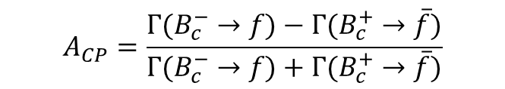
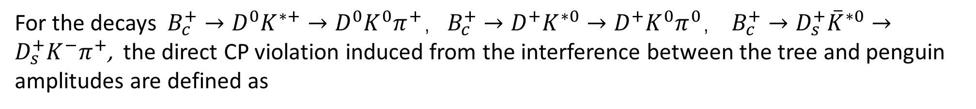
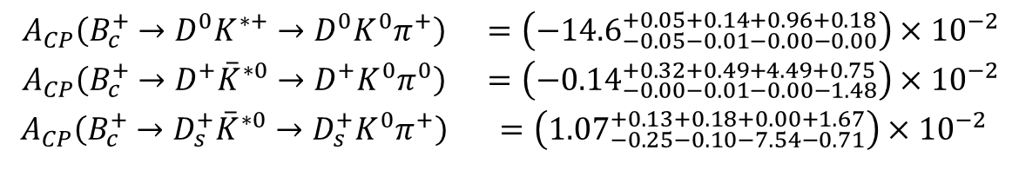
04
Quasi-two-body decays $B_{c}→K^{∗}h→Kπh (h=D,D_{s},K,π,η,η^{′})$
For the decays $B_{c}^{+}→D^{0}K^{∗+}→D^{0}K^{0}π^{+}，B_{c}^{+}→D^{+}K^{∗0}→D^{+}K^{0}π^{0}\text{，} B_{c}^{+}→D_{s}^{+}{\overset{‾}{K}}^{∗0}→D_{s}^{+}K^{−}π^{+}$, the direct CP violation induced from the interference between the tree and penguin amplitudes are defined as
$$A_{CP}=\frac{Γ(B_{c}^{−}→f)−Γ(B_{c}^{+}→\overset{‾}{f})}{Γ(B_{c}^{−}→f)+Γ(B_{c}^{+}→\overset{‾}{f})}$$
$$\begin{matrix}A_{CP}\left(B_{c}^{+}→D^{0}K^{∗+}→D^{0}K^{0}π^{+}\right) & =\left(−{14.6}_{−0.05−0.01−0.00−0.00}^{+0.05+0.14+0.96+0.18}\right)×{10}^{−2} \\ A_{CP}\left(B_{c}^{+}→D^{+}{\overset{‾}{K}}^{∗0}→D^{+}K^{0}π^{0}\right) & =\left(−{0.14}_{−0.00−0.01−0.00−1.48}^{+0.32+0.49+4.49+0.75}\right)×{10}^{−2} \\ A_{CP}\left(B_{c}^{+}→D_{s}^{+}{\overset{‾}{K}}^{∗0}→D_{s}^{+}K^{0}π^{+}\right) & =\left({1.07}_{−0.25−0.10−7.54−0.71}^{+0.13+0.18+0.00+1.67}\right)×{10}^{−2}\end{matrix}$$

Slide 26
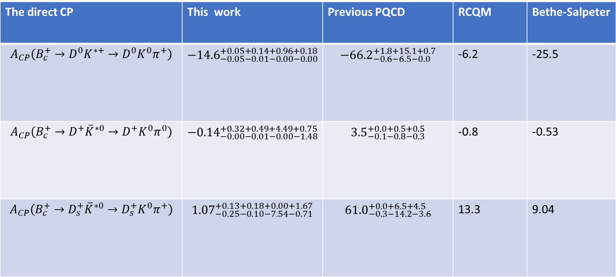
04
Quasi-two-body decays $B_{c}→K^{∗}h→Kπh (h=D,D_{s},K,π,η,η^{′})$
The direct CP | This work | Previous PQCD | RCQM | Bethe-Salpeter
$$A_{CP}\left(B_{c}^{+}→D^{0}K^{∗+}→D^{0}K^{0}π^{+}\right)$$ | $$−{14.6}_{−0.05−0.01−0.00−0.00}^{+0.05+0.14+0.96+0.18}$$ | $$−{66.2}_{−0.6−6.5−0.0}^{+1.8+15.1+0.7}$$ | -6.2 | -25.5
$$A_{CP}\left(B_{c}^{+}→D^{+}{\overset{‾}{K}}^{∗0}→D^{+}K^{0}π^{0}\right)$$ | $$−{0.14}_{−0.00−0.01−0.00−1.48}^{+0.32+0.49+4.49+0.75}$$ | $${3.5}_{−0.1−0.8−0.3}^{+0.0+0.5+0.5}$$ | -0.8 | -0.53
$$A_{CP}\left(B_{c}^{+}→D_{s}^{+}{\overset{‾}{K}}^{∗0}→D_{s}^{+}K^{0}π^{+}\right)$$ | $${1.07}_{−0.25−0.10−7.54−0.71}^{+0.13+0.18+0.00+1.67}$$ | $${61.0}_{−0.3−14.2−3.6}^{+0.0+6.5+4.5}$$ | 13.3 | 9.04

Slide 27
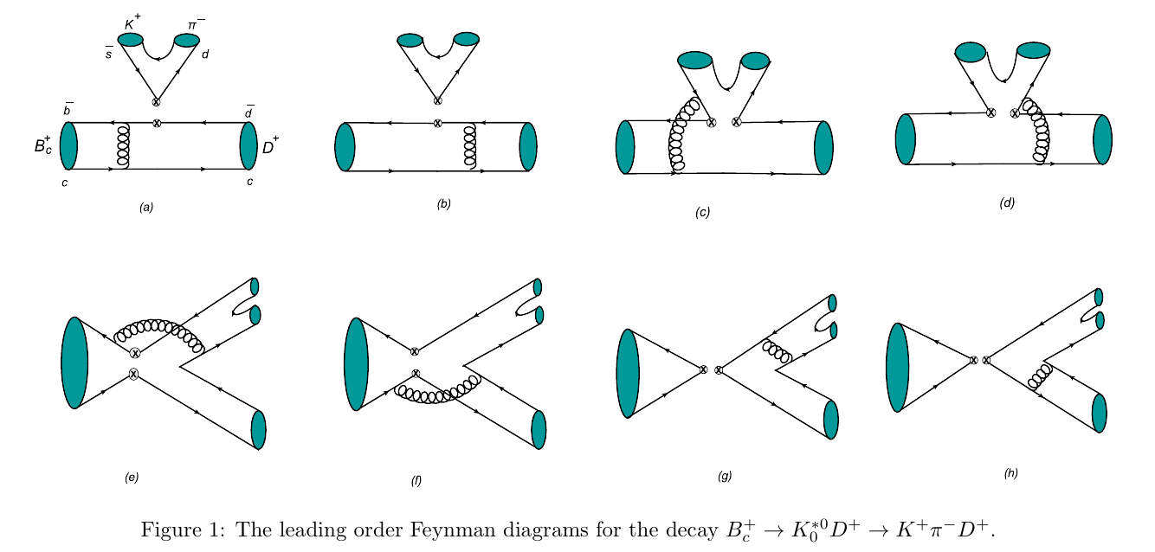
05
Quasi-two-body decays $B_{c}→{K_{0}^{}}_{}^{∗}(1430,1950)h→Kπh (h=D,D_{s})$

Slide 28



05
Quasi-two-body decays $B_{c}→{K_{0}^{}}_{}^{∗}(1430,1950)h→Kπh (h=D,D_{s})$
The S-wave K$π$pair LCDAs are defined as
where the twist-2 and twist-3 are given as follows

Slide 29

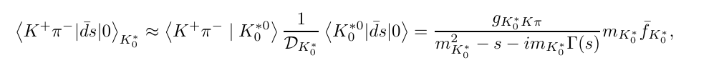

05
Quasi-two-body decays $B_{c}→{K_{0}^{}}_{}^{∗}(1430,1950)h→Kπh (h=D,D_{s})$
The time-like form factor $F_{Kπ}$(s) is related to the scalar for factor ${F^{Kπ}}_{0}$(s) by the formula
under the relativistic Breit-Wigner (RBW) parameterization
under the LASS parametrization

Slide 30
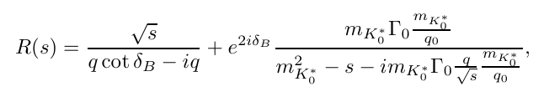


05
Quasi-two-body decays $B_{c}→{K_{0}^{}}_{}^{∗}(1430,1950)h→Kπh (h=D,D_{s})$
Where R(s) is defined as
q is the magnitude of the momentum for the daughter meson K or $π$
The coupling constant

Slide 31


05
Quasi-two-body decays $B_{c}→{K_{0}^{}}_{}^{∗}(1430,1950)h→Kπh (h=D,D_{s})$
There exists a significant difference of the branching ratios for the decays $B_{c}→{K_{0}}^{∗}(1430)D_{(s)}$ $→KπD_{(s)}$obtained by using the RBW and LASS parameterizations.
The difference is not large for the decays $B_{c}→{K_{0}}^{∗}(1950)D_{(s)}$ $→KπD_{(s)}$ between these two parameterizations with $Γ=0.201 GeV.$

Slide 32

05
Quasi-two-body decays $B_{c}→{K_{0}^{}}_{}^{∗}(1430,1950)h→Kπh (h=D,D_{s})$
Under the so-called narrow width approximation (NWA) with taking into account the finite-width effects, one can get the corresponding two body decays.

Slide 33


05
Quasi-two-body decays $B_{c}→{K_{0}^{}}_{}^{∗}(1430,1950)h→Kπh (h=D,D_{s})$
Table:The direct CP violations (%) of the decays , where Ref.[16] the results given in two-body
framework .
The direct CP violations for the decays $B_{c}→{K_{0}}^{∗}(1430)D_{(s)}$ $→KπD_{(s)}$obtained by using the LASS parametrization are closer to the previous PQCD calculations under the two-body framework.

Slide 34

05
Quasi-two-body decays $B_{c}→{K_{0}^{}}_{}^{∗}(1430,1950)h→Kπh (h=D,D_{s})$
Table:The direct CP violations (%) of the decays , where Ref.[16] the results given in two-body framework .
The CP violations for the decays $B_{c}→{K_{0}}^{∗}(1950)D_{(s)}$ $→KπD_{(s)}$ between these two parametri
-zations are closer to each other, which indicate that the effect from the nonresonant contribution for ${K_{0}}^{∗}(1950$) may not be so important as that for ${K_{0}}^{∗}(1430$).

Slide 35

05
Quasi-two-body decays $B_{c}→{K_{0}^{}}_{}^{∗}(1430,1950)h→Kπh (h=D,D_{s})$
Figure: The differential distribution of $A_{CP}$in $ω$for the decays $B_{c}→{K^{∗}}_{0}^{}$(1430)$D_{(s)}$obtained in
the BRW (left) and the LASS (right) parametrizations .

Slide 36

05
Quasi-two-body decays $B_{c}→{K_{0}^{}}_{}^{∗}(1430,1950)h→Kπh (h=D,D_{s})$
Figure: The differential distribution of $A_{CP}$in $ω$for the decays $B_{c}→{K^{∗}}_{0}^{}$(1950)$D_{(s)}$obtained in
the BRW (left) and the LASS (right) parametrizations .

Slide 37


05
Summary
（1）The branching ratios of the quasi-two decays $B_{\left(s\right)}→K^{∗}γ→Kπγ、B_{c}→K^{∗}h→Kπh\left(h=D,D_{s},K,π,η,η^{′}\right) and B_{c}→{K_{0}^{}}_{}^{∗}\left(1430,1950\right)h→KπD_{\left(s\right)},$which are consistent with those calculated under the two-body framework. It indicated that the PQCD approach can be generalized to B meson three-body decays.
（2）There exist significant differences for direct CP violations between different works, which need to be clarified.
（3）From the $Kπ$invariant mass $m_{Kπ}$-dependences of these concerned decay spectrums, one can find that the main portions of the branching fractions concentrate in a very small region of $m_{Kπ}.$
(4) The effect from the nonresonant contribution for ${K_{0}}^{∗}(1950$) may not be so important as that for ${K_{0}}^{∗}(1430$).

Slide 38

04
Quasi-two-body decays $B_{c}→K^{∗}h→Kπh (h=D,D_{s},K,π,η,η^{′})$
The predicted${ B}_{c} ^{+}→D^{0}{ K}^{∗+}→D^{0}{ K}^{0}π^{+} and{ B}_{c}^{+}→D^{+}K^{∗0}→D^{+}K^{0}π^{0}$decay spectra in the K$π$ invariant mass.

Slide 39

05
Quasi-two-body decays $B_{c}→{K_{0}^{}}_{}^{∗}(1430,1950)h→Kπh (h=D,D_{s})$
Hadrons | Mass(GeV) | Width(GeV) | $$I(J^{P})$$ | Decay Modes
${K^{∗}}_{0}$(1430) | 1.425$±0.050$ | 0.270$±0.0$80 | $$\frac{1}{2}(0^{+})$$ | K$π^{} \left(93±10\right)\%$
${K^{∗}}_{0}$(1950) | 1.944$±0.0$18 | 0.10$0±0.$40(PDG,22) (0.201$±$0.34$±0.$79,LASS) (0.229$±$0.26$±$0.16,LHCb,new) | $$\frac{1}{2}(0^{+})$$ | $K^{−}π^{+}$(52$±$14)%

Slide 40

05
Quasi-two-body decays $B_{c}→{K_{0}^{}}_{}^{∗}(1430,1950)h→Kπh (h=D,D_{s})$

