Slide 1
TPS65ISC工艺参数
张颖
2024-8-15

Slide 2
TJ回复工艺衬底问题
关于能否使用P型衬底：
可以使用P型衬底
支持四阱：NW, PW, Deep PW, Deep NW
TJ提供了补充PDK和DRM (TPS65ISC_3M_PSUB)

Slide 3
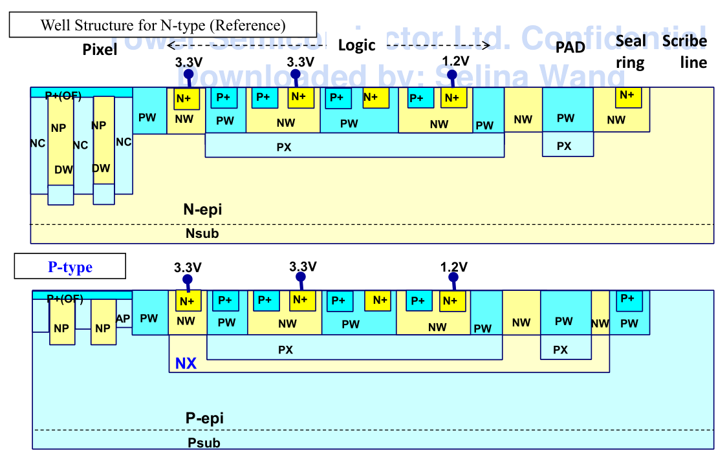
TJ回复工艺衬底问题
可以使用的阱结构
与CERN使用工艺的区别
TJ目前回复只提供标准的工艺结构，没有其它选择；CERN额外使用了modified和modified w/gap两种工艺结构。
金属层数4层；CERN最初使用5，目前7层。

Slide 4
Reply from TJ
We have TPS65ISC PSUB technology that uses p-type starting material instead of n-type which is the standard in TPS65ISC platform. The substrate is 10um thick p-epi (resistivity is ~130 ohm-cm) on top of p+ substrate (0.01~0.016 ohm-cm).Both deep nwell and deep pwell are available for isolation between substrate and deep pwell and that between deep nwell and nwell. I checked internally for starting material with different resistivity and/or thickness, but currently no other option is supported. If you are OK with the standard material and would like to further evaluate the PSUB technology, please let us know.
Yes, we do have a separate DRM (supplementary to the TPS65ISC DRM) and PDK for the PSUB technology. I have asked our team to grant access for you. We will update you when it is done. For any non-standard offerings, please contact our CIS BU through the sales channel.

