Slide 1
chATLAS
An AI Assistant for the ATLAS Collaboration
Jeremy Couthures¹, Daniele Del Santo², Gabriel Facini³, Joe George⁴, Runze Li⁵, Daniel Murnane⁶, Cary Randazzo⁷
Aug 20, 2024 Beijing China
(1)
(2)
(3)
(4)
(5)
(6)
(7)

Slide 2
Main Topics in this Talk
Introduction, Necessary Background
chATLAS, Technical Details and Status
Results of work at present
Plans for future updates
Conclusions

Slide 3
Introduction, Necessary Background
ATLAS Experiment - Size and its logistical effects on communication
A brief talk about the RAG type of LLM
chATLAS Background

Slide 4
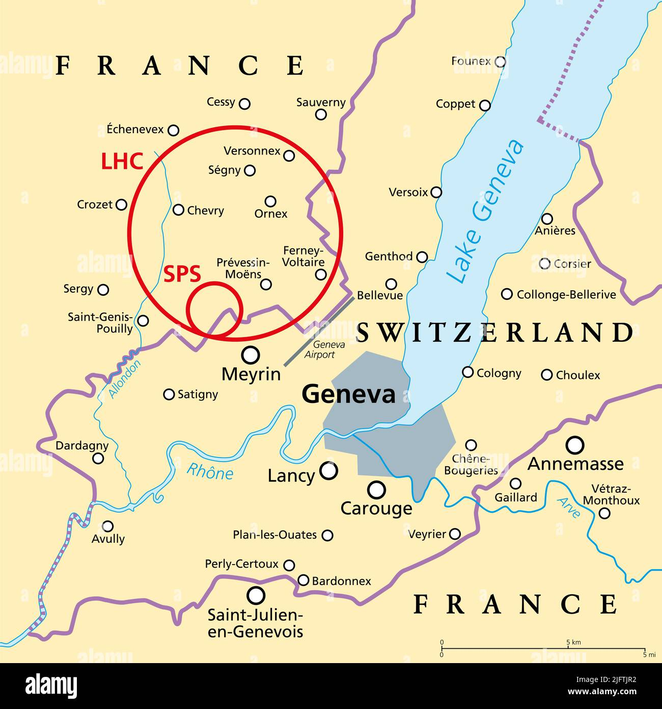
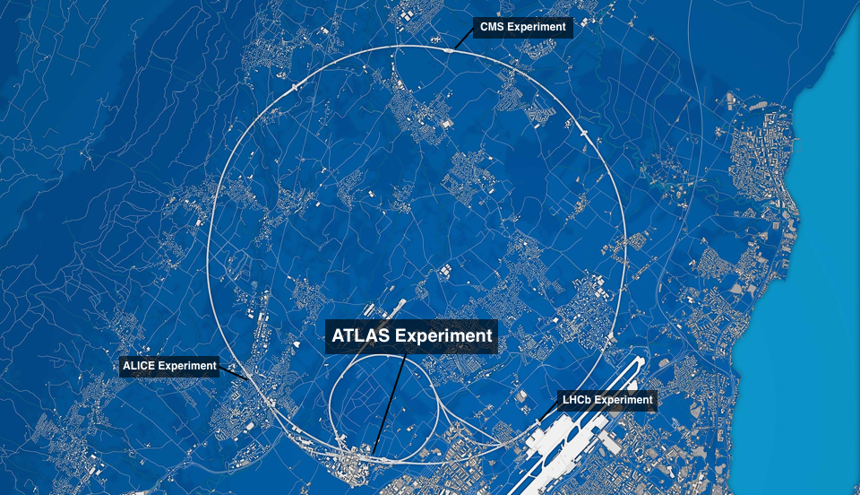
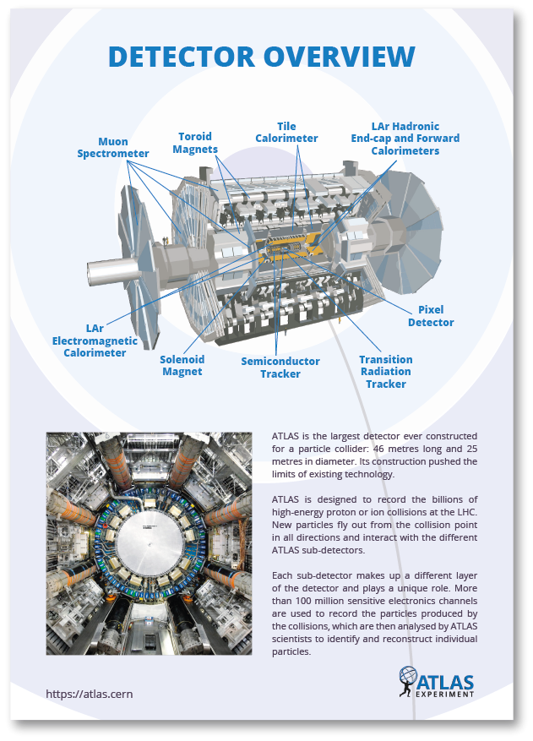
Introduction, Necessary Background
CERN - HEP collaboration
LHC - 27km
ATLAS
Geneva Switzerland
… next slide

Slide 5
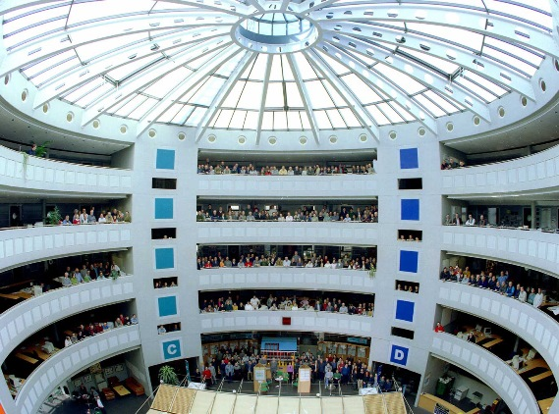
Introduction - The Need for LLM/RAG
ATLAS is big.
This makes it hard to communicate efficiently.
It would be nice to have an AI tool that intercepts, organizes, and can search and communicate this information effectively - A chatbot knowledgeable about HEP, the ATLAS Experiment, and internal information to assist researchers, students, and more.
The detector is 46m long, 25m high, and 25m wide. It is one of the largest collaborative efforts ever attempted in science, with approximately 6000 members and 3000 scientific authors.

Slide 6
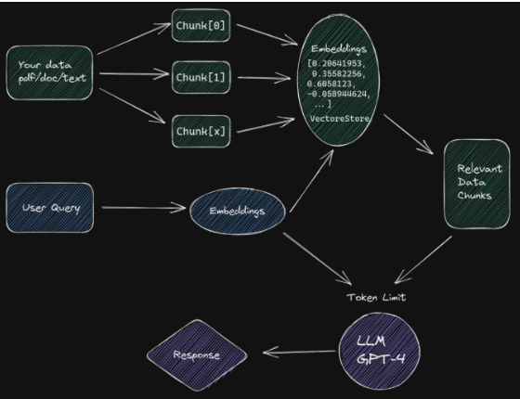
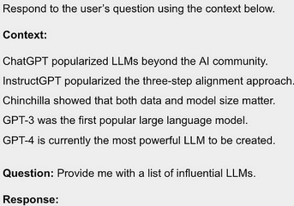
Introduction - A brief talk about the RAG type of LLM
Different types of RAG realization
Retriever Type: Sparse(Passages) vs.
Dense(continuous embeddings)
Retriever Granularity: Chunks vs
Tokens retrieved (fast and difficult)
Pre/Post Retrieval Enhancement
Generator Modifications:
*Input-Layer Integration,
Output-Layer Integration, (Dual output distributions, see kNN-LM)
Intermediate-Layer Integration (Chunked Cross Attention)

Slide 7
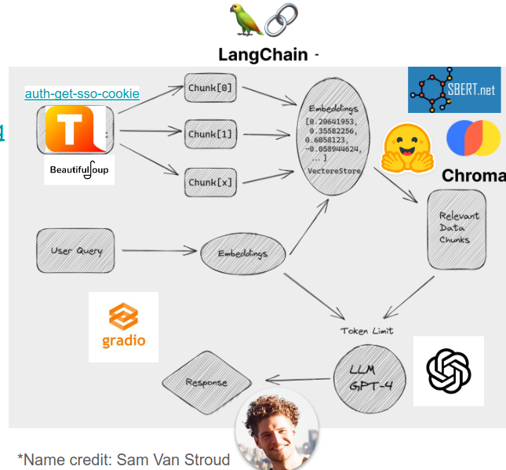
Introduction - chATLAS Background
Developers in ATLAS were independently working on a similar idea.
Skills and projects were synthesized into chATLAS
Simple start
UI added and moved to flask (Joe George)

Slide 8
chATLAS - Technical Details and Status
Scraping and Document Collection (ATLAS has a Lot of Data)
Embedding and Vector Database
Evaluation
UI & Serving in Production

Slide 9
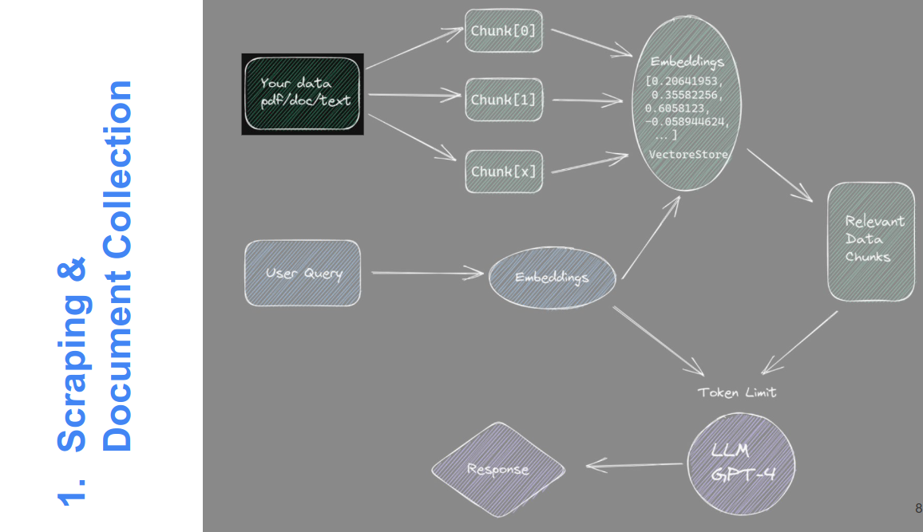
chATLAS - Scraping and Document Collection

Slide 10
chATLAS - Scraping and Document Collection
Egroup
Archive
Jira
Twiki
Group level Docs
Indico Meetings
PDF Plots
ATLAS Software Docs
CDS Papers & Notes
ATLAS Codebases
Mattermost

Slide 11
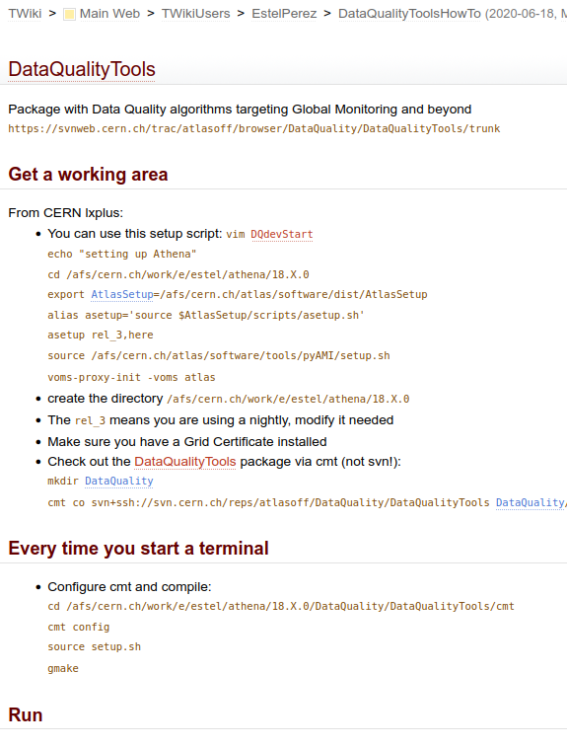
chATLAS - Scraping and Document Collection
Twiki and CDS
Initial scrape using BeautifulSoup and auth-get-sso-cookie followed by,

Slide 12
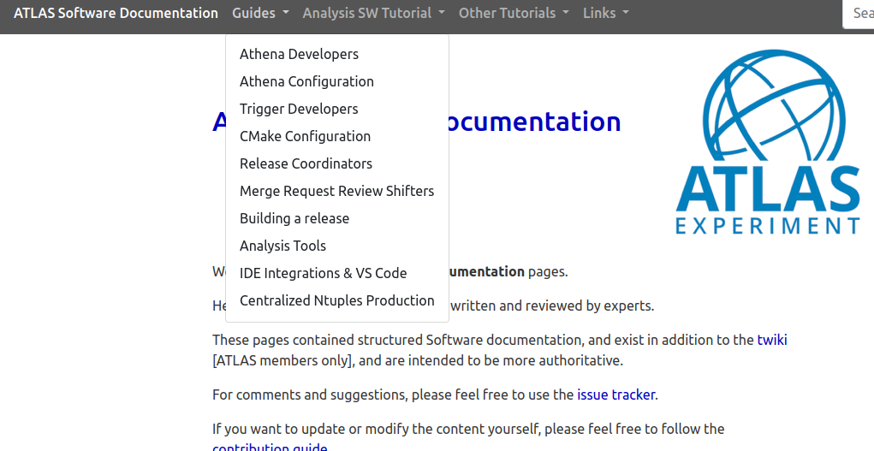
chATLAS - Scraping and Document Collection
ATLAS Software Docs
Hundreds of ATLAS Software Docs
Using:
BeautifulSoup
and auth-get-sso-cookie

Slide 13
chATLAS - Scraping and Document Collection
E-group
Archive
Measurement Update: 282,452 Messages!

Slide 14
chATLAS - Scraping and Document Collection
E-group Archive Anonymization
Tool was developed to Anonymize data as it is being gathered OR after
Uses a combination of 3 Named Entity Recognition(NER) models: Transformer based, Spacy based, NLTK based (NLTK seems most performant for this style/structure)
The Tool was designed and optimized around ATLAS egroups message data so it may have varying performance when applied elsewhere (experiments pending)
Records unique identity of individuals (“Anonymous_1”, _2, _etc) so the model can keep track who is saying what and how it relates to the meaning of the text.

Slide 15
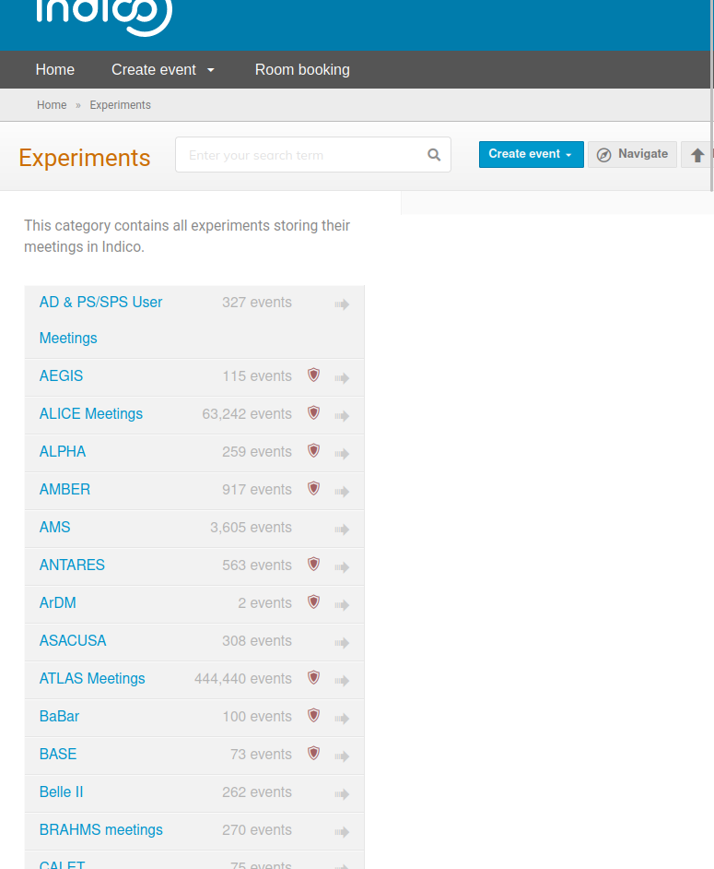
chATLAS - Scraping and Document Collection
Indico Meetings
Using:
Nougat
and
Marker
440,440 ATLAS Indico Meeting Events

Slide 16
chATLAS - Scraping and Document Collection
PDF Plots,
ATLAS Codebases,
Group level Docs
Mattermost,
Jira,
Tools Used:
(Pending further experiments)
Measurements for these will depend on further investigation - expected to large also

Slide 17
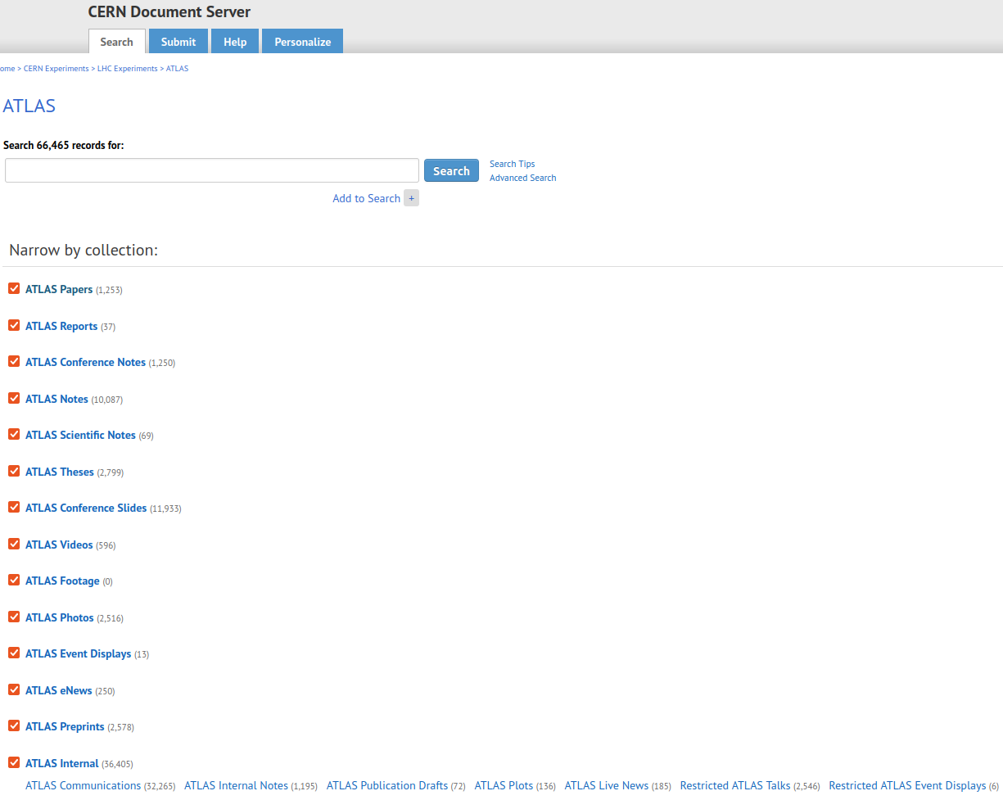
chATLAS - Scraping and Document Collection
CDS Papers & Notes
Using:
Nougat and Marker
Total: “66,465 records found”
36,405 are Internal including communications, notes, etc.

Slide 18
chATLAS - Scraping and Document Collection

Slide 19
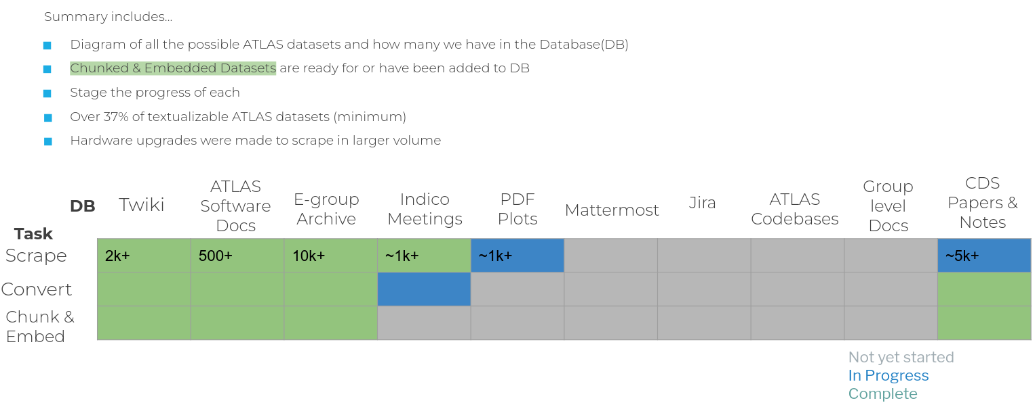
chATLAS - Scraping and Document Collection
Summary

Slide 21
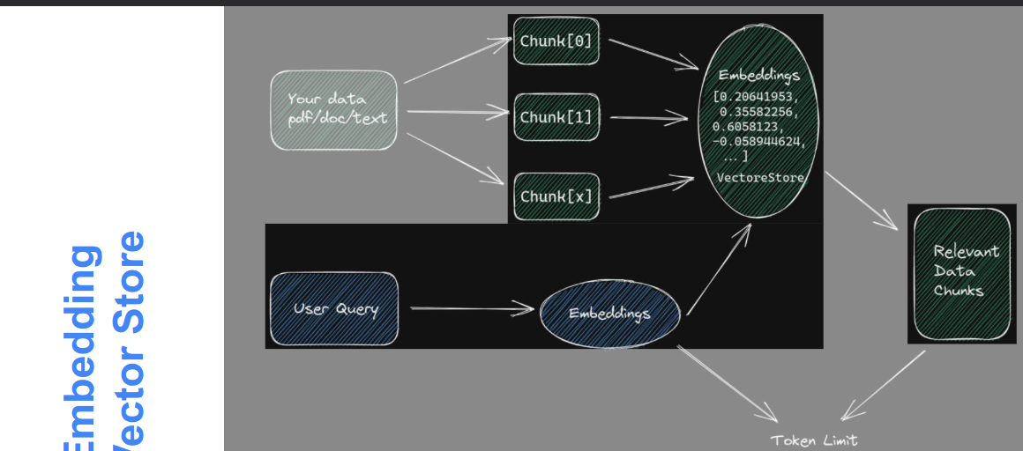
chATLAS - Embedding and Vector Database

Slide 22
chATLAS - Embedding and Vector Database

Slide 23
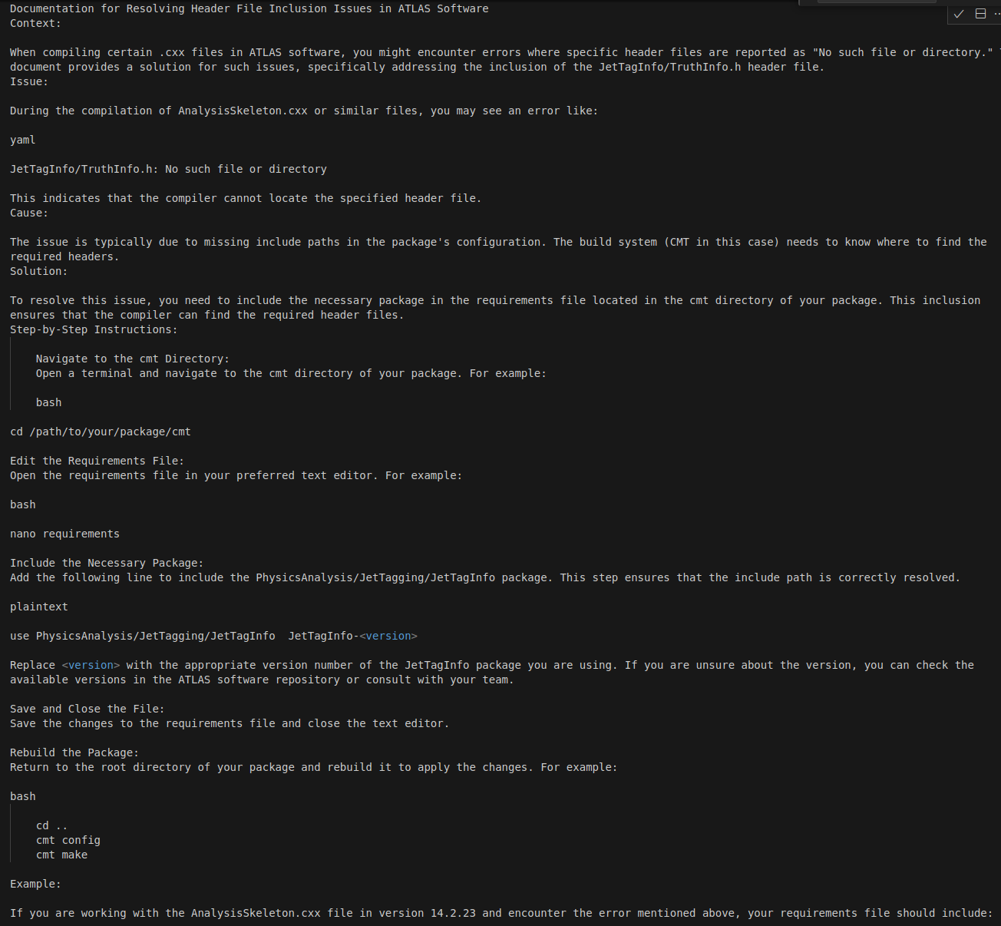
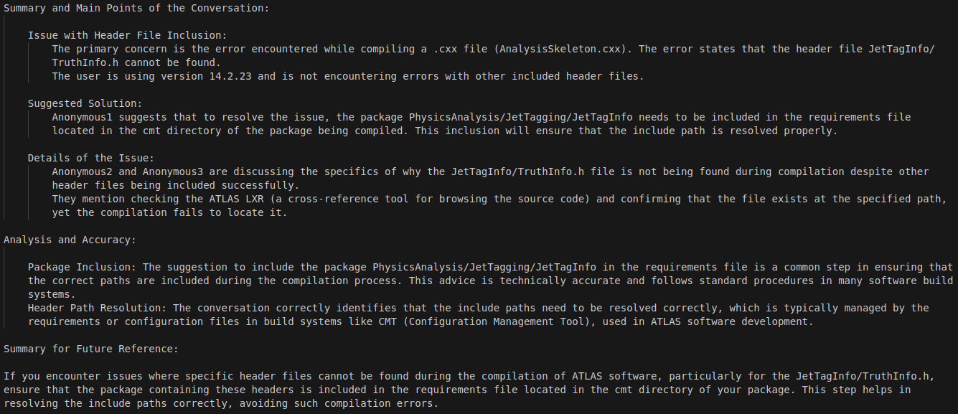
chATLAS - Embedding and Vector Database
(Egroup Archive) User Experience and Data Quality Improvement
↓
→
And then, Embedded & Chunked ←

Slide 24
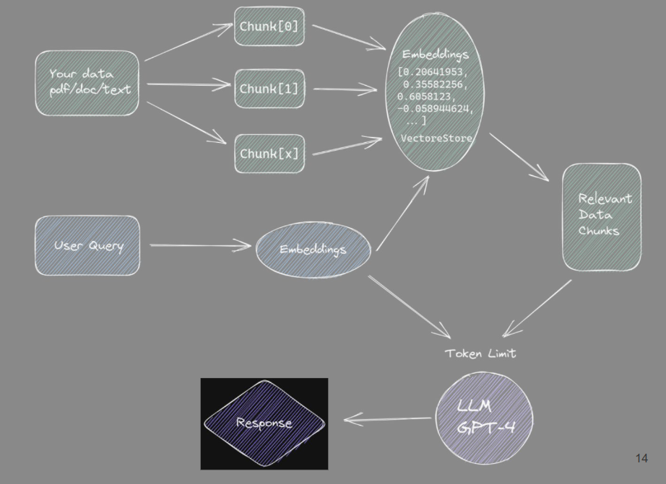
chATLAS - Evaluation

Slide 25
chATLAS - Evaluation
What kind of questions can our RAG answer?

Slide 26
Results of Present Work
Chunk 1:
when compiling certain `. cxx ` files in atlas software, you might encounter errors where specific header files are reported as " no such file or directory. " this document provides a solution for such issues, specifically addressing the inclusion of the ` jettaginfo / truthinfo. h ` header file. the issue is typically due to missing include paths in the package's configuration. the build system ( cmt in this case ) needs to know where to find the required headers. to resolve this issue, you need to include the necessary package in the ` requirements ` file located in the ` cmt ` directory of your package. this inclusion ensures that the compiler can find the required header files. step - by - step instructions : 1. navigate to the cmt directory : open a terminal and navigate to the ` cmt ` directory of your package. 2. edit the requirements file : open the ` requirements ` file in your preferred text editor. 3. include the necessary package : add the following line to include the ` physicsanalysis / jettagging / jettaginfo ` package. 4. save and close the file : save the changes to the ` requirements ` file and close the text editor. 5. rebuild the package : return to the root directory
Chunk 2:
requirements ` file and close the text editor. 5. rebuild the package : return to the root directory of your package and rebuild it to apply the changes. if you are working with the ` analysisskeleton. cxx ` file in version 14. 2. 23 and encounter the error mentioned above, your ` requirements ` file should include : use physicsanalysis / jettagging / jettaginfo jettaginfo - 14 - 2 - 23 after making these changes, try recompiling your package. the header file should now be located correctly, and the compilation should proceed without the " no such file or directory " error. ensure that you have the necessary permissions to edit the ` requirements ` file and rebuild the package. if you continue to encounter issues, double - check the package names and versions, and ensure that all dependencies are correctly specified. by including the required package in the ` requirements ` file, you can resolve header file inclusion issues and ensure successful compilation of your atlas software packages. this solution helps in maintaining a well - configured build environment and streamlines the development process.
Vector Store Inspection:
page_content='when compiling certain `. cxx ` files in atlas software, you might encounter errors where …
page_content='requirements ` file and close the text editor. 5. rebuild the package : return to the root…

Slide 27
Results of the Previous Architecture
Generated Response
How do I resolve the 'JetTagInfo/TruthInfo.h: No such file or directory' error?
To resolve the 'JetTagInfo/TruthInfo.h: No such file or directory' error, you need to follow these steps:
1. **Navigate to the `cmt` directory**:
- Open a terminal and navigate to the `cmt` directory of your package.
2. **Edit the `requirements` file**:
- Open the `requirements` file in your preferred text editor.
3. **Include the necessary package**:
- Add the following line to the `requirements` file to include the `PhysicsAnalysis/JetTagging/JetTagInfo` package:
```plaintext
use PhysicsAnalysis/JetTagging/JetTagInfo JetTagInfo-14-2-23
```
4. **Save and close the file**:
- Save the changes to the `requirements` file and close the text editor.
5. **Rebuild the package**:
- Return to the root directory of your package.
- Rebuild the package to apply the changes.
After these steps, try recompiling your package. The header file should now be found correctly, and the compilation should proceed without the "no such file or directory" error.
Ensure that you have the necessary permissions to edit the `requirements` file and rebuild the package. If issues persist, double-check the package names and versions, and ensure that all dependencies are correctly specified.
Now, it needs a nice UI!

Slide 28
chATLAS - UI & Deployment
Deployment

Slide 29
chATLAS - UI & Deployment
Deployment

Slide 30
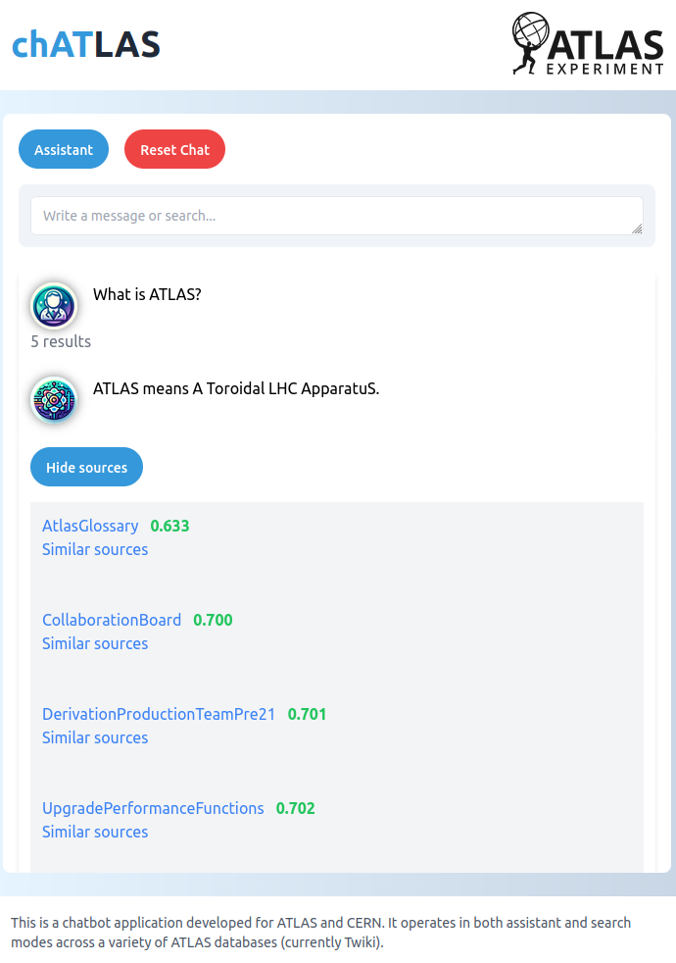
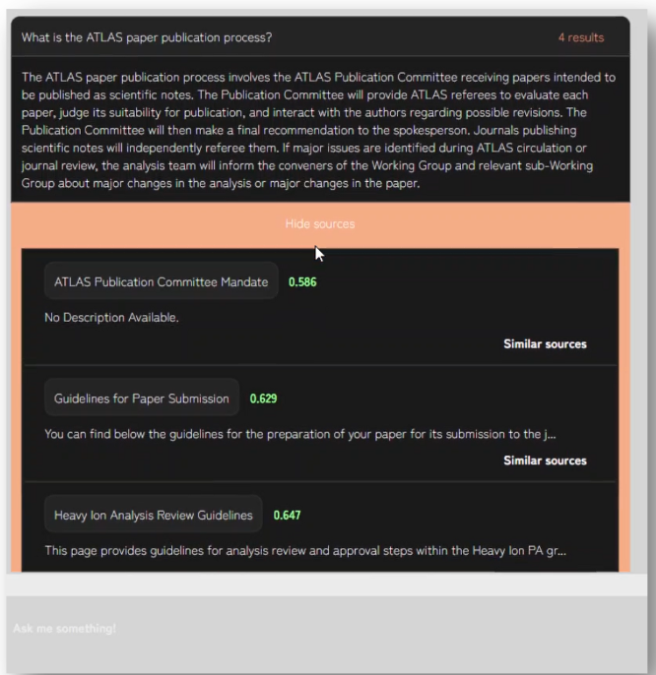
Results of Present Work

Slide 31
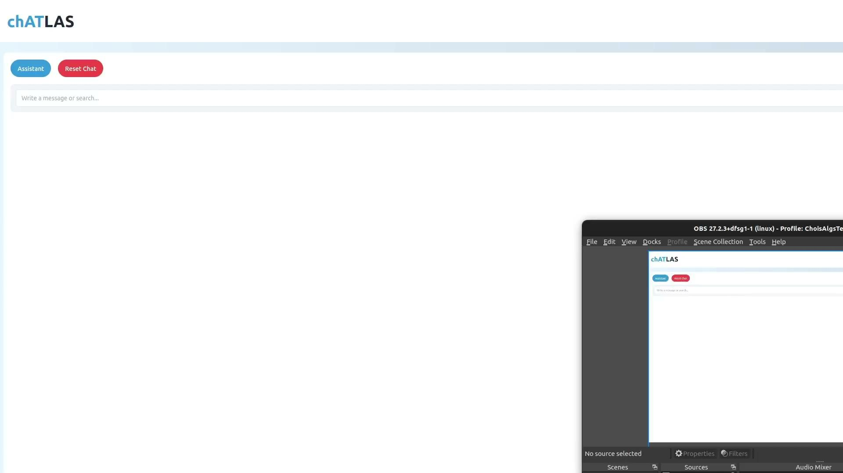

Slide 32
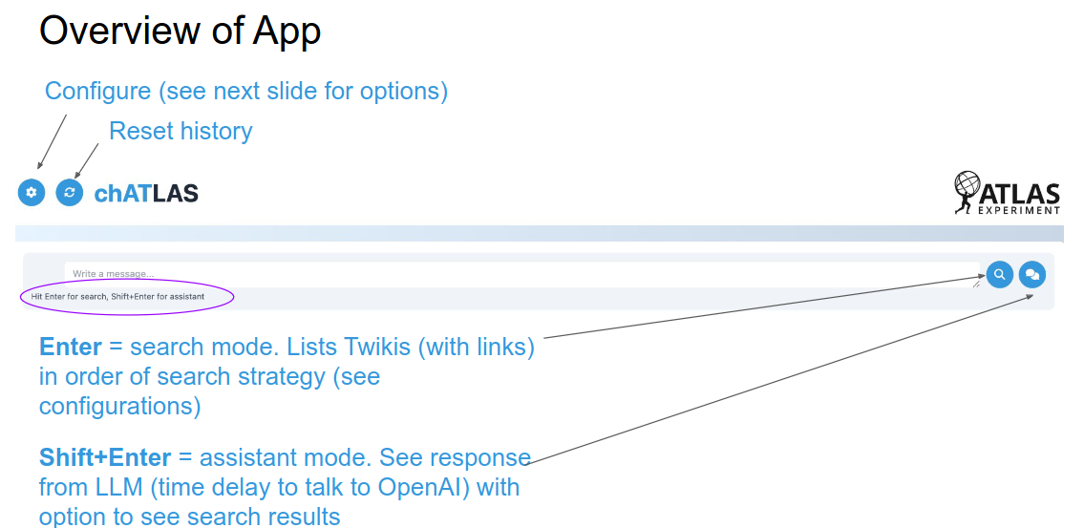

Slide 34
Future Evaluation Plans
Exploring other extensive and complete evaluation methods (results in future update)

Slide 35
Other Plans for Future Updates
Gather and Install more Data to RAG
CDS papers (in alpha), conferences, pub notes, etc.
E-groups (scraped, anonymized, embedded)
Indio (some sources in hand)
Daily updates such as from new/changes to Twikis
Find my plot - find plots more easily by storing information in DB Running - need to serve via API
Fine tune of open source LLM a la AstroLLaMa - low stats show promise
Serving open source LLM via API running at university
Improve quality through advanced RAG techniques
Or a mixture of experts like ChatGPT
UI Improvements: thumbs up/down etc (RLHF?)
Knowledge Graphs
Detailed and extensive Evaluation system for incremental progress
Multimodality ideas, check back for updates

Slide 36
Conclusions
chATLAS project established in the spare time of few developers
Still in early development
Deployment platform stability is a major issue
Open invite to contribute
If there was a collaborative effort to store and format information that prepares them for installing to AI, it could reduce the efforts required by development teams and new physics could be discovered sooner
ATLAS has a lot of data, takes time to gather, organize, format, and process
chATLAS started as a standard RAG, but it has evolved to meet needs of ATLAS, aid discovery, and explore other useful applications

Slide 37
End
__________________
Questions?

