Slide 1
CEPC Time of flight and outer tracker with LGAD
Yunyun Fan
Tuesday, Aug. 20, 2024

Slide 2
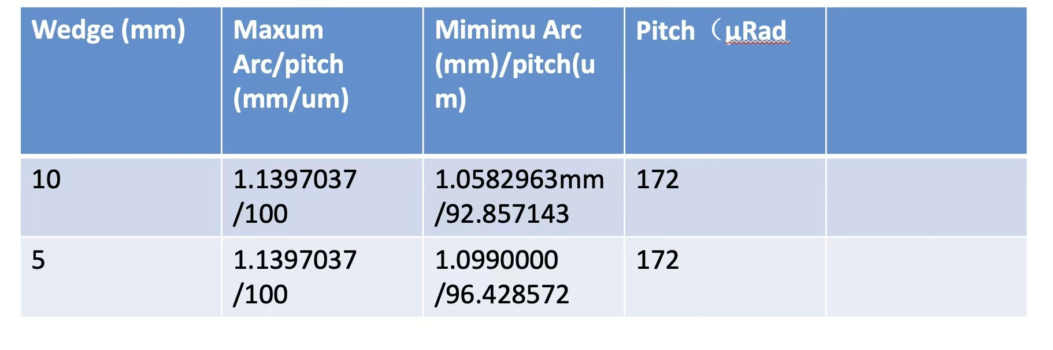
Sensor design
Design for AC-LGAD strip to be submitted to IME to produce
1 cm length (According to the suggestion of ), 2 cm length strip AC-LGAD
1 cm, 0.5 cm length sector AC-LGAD, which have same pitch with the real one
Cooperated with Italy colleagues (Discussed during the International meeting)

Slide 3
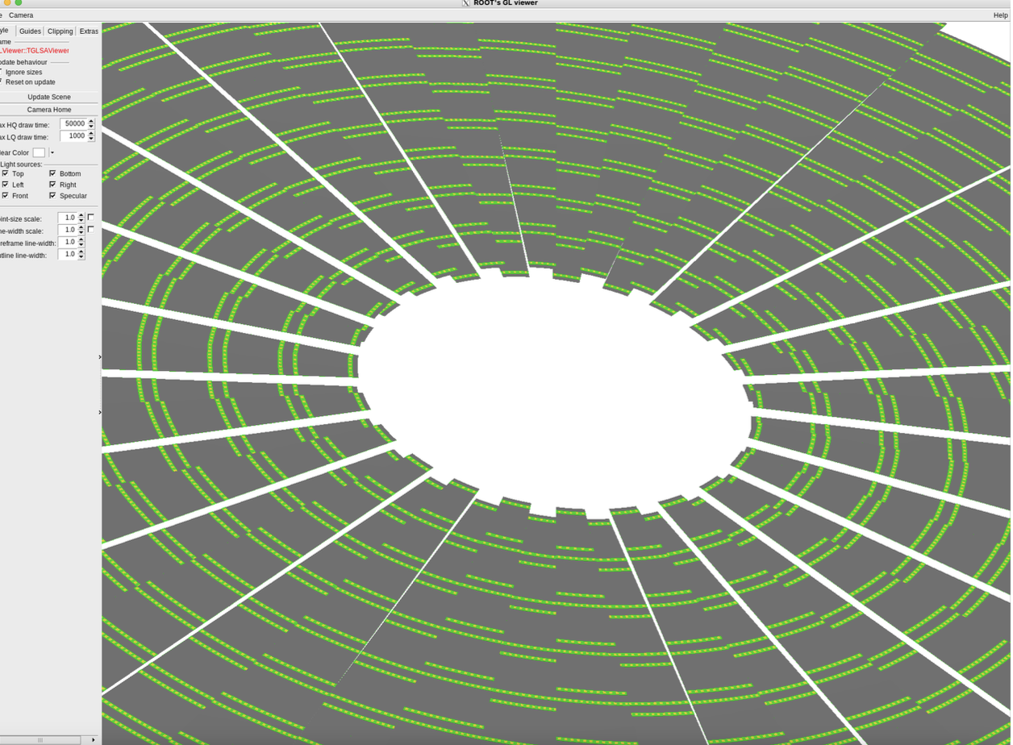
CEPCSW Progress for ToF&out tracker
Got the geometry of barrel and endcap into CEPCSW (SJTU, Yudian KunLiu)
Hit rate raw estimation: maximum rate 35K Hz/cm² (NKU, Bo Liu)
Discussion with Haoyu, the hit rate still need to merge the steps in simulation to see how much hit rate could be reduced
Detector/DetCRD/src/
Tracker/ SiTracker_otkendcap_v01_geo.cpp

Slide 4
Mechanics design
According to previous thermal simulation, the cooling should from the ASIC sides.
Jinyu Fu have tried strategy to cool the ASIC with thermal conductor which could transfer the thermal from the surface of ASIC to cooling pipes.
 | Per channel | Per ASIC | Per module （28 ASIC）
Pwer distribution | 20 mW-30 mW | 2.56 W – 3.84 w | 71.68 W- 107.52 W

Slide 5
Backup

Slide 6
Hit rate estimation input for electronics
Z pole
Strip：0.1mm x 70 mm
Updated with new CEPCSW
Old one is 100K Hz/cm²
Maximum hit rate estimation
 | Hit rate （Hz/cm²） | Hit rate per ASIC（Hz） | Hit rate per strip （Hz）
Barrel | 140 | 1254.4 | 9.8
Endcap | ～15k （at 20mm ） | ～134.4k | ～1050
Cluster size：1-2 strip （most is within 1 strip）
Occupancy at endcap ：
  0.105% (10bit,1 µs deadtime)
  0.42% (12 bit, 4 µs deadtime)

Slide 7
Hit rate estimation input for electronics
Z pole
Strip：0.1mm x 70 mm
Updated with new CEPCSW
Old one is 100K Hz/cm²
Average hit rate estimation
 | Hit rate （Hz/cm²） | Hit rate per ASIC（Hz） | Hit rate per strip （Hz）
Barrel | 140 | 1254.4 | 9.8
Endcap | ～15k （at 20mm ） | ～134.4k | ～1050
Cluster size：1-2 strip （most is within 1 strip）
Occupancy at endcap ：
  0.105% (10bit,1 µs deadtime)
  0.42% (12 bit, 4 µs deadtime)

