Slide 1


CEPC Muon Detector
Xiaolong Wang
(for the Muon Detector Group)
Fudan University
Tuesday Meeting, 8/20/2024

Slide 2
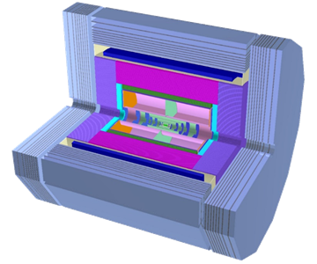
Questions and plans
Optimization of the design:
  The number of layers,
  The width of a PS bar,
  The readout system.
Plans:
  Enhance the work on software and simulation,
    Develop the algorithms for muon track reconstruction and muon identification.
    Studies of the physics performance and impact.
    Potential for New Physics: LLP?
  Enhance the work on readout electronics:
    Reference to the readout system designed for JUNO-TAO
    R&D on TOT scheme.
  R&D on RPCs based on low-resistance glass, new in China.
Barrel
Endcap
Endcap

Slide 3
Edition of the TDR
Writing TDR with the input from the review talk.

Slide 4
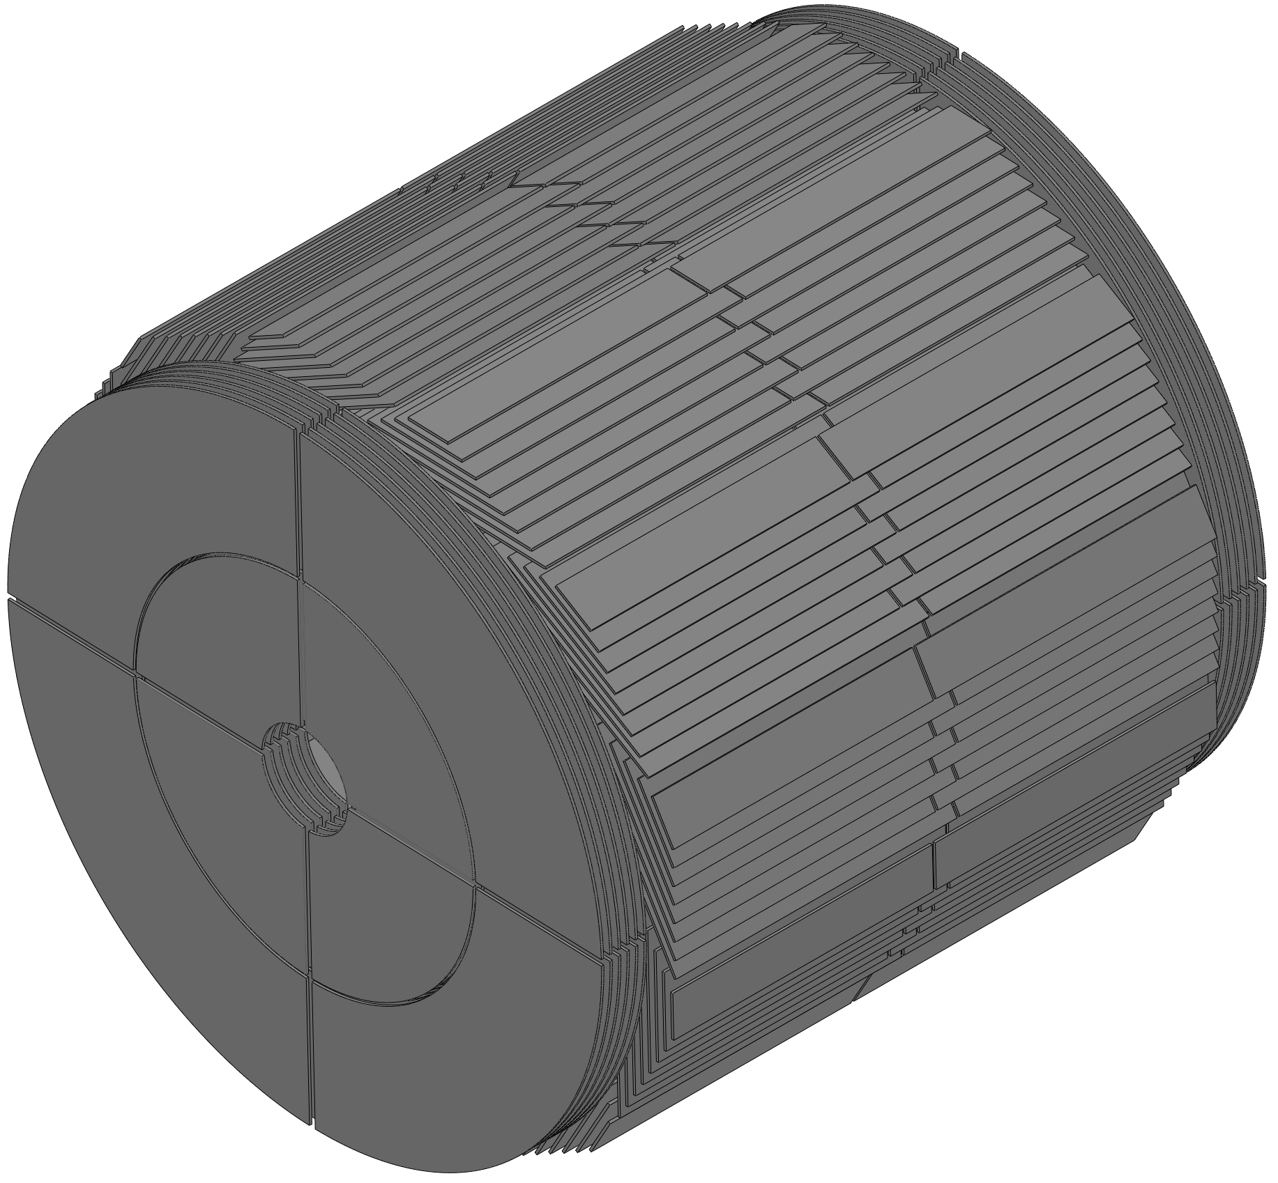
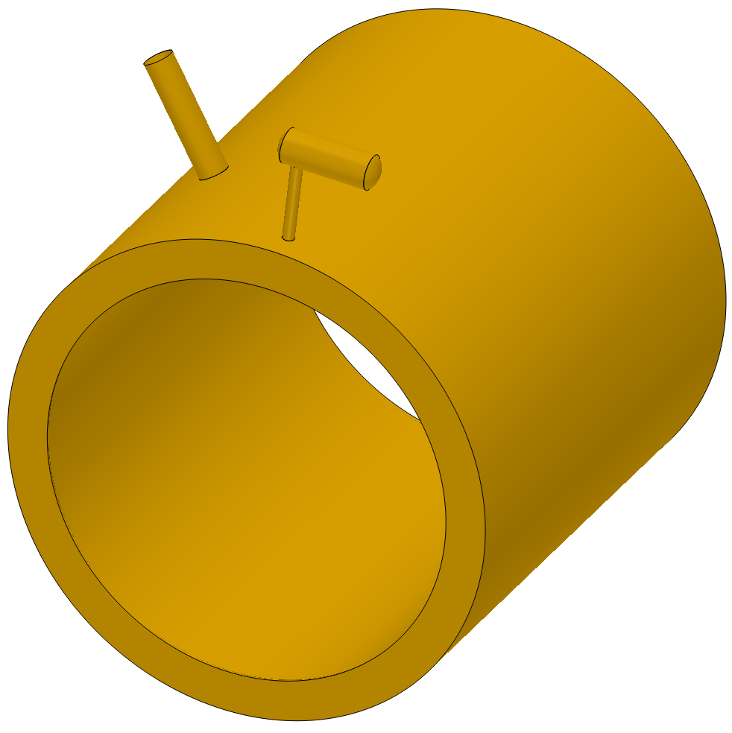
Work with mechanics group
We work closely with the mechanics group. Ji Quan and Xia Shang were invited to the muon group for weekly discussion.
A new question: the positions of the chimneys of the Magnet.
?
?
The dead zone of the coverage angle is related to the positions of the chimneys.

