Slide 1



CEPC Detector Magnet
Feipeng Ning
On behalf of SC magnet Team
Aug. 22, 2024, CEPC Mechanical workshop

Slide 2
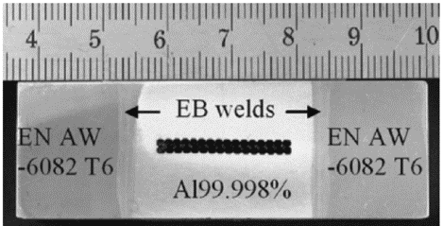
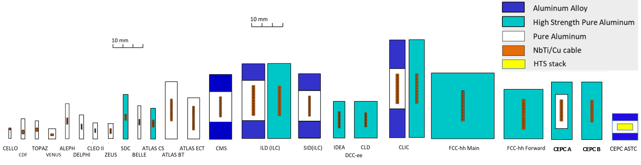
Aluminium-stabilized superconducting conductor
Aluminium-stabilized Nb-Ti/Cu conductor types
CMS
Pioneer
Now
Future

Slide 3
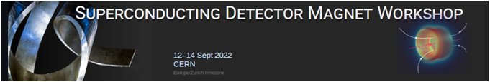
Aluminium-stabilized superconducting conductor
Aluminium-stabilized Nb-Ti/Cu conductor
The Superconducting Detector Magnet Workshop is organized by CERN and KEK, and is hosted at CERN in hybrid format
For the purpose of:
  Addressing the issue of commercial availability of aluminum-stabilized conductor technology for future superconducting detector magnets
  Informing the community of on-going and future projects
  To exchange ideas, concepts, best practices, and to advance superconducting detector magnet technology
  Fostering collaboration
With 88 participants (55 on-site and 33 online) from 36 institutes and companies
Welcome!
The aluminum-stabilized Nb-Ti/Cu conductor is the traditional workhorse that is used in nearly all superconducting detector magnets
For a given amount of mass, aluminum-based superconducting conductors give strong performance needed for superconducting detector magnets:
Significant heat capacity for a given amount of weight
Excellent electrical and thermal conductivity at 4 K (pure or nickel-doped aluminum)
Very good mechanical properties (nickel-doped aluminum or aluminum-alloy)
Affordable, in combination with superconducting Nb-Ti/Cu Rutherford cables
However, in recent years, commercial availability has been an issue
Can we obtain it? Do viable alternatives exist?

Slide 4
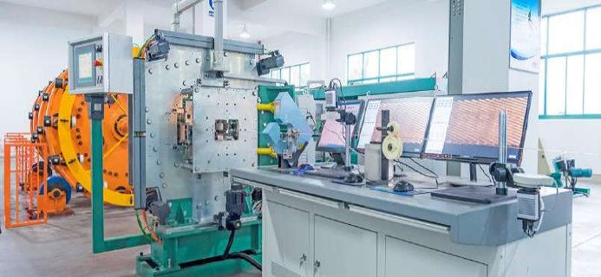
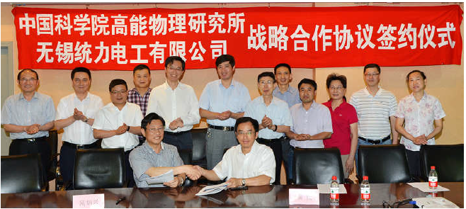
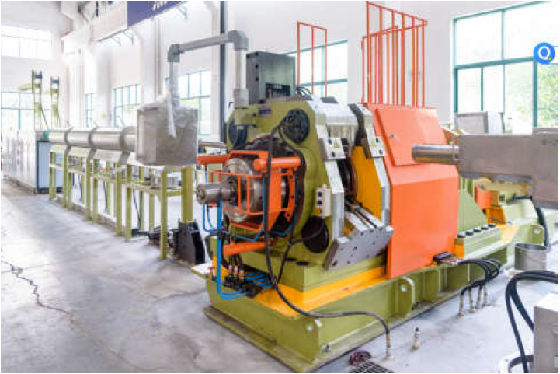
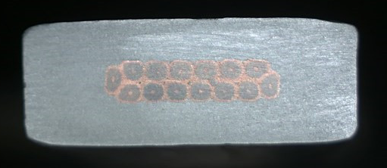
Aluminium-stabilized superconducting conductor
Conductors
  Conductor is the foundation of the magnet development. Most of the detector magnets used or will use the Aluminum-stabilized Nb-Ti/Cu conductors.
Rutherford Cable
Aluminum stabilized NbTi/Cu conductor
The IHEP and Toly company have jointly established an aluminum coated conductor production line in 2015.
Extrusion machine
4

Slide 5
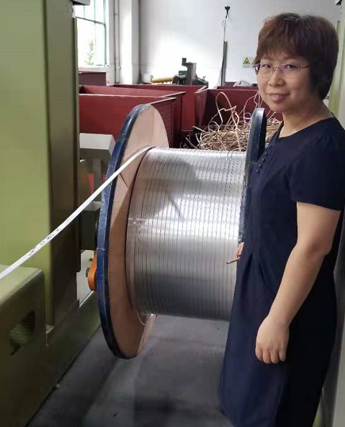
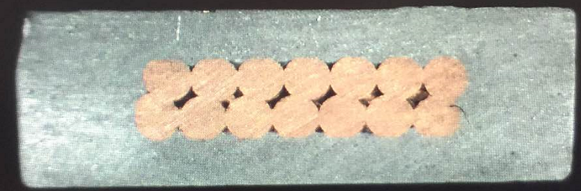
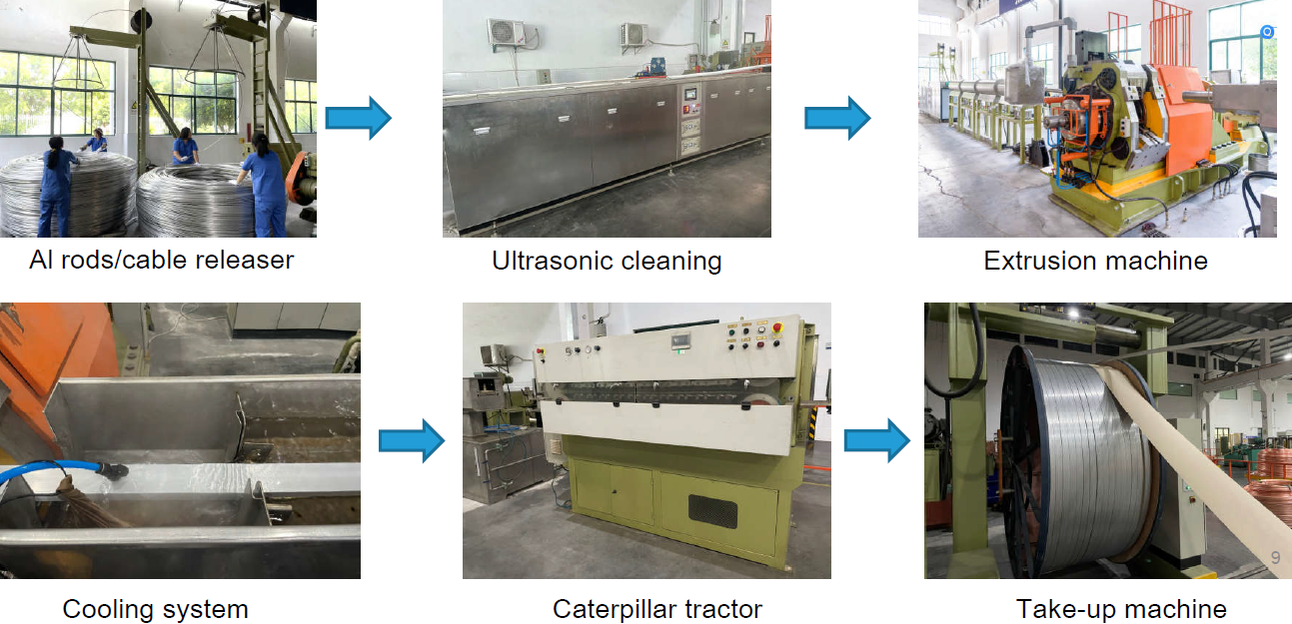
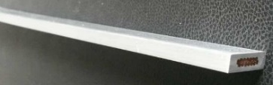
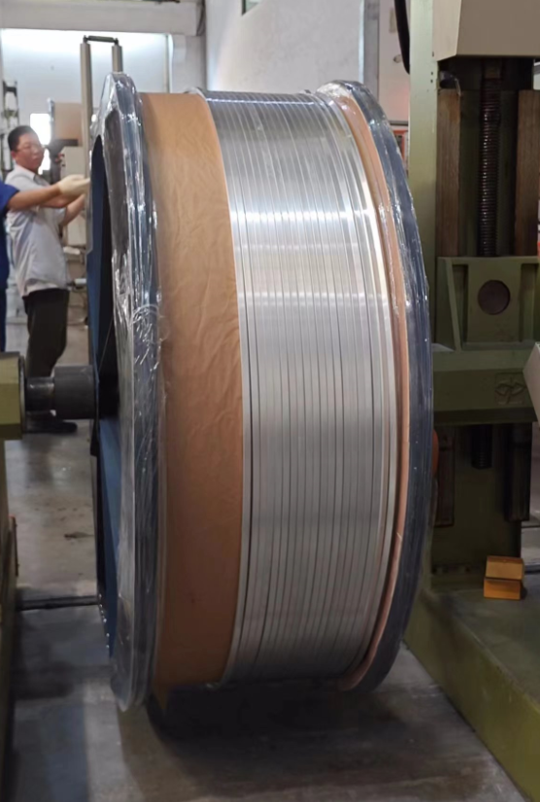
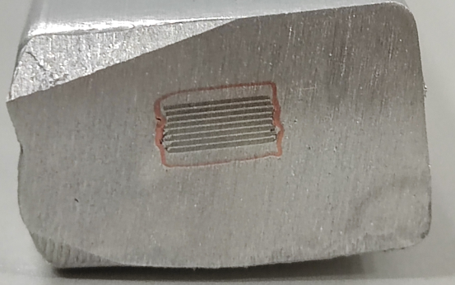
Production line
LTS: Aluminum stabilized NbTi Rutherford cable
Al-stabilized Conductors
1.5 km
HTS: Aluminum stabilized Stacked REBCO Tape Cable
Aluminum coated conductor production line
100 m
5

Slide 6
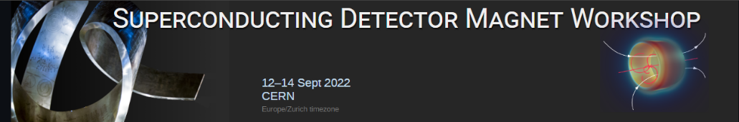
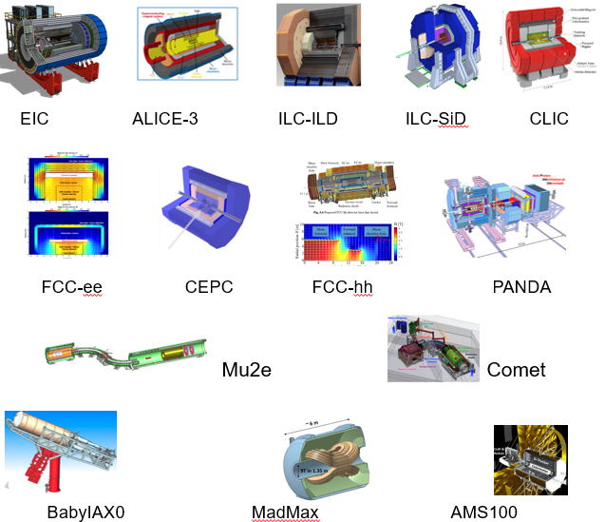
Introduction of Detector magnet
Detector Magnet needed in the future
 | Experiments | Site | B [T} | Size, ID x L [m] | Note | Fabrication Expected
Collider | EIC-Detector | BNL | 1.5~3 | 2.5~3.2 x 8.5 | Solenoid | 2025 ~
 | ILC-ILD | Japan | 4 | 6.88 X 7.35 | Solenoid | 2030 ~
 | ILC-SiD | Japan | 5 | 5 X 5 | Solenoid | 2030 ~
 | CLIC-ILD | CERN | 4 | 6.8 X 8.3 | Solenoid | 2035 ~
 | CLIC-SiD | CERN | 5 | 5.4 X 6.5 | Solenoid | 2035 ~
 | CLIC | CERN | 4 | 7 X 8.3 | Solenoid | 2035 ~
 | FCC-ee IDEA | CERN | 2 | 4.2 X 6.0 | Solenoid | 2035 ~
 | FCC-ee CLD | CERN | 2 | 7.4 X 7.4 | Solenoid | 2035 ~
 | FCC-hh | CERN | 4 | 10 X 20 | Solenoid | 2060 ~
 | ALICE-3 | CERN | 2 | 3 x 7.5 | Solenoid | 2027 ~
 | CEPC | IHEP | 3 | 7.07*9.05 | Solenoid
Others | Mu2e | Fermilab | 5 ~ 2.5 | 1.5 X 4 | Production | Under construction
 | Muon-g-2 | Fermilab | 1.473 | 0.09 X 14.22▪2π | Storage solenoid | Reuse after BNL
 | COMET | J-PARC | 5 ~ 3 | 1.3 X 1.6 | Capture Sol. | Under const.
 | Muon-g-2 | J-PARC | 3 | 0.66 X 0.33 | Solenoid | 2025 ~
 | BabyIAXO | DESY | 2 | 0.7 X 10 | D. Racetrack | TBD
 | IAXO | DESY | 5 - 6 | 5 X 25 | Toroid | TBD
 | Panda | GSI | 2 | 1.8 x 3.1 | Solenoid | TBD
 | Madmax | DESY | 9 | 1.35 x 1.2 | Dipole | TBD

Slide 7
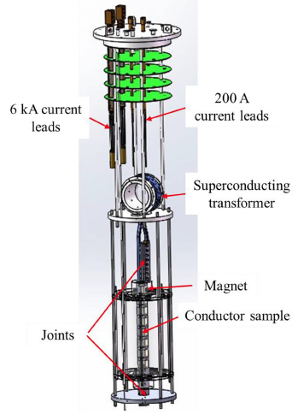
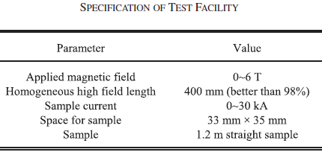
Cable test platform
LTS cable cross section 22*56 mm2，Critical current：4.2K, 5T about 60kA，
HTS cable 20*25 mm2，Critical current：4.2K, 4T⊥，about 60kA
合肥等离子体所：
小样品(30mm, 40kA)测试费用：30w

Slide 8
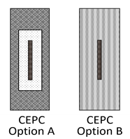
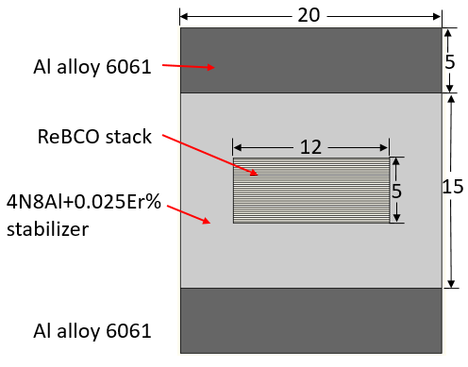
Cable test platform
铝稳定体低温超导电缆：
  截面尺寸：56*22mm，超导线股数32~36芯，
  测试需求：电缆的临界电流预估为60kA@5T, 4.2K
铝稳定体高温超导叠型电缆：
  小尺寸样缆的截面为15*10mm²，超导带材根数14；大电缆截面25*20mm², 超导带材根数35；
  小尺寸样缆的临界电流大约为10kA@4T垂直场,4.2K，大尺寸电缆的临界电流大约为60kA。预估临界电流60kA@4T垂直场,4.2K
铁基超导电缆
  临界电流5kA，长度需求1米左右，背场磁场强度暂无需求。

Slide 9
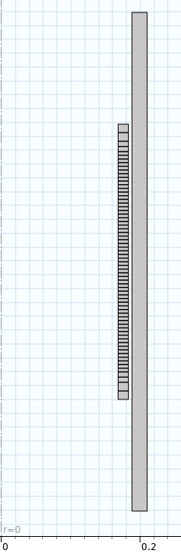
Cable test platform
方案一：基于现有垂测杜瓦内径450mm，重新设计杜瓦盖板、12T背场磁体LTS(7T)+HTS(5T) ，孔径325mm考虑到现有杜瓦盖板尺寸偏小，对于安装20KA以上的电流引线空间不足，拟采用感应法进行临界电流的测量，根据相关文献介绍，测量精度可以达到5%以内，可以满足超导电缆测试要求。LTS内径376mm，HTS内径325mm
测试平台结构：杜瓦盖板、12T背场超导磁体（内径320mm）、600A电流引线4根（背场磁体用）、200A电流引线一对（变压器原方线圈用）、温度计、液位计、罗氏线圈（样品电流测量）等
费用估算：杜瓦盖板及引线三对30万；
背场超导磁体: 铌钛线材提供7T场，用量21km；YBCO带材提供5T场，用量4.8mm宽带材4 km，7mm宽带材1.2 km. 超导材料预估费用25+73=98万；
线圈制造及工装预估费用30万；
各类传感器预估费用：20万；
600A电源两台，300A电源一台：预估费用30万。
合计：30+98+30+20+30=208万。
LTS
HTS

Slide 10
Cable test platform
方案二：重新进行设计。兼容超导电缆测试、BEPCII-U超导线圈垂测功能。考虑12T背场超导线圈有效内径400mm，样品腔与背场线圈位于两个独立的真空腔室内，方便更换样品，BII线圈也可以直接放入测试杜瓦。由于空间充足，可以排布20KA电流引线的布局，因此可以用直测法进行测量。
  测试平台结构：杜瓦盖板、12T背场超导磁体LTS(7T)+HTS(5T)、600A电流引线4根（背场磁体用）、20KA电流引线一对（测试样品用）、温度计、液位计等。LTS内径450mm，HTS内径400mm
  测试杜瓦、盖板及两对600A电流引线50万；
  背场超导磁体: 铌钛线材提供6.8T场，用量26km；YBCO带材提供5.2T场，用量4.8mm宽带材5200米，7mm宽带材1600米。超导材料预估费用30+70+30=130万;
  线圈制造及工装预估费用40万;
  20KA电流引线一对：70万;
  各类传感器预估费用：20万;
  600A电源两台，20KA电源一台：预估费用200万。
合计：50+130+40+70+20+200=510万。
LTS
HTS

Slide 11
Thank you for your attention!
Aug. 7th, 2024, CEPC Detector Ref-TDR Review

