Slide 1




Horizontal IP feedback system at SuperKEKB based on fast luminosity measurements
Philip Bambade IJCLab – Orsay
Acknowledgements: Y. Funakoshi, M. Masuzawa, H. Nakayama, Y. Ohnishi, S. Uehara (KEK – Tsukuba)
Dima. El Khechen (2013-2016), Cheng-Guo Pang (2016-2019), Salvatore Di Carlo (2017-2019), Meng Li (2023-present)
Mini-workshop on CEPC Fast Luminosity Feedback System September 14, 2024 Beijing - China

Slide 2
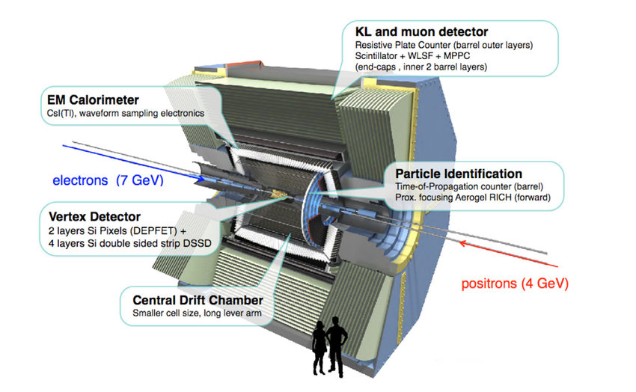
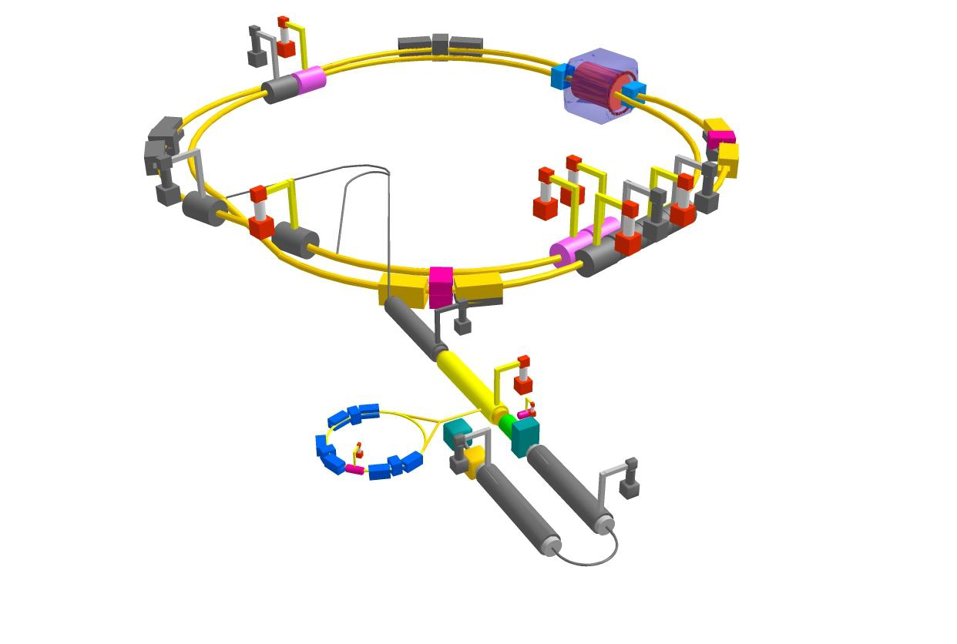
The SuperKEKB/Belle II project
 | Electron | Positron
Energy (GeV) | 7 | 4
Current (A) | 3.6 | 2.6
SuperKEKB (Electron-Positron Collider)
C.M.S. Energy: √s = 10.58 GeV
Luminosity: L = 8 x 10³⁵ cm^{– 2}s^{–1} （Luminosity Frontier Machine）
Belle-II
Main Ring
Injector Linac
Belle II (General purpose detector)
Vertex detectors: Pixel Vertex Detector (PXD),
Silicon strip Vertex Detector (SVD)
Tracking: Central Drift Chamber (CDC)
Calorimeter: Electromagnetic CaLorimeter (ECL)
Particle ID: Aerogel Ring Image CHerenkov detector (ARICH)
K-Long and Muon detector (KLM)
Time-Of-Propagation counter (TOP)
Damping Ring

Slide 3
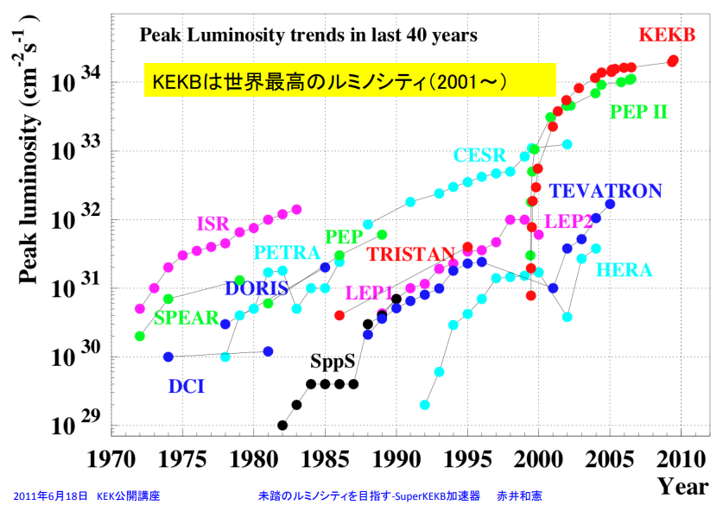
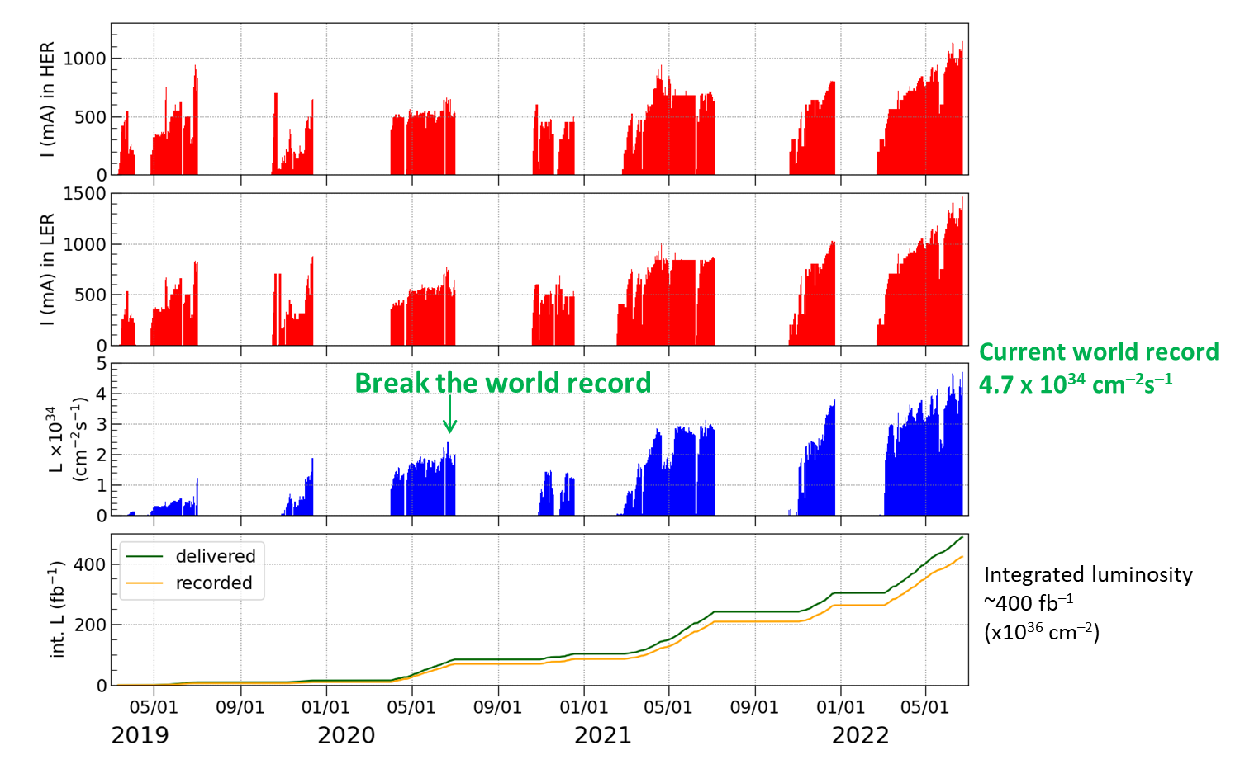
Luminosity Frontier
N = σ x L
B-pair production rate (pair/sec) :
σ = cross-section for B pair production = 1.1nb L = luminosity.
→ 110 pairs of B mesons produced / second for L = 10³⁵ cm^{–2}s^{–1}.
World’s history before SuperKEKB
Our history, current record: 4.7x10³⁴ cm^{–2}s^{–1}
SuperKEKB ➔ unchartered luminosity territory ➔ new techniques

Slide 4
KEKB ↔ SuperKEKB parameters
× 1/20 β_{y}
σ_{y} ≈ 50-60 nm
(similar as ILC/ATF2)
× 2-3 beam currents
similar beam-beam strength
(tune-shift)
→ up to × 40 peak luminosity

Slide 5
Nanobeam collision scheme
Opportunities
Very small β_{y} avoids “hour-glass” limitation (effective bunch length ≈ depth of field of the optics)
Collide more charge @ tiny vertical beam size with similar beam-beam tune-shift strength parameter
Challenges
1. Optical aberrations near IP must be cancelled to achieve / maintain tiny beam spots
2. Control beam-beam tune-shift with more complex IP beam-beam dynamics + optical aberrations
3. Continuously inject intense beams in strongly demagnified IP optics → injection backgrounds… beam tails…
× 1/20 β_{y}
× 2-3 beam currents
× 1/20 σ_{y}

Slide 6
Nanobeam scheme reduced bunch overlap visible on reconstructed track vertex Z distribution

Slide 7
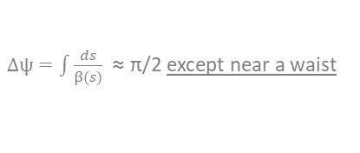
IP optical aberrations blowing up the beam size are unavoidable → reliable measurement for correction only possible at the IP…
+ higher order terms (geometric & chromo-geometric)
ideal spot waist shift linear x-y coupling linear dispersion
Optical functions in LER ±27 m around IP SC final focus system integration with Belle II
IP
quad strength tolerance for waist shift < β* / L* ≈ 3 10⁻⁴
σ_{quad} ≈ 0.2 mm
IP
matching quads to select β*
$∆\text{ψ}=\int{\frac{ds}{β(s)}}$ ≈ π/2 except near a waist
σ_{IP} ≈ 60 nm
Propagate IP aberration in low-β insertion → no visibility (except, possibly, at a secondary waist)
Must tune directly at IP (luminosity…)
Δψ
π/2
π/2

Slide 8
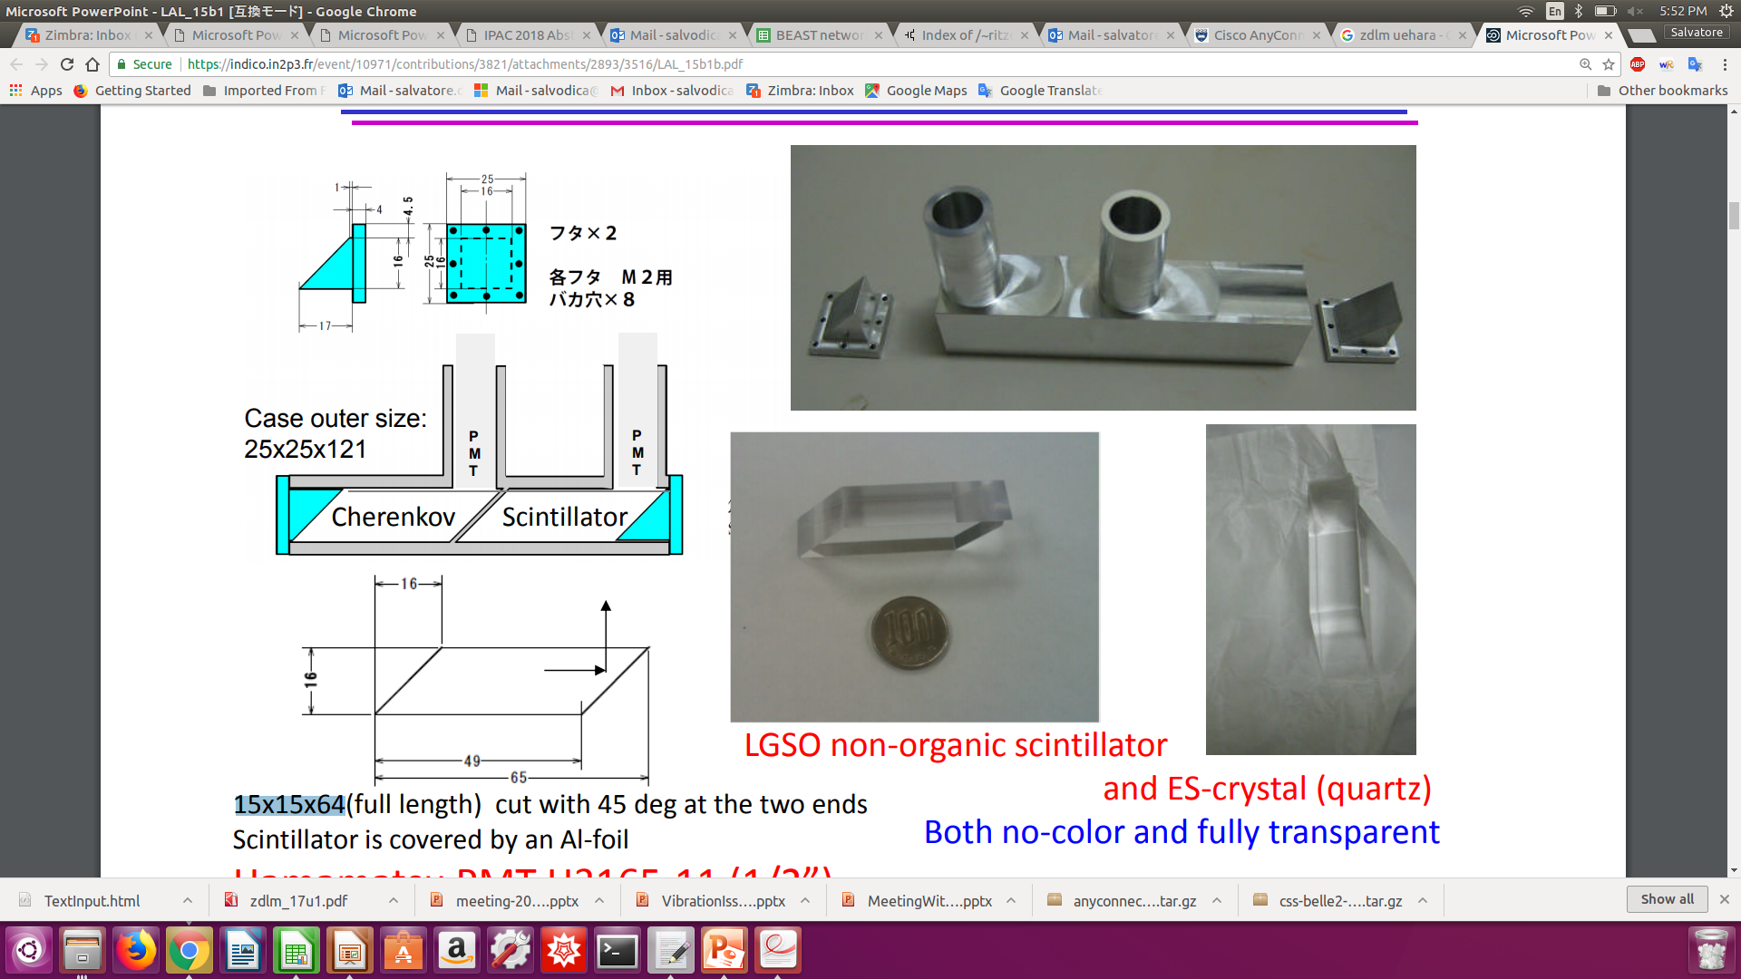

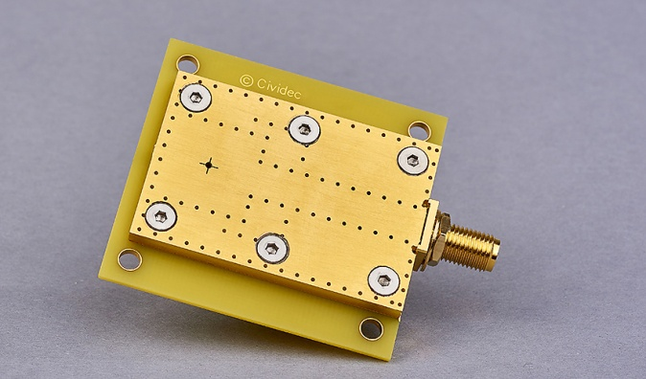
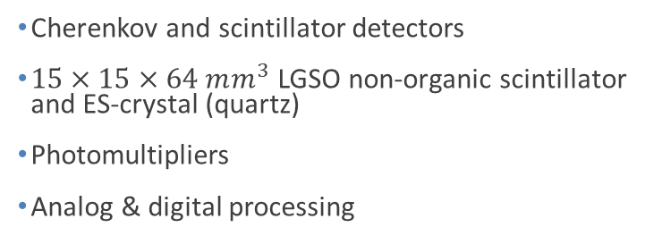

Two complementary techniques for fast luminosity measurements
- compare / collaborate / mutually supporting
- share simulation, mechanics, some data…
- since 2012
LumiBelle2 / IJCLab
ZDLM (Zero Degree Luminosity Monitor) / KEK
single crystal CVD diamond sensors
$4×4×0.5/0.14 mm^{3}$
Fast charge/current amplifiers
Digital electronics and processing
Cherenkov and scintillator detectors
$15×15×64 mm^{3}$ LGSO non-organic scintillator and ES-crystal (quartz)
Photomultipliers
Analog & digital processing
Notes:
LGSO (Lu2-xGdxSiO5)

Slide 9
What for / specs ?
“Dithering” feedback
Correct for few Hz horizontal motion
79 Hz orbit “dithering” + luminosity sampling @ 1 kHz → reconstruct baseline freq. + 2nd harmonic
Efficient separation from other “slow” variations
1% relative precision @ 1 kHz sufficient (cf. C.-G. Pang et al., J.Phys.Conf.Ser. 1067 (2018) no.7, 072023)
Provide analog signal as input to lock-in amplifier
Bunch by bunch luminosity diagnostic
Nominally 4 ns bunch separation → need short signal pulses, ideally < 4 ns
1% or better relative precision @ 1 Hz
IP vertical beam size measurement + tuning at very low currents
Single beam orbit + optics corrections in two rings
Vertical e+ and e- beam size optical tuning → suppress local aberrations in nanobeam final focus
Control of beam-beam blowup → find best spot in tune diagram
Very low current → avoid confusion from beam-beam induced blowup
Dynamic range L ≈ 10³² → 10³⁶ cm⁻² s⁻¹
Non luminosity scaling contamination < 1% (e.g. beam gas bremsstrahlung and Touschek losses)
Manage radiation damage at highest luminosity
Notes:
LGSO (Lu2-xGdxSiO5)

Slide 10
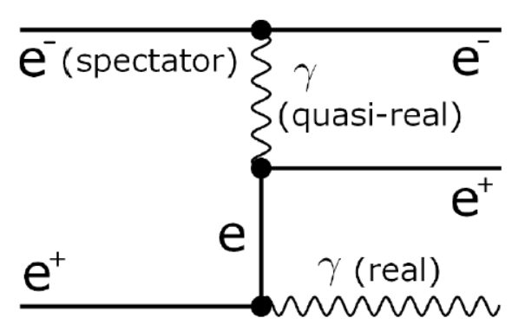
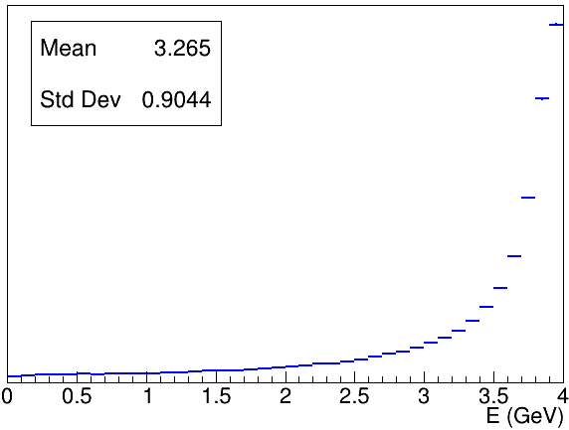
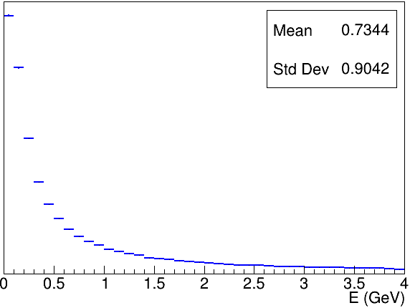
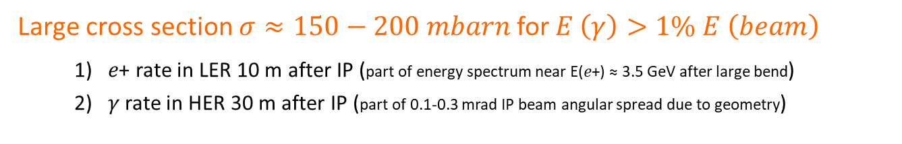






Bhabha process at vanishing scattering angle
a.k.a. Single Bremsstrahlung
Dima El Khechen et al., PRAB 22, 062801 (2019)
Large cross section $σ≈150−200 mbarn$ for $E \left(γ\right)>1\% E \left(beam\right)$
    1) 𝑒+ rate in LER 10 m after IP (part of energy spectrum near E(𝑒+) ≈ 3.5 GeV after large bend)
    2) 𝛾 rate in HER 30 m after IP (part of 0.1-0.3 mrad IP beam angular spread due to geometry)
$$E (e^{−})=7GeV$$
$$E (e^{−})=7GeV$$
$$E (e^{+})$$
𝑒+
$$E (e^{+})=4GeV$$
$$E (γ)$$
$$L∝\frac{dN}{dt}$$
Only relative luminosity → with certain conditions…
Acceptance depends on choice of sensor / location
Also some variation with beam parameters…
𝜎_{Bhabha@zero-degree} not precisely computed in QED
➔ OK for usage on “short” enough time-scales
➔ care for beam parameter dependence
𝛾
Notes:
LGSO (Lu2-xGdxSiO5)

Slide 11
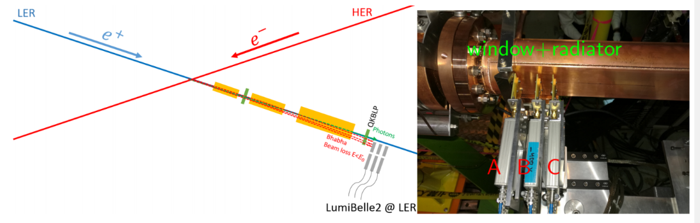
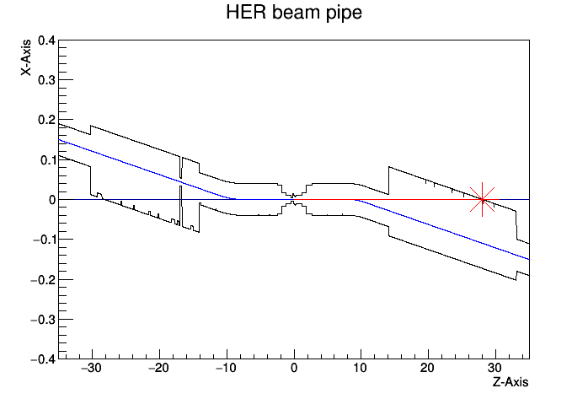
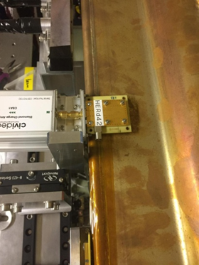
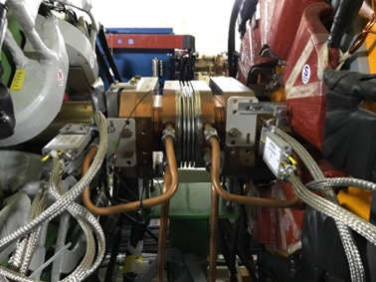
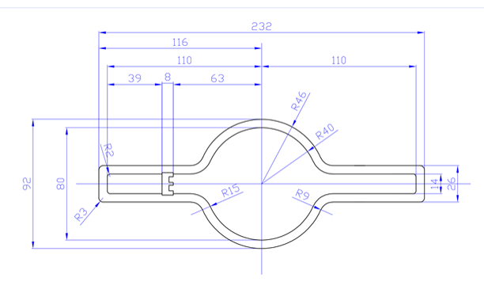

Implementation in LER and HER
Cheng Guo Pang et al., Nucl.Instrum.Meth. A931 (2019) 225-235
POSITRON RING (measure e+)
Optimal position found at 10 m behind IP using SAD
Over-bent Bhabha positrons → vacuum chamber
Special beam pipe with window + Tungsten radiator
Start-to-end simulation (GuineaPig++, SAD, GEANT4)
IP
0.4
ELECTRON RING (measure $γ$)
28 m
Photon ray-tracing in detailed vacuum chamber geometry + GEANT4
Original position at 30 m (2018)
New optimal position found at 28 m with ≈ 10 times higher rate
IP
X(m)
0
loss position distribution
Notes:
Radiation length of Tungsten is 0.3504 cm

Slide 12

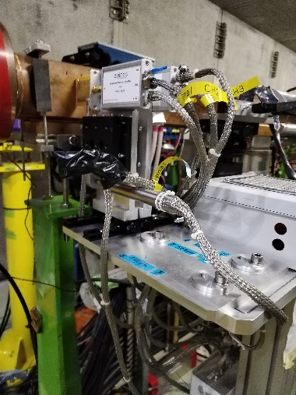
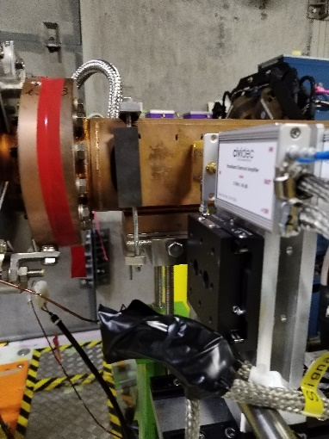
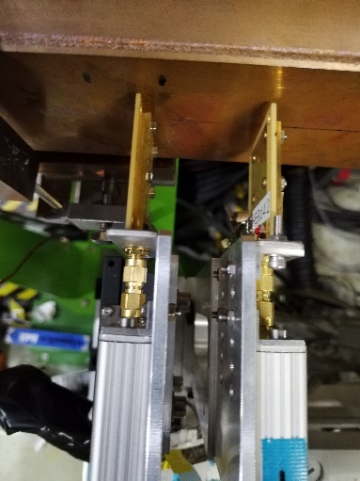
IP
HER
LER
removed
present setup
CH1
CH2
CH3
CH4
ADC Channels
140 μm + current amp 2 GHz
500 μm + charge amp 10 ns

Slide 13
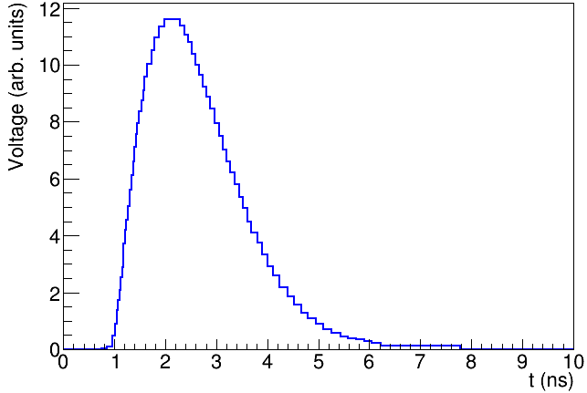
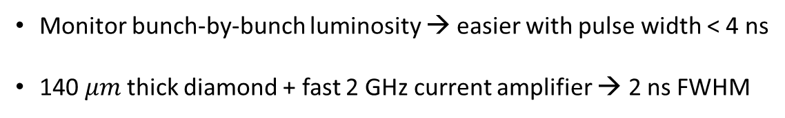
LumiBelle2 diamond sensor signals
High charge carrier mobility → fast signal formation
Wide band-gap (5.5 eV) → good radiation tolerance
DIAMOND
AMPLIFIER
SuperKEKB nominal collision spacing = 4 ns
Monitor bunch-by-bunch luminosity → easier with pulse width < 4 ns
140 $μm$thick diamond + fast 2 GHz current amplifier → 2 ns FWHM
2 ns
FWHM
Notes:
Radiation length of Tungsten is 0.3504 cm

Slide 14
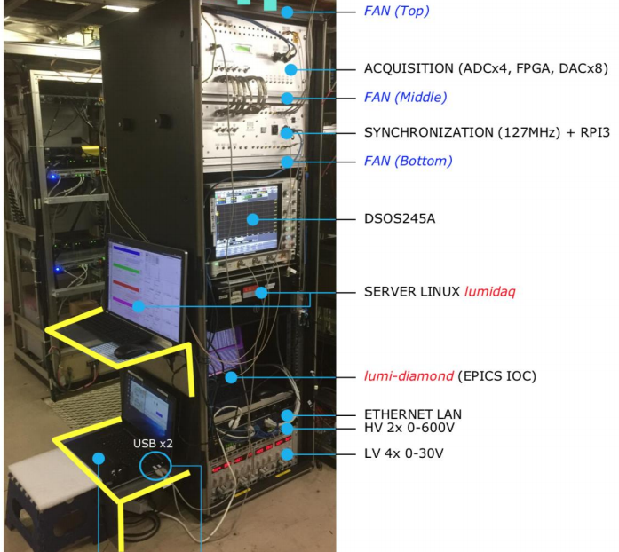
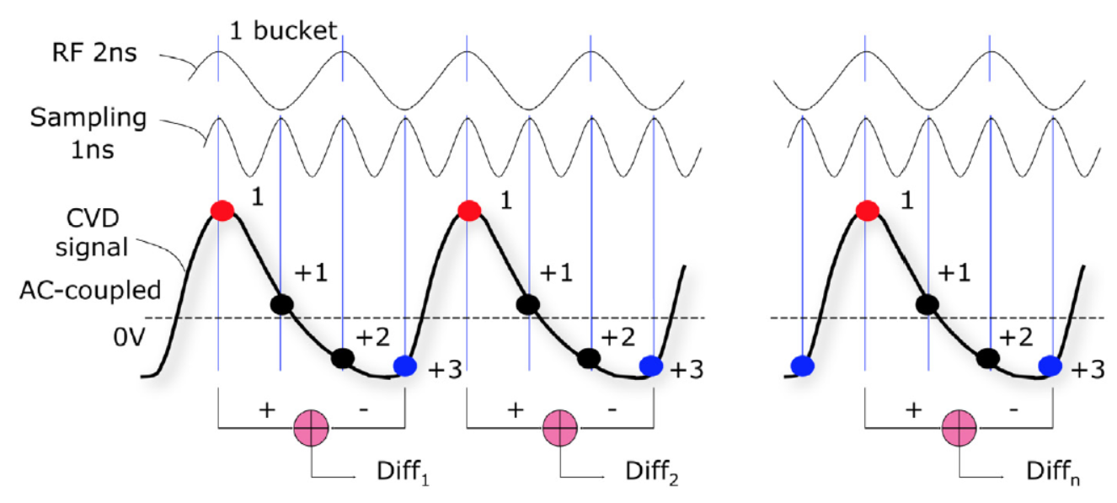

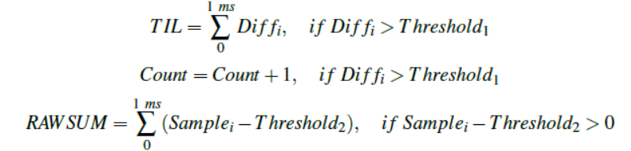
LumiBelle2 signal processing
多学科122
E-HUT F-8
2 / 10 ns FWHM signals from 140 / 500 μm with 2 GHz current / low noise charge amp sampled every 1 ns
Synchronized to RF clock → continuous monitoring, averaging at 1 kHz and 1 Hz (bunch by bunch and all bunches together)
Luminosity proportional to amplitude of signal peaks
  ADC is AC-coupled → record difference between peak and baseline → “TIL” & “BIL”
  Raw sum of all samples also ∝ luminosity and recorded → “RAWSUM”
  Number of peaks also recorded (constant fraction discriminator) → “COUNT”
➔ EPICS broadcasting @ 1 Hz ➔ “1 Hz, 1 KHz, bunch-by-bunch, bunch-current” data streams transferred daily for archiving

Slide 15
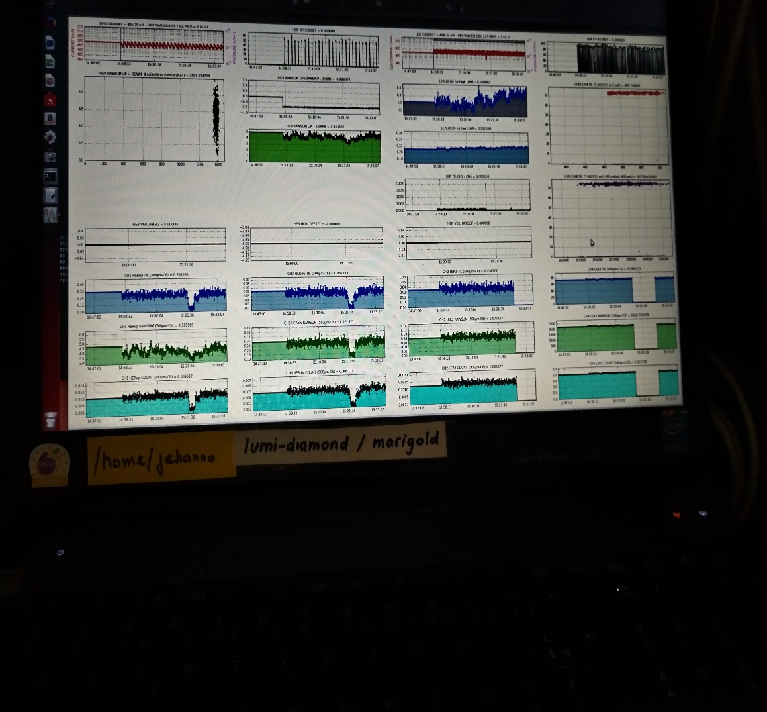
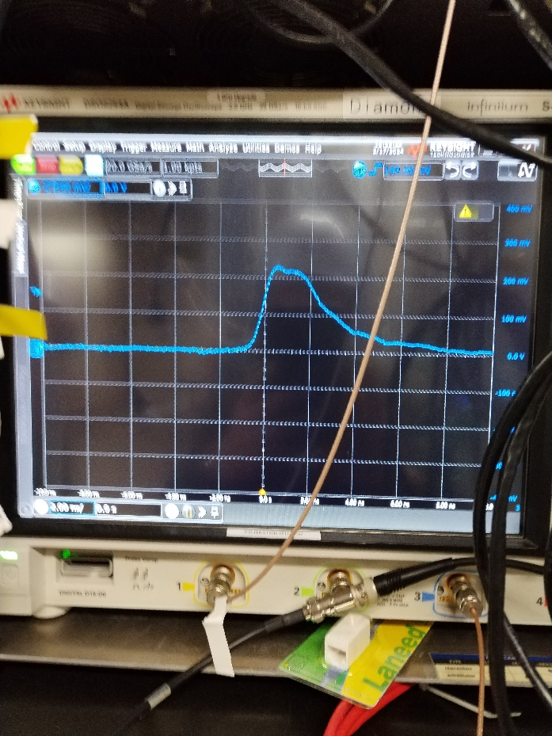
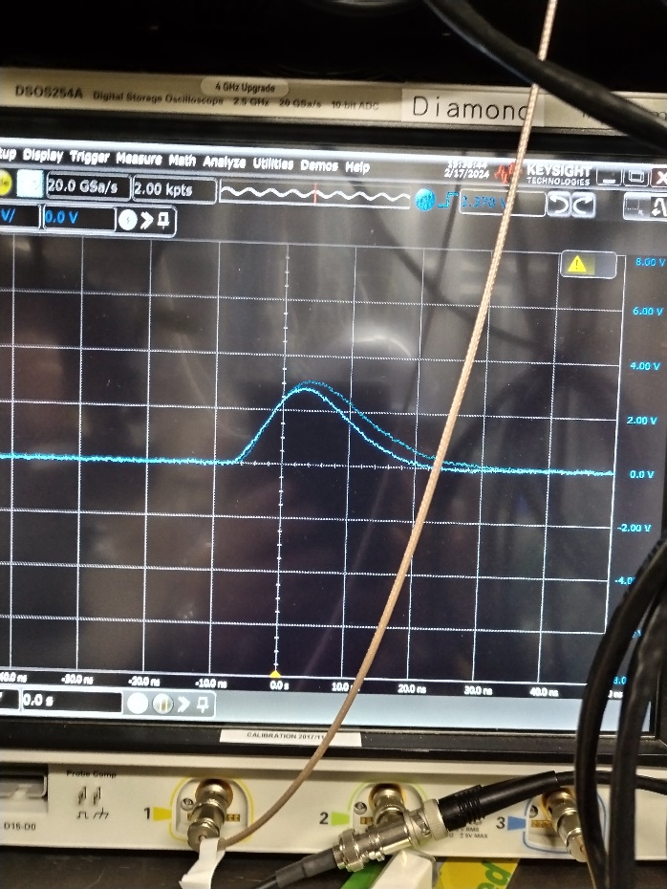
LER 400 mA single beam vacuum scrubbing – 17/02/2024
(beam gas Bremsstrahlung events)
E-HUT / lumi-diamond PC
E-HUT / Keysight digital scope
LER channel 2
LER channel 4
On-line EPICS data plotter 140 μm diamond 500 μm diamond
2 GHz current amp 10 ns charge amp

Slide 16
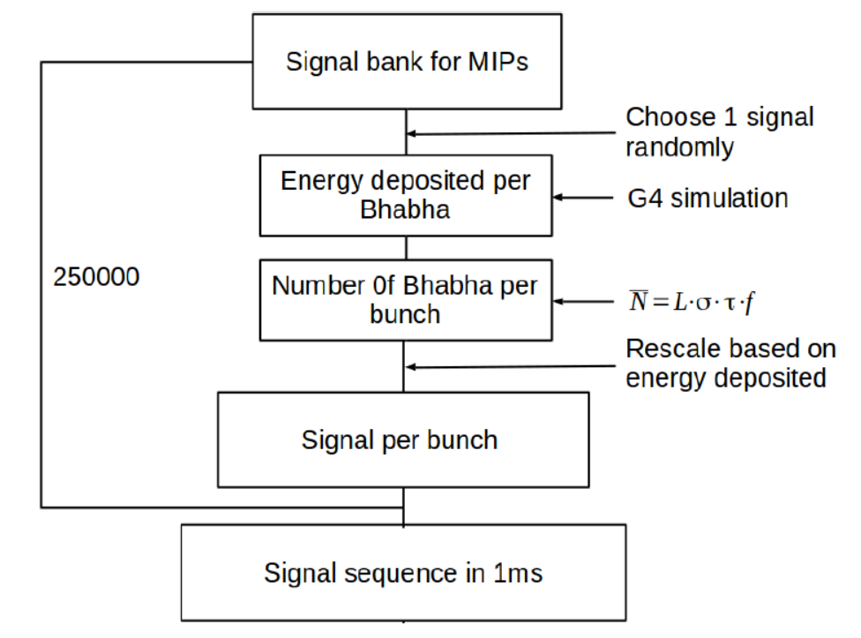
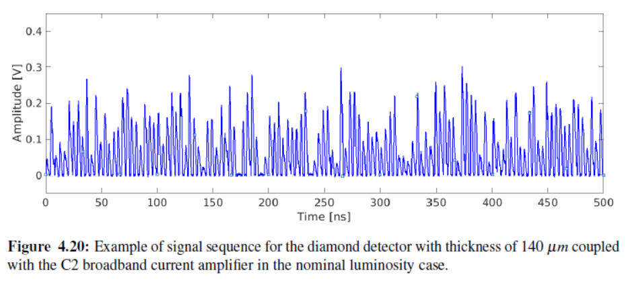
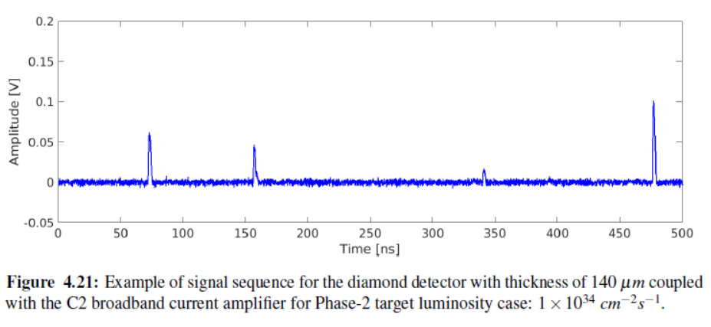
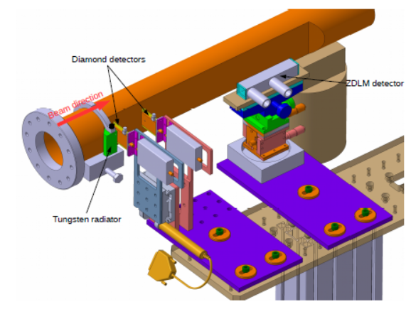
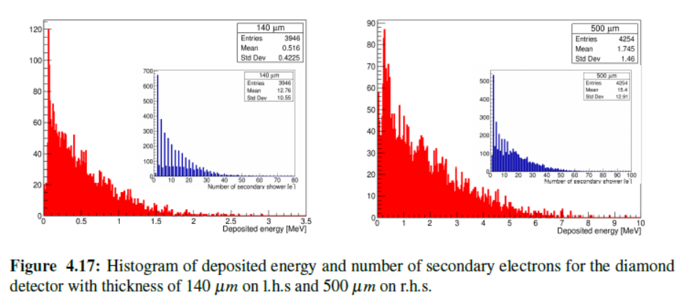
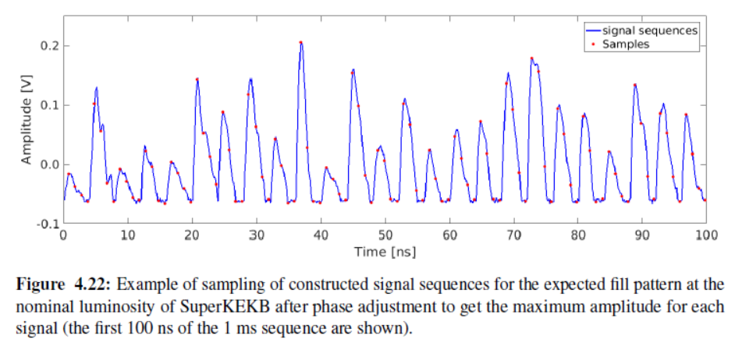
Signal formation and DAQ simulation

Slide 17
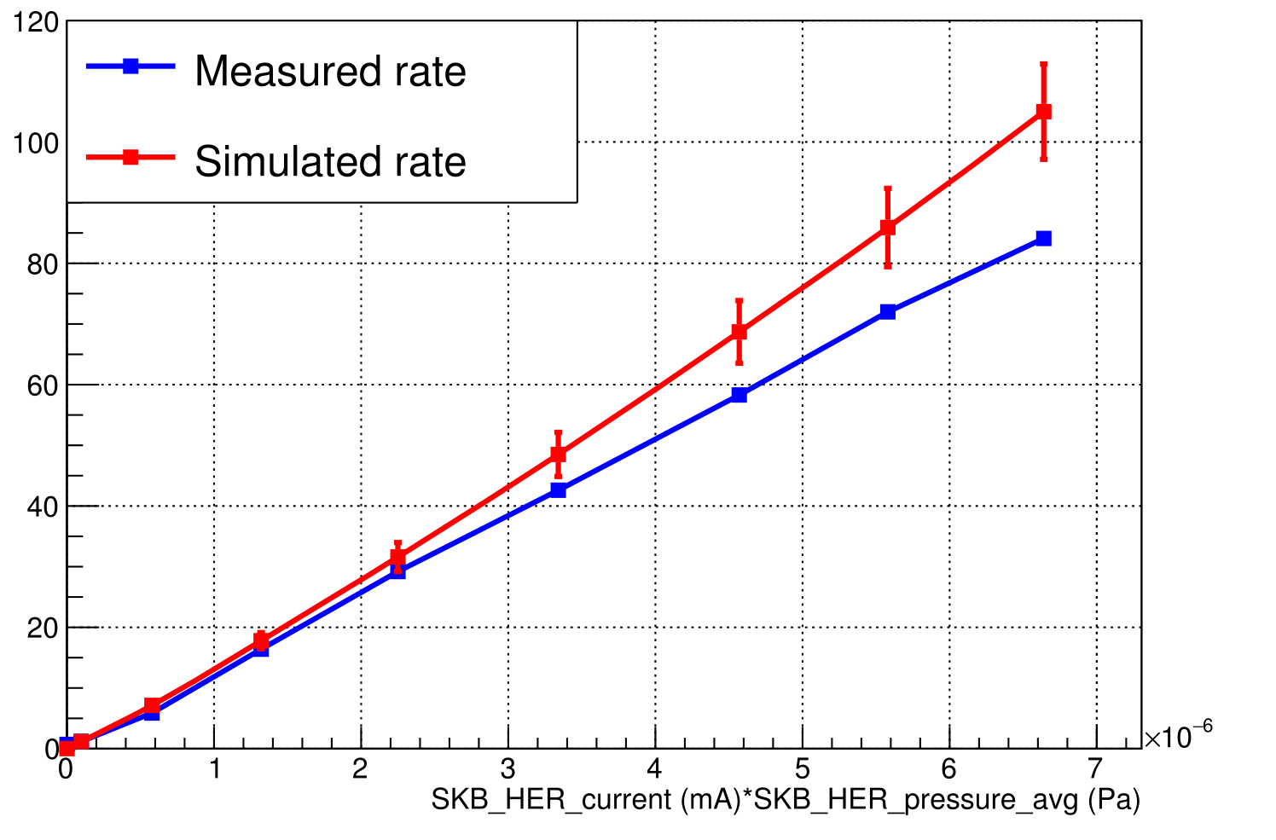
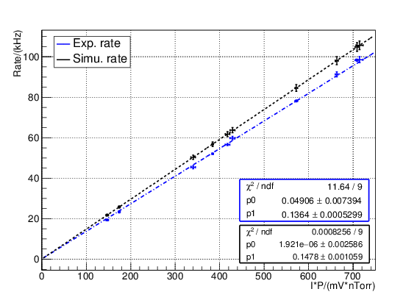
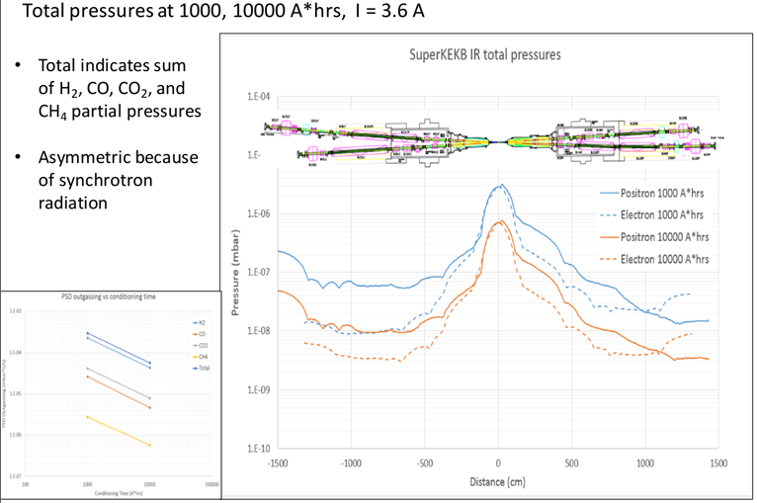
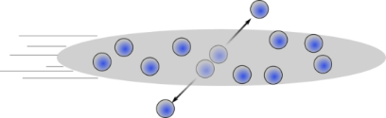
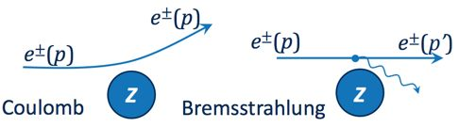


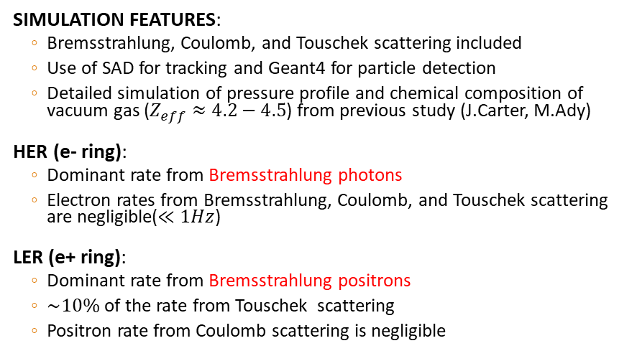


Background study
SIMULATION FEATURES:
  Bremsstrahlung, Coulomb, and Touschek scattering included
  Use of SAD for tracking and Geant4 for particle detection
  Detailed simulation of pressure profile and chemical composition of vacuum gas ($Z_{eff}≈4.2−4.5$) from previous study (J.Carter, M.Ady)
HER (e- ring):
  Dominant rate from Bremsstrahlung photons
  Electron rates from Bremsstrahlung, Coulomb, and Touschek scattering are negligible($≪1Hz$)
LER (e+ ring):
  Dominant rate from Bremsstrahlung positrons
  $\sim 10\%$ of the rate from Touschek scattering
  Positron rate from Coulomb scattering is negligible
$$Measurement vs Simulation$$
$$Rate(Hz)$$
e- ring
$$Rate(kHz)$$
e+ ring
Scattering position of Bremsstrahlung
particles detected in LumiBelle2 / LER
$$I×P$$
Jason CARTER (ANL) & Marton ADY (CERN)
Touschek
Simulated vacuum profile in IR

Slide 18
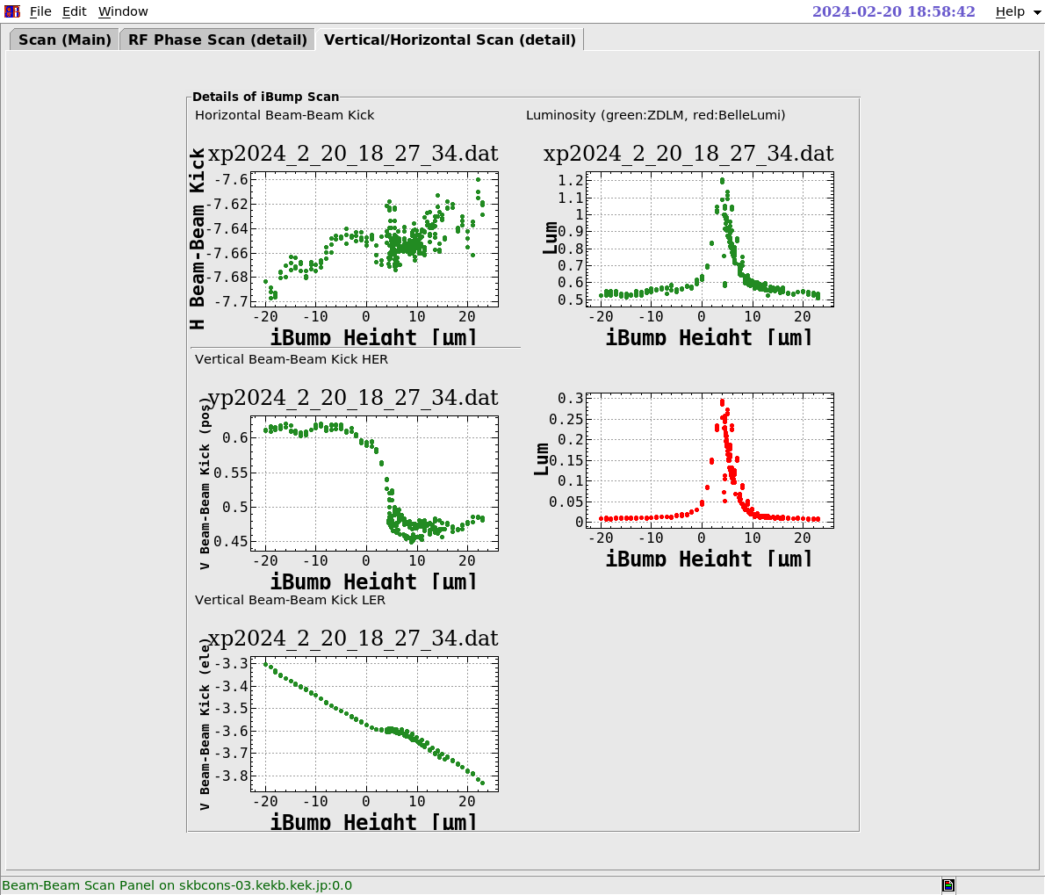
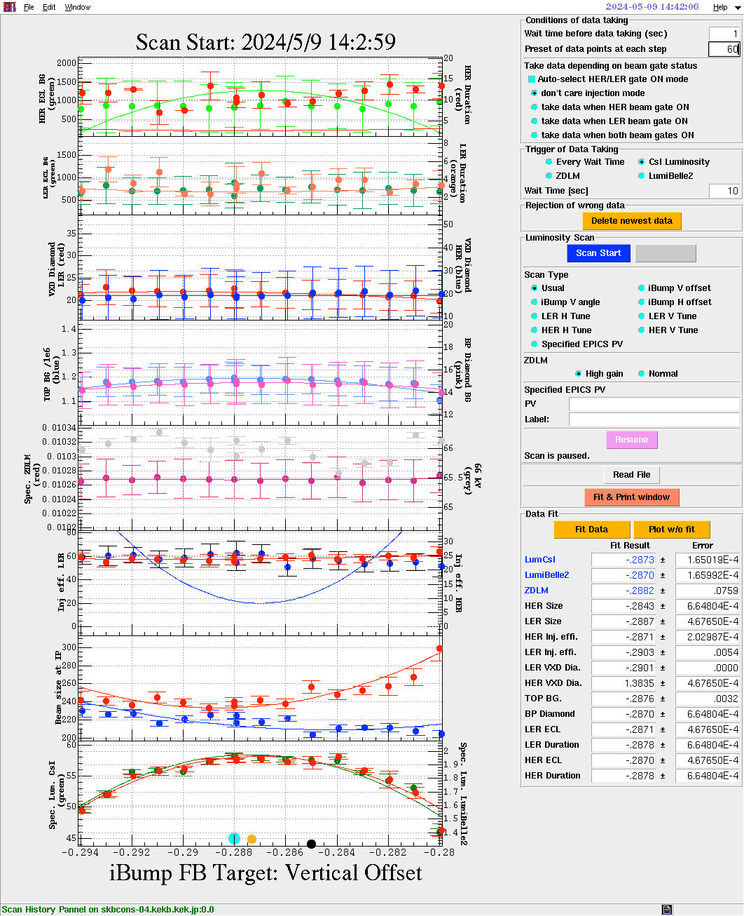
Setting up and optimizing beam collision with LumiBelle2
Initial scanning of IP beam offset to enable Regularly optimizing IP beam offset
collisions at very beginning of the run… to maximize luminosity…

Slide 19
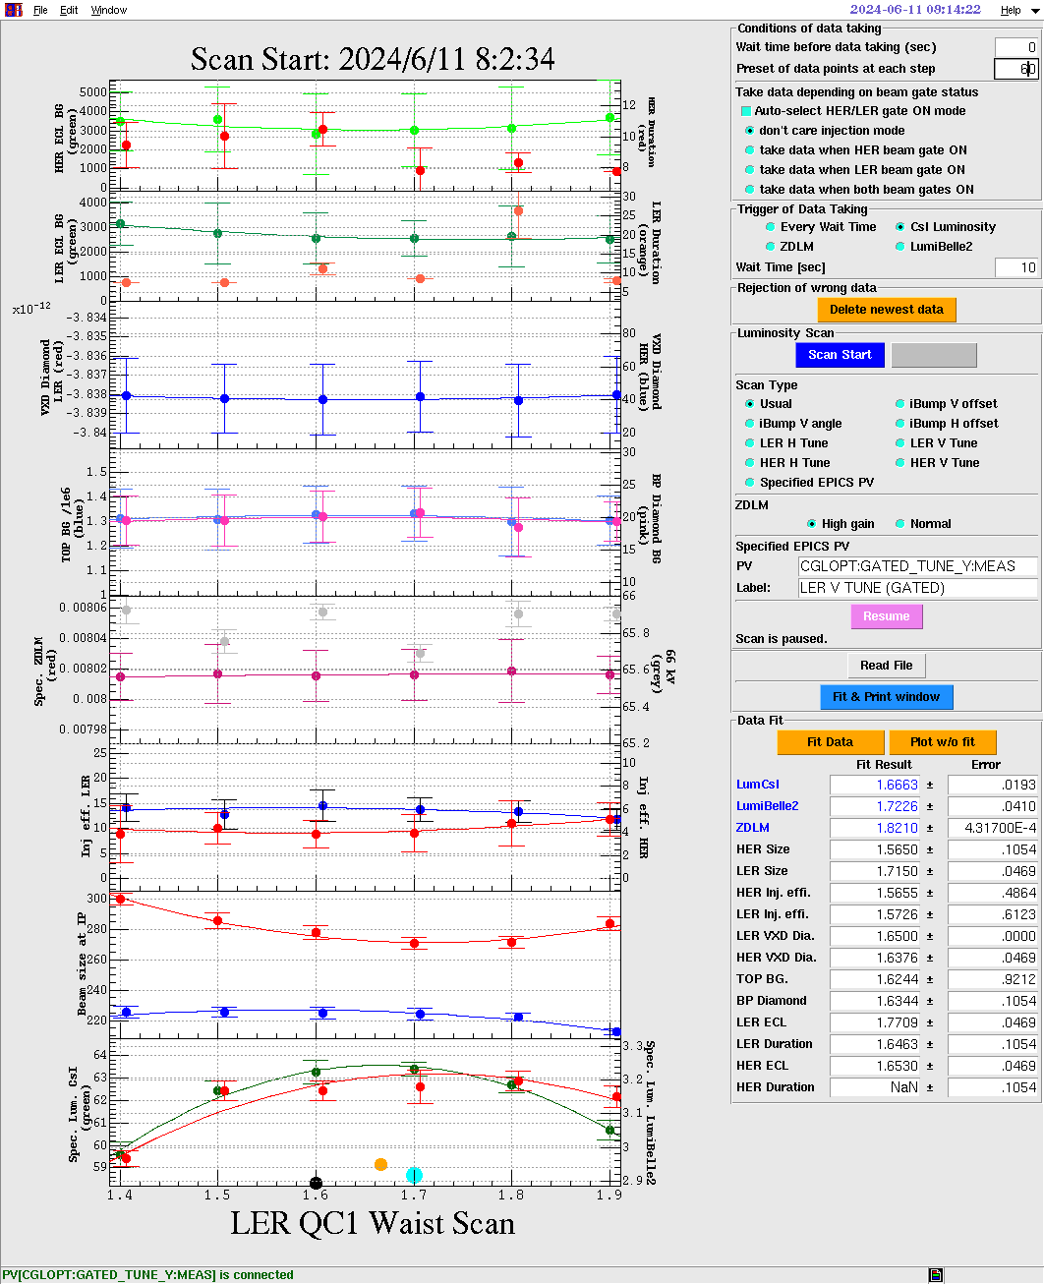
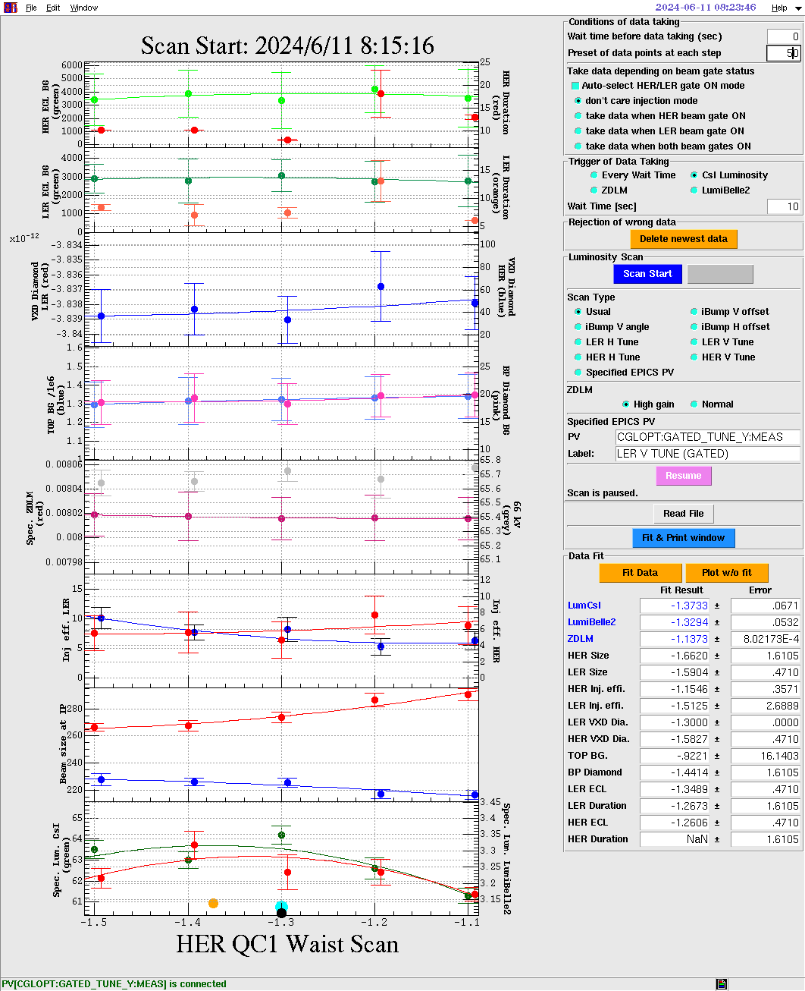
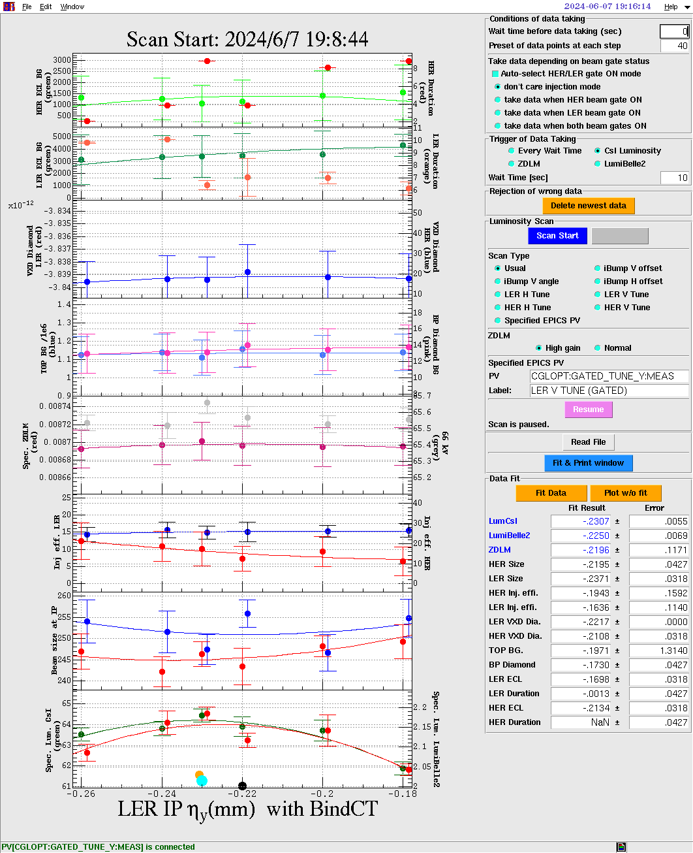
Minimising electron and positron IP beam sizes with LumiBelle2…

Slide 20
LumiBelle2 1Hz bunch-by-bunch luminosity
2346 bunches on 04-05-2024

Slide 21
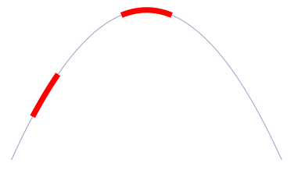
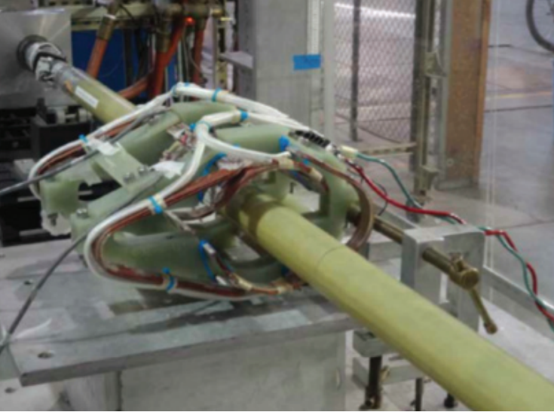
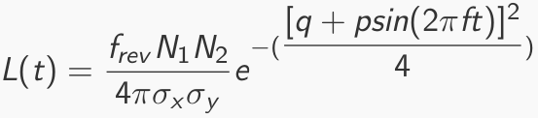
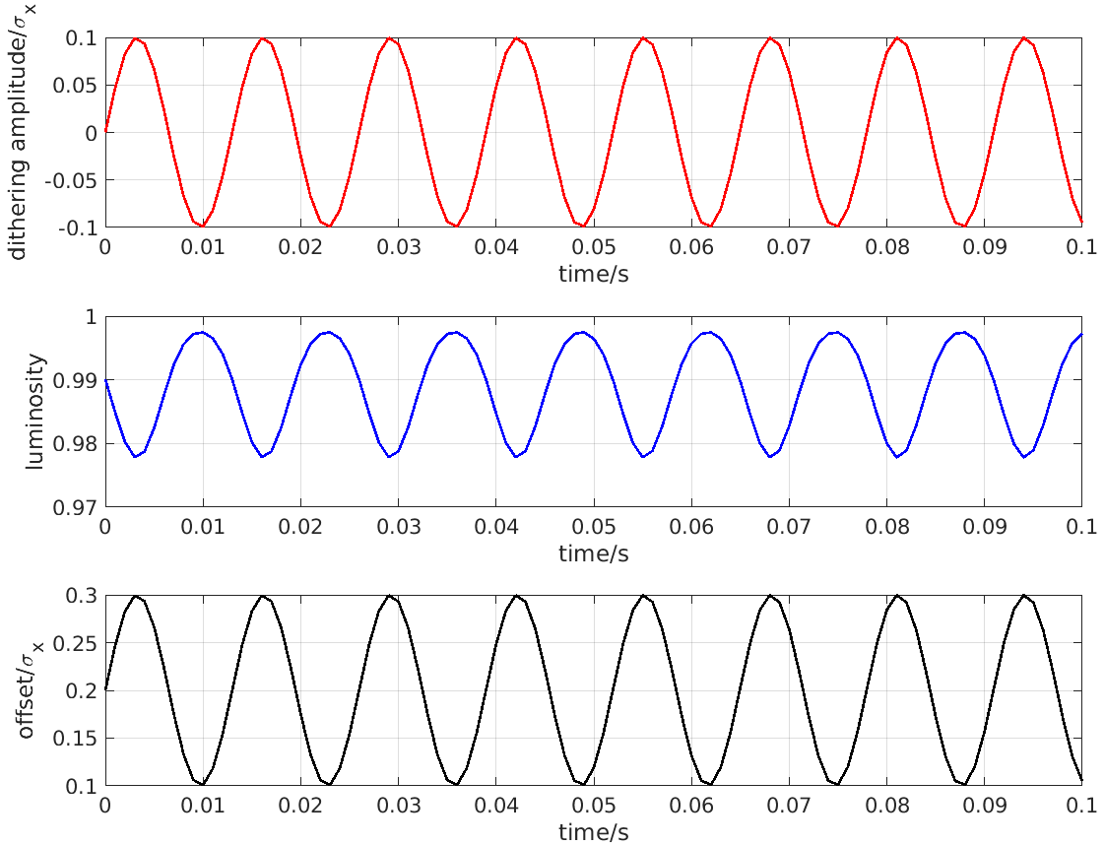
Fast & slow beam position variations at IP require feedback corrections
Beam-beam deflection for fast vertical motion
Luminosity feedback by “dithering” for slower horizontal motion
Δy at IP= ∼ 5nm ∼ 1/10σ_{y}*
BPM
Δy at BPM= ∼ 1.3μm
Vertical vibration ∼ 25-100 Hz
Sampling (BPMs) ∼ 32 kHz
IP
BPM
↔
Horizontal motion ∼ few Hz
Modulation freq. f₀ ∼ 79 Hz
Sampling (lumi. meas.) ∼ 1 kHz
- minimize f₀ output component
- dithering × lumi. signal → phase
2×f₀
Luminosity
↔
f₀
x
Dithering coil x 12
DITHERING
LUMINOSITY

Slide 22


Luminosity degradation with horizontal offset nanobeam collision geometry
Sensitivity similar to head-on collisions for β_{y} → 0.3 mm

Slide 23




Horizontal orbit dithering feedback simulation basic ingredients & setup
Cheng Guo Pang, Doctoral thesis, https://theses.hal.science/tel-03092297
Inverse FFT of measured GM spectra

Slide 24

Horizontal dithering orbit feedback simulation response to fixed offset

Slide 25







1st dithering feedback test in Phase 2
Mika Masuzawa et al., “Early Commissioning of the Luminosity Dither Feedback for SuperKEKB ”, IBIC2018 MOPA13
Yoshihiro Funakoshi et al., “Early Commissioning of the Luminosity Dither Feedback for SuperKEKB ”, eeFACT2018 WEXBA04
$$4 dither coils on each side of IP$$
$$Δx$$
e-
e+
$$Δx=o+d sin⁡(2πf_{0}t)$$
e- beam artificially given an offset, while e+ beam was dithered
Compute beam offset magnitude to cancel magnitude [V] of luminosity FFT component at dithering driving frequency $f_{0}$
Beams brought back to optimal position (remove unwanted offset o=0) applying this offset with
- sign set by relative phase of input dithering and induced luminosity variation
- damping factor (depends on precision / noise levels)
Corresponding bump parameters sent to magnet control system via EPICS
After first 2 attempts + PI algorithm parameter optimization, the 3rd feedback test could smoothly minimize the induced offset

Slide 26



Horizontal dithering orbit feedback simulation response to ground motion
Luminosity precision 2-3% @ 1 kHz
➔ Luminosity loss < 1%

Slide 27
Concluding remarks
First tests of horizontal IP orbit offset feedback at SuperKEKB indicate basic feasibility
Not currently operated but will probably be needed when β_{y} reaches design value of 0.3 mm
Testing showed that interplay with operating beam-beam deflection based vertical IP orbit offset feedback will need to be taken into account…
Dithering technique based on luminosity may also be considered for vertical IP orbit offset feedback
Missing from the simulation → careful representation of transfer function between ground motion and IP offsets (including ground motion coherence length in IR, mechanical response of supports within final doublet cryostat, detailed ring beam dynamics,…)
Issue of radiation tolerance need further study
LumiBelle2 @ KEK operated by IJCLab partly remotely and with help from KEK, but very understaffed ➔ contributions & improvements from IHEP would be highly welcome

Slide 28
Thanks

Slide 29
Extra slides

Slide 30








1Hz luminosity from ECL, ZDLM and LumiBelle2 LER 500/140 μm & HER 500 μm channels
04-05-2024

Slide 31
Luminosity sampled history from ECL, ZDLM and LumiBelle2 LER 140 μm channel
26/03/2024 → 31/07/2024
Meng Li et al., “Status and performance of LumiBelle2 in the 2024 beam operation of SuperKEKB”, IBIC2024 THP16
AI “forest method”
LumiBelle2 / ECL

Slide 32


Luminosity sampled history from ECL, ZDLM and LumiBelle2 LER 500 μm channel
26/03/2024 → 31/07/2024
AI “forest method”
LumiBelle2 / ECL

Slide 33

First collisions (luminosity): 25 April, 2018
VERTICAL SCAN
PHASE SCAN
VERTICAL SCAN
PHASE SCAN
Vertical and phase (longitudinal) scans were performed to find the optimal position of the beams
The LumiBelle2 and ZDLM channels worked well and were in agreement
Successfully measured and provided the luminosity on-line from the first collision up to this date

Slide 34

C. G. Pang et al.: Nucl.Instrum.Meth. A931 (2019) 225-235

Slide 35












Beam size estimation with vertical offset scans
S. Di Carlo, 2018
Analytical result integrating Gaussian distributions with vertical offset:
$$\frac{L}{L_{0}}=exp\left(−\frac{Δy^{2}}{2Σ_{y}^{2}}\right)$$
$$Δy$$
e+
e-
$${2Σ}_{y}$$
$$Σ_{y}^{2}={σ_{1,y}^{∗}}^{2} +{σ_{2,y}^{∗}}^{2}≈2{σ_{y}^{∗}}^{2}$$
assumes rigid beams
$$Δy (μm)$$
Benchmark vs ECL
$$L_{σ_{y}^{∗}}=\frac{{fN}_{+}N_{−}}{4πσ_{x,eff}^{∗}σ_{y}^{∗}}$$
$$L(cm^{−2}s^{−1})$$
$$σ_{y}^{∗}(μm)$$
$$L_{σ_{y}^{∗}}/L_{ECL}>1$$
$$Date$$
I⁺ × I⁻ (mA²)
$σ_{y}^{∗}$ estimation biased due to non constant beam-beam blow-up during the scan
beam-beam
simulation
(S. Di Carlo & D. Zhou)
Bias
Blow-up

Slide 36
LumiBelle2 bunch-by-bunch luminosities, folded vertical bunch sizes and relative offsets
C. G. Pang et al.: Nucl.Instrum.Meth. A931 (2019) 225-235
8% spread mainly depends on bunch current differences
Bunch-by-bunch luminosity precision: 1-2% at 1Hz
dominated by spread in bunch-by-bunch currents
8nm RMS spread in bunch-by-bunch vertical offsets (2.3% of average bunch size)
2% RMS spread in bunch-by-bunch vertical beam sizes

