Slide 1




Preliminary Design Considerations for IP Luminosity Feedback System at CEPC
Meng Li
P. Bambade, D. Wang, H.Y. Shi, S. Bai, J. Gao
Mini-workshop on CEPC fast luminosity feedback
Sept. 14, 2024, IHEP

Slide 2
CONTENTS
Necessity of the Fast Luminosity feedback for CEPC
Vertical IP orbit feedback—based on BPMs
Horizontal IP orbit feedback—based on luminosity monitor

Slide 3
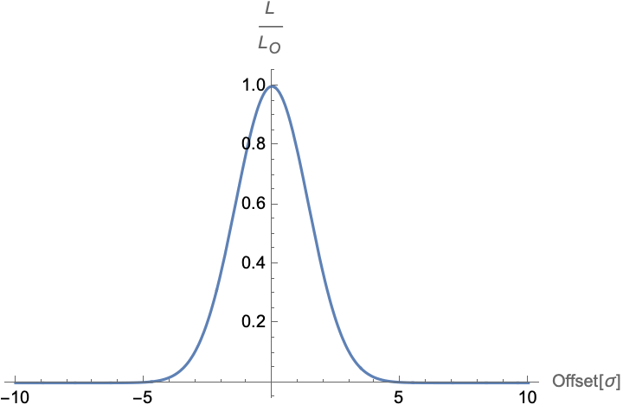

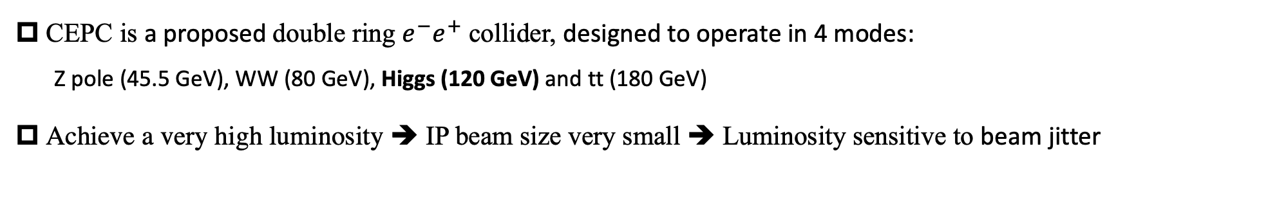


Motivation
CEPC is a proposed double ring $e^{−}e^{+}$ collider, designed to operate in 4 modes:
Z pole (45.5 GeV), WW (80 GeV), Higgs (120 GeV) and tt (180 GeV)
Achieve a very high luminosity ➔ IP beam size very small ➔ Luminosity sensitive to beam jitter
( $5×{10}^{34}{cm}^{−2}s^{−1}$ )
( $σ_{y}^{∗}=36nm$ )
( ground motion and other effects )
➔Excellent control two colliding beams to maintain an optimum collision and prevent luminosity loss
➔Require fast IP orbit feedback system
Machine tuning and beam parameters studies at IP to increase luminosity and optimize performance
➔Require luminosity measurement at very low current
$$L/{L_{0}}$$
Fast luminosity measurements and an orbit feedback system at the IP are essential for CEPC.

Slide 4
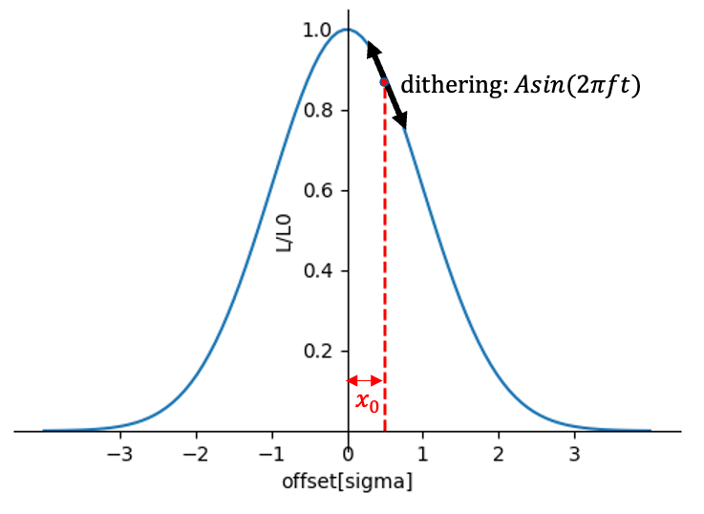
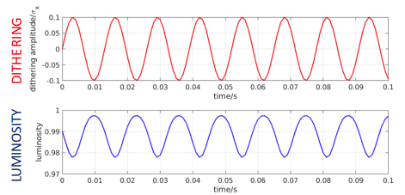
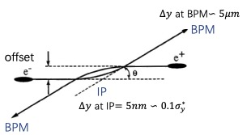
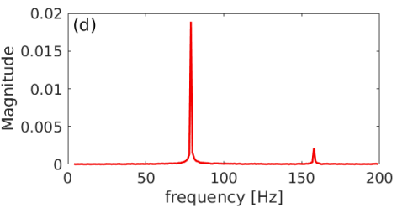
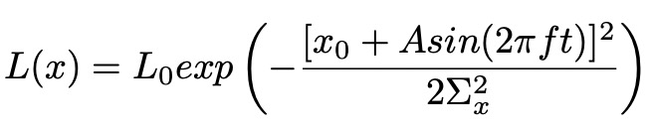


Methods
We considered two possible methods for the IP orbit feedback system at CEPC——similar to SuperKEKB.
Beam-beam deflection driven method
Luminosity driven system
Based on the measurement of the beam orbit around the IP.
The offset at the IP is too small to be accurately measured, but this small offset can be converted into a large offset due to the mutual electromagnetic deflection as the beams propagate forward and collide. By measuring this offset with BPMs upstream and downstream of the IP, we can estimate the offset at the IP and the sign. If accuracy of BPM is precise enough, we may maintain the optimum collision with almost no luminosity loss. We usually prioritize this method for this reason.
Based on measurements of the luminosity. Due to the lumi- nosity being a symmetrical function of offset, we can only know the offset between two beams, but cannot easily know its sign. And some other effects ( beam size and intensity) may also cause luminosity changes at relatively low frequency. To solve this problem, we should introduce a dithering with certain frequency, and then luminosity will change with same frequency, we can extract orbit shifts and correct them.
$${∆y}_{±}^{′}=−\frac{r_{e}N_{∓}}{γ_{±}σ_{y∓}^{∗}\left({\tilde{σ}}_{x∓}^{∗}+σ_{y∓}^{∗}\right)}{∆y}_{IP}$$
$${∆y}_{BPM}=\sqrt{β^{∗}β_{BPM}}∆y^{′}$$
The design of luminosity feedback system depends on the Designed machine parameters, Position and resolution of the IP BPMs, Ground motion of the construction site.

Slide 5
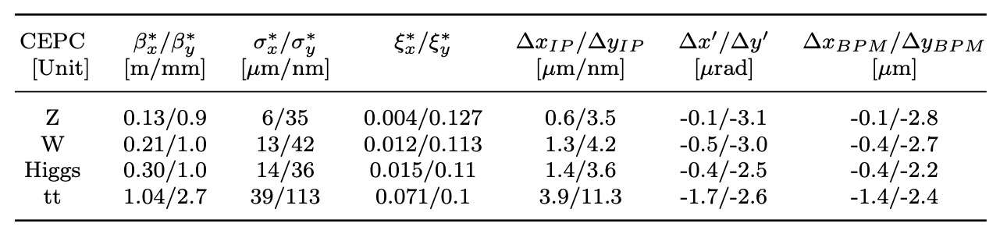
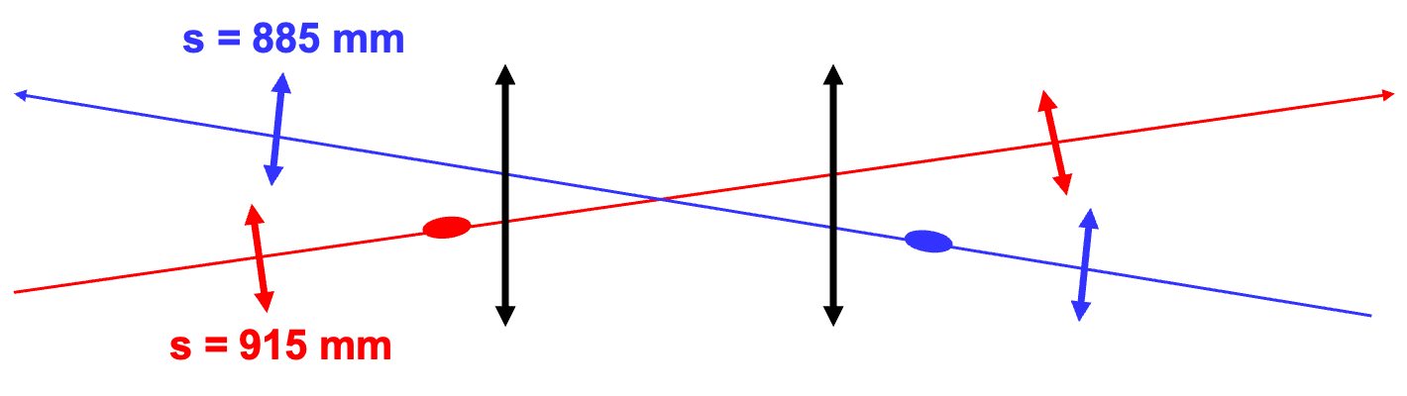
Estimate the performance of the beam-beam deflection at CEPC
Consider the case where the offset at IP is 10% of the beam size caused by ground motion and the luminosity loss is about 1% . The beam-beam angular deflection can be estimated based on the CEPC TDR parameters and the distance from the IP to the IP BPM of about 0.9m.
For the vertical orbit feedback system, this method may work, since the offset is sizable compared to typical expected BPM resolution(0.2um).
But for horizontal the beam-beam deflection is too weak, makes it difficult to measure such a small beam deflection. The luminosity driven method will be used for the horizontal orbit feedback.

Slide 6
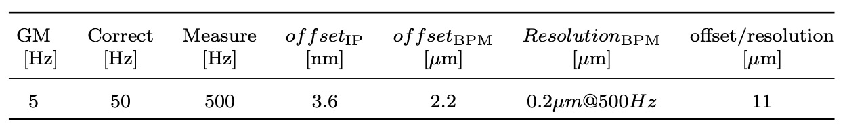
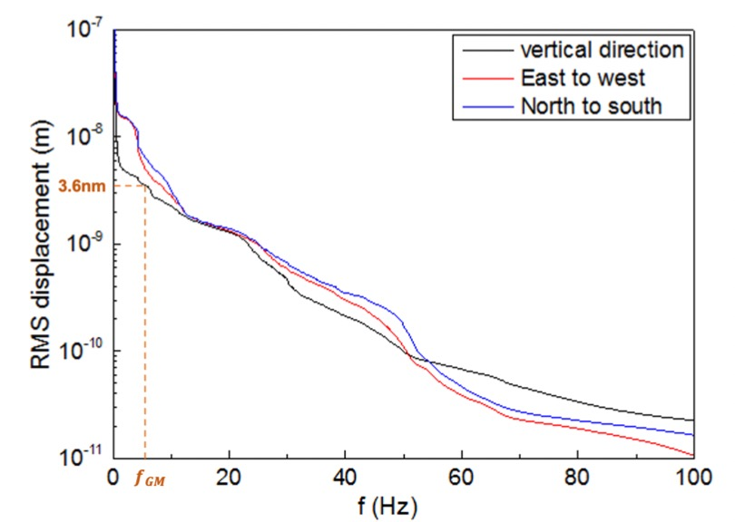
Vertical IP orbit feedback
We prioritize using the beam-beam deflection method for vertical orbit feedback at the IP.
Higgs mode (2.24μm) is the smallest among the four energy modes. To keep luminosity loss within 1%, the maximum allowable offset between the two colliding beams at the IP is 0.1σy∗ (3.6 nm)
Good enough to accurately measure orbit changes
However, relying solely on a single pair of BPMs for IP fast orbit feedback is insufficient.
Potential BPM failures
Actual accuracy and resolution lower than design
BPM resolution get worse when operates at lower beam intensity
➔ it is essential to have at least two or more pairs of BPMs
cross-verification
further improve measurement precision

Slide 7
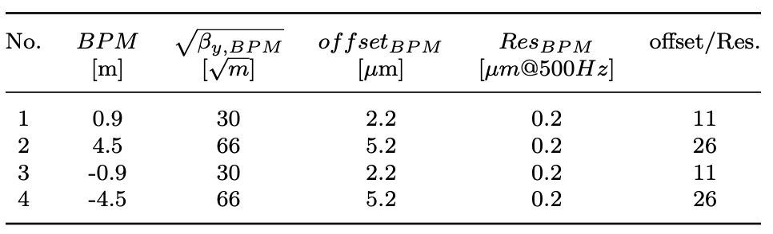
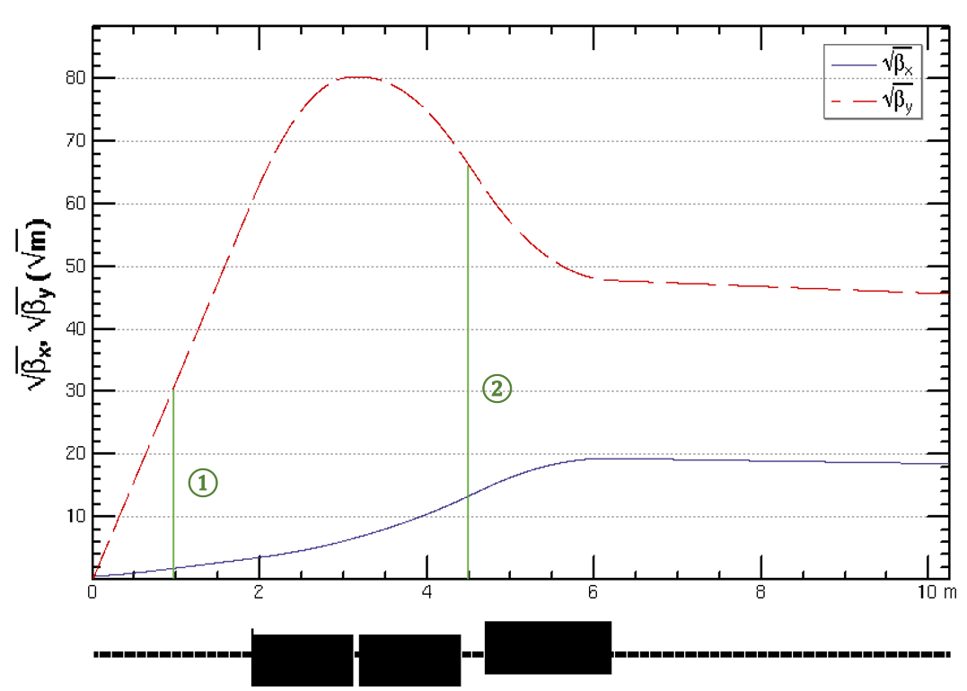
Vertical IP orbit feedback
Utilize two pairs of BPMs for vertical beam orbit feedback, placed at symmetric positions on each side of the IP, located at distances of 0.9m and 4.5m

Slide 8
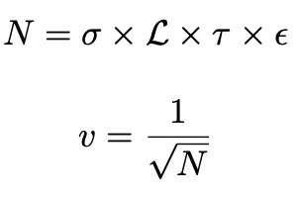
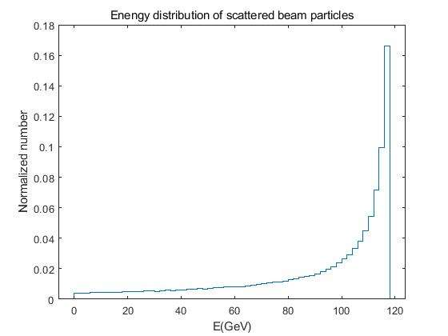
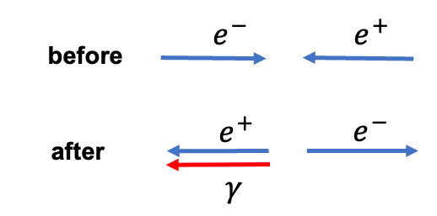
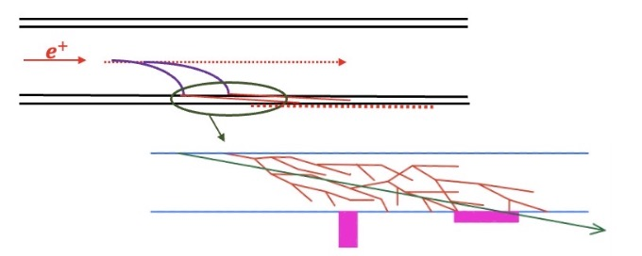
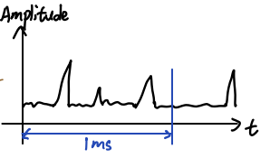

Horizontal IP orbit feedback
Luminosity-driven method with a dithering system used for orbit feedback and luminosity optimization
➔ considering the weak beam-beam deflection and a lower required feedback speed (1kHz)
The fast luminosity monitor based on radiative Bhabha at zero degree
--single Bremsstrahlung of of one beam particle in the field of an opposing beam particle
➔very large cross section (127mbarn)
➔ Bhabha particles produced at the IP is proportional to the luminosity
$$L∝\frac{dN}{dt}$$
Only relative luminosity →. → count the number and amplitude of signals
*
The low-energy scattered Bhabha electrons will be deflected downstream of the IP at different locations when they go through the successive quadruples and dipoles of the ring.
luminosity can be considered proportional to the number of detected signals

Slide 9
Fast luminosity monitor design plan
Generating the Bhabha particles through the program( BBBREM or GUINEA-PIG)
Tracking scattered positrons up to 100 meters downstream of the IP using the SAD code and calculate the loss map to identify a possible position for placing a luminosity detector
fraction of scattered electrons hitting the beam pipe is close to the required value
radiative Bhabha process at zero degree dominates over other particle loss processes
ensure that the Bhabha event rate at this position is minimally affected by beam-beam deflection
Detailed simulation in Geant4 to estimate the signal in the detector and radiation dose simulation
Considering / selecting the detector technology (e.g., Cerenkov, array of pin diodes,etc...)

Slide 10
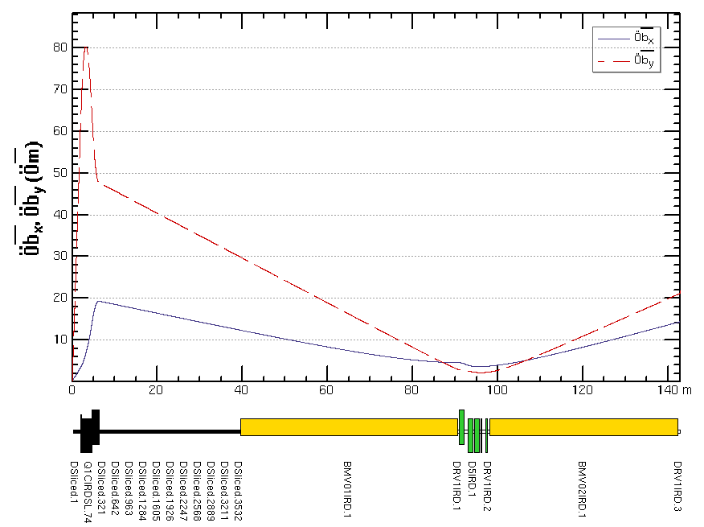
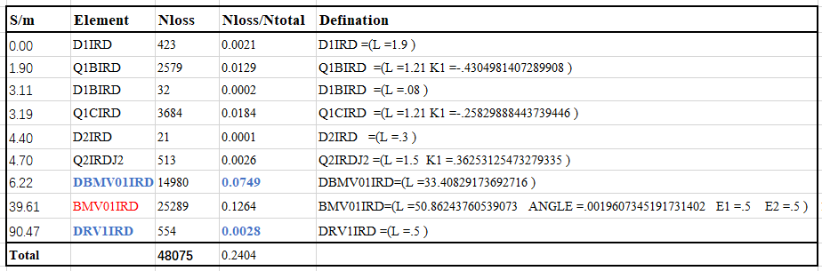
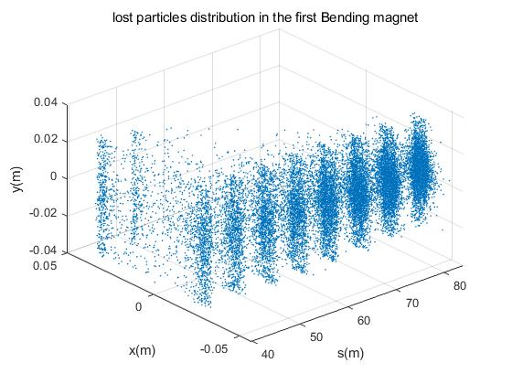
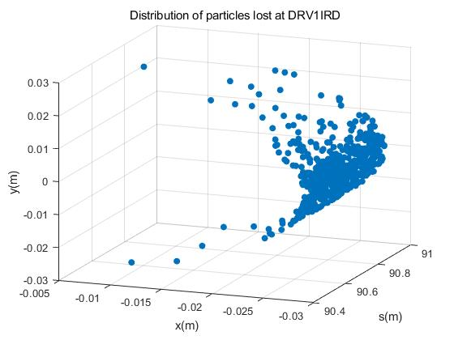
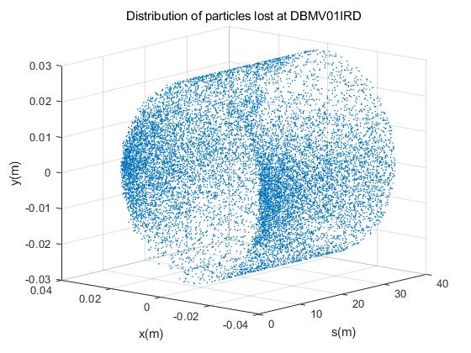
Position of fast luminosity monitor for CEPC
The low-energy scattered electrons from the IP first go through three quadrupole magnets, 33m dirft, 51m bending magnet..
The scattered Bhabha electrons primarily get lost after the three quadrupoles and on the first dipole magnet. Due to the drift section behind the dipole magnet is shorter, the number of lost in this section is relatively low.
1
2
3
Three potential locations were considered: before, inside, and after the first bending magnet

Slide 11
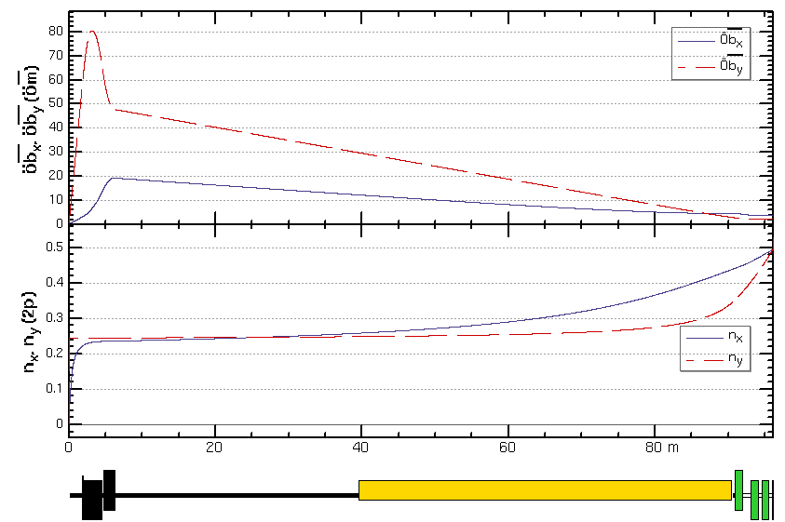
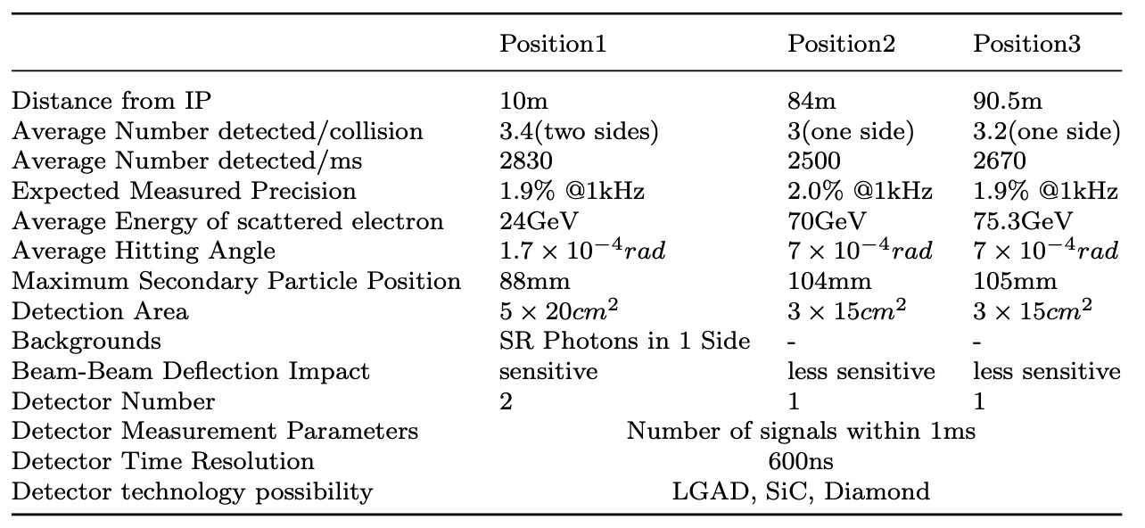
Position of fast luminosity monitor for CEPC
Three potential locations were considered: before, inside, and after the first bending magnet.
IP
1
2
3
Aiming for a precision of about 2% in 1 ms

Slide 12
Summary and outlook
The implementation of a fast luminosity feedback system at the IP is crucial for CEPC to ensure optimal collision and achieve maximum luminosity.
The proposed approach involves utilizing the beam-beam deflection driven method based on BPMs for vertical orbit feedback and a luminosity-driven method for horizontal feedback.
Candidate positions for BPMs and luminosity detector have been identified.
However, there is still more work to be done, such as the design of the BPM and feedback electronics, the design of detectors and data acquisition system, and the entire feedback system simulation from start to end, and so on.

Slide 13
Thanks for your attention

Slide 14
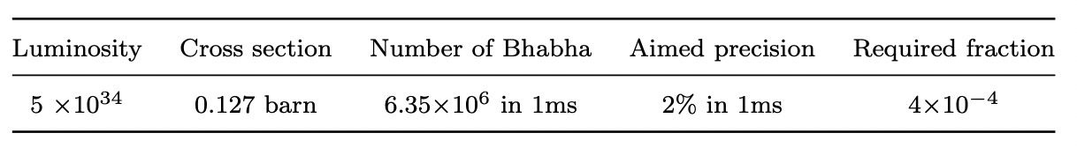
Horizontal IP orbit feedback
Luminosity-driven method with a dithering system used for orbit feedback and luminosity optimization
➔ considering the weak beam-beam deflection and a lower required feedback speed (1kHz)
The fast luminosity monitor based on radiative Bhabha at zero degree
--single Bremsstrahlung of of one beam particle in the field of an opposing beam particle
➔very large cross section (127mbarn)
➔ Bhabha particles produced at the IP is proportional to the luminosity
➔ Sensitive to the change of luminosity in proportion way (relative luminosity measurement)
*
* need further review

Slide 15
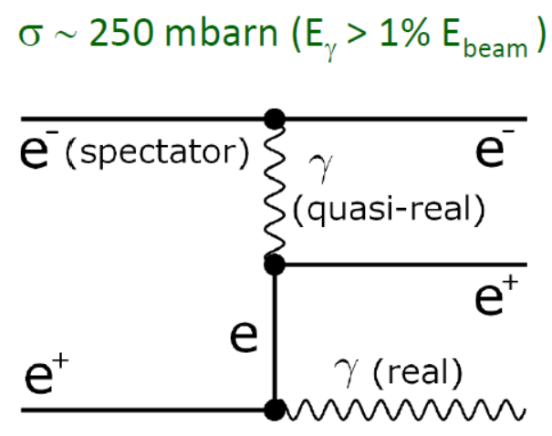
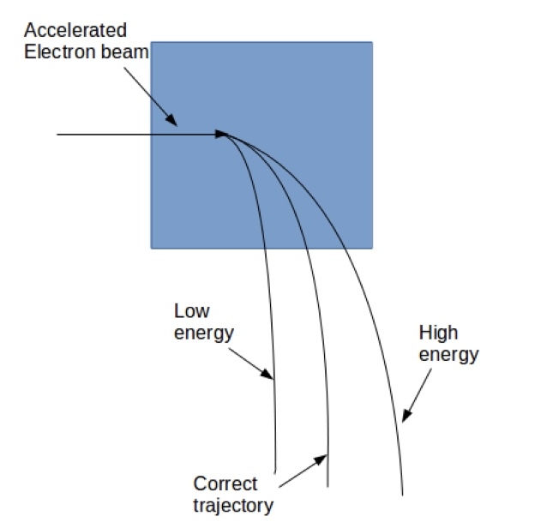
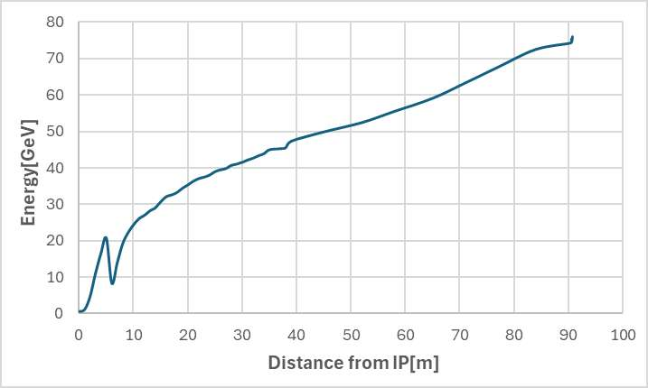






Fast Luminosity Monitor working principle
Radiative Bhabha scattering at zero degree — single Bremsstrahlung of single positron in the field of one electron.
This process is also one of the main sources of particles losses in a very high luminosity e-e+ collider.
Only relative luminosity →. → count the number of signals
$$L∝\frac{dN}{dt}$$
$$E (e^{−})=120GeV$$
$$E (e^{−})=120GeV$$
$$E (e^{+})$$
$$E (e^{+})=120GeV$$
$$E (γ)$$

Slide 16
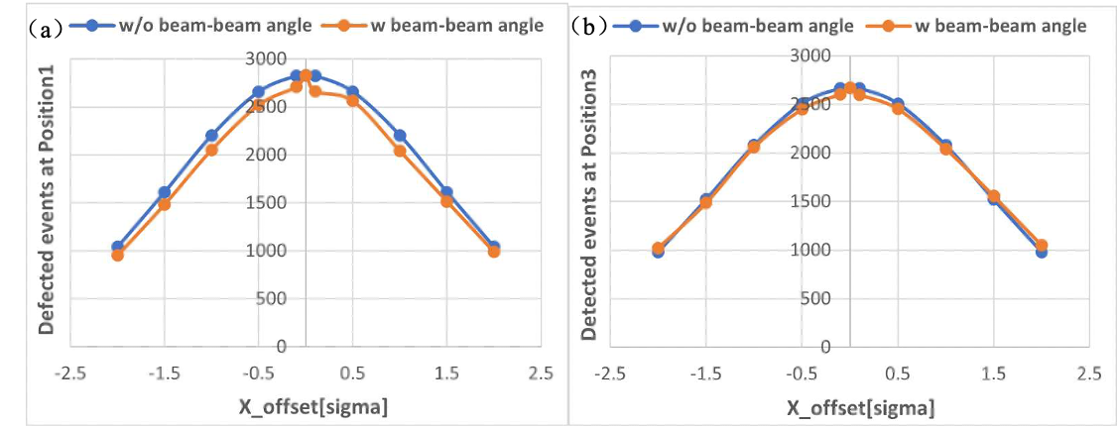
Position of fast luminosity monitor for CEPC
Furthermore, the simulated expected number of Bhabha events that will be detected in different offset cases each millisecond for position 1 and position 3 shows an almost linear relationship with the offset at the IP and varies greatly, making it easy for detectors to measure.

Slide 17
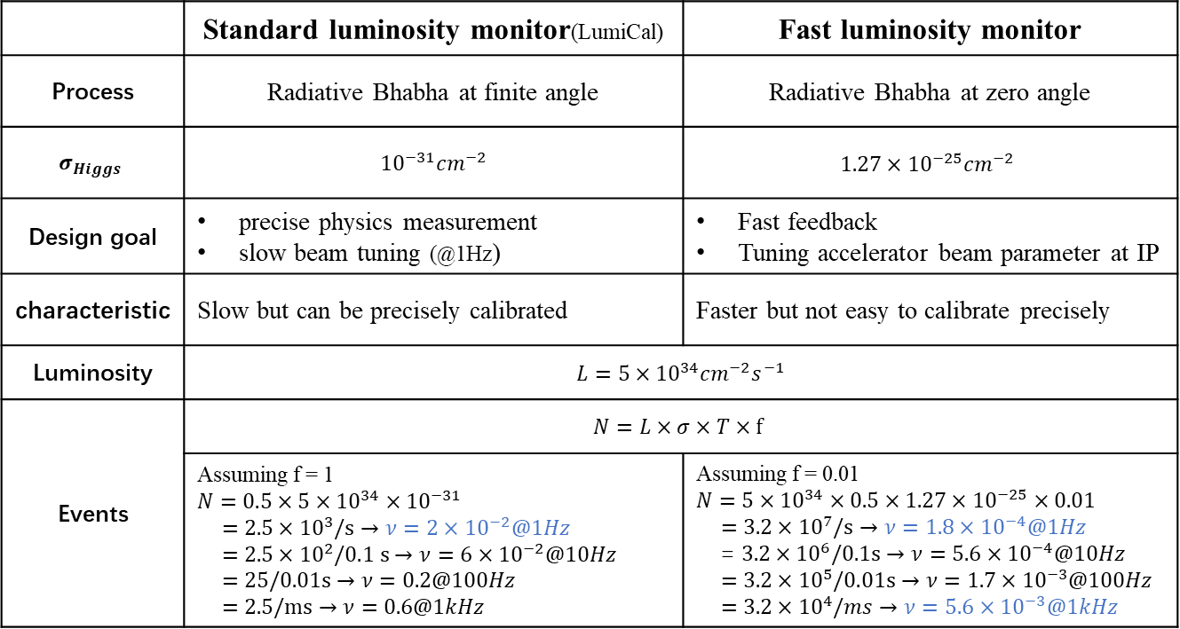
Necessity of the Fast Luminosity Monitor for CEPC
Any Collider must have a luminosity monitor, but not necessarily a fast luminosity monitor. If want to do fast IP luminosity tuning and feedback, maybe should have a fast and precise luminosity monitor.
 | Standard luminosity monitor(LumiCal) | Fast luminosity monitor
Process | Radiative Bhabha at finite angle | Radiative Bhabha at zero angle
$$σ_{Higgs}$$ | $${10}^{−31}{cm}^{−2}$$ | $${1.27×10}^{−25}{cm}^{−2}$$
Design goal | precise physics measurement slow beam tuning (@1Hz) | Fast feedback Tuning accelerator beam parameter at IP
characteristic | Slow but can be precisely calibrated | Faster but not easy to calibrate precisely
Luminosity | $$L=5×{10}^{34}{cm}^{−2}s^{−1}$$
Events | $$N=L×σ×T×f$$
 | Assuming f = 1 $$N=0.5×5×{10}^{34}×{10}^{−31}$$ $$=2.5×{10}^{3}/s→ν=2×{10}^{−2}@1Hz$$ $$=2.5×{10}^{2}/0.1 s→ν=6×{10}^{−2}@10Hz$$ $$=25/0.01s→ν=0.2@100Hz$$ $$=2.5/ms→ν=0.6@1kHz$$ | Assuming f = 0.01 $$N=5×{10}^{34}×0.5×1.27×{10}^{−25}×0.01$$ $$=3.2×{10}^{7}/s→ν=1.8×{10}^{−4}@1Hz$$ = $3.2×{10}^{6}/0.1s→ν=5.6×{10}^{−4}@10Hz$ $$=3.2×{10}^{5}/0.01s→ν=1.7×{10}^{−3}@100Hz$$ $$=3.2×{10}^{4}/ms→ν=5.6×{10}^{−3}@1kHz$$

Slide 18
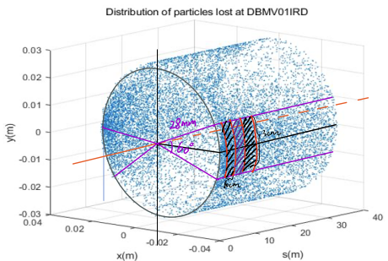
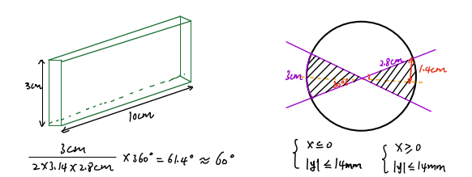
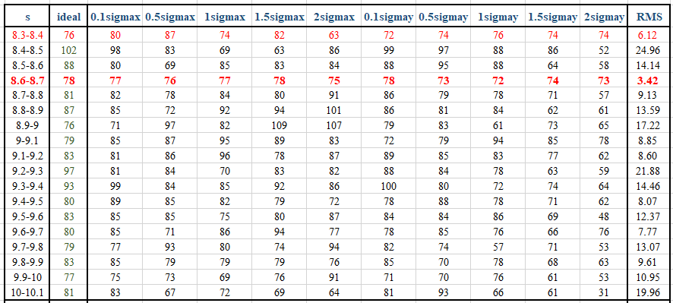
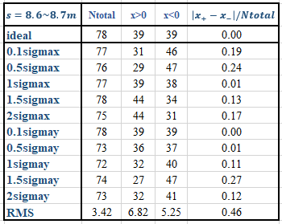

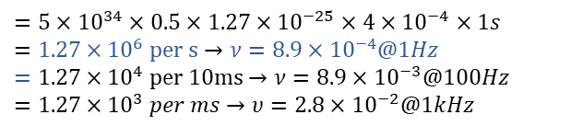
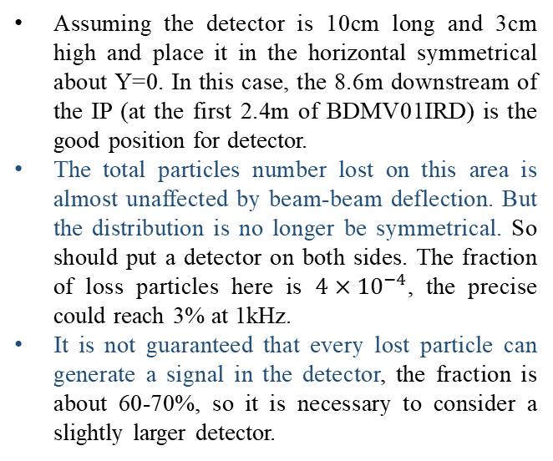

Select a best position to place the detector
$$f=\frac{N_{loss}}{N_{total}}=\frac{78}{2×{10}^{5}}=4×{10}^{−4}$$
$$N=L×σ×T×f$$
$$=5×{10}^{34}×0.5×1.27×{10}^{−25}×4×{10}^{−4}×1s$$
$$=1.27×{10}^{6} per s→ν=8.9×{10}^{−4}@1Hz$$
$$=1.27×{10}^{4} per 10ms→ν=8.9×{10}^{−3}@100Hz$$
$$=1.27×{10}^{3} per ms→υ=2.8×{10}^{−2}@1kHz$$
Assuming the detector is 10cm long and 3cm high and place it in the horizontal symmetrical about Y=0. In this case, the 8.6m downstream of the IP (at the first 2.4m of BDMV01IRD) is the good position for detector.
The total particles number lost on this area is almost unaffected by beam-beam deflection. But the distribution is no longer be symmetrical. So should put a detector on both sides. The fraction of loss particles here is $4×{10}^{−4}$, the precise could reach 3% at 1kHz.
It is not guaranteed that every lost particle can generate a signal in the detector, the fraction is about 60-70%, so it is necessary to consider a slightly larger detector.

Slide 19
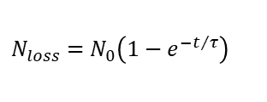
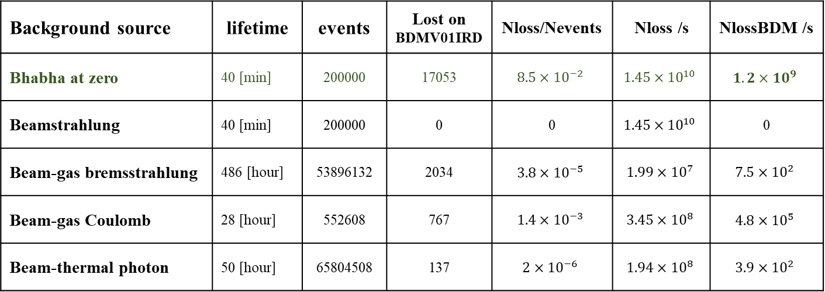
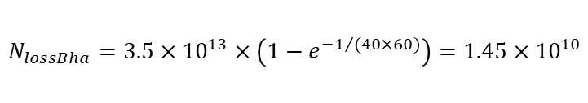

Evaluate the level of background
Haoyu Shi, Sha Bai
Background source | lifetime | events | Lost on BDMV01IRD | Nloss/Nevents | Nloss /s | NlossBDM /s
Bhabha at zero | 40 [min] | 200000 | 17053 | $$8.5×{10}^{−2}$$ | $$1.45×{10}^{10}$$ | $$1.2×{10}^{9}$$
Beamstrahlung | 40 [min] | 200000 | 0 | 0 | $$1.45×{10}^{10}$$ | 0
Beam-gas bremsstrahlung | 486 [hour] | 53896132 | 2034 | $$3.8×{10}^{−5}$$ | $$1.99×{10}^{7}$$ | $$7.5×{10}^{2}$$
Beam-gas Coulomb | 28 [hour] | 552608 | 767 | $$1.4×{10}^{−3}$$ | $$3.45×{10}^{8}$$ | $$4.8×{10}^{5}$$
Beam-thermal photon | 50 [hour] | 65804508 | 137 | $$2×{10}^{−6}$$ | $$1.94×{10}^{8}$$ | $$3.9×{10}^{2}$$
Assuming linear loss, i.e., the number of particles lost each turn is the same
$$N_{0}=N_{p}×N_{b}=1.3×{10}^{11}×268=3.5×{10}^{13}$$
$$T=\frac{C}{v}=\frac{100}{3×{10}^{5}}=3.3×{10}^{ −4}s$$
$$N_{loss}=N_{0}\left(1−e^{−t/τ}\right)$$
The number of lost particles due to Bhabha at zero degree in 1s :
$$N_{lossBha}=3.5×{10}^{13}×\left(1−e^{−1/{(40×60)}}\right)=1.45×{10}^{10}$$
The number lost on BDMV01IRD in which：
$$N_{lossBDM}=1.45×{10}^{10}×0.085=1.2×{10}^{9}$$
At BDMV01IRD, the radiative Bhabha at zero angle process dominates over the sum of all the other processes, can be ignored.

Slide 20
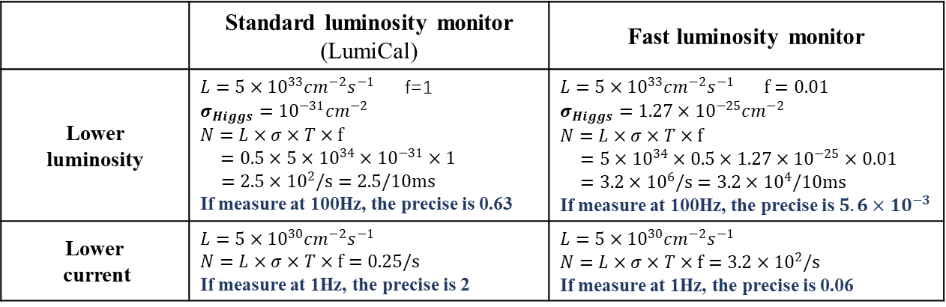
Necessity of the Fast Luminosity Monitor for CEPC
Used for IP orbit feedback as a back up
All previous calculations assume that BPM can achieve design precise, and all machine parameters can reach the design values, we can put many BPMs near maximum beta position. But if the BPM in one direction is not so precise and at the beginning of the operation, the nominal parameters will not be achieved, the offset generated at BPM is not big enough to accurately measured with these BPMs.
And the luminosity is at least 10 times lower than the nominal value, and the cross-section of standard luminosity monitor is not large enough, so standard luminosity monitor also doesn’t work for fast feedback, then maybe the luminosity monitor can be alternative.
Used for beam size tuning
Whether you do beam size tuning with beam-beam deflection or luminosity, will introduce beam-beam blow up. We should minimize beam-beam blow-up by reducing strongly beam current, maybe factor of 100, then luminosity drops to ${10}^{30}$. And in that case, standard luminosity monitor doesn’t work, you need to wait ${10}^{4}s$.
 | Standard luminosity monitor (LumiCal) | Fast luminosity monitor
Lower luminosity | $L=5×{10}^{33}{cm}^{−2}s^{−1}$ f=1 $σ_{Higgs}={10}^{−31}{cm}^{−2}$ $$N=L×σ×T×f$$ $=0.5×5×{10}^{34}×{10}^{−31}×1$ $$=2.5×{10}^{2}/s=2.5/10ms$$ If measure at 100Hz, the precise is 0.63 | $$L=5×{10}^{33}{cm}^{−2}s^{−1} f=0.01$$ $σ_{Higgs}={1.27×10}^{−25}{cm}^{−2}$ $$N=L×σ×T×f$$ $=5×{10}^{34}×0.5×1.27×{10}^{−25}×0.01$ $=3.2×{10}^{6}/s=3.2×{10}^{4}/10ms$ If measure at 100Hz, the precise is $5.6×{10}^{−3}$
Lower current | $$L=5×{10}^{30}{cm}^{−2}s^{−1}$$ $$N=L×σ×T×f=0.25/s$$ If measure at 1Hz, the precise is 2 | $$L=5×{10}^{30}{cm}^{−2}s^{−1}$$ $$N=L×σ×T×f=3.2×{10}^{2}/s$$ If measure at 1Hz, the precise is 0.06

