Slide 1
High Luminosity Fast Feedback System Design for CEPC interaction point
Shu-Jun Wei
2024.09.14

Slide 2
Content
Framework of the luminosity feedback control system at Interaction Point
BPMs near the CEPC IP
Luminosity monitor sub-system
Fast orbit Controller Electronics
Some statement
Summary

Slide 3
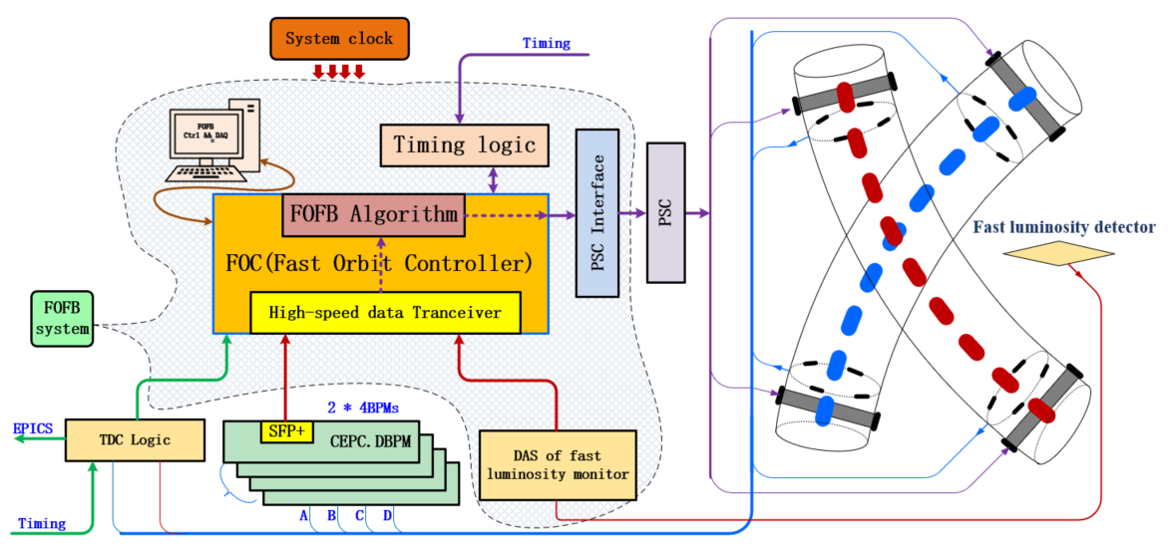
1，Framework of the FOFB system at CEPC IP
Fast Orbit Feedback Controller
  BPMs
  Luminosity Monitor
  TDC logic
  Interface to PSC
  ……

Slide 4
Main electronics function block of Orbit feedback system for CEPC IP
BPM sub-system
  BPM detector
  PT module
  Digital BPM electronics
Luminosity monitor
sub-system
  Luminosity detector
  Front-end electronics
  DAS electronics
Interaction Point fast orbit feedback control system of CEPC
  BPM interface logic
  Luminosity monitor interface logic
  TDC logic
  FOC, Fast Orbit Controller
  Power Supply Controller Interface
  ……

Slide 5
2，BPMs near the CEPC IP
Only 4 BPM detectors are designed and reserved in the CEPC IP area.

Slide 6
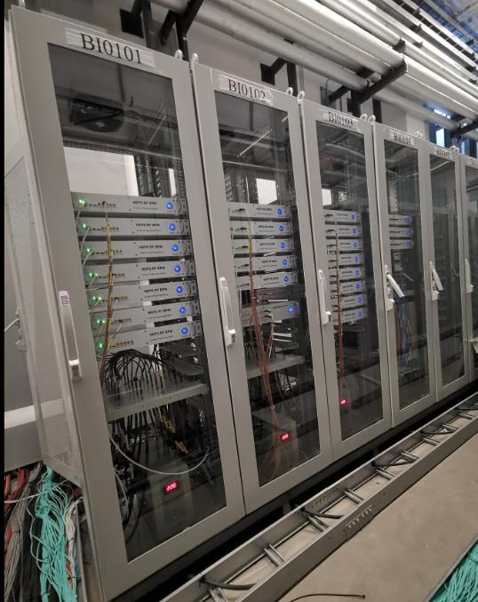
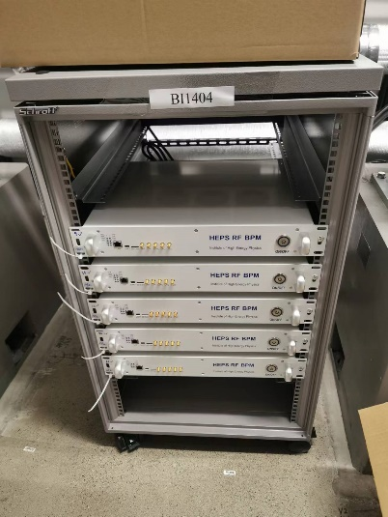
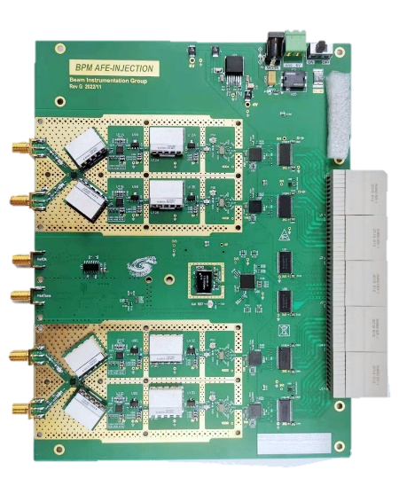
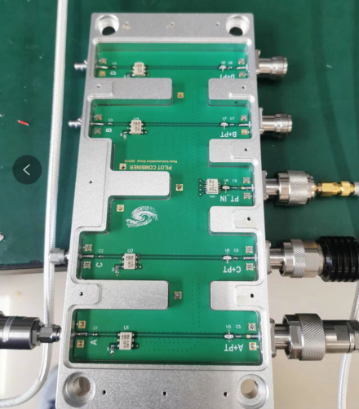
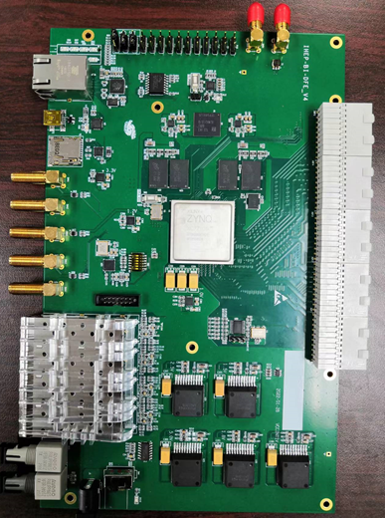
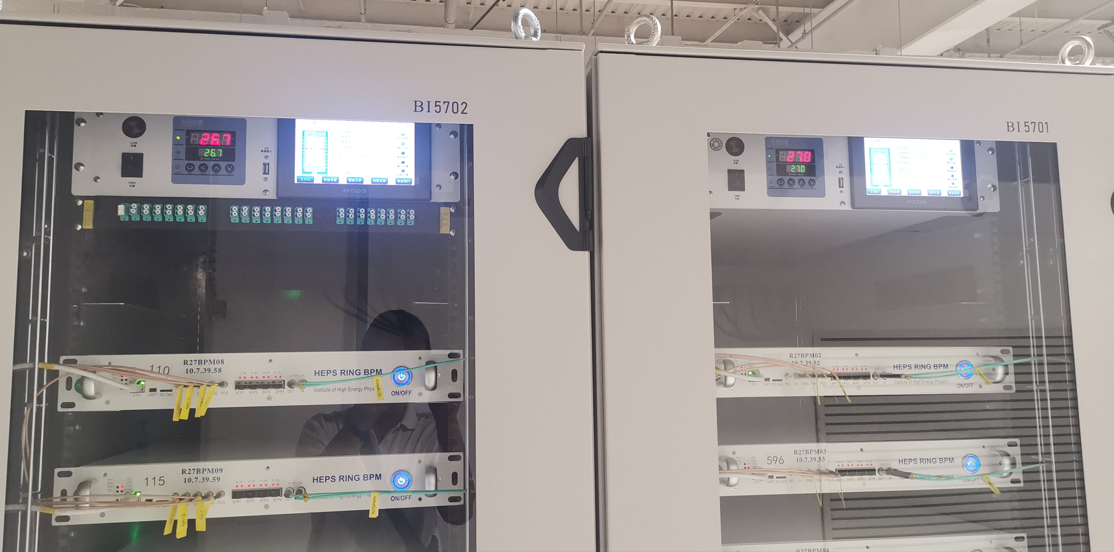
BPM Electronics
BPM Electronics on HEPS

Slide 7
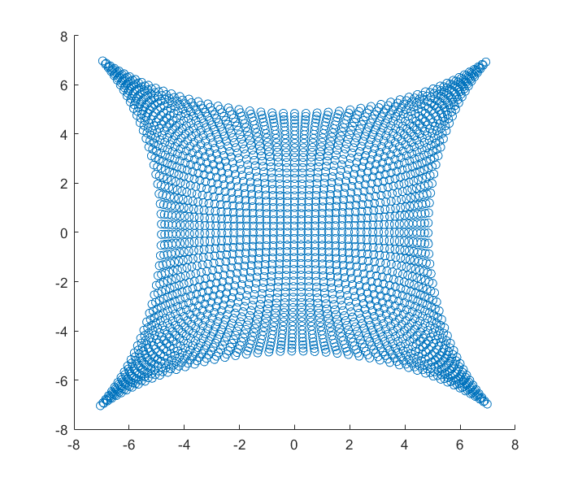
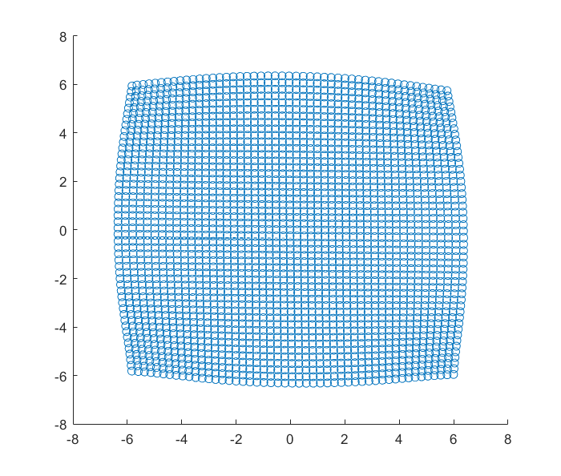
New algorithm for CEPC BPM
The method can used to improve the measurement accuracy of the BPMs, when the beam is far from the BPM center point.

Slide 8
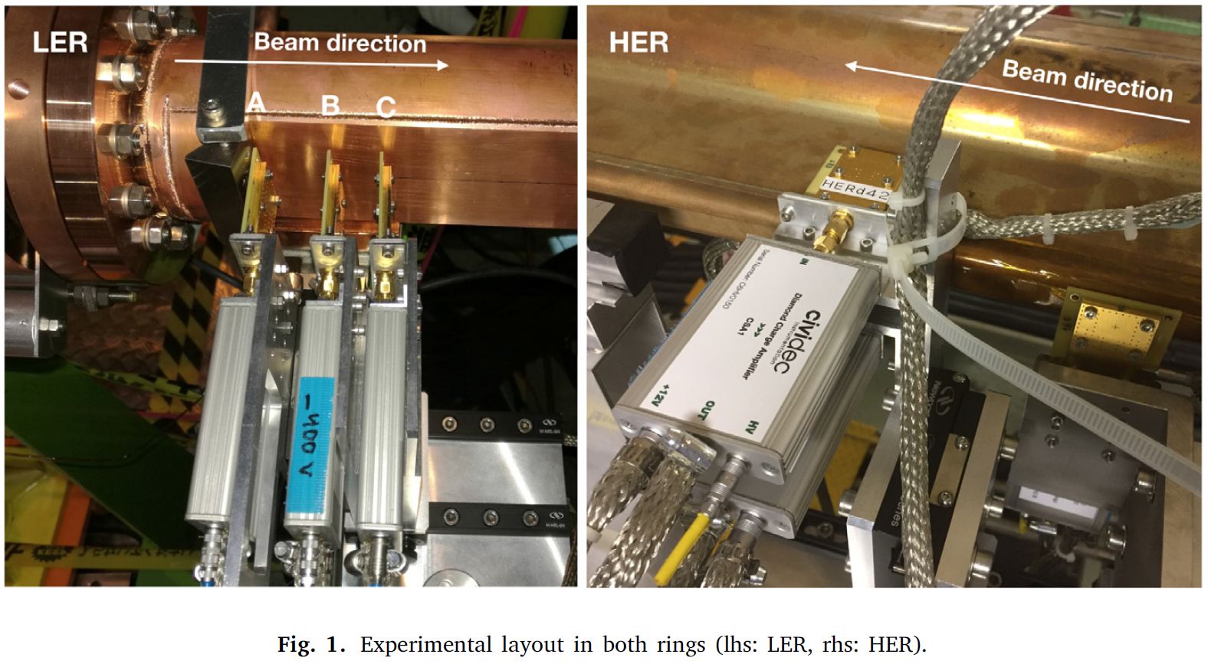
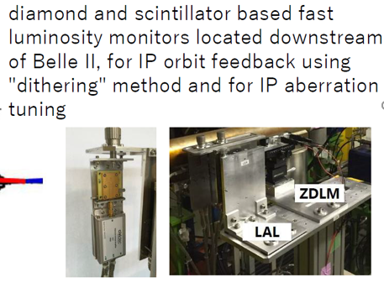
3, Luminosity monitor sub-system
Fast Luminosity monitor is necessary for CEPC.
Fast luminosity monitoring for the Super-KEKB collider.

Slide 9
3. Luminosity monitor sub-system
Luminosity monitor system building
  Fast Luminosity monitor detector: adopt the commercial products or developed by other working group.
  DAS electronics: design the front end electronics and DAS electronics by ourself.

Slide 10
4, Fast Orbit Controller electronics
FOC Input signals
  Digital BPMs data
  Luminosity monitor data
  Electron and positron beam arriving time
  Clock and Timing signal
FOC output signals
  Fast corrector power supply setting
  Dithering controlling information

Slide 11
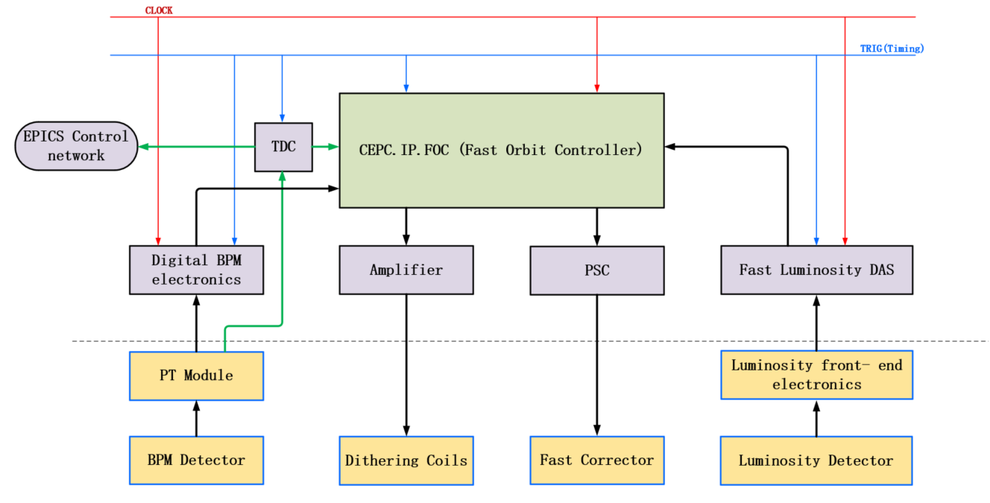
Fast Orbit Controller electronics
FOC and it related electronics

Slide 12
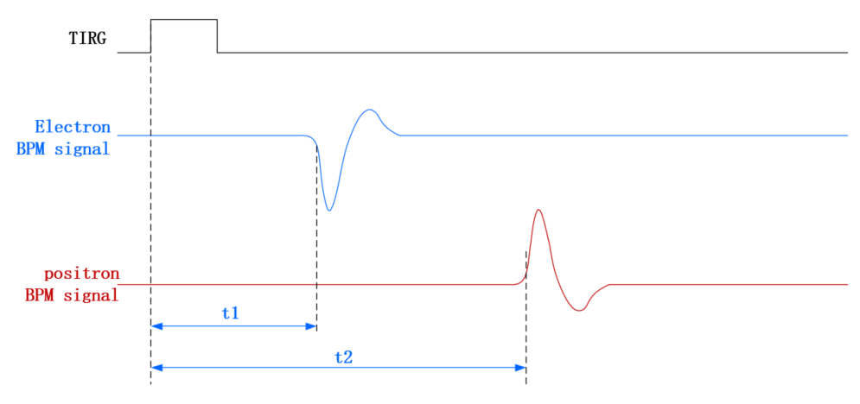
Fast Orbit Controller electronics
Electron and Positron beam arriving time monitor

Slide 13
5. Two statements
The digital BPM electronics used in HEPS can not be copied to CEPC directly.
  Compared to HEPS, the digital BPM in CEPC have a high measurement accuracy over a wide range, so the hardware and the firmware must be optimized.
The FOFB system of HEPS can not be directly used in CEPC.
  Different hardware interfaces.
  Different control principles and logic.

Slide 14
6. Summary
3 main parts are include in CEPC fast feedback system.
  High precision digital BPM electronics
  Fast luminosity monitoring system
  Local, Real time, FOFB electronics
Arriving time of electron and positron should be measured and monitored.
The digital BPM and FOFB electronics used in HEPS cannot be directly copied to CEPC.

Slide 15
Thanks for your attention

