Slide 1
BLM & ZDD for BEPC2
Xiao CAI
2024.9.14

Slide 2
BLM (BEPCII luminosity monitor,@west side)
ZDD (Zero Degree Detector, @east side)
Electronics

Slide 3
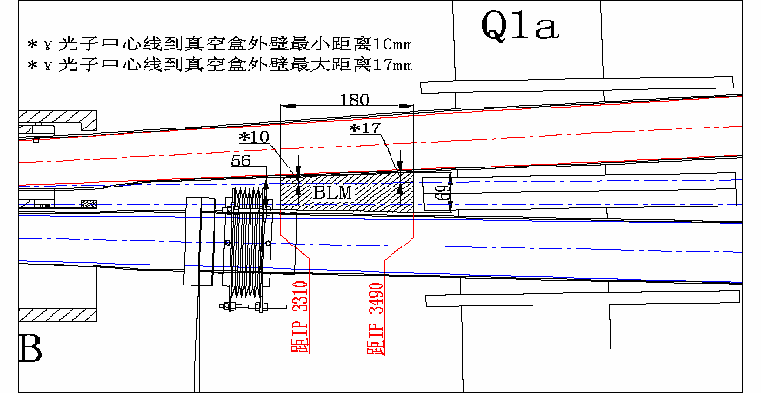
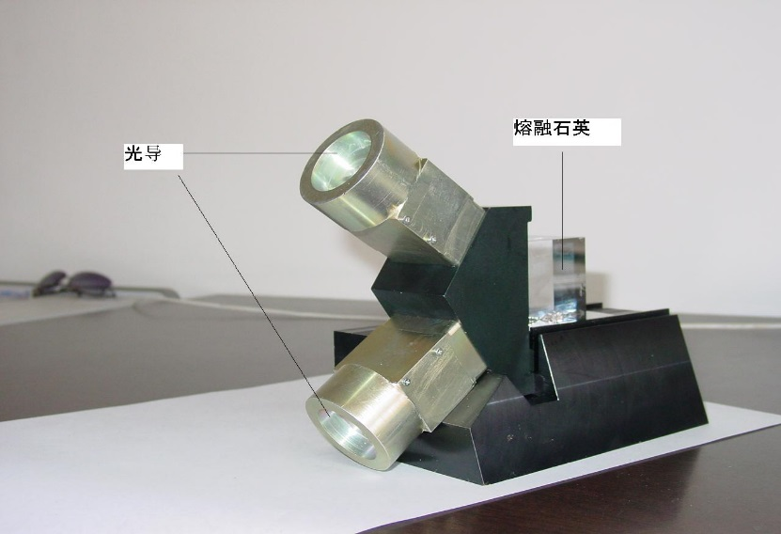
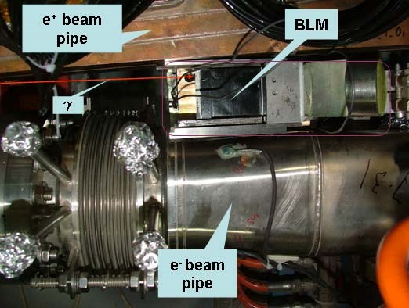


BLM (Provided by USTC, 2009)
$$e^{+}e^{−}→e^{+}e^{−}γ$$
PMT
Tungsten
converter
Light Guide
$$γ$$
Fused Silica
Fused Silica
Light Guide

Slide 4
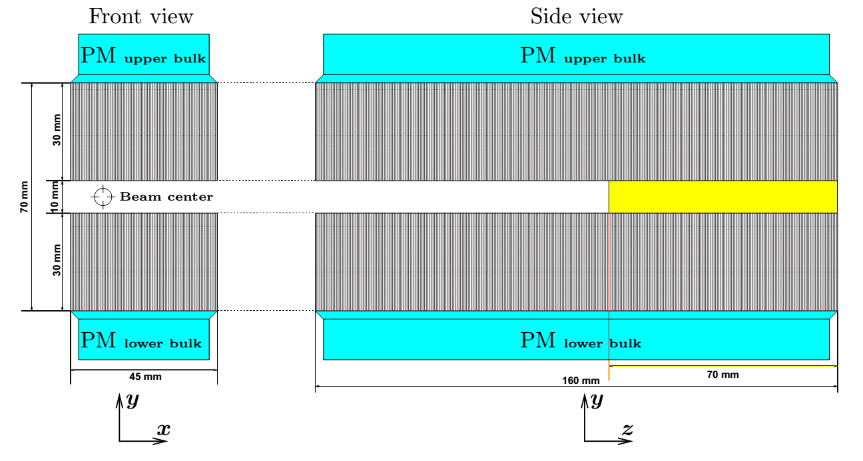
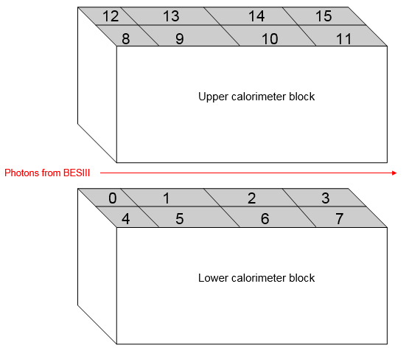
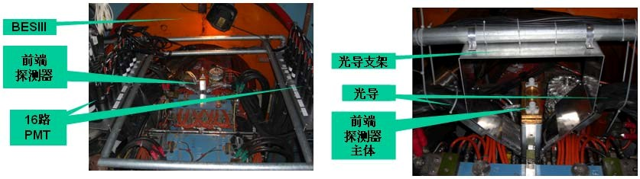


ZDD (provided by INFN-LNF, 2011)
$$e^{+}e^{−}→Hγ$$
$$γ$$
lead-scintillating fibers
lead-scintillating fibers

Slide 5
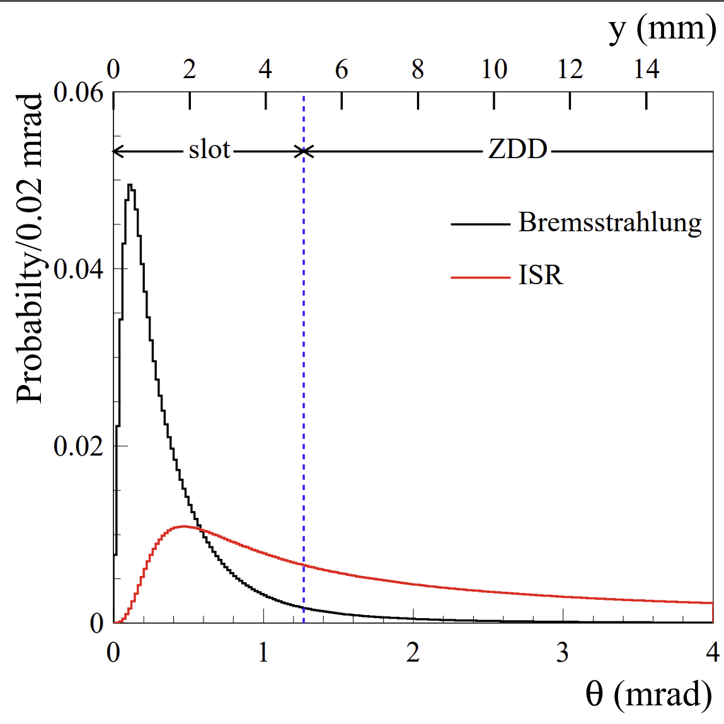
Angular distributions for emitted photons in Bremsstrahlung (black histogram) and ISR (red histogram) processes

Slide 6
LUM/ZDD electronics
LUM (west side)
Write threshold
PMT signal
×10 Fast amplifier
Discriminator
DAQ
~30m cable
DAQ input signal:
TTL, height >2.5V
Fast signal, width 2~3ns
Preamplifier box
Slow control PC
ZDD (east side)
Write threshold
ZDD signal
×10 Fast amplifier
Discriminator
DAQ
~30m cable
Preamplifier box
Flash ADC
BES3 DAQ
ZDD VME crate
BES experimental hall
BES electronics hall (next to BES control room)
PMT signal & ZDD signal: front edge ~2ns, FWHM ~3.2ns, Pulse height ~100mV
ZDD 16 PMT signals send to ZDD VME system (flash ADC), as a part of BES3 physics data acquirement.
A sum signal for 4 PMTs (block 1/5/9/13) of ZDD send to preamplifier box for BEPC2 beam tunning.
Preamplifier box located at BES Electronics Platform first floor.

Slide 7
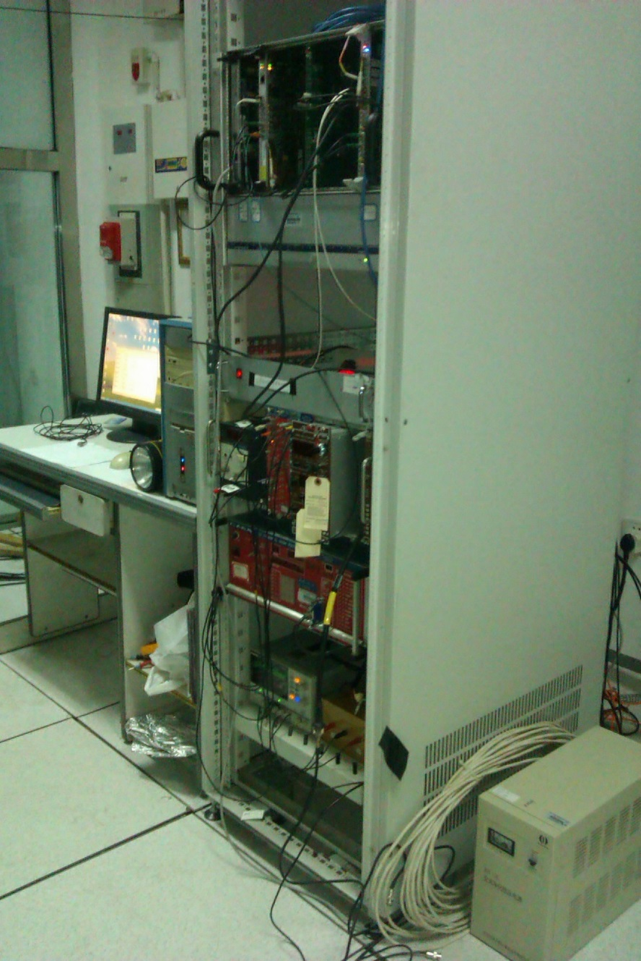
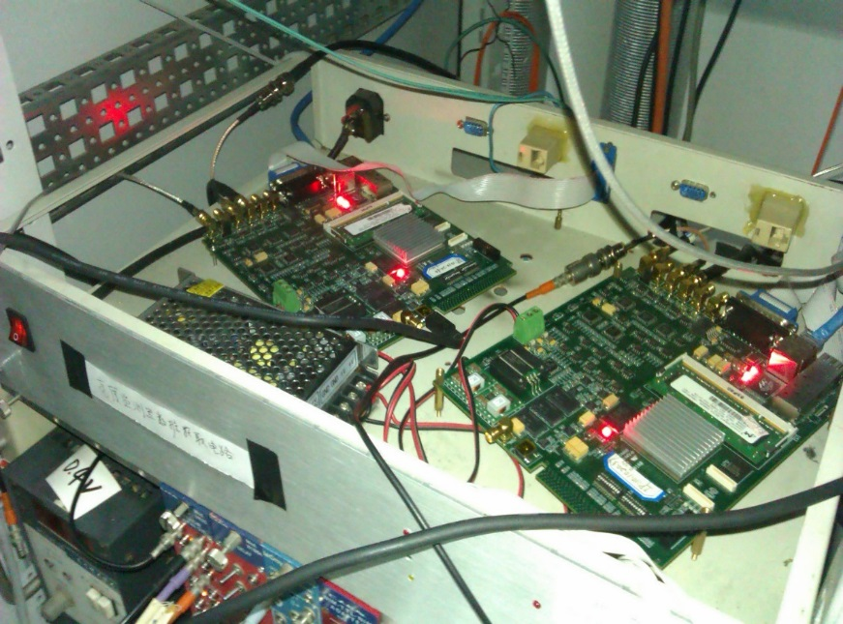
Electronics in BES control room
VME Crate
(Provide Time Signal)
Lum Crate
(Lum DAQ board)
DC Power Supply
(for Pre-Amplifier)

Slide 8
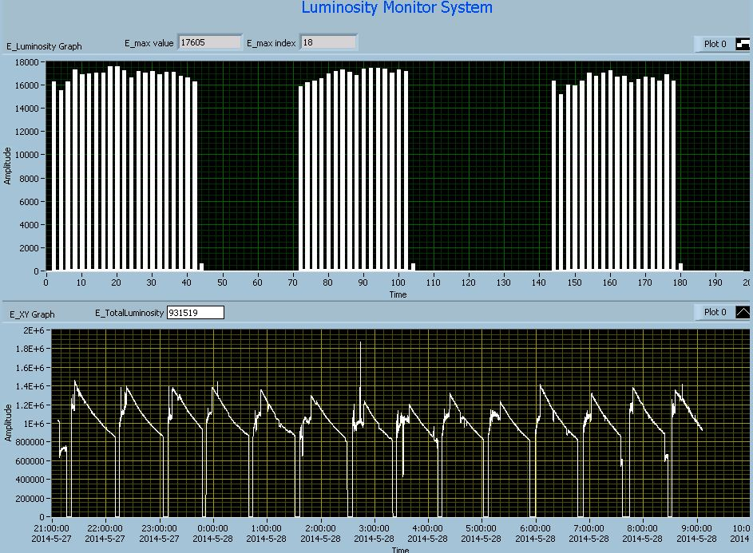
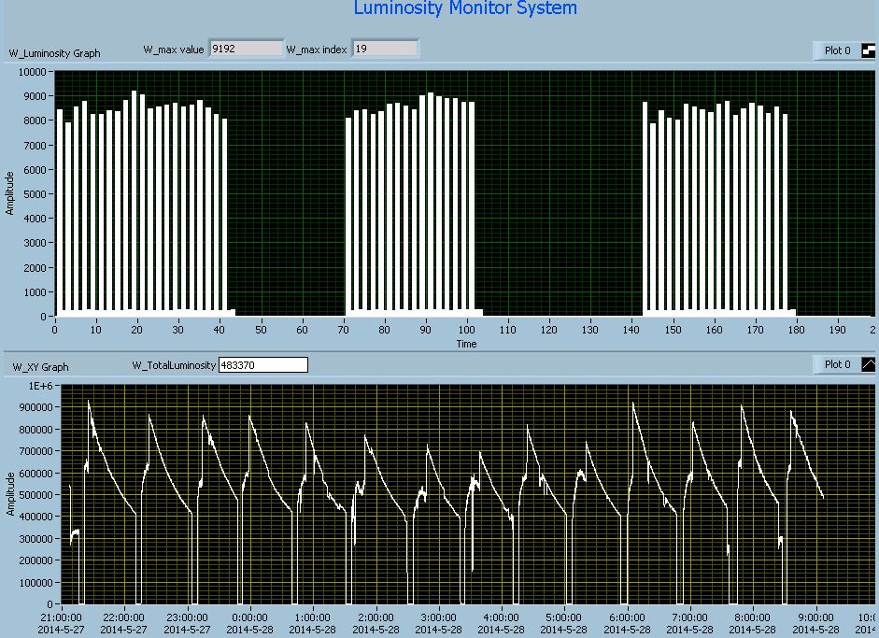
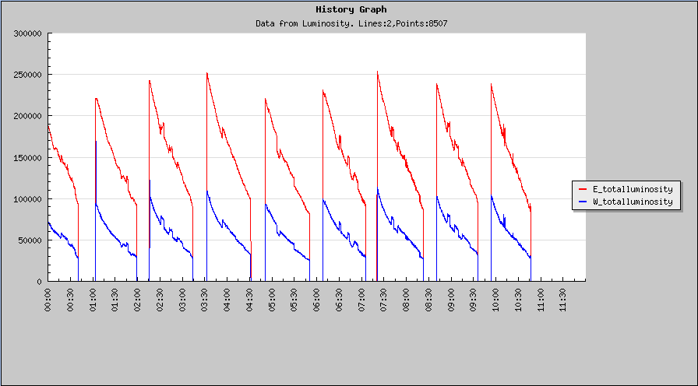
Online relative luminosity and history graph
Note: only have some old pictures in laptop, sorry for it!

Slide 9
Detector running status
2007, BLMs installation(east & west side)
2011, east side BLM uninstallation, ZDD installation
2011, new DAQ electronics installation (provided by IHEP trigger group)
2015-2017, output signal of preamplifier box decay, a NIM electronics added before DAQ to amplify signal.
2020, ZDD preamplifier box crashed again, ZDD not work for several months.
2021, a company make 4 new preamplifier boxes for us, ZDD running well.

Slide 10
Thanks!

