Slide 1
Design of the Fast Orbit Feedback of HEPS
Huang Xiyang, Jiao Yi, Wei shujun
2024-9-14

Slide 2
Main content
1
Introduction
2
Fast orbit feedback and related simulation
3
Conclusion

Slide 3
1
Introduction

Slide 4
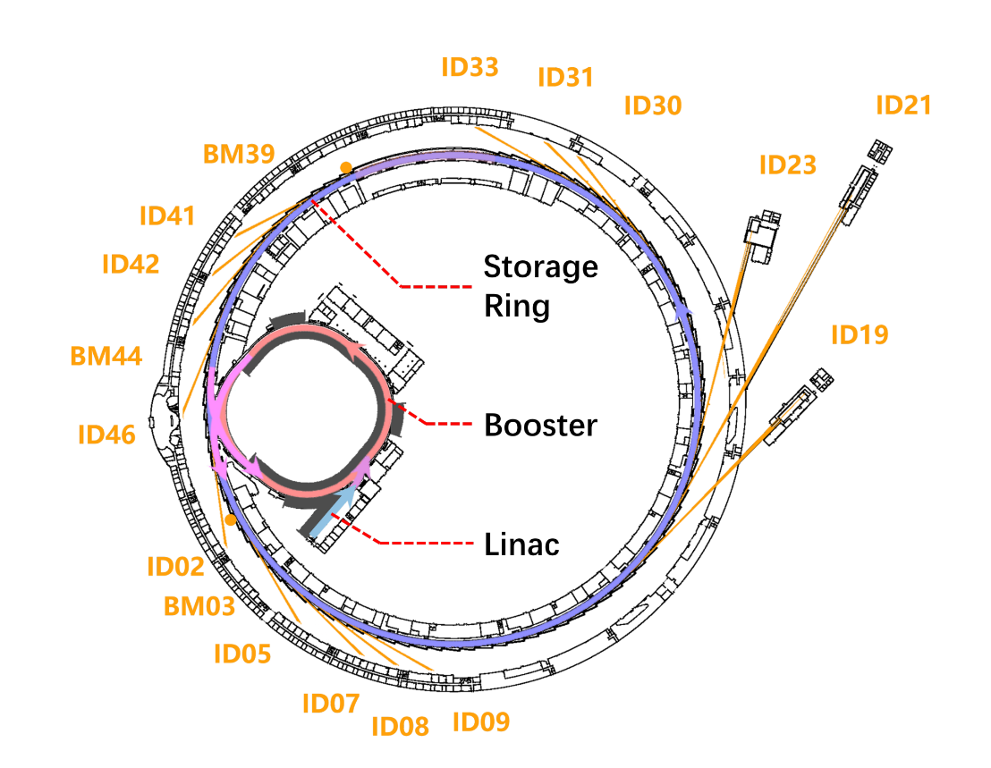
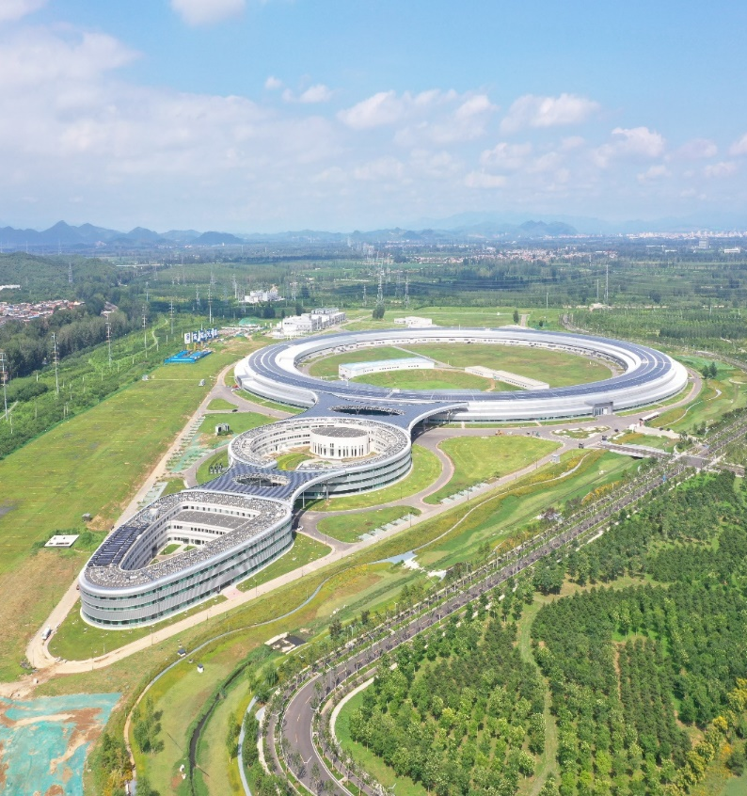
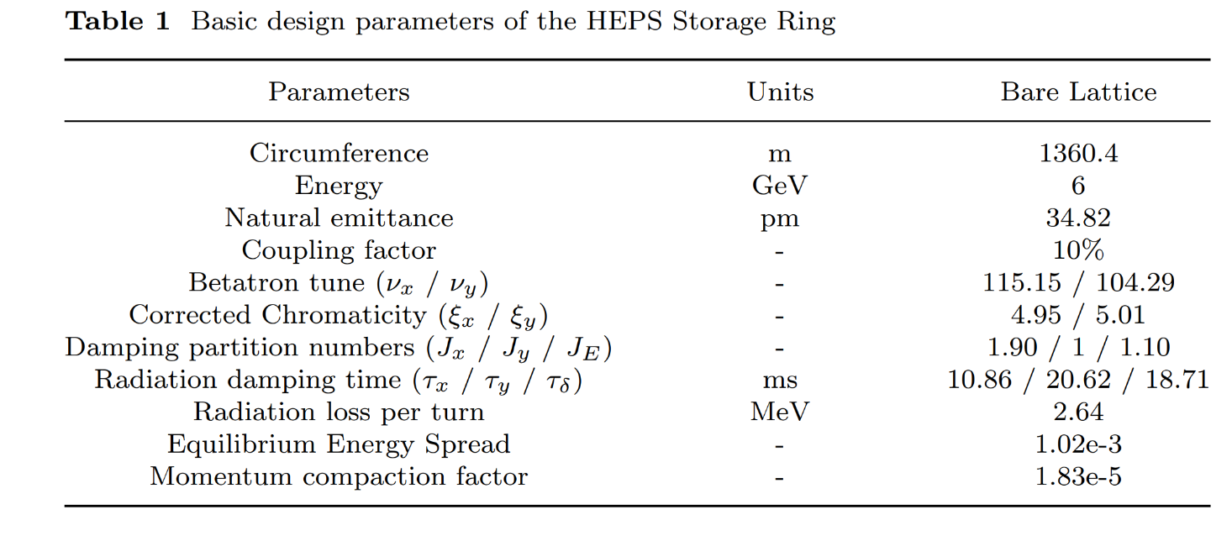
2024.7

Slide 5
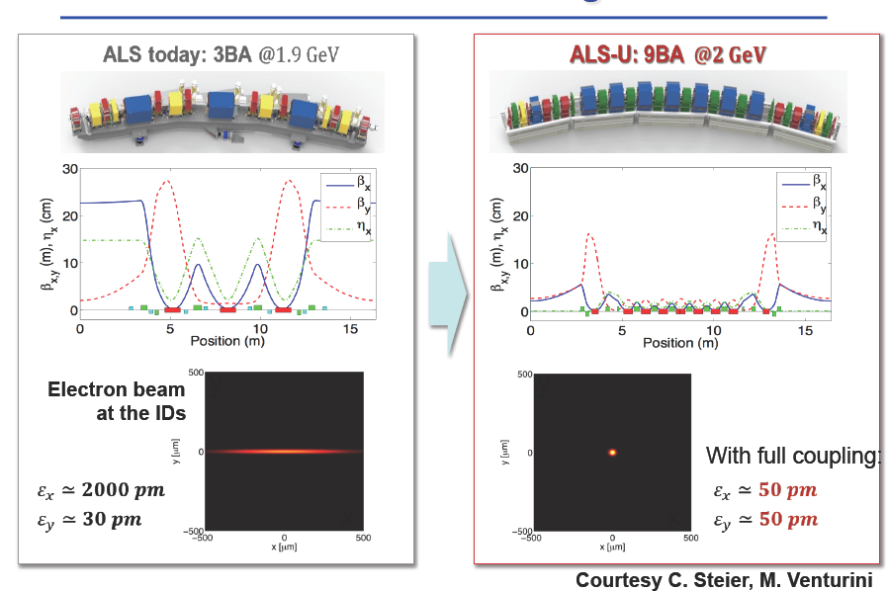

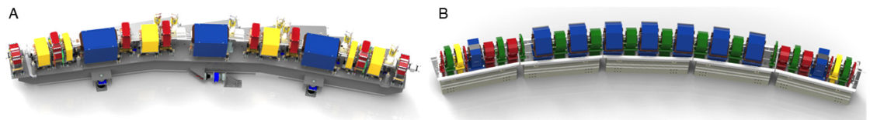
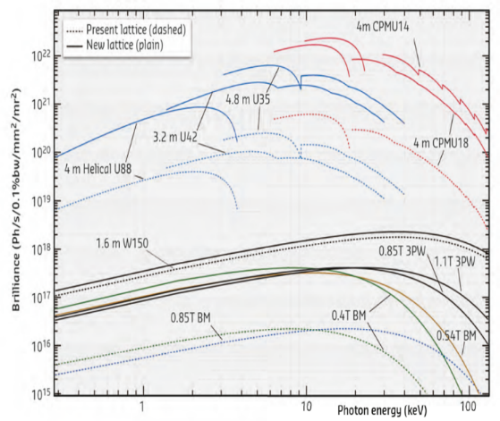
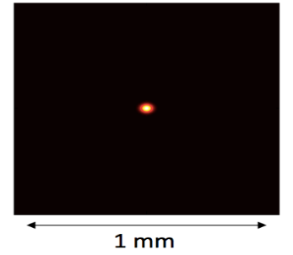

The fourth-generation light source
Emittance of third-generation light source：1000~5000 pm⋅rad
Emittance of forth-generation light source ：$≲$ 100 pm⋅rad
Third-generation
Fourth-generation
Multi Bend Achromat, MBA
lattice
ESRF -> EBS

Slide 6
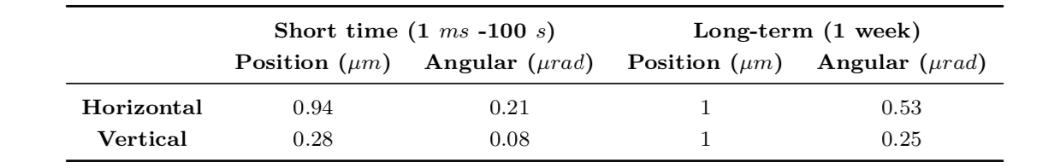

The fourth-generation light source
Emittance of third-generation light source：1000~5000 pm⋅rad
Emittance of third-generation light source ：$≲$ 100 pm⋅rad
Third-generation
Fourth-generation
Multi Bend Achromat, MBA
lattice
ESRF -> EBS

Slide 7
The fourth-generation light source
HEPS FOFB Goal:
Frequency：>500 Hz
Time：<10% beamsize~300 nm@V
Emittance of third-generation light source：1000~5000 pm⋅rad
Emittance of third-generation light source ：$≲$ 100 pm⋅rad
Third-generation
Fourth-generation
Multi Bend Achromat, MBA
lattice
ESRF -> EBS

Slide 8
FOFB of the light sources in the world
Based on Nicolas Hubert’s talk, DIPAC09
Third-generation | Feedback | Bandwidth
ALBA | Fast | DC - 130 Hz
BESSY II | Fast | DC - 10 Hz
DIAMOND | Fast | DC - 130 Hz
ELETTRA | Fast | DC - 150 Hz
ESRF | Slow + Fast | DC - 150 Hz
SLS | Fast | DC - 100 Hz
SPEAR3 | Fast | DC - 100 Hz
ALS | Slow + Fast | DC - 60 Hz
APS | Slow + Fast | DC - 100 Hz
TPS | Fast | DC – 100(v)/60(h) Hz
NSLS II | Fast （+ SC） | DC - 250 Hz
SOLEIL | Slow + Fast | DC - 250 Hz
SSRF | Slow + Fast | DC - 100 Hz
Fourth-generation | Feedback | Bandwidth
APS-U* | Fast + Slow | 1 kHz
Sirius | Fast + Slow | DC-1 kHz
ESRF-EBS | Fast + Slow | DC - 150 Hz
MAX IV | Slow | -

Slide 9
2
Fast orbit feedback and related simulation

Slide 10
FOFB system
576 BPM
16 FOC station
384 PS controller
12 BPM→1 station
3 station → 1 FOC
1 FOC → 24 PSC
Data collection : 3 BPM stations => 1 FOFB station to reduce latency of global data distribution.
Global data distribution : Bi-direction, multi-channel high speed serial transmission with redundancy.
Muti-Mode Fiber & optical transceivers used for BPM data collection to reduce cost.
Single-Mode Fiber & optical transceivers used for global data distribution to ensure long distance transfer reliability.
X-BPMs integration into nearby stations.
Topology of FOFB system

Slide 11
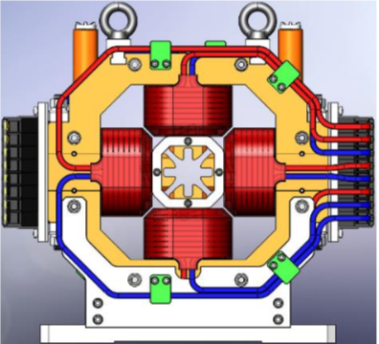
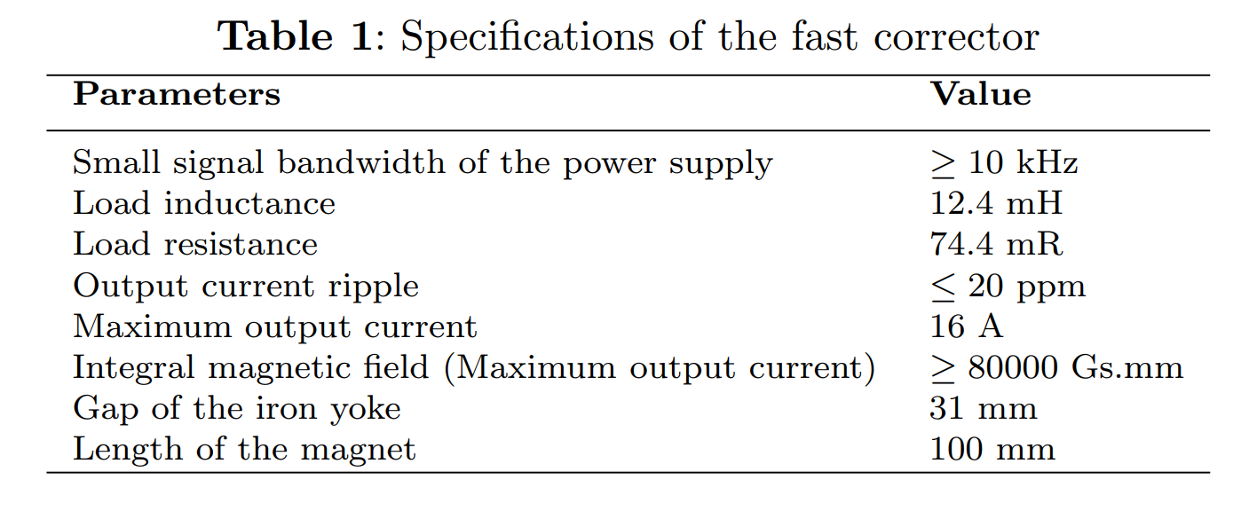
Fast corrector and power supply
Courtesy of X. Sun& P. Liu
Prototype of the fast corrector magnet

Slide 12
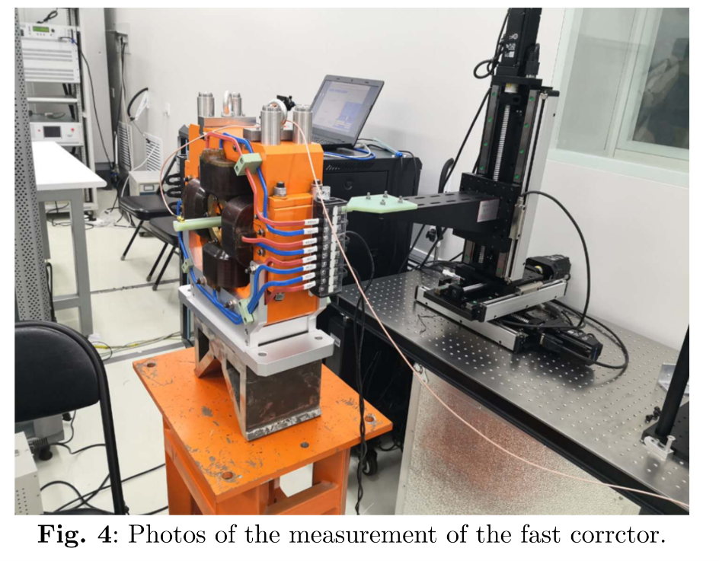
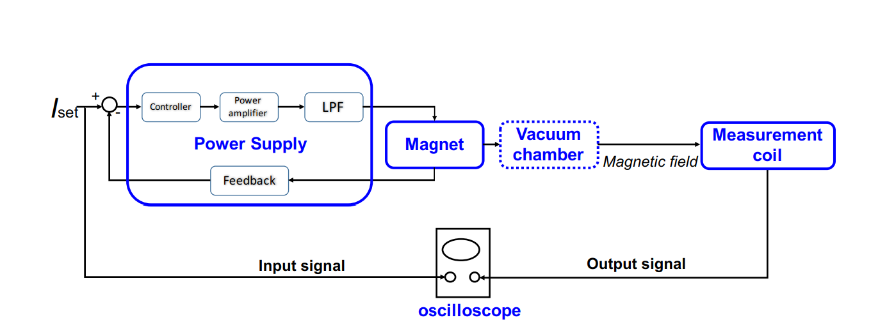
Fast corrector and power supply
Diagram of

Slide 13
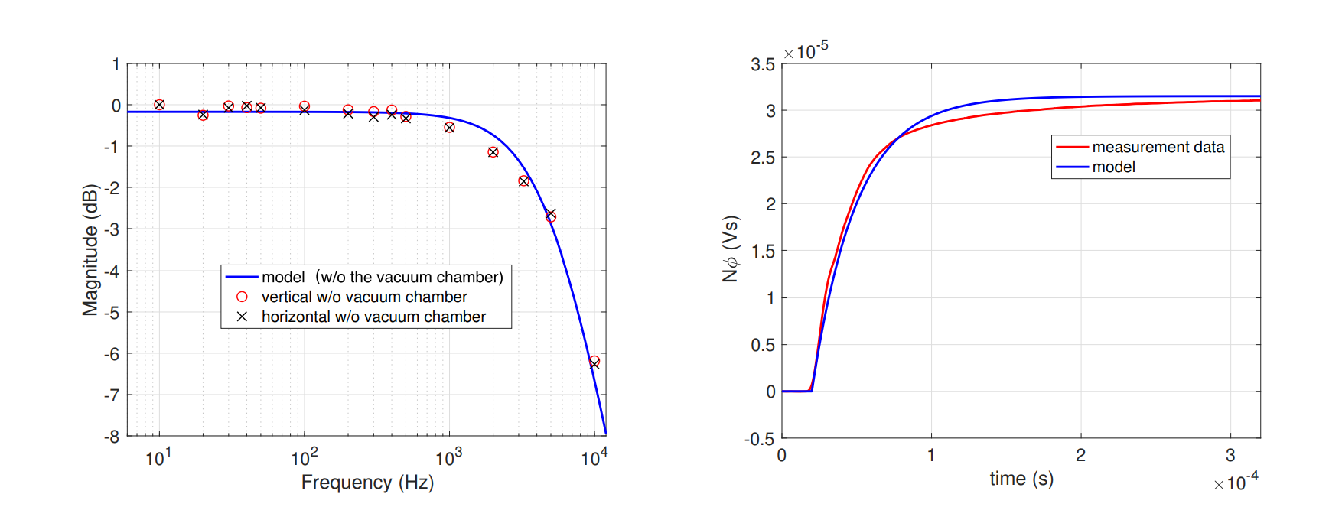
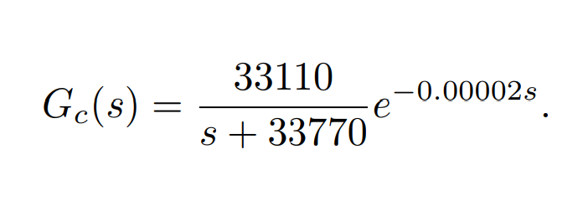
Fast corrector and power supply
(Left) Amplitude-frequency measurement data of the magnetic field in both planes and the fitting transfer function. (Right) Comparison of step response test data in the vertical plane and the fitting transfer function

Slide 14
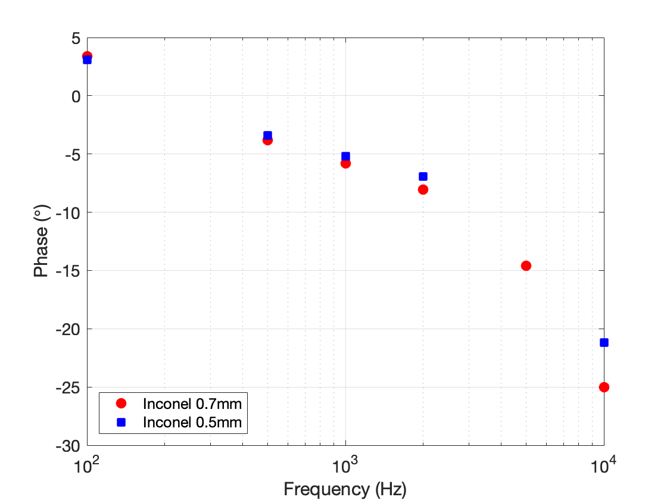
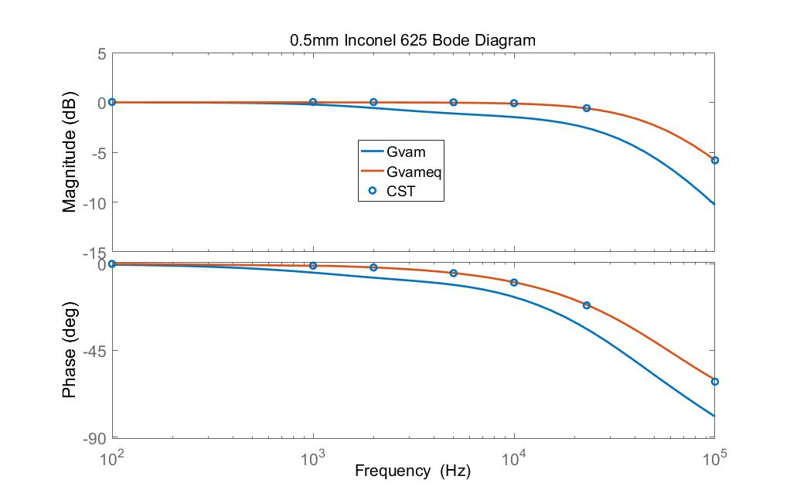
Vacuum chamber
requirement：Inconel 625，thickness = 0.5 mm， Bandwidth>30kHz
Courtesy of Y. Wei & N. Wang

Slide 15
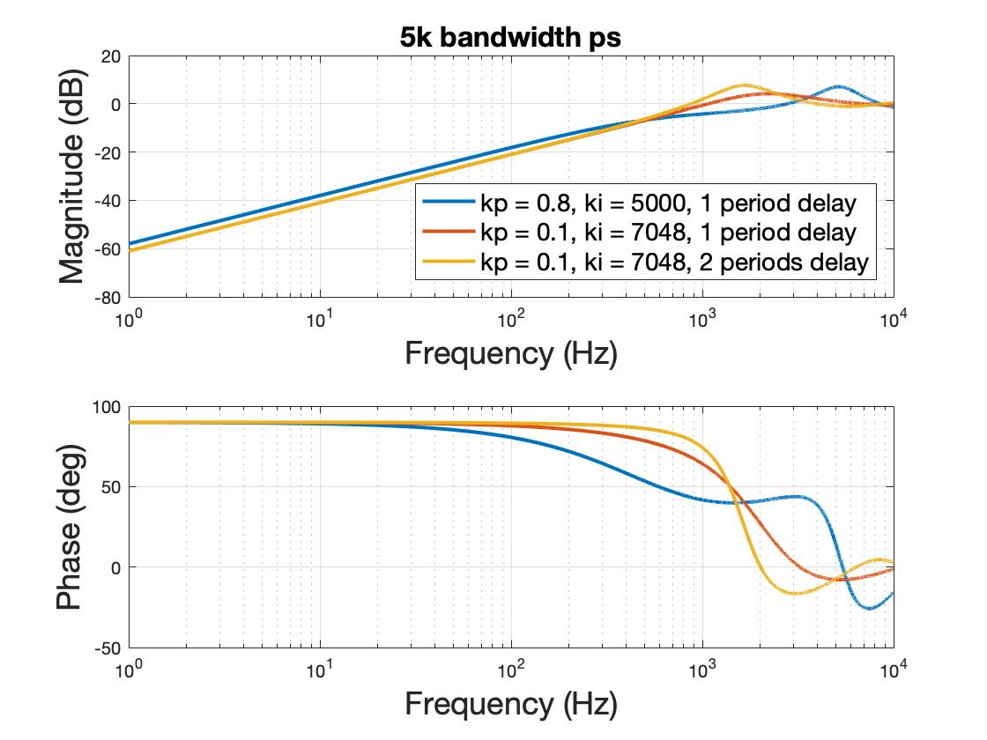
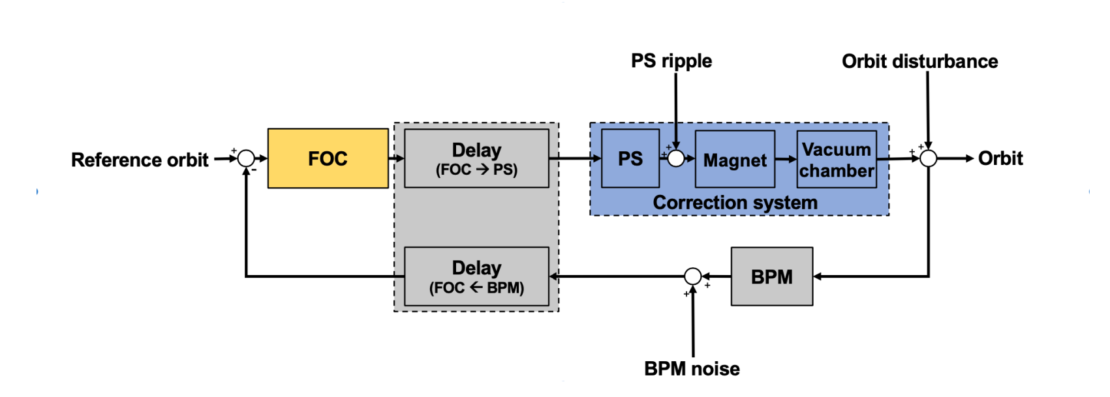
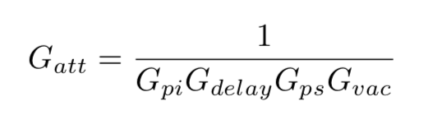
Feedback Control loop
Closed loop: 22kHz sampling
System response for different PID

Slide 16
Feedback Control loop
Closed loop: 22kHz sampling
The closed-loop bandwidth >500 Hz
System response for different PID

Slide 17
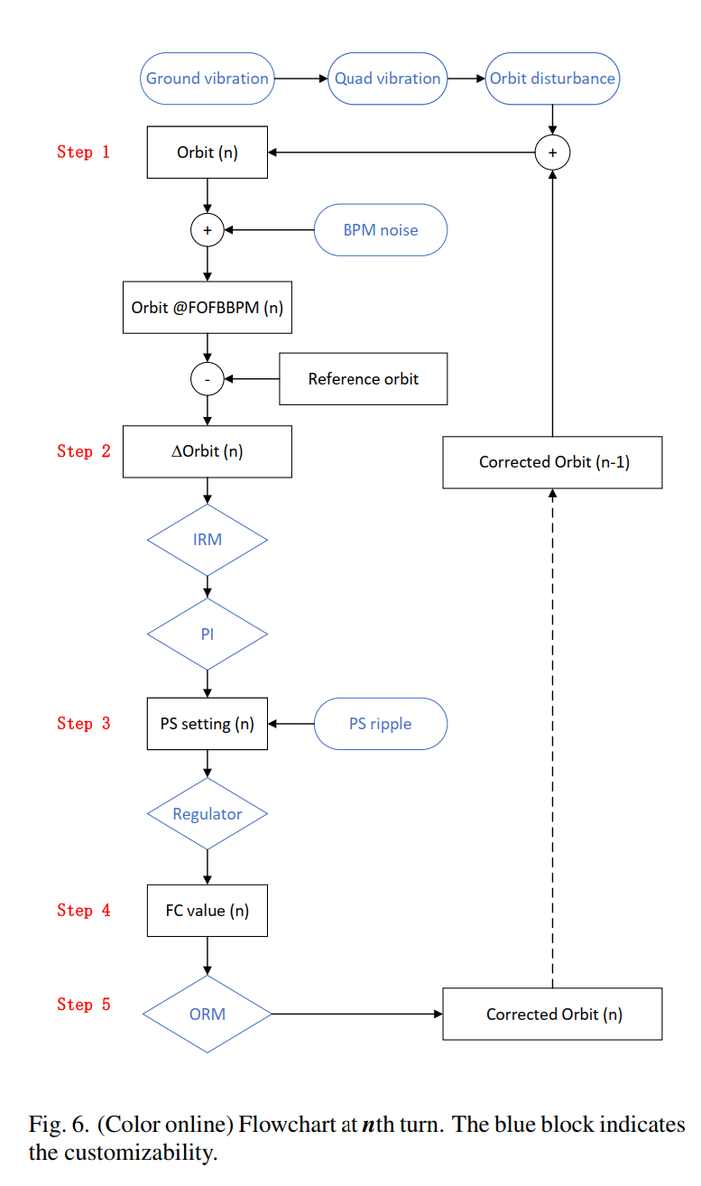
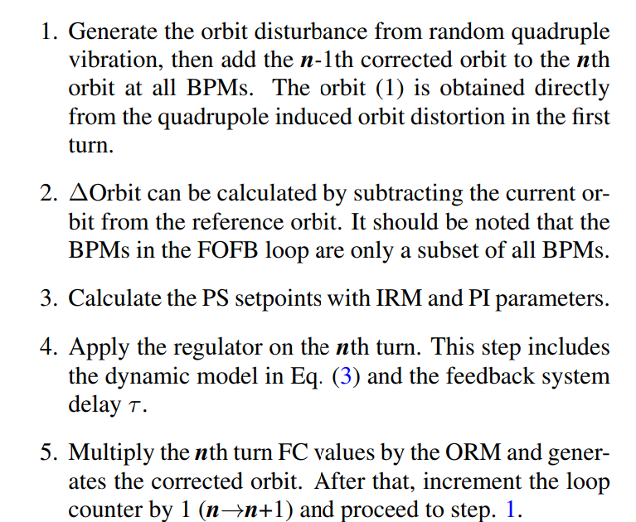
Simulation procedure
The subsystems’ time response can be modeled from the measurement results.

Slide 18
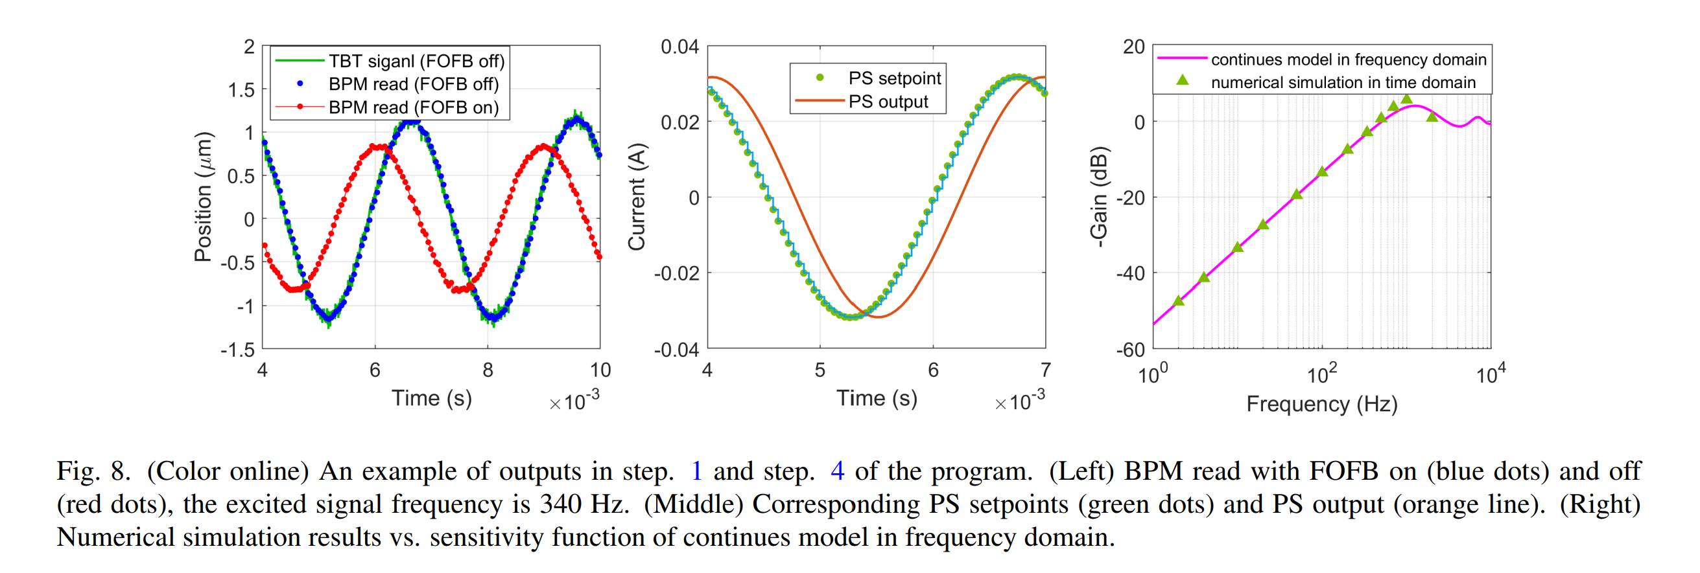
Time domain simulation

Slide 19
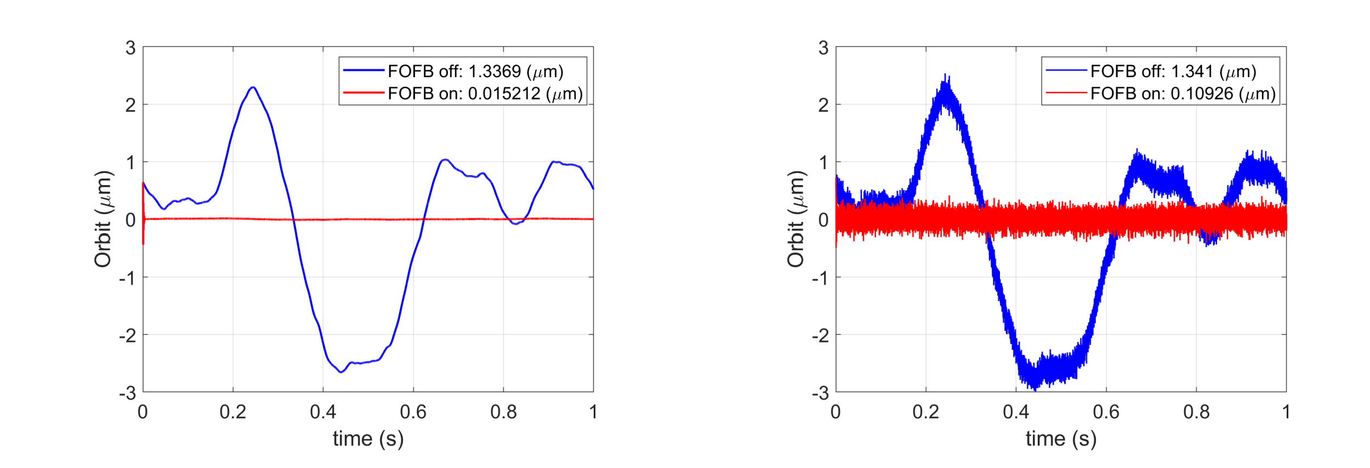
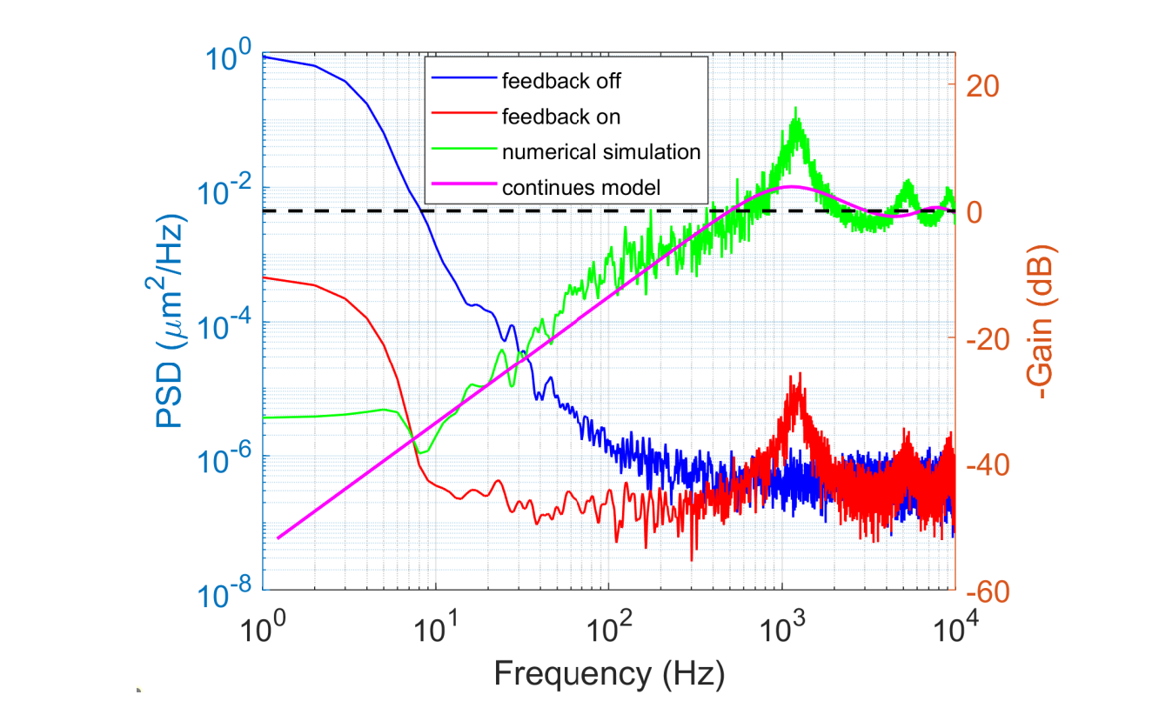
Time domain simulation
FOFB on/off w & w/o BPM noise.
Compare with the continues model

Slide 20
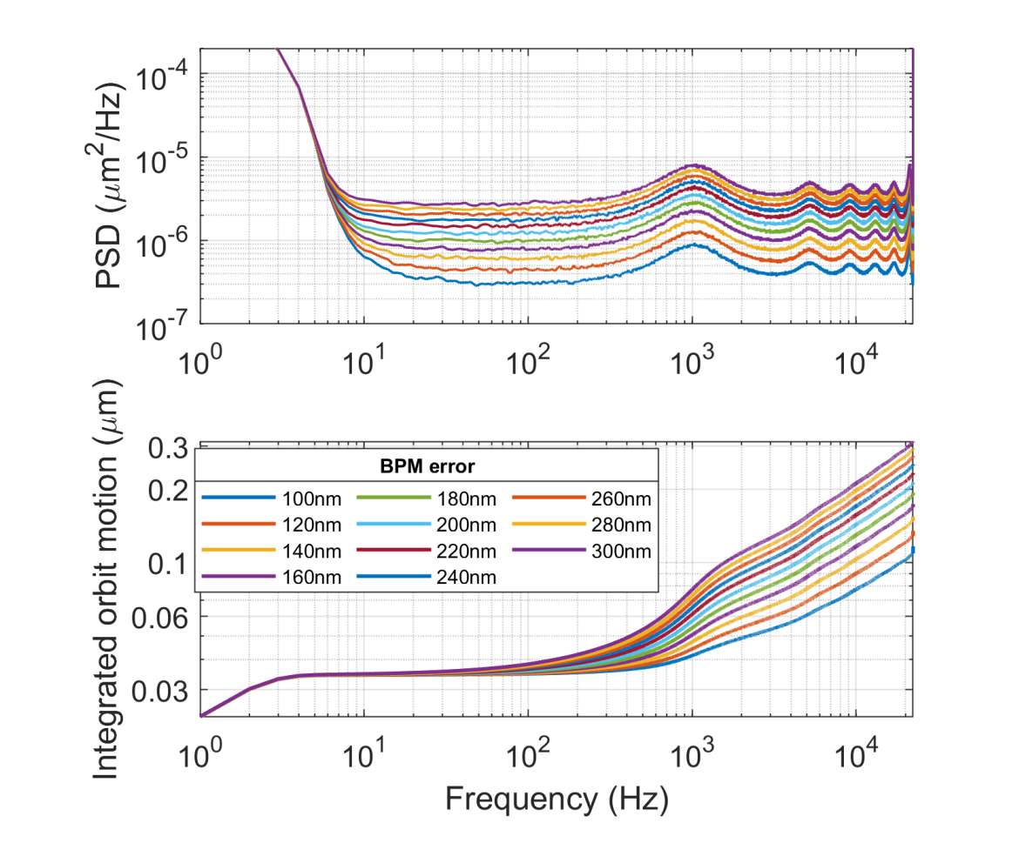
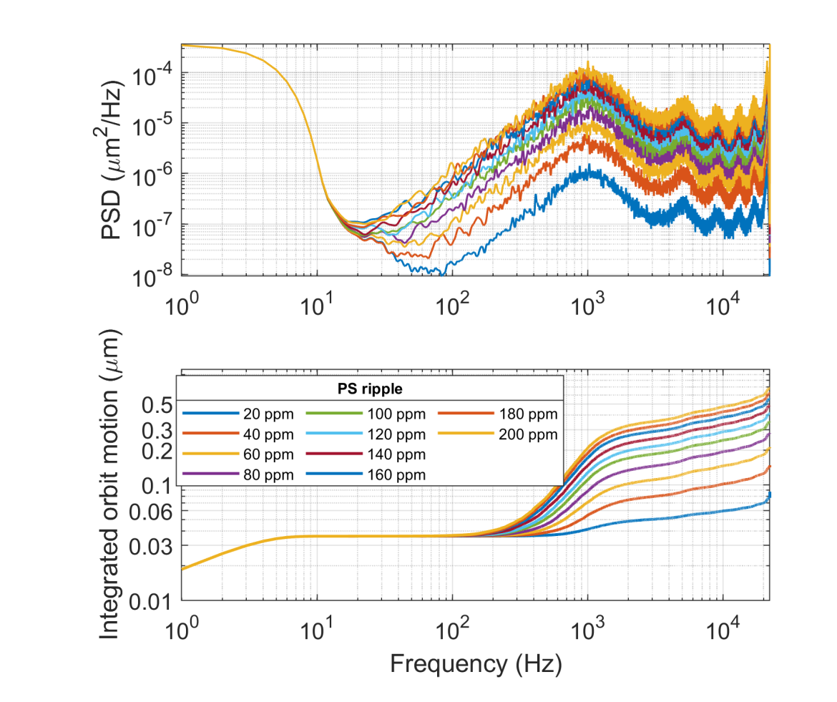
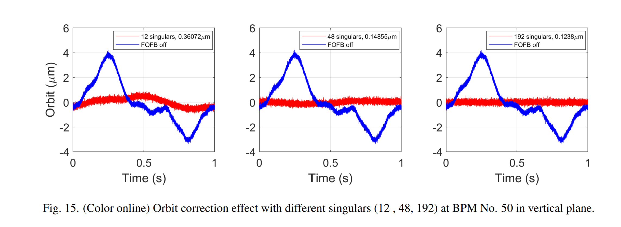
The impact of noises
BPM noise
PS noise
RM noise
…
BPM noise
PS noise

Slide 21
3
Conclusion

Slide 22
Conclusion
To fulfill the stability requirements of the HEPS, we will adopt a fast orbit feedback system with a closed-loop bandwidth exceeding 500 Hz.
We have carefully designed the FOFB communication structure, as well as various hardware subsystems such as the fast corrector power supply, magnet, vacuum chamber, and optimized the system latency, although some hardware-related details are not mentioned in this talk.
Through frequency domain analysis and time-domain numerical simulations, we predict the performance of the FOFB system, and its impact of noises.

Slide 23
Thank you！

